Slide 1

The Society for the Advancement
of Material and Process Engineering
Manufacturing Trials of Integrally Stiffened Composite Panels using Automated Fiber Placement

Slide 2


Manufacturing Trials of Integrally Stiffened Composite Panels using Automated Fiber Placement
Dawn Jegley
ISAAC Lead, NASA Langley Research Center

Slide 3

Welcome Slide
Dawn Jegley
Structural Mechanics and Concepts Branch, NASA Langley Research Center (LaRC)
Integrated Structural Assembly of Advanced Composites (ISAAC) Lead
39 years working structural mechanics and composite structures design, analysis, fabrication, and testing at LaRC

Slide 4
Outline
Background
Manufacturing trial panel characteristics
Defects
Concluding remarks and next steps

Slide 5
Lightweight Structures
Carbon-epoxy construction offers many opportunities to tailor designs to reduce weight
Modern aircraft do not take full advantage of the potential benefits of tailoring
To take better advantage of structural tailoring, an understanding of the manufacturing limitations is needed
The realities of fabrication are sometimes neglected in the design of tailored composite structures
  Placement-induced defects (e.g., gaps between fibers)
  Local features such as tapers at stiffener edges

Slide 6
Integral Stiffening
Traditionally, stiffeners are placed on the surface of a skin
  Stiffeners can separate from the skin under loading or as a result of impact damage
  Holes are drilled and fasteners added to prevent separation
Alternately, strategically placed stiffener plies can be interleaved with full-panel skin plies
  Interleaving encapsulates the stiffeners to hold them in place
  No need for holes and fasteners
Straight fibers or steered fibers (curved in-plane) can create stiffeners tailored to loading conditions
Notes:
Stiffeners placed on top of a skin are likely top pop off if the panel is subjected to bending loads or in the even of impact damage to the skin
Separation of the stiffener from the skin can be minimized by adding fasteners, requiring holes which can be crack initiation points
Separation of a stiffener from the skin can be prevented by interleaving full-panel plies with the stiffener plies to encapsulate the stiffeners and hold them in place

Slide 7
Objective
Develop manufacturing-based guidelines for integral stiffener design (Design for Manufacturing, DFM)
  Evaluate manufacturing defects inherent in integral stiffener fabrication
  Determine manufacturing limitations in using automated fiber placement (AFP)
Notes:
DFM

Slide 8
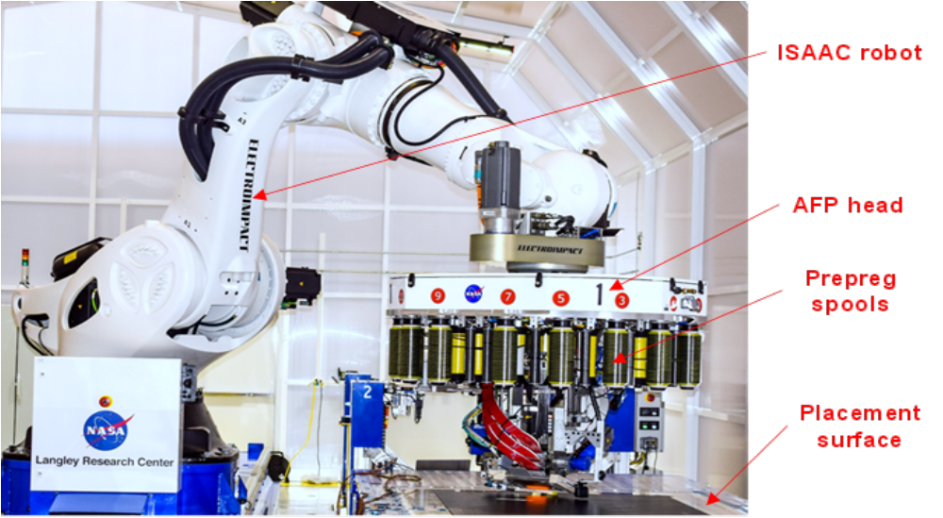
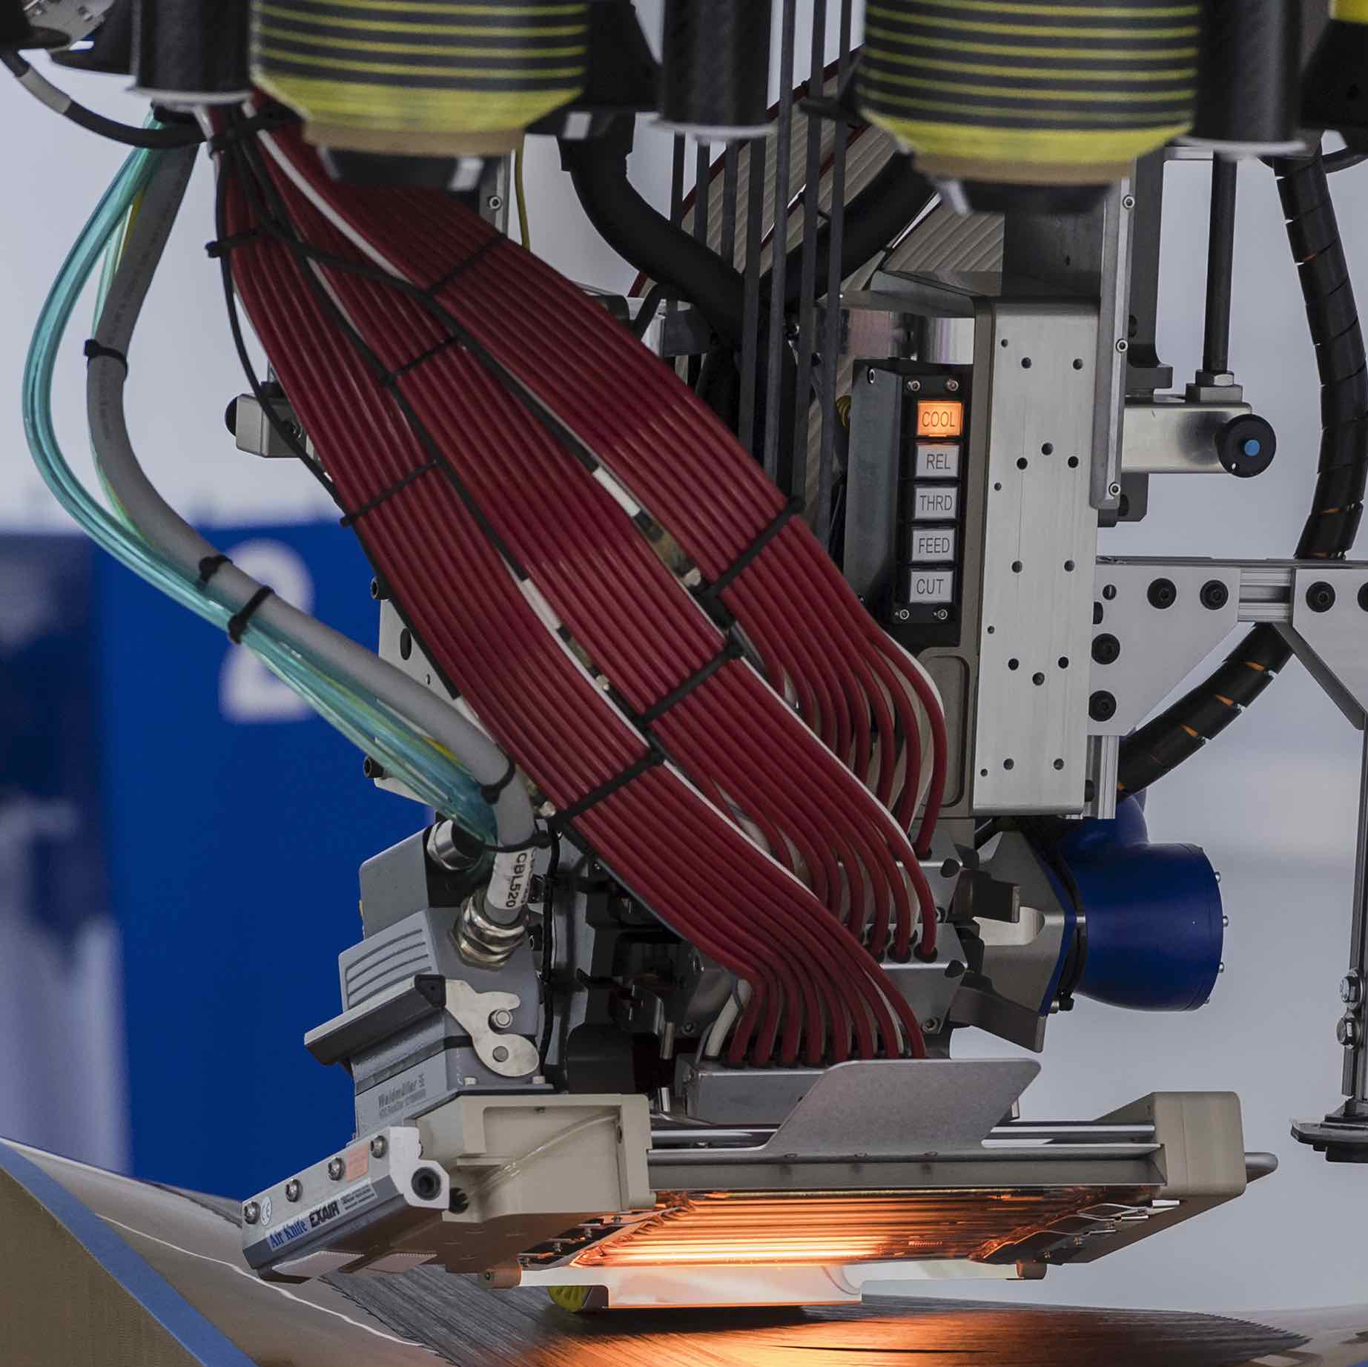
Automated Fiber Placement
ISAAC robot used to place 6.35-mm-wide carbon-epoxy tows
One to sixteen tows placed at a time in preprogrammed paths
Prepreg tape
  Toray T800S/3900
  Thickness 0.216 mm thick
ISAAC robot
AFP head
Prepreg spools
Placement surface
Spools
Heater
Roller
Notes:
Guidelines specific to ¼ inch tows
Limitations specific to ISAAC
6.35 mm
.0085 in

Slide 9
Manufacturing Trials
A series of panels were built focusing on different manufacturing defects
Knowledge gleaned from each trial was infused into next
Activity | Condition considered
1 | Staggered tows in stiffeners
2 | Interleaving skin with stiffeners
3 | Stiffener intersections
4 | Ply omissions
5 | Curved stiffeners, thin plies, debulking

Slide 10
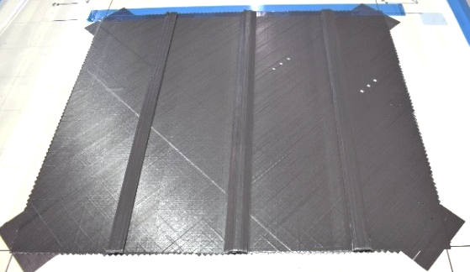
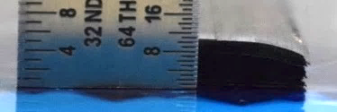
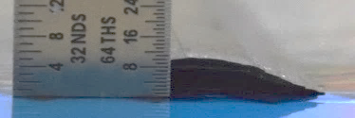
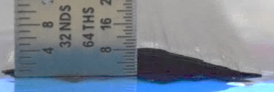
Stagger Evaluation
Vertical wall
Skin
28 stiffener plies
Add text here….
No stagger,
2 tows/layer
Taper wall
Skin
Half-tow-width stagger,
2 tows/layer
0º
Taper wall
Skin
Half-tow-width stagger,
4 tows/layer
No stagger
1.588 mm
Quarter-tow-width stagger
3.175 mm
Half-tow-width stagger

Slide 11
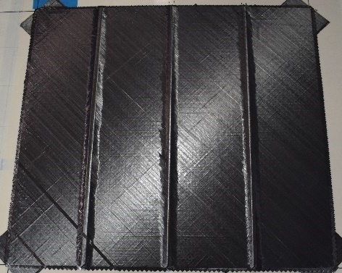
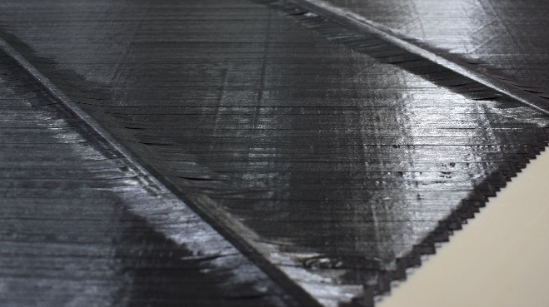
Interleaving Evaluation
Bridging
Air-filled gap
Interleaved ply does not follow the contour of the stiffener
Three stiffener plies between interleaved plies is too many
Half-tow-width stagger
Quarter-tow-width stagger
Bridging
0º
Full-panel layers
No stagger
Skin [0/45]
Half-tow-width stagger

Slide 12
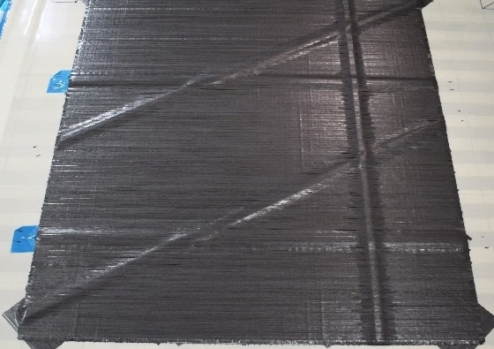
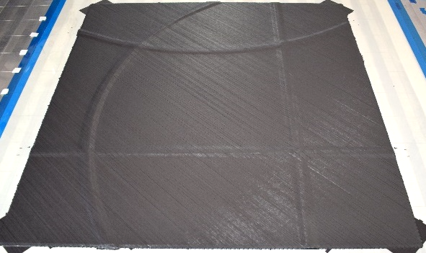
Non-Orthogonal and Curved Paths
Half-tow stagger
Interleave every two stiffener plies
30º and 45º stiffeners (to lead to more structural tailoring)
114.3-cm and 76.3-cm radius (more structural tailoring)
76.3-cm-radius arcs
30º stiffeners
0º
Notes:
5b,5d

Slide 13
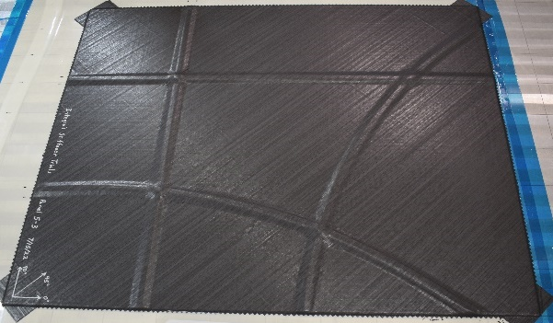
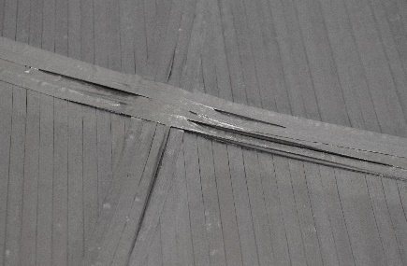
Curved Stiffeners
Folding
Wrinkling
0º
Defects such as wrinkling and folding
Understanding simple arcs is a step toward understanding defects in more complex fiber (tow) paths

Slide 14
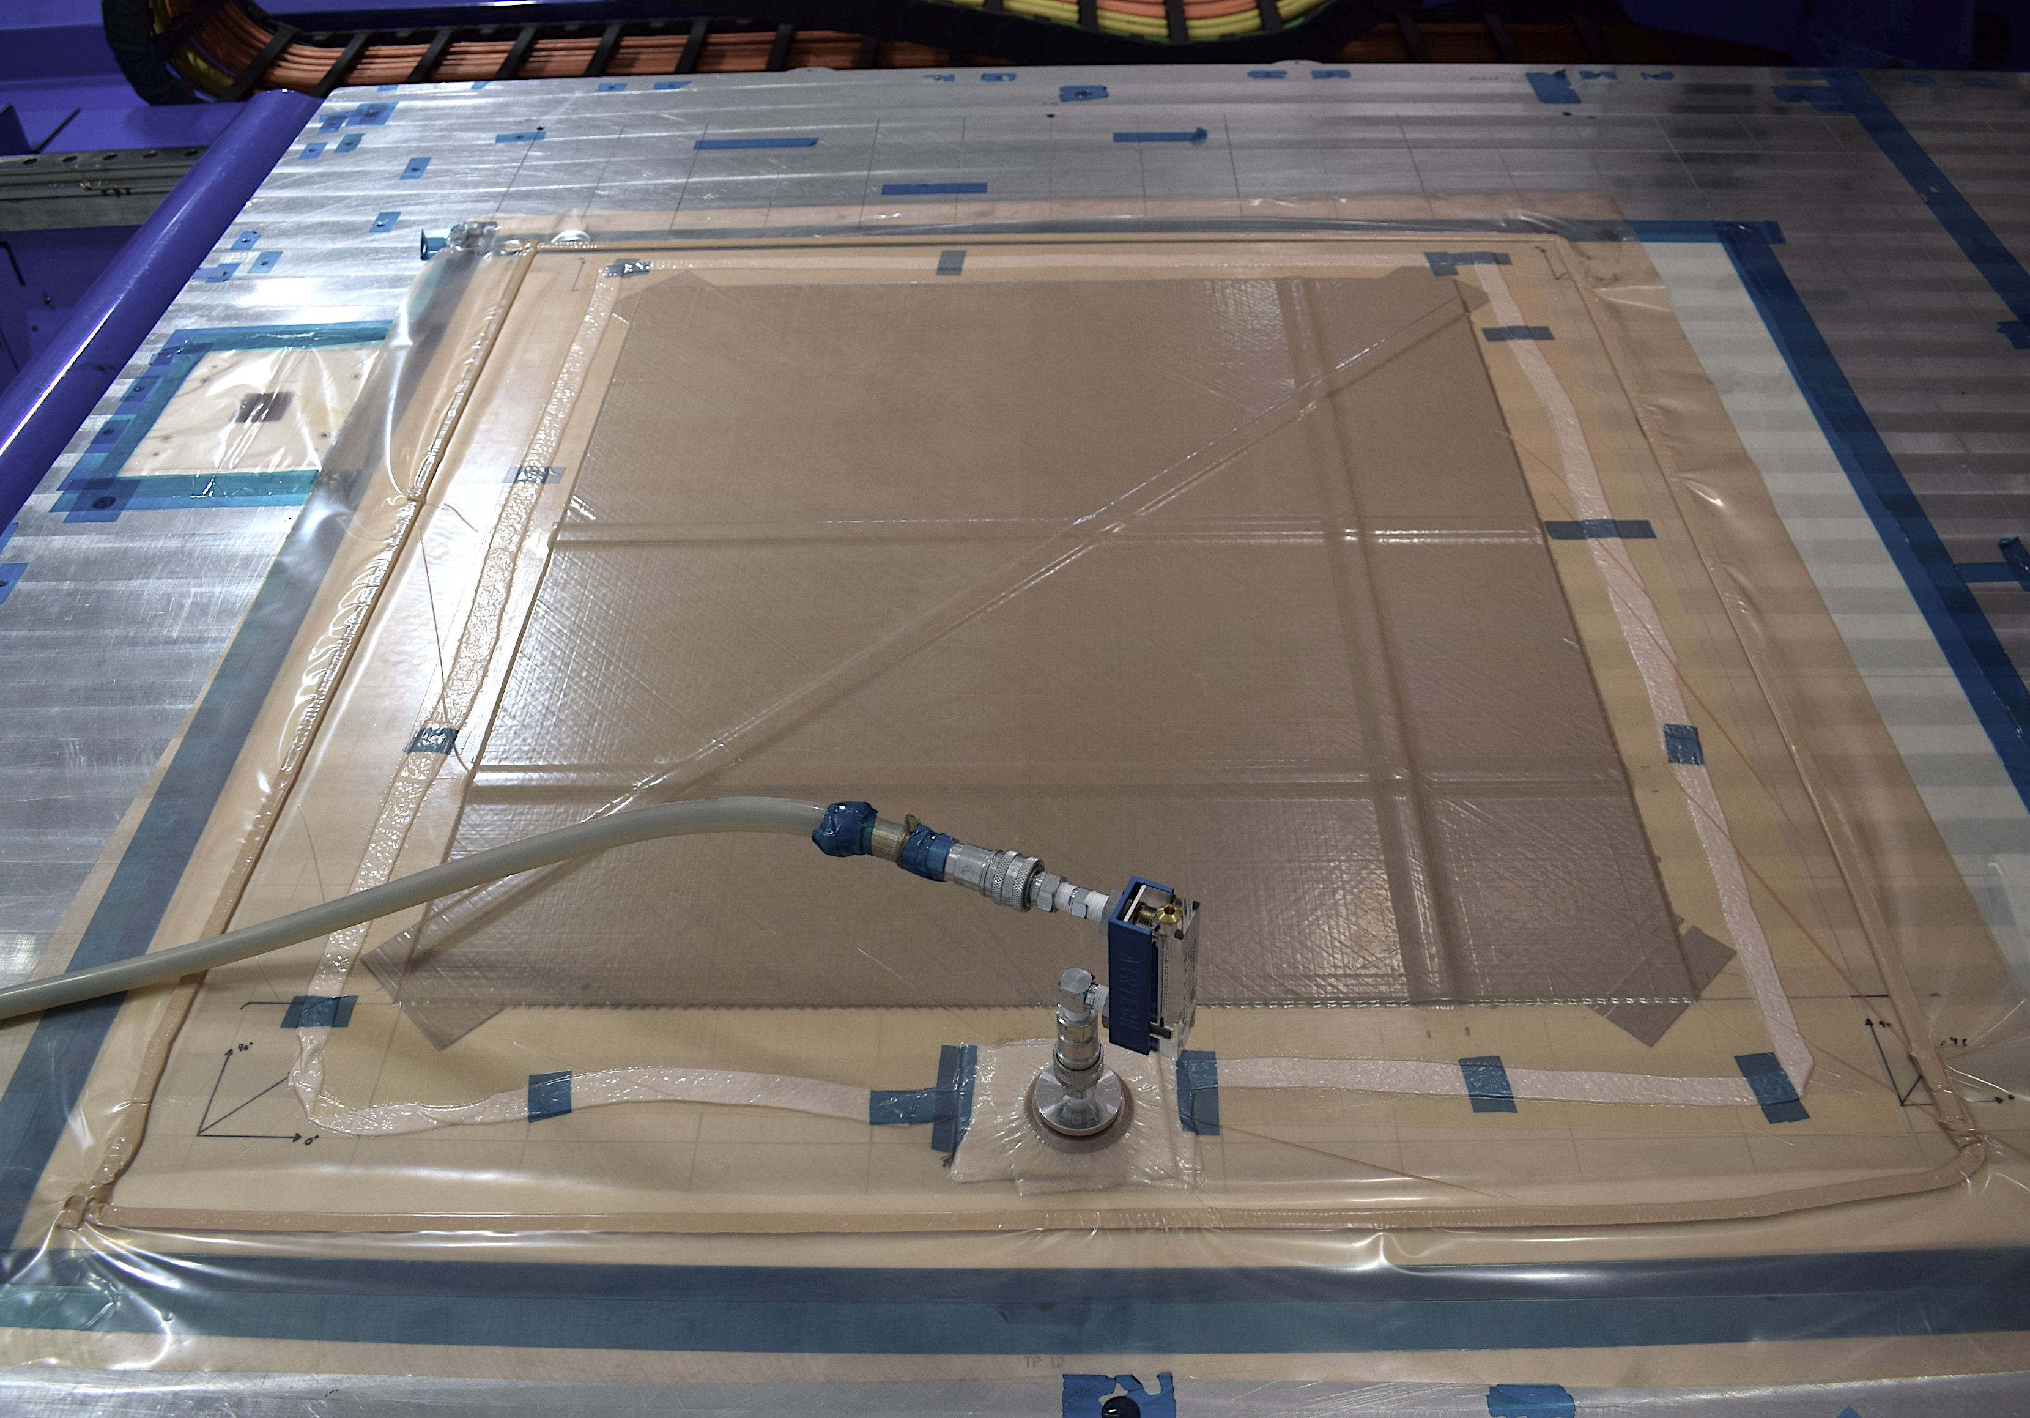
Debulks
After placing a number of AFP layers, the panel was sealed and vacuum pressure was used to extract air to compact plies
Bridging was visibly reduced by debulking
Thermography was used to better quantify the effect of debulking
Notes:
Approx 20 minutes

Slide 15
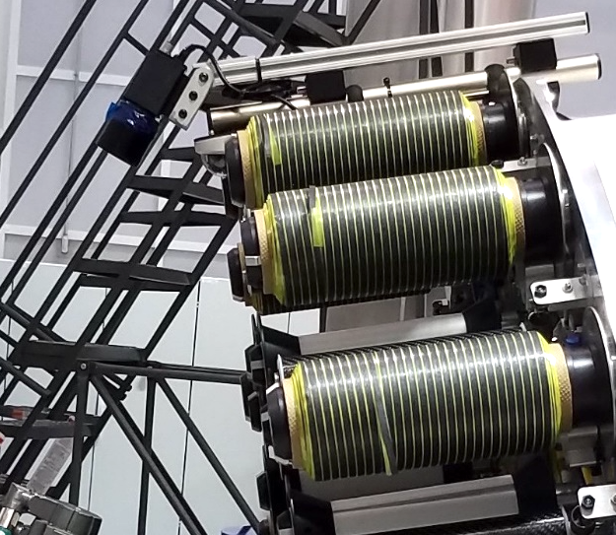
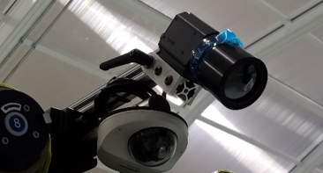
In Situ Thermography
Applied heat to panel surface
Heat spreading in a uniform manner indicates consistent contact from one layer to the next
Areas of nonuniform heat flow appear as bright spots and indicate defects such as air-filled gaps
Surface temperature field variations shown on following charts
Scans 10.2-cm wide are stitched together to show entire panel
Notes:
Acknowledge Peter/Elizabeth

Slide 16
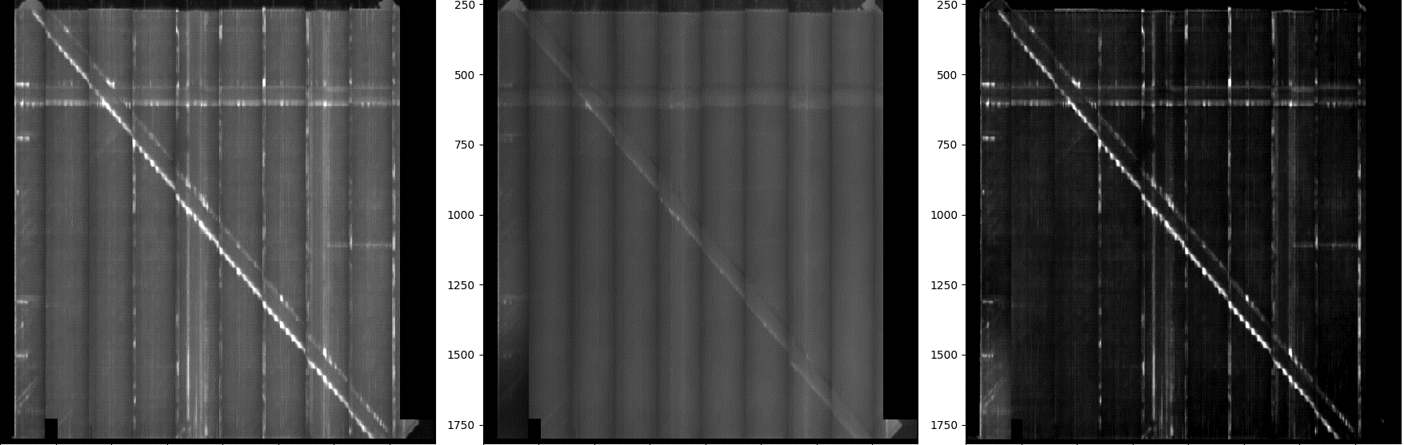
Debulk at 50% Completion
6 Full-Panel Plies
8 Stiffener Plies in Each Stiffener
Pre-debulk
Post-debulk
Difference
Stiffeners
90º
0º
45º
0°
Lighter regions indicate less heat flow due to air-filled gaps
Notes:
5a

Slide 17
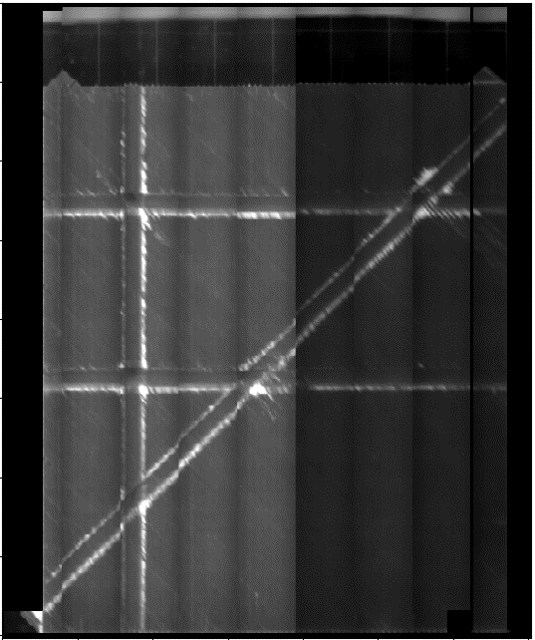
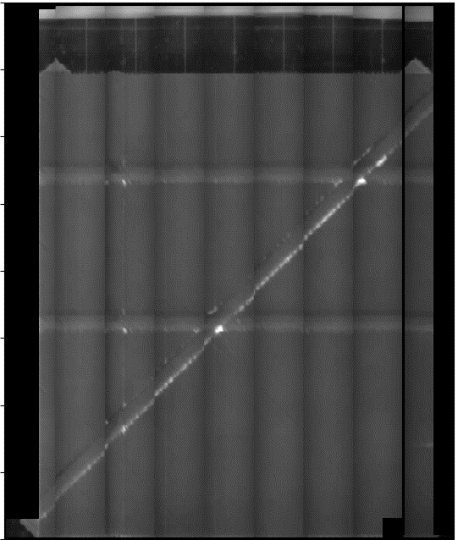
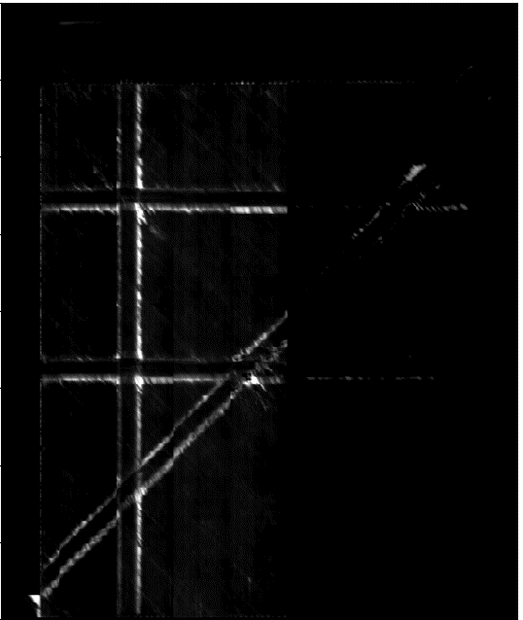
Debulk at 75% Completion
9 Full-Panel Plies
12 Stiffener Plies in Each Stiffener
Pre-debulk
Post-debulk
Difference
0º
Lighter regions indicate less heat flow due to air-filled gaps
Notes:
5a

Slide 18
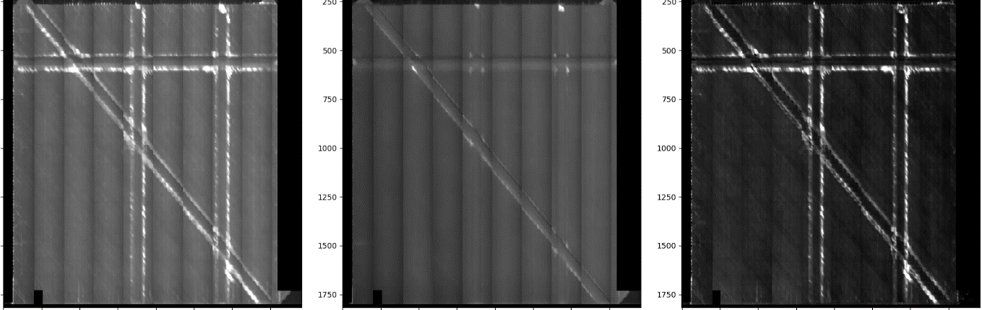
Debulk at 100% Completion
12 Full-Panel Plies
16 Stiffener Plies in Each Stiffener
Pre-debulk
Post-debulk
Difference
0°
Most air in gaps is removed by debulks
Debulks at 50% and 100% completion adequate

Slide 19
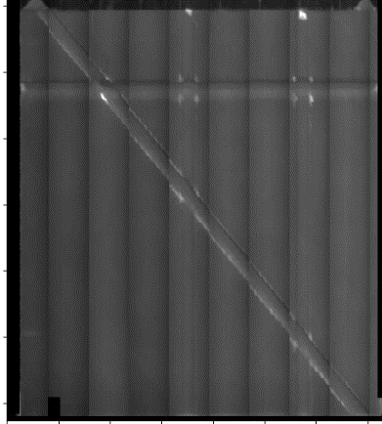
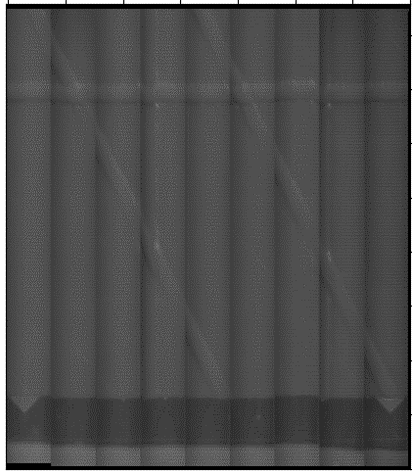
Bridging at Stiffener Intersections
(Post-Debulk)
0º
45º stiffener
30º stiffeners
30º stiffeners showed significantly less bridging than the 45º stiffener
Lighter regions indicate less heat flow due to air-filled gaps

Slide 20
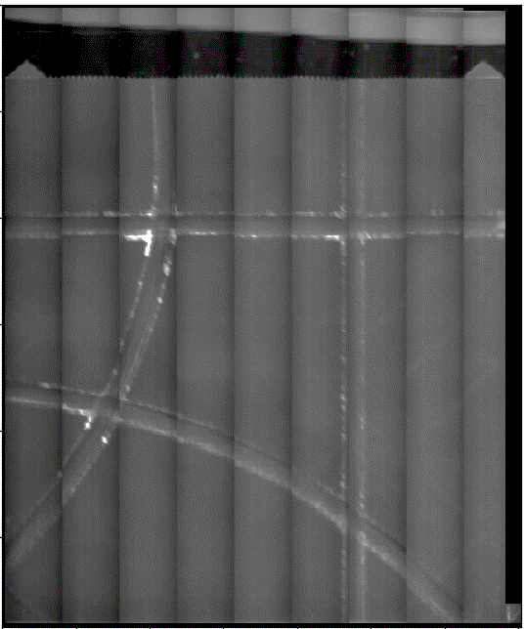
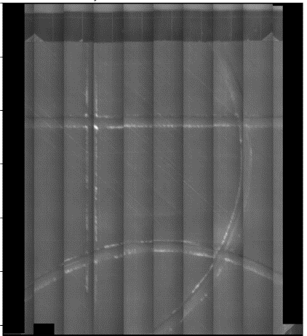
Defects Induced by Curvature
(Post-Debulk)
0°
114.3-cm radius
76.3-cm radius
Intersections involving the 114.3-cm-radius stiffener showed more bridging than those for the 76.3-cm-radius stiffener
Acreage curved path areas showed more bridging (or other defects) around the 76.3-cm-radius stiffener than the 114.3-cm-radius stiffener

Slide 21
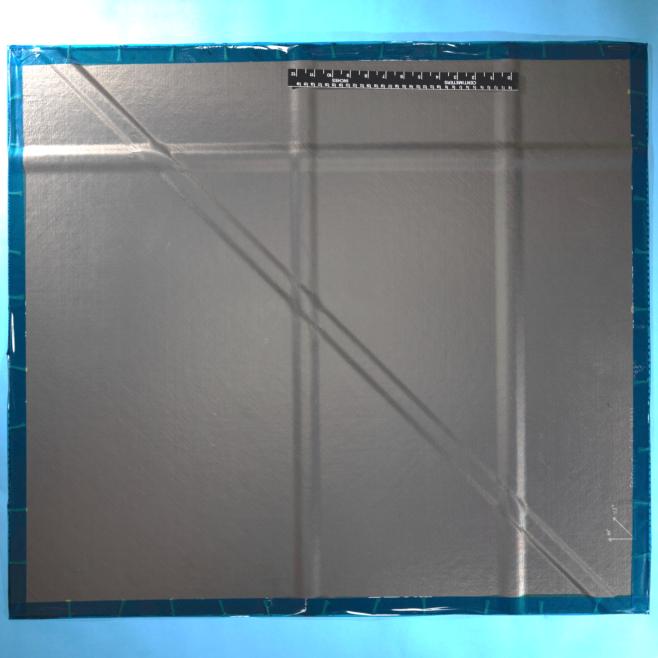
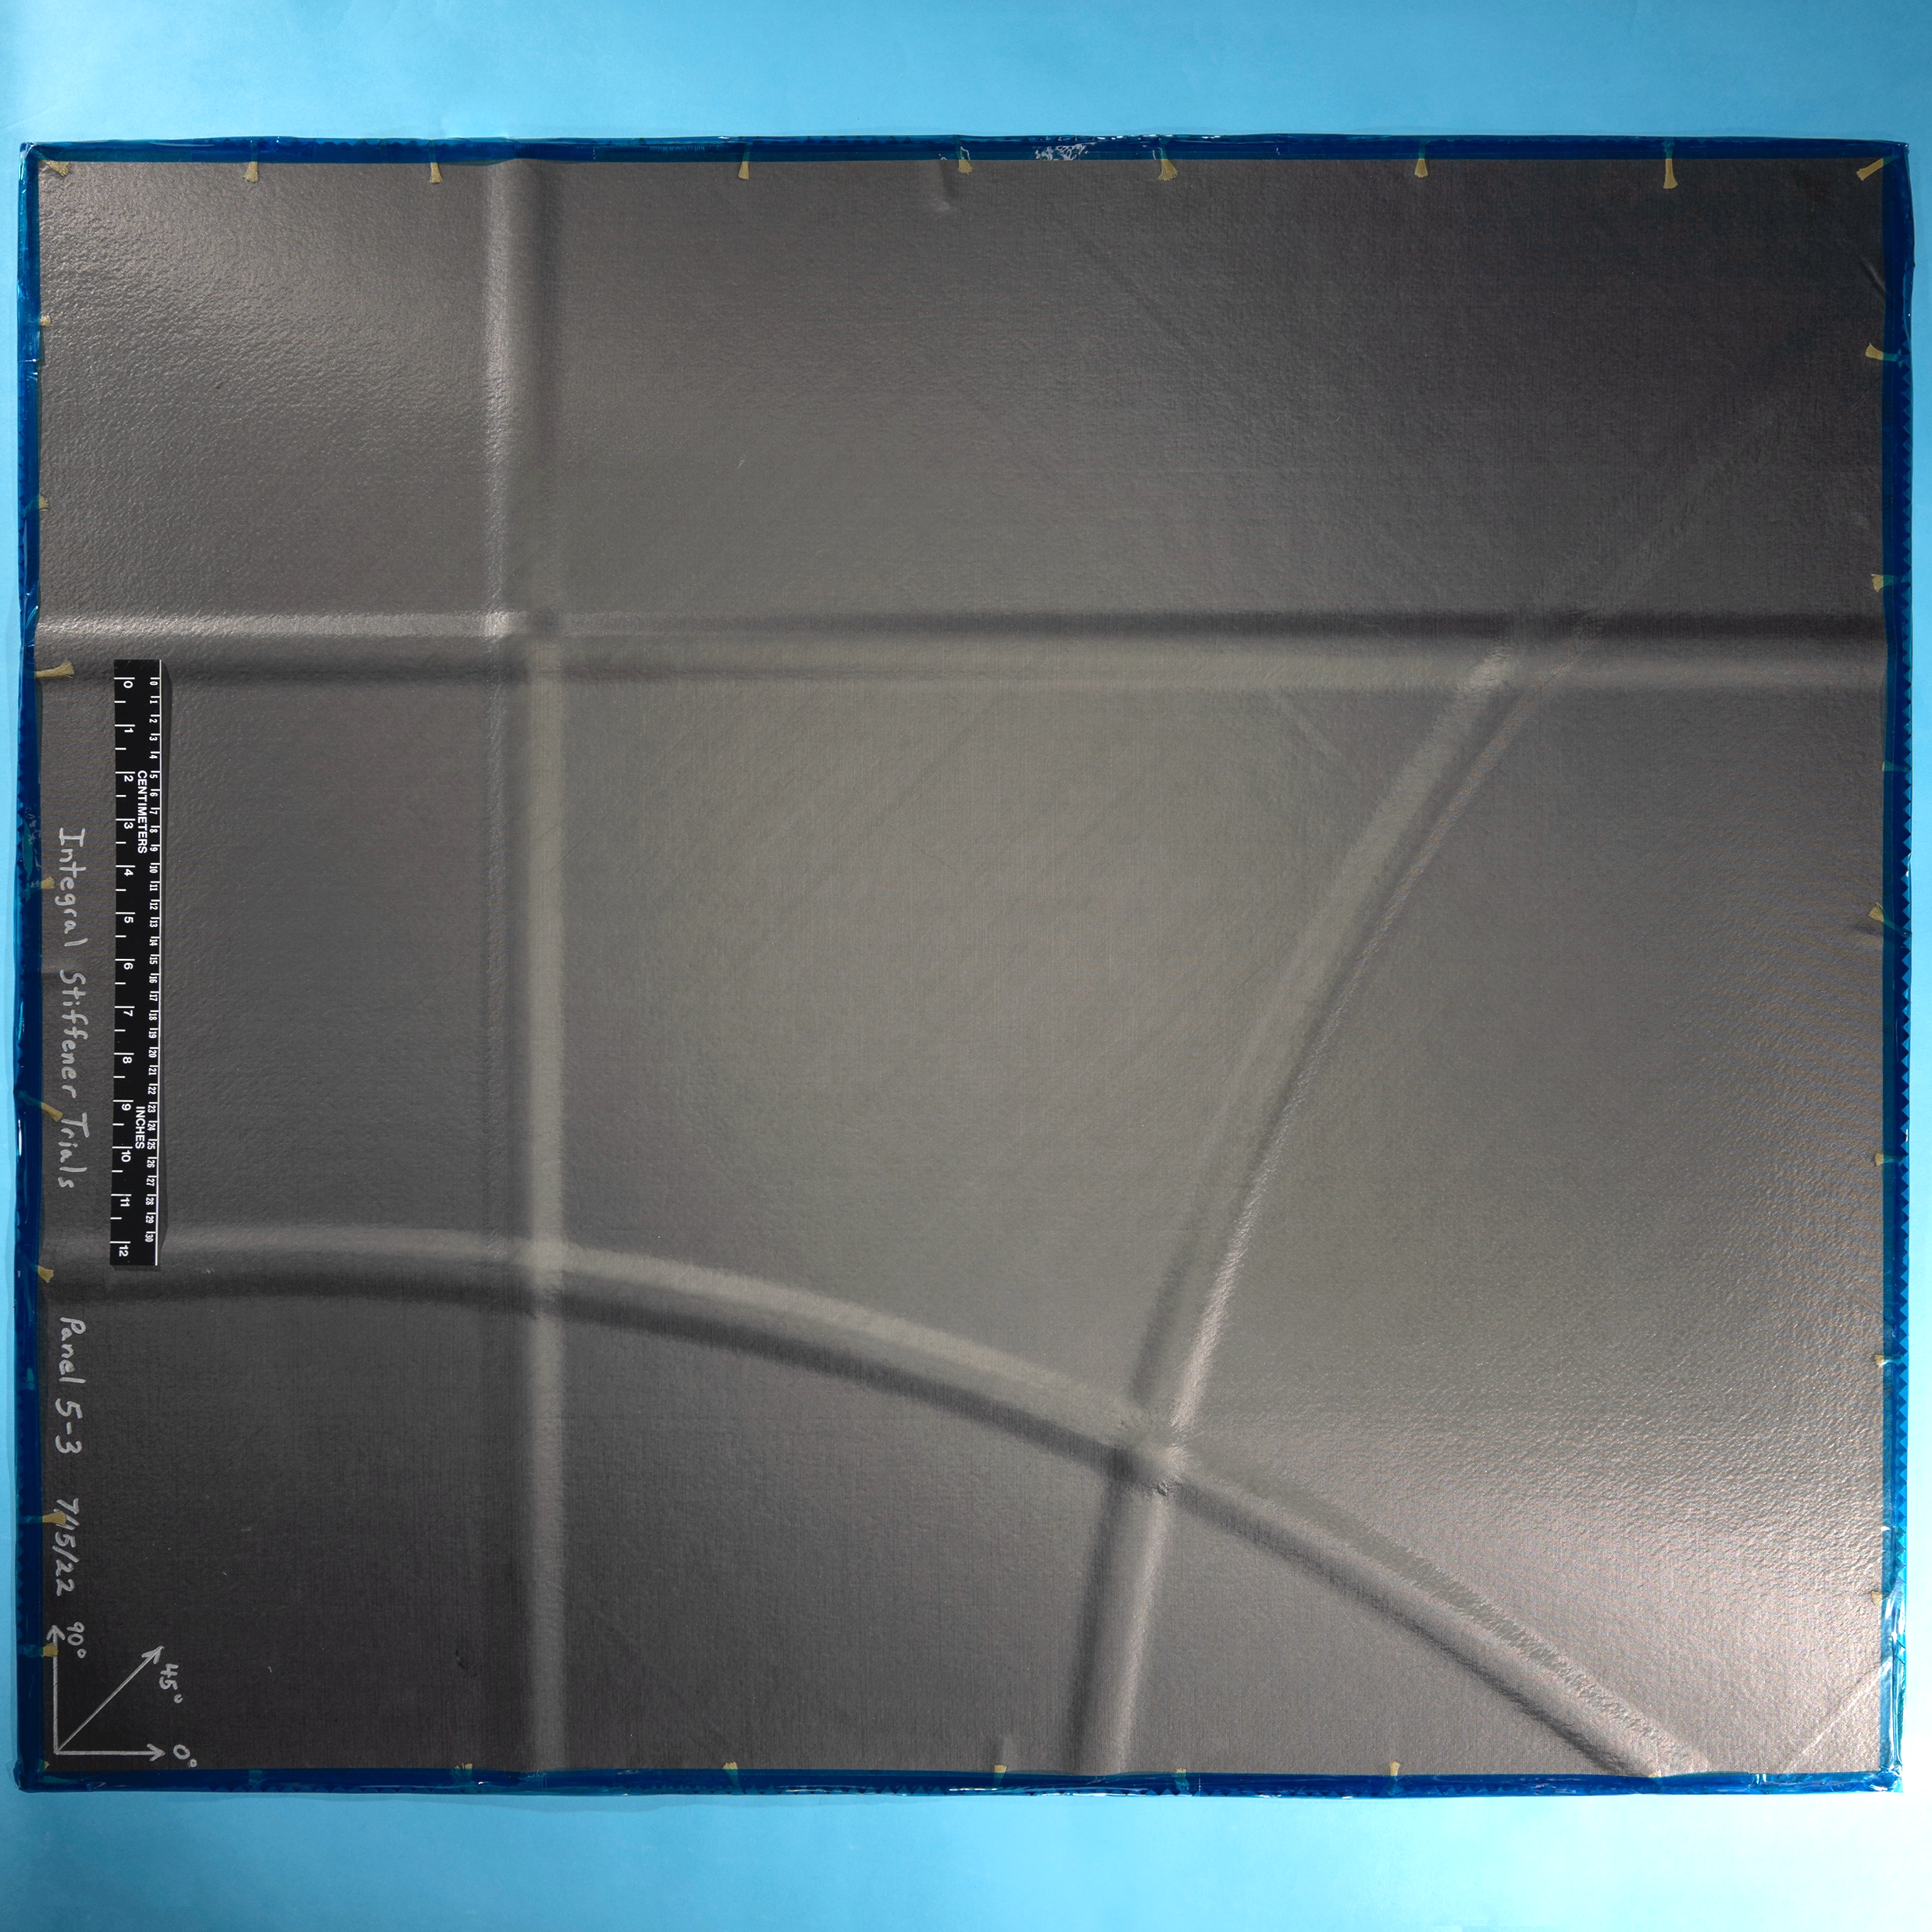
Cured Panels
Selected panels have been cured and are being prepared for testing to examine stiffener behavior
Notes:
Ultrasound, cs, test
Revisit number of stiffener plies between interleaved plies with debulks

Slide 22
Concluding Remarks
Tapered stiffener edges minimize bridging
Intersection of stiffeners 30° apart had less bridging than at 45° apart
Debulks reduce air-filled gaps at stiffener edges
Debulks at midpoint and final point adequate to remove most air for the examined configurations
Curved stiffeners show larger air-filled gaps due to defects such as wrinkling than straight stiffeners
Curved stiffeners with larger radius have less folding and wrinkling but more air at intersections than for smaller radius

