Slide 1




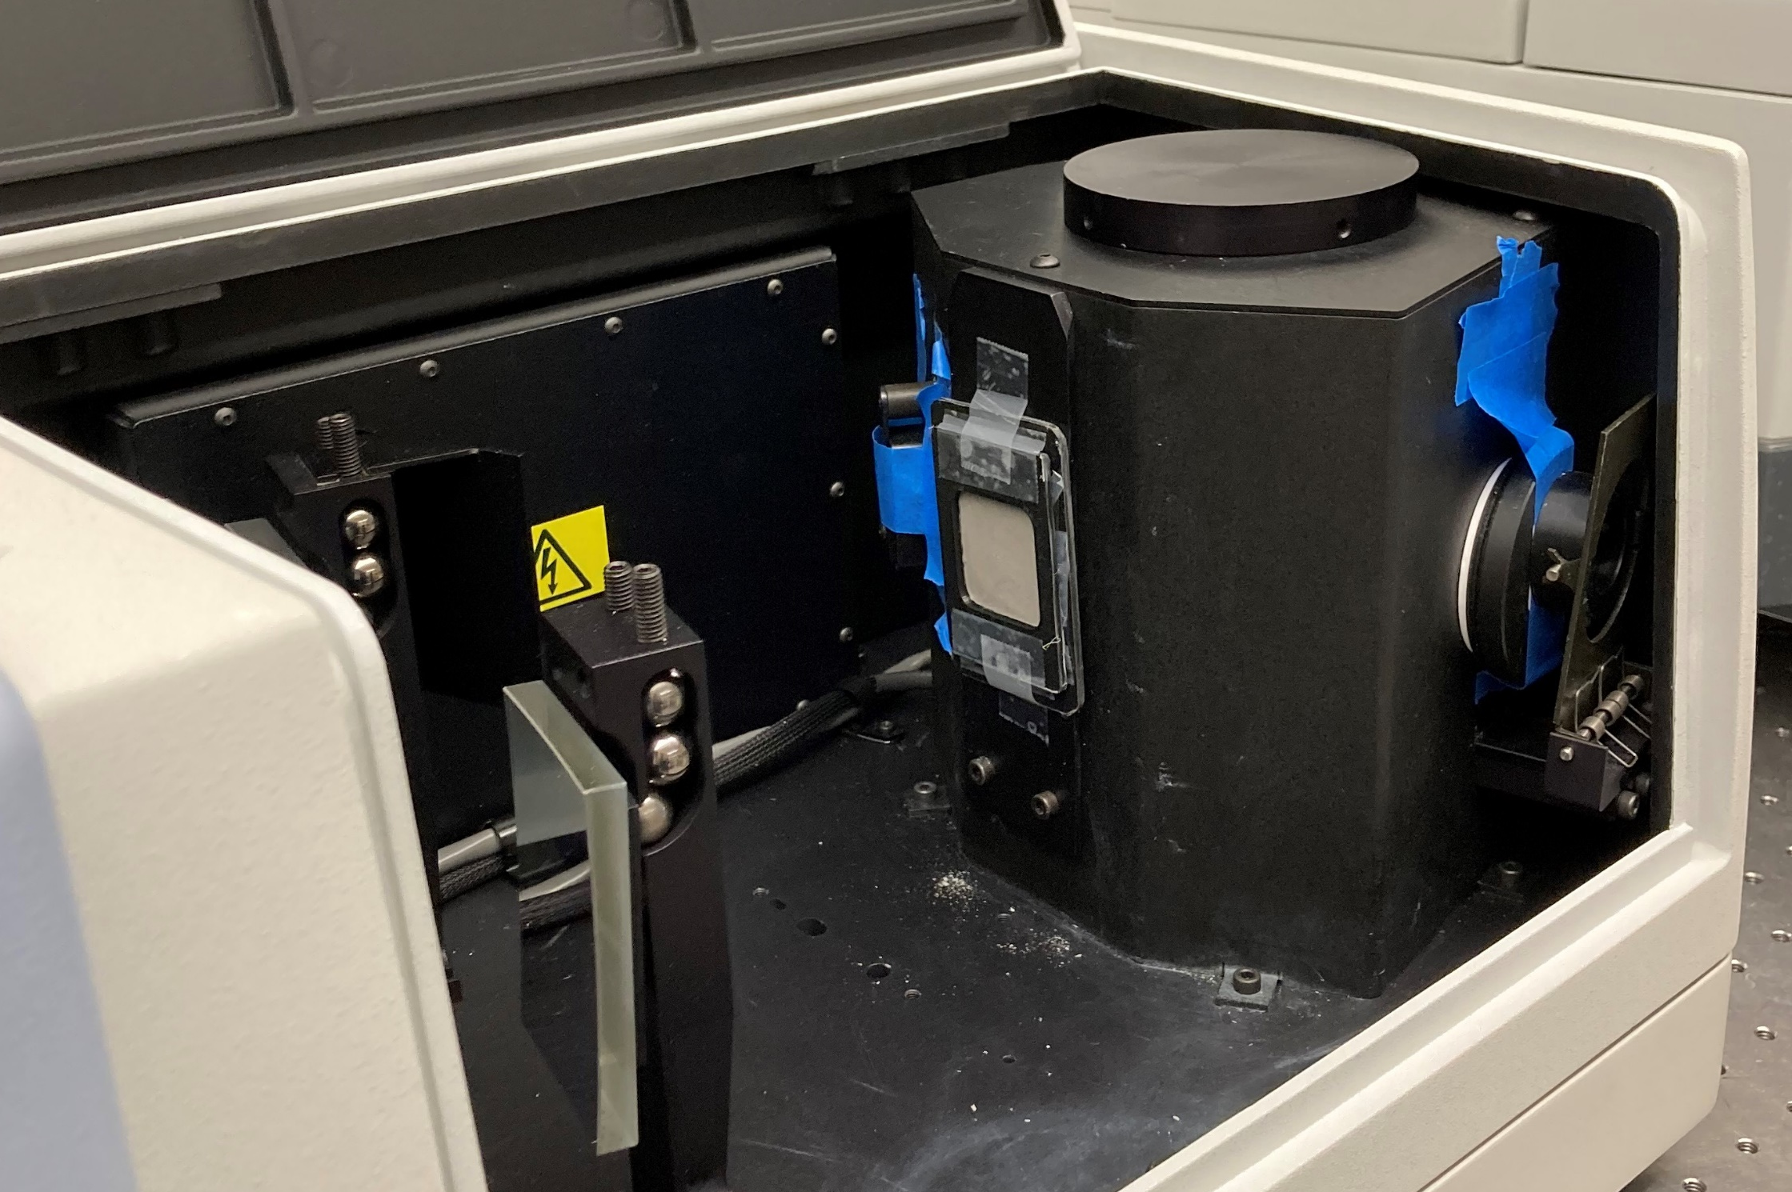
Thermo-optical Properties of Lunar Dust Simulants
Abigail A. Zinecker¹ and Brittany H. Spivey²
¹NASA Johnson Space Center (2101 E NASA Pkwy, Houston, TX 77058)
²Jacobs (2224 Bay Area Blvd, Houston, TX 77058)
Introduction
Lunar dust coverage can significantly impact the thermo-optical properties of external surfaces for spacecraft and systems operating in the Lunar orbit or on the Lunar surface. This impacts the thermal control of these vehicles. Testing must be done to determine how much surface optics are affected by varying levels of lunar dust coverage. Optics and Particle Size Distributions (PSDs) of the simulant used in these tests are critical to the results [2]. Many lunar simulants are available for testing, but their thermo-optical properties are not well characterized. To resolve this unknown, 13 different lunar dust simulants’ IR emissivity, ε, and solar absorptivity, α, were measured and are presented with their PSDs here. Solar absorptivities of lunar samples were calculated from reflectance spectra found in the Lunar Sourcebook and are compared to the measured absorptivities of the simulants.
Results
Table 1. Lunar Dust Sample and Simulant Optics Comparison
Sample | Region | Solar α | IR ε
Lunar Mare Sample [3] | Mare | 0.811-0.834 | -
OPRL2N | Mare | 0.804 | 0.900
Exolith LMS 1 | Mare | 0.777 | 0.895
JSC 1A | Mare | 0.794 | 0.903
Lunar Highlands Sample [3] | Highlands | 0.557-0.619 | -
Exolith LHS 1 | Highlands | 0.603 | 0.873
NU LHT 2M | Highlands | 0.631 | 0.882
NU LHT 4M | Highlands | 0.638 | 0.876
OPRH4W30 | Highlands | 0.618 | 0.879
OPRH3N | Highlands | 0.671 | 0.885
OPRH3W20 | Highlands | 0.674 | 0.887
OPRH3W25 | Highlands | 0.667 | 0.884
OPRH3W30 | Highlands | 0.665 | 0.883
OPRH3W35 | Highlands | 0.645 | 0.875
NU LHT Agglutinates | Both | 0.698 | 0.887
Optics Measurement Methodology
Simulants were not ground, sieved, or otherwise processed. Samples were prepared for optics measurement by dispersing the particles in isopropyl alcohol and then dissolved in order to achieve a loose packed particle bed in specially 3D printed sample containers. They were then placed on a hot plate to remove the moisture resulting in a flat, uniform thickness surface. Each container was sealed with optically transparent low-density polyethylene before being placed in the spectrometers to measure solar and IR transmittance and reflectance, as shown in Figure 1. Solar optics were measured in a Perkin Elmer Lambda 950 Spectrometer with a 150 mm integrating sphere and IR optics were measured with a Thermo Scientific Nicolet iS50 with a midIntegrat Sphere from Pike Technologies. Reflectivity and transmissivity data were post-processed using the AM0 solar spectrum to return α [1].
Figure 2. PSD of Lunar Simulants. Dotted line represents Mare simulants and solid line represent highland simulants
Conclusion
There was more variation in simulant α than ε. Lunar mare simulants have a higher α than highlands simulants, as is expected. Mare simulants were slightly lower than the values calculated from published reflectivity of lunar Mare samples while highlands simulants were generally slightly higher than highlands samples [3]. The IR ε of all simulants were about the same and had a standard deviation <0.01. It has been shown that the smaller particle sizes of lunar simulants the higher the reflectivity [2]. Interestingly, these results cannot support that. The agglutinate content should also impact reflectivity [3]. OPRH3W simulants indicate increased absorptivity with decreasing agglutinate content, contrary to NU LHT samples. More optics measurements are needed where PSDs are equalized before testing.
Figure 1. One of the simulants inside the 3D-printed sample container mounted inside the Lambda 950 Spectrometer.
References
[1] ASTM, Standard Extraterrestrial Reference Spectrum, ASTM E490-00a, 2019.
[2] Gaier, J., Street, K., & Gustafson, R. (2010). Measurement of the solar absorptance and the thermal emittance of lunar simulants. 40th International Conference on Environmental Systems.
[3] Vaniman, D., & French, B. M. (2005). 6. Lunar Rocks. In Lunar sourcebook: A user's guide to the Moon (pp. 210–257). essay, Cambridge University Press / Lunar and Planetary Institute.
Future Work
Next steps for this team are performing dust coverage testing on different surface materials to evaluate change in surface thermo-optical properties and therefore heat rejection capability. The team also plans to use this data to predict worst-case optics of surfaces analytically and validate with test data. More research may be needed on correlating PSDs and agglutinate content with reflectance since previous work indicates a correlation [2].
Acknowledgments
This work was funded by the NASA Gateway Program and optics measurements were performed at the FLEX Lab at Purdue University with the help and expertise of Dr. Joseph Peoples. Simulant PSDs were obtained from wet dispersal techniques at the Simulant Development Lab at NASA Johnson Space Center with the assistance of Dr. Ross Kovtun.

