Slide 1


National Aeronautics and
Space Administration
NASA In-Space Manufacturing
Current Status
Christopher Roberts| MSFC | March 16, 2023
Solid State Additive Manufacturing (SSAM)
Point-of-Need Technical Interchange Meeting International Working Group
www.nasa.gov

Slide 2
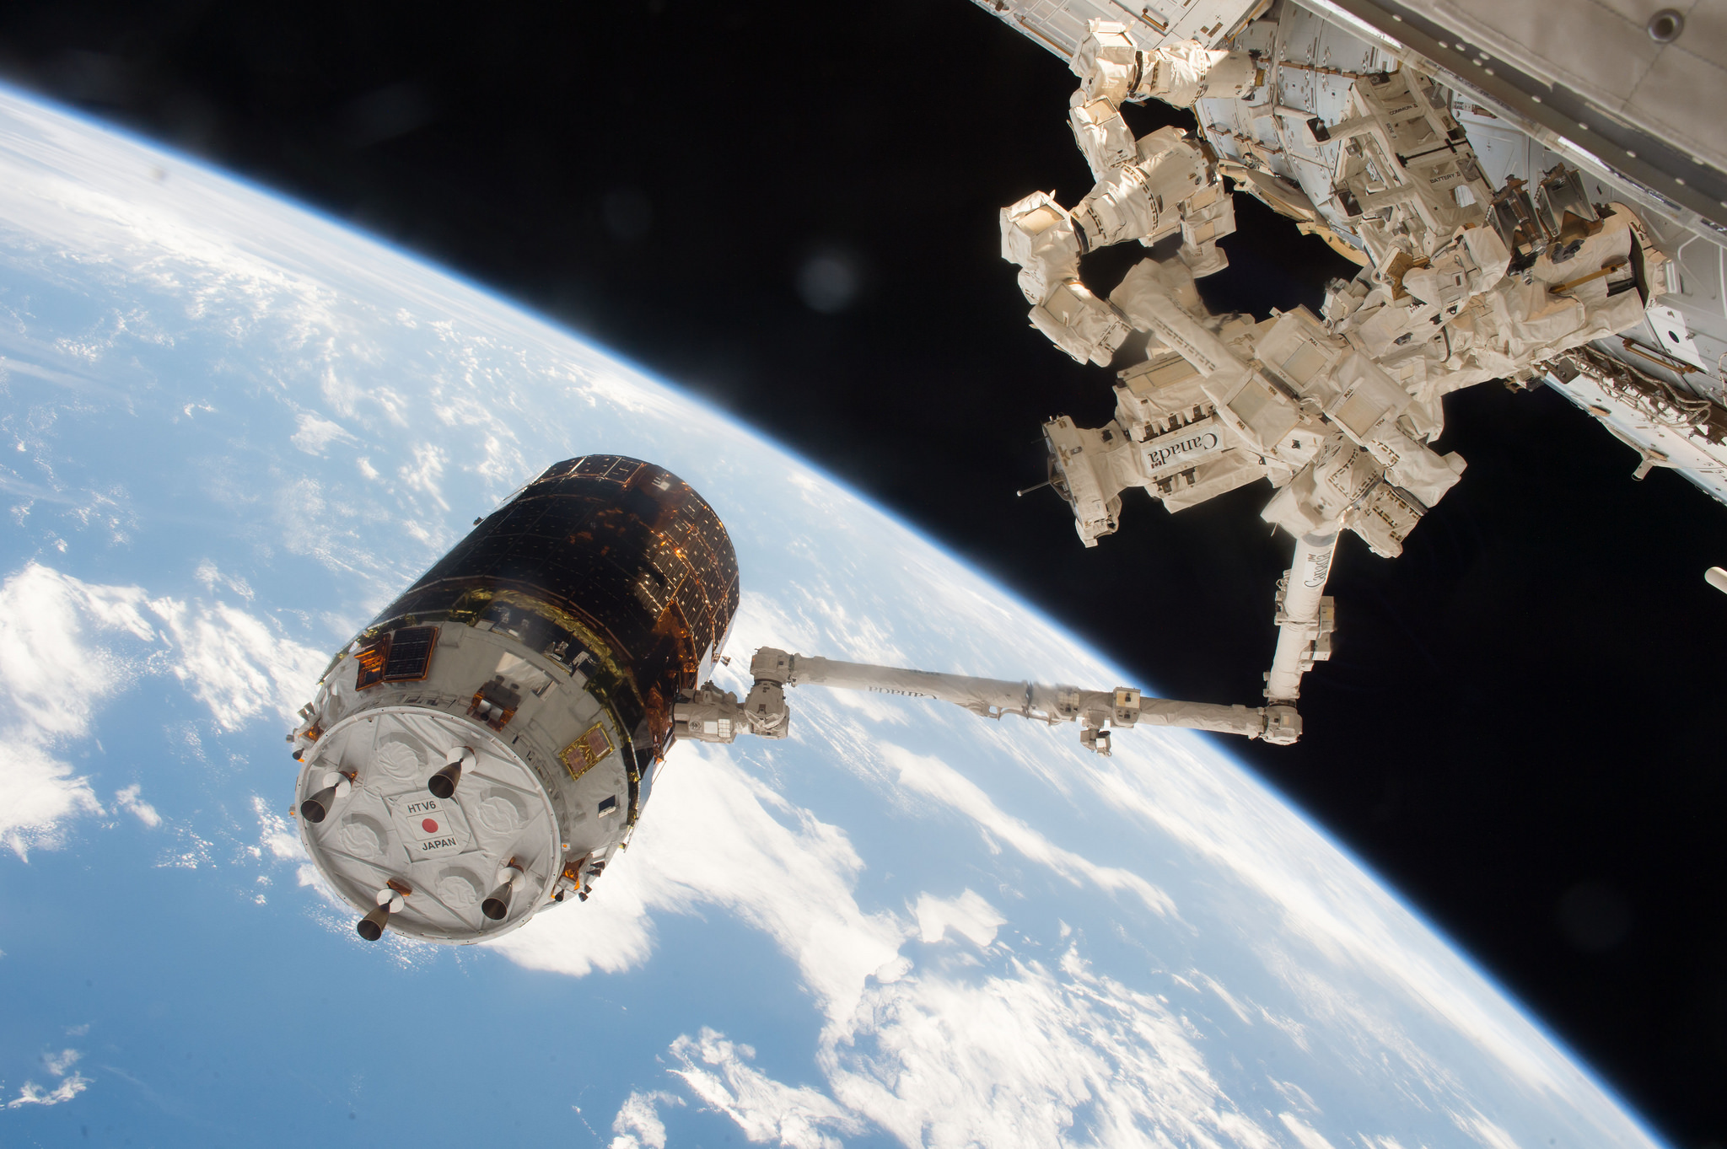

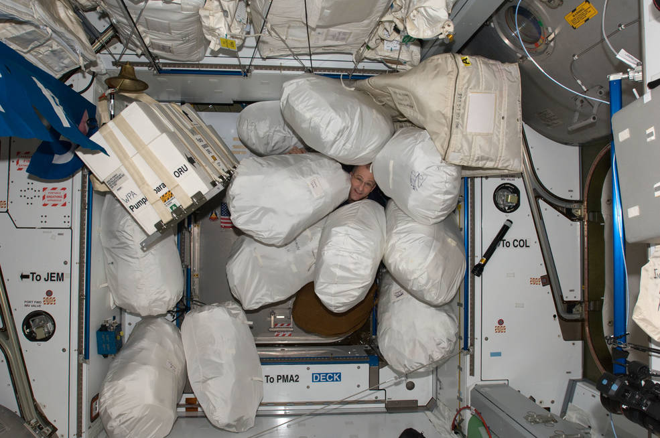
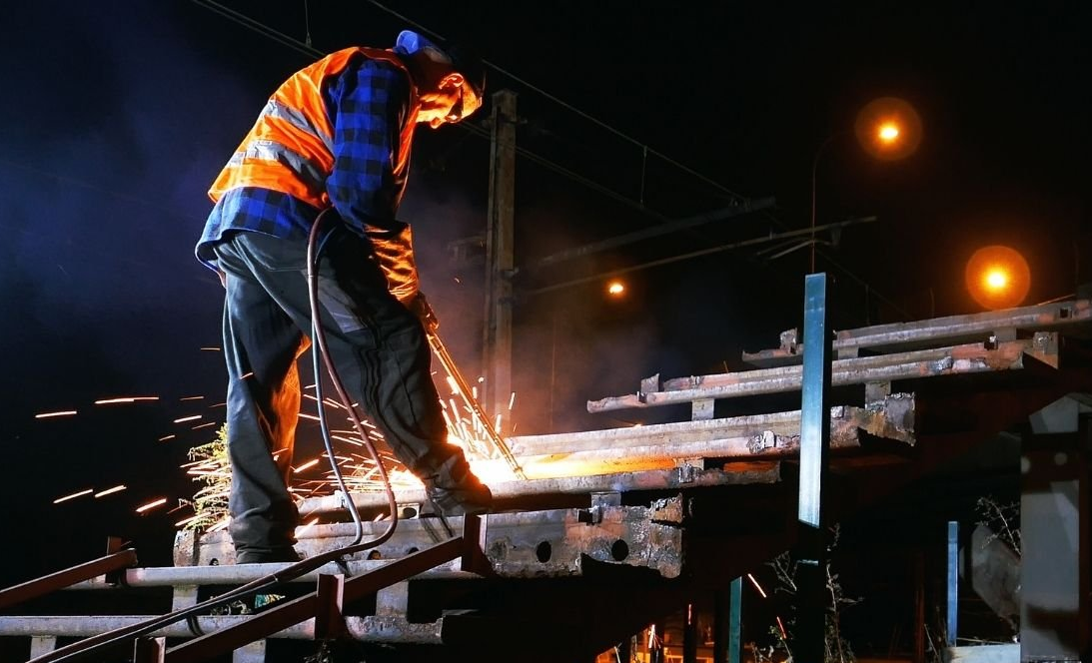
Why?
Cargo Delivery to ISS
(image credit NASA)
Earth Based Infrastructure
https://www.axis.com/solutions/critical-infrastructure/communication-towers
Trash Management on ISS
(image credit NASA)
https://www.chartercollege.edu/news-hub/how-will-new-infrastructure-deal-impact-welding-careers

Slide 3
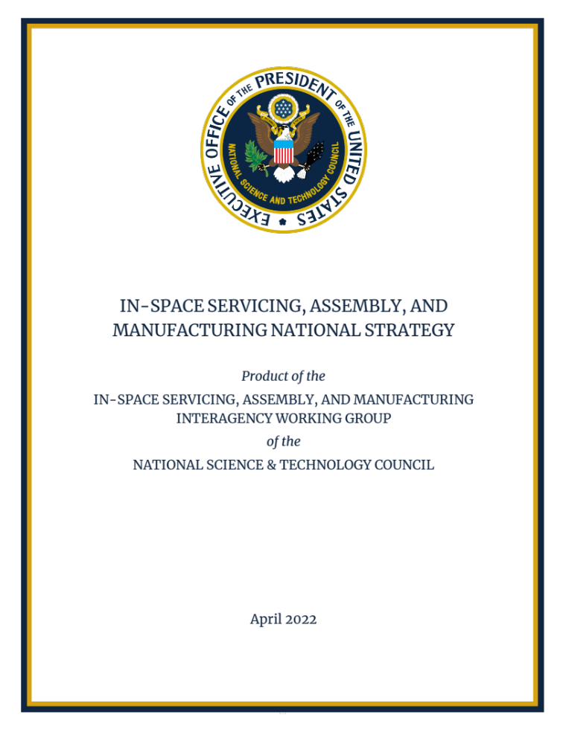
Why?
“ISAM capabilities can create the foundation for sustainable operations and serve as a strategic enabler to spur U.S. scientific and technological innovation, ensure the freedom to operate, and preserve the use of space for future generations.”
In-Situ Resource Utilization
In-Space Serving, Assembly, and Manufacturing
In-Space Manufacturing
Upstream & Downstream Supporting Services
Adapted from In-Space Manufacturing-2022 Industry Survey
Erik Kulu
Notes:
Add in Ven diagram

Slide 4
Collaborations & Partnerships
Academic
University of Louisville
University of California Berkley
University of Nebraska
University of Alabama Huntsville
Appalachian State
Auburn University
Boise State
Georgia Tech
California Tech
Iowa State University
University of Miami
Florida A&M University
Oregon State
West Virginia University
Youngstown University
University of El Paso
University of Wisconsin
University of Wyoming
University of Delaware
University of Texas El Paso
Ohio State University
NASA Centers
Marshall Space Flight Center
Ames Research Center
Johnson Space Center
Kennedy Space Center
Goddard Space Flight Center
Air Force Research Center
Jet Propulsion Laboratory
Glenn Research Center
Industry
Techshot
Redwire Space
Cornerstone Research Group
NextFlex
nScrypt
Multi3D
LambdaVision
Faraday Incorporated
Branch Technologies

Slide 5
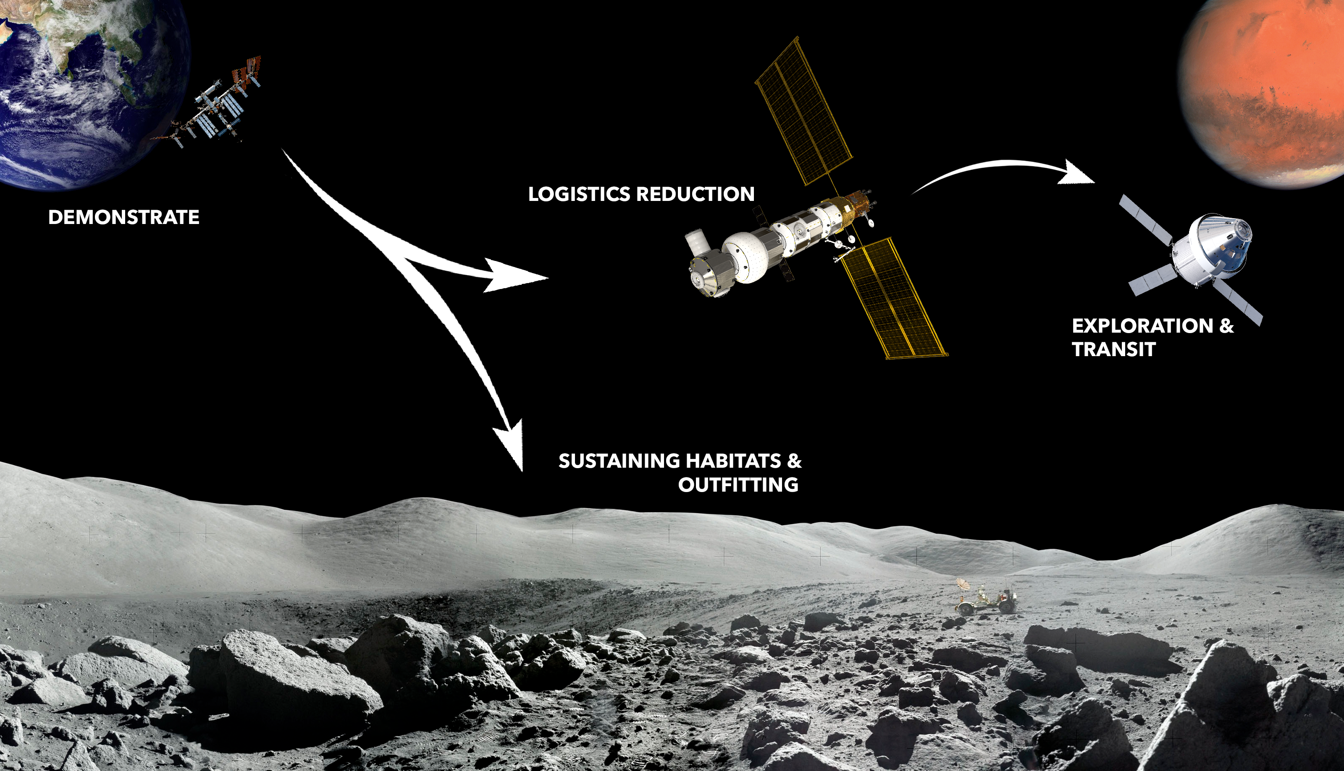
Notional Infusion Path
In Space Manufacturing Strategy
& Commercial Manufacturing
Currently working Strategic Planning, Tech Maturation, and Roadmaps
Notes:
Factory in space/repair hub

Slide 6
Goals & Objectives
ISS
CLDs
Gateway
Transit
1) Develop a Space Economy
Applications: Manufacture goods for Government and Industry
  Utilize the microgravity environment
  Enable Outfitting of Habitats
Focus: AM Metals, Polymers, Electronics, and Logistics Reduction
2) Enable Sustainable Deep Space Missions
Applications: Living Sustainably on the Lunar Surface and Mars
  Medical Devices
  Crew Tools & Engagement
  Habitats Outfitting & Infrastructure
  EVA Aids (ex. modular excursion devices)
Focus: Enabling living and working in space to be sustainable → reducing operations cost.
Notes:
Add in Ven diagram

Slide 7
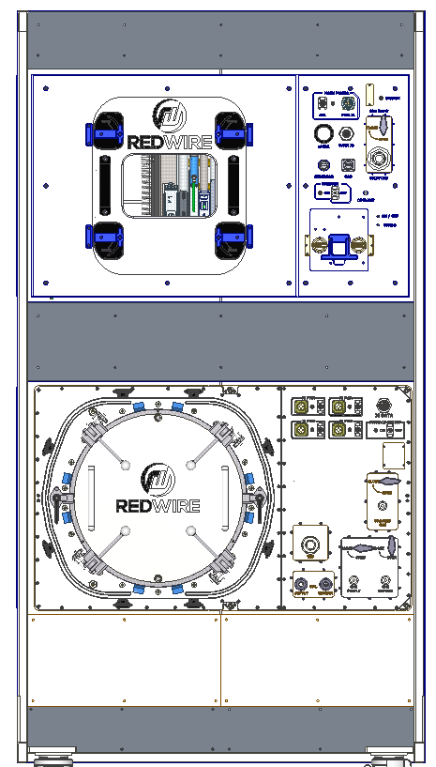
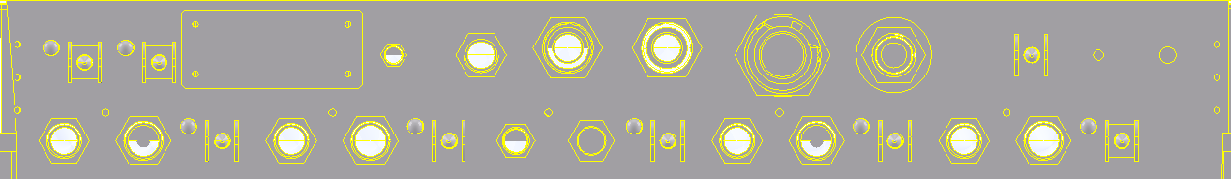
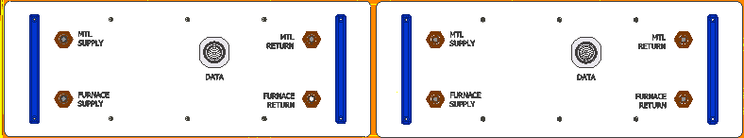

Current Status: FabLab
NextSTEP BAA
Awarded
BAA Completion
PDR
CDR
Hardware Delivery
Demonstration Complete
RFI Released
CCRPP
TO 1 Mod 5
TO 3
YET2 Study
TO 1
2016-2017
2018
2020
2021
2022
2023
2024
2025
Advanced Toolplate:
    Printing of Metal and Polymer Parts
    Finish Milling
Inspection Subsystem
    Defect Detection and Remediation
Environmental Control
    FOD capture system
Electronics Manufacturing
    Smart Pumps, Directed Energy, Pick and Place, etc.
Avionics and Control
Print Module
Full Payload
Glovebag concept for FOD control
Part Transfer Box for transport between modules
Remote Commanding for limited crew interaction
Compatible with science investigations beyond the ISM project
Furnace Module
Sintering of Metal Parts
Brazing of Assemblies
Avionics and Controls
2000W Peak Power
Process Gas Drawer
Provides Argon to Furnace Module
6
Notes:
Add in Ven diagram

Slide 8
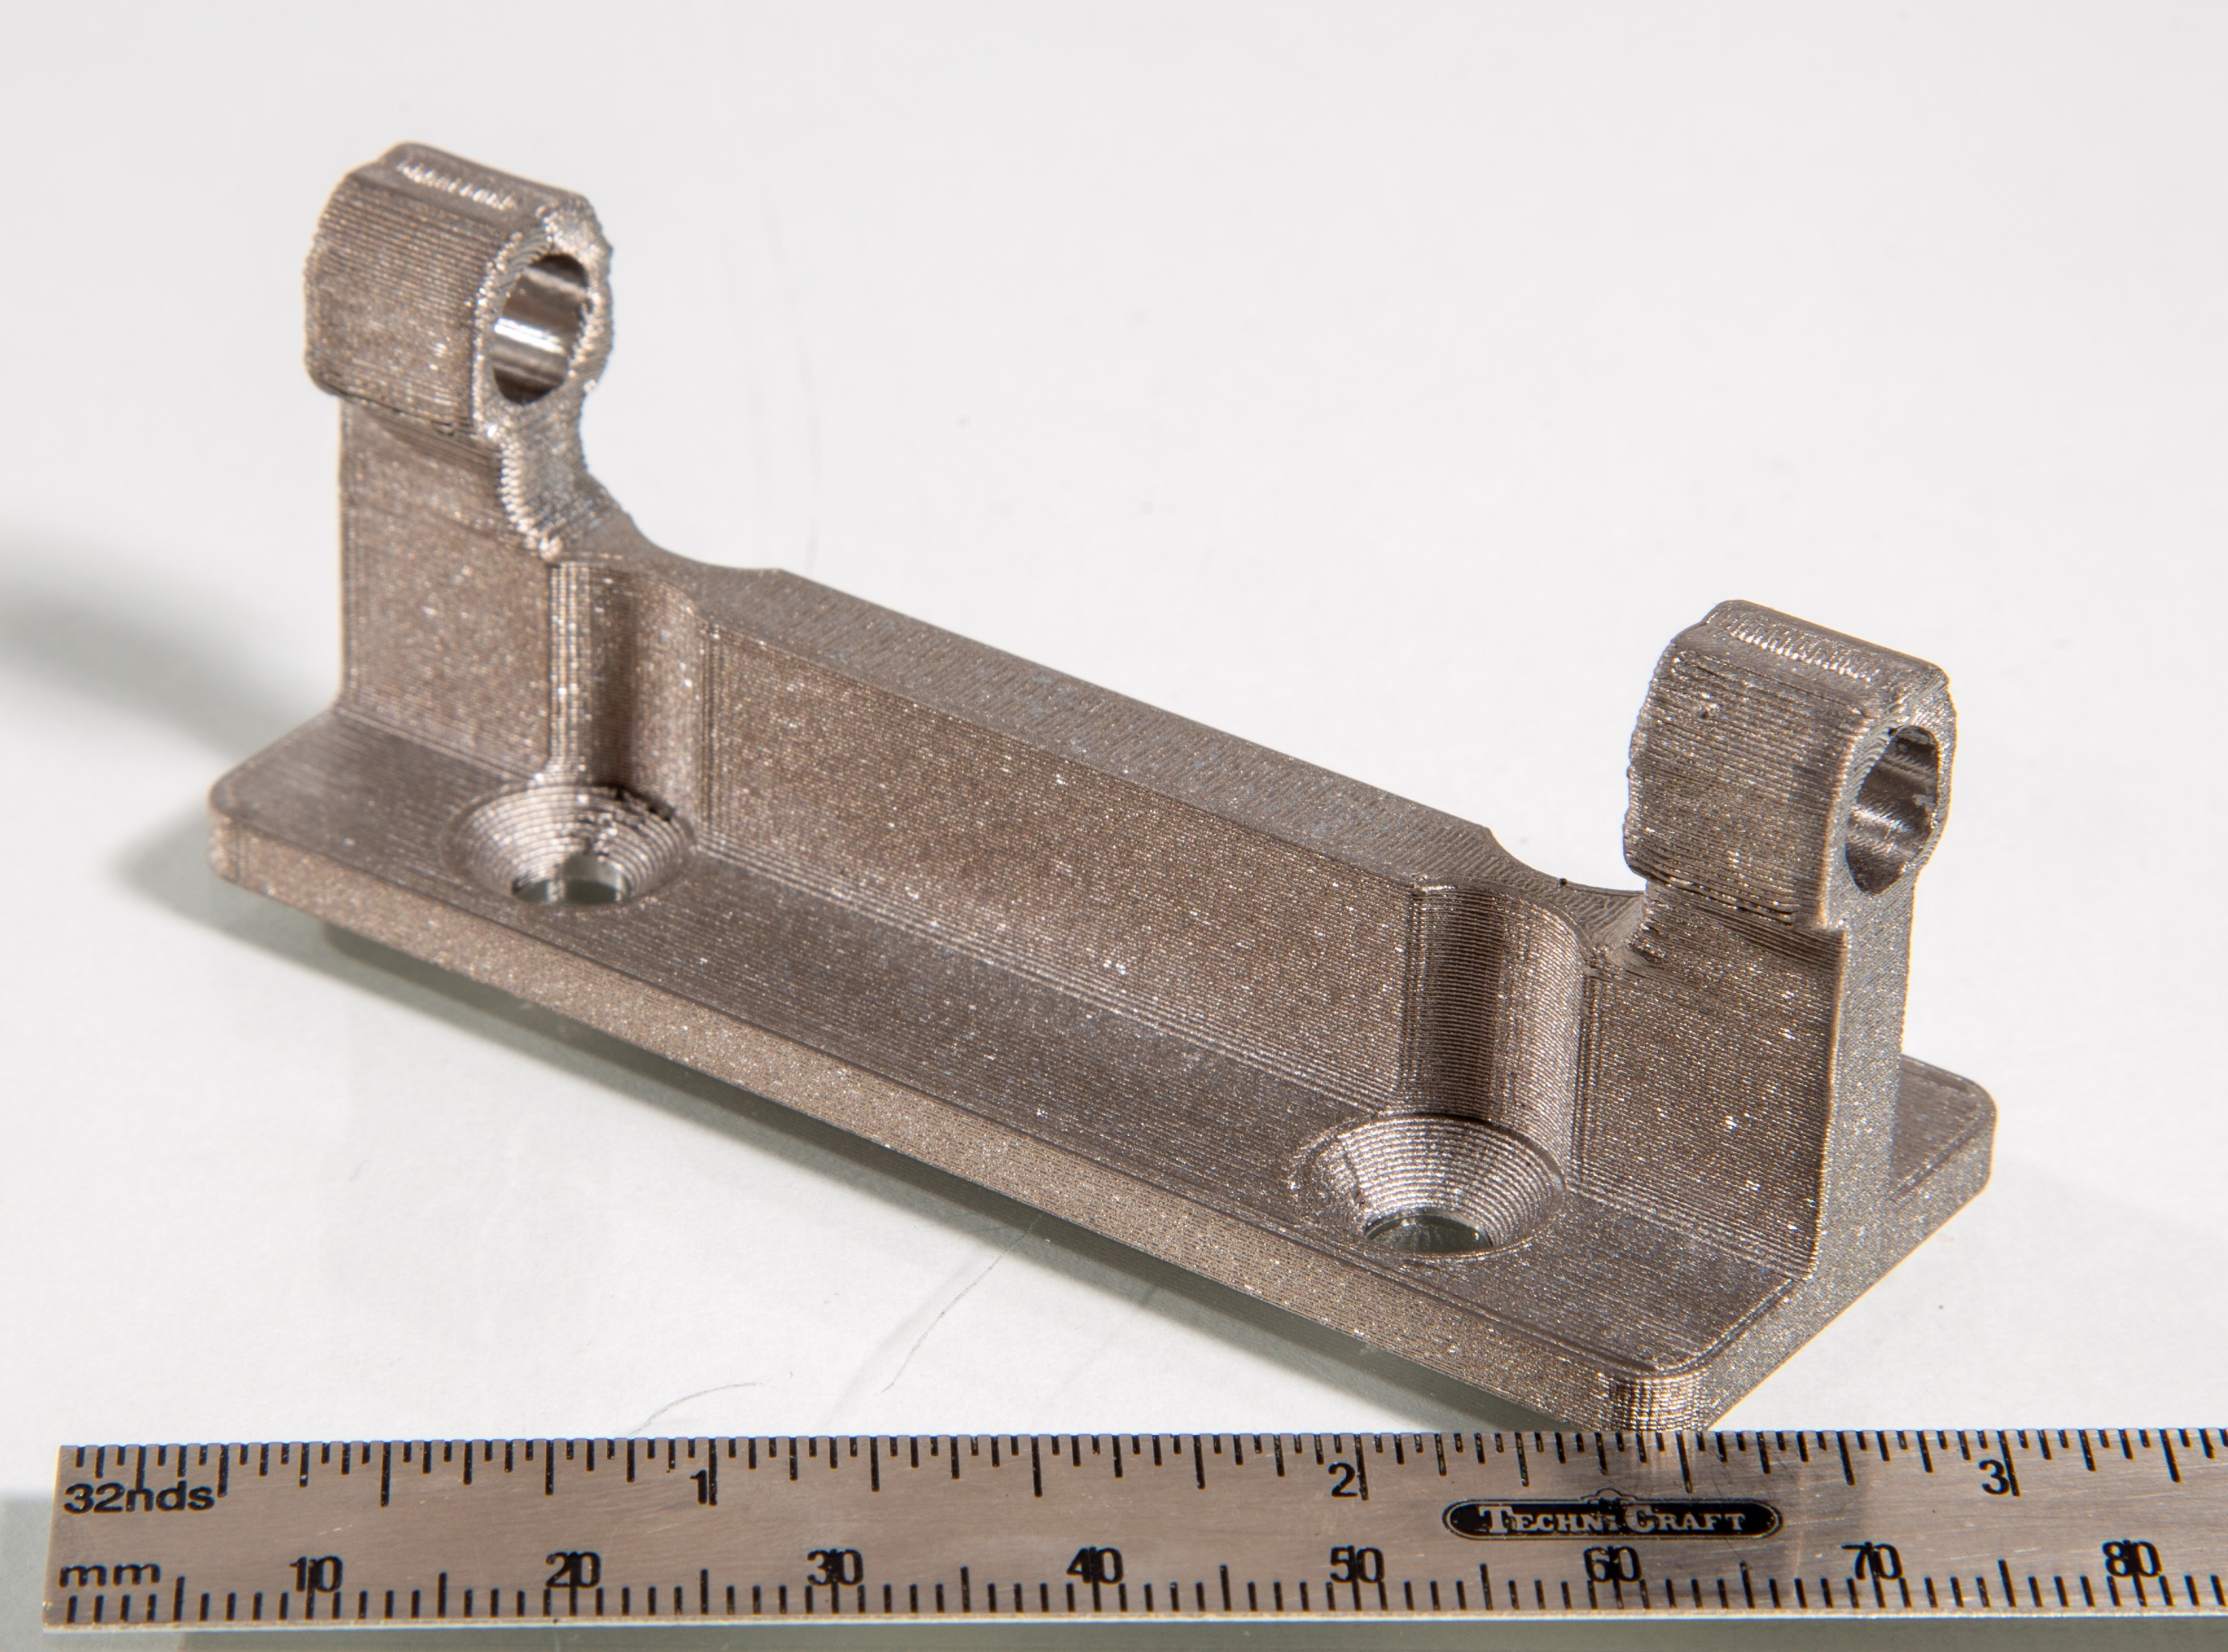
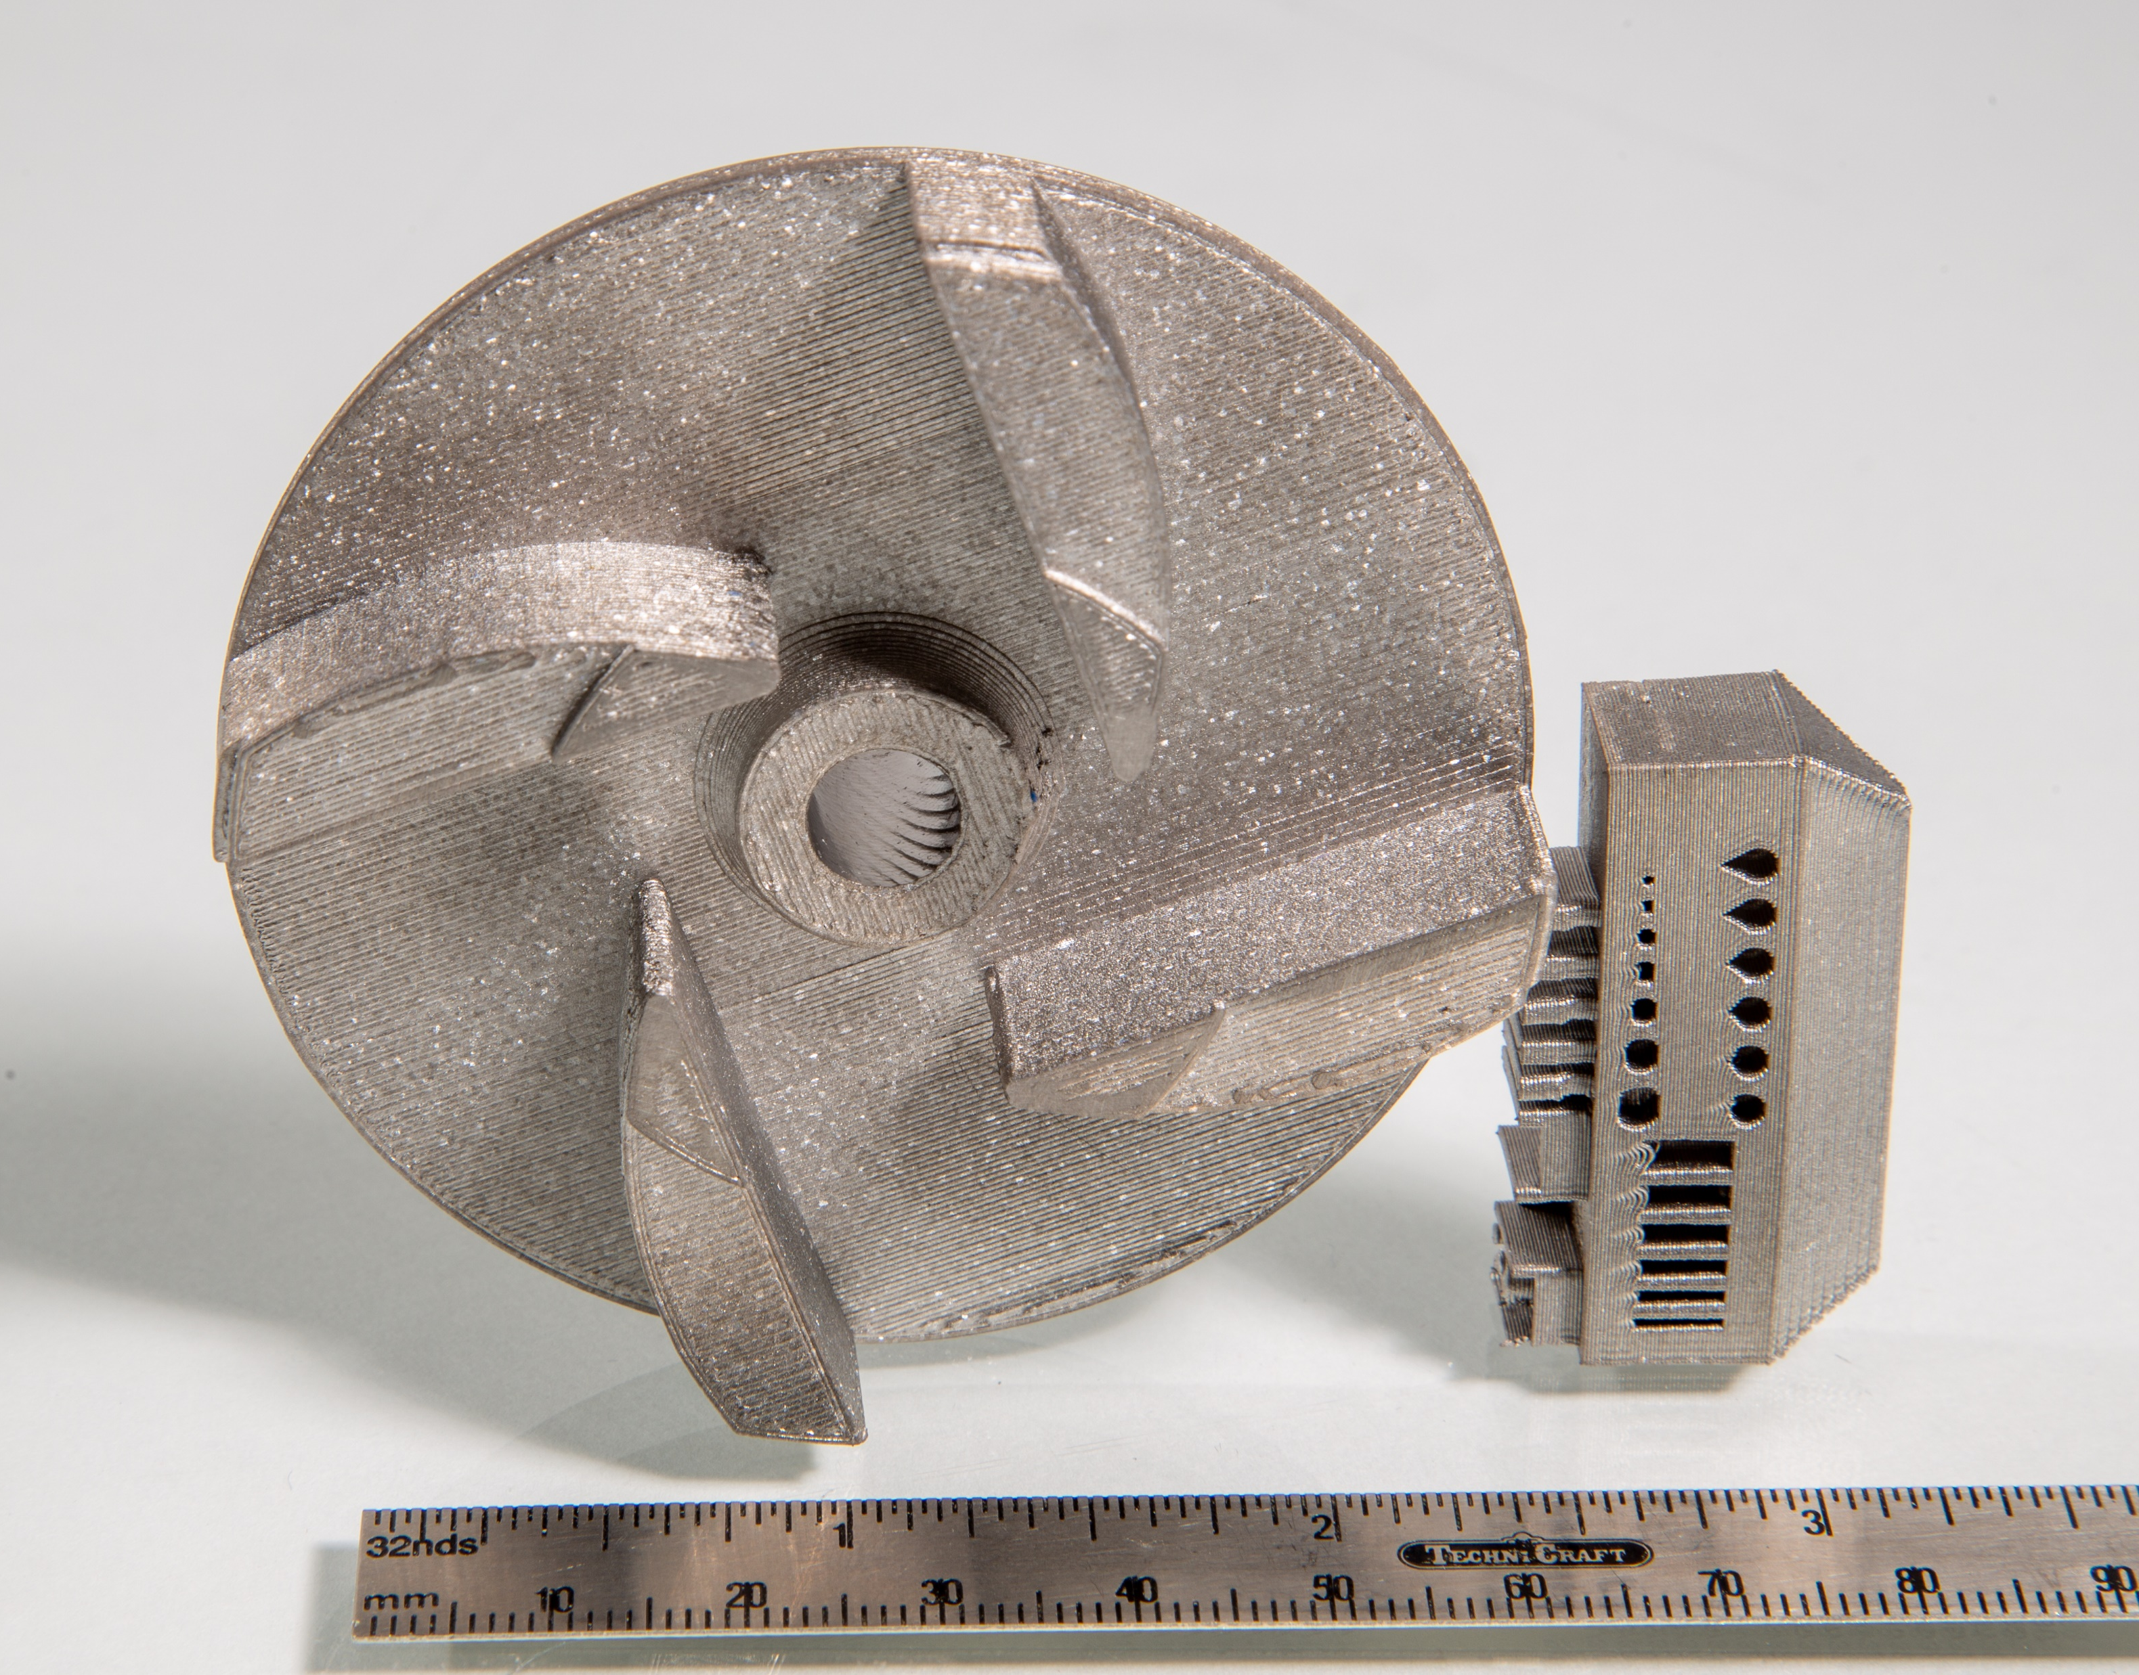
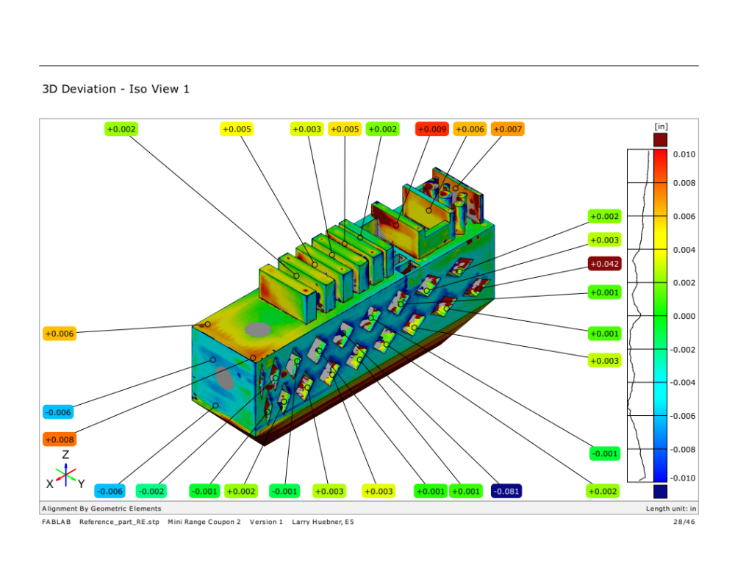
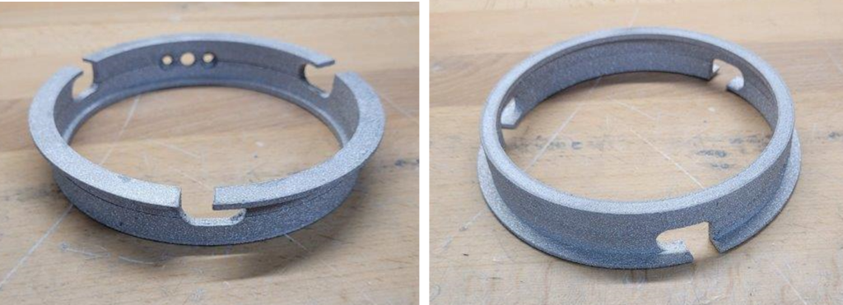
Current Status: FabLab Continued
Materials Development
Baseline: Ti-64
Additional Metals: Aluminum
Brazing of Ti-64
Known Needs:
Stainless Steel
Ceramics
Space Suit Wrist Disconnect manufactured by FabLab. Image courtesy of Techshot a Redwire company.

Slide 9
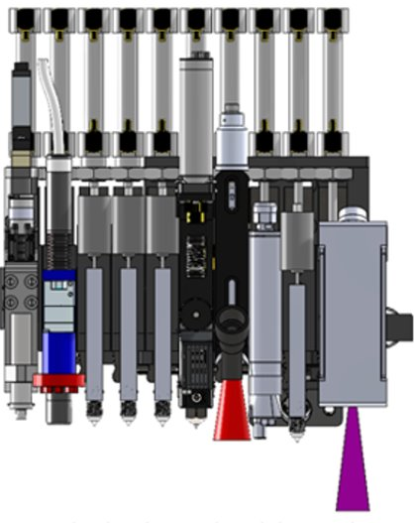
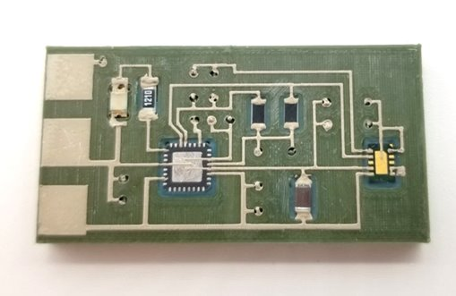
Current Status: On Demand Manufacturing of Electronics
Project Goal: To develop and demonstrate the feasibility of a low-gravity, on–demand manufacturing system for flexible hybrid electronic devices on ISS.
FabLab Advanced Toolplate-​
Flight Opportunities is funding suborbital flight testing of the Advanced Toolplate and newly developed tools (anticipated May 2023)
EHD (Electrohydrodynamic) Ink Jet and Electrodeposition of Covetic materials tools are in development for FY23 integration into Advanced Toolplate. ​ EHD awarded parabolic flight test.
Advanced Toolplate for the FabLab System
Additively-printed CO2 sensor​

Slide 10
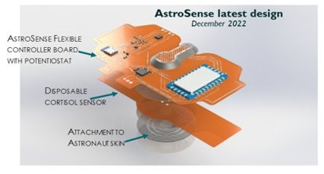
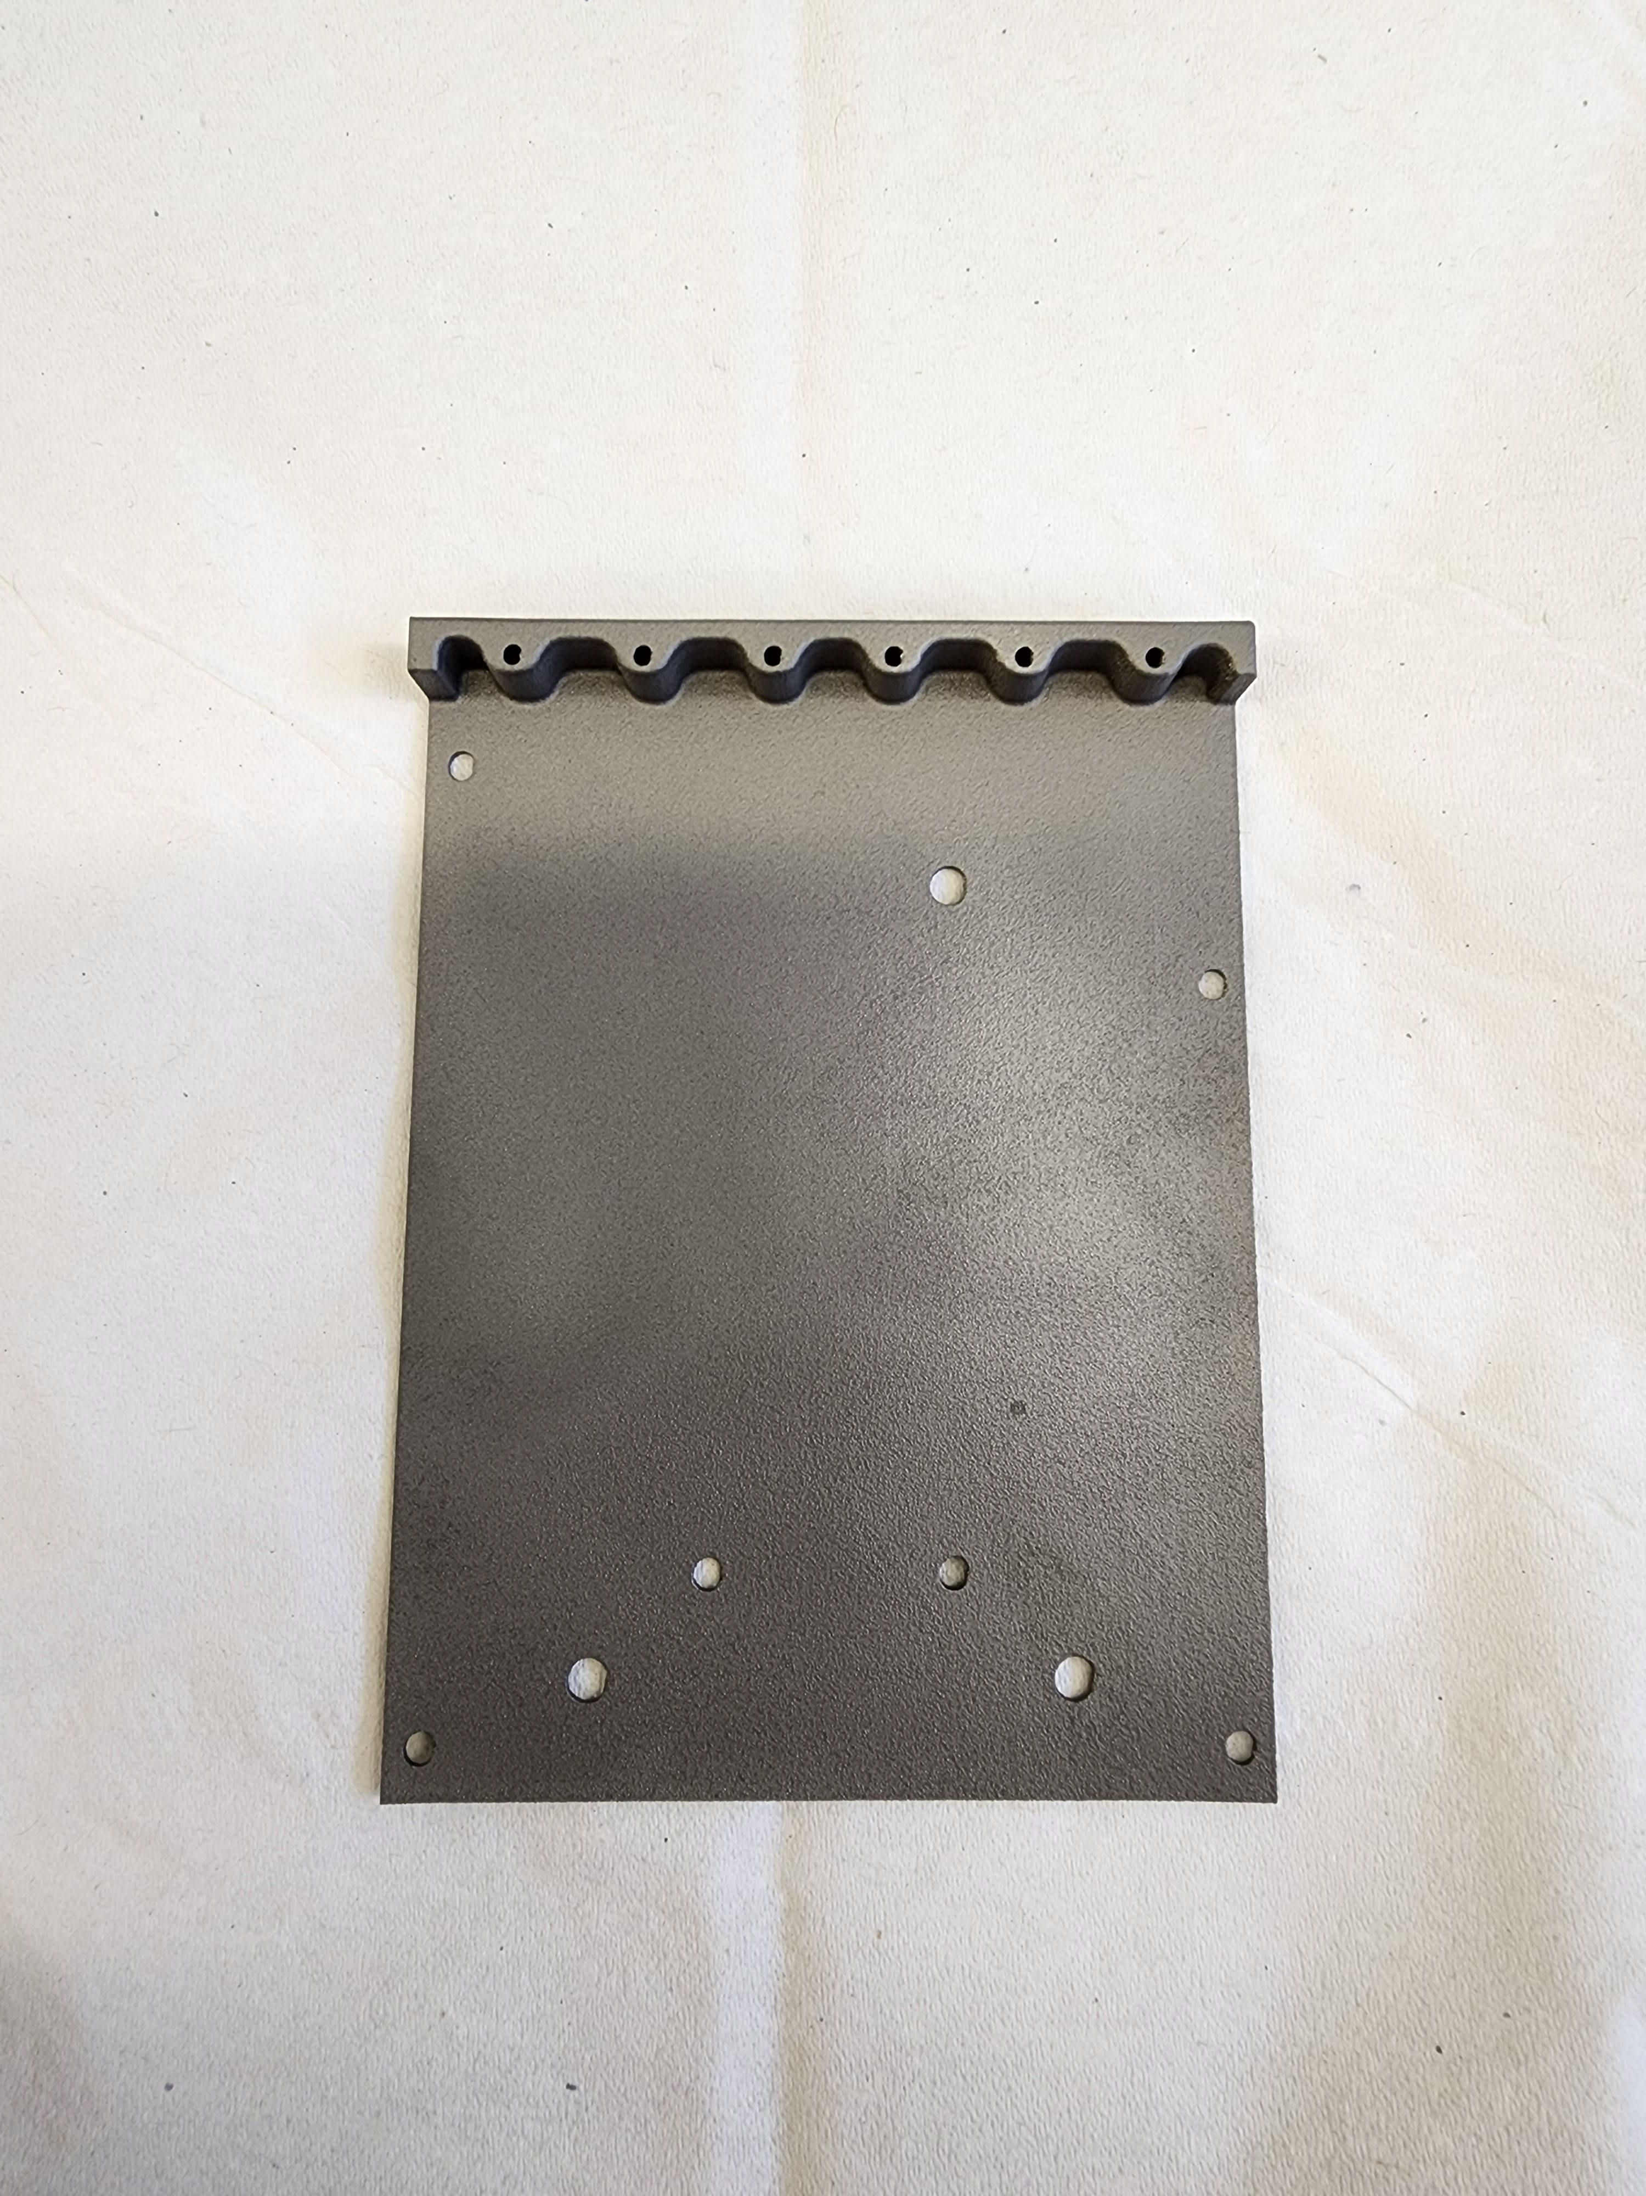
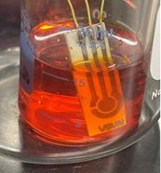
Current Status: ODME Continued
Sensors:
ECLSS Conductivity Sensor
HYDRA RFID Antenna Base
AstroSense Crew health Monitoring
Advanced Processes:
Laser Ablation
Laser Sintering
Partnered with In-Space Production
Aimed at manufacturing goods in space for use terrestrially
  Retinal Implants
  Semiconductors
AstroSense wireless crew health sensor device
Latest version HYDRA RFID antenna base
Conductivity sensor​ in ECLSS pretreat

Slide 11
Current Status: In-Space Welding
Repair
Assembly
Modeling
Manufacturing
NASA has not made a weld in space for 50 years
No current, formal in-space welding program
  Current effort limited to small efforts (i.e. CANs, ECIs, etc.)
  Laser beam welding in space: maturation and model validation with flat floor and parabolic flight experiments (OSU)
  Two laser weld demonstrations to anchor computational and digital twin models
  Development of a High-Fidelity Robotic System
  Digital Twin for In-Space Welding (UTEP)
  Development of and experiments with a robot digital twin to characterize motion and forces associated with Butt Weld joint fit-up
  Aims to better understand free flying systems
Notes:
Materials Informations and ditgital twin modeling to generate structure properties relationships
Collaborative robotics

Slide 12

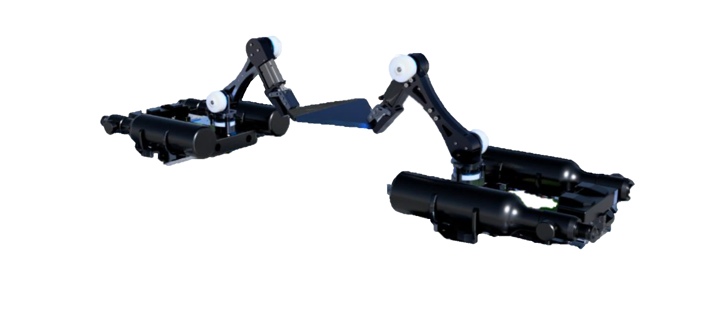
Current Status: In-Space Welding Continued
Low TRL Development:
Novel systems based on terrestrial solid-state technology
Cold Welding investigations
Notes:
Second generation systems built upon teresterial solid state technology
Cold welding – University consortium to develop cold welding processes

Slide 13
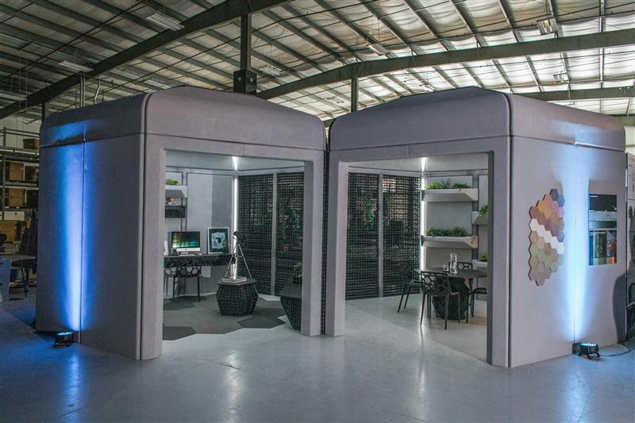
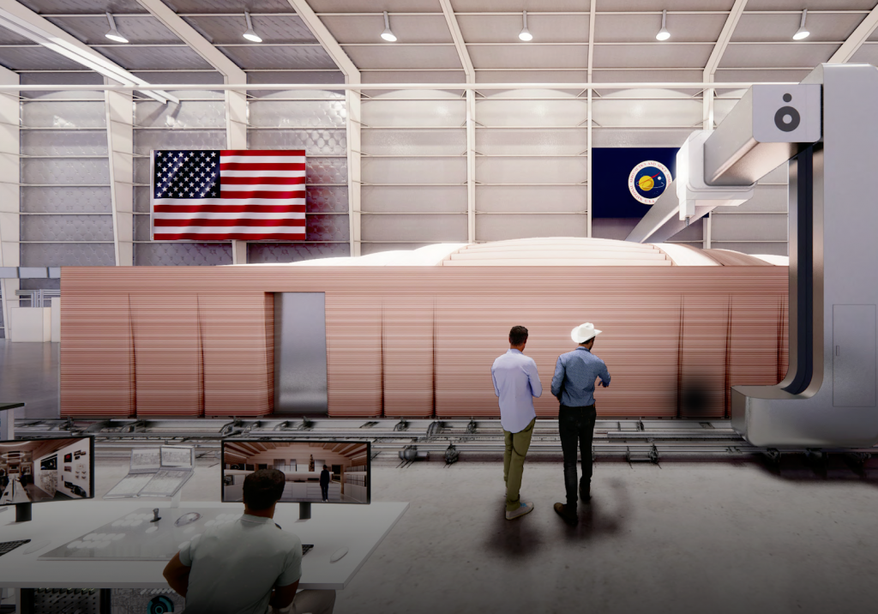
Current Status: Outfitting
Branch Technologies:
Demonstrated potential outfitting solutions.
Investigated materials, process and design considerations.
CHAPEA Project Collaboration:
Crew analogue of Martian Habitat
Focus: Understanding crew interactions with manufacturing systems and potential applications

Slide 14
Current Status: Outfitting
Project Formulation
Taxonomy development for outfitting, construction, and manufacturing
Priority Analysis for Outfitting Technologies
Integration in to Design Studies and Concept Missions
Taxonomy Development
Industry Survey
Prioritization
Needs / Gap Analysis
Technology Development

Slide 15
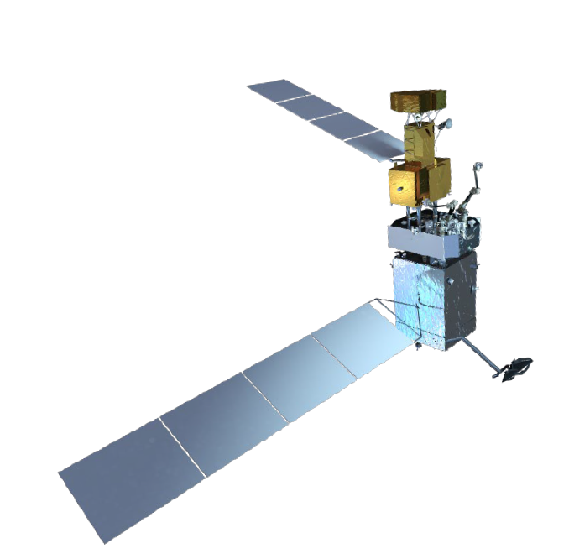
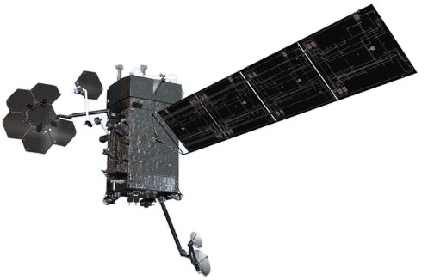
OSAM Missions: OSAM-1
Robotic Servicing
Demonstration Goals:
Autonomous rendezvous and inspection
Autonomous capture of client satellite
Tele-operated robotic servicing
Refueling of client satellite
Relocation of client satellite
Release and safely depart from client
In-space assembly of an antenna
In-space manufacturing of a beam
Launch Date: February 2026
Additive Manufacturing

Slide 16
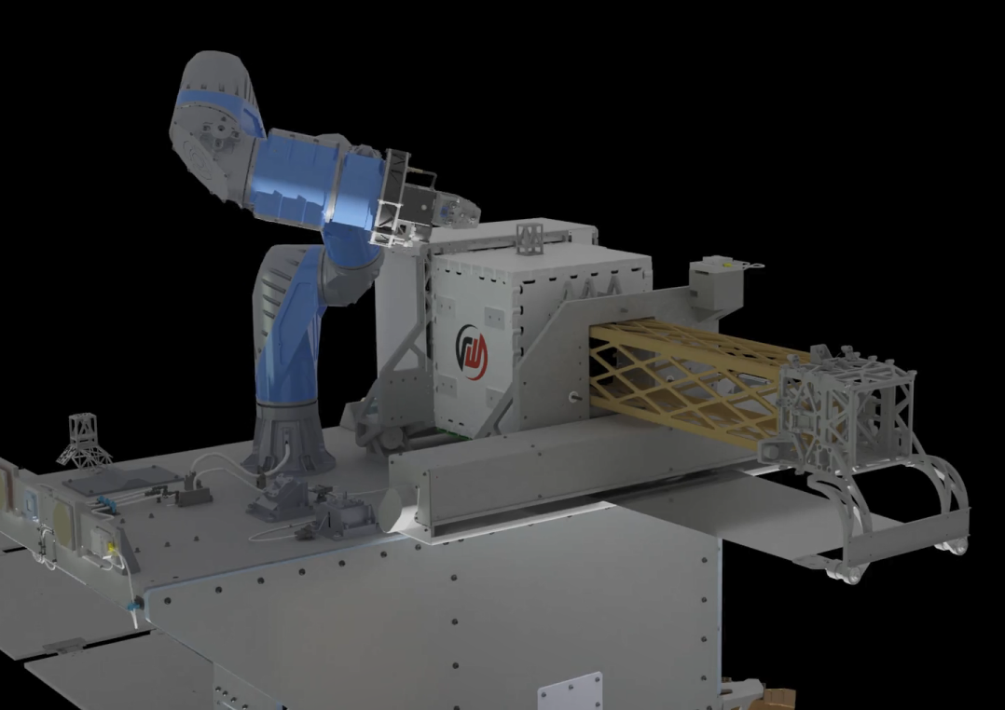
OSAM Missions: OSAM-2
  Class D Demonstration mission
  Mk 11 Extended Structure Additive Manufacturing Machine (ESAMM)
  Anticipated 2023 Status:
    Receive Robotic Arm
    End to End Test
    Flight unit assembly and verification testing
    Payload Integration
    Receive Bus
    Subsystem environmental testing

Slide 17
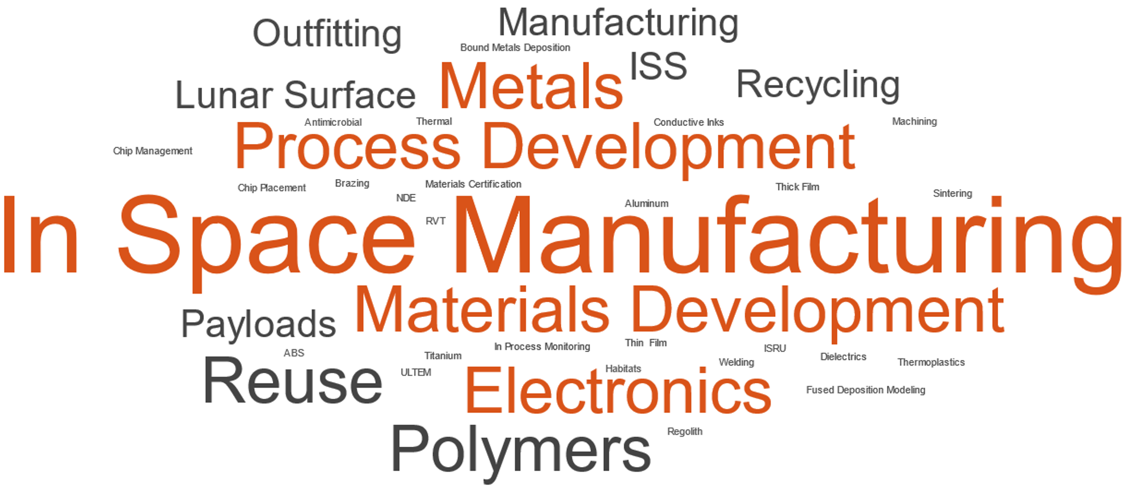
Notes:
Material Extraction
Alloy Development
Computation Materials Development

Slide 18
Forward Focus
Expand In-Space Manufacturing efforts to include additional processes
  Welding Demonstrations
  Pharmaceutical Manufacturing
  Large Format Printing (outfitting focused)
  Physics Based Modeling & Computational Materials Development
  Process Specific Alloy Development
Autonomous Operations
Standardization & Materials Characterization
  Current standards are not conducive to in-space manufacturing
  Design Values
Second generation systems

Slide 19
Backup

Slide 20
ISM Portfolio Overview - Org and Funding
STMD/GCD,FO
ESDMD/EC
In-Space Manufacturing (ISM) Portfolio
PM - Jim Stott/ST23
CE – Chris Roberts/EE05
Strategic Planning
Outfitting
PI – Brady Kimbrel
On-Demand Multi-material Manufacturing
(ODMM) Project
PI – Alex Blanchard
On-Demand Manufacturing of Electronics
(ODME) Project
PI – Curtis Hill
CHAPEA
Rachel Bardsley
RFID Enabled Autonomous Logistics Management
(REALM) Task
Nextflex
Recycle & Reuse (R&R)
Fablab

