Slide 1


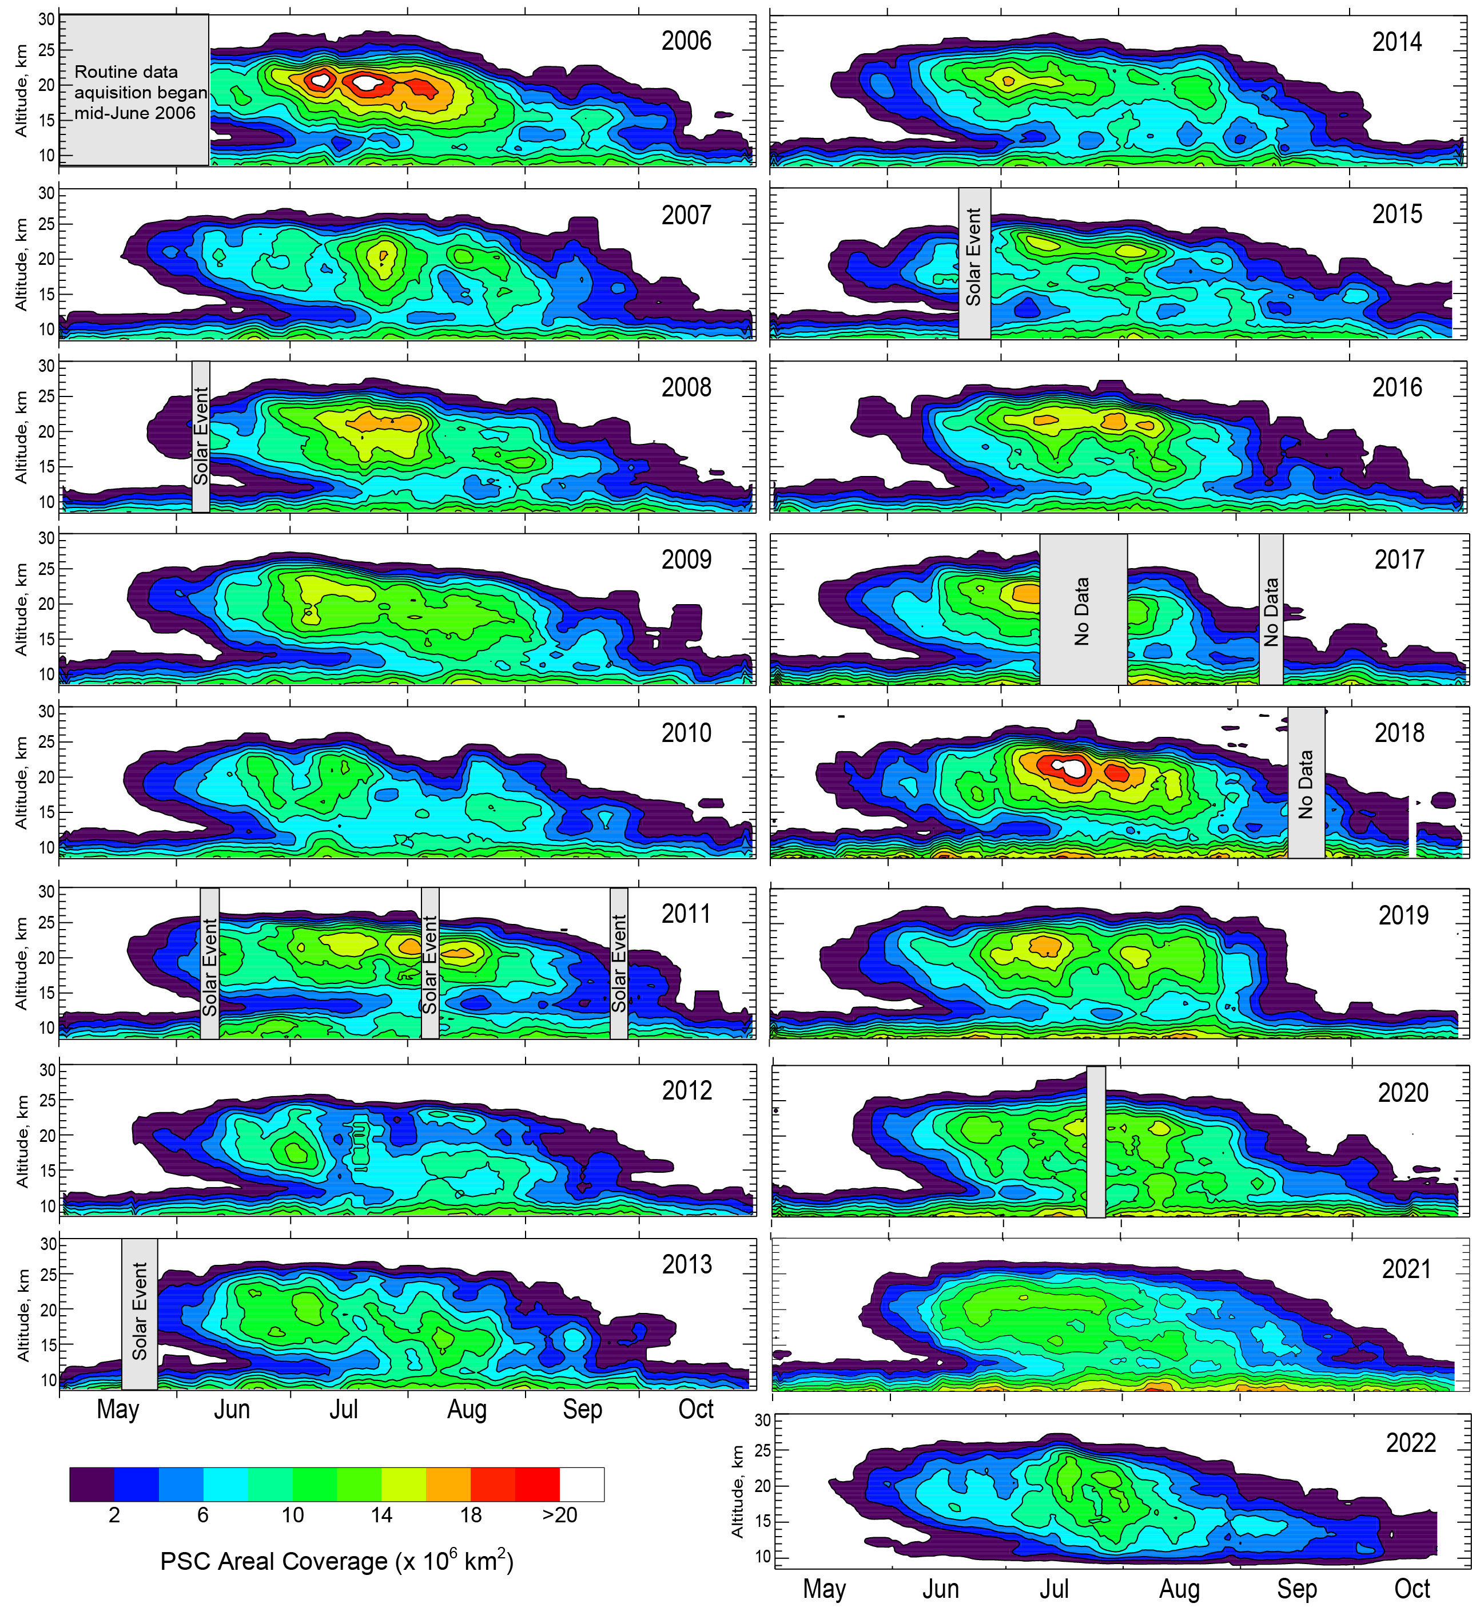
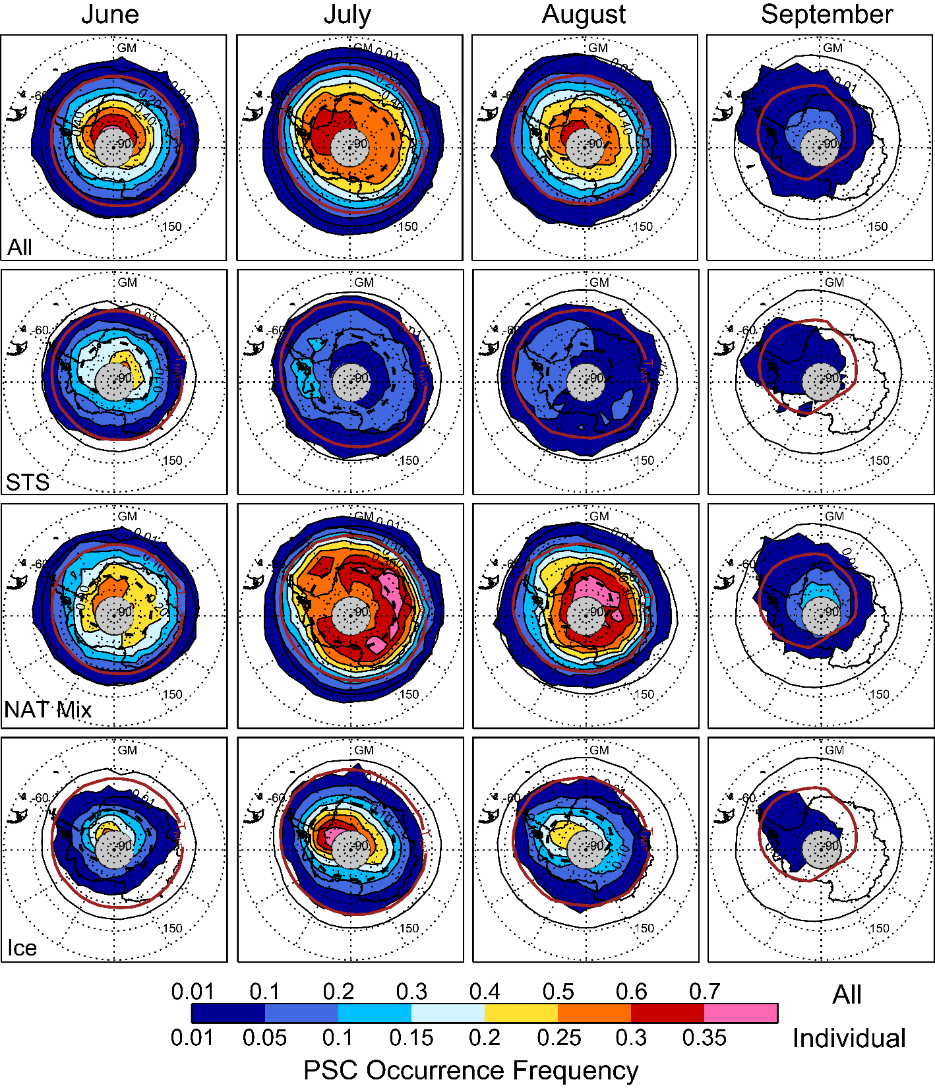
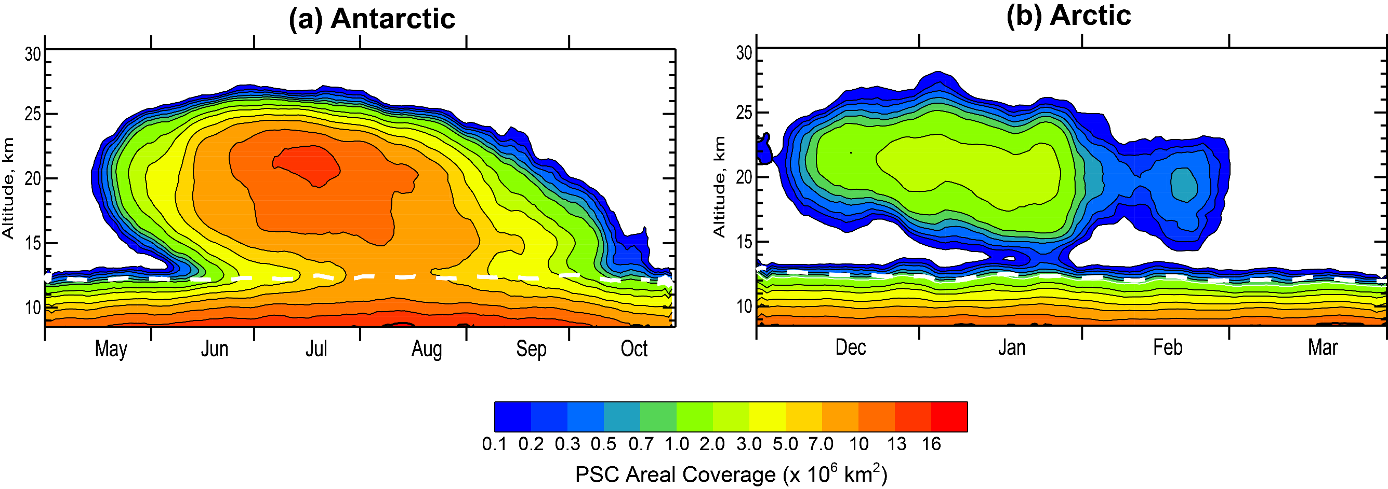
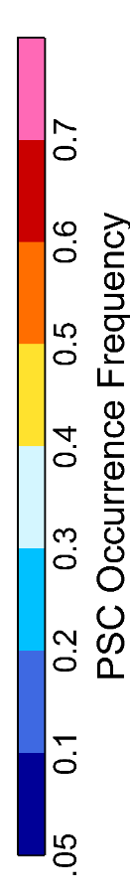
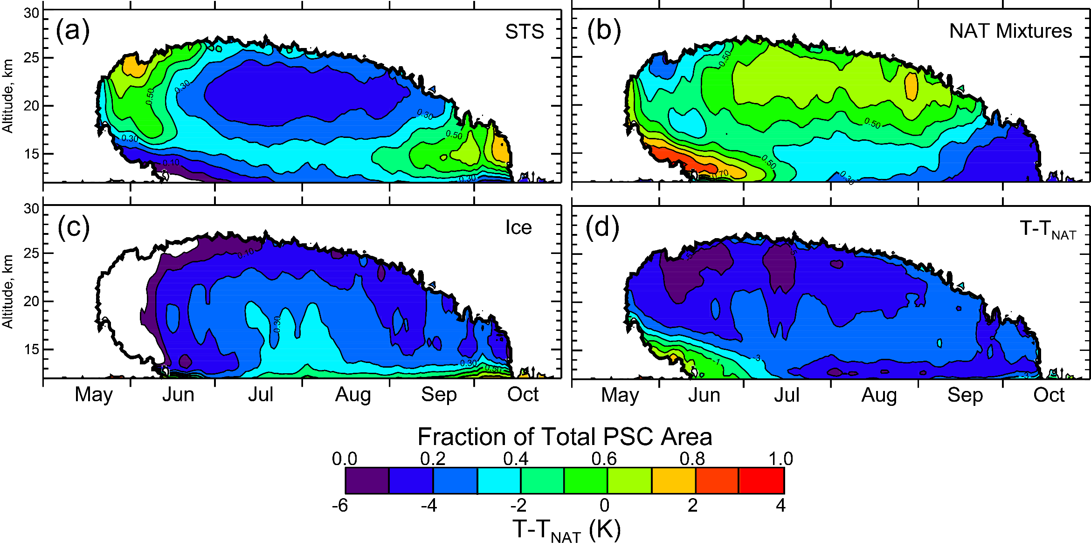
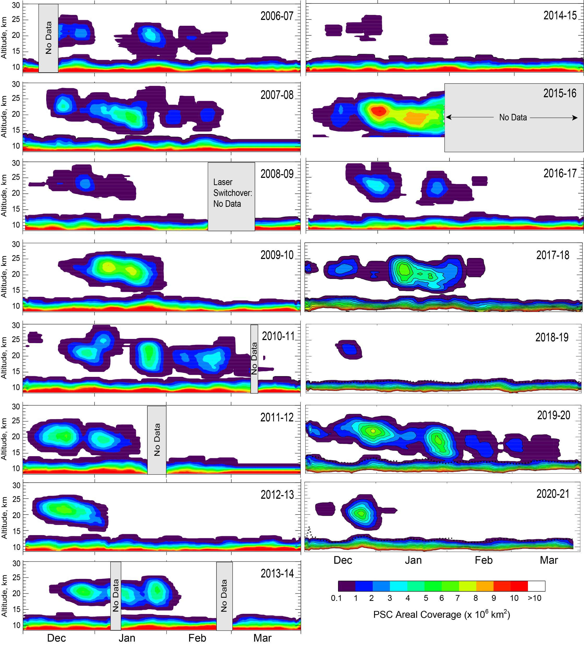
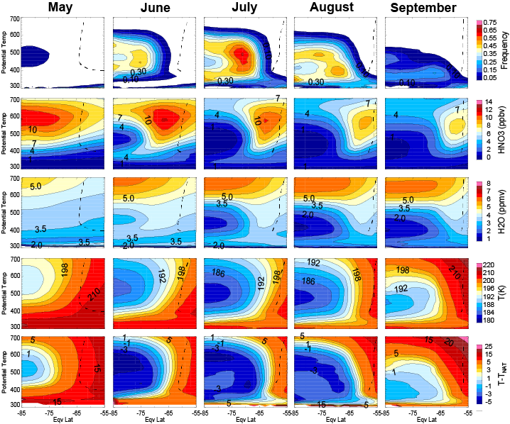
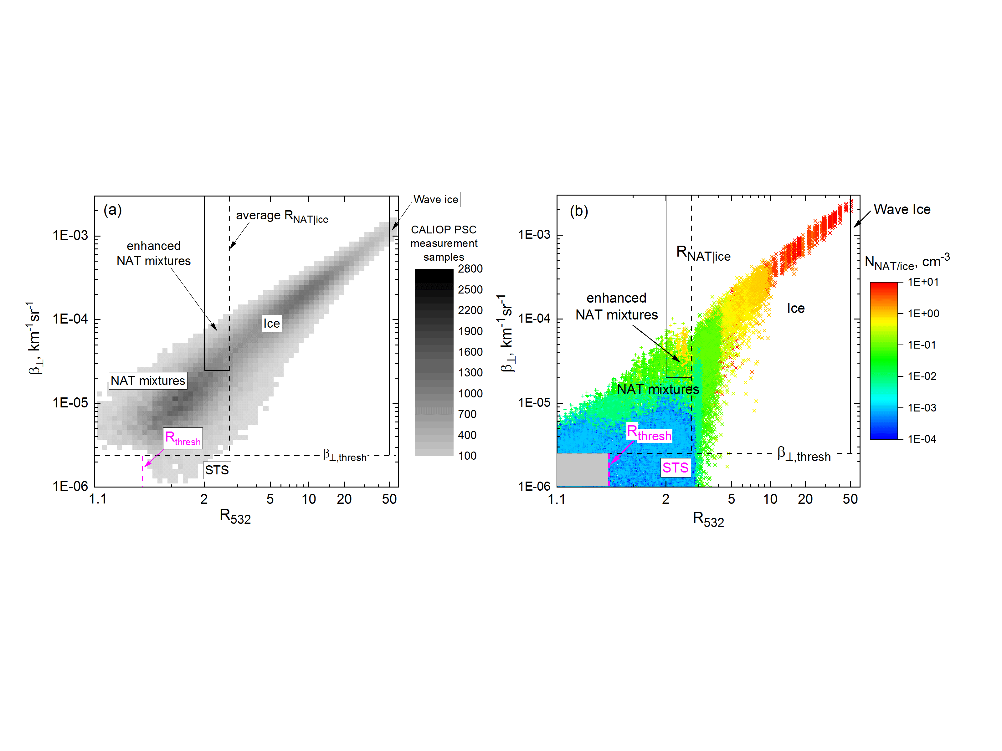
Updated PSC climatology based on CALIOP measurements from 2006-2023
Michael Pitts¹ and Lamont Poole²
¹NASA Langley Research Center, Hampton, Virginia USA; ²Space Systems, LLC, Hampton, Virginia USA
Abstract
Antarctic PSC Seasonal Evolution (2006-2022)
Mean Antarctic Geographical Distributions (2006-2022)
Climatological PSC Areal Coverage
After more than three decades of research, the roles of polar stratospheric clouds (PSCs) in stratospheric ozone depletion is well established. Heterogeneous reactions on PSCs convert the stable chlorine reservoirs HCl and ClONO₂ to chlorine radicals that destroy ozone catalytically. PSCs also prolong ozone depletion by delaying chlorine deactivation through the removal of gas-phase HNO₃ and H₂O by sedimentation of large nitric acid trihydrate (NAT) and ice particles. A substantial recovery of the ozone layer is expected by the middle of this century with reduced global production of ozone depleting substances in accordance with the Montreal Protocol and subsequent amendments. But as climate changes, leading to a colder and perhaps wetter stratosphere and upper troposphere, reliable model predictions of recovery of the Antarctic ozone hole and of potentially more severe ozone depletion in the Arctic are challenging. This is due both to a lack of detailed understanding of the underlying physics and the fact that many global models use simple parameterizations that do not accurately represent PSC processes.
A more complete picture of PSC processes on vortex-wide scales has emerged from the CALIOP (Cloud-Aerosol Lidar with Orthogonal Polarization) instrument on the CALIPSO satellite that has been observing PSCs at latitudes up to 82 degrees in both hemispheres since June 2006. The CALIOP Version 2.0 (v2) PSC algorithm was recently developed to address known deficiencies in previous algorithms and includes additional refinements to increase the robustness of the inferred PSC composition. In this paper, we present an updated PSC reference data record and comprehensive climatology constructed by applying the v2 algorithm to the more than 17-year CALIOP spaceborne lidar dataset.
2016-2022 mean daily CALIOP PSC areal coverage over the (a) Antarctic and (b) Arctic. The climatological daily maximum MERRA-2 tropopause heights (dashed white lines) indicate the upper extent of cirrus.
Antarctic Seasonal Evolution by Composition
PSC Detection and Composition Classification
PSCs are detected as statistical outliers from background aerosol using nighttime 532-nm scattering ratio (total/molecular backscatter, R₅₃₂) and perpendicular backscatter, β⊥
Composition classification is based on comparison of CALIOP β⊥ and R₅₃₂ observations with theoretical optical calculations for likely compositions
    PSCs separated into five composition classes:
        STS = Supercooled Ternary (H₂SO₄-H₂O-HNO₃) Solution
        NAT (Nitric Acid Trihydrate) mixtures, NAT-enhanced = external mixtures of liquid (binary H₂SO₄ aerosol or STS) droplets and NAT particles (in increasing number density)
        Ice, wave ice = H₂O ice (synoptic, mountain-wave-induced)
            β┴ outliers: NAT mixtures/ice; R₅₃₂ outliers: STS
Nearly coincident Aura MLS measurements of gas-phase PSC precursors HNO₃ and H₂O utilized to adjust composition class boundaries to account for irreversible removal of these gases by sedimentation of large PSC particles
Measurement uncertainties used to calculate composition confidence indices
PSC products are compiled on a high spatial resolution grid (5-km horizontal x 180-m vertical spacing) along the orbit track
Overall PSC occurrence frequency shows a climatological maximum between longitudes 90ºW and 0º, which is the preferential region for forcing by orography and upper tropospheric anticyclones
NAT mixtures widespread over interior of the vortex with ring of increased occurrence over East Antarctica in July consistent with so-called NAT belt observed by MIPAS
Ice PSCs exhibit distinct maximum in July and August in 0º-90º W longitude quadrant due to frequent mountain wave and upper-tropospheric forcing events in this region
STS is predominant early at z > 20 km (largest T departures below T_{NAT}) and again late in the season
NAT mixtures are widespread at z > 20 km after mid-June and predominant at lower altitudes early in the season (T ≅ T_{NAT})
Ice peaks in July/August but is never predominant composition
Arctic PSC Seasonal Evolution (2006-2021)
Antarctic Zonal Cross Sections (2006-2022)
Interannual Variability in PSC Spatial Coverage
CALIOP Data
Time series of 2006-2018 mean, standard deviation, and range of daily values of CALIOP (a) Antarctic and (b) Arctic PSC spatial volume (daily areal coverage integrated over altitude). Maxima and minima are color-coded by the year in which they occurred.
Theoretical Optical Calculations
Next Generation CALIOP Algorithm
We are developing a third-generation (Gen3) PSC detection and composition algorithm that incorporates a new, more robust two-dimensional, multi-channel CALIOP feature detection scheme (2D-McDA). We will also devise and implement an improved two-dimensional PSC composition classification scheme that utilizes multiple parameters (e.g., CALIOP 532-nm parallel and perpendicular scattering ratios, CALIOP 1064-nm total scattering ratio, MLS HNO₃ and H₂O, ambient temperature, and temperature histories) in a Bayesian approach to determine the most likely PSC composition and help constrain solid PSC particle number density and size/shape. The combined CALIOP/MLS analyses will allow us to study in detail the full life cycle of PSCs and their resulting impact on gas-phase HNO₃ and H₂O, which should lead to improved parameterizations of PSC microphysics in global chemistry-climate models (CCMs) where detailed particle information is not available. The Gen3 CALIOP PSC algorithm will be a natural stepping-stone toward the analysis of data collected during future spaceborne lidar missions, such as NASA’s Atmosphere Observation System (AOS) mission currently scheduled for launch late in this decade.
(a) 2-D histogram of CALIOP Antarctic PSC data for July 10–18, 2008 at latitudes 65°S–75°S and potential temperatures (θ) 475–525 K. (b) Theoretical optical calculations for non-equilibrium liquid-NAT and liquid-ice mixtures. The dashed and gray boxes at the lower left represent points that fall below both CALIOP v2 PSC detection thresholds and are classified as non-PSCs, that is, background stratospheric sulfuric acid aerosols.
Equivalent latitude/potential temperature cross sections of 13-year average, monthly zonal mean PSC occurrence frequency, cloud-free MLS HNO₃ and H₂O, MERRA-2 temperature, and T-T_{NAT}. PSC occurrence is limited deep inside the vortex due to severe denitrification/dehydration. The highest PSC frequency occurs closer to the vortex edge where there is an optimal combination of sufficient condensables and cold temperatures.

