Slide 1
NASA: Committed to Open Science
Louis Barbier, PhD
Associate Chief Scientist, Office of the Chief Scientist
NASA Headquarters
April 3, 2023

Slide 2
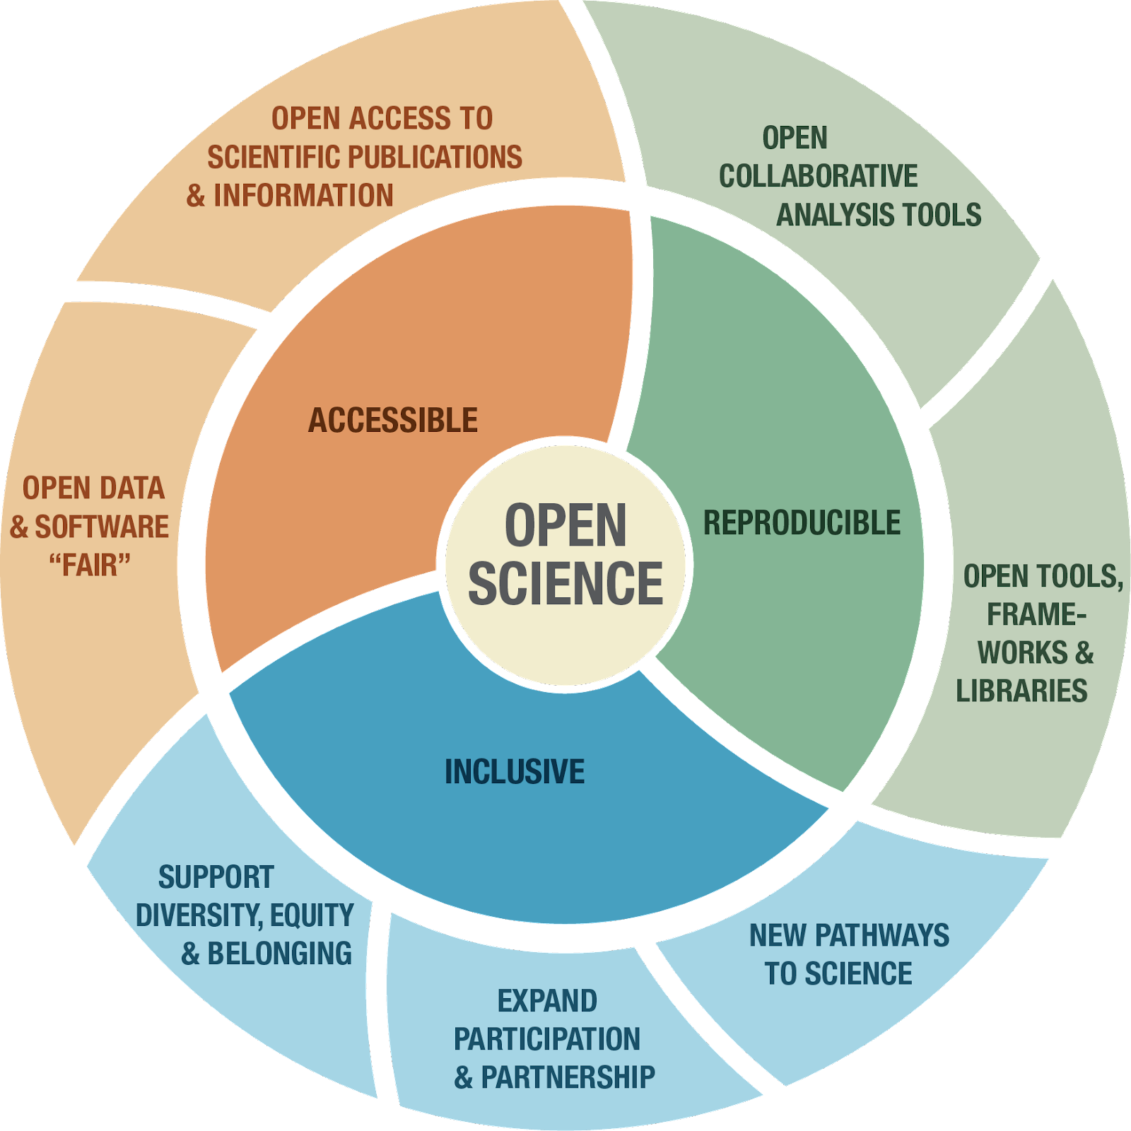


2
NASA’s Perspective on the 2022 OSTP Public Access Memo
NASA strongly supports the intent of the 2022 OSTP Public Access Memo, Ensuring Free, Immediate, and Equitable Access to Federally Funded Research
Promoting the full and open sharing of scientific research results with research communities, private industry, academia, and the general public is one of NASA’s long-standing core values.

Slide 3
3
NASA’s Approach: Open Science Core Values
Openness is fundamental, security is essential, and freedom and integrity are crucial
Increase the accessibility, inclusion, and reproducibility of NASA scientific activities
When possible, minimize the burden both within NASA and for our research communities
  NASA’s Office of the Chief Scientist (OCS) is leading an Agency-wide update to the 2014 NASA plan. Membership includes representation from across the Agency
  The draft updated Public Access Plan was submitted to OSTP for review on Feb. 21, 2023

Slide 4
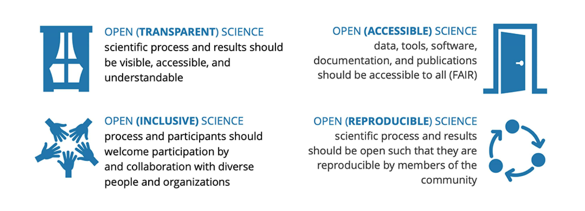
A SHIFT IN THE WAY SCIENCE IS DONE

Slide 5
5
NASA’s Office of the Chief Scientist (OCS)
Agency-wide group efforts to date:
    Reviewed NASA Open Access Policy – NPD 2230.1 Research Data and Publication Access - no changes were needed to be compliant with the new OSTP memo of 2022
    Revised NASA’s 2014 Open Access Plan for consistency with the OSTP 2022 memo
    Submitted draft revision on Feb. 21, 2023 to OSTP for review
    Significant changes to be expected:
        Removing requirement for a one year embargo on publications
        Software (s/w) guidance for the process for releasing and maintaining s/w (consistent with multiple existing NASA policy documents covering s/w)
        Encouraging sharing of data that goes beyond a publication

Slide 6

6
NPD 2230.1 Research Data and Publication Access
Basic policy for the implementation of processes to ensure public access to scientific peer-reviewed publications and data sets
NASA SMD Open-source Science Initiative and Transform to Open Science (TOPS) mission
Advance open science policies, cyberinfrastructure, tools, and communities
SMD Strategy for Data Management and Computing for Groundbreaking (SDMCG) Science
Advances the management and computation capabilities to support groundbreaking science at NASA
Updated SMD Scientific Information Policy ~Nov 22 (SPD-41a)
Updates to the 2021 policy, aligns with requirements of 2022 OSTP 2022 memo
OSTP Memo ~ Feb 2013
Expanding Public Access to the Results of Federally Funded Research
Updated draft NASA Public Access Plan
Submitted to OSTP, compliant with OSTP 2022 Memo
2014
2021
2023
2013
2016
2019
2022
NASA Plan for Increasing Access to the Results of Scientific Research
Expanded the breadth of NASA’s open-access culture to include data and publications for all of the scientific research that the Agency sponsors
SMD Scientific Information Policy (SPD-41)
Policy was created based on recommendations from SMD's 2019 SDMCG and is based on existing Government directives and NASA and SMD policies https://go.usa.gov/xtNTJ
NASA’s Year of Open Science
OSTP Memo ~ Aug 2022
No embargo period for federally funded research publications
NPD = NASA Policy Directive; SMD = NASA’s Science Mission Directorate; SPD = SMD Policy Document

Slide 7
Transform to Open Science – TOPS!
TOPS is NASA’s ambitious plan to accelerate open science practices. It’s a 5 year journey that will:
  Accelerate major scientific discoveries
  Broaden participation by historically excluded communities
  Increase understanding and adoption of open science principles and techniques
NASA TOPS will be partnering with 12 professional societies in the scientific community to advance the adoption of open science, roll out an open science curriculum, and support MSIs engagement with NASA through prizes, challenges, and hackathons.
TOPS. (2022). Creative Commons Attribution 4.0 License. https://doi.org/10.5281/zenodo.5225076

Slide 8
Spark Change and Inspire!
More Data
More Collaborators
More Discoveries!

Slide 9
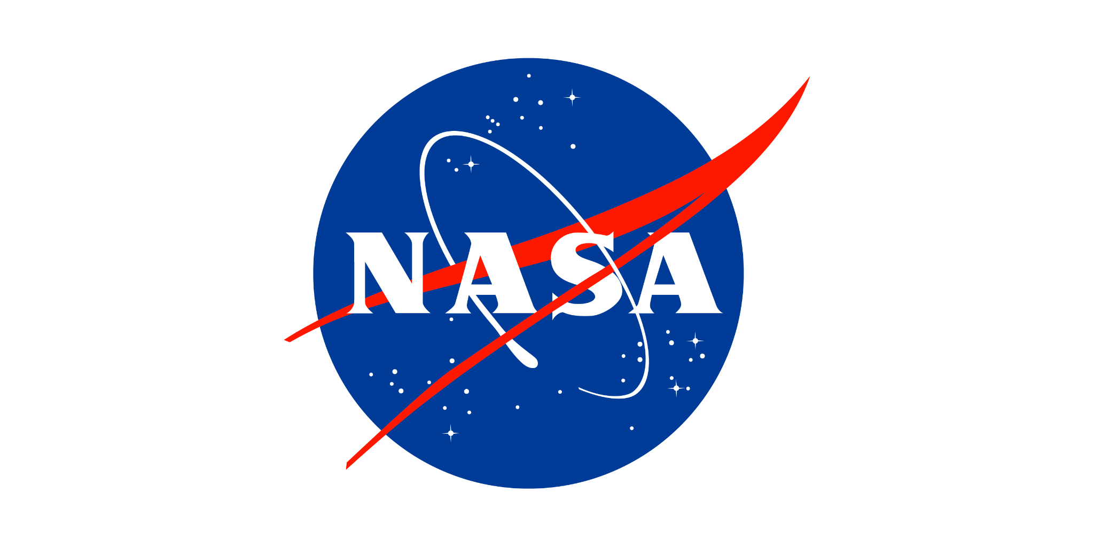

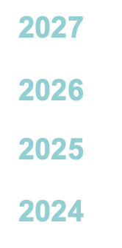

Thank You!

Slide 10
Backup

Slide 11
Key Points
OSTP Open Access Memo Reference
These links are to the White House article about the memo signed August 2022 to ensure that federally funded research is freely available without delay. This memo is the next step after the 2013 memo which charged federal agencies with developing and implementing a plan to increase public access to federally funded research.
Open Access Publication
The memo requires that any federally funded research must be published in journals that allow for open access to its articles immediately upon publication.
Open Access to Data Used in Publications
The memo also says that these publications must be made without an embargo on the data. This data is specifically that which was used to make the publication.

Slide 12
Impacts to NASA Scientists
Publishing Impact
NASA Science Programs will need to provide its scientists with additional budget to cover open access fees. Need to be certain we do not unwittingly preclude publication of NASA science in top journals due to the open access policies.
Non-Published Data
The memo also calls on agencies to develop an approach on how to share non-published data.
Future Contracts, Grants and Agreements
We need to be sure that future funding calls make clear that federally funded research must follow federal laws and OMB policies, including the open access publication and associated data rules. This is regardless of the rules of the publisher. This must be part of the budgets submitted in future proposals.

Slide 13
13
NASA’s Science Mission Directorate (SMD)
In August 2021 SMD released the “SMD Scientific Information Policy” (SPD-41), which brings together and NASA and federal policy, https://go.usa.gov/xtNTJ
    Aligned with NPD 2330.1
In November 2021, a draft updated version, SPD-41a was released with proposed additions.
    An RFI* was released to the community and closed on March 4, 2022
    SPD-41a was revised to address community input and released in Dec. 2022, https://science.nasa.gov/science-red/s3fs-public/atoms/files/SMD-information-policy-SPD-41a.pdf
    SPD-41a is consistent with the OSTP Public Access memo
    Expect proposers to include open science costs in proposal budgets
*RFI = Request for Information

