Slide 1
Uncertainty Quantification (UQ) for Modeling and Simulation at NASA
^{Presenter: James Warner}
Team: Patrick Leser, Paul Leser, Geoff Bomarito
Durability, Damage Tolerance, & Reliability Branch
^{NASA Langley Research Center}
Statistical Engineering Interagency Agreement Meeting
March 24th, 2023

Slide 2
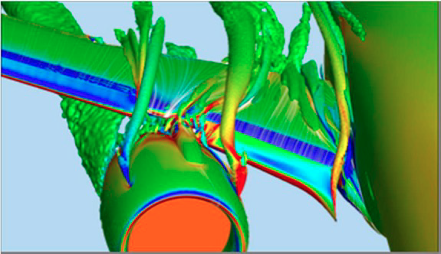
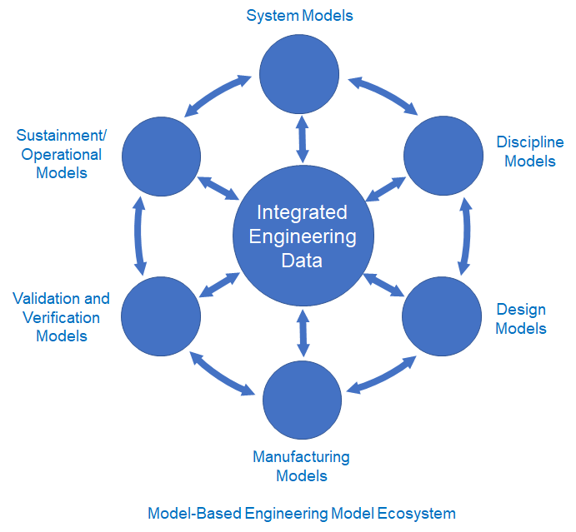
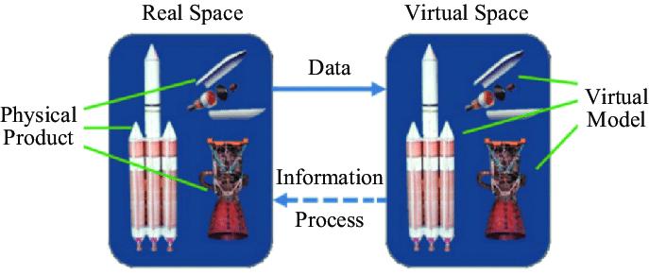
UQ: Enabling Credible Modeling and Simulation (M&S) at NASA
M&S-Enabled Paradigms at NASA
Motivation and Challenge
System Models
Certification by Analysis
Accelerating reliance on M&S
All models are wrong (but some are useful)*
Sustainment/ Operational Models
Discipline Models
Real Space
Virtual Space
Validation and Verification Models
Solution
Data
Validation and Verification Models
Design Models
Physical Product
Virtual Model
Integrate uncertainty quantification (UQ) into M&S for credibility
UQ answers: how wrong might the model be? When is it useful?
Information
Model-Based Engineering
Digital Twin
Process
Manufacturing Models
Models vs. Reality
Real world
Model
Model + UQ
Approach
Perform research and development of new state-of-the-art UQ methods
Transition advanced UQ methods from research to engineering practice
Response
Scenario 1
Scenario 2
*George Box, Journal of American Statistical Association, 1976.
Notes:
*describe diagram in more detail (model is useful for scenario 1 but not 2)

Slide 3
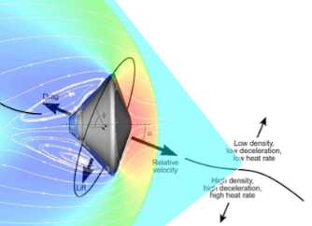
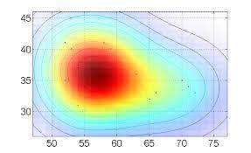



Multifidelity UQ Research and Development
Available Computational Models
Motivation and Challenge
Physics-based simulation
UQ is computationally demanding
Multiple models often exist for predicting the same phenomena
Efficient, high-precision probabilistic prediction
Data-driven model
Increasing Accuracy
Increasing Speed
Model Fusion
Solution
…
Multifidelity UQ fuses predictions from:
High-fidelity model for accuracy guarantees
Low-fidelity models for speedup
Analytical model
Approach
Development of in-house and open-source software packages
Cutting-edge research with external partners from govt. and academia
Multi-model Monte Carlo with Python; Open source via NASA Github

Slide 4
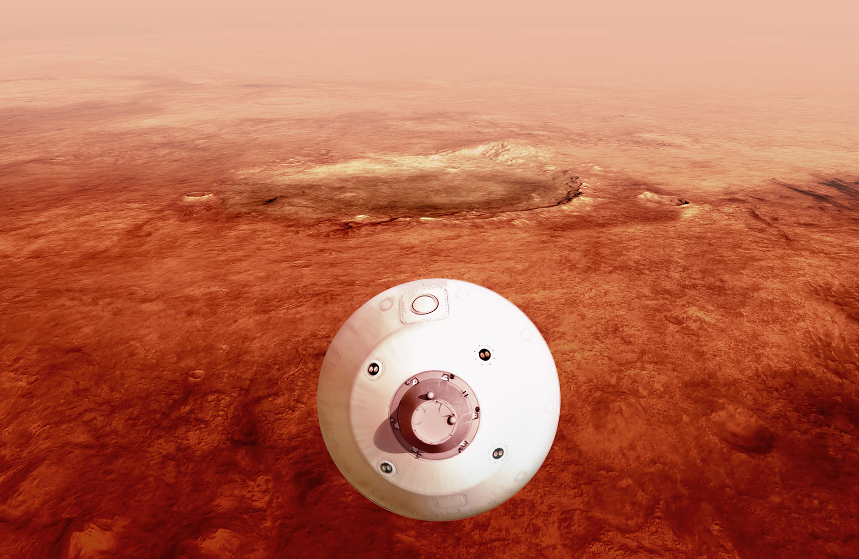
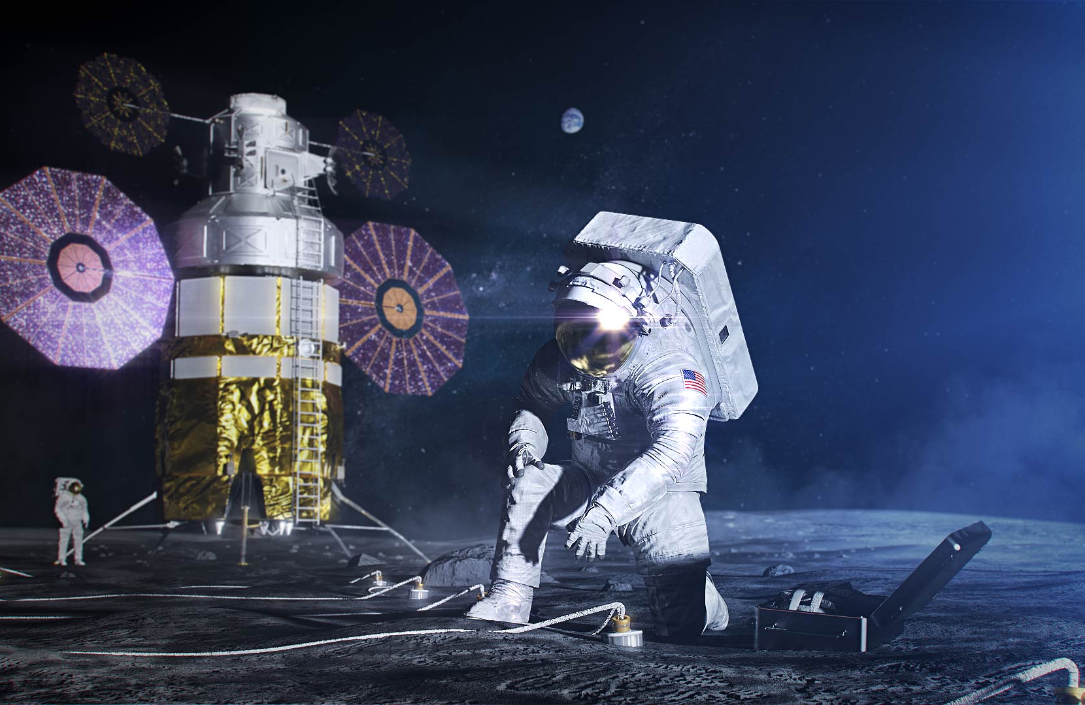
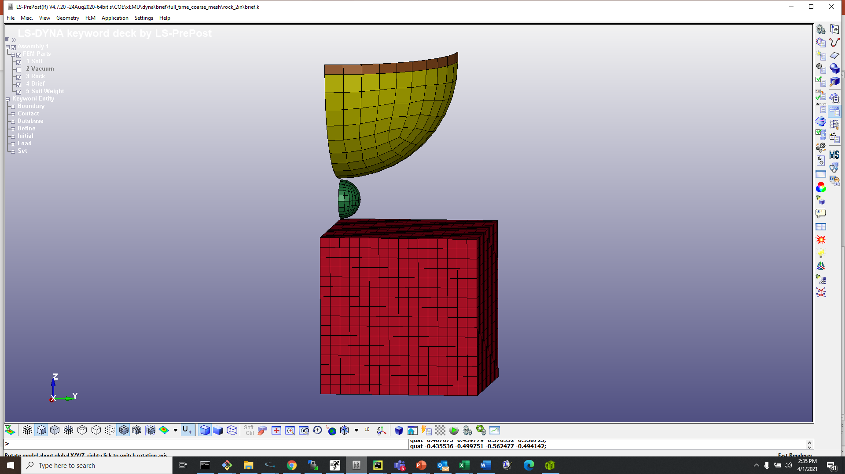
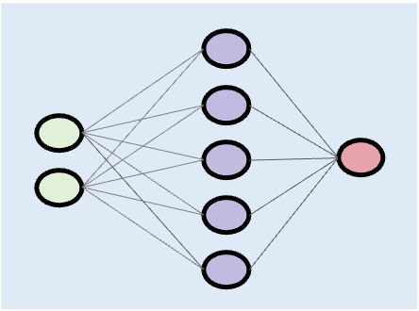
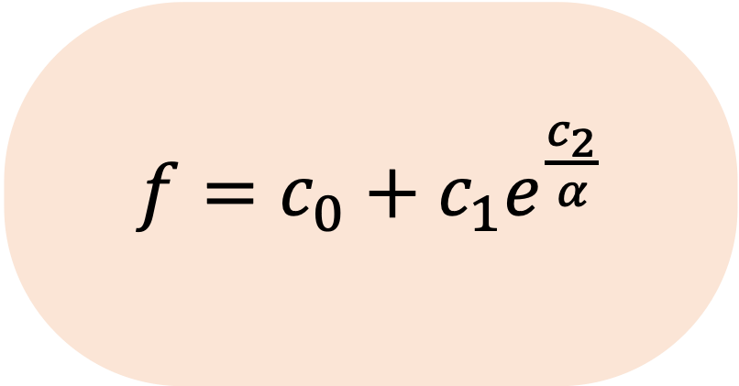
Transitioning UQ Research to NASA Engineering
Trajectory Simulation for Entry, Descent, and Landing (EDL)
Leveraged state-of-the-art multifidelity UQ to substantially improve upon traditional UQ approaches
Reliability Analysis for the Exploration Extravehicular Mobility Unit (xEMU) Spacesuit
Introduced UQ where it traditionally is not used and demonstrated its benefits
Suit Component
Rock
Impact
Regolith

Slide 5

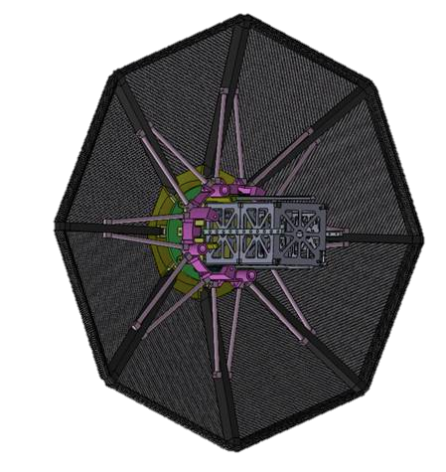
Trajectory Simulation for EDL
Challenge: Traditional UQ methods used for EDL cannot achieve target landing precision required for future Moon and Mars missions
Current Vehicle State
Dispersion analyses simulate many trajectories to account for uncertain variables
Dispersion analyses simulate many trajectories to account for uncertain variables
Leveraging a high-fidelity model alone is too time consuming
Predicted landing location
Individual high-fidelity predictions
Atmospheric Conditions
Notes:
*Hurricane analogy

Slide 6
Trajectory Simulation for EDL
Challenge: Traditional UQ methods used for EDL cannot achieve target landing precision required for future Moon and Mars missions
Dispersion analyses simulate many trajectories to account for uncertain variables
Leveraging a low-fidelity model alone is too inaccurate
Predicted landing location
Individual low-fidelity predictions

Slide 7
Trajectory Simulation for EDL
Challenge: Traditional UQ methods used for EDL cannot achieve target landing precision required for future Moon and Mars missions
Approach: high- and low-fidelity model fusion with multifidelity UQ
Dispersion analyses simulate many trajectories to account for uncertain variables
Multifidelity UQ improves efficiency and precision
Predicted landing location
Few high-fidelity sims
Many low-fidelity sims

Slide 8
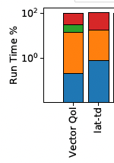
Trajectory Simulation for EDL
Challenge: Traditional UQ methods used for EDL cannot achieve target landing precision required for future Moon and Mars missions
Approach: high- and low-fidelity model fusion with multifidelity UQ
Results: Up to 100X performance improvement for trajectory simulation*
Trajectory Simulation Models
Computational Resource Allocation
Performance Improvement for Predicting Trajectory Quantities
High- Fidelity**
10²
100X
Multifidelity UQ
Simplified Physics
Run Time %
High Fidelity Only
10⁰
10X
Low-fidelity
Simplified Dynamics
Optimal Resource Allocation
Model Fusion
Data Driven
Landing Latitude
Landing Longitude
Roll Rate
Max. Altitude
Mach1 Altitude
Flight Time
Terminal Velocity
Angle of Attack
Multifidelity UQ
High-Fidelity Only
*J. E. Warner et al. Multi-Model Monte Carlo Estimators for Trajectory Simulation. AIAA SciTech 2021.
**Program to Optimize Simulated Trajectories II (POST2)
Notes:
*Resource allocation & model fusion are automated in software
*Precision increases in terms of X instead of %

Slide 9
Trajectory Simulation for EDL
Challenge: Traditional UQ methods used for EDL cannot achieve target landing precision required for future Moon and Mars missions
Approach: high- and low-fidelity model fusion with multifidelity UQ
Results: Up to 100X performance improvement for trajectory simulation
Impact:
A breakthrough for making onboard, real-time guidance technology feasible
A broadly applicable multifidelity UQ capability delivered for NASA problems
Notes:
Note effort taken to get the funding & support

Slide 10

Reliability Analysis for the xEMU Spacesuit
Challenge: Traditional certification approaches using factor of safety (FoS) cannot satisfy both weight and robustness requirements
Traditional Design Based on FoS
FoS Shortcomings
Difficulties specifying for new vehicles, materials, environments
Inconsistencies observed across programs, organizations
(Often) Overly conservative - may be sequentially applied by multiple teams
(Potentially) Under conservative – no direct connection to design reliability/risk
Factor of Safety
Knockdown factor
Calculated
Margin
Calculated
Load (L)
Resistance (R)
Certify design if Margin $≥$ 0
Notes:
Need to point out that it’s robustness to impact events / astronaut falls

Slide 11
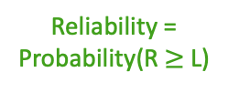

Reliability Analysis for the xEMU Spacesuit
Challenge: Traditional certification approaches using factor of safety (FoS) cannot satisfy both weight and robustness requirements
Traditional Design Based on FoS
Reliability-Based Design
Factor of Safety
Knockdown factor
Failure Probability
Reliability = Probability(R $≥$ L)
Probability Density
Calculated
Margin
Calculated
Load (L)
Resistance (R)
Load (L)
Resistance (R)
Certify design if Margin $≥$ 0
Certify design if Reliability $≥$ Target Value
xEMU Impact Dynamics Project Lead sought alternative reliability-based approach “to reduce conservatism where possible in order to avoid the pitfall of a heavy and overdesigned suit structure”
Notes:
Point out that you can still add in conservatism to probabilistic approach

Slide 12
Reliability Analysis for the xEMU Spacesuit
Challenge: Traditional certification approaches using factor of safety (FoS) cannot satisfy both weight and robustness requirements
Approach: Introduced general UQ workflow for estimating reliability*
1. Identify model parameters with largest effect on reliability
4. Estimate reliability given calibrated parameter uncertainties
3. Estimate parameter uncertainty using test data
2. Identify test specs that maximize parameter uncertainty reduction
*J. E. Warner et al. Assessing Next-Gen Spacesuit Reliability: A Probabilistic Analysis Case Study. NASA/TM-20210019495.
Notes:
OED also informs # tests to be performed

Slide 13
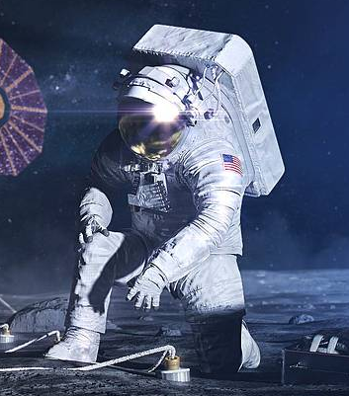
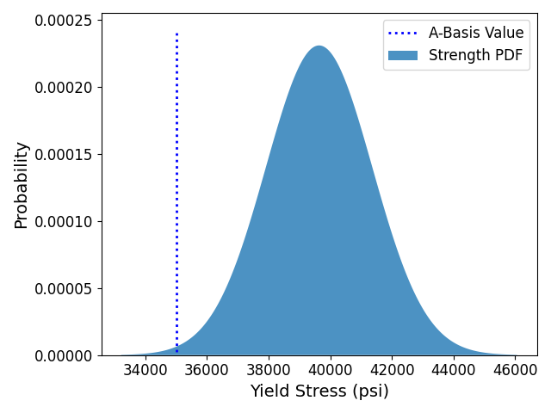
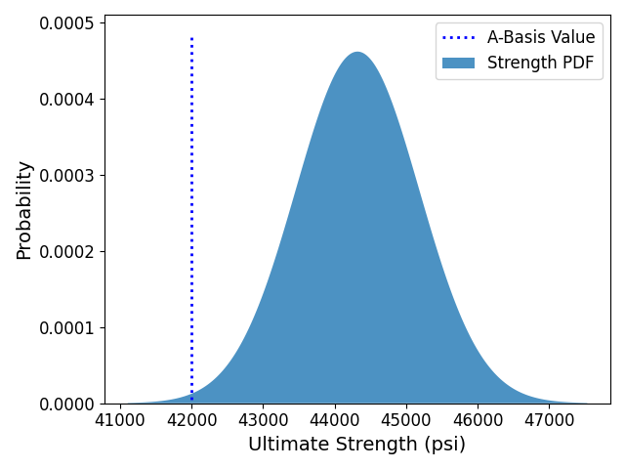
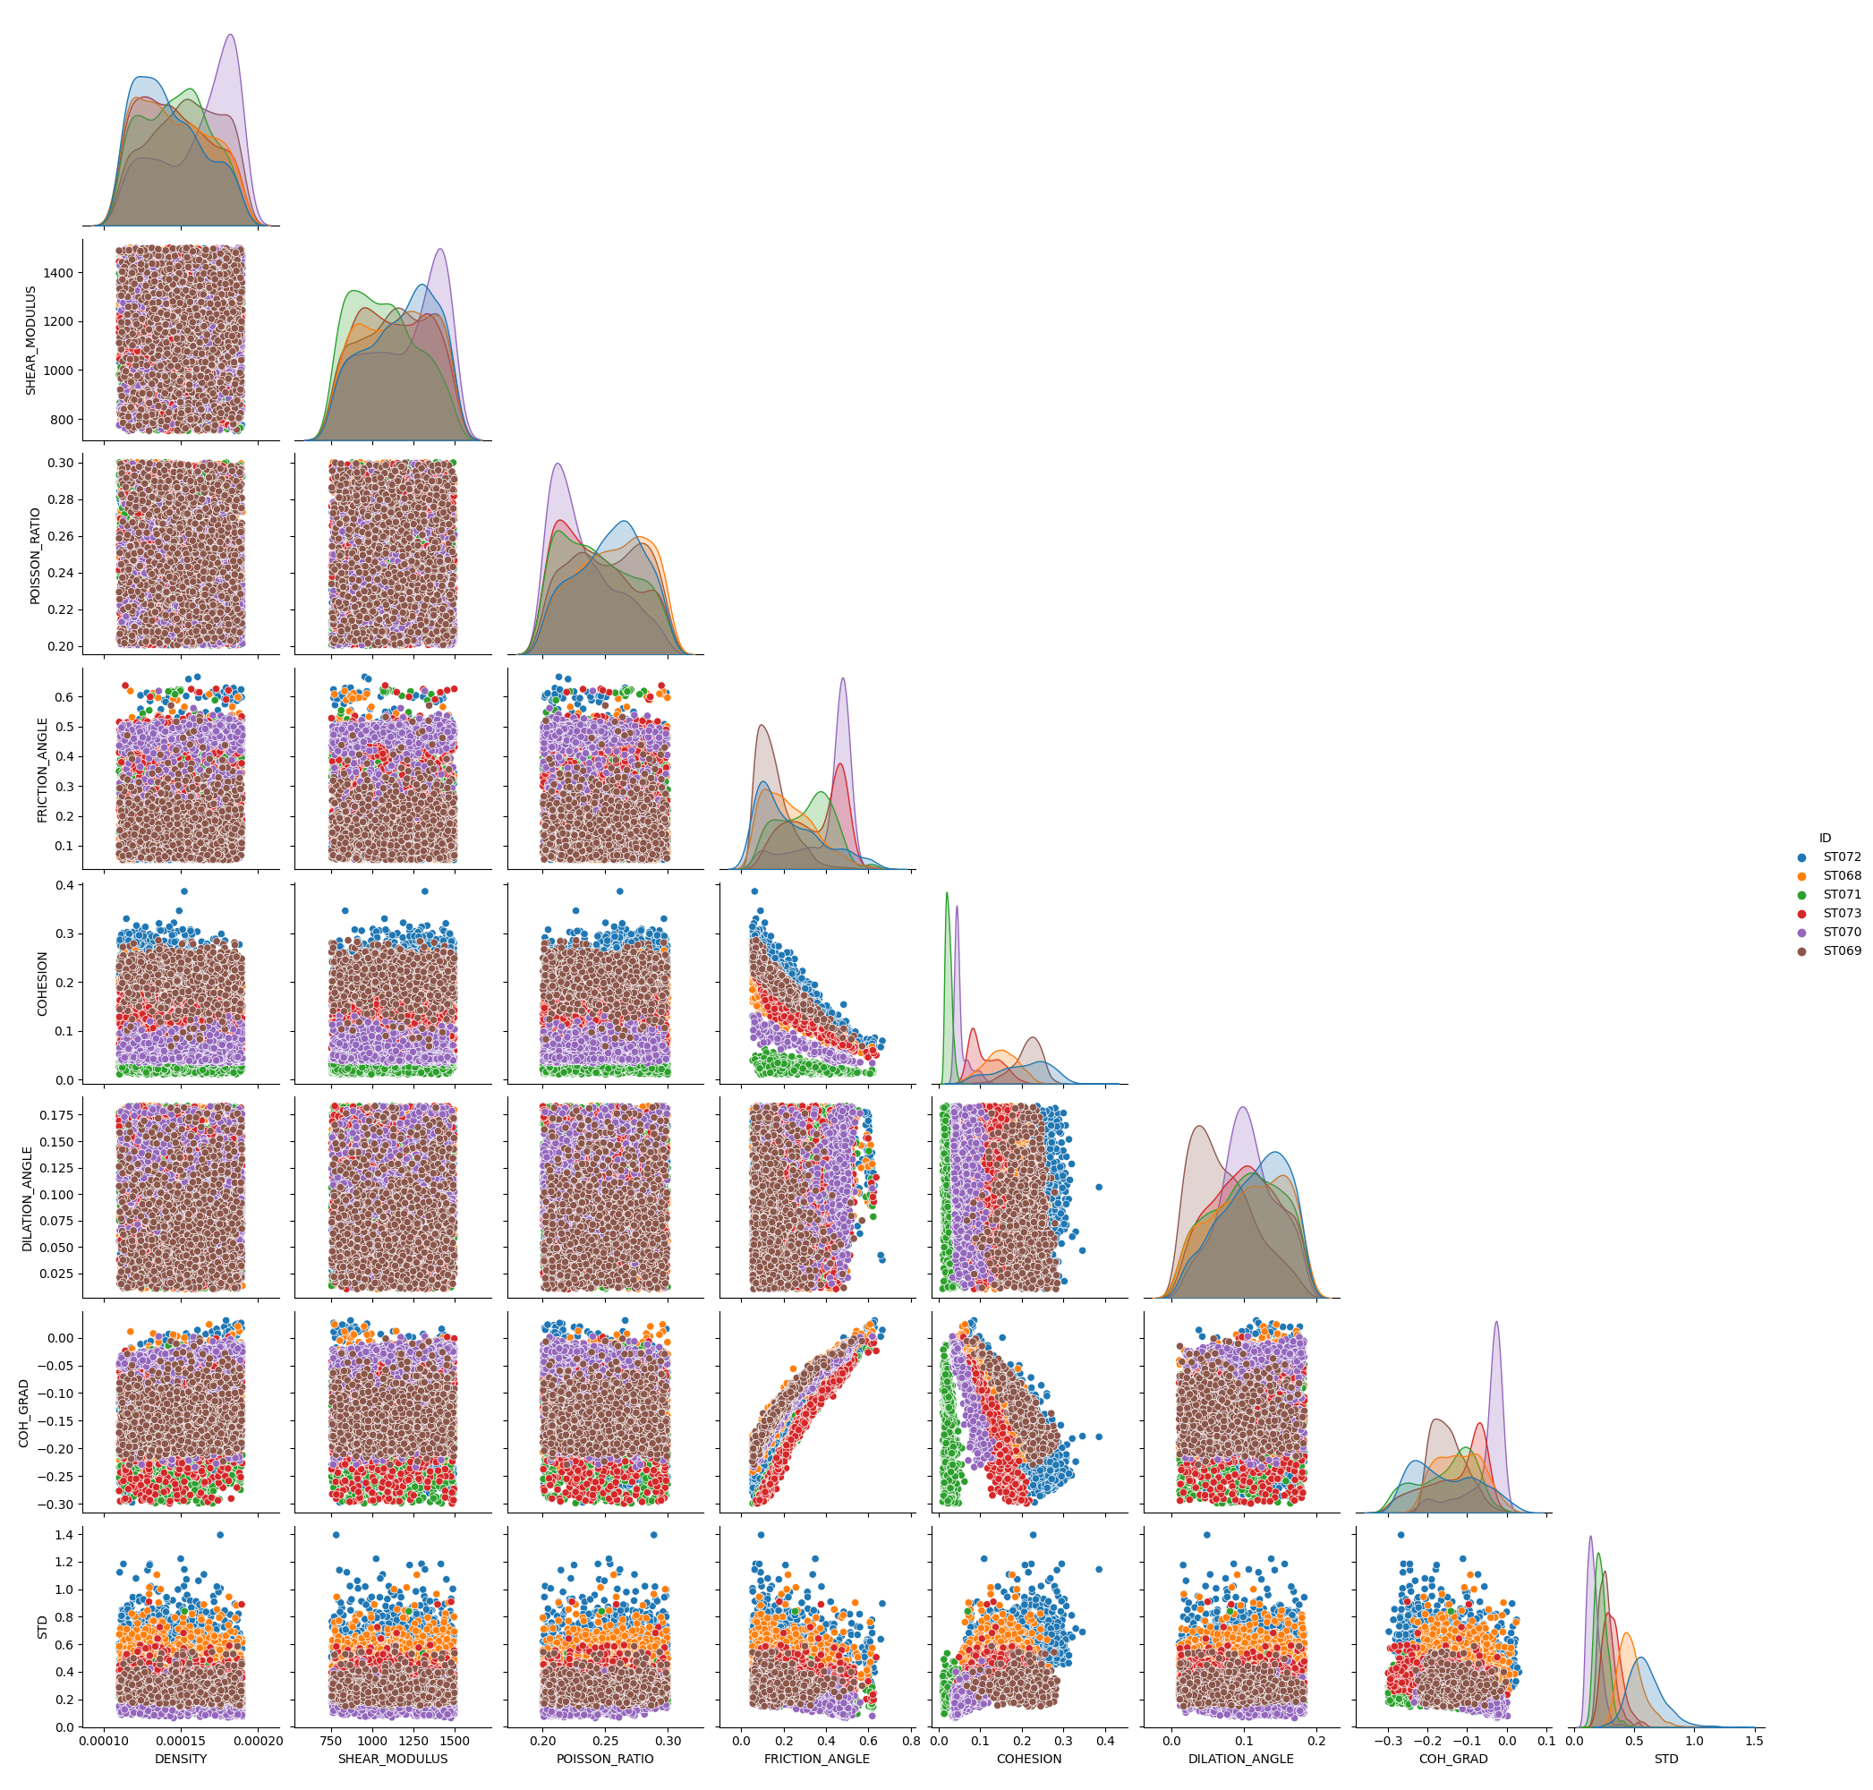

Reliability Analysis for the xEMU Spacesuit
Challenge: Traditional certification approaches using factor of safety (FoS) cannot satisfy both weight and robustness requirements
Approach: Introduced general UQ workflow for estimating reliability
Results: applied UQ workflow to verify that the probability no impact failure (PnIF) in the xEMU brief is greater than the requirement
Model Parameter Uncertainty
Computational Model
Reliability Prediction
xEMU Brief Material Properties
PnIF $≥99.9999\%$ ✅
Impact
Impact Failure Probability
xEMU Waist Brief Hip Assembly
Regolith Properties
Probability
Stress
Strength
Lunar Surface (Apollo 16 site)
Brief/Rock/Regolith Impact Model
Sensitivity Analysis + Model Calibration
Uncertainty Propagation
Notes:
Point out that you can still add in conservatism to probabilistic approach

Slide 14
Reliability Analysis for the xEMU Spacesuit
Challenge: Traditional certification approaches using factor of safety (FoS) cannot satisfy both weight and robustness requirements
Approach: Introduced general UQ workflow for estimating reliability
Results: applied UQ workflow to verify that the probability no impact failure (PnIF) in the xEMU brief is greater than the requirement
Impact:
Viable path forward for certifying lightweight, next-generation xEMU spacesuit
Reliability-based design paradigm for reduced conservatism/cost/risk at NASA
Notes:
Note effort taken to get the funding & support

Slide 15
Summary: UQ at NASA
UQ is required for the credible use of M&S for all NASA missions
Make predictions with confidence, quantified uncertainty to inform critical decisions
Enable paradigms like reliability-based design, Digital Twin, certification by analysis
Many hurdles to UQ adoption, workforce development is key
Learning curve for successfully applying UQ for real world problems
Rapidly evolving research field
Overwhelming number of tools, methods
NASA UQ researchers continue to work to overcome these challenges
Organized UQ Seminar Series in Spring 2023 with presentations and tutorials by external speakers (most recently, Prof. Bobby Gramacy from Va. Tech. on 3/20)
Developing/releasing UQ software; providing tutorials on UQ approaches

