Slide 1

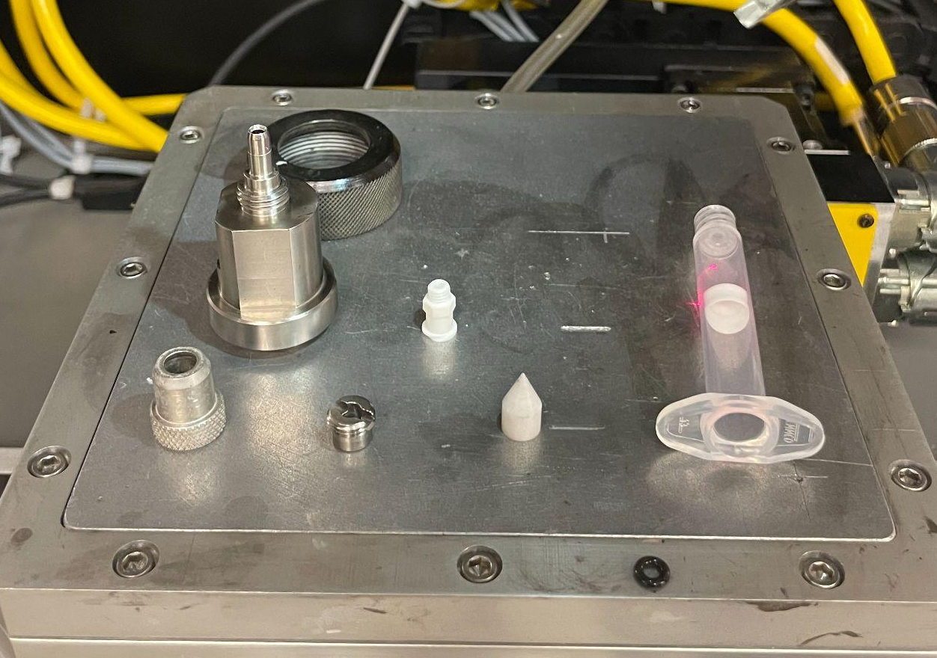
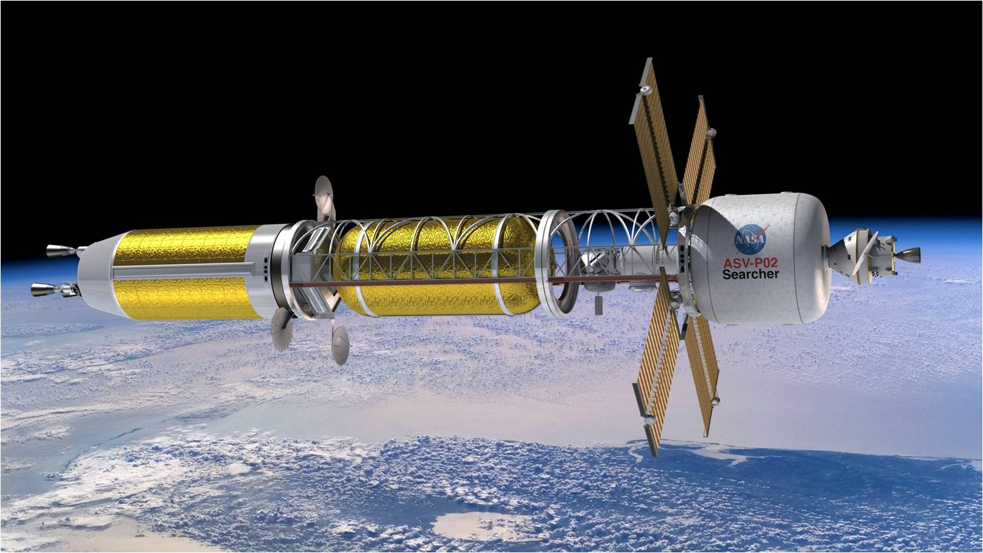
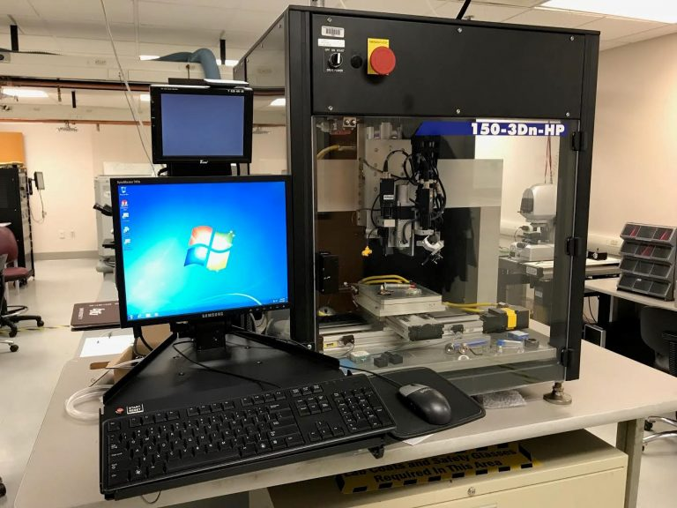
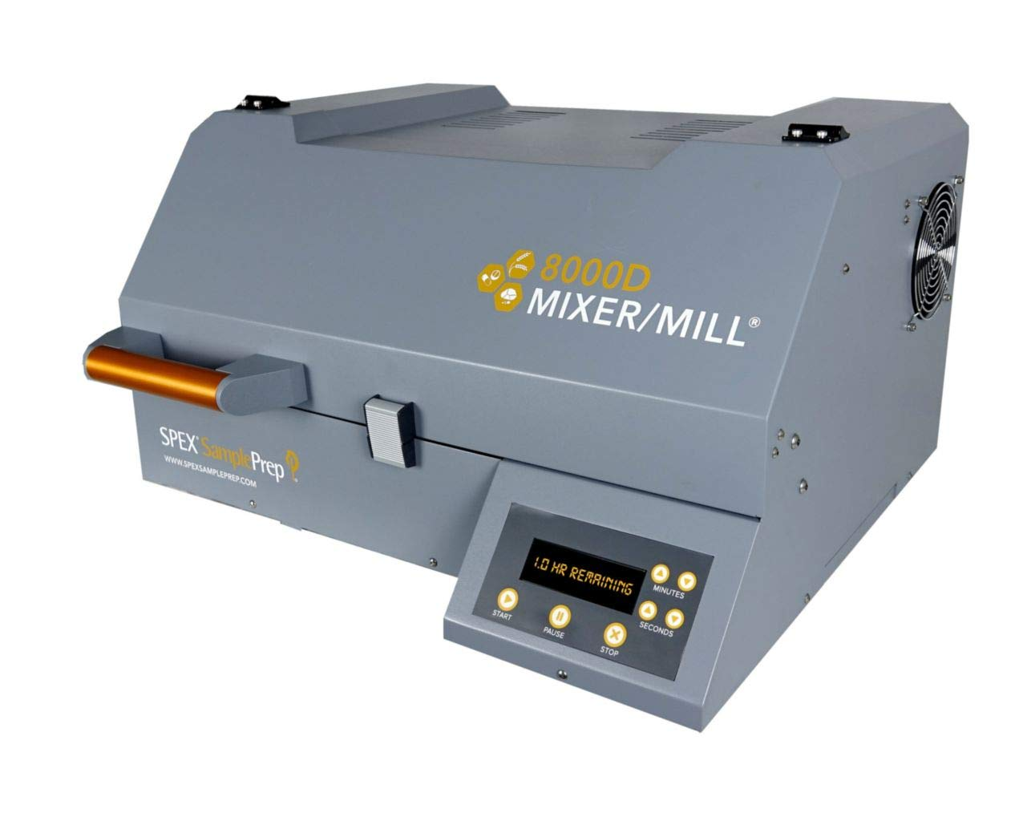
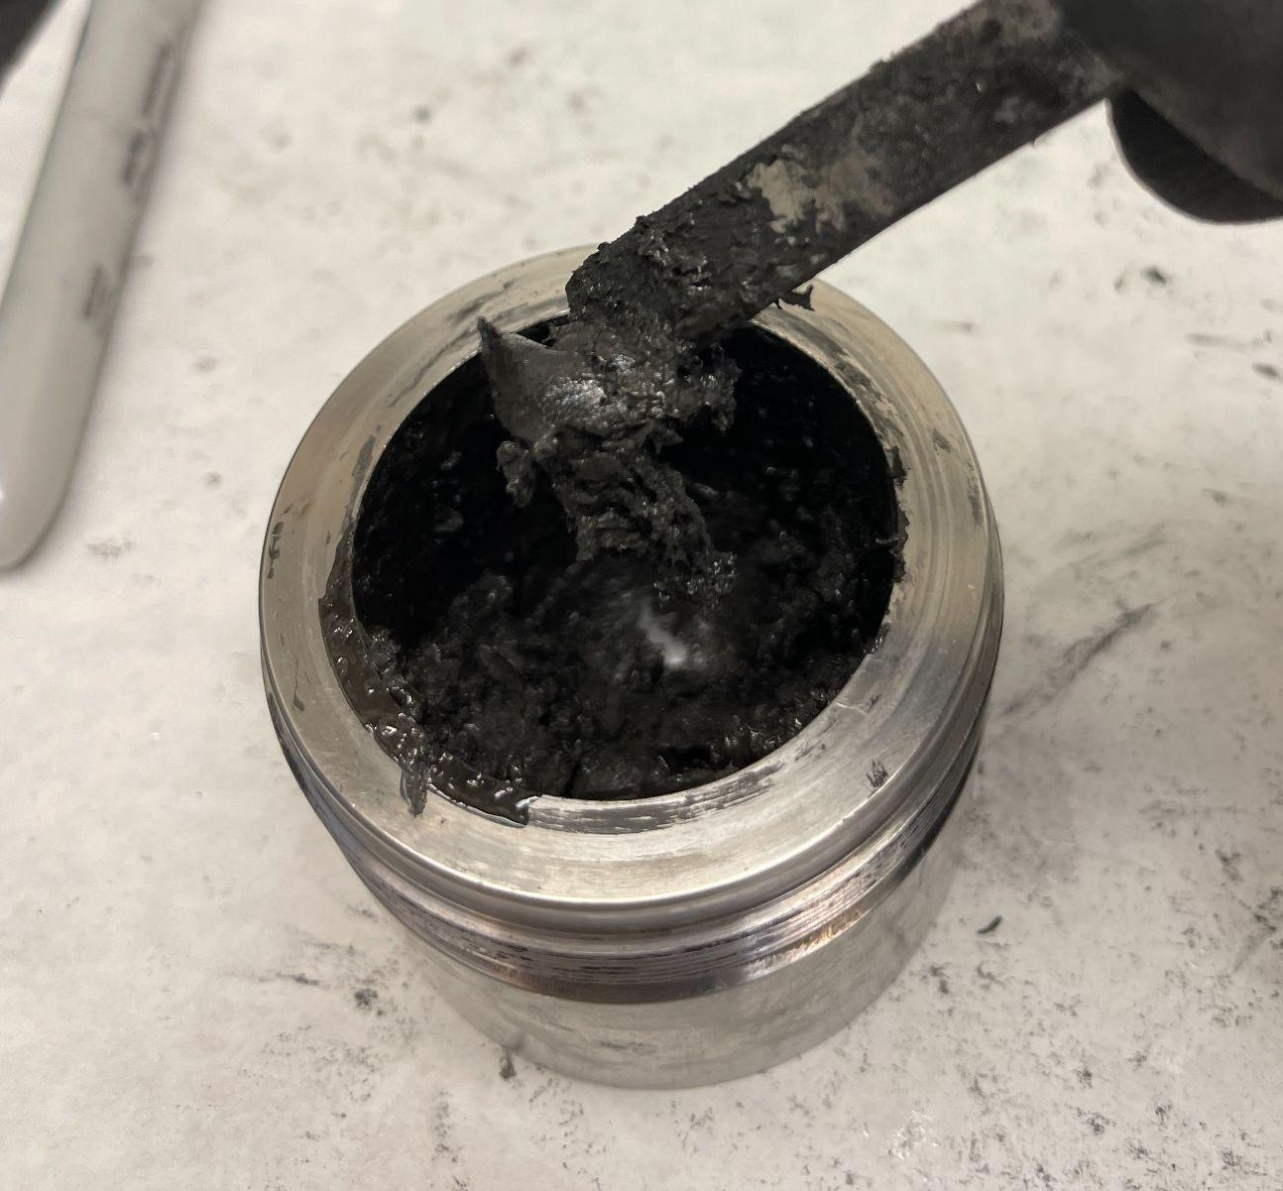
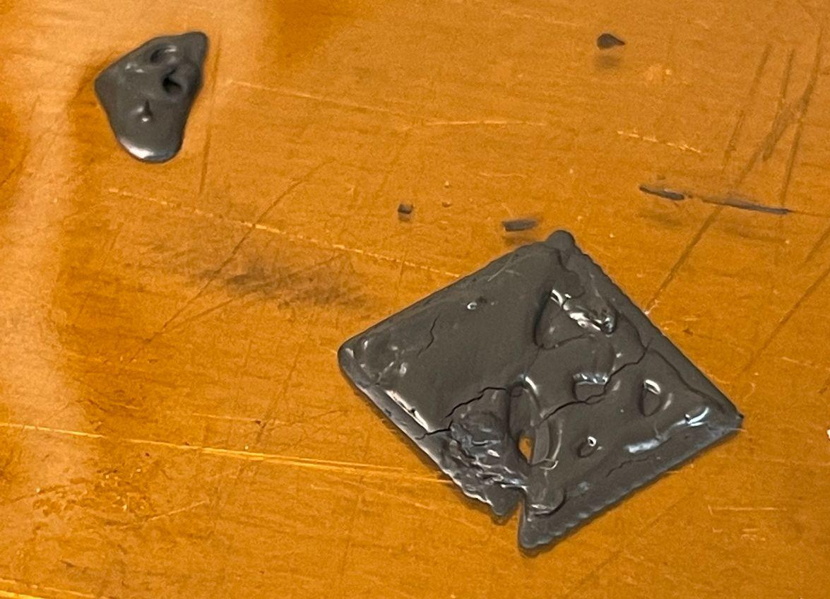
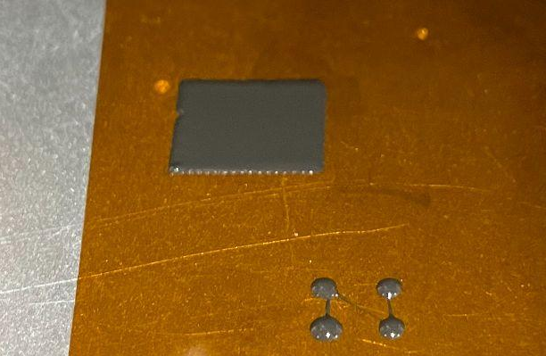
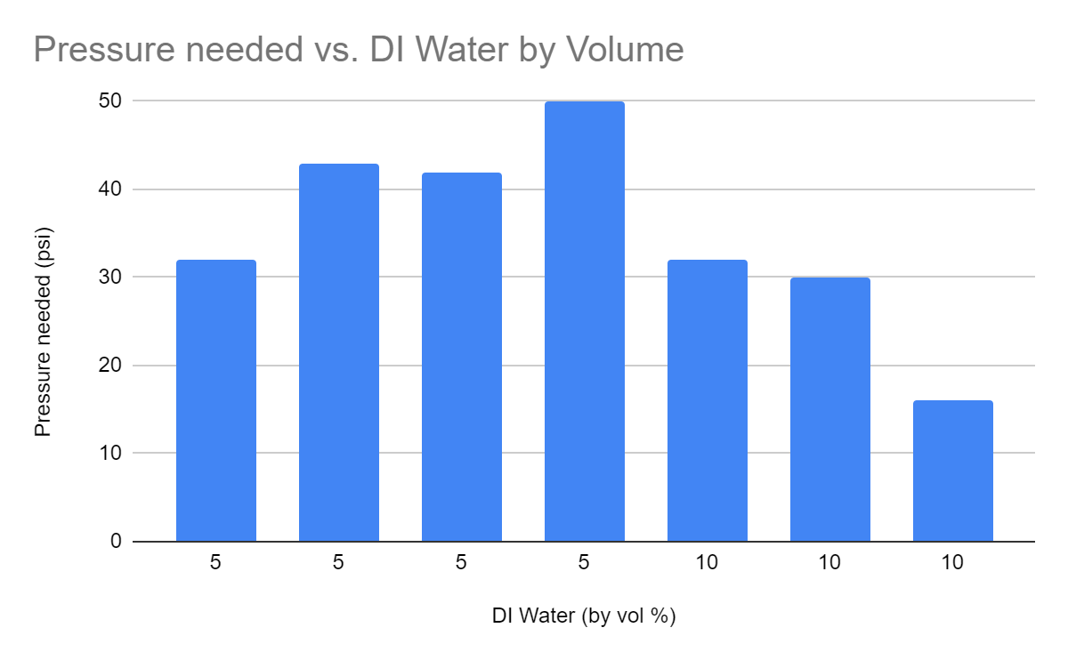
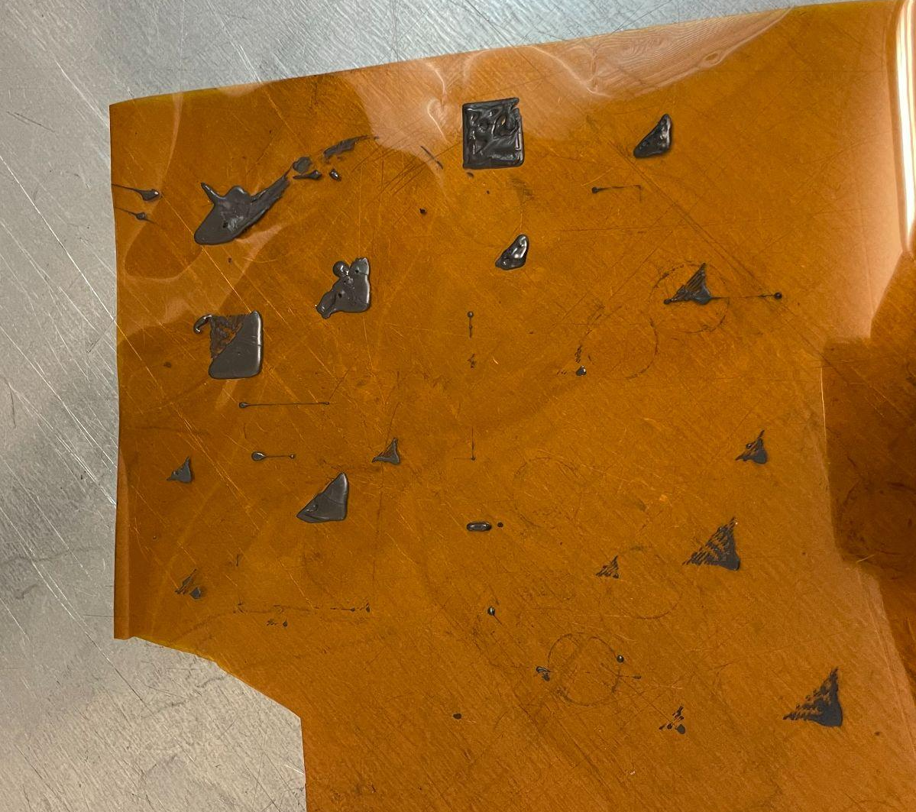
ADDITIVE MANUFACTURING OF ZrC FOR NUCLEAR THERMAL PROPULSION APPLICATIONS
Jacqueline R. Stone^{1, 2}, Ryan D. Finkelstein^{1, 2}, Brian J. Jaques^{1, 2,}, Jhonathan Rosales³
1. College of Engineering, Boise State University, Boise, ID
2. Center for Advanced Energy Studies, Idaho Falls, ID
3. Marshall Flight Center, National Aeronautics and Space Administration, Huntsville, AL
Connects entire printing tip to machine
Connects syringe to main body
I. INTRODUCTION
II. EXPERIMENTAL
Insert the syringe here, main body
Motivation
The complex fuel geometries required by these reactors can be achieved by novel techniques fairly easily, cheaply, and safely.
In this specific study, we are looking at using Zirconium Carbide (ZrC) to use as a surrogate for Uranium Carbide (UC) due to their similar behaviors under high temperatures. An ink made with ZrC will be made and will be extruded into unique, complex geometries. This is a great starting point to test additive manufacturing on these ceramics.
Holds tip into the main body
Background
Looking into the future, we are seeing that nuclear is becoming a more and more viable fuel source for space applications due to it being one of the safest energy forms, low greenhouse gas emissions, and inexpensive maintenance.
National Aeronautics and Space Administration (NASA) and a few others are looking at nuclear fuels in relation to space travel, specifically in the form of Nuclear Thermal Propulsion (NTP) [1]. NTP provides the answer for space travel to Mars where chemical rockets would not complete the job. A concept art of what these spacecrafts could look like is shown (Figure 1). Uranium Carbide fuel has been chosen to heat a liquid propellant for propulsion.
Ink was made with ZrC powder and PEI polymer, with varying amounts of HCl and DI water to create structures tin the Nscrypt direct write AM printer (Figure 2).
Typical inks were made with:
Inconsistent inks proved challenging in the printing stage
50% PEI
40-50% ZrC powder
5-10% DI water
5% HCl
With the goal of printing dense 3D structures, each ink was repeatedly tested on the printer.
This included tests of:
Various shapes
DIfferent line thicknesses
Multiple layers
Keeps tip in main body
Printer tip
Syringe and plunger
Figure 1: Concept art of a spacecraft powered by NTP [1]
NTP provides [2]:
1) Limited crew exposure to radiation
2) Higher efficiency than chemical rockets
Chemical reactions are about 450 seconds, where NTP reactions are about 900 seconds
3) Greater flexibility, being able to spend over 2 years in space
O-ring
Goal
Formulate and produce a printable, repeatable ink for printing complex 3-Dimensional structures to gain a better understanding of what printing ceramics similar to these could look like.
Every ink was mixed in the SPEX Sample Prep Mill (Figure 4) using 3-30 minute intervals.
First 30 minutes: PEI and ½ of ZrC were mixed
Second 30 minutes: PEI and all of ZrC were mixed
Third 30 minutes: PEI, all of ZrC, and varying amounts of HCl and DI water
Figure 4: SPEX Sample Prep Mill used to fabricate the inks [3]
III. RESULTS
IV. DISCUSSION
Figure 2: Nscrypt 150-3Dn-HP direct write AM printer, and labelled printer components
Mixing the Ink
Printing the Ink
Prior to using the SPEX mill for these inks, the inks were being hand-mixed. This proved difficult for a few reasons:
  Introducing lots of oxygen into the ink
  Not uniformly mixed
  Overall difficult for the mixer
After making the switch to the SPEX mixer:
  There were less air bubbles introduced into the inks,
  Noticeable differences in the consistency of the inks
  Rather than hitting PEI and dry powder separately, the inks became more as one homogenous mixture
Inconsistent inks proved challenging in the printing stage
There are many parameters within this complicated printer, and a spreadsheet contains each of the possible parameters has been avidly tended to
Complex geometries with these ink were possible (Figure 7), with careful and unique parameters to show how accurate we can be with this printer.
Conclusions
Inks will continue to be mixed using the SPEX Sample Prep Mill, due to the large contributions towards uniformity the mill has provided.
Layerable samples are achievable(Figure 9), and will continue to be worked on to ensure that this is not only achievable but consistently repeatable.
Inks with 40% PEI print out more recognizable shapes, with typically less pressure required by the printer
Inks with 15% liquid by volume also provide the ease of printing with low pressure needed
Characterizing samples are the next steps, starting with:
  X-Ray Diffraction
  LECO Analyzation
Once viable samples start to come out of these prints, we will be sintering the samples in various forms to figure out what works the best. Possible sintering methods include using:
  Quartz tube furnaces
  Furnaces under vacuum/environment
Figure 7: Image of an ink that was made with 50% PEI and 50% ZrC while printing
Figure 5: Image of the typical ink produced, very high viscosity and difficult to hand mix
Figure 9: A sample made with multiple layers of ink, 50% PEI and 40% ZrC
The ink that printed with the least amount of pressure and with the most recognizable shapes was an ink with 50% PEI, 50% ZrC, 5% DI water and 5% HCl (by volume) (Figure 6).
  Low pressure is good just because it takes less time to extrude, and requires less work from the printer
Typically, the inks that were made with 10% DI water and 5% HCl printed with less pressure, and in more recognizable shapes than the inks made with the 5% HCl and 5% DI water (Figure 8).
Future Work
Continuing this project, the goal is find the best possible ink in which to print, and characterize the samples once achieving this ideal ink. This might include possibly lowering the solid loading volume, or increasing the liquid loading volume.
`
Figure 6: All printed within the same day, to show the non homogeneous mixtures we were achieving prior to SPEX
Figure 8: Chart of pressure needed to print vs. DI Water by volume
REFERENCES
ACKNOWLEDGEMENTS
[1] Harbaugh, J. (2021, June 25). Nuclear thermal propulsion. NASA. Retrieved March 8, 2023, from https://www.nasa.gov/mission_pages/tdm/nuclear-thermal-propulsion/index.html
[2] 6 things you should know about nuclear thermal propulsion. Energy.gov. (2021, December 10). Retrieved March 12, 2023, from https://www.energy.gov/ne/articles/6-things-you-should-know-about-nuclear-thermal-propulsion#:~:text=Nuclear%20thermal%20propulsion%20(NTP)%20systems,chance%20of%20exploring%20deep%20space.
[3] Spex sampleprep 8000D dual mixer/mill - specialty lab equipment, instruments, and apparatuses, mills. SPEX SamplePrep 8000D Dual Mixer/Mill 24 x 17 x 11 in; 115 V/60 Hz:Specialty | Fisher Scientific. (n.d.). Retrieved March 12, 2023, from https://www.fishersci.com/shop/products/spex-sampleprep-8000d-dual-mixer-mill/8000D
The current tasks were completed at Boise State University and funded by the Nuclear Thermal Propulsion Project from NASA Marshall Flight Center

