Slide 1
Combined Bernstein Polynomial, Optimal Reciprocal Collision Avoidance, Differential Dynamic Programming for Trajectory Replanning and Collision Avoidance for UAM Vehicles
Combined Bernstein Polynomial, Optimal Reciprocal Collision Avoidance, Differential Dynamic Programming for Trajectory Replanning and Collision Avoidance for UAM Vehicles
Aerospace Control and Guidance Systems Committee Meeting
Matthew Houghton, Michael Acheson, Andrew Patterson, Alex Oshin, Irene Gregory
NASA Langley Research Center
Dynamic Systems & Control Branch D316
Presentation Slides
Notes:
Hello, my name is Matthew Houghton. I am with the NASA Langley Research Center Dynamic systems and control branch. Together with Michael Acheson, Andrew Patterson, Alex Oshin, and Irene Gregory, this is a presentation of our group's work on Combined Bernstein polynomial Optimal Reciprocal collision avoidance Differential dynamic programming for traj…

Slide 2
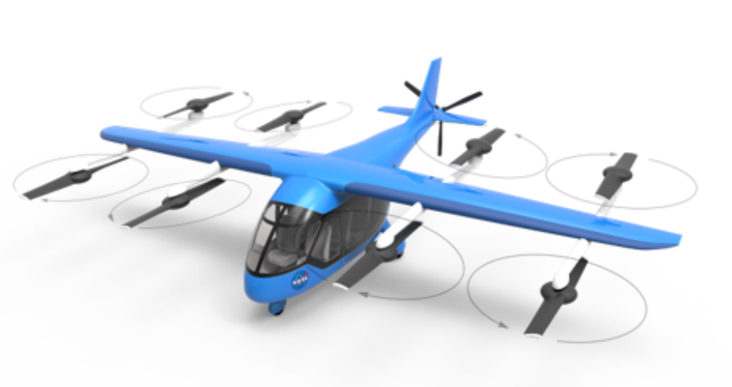
Outline
Motivation: Trajectory Replanning and Collision Avoidance for VTOL vehicles with highly nonlinear dynamics are slow and computationally costly
COBRA-DDP proposed
  Bernstein Polynomials
  Optimal Reciprocal Collision Avoidance
  Differential Dynamic Programming
Experiments:
  Sample Results demonstrating the algorithm
Conclusions and Ongoing Work
Lift + Cruise VTOL Vehicle
matthew.d.houghton@nasa.gov
Notes:
Many UAM vehicles and vehicle concepts are known to have highly complex nonlinear dynamics due to effector overactuation and multiple aircraft transitions in their standard concept of operations. General trajectory planning with these types of dynamics is computationally complex and made even worse by the introduction of state constraints for collision avoidance. The motivation behind this work was to generate dynamically feasible trajectories for UAM VTOL vehicles that provide collision avoidance of obstacles while decreasing computational cost. To do so, we propose the COBRA-DDP algorithm, an integration of Bernstein polynomials, the Optimal reciprocal collision avoidance algorithm, and Differential Dynamic programming. In this presentation, we will break down the components necessary for the algorithm, provide experimental results demonstrating the effectiveness of COBRA-DDP and discuss conclusions and future work.

Slide 3
(CO)mbined (B)ernstein Polynomial, Optimal (R)eciprocal Collision (A)voidance DDP
Trajectory Re-planner Requirements:
“Real-time” dynamically feasible trajectories for UAM class (transitioning) vehicles with separation assurances
Dynamic planning for large number of (stationary & moving) cooperative/uncooperative obstacles
Piecewise Bernstein Polynomial Curves:
Advantages: Fast and compact trajectory representation, smooth derivatives (position, velocity & acceleration)
Disadvantages: One piece-wise segment can’t represent all curves exactly (e.g., circular arcs)
Optimal Reciprocal Collision Avoidance (ORCA):
Advantages: Fast computation for large number of cooperative/non-cooperative with separation assurances
Disadvantages: No assurance of dynamic feasibility
Differential Dynamic Programming (DDP):
Advantages: Fast computation of dynamically feasible optimal trajectories
Disadvantages: Degraded computation speed for incorporation of state constraints (e.g., obstacles)
Combine to get best of each algorithm!
matthew.d.houghton@nasa.gov
Notes:
Given the types of crowded airspace that UAM vehicles will be expected to operate within, a trajectory replanner must be able to provide dynamically feasible trajectories in real time and these trajectories must be able to account for a large number of obstacles, both stationary and moving; cooperative and uncooperative. To tackle these requirements, the algorithm, Com… or COBRA-DDP utilizes the strengths of its core components, BP’s, ORCA, and DDP while mitigating their individual limitations
Bernstein polynomials are a fast and compact means of trajectory representation, but one segment is not capable of representing all curves, ORCA allows for fast computation of collision avoidance trajectories given multiple obstacles but does not insure dynamic feasibility, and final DDP provides optimization of dynamically feasible trajectories, but has a significant degradation in computational speed with the incorporation of state constraints, ie obstacles.

Slide 4
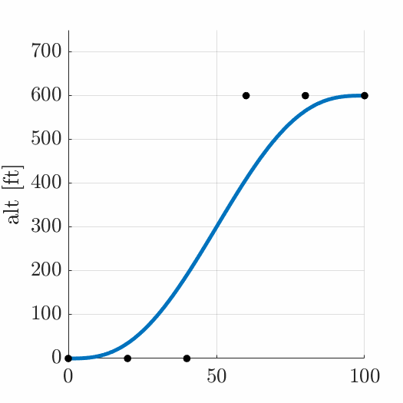
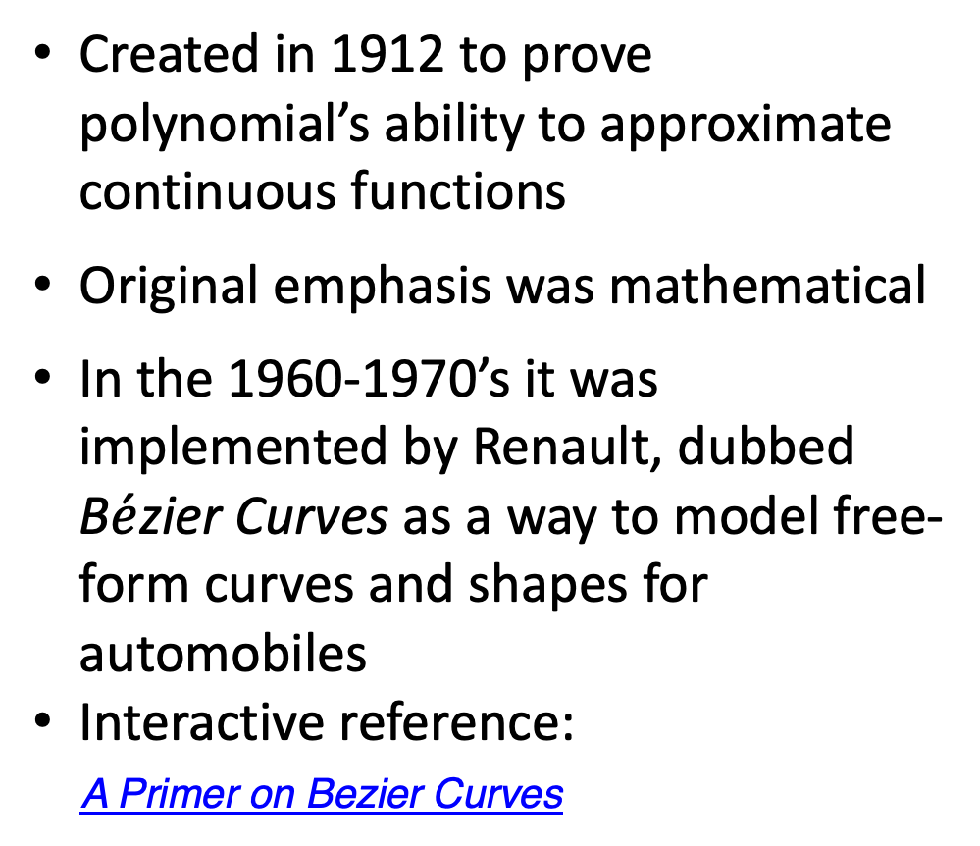
Bernstein Polynomials
Created in 1912 to prove polynomial’s ability to approximate continuous functions
Original emphasis was mathematical
In the 1960-1970’s it was implemented by Renault, dubbed B$\acute{e}$zier Curves as a way to model free-form curves and shapes for automobiles
Interactive reference:
A Primer on Bezier Curves
x [ft]
matthew.d.houghton@nasa.gov

Slide 5
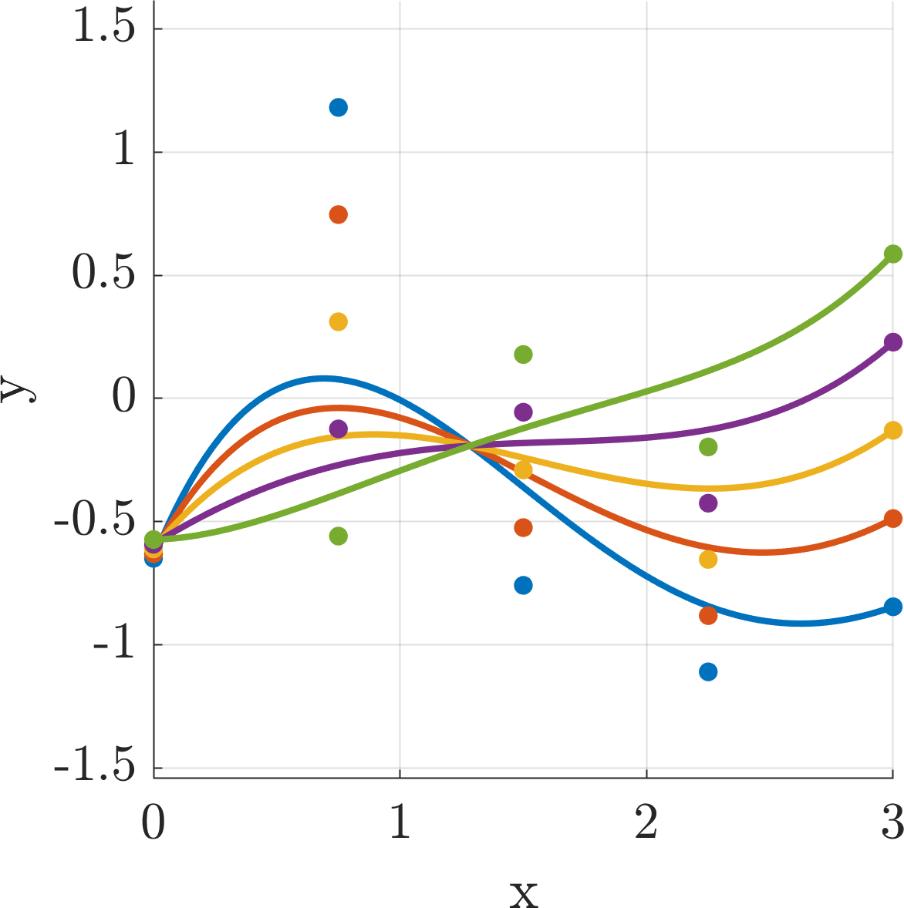
Bernstein Polynomials
Basics
Polynomial curves using Bernstein basis (rather than monomial basis)
Polynomial coefficients become control points
Benefits of Bernstein Form
Control points have physical interpretation
  Curve connected to end points
  Curve contained inside control points
Fast collision and constraint checking algorithms
  Dynamic feasibility checks
Differentiation yields Bernstein curve
Control point
Curve Evaluation
Bernstein Polynomial control points and evaluations.
matthew.d.houghton@nasa.gov
Notes:
Bernstein polynomial or BP curves provide a parametric representation of trajectories that are compact and allow for sampling at arbitrary times. BP’s have a physical interpretation that allows for fast constraint checking and can directly compute derivatives, as the differentiation of a BP curve also yields a BP curve.
Main Idea
Parametric representation is good:
- allows sampling at arbitrary times
- compact representation for curves that can be expanded as needed (more sample times/ more derivative evaluations etc)
Bernstein polynomials have nice properties (not necessarily true of other polynomial representations)
- integration with other methods
- constraint checking
Limitation
- Can directly compute derivatives
- But derivatives cannot be specified a priori

Slide 6
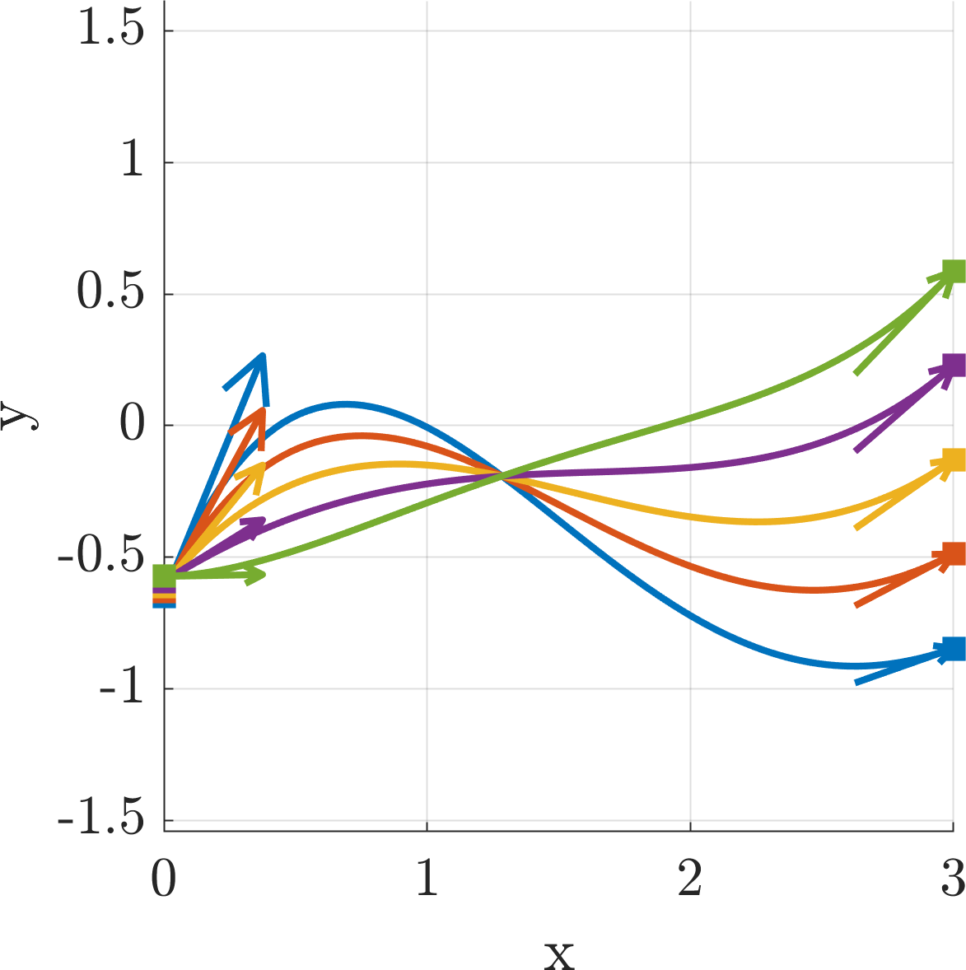
Dynamic Waypoints
Waypoints allow specification of spatial/dynamic initial/terminal constraints.
e.g. climb from 100 to 200 ft and accelerate from 0 fps to 4 fps.
Conversion
Generate Bernstein control points from waypoints (matrix multiplication)
Bernstein polynomials are the back-end
Use
ORCA waypoints are expressed as terminal constraints on time, position, velocity
DDP samples Bernstein polynomial at arbitrary times
Velocity Constraint Vector
Bernstein Curve Evaluation
Waypoints
Waypoints connected by polynomial curve evaluations (Only position and velocity constraints shown)
matthew.d.houghton@nasa.gov
Notes:
Waypoints allow us to directly express initial/terminal dynamic constraints of a trajectory. By utilizing the unique mapping from waypoints to Bernstein control points, ORCA waypoints can be directly converted into a continuous curve which can be sampled by DDP to inform path planning
Main Idea
Waypoints allow us to directly express initial/terminal dynamic constraints on trajectory
Challenge
How do we compute a curve from this waypoint?
Answer
There is a unique mapping from waypoints to Bernstein control points
- based on definition of Bernstein derivative
Enables
ORCA: output can be directly converted into continuous curve
Continuous curve can be sampled by DDP to inform path planning

Slide 7
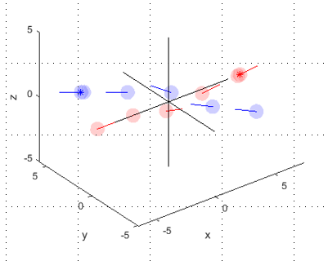
ORCA
Optimal Reciprocal Collision Avoidance Algorithm
(robotics community focused):
Collision Avoidance: Robotics literature defines as autonomous robot navigation with fixed/moving obstacles (other intelligent vehicles) Recurring cycle: Sense/Act, repeat
ORCA:
Input: Position and velocity knowledge (own-ship, obstacles/vehicles)
Output: Next own-ship velocity step (magnitude and direction)
Point modeling (no vehicle dynamics) with safety sphere (keep-out radius)
“Velocity object” representations, provide mathematical guarantees of collision free for look-ahead time
Cooperative law: Each vehicles applies ½ velocity correction
Uncooperative law: Own-ship takes 100% of velocity correction
Cooperative Control
Credit: Bart Bacon, Langley Research Center
= Own-ship & Stationary
Obstacle
= Planned & ORCA (safe) Velocities
matthew.d.houghton@nasa.gov
Notes:
The ORCA algorithm originates from the robotics community as a navigational method capable of path planning with multiple fixed and moving obstacles. ORCA begins by taking in position, velocity, and safety radius information of both the own-ship and obstacles. ORCA then converts the information into a velocity object representation that provides mathematical guarantees of a collision free trajectory given a set look-ahead time. It then outputs the velocity magnitude and direction necessary to complete the trajectory, where the velocity can be adjusted depending on the other vehicle or obstacles cooperation with the maneuver.

Slide 8
ORCA + Velocity Obstacle Explanation
p_{y}
v_{y}
v_{des}
2r
Collision Avoidant vel
2r
p_{x}
v_{x}
matthew.d.houghton@nasa.gov

Slide 9
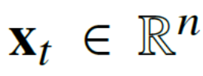
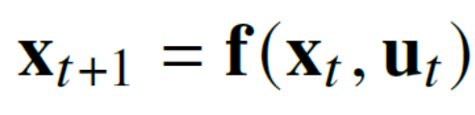

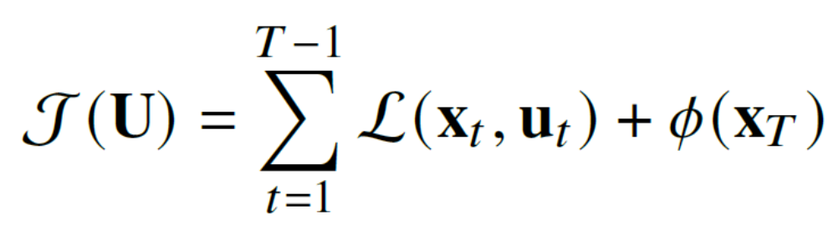





Optimal Trajectory Problem
Problem: Find optimal control (and states) to achieve a desired end state while minimizing cost
State Vector
Discrete system nonlinear dynamics
Control Vector
Cost Function
Running Cost
Terminal Cost
State Trajectory
Control Trajectory
Finite Time
matthew.d.houghton@nasa.gov
Notes:
Quadratic typical running cost

Slide 10
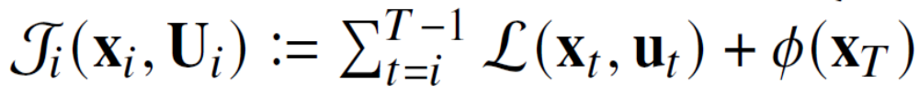

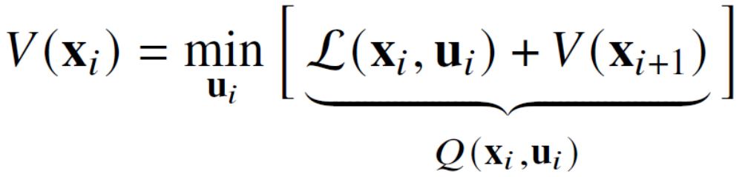
Differential Dynamic Programming
DDP: Given nominal trajectory, use linear (or quadratic) approx. of system nonlinear dynamics and quadratic approx. of cost to yield updates to optimal controls that quadratically converge
Cost Function
Truncated Control Sequence
Bellman’s Principle of Optimality: Find overall optimal control as sequence minimization for each truncated control sequence backwards in time (cost-to-go)
matthew.d.houghton@nasa.gov
Notes:
Differential Dynamic programming name it again here

Slide 11
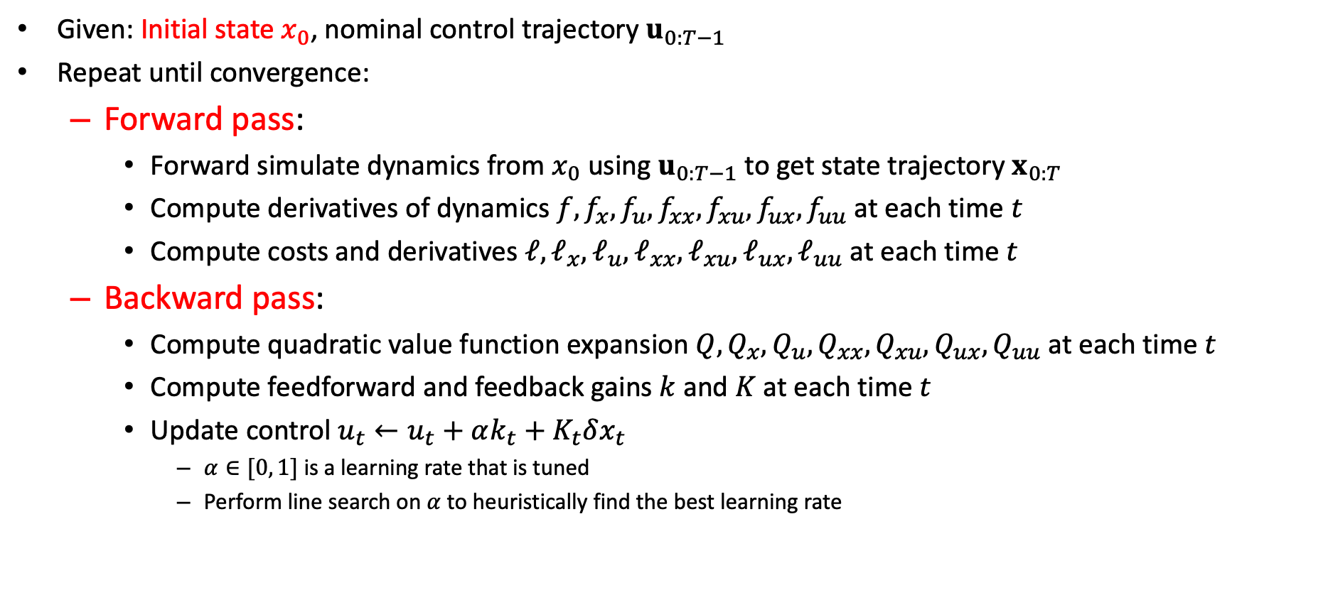
Differential Dynamic Programming
Given: Initial state $x_{0}$, nominal control trajectory $u_{0:T−1}$
Repeat until convergence:
  Forward pass:
    Forward simulate dynamics from $x_{0}$ using $u_{0:T−1}$ to get state trajectory $x_{0:T}$
    Compute derivatives of dynamics $f, f_{x}, f_{u}, f_{xx}, f_{xu}, f_{ux}, f_{uu}$ at each time $t$
    Compute costs and derivatives $ℓ,ℓ_{x},ℓ_{u},ℓ_{xx},ℓ_{xu},ℓ_{ux}, ℓ_{uu}$ at each time $t$
  Backward pass:
    Compute quadratic value function expansion $Q, Q_{x}, Q_{u}, Q_{xx}, Q_{xu}, Q_{ux}, Q_{uu}$ at each time $t$
    Compute feedforward and feedback gains $k$and $K$at each time $t$
    Update control $u_{t}←u_{t}+αk_{t}+K_{t}δx_{t}$
      $α∈[0, 1]$ is a learning rate that is tuned
      Perform line search on $α$ to heuristically find the best learning rate
matthew.d.houghton@nasa.gov

Slide 12
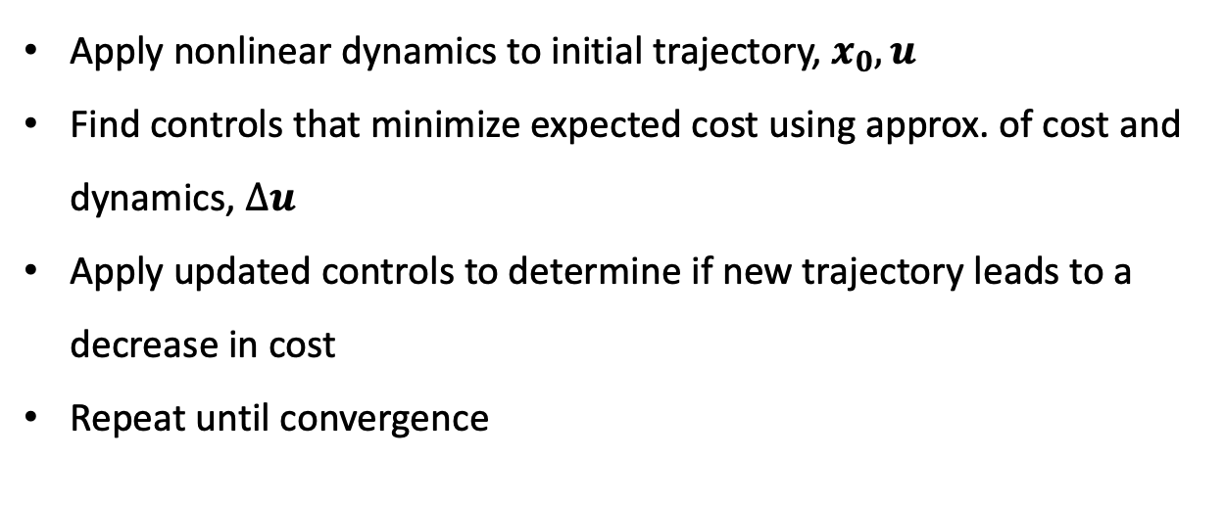




Differential Dynamic Programming
Apply nonlinear dynamics to initial trajectory, $x_{0},u$
Find controls that minimize expected cost using approx. of cost and dynamics, $∆u$
Apply updated controls to determine if new trajectory leads to a decrease in cost
Repeat until convergence
H
$$∆u$$
$$∆u$$
Cost
$$∆u$$
$$∆u$$
Iteration
matthew.d.houghton@nasa.gov

Slide 13
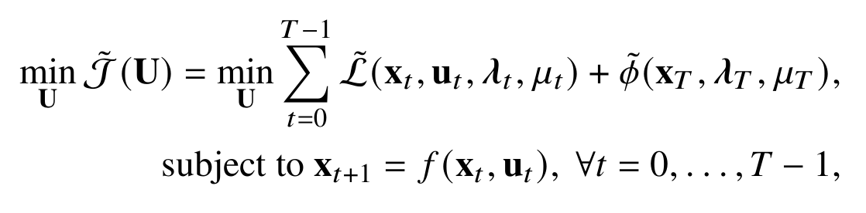
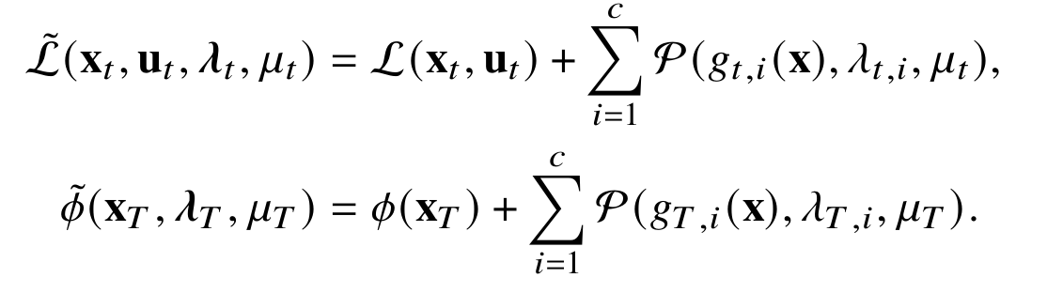
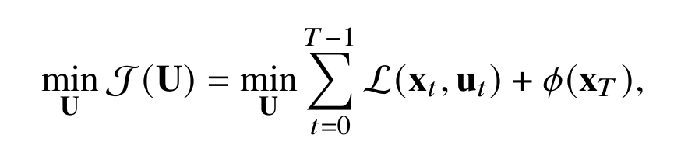
DDP and AL-DDP
Differential Dynamic Programming (DDP):
Given nominal trajectory, use linear (or quadratic) approximation of system nonlinear dynamics and quadratic approximation of cost, yields updates that quadratically converge
Standard DDP does not handle state or control constraints
Augmented Lagrangian DDP (AL-DDP):
Adds state constraints to the original optimal control problem
Convert single constrained problem into series of unconstrained problems using penalty functions
Optimization for state constraints greatly increases computational complexity, requires an inner and outer loop
where
matthew.d.houghton@nasa.gov
Notes:
DDP is an optimal control approach that enables planning over nonlinear dynamics using quadratic approximations of the cost and quadratic or linear approximations of the dynamics to displays quadratic convergence. The standard implementation of DDP uses the cost set up below and does not consider state or control constraints. To incorporate the state constraints necessary for collision avoidance, there are variations such as Augmented Lagrangian DDP or AL-DDP. This method converts the single constrained problem into a series of unconstrained problems by adding a penalty functions to the cost as shown. This creates an inner loop and outer loop where the trajectory is optimized followed by adjustments to the penalty parameters if the constraints are not met. This process increases the computational complexity of the algorithm relative to the standard variation.

Slide 14

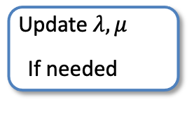
DDP Depiction
AL -DDP Depiction
Trajectory
Every n iterations:
Forward Pass
Uses full nonlinear dynamics!
Forward Pass
Backward Pass
Check Constraints
Optimal Controls __
Update $λ, μ$
If needed__
matthew.d.houghton@nasa.gov

Slide 15
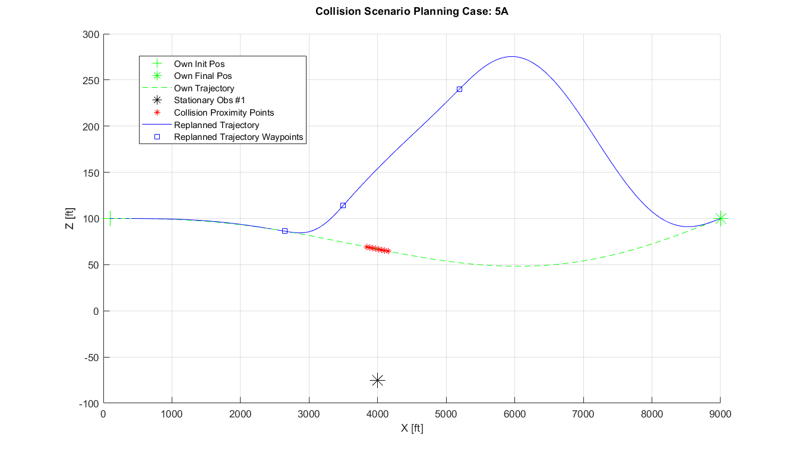
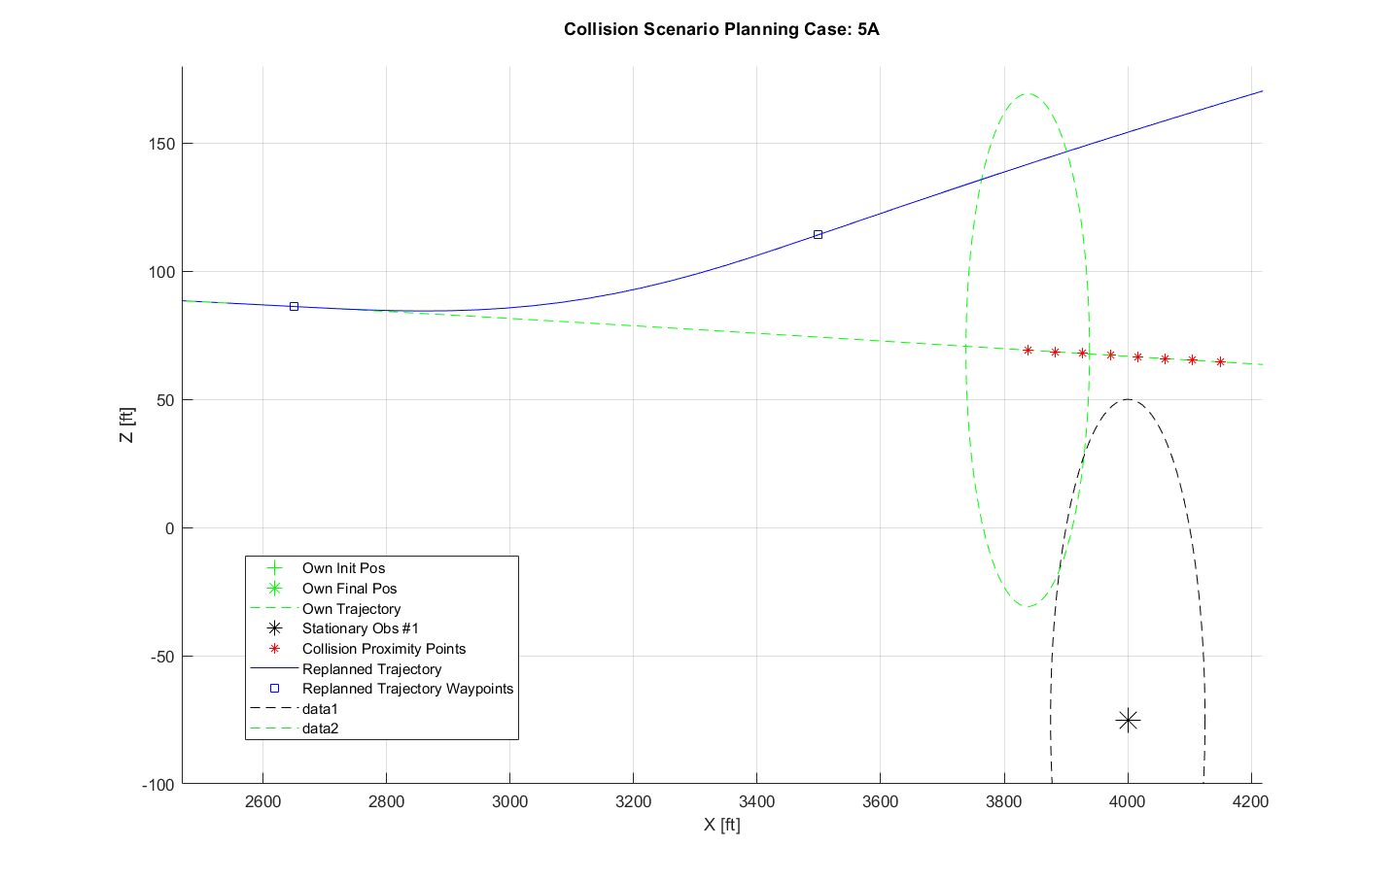
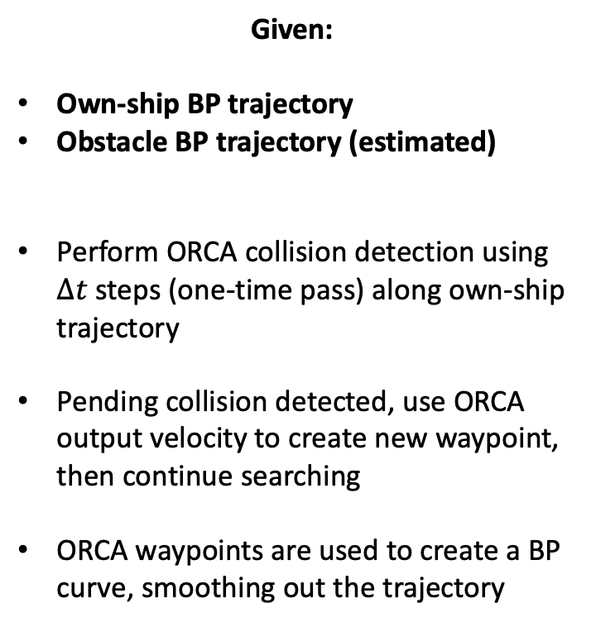

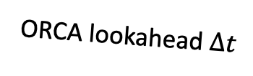
Integration: ORCA + Bernstein Polynomials
Goal: Modify own-ship BP trajectory to ensure smooth collision avoidance
Given:
Own-ship BP trajectory
Obstacle BP trajectory (estimated)
Perform ORCA collision detection using $∆t$ steps (one-time pass) along own-ship trajectory
Pending collision detected, use ORCA output velocity to create new waypoint, then continue searching
ORCA waypoints are used to create a BP curve, smoothing out the trajectory
Replanned waypoints
Own-ship
Safety
Radius
$$∆t$$
ORCA lookahead $∆t$
Obstacle
Safety
Radius
Proximity
Violations
Stationary
Obstacle
Original BP
Trajectory
matthew.d.houghton@nasa.gov
Notes:
Now we will discuss the integration of ORCA and BPs. The goal of this integration is to recognize potential collisions and modify the ownship trajectory to ensure smooth collision avoidance. Initially, BP trajectories of waypoints for the ownship and obstacles are passed into ORCA. ORCA then performs collision detection along each timestep of the own-ship trajectory. If a collision is detected, ORCA determines the velocity that avoids collision and is closest to the desired velocity. This information is used to update the set of BP trajectory waypoints and provides a smooth collision avoidant trajectory.

Slide 16
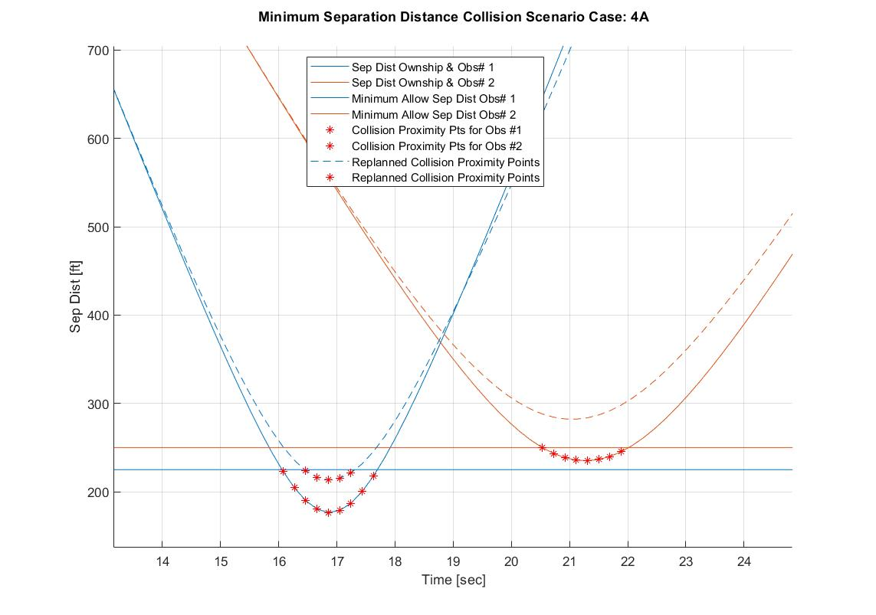
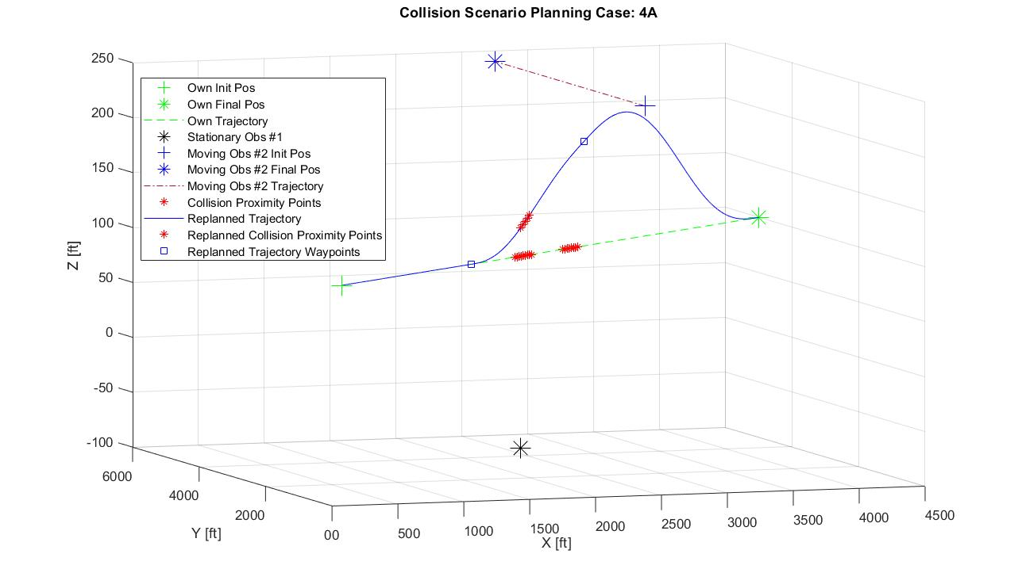
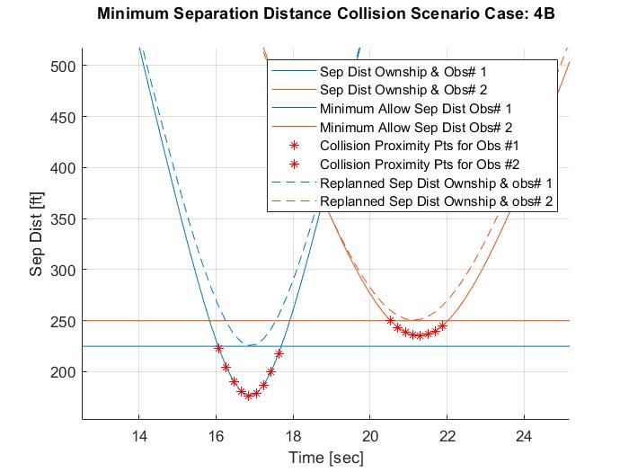
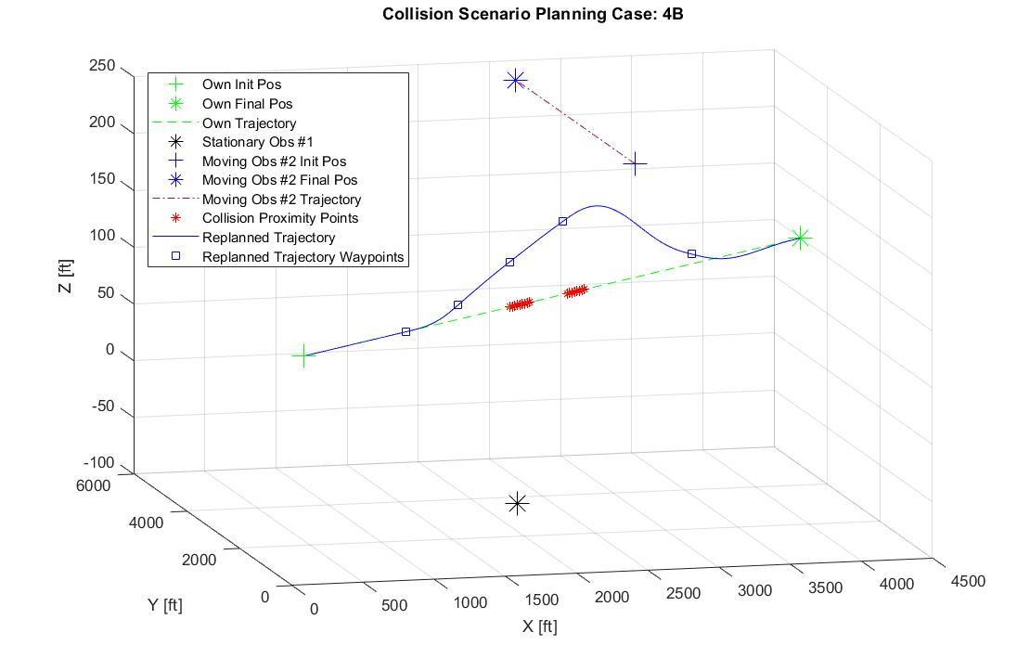
ORCA Augmentations: Dynamic Replanning
Initial trajectory collides with the safety radius of both the stationary obstacle below and moving obstacle above
ORCA replans points to avoid obstacle using simplified dynamics
BP curve causes new collision by attempting to implement a more dynamically viable trajectory
Moving Obstacle path
Replanned waypoints
Start of
maneuver
Stationary Obstacle
Shifted start
back
matthew.d.houghton@nasa.gov

Slide 17


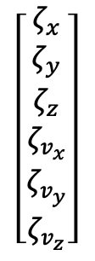
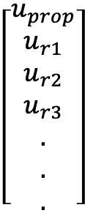
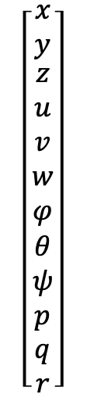



Integration: Bernstein Polynomials + DDP
Parameterization Preserving
BP
$ζ_{x}$, $ζ_{y}$, $ζ_{z}$
$$[x,y,z]$$
DDP
Waypoints
States Controls
Allows arbitrary/exact conversion
$$\left[\begin{matrix}ζ_{x} \\ ζ_{y} \\ \begin{aligned}ζ_{z} \\ ζ_{v_{x}} \\ ζ_{v_{y}} \\ ζ_{v_{z}}\end{aligned}\end{matrix}\right]$$
$$\left[\begin{matrix}x \\ y \\ \begin{aligned}z \\ u \\ v \\ w \\ φ \\ θ \\ ψ \\ p \\ q \\ r\end{aligned}\end{matrix}\right]$$
$$\left[\begin{aligned}u_{prop} \\ u_{r1} \\ u_{r2} \\ u_{r3} \\ . \\ . \\ .\end{aligned}\right]$$
Analytic
Conversion
$ζ_{v_{x}}$, $ζ_{v_{y}}$, $ζ_{v_{z}}$
$$\left[φ,θ,ψ,u,v,w\right]$$
Exact evaluation at a specific time, no representation for all time
Trim Table
$$u,v$$
Everything else
Approximation, based on linearization
matthew.d.houghton@nasa.gov
Notes:
Next, let’s discuss the interaction between BPs and DDP. Once ORCA provides the new simplified trajectory via BP waypoints, it is converted into useful states for DDP to optimize. For the Lift + Cruise vehicle used in the experiments, DDP requires the position, body velocities, Euler angles, angular rates, rotor rates, and effector surfaces for a trajectory.
The position of the vehicle can be directly converted from the simplified trajectory, while the body velocities and euler angles can be analytically converted from the inertial velocities of the trajectory.
Finally, the other states and controls are linearly interpolated from a set of trim conditions for the vehicle in cruise at various speeds.
While nonoptimal, these states and controls serve as a reasonable initial trajectory for DDP to optimize. Thanks to the BP waypoint specification, the simplified trajectory is able to be sampled efficiently at any timestep necessary for DDP to feasibly control the vehicle.

Slide 18
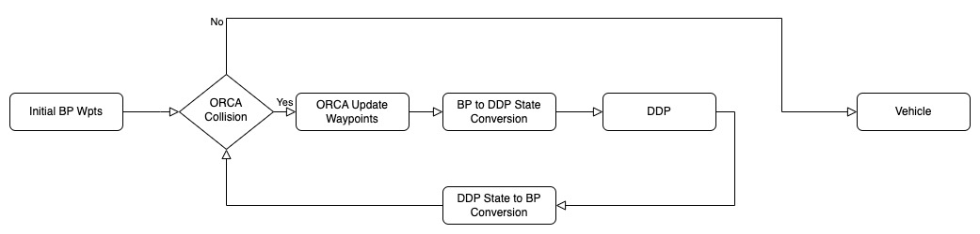
Algorithm Implementation
Leverages ORCA fast collision avoidance checks and preferential avoidance direction selection
BP’s serve as compact trajectory representation between ORCA and DDP that can be quickly evaluated at any time along the curve
DDP provides dynamically feasible optimal trajectories given simplified ORCA information
matthew.d.houghton@nasa.gov
Notes:
So to put it all together, we have a flow chart depicting the the algorithm implementation.
COBRA-DDP takes in an initial trajectory that is able to be converted into BP waypoints, this for example can be a previous DDP optimized trajectory or a typical flight path.
ORCA checks along the trajectory for potential collisions, and if none are found, the vehicle continues with the previous trajectory.
If a collision is found, ORCA uses the desired velocity direction to calculate a simplified collision avoidant trajectory that is converted into BP waypoints to create a new smooth trajectory
The trajectory is converted to the vehicle states and controls necessary for DDP to optimize.
DDP then provides a dynamically feasible trajectory for the vehicle to follow that is checked for collision by ORCA and if shown to avoid the collision, is passed as an updated trajectory for the vehicle.
This approach leverages the speed of ORCA’s collision checking, its ability to inform a collision avoidant trajectory with a desired velocity, the evaluation benefits of BPs and DDP’s ability to optimize for a dynamically feasible trajectory

Slide 19
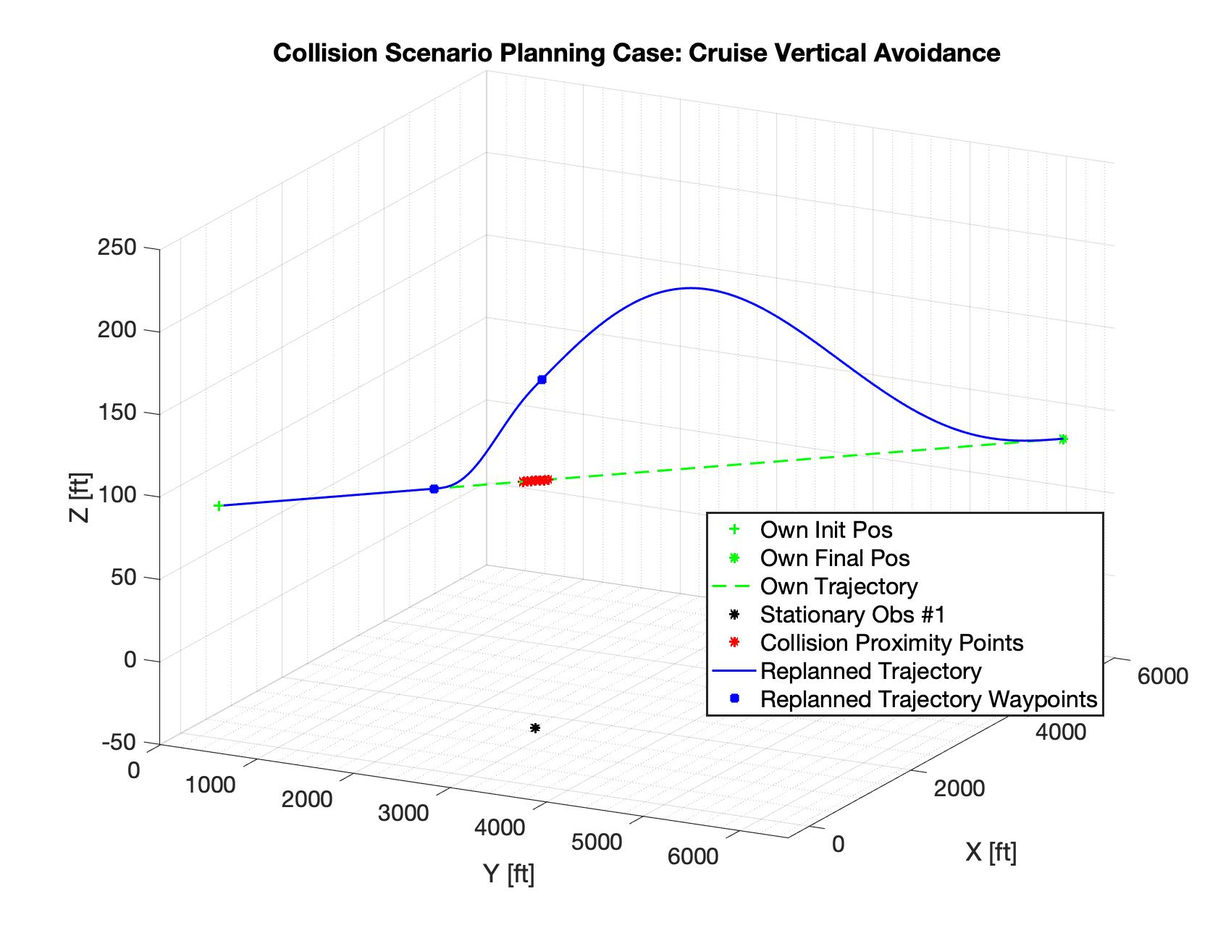
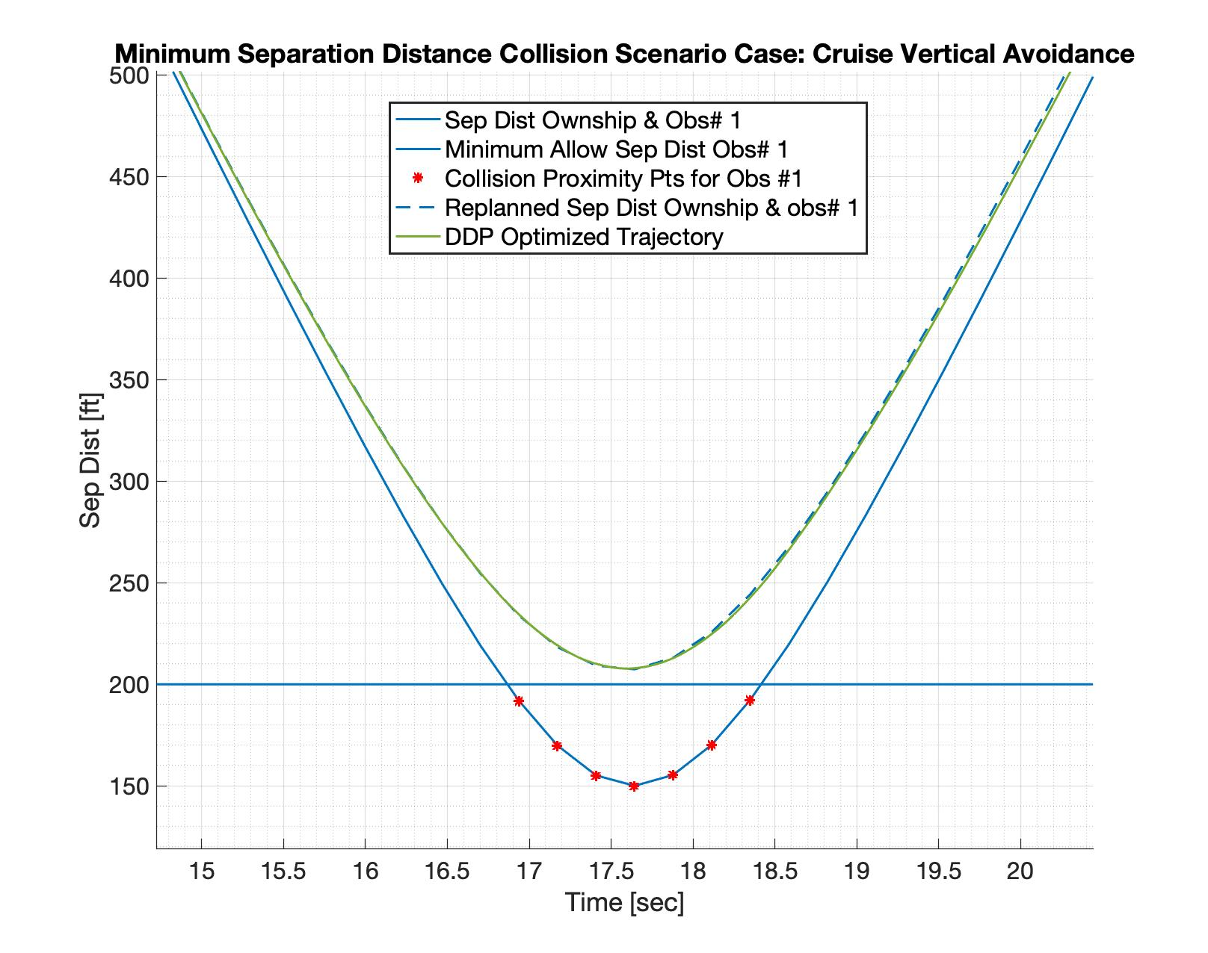
Experiments: Cruise to Altitude Change
170 ft/s cruise with 200 ft safety radius
Static obstacle 150 ft below
Recognizes safety breach
ORCA recalculates, maintains safety radius
ORCA waypoints converted into BP curves
BP curves integrated with trim knowledge and passed to DDP
DDP optimized new trajectory avoids obstacle
matthew.d.houghton@nasa.gov
Notes:
The following experiments were applied to the NASA (RVLT) revolutionary Vertical Lift Technologies(RVLT) Lift + Cruise UAM Vehicle. The initial trajectory shown in the above figure as green has a safety breach caused by the black obstacle below it. When provided the initial trajectory, COBRA-DDP recognizes the proximity violations denoted as red asterisks, and replans the blue trajectory waypoints to avoid the collision. DDP then optimizes this suggested trajectory to make it dynamically feasible. The lower plot shows the minimum separation distance of each trajectory. The blue line shows the initial trajectory where it fails to maintain separation. The ORCA suggested trajectory and DDP optimized trajectory are depicted as the blue dashed line and the green line respectively. Both are able to avoid collision in this case.

Slide 20
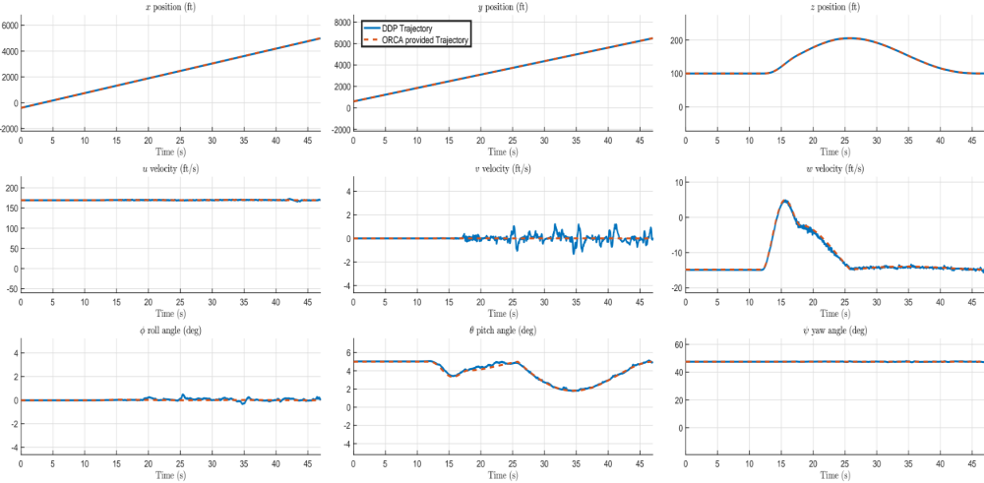
Cruise to Altitude Change
matthew.d.houghton@nasa.gov
Notes:
Here we look at the states to see how effectively DDP in blue was able to follow the suggested trajectory in orange. While there are some adjustments made by DDP in velocities and angles necessary to make the trajectory dynamically feasible, overall DDP effectively follows the position requirements necessary to avoid collision

Slide 21
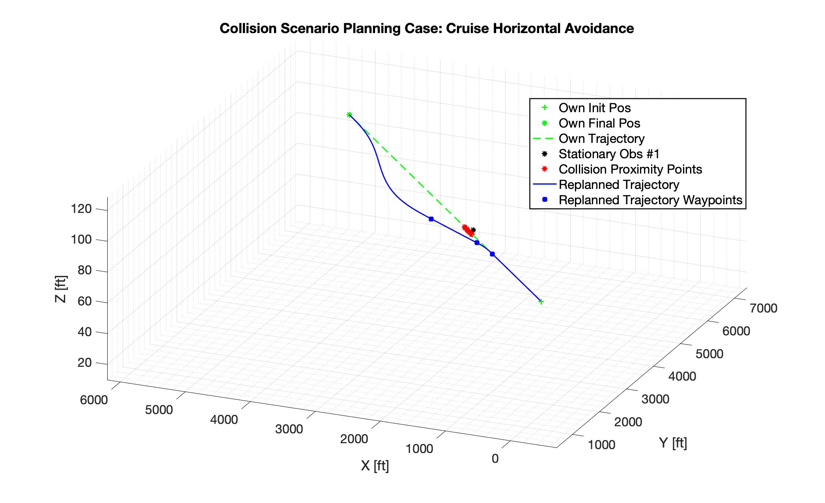
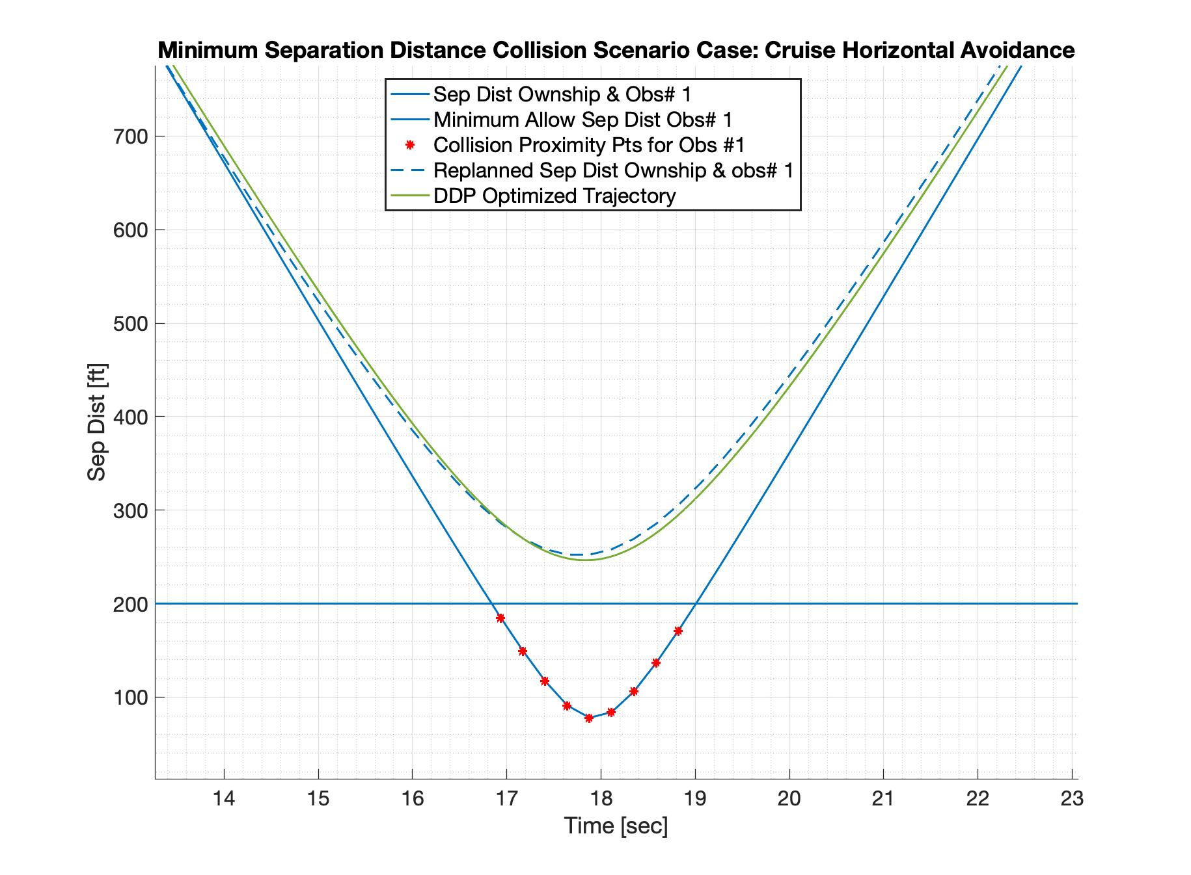
Cruise to Horizontal Maneuver
170 ft/s cruise with 200 ft safety radius
Static obstacle 75 ft to the right
Recognition of safety radius breach
ORCA recalculates, maintains safety radius
ORCA waypoints converted into BP curves
BP curves integrated with trim knowledge and passed to DDP
DDP optimized new trajectory avoids obstacle
matthew.d.houghton@nasa.gov
Notes:
Here we present a similar initial trajectory though with a stationary obstacle 75 ft to the right, violating the safety radius. Again COBRA-DDP is able to recognize the potential violation and replan a dynamically feasible maneuver that is able to maintain separation distance.

Slide 22
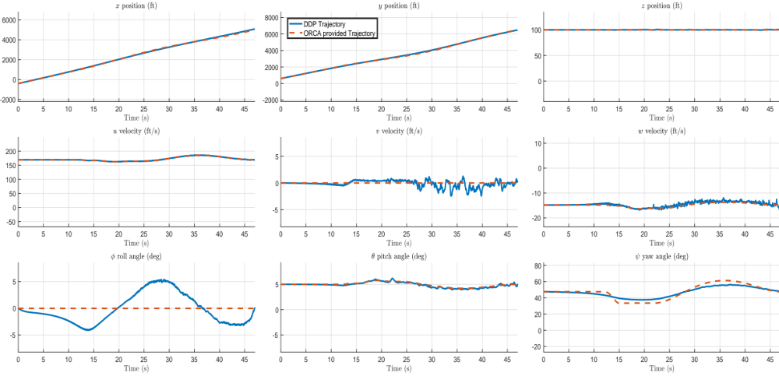
Cruise to Horizontal Maneuver
DDP was provided wing-level cruise trim values for suggested trajectory
matthew.d.houghton@nasa.gov
Notes:
In the direct state comparison, there is a noted difference between the suggested roll angle and the DDP roll angle. This is due to the conversion of the BP trajectory from waypoints to states only having cruise trim values for creating the suggested trajectory. Despite the infeasibility of this trajectory, DDP optimized to roll properly and perform a collision avoidant maneuver.

Slide 23
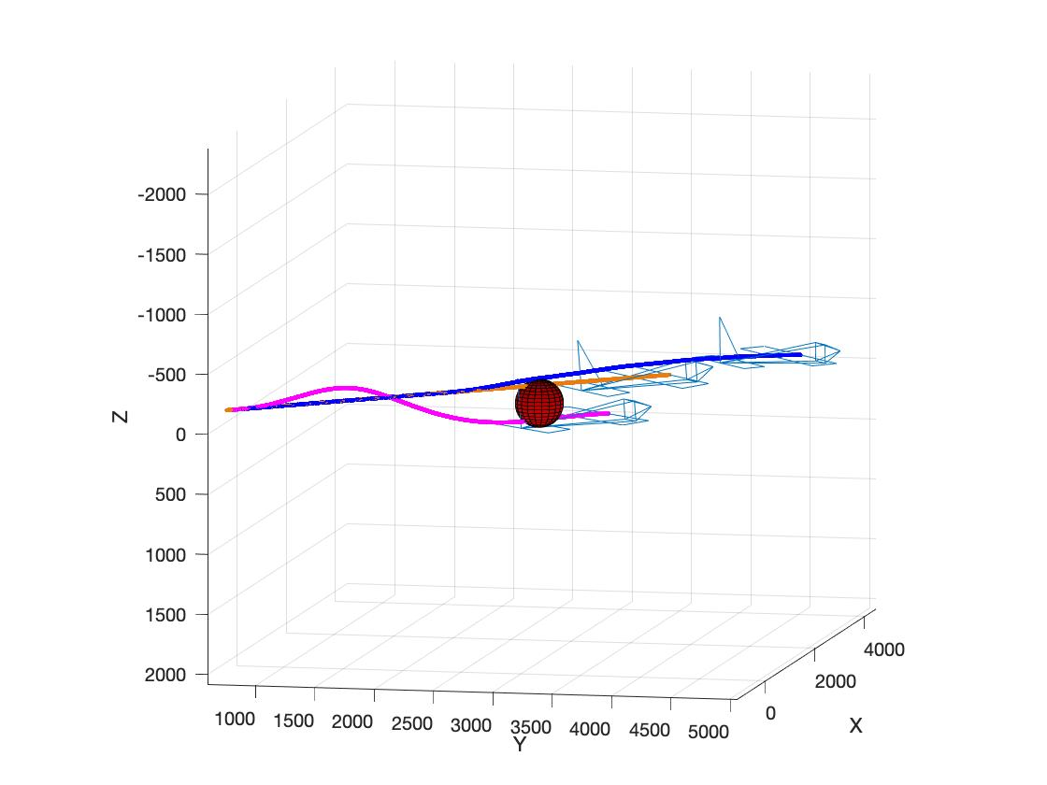
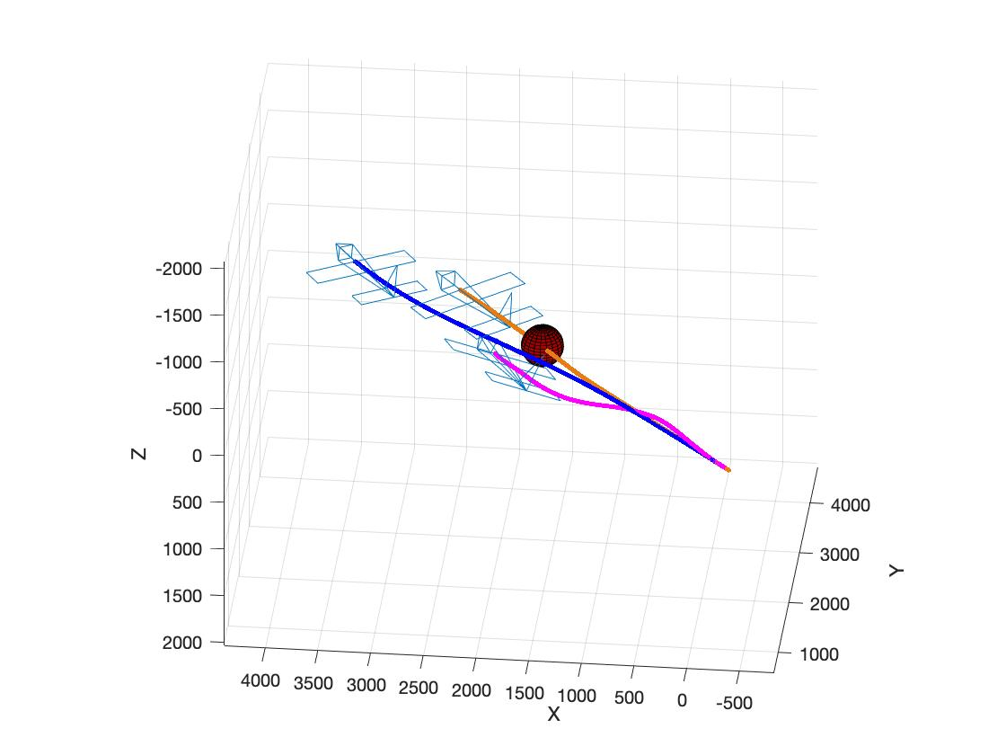
AL-DDP Warmstarting with COBRA-DDP
AL-DDP Warmstart Experiments
Provided cruise initial trajectory:
  AL-DDP Fails (orange trajectories)
Provided no warmstart initial trajectory:
  AL-DDP always avoids under obstacle (magenta trajectories)
Provided COBRA-DDP trajectory:
  Successful replanning and avoids collision (blue trajectories)
COBRA-DDP’s trajectory provides a feasible warmstart trajectory to help minimize computation of AL-DDP
COBRA-DDP enables selection of desired velocity, allowing for the set up of potential flight rules or expected avoidance patterns
(e.g. left to left)
-
-
-
-
Cruise Altitude Change Experiment
Z
-
-
-
-
Cruise Horizontal Turn Experiment
matthew.d.houghton@nasa.gov
Notes:
Finally, we review a comparison of COBRA-DDP and its potential benefits for state-constrained algorithms such as AL-DDP. AL-DDP was tasked with providing collision avoidant trajectories for the two previous experiments. In both cases, when provided the same warmstart information as COBRA-DDP, the simple cruise trajectory, AL-DDP was unable to optimize out of a collision. These trajectories are shown in orange on the plots. When provided no warmstart information, AL-DDP consistently optimizes a trajectory that avoids underneath the obstacle, even in the turning case. These maneuvers, shown in magenta, while not inherently dangerous, pose a concerning limitation for implementations using this information. Lastly, AL-DDP was provided COBRA-DDP’s trajectory as warmstart information. Shown in blue, AL-DDP is able to optimize the trajectory further while maintaining a similar flight maneuver as COBRA-DDP. This demonstrates that COBRA-DDP is capable of also providing a warmstart trajectory for other state constrained algorithms while providing a preferred collision avoidance direction.

Slide 24
Conclusions and Ongoing Work
Conclusion:
BP curves serve as an effective transfer of trajectory information between ORCA and DDP
COBRA-DDP plans dynamically feasible collision avoiding trajectories and can select preferential avoidance direction
COBRA-DDP can enhance the optimization of other state-constrained optimizers such as AL-DDP
Ongoing Work:
MPC implementation of COBRA-DDP
Demonstration of collision avoidance with multiple moving/stationary, cooperative/uncooperative obstacles
matthew.d.houghton@nasa.gov
Notes:
In conclusion, COBRA-DDP is able to plan dynamically feasible collision avoidant trajectories. It is able to select preferential avoidance directions that can serve as the basis for flight traffic rules and the results are able to enhance the optimization of other state-constrained optimizers. Future work in this direction would involve a model predictive control implementation of COBRA-DDP, demonstrating its advantage when considering many obstacles, and providing enhancements to the current algorithm to improve planning and the speed of its implementation.

Slide 25
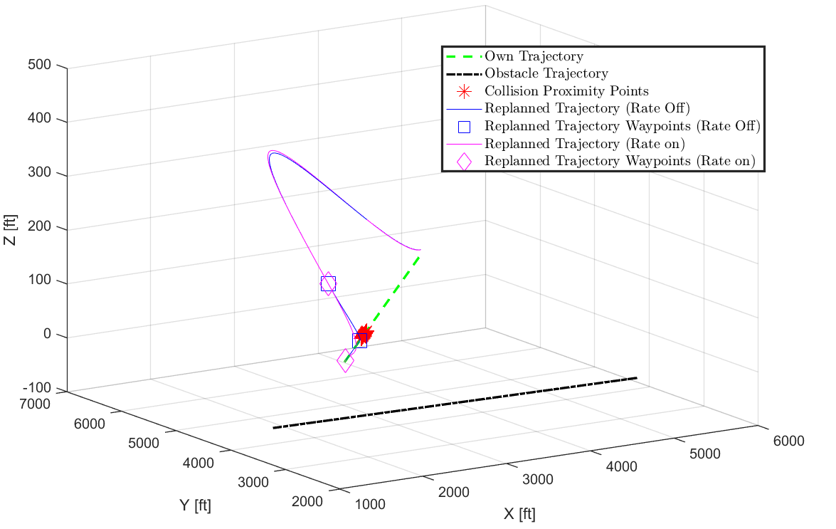
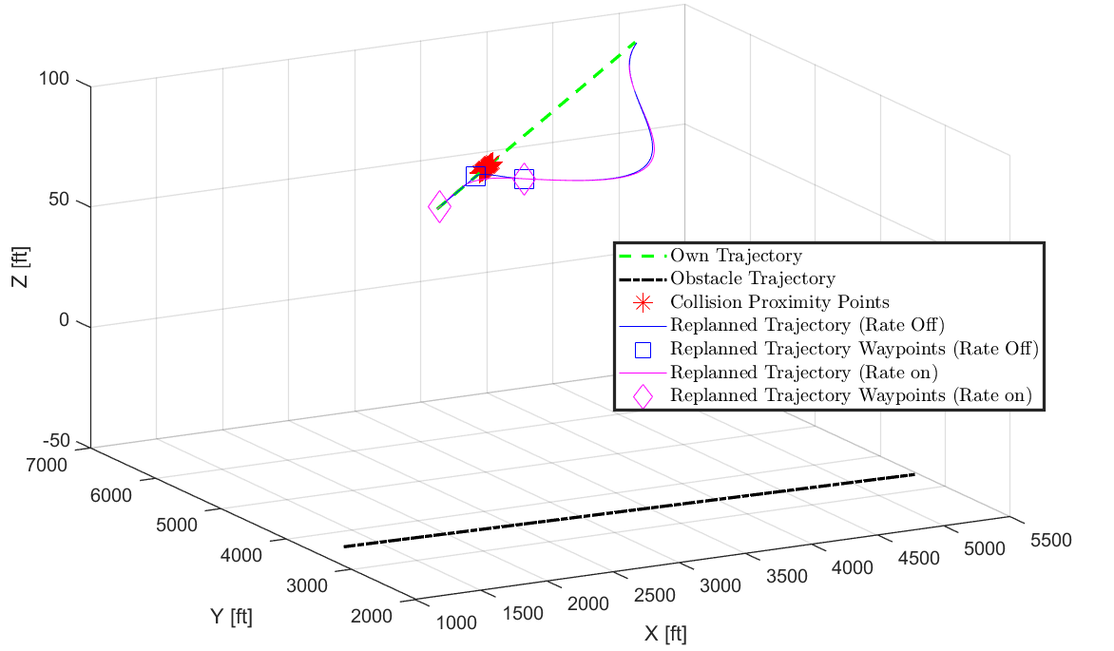
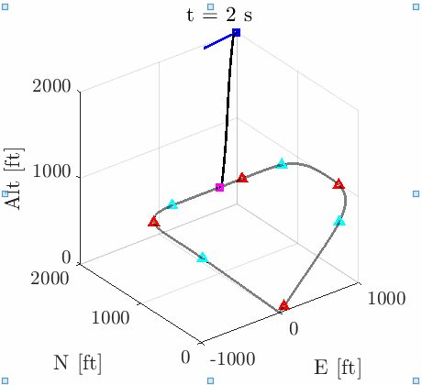
Further Details on Ongoing Work
Ongoing Work:
Further ORCA augmentation to consider complex vehicle maneuvers
What advantages are available to vehicles that communicate to each other using BP curves?
Selection of v_{des} can help maintain traffic rules (e.g. left to left)
Transmitting BP Curves can help plan synchronized cooperation
matthew.d.houghton@nasa.gov

Slide 26
Acknowledgements & References
Acknowledgements:
NASA Aeronautics Research Mission Directorate (ARMD), Transformative Tools
and Technologies (TTT) project,
under the Autonomous Systems / Intelligent Contingency Management (ICM)
References:
Farouki, R. T., “The Bernstein polynomial basis: A centennial retrospective,” Computer Aided Geometric Design, Vol. 29, No. 6, 2012, pp. 379–419.
Jacobson, D. H., and Mayne, D. Q., Differential Dynamic Programming, American Elsevier Pub. Co., 1970.
Birgin, E. G., Castillo, R. A., and Martinez, J. M., “Numerical comparison of augmented Lagrangian algorithms for nonconvex problems,” Computational Optimization and Applications, Vol. 31, No. 1, 2005, pp. 31–55.
van den Berg, J., Guy, S. J., Lin, M., and Manocha, D., “Reciprocal n-body Collision Avoidance,” In Proc. of the IEEE International Conference on Robotics and Automation, 2010.
Silva, C., Johnson, W. R., Solis, E., Patterson, M. D., and Antcliff, K. R., “VTOL urban air mobility concept vehicles for technology development,” Aviation Technology, Integration, and Operations Conference, 2018.
Kamermans, M., “A Primer on Be`zier Curves,” , 2022. Https://pomax.github.io/bezierinfo/.
matthew.d.houghton@nasa.gov
Notes:
We would like to acknowledge the T cubed project, Autonomous systems and intelligent contingency management for their support.

Slide 27
Questions?
Please contact: matthew.d.houghton@nasa.gov
for any questions.
Thank you.
matthew.d.houghton@nasa.gov
Notes:
Thank you so much for your time. If you have any questions, please contact us via the email address provided. Thank you.

