Slide 1

V0.1.0 Technology Demonstration for Pratt & Whitney
4/6/23 – NASA Glenn Research Center and Online
Jennifer Gratz* – Aviary Task Lead
Jason Kirk⁺ – Aviary Task Co-Lead
*NASA Glenn Research Center civil servant
⁺NASA Langley Research Center civil servant

Slide 2
Order of Operations: What are We Going to Talk About?
Why we need Aviary
What Aviary does/what its job is

Slide 3
Order of Operations: What are We Going to Talk About?
Why we need Aviary
What Aviary does/what its job is

Slide 4
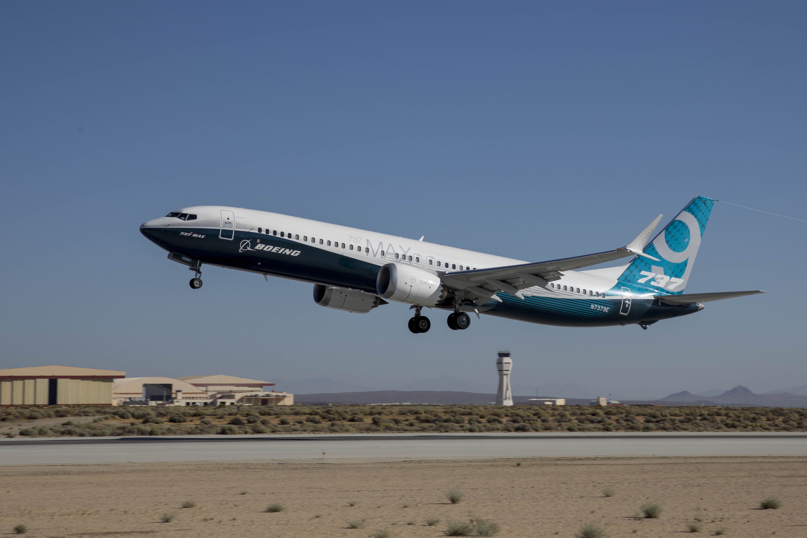
Motivation: We Need New Aircraft Analysis Tools
NASA’s plan for future flight demonstrators needs analysis of advanced aircraft concepts
  Outdated tools with outdated assumptions
  Outdated processes un-couple disciplines
Aircraft Description
Traditional Design Method
Data thrown “over-the-wall”
Manual iteration required
Discipline 1 Team
Discipline 2 Team
Notes:
Sustainable Flight National Partnership (SFNP)
Image 1: https://www.edwards.af.mil/News/Article/1310317/737-max-in-skies-over-edwards/

Slide 5
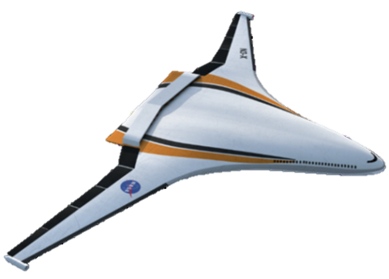
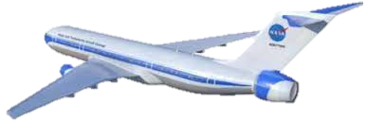
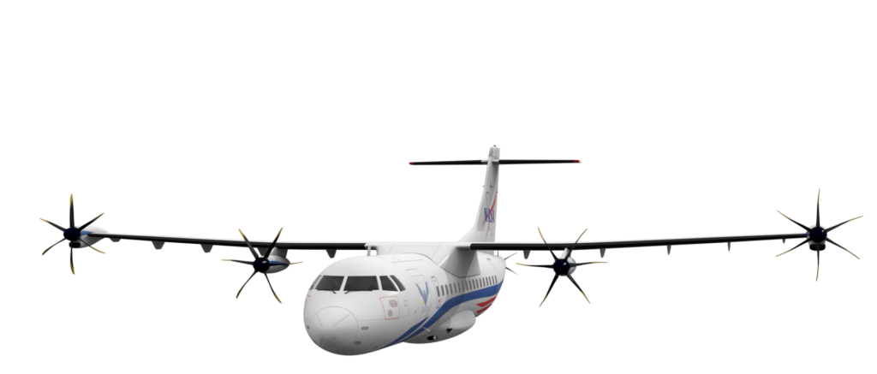
Motivation: Aviary is Addressing these Needs
Retains modeling capability of FLOPS/GASP
Allows tight coupling/integration of disciplines by
putting all disciplines in the same code
Builds new tools with valid assumptions
Aircraft Description
Aviary Design Method
Data coupled together
No manual iteration required
Discipline 1 Team
Discipline 2 Team

Slide 6
Order of Operations: What are We Going to Talk About?
Why we need Aviary
What Aviary does/what its job is

Slide 7


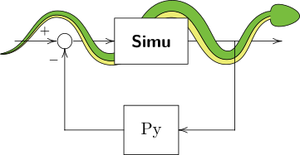
What is Aviary?
is NASA’s next-generation aircraft modeling and optimization framework. Our goals are to:
Combine and replicate the capabilities of legacy codes
Use a modern code architecture built on , to construct modular components that can be easily modified or replaced with custom tools or methods
Perform coupled optimization with , , and
Provide capability to analyze advanced future aircraft concepts, including EAP
Open-source release for maximum impact to the aerospace research community
Combine legacy tools
Coupled Optimizations
Open source software
Modular for modification and substitution
Analyze advanced concepts

Slide 8
Disciplines of Aircraft Analysis
Static Analysis
Mission Analysis
EOMs
Integration Tools
Propulsion
Geometry
Mission Building
Weights
Aerodynamics
Post Processing
Other Subsystems

Slide 9
Job of Aviary – Core
Static Analysis
Mission Analysis
EOMs
Integration Tools
Propulsion
Geometry
Simple Explicit Integration (TBD)
Prescribed Mission EOMs
Height Energy EOMs
Collocation Integration (dymos)
Tabular Propulsion
FLOPS/GASP Geometry Superset
Explicit Shooting Integration (SimuPy)
2DOF EOMs
Mission Building
Weights
Aerodynamics
FLOPS-based Empirical Weights
Pre-built Aviary-based Mission
GASP-based Empirical Weights
FLOPS-based Empirical Aero
GASP-based Empirical Aero
Post Processing
Other Subsystems

Slide 10
Job of Aviary – 1st Integration Demo
Static Analysis
Mission Analysis
EOMs
Integration Tools
Propulsion
Geometry
Simple Explicit Integration (TBD)
Prescribed Mission EOMs
Height Energy EOMs
Collocation Integration (dymos)
Tabular Propulsion
pyCycle
FLOPS/GASP Geometry Superset
OpenVSP
Explicit Shooting Integration (SimuPy)
2DOF EOMs
Mission Building
Weights
Aerodynamics
FLOPS-based Empirical Weights
Pre-built Aviary-based Mission
GASP-based Empirical Weights
FLOPS-based Empirical Aero
GASP-based Empirical Aero
VSPaero
Post Processing
Other Subsystems
Battery Modeling

Slide 11
Job of Aviary – 1st Integration Demo
Static Analysis
Mission Analysis
EOMs
Integration Tools
Propulsion
Geometry
Simple Explicit Integration (TBD)
Prescribed Mission EOMs
Height Energy EOMs
Collocation Integration (dymos)
Tabular Propulsion
pyCycle
FLOPS/GASP Geometry Superset
OpenVSP
Explicit Shooting Integration (SimuPy)
2DOF EOMs
Mission Building
Weights
Aerodynamics
FLOPS-based Empirical Weights
Pre-built Aviary-based Mission
GASP-based Empirical Weights
FLOPS-based Empirical Aero
GASP-based Empirical Aero
VSPaero
Post Processing
Other Subsystems
Battery Modeling

Slide 12
Job of Aviary – 2nd Integration Demo (MBSA&E)
Static Analysis
Mission Analysis
EOMs
Integration Tools
Propulsion
Geometry
Simple Explicit Integration (TBD)
Prescribed Mission EOMs
Height Energy EOMs
Collocation Integration (dymos)
Tabular Propulsion
pyCycle
FLOPS/GASP Geometry Superset
OpenVSP
Explicit Shooting Integration (SimuPy)
2DOF EOMs
Mission Building
Weights
Aerodynamics
FLOPS-based Empirical Weights
Pre-built Aviary-based Mission
GASP-based Empirical Weights
FLOPS-based Empirical Aero
GASP-based Empirical Aero
TACS
VSPaero
Post Processing
Other Subsystems
Battery Modeling
Stability and Control Modeling
Acoustics Modeling
Cost Modeling

Slide 13
Job of Aviary - Future
Static Analysis
Mission Analysis
EOMs
Integration Tools
Propulsion
Geometry
Simple Explicit Integration (TBD)
Prescribed Mission EOMs
Height Energy EOMs
Collocation Integration (dymos)
Tabular Propulsion
pyCycle
FLOPS/GASP Geometry Superset
OpenVSP
User-defined EOMs
Explicit Shooting Integration (SimuPy)
User-defined Integration
NPSS
Additional User-defined Subsystems
2DOF EOMs
Additional User-defined Subsystems
Mission Building
Weights
Aerodynamics
FLOPS-based Empirical Weights
Pre-built Aviary-based Mission
User-built Aviary-based Mission
User-built User-based Mission
GASP-based Empirical Weights
FLOPS-based Empirical Aero
GASP-based Empirical Aero
CART3D
TACS
FUN3D
SUITCASE
Additional User-defined Subsystems
Additional User-defined Subsystems
HCDstruct
VSPaero
Post Processing
Other Subsystems
Fleet Emissions Modeling
Acoustics Modeling
Battery Modeling
Stability and Control Modeling
Thermal Modeling
Cost Modeling
Additional User-defined Subsystems
Additional User-defined Subsystems

Slide 14
Job of Aviary – Model Interface
prop
Static Analysis
Propulsion
Legend
prop
Geometry
Aviary Core Subsystem
prop
Weight
User Subsystem
prop
Aviary Integration Features
Aero
Other Static Subsystem(s)
Mission Analysis
prop
EOMs
prop
Integrator
Acoustics Modeling
Post Processing
prop
Cost Modeling
Missions
Fleet Emissions Modeling
Other Post-processing Subsystem(s)

Slide 15
Thank you to the Aviary Team!
Team
Eliot Aretskin-Hariton (GRC)
Darrell (DJ) Caldwell (LaRC)
Rob Falck (GRC)
Jennifer Gratz (GRC)
John Jasa (GRC)
Jason Kirk (LaRC)
Caroline Kuhnle (GRC)
Kenneth (Kenny) Lyons (ARC)
Ben Margolis (ARC)
Kenneth (Ken) Moore (GRC)
Erik Olson (LaRC)
Dahlia Pham (ARC)
Carl Recine (ARC)
Janet Ross (LaRC)
Advisors
Joseph Garcia (ARC)
Justin Gray (formerly GRC)
Eric Hendricks (GRC)
Ben Phillips (LaRC)

Slide 16
Thank you for the Support!
Special thanks to the Advanced Air Transport Technology (AATT) project and the Transformational Tools and Technologies (TTT) project for funding this work

Slide 17
Q&A Session

Slide 18
Backup

Slide 19
Job of Aviary – Discipline and Fidelity Selection Examples
Weights
Geometry
TACS
User-defined
TACS
Propulsion
HCDstruct
SUITCASE
GASP Empirical
Aviary Aircraft Model
FLOPS Empirical
Aero
EOMs
User-defined
User-defined
VSPaero
Prescribed Mission
FUN3D
2DOF
GASP Empirical
Height Energy
CART3D
GASP Empirical
FLOPS Empirical
Height Energy

Slide 20
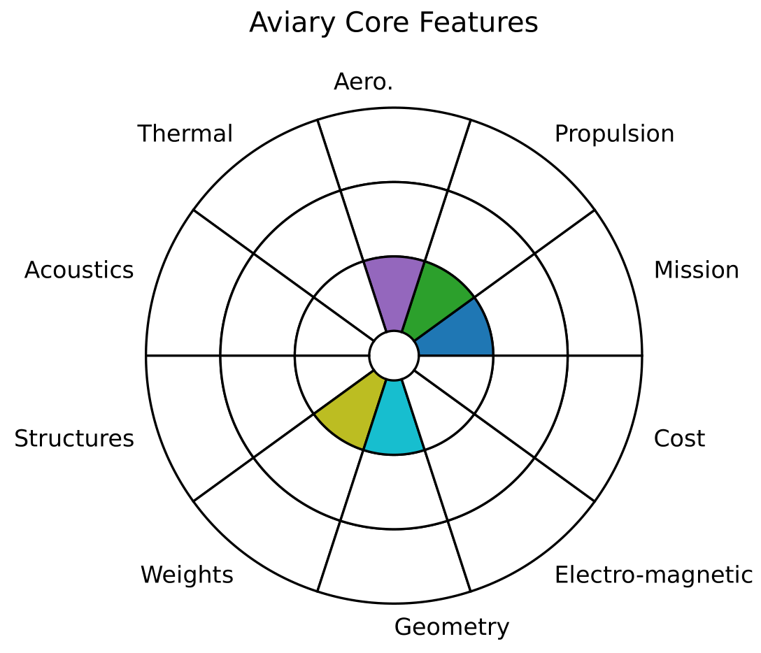
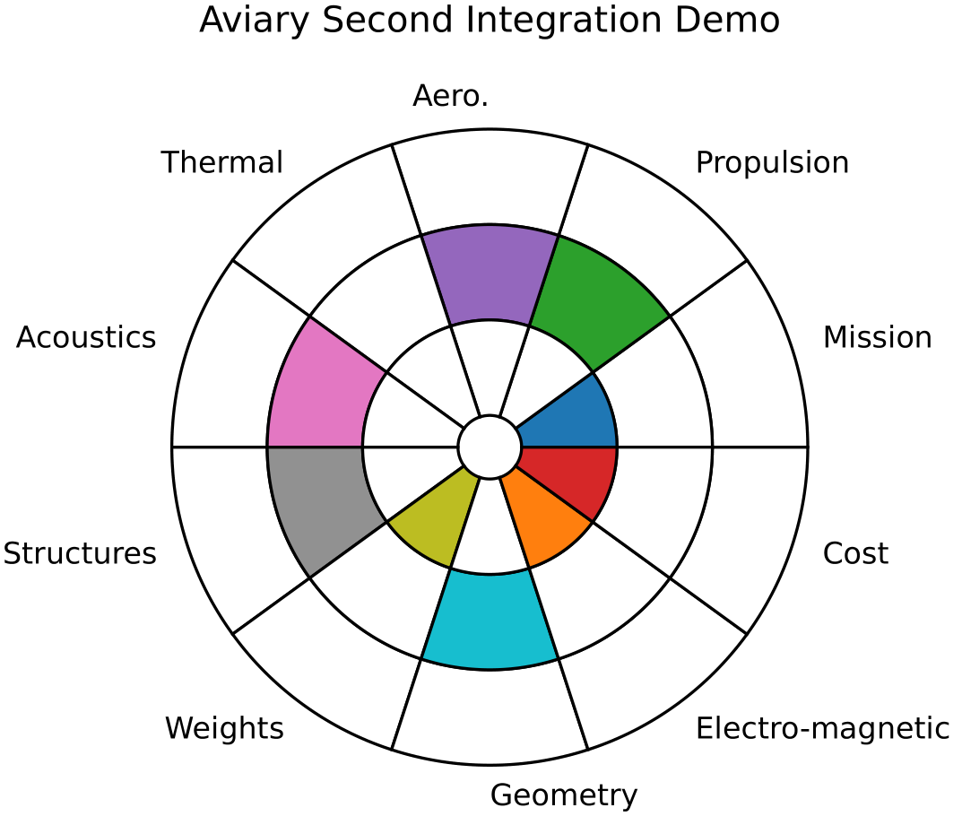
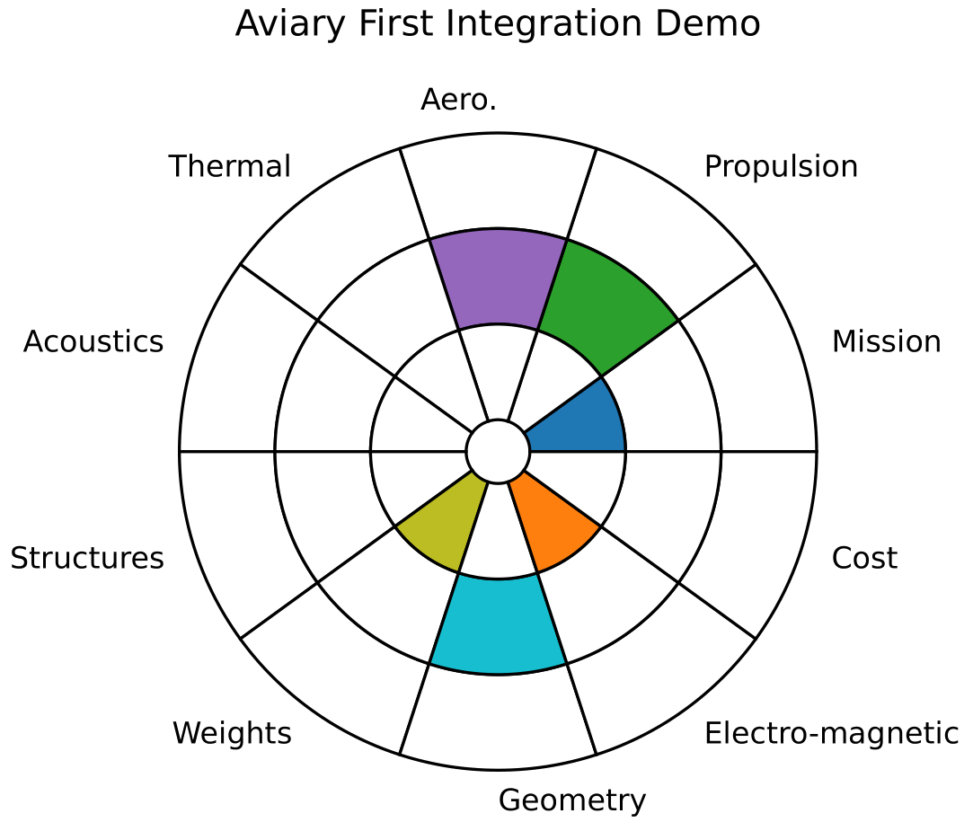
Recap with Radar Charts

Slide 21
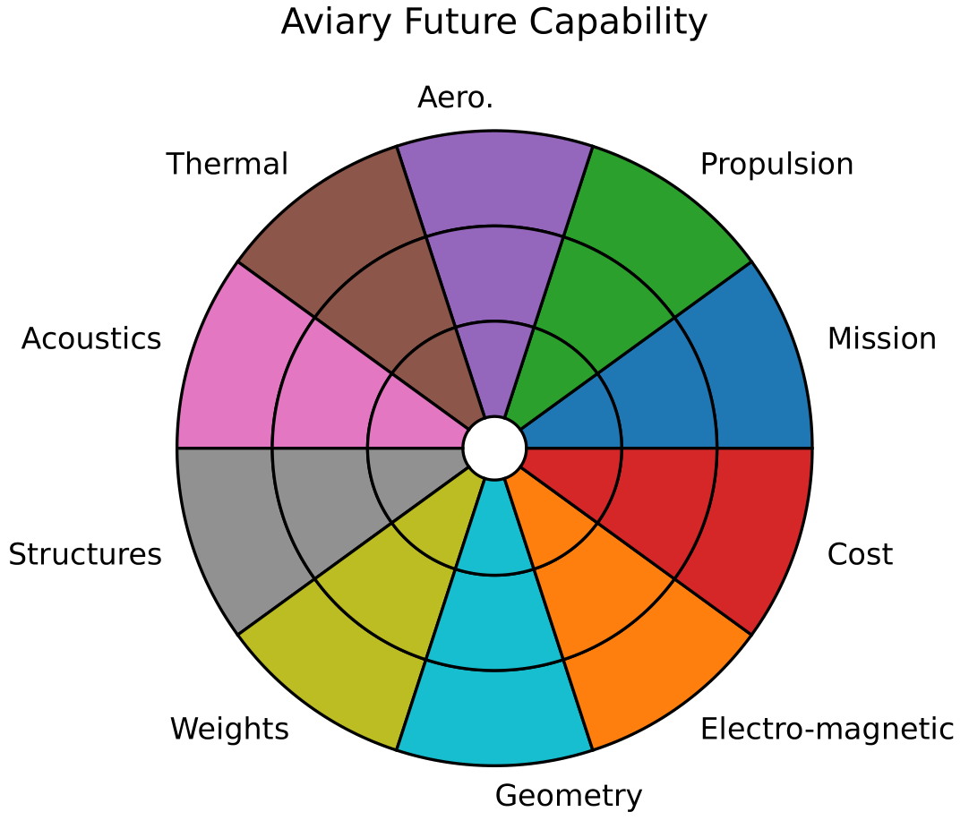
Recap with Radar Charts

Slide 22
Aviary Timeline
Major points in timeline
January 2023 – Aviary v0.1.0 internal release completed
May 2023 – Annual Aviary developer workshop
August 2023 – Milestone for basic electrified TTBW
September 2023 – Milestone to merge/expand electrified TTBW with MBSA&E
December 2023 – Milestone for second type of integrator
Internal Release
MBSA&E eTTBW
Second Integrator
Basic eTTBW
Workshop
January
February
March
April
May
June
July
August
September
October
November
December
2023

Slide 23
Recall the Job of Aviary Core: 5 Disciplines
Static Analysis
Mission Analysis
EOMs
Integration Tools
Propulsion
Geometry
Simple Explicit Integration (TBD)
Prescribed Mission EOMs
Height Energy EOMs
Collocation Integration (dymos)
Tabular Propulsion
FLOPS/GASP Geometry Superset
Explicit Shooting Integration (SimuPy)
2DOF EOMs
Mission Building
Weights
Aerodynamics
FLOPS-based Empirical Weights
Pre-built Aviary-based Mission
GASP-based Empirical Weights
FLOPS-based Empirical Aero
GASP-based Empirical Aero
Post Processing
Other Subsystems

Slide 24
Recall the Job of Aviary Core: 5 Disciplines
Static Analysis
Mission Analysis
EOMs
Integration Tools
Propulsion
Geometry
Simple Explicit Integration (TBD)
Prescribed Mission EOMs
Height Energy EOMs
Collocation Integration (dymos)
Tabular Propulsion
FLOPS/GASP Geometry Superset
Explicit Shooting Integration (SimuPy)
2DOF EOMs
Mission Building
Weights
Aerodynamics
FLOPS-based Empirical Weights
Pre-built Aviary-based Mission
GASP-based Empirical Weights
FLOPS-based Empirical Aero
GASP-based Empirical Aero
Post Processing
Other Subsystems

Slide 25
The 5 Disciplines of the Aviary Core
Each discipline has roots in GASP and FLOPS
Some disciplines allow a choice of source, others combine sources together
Propulsion
Geometry
FLOPS
FLOPS
GASP
GASP
Weights
Aerodynamics
Mission
FLOPS
GASP
FLOPS
GASP
FLOPS
GASP

Slide 26
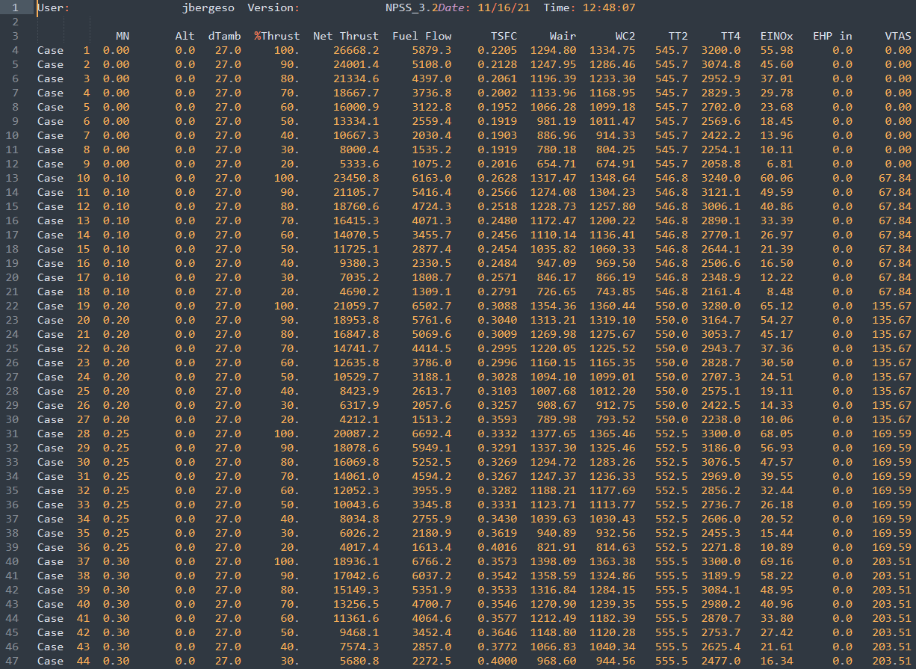
Propulsion – How it Works
Propulsion
FLOPS
Behavior in Aviary:
No distinction between GASP and FLOPS methods
User provides engine deck which Aviary interpolates
Throttle control is percentage of maximum power
Aviary will combine calculations from GASP and FLOPS
GASP
Similarities/Differences from GASP/FLOPS:
GASP/FLOPS both interpolate on engine deck
We will not support GASP format
  We will provide a conversion tool
Our throttle control is a percentage of maximum power
  GASP used burner temperature (T4)
  FLOPS used power code (PC)
Interpolate

Slide 27
Weights – How it Works
Weights
FLOPS
GASP
Unique Inputs
Unique Inputs
The weight estimating relationships in GASP/FLOPS are different empirical relations
Aviary wholesale replicates the GASP/FLOPS equations
Major outputs of both are:
  Operating empty weight
  Payload weight
Major input to both is:
  gross takeoff weight
The user can select either one with no impact on what other subsystems are required
The two types (GASP/FLOPS-based) will return slightly different answers
Common Inputs
(includes gross takeoff weight)
Process 1 (GASP-based empirical equations)
Choose
Process 2 (FLOPS-based empirical equations)
Common Outputs
(slightly different values)
(includes operating empty weight and payload weight)
Unique Outputs
Unique Outputs

Slide 28
Aerodynamics – How it Works
Aerodynamics
FLOPS
GASP
Unique Inputs
(includes angle of attack)
Unique Inputs
Common Inputs
(includes atmospheric/flight conditions)
The aerodynamic estimating relationships in GASP/FLOPS are different empirical relations
Aviary wholesale replicates the GASP/FLOPS equations
Major outputs of both are:
  Lift (equal to mass in FLOPS-based case)
  Drag
Major inputs to both are:
  Atmospheric/flight condition information
  Geometry information
The aerodynamics and mission subsystems are intrinsically linked – their origin code must match
Process 1 (GASP-based empirical equations)
Choose
Process 2 (FLOPS-based empirical equations)
Common Outputs
(slightly different values)
(includes lift and drag)
Unique Outputs
Unique Outputs

Slide 29
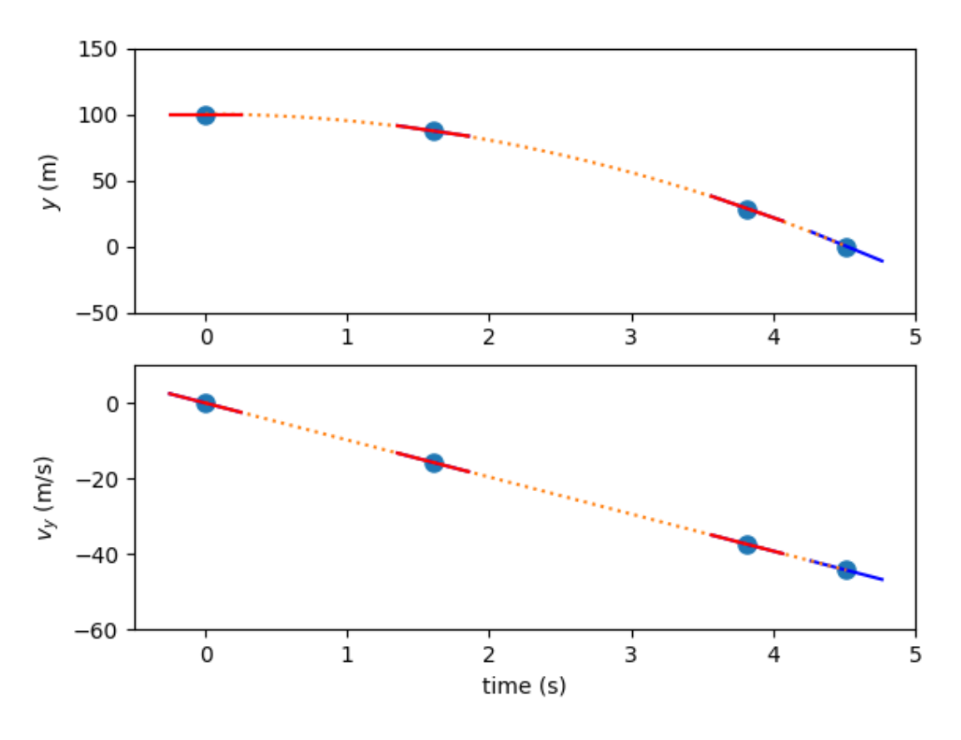






Mission – How it Works
Mission
FLOPS
GASP
2DOF Equations
Integration by Collocation
$$γ=\sin^{−1}\left(\frac{T−D}{W}\right)$$
Height Energy Equations
$$\dot{h}=TAS∗\sin{(γ)}$$
$$\dot{e}=v∗\frac{T−D}{m}$$
$$\dot{r}=TAS∗\cos\left(γ\right)$$
$$\dot{h}=\frac{\dot{e}−v∗\dot{v }}{g}$$
Coming soon:
Coming soon:
$$\dot{r}=\sqrt{v^{2}− {\dot{h}}^{2}}$$
Analytic Shooting Integration
Prescribed mission equations
γ = flight path angle
h = altitude
r = range
v = aircraft velocity
g = gravitational acceleration
e = specific energy
Coming soon:
Simple Explicit Integration

Slide 30
Mission – How it Works
Mission
FLOPS
GASP
2DOF Equations
Integration by Collocation
$$γ=\sin^{−1}\left(\frac{T−D}{W}\right)$$
Height Energy Equations
$$\dot{h}=TAS∗\sin{(γ)}$$
$$\dot{e}=v∗\frac{T−D}{m}$$
$$\dot{r}=TAS∗\cos\left(γ\right)$$
$$\dot{h}=\frac{\dot{e}−v∗\dot{v }}{g}$$
Coming soon:
Coming soon:
$$\dot{r}=\sqrt{v^{2}− {\dot{h}}^{2}}$$
Analytic Shooting Integration
Prescribed mission equations
γ = flight path angle
h = altitude
r = range
v = aircraft velocity
g = gravitational acceleration
e = specific energy
Coming soon:
Simple Explicit Integration

Slide 31
Recall the Job of Aviary Model Interface
prop
Static Analysis
Propulsion
Legend
prop
Geometry
Aviary Core Subsystem
prop
Weight
User Subsystem
prop
Aviary Integration Features
Aero
Other Static Subsystem(s)
Mission Analysis
prop
EOMs
prop
Integrator
Acoustics Modeling
Post Processing
prop
Cost Modeling
Missions
Fleet Emissions Modeling
Other Post-processing Subsystem(s)

Slide 32
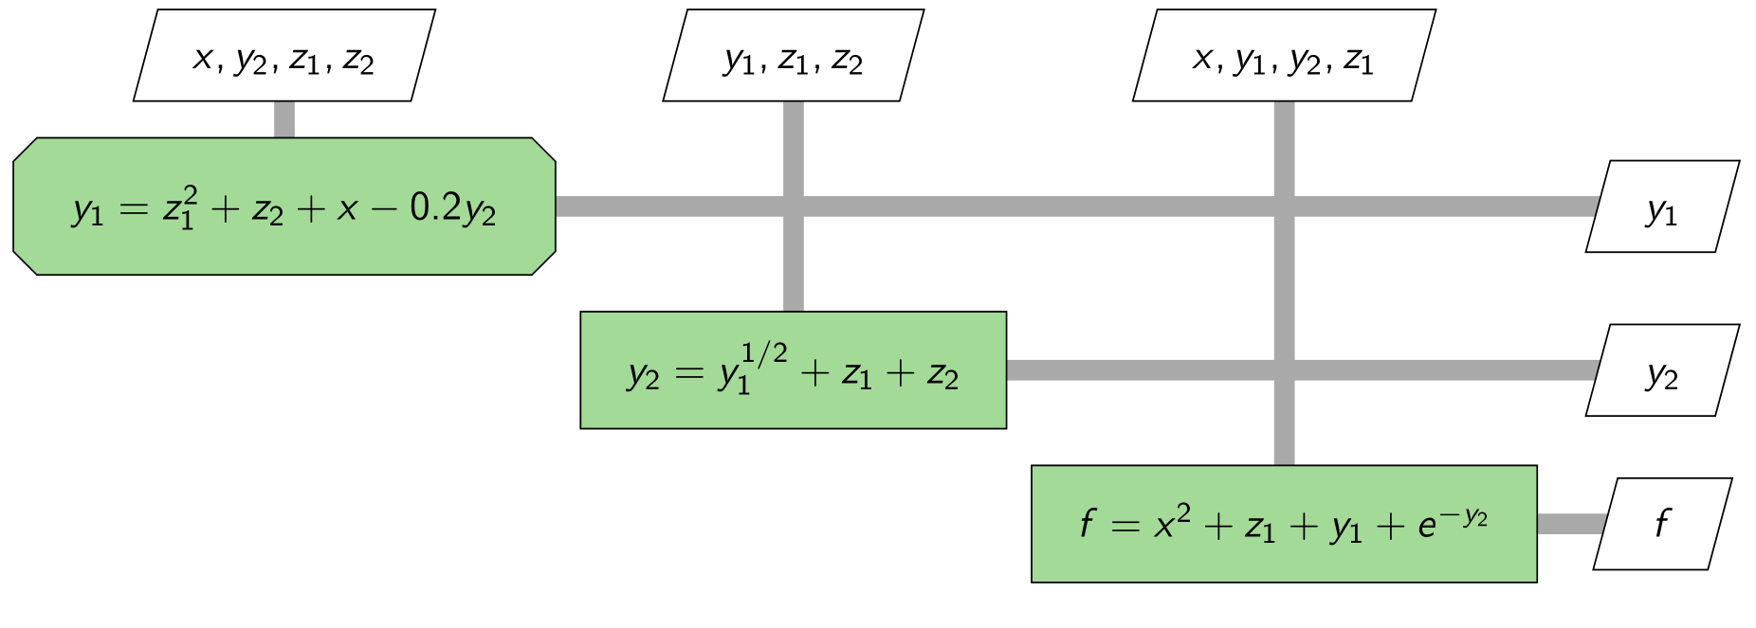
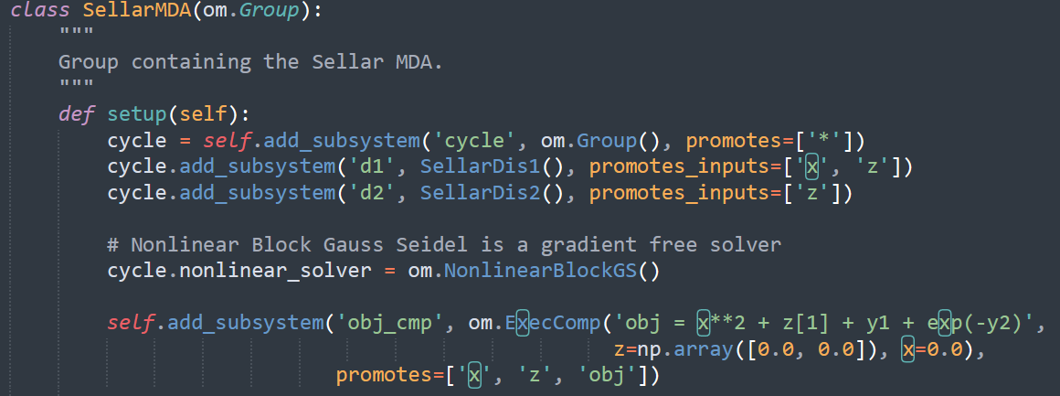
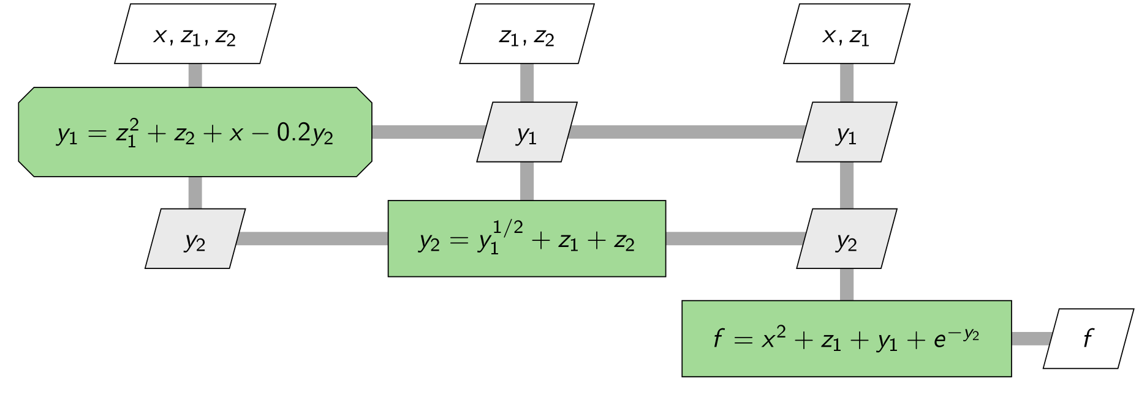
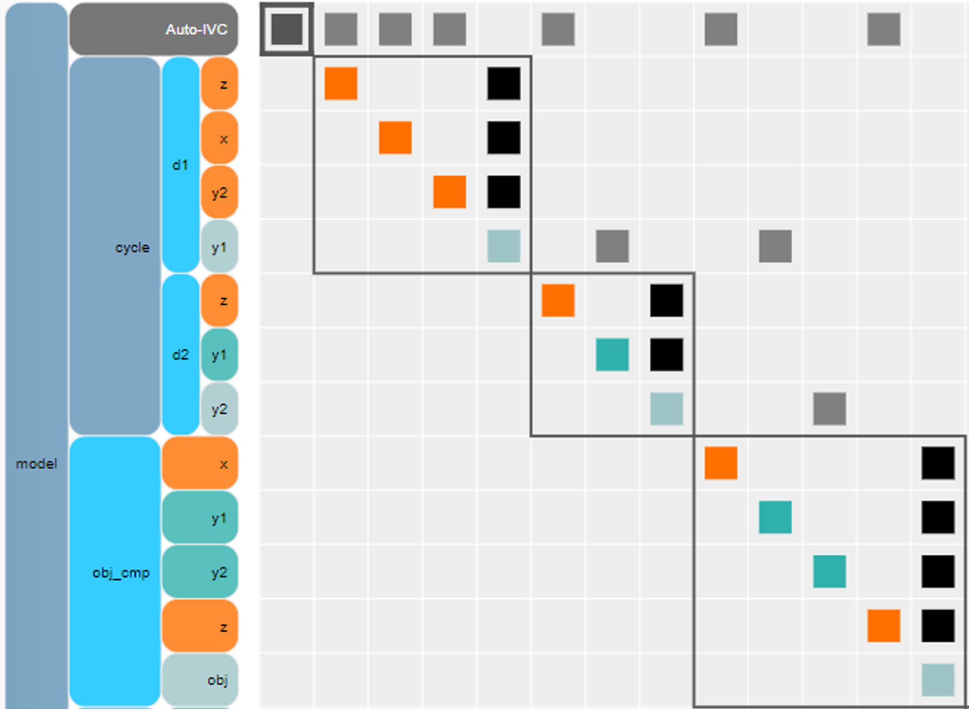
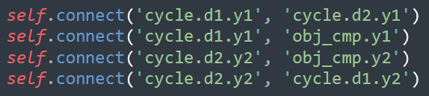
Typical Model Interface – User Tasks
Add subsystems together into OpenMDAO group
Analyze subsystems and decide what variables to link
Create all variable linkages
Debug variable links

Slide 33
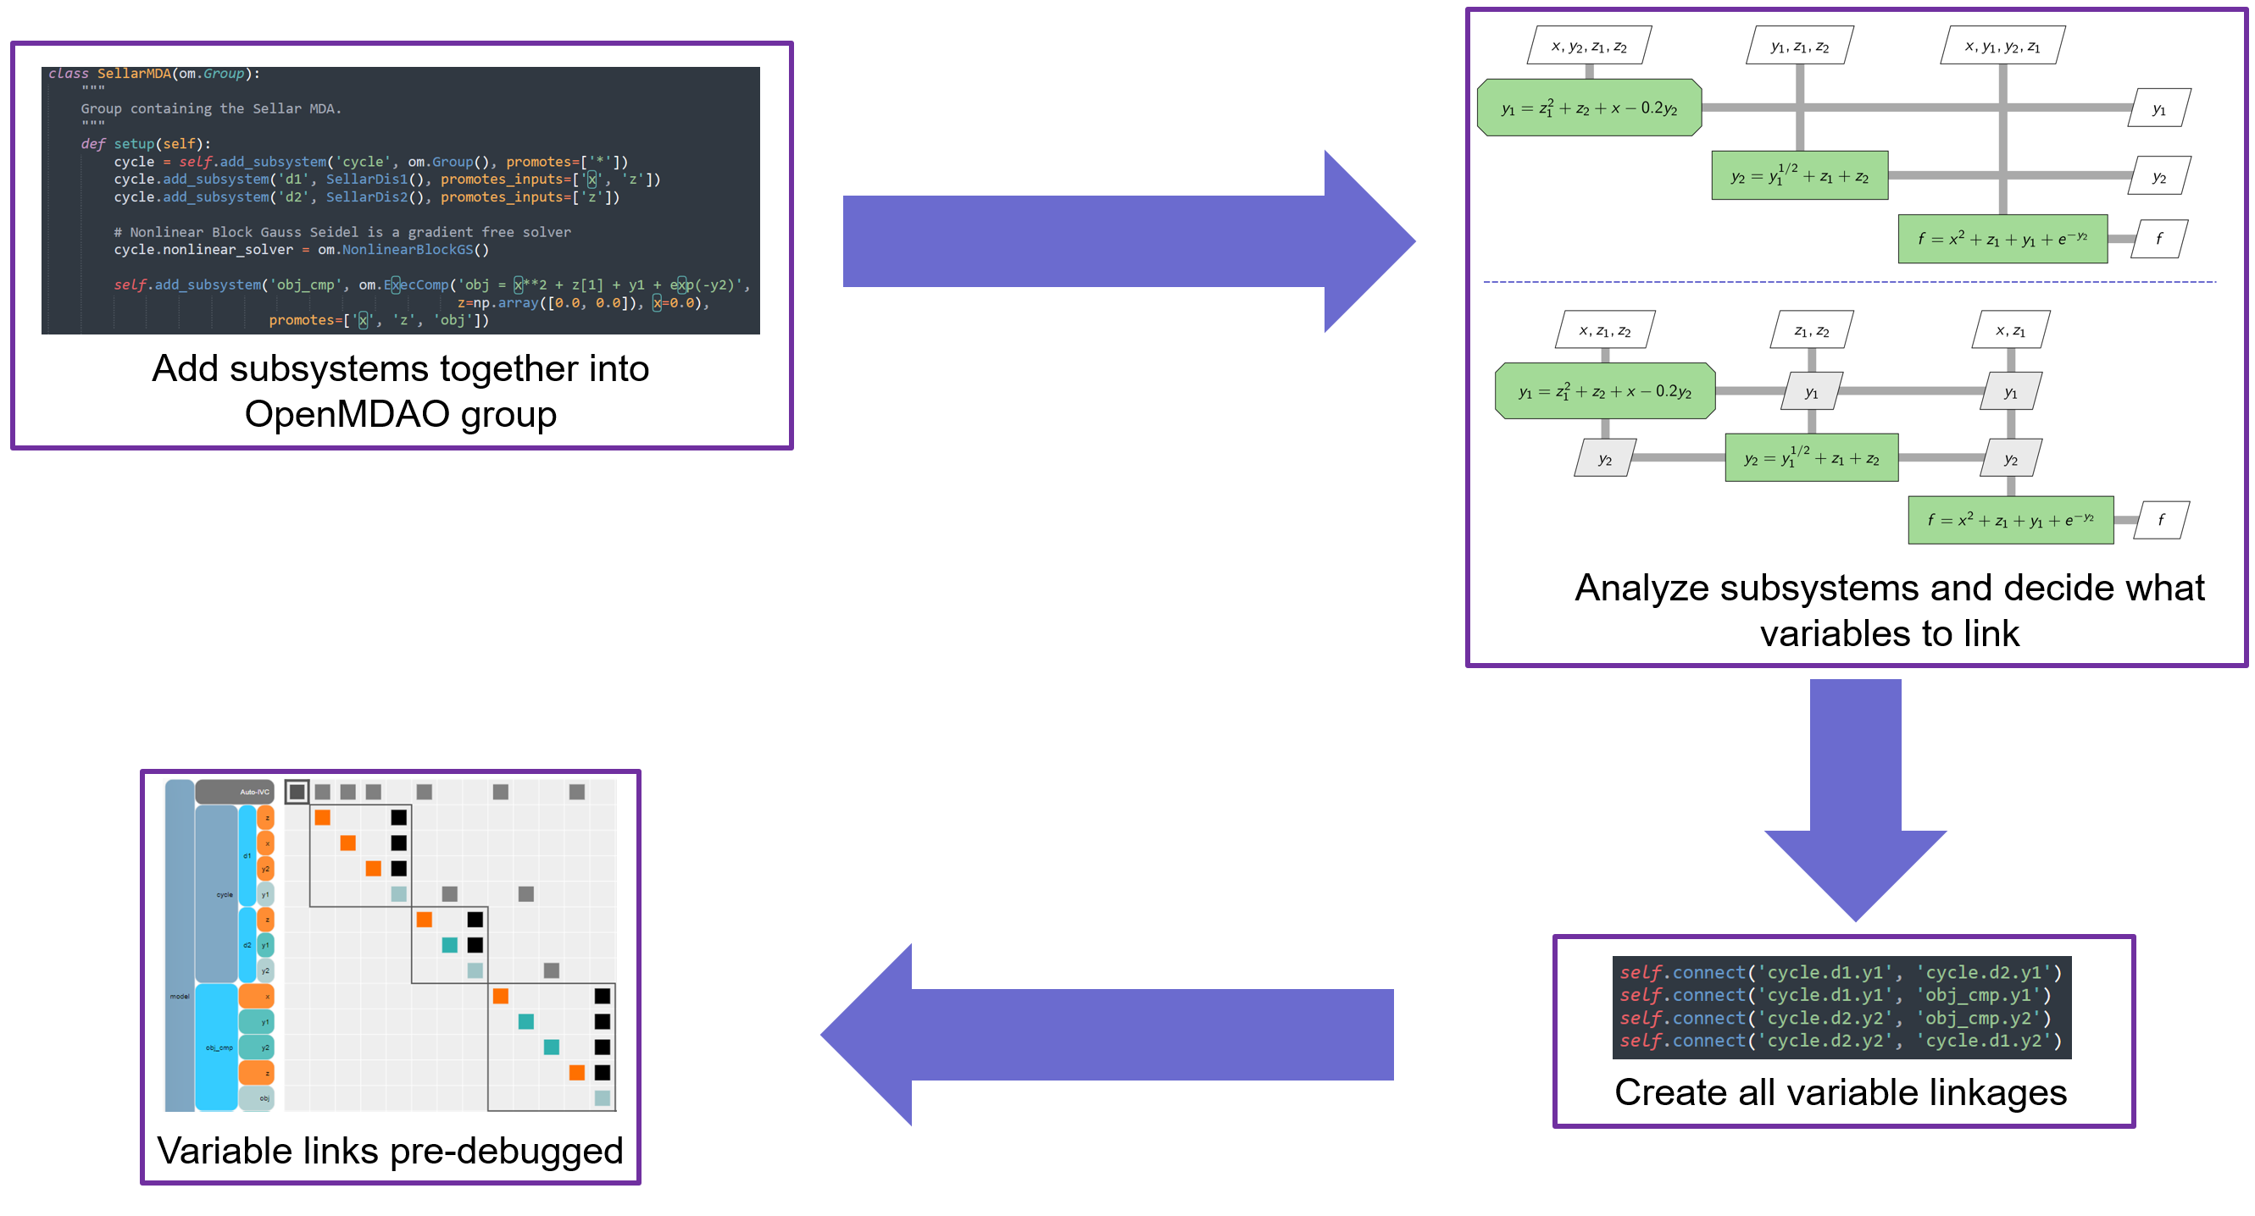
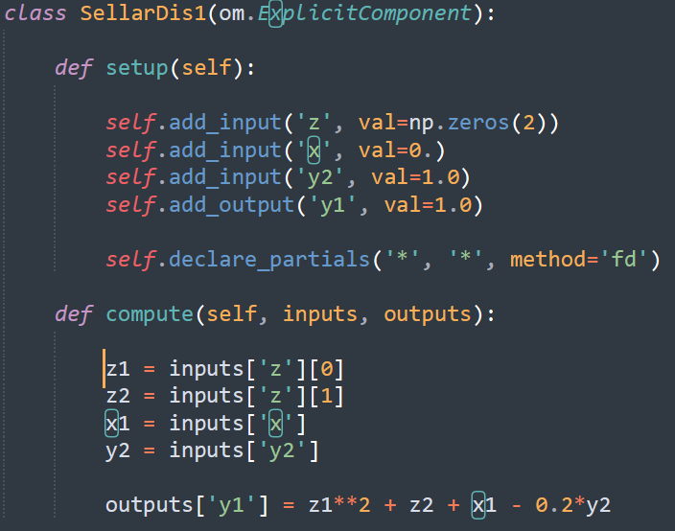
Aviary Model Interface – Planned Implementation
Aviary user interface handles the process from the previous slide
Aviary IO tool specifies required inputs and outputs of user subsystem(s)
User provides compatible subsystem(s) to the Aviary model interface
Aviary automatically connects the subsystem(s) to the model

Slide 34
User Interface: How do You Interact with Aviary?
A “hierarchy” of UI layers is planned to accommodate all user experience levels
  Current status of Aviary is analogous to “Advanced” UI layer
Basic User (minimum flexibility, negligible complexity)
Minimal coding required – provide input file and execute
Limited analysis options (FLOPS/GASP similar)
Intermediate User (moderate flexibility, moderate complexity)
Lean on Basic UI, swap subsystem modules or make small changes to analysis
Advanced User (maximum flexibility, maximum complexity)
User writes custom Python scripts to set-up/run analysis
User introduces custom components or subsystems

Slide 35
Future User Interface
Basic
Intermediate
Advanced
Inputs are csv files or similar
Inputs are for aircraft definition, mission, and optimizer settings
Questions:
  How much flexibility would you require?
  Should the files be separate or combined?
Inputs are slightly more complicated, actual code files
Can have more flexibility in subsystem and mission choice
Questions:
  Would you put in the effort to learn this level?
  Should this level support adding user-written subsystems?
Light wrapper around OpenMDAO problem
Requires knowledge of OpenMDAO
Complete flexibility
Questions:
  Would you put in the effort to learn this level?
  What could make this level easier to access?
This is an area where we would especially like to hear your concerns, thoughts, and feedback!

Slide 36
Variable Hierarchy
Variables are organized using physical decomposition hierarchy
All variables are promoted to the top level, accessible by every component
Key Features:
  Verbose naming for clarity
  Simplifies naming
  IDEs can autocomplete variable names – prevent typos
  OpenMDAO automatically connects all inputs & outputs
Aircraft.Fuselage.LENGTH = ‘aircraft:fuselage:length’
Top-Level Group
Component / Category
Attribute
OpenMDAO Variable Name

Slide 37
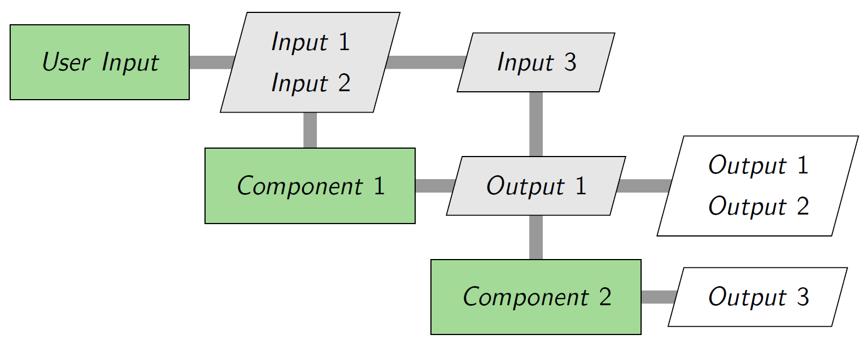
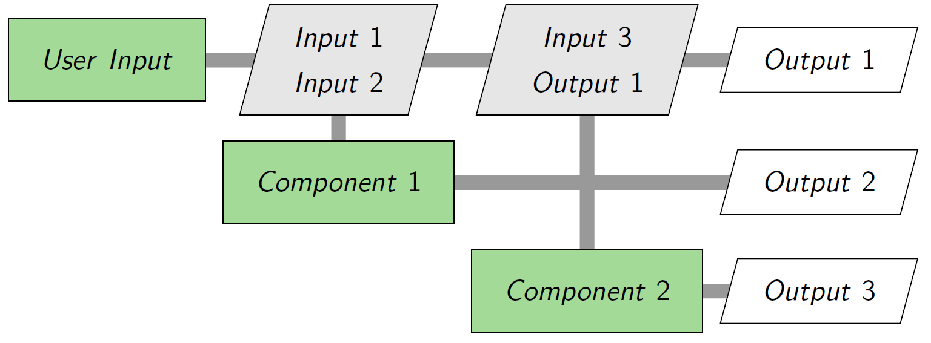
Variable Overriding
FLOPS allows the user to set the value of a variable that is usually an output of the code
Aviary replicates this by “overriding” output values with user-provided inputs
Normal Data Flow
Component 1 calculates Output 1 and Output 2
Output 1 is passed as an input to Component 2
User Override Scenario
User knows Output 1 and provides that value
Component 1 still executes and calculates outputs
Calculated value for Output 1 not connected or promoted

Slide 38
Test Cases for v0.1.0
Test Case | Propulsion Origin | Weight Origin | Mission/ aerodynamics Origin
1 (FpGwFm) | FLOPS | GASP | FLOPS
2 (GpGwFm) | GASP | GASP | FLOPS
3 (FpGwGm) | FLOPS | GASP | GASP
4 (GpFwGm) | GASP | FLOPS | GASP
5 (FpFwGm) | FLOPS | FLOPS | GASP
6 (GpFwFm) | GASP | FLOPS | FLOPS
7 (GpGwGm) | GASP | GASP | GASP
8 (FpFwFm) | FLOPS | FLOPS | FLOPS

Slide 39
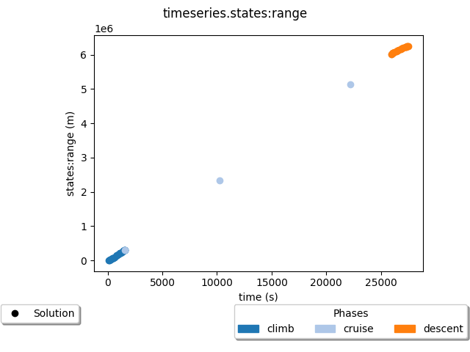
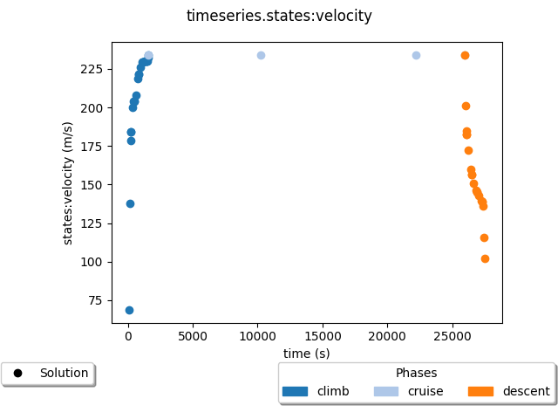
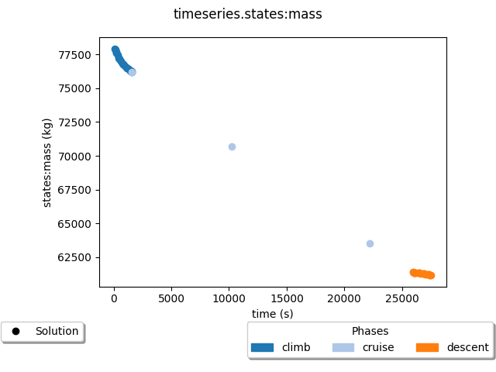
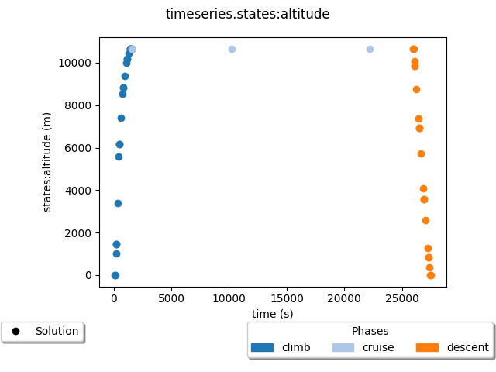
Test Case 1 (FpGwFm)

Slide 40

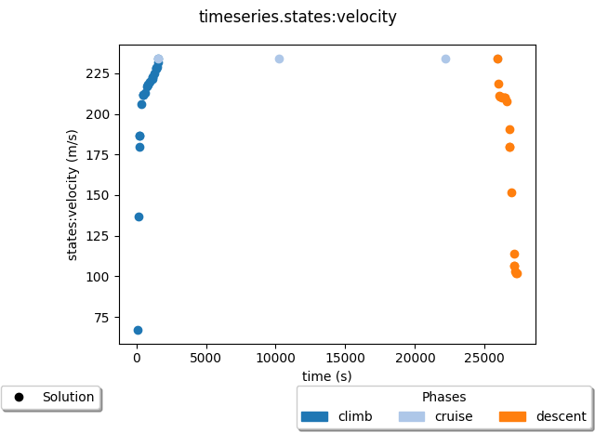
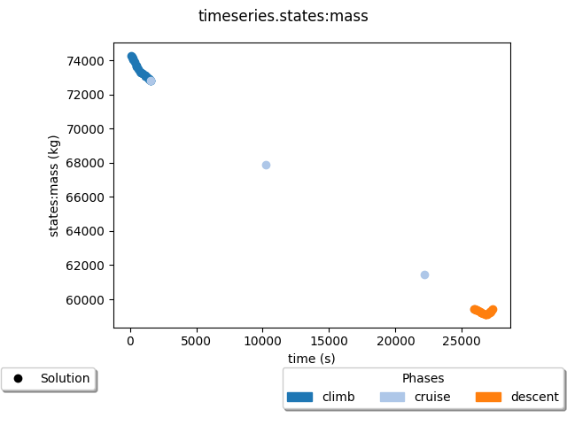
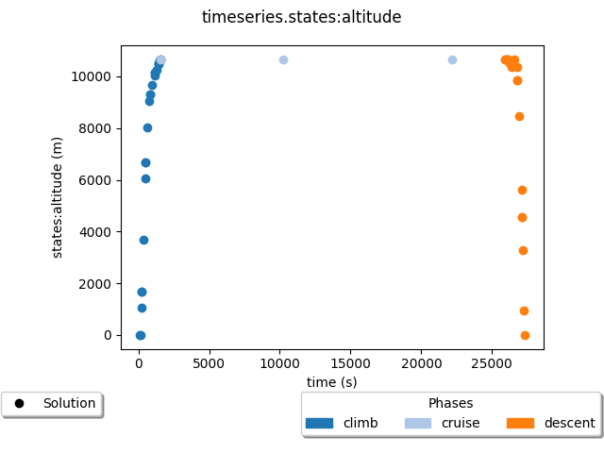
Test Case 2 (GpGwFm)

Slide 41
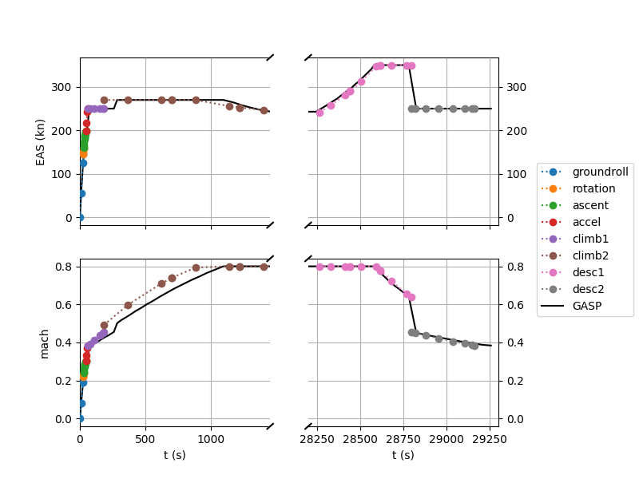
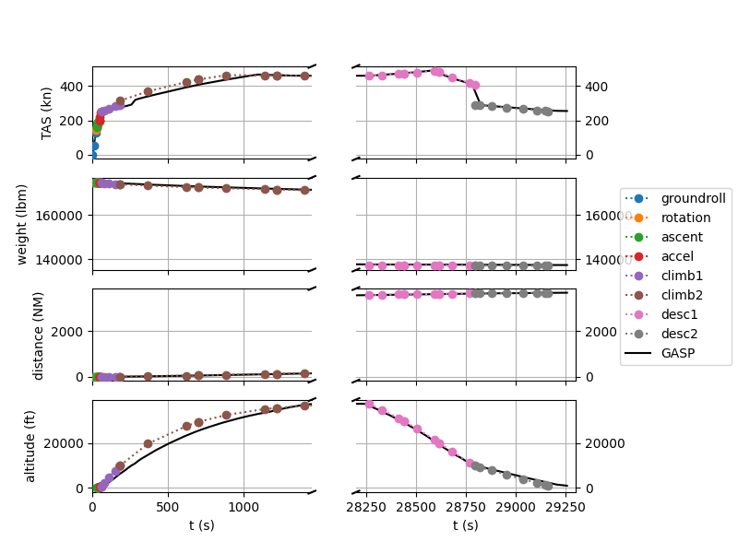
Test Case 3 (FpGwGm)

Slide 42
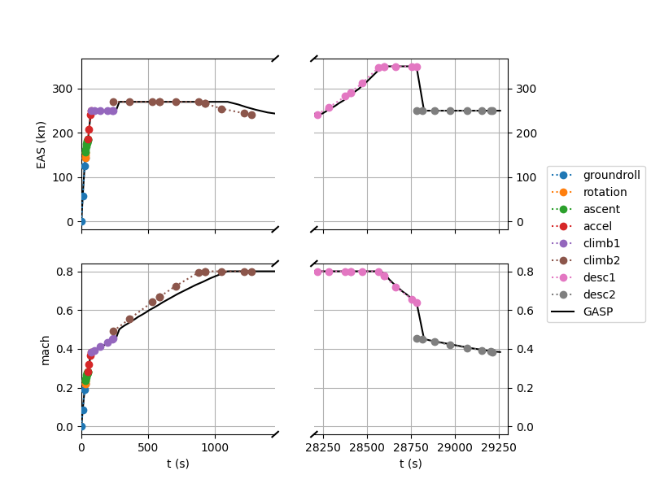
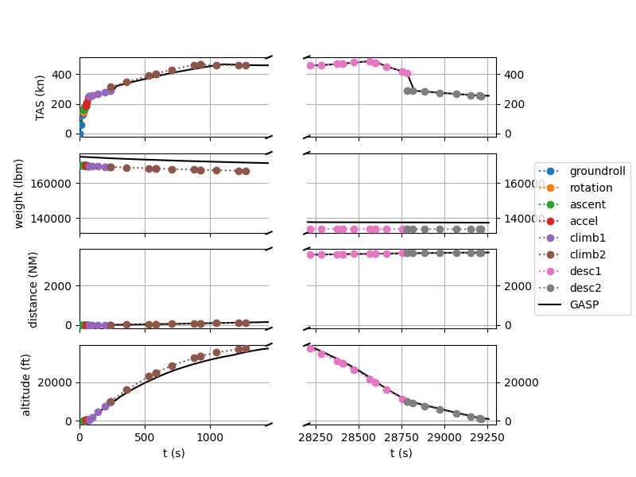
Test Case 4 (GpFwGm)

Slide 43
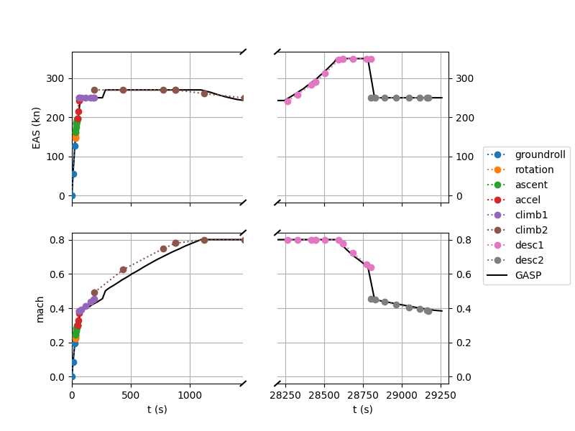
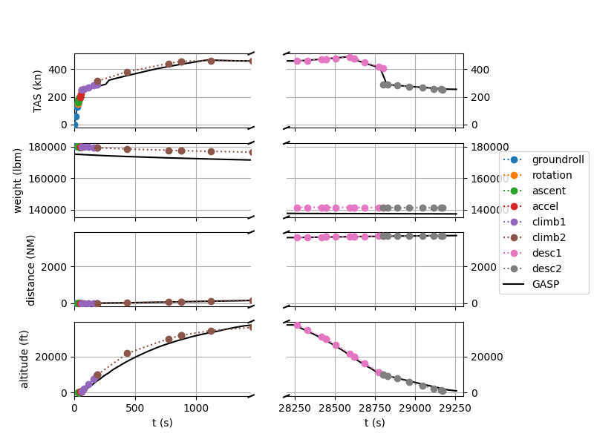
Test Case 5 (FpFwGm)

Slide 44

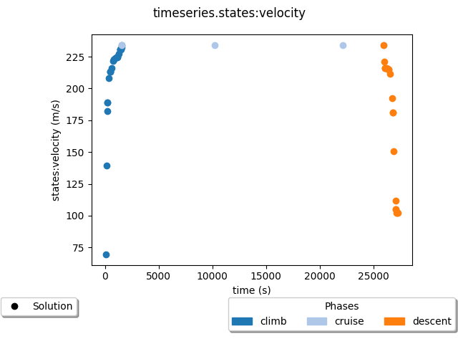
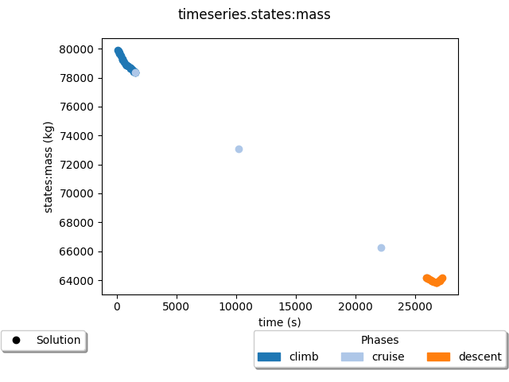
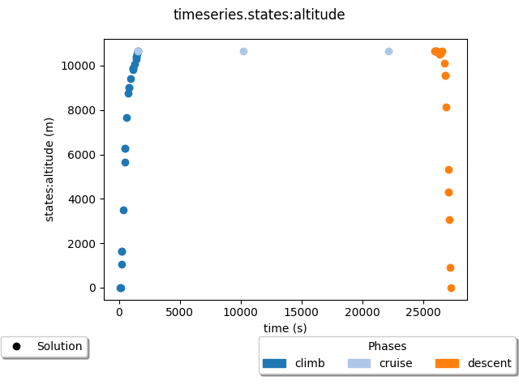
Test Case 6 (GpFwFm)

Slide 45
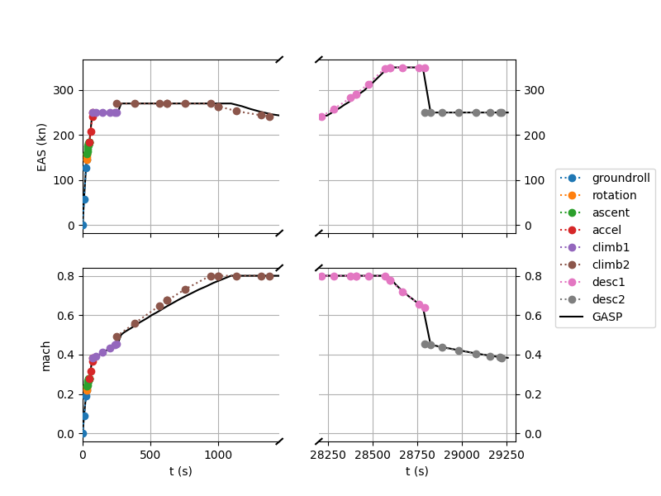
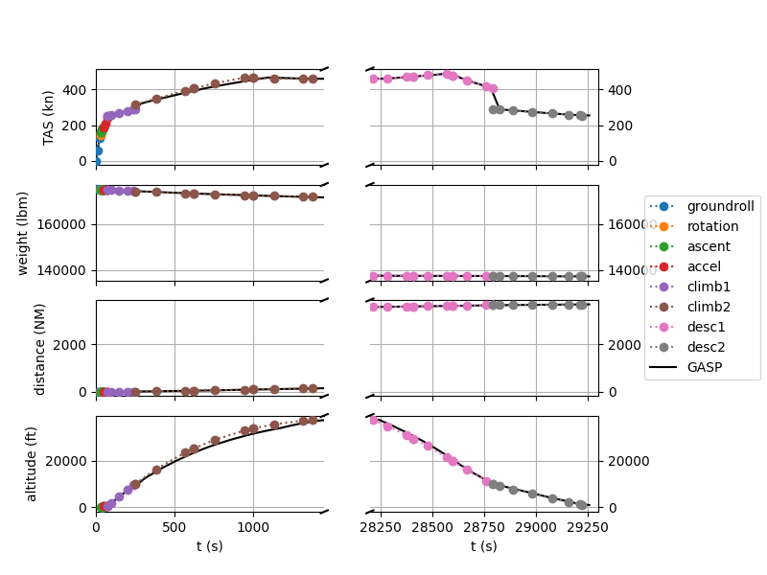
Test Case 7 (GpGwGm)

Slide 46

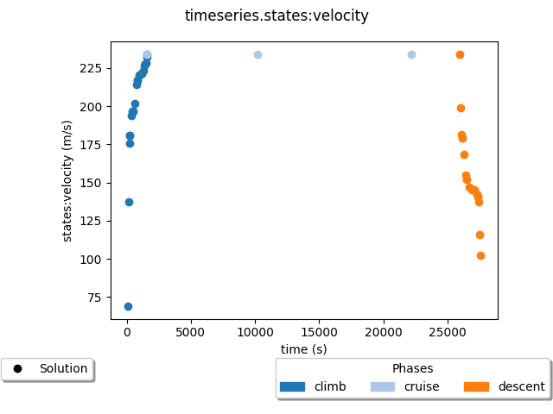
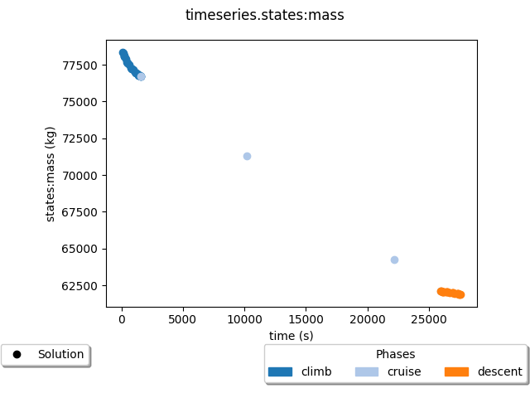

Test Case 8 (FpFwFm)

