Slide 1



NASA’s Composite Overwrap Lessons Learned on 40k Thrust Chamber Assemblies
Allison Clark
Composite Manufacturing Engineer
NASA: Marshall Space Flight Center

Slide 2

Paper Contributions
NASA
Allison Clark – Co-Lead of composite technology development for RAMPT
Tyler Hudson – Co-Lead of composite technology development for RAMPT
Sandi Miller – Ceramic and Polymer Composite Engineer
Cheol Park – Composite Structural Materials Research Engineer
Paul Gradl – RAMPT Principal Investigator
Kord Technologies
Mike Goetz – Missile and Rocket Engineer
Brandon Connell – Stress Engineer

Slide 3



Introduction
Speaker Name: Allison Clark
Company: NASA’s Marshall Space Flight Center
Job Title: Composite Manufacturing Engineer
Bio: Ms. Clark holds a Bachelor’s in Chemical Engineering from Auburn University. She joined the Advanced Composites Manufacturing Team at Marshall Space Flight Center in 2019 specializing in filament winding with expertise in composite solid rocket motor cases and pressure vessels.

Slide 4
Outline
Overview
Materials
Manufacturing Process Development Part 1
Manufacturing Process Development Part 2
Test Article Development
Conclusions

Slide 5
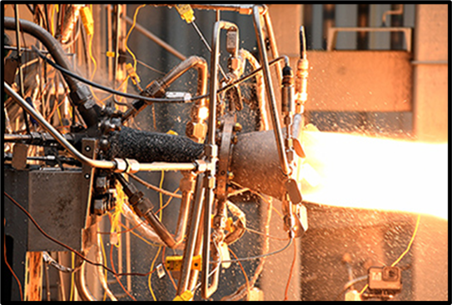
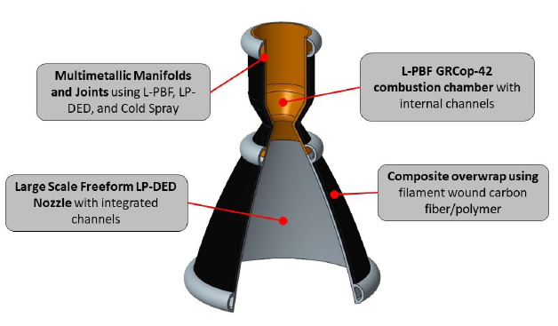


Overview
Project Description
  The RAMPT (Rapid Analysis Manufacturing and Propulsion Technology) project will mature novel design and manufacturing technologies to increase scale, significantly reduce cost, and improve performance for regeneratively-cooled thrust chamber assemblies, specifically the combustion chamber and nozzle for government and industry programs.
Technology Product Capability
  The RAMPT project is developing and advancing multi-metallic freeform manufacturing, composite overwrap techniques, and analysis capabilities required to implement them to reduce design and fabrication cycles for large scale lightweight regeneratively-cooled liquid rocket engine components.
  RAMPT is reducing design, fabrication, assembly schedules while allowing for reduced parts, increased reliability, significant weight reduction and creating a healthy American supply chain.
  Four technology areas being developed: 1) Freeform Blown Powder Nozzle; 2) Composite overwrap structural jacket; 3) Bimetallic radial deposition for manifolds; and 4) Modeling and analysis tools for additive and regeneratively-cooled design.
Project Objective
  Develop composite overwrap techniques to enable significant weight reduction of the chamber assembly, reducing overall cost and manufacturing schedules, and reducing distortions in the chamber caused by prior bimetallic cladding. for a large Thrust Chamber Assembly (TCA).
Customer(s): Game Changing Development (GCD), Space Launch System (SLS), DoD, space industry and commercial companies.

Slide 6
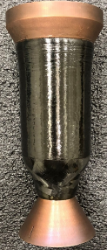
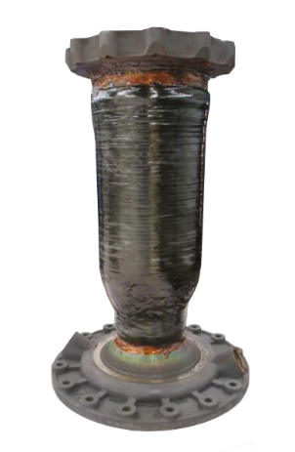

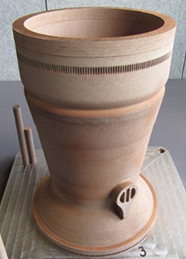
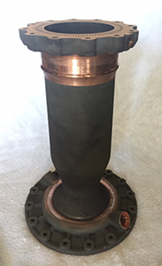
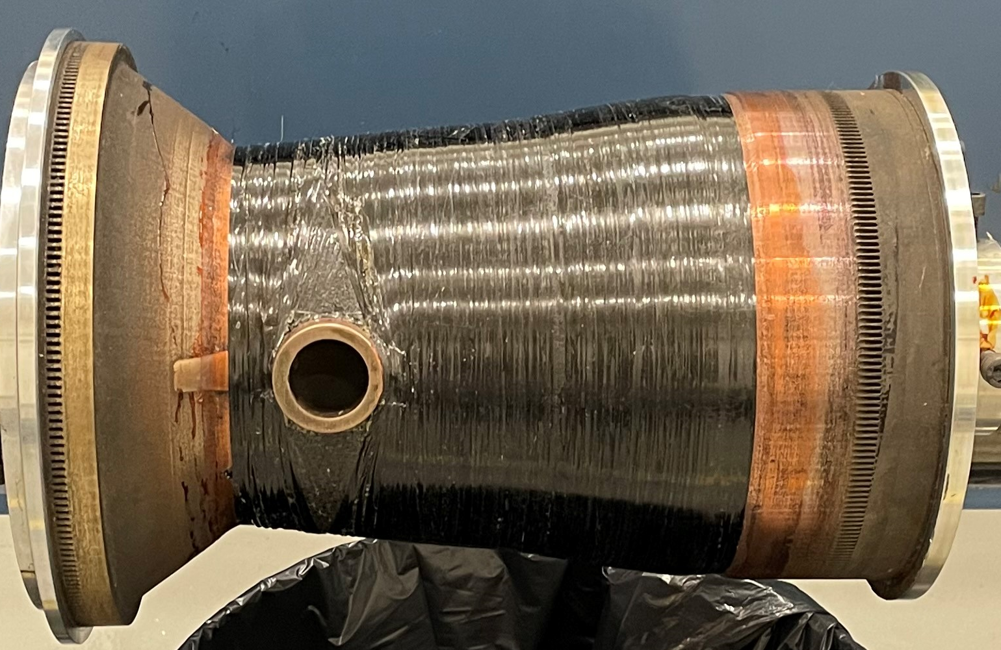
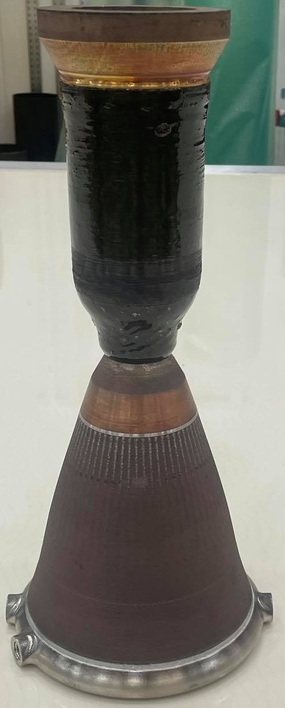
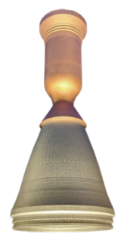
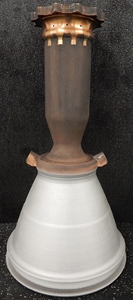
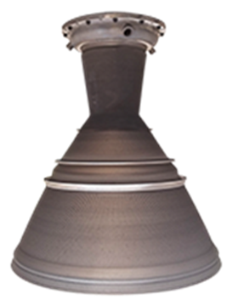
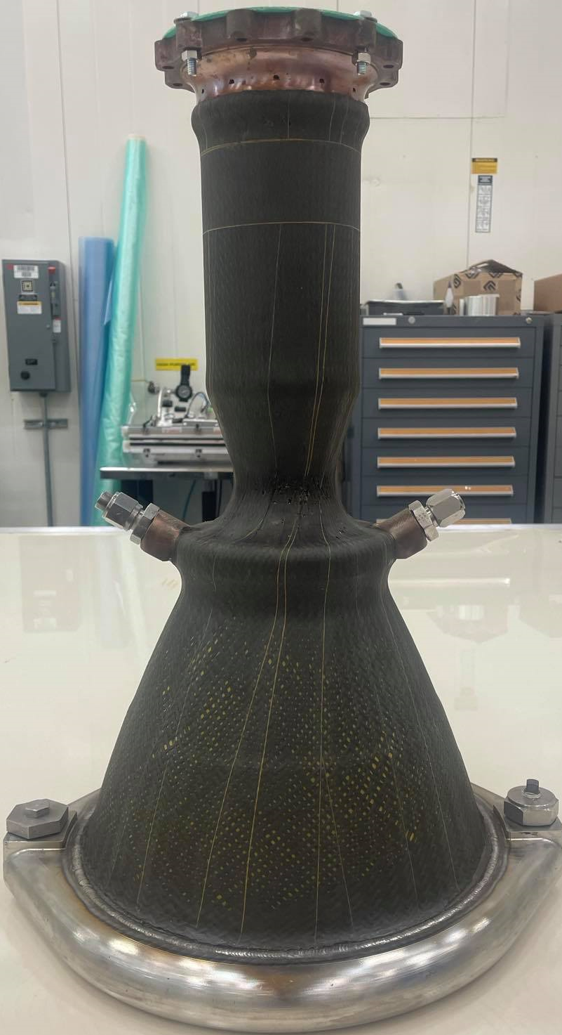
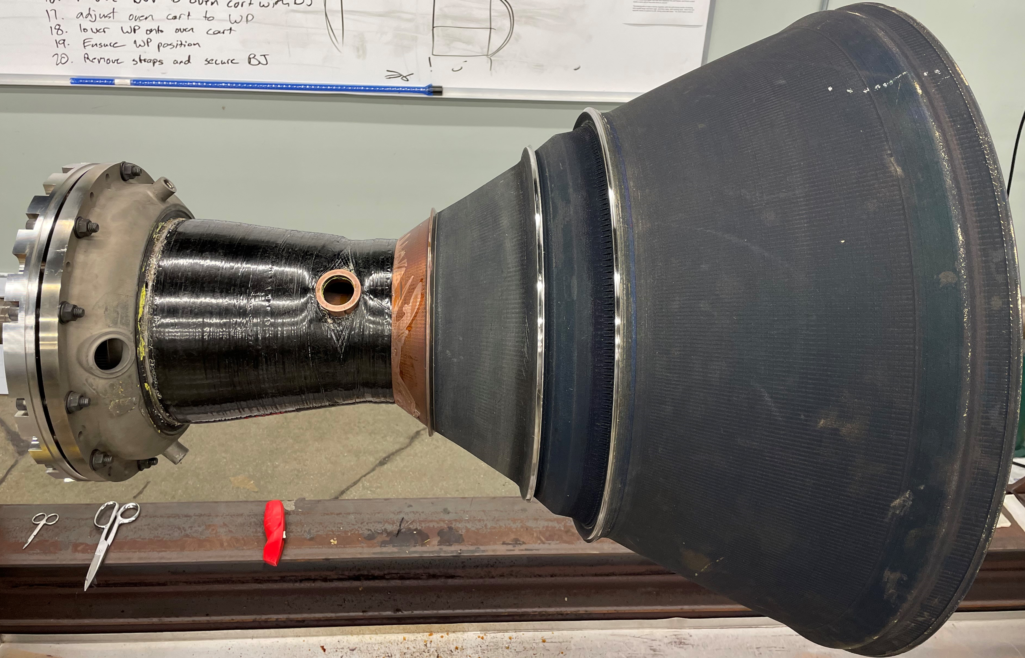
Overview
2k-lb_{f}
7k-lb_{f}
40k-lb_{f}
Decoupled chamber
Decoupled chamber
Decoupled chamber
Coupled chamber
Coupled chamber
Coupled chamber
LOX/LH2
LOX/LCH4
LOX/LH2

Slide 7
Materials
Testing Requirements
  The 40k chamber uses liquid oxygen/liquid hydrogen (LOX/LH2) propellants and the temperature range is -240 ℃ (-400 °F) to 66 ℃ (150 °F). The internal combustion chamber pressure will be approaching 11,031 kPa (1,600 psig).
Fiber
  IM7G, 12K tow carbon fiber from Hexcel® was selected because of advantageous mechanical properties, experience with the fiber from previous chamber builds, and its availability at the start of the project.
Resin
  EPON® 828 epoxy combined with curing agent W was selected after the trials with the BMI for ease of manufacturing and versatility. Although the 828/W matrix was ultimately selected, resin material characterization of both the 828 and 5250-4 resins were evaluated and will be documented in future works. These studies looked at tests such as dynamic mechanical analysis (DMA) and differential scanning calorimetry (DSC) for both resin systems.
Surface Prep
  Prior to filament winding, all chamber surfaces are polished with aluminum free 80 grit then 120 grit sandpaper to remove surface roughness and oxidation. The surfaces are washed clean with ethanol then treated with multiple coats of Frekote NC700 mold release agent [3].

Slide 8
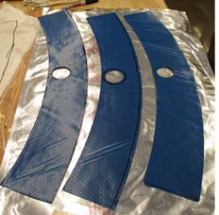
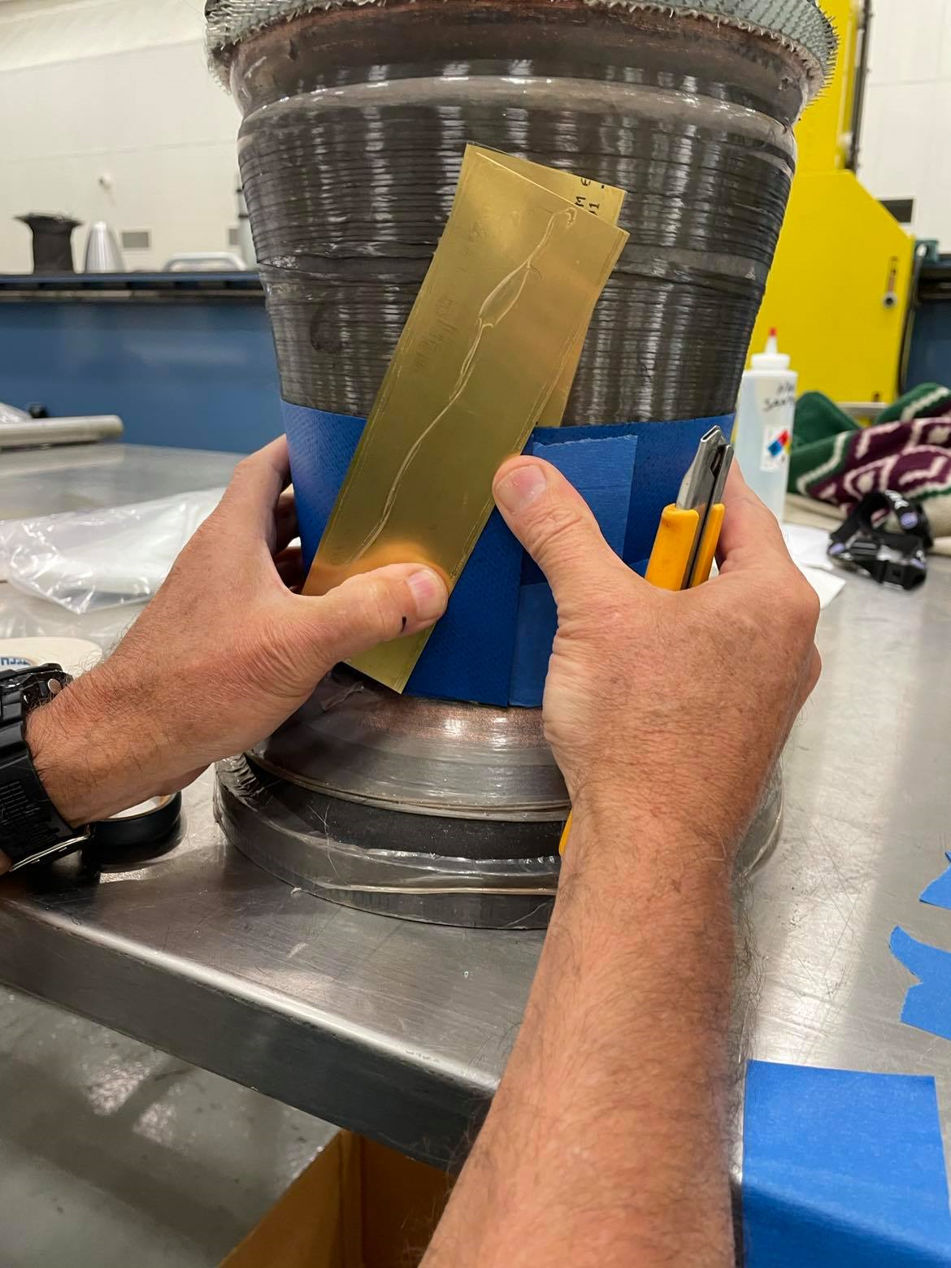
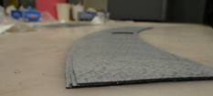
Manufacturing Process Development Part 1
Using a CAD model of the 40k chamber, custom pieces of prepreg fabric strips were cut out using a Gerber cutting table to wrap around the port hole
Prepreg were made from IM7G/8552 fabric rolls
Angled butt joint fitting

Slide 9
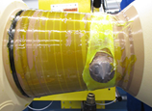
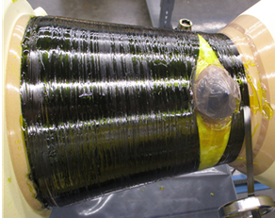
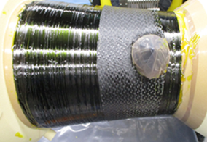
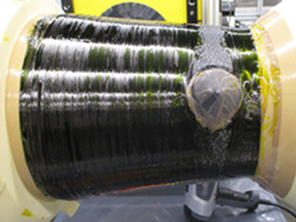
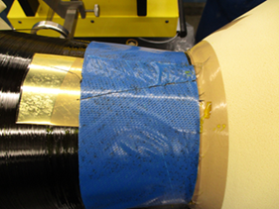
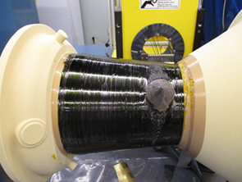
Manufacturing Process Development Part 1
Chamber Trial 1: ([fiberglass][+90][prepreg][-90][prepreg][+90][prepreg][-90])
Resin/Fiberglass Layer
Hoop Layer 1
Prepreg Layer 1
Hoop Layer 2
Butt Joint Cut
Final Hoop Layer
*The viscous resin was heated to 82 ℃ (180 °F) to become thin enough for hand application, but prior to any the onset of resin cure. The team used a hand layup method due to the fact the resin would bead up and become too viscous too quickly from the resin bath to the part if the winder’s resin carriage was used.

Slide 10
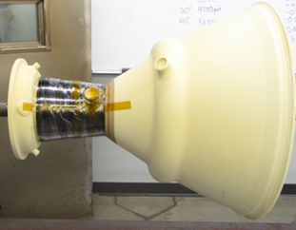
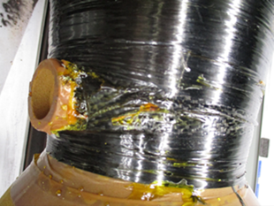
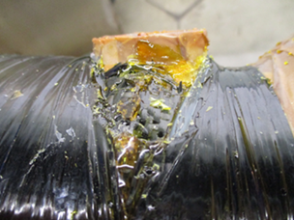
Manufacturing Process Development Part 1
Lessons Learned from Chamber Trial 1
For this first chamber trial, only a single layer of shrink tape was applied to entire composite and preshrunk before oven curing. After cure the chamber was satisfactory, except for the area around the port. The prepreg pieces ended up wrinkling in the exposed regions and there was resin pooling around the port hole. The main take away from trial 1 was that the team needed a better tooling system besides shrink tape alone to keep the fabric from wrinkling. While adding fabric in between wet wound layers is not a novel idea, usually they are fully covered after. The hoop wraps squeezed the prepreg causing them to buckle in the open regions when the resin reached low viscosity during oven cure.

Slide 11
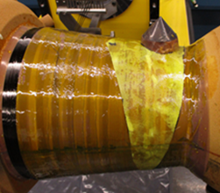
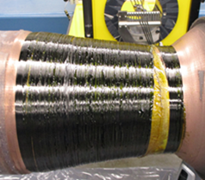
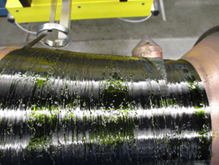
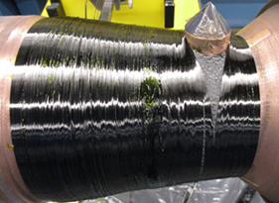
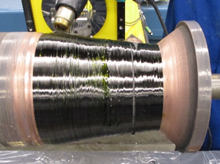
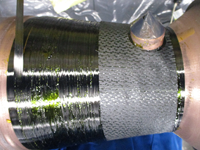
Manufacturing Process Development Part 1
Chamber Trial 2: ([fiberglass][+90][prepreg][-90][prepreg][+90][prepreg][-90][+90]fwd-end[-90]fwd-end)
Resin and Fiberglass
First Hoop Layer
Second Hoop Layer
Final Hoop Layer
Fourth Hoop Layer
Second Prepreg Layer
*Trial 2 had similar manufacturing steps as trial #1 with the additions of more hoop wraps to meet the 0.06-inch-thick minimum requirement and a silicone caul plate to aid in compaction and resin consolidation around the port region.

Slide 12
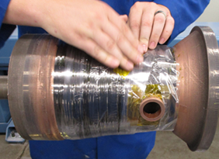
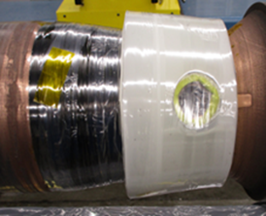
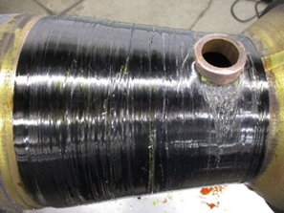
Manufacturing Process Development Part 1
Lessons Learned from Chamber Trial 2
The filament winding process was essentially the same as the first trial but added hoop layers to the part. Along with shrink tape, a silicone caul sheet was made to wrap around the part during cure to help with the wrinkling. However, this still did not provide enough pressure to keep the prepreg from wrinkling in the exposed areas. It was hard to control resin application with it being too viscous at room temperature. With further improvements to techniques and modifications to machinery, the team believes it can be done, but in the interest of time to the project, the team decided to switch back to the 828 epoxy. For the wrinkle control, a soft caul plate was not enough to keep the ridges from forming in the prepreg; something more ridged needed to be added.

Slide 13
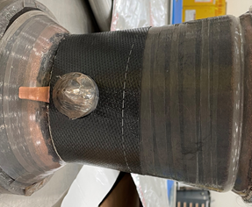
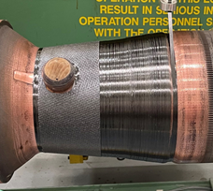
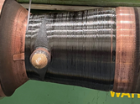
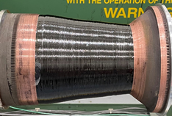
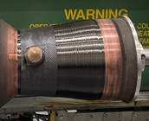
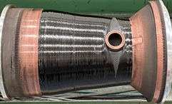
Manufacturing Process Development Part 2
MSFC Chamber Trial 3: ([prepreg][+90][prepreg][-90][prepreg][+90])
First Prepreg Layer
First Hoop and Second Prepreg Layer
Second Hoop Layer
Final Part Before Cure
Final Prepreg Layer
*The 40k manufacturing demonstration was sent back to MSFC where the team decided to switch to the 828/W resin matrix combination to help ease manufacturing difficulties and have better resin control overall

Slide 14
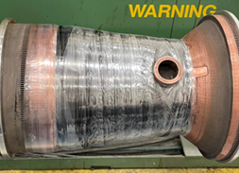
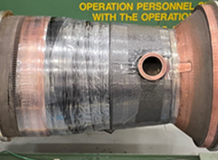
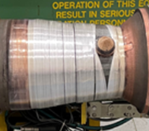
Manufacturing Process Development Part 2
Lessons Learned from Chamber Trial 3
The main goal of this trial was to improve the tooling technique. A gap had been observed around the port hole and would extend circumferentially around the chamber. To reduce this gap during winding, MSFC used manual techniques to guide the fibers while still under tension to close the gap as much as possible. Two triangular gap shapes were used around the port to reduce the discontinuity around the entire chamber.
The team started with:
  A shrink tape layer again and a layer of Teflon® tape for a resin leakage barrier
  Two triangular rubber inserts to fit into the spaces between the hoop layers left open
  A custom caul sheet made of IM7/8552
  To provide significant pressure to the caul plate and rubber inserts, another layer of cheaper fiber was dry wound overtop at 8 lb_{f} of tension.
The final product had significant improvement compared to the previous trials and reduced prepreg wrinkling and improved resin consolidation.

Slide 15
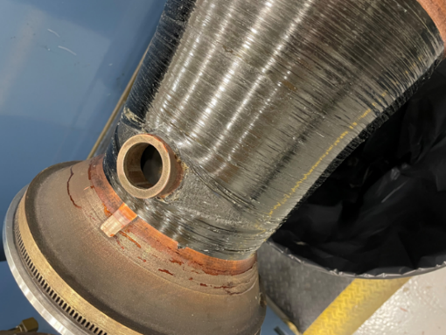
Manufacturing Process Development Part 2

Slide 16
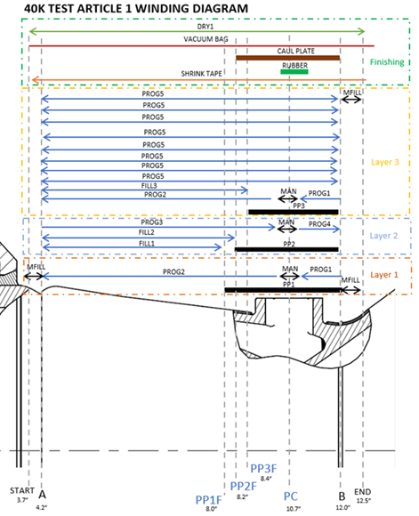
Test Article Development
Building on experience from all the previous trials, this winding diagram was chosen for the test article. The final article’s surface profile was slightly different from those of the manufacturing demonstration articles, which helped simplify the final layup. The wind was also conducted without cutting the layers between hoop layers.

Slide 17
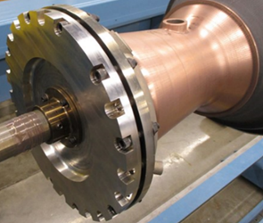
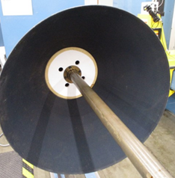
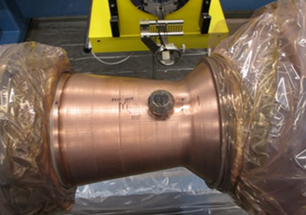
Test Article Development
A flange adapter was bolted to the forward end of the chamber and held in place on the shaft by a collar. A PTFE bell adapter plate was inserted in the aft-end bell to provide support for the nozzle to center around the shaft without flexing during winding.
The surface of the copper chamber was dark due to oxidation, so surf prep was needed before the winding procedure. Surface prep followed the same steps as the 7k chamber [3].

Slide 18
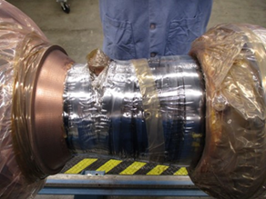
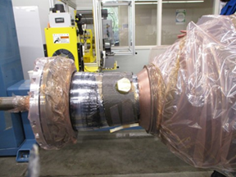

Test Article Development
To prepare the article for cure the following steps were taken:
1. Applied shrink tape to the entire chamber section starting on the aft end and traversing to the forward end.
2. Applied the silicone rubber inserts and the NASA provided caul plate around the chamber port.
3. Covered the chamber region with high temperature vacuum bagging material and sealed the chamber port with bagging material and tacky tape.
4. Inserted the taped half inch strip of stick along the length of the chamber to be used as the cutting surface when removing the dry fiber.
5. Wrapped the chamber region with dry fiber with high tension.

Slide 19

Test Article Development
Lessons Learned from Test Article Development
The overwrap was too thick with all the extra layers and caused significant build up around the port leading to the overwrap being higher than the actual port. The cap on the port concealed the edge so the overage was not noticed until the cap was removed. The inlet port attaches to a threaded flange for the final test chamber so a couple extra layers will be removed in future builds. The extra build up caused a small change in the tooling design where a shim was added between the port hole and the overwrap to open up the flat surface of the port hole again. This also changed where the sealing tacky tape was added before cure. The change in tooling design also caused resin to infiltrate inside of the port into the individual chamber cooling channels. The resin leaking into the port causes a significant risk to the test article due to the potential to block the internal cooling channels. The chamber did have uniform surface finish and good resin consolidation all around. There was also no wrinkling in the prepreg area around the port.

Slide 20
Conclusion
The RAMPT project team has designed and successfully manufactured a series of additively manufactured (AM) GRCop copper-alloy combustion chambers with a composite overwrap to push the boundaries of current engine designs. Significant progress on the designs up to 40k-lbf thrust chambers contributed to good progress of the combined AM-composite technology during 2021 and 2022. Despite the chamber being considerably more difficult to wrap, the team was able to reach a final layup and tooling configuration that meet the given requirements.
With the successful build and demonstration of the 2k, 7k, and 40k chambers, the building block approach for RAMPT has been proven and the lessons learned can be applied to even larger sized thrust chambers. There have been successful tests of 2k and 7k chambers and the team anticipates the future testing of the 40k in 2023. This new hardware design and manufacturing approach can help the aerospace industry grow in creating more complex designs that lead to significant weight reduction, sustainable lower cost, and lead time reduction of flight hardware.

Slide 21


Slide 22







Slide 23
References
1. Protz, C.S., Gradl, P.R., Fikes, J., Garcia, C., Pelham, L., Clark, A., Hudson, T.B., Miller, S., Ogles, M., “Large-scale lightweight composite overwrap combustion chambers and nozzles under the rapid analysis and manufacturing propulsion technology (RAMPT project),” 2019 Joint Army-Navy-NASA-Air Force (JANNAF), 11th Liquid Propulsion Subcommittee (LPS) Proceedings, Tampa, FL, December 9-13, 2019.
2. Protz, C.S., W.C. Brandsmeier, K.G. Cooper, J.C. Fikes, P.R. Gradl, Z.C. Jones, C.R. Medina., D. L. Ellis, K.M. Taminger, “Thrust Chamber Assembly Using GRCOP-84 Bimetallic Additive Manufacturing and Integrated Nozzle Film Coolant Ring Supporting Low-Cost Upper Stage Propulsion,” 10th JANNAF Liquid Propulsion Subcommittee Meeting, Long Beach, CA, 2018.
3. Clark, A., Hudson, T.B., Miller, S., Edrington, S., Park, C., Protz, C., “Lightweight Thrust Chamber Composite Overwrap Lessons Learned,” The Composite and Advanced Materials Expo, Dallas, TX, 2021.
4. Gradl, P.R., Protz, C.S., Fikes, J., Clark, A., Evans, L., Miller, S., Ellis, D., Hudson, T.B., “Lightweight thrust chamber assemblies using multi-alloy additive manufacturing and composite overwrap,” AIAA Propulsion & Energy Forum Proceedings, New Orleans, LA, August 24-26, 2020.
5. Gibson, J.T., Gradl, P.R., Katsarelis, C.C., Teasley, T.W., Garcia, M.B., Clark, A.M., Stark, J.B., “Maturation and Hot Fire Testing of Additively Manufactured Bimetallic Composite Overwrap Thrust Chamber Assemblies,” 13th JANNAF Liquid Propulsion, 12th Spacecraft Propulsion Subcommittee Meeting, Huntsville, Al, 2022.

