Slide 1
Shoshone River Water Resources II
Quantifying Sediment Input in the Shoshone River in Wyoming using the Soil and Water Assessment Tool for Enhanced Water Quality Monitoring
Christian Bitzas • Jillian Greene • Robyn Holmes • Isabella St John
Pop-Up Project | Spring 2023
Notes:
Introduce team members and scope of project. Issue: Sediment accumulation behind the Willwood Dam and the downstream release of sediments into the Shoshone River in Wyoming. This project sought to determine the source location of these sediments to guide future management practices.

Slide 2
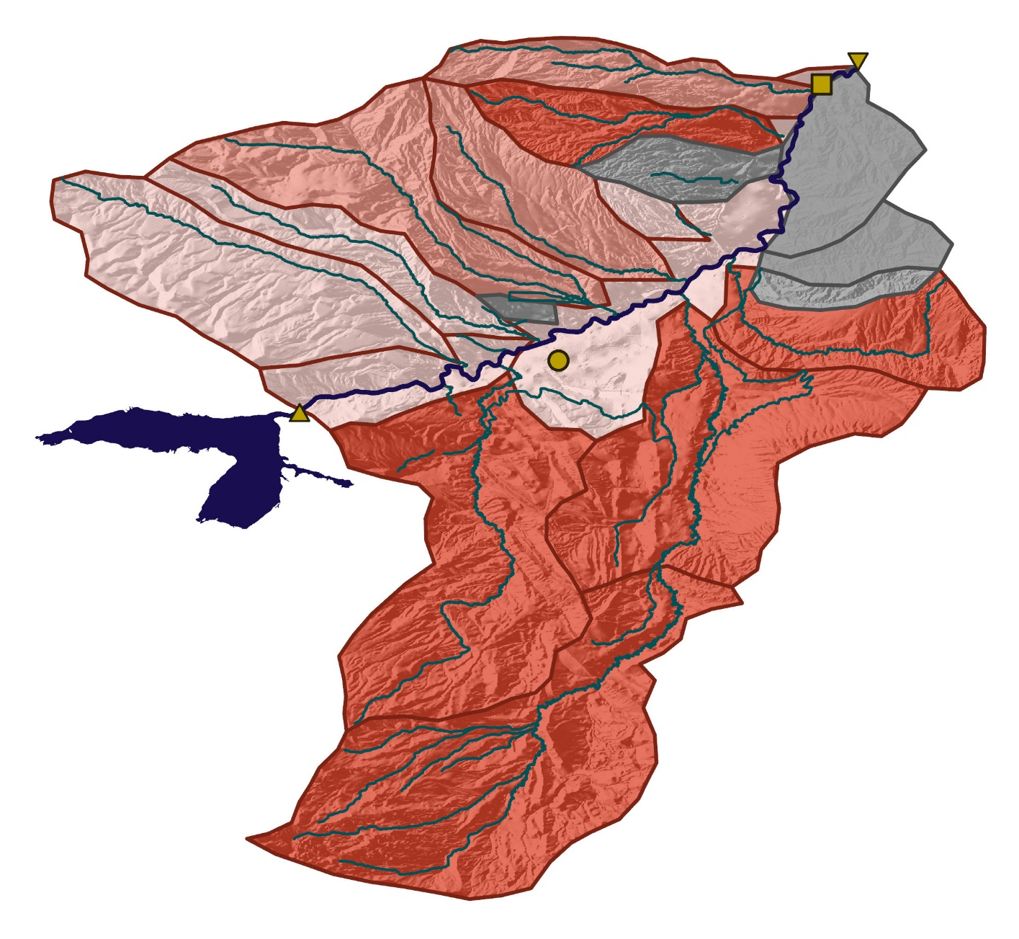
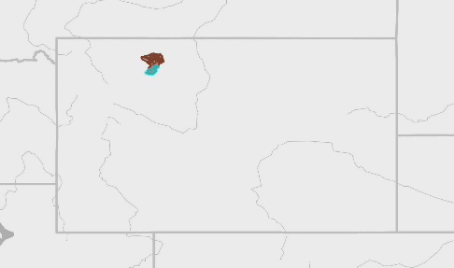

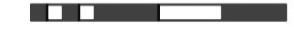
STUDY AREA
Study Area
  Shoshone River Watershed
    Buffalo Bill Dam to Willwood Dam
    Tributaries & irrigation canals feed into the river
  Surrounded by mountains
  Annual precipitation: 10.5in
Study Period
  Jan. 2019 – Oct. 2021
    USGS operated water monitoring station
Cody, WY
Buffalo Bill Dam
Willwood Dam
USGS Gage
Shoshone River
Major Tributaries
Buffalo Bill Reservoir
Low Priority
Medium Priority
High Priority
Unknown
Wyoming
Subwatersheds
0 5km 10km
N
Notes:
Our project takes place in the Shoshone River Watershed in Northwestern Wyoming, examining the stretch of the river between the Buffalo Bill Dam and the Willwood Dam and the surrounding canals and channels that feed the river shown in the map on the right. The region is surrounded by several mountains and gets about 10.5 inches of rain and snow per year. Our study period includes the dates of which the USGS operated a water monitoring station in the river; from the beginning of 2019 through October of 2021.
-------------------Image Credits------------------------------​
Images and figures created by the Shoshone Water II DEVELOP team​
Basemap Citation: Esri, HERE, Garmin, FAO, NOAA, USGS, EPA

Slide 3
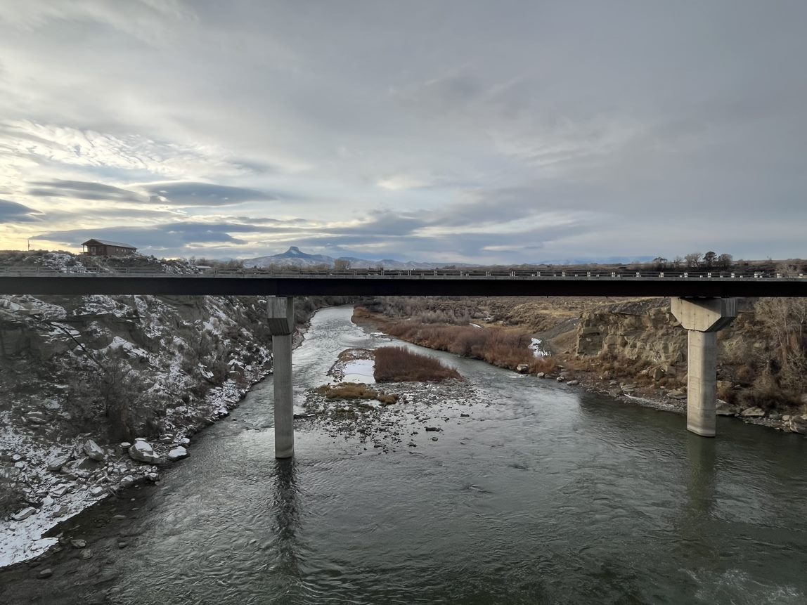
OBJECTIVES
Increase understanding of sediment sources through:
Conduct Soil and Water Assessment Tool (SWAT) analysis
Improve plume detection via turbidity remote sensing
Conduct snow cover analysis
Image Credit: Caroline Williams
Notes:
Objectives of our project include creating a hydrological model using the Soil and Water Assessment Tool to analyze specific subbasins where high sedimentation into the waterways is occurring, **sediment **, and creating a time series analysis of snow cover and hydrologic variables to relate changes in snow cover extent over time with periods of increased sediment accumulation.
-------------------Image Credits------------------------------​
Image of the Shoshone River provided by Caroline Williams.

Slide 4
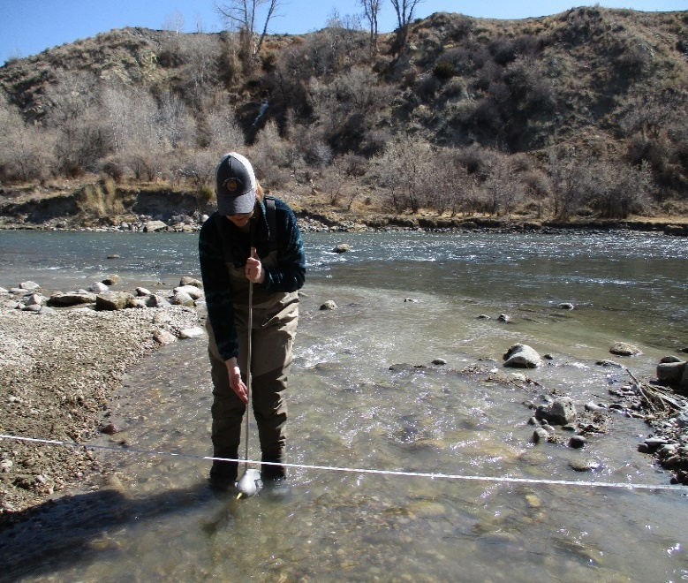
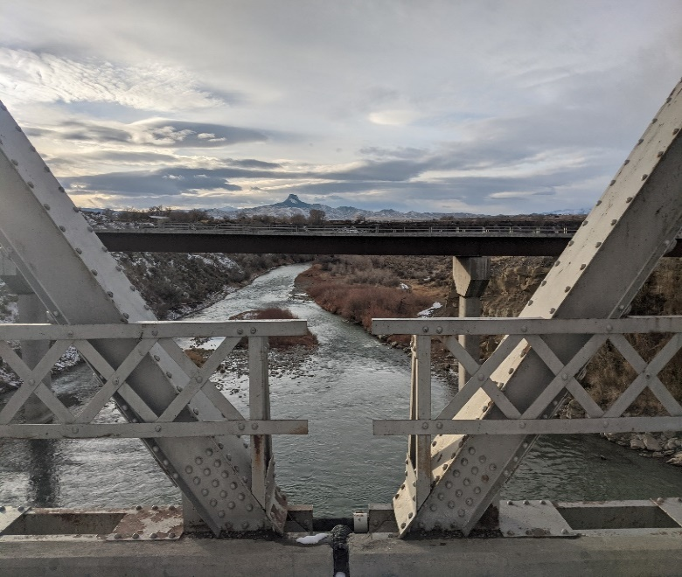
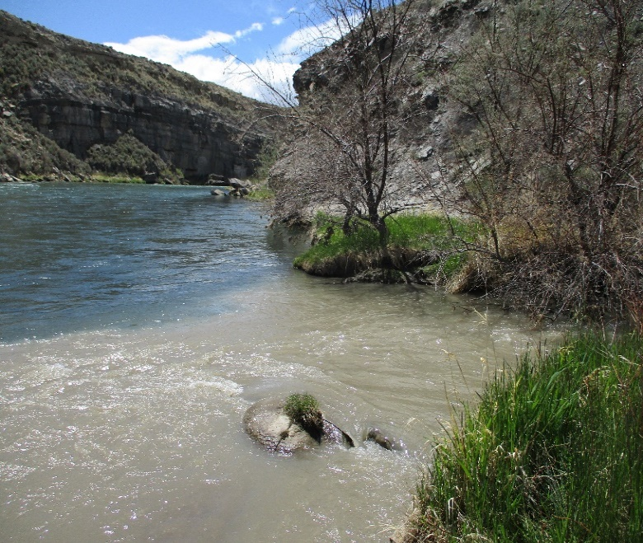
PARTNERS
WY
Department of Environmental Quality
Shoshone
River Partners
USGS WY-MT Water Science Center
Images: Carmen McIntyre & Robyn Holmes
Notes:
Our partners for this project include the Wyoming Department of Environment Quality, Shoshone River Partners (previously named working group 3), and the USGS Wyoming-Montana Water Science Center. Our partners provided direction for this project, input on relevant issues, as well as stream gauge data.
-------------------Image Credits------------------------------​
Monitoring image of the Shoshone River and right image of a turbid tributary joining the shoshone provided by Carmen McIntyre, Shoshone River Partners.
Left image of the Shoshone, taken off the Willwood dam provided by Robyn Holmes.
​

Slide 5



COMMUNITY CONCERNS
Ecological
Economic
Quality of Life
Impaired fish spawning habitat
Aquatic insects
Rafting, angling, tourist recreation
Irrigated agriculture
Community member recreation
Notes:
Overarching community concerns with sediment build-up at the Willwood Dam include ecological, economic, and quality of life impediments. Ecologically, the sediment releases often result in mass fish kills and impairment of the fish spawning habitat. Furthermore, the impaired habitat threatens the existence of aquatic insects and overall biodiversity. The Shoshone River region relies on tourism profits for the economy, and the mass sediment releases impede the ability for rafting, angling, and tourist recreation. Additionally, the river provides a consistent irrigation for local agriculture, and the issues posed by build-up at the dam create an unpredictable hydrology for farmers. Lastly, community members' quality of life can also be impaired by the inability for recreation activities following mass sediment releases.
------------------------------Image Credits ------------------------------ ​
Logos obtained from PowerPoint

Slide 6
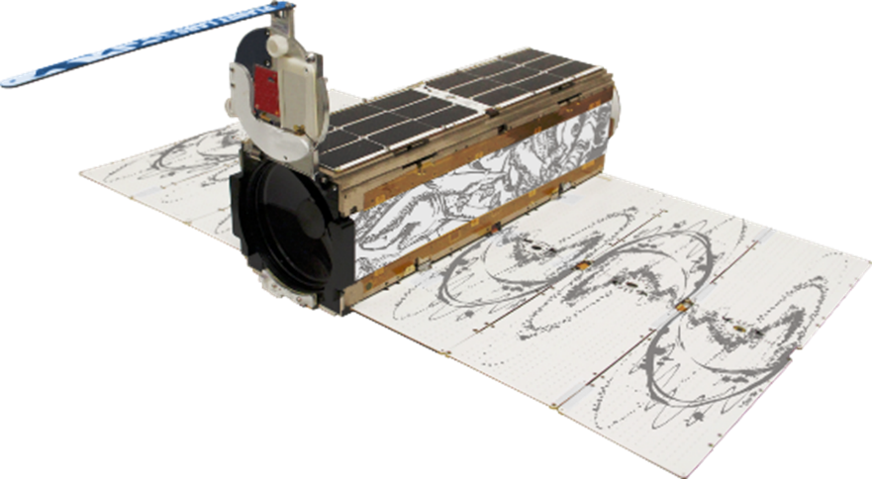
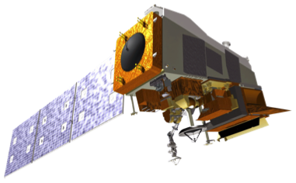
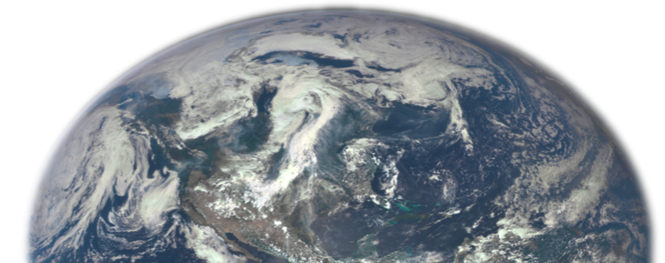
SATELLITES
PlanetScope
Suomi NPP
4 band (RGBn) imagery
3m resolution
Daily
Visible Infrared Imaging Radiometer Suite (VIIRS)
375m resolution
Daily
Image Credit: NASA, Planet Labs PBC
Notes:
PlanetScope is a high spatial and temporal resolution remote sensing product which was used for Sediment RS. A high temporal resolution is important for sediment remote sensing because events can happen for short periods of time and a longer revisit time would miss a more. The Shoshone River is only around 30m wide, so the spatial resolution was also important for this analysis.
Suomi NPP VIIRS used for snow cover analysis. It has a 375m spatial resolution and a daily temporal resolution.
------------------------------Image Credits ------------------------------ ​
Image credit: NASA
Image source: https://solarsystem.nasa.gov/planets/earth/overview/
Image Credit: Planet Labs PBC. Used with Permission

Slide 7



METHODS: SWAT
GIS Data
DEM
Land Use
Soil Type
Hydrology
SWAT Model
Weather Data
Precip
Temp
Wind
Sol Rad
Hum
Observed Data
Streamflow
Sediment
Sensitivity Analysis
Visualize Results
SWAT Calibration & Validation
Notes:
The Soil and Water Assessment tool operates on a combination of geospatial data and climate data. The geospatial data includes a digital elevation model for altitude and slope, land use cover data, soil types, and hydrologic shapes, such as lakes or streams. The climate data includes daily observed precipitation, minimum and maximum temperature, wind speed, solar radiation, and relative humidity. These combined inputs create a base-level SWAT model which is subsequently calibrated with observed data, in our case, streamflow and sediment flow at one point in the Shoshone River from late 2018 through 2021. The model then provides a variety of outputs to be cartographically visualized for high-resolution visualization of parameters.
------------------------------Image Credits ------------------------------ ​
Logos obtained from PowerPoint

Slide 8
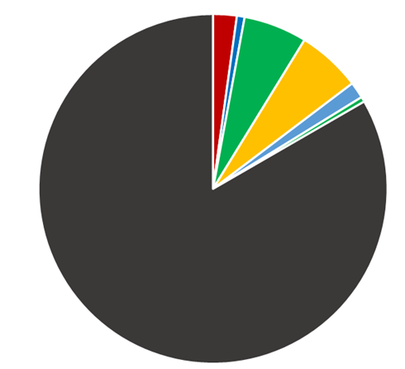


METHODS: SWAT
SWAT Grid Model
500m grid cells
4636 subbasins
7467 hydrological response units
Land Use Area
Urban
Wetlands
Forest
Crops
Pasture
Grasslands
Shrubland
0 2.5 5
N
Notes:
Our SWAT model used a 10m DEM with a grid size of 50 cells resulting in 500m grid cells allowing for high-resolution analysis. This created a watershed model with over 4500 subbasins and 7400 hydrological response units. The land use in the watershed was over ¾ shrub/rangeland with small percentages of the area being other land use types including wetlands, forest, agriculture, and urban area, displayed in the next slide.
------------------------------Image Credits ------------------------------ ​
Pie chart created by the Shoshone WR II team.
Map created using SWAT output.

Slide 9
METHODS: SWAT
SWAT Land Use Map
SWAT Soil Map
Water
Urban – MD
Urban – HD
Commercial
Institutional
Bare Rock
Deciduous
Evergreen
Mixed Forest
Shrubland
Grassland
Pasture
Agriculture
Woody Wetlands
Wetlands
2055 Soil Groups
0 2.5 5
0 2.5 5
N
N
Notes:
The SWAT model used land use data from the National Land Cover Database including 15 land use types in the study area, primarily being shrubland or bare rock. The soil map is from the soil survey geographic database, and includes over 2000 soils in the study area. It should be noted that 266 of these soil types were unknown; therefore were coerced to the most frequently occurring soil type for the SWAT analysis
------------------------------Image Credits ------------------------------ ​
Maps created by the Shoshone WR II team using SWAT outputs.

Slide 10

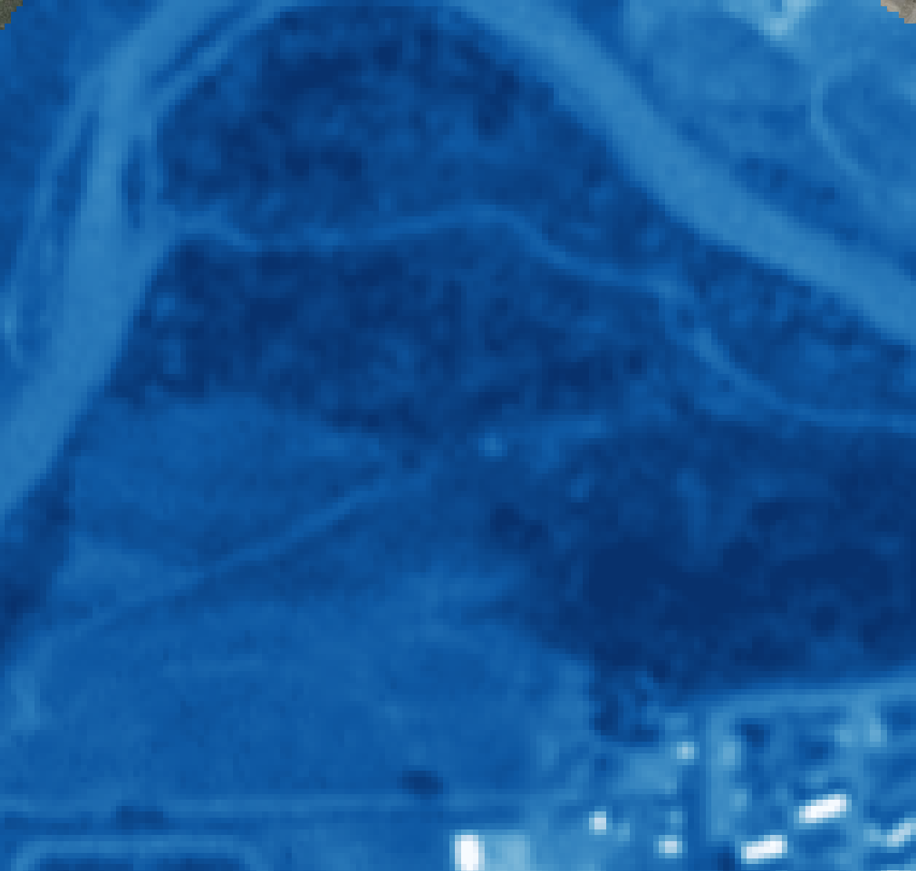

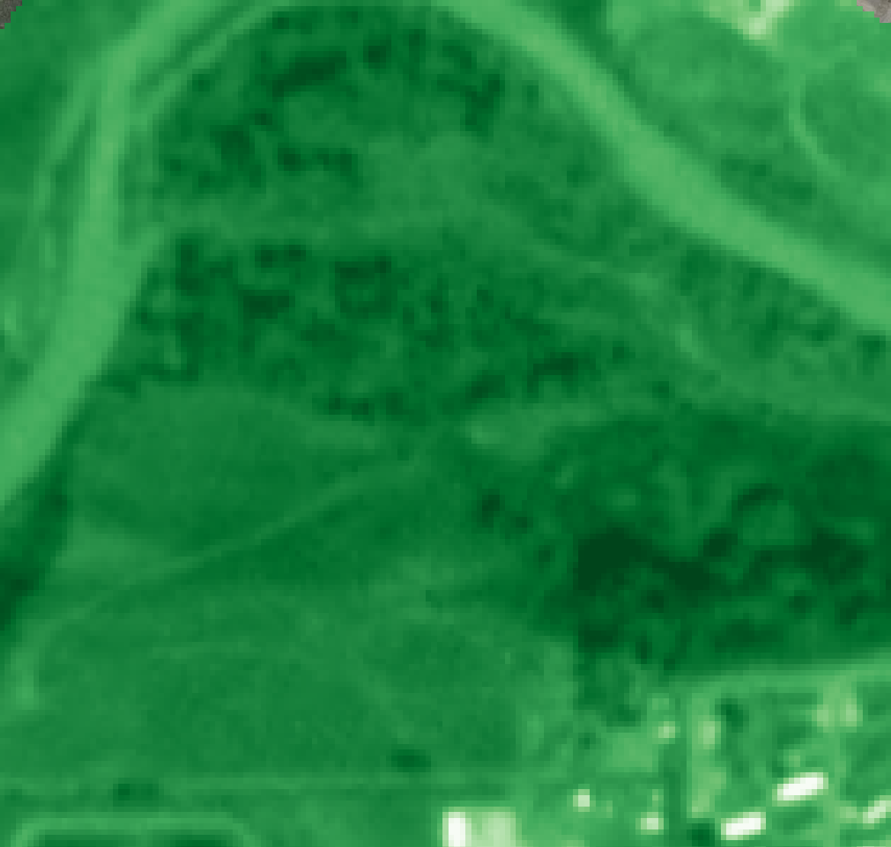
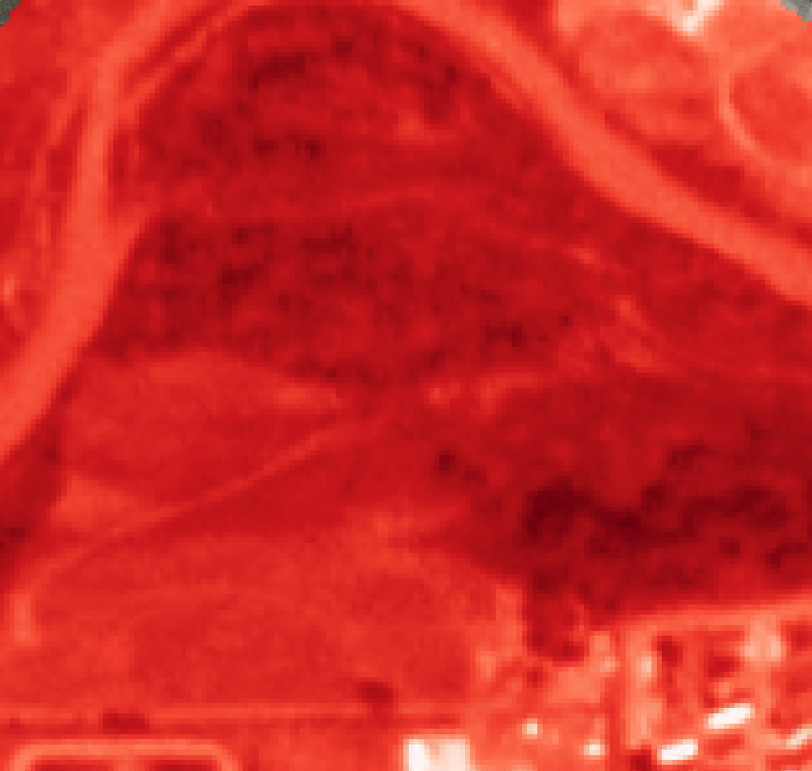
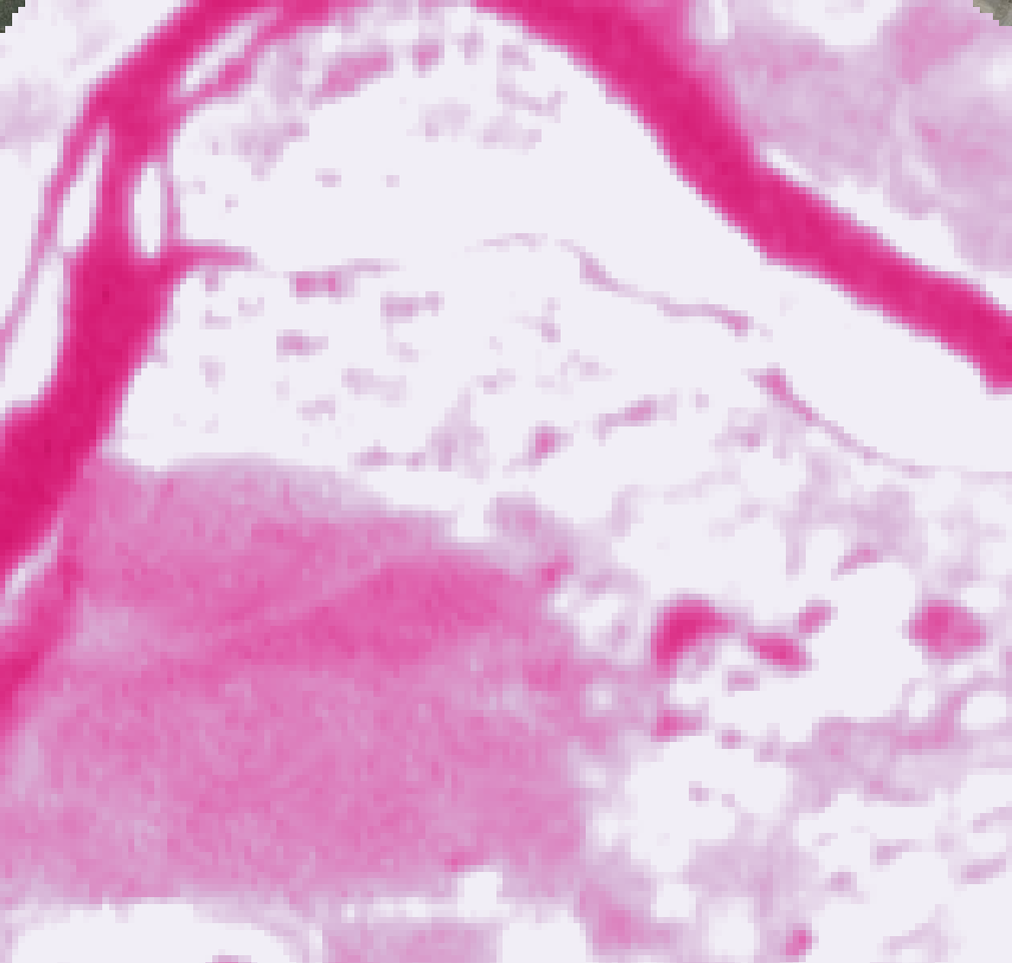

METHODS: Remote Sensing (RS) Basis
PS Image
PS Image
PS Image as bands
Images: PowerPoint, Planet Labs PBC
Notes:
The general concept of passive remote sensing is that a wide range of wavelengths in the electromagnetic spectrum //shine at// the Earth and, depending on the surface, different amounts are reflected back towards space. The reflectance can be captured as images takes from satellites. Though, due to sensor and storage limitations only certain windows of wavelengths are recorded. PlanetScope records 4 bands: Blue, Green, Red, and Near Infrared.
------------------------------Image Credits ------------------------------ ​
Sun, earth: Powerpoint Icons
PlanetScope Images: Planet Labs PBC used with permission

Slide 11
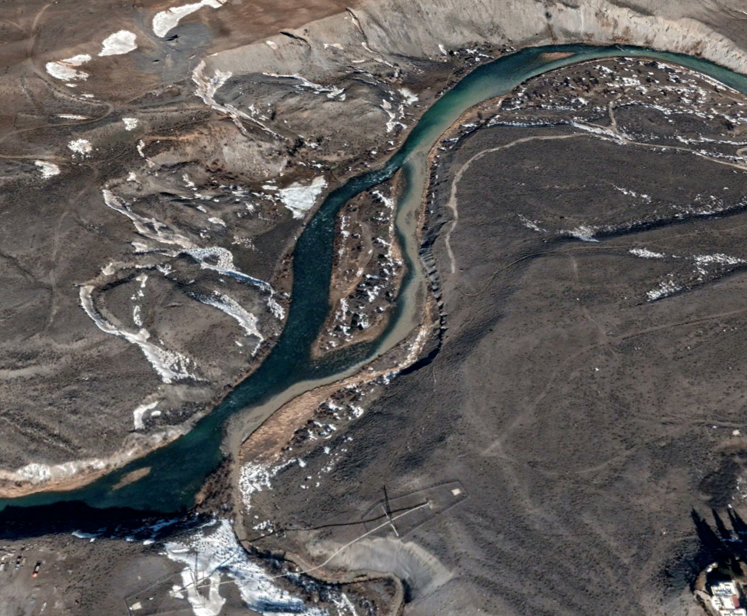

METHODS: Sediment RS
Sulphur Creek Sediment Plume
Low Turbidity:
High Turbidity:
Images: Google Earth, Carmen McIntyre
Notes:
We were able to use remote sensing to quantify sediment concentration because suspended sediment changes the reflectance profile of water. Specifically, suspended sediment particles tend to increase reflectance of red and NIR, while only minimally effecting blue and green. Remote sensing has the benefit of being able to look at turbidity spatially, which is relevant to the study area because there are a lot of tributaries that are remote and flashy so it is difficult to set up and maintain monitoring stations.
Note that this is an image from Google Earth and it is higher spatial resolution than PlanetScope but it does a really good job of illustrating a sediment plume.
------------------------------Image Credits ------------------------------
Sulphur Creek Sed Plume – Google Earth Baselayer
Water images – Carmen McIntyre

Slide 12
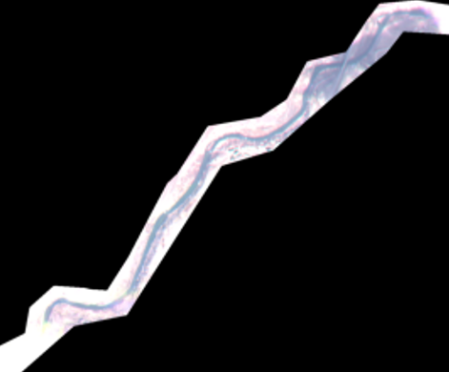
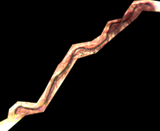

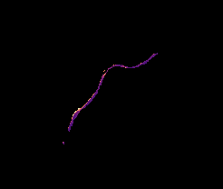
METHODS: Sediment RS
Merge Raw PlanetScope Images
Orthotile Analytic, Top of Atmosphere Radiance
Apply Atmospheric Corrections
ACOLITE software, Dark Spectrum Fitting algorithm
Mask Clouds, Low Conf. Pixels, & Land
Planet’s UDM2 layer, Normalized Difference Water Index + Otsu’s method thresholding, clip to shapefile
Calculate Turbidity
Equation calibration or machine learning
Images: PlanetScope
Notes:
Last term we tried using Planet’s surface reflectance product and ran into issues with unreliable reflectance, especially in near IR. This term we applied atmospheric corrections using the software ACOLITE. Acolite uses the Dark Spectrum fitting algorithm which adjusts reflectance values based on the least reflective area of the image. After atmospheric correction, we removed pixels that Planet’s supervised machine learning algorithm identified as being low confidence. We used the normalized difference water index with otsu’s method of threshold determination to remove land pixels and finally clipped to a shapefile to remove any water pixels outside of the river.
------------------------------Image Credits ------------------------------ ​
Images from/derived from PlanetScope.

Slide 13
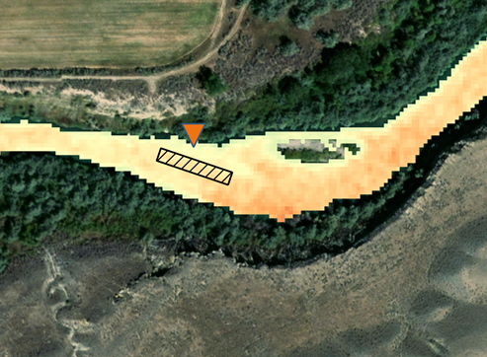
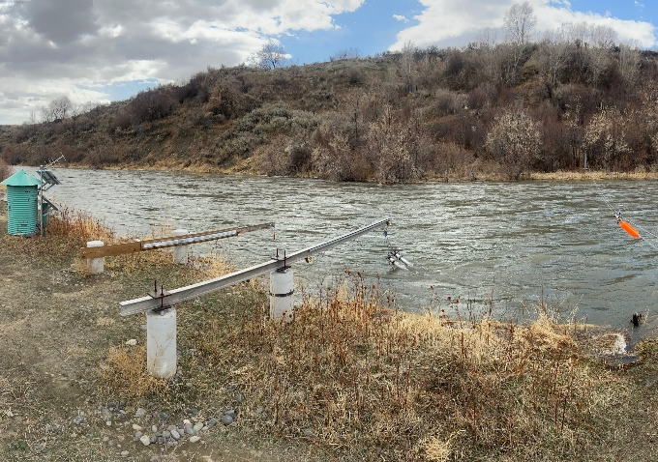
METHODS: Sediment RS
Date | Blue | Green | Red | NIR
2019-03-18 17:50:45 | 6.5E-06 | 8.41E-06 | 9.03E-06 | 1.03E-05
2019-05-30 17:59:25 | 5.62E-06 | 9.49E-06 | 1.2E-05 | 9.73E-06
… | … | … | … | …
Equation Calibration
(scipy.optimize.
basin_hopping)
Date | Streamflow (cfs) | Turbidity (FNU)
2018-10-01 07:00:00 | 707.6406 | 13.7
2018-10-01 07:15:00 | 708.026 | 18.2
… | … | …
Machine Learning
(sklearn.ensemble.
RandomForestClassifier)
Image Credits: Google Earth, Jason Alexander
Notes:
To create quantitative sediment maps, we used turbidity measurement at a USGS monitoring station on the Shoshone River, just above the Willwood Dam. Turbidity measurements were available at 15-minue intervals for most of the study period. We extracted reflectance values from each image at the location of the USGS monitoring station then merged these two datasets on time gave us reflectance paired with measured turbidity nearest that time which we could then feed to Calibration and Machine Learning. Calibration and machine learning effectively accomplish the same thing by finding an effective way to map reflectance to turbidity, but we were interested in comparing the two methods to see which would work better since both methods are commonly used for this purpose.
------------------------------Image Credits ------------------------------ ​
Google Earth baselayer, PlanetScope-derrived turbidity
Monitoring station photo -- Jason Alexander (project partner at USGS), used with permission

Slide 14
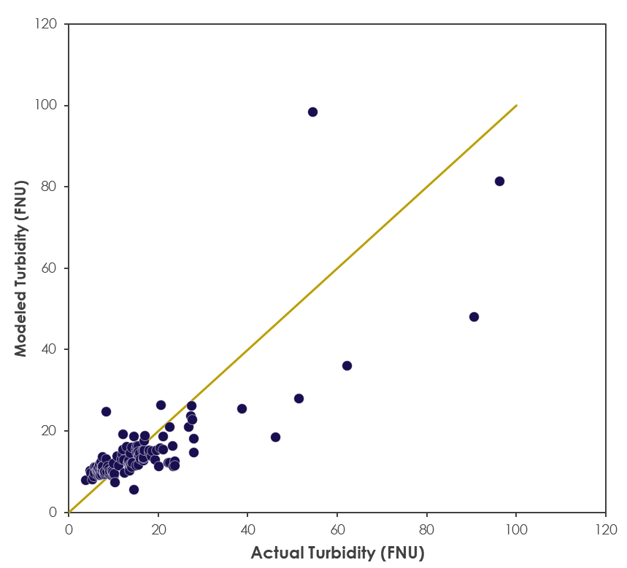

METHODS: Sediment RS – Eqn. Optimization
120
100
80
60
40
20
0
Calibration – Actual vs Predicted Turbidity
(May-Oct, Outliers Excluded)
1:1 Relationship
Satellite Image
$$Turbidity=e^{a ∗Red+b}$$
  a = 277811.5
  b = 1.410944
Remotely Sensed Turbidity (FNU)
Statistic | Value
R² | 0.808
NSE | 0.803
KGE | 0.801
0 20 40 60 80 100 120
In-situ Turbidity (FNU)
Notes:
The first method was mostly developed last term, but we refined it this term by using the new set of atmospherically corrected data. We tested both double and single band equations using an optimization function to adjust the coefficients to minimize RMSE. Reflectance had an exponential relationship with turbidity and single band red ended up having the best relationship.
------------------------------Image Credits ------------------------------ ​
Plot created by Shoshone WR II team.

Slide 15
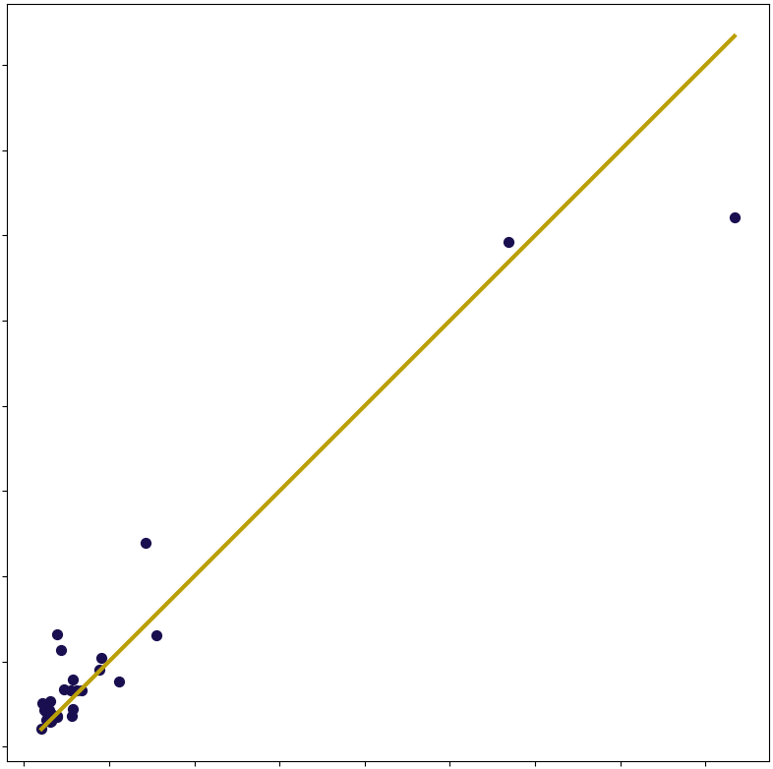
METHODS: Sediment RS – Machine Learning
ML – Actual vs Predicted Turbidity
(Validation Only)
200
175
150
125
100
75
50
25
0
Statistic | Value
R² (Validation) | .929
Band | Relative Importance
Red | 38%
Green | 20%
Blue | 13%
NIR | 29%
Predicted Turbidity (FNU)
0 25 50 75 100 125 150 175 200
Actual Turbidity (FNU)
Notes:
The machine learning model used a “random forest” with 1000 trees. We had 157 datapoints to analyze and train the model. 80% of the points were used for training and the other 20% of points were used as validation. The model determined that the red and NIR bands are the most important in predicting turbidity and it gave more weight to these band values. The model resulted in a R^2 value of .929. The plot on the right shows the predicted data (y axis) and the observed data (x axis). The line is the 1:1 (meaning observed and predicted points are the same which is desired). The closer to the 1:1 line, the better.
------------------------------Image Credits ------------------------------ ​
Plot created by Shoshone WR II team.

Slide 16
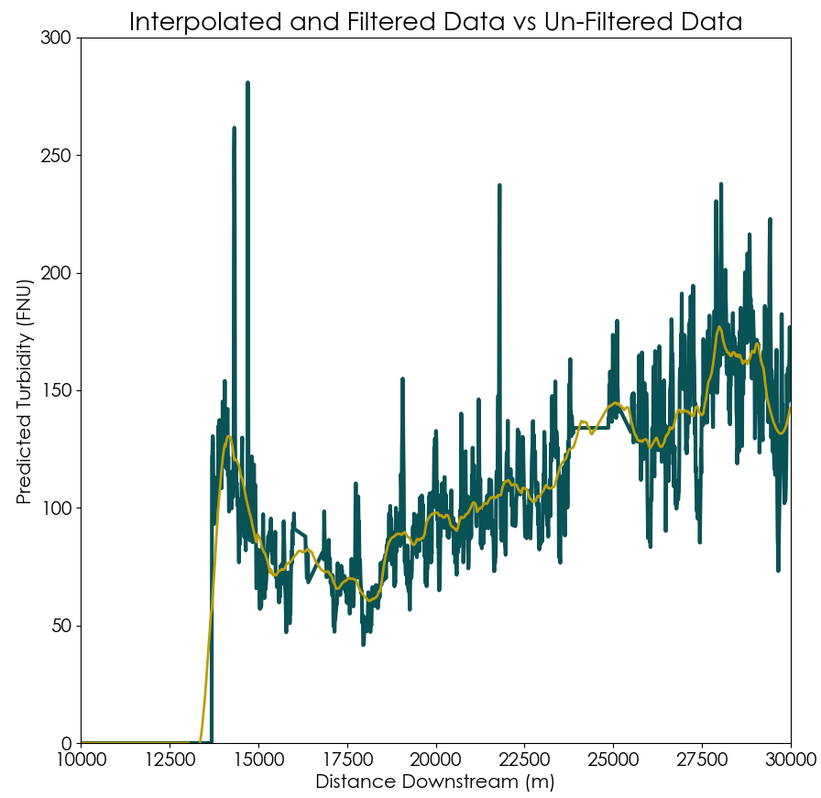
METHODS: Sediment RS – Auto Plume Detection
1
Interpolate ML Data
Remove no data (0) values.
300
250
200
150
100
50
0
2
Apply Savitzky-Golay Filter
Reconstruct data using 3rd order polynomials to drastically reduce noise.
Predicted Turbidity (FNU)
3
Plot Segmented Trendlines
Plot trendline of length 1KM at the start of each tributary of interest.
4
Determine Possible Plume Events
Name streams that exceed 50 FNU per 1KM increase and mark as possible event.
10 12.5 15 17.5 20 22.5 25 27.5 30
Distance Downstream (km)
Notes:
For additional analysis, a automatic plume detection method was created to possible plume events. This method of locating sediment plumes and identifying which tributary is came from is a 4 step process. The first step is to interpolate no-data or zero data points. Following this, step 2 is to apply the Savitzky-Golay fitler. This is a popular filter of denoising for signal processing. It recreates signals using polynomials. Our method uses 3rd order polynomials with a window size of 128 points. 3rd, you plot trendlines at where each tributary dumps into the Shoshone river, and plot the trendline out to 1KM. Finally, if the trendline shows an average increase of more than 50FNU over 1KM, it’s marked as an event and the tributary name is recorded.
------------------------------Image Credits ------------------------------ ​
Plot created by Shoshone WR II team.

Slide 17







Snow cover extent values
Time series analysis of % snow cover values and hydrologic variables
METHODS: Snow
Download Suomi NPP VIIRS VNP10A1F Images & Climate/Stream data for entire study period (1035 days)
Reclassify pixel values for clipped images
Graph snow cover % values and stream/climate data in time series
Isolate extent of watershed for VNP10A1F images from shapefile
Export % Snow-Covered Pixels values to table
Notes:
Very simplified process for snow cover time series. 2 parts: snow cover and time series. Methods for obtaining snow cover values from satellite imagery in more detail on next slide. The graphic also briefly discusses use of climate and stream data for time series. Hydrologic variables are in-situ measurements from NOAA (climate) from a station in CODY and USGS (stream) from gauge above Willwood Dam.
------------------------------Image Credits ------------------------------ ​
Logos obtained from PowerPoint

Slide 18
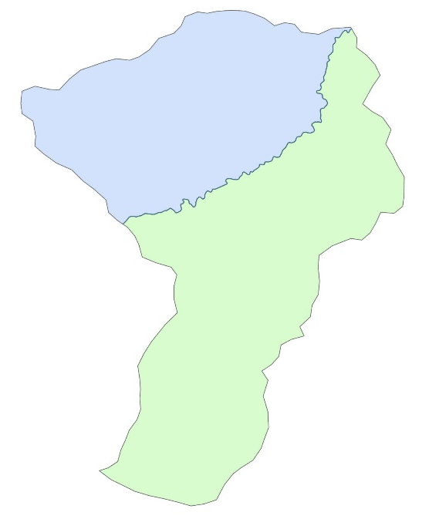
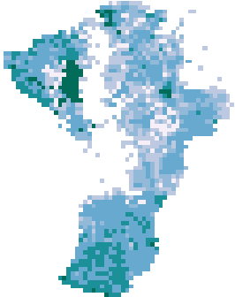
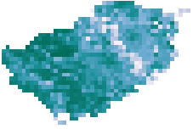
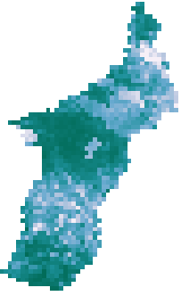



METHODS: Snow – Snow Cover Extent
Imagery from Suomi NPP VIIRS snow cover product VNP10A1F
  Preprocessed using NDSI (Normalized Difference Snow Index)
Satellite image clipped to watershed extent
  1: Full extent
  2 & 3: Division of watershed at Shoshone River
% of pixels with a value between 10 – 100 out of total pixels in image
0-10​​ | No Snow​​
10-100​​ | Snow​​
>201​​ | No Decision​​
Notes:
Methods for obtaining snow cover values. Daily temporal scale for Suomi images with a tradeoff of 375 m spatial resolution. The snow cover product from Suomi VNP10A1F are preprocessed, where pixel values reflect NDSI values and have also had a cloud gap filling procedure applied. NDSI is the normalized difference between green (G) spectral bands and the shortwave infrared bands (SWIR). All 1035 images were clipped to study area shapefile in 3 batches, the full extent, and then also clipped to the NW and SE regions of the watershed divided by the Shoshone River in order to compare snow cover values spatially as well as temporally. The clipped images were then reclassified using the parameters in the table, based on the pixel values described in the VNP user guide; where 10-100 = snow covered, 0 = no snow, and values >201 are counted as algorithm flags such as clouds or water or no decision and are therefore excluded. This was a similar method used by Riggs and Hall (2020) for pixel reclassification and count to determine snow cover extent for this Suomi snow cover product. The pixels now classified as ‘snow’ were counted and the percentage of snow-covered pixels from the total number of pixels in image was found, this was done for each day in the study period and then those values were exported into a .csv file.
------------------------------Image Credits ------------------------------ ​
Image and maps made using Suomi VIIRS imagery.

Slide 19
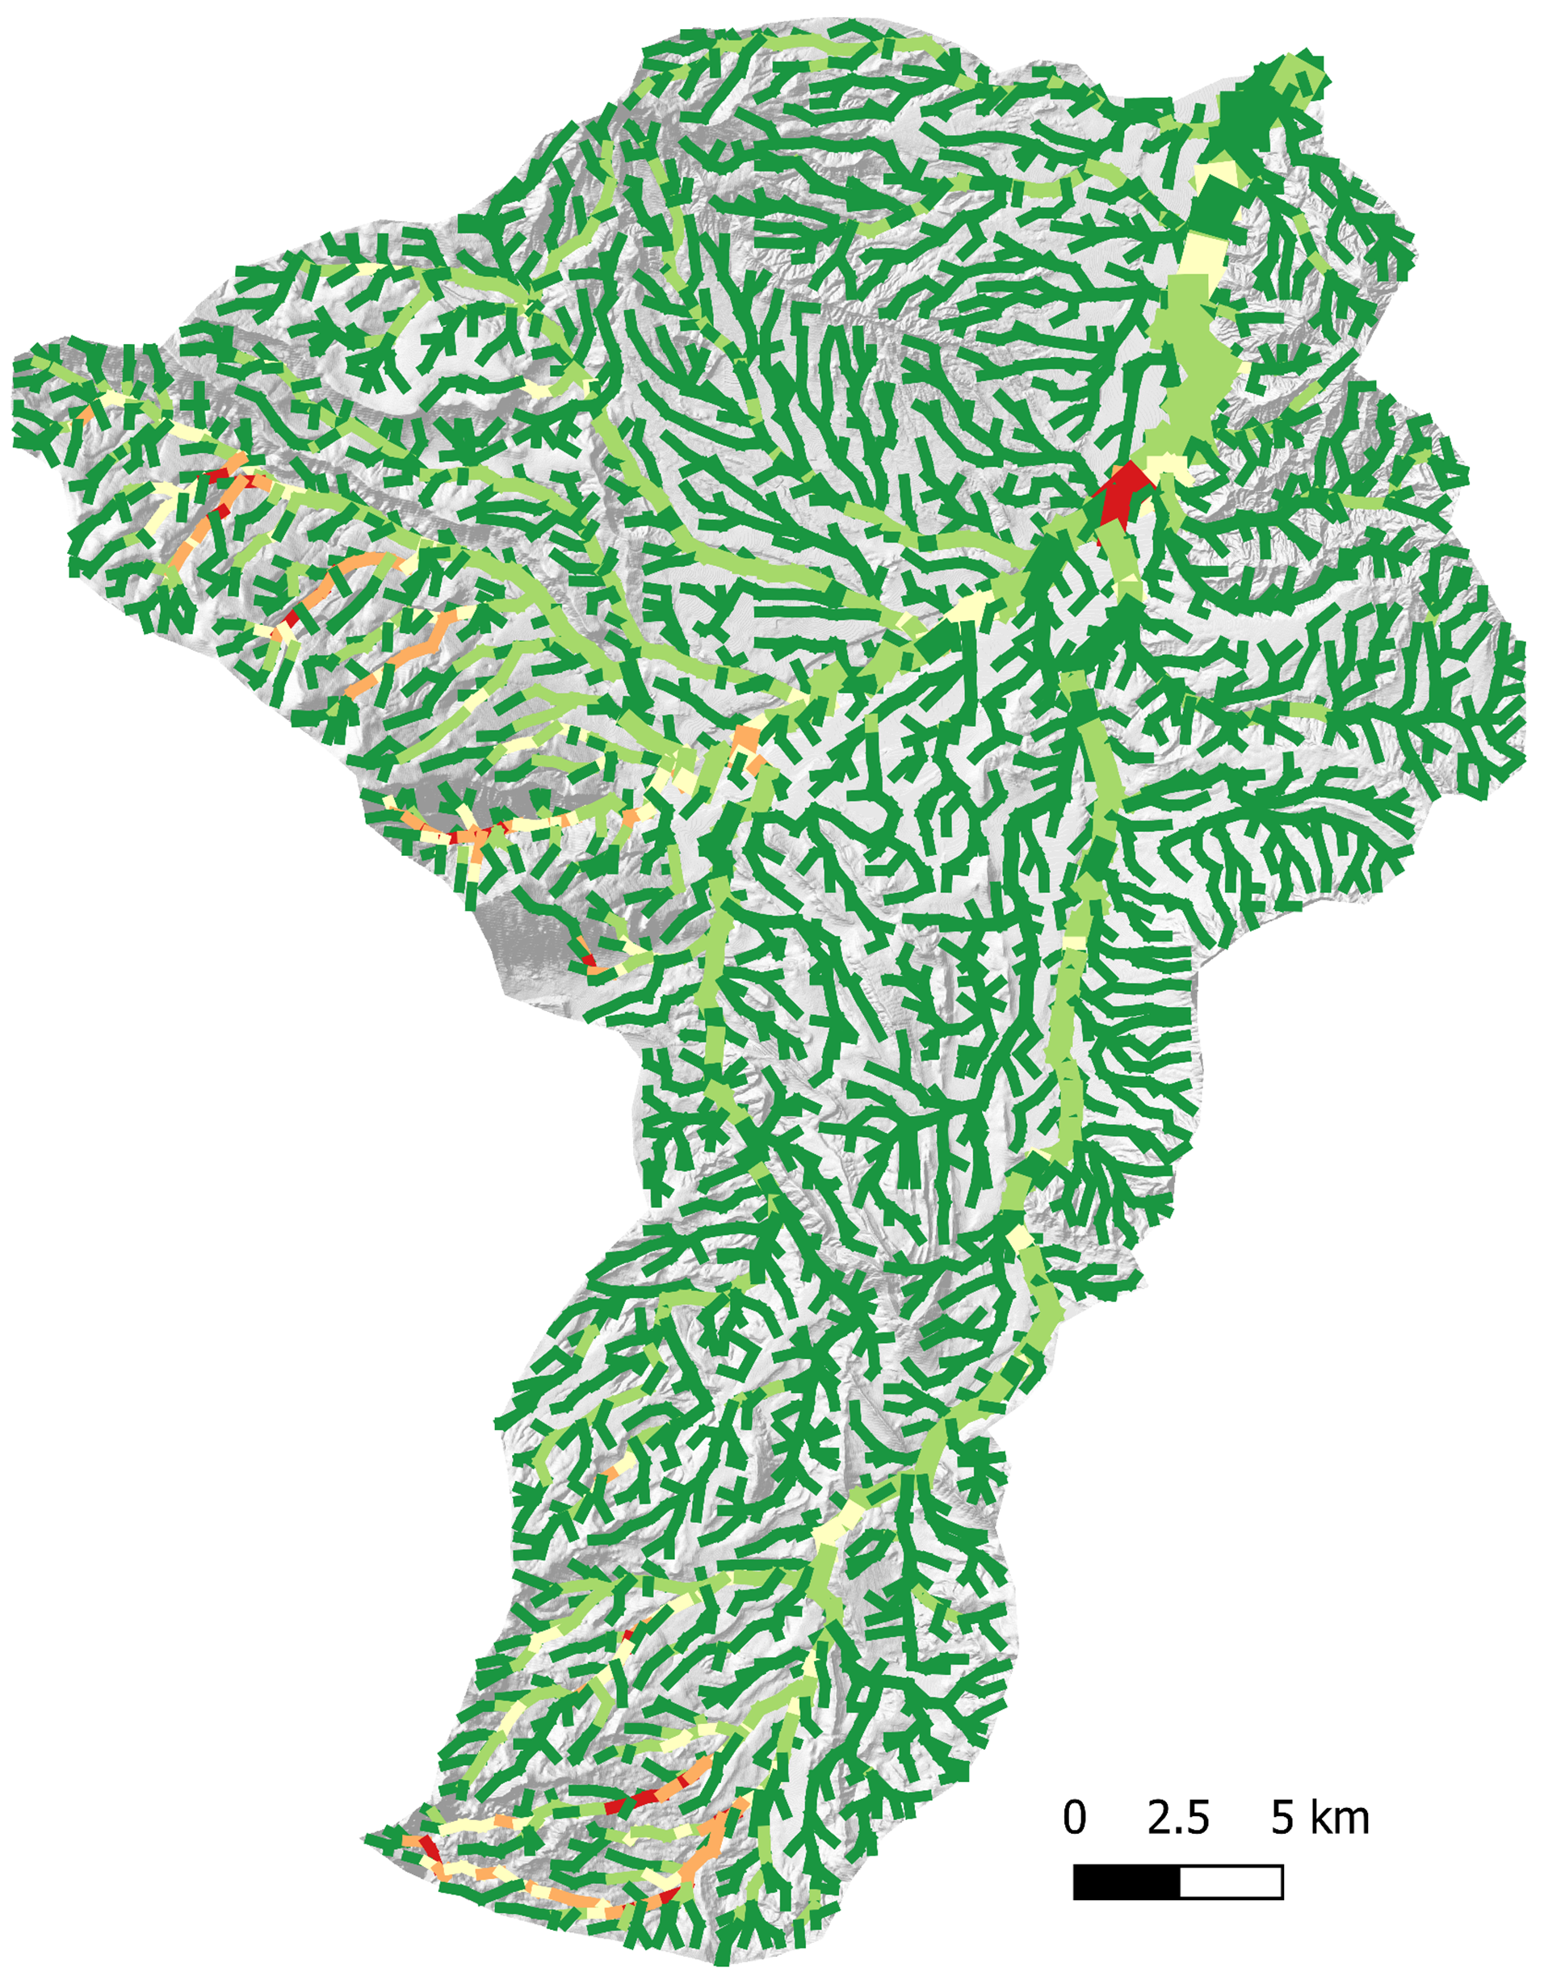

RESULTS: SWAT Soil
Sediment Input
Lateral Soil Flow into Channels
Sediment Input,
daily means (tons)
Soil flow (mm)
0 – 39
39 – 131
131 – 290
290 – 586
586 – 1255
0.0 - 9.2
9.2 - 35.7
35.7 - 88.9
88.9 - 274.1
274.1 - 690.0
Willwood Dam
Willwood Dam
0 2.5 5
0 2.5 5
N
N
Notes:
Moving into results, the SWAT model provided several output visuals relevant to our project covering both sedimentation sources and snow cover in the region. On this slide, you will see the daily mean sediment flow through channels, with high input channels in the Western and Southern regions as well as one very high sediment flow channel in the Northern Shoshone River approaching the Willwood Dam. On the right, we have daily mean lateral soil flow into channels by subbasin, or grid cell. You'll notice a correlation between these two maps with high soil flow into the channels being in the Western and Southern subbasins, as well as one additional patch in the northern Shoshone River region corresponding to the red channel on the left. These maps corroborate one another and point out potential areas of interest for watershed managers.
------------------------------Image Credits ------------------------------ ​
Maps created by Shoshone WR II team using SWAT+ outputs.

Slide 20
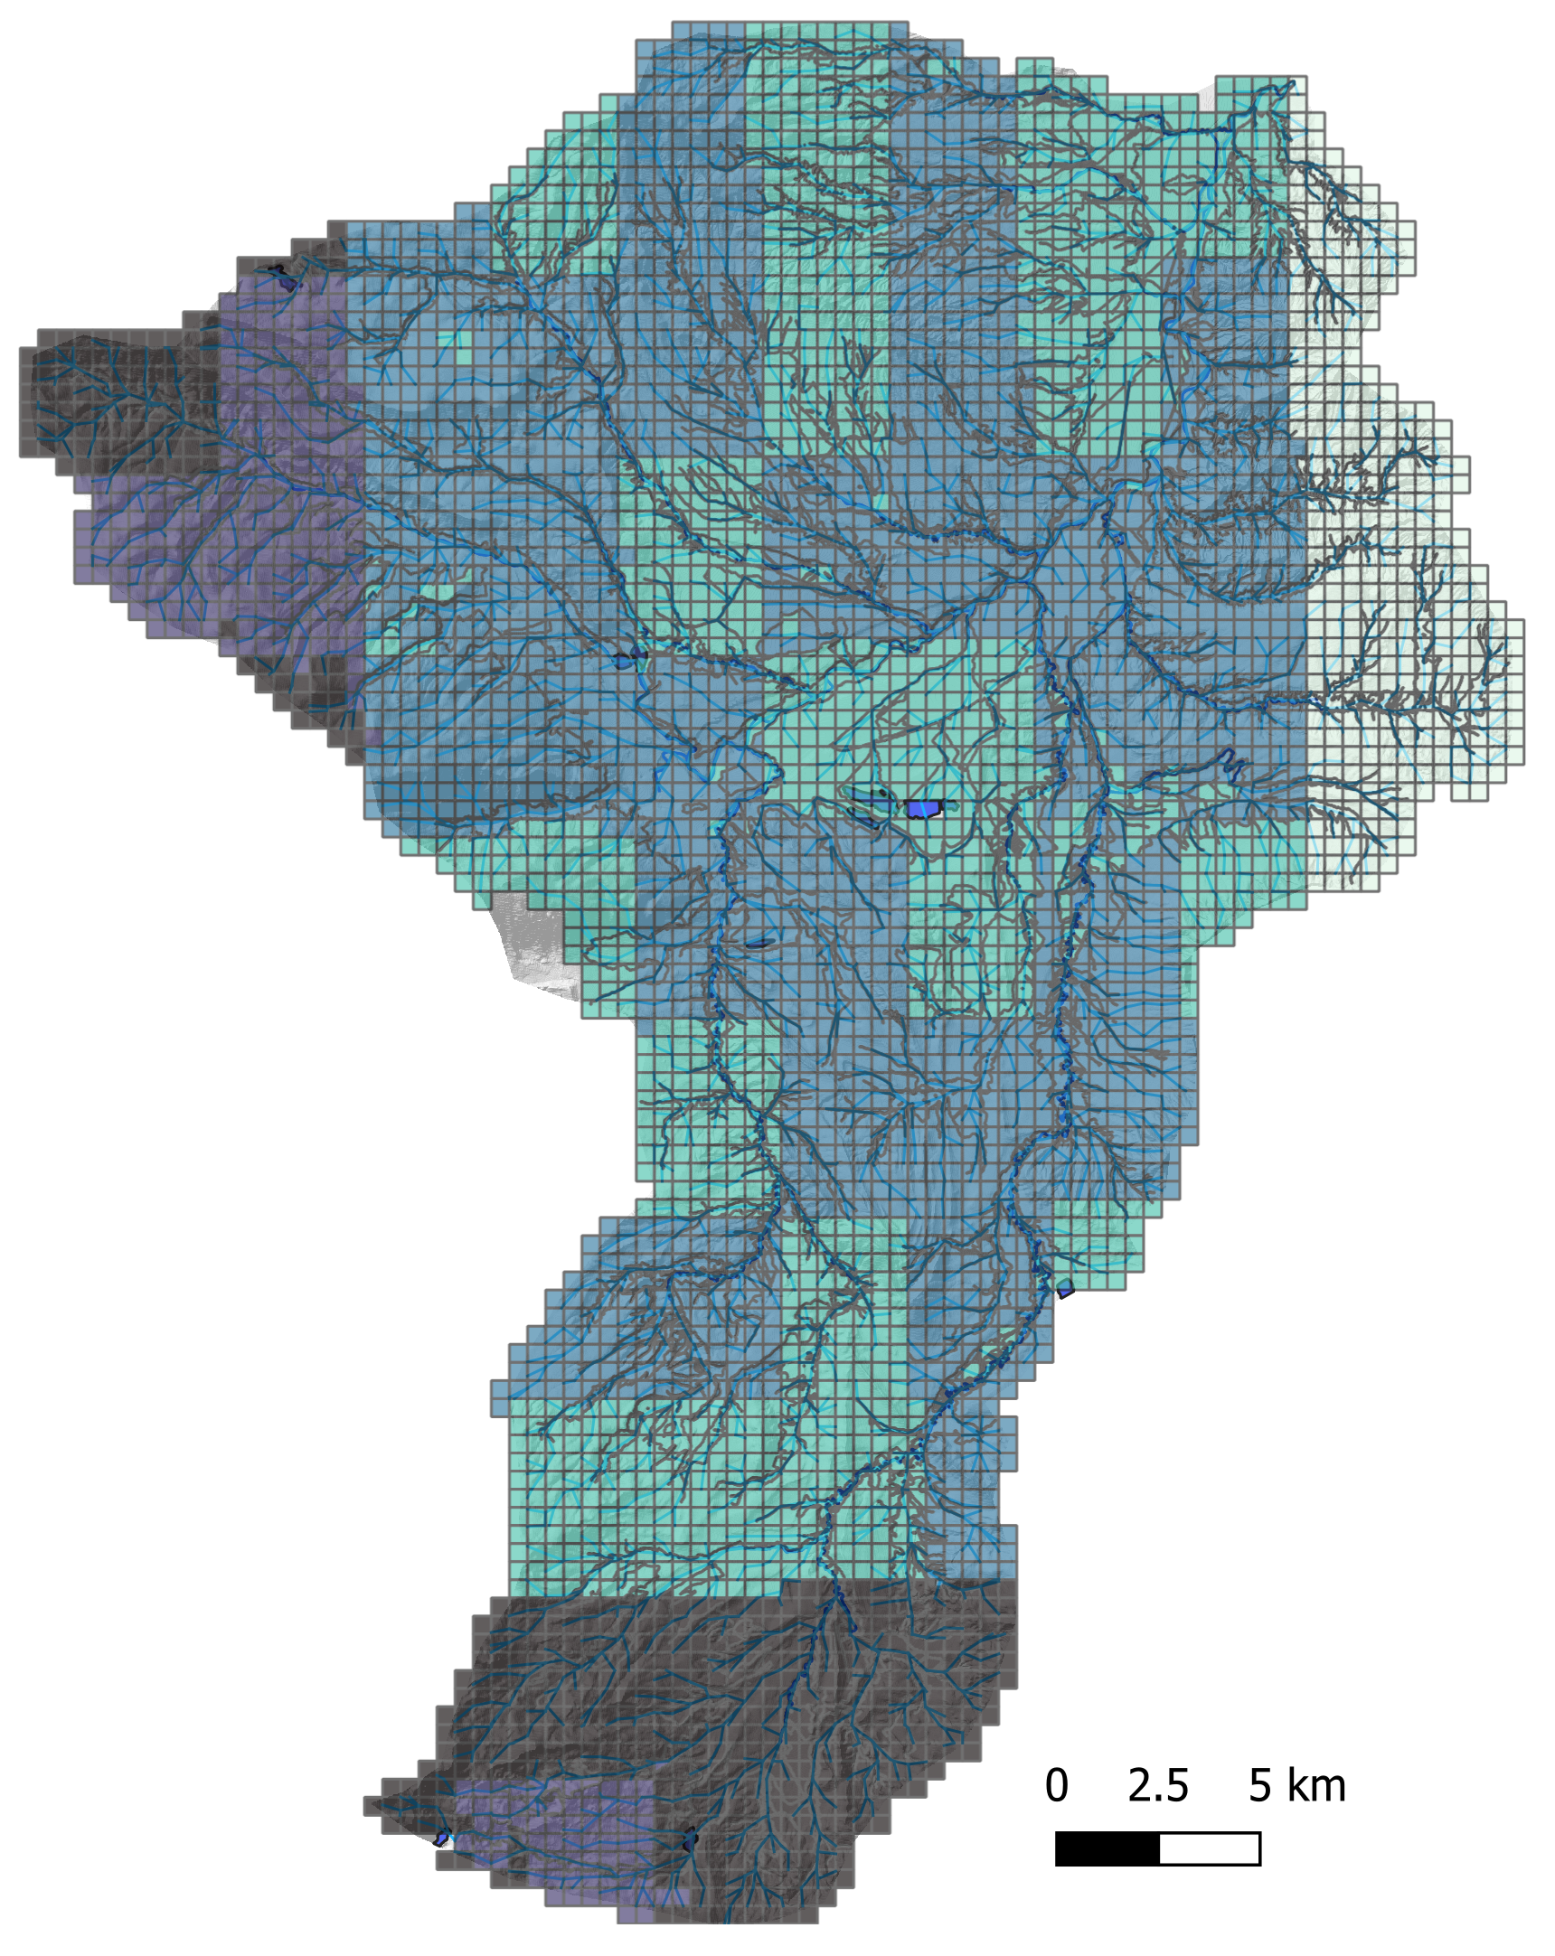
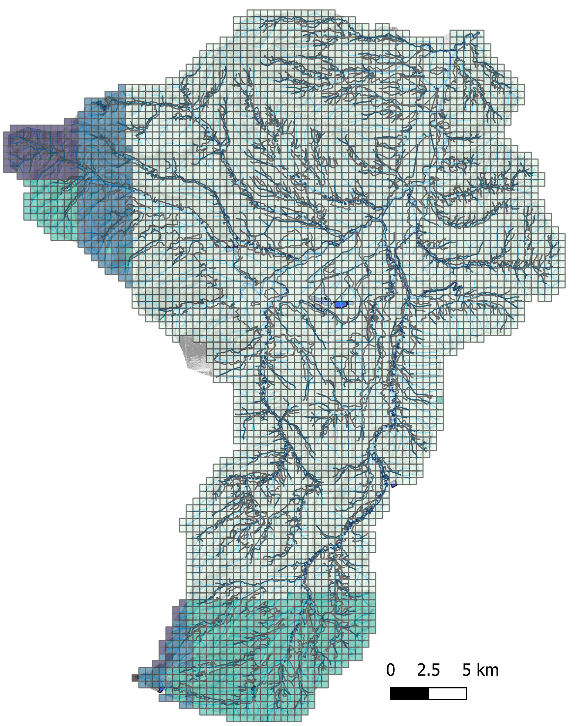
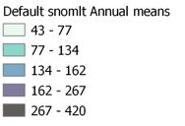
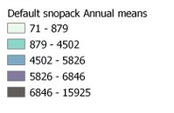
RESULTS: SWAT Snow
Mean Annual Water Equivalent in Snowpack
Mean Annual Snow or Ice Melt
Snow Melt (mm)
Snowpack (mm)
43 – 77
77 – 134
134 – 162
162 – 267
267 – 420
71 – 879
879 – 4,502
4,502 – 5,826
5,826 – 6,846
6,846 – 15,925
Willwood Dam
Willwood Dam
0 2.5 5
0 2.5 5
N
N
Notes:
Continuing, you will see that snow melt and snow pack exist in above average amounts, yet again, in these western and southern subbasins. The concepts could be intertwined, with high snow melt events causing high soil erosion into nearby channels. The main difference between these maps and the previous two is that the area of interest in the Northern Shoshone River does not appear to have any significantly high snow results as with sediment flow (can pan to previous slide if needed for this comparison).
------------------------------Image Credits ------------------------------ ​
Maps created by Shoshone WR II team using SWAT+ outputs.

Slide 21
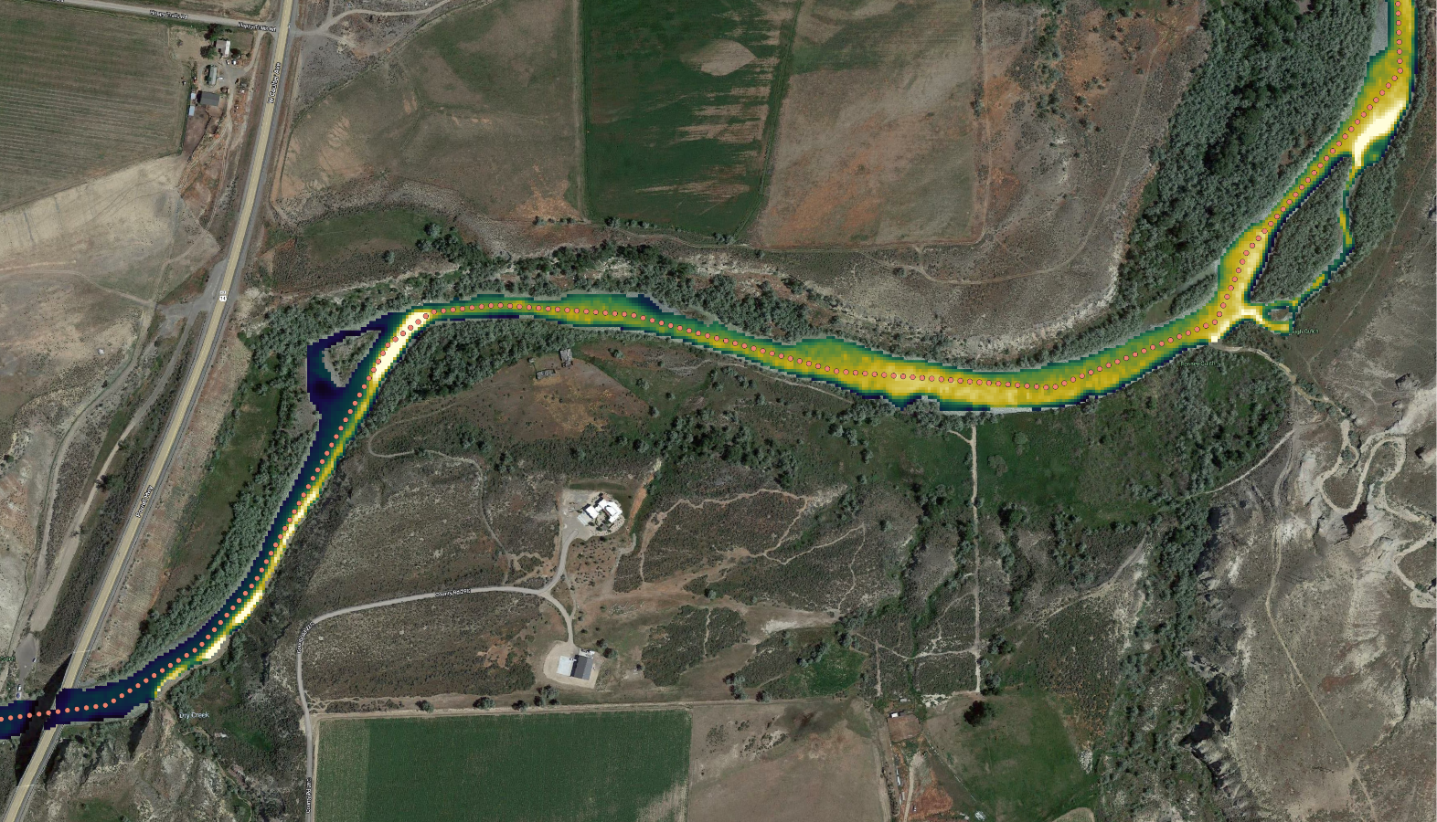
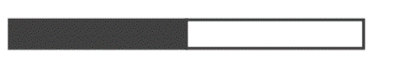
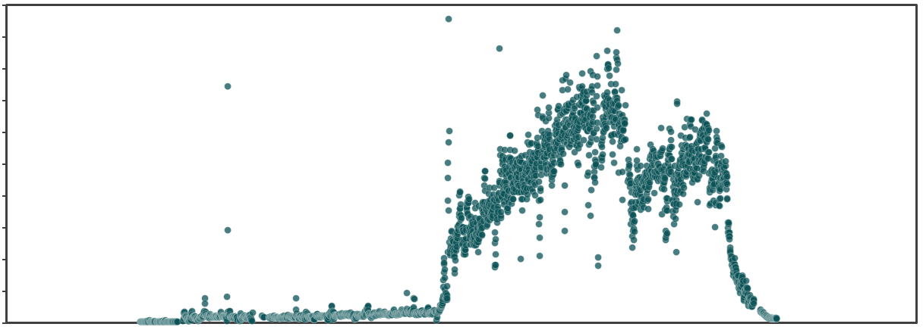
RESULTS: Sediment RS – Spatial Analysis
Turbidity Sample Point
Turbidity (FNU)
Sampling turbidity values along the river centerline allows us to locate sediment plumes.
3000
0
0m 100m 200m
N
Penney Gulch
5000
4500
4000
3500
3000
2500
2000
1500
1000
500
0
Spike indicates sediment plume:
Turbidity, T (NTU)
C
Dry Creek
WY-120 Bridge
Willwood Dam
N Fork Hwy/
US-16
Sulphur Creek
Dry Creek
USGS Gage
Images: Google, PlanetScope
Location
Penney Gulch
Notes:
Once we had a turbidity relationship we needed to figure out to find sediment plumes in 400 images. To get a summary of what was going on in each image, we extracted turbidity values every 10m along the river centerline (as seen in the small dots in the map) then plotted turbidity over distance as seen in the graph. The map is only snowing a small area of the river that has a very clear plume and the circled area on the plot corresponds with the area on the map.
------------------------------Image Credits ------------------------------ ​
Turbidity layer on the map derived from PlanetScope, basemap is Google Hybrid imagery.
Plot created by Shoshone WR II develop team.

Slide 22
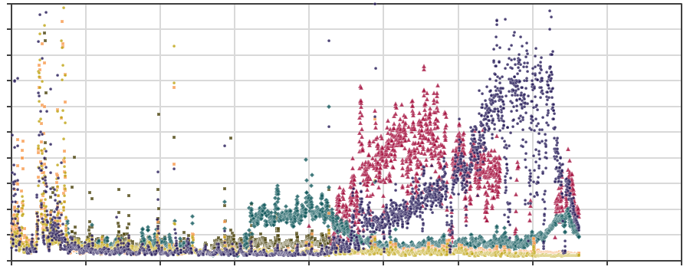
RESULTS: Sediment RS – Spatial Analysis
500
450
400
350
300
250
200
150
100
50
0
C
Spike with sustained high levels of turbidity afterwards indicates plume.
Turbidity (FNU)
Baseline
turbidity is
usually below
20 FNU.
0 5 10 15 20 25 30 35 40 45
Rapids and shadows in upper watershed cause spikes unrelated to turbidity.
Distance downstream of the US-16 Bridge (km)
July 22nd, 2019 | October 31st, 2020 | April 4th, 2021
June 10th, 2021 | July 19th, 2021 | October 15th, 2021
Notes:
This plot illustrates a bunch of different situations seen in turbidity plots. Some days have low turbidity though the whole study area. Baseline turbidity is below 20 FNU. Since turbidity is based on (red) reflectance it can be influenced by things other than turbidity, for example the far left side of the plot has some really high spikes and this was present in that location for all images. This part of the river has a lot of rapids and large rocks in the channel which have a spectral signature that registers as high turbidity. It’s a little hard to see in this plot because I have it as individual points that aren’t connected by lines but bridges and dams also show up as really high turbidity. An actual turbidity plume shows up as a sharp rise in turbidity that is the sustained for a significant distance downstream.
------------------------------Image Credits ------------------------------ ​
Plot created by Shoshone WR II develop team.

Slide 23
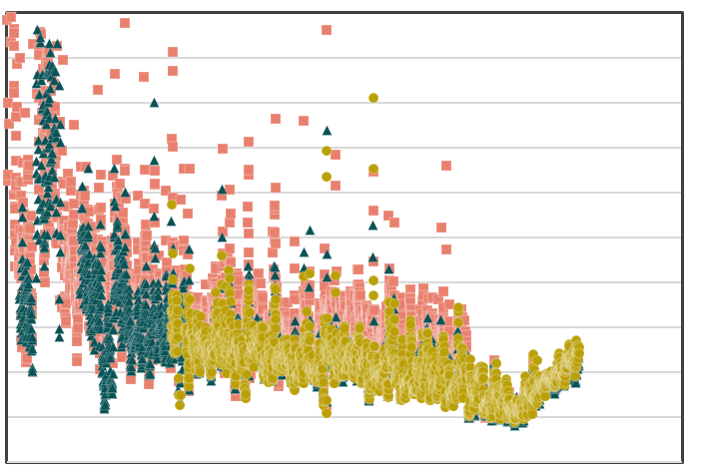
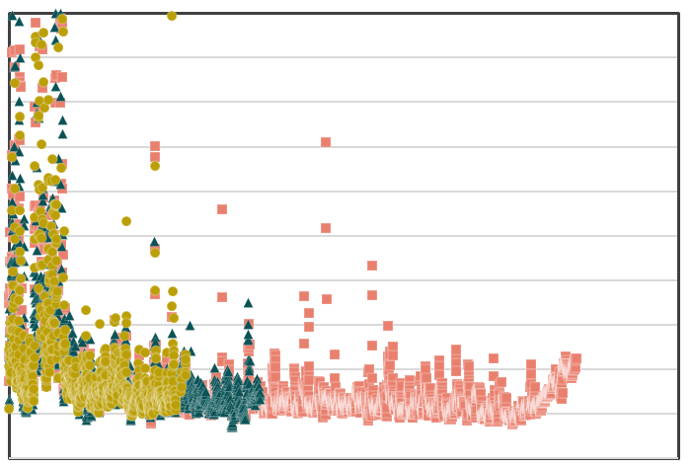
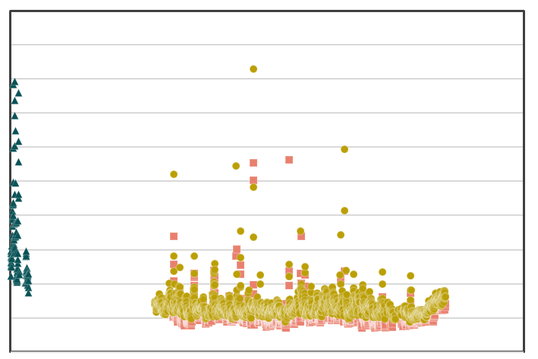
METHODS: Sediment RS
Turbidity tracks well between multiple images taken on the same day:
100
90
80
70
60
50
40
30
20
10
0
100
90
80
70
60
50
40
30
20
10
0
100
90
80
70
60
50
40
30
20
10
0
Turbidity (FNU)
Turbidity (FNU)
Turbidity (FNU)
0 5 10 15 20 25 30 35 40 45
0 5 10 15 20 25 30 35 40 45
0 5 10 15 20 25 30 35 40 45
Distance downstream of the
US-16 Bridge (km)
Distance downstream of the
US-16 Bridge (km)
Distance downstream of the
US-16 Bridge (km)
Sept. 3rd, 2021, 17:17:00
Sept. 3rd, 2021, 17:30:24
Sept. 3rd, 2021, 17:31:17
Sept. 22nd, 2021, 17:16:58
Sept. 22nd, 2021, 17:34:53
Sept. 22nd, 2021, 18:39:06
Sept. 27th, 2021, 17:16:58
Sept. 27th, 2021, 17:34:53
Sept. 27th, 2021, 18:39:06
Notes:
Some days actually have multiple images from the same day. These plots show those days plotted on the same axis and while there are slight differences, at least 90% of images track really well on the same day which gives me a lot more confidence in comparing turbidity values quantitatively between images.
------------------------------Image Credits ------------------------------ ​
Plot created by Shoshone WR II develop team.

Slide 24
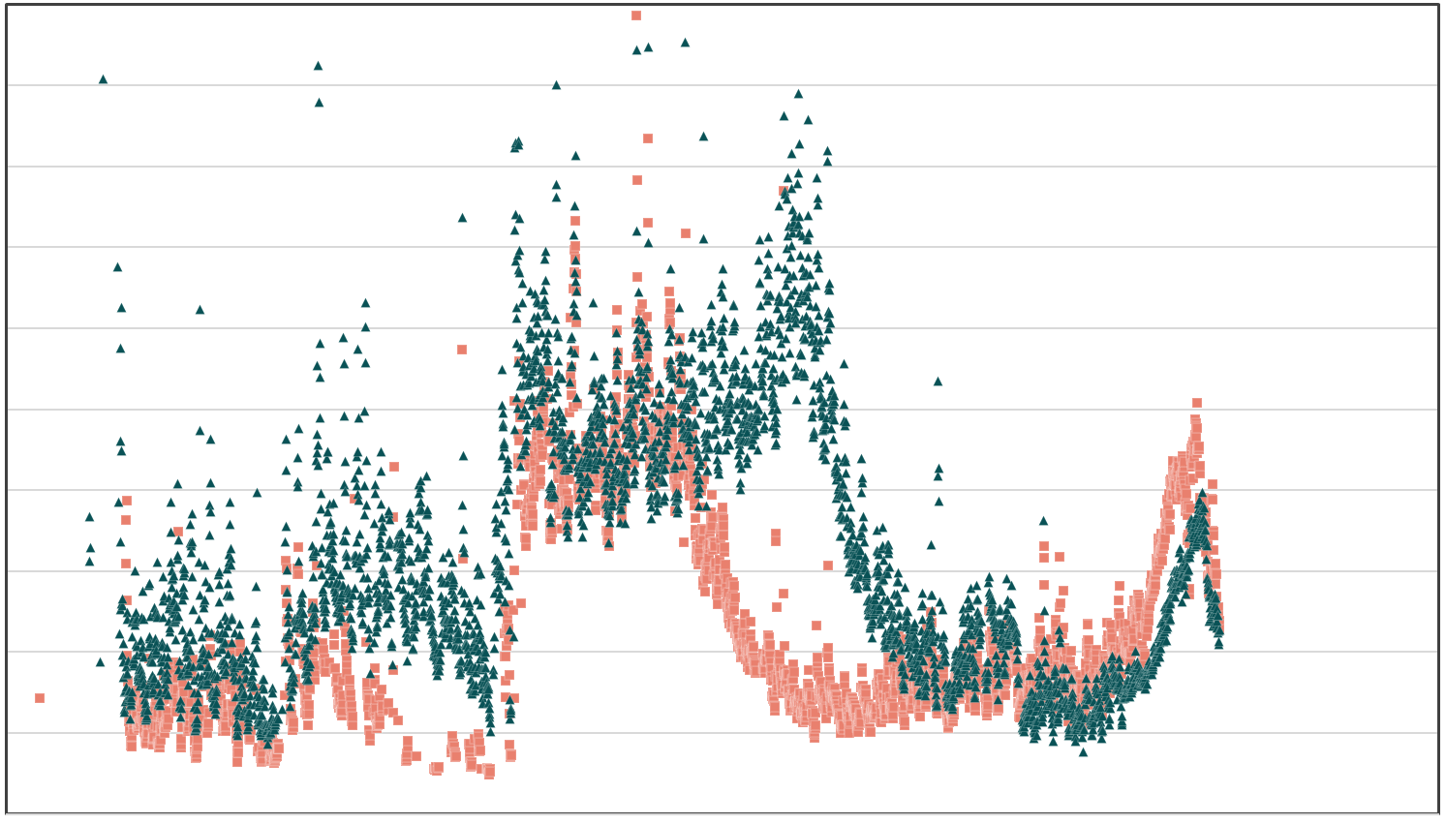
RESULTS: Sediment RS
Two images taken 68 minutes apart capture sediment plume movement:
200
180
160
140
120
100
80
60
40
20
0
C
Turbidity (FNU)
April 4th, 2021, 17:21:03
April 4th, 2021, 18:29:37
0 5 10 15 20 25 30 35 40 45
Distance downstream of the US-16 Bridge (km)
Notes:
I also came across this really interesting situation where at first it may look like turbidity measurements are not constant between images but after looking at the timesteps I actually think what we’re seeing here is the progression of a plume moving downstream. These observations were taken a little over an hour apart and the plume appears to have moved around 5km or 3 miles downstream which seems about right for the speed of a river. Looking at the images it was actually really hard to say for sure but I think the graph is actually way easier to interpret than an image in this case.
------------------------------Image Credits ------------------------------ ​
Plot created by Shoshone WR II develop team.

Slide 25
RESULTS: Sediment RS
Penney Gulch and Dry Creek had the highest turbidity plumes with turbidity over 200 FNU on multiple days
Sulphur Creek also had relatively frequent and significant plumes but less concentrated
Turbidity Sample Point
Turbidity (FNU)
3000
0
0m 100m 200m
N
Penney Gulch
Dry Creek
Notes:
After going through plots of all 400 observations and recording which ones had likely plumes, I went into the raw images and turbidity images to make sure that was an accurate interpretation and to determine which tributary each plume was coming from. Dry creek and Sulphur creek really stood out as having the most and highest concentration sediment plumes. Sulphur creek also had some really clear plumes but seemed to be less concentrated sediment. I do want to note briefly now, and we’ll come back to it more in depth later, that there are several factors which could bias which creeks we actually picked up as high sediment contributors including many events being missed due to clouds. However the fact that these three had significant remotely sensed events confidently points to these being at least some of the high sediment load streams.
------------------------------Image Credits ------------------------------ ​
Turbidity layer on the map derived from PlanetScope, basemap is Google Hybrid imagery.

Slide 26
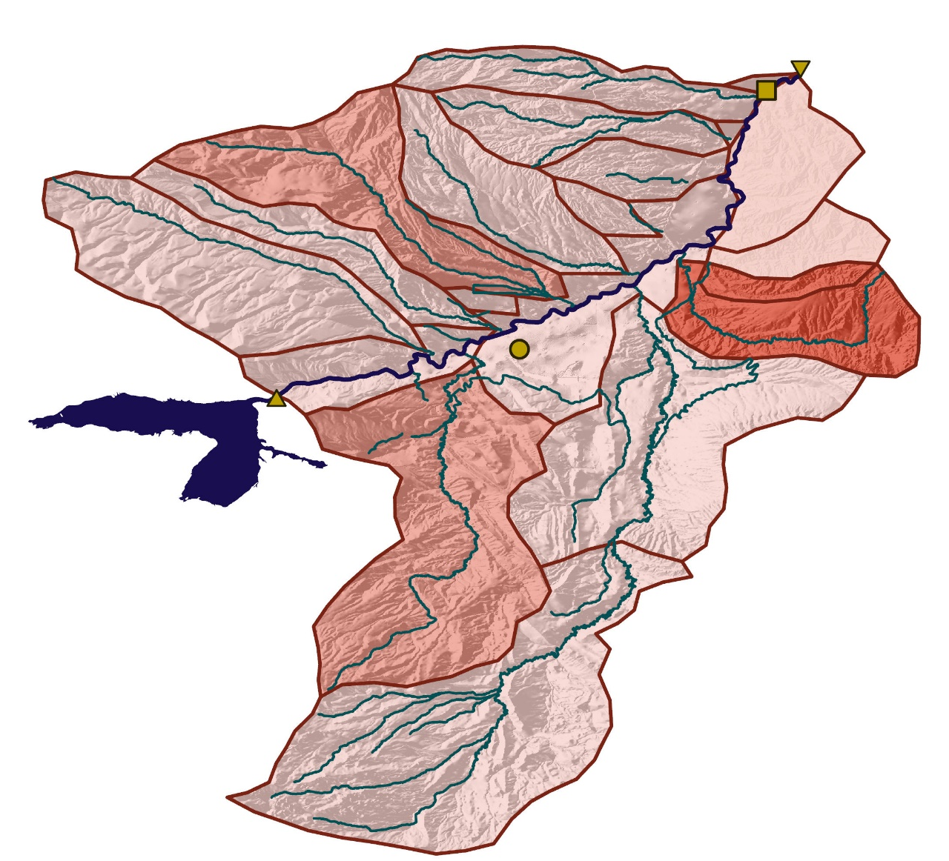

RESULTS: Sediment RS
# | Stream Name | # RS Events | Prior Concern Level
1 | Sulphur Creek | Medium | High
2 | Cottonwood Creek | Low | Medium
3 | Sage Creek | Low | High
4 | Idaho Creek | Low | Medium
5 | Dry Creek/ Homesteader Creek | High | High
6 | Penney Gulch | High | Unknown
Cody, WY
Buffalo Bill Dam
Willwood Dam
USGS Gage
Shoshone River
Major Tributaries
Buffalo Bill Reservoir
Low Priority
Medium Priority
High Priority
Subwatersheds
0 5km 10km
N
Notes:
I also want to specifically point out that Penney Gulch previously had not been identified as a high sediment load stream and plumes may have been assumed to be only coming from Dry/Homesteader.
------------------------------Image Credits ------------------------------ ​
Map created by the Shoshone WR II team.

Slide 27
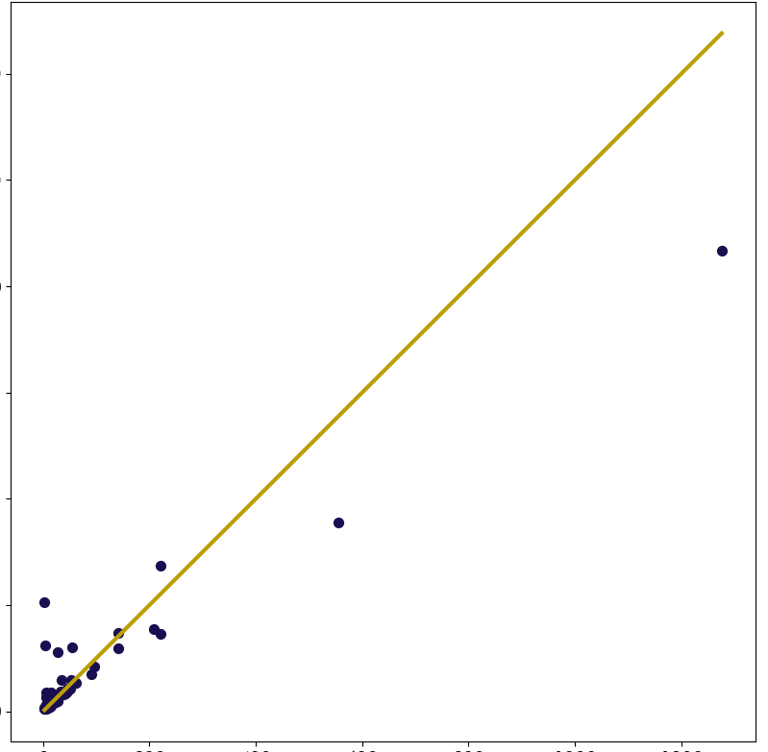
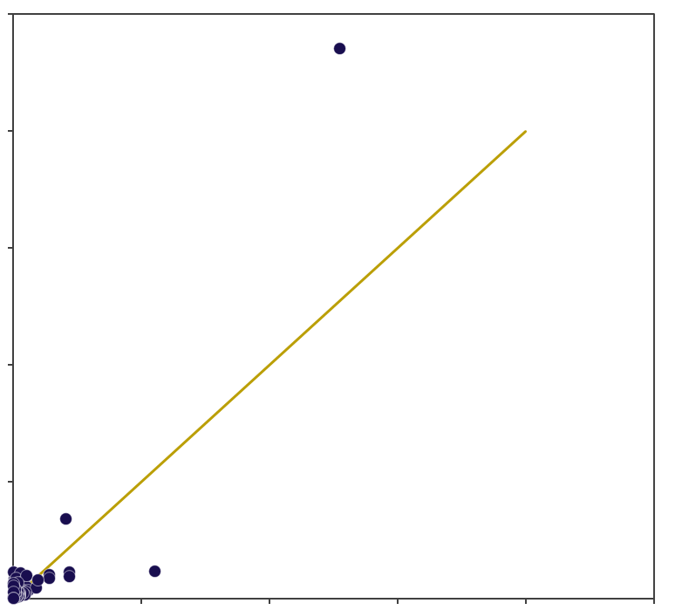
RESULTS: Sediment RS – Comparing Methods
Machine Learning
Calibration Equation
Validation Data R² = 0.93
All Data R² = 0.92
All Data R² = 0.80
The machine learning co-efficient of determination (R²) is higher (better) than the calibration equation.
ML – Actual vs Predicted Turbidity
Calibration – Actual vs Predicted Turbidity
(All Data)
2500
2000
1500
1000
500
0
(All Data)
1200
1000
800
600
400
200
0
Predicted Turbidity (FNU)
Predicted Turbidity (FNU)
Observed VS Predicted Turbidity
0 200 400 600 800 1000 1200
1:1 (Observed = Predicted) Line
0 500 1000 1500 2000 2500
Actual Turbidity (FNU)
Actual Turbidity (FNU)
Notes:
One way to compare the two methods of turbidity prediction, is to use the co-efficient of determination. This value gives a rough idea of how well the method predicts turbidity when compared to observed data. The machine learning model resulted in a R^2 of .93 while the calibration equation had a R^2 value of .XX. The plot is similar to the one at the beginning of the presentation, and shows the predicted and observed points compared to each other. This plot is of all data.
------------------------------Image Credits ------------------------------ ​
Plots created by Shoshone WR II develop team.

Slide 28
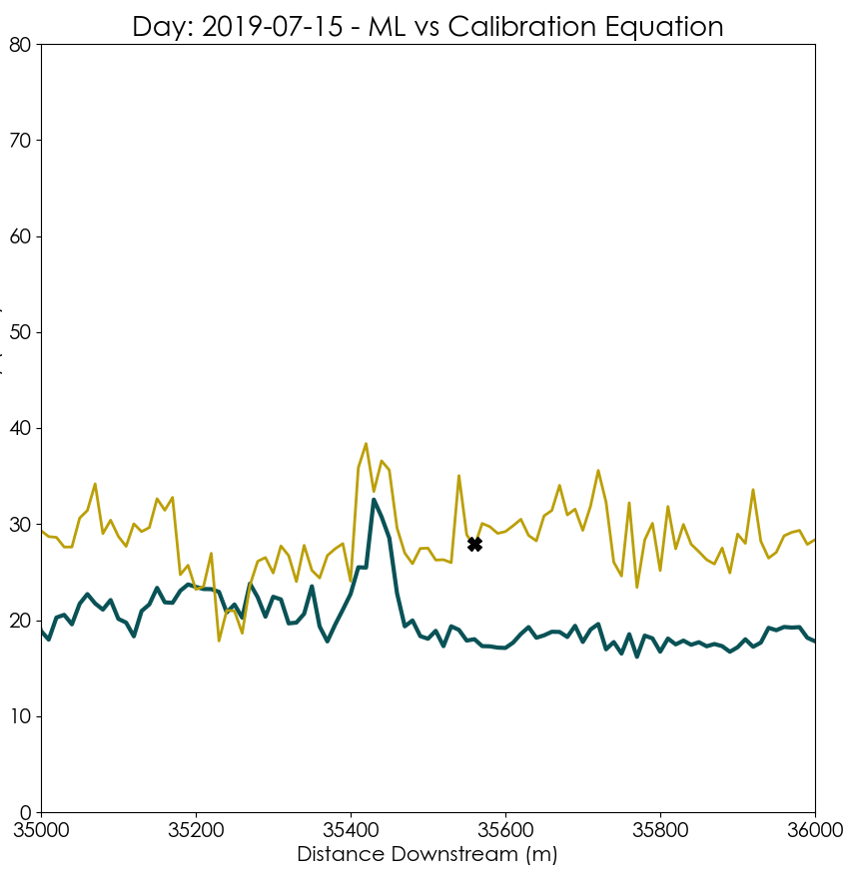
RESULTS: Sediment RS – Comparing Methods
Day: 2019-07-15 : ML vs Calibration Equation
80
70
60
50
40
30
20
10
0
Initial analysis seems to point at the method of machine learning out-predicting the calibration equation method.
Out of 33 comparisons between predicted and observed points:
Predicted Turbidity (FNU)
The Machine learning Method was closer to the observed point
24 times (72.7%)
The Calibration Equation Method was closer to the observed point
9 times (27.3%)
35 35.2 35.4 35.6 35.8 36
Distance Downstream (km)
Machine Learning Prediction
Calibration Equation Prediction
USGS Station (Point of Observed Data)
Notes:
An additional comparison is to plot the amount of turbidity predicted by each method on a longitudinal scale (distance downstream). The two methods are plotted, and the observed data point is also plotted at the distance of about 35.6km downstream, where the turbidity was measured on that day. Out of 33 comparisons, the machine learning model was closer to the observed point 24 times (or about 73% of the time) and the calibration equation method was closer 9 times (or about 27% of the time).
------------------------------Image Credits ------------------------------ ​
Plot created by Shoshone WR II develop team.

Slide 29
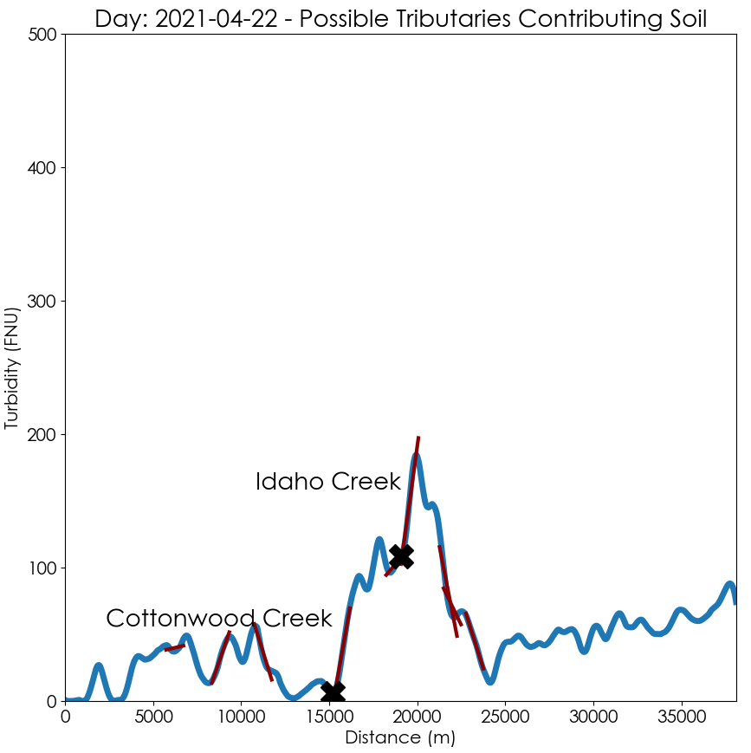
RESULTS: Sediment RS – Auto Plume Detection
Day: 2021-04-22 : Possible Tributaries Contributing Soil
Out of 397 days analyzed:
20 days had possible plumes.
31 total possible plume events were detected.
500
400
300
200
100
0
Stream Name | # RS Events | Prior Concern Level
Sulphur Creek | 7 | High Priority
Cottonwood Creek | 7 | Medium Priority
Idaho Creek | 4 | Medium Priority
Dry Creek/Homesteader Creek | 3 | High Priority
Dry Creek | 3 | Low Priority
Dry Gulch | 3 | Low Priority
Penney Gulch | 2 | Unknown
Sage Creek | 1 | High Priority
Trail Creek | 1 | Low Priority
Predicted Turbidity (FNU)
Idaho Creek
Cottonwood Creek
0 5 10 15 20 25 30 35
Distance Downstream (km)
Notes:
This shows the results of the automatic plume detection method. This method of automatically detecting plumes looks at an average of a 50 unit of turbidity increase over 1KM after where the tributary enters the Shoshone river. If there is a 50 unit of turbidity increase, the plume is marked as a possible event, the tributary is named on the plot, and the # of total possible events are recorded for each tributary.
------------------------------Image Credits ------------------------------ ​
Plot created by Shoshone WR II develop team.

Slide 30
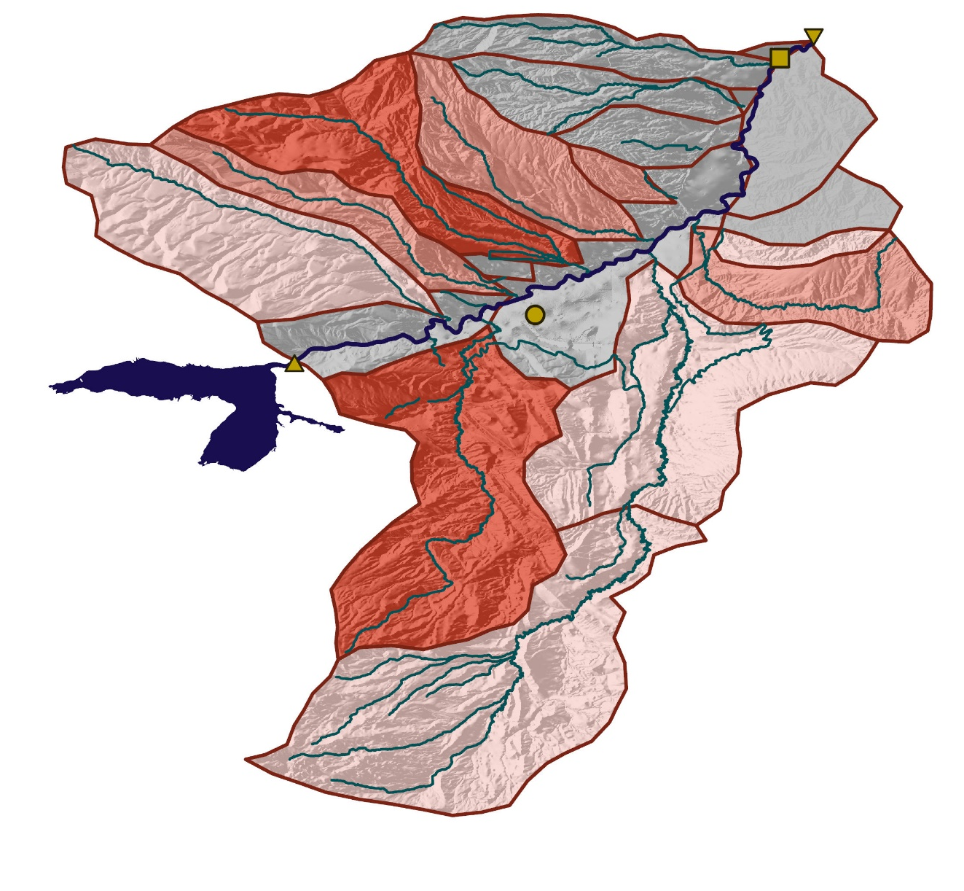
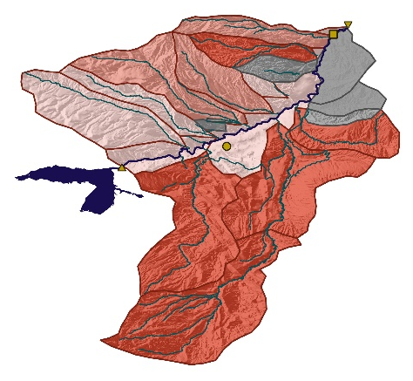
RESULTS: Sediment RS – Comparing Methods
Manual Event Interpretation
Automated Event Interpretation
Previous Priorities
Cody, WY
Buffalo Bill Dam
Willwood Dam
USGS Gage
Shoshone River
Major Tributaries
Buffalo Bill Reservoir
Low Priority
Medium Priority
High Priority
Unknown
Subwatersheds
0 5km 10km
N
Notes:
These maps compare the priority watersheds as determined by manual event interpretation (looking though plots and images) automated interpretation and the priorities identified by Shoshone River Partners.
Take into consideration that there were not consistent criteria between these three methods of categorization. Our two maps were created by categorizing by relative number and/or severity of events seen in each subwatershed.
------------------------------Image Credits ------------------------------ ​
Maps created by the Shoshone WR II team.

Slide 31
RESULTS: Sediment RS – Comparing Methods
 | Pros | Cons
Machine Learning | Automatically & easily determines patterns to represent data (may be better with more complex band interactions) Outputs relative importance of bands. Seems to predict winter month inconsistences well. | Long image Processing time (~10min / image) Very complex to prove “how” the model calculated the output.
Calibration | Faster to run image processing. You know exactly what the equation/relationship used was. | Need user input to choose equation. May struggle with complex relationships or take data preprocessing (ie. had to figure we needed to give it ln(T)).
Notes:
Machine learning is a easy to setup approach that performs sufficiently. It automatically finds patterns to predict the about than may be hard to find if you are manualing creating a calibration equation. The downside is that it takes a while to process images (~10min per image). To process 500 images, it would take about 3.5 days to process. The calibration equation can quickly process images. Another perk of the calibration equation, is that you know the exact equation/relation that was used to create the equation to predict turbidity. Machine learning is a compelx process that is hard to prove why the output is what it is.

Slide 32
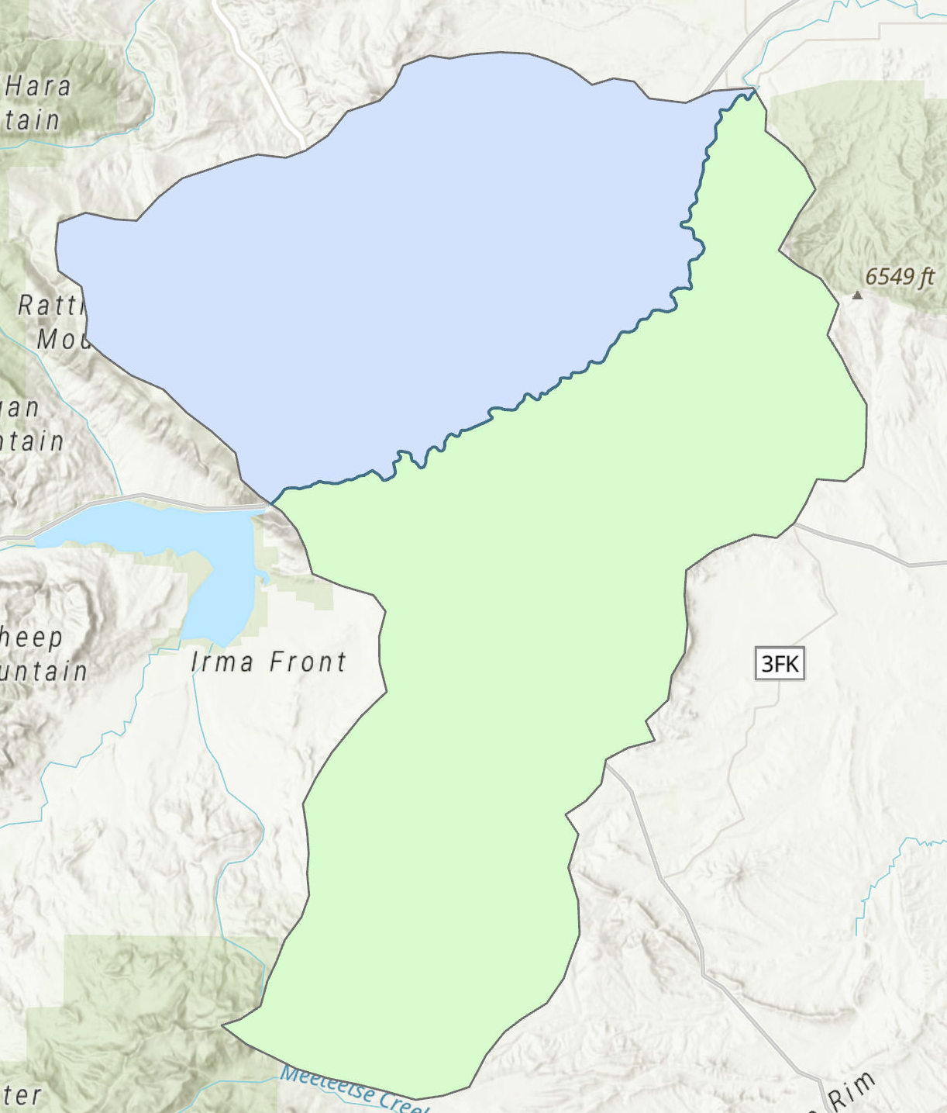
1/1/2019
2/1/2019
3/1/2019
4/1/2019
5/1/2019
6/1/2019
7/1/2019
8/1/2019
9/1/2019
10/1/2019
11/1/2019
12/1/2019
1/1/2020
2/1/2020
3/1/2020
4/1/2020
5/1/2020
6/1/2020
7/1/2020
8/1/2020
9/1/2020
10/1/2020
11/1/2020
12/1/2020
1/1/2021
2/1/2021
3/1/2021
4/1/2021
5/1/2021
6/1/2021
7/1/2021
8/1/2021
9/1/2021
10/1/2021
RESULTS: Snow Cover Time Series
NW
100
90
80
70
60
50
40
30
20
10
0
SE
% Snow Cover
SEBank % Snow Covered Pixels
NWBank % Snow Covered Pixels
FullSA % Snow Covered Pixels
Notes:
Graph showing percentage of snow-covered pixel values. Grey values represent the entire watershed, green the southeast (SE) portion, and blue the northwest (NW) portion. The values follow similar trends probably due to relationship with temperature and precipitation over the entire region. However, the NW region of the watershed has consistently greater percentage of area snow covered, at an average of 26.8% more snow covered pixels than the SE region for the entire study period.

Slide 33
1/1/2019
2/1/2019
3/1/2019
4/1/2019
5/1/2019
6/1/2019
7/1/2019
8/1/2019
9/1/2019
10/1/2019
11/1/2019
12/1/2019
1/1/2020
2/1/2020
3/1/2020
4/1/2020
5/1/2020
6/1/2020
7/1/2020
8/1/2020
9/1/2020
10/1/2020
11/1/2020
12/1/2020
1/1/2021
2/1/2021
3/1/2021
4/1/2021
5/1/2021
6/1/2021
7/1/2021
8/1/2021
9/1/2021
10/1/2021
1/1/2019
2/1/2019
3/1/2019
4/1/2019
5/1/2019
6/1/2019
7/1/2019
8/1/2019
9/1/2019
10/1/2019
11/1/2019
12/1/2019
1/1/2020
2/1/2020
3/1/2020
4/1/2020
5/1/2020
6/1/2020
7/1/2020
8/1/2020
9/1/2020
10/1/2020
11/1/2020
12/1/2020
1/1/2021
2/1/2021
3/1/2021
4/1/2021
5/1/2021
6/1/2021
7/1/2021
8/1/2021
9/1/2021
10/1/2021
RESULTS: Snow Cover Time Series
1/1/2019
2/1/2019
3/1/2019
4/1/2019
5/1/2019
6/1/2019
7/1/2019
8/1/2019
9/1/2019
10/1/2019
11/1/2019
12/1/2019
1/1/2020
2/1/2020
3/1/2020
4/1/2020
5/1/2020
6/1/2020
7/1/2020
8/1/2020
9/1/2020
10/1/2020
11/1/2020
12/1/2020
1/1/2021
2/1/2021
3/1/2021
4/1/2021
5/1/2021
6/1/2021
7/1/2021
8/1/2021
9/1/2021
10/1/2021
1/1/2019
2/1/2019
3/1/2019
4/1/2019
5/1/2019
6/1/2019
7/1/2019
8/1/2019
9/1/2019
10/1/2019
11/1/2019
12/1/2019
1/1/2020
2/1/2020
3/1/2020
4/1/2020
5/1/2020
6/1/2020
7/1/2020
8/1/2020
9/1/2020
10/1/2020
11/1/2020
12/1/2020
1/1/2021
2/1/2021
3/1/2021
4/1/2021
5/1/2021
6/1/2021
7/1/2021
8/1/2021
9/1/2021
10/1/2021
4.5
4
3.5
3
2.5
2
1.5
1
0.5
0
100
90
80
70
60
50
40
30
20
10
0
Precipitation
% Snow Cover
FullSA % Snow Covered Pixels
Snow + Liquid Precipitation (in.)
100
80
60
40
20
0
-20
100
80
60
40
20
0
Temperature
% Snow Cover
FullSA % Snow Covered Pixels
Average Temperature (F)
Notes:
Graphs for precipitation and temperature for study period compared against % snow cover for entire watershed. Demonstrates the conditions present for snow fall/snow melt (large increases/decreases in snow cover)

Slide 34
RESULTS: Snow Cover Time Series
Discharge
100
90
80
70
60
50
40
30
20
10
0
100
90
80
70
60
50
40
30
20
10
0
7000
6000
5000
4000
3000
2000
1000
0
7000
6000
5000
4000
3000
2000
1000
0
% Snow Cover
Discharge
% Snow Cover
Discharge
Turbidity
Suspended Sediment Concentration
1/1/2019
4/1/2019
9/1/2019
9/1/2020
3/1/2021
1/1/2019
7/1/2019
6/1/2020
1/1/2021
8/1/2021
4/1/2021
9/1/2021
8/1/2019
2/1/2020
7/1/2020
2/1/2021
6/1/2021
5/1/2019
1/1/2020
4/1/2020
8/1/2020
7/1/2021
2/1/2019
6/1/2019
5/1/2020
5/1/2021
3/1/2019
3/1/2020
4/1/2019
9/1/2019
9/1/2020
3/1/2021
7/1/2019
6/1/2020
1/1/2021
8/1/2021
4/1/2021
9/1/2021
8/1/2019
2/1/2020
7/1/2020
2/1/2021
6/1/2021
5/1/2019
1/1/2020
4/1/2020
8/1/2020
7/1/2021
2/1/2019
6/1/2019
5/1/2020
5/1/2021
12/1/2019
11/1/2020
10/1/2021
3/1/2019
3/1/2020
10/1/2020
10/1/2019
12/1/2020
11/1/2019
12/1/2019
11/1/2020
10/1/2021
10/1/2020
10/1/2019
12/1/2020
11/1/2019
Turbidity
NWBank % Snow Covered Pixels
Discharge cubic ft per sec
Turbidity
SEBank % Snow Covered Pixels
Discharge cubic ft per sec
4500
4000
3500
3000
2500
2000
1500
1000
500
0
100
90
80
70
60
50
40
30
20
10
0
4500
4000
3500
3000
2500
2000
1500
1000
500
0
100
90
80
70
60
50
40
30
20
10
0
% Snow Cover
% Snow Cover
1/1/2019
4/1/2019
9/1/2019
9/1/2020
3/1/2021
7/1/2019
6/1/2020
1/1/2021
8/1/2021
4/1/2021
9/1/2021
8/1/2019
2/1/2020
7/1/2020
2/1/2021
6/1/2021
1/1/2019
5/1/2019
1/1/2020
4/1/2020
8/1/2020
7/1/2021
2/1/2019
6/1/2019
5/1/2020
5/1/2021
3/1/2019
12/1/2019
3/1/2020
11/1/2020
10/1/2021
10/1/2020
10/1/2019
12/1/2020
11/1/2019
4/1/2019
9/1/2019
9/1/2020
3/1/2021
7/1/2019
6/1/2020
1/1/2021
8/1/2021
4/1/2021
9/1/2021
8/1/2019
2/1/2020
7/1/2020
2/1/2021
6/1/2021
5/1/2019
1/1/2020
4/1/2020
8/1/2020
7/1/2021
2/1/2019
6/1/2019
5/1/2020
5/1/2021
3/1/2019
12/1/2019
3/1/2020
11/1/2020
10/1/2021
10/1/2020
10/1/2019
12/1/2020
11/1/2019
SSC
Turbidity FNU
SSC
NWBank % Snow Covered Pixels
SEBank % Snow Covered Pixels
Turbidity FNU
100
90
80
70
60
50
40
30
20
10
0
1400
1200
1000
800
600
400
200
0
% Snow Cover
% Snow Cover
100
90
80
70
60
50
40
30
20
10
0
1/1/2019
4/1/2019
9/1/2019
9/1/2020
3/1/2021
7/1/2019
6/1/2020
1/1/2021
8/1/2021
4/1/2021
9/1/2021
8/1/2019
2/1/2020
7/1/2020
2/1/2021
6/1/2021
5/1/2019
1/1/2020
4/1/2020
8/1/2020
7/1/2021
2/1/2019
6/1/2019
5/1/2020
5/1/2021
3/1/2019
12/1/2019
3/1/2020
11/1/2020
10/1/2021
10/1/2020
10/1/2019
12/1/2020
1/1/2019
4/1/2019
9/1/2019
9/1/2020
3/1/2021
11/1/2019
7/1/2019
6/1/2020
1/1/2021
8/1/2021
4/1/2021
9/1/2021
8/1/2019
2/1/2020
7/1/2020
2/1/2021
6/1/2021
5/1/2019
1/1/2020
4/1/2020
8/1/2020
7/1/2021
2/1/2019
6/1/2019
5/1/2020
5/1/2021
3/1/2019
12/1/2019
3/1/2020
11/1/2020
10/1/2021
10/1/2020
10/1/2019
12/1/2020
11/1/2019
SEBank % Snow Covered Pixels
Suspended Sediment Concentration mg/L
NWBank % Snow Covered Pixels
Suspended Sediment Concentration mg/L
NW Watershed
SE Watershed
Notes:
Image to compare three variables (discharge, turbidity, and SSC) from in-situ measurements. This figure demonstrates the temporal relationship between the 3 variables and the data for each variable will be more closely examined on subsequent slides.
Definitions:
Turbidity:
Turbidity is the measure of relative clarity of a liquid. It is an optical characteristic of water and is a measurement of the amount of light that is scattered by material in the water when a light is shined through the water sample.
Discharge:
Discharge is the volume of water moving down a stream or river per unit of time. Calculated as water velocity x chanel area (depth x width)
Suspended Sediment Concentration:
Dry weight of sediment from a known volume of water-sediment mixture (clay, silt, sand and organic matter) (mg/L).
FNU:
Formazin Nephelometric Unit
Definitions from USGS and EPA

Slide 35
1/1/2019
2/1/2019
3/1/2019
4/1/2019
5/1/2019
6/1/2019
7/1/2019
8/1/2019
9/1/2019
10/1/2019
11/1/2019
12/1/2019
1/1/2020
2/1/2020
3/1/2020
4/1/2020
5/1/2020
6/1/2020
7/1/2020
8/1/2020
9/1/2020
10/1/2020
11/1/2020
12/1/2020
1/1/2021
2/1/2021
3/1/2021
4/1/2021
5/1/2021
6/1/2021
7/1/2021
8/1/2021
9/1/2021
10/1/2021
RESULTS: Snow Cover Time Series
Discharge
7000
6000
5000
4000
3000
2000
1000
0
1/1/2019
2/1/2019
3/1/2019
4/1/2019
5/1/2019
6/1/2019
7/1/2019
8/1/2019
9/1/2019
10/1/2019
11/1/2019
12/1/2019
1/1/2020
2/1/2020
3/1/2020
4/1/2020
5/1/2020
6/1/2020
7/1/2020
8/1/2020
9/1/2020
10/1/2020
11/1/2020
12/1/2020
1/1/2021
2/1/2021
3/1/2021
4/1/2021
5/1/2021
6/1/2021
7/1/2021
8/1/2021
9/1/2021
10/1/2021
100
90
80
70
60
50
40
30
20
10
0
Discharge
% Snow Cover
NW Watershed
NWBank % Snow Covered Pixels
Discharge cubic ft per sec
7000
6000
5000
4000
3000
2000
1000
0
100
90
80
70
60
50
40
30
20
10
0
Discharge
% Snow Cover
SE Watershed
SEBank % Snow Covered Pixels
Discharge cubic ft per sec
Notes:
Discharge values compared against snow cover for each side of the watershed divided at the river. The discharge values are the same for each graph and are not representative of values for each side of the watershed, but rather the Shoshone River. (This applies to all values excluding % snow cover)

Slide 36

RESULTS: Snow Cover Time Series
7000
6000
5000
4000
3000
2000
1000
0
1/1/2019
2/1/2019
3/1/2019
4/1/2019
5/1/2019
6/1/2019
7/1/2019
8/1/2019
9/1/2019
10/1/2019
11/1/2019
12/1/2019
1/1/2020
2/1/2020
3/1/2020
4/1/2020
5/1/2020
6/1/2020
7/1/2020
8/1/2020
9/1/2020
10/1/2020
11/1/2020
12/1/2020
1/1/2021
2/1/2021
3/1/2021
4/1/2021
5/1/2021
6/1/2021
7/1/2021
8/1/2021
9/1/2021
10/1/2021
100
90
80
70
60
50
40
30
20
10
0
Discharge Above Willwood Dam vs Snow Cover
Spring Sediment Mobilization
March 28th – April 4th
+
Late Season Snow Melt
April 7th
4000 cfs flows released upstream from Buffalo Bill Reservoir
Discharge
% Snow Cover
FullSA % Snow Covered Pixels
Discharge cubic ft per sec
Notes:
The same discharge values are shown here, compared to the snow cover for the entire study area. Periods of high discharge values are highlighted in spring months and correlated to planning operations for environmental flows and seasonal snow melt.

Slide 37
1/1/2019
2/1/2019
3/1/2019
4/1/2019
5/1/2019
6/1/2019
7/1/2019
8/1/2019
9/1/2019
10/1/2019
11/1/2019
12/1/2019
1/1/2020
2/1/2020
3/1/2020
4/1/2020
5/1/2020
6/1/2020
7/1/2020
8/1/2020
9/1/2020
10/1/2020
11/1/2020
12/1/2020
1/1/2021
2/1/2021
3/1/2021
4/1/2021
5/1/2021
6/1/2021
7/1/2021
8/1/2021
9/1/2021
10/1/2021
RESULTS: Snow Cover Time Series
Turbidity
4500
4000
3500
3000
2500
2000
1500
1000
500
0
1/1/2019
2/1/2019
3/1/2019
4/1/2019
5/1/2019
6/1/2019
7/1/2019
8/1/2019
9/1/2019
10/1/2019
11/1/2019
12/1/2019
1/1/2020
2/1/2020
3/1/2020
4/1/2020
5/1/2020
6/1/2020
7/1/2020
8/1/2020
9/1/2020
10/1/2020
11/1/2020
12/1/2020
1/1/2021
2/1/2021
3/1/2021
4/1/2021
5/1/2021
6/1/2021
7/1/2021
8/1/2021
9/1/2021
10/1/2021
100
90
80
70
60
50
40
30
20
10
0
Turbidity
% Snow Cover
NW Watershed
NWBank % Snow Covered Pixels
Turbidity FNU
4500
4000
3500
3000
2500
2000
1500
1000
500
0
100
90
80
70
60
50
40
30
20
10
0
Turbidity
% Snow Cover
SE Watershed
SEBank % Snow Covered Pixels
Turbidity FNU
Notes:
Turbidity values compared against snow cover for each side of the watershed divided at the river. These are values from in-situ measurements not the turbidity analysis conducted in other parts of this project.

Slide 38
RESULTS: Snow Cover Time Series
1/1/2019
2/1/2019
3/1/2019
4/1/2019
5/1/2019
6/1/2019
7/1/2019
8/1/2019
9/1/2019
10/1/2019
11/1/2019
12/1/2019
1/1/2020
2/1/2020
3/1/2020
4/1/2020
5/1/2020
6/1/2020
7/1/2020
8/1/2020
9/1/2020
10/1/2020
11/1/2020
12/1/2020
1/1/2021
2/1/2021
3/1/2021
4/1/2021
5/1/2021
6/1/2021
7/1/2021
8/1/2021
9/1/2021
10/1/2021
1400
1200
1000
800
600
400
200
0
Turbidity vs Snow Cover
100
90
80
70
60
50
40
30
20
10
0
Turbidity
% Snow Cover
FullSA % Snow Covered Pixels
Turbidity FNU
Notes:
The same turbidity values are shown here, compared to the snow cover for the entire study area. Max values capped at 1500 for turbidity to better see trends for lower FNU values. Some correlation represented between snow melt events (significant decrease in snow cover) and spikes in turbidity, specifically 2021. Note that there are higher turbidity values detected in Summer months.

Slide 39
1/1/2019
2/1/2019
3/1/2019
4/1/2019
5/1/2019
6/1/2019
7/1/2019
8/1/2019
9/1/2019
10/1/2019
11/1/2019
12/1/2019
1/1/2020
2/1/2020
3/1/2020
4/1/2020
5/1/2020
6/1/2020
7/1/2020
8/1/2020
9/1/2020
10/1/2020
11/1/2020
12/1/2020
1/1/2021
2/1/2021
3/1/2021
4/1/2021
5/1/2021
6/1/2021
7/1/2021
8/1/2021
9/1/2021
10/1/2021
RESULTS: Snow Cover Time Series
Suspended Sediment Concentration
1400
1200
1000
800
600
400
200
0
1/1/2019
2/1/2019
3/1/2019
4/1/2019
5/1/2019
6/1/2019
7/1/2019
8/1/2019
9/1/2019
10/1/2019
11/1/2019
12/1/2019
1/1/2020
2/1/2020
3/1/2020
4/1/2020
5/1/2020
6/1/2020
7/1/2020
8/1/2020
9/1/2020
10/1/2020
11/1/2020
12/1/2020
1/1/2021
2/1/2021
3/1/2021
4/1/2021
5/1/2021
6/1/2021
7/1/2021
8/1/2021
9/1/2021
10/1/2021
100
90
80
70
60
50
40
30
20
10
0
SSC
% Snow Cover
NW Watershed
NWBank % Snow Covered Pixels
Suspended Sediment Concentration mg/L
1400
1200
1000
800
600
400
200
0
SSC
100
90
80
70
60
50
40
30
20
10
0
% Snow Cover
SE Watershed
SEBank % Snow Covered Pixels
Suspended Sediment Concentration mg/L
Notes:
Suspended sediment concentration values compared against snow cover for each side of the watershed divided at the river.

Slide 40
1/1/2019
2/1/2019
3/1/2019
4/1/2019
5/1/2019
6/1/2019
7/1/2019
8/1/2019
9/1/2019
10/1/2019
11/1/2019
12/1/2019
1/1/2020
2/1/2020
3/1/2020
4/1/2020
5/1/2020
6/1/2020
7/1/2020
8/1/2020
9/1/2020
10/1/2020
11/1/2020
12/1/2020
1/1/2021
2/1/2021
3/1/2021
4/1/2021
5/1/2021
6/1/2021
7/1/2021
8/1/2021
9/1/2021
10/1/2021
RESULTS: Snow Cover Time Series
1400
1200
1000
800
600
400
200
0
Suspended Sediment Concentration vs Snow Cover
100
90
80
70
60
50
40
30
20
10
0
SSC
% Snow Cover
FullSA % Snow Covered Pixels
FullSA % Snow Covered Pixels
Suspended Sediment Concentration mg/L
= Decrease in snow cover + increase in SSC
Notes:
The same SSC values are shown here, compared to the snow cover for the entire study area. Periods where a decrease in snow cover (possibly meaning snow melt events) and a sudden increase in SSC are highlighted.

Slide 41

ERRORS/UNCERTAINTIES
SWAT Model
  266 unknown soil types coerced to most common type
  Limited observed data
  Does not account for irrigation or reservoir releases
Sediment RS
  Winter = high variability in reflectance
  Clouds limit imagery dates, may bias results
  Difficult to distinguish small plumes downstream of other plumes
  Shallow areas, rapids, sand bars, unclipped land, & aquatic vegetation
Snow Cover TS
  Snow/cloud reflectance interference
  Spatial vs temporal resolution tradeoff
Image: Carmen McIntyre
Notes:
Some errors and uncertainties with the methods of our project include the unknown soil types mentioned earlier. Because 266 of the 2000 soil groups were undefined, they needed to be coerced to a known soil type in order to be read by SWAT. We chose to coerce these to the most frequently occurring soil type in the study region; however, this could have affected certain soil variables relevant to the community concerns. Most notably, this could have affected the soil erodibility factors. Additionally, SWAT is typically calibrated with 7-10 years of observed data at one or more gauges. With the Shoshone River study area, only 3 years of observed data was available at one point; therefore, our calibration was insufficient
**sediment**
We didn’t have time to go into this but we figured out this term during calibration that winter had highly variable reflectance that did not track with turbidity. It’s most likely this was caused by reflectance off snow and ice and possibly compounded by low levels in the tailwater behind willwood dam (which would influence water levels at the USGS gage). This may impact our ability to accurately measure turbidity during winter months, though this may not be an issue with ML.
While it is high temporal resolution information, it isn’t continuous and, especially right after rainfall events when sediment mobilization events are likely to happen. Having imagery from only a small fraction of total rainfall events may bias our results (from small sample size)
Another issue is very small plumes or moderate plumes can be difficult to detect in already turbid water, therefore plumes might get masked by upstream plumes.
Additionally there are multiple causes of inaccurate turbidity observations such as shallow water, rapids, sand bars or other unclipped land and aquatic vegetation which are all challenging to remove.
**snow**
The snow cover percent data is calculated using satellite imagery, which can be impacted by interference in surface reflectance, especially cloud and snow reflectance. The spatial resolution for the snow cover images were 375m, which was a tradeoff in favor of daily temporal resolution. More precise data may be created from finer resolution imagery to reflect subtler differences of snow cover across the landscape.
------------------------------Image Credits ------------------------------ ​
Image of the Willwood Dam provided by Carmen McIntyre, Shoshone River Partners.

Slide 42
CONCLUSIONS
SWAT+
The model provides high resolution analysis with limited gauge data
Visualizes sediment flow and identifies specific regions of issue
Lack of sufficient observed data resulted in model uncertainties
Soil flow (mm)
0.0 - 9.2
9.2 - 35.7
35.7 - 88.9
88.9 - 274.1
274.1 - 690.0
0 5km
Notes:
The SWAT+ model is sufficient in providing high-resolution analysis of a watershed to determine high-priority regions of remediation. With limited stream gauge data, SWAT+ is better at identifying where high sedimentation and snowfall is occurring rather than targeting specific quantitative amounts.

Slide 43

CONCLUSIONS
Sediment RS
Remote sensing provides reliable spatial turbidity measurements for the Shoshone River
Penney Gulch, Sulphur Creek and Dry Creek had the largest plumes
Both machine learning and Calibration perform well but ML perform slightly better than calibration
Notes:
Our methods for remotely sensing turbidity in the Shoshone river are now very reliable, especially for summer months. Analyzing data for 2019-2021 revealed Penney Gulch, Dry/Homesteader Creek and Sulphur creek to have the largest and most frequent plumes. Machine learning and calibration both perfomed sufficiently well though we have reasons to believe machine learning performed better. They were also about equally easy to implement though that depends what skills and knowledge you already have. ML learning did take much longer to process images depending on study area, period, and computing resources, that might be an issue.
------------------------------Image Credits ------------------------------ ​
Basemap and turbidity derived from PlanetScope Imagery.

Slide 44
CONCLUSIONS
Snow Cover TS
Provides visual representation of relationships between hydrologic variables, including the influence of snow cover/snow melt
Correlation between trends in snow cover with other factors that influence sediment transport
Use of remote sensing to quantify snow cover extent
Notes:
Snow cover analysis allows for creating quantitative snow cover extent values which can be analyzed and/or disseminated. These extent values can be used for both temporal and spatial applications. Use of these values in the time series, allows for visualization of relationships and trends between snow cover extent and hydrologic factors that influence sediment transport.
In conclusion, remote sensing and hydrological modeling are both feasible options to direct watershed management practices for reducing sedimentation to the Willwood Dam.
------------------------------Image Credits ------------------------------ ​
Image and maps made using Suomi VIIRS imagery.

Slide 45
CONCLUSIONS
Overall
Analysis resulted in the identification of sediment sources contributing to sediment accumulation behind Willwood Dam
Coupling environmental modeling and remote sensing provides effective and accessible results to direct management practices
Cody, WY
Buffalo Bill Dam
Willwood Dam
USGS Gage
Shoshone River
Major Tributaries
Buffalo Bill Reservoir
Low Priority
Medium Priority
High Priority
Subwatersheds
0 5km 10km
N
Notes:
Remote sensing-based turbidity observations added information on which tributaries to focus on while trying to tackle the issue of excess sediment in the Shoshone river basin. These results can be included in future management considerations and decisions.
------------------------------Image Credits ------------------------------ ​
Map created by Shoshone WR II team.

Slide 46

FUTURE WORK
SWAT Model
  Continue to refine SWAT+ model with observed data
Sediment RS
  Sediment transport estimations based on plume size, concentration, and streamflow could be explored
Snow Cover TS
  Methods for snow cover analysis are scalable and can be applied to specific sub-watersheds
Image: Carmen McIntyre
Notes:
Going forward, we would like to continue to refine the Shoshone River SWAT model with any further observed stream data, and tweak the soil data to better match the undefined soils in their respective regions.
** sediment **
** snow **
Additional spatial applications of the snow cover ts methods may be of future interest, such as potentially looking at variation in snow cover extent on a smaller (sub-basin) scale.
With these results, the Shoshone River Partners will be able to go forward in using remote sensing and modeling to implement remediation techniques in the identified high-priority areas. In doing so, soil erosion into tributaries should decrease causing a reduction in the amount of sediment reaching and building up at the Willwood Dam. With lower sediment build-up releases can be less frequent and less intense which will preserve the aquatic habitat and biodiversity and allow for the surrounding community to flourish.

Slide 47
Special thank you to our Science Advisor and Fellow:
Austin Madson (University of Wyoming, Assistant Professor)
Caroline Williams (NASA DEVELOP, Fellow)
We would also like to thank our project partners for their input and guidance:
David Waterstreet (WYDEQ)
Carmen McIntyre (WYDEQ, Shoshone River Partners)
Jason Alexander (USGS)
Finally, the previous project contributors:
Cassie Ferrante
Nelson Lemnyuy
Will Campbell
Thank you to the WyGISC department for hosting us!
Notes:
Once again, thank you so much for attending our presentation. Before we close, our team would like to give a huge thanks to our adviser, Austin, and our fellow, Caroline, as well as our partners David, Carmen, and Jason. Finally, we would like to note the three contributors from term 1 of this project: Cassie, Nelson, and Will. We would also like to thank Austin and the WyGISC department for hosting us this term at the Pop-Up location! Thank you all for your contributions, and with that, we will open the floor for any questions.

Slide 48
EXTRA SLIDES

Slide 49


METHODS: Sediment RS
Log transforming turbidity makes the reflectance relationship more linear:
Turbidity vs Red Reflectance
ln(Turbidity) vs Red Reflectance
0.00003
0.000025
0.00002
0.000015
0.00001
0.000005
0
0.000025
0.00002
0.000015
0.00001
0.000005
0
Red Reflectance
Red Reflectance
0 200 400 600 800 1000 1200 1400
0 1 2 3 4 5 6 7 8
Turbidity
R² = 0.3197
ln(Turbidity)
R² = 0.2249
Notes:
The plot on the left shows turbidity vs red reflectance while the plot on the right uses the natural log of turbidity. While the R2 is worse (I can’t explain why) you can see visually that it is much closer to a linear relationship.

Slide 50

Jan
Feb
March
April
May
June
July
August
September
October
November
December
METHODS: Sediment RS
Plotting turbidity and reflectance by day of year reveals a different relationship in the winter:
0.000025
0.00002
0.000015
0.00001
0.000005
0
Reflectance and ln(Turbidity), sorted by DOY
10
9
8
7
6
5
4
3
2
1
0
Band Reflectance
ln (Turbidity)
Day of Year
Blue
Green
Red
NIR
ln(Turbidity)
Notes:
In this plot, band reflectance and log(turbidity) are plotted for each image, sorted by day of year. Band reflectance tracks well with turbidity during the summer months but sorting by DOY revealed that reflectance is much higher and variable during the winter.

Slide 51

METHODS: Sediment RS
Removing Nov-April greatly improves the relationship:
Turbidity vs Red Reflectance
Turbidity vs Red Reflectance
0.000025
0.00002
0.000015
0.00001
0.000005
0
(All Months)
0.000025
0.00002
0.000015
0.00001
0.000005
0
(May 1 – Oct. 31)
Red Reflectance
Red Reflectance
0 1 2 3 4 5 6 7 8
0 1 2 3 4 5 6 7 8
ln(Turbidity)
R² = 0.2249
ln(Turbidity)
R² = 0.8045
Notes:
The left image shows the relationship between red reflectance and natural log of turbidity for all dates, November-April have been removed in the right image, giving a much stronger relationship.

Slide 52


METHODS: Sediment RS
Observed VS Predicted Turbidity
1:1 (Observed = Predicted) Line
2500
2000
1500
1000
500
0
In-situ vs Remotely Sensed Turbidity
In-situ vs Remotely Sensed Turbidity
2500
2000
1500
1000
500
0
(All Months)
(All Months)
RS Turbidity (calibrated) (FNU)
RS Turbidity (calibrated) (FNU)
In-situ Turbidity (FNU)
0 500 1000 1500 2000 2500
0 500 1000 1500 2000 2500
In-situ Turbidity (FNU)
In-situ Turbidity (FNU)
Notes:
The left plot shows modeled vs actual turbidity excluding winter image dates while the right includes winter dates.

Slide 53

METHODS: Sediment RS
Observed VS Predicted Turbidity
1:1 (Observed = Predicted) Line
In-situ vs Remotely Sensed Turbidity
In-situ vs Remotely Sensed Turbidity
140
120
100
80
60
40
20
0
(All Months, outliers removed)
120
100
80
60
40
20
0
(May 1st – Oct 31st, outliers removed)
RS Turbidity (calibrated) (FNU)
RS Turbidity (calibrated) (FNU)
0 50 100 150 200 250
0 20 40 60 80 100 120
In-situ Turbidity (FNU)
In-situ Turbidity (FNU)
Notes:
The left plot shows modeled vs actual turbidity excluding winter image dates while the right includes winter dates. Both have been cropped to exclude major outliers so low values can be seen.

Slide 54








METHODS: Sediment RS
Equations tested during calibration:
Single Band
Double Band
Linear:
$$\ln\left(T\right)=a∗Band+b$$
DB1:
$$\ln\left(T\right)=a∗Band1+b∗{Band2}^{2}$$
Exponential:
$$\ln\left(T\right)=a ∗ e^{b ∗ Band}$$
$$\ln\left(T\right)=\frac{Band1}{a+b ∗Band2}$$
DB2:
$$\ln\left(T\right)=\frac{Band1}{a+b ∗ {Band2}^{2}}$$
Polynomial:
$$\ln\left(T\right)=a ∗{Band}^{2}+b$$
DB3:
Log:
$$\ln\left(T\right)=a+b∗log⁡(Band)$$
DB4:
$$\ln\left(T\right)=a ∗{Band1}^{b ∗Band2}$$
Notes:
We tested out 8 equations which are shown on this slide. A and b represent coefficients which were adjusted to fit the equation during calibration.

Slide 55
METHODS: Sediment RS
Single band calibration output:
Used this one.
Notes:
This slide shows the output of turbidity calibration. We used RMSE as the objective function and determined best fit by considering R2, NSE, and KGE. Single band linear relationship between ln(Turbidity) and the red band provided the best fit.

Slide 56
METHODS: Sediment RS
Double band calibration output:
Notes:
This slide shows the output of turbidity calibration. We used RMSE as the objective function and determined best fit by considering R2, NSE, and KGE.

Slide 57



Results: Automatic Plume Detection
Day: 2019-09-12 – Possible Tributaries Contributing Soil
Day: 2020-10-31 – Possible Tributaries Contributing Soil
Day: 2019-09-13 – Possible Tributaries Contributing Soil
500
400
300
200
100
0
500
400
300
200
100
0
500
400
300
200
100
0
Turbidity (FNU)
Turbidity (FNU)
Turbidity (FNU)
(All Data)
0 5 10 15 20 25 30 35
0 5 10 15 20 25 30 35
0 5 10 15 20 25 30 35
Distance (km)
Distance (km)
Distance (km)

Slide 58



RESULTS: Machine Learning VS Cal. Eq.
Day: 2019-06-12 – ML vs Calibration Equation
Day: 2019-05-06 – ML vs Calibration Equation
Day: 2019-06-06 – ML vs Calibration Equation
80
70
60
50
40
30
20
10
0
80
70
60
50
40
30
20
10
0
80
70
60
50
40
30
20
10
0
Predicted Turbidity (FNU)
Predicted Turbidity (FNU)
Predicted Turbidity (FNU)
35 35.2 35.4 35.6 35.8 36
35 35.2 35.4 35.6 35.8 36
35 35.2 35.4 35.6 35.8 36
Distance Downstream (km)
Distance Downstream (km)
Distance Downstream (km)
Machine Learning Prediction
Calibration Equation Prediction
USGS Station (Point of Observed Data)

Slide 59
CONCLUSIONS
SWAT+
The model provides high resolution analysis with limited gauge data
Visualizes sediment flow and identifies specific regions of issue
Lack of sufficient observed data resulted in model uncertainties
Soil flow (mm)
Sediment RS
Remote sensing provides reliable spatial turbidity measurements for the Shoshone River
Penney Gulch, Sulphur Creek and Dry Creek had the largest plumes
Both machine learning and Calibration perform well but ML perform slightly better than calibration
0.0 - 9.2
9.2 - 35.7
35.7 - 88.9
88.9 - 274.1
274.1 - 690.0
0 5km
Notes:
The SWAT+ model is sufficient in providing high-resolution analysis of a watershed to determine high-priority regions of remediation. With limited stream gauge data, SWAT+ is better at identifying where high sedimentation and snowfall is occurring rather than targeting specific quantitative amounts.
**sediment rs conclusion **

Slide 60
CONCLUSIONS
Snow Cover TS
Provides visual representation of relationships between hydrologic variables, including the influence of snow cover/snow melt.
Correlation between trends in snow cover with other factors that influence sediment transport.
Use of remote sensing to quantify snow cover extent.
Overall
Coupling environmental modeling and remote sensing provides effective and accessible results to direct management practices.
Notes:
Snow cover analysis allows for creating quantitative snow cover extent values which can be analyzed and/or disseminated. These extent values can be used for both temporal and spatial applications. Use of these values in the time series, allows for visualization of relationships and trends between snow cover extent and hydrologic factors that influence sediment transport.
In conclusion, remote sensing and hydrological modeling are both feasible options to direct watershed management practices for reducing sedimentation to the Willwood Dam.

