Slide 1


Ceramic aerogels for space high temperature applications
National Aeronautics and Space Administration
Haiquan Guo (USRA)
Jamesa L. stokes (NASA GRC)
MRS Spring meeting, April 2023
www.nasa.gov

Slide 2
National Aeronautics and Space Administration
Acknowledgement
Francis Hurwitz (NASA GRC retiree)
Elizabeth J. Young-dohe (NASA GRC)
Richard B. Rogers (NASA GRC)
Many intern students
Clay Klein
David Phan
Aileen Peer
Hayley Richardson
Helena Wood
Matthew K. Meyer
Kevin Yu
Eric Schmid
Diane Kjelby
Derek R. Miller
Katy N. Newlin
….
NASA fellowship students
Nathaniel Olson
Rebecca Walker
www.nasa.gov

Slide 3

National Aeronautics and Space Administration
What are aerogels?
Sol
Gel
Aerogel
Made by removing solvent from wet gels without collapsing the structure
Highly porous solids with extremely small pore size
Low density
High surface area
Low thermal conductivity
  reduces heat transfer (convection, conduction, and radiation)
www.nasa.gov

Slide 4
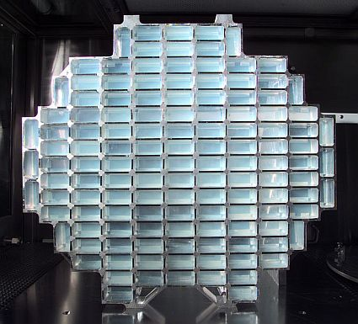
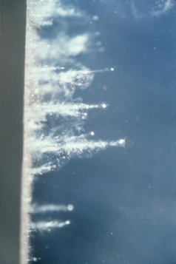
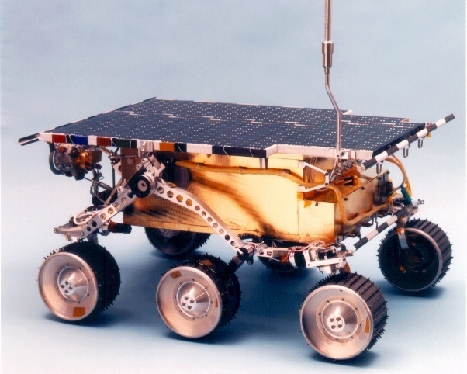
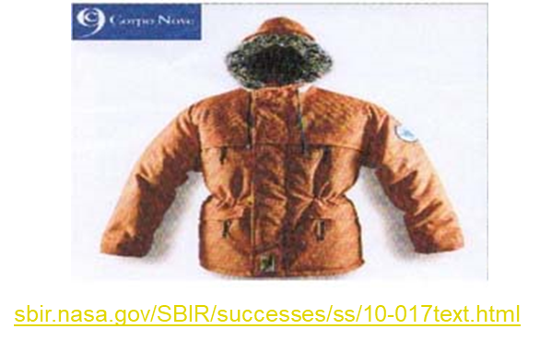
National Aeronautics and Space Administration
Aerogels and their space applications
Silica Aerogels
The first produced aerogel
Optically translucent
Silica aerogels begin to sinter about 700˚C
Collecting Comic Space Dust
Insulation on Rovers
www.nasa.gov

Slide 5
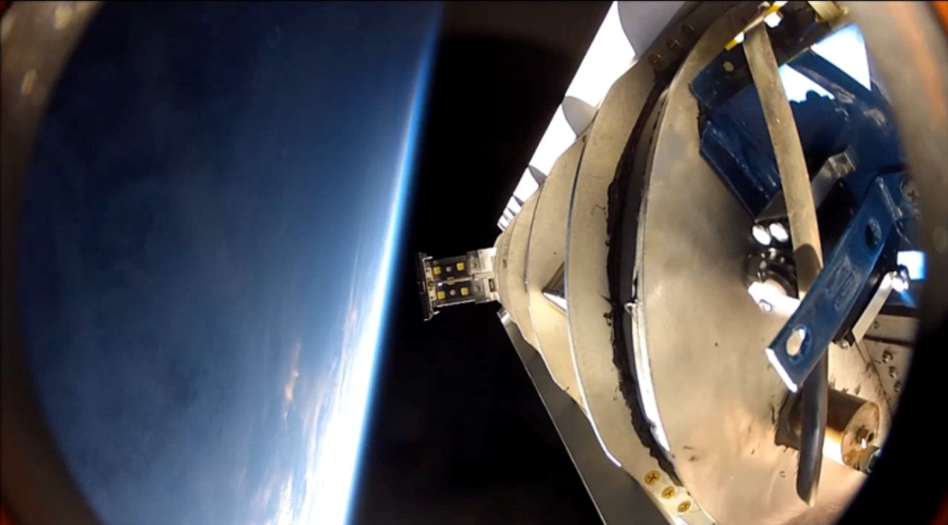
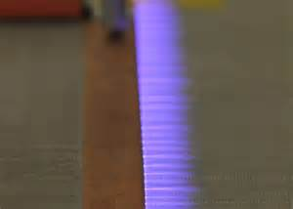
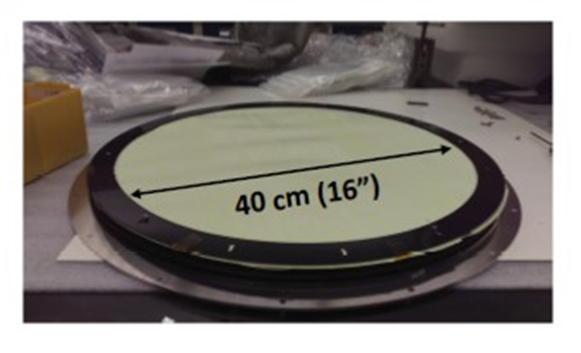
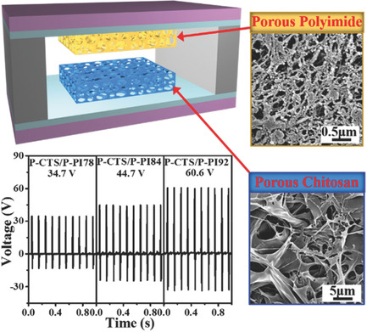
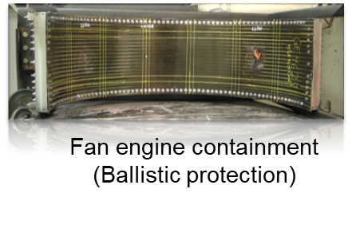
National Aeronautics and Space Administration
Aerogels and their space application
Polyimide aerogels
Mechanically stronger
Polymer aerogels degrade < 450˚C.
Meteorite collector
Antenna
Actuators
Electrical insulation for CNT cable
IR scattering filter
https://www.scientia.global/fine-tuning-polymers-as-flexible-antenna-substrates-for-aircraft/
G. Sauti, et al., U.S. Patent 9,137,883.
M. A. B. Meador, et al., U.S. Patent 10428181.
H. Guo, et al., ACS Appl. Mater. & Inter., 2020,12, 33288.
H. Guo, et al., ACS Appl. Polym. Mater. 2019, 1, 7, 1680.
Q. Zheng, et al., Adv. Fun. Mater. 2018, 28, 1706365.
T. Essinger-Hileman, et al., Applied Optics, 59, 2020, 5439. (GSC-18207-1)
Nanogenerators
J.A. Del Corso et al., 9th International Planetary Probe Workshop June 2012, Toulouse.
www.nasa.gov

Slide 6
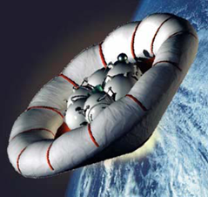

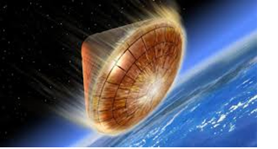
National Aeronautics and Space Administration
Many applications require higher temperature stability.
Lower thermal conductivity: improve performance
Light weight: reduce cost, increasing payload
Reusable when possible
Mechanical durability
Inflatable decelerator
Heat shielding
www.nasa.gov

Slide 7
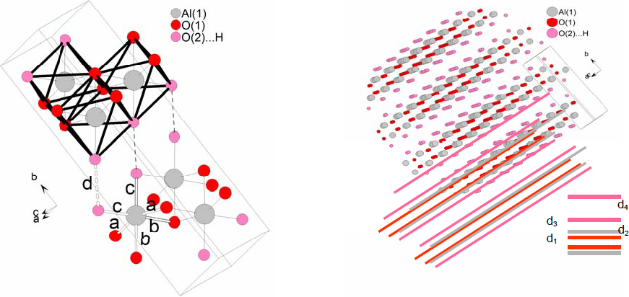
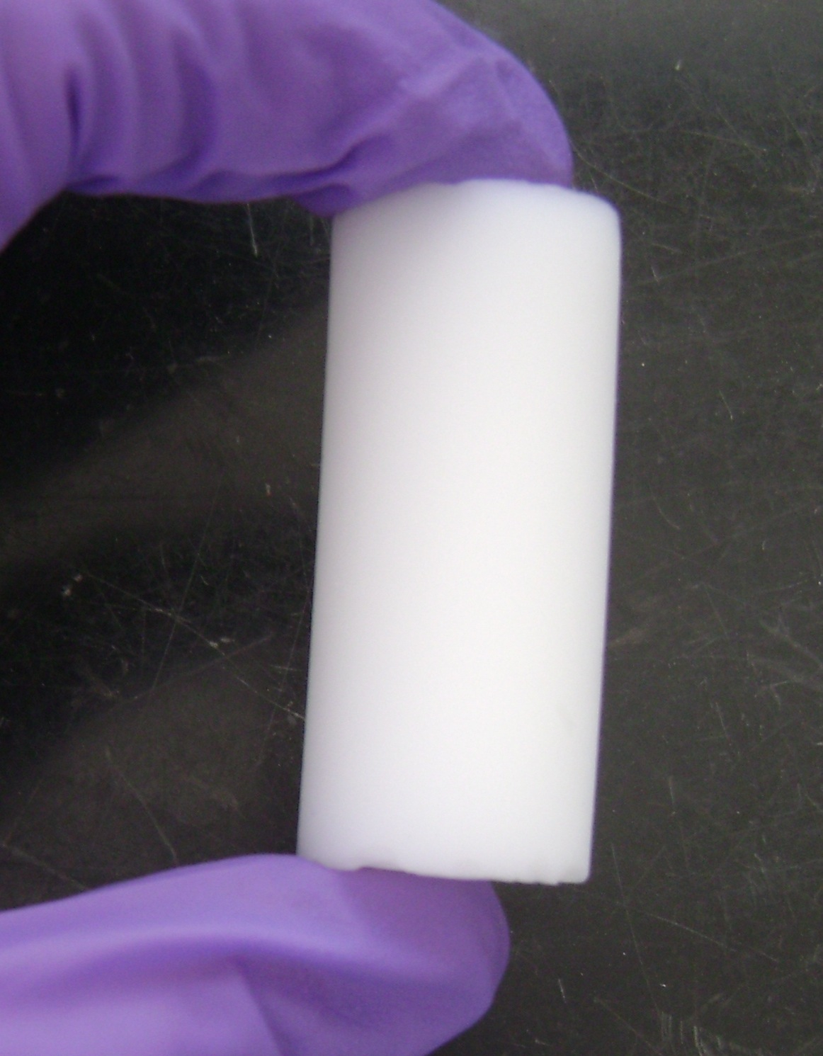
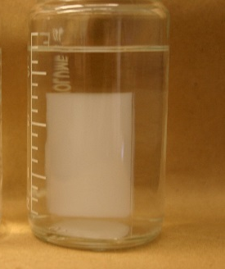
National Aeronautics and Space Administration
Aluminosilicate aerogel synthesis
Boehmite [AlO(OH)]
Tetraethyl orthosilicate (TEOS)
O
+
Si
O
O
O
AlO₆ octahedra
supercritical CO₂
hydrogel
aerogel
S. Brühne, Cryst. Growth Des., 2008, 8, 489–493n
P. R. Aravind, et al Microporous and Mesoporous Mater. 2006, 96, 14–20
F. I. Hurwitz, M. Gallagher, T. Olin, M. K. Shave, M. Α. Ittes, K. N. Olafson, M.G. Fields, R. B. Rogers, and H. Guo, Inter. J. of Appl. Glass Sci. 2004, 1–11
www.nasa.gov

Slide 8
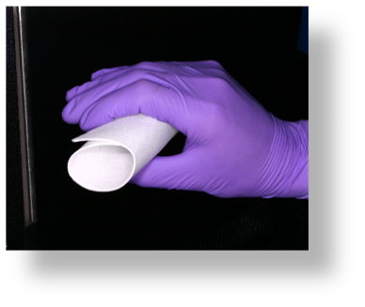
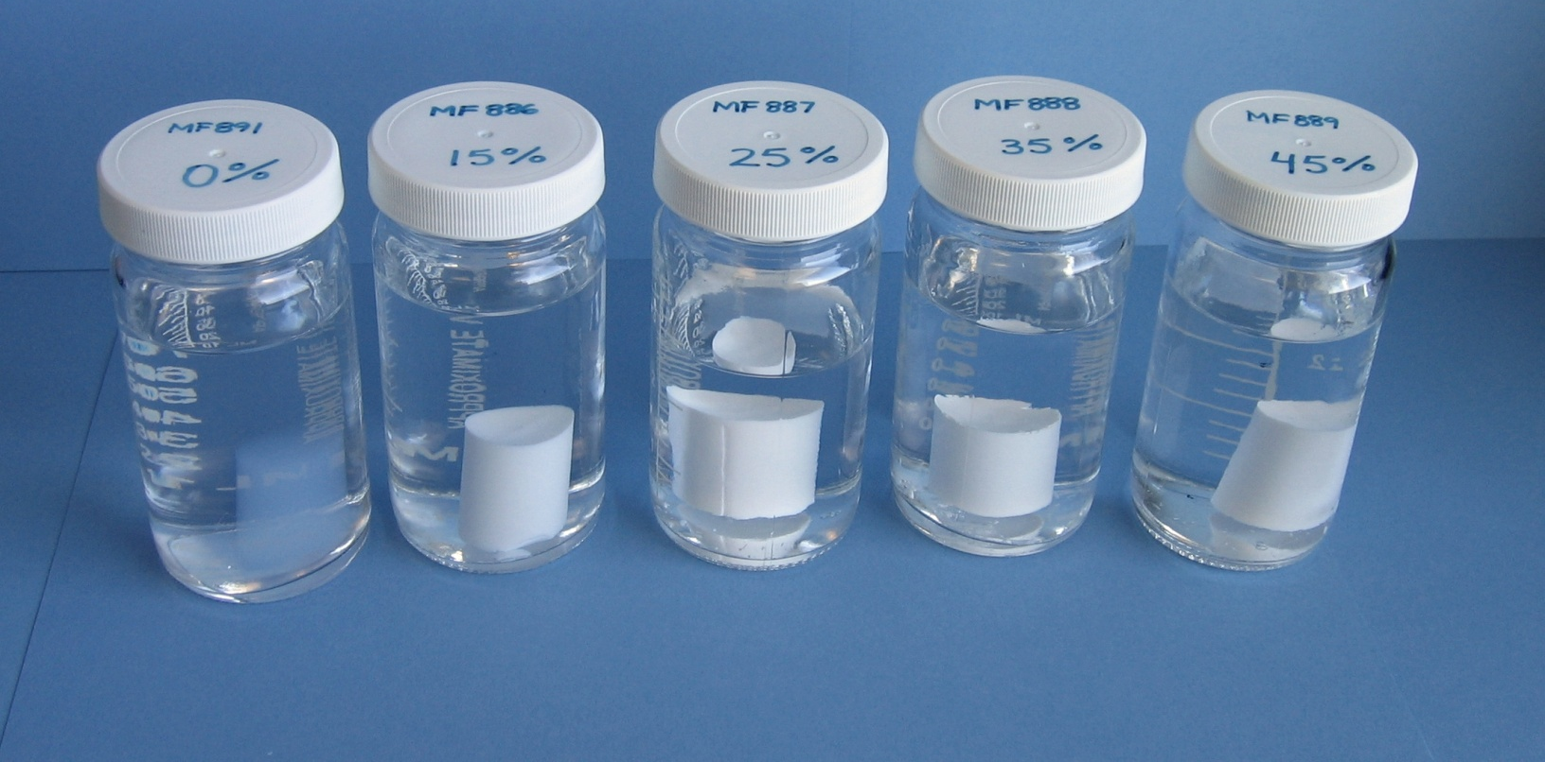
National Aeronautics and Space Administration
Aluminosilicate aerogels and their composites
Aluminosilicate aerogels can be used >1100˚C (400˚C above silica aerogels)
Can be opacified to reduce radiation heat transfer
Reinforced with non-woven ceramic fiber papers or felts
Composites can be flexible
They can be modified to be hydrophobic
Composite densities of 0.07- 0.2 g/cm³, lighter than Microtherm HT (0.3428g/cm³), tailored with choice of reinforcement
Low thermal conductivity
Alumina paper impregnated with aluminosilicate aerogel
Hydrogels with varying levels of TiO₂ incorporation
F. I. Hurwitz, H. Guo, R.B. Rogers, E, J. Sheets, D. R. Miller, K. N. Newlin, M. K. Shave, A. R. Palczer, and M. T. Cox, J Sol-Gel Sci. Tech., 2012, 64, 367-374
F. I. Hurwitz and H. Guo, U.S. Patent 10343131, 10343131 B1
www.nasa.gov

Slide 9
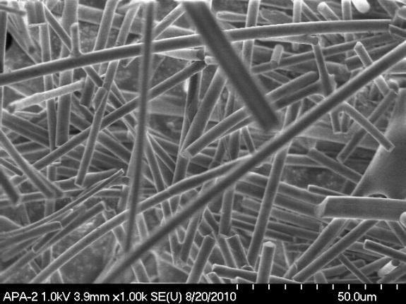
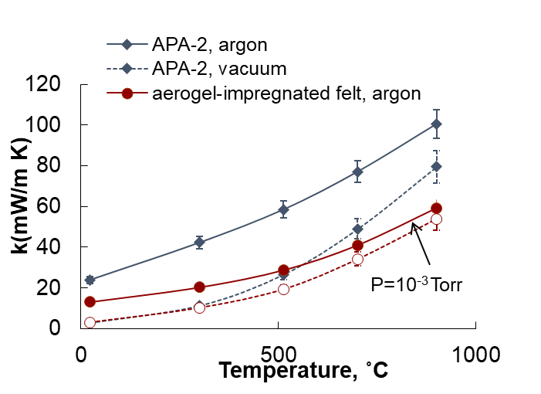
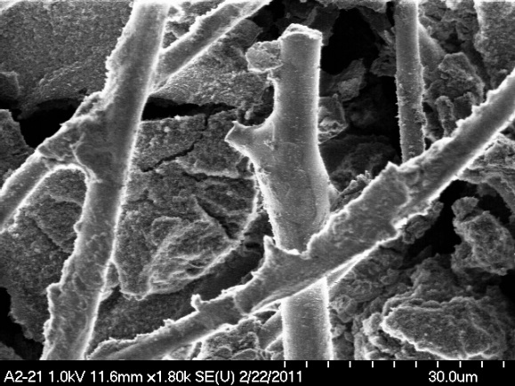

National Aeronautics and Space Administration
Aluminosilicate Aerogel Composites
Thermal conductivity
APA-2 alumina paper
Aluminosilicate aerogel/ APA-2 felt composite
Aerogel well bonded to fiber—does not “flake”
F. I. Hurwitz and H. Guo, U.S. Patent 10343131, 10343131 B1
J. Gembarovic and R. E. Taylor, Int J Thermophys, 2007, 2164–2175
www.nasa.gov

Slide 10
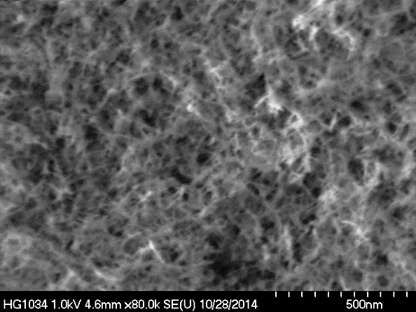
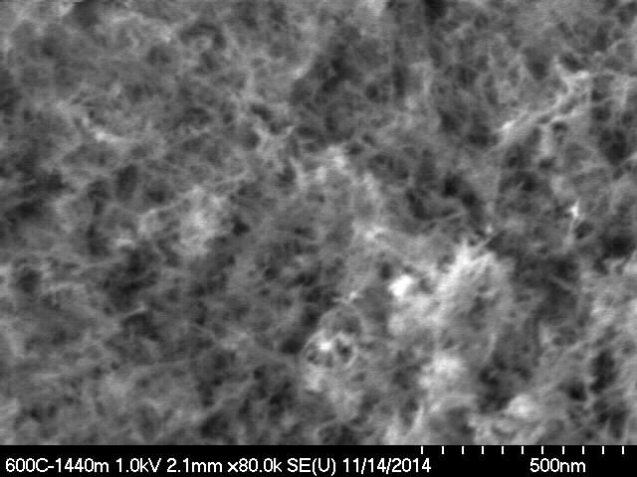
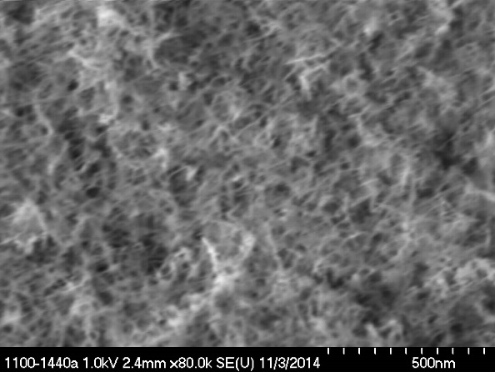
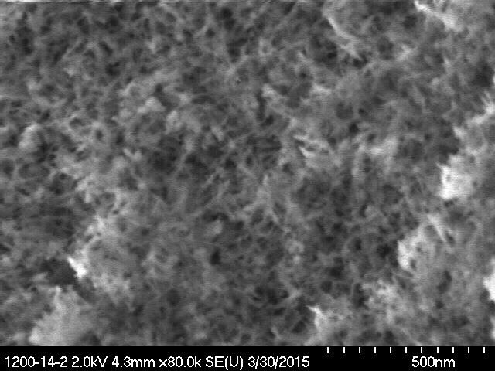
National Aeronautics and Space Administration
Persistence of mesoporous structure heated at 1100 and 1200˚C
As supercritically dried
600˚C, 24h
1100˚C, 24h
1200˚C, 24h
www.nasa.gov

Slide 11
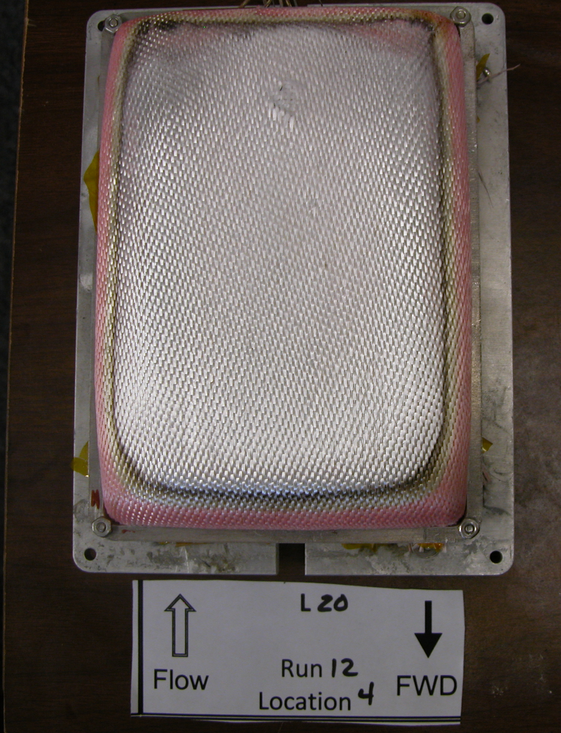
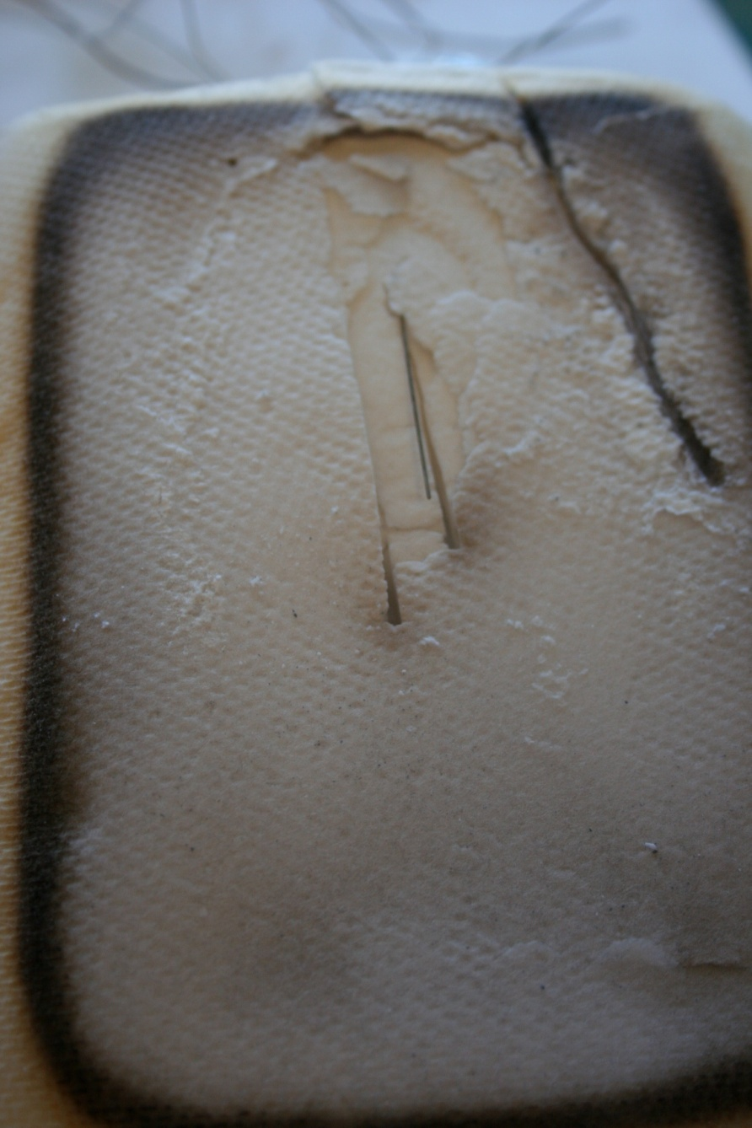
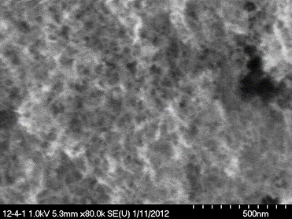
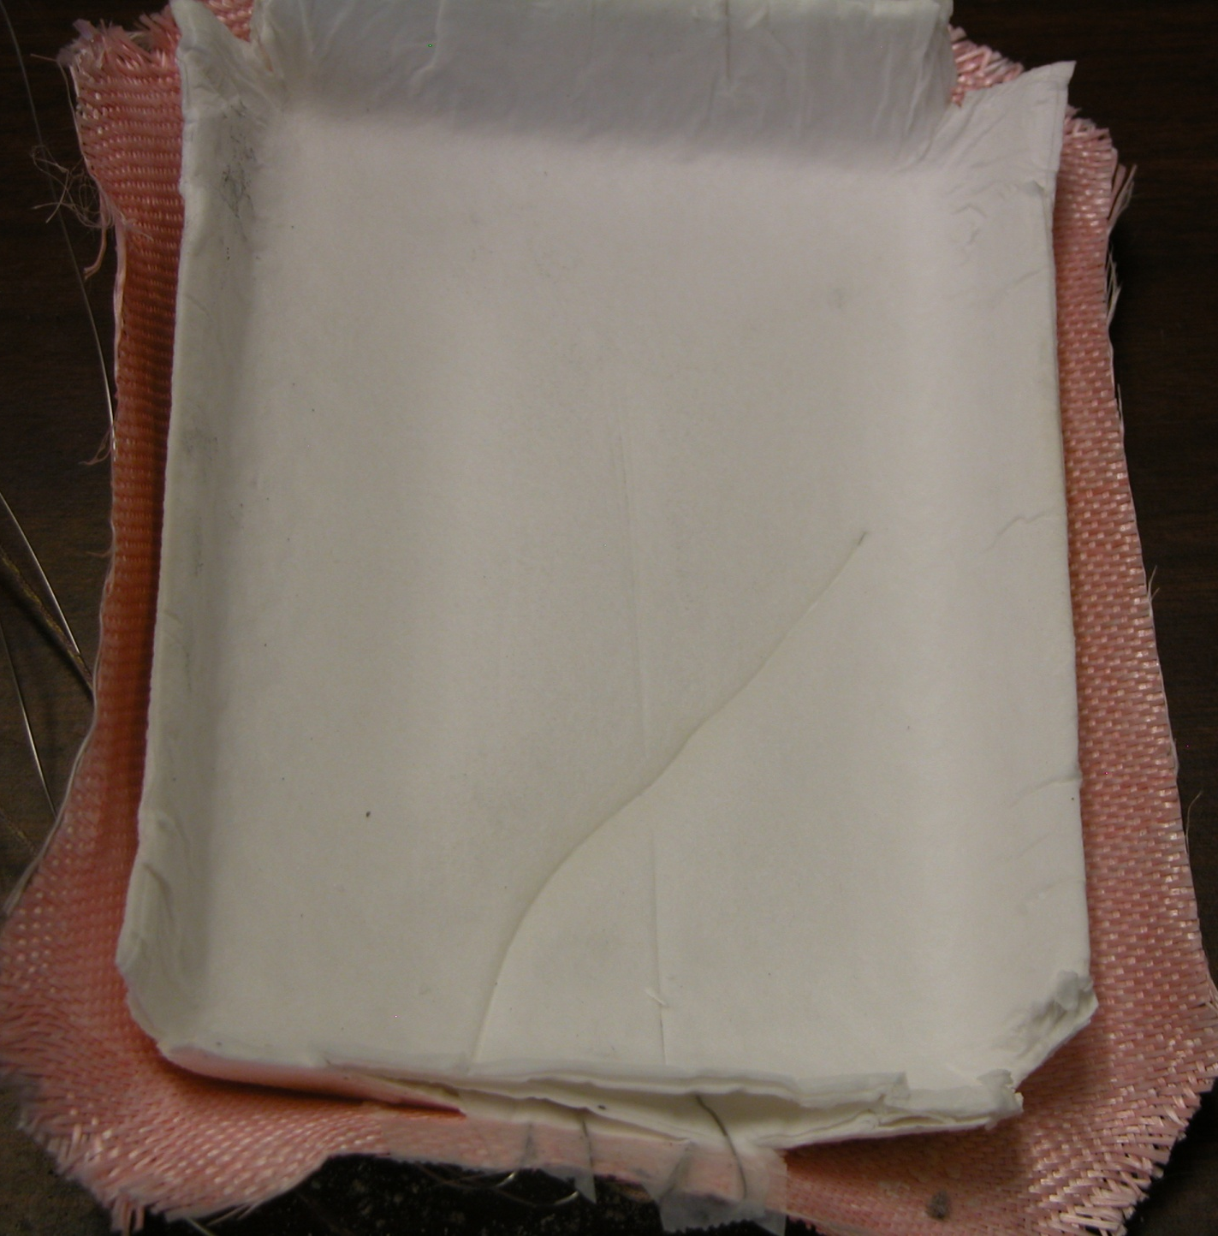
National Aeronautics and Space Administration
LaRC 8’HTT test (to evaluate for EDL)
2 BF-20/7 AS-APA-2/Aluminized Kapton
17W/cm² flux; 1435 psi @3300˚R combustor pressure
Temperature between aerogel composite and Kapton nominally 50˚C, a drop of 700˚C across 7 layers)
Aerogel microstructure is maintained
Underside, APA-2/aerogel layer 7
Post-test Run 12 Loc 4
Post-test BF-20 layers removed
www.nasa.gov

Slide 12
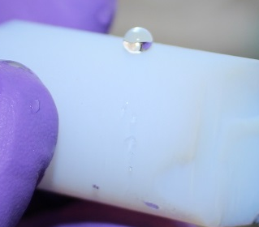
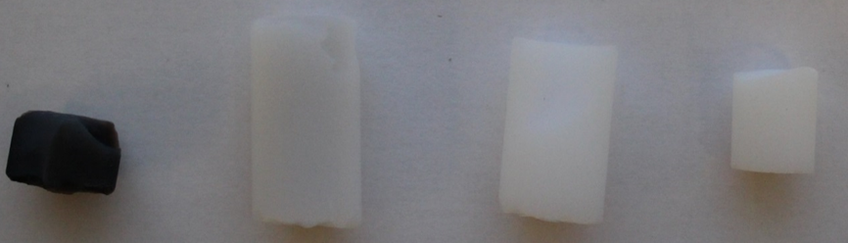
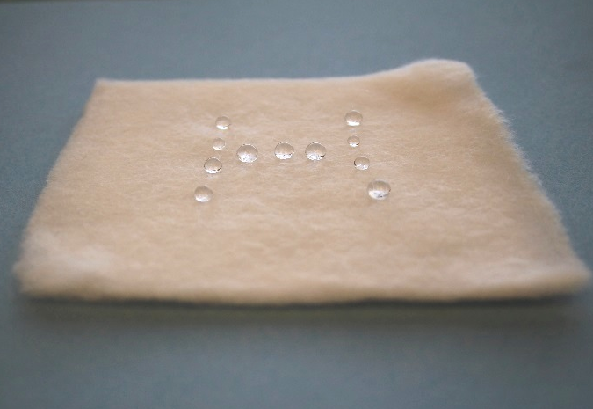
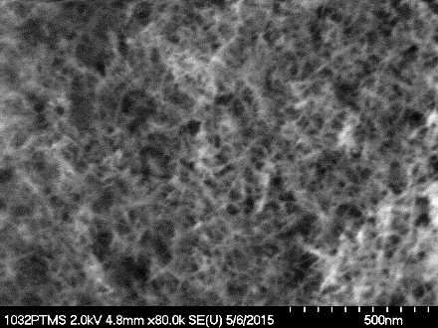
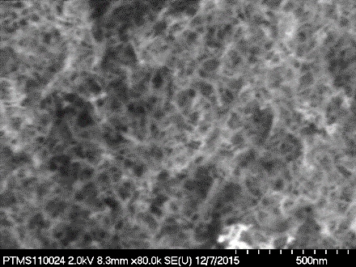
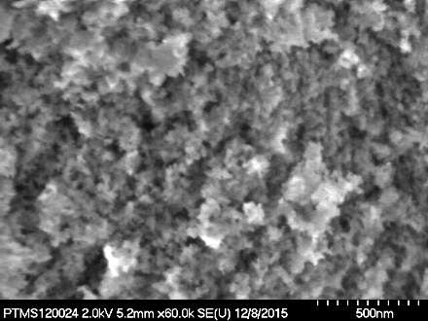
National Aeronautics and Space Administration
Hydrophobic aluminosilicate aerogel
600ºC 1000ºC 1100ºC 1200ºC
RT
1100ºC
1200ºC
Quartz felt /aluminosilicate/PTMS
F. I. Hurwitz and H. Guo, U.S. Patent 10343131, 10343131 B1
www.nasa.gov

Slide 13
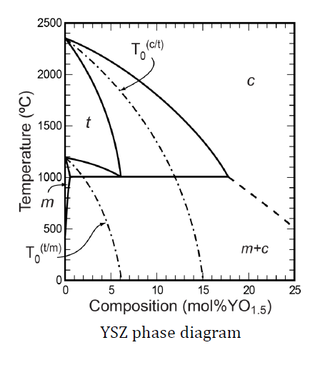
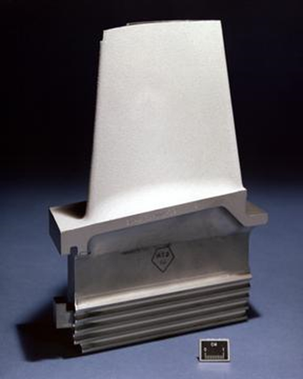
National Aeronautics and Space Administration
YSZ, Y/YbSZ, or YbSZ aerogels
Thermal barrier coatings
•YSZ is a ceramic used in thermal insulating layers on super alloys in aircraft engines ZrO₂-Y₂O₃
•Phases of zirconia changed by substitution of Zr⁴⁺ with Y³⁺
•Minimize surface area loss
•Low thermal conductivity 0.8-2.9 W/(m·K), would be much lower as an aerogel
•High thermal stability
Co-Doping YSZ with Ytterbia
•Ytterbium was chosen due its higher atomic mass and lower valence in comparison to Zr⁴⁺
•Produces lower thermal conductivities
•Higher sintering resistance at high temperatures than YSZ
•Stabilization of tetragonal zirconia formation
G. Witz et al., J. Am. Ceram. Soc., 2007, 90, 2935–2940
N. S. Olson, F. I. Hurwitz, H. Guo, N. J. Madden, J. L. Stokes, R. B. Rogers, J. A. Krogstad, J. Am. Ceram. Soc. 10.1111/jace.17792.
F. I. Hurwitz, R. B. Rogers, H. Guo, A. Garg, N. S. Olson, D. Phan, J. L. Cashman, J. Am. Ceram. Soc. 2020, 103, 6700-6711.
www.nasa.gov

Slide 14
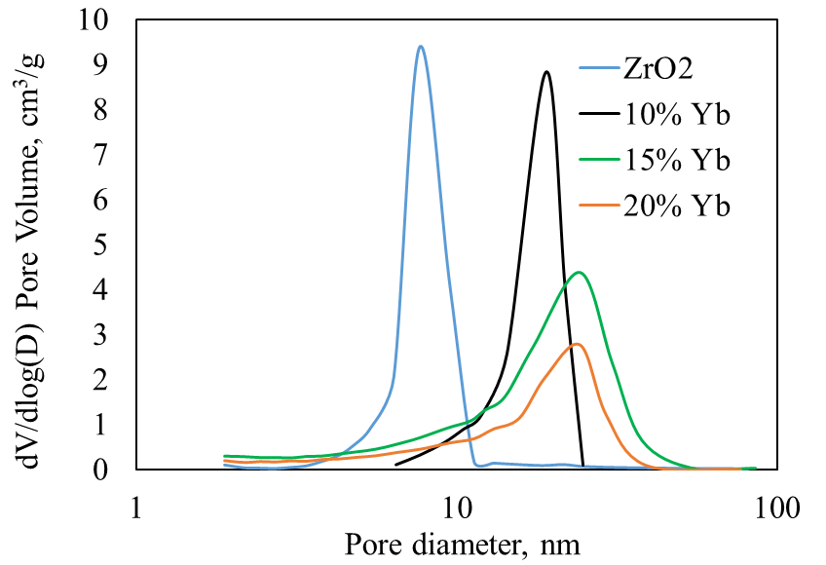
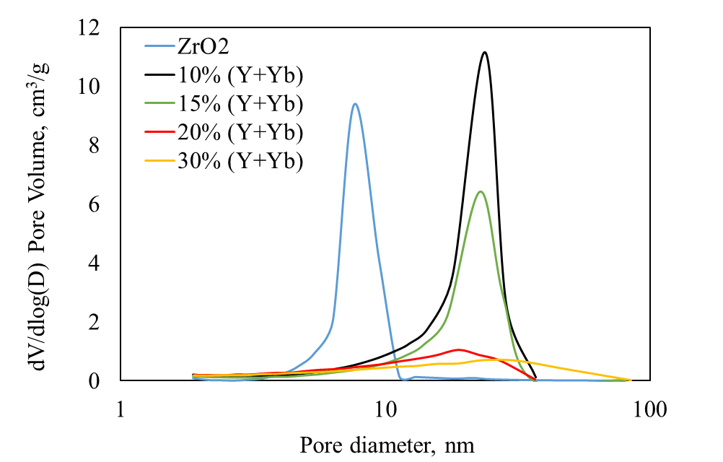
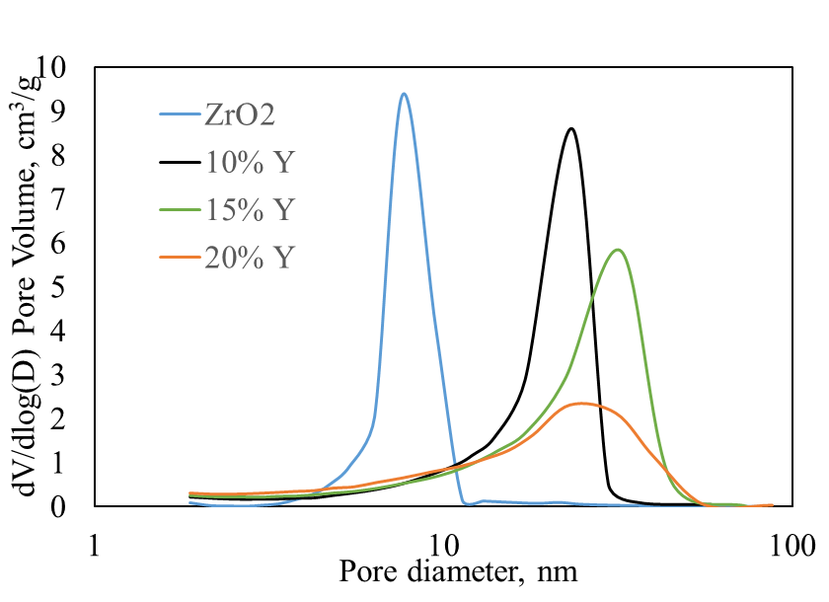
National Aeronautics and Space Administration
With dopant increasing, surface area decreases, pore size increases
www.nasa.gov

Slide 15
National Aeronautics and Space Administration
High additions (>20 mol% ) of dopant can keep mesoporous structure
N. S. Olson, F. I. Hurwitz, H. Guo, N. J. Madden, J. L. Stokes, R. B. Rogers, J. A. Krogstad, J. Am. Ceram. Soc., 2021, 104, 4190-4202.
www.nasa.gov

Slide 16
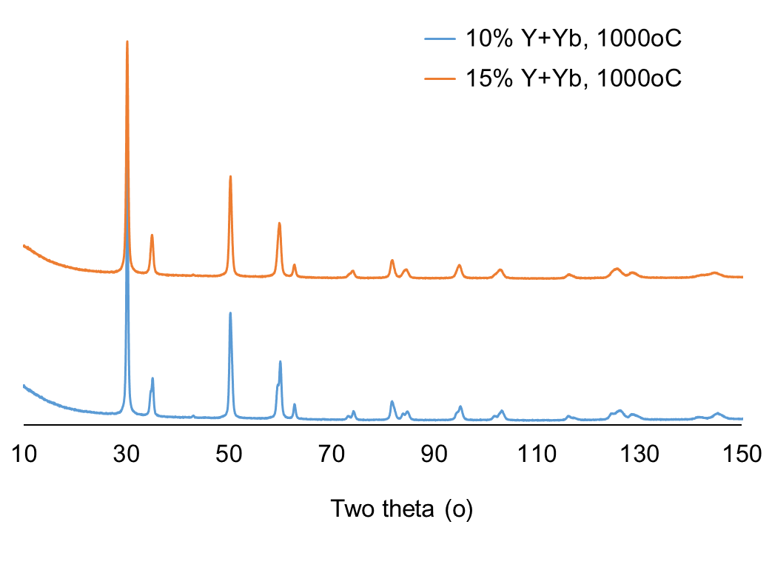
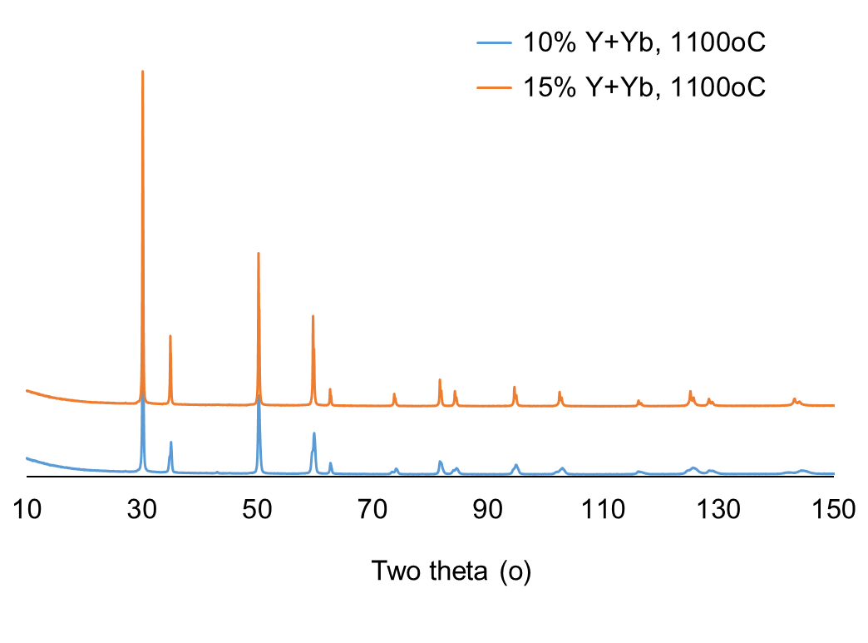
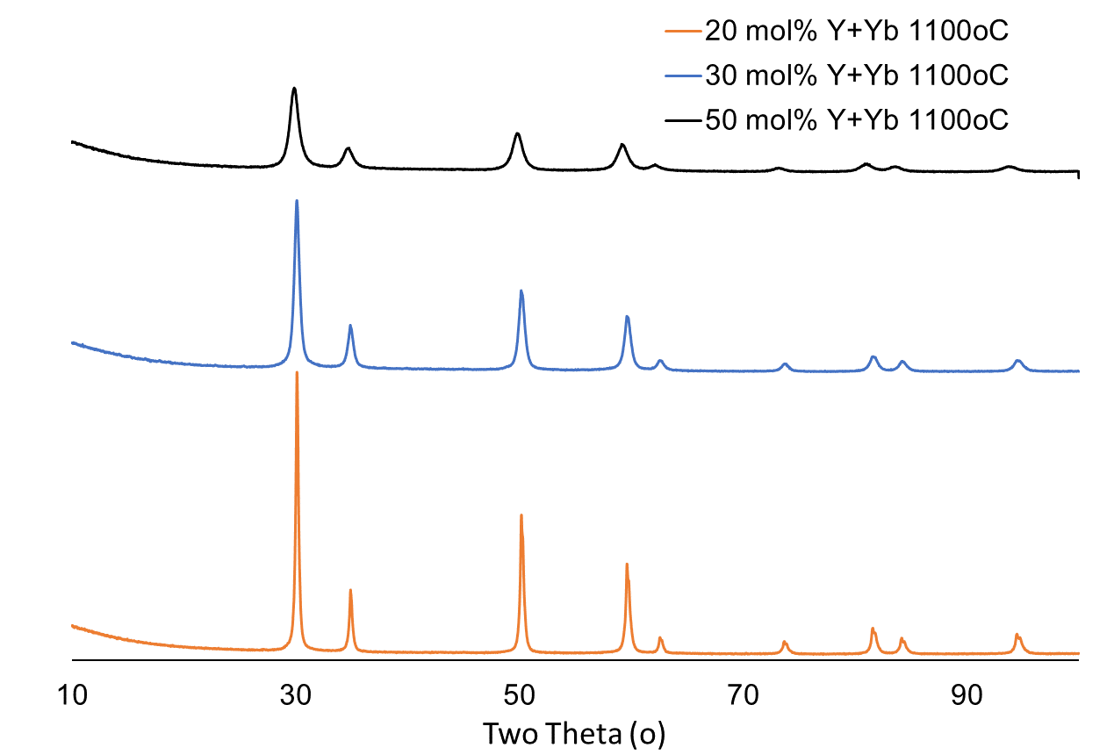
National Aeronautics and Space Administration
•At 1000ºC, 10% and 15% dopant both show tetragonal structure
•At 1100ºC, 10% dopant shows tetragonal, 15% dopant shows cubic structure
•A cubic structure is present when dopant >20mol%
•Smaller crystallite size is indicated as the dopant concentration increases
www.nasa.gov

Slide 17
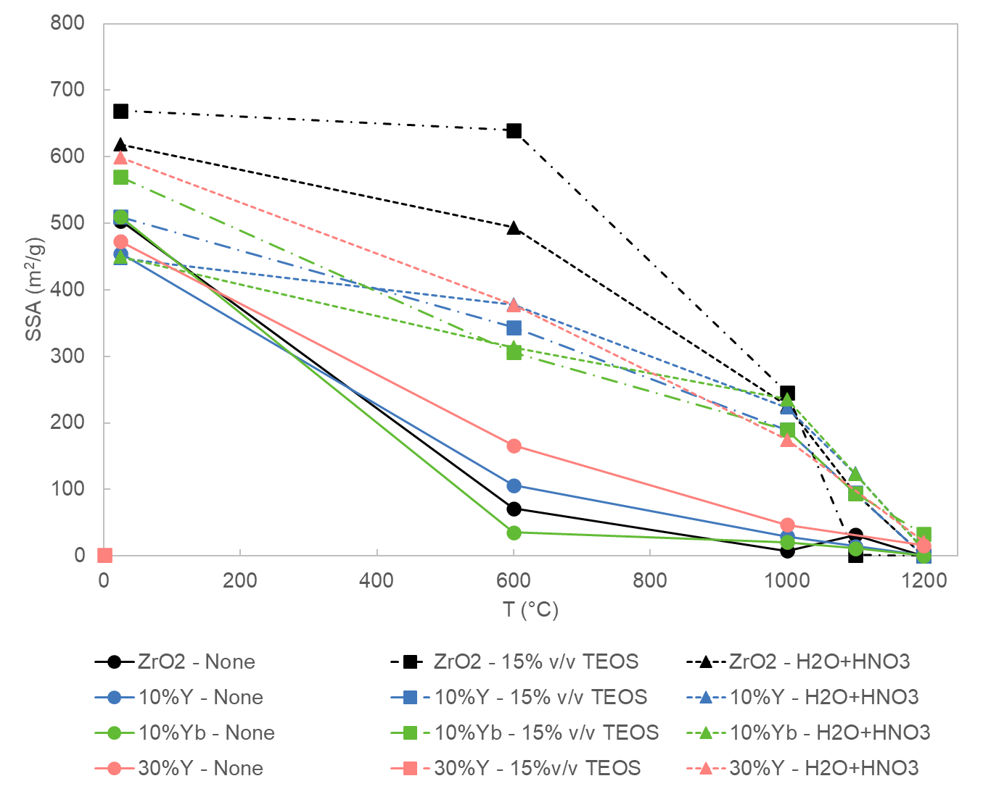
National Aeronautics and Space Administration
SiO2-YSZ or YbSZ core-shell structure
SiO₂ coating suppress the crystalline size growth, and maintains surface area > 100m²/g at 1100ºC
www.nasa.gov

Slide 18
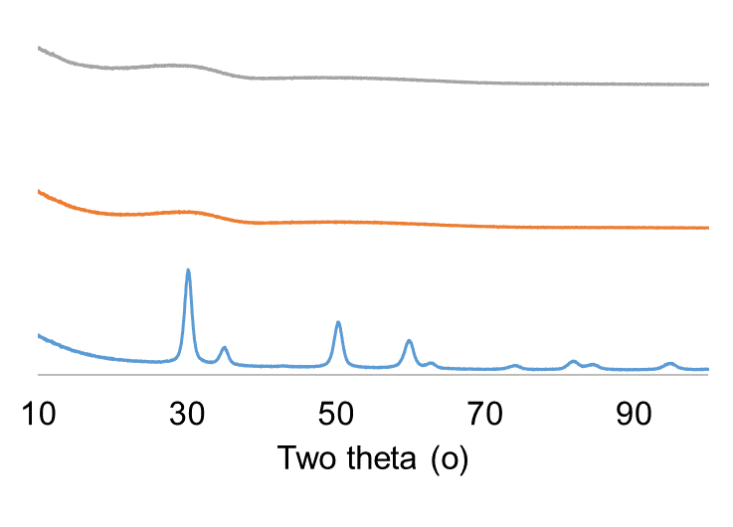
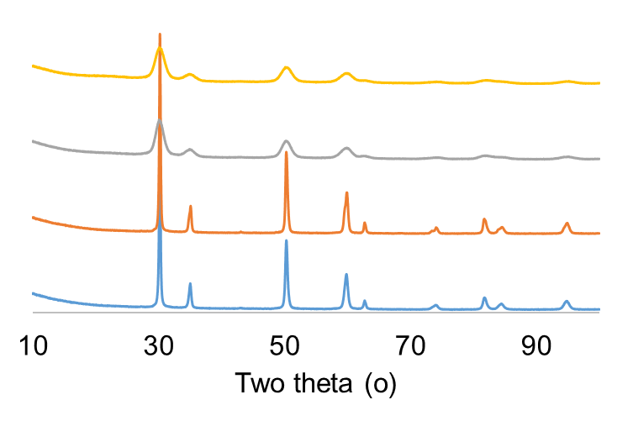
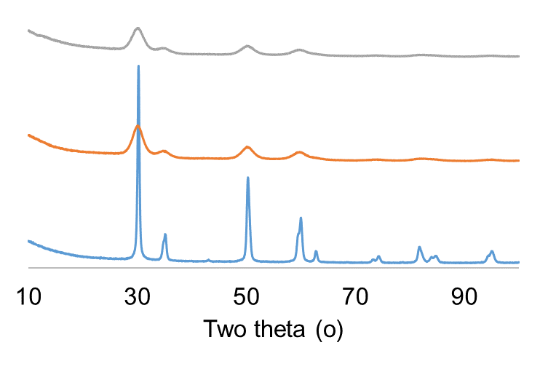
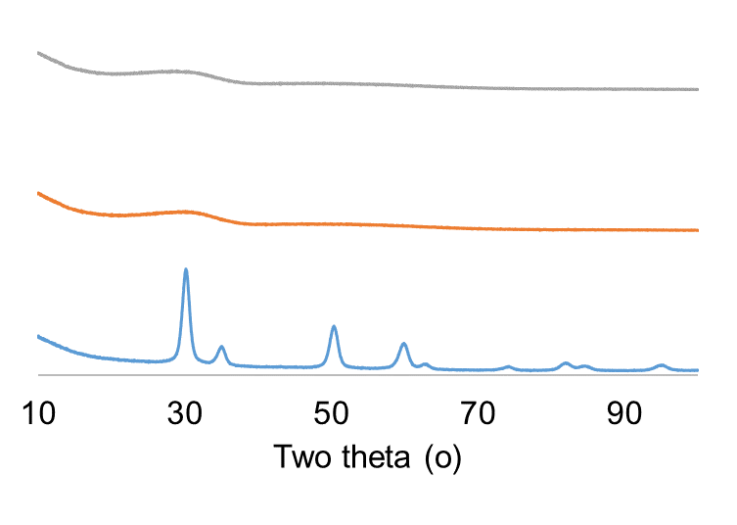
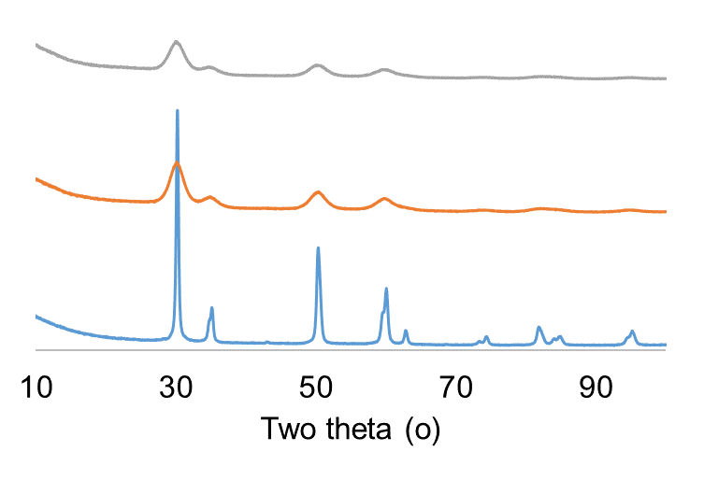
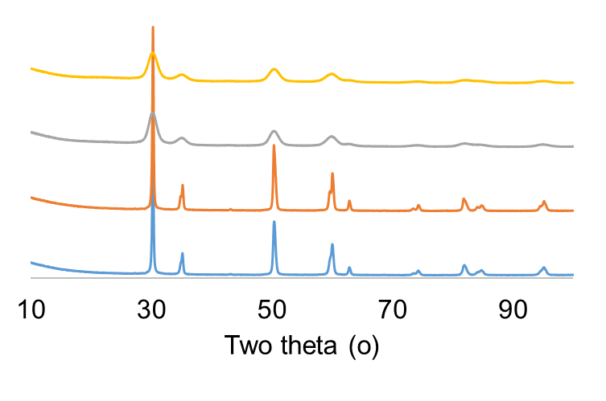
National Aeronautics and Space Administration
SiO₂ coating suppress the phase change and crystalline growth
600ºC
1000ºC
1100ºC
C
C
C
10%Y-YSZ
B
B
B
A-air
A
A
A
C
C
C
B
B
B
10%Yb-YbSZ
A-air
A
A
A
A: no SiO₂ coating B: SiO₂ coating method 1 C: SiO₂ coating method 2
www.nasa.gov

Slide 19
National Aeronautics and Space Administration
Summary
Aluminosilicate aerogels
•Aluminosilicate aerogels can be used up to 1100ºC.
•Their composites are not flakey and can be flexible.
•The aerogel and their composites can be modified to be hydrophobic.
Yttria and/or Ytterbia stabilized Zirconia aerogels
•The surface areas of the as dried aerogels depend on the total dopant level and water ratio, but no relationship with Y to Yb ratio.
•With increase dopant level, the pore size increases up to 20% dopant, and surface area decreases with the increased dopant.
•Dopant level and the choice of dopant can affect the phase change and crystalline size growth
•Increasing dopant above 20% can avoid the phase transformation and suppress the crystalline growth at 1100ºC
•SiO₂ coating can effectively suppress the crystalline growth and phase change.
www.nasa.gov

Slide 20
National Aeronautics and Space Administration
Thank you!
www.nasa.gov

Slide 21
National Aeronautics and Space Administration
SiO₂ coating suppress the phase change and crystalline growth
www.nasa.gov

