Slide 1


Observation-based radiative heating rate profiles
Seiji Kato, Seung-Hee Ham, and Fred G. Rose
NASA Langley Research Center
ICCP-GSRA workshop and 2nd EarthCARE modeling workshop
March 27-29, 2023

Slide 2
Outline of this talk
Tight connections among cloud radiative effects, dynamics in the atmosphere, and hydrological cycle
Radiative heating rate profile derived from A-train observations
Entropy balance equation
Balance among radiative heating rate profiles, irreversible processes, and entropy stored in the atmosphere.
Irreversible processes associated with clouds are large contributors of entropy production rates in the atmosphere.

Slide 3
Effect of longwave cloud effect
(Control – no LW cloud effects)
Temperature (K)
Zonal wind (ms⁻¹)
Hatched: negative values
Longwave cloud radiative effect: Warm the tropical mid-latitude atmosphere, strengthening zonal wind
Slingo and Slingo 1988

Slide 4
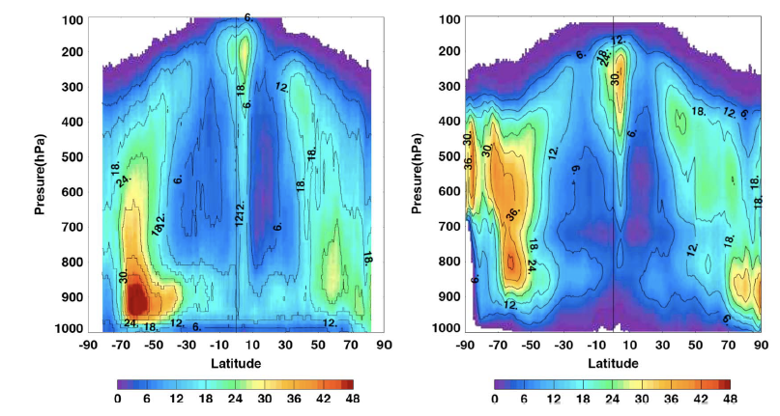
Zonal monthly mean active sensor derived cloud vertical profile (April 2010)
CALOPSO + CloudSat
Aqua MODIS
Percentage of cloud occurrence in a 1 degree zonal and 1 hPa layer
(%)

Slide 5
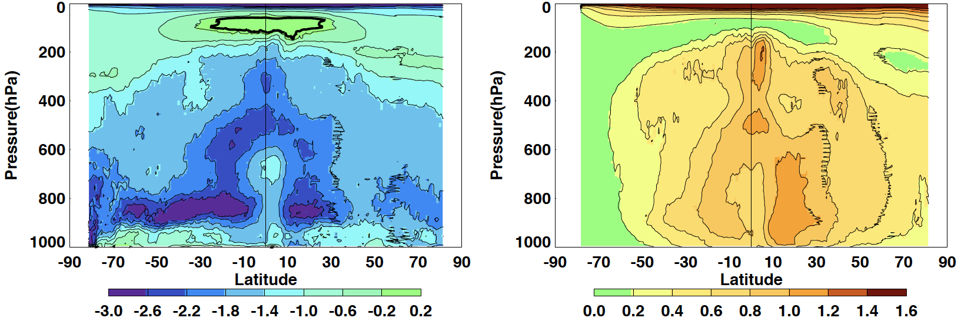
Longwave and shortwave monthly zonal mean radiative heating rate in K day⁻¹
Longwave
Shortwave
K day⁻¹
K day⁻¹
Notes:
Strong cloud top cooling

Slide 6
Mean zonal longwave + shortwave radiative heating rates in K day⁻¹
Atmosphere is cooled radiatively
Radiative cooling is relatively flat zonally
But diabatic heating by precipitation is much larger in the tropics
K day⁻¹

Slide 7
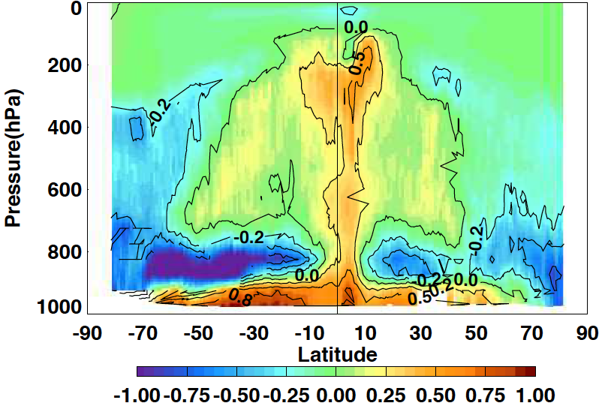
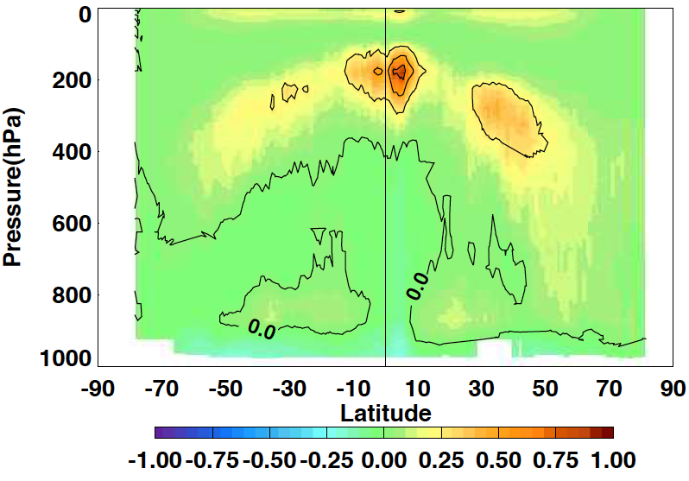
Zonal monthly mean cloud radiative effect in K day⁻¹
Longwave
Shortwave
Clouds help reducing radiative cooling in the tropics and enhance radiative cooling in polar regions
i.e. contributing the production of mean zonal available potential energy
Large cloud top cooling and warming in the tropics between 400 hPa to 200 hPa

Slide 8
Simplest system (Planck 1906)
Temperature of the atmosphere (black) = Ta
Temperature of the surface (black) = Ts
Entropy produced by the surface is the sum of 1) and 2)
Due to heating and cooling σ(Ta⁴-Ts⁴)/Ts
Due to radiation exchange (4/3)σTs⁴/Ts – (4/3)σTa⁴/Ta
Total entropy production by the surface
σ(Ta⁴-Ts⁴)/Ts + (4/3)σTs⁴/Ts – (4/3)σTa⁴/Ta
(the second and third term can be looked as the entropy flux, positive outward)

Slide 9
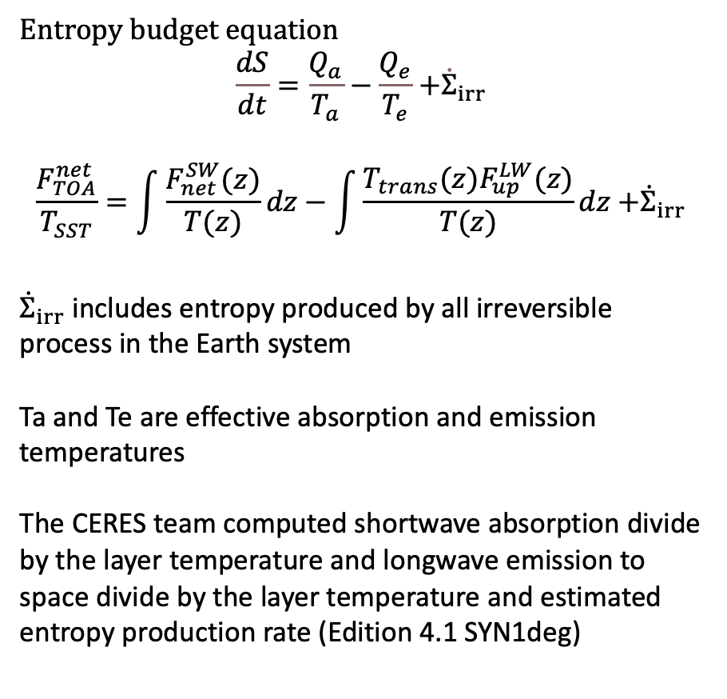
A thermodynamic view of Earth energy imbalance
A conceptional model to understand an entropy view
Entropy budget equation
$$\frac{dS}{dt}=\frac{Q_{a}}{T_{a}}−\frac{Q_{e}}{T_{e}}{+\dot{Σ}}_{irr}$$
$$\frac{F_{TOA}^{net}}{T_{SST}}=\int{\frac{F_{net}^{SW}(z)}{T(z)}dz}−\int{\frac{T_{trans}{(z)F}_{up}^{LW}(z)}{T(z)}dz}{+\dot{Σ}}_{irr}$$
${\dot{Σ}}_{irr}$ includes entropy produced by all irreversible process in the Earth system
Ta and Te are effective absorption and emission temperatures
The CERES team computed shortwave absorption divide by the layer temperature and longwave emission to space divide by the layer temperature and estimated entropy production rate (Edition 4.1 SYN1deg)
Te = 257 K
Qe: Cooling
air
We do not ask how Earth is heated and cooled.
Ta = 282K
water
Qa: Heating

Slide 10
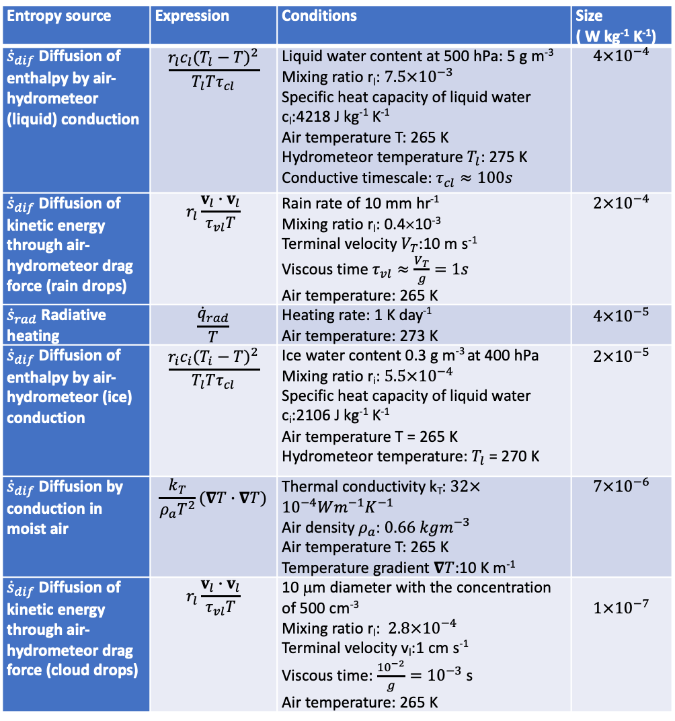
Magnitude of entropy production by process
Entropy source | Expression | Conditions | Size ( W kg⁻¹ K⁻¹)
${\dot{s}}_{dif}$ Diffusion of enthalpy by air-hydrometeor (liquid) conduction | $$\frac{r_{l}c_{l}(T_{l}−T)^{2}}{T_{l}Tτ_{cl}}$$ | Liquid water content at 500 hPa: 5 g m⁻³ Mixing ratio r_{l}: $7.5×{10}^{−3}$ Specific heat capacity of liquid water c_{l}:4218 J kg⁻¹ K⁻¹ Air temperature T: 265 K Hydrometeor temperature $T_{l}$: 275 K Conductive timescale: $τ_{cl}≈100s$ | $$4×{10}^{−4}$$
${\dot{s}}_{dif}$ Diffusion of kinetic energy through air-hydrometeor drag force (rain drops) | $$r_{l}\frac{v_{l}∙v_{l}}{τ_{vl}T}$$ | Rain rate of 10 mm hr⁻¹ Mixing ratio r_{l}: 0.4×10⁻³ Terminal velocity $V_{T}$:10 m s⁻¹ Viscous time $τ_{vl}≈\frac{V_{T}}{g}=1s$ Air temperature: 265 K | $$2×{10}^{−4}$$
${\dot{s}}_{rad}$ Radiative heating | $$\frac{{\dot{q}}_{rad}}{T}$$ | Heating rate: 1 K day⁻¹ Air temperature: 273 K | $$4×{10}^{−5}$$
${\dot{s}}_{dif}$ Diffusion of enthalpy by air-hydrometeor (ice) conduction | $$\frac{r_{i}c_{i}(T_{i}−T)^{2}}{T_{l}Tτ_{cl}}$$ | Ice water content 0.3 g m⁻³ at 400 hPa Mixing ratio r_{i}: $5.5×{10}^{−4}$ Specific heat capacity of liquid water c_{i}:2106 J kg⁻¹ K⁻¹ Air temperature T = 265 K Hydrometeor temperature: $T_{l}$ = 270 K | $$2×{10}^{−5}$$
${\dot{s}}_{dif}$ Diffusion by conduction in moist air | $$\frac{k_{T}}{ρ_{a}T^{2}}(∇T∙∇T)$$ | Thermal conductivity k_{T}: $32×{10}^{−4}Wm^{−1}K^{−1}$ Air density $ρ_{a}$: $0.66 kgm^{−3}$ Air temperature T: 265 K Temperature gradient $∇T$:10 K m⁻¹ | $$7×{10}^{−6}$$
${\dot{s}}_{dif}$ Diffusion of kinetic energy through air-hydrometeor drag force (cloud drops) | $$r_{l}\frac{v_{l}∙v_{l}}{τ_{vl}T}$$ | 10 μm diameter with the concentration of 500 cm⁻³ Mixing ratio r_{l}: $2.8×{10}^{−4}$ Terminal velocity v_{l}:1 cm s⁻¹ Viscous time: $\frac{{10}^{−2}}{g}={10}^{−3}$ s Air temperature: 265 K | $$1×{10}^{−7}$$
Large entropy productions in the atmosphere occur in processes associated with clouds

Slide 11
Summary
Earlier studies show that cloud radiative effects have impacts on dynamics and hydrological cycle.
Active sensors provide vertical profile of clouds and aerosol properties that can be used to compute radiative heating profiles.
According to the entropy balance equation, vertical radiative heating rate profiles is balanced with entropy production rate by reversible processes and entropy stored in the atmosphere.
Processes associated with clouds contribute most to entropy production rate in the atmosphere.
Propose to use observation-based radiative heating rate profiles to assess irreversible processes in climate models.

Slide 12
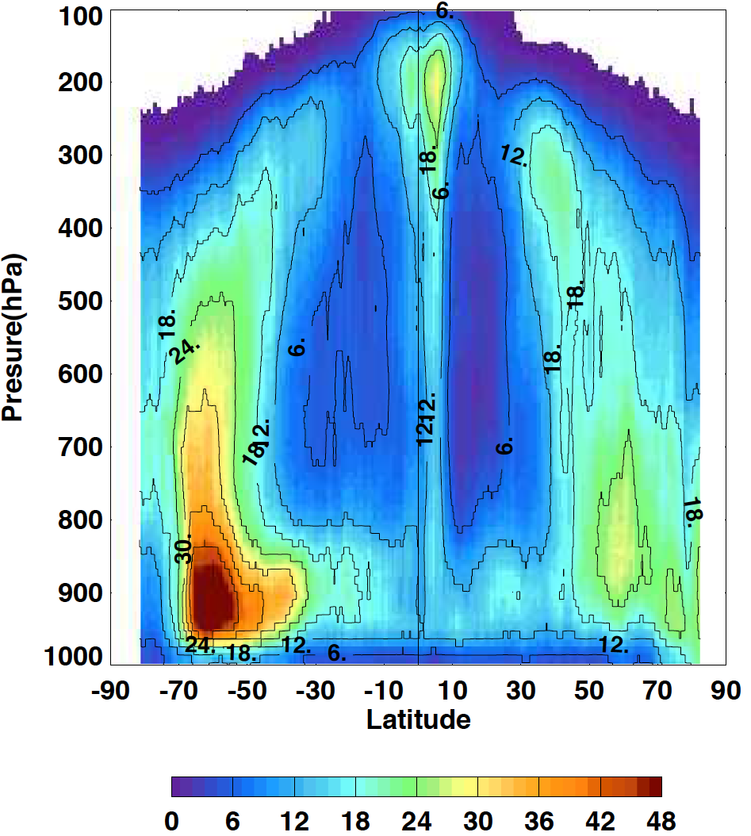
Zonal monthly mean active sensor derived cloud vertical profile (April 2010)
Percentage of cloud occurrence in a 1 degree zonal and 1 hPa layer
(%)

