Slide 1
Coronado Ecological Conservation
Assessing Vegetation Change Due to Border Wall Construction and Shifting Social Trails
Carson Schuetze • Tyler Guigneaux • Josie Bourne • Charles Robinette
Georgia – Athens | Spring 2023
Notes:
We are the Coronado Ecological Conservation team at the GA, Athens Node. We have been Utilizing NASA Earth observations to assess invasive species spread and change in vegetation health in southeastern Arizona due to the construction of the US-Mexico border wall. The NPS at Coronado National Memorial will use our end products to bolster their plans and funding requests for restoration work in the disturbed areas.
------------------------------Image Information Below ------------------------------
•Image Credit: Image created by the CORO Eco DEVELOP Team

Slide 2
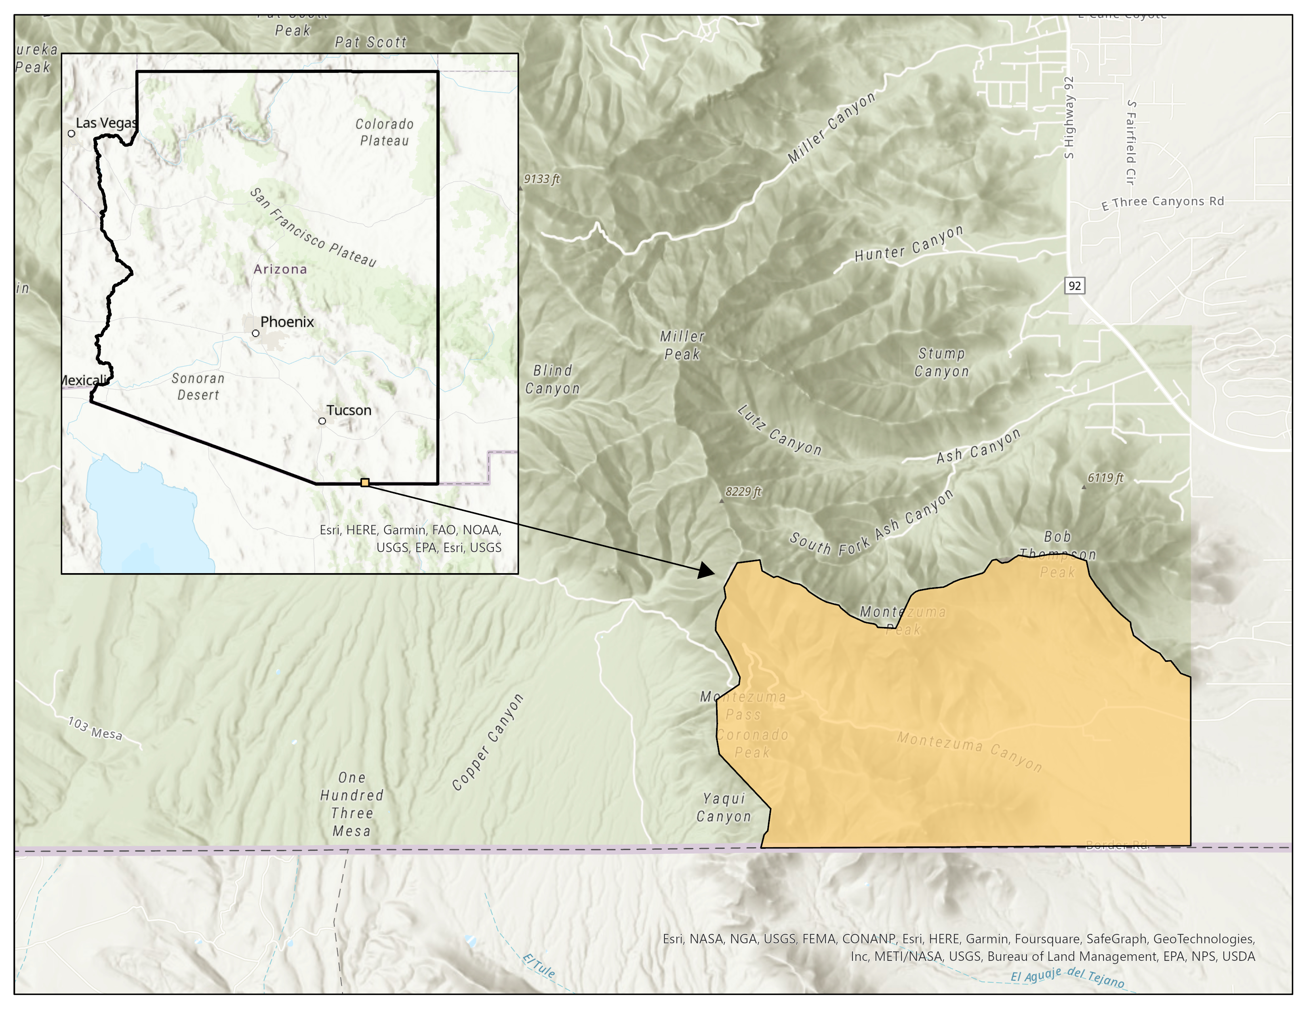
STUDY AREA
Location
Coronado National Memorial, Arizona
United States – Mexico border
Period
1984 – 2022
April – October
N
W
E
S
Coronado National Memorial
U.S.-Mexico border
0 .5 1 2 3 4
Miles
Notes:
Our study area here in yellow, Coronado National Memorial, is located in Southeastern Arizona along the US-Mexico border. It sits within the Sky Island mountains of Arizona, one of the most biologically diverse regions in the country.
Our study years of 1984-2022 were chosen to track long-term vegetation change and include major events like fires and border construction within the park
Through researching phenology data and conversations with our partners, we decided to focus on April – September so that we could capture multiple green-up periods of both native and invasive plants, as well as assess vegetation post-monsoon season.
You will see that most of our imagery in this presentation comes from June, as it is the only month with imagery available across all 4 datasets.

Slide 3
OBJECTIVES
Assess vegetation health and extent
Visualize vegetation change using maps and time-series
Produce landcover classifications
Identify invasive species using classification models
Notes:
The team was to implement remotely sensed data in vegetation classification in order to thoroughly assess vegetative health/change, and identify invasive species spread. The team produced vegetation health maps and time series in addition to vegetation class maps/ time series, focusing on the effects of the border wall and its construction activities. These products will be used by the partners to prioritize sites for restoration and mitigation.

Slide 4
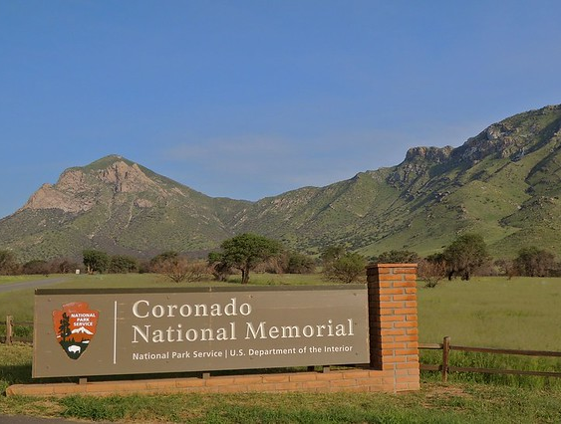
PARTNERS
End User
National Park Service, Coronado National Memorial
JoAnn Blalack, Integrated Resource Manager
Jessica Garcia, Physical Scientist
Robert Matthewman, GIS Intern
Nicole Gonzalez, Biologist
Photo credit: National Park Service,
Coronado National Memorial
Notes:
The end user for this project is NPS at Coronado National Memorial, where we’ve been working closely with four people who wanted to see how they could integrate remotely sensed data into their vegetation mapping for multiple purposes.
Image credit: NPS - https://www.nps.gov/media/photo/gallery-item.htm?pg=1932412&id=978A5AA5-1DD8-B71B-0BA51FBE417D7640&gid=67075997-155D-451F-6720AB33F45E82F1

Slide 5
COMMUNITY CONCERNS
Ecosystem
Biodiversity, habitat, food
Fire Risk
Soil degradation, natural hazards, & lasting natural community change
Economic and Cultural Value
Disruption to tourism and diminished overall
aesthetic
Photo Credits: Office 365
Notes:
- 1994: construction efforts to fortify the US-Mexico border require remote routes through previously densely vegetated land
- more than 40 federal laws waived in the name of border protection; NEPA, the Clean Air and Water Acts, and the Endangered Species Act
-700 miles of wall constructed under the Bush administration and 650 under the Trump administration
- changes in ecosystem services (biodiversity and habitat) occurring at the Southern border
- alterations to the landscape, vegetative health, and invasive species presence can leave a lasting impact on the local fire cycle
- invasive species have different phenology and thrive in conditions that natives wouldn’t (degraded soils with less compaction) leading to a decline in natives
- decline in native vegetation = decrease in native animals who would feed on those plants -> unregulated fuel source for wildfires
- construction has already impacted more than 1,500 native animals and plants
- modifications to the landscape disrupt the area’s natural hydrology, causing flooding hazards
- 2008: poor drainage along the wall left two civilians dead, estimated eight million dollars in damage in the Mexican border town of Nogales following a monsoon
- Indian Burial Act was waived
- economic implications: Arizona Trail and NPS fees
- during construction of the wall in 2021, hikers were prohibited from walking the first section of the 800 mile trail; after Trail was reopened in 2022, areas of surrounding land are noticeably disrupted; community members worried it's past the point of remediation
- deterring visitors means foregoing stimulation to the local economy
The NPS is currently working on restoration plans for the affected areas and hopes to utilize NASA Earth observations to their benefit in restoring this diverse ecosystem and valuable land.
_________________________________________
Photo Credits: Image from PPT stock images

Slide 6
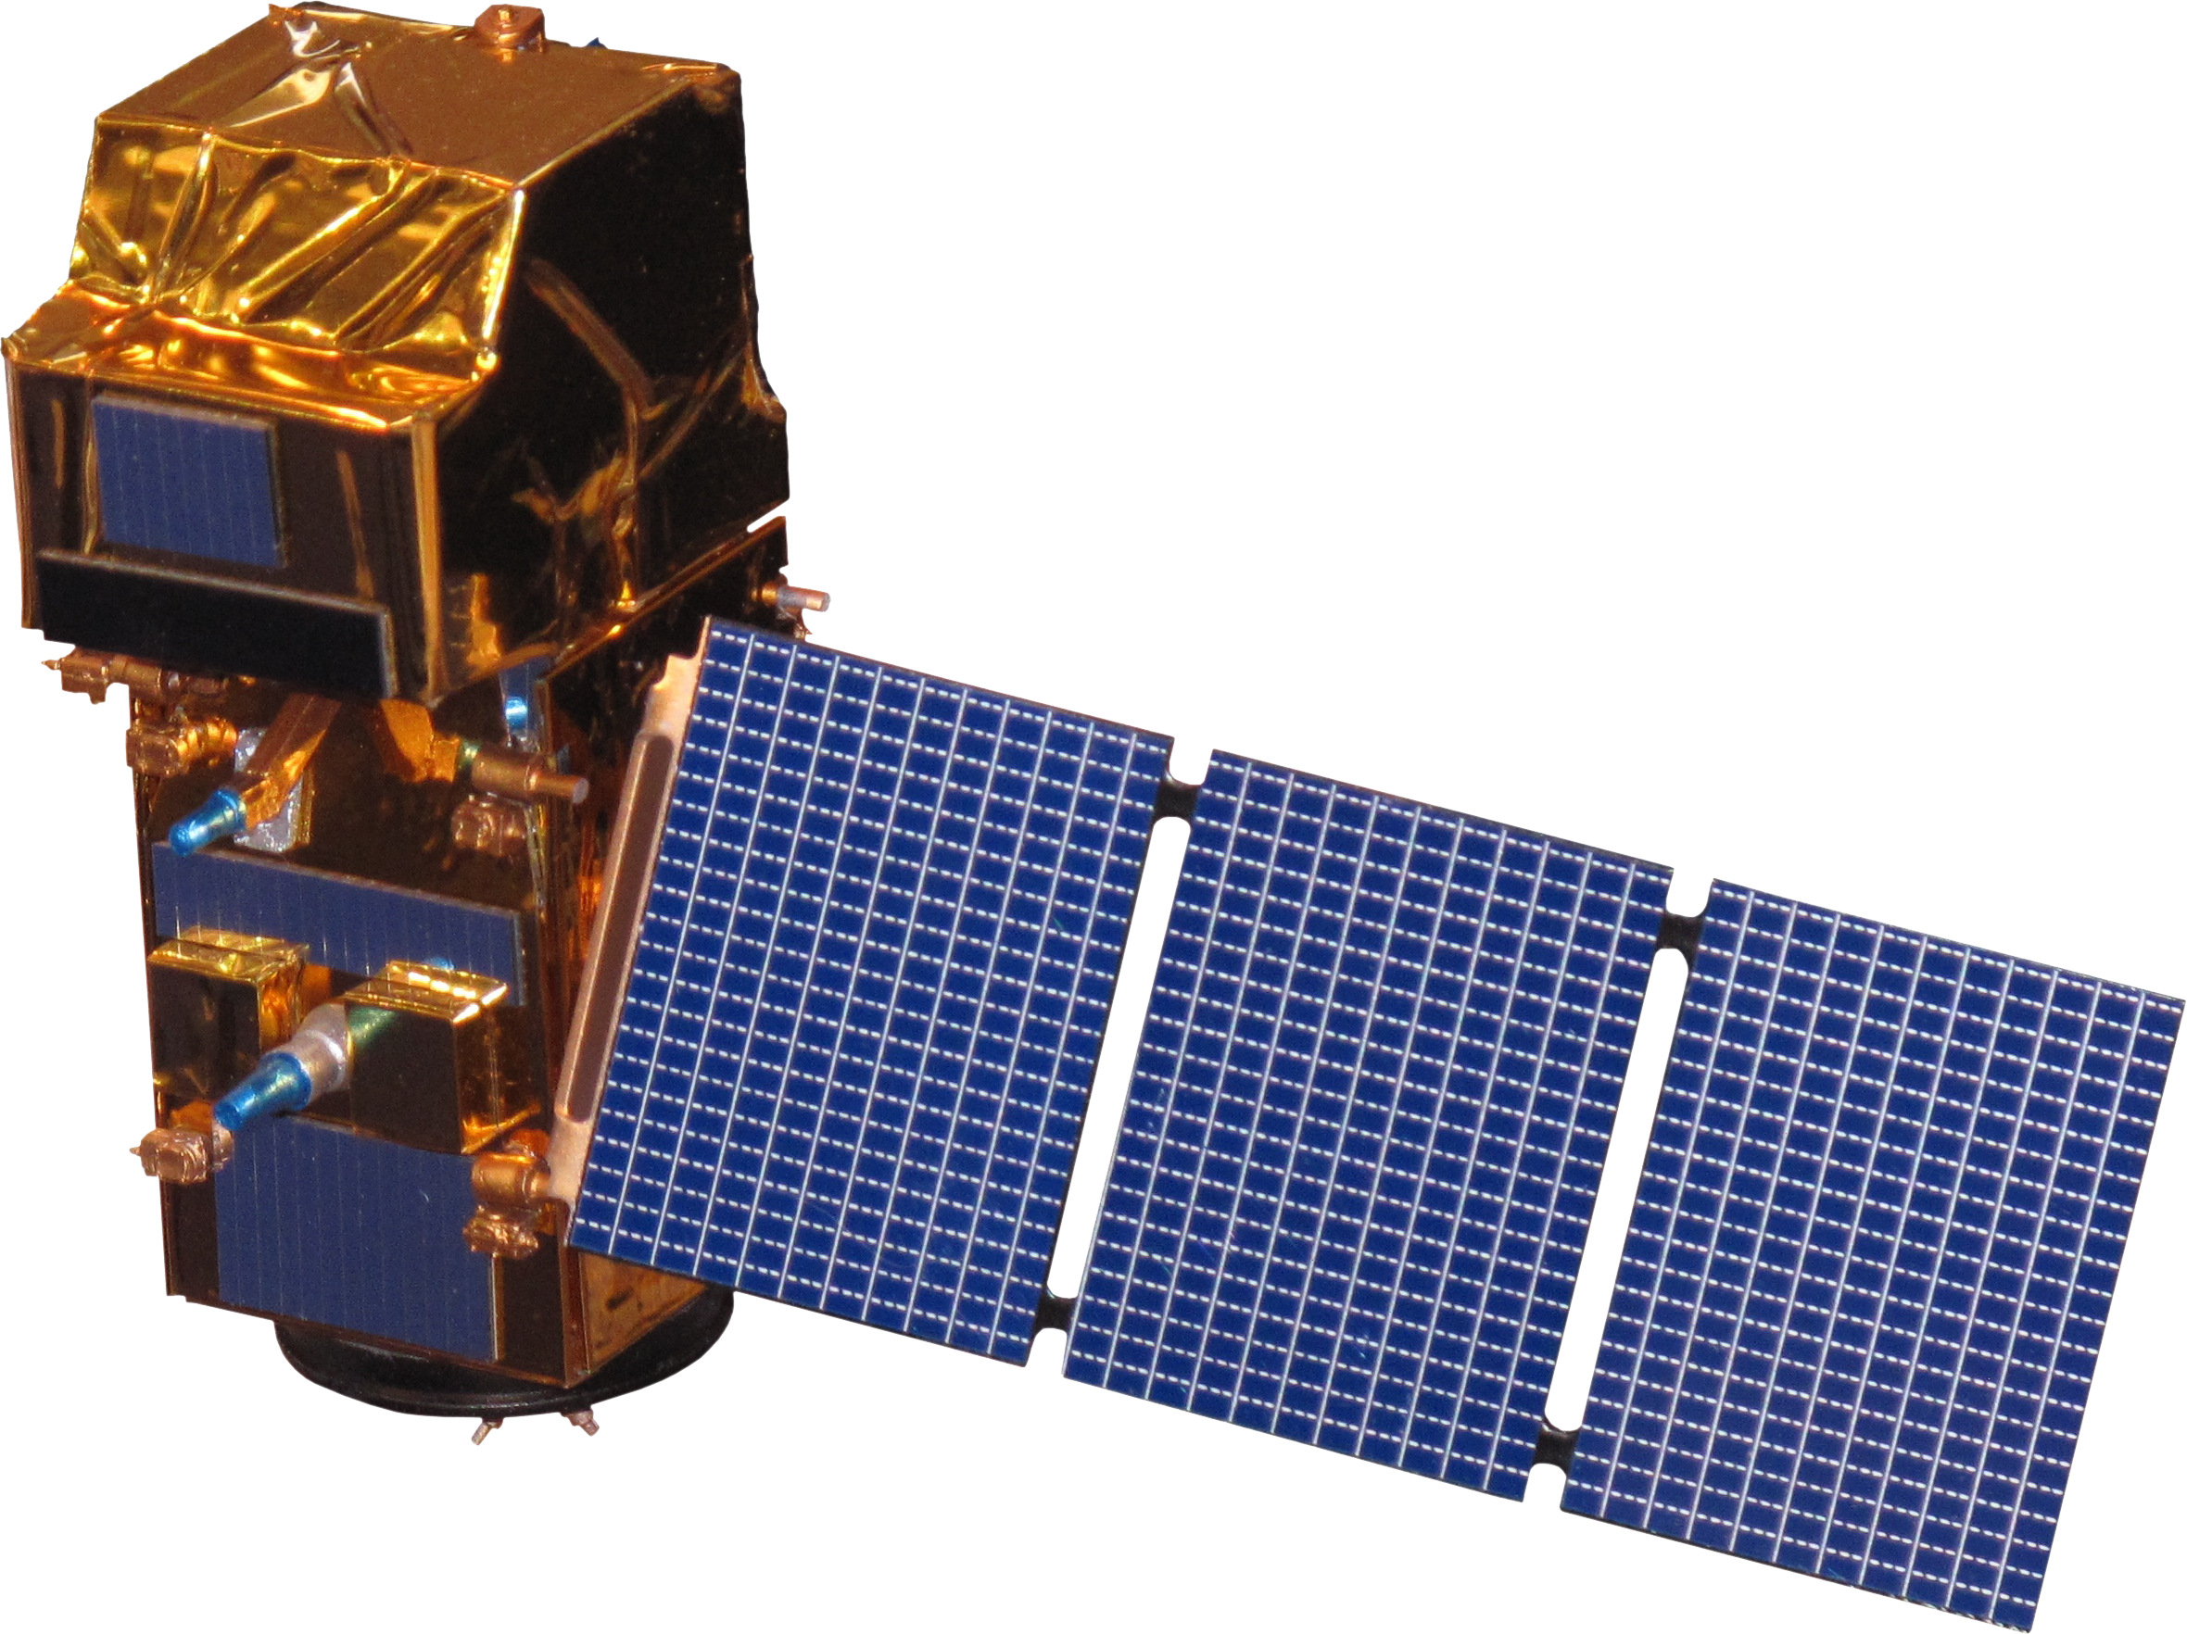
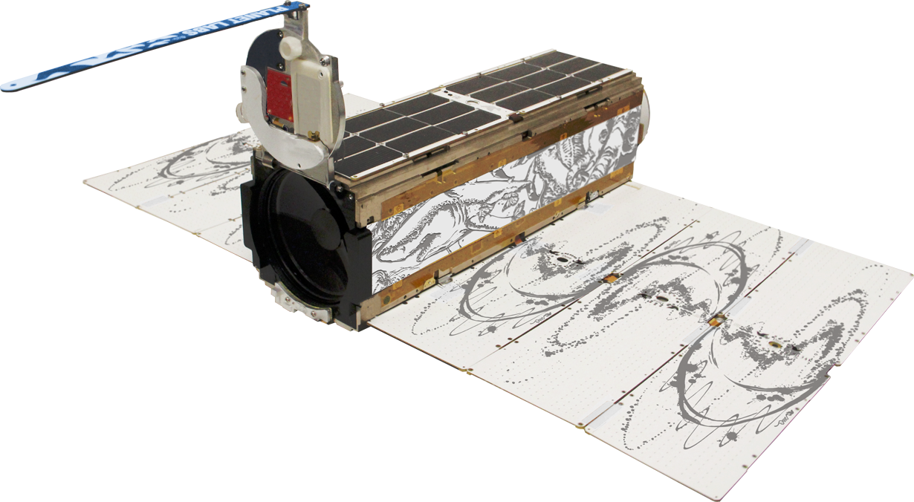
EARTH OBSERVATIONS
Sentinel 2 | MSI
Temporal Resolution: 5 - 10 days
Spatial Resolution: 10 - 20 meters
Landsat 5 | TM
Temporal Resolution: 16 days
Spatial Resolution: 30 meters
Temporal Resolution: 16 days
Spatial Resolution: 30 meters
Landsat 8 | OLI
NAIP | Aerial
Temporal Resolution: 1 - 3 years
Spatial Resolution: 0.6 - 1 meter
Planet | DOVEs
Temporal Resolution: 1 day
Spatial Resolution: 3 - 7 meters
Photo Credit: PPT Bing ext. (NAIP), NASA, Planet Labs
Notes:
The team used NASA, ESA, and commercial Earth observations to focus on two green-up periods from April to October of each year from 1984, though each dataset had either a temporal or spatial limitation, or both.
A couple special ones to note are these last two:
NAIP: NAIP is collected to aid in monitoring agricultural crops. NAIP images are orthorectified which combines the image characteristics of an aerial photograph with the georeferenced qualities of a map (USGS, 2018).
Planet Scope: This daily imagery is possible due to the constellation of over 200 DOVE satellites. The data are preprocessed before delivery for scientific use.
_____________________________________________________________________________________
Photo Credits:
Drone photo(NAIP) by Unknown author is licensed under CC BY-NC and found through the PPT Bing extension .
Earth Image Credit: PowerPoint Stock Images
Satellite Images Source: https://www.devpedia.developexchange.com/dp/index.php?title=List_of_Satellite_Pictures ,https://www.planet.com/company/approach/

Slide 7
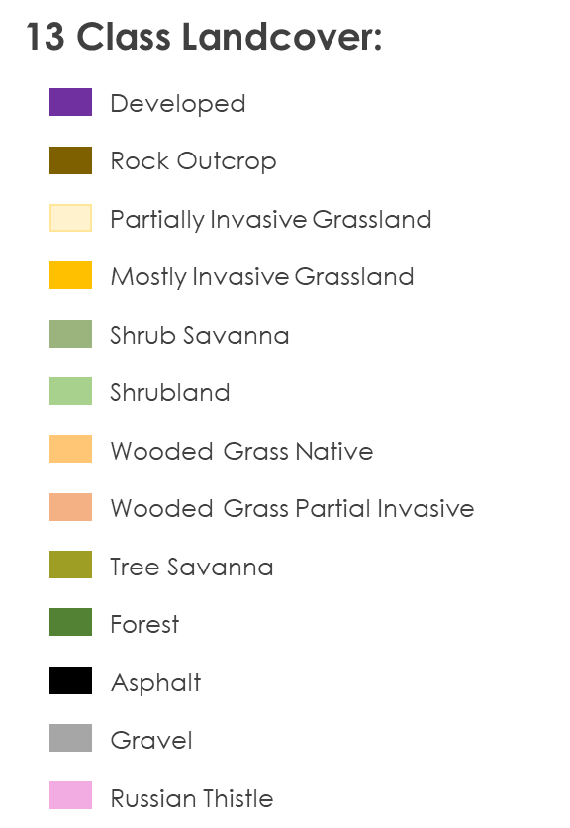
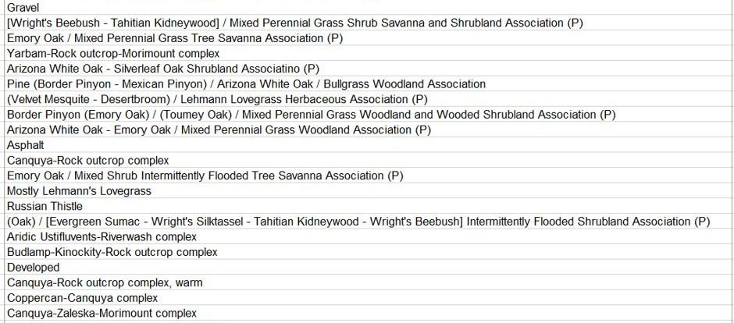
METHODOLOGY: Data Collection
Phenology
Two green-up periods: April & June
NPS recommended observing post-monsoon season
Data collection period: April – October
Datasets
49 vegetation classes provided by NPS were condensed to 13
Vegetation association
Level of invasiveness
mage Credit: Bernardo62
Notes:
Datasets:
Partner provided training point set collected in 2023, which we condensed from 49 classes to 13 based on provided information about vegetation associations and the level of invasiveness from native to partially, mostly, or fully invasive.
Using ArcGIS Pro, invasive and native presences were compared throughout the year, finding green up periods in both April and June (50% greenness mid-July)
Between those findings and recommendation from NPS to observe after the monsoon season (June), the decided data collection period was April-October, with a focus on June to examine green-up and accommodate NAIP imagery

Slide 8
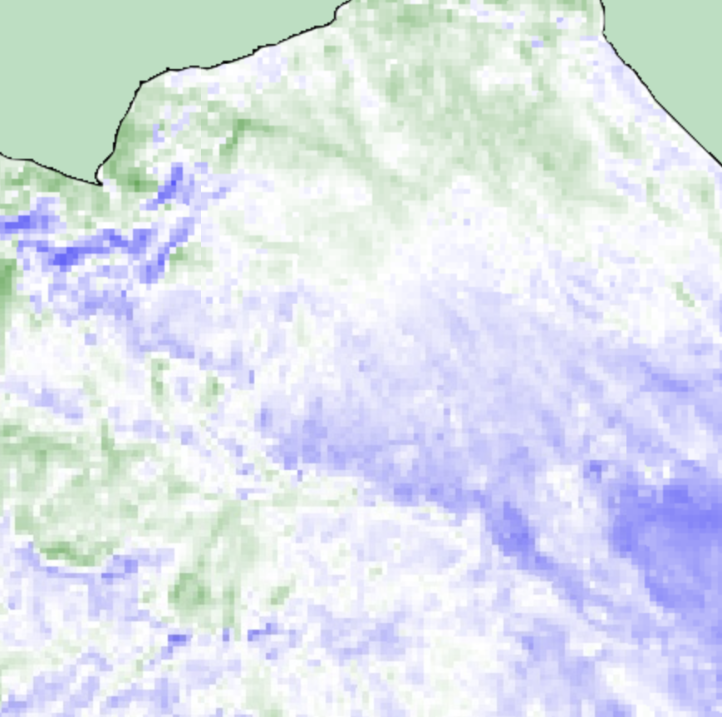
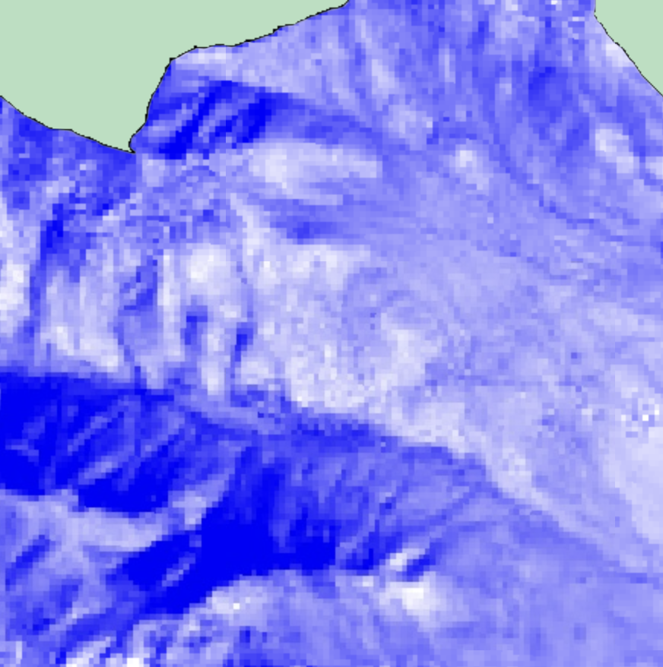
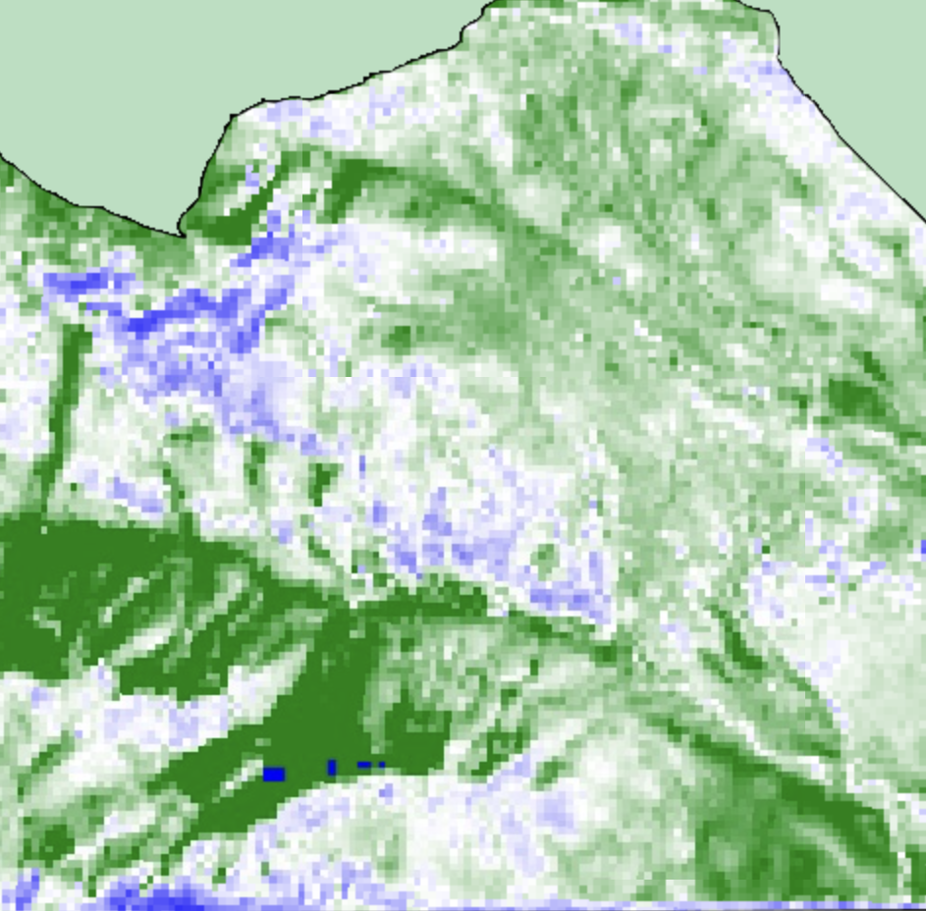
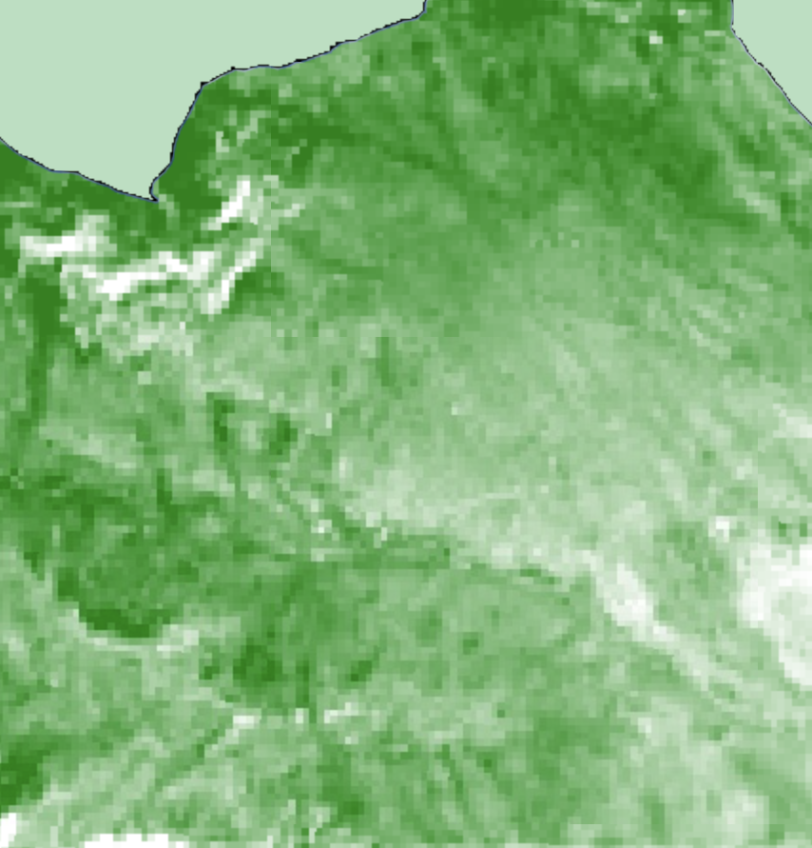
METHODOLOGY: Data Processing
Vegetation Indices
NDVI
Filtered imagery
Study period
Cloud cover
Clipped to study area
Cloud masked
Scaled
TC Wetness
Google Earth
Engine
EVI
TC Greenness
NDMI
TC Brightness
MSAVI-2
Notes:
Datasets:
Sentinel-2 MSI, NAIP, Landsat 5 TM, Landsat 8 OLI, and PlanetScope image collections were imported to GEE and filtered by the study period and cloud cover before being clipped to the study area and cloud masked.
Index Calculations for all datasets included Normalized Difference Vegetation Index (NDVI), Enhanced Vegetation Index (EVI), Normalized Difference Moisture Index (NDMI) , and Modified Soil Adjusted Vegetation Index 2 (MSAVI-2); Landsat and Sentinel 2 also performed Tasseled Cap B, W, and G.
Principle Component Analysis to combat high intercorrelation between indices and increase unsupervised classification accuracy
___________________________________________________________________

Slide 9
METHODOLOGY: Principal Component Analysis
High inter-correlation between indices
NDVI, EVI, NDMI, MSAVI2, TCW, TCG, TCB, and relevant spectral indices
Reduce number of inputs and increase accuracy of unsupervised classifiers
Notes:
Because the spectral indices we chose based on the literature review were highly inter-correlated, we chose to conduct principal component analyses.
PCA takes in all of your highly correlated variables and, using some cool linear algebra, gives you the same amount of new uncorrelated variables, called principal components.
Usually the first couple principal components explain over 95% of the original variance in the data.
So, we can throw out the original variables and choose a selection of the top few principal components to reduce the number of inputs to the classification or clustering algorithm.
The team conducted PCA for Landsat and Sentinel, including all vegetation health indices and spectral bands in the right spatial resolution.
This allowed Sentinel RF to go from 17 input variables to 4, and Landsat from 14 to 3, while still covering over 99% of the original variance in the data.
___________________________________________________________________
Photo Creds: Charts created by the team in Microsoft Excel.

Slide 10
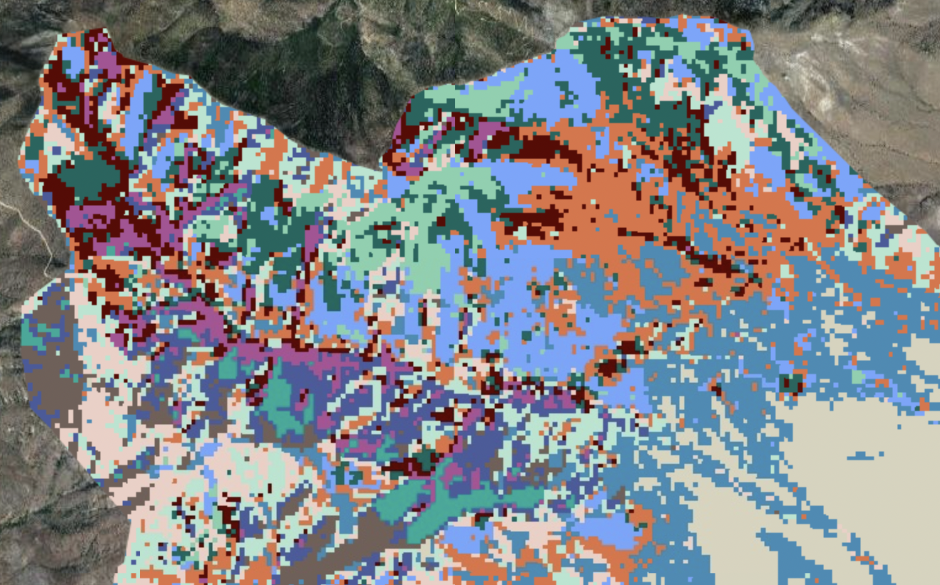
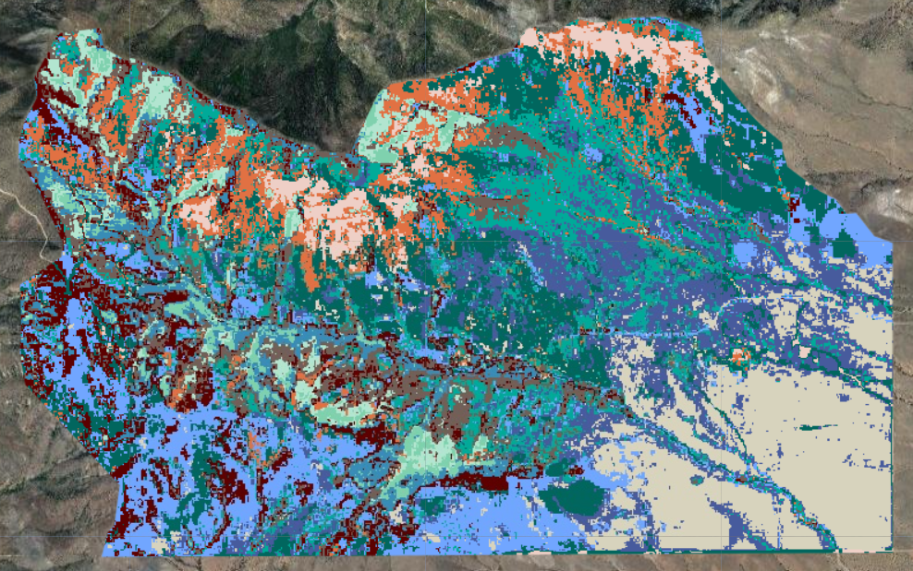
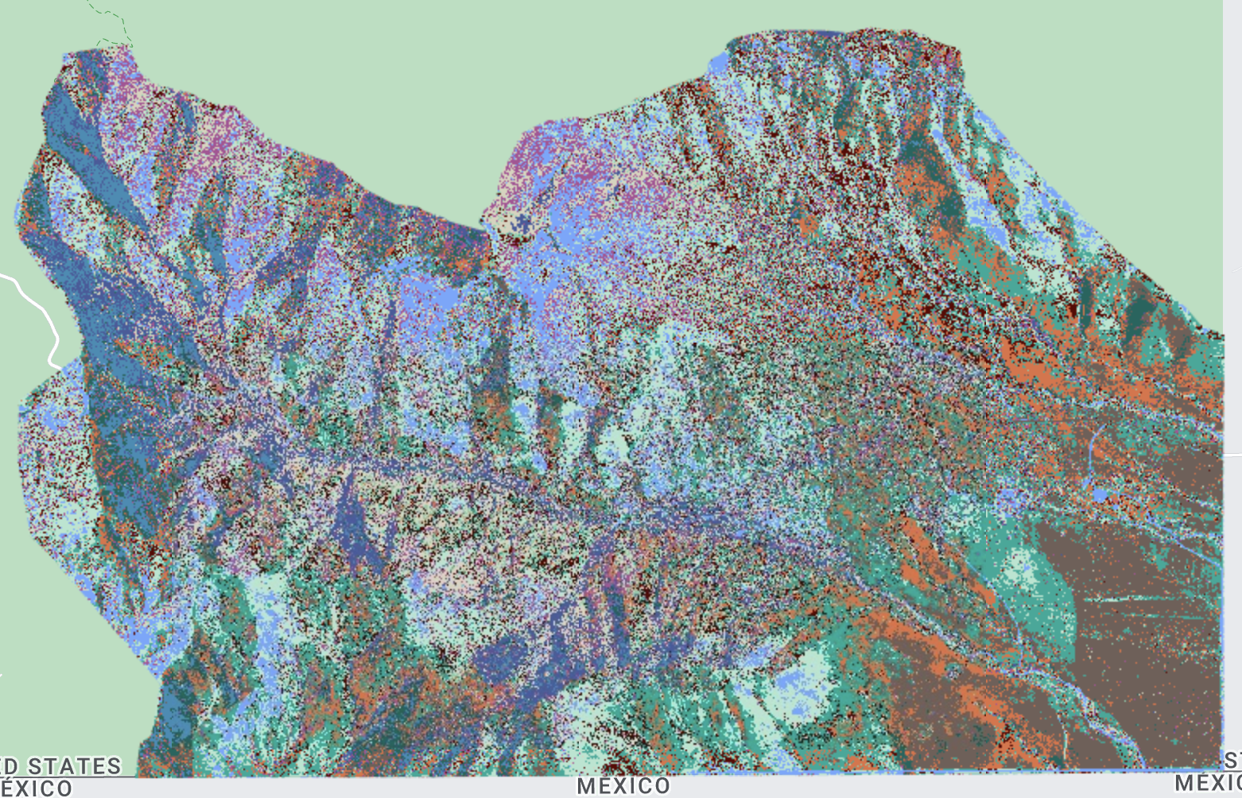
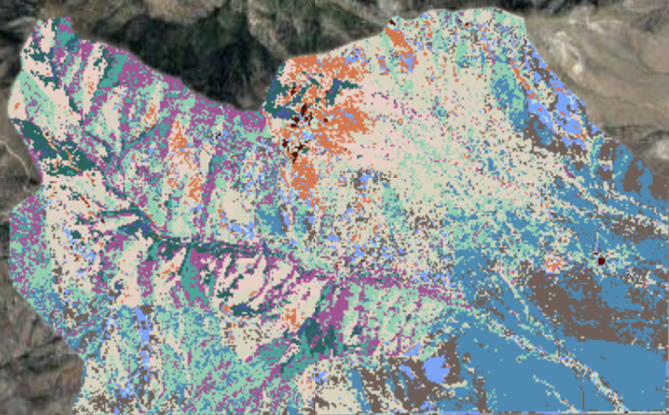
METHODOLOGY: K-means++
Landsat 8|2019
Resolution: 30m
Sentinel-2|2019
Resolution: 10 - 20m
Planet Scope|2019
Resolution: 3.25m
Pixels: 16,655
NAIP|2019
Resolution: 1m
Pixels: 500,000
0 .5 1 2 3 4
Miles
Notes:
These are images across all four datasets, Landsat, Planet Scope, NAIP, & Sentinel-2 for June 2022 with an unsupervised classification producing 13 classes.
K-means++ is an iterative machine learning algorithm that produces an unsupervised classification of k clusters based on variable inputs. The algorithm maximizes both within-group similarities and between-group differences. We used k-means to produce images with 13 clusters, which could pick out signals such as grasslands, roads, and forested areas. While the colors in each image are randomly assigned to the computer-generated classes, the above images provide a starting point for examining landscape segmentation and understanding the differences in spatial resolution across our sensors.
One of the main differences as a result of our differing resolutions is that Landsat and Sentinel-2 dataset sampled every pixel within the image, while the NAIP and PlanetScope imagery needed to set the number of pixels sampled to 500,000 and 16,655 pixels, respectively, in order to compute at such a high resolution.
Includes copyrighted material of Planet Labs PBC. All rights reserved.

Slide 11
METHODOLOGY: Random Forest
Predictors
Training Data
Predictors
Classifiers
Planet and NAIP: R, G, B, NIR / NDVI, EVI, MSAVI2
Landsat: + SWIR1-2 / NDMI, TCW, TCG, TCB
Sentinel: ++ Red Edge 1 - 4
On the ground data provided by NPS: 70% from each class
13 Classes
4 Classes
On the ground data provided by NPS: 30% from each class
Various accuracy metrics
Comparison across datasets
Validation
Supervised
Classification
Training Data
Validation
Image Credit: Bernardo62
Notes:
The next step was to run a supervised classification. In order to do this, we needed to feed in 70% of the training points provided to us (or ground truth data) that we received from our partners. For the random forest approach, the Sentinel and Landsat classifiers used the principal components, and NAIP and Planet used all possible vegetative indices and spectral bands.
The RF was run to classify with both 13 classes and 4 classes, and then validation was performed using 30% of the point sample from each class.
------------------------------Image Information Below ------------------------------
•Image Credit:

Slide 12
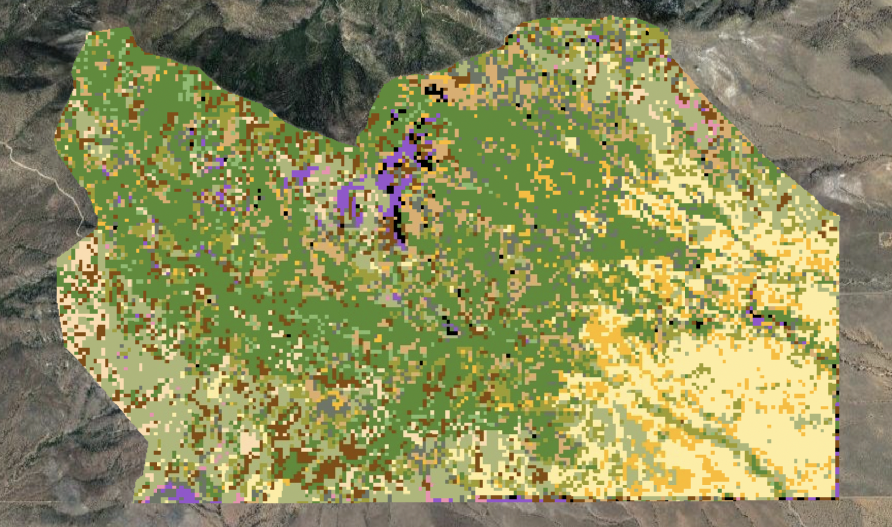
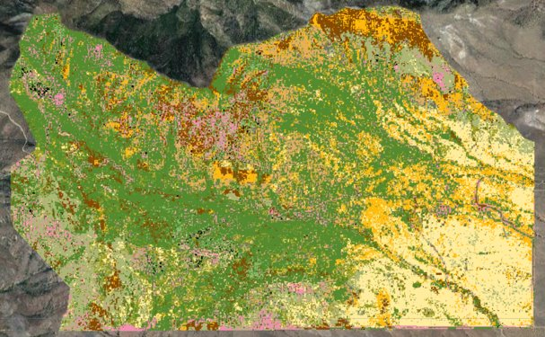
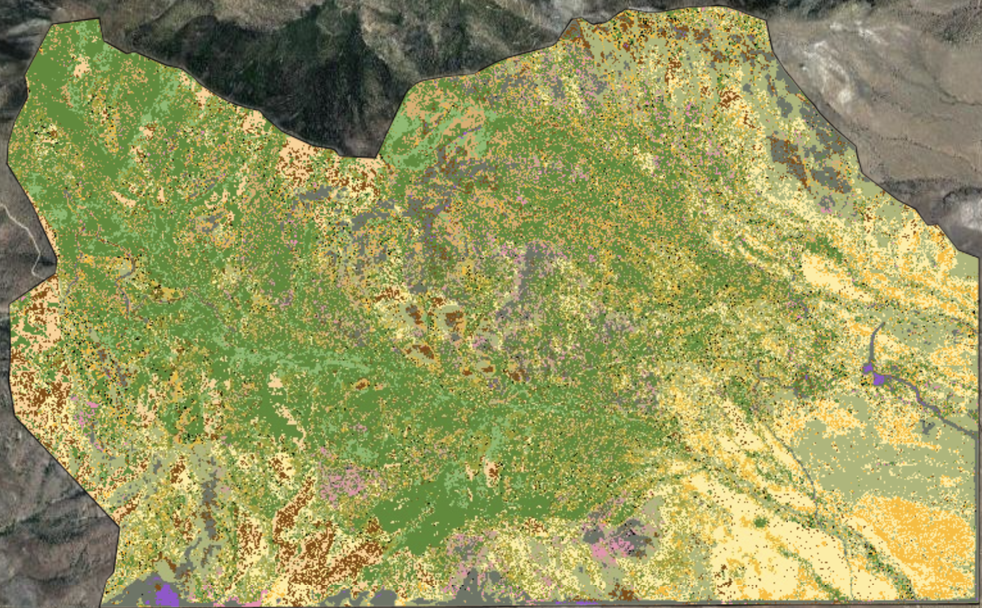
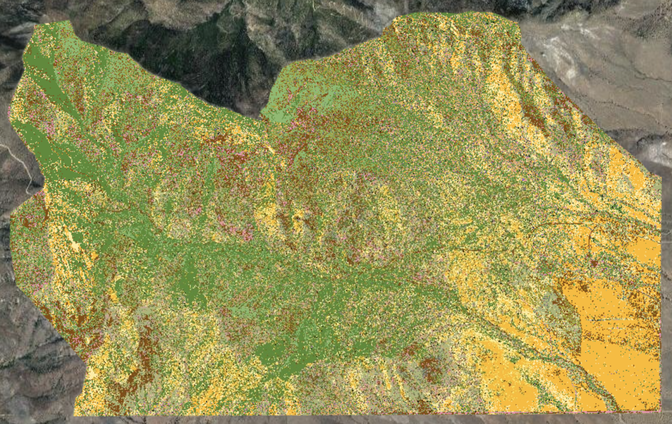
RESULTS: Random Forest – 13 Classes
Partially Invasive Grassland
Developed
Shrubland
Wooded Grass Native
Forest
Asphalt
Russian Thistle
Mostly Invasive Grassland
Rock Outcrop
Shrub Savanna
Wooded Grass Partial Invasive
Tree Savanna
Gravel
Landsat 8|2022
Resolution: 30m
Sentinel-2|2022
Resolution: 10m
Planet Scope|2022
Resolution: 3.25m
Pixels: 16,655
NAIP|2019
Resolution: 1m
Pixels: 1,000,000
0 .5 1 2 3 4
Miles
Notes:
Here you can compare the 13 class RF for each dataset. Greens and browns represent shrub and forested lands, purple and black developed areas, and yellow grasslands. Pay special attention to dark gold: Lehmann lovegrass and pink: Russian Thistle.
It is important to note that NAIP data for 2022 is not yet available, so the most recent date we were able to use was 2019.
These results aligned with what our partners reported in that the southeast corner of the park is dominated by Lehmann's lovegrass and the majority of the Russian thistle can be found along the southern border of the park near the border road.
Interestingly, Landsat and Sentinel both had higher accuracies than the PlanetScope and NAIP classifications. We believe Planet and NAIP may be overfitting the data due to their extremely fine spatial resolution. In addition, perhaps Landsat and Sentinel’s additional spectral bands contribute more precise information to the classifier.
Includes copyrighted material of Planet Labs PBC. All rights reserved.

Slide 13
RANDOM FOREST: From 13 Classes to 4
13 Class Landcover:
4 Class Landcover:
Focus on Invasive Species
Developed
Rock Outcrop
Mostly Invasive
Partially Invasive Grassland
Mostly Invasive Grassland
Partially Invasive
Shrub Savanna
Shrubland
Native
Wooded Grass Native
Wooded Grass Partial Invasive
Developed/Bare Ground
Tree Savanna
Forest
Asphalt
Gravel
Russian Thistle
mage Credit: Bernardo62
Notes:
In order to focus on invasive species spread as requested by the NPS, we further condensed the 13 classes into 4: developed/ bare ground, native, partially invasive, and mostly invasive. We then re-ran the classifier with the 4 classes.

Slide 14
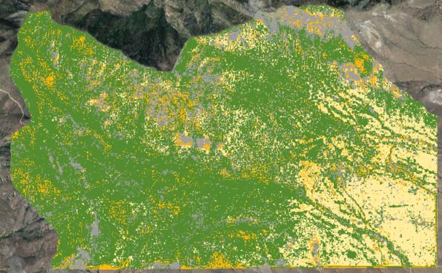
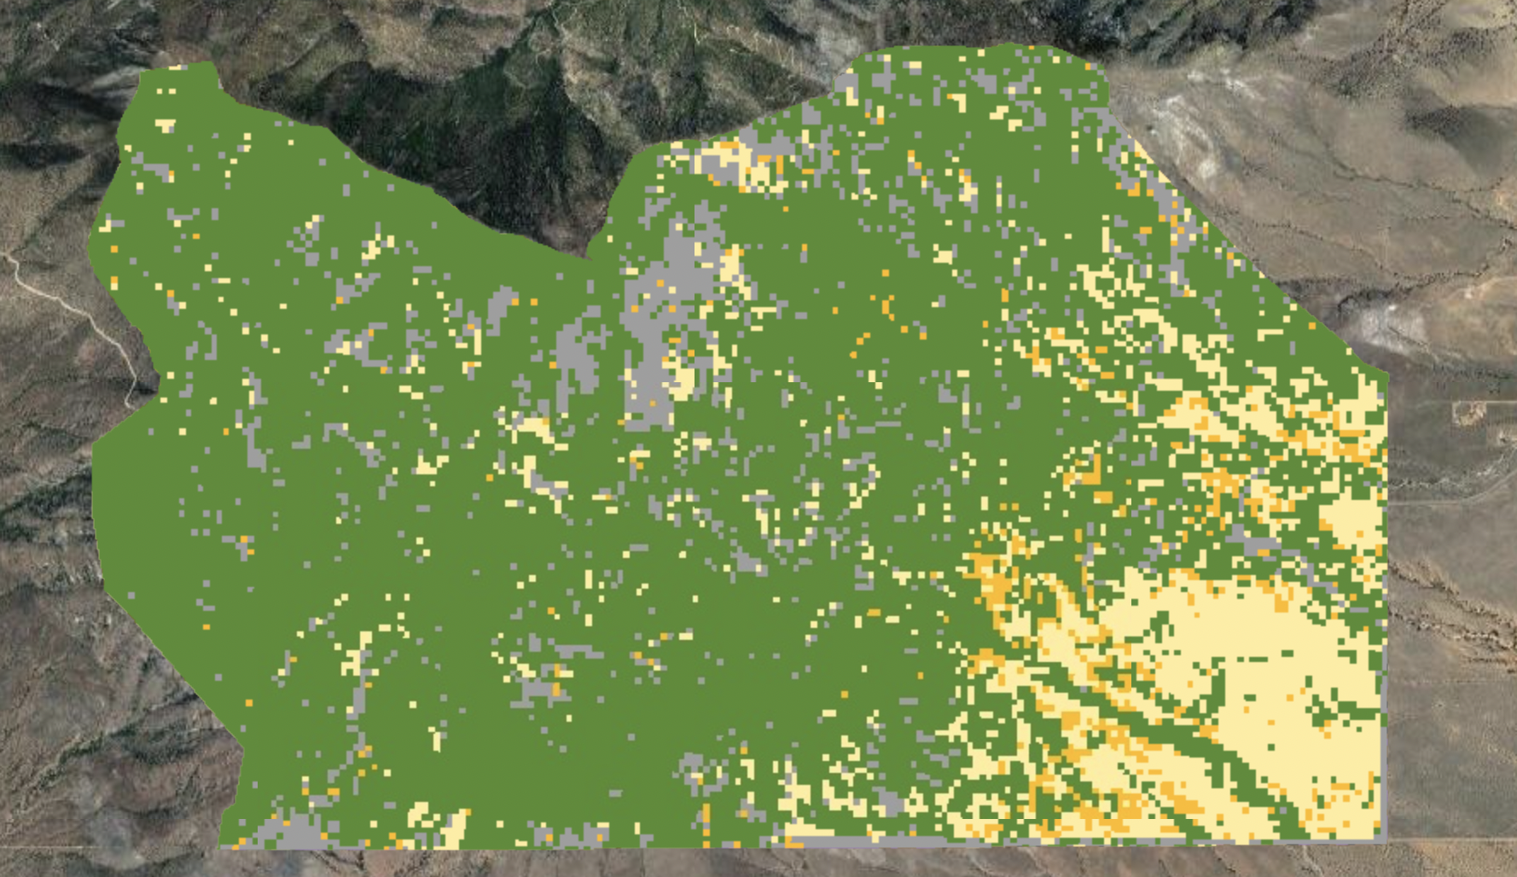
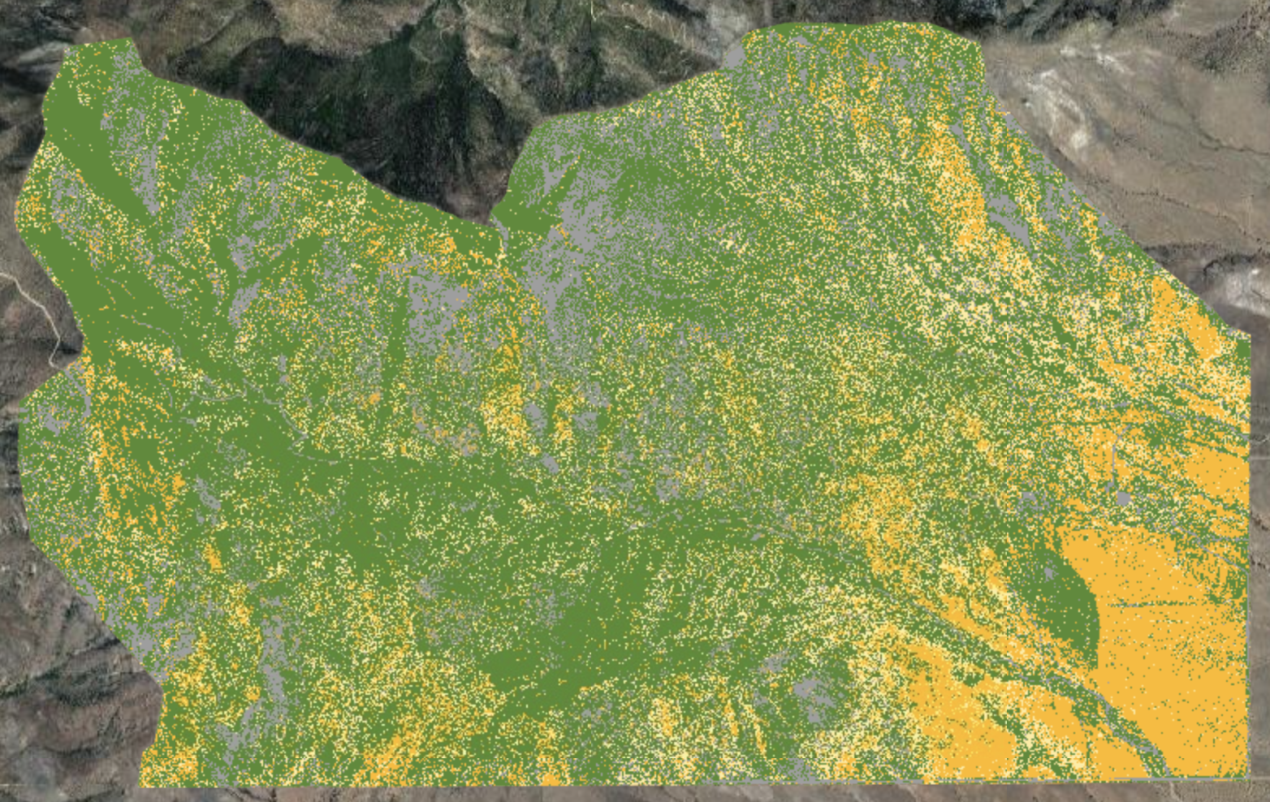
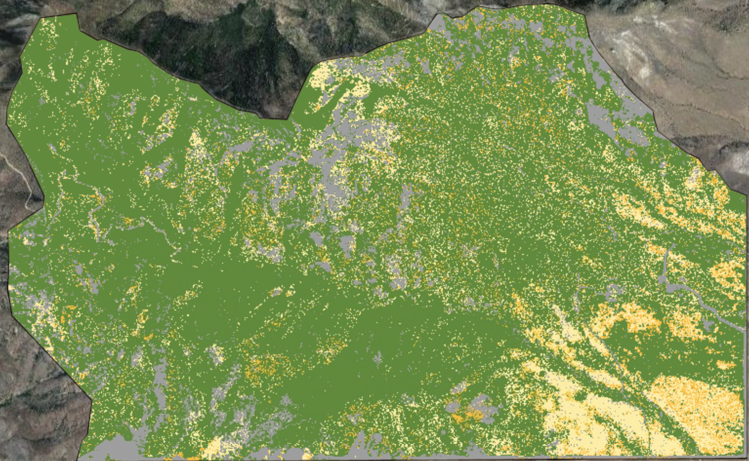
RESULTS: Random Forest – 4 Classes
Partially Invasive
Mostly Invasive
Native
Developed/Bare Ground
Landsat 8|2022
Resolution: 30m
Sentinel-2|2022
Resolution: 10 - 20m
Planet Scope|2022
Resolution: 3.25m
NAIP|2019
Resolution: 1m
Pixels: 1,000,000
0 .5 1 2 3 4
Miles
Notes:
These classifications had even higher accuracies, up to 60–75% depending on the sensor, and are easier to read at a glance—the dark yellow represents mostly and fully invasive vegetation, the light yellow represents partially invasive vegetation, the gray is developed or rock, and the green is native vegetation.
Again, we see clustering of invasives in the park's southeast corner and along the international border.
Includes copyrighted material of Planet Labs PBC. All rights reserved

Slide 15
RESULTS: Random Forest Accuracy Assessment
Sentinel-2
Notes:
You can see how the accuracy of the 13 and 4 class classifiers compares between datasets.
Landsat and Sentinel had the highest accuracies, while Planet had the lowest.
In the 13 class that was the most often misclassified was Forest, both for false positives and false negatives. This graph on the right shows the percent of forest misclassifications out of the total misclassifications (# of forest FPs/ total forest FPs) & (# of forest FNs/ total forest FNs).
In this case, A false positive refers to a validation point that was labeled as forest but was actually another class. A false negative refers to a validation point that should have been labeled as forest but was labeled as another class.

Slide 16
RESULTS: Random Forest Accuracy Assessment
Notes:
The producer’s accuracy tells you the percent of points in each class that were classified correctly by the RF.
The consumer’s accuracy tells you of the points that were classified as a certain class, what % of them were actually correct?
For ease of comparison, we took the producer’s accuracy and condensed down to the 4 classes of interest.
We can see a couple of key points of interest here.
First, the accuracies are surprisingly different for the 13 and 4 class classifiers.
Second, for both classes, sentinel had a 100% success rate in picking out invasive species.
Landsat and NAIP had more consistent consumer and producer’s accuracies throughout all classifications.

Slide 17
RESULTS: Vegetation Health Time Series Analysis
Landsat 5 & 8 Median Time Series (1986–2022)
0.20
0.18
0.16
0.14
0.12
0.10
0.08
0.06
0.04
0.02
0.00
Median MSAVI-2
Border Wall Construction
Peak Fire
Horseshoe Fire
1988 1990 1992 1994 1996 1998 2000 2002 2004 2006 2008 2010 2012 2014 2016 2018 2020 2022
Year
Image Credit: Bernardo62
Notes:
This is a time-series created with a combination of Landsat 5 imagery from 1986–2011 and Landsat 8 imagery from 2013–2022. It is worth noting that there was a gap in the data for 2012.
The team calculated the Modified Soil Adjusted Vegetation Index 2 for each year to showcase the change in vegetation overtime through out the park. MSAVI2 is a metric designed to evaluate vegetation health in places with a lot of bare soil.
What's interesting here are these two significant dips in median vegetation. The first dip is likely due to the Peak Fire that actually occurred in June of 1988, and you see this dramatic decline of vegetation since about 2,600 acres of land burned was with in the park.
The second dramatic dip is likely due to the Horseshoe Fire that occurred in May of 2011. Almost 100% of the park's acreage burned in this human-caused fire.
We have also highlighted the beginning of the border wall construction inside Coronado national memorial, which coincides with another dip in vegetation health.

Slide 18
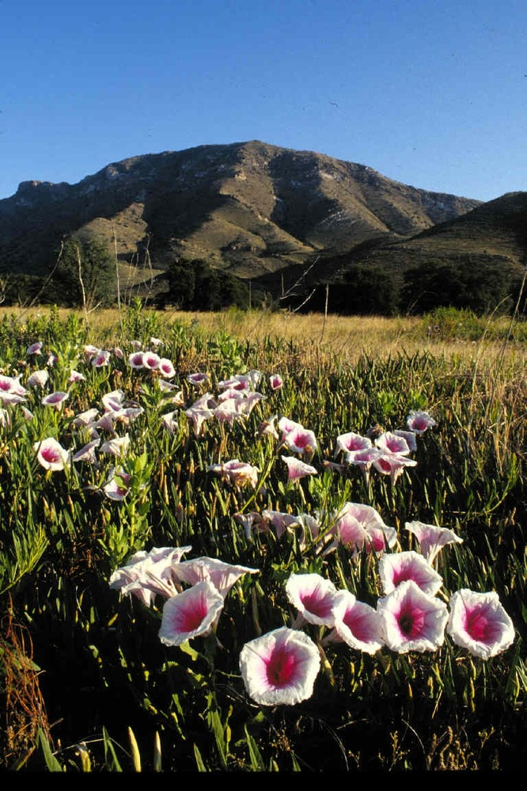
CONCLUSIONS
Principal component analysis effectively reduced the necessary number of inputs for machine learning algorithms
Random forest proved to be a useful method of invasive species detection, especially at a 4-class level with Sentinel and Landsat
Steep drops in vegetation health occurred corresponding to disturbance events like wildfire and border wall construction
We created a solid foundation for the NPS at Coronado National Memorial to integrate remotely sensed data into vegetation mapping and provided them with suggestions for improving the accuracy and usefulness of these tools moving forward
Photo credit: National Park Service,
Coronado National Memorial
Notes:
We are glad we used PCA to reduce the inputs to our machine learning algorithms while preserving variance in the data, ultimately lending to quite a successful random forest classifier.
We were able to identify historical events correlated with significant changes in vegetation health using Landsat 5 and 8.
We are so excited to pass off our final products to our partners for their restoration planning and to help add a new tool to their vegetation mapping toolbox and we look forward to seeing how they use and improve on these products in the next few years.
-------------------------------------------------------------------------
Photo credit: NPS CORO
https://www.nps.gov/npgallery/GetAsset/670759F9-155D-451F-6756B182AE1D2943/proxy/hires?

Slide 19
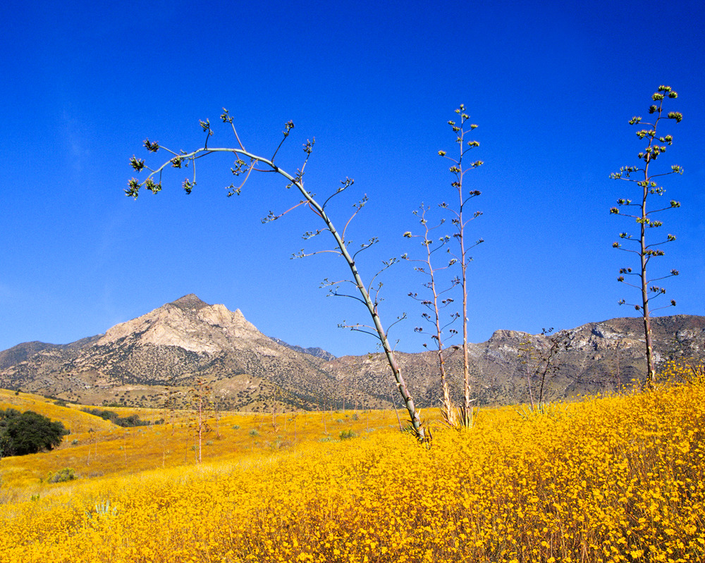
LIMITATIONS
Temporal inconsistency across datasets
Limited ground truth data for current and historical classification
Insufficient time for all desired analysis
Coarse spatial resolution for historical classification
Photo credit: National Park Service,
Coronado National Memorial
Notes:
Not enough data in each training data set: we wanted at least 30 in each class. The classes that had less than 30 included "developed", invasive grassland, shrubland, native wooded grassland shrubland, asphalt, and gravel. While adding more points to these categories would improve overall accuracy of the 13 class classification, this was less of a problem for the 4 class version.
Historical classification could only be done by Landsat because the other datasets did not have enough historical data. Landsat unfortunately has incredibly coarse resolution to be tasked with detecting invasive plants.
Additionally, we don't have a complete set of ground truth data points for historical imagery and comparisons; this presents a large challenge particularly for Russian thistle identification, as it is an annual. We do have a set of invasive points from 1999-2001 which Landsat was able to utilize, but this set only has 4 Russian thistle points spread across the 3 year collection period which likely impacts accuracy. We did not run RF classifiers for previous years as we did not want to train a classifier on irrelevant data points.
NAIP imagery was not yet available for 2022, so the most recent image available was 2019. We hoped NAIP would perform well due to its very fine spatial resolution but unfortunately, without accurate training data for the available imagery, we can only take a very mild guess at how the classifier is performing.
Photo credit: national park service, Coronado national memorial
https://www.nps.gov/npgallery/GetAsset/9793959C-1DD8-B71B-0BDC4B46329B7B63/proxy/hires?

Slide 20
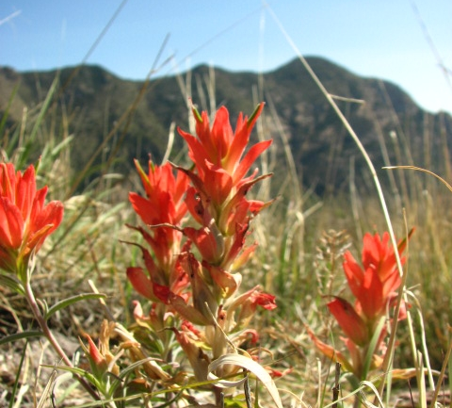
FUTURE WORK
Collect more in situ data
Research other classification methods
Compute NAIP surface reflectance
Investigate disturbed areas and effects on invasive spread in CORO
Photo credit: National Park Service,
Coronado National Memorial
Notes:
An exciting opportunity for future work includes continued collection of training points. This project provides a baseline for invasive assessment, which can be compared to future years to understand invasive spread and evaluate management success.
We would love to investigate other classifiers that have been used for land cover classification and invasive species detection, such as MaxEnt or ISODATA.
Finally, while Landsat, Sentinel, and PlanetScope were all converted to surface reflectance and scaled as part of our data processing, NAIP imagery is much harder to scale but would potentially benefit greatly from scaling, as the aerial collection methods lend themselves to varying digital numbers within a mosaicked image
------------------------------Image Information Below ------------------------------
•Image Credit: national park service, Coronado national memorial
https://www.nps.gov/npgallery/GetAsset/671BE2B5-155D-451F-67F2243F07B8B45D/proxy/hires?

Slide 21
Dr. Marguerite Madden
UGA, Center for Geospatial Research
Joseph Spruce
Science Systems and Applications, Inc.
Sarah Payne
Fellow, NASA DEVELOP National Program
Robert Matthewman
GIS Intern, National Park Service
Nicole Gonzalez
Biologist, National Park Service
Jessica Garcia
Physical Scientist, National Park Service
JoAnn Blalack
Integrated Resource Manager, National Park Service
This material contains modified Copernicus Sentinel data (2019-2022), processed by ESA. Includes copyrighted material of Planet Labs PBC. All rights reserved. ​
Dr. Marguerite Madden
University of GA, Center for Geospatial Research

