Slide 1
Subgroup 3 (Human Response and Metrics) Briefing
Siddhartha Krishnamurthy (NASA), Yahia Ismail (Supernal)
UAM Noise Working Group Meeting
March 23, 2023

Slide 2
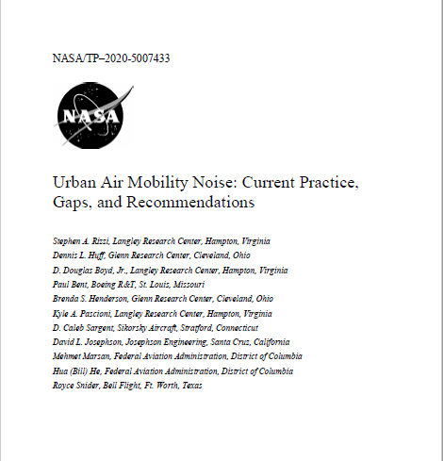
UAM Vehicle Noise Human Response Study
UNWG white paper recommended human response study to understand community variation in noise perception
Study Goals:
  Assemble a wide range of UAM vehicle sounds for use in human response studies.
  Create a rich human response database
  Provide insights into human response to UAM vehicle noise
Two Phases:
  Feasibility Test (completed)
  Implementation Phase on UAM noise human response (current focus)
NASA decided to develop and utilize a remote psychoacoustic testing capability for this study
¹S. A. Rizzi, D. L. Huff, D. D. Boyd, Jr., P. Bent, B. S. Henderson, K. A. Pascioni, D. C. Sargent, D. L. Josephson, M. Marsan, H. He and R. Snider, "Urban Air Mobility Noise: Current Practice, Gaps, and Recommendations," NASA/TP–2020-5007433, October 2020.

Slide 3
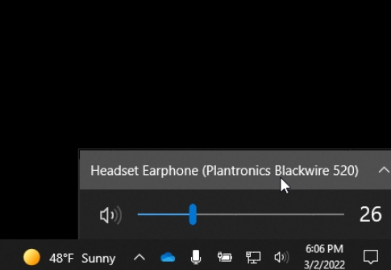
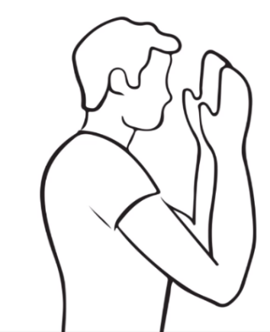
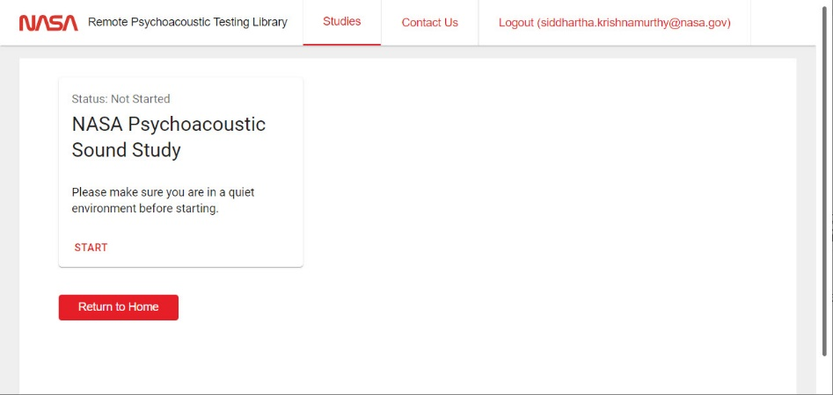
Feasibility Test of UAM Vehicle Noise Human Response Study
Remote Feasibility Test administered from October 15 – 30, 2022, using newly developed NASA remote psychoacoustic test platform
48 remote test subjects fully completed psychoacoustic test.
Computer/Headphone Volume Subjective Calibration Procedure
Annoyance Response Prompt for Each Sound

Slide 4
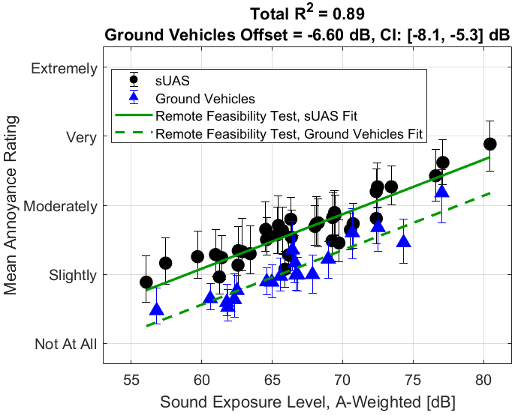

Feasibility Test Main Results
Results presented yesterday (Wed, March 22)
Results also in paper and presentation at SAE Noise and Vibration 2023 (May 2023)
Determined annoyance response difference between two geographically distinct subject groups
Replicated difference between sUAS and ground vehicle annoyance response from in-person test
Found use of contextual cue affected sUAS noise response but not ground vehicle noise response
No-Cue: “How annoying was the sound to you?”
With-Cue: “Imagine hearing this sound several times each day while outdoors and near your home, how annoying would this sound be to you?”
West
East

Slide 5
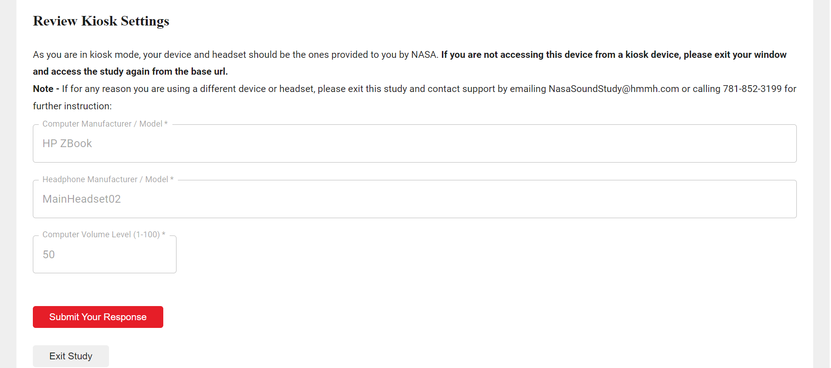
Remote Test Platform Augmentation with Kiosks
Kiosk-mode remote test application replaces manual sound calibration with a review of kiosk settings. Note: image below is not final layout of kiosk review page.
Select test subjects will be sent specific tablet computers (kiosks) and headphones
Kiosks to be available for Implementation Phase (Phase 2) of UAM vehicle noise human response study

Slide 6
Research Topics for Implementation Phase (Phase 2) of UAM Vehicle Noise Human Response Study
UAM vehicle noise annoyance:
  In different ambient soundscapes
  Between geographically distinct communities
  Differences from existing aircraft noise sources.
Working with OEMs on research goals.

Slide 7
White Paper Recommendations Requiring Additional Attention from Subgroup 3
Comprehensive evaluation of metrics that supplement the day-night average sound level
Laboratory studies to compare UAM vehicle noise and existing aircraft noise sources with goal to inform community testing.
Recommended actions proposed in last UNWG meeting.
Subgroup 3 has since discussed topic (1)
  Subgroup 3 to select someone to compile lessons learned from introduction of other emerging technology aircraft like package delivery drones.

Slide 8
Questions?

Slide 9
Image References
All images in this presentation generated by presenter.

