Slide 1
Trusted Autonomous Systems
James B. Dabney, University of Houston – Clear Lake
Pavan Rajagopal, CACI
Julia M. Badger, NASA JSC
13 April 2023
This publication does not contain information which falls under the purview of the US Munitions List (USML), as defined in the International Traffic in Arms (ITAR), 22 CFR 120-130, and is not export controlled. This publication does not contain information within the purview of the Export Administration Regulation (EAR), 15 CFR 730-744, and is not export controlled. This document (DAA 20230003721) has been reviewed in STRIVES.

Slide 2
Overview
  NASA Artemis Program & Lunar Gateway
  Gateway Vehicle Systems Manager
  Trusted Autonomy Challenges
  Assume-Guarantee Contracts Overview
  Development Contracts
  Operational Contracts

Slide 3
NASA Artemis Program
Artemis Program is returning people to the Moon for exploration and preparation for planetary missions
Artemis is a family of systems that cooperate to get astronauts safely to the Moon and safely home to Earth

Slide 4
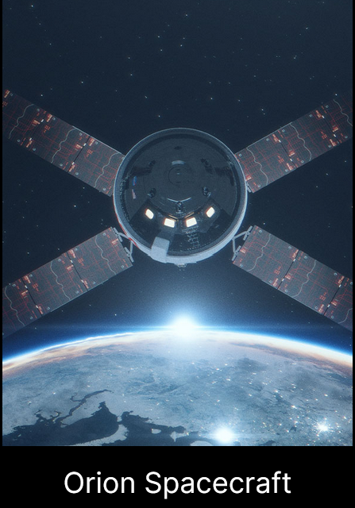
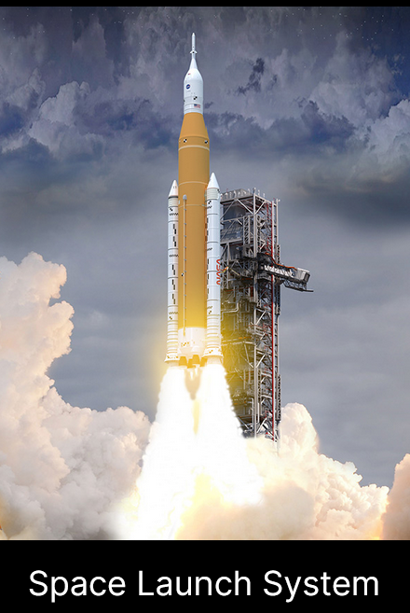
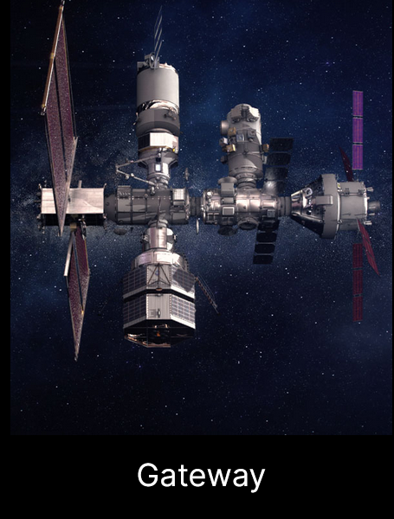
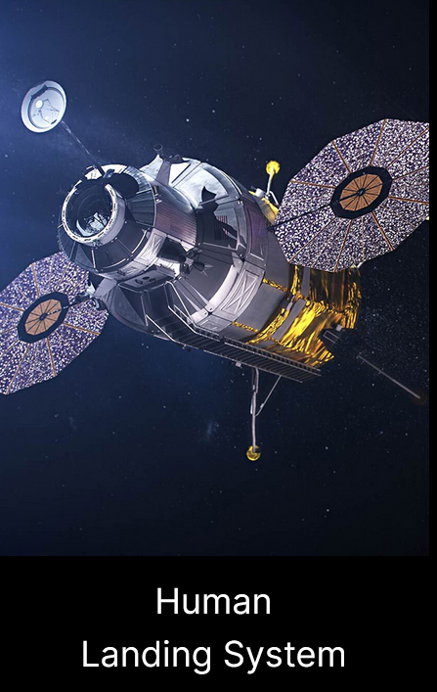
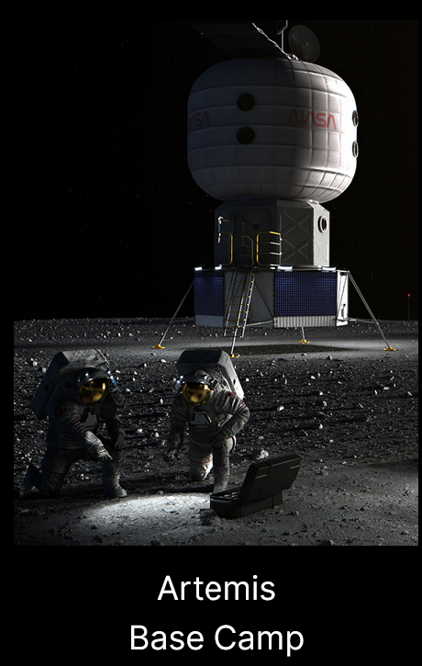
Artemis Family of Systems

Slide 5
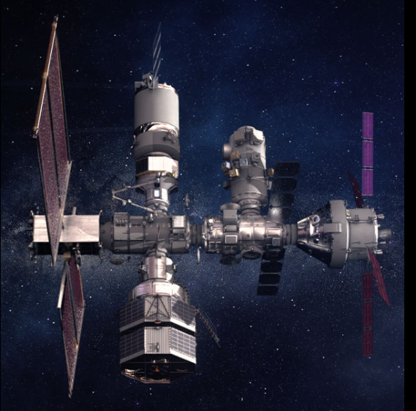
Lunar Gateway
Artemis space station in cislunar (NRHO) orbit
Gradual buildup of modules
Initial Co-Manifested Vehicle
  Habitation and Logistics Outpost (HALO)
  Power and Propulsion Element (PPE)
Sustaining
  International Habitation Module (IHAB)
  Airlock
  Visiting vehicles – Orion spacecraft

Slide 6
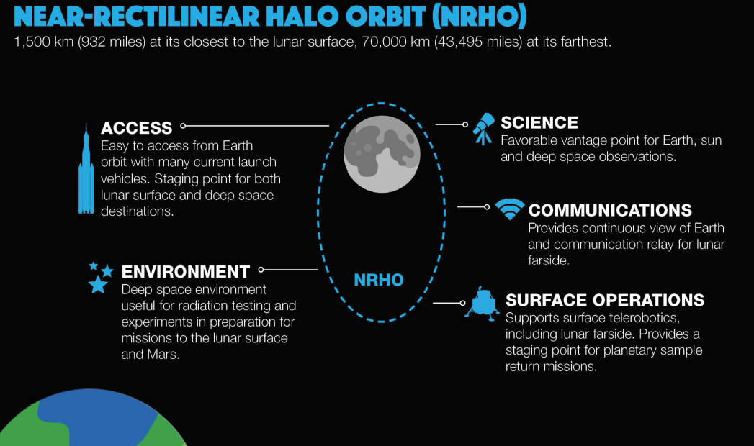
Gateway Cislunar Orbit
Near-rectilinear halo orbit
Orbits around a neutral gravity point in the Earth-Moon system
Ref: W. Gerstenmaier, J. Crusan, “Cislunar and Gateway Overview”

Slide 7
Need for Autonomy
Exploration spacecraft becoming more complex and autonomous
Gateway Vehicle System Manager (VSM)
  Manage unattended spacecraft for extended duration operations
  Monitor and coordinate numerous subsystems through module system managers (MSMs)
  Transition between varying levels of autonomy depending on crew and ground operator interaction

Slide 8
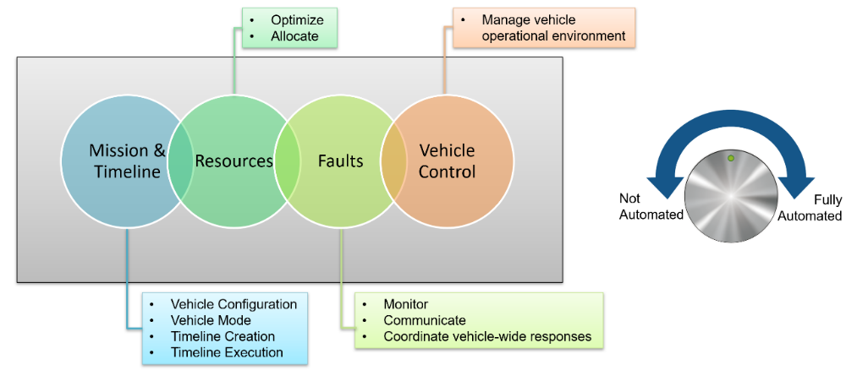
Vehicle System Manager
Four management functions
Integrates modules; interfaces with humans and visiting vehicles
Fully autonomous when uncrewed and no active ground control
Can dial down autonomy to collaborate with flight crews and ground in operating vehicle

Slide 9
Need for Enhanced Assurance
VSM will encounter unexpected situations
  Environmental anomalies
  Unanticipated operational sequences
  System failures
VSM must stay within safe boundaries
  Enforced during operation
  Ensure safe recovery

Slide 10
Assume-Guarantee Contracts
AGCs define expected behavior of systems, subsystems, components
Assumptions or pre-conditions on the subsystem’s inputs bound the conditions in which the contract applies
Guarantees or post-conditions of a subsystem’s contract declare conditions that the subsystem’s outputs must satisfy and can serve as verification goals
Contracts can be used to define safety properties or hazard controls:
  E.g., a car should not start unless the transmission is in park mode
  Can be converted to a mathematical specification and model checked to ensure that specified system has the desired behavior and safety properties
Notes:
See if you can convert this into a graphic

Slide 11
Defining AGCs
Contract sources for VSM
  Internal VSM contracts
    Derived from software requirement specifications, scenarios/use cases
    Watchdog-type functionality
  MSM contracts – critical behavior of Gateway module system managers
    Defined in MSM Interface Control Document (ICD)
    MSM provider has primary responsibility for compliance
    VSM must detect and react to anomalies at MSM interface

Slide 12
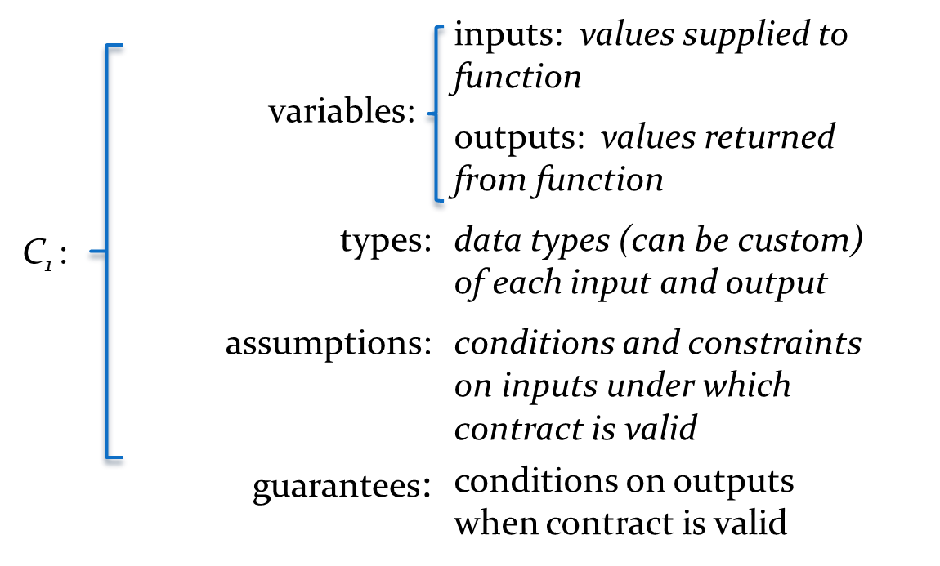
Documenting AGCs (Template)

Slide 13
Selecting Contracts for Implementation
Contracts are expressed mathematically
  Propositional logic
  Mission time Linear Temporal Logic
Set of possible contracts is large and must be trimmed to feasible size
Selection factors
  Mission or safety-critical
  Not covered by fault management
  Contract has temporal element
  Function is very complex

Slide 14
Assessing Complexity
Complexity indicators
  Number of possible execution paths (or states and transitions)
  Number of interacting, interdependent applications.
  Single application with limited number of paths – traditional testing approaches
Multiple states and paths or multiple interacting applications
  Potential for
    Deadlocks
    Race conditions
    Other emergent behaviors
  Traditional testing may not be adequate
  Good candidate for formal specification and model checking

Slide 15
Development and Operational Verification
Developmental verification
  Performed at design time
  Functionality represented as state machine using modeling language such as TLA+ or Promela
  Contracts implemented as temporal formulas and compliance evaluated using model checker such as TLC or Spin
Operational verification
  Performed at runtime
  Functionality is operational system
  Contracts implemented as inline code or using runtime verification engine such as R2U2

Slide 16
Elements of Development AGCs
State Machine
  Represents the configurations of the system (states)
  Represents feasible transitions from state to state (events)
AGC
  Represented using propositional logic and linear temporal logic
  Implemented as assertions and LTL formulas evaluated by model checker

Slide 17
Organization of the Parts
Separate lists
  States Q
  Events S
  Transitions D, where each d is a [q, s, q’] triple
Data structure
  state[n].event[m]
  where there are N states and each state has an array of event-transition pairs
  Event nodes could be a list d.s, d.q’ where q’ is n, an index into the state(.) list

Slide 18
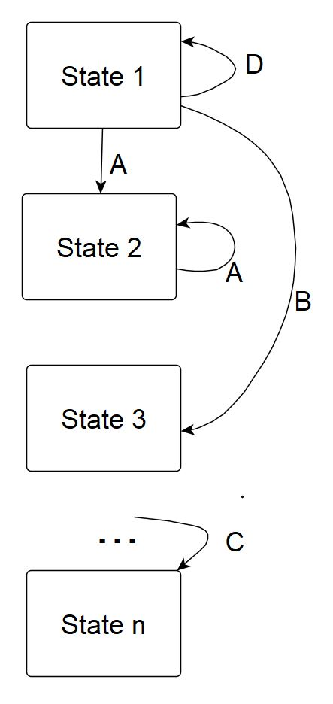
Example State Machine

Slide 19
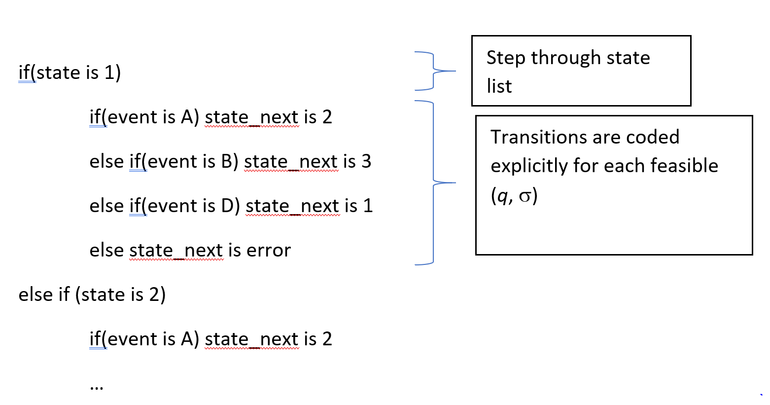
State-Based State Machine Model

Slide 20
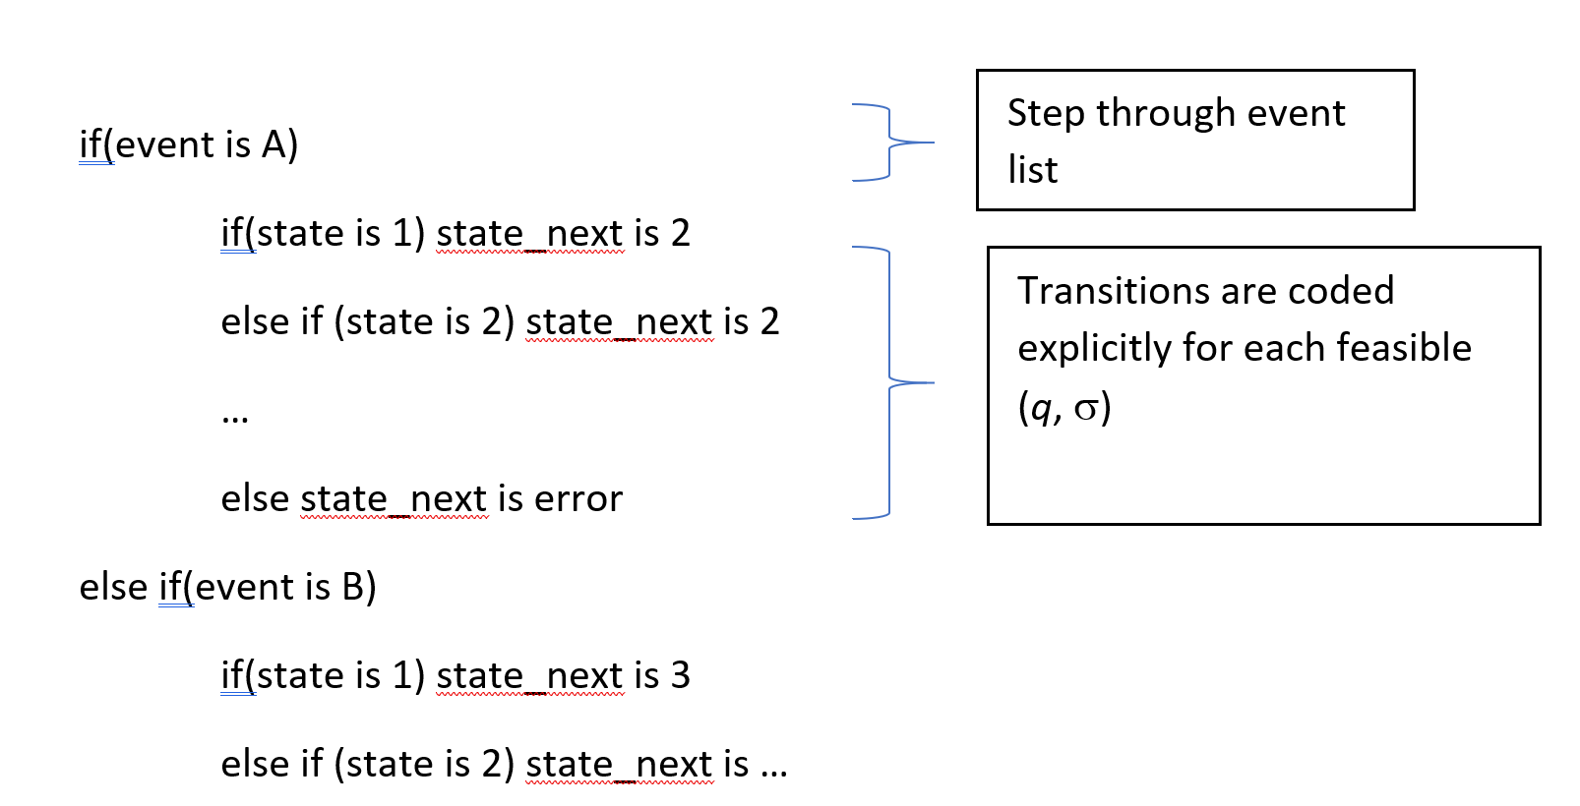
Event-Driven State Machine Model

Slide 21
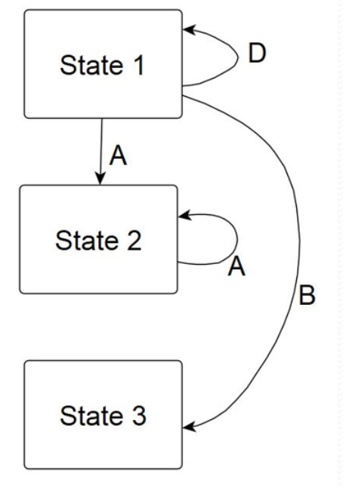
Simple State Machine Template - PlusCal
------------------------ MODULE SimpleStateMachineC ------------------------
EXTENDS Integers, TLC, Sequences
(* --algorithm SimpleStateMachineC
variables
StateCur = "1", StateNext = "1";
process StateMachineProc = "SimpleProcess"
variables StateHist = <<>>, ProcDone = FALSE ;
begin
ProcLoop:
while ~ProcDone do
StateUpdate:
StateCur := StateNext ;
StateHist := Append(StateHist, StateCur) ;
StateDo:
if(StateCur = "1") then
either
StateNext := "2" ;
or
StateNext := "3" ;
or
StateNext := "1" ;
end either ;
elsif(StateCur = "2") then
StateNext := "2" ;
elsif(StateCur = "3") then
ProcDone := TRUE ;
else
ProcDone := TRUE ;
print("Invalid State") ;
end if ;
end while ;
end process ;
end algorithm ; *)

Slide 22
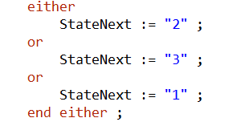
Checking the Model
PlusCal model compiles to TLA+
Check using model checker TLC
Model checking tries each timeline
  Either produces
  multiple parallel
  timelines
State 2 leads to
itself only, producing a livelock

Slide 23
Defining Assume-guarantee contracts (AGCs) in PlusCal/TLA+
Use invariants or temporal formulas
Invariant – logical statement that is always true
Temporal formula – use temporal operators, such as
  Always []
  Eventually <>

Slide 24
Contract Using Invariant
Invariant: Given a variable SparesAvailable that tracks spares parts, there will always be at least one spare available
Define invariant in PlusCal
  define
  SparesAlways == SparesAvailable > 0
  end define;

Slide 25
Contract Using Temporal Formula
Given a variable SparesAvailable that tracks spares parts, there will eventually be at least one spare available
Define temporal formula in PlusCal
  define
  SparesEventually == <>(SparesAvailable > 0)
  end define;

Slide 26
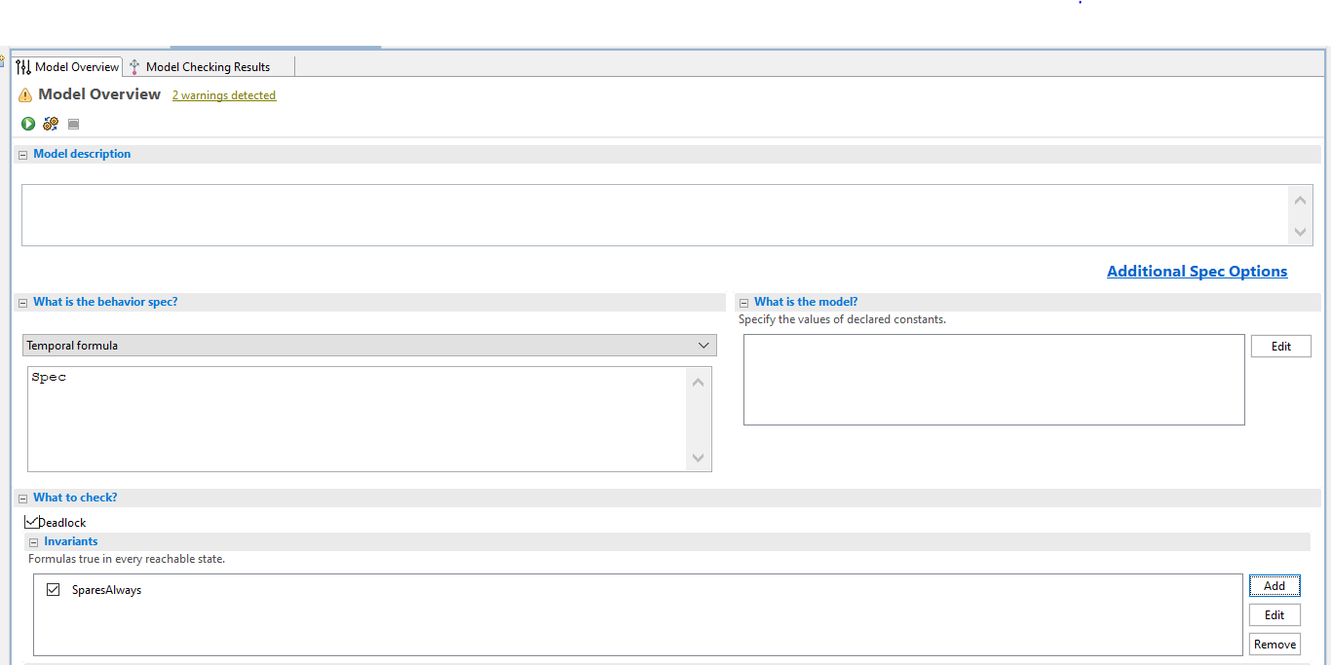
Using TLC to Check Contracts: Invariants

Slide 27
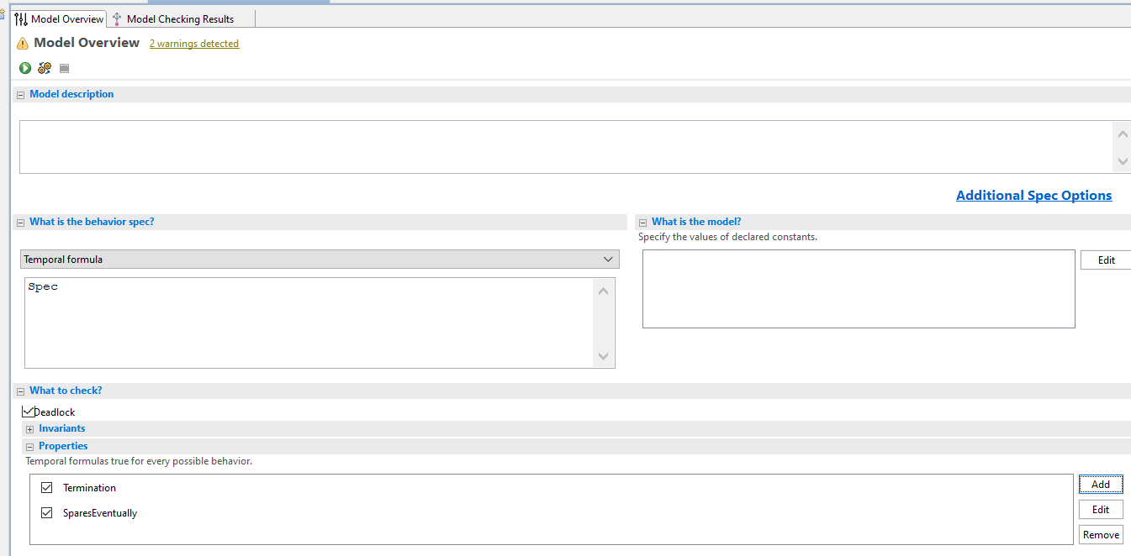
Using TLC to Check Contracts: Temporal Formulas

Slide 28
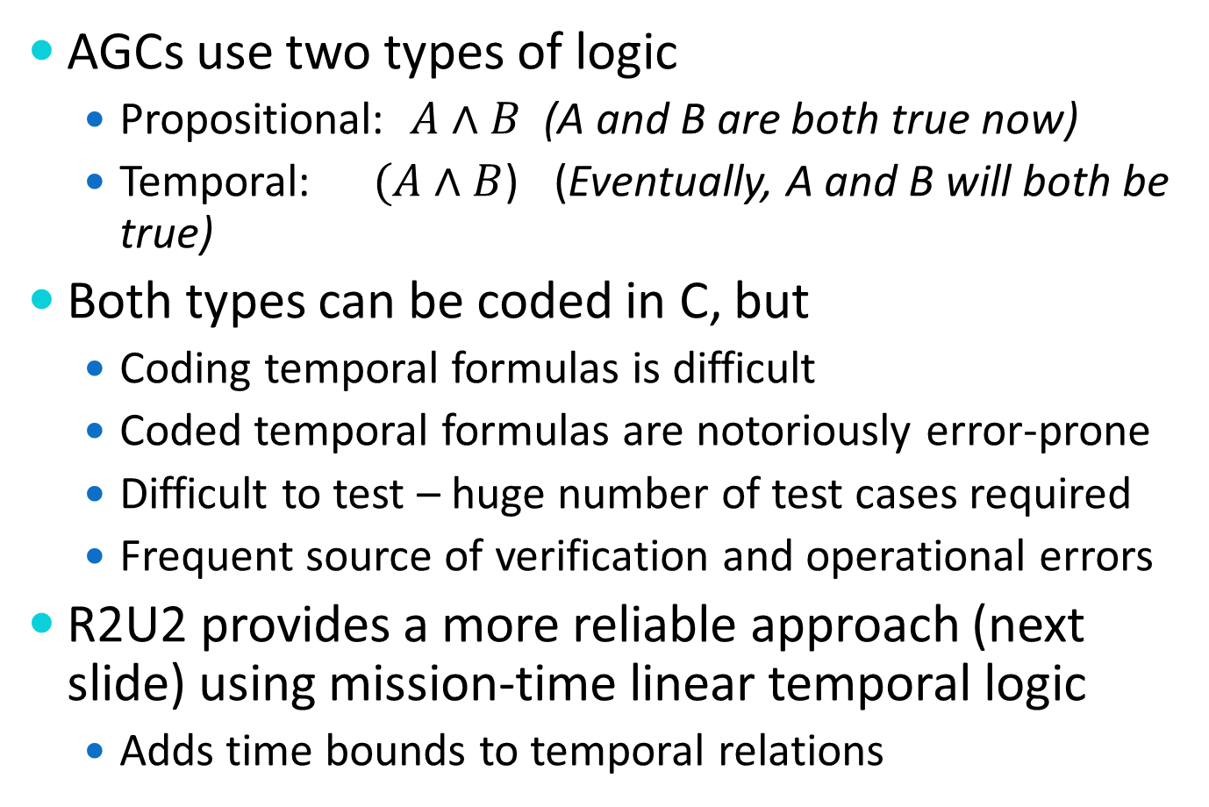
Specifying Operational Contracts
AGCs use two types of logic
  Propositional: $A∧B$ (A and B are both true now)
  Temporal:$(A∧B$) (Eventually, A and B will both be true)
Both types can be coded in C, but
  Coding temporal formulas is difficult
  Coded temporal formulas are notoriously error-prone
  Difficult to test – huge number of test cases required
  Frequent source of verification and operational errors
R2U2 provides a more reliable approach (next slide) using mission-time linear temporal logic
  Adds time bounds to temporal relations

Slide 29
R2U2 Advantages
R2U2 formulas are written in math notation
  Precise
  Unambiguous
Compact, optimized for size and speed
R2U2 inferencing engine proven correct with respect to operator space
https://research.temporallogic.org/papers/KZJZR20.pdf
Correctness proof is the most complete form of verification, infeasible via testing
https://www.researchgate.net/publication/3187522_The_Infeasibility_of_Quantifying_the_Reliability_of_Life-Critical_Real-Time_Software

Slide 30
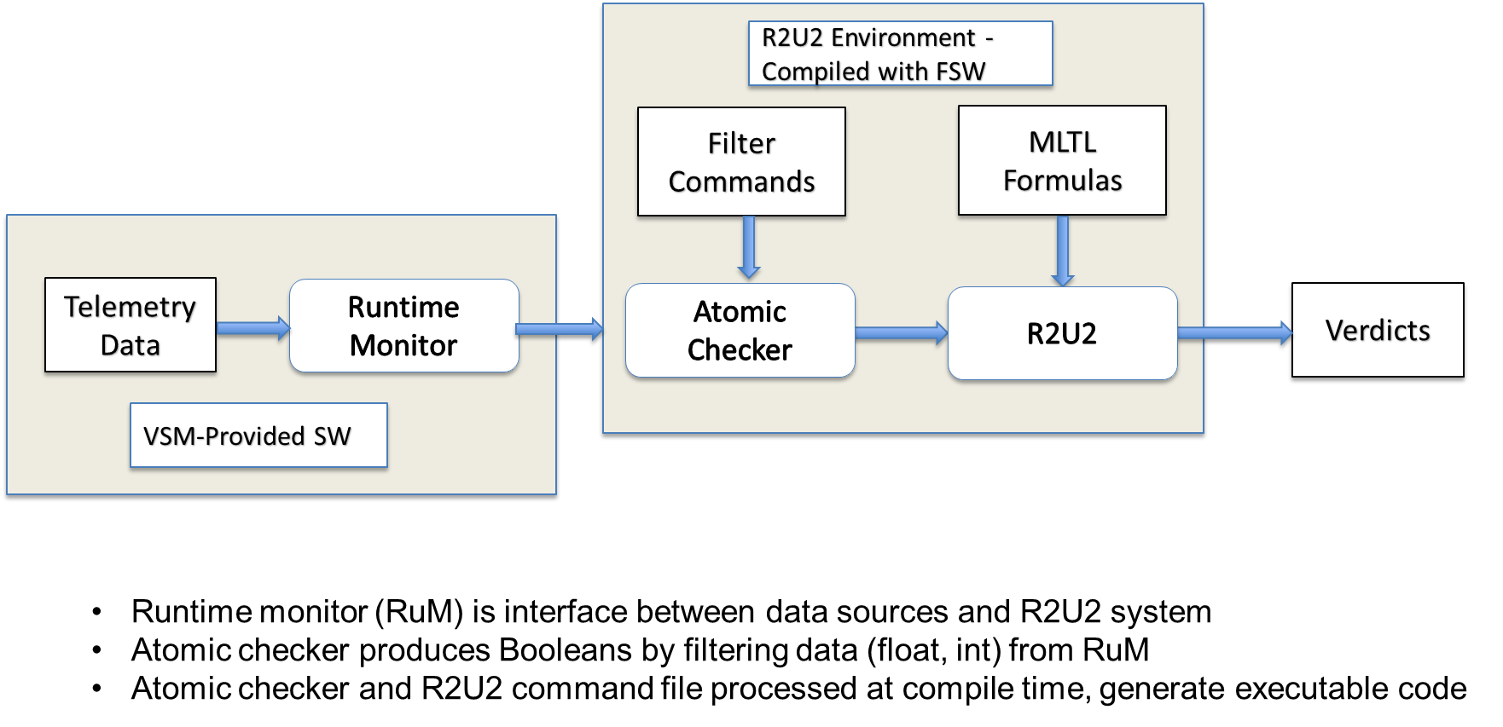
Operational Contract Implementation

Slide 31
Workflow for Implementing & Testing
Offline implementation & verification
  Contracts specified in R2U2 MLTL file format
    Atomic checker commands – convert input stream to booleans
    MLTL specifications to document temporal formulas
  Parser converts MLTL file into binaries that drive executable
  Input stream simulated using csv format
  R2U2 executable processes CSV, displays verdict stream
Flight software (online) implementation
  Runtime monitor (RuM) references same binaries
  RuM extracts input stream from telemetry
  Calls R2U2 library functions; passes input stream
  Passes R2U2 verdict stream to Fault Manager for processing
Notes:
See if we can convert this to a diagram

Slide 32
Summary
Autonomous , trustworthy mission-critical systems are becoming more common
Assume-guarantee contracts provide a means to improve trustworthiness
Development contracts use state machine models and model checking tools such as TLA+
Operational contracts use inline code and special runtime model checking tools such as R2U2

