Slide 1
Overview of NASA Fission Surface Power
The Space & Emerging Technologies (SET) Working Group (WG) of the U.S. Nuclear Industry Council (USNIC)
March 27, 2023
Tim Smith
NASA Glenn Research Center
Sebastian Corbisiero
Idaho National Laboratory

Slide 2
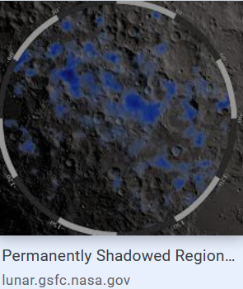
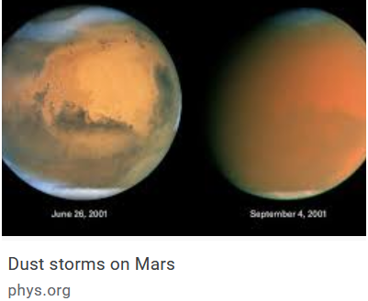
Why Develop a Fission Surface Power System?
Nuclear Power for the Moon and Mars
Nuclear power systems will enable robust exploration of the Moon and Mars
Reliable and robust energy production is essential to human and scientific exploration missions to the Moon (to support Artemis) and Mars
Fission power systems can provide abundant and continuous surface power in all environmental conditions on the Moon and Mars:
Lunar night is 14.5 Earth days long and permanently shadowed regions may contain water ice. Surface nuclear power is required for a sustainable lunar presence
Mars has recurring planet-wide dust storms that can last for weeks or months
A fission system designed for a capability demonstration on the Moon will be directly applicable to human Mars exploration
Recent analyses indicate that a Mars fission surface power system is likely to enable 2x less mass to be flown to space and be more reliable than a comparable solar power system in the 10 to 40 kWe class

Slide 3
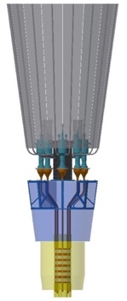
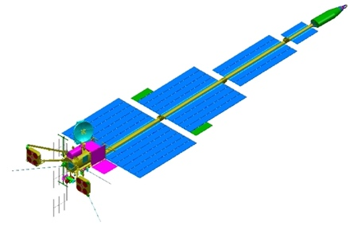
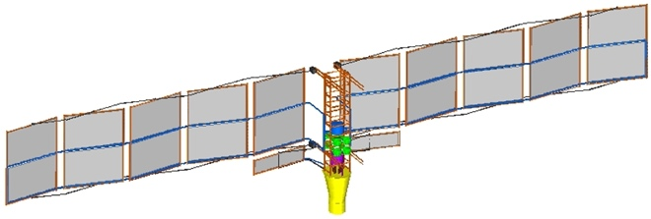
Brief History of NASA Developments
2000
2005
2010
2015
2020
Prometheus
Fission Surface Power
Kilopower
FSP 2.0
200 kWe, 20 yr life
NEP science mission to Jovian moons
1200K HeXe-cooled UN reactor with Brayton
6600 kg, 33 kg/kWe
Prime selected and PMSR completed (~$400M spent)
40 kWe, 8 yr life
Long-duration lunar & Mars surface power
900K NaK-cooled UO2 reactor with Stirling
5800 kg, 145 kg/kWe
Non-nuclear system test completed (~$50M spent)
1 kWe, 10 yr life
Low-tech fission alternative to RPS
1100K Na HP-cooled UMo reactor with Stirling
400 kg, 400 kg/kWe
Reactor prototype test completed (~$20M spent)

Slide 4
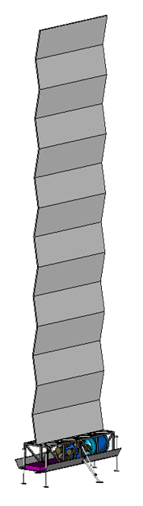
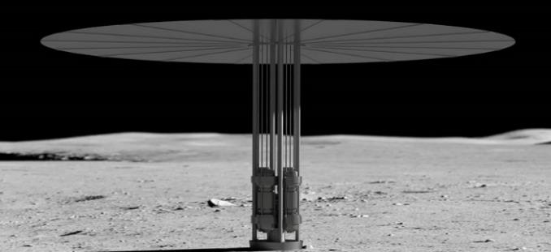
What is a Fission Surface Power System?
The Fission Surface Power hardware development is part of NASA Space Technology Mission Directorate’s (STMD) Space Nuclear Technologies Portfolio
  Fission Surface Power
  Nuclear Thermal Propulsion and Nuclear Electric Propulsion
It is an autonomous nuclear power system that is launched, placed on the Moon’s surface by a lander, transported to its operational location, activated, and connected to a user power interface up to a kilometer away
NASA and the Department of Energy (DOE) are collaborating on the development of a 40 kWe lunar fission power system for delivery to the launch site by 2028
It will have a ten-year life, consisting of a 1-year demonstration followed by operational support for Artemis
It will be designed so it is extensible to Mars missions

Slide 5
Fission Surface Power System Development Strategy
  Awarded three Phase 1 - FSP System Design Contracts
  Government Reference Design
    Evolving reactor and integrated system design to guide subsystem trades
  Developing Technology Maturation Plan (TMP) – comprehensive plan to advance critical subsystem and system integration technologies
  Government Technology Maturation underway
    DOE working on metal hydride moderators, shielding and instrumentation and controls
    DOE holding periodic webinars for OGA’s and industry (first completed 12/9/2022)
    NASA initiated PMAD development investigations and integrated heat pipe – Stirling converter test underway
Solicitation Release (11/2021)
Phase 1 Complete
(10/21/2023)
Phase 2 Awards (TBD)
FSP Flight Hardware Delivery
Industry Phase 1 FSP Initial System Design
Industry Phase 2 FSP Flight System DDT&E
Government Reference Design
Integration, Launch & Demo Operations
Nuclear and Non-Nuclear Technology Maturation

Slide 6
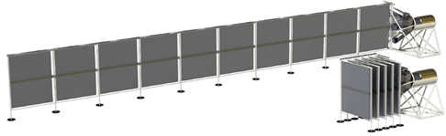

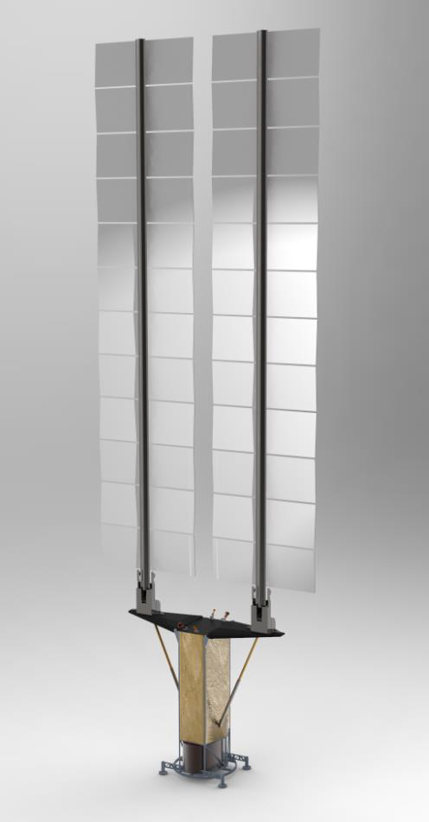






FSP Contracts
LEU moderated reactor using UO₂ fuel elements with a monolithic beryllium oxide moderator and a He-Xe coolant in a single pass design. Employs direct gas-Brayton cycle power conversion
LEU moderated horizontal reactor using Uranium Nitride fuel pins within beryllium oxide hexagonal blocks. Employs closed Brayton cycle power conversion with heat pipes
with Maxar and Boeing:
LEU moderated reactor with TRISO-X fuel in plate form; layers of yttrium hydride solid moderator; Stirling pairs for power conversion using heat pipes

Slide 7
NASA Government Reference Design Concept
Operations Approach:
Lander: Provides transit and delivery to the Moon; deploys the FSP System to the lunar surface
Transportability: Six-wheel pressurized rover chassis move pallets from lander to operating site
Power Production: One-year demonstration phase followed by nine years of power delivery to lunar surface elements
Concept Results (Glenn Research Center’s COMPASS Team):
FSP System delivered in 3 pallets: Reactor, Controller, User Load Interface
Reactor Pallet:
  A HALEU-moderated reactor with radiation shielding to protect co-located plant equipment, nearby electrical controls (50 m), and crew habitation area (1 km)
  Power conversion consists of four 12 kWe Stirling converters (48 kWe gross)
  Deployable radiators that leverage the International Space Station design but operate at higher temperature (>400 K)
  Shielded Ka-Band link for communications to Earth
Controller Pallet: Stirling electrical controllers, high-voltage boost electronics, thermal management, spool and 50 m cable
User Load Interface: Electronics to convert high transmission voltage to 120 Vdc for loads, thermal management, spool and 1 km cable
A 40 kWe transportable FSP system is feasible
7

Slide 8
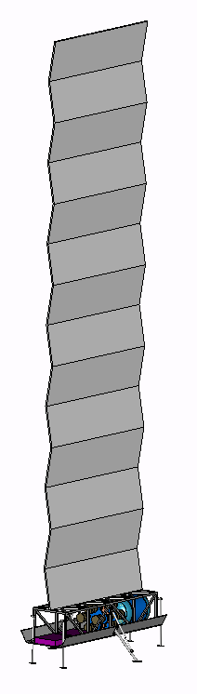
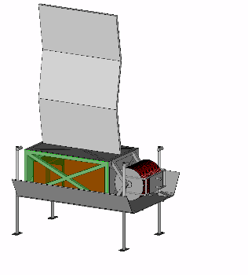
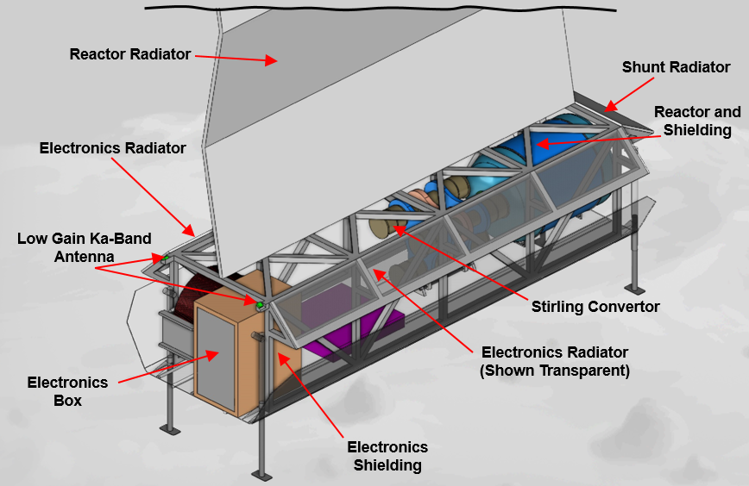
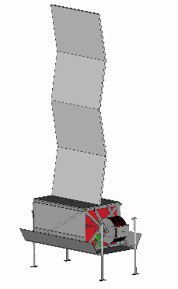
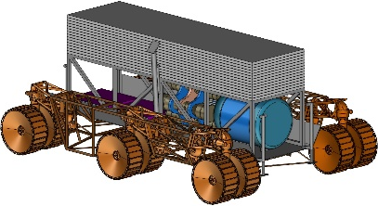
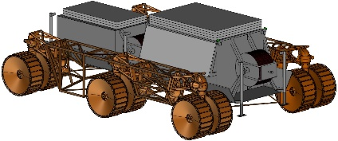
NASA Government Reference Design Concept
40 kWe, Transportable System
Deployed configuration
Pallet User I/F
Reactor Pallet
1 km
50 m
Controller Pallet
40 kWe Reactor Pallet
Stowed configuration for transport
Rover and Lander not in Project Scope

Slide 9
Fission Surface Power Summary
NASA is working with the Department of Energy and their federally funded laboratories to establish a lunar fission surface power system
NASA focus is on designing, building, and demonstrating a low enriched uranium fission surface power system that is directly applicable for Moon and Mars, scalable to higher power levels
NASA will continue to be closely engaged with industry to seek innovative, unique design approached for fission surface power systems

Slide 10
Questions?
Thank-you!

Slide 11
Constellation-era FSP Bibliography
NASA’s Exploration Systems Architecture Study, Final Report NASA-TM-2005-214062
A Comparison of Fission Power System Options for Lunar and Mars Surface Applications NASA/TM-2006-214120
Lunar Fission Surface Power System Design and Implementation Concept STAIF 2006
A Historical Review of Brayton and Stirling Power Conversion Technologies for Space Applications NASA/TM-2007-214976
Affordable Fission Surface Power System Study Final Report 2007
High Temperature Stability of Dissimilar Metal Joints in Fission Surface Power Systems STAIF 2007
Post Irradiation Evaluation of Thermal Control Coatings and Solid Lubricants to Support Fission Surface Power Systems STAIF 2007
Materials-of-Construction Radiation Sensitivity for a Fission Surface Power Convertor SNC 2007
System Concepts for Affordable Fission Surface Power NASA/TM-2008-215166
Overview of Multi-Kilowatt Free-Piston Stirling Power Conversion Research at Glenn Research Center NASA/TM-2008-215061
Test Results From a Simulated High-Voltage Lunar Power Transmission Line NASA/TM-2008-215164
Cold Start of a Radiator Equipped with Titanium-Water Heat Pipes IECEC 2008
Investigation of Liquid Metal Heat Exchanger Designs for Fission Surface Power NASA/TM-2009-215505
Experimental and Analytical Performance of a Dual Brayton Power Conversion System NASA/TM-2009-215511
Mars Design Reference Architecture 5.0 NASA/SP-2009-566
Thermal Interface Evaluation of Heat Transfer from a Pumped Loop to Titanium-Water Thermosyphons IECEC 2009
Development of High Temperature Dissimilar Joint Technology for Fission Surface Power Systems IBSC 2009
Closed Brayton Cycle Power Conversion Unit for Fission Surface Power Phase I Final Report NASA/CR-2010-215673
Test Results From a Direct Drive Gas Reactor Simulator Coupled to a Brayton Power Conversion Unit NASA/TM-2010-215843
Performance Testing of a Prototypic Annular Linear Induction Pump for Fission Surface Power NASA/TP-2010-216430
Recent Advances in Power Conversion and Heat Rejection Technology for Fission Surface Power NASA/TM-2010-216761
Wood, Free-Piston Stirling Power Conversion Unit for Fission Surface Power, Phase I Final Report NASA/CR-2010-216750
Fission Surface Power System Initial Concept Definition NASA/TM-2010-216772
Summary of Test Results From a 1 kW-Class Free-Piston Stirling Power Convertor Integrated With a Pumped NaK Loop NASA/TM-2010-216934
A Summary of NASA Architecture Studies Utilizing Fission Surface Power Technology NASA/TM-2011-216819
Radiation Specifications for Fission Power Conversion Component Materials NASA/TM-2011-216996
Material Studies Related to the Use of NaK Heat Exchangers Coupled to Stirling Heater Heads NASA/TM-2011-217001
Performance of a Kilowatt-Class Stirling Power Conversion System in a Thermodynamically Coupled Configuration NASA/TM-2011-217098
Design and Test Plans for a Non-Nuclear Fission Power System Technology Demonstration Unit NASA/TM-2011-217100
Summary of the Manufacture, Testing And Model Validation of a Full-Scale Radiator For Fission Surface Power Applications NETS 2011
Evaluating Heat Pipe Performance in 1/6 g Acceleration: Problems and Prospects NETS 2011
Development Status of the Fission Power System Technology Demonstration Unit NASA/TM-2012-217717
Magnetic Materials Suitable for Fission Power Conversion in Space Missions NASA/TM-2012-217752
A Compendium of Brazed Microstructures For Fission Power Systems Applications NASA/TM-2012-217623
Titanium-Water Thermosyphon Gamma Radiation Exposure and Results NASA/TM-2012-217732
Heat Pipes and Heat Rejection Component Testing at NASA Glenn Research Center NASA/TM-2012-217205
Kilowatt-Class Fission Power Systems for Science and Human Precursor Missions NASA/TM-2013-216541
Cold-end Subsystem Testing for the Fission Power System Technology Demonstration Unit NASA/TM-2013-216545
Thermosyphon Flooding in Reduced Gravity Environments Test Results NASA/TM-2013-217905
Dynamic Energy Conversion: Vital Technology for Space Nuclear Power Journal of Aerospace Engineering 2013
Design Issues for Using Magnetic Materials in Radiation Environments at Elevated Temperature NETS 2013
Lap Shear Testing of Candidate Radiator Panel Adhesives NETS 2013
Development of NASA's Small Fission Power System for Science and Human Exploration P&E Forum 2014
Integrated Surface Power Strategy for Mars NETS 2015
Free-Piston Stirling Power Conversion Unit for Fission Power System, Phase II Final Report NASA/CR-2016-219088
Two-Step Multi-Physics Analysis of an Annular Linear Induction Pump for Fission Power Systems NASA/TM-2016-219157
Fission Surface Power Technology Demonstration Unit Test Results NASA/TM-2016-219382
Improving Power Density of Free-Piston Stirling Engines NASA/TM-2016-219383
Status of the Development of Low-Cost Radiator for Surface Fission Power NETS 2016
Solar vs. Fission Surface Power for Mars AIAA Space 2016

