Slide 1
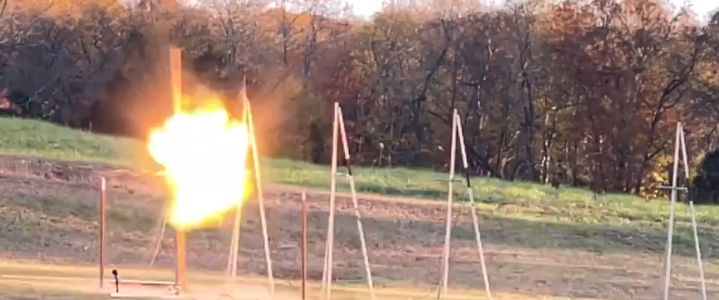



An Interim Set of TNT Curves for LOX/LNG Explosions
James Blackwood (N2L), Troy Skinner (N2L), Spencer Harrison (N2L), Brandon Whitworth (N2L), Michael Hays (NASA MSFC), Paul Wilde (IAASS)
05/24/2023

Slide 2
Introduction
Several new and large LVs are under development that use liquid methane (or LNG) as a fuel instead of the traditional kerosene and liquid hydrogen fuels
  A consortium of NASA, USSF, and FAA have planned and are funding a ~3yr campaign to experimentally determine the appropriate TNT equivalencies for Liquid Oxygen – Liquid Methane / Natural Gas (LOX/LNG) Launch Vehicles (LVs)
  LOX/LNG quantity distance (QD) standards were required to safely prepare the various test sites for this testing
N2L, Inc. and NASA Marshall Space Flight Center (MSFC) developed a set of interim curves to be used until the full test-validated values are determined

Slide 3
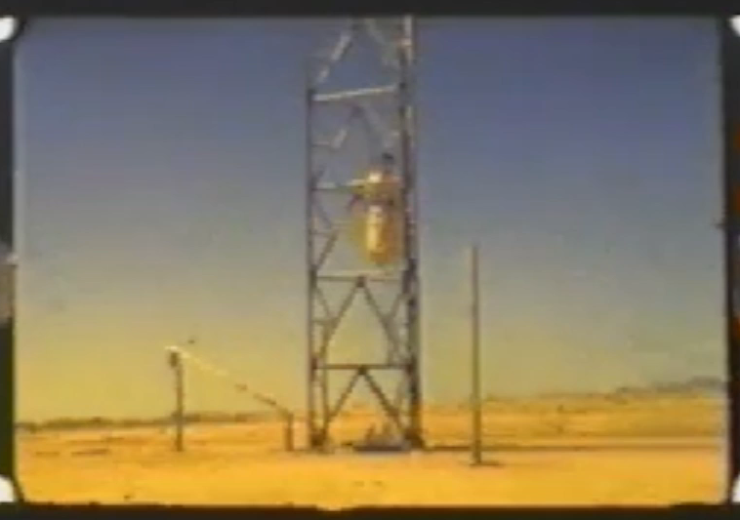
NASA MSFC Blast Model
CUI//SP-EXPT
NASA MSFC Blast team has a validated cryogenic explosion model
  LOX/LH₂ used to assess safety and derive environments for SLS program and commercial providers
  LOX/RP-1 use as validation case against and to analyze historic accidents and test programs
Non-high explosive model to reduce conservatism associated with TNT based analysis
Methods used to develop LOX/LH₂ & LOX/RP-1 model applied to LOX/LCH₄ to support commercial providers and current launch vehicle trends
Resulting model was compared against COMET data to validate inputs and assumptions

Slide 4
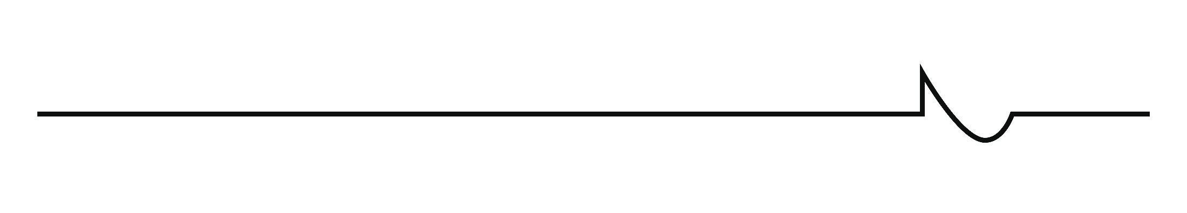
NASA LOX/LH₂ Explosion Model Overview
Internally – Liquid Blast Overpressure Model (LBOM)
  Simple analytical model that leverages data from HOVI and PYRO
  Requires three significant inputs
    Size of combustion zone
    Mixture ratio and/or mixing time to define initial pressure
    Fuel and Oxidizer type (LOX/LH₂ shown here)
Similar to work by Baker, Tang, Strehlow, Taylor, and others
  The combustion zone is assumed flat in overpressure
    Ideal for Pressure vessel bursts and burning propellant inside a case
    Works well if combustion is rapid enough as in the case of LV propellant accidents
  The decay zone decreases according to widely accepted method by Baker
Inside the Fireball
Ideal Gas
T = 100K (corroborated by WSTF)
P = ambient
m ≤ Farber limit
Stoichiometric mixture of GH₂/GO₂
Max pressure limited by ZND
480psi max
Outside the Fireball
Decay method outlined by Baker (NASA CR134906) – instantaneous release of PdV work

Slide 5
Overpressure Limit for LOX/LH₂
Determined upper limit (worst case) overpressure based on detonation of stoichiometric mixture
  Upper limit of experimental data is less than calculation (~480 psi)
  Largest observed LOX/LH₂ explosion during a test program was ~330 psi in HOVI 9
ZND calculation is higher than maximum experimental values
  ZND: Zel’dovich, von Neumann, and Döring Detonation Model
Laboratory Experimental Results

Slide 6
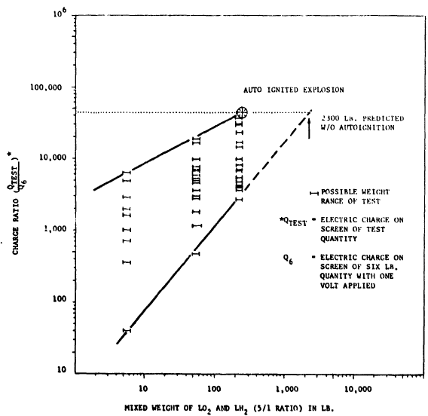
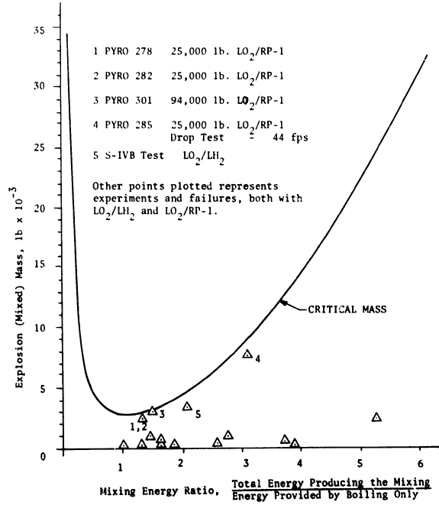
Mixing Limit
Cryogenic mixtures of LOX/Fuel are self-limiting
Charge buildup from mixing/boiling action limits explosion volume
Charge Build Up
Mixing Function
Measured charge between the two propellants increases with mixed propellant weight
When charge reached sufficient strength the mixture auto-ignited
Only possible in laboratory setting by bleeding off charge
and/or possibly MOX
HE initiation or high-speed impacts?
Typical liquid rocket propellant explosion cases
All known liquid propellant tests or accidents have been under this line (up to at least ~200ft/s impact speed)

Slide 7
Theoretical Limits
LOX/RP-1 = 2,800lbs (calculated by Farber)
LOX/LH₂ = 2,300lbs (calculated by Farber)
LOX/LCH₄ = 8,800lbs (calculated using Farber method)
Without external high energy source to force more propellant together, these should be the theoretical maximum amount of propellant to participate in combustion
NASA MSFC uses these weights and detonation pressures and statistics from HOVI and PYRO to model LOX/Fuel explosions
  To date, no measured overpressure from either test or accident has exceeded the overpressure predictions from this model

Slide 8
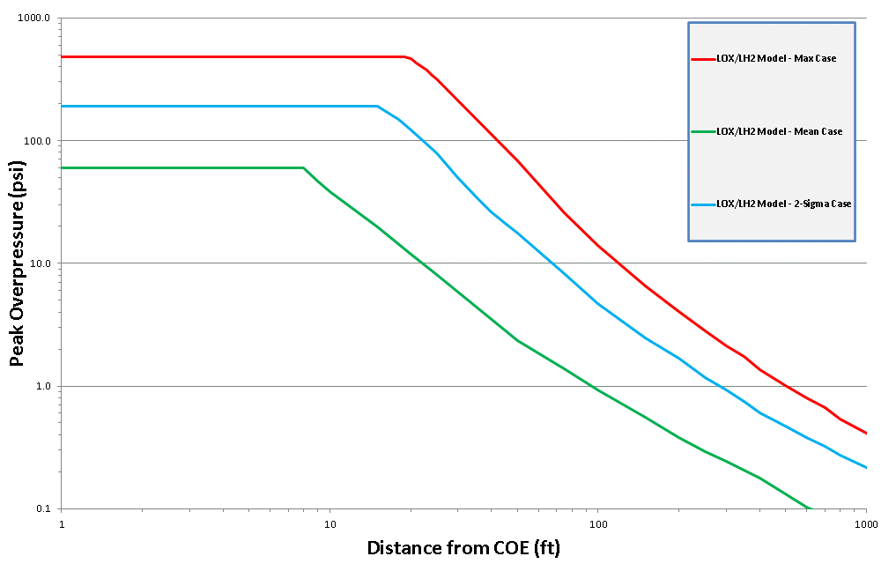
NASA LOX/LH₂ Cryogenic Explosion Model

Slide 9
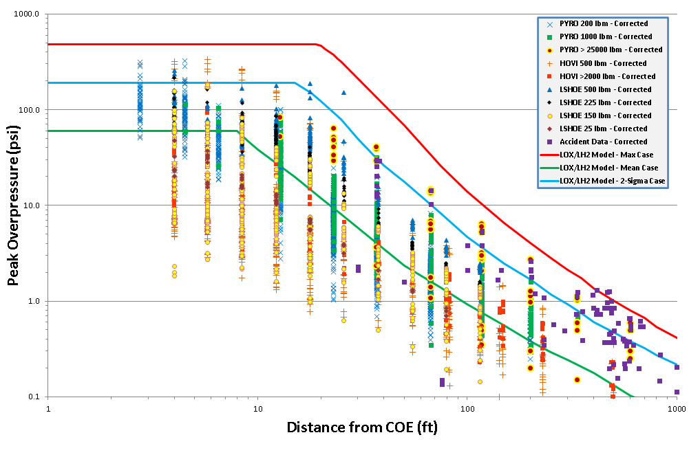
NASA LOX/LH₂ Model Comparison to Data
Red, blue, and green curves are from physical model, not a curve fit to the data
Max case based on Farber & overpressure limit
Using statistics from HOVI and PYRO for mean & +2σ case seems to agree with charge statistics from Farber

Slide 10
LOX/LCH₄ Cryogenic Explosion Model
Overpressure Limit
  ~765 psi
Mixing Limit
  8,800lbs (calculated)
  Fireball is similar size to LOX/LH₂ due to higher methane density
Inside the Fireball
Ideal Gas
T = 100K (corroborated by WSTF)
P = ambient
m ≤ Farber limit
Stoichiometric mixture of GCH₄/GO₂
Max pressure limited by ZND
765psi max
Outside the Fireball
Decay method outlined by Baker (NASA CR134906) – instantaneous release of PdV work

Slide 11
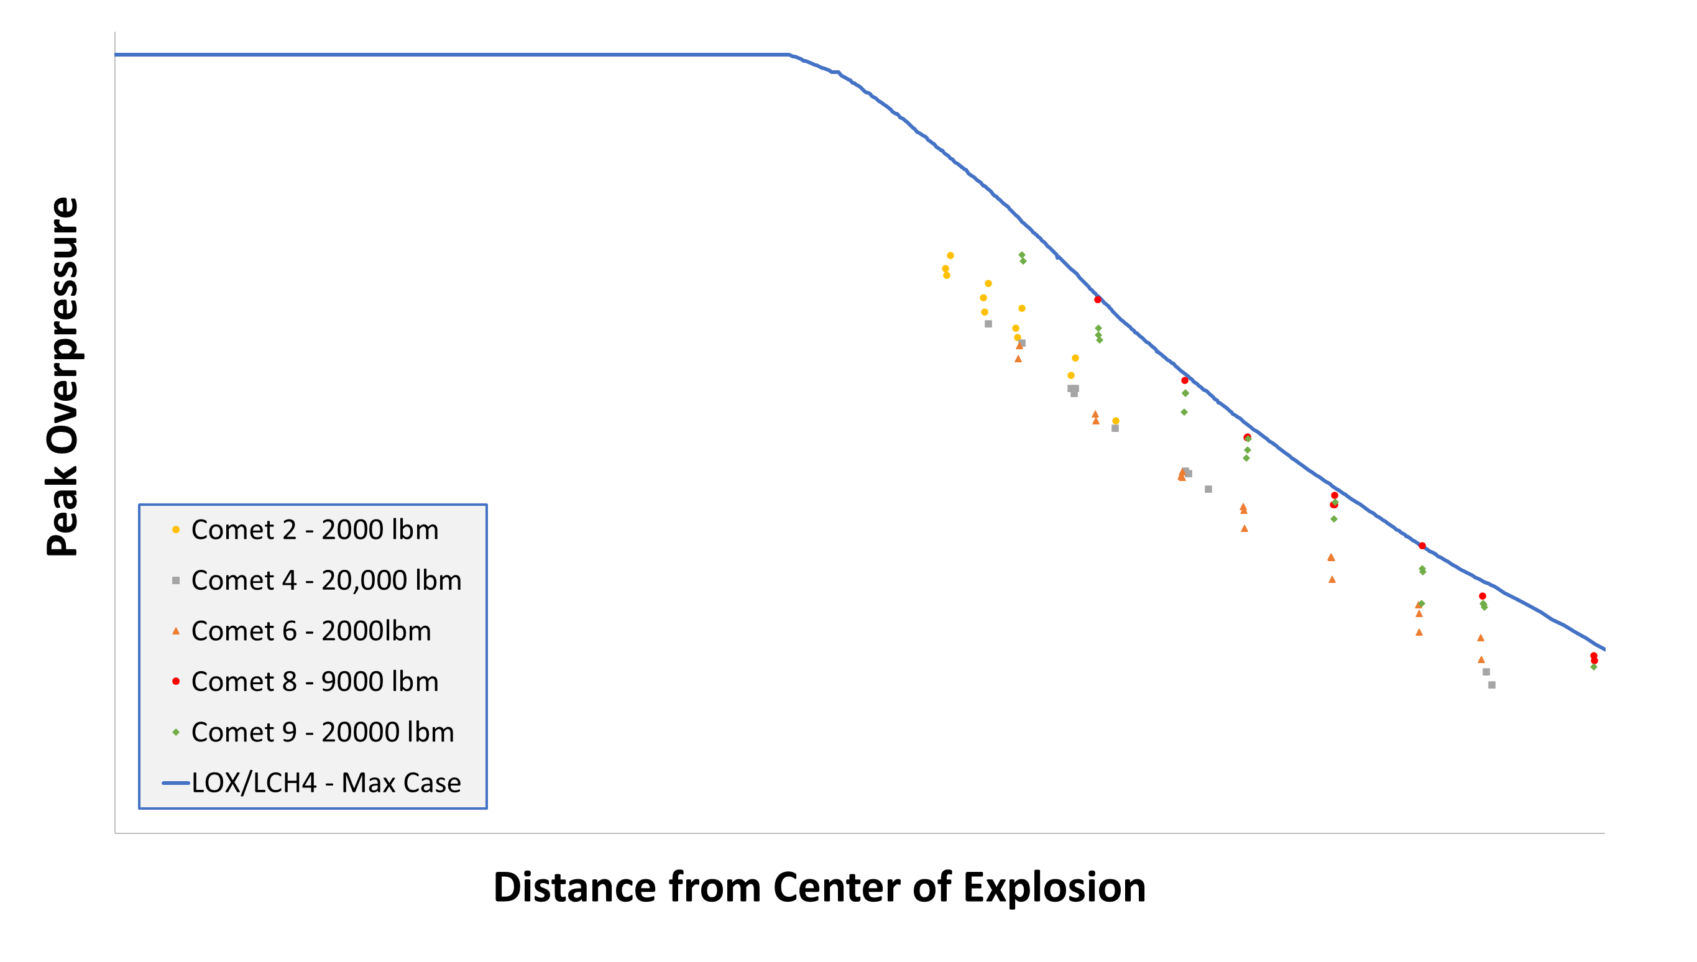
LOX/LCH₄ Explosion Model with COMET Data

Slide 12
LOX/LCH₄ Explosion Model Comparison to Data
Highest measured COMET overpressures (COMET 8) fall approximately along the theoretical explosion curve
  COMET designed for “worst-case-scenario” and to “enhance propellant mixing.”
COMET data was quasi-hemispherical.
  Center of explosion was elevated and the hemispherical assumption did not account for reduced losses at ground surface
TNT calibration shot indicates measured test data is high
COMET data are still below the Maximum Overpressure and Farber limit even without accounting for HOB and calibration items

Slide 13
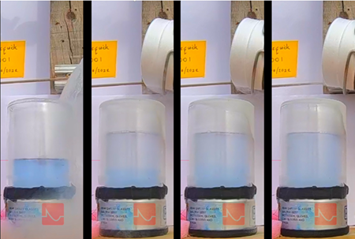
LOX/LNG Miscibility
Unlike other cryogenic fuel combinations, LOX and LNG are miscible
Miscibility has unknown affect on autoignition limits
N2L, Inc. has performed small scale preliminary mixing tests with LOX and LNG
  Confirmed miscibility
  Mixing can take several minutes under static conditions
Liquid Methane
Liquid Oxygen

Slide 14
Methodology for Developing LOX/LNG Blast Model
Break the problem into three scenarios:
  Static
    For pad explosions and low velocity fall back
    Use NASA MSFC LOX/LNG blast model
  Dynamic
    For intact impact greater than 75ft/s
    Use simple physical model and MOX detonation assumption
  MOX
    For special cases where LOX and LNG are allowed to slowly mix for 10s to 100s of seconds
    Use as-tested high explosive yield of MOX
Conservative assumptions/inputs made throughout all steps

Slide 15
Static Approach
Follow Farber method for LOX/LH2 and LOX/RP but with appropriate physical parameters inputs for LOX and LNG
  Produces a practical maximum limit of 8,800lb of mixed propellant
Use MSFC blast model to propagate shock wave
Equate to TNT to determine equivalence
Assumptions
  Complete and uniform mixing
  Yield is not a function of impact speed below 75ft/s similar to that shown in Project PYRO for LOX/LH2 and LOX/RP

Slide 16
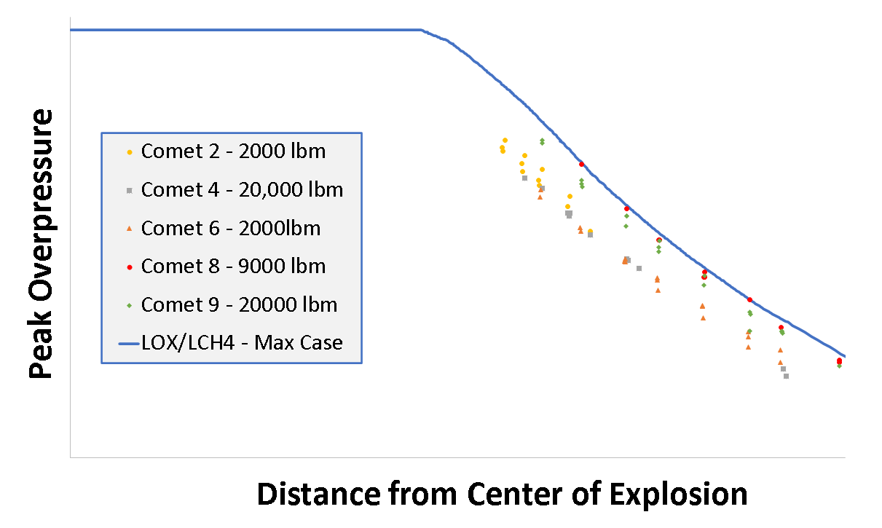
Static Step 2 – Apply MSFC LOX/LNG Blast Model
Developed from first principles and test data
Uses high pressure, high temperature fast fireball for combustion, then propogate shock wave
Accurately predicts all known LOX/LNG explosions so far

Slide 17
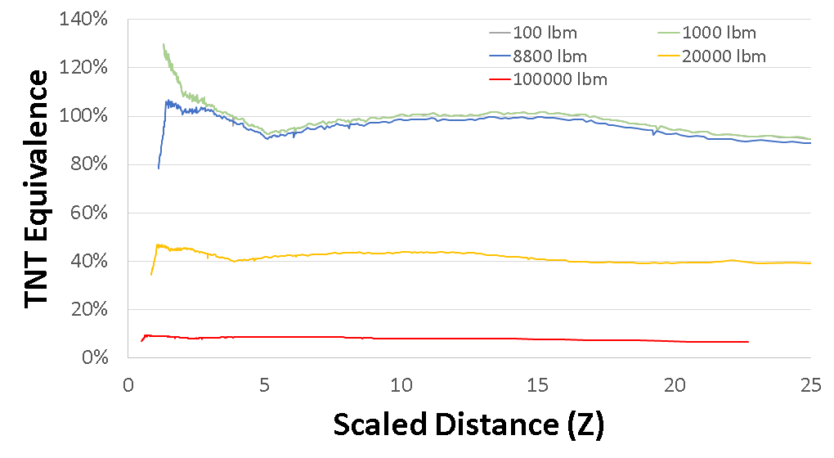
Static Step 3 – Equate to TNT
Weight values between 1,000lb and 10,000lb tend to hover around 100% TNT equivalence
As propellant weight grows much greater than 10,000lb the TNT equivalence tends to drop off

Slide 18
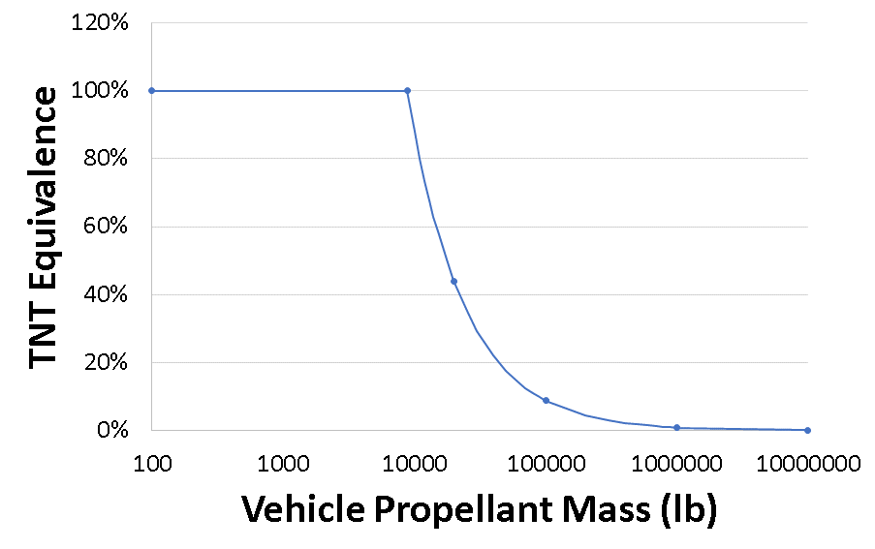
Static Final Result
Weights less than 10,000lb are 100% TNT equivalence
This graph can be used to determine the maximum TNT equivalence of any LOX/LNG LV that fails on the pad or impacts the ground at speeds less than 75ft/s

Slide 19
Dynamic Approach
Develop multiplier on static yield using assumptions below
Calculate mixed mass using simple physical mixing model
Determine effective TNT equivalence
Assumptions
  400ft/s (and greater) impact speed causes detonation of all mixed propellant
  Mixed propellant mass completely detonates as MOX (TNT Eq = 160%)

Slide 20
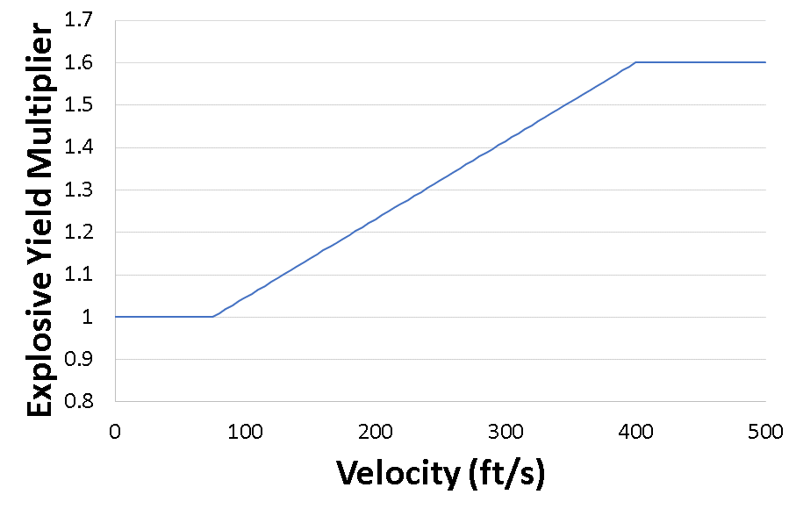
Dynamic Step 1 - Multiplier
Multiplier of 1 for impact speeds less than 75ft/s (i.e. no change from static yield)
At 400ft/s all mixing propellant behaves as MOX high explosive (i.e. 160% TNT equivalence)
Once mixed mass is determined this curve is used to appropriately increase the yield

Slide 21
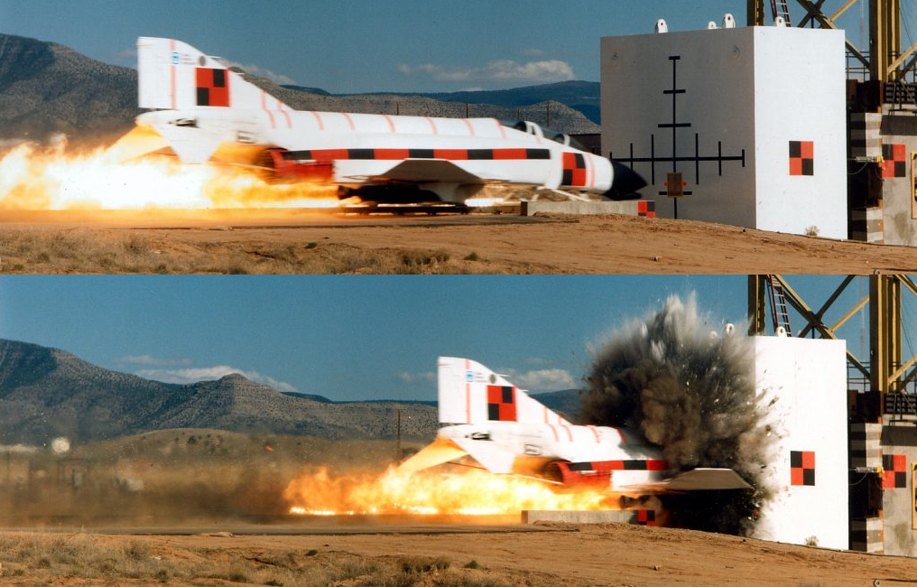
Dynamic Step 2 – Mixed Mass
Impact videos show that the upper portion of the vehicle is still intact at the time of explosion
Use impact speed and a practical maximum ignition time to determine maximum amount of propellant that could become mixed before detonation
Destroyed Volume
F4 Phantom Impact Test
Sandia National Laboratories

Slide 22

Dynamic Final Result
${TNT}_{EQ}=Y_{m}∙\frac{ρvt_{i}πr^{2}}{M}$ (1)
where, Y_{m} is the yield multiplier from Figure 4
ρ is the effective mixed propellant density for LOX/LNG, 51.73 lb/ft³
v is the impact velocity (ft/s)
t_{i} is the ignition time after impact (s)
r is the vehicle radius (ft)
M is the vehicle propellant mass

Slide 23
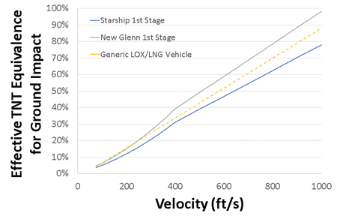
Dynamic Final Result (Continued)
Since most LOX/LNG LVs have similar L/Ds the intact impact yield is similar
Therefore, an average TNT equivalence (yellow dashed line) can be used for an approximation if desired
  TNT_{EFF} = 0.009v-0.0268

Slide 24
MOX Approach
Use 160% TNT equivalence for total mixed amount of propellant
Early testing results show that this scenario is possible if mixing is benign enough and allowed to mix long enough

Slide 25
Summary
Interim TNT curves for LOX/LNG explosions have been developed to account for three mixing scenarios
Static – use mass-based equivalence
Dynamic – use velocity-based multiplier
MOX – use 160% mass equivalence
Data from ongoing test programs will be used to refine models and statistics

Slide 26
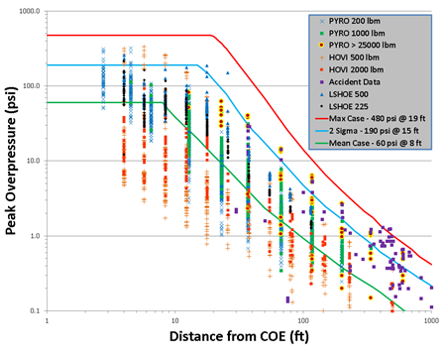
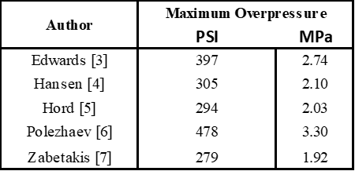
NASA MSFC Blast Model for LOX/LH2
Developed from first principles and test data (HOVI, Project PYRO)
Uses high pressure, high temperature fast fireball for combustion, then propagate shock wave
Accurately predicts all known LOX/LH2 explosions so far

