Slide 1
Georgia Disasters II
Evaluating the Impacts of Hurricane Irma on Georgia Heirs’ Property Owners Using NASA Earth Observations
Shakirah Rogers • Nathan Tesfayi • Clarence Jackson • Matthew Murray
Georgia – Athens | Spring 2023
Notes:
Short title font size: 32pt Long title font size: 22pt Team names font size: 20pt
(group intros)
This study is on the impacts of Hurricane Irma in southern Georgia on a vulnerable group, called heirs property owners.

Slide 2
Background
September 11th, 2017
Landfall in US as Cat. 4
Max wind: 62 mph
Rainfall: 3-7" inland
Storm surge: 3-5ft
US: $50.5 billion
GA: $670 million
Imagery Credit: NASA
Created By: Wiki Commons user OverlordQ
Location/Intensity Data Credit: NOAA
Notes:
Now for some more background on the hurricane. Irma made landfall September 11th, 2017. It was a Category 5 Hurricane when it traveled over Cuba and degraded to Category 4 off the coast of Florida. The storm brought maximum wind gusts of 62 miles per hour. The surge along the Southern Georgia coast was 3-5ft, with inland rainfall reaching 3-7". In the US, the property damage was estimated to be $50.5 billion, while in Georgia the damage was $670 million. This makes Hurricane Irma the 6th costliest hurricane in United States history.
------------------------------Image Information Below ------------------------------
In Photo: Hurricane Irma as tracked by the National Hurricane Center, color coded to the Saffir-Simpson scale; Created by Wiki Commons user OverlordQ in the WikiProject Tropical cyclones/Tracks
Image Source: https://commons.wikimedia.org/wiki/File:Irma_2017_track.png

Slide 3
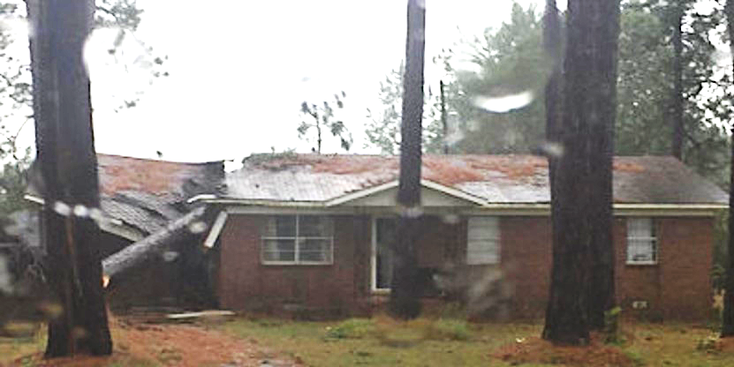
Community Concerns
Post-disaster: ineligibility to receive disaster relief funds, blighted properties, land stealing, and loss of generational wealth
Heirs’ Property Owners
Imagery Credit: USDA
Imagery Credit: WXFL/Kerri Copello
Notes:
This project looks at a group legally vulnerable to natural disasters called heirs property owners. When a property owner dies without a clear will to one individual, or an existing will is not properly executed, the deed exists in an in-between state where it is owned by all legal heirs. In the diagram on the left, this would mean all children, grand-children, and spouses. This tangled title makes heirs property owners ineligible to receive disaster relief funds. Post-disaster, these properties can become blighted and unsafe. Additionally, heirs property owners are more susceptible to land stealing and loss of generational wealth, regardless of natural disasters. Most heirs property owners are low to moderate income and racial minorities.
This issue with first rose to prominence after Hurricane Katrina and is a large issue throughout the South.
Image Credit:
https://www.farmers.gov/working-with-us/heirs-property-eligibility
Tree on a house in Turner County, GA
https://www.weather.gov/tae/Irma2017

Slide 4
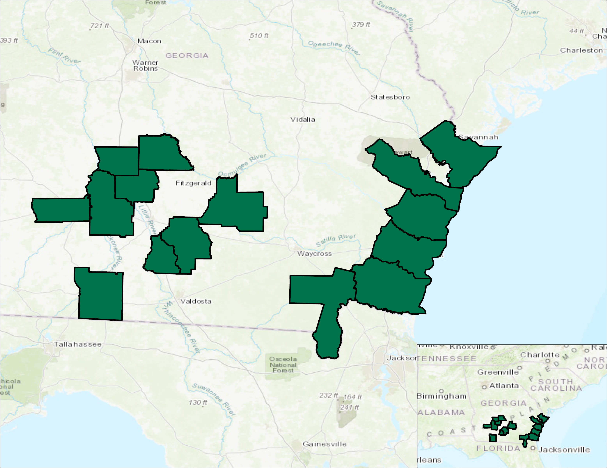
Project
Location
Study Area
15 counties across southern Georgia
Close to $1 billion in estimated heirs’ property
Located in the path of Hurricane Irma
Study Period
January 2012 – September 2017
Wilcox
Chatham
Crisp
Liberty
Turner
Doughtery
Worth
Coffee
McIntosh
Berrien
Glynn
Cook
Thomas
Charlton
Camden
0
30 mi
Basemap credit: ESRI, HERE, Garmin, USGS, NGA, EPA, USDA, NPS
Notes:
The study area includes 15 counties in southern Georgia. These 15 counties were designated for Federal Emergency Management Agency (FEMA) Public Assistance and Individual Assistance. This covers: emergency infrastructure repairs, debris removal, and immediate housing and safety needs. Inland counties were located directly in the path of Hurricane Irma, while coastal counties were subjected to the 3-5 ft storm surge.
The study period began in January 2012, to establish a floodless baseline measurement, through Hurricane Irma’s landfall in 2017.
------------------------------Image Information Below ------------------------------
Basemap credit: ESRI, HERE, Garmin, USGS, NGA, EPA, USDA, NPS
Map created by DEVELOP Team

Slide 5
Partner Organization
NASA DEVELOP
Outreach, Workshops, Webinars
Clients Reach Out to The Center
Title Cleared
The Center
Economic Prosperity
Georgia Heirs Property Law Center
"Growing Georgia's economy through property rights."
Agenda: land loss prevention, provide legal assistance, asset education, and outreach
Mission: Increase generational wealth, economic value, and community stability
Notes:
NASA DEVELOP Spring 2023 project is a continuation NASA DEVELOP Fall 2022 project "Georgia Disasters," continuing the partnership with the Georgia Heirs Property Law Center.
Georgia Heirs Property Law Center is a non-profit law firm, started in 2015.
Major agenda of the organization is legal support, land loss prevention, asset education.
Mission: The Georgia Heirs Property Law Center focusing on increases generational wealth, economic value, community stability and preserving property rights of low- and moderate-income Georgians.
Georgia Heirs Property Law Center, works with heirs property owners to not only obtain the necessary relief, but to help facilitate the management of the property.
The intent of our project is to provide The Center with data to refine their extant outreach methods to better serve the communities they work for.
------------------------------Image Information Below ------------------------------
Icon Credits: Microsoft PowerPoint

Slide 6
Objectives
Flood Extent Maps
Likely Heirs’ Properties
Notes:
To accomplish this, we have two main objectives:
Refine flood extent maps from the previous term
2) Use tax appraisal data from CAMA to identify a parcel as a likely heirs property
------------------------------Image Information Below ------------------------------
Icons from Microsoft Office 365

Slide 7
Earth Observations
Landsat 8
Sentinel-1
Sentinel-2
Imagery Credit: NASA, ESA
Notes:
The Earth observations in this research came from Landsat 8, Sentinel-1, and Sentinel-2. The Landsat 8 and Sentinel-2 imagery on the left and right use surface reflectance information, which is how our eyes read information. The imagery made by Sentinel-1 C-SAR, in the center for instance, uses backscatter information. This comes from an active sensor that emits then reads back microwaves.
Landsat 8 has a 16-day revisit time and 30m spatial resolution. Sentinel-2 has a 5-day revisit time with a 10m spatial resolution. Sentinel-1 has a 6-day revisit time and a 5m spatial resolution.
------------------------------Image Information Below ------------------------------​
•Credits for satellite images of Landsat 7, 8: USGS
Image sources for satellite images
Satellites: https://www.devpedia.developexchange.com/dp/index.php?title=List_of_Satellite_Pictures
Landsat 8: https://www.nasa.gov/image-feature/glaciers-ebb-on-south-georgia-island
Sentinel-1 C-SAR: https://www.esa.int/Applications/Observing_the_Earth/FutureEO/CryoSat/Secrets_of_hidden_ice_canyons_revealed
Sentinel-2: https://www.esa.int/Applications/Observing_the_Earth/Space_for_our_climate/Revealing_coastline_dynamics_of_the_Danube_Delta

Slide 8
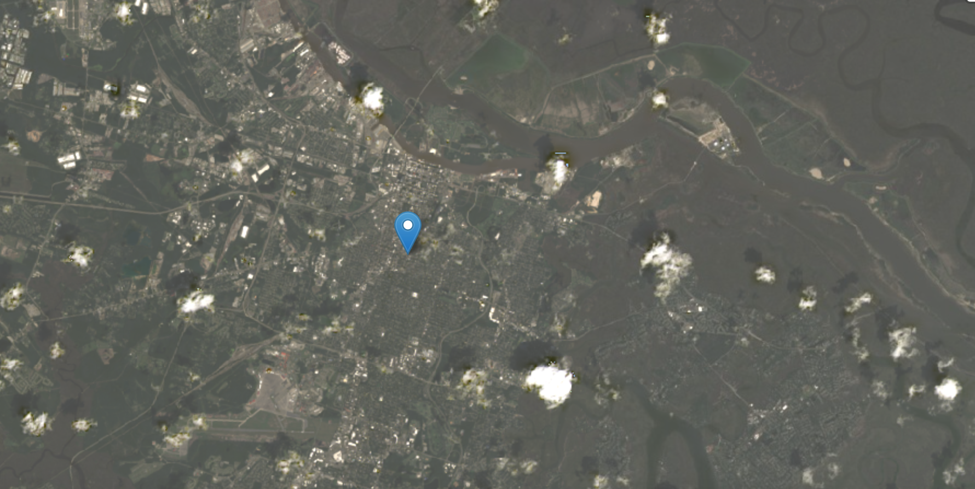
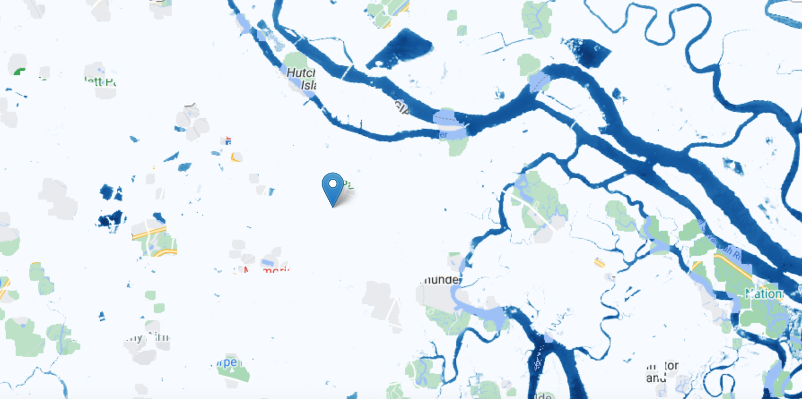
Flood Methodology
Sentinel-1 C- SAR
Backscatter
VV Polarization
Pseudo Terrain Correction
Speckle Filter
Sentinel-2 MSI
Top of Atmosphere
Correct Collection
Cloud Filtering
Landsat 8 OLI
Surface Reflectance
mNDWI
Edge Otsu Method
Flood Extent Map
LS8 - Savannah, GA
LS8 - Savannah, GA
Notes:
The project has two main objectives: Flood Extent Identification/Validation and Probable Heirs property indicators
To create the flood extent maps, we used Google Earth Engine's HYDRAFloods tool to detect surface water and monitor flood extent. To observe the flooding from Hurricane Irma, we used top of atmosphere, surface reflectance, and backscatter data.
First, we used 2 satellites that measure surface reflectance: Sentinel–2 MSI and Landsat 8 OLI. We applied a modified normalized difference water index (mNDWI) to help differentiate between water and non-water in optical imagery. Sentinel-1 was used for backscatter. We specifically used the VV polarization from S-1, because water is more distinguishable than other polarization methods. Both flood extent maps use the Edge Otsu method, a thresholding algorithm which classifies the data into water and non-water classes.

Slide 9
CAMA Methodology
Last sale date more than 30 years
2
Special terms (heirs of, etal, c/o, etc.)
10
Favorable tax status
-1
Joined By
Realkey Identifier
Probable Heirs’ Property
Out-of-county
mailing address
1
Owned by non-natural persons
-1
Methodology
Methodology
Landsat 7 ETM
Landsat 7 ETM
Permanent Water and Edge Otsu Method
GEE Python API
Permanent Water and Edge Otsu Method
GEE Python API
mNDWI
NDWI
mNDWI
NDWI
Landsat 8 OLI
ACS
Potential Heirs’ Parcels
Landsat 8 OLI
ACS
Potential Heirs’ Parcels
Sentinel-2 MSI
Backscatter
Sentinel-2 MSI
Backscatter
Overlay
ArcGIS Pro
Flood Extent Maps
Overlay
ArcGIS Pro
Flood Extent Maps
Sentinel-1 C-SAR
Sentinel-1 C-SAR
Heirs’ Property Impact Maps and Tables
Heirs’ Property Impact Maps and Tables
Notes:
For a given county, the associated CAMA data was read into a Google Colab Python notebook from multiple CSV files using the open source “pandas” library and native Python methods. Data is read into a pandas dataframe, with rows corresponding to unique parcels identified by their “RealKey” and columns of the different data used by county tax assessors. Heirs property is difficult to identify in the best of circumstances, and in using the CAMA data, we worked with our partners at The Center and science advisors in order to identify these 5 parameters, as well as the relative weights as shown right of the parameter.
The weights were chosen in order to give relative importance to particular parameters, namely what we called "special terms", and in order to depress the importance of signifiers that would indicate either a clean title, or a parcel owned by a business or corporation. Additionally, the threshold for heirs identification is chosen such that a property can be determined to be heirs property if it is associated with one of the special terms, or has a latest sale-date more than 30 years ago and an out-of-state mailing address for the entity paying the taxes.

Slide 10
CAMA Methodology
REALKEY | Sale Date | Special Terms | Tax Status | Out of State | Non-Natural Persons | Probable Heirs’ Property?
11111 | Y | Y | N | N | N | Yes
22222 | N | Y | N | Y | N | Yes
33333 | Y | N | N | N | N | No
44444 | N | N | Y | Y | N | No
55555 | Y | N | Y | Y | N | No
An example table showing the result of CAMA parameter identification in Python
Methodology
Landsat 7 ETM
Permanent Water and Edge Otsu Method
GEE Python API
mNDWI
NDWI
Landsat 8 OLI
ACS
Potential Heirs’ Parcels
Sentinel-2 MSI
Backscatter
Overlay
ArcGIS Pro
Flood Extent Maps
Sentinel-1 C-SAR
Heirs’ Property Impact Maps and Tables
Notes:
This is an example of what a collection of parcels looks like once their adherence to the previous slide's parameters has been determined and likelihood of being an heirs property has been ascertained. Only the probable heirs parcels are reported and used in our heat map.

Slide 11
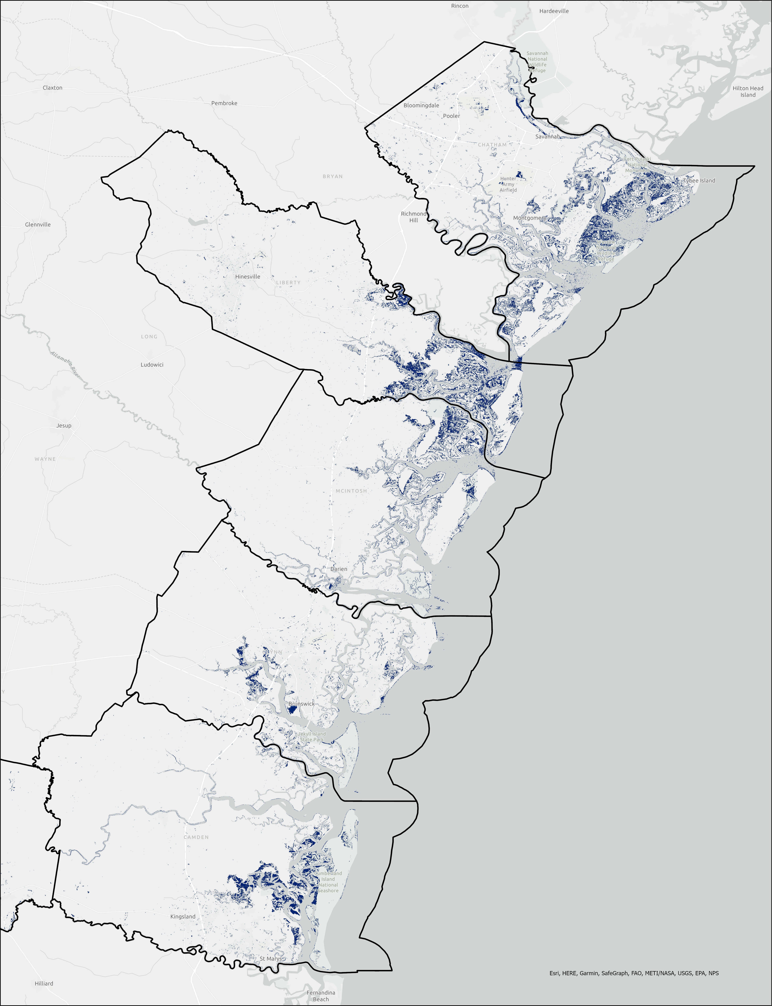
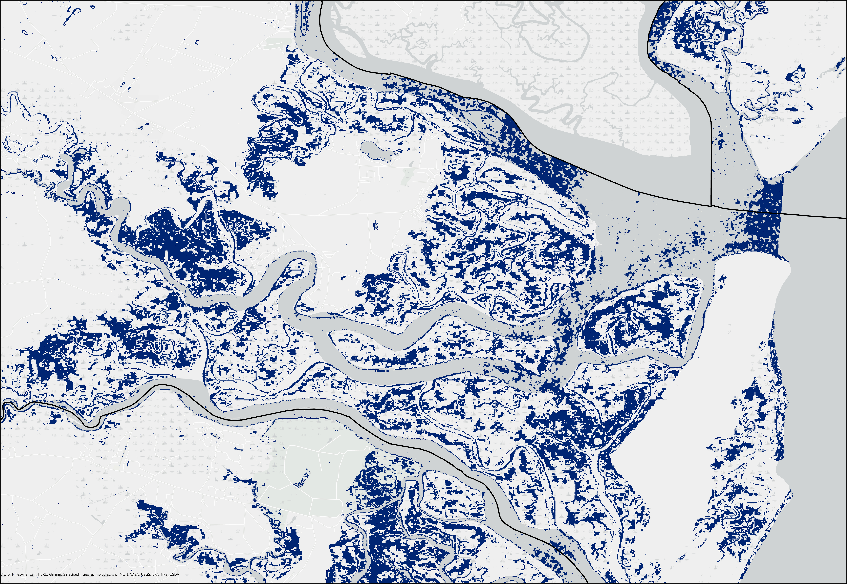
Results: Flood Extent Maps – Coastal
Chatham
Below: Remotely Sensed Flood Extent in Liberty County
Liberty
McIntosh
Glynn
Camden
Flood
0
20 mi
Basemap credit: ESRI
Notes:
Now you’ll be seeing maps on the next few slides. Each map represents the flood extent of Hurricane Irma within the 15 counties. In the inset map, you can see where our study area lies within the state of Georgia. Blue observed flooding.
------------------------------Image Information Below ------------------------------
In photos: Optical Imagery Flood Extent Map from Hurricane Irma
Image Source: Made by the Georgia Disasters Team II

Slide 12
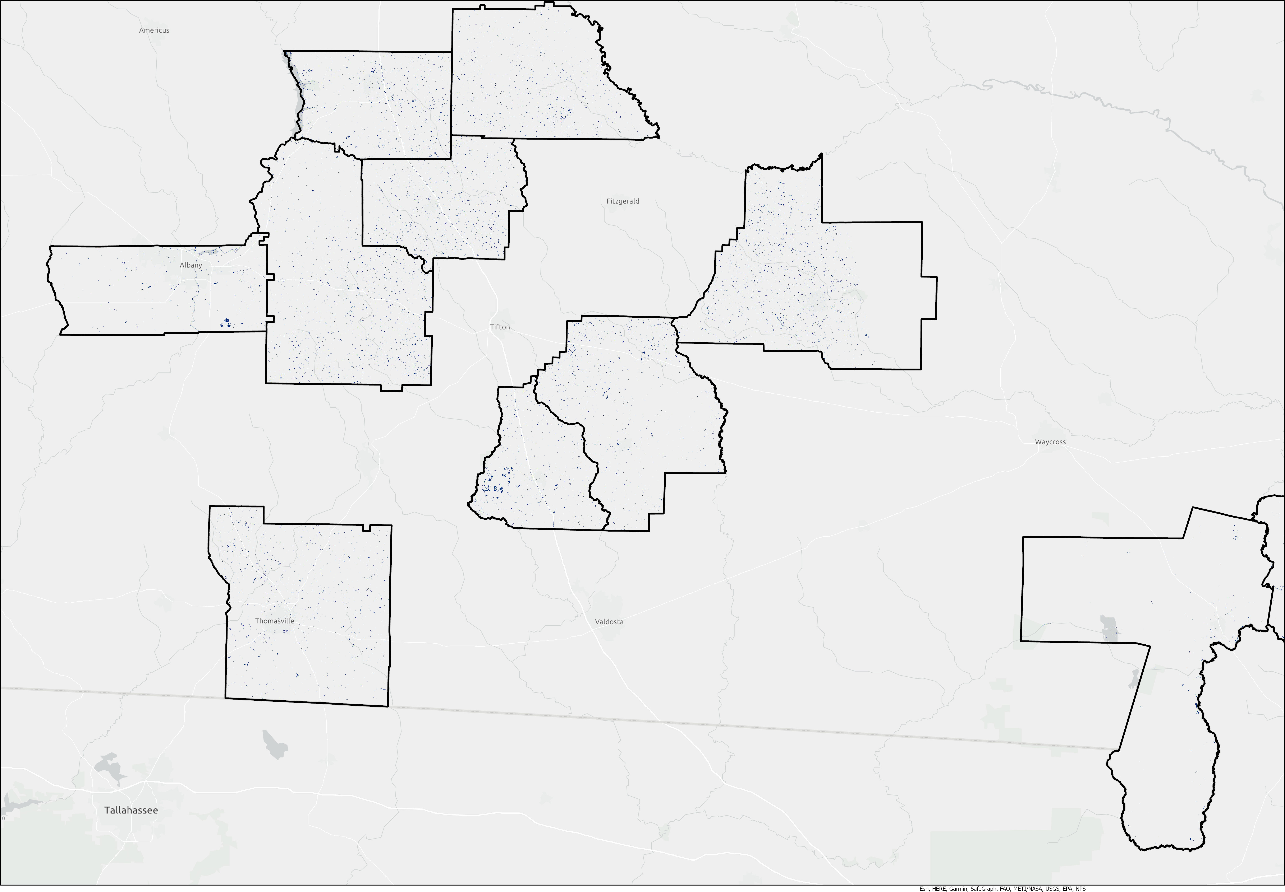
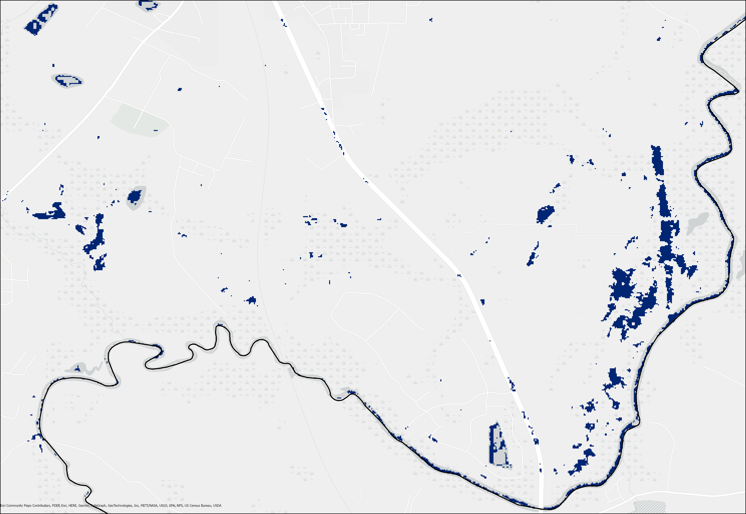
Results: Flood Extent Maps – Inland
Wilcox
Flood
Crisp
0
20 mi
Below: Remotely Sensed Flood Extent in Charlton County
Turner
Dougherty
Worth
Coffee
Berrien
Cook
Thomas
Charlton
Basemap credit: ESRI
Notes:
Now you’ll be seeing maps on the next few slides. Each map represents the flood extent of Hurricane Irma within the 15 counties. In the inset map, you can see where our study area lies within the state of Georgia. Blue observed flooding.
------------------------------Image Information Below ------------------------------
In photos: Optical Imagery Flood Extent Map from Hurricane Irma
Image Source: Made by the Georgia Disasters Team II

Slide 13
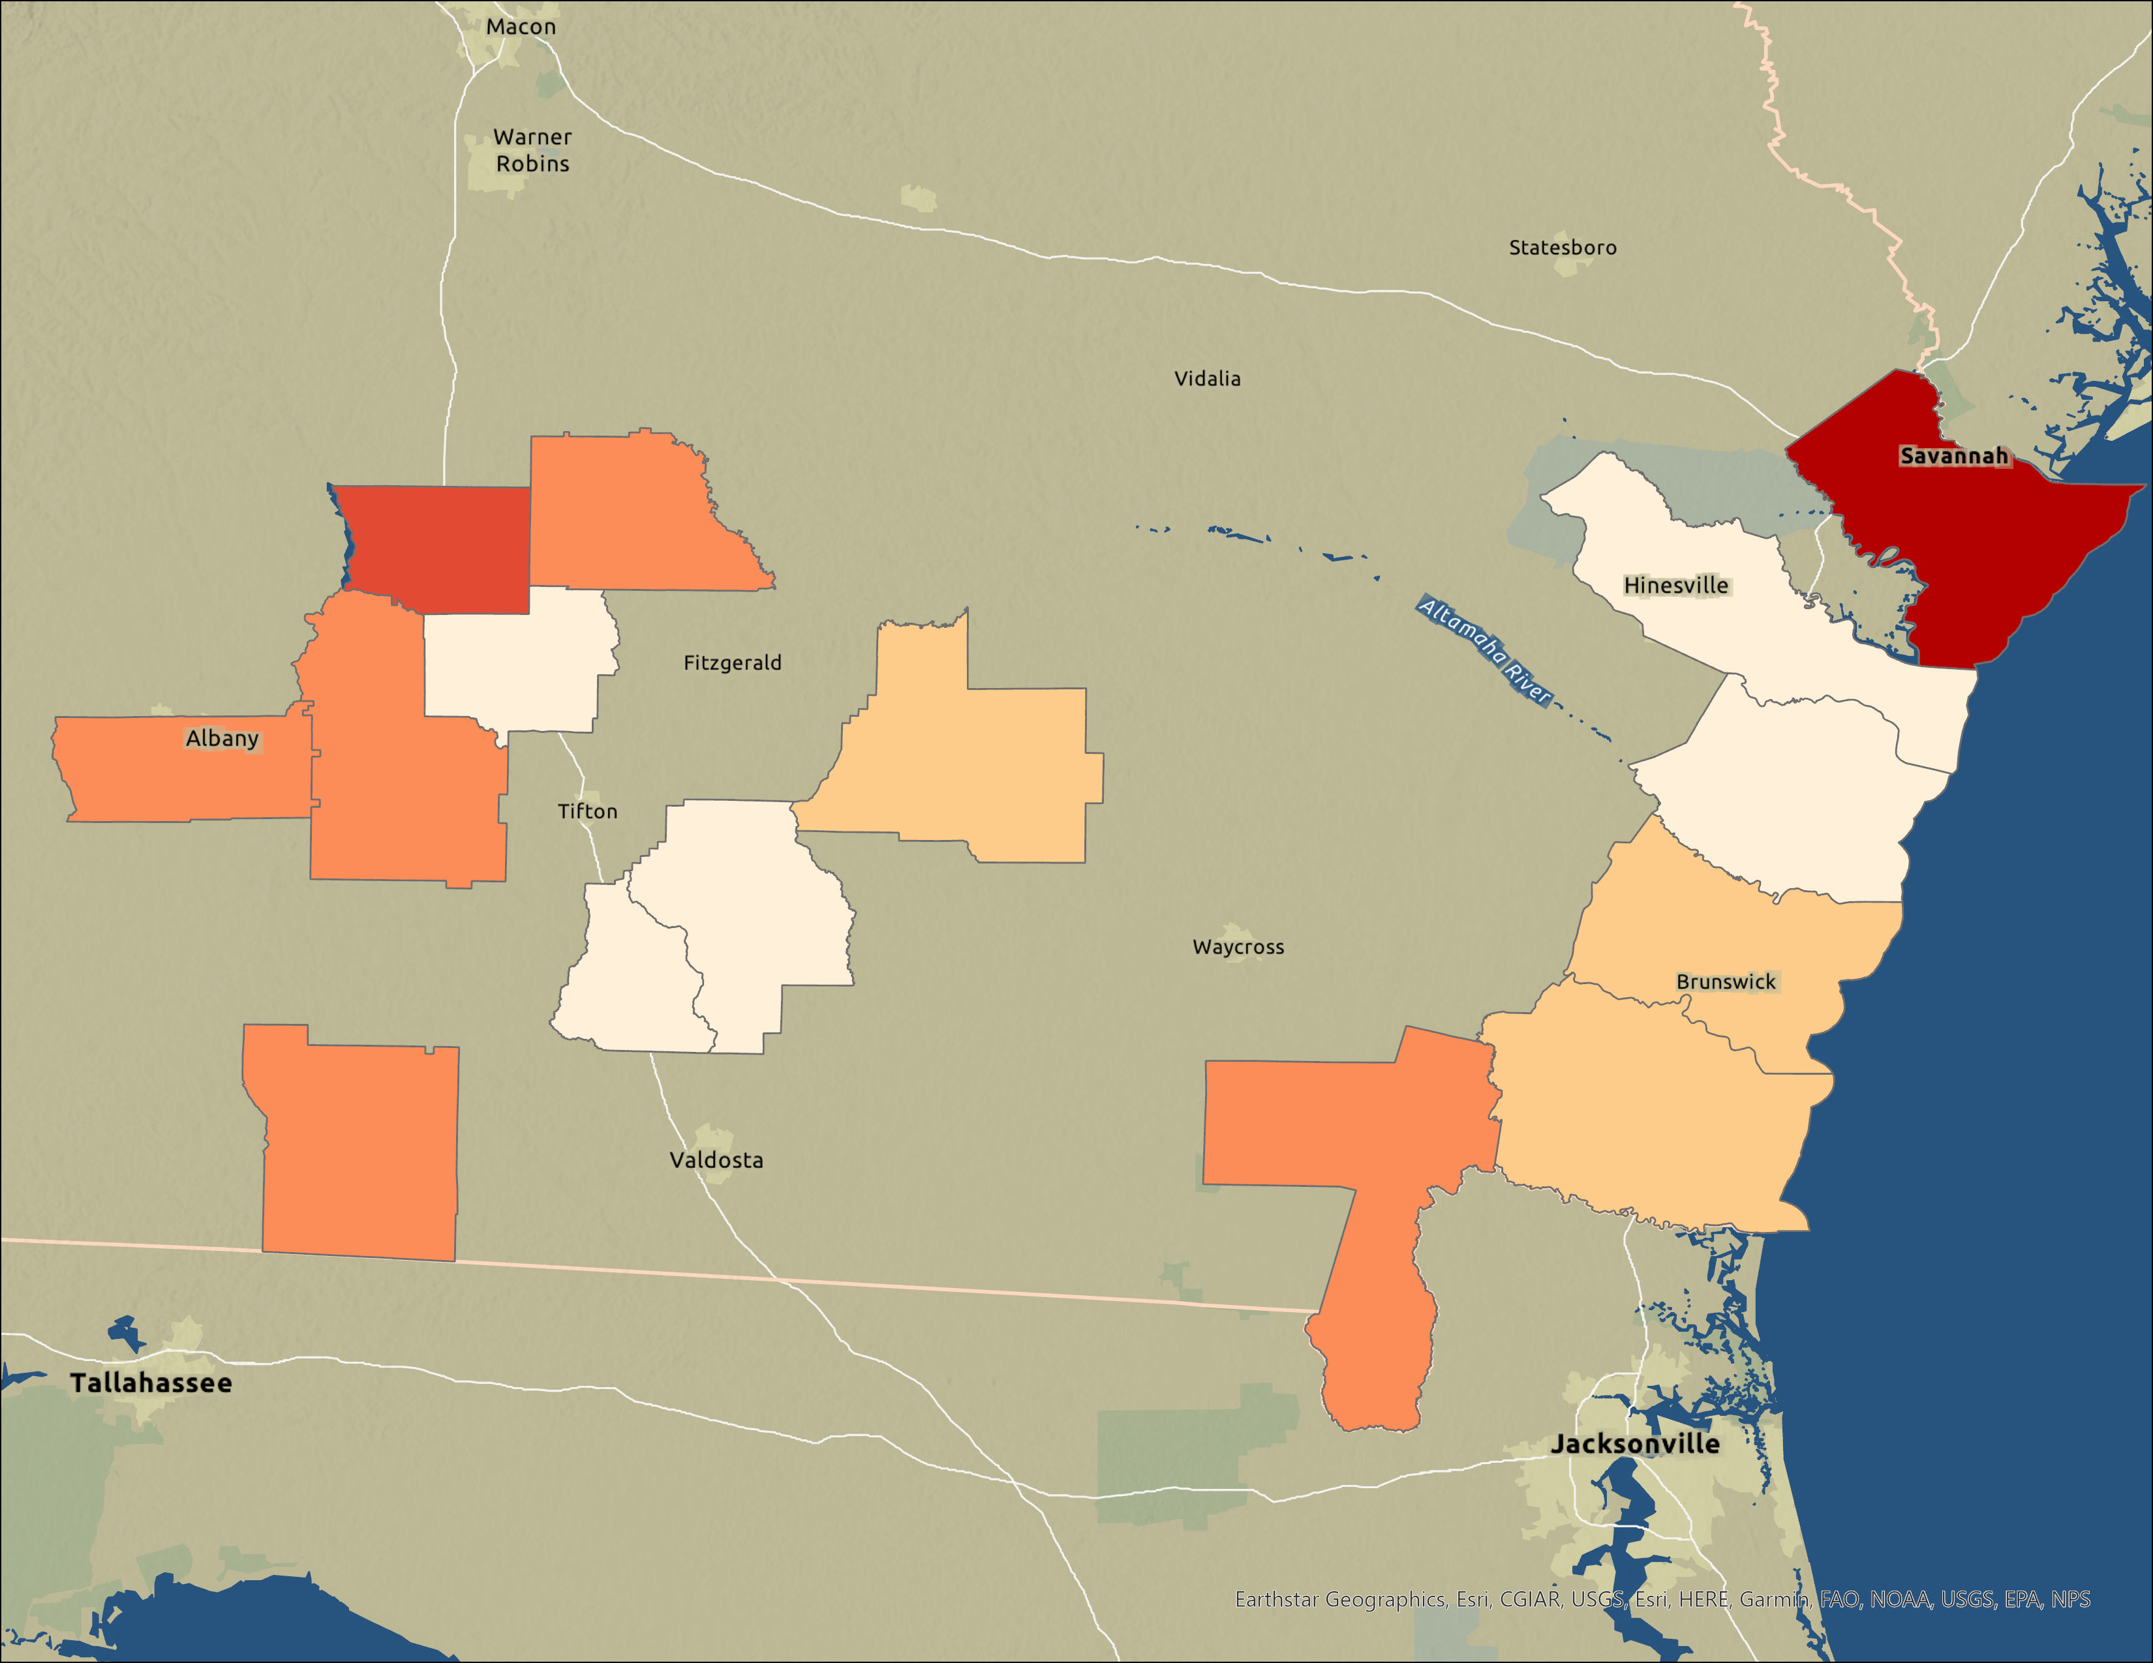
Results: CAMA – Heirs’ Properties
Wilcox
Chatham
Crisp
Turner
Liberty
Dougherty
Worth
Coffee
McIntosh
Berrien
Glynn
Cook
Thomas
Charlton
Camden
0
20 mi
Percent Heirs’
2.8 – 4.6%
7.1 – 9.9%
1.9 – 2.8%
4.6 – 7.1%
9.9 – 13.0%
Notes:
This is the heirs properties dected per-county shown as a percentage of the parcels in a given county. Some things to note are that we see our largest percentage of heirs property in Chatham county, with regions near the coast being slightly less likely to have heirs property than farming regions located inland. Errors will be discussed more in the next slide, but also note that these percentages are not exhaustive and there are limitations to our method(s).
------------------------------Image Information Below ------------------------------
In photos: Study Area Map with counties colored to represent the relative percentage of heirs properties detected in each
Image Source: Made by the Georgia Disasters II Team

Slide 14
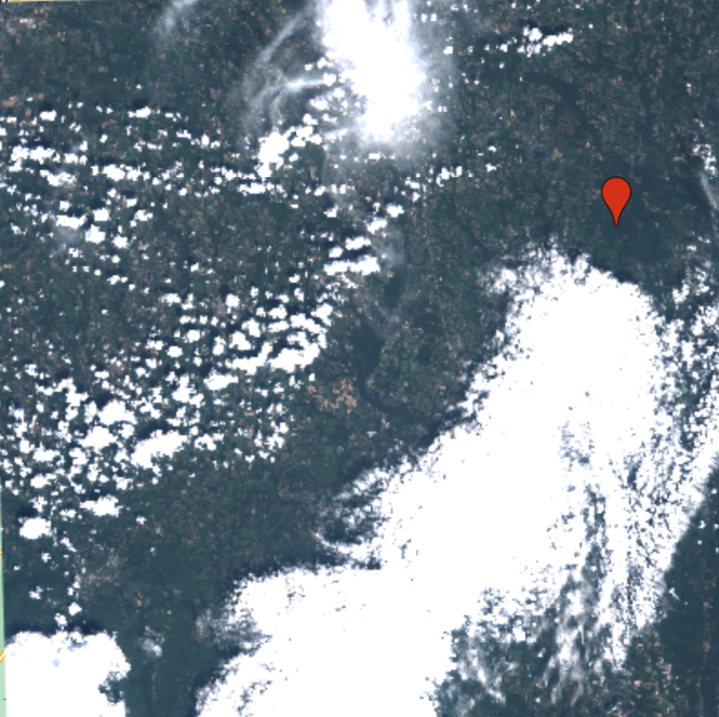
Errors & Uncertainties
Optical Imagery
Sentinel-2 TOA imagery
Cloudiness
SAR Imagery
Limited by geometry of area
Likely undercounting flood
Example of Cloudy Sentinel-2 Imagery
Heirs’ Property Identification
Heirs’ ID has no consistent indicators
Little opportunity to validate to another dataset
Notes:
Optical Imagery
~~~~~~~~~~~~~
Uses surface reflectance which created limitations when creating the flood maps due to the cloud cover.
Using the Edge Otsu method had difficulties identifying flooding along waterways and struggled with pixel classification. Suspect it may have been over-identifying vegetation as water
SAR Imagery
~~~~~~~~~~
C-SAR uses C- band wavelength that cannot penetrate dense tree canopies.
Due to the time period in which the Hurricane occurred we had to use the Sentinel-2 Level 1 Collection instead of Level 2A. This meant we had to perform our own atmospheric corrections by using the dark object subtraction method.
Another limitation included measuring the flood extent using this sensor, because of the backscatter from the terrain, buildings and trees. To account for this issue a 20m buffer was created.
CAMA
~~~~~
The heirs property likelihood could be more refined by the number of parameters used. The CAMA data used to filter property information had a lot of potential identification parameters, most of which we discarded due to those parameters recorded having no obvious connection. The CAMA data is also incredibly unorganized and non-uniform from county to county making the type of cross-county analysis we are trying to do challenging. The years of available CAMA data are limited by what each county has put together and how they have decided to format it.

Slide 15
Conclusions
Flooding
Majority of flooding due to Irma along the coast
Storm surge is more relevant than inland rain for standing water
Heirs’ Properties
Heirs’ property along the coast is easy to identify in the National Consciousness
The GA-SC low country is home to the Gullah-Geechee communities, a historically disenfranchised group
Chatham's large percentage likely related to Savannah's historic role in the Transatlantic Slave Trade
Coastline parcels are at special risk for flooding and land stealing due to development desirability
Notes:
Read the slide

Slide 16
Imagery Credit: rexhammock
Future Work
Further investigation into heirs’ property identification
Train neural network on a verified dataset to find other identifiers of heirs’ properties
Compare different thresholding algorithms to increase accuracy of flood compared to the USGS in situ data
Perform more comprehensive atmospheric corrections on the Sentinel-2 MSI L1C (TOA) imagery
Notes:
One of the largest challenges to identification of heirs’ property is the data available, determining what pieces of that data are relevant and in what weight or capacity. This is a task potentially suited for machine learning. Being able to train a neural network on some subset of confidently, positively identified heirs properties, a future team could discover identifiers or combine data in ways that would not be possible to do manually.
For the flood identification, areas of improvement are two-fold:
Firstly, the thresholding algorithm the team used for flood identification, while very robust and effective, was over-identifying vegetation and cloud shadows as possible flood waters. This could be corrected for by incorporating the USGS in situ measurements as part of the thresholding algorithm. Namely, iterating over multiple thresholds and validating each against the in situ measurements for the "best" or most robust measurement. Second, several of the instruments, data collections, and bands that the team hoped to use were either unusable, or required more post-processing than was able to be completed in this project term. Sentinel-2 was the most robust, and if resources had been allocated there from the beginning, the team could have done more post-processing methods, like Dark Object Subtraction, that eluded us due to time.
------------------------------Image Information Below ------------------------------
https://wordpress.org/openverse/image/6747bd5f-b19e-4ad8-9b5b-4b4b8c2780b9; "Sunrise, Georgia Coast" by rexhammock is licensed under CC BY-SA 2.0.

Slide 17
​
Previous Team:
Isabella Chittumuri (DEVELOP)
Nancee Uniyal (DEVELOP)​
Advisors:
Dr. Cassandra Johnson Gaither (USDA Forest Service)
Dr. Marguerite Madden (University of Georgia)
Joseph Sousa (Georgia Department of Community Affairs)​
Special Thanks To:
Jimmy Nolan (Carl Vinson Institute)
Dr. Ryan Thomson (Auburn University)​
Dr. Conner Bailey (Auburn University)​
Sarah Payne (NASA DEVELOP Georgia Node Fellow)
Nemin Wu (University of Georgia)
Notes:
We would like to thank all who make this project successful. A special thank you to our science advisor Dr. Marguerite Madden, Professor and Director of the Center for Geospatial Research Lab (CGR), University of Georgia, and our wonderful Sarah Payne, NASA DEVELOP fellow for the Georgia node. We would like to acknowledge our partners for their collaboration with DEVELOP. Thank you for listening!

