Slide 1
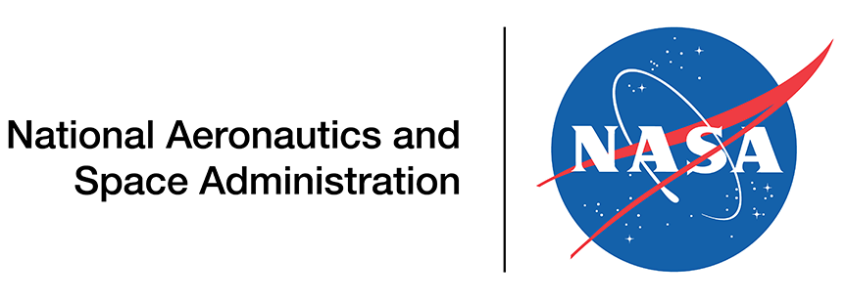


Sphero STEM Symposium Keynote
U.S. Space & Rocket Center
Huntsville, AL
April 7, 2023

Slide 2
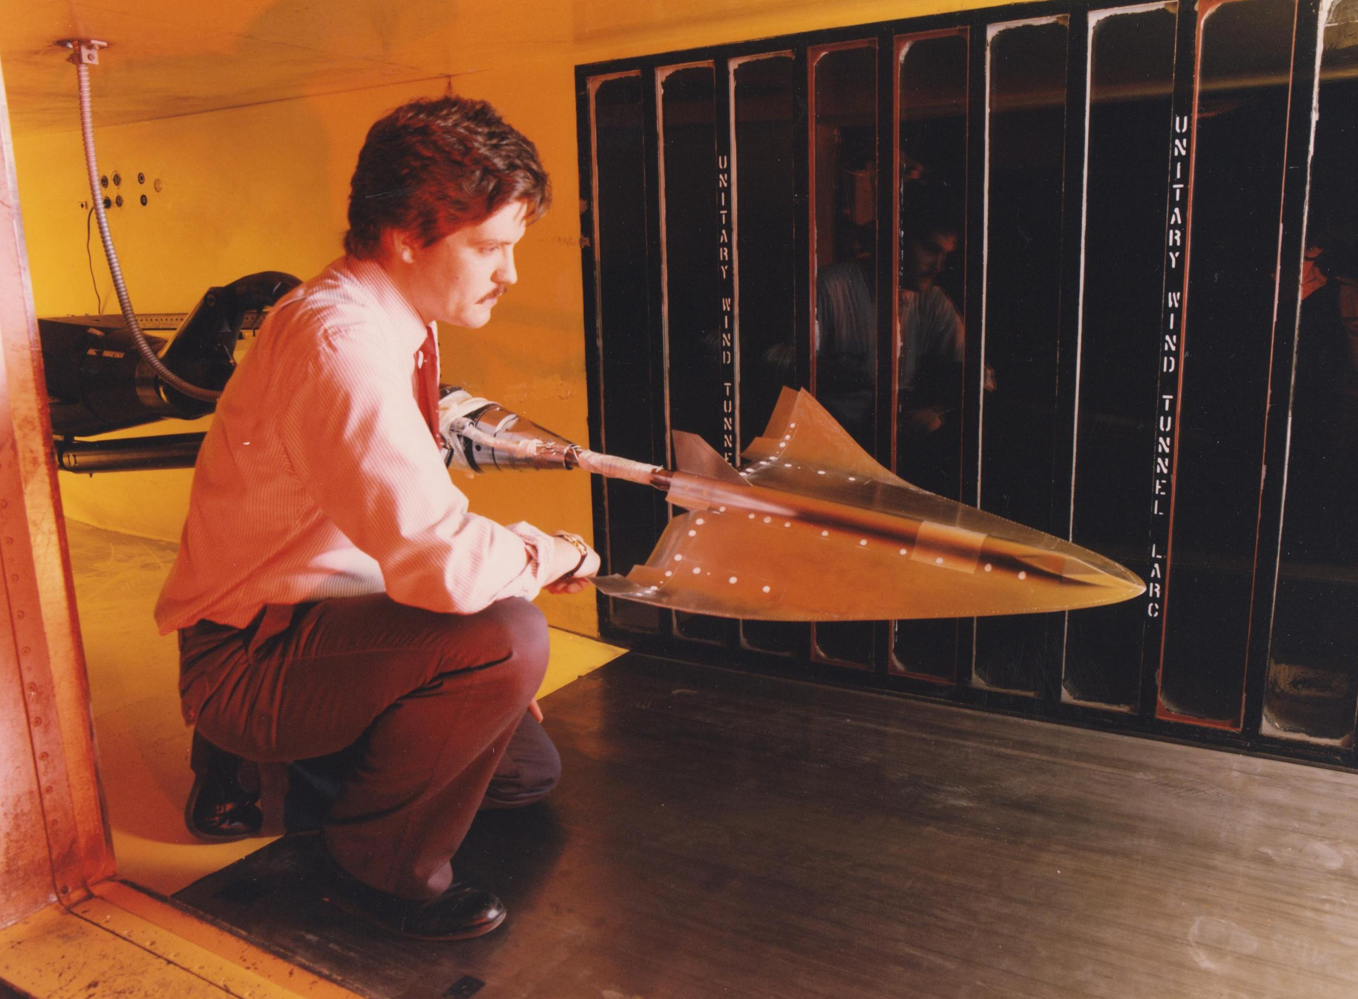
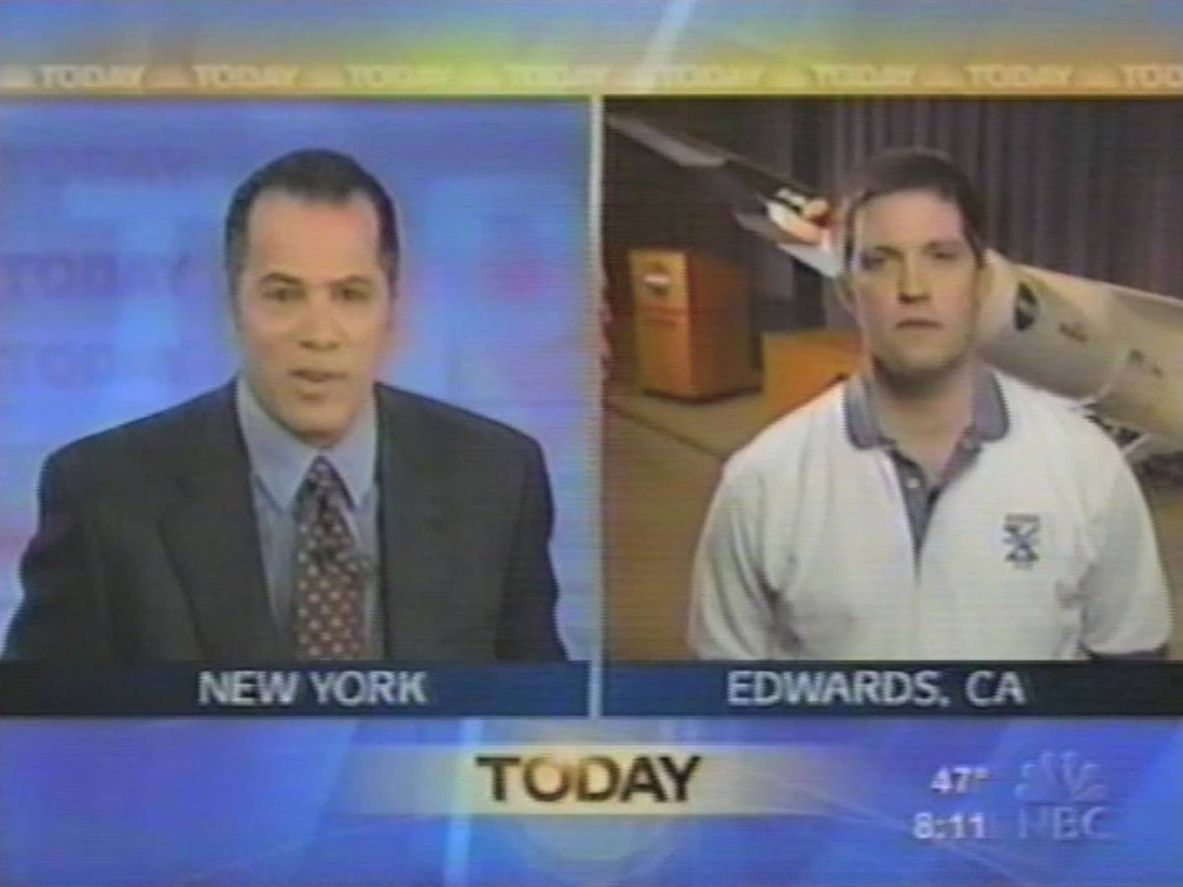
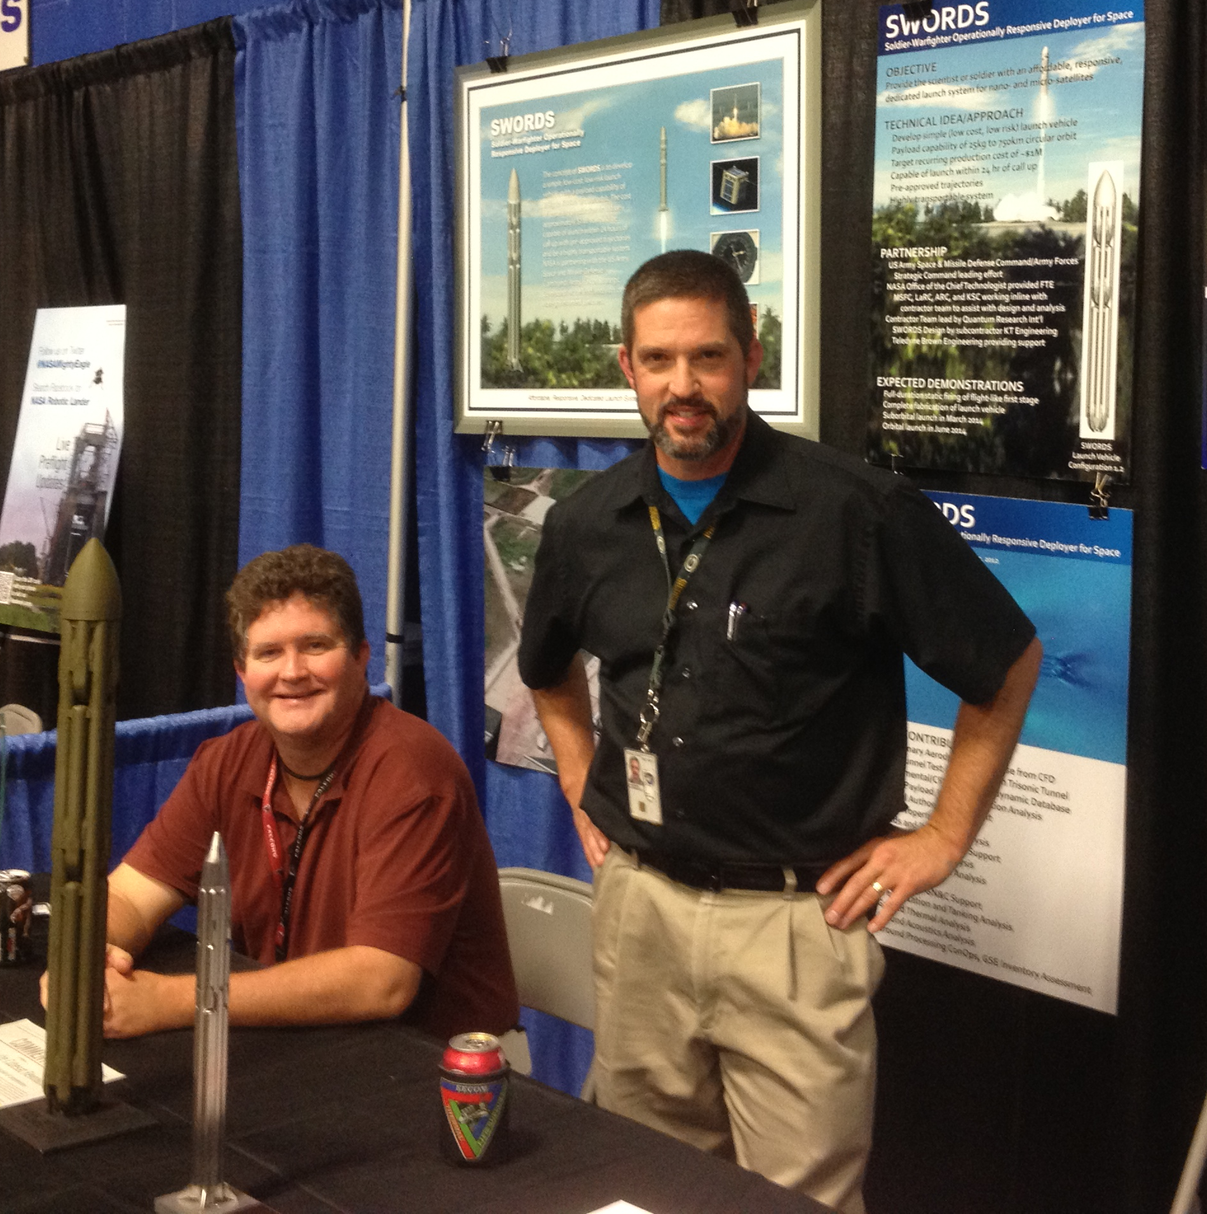
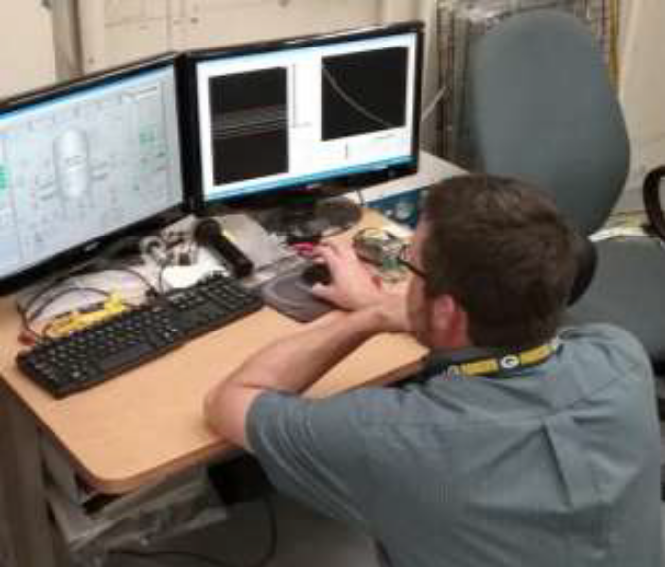
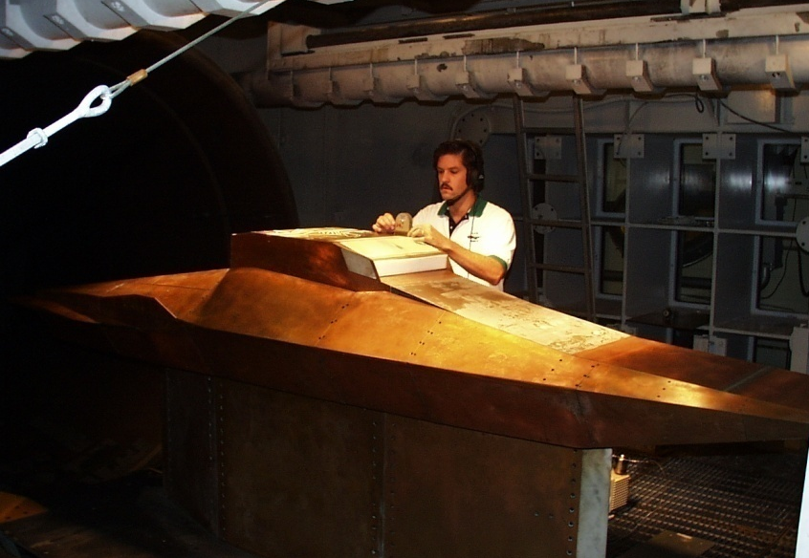
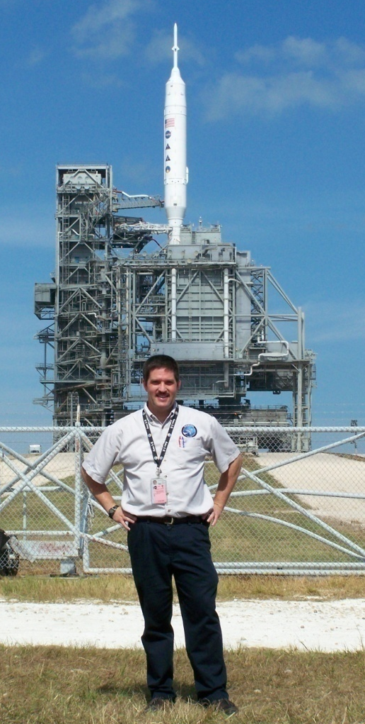
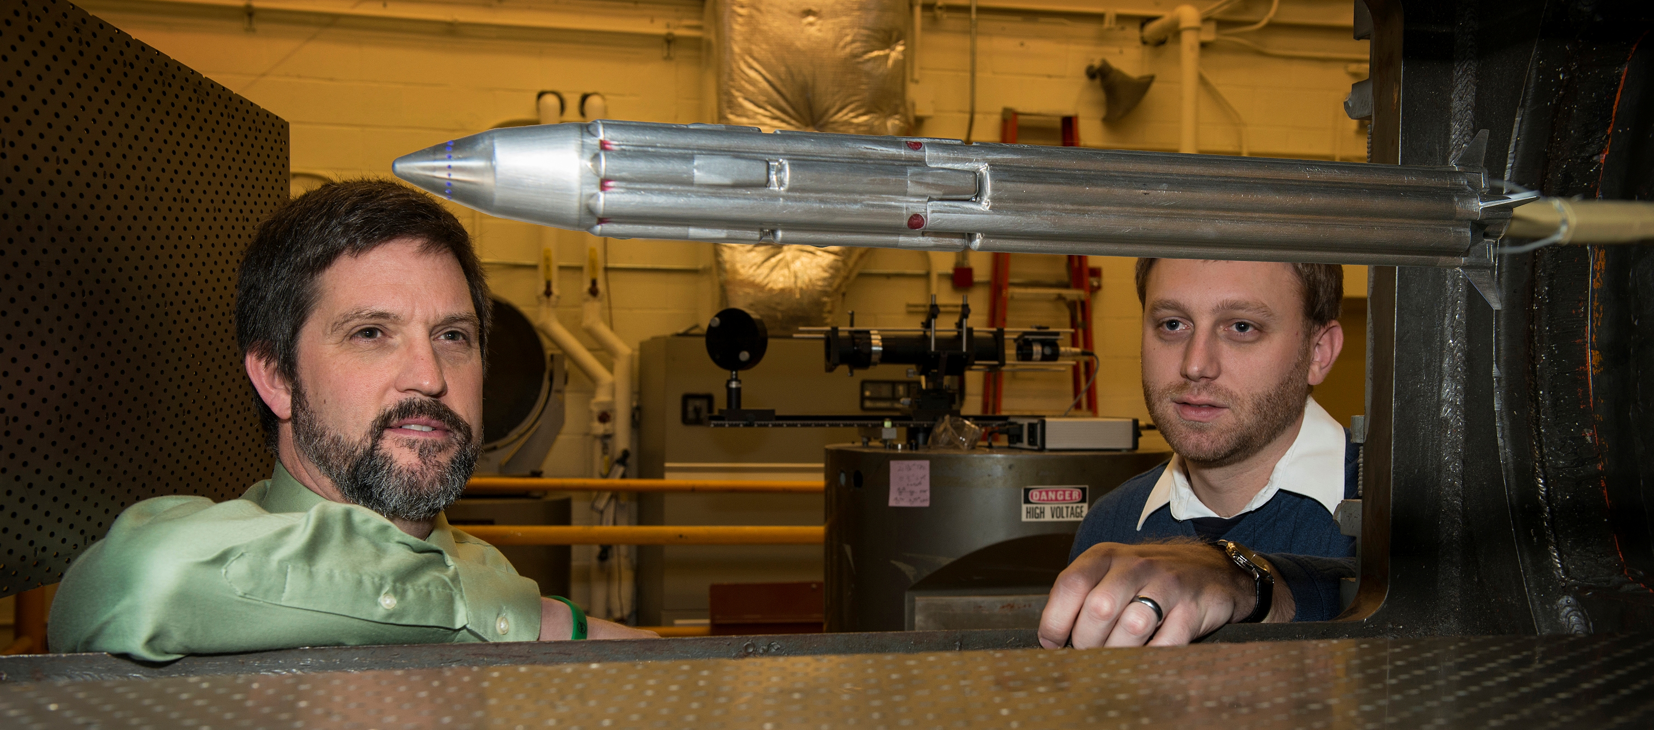
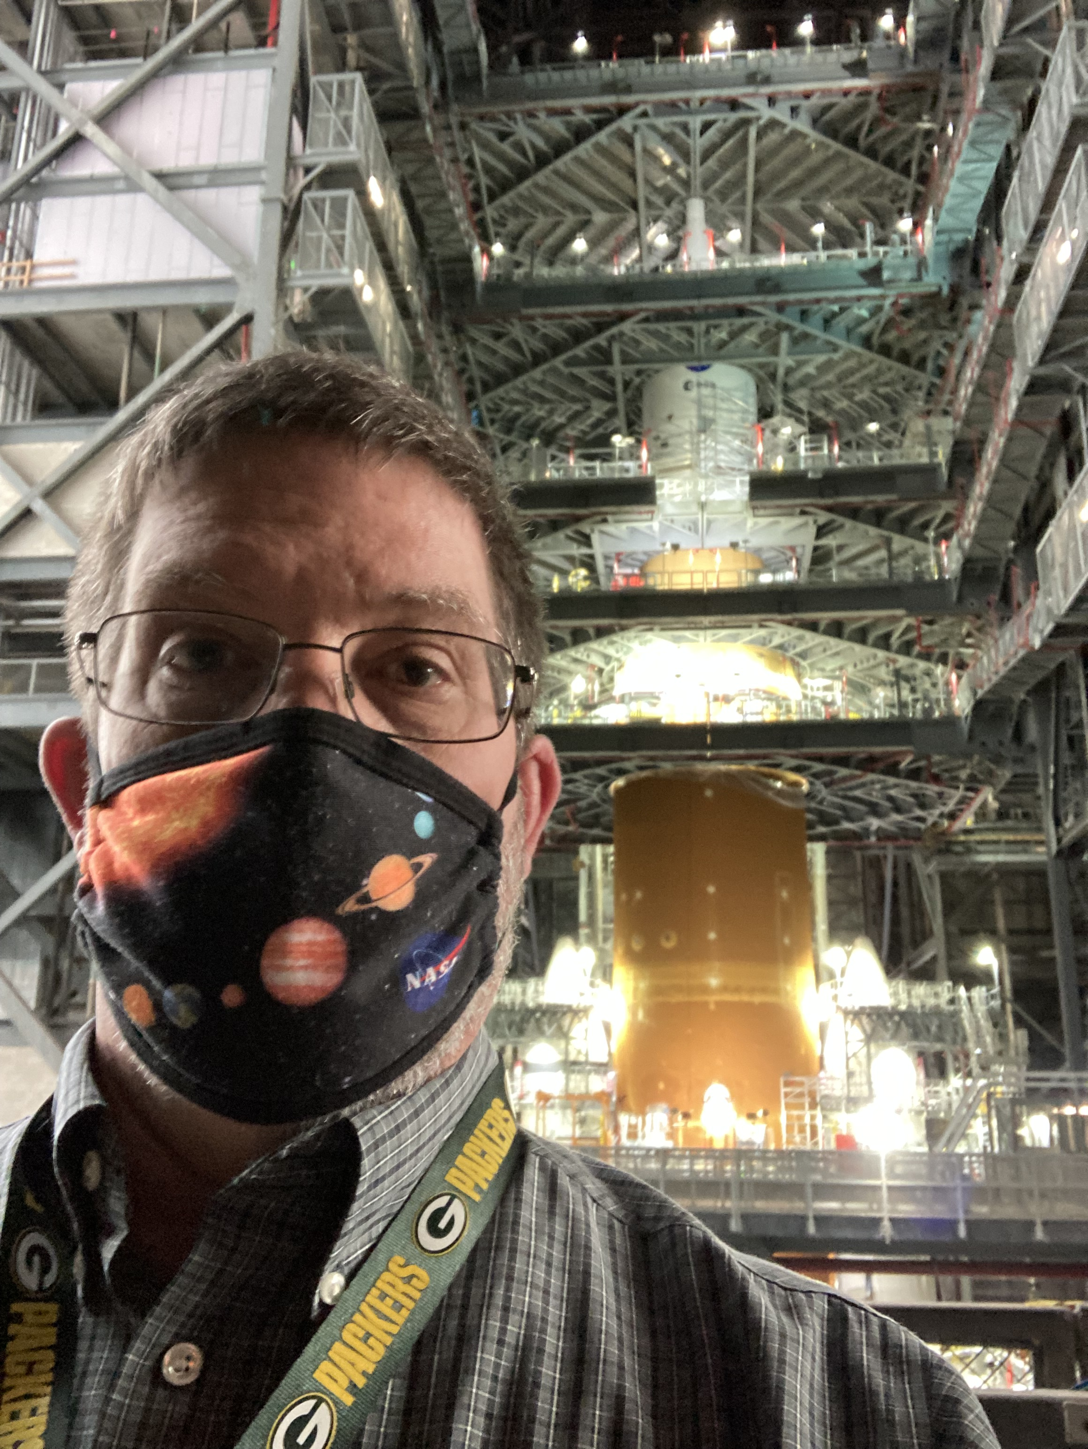
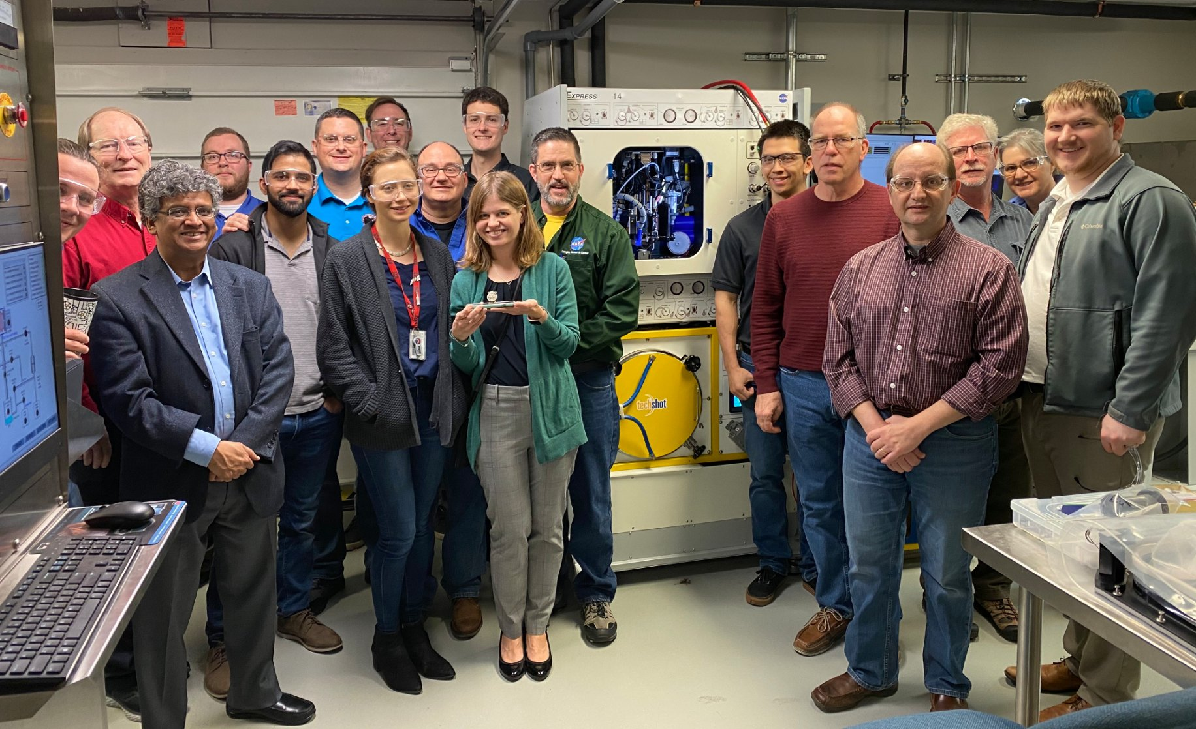
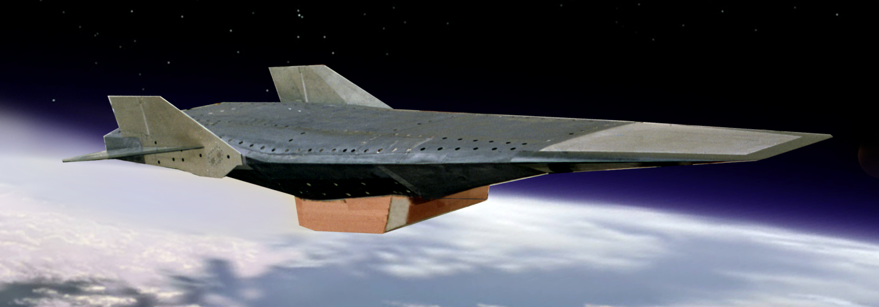
Keynote Speaker Summary
2

Slide 3

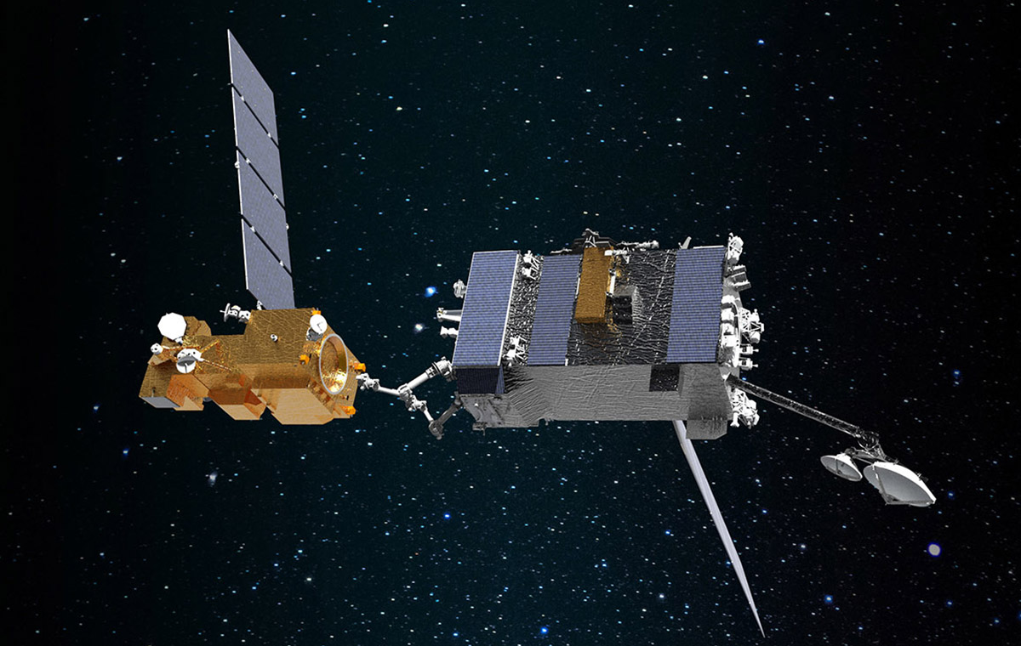
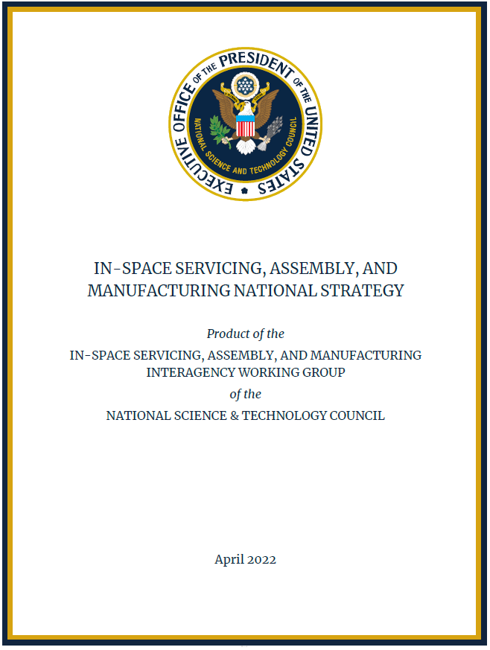
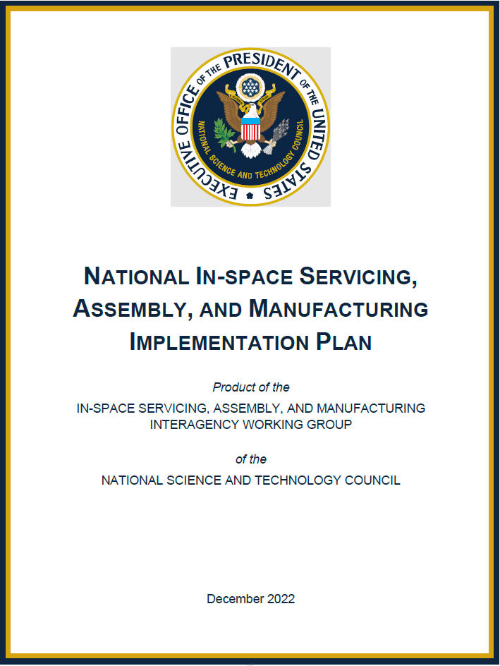
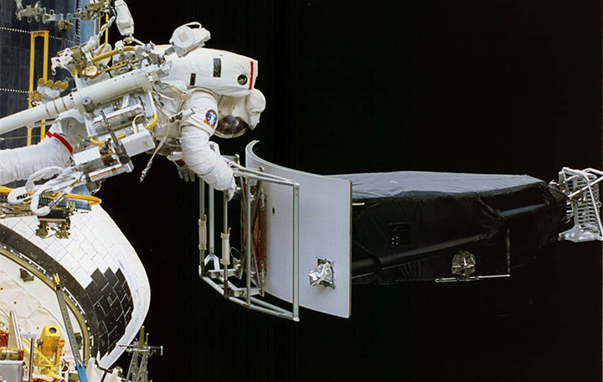
OSAM is now ISAM
  ISAM seeks to design modular space systems for maintainability, serviceability, interoperability, and upgrades; develop capabilities for assembly of complex space systems; and facilitate manufacturing in space using Earth- and locally-sourced materials
  NASA is part of the ISAM consortium with DoD, OGA, Industry, Nonprofit Research Institutes, and Academia
    Two NASA ISAM flight demonstrations are OSAM-1 and OSAM-2
Apr 2022
Dec 2022
3

Slide 4
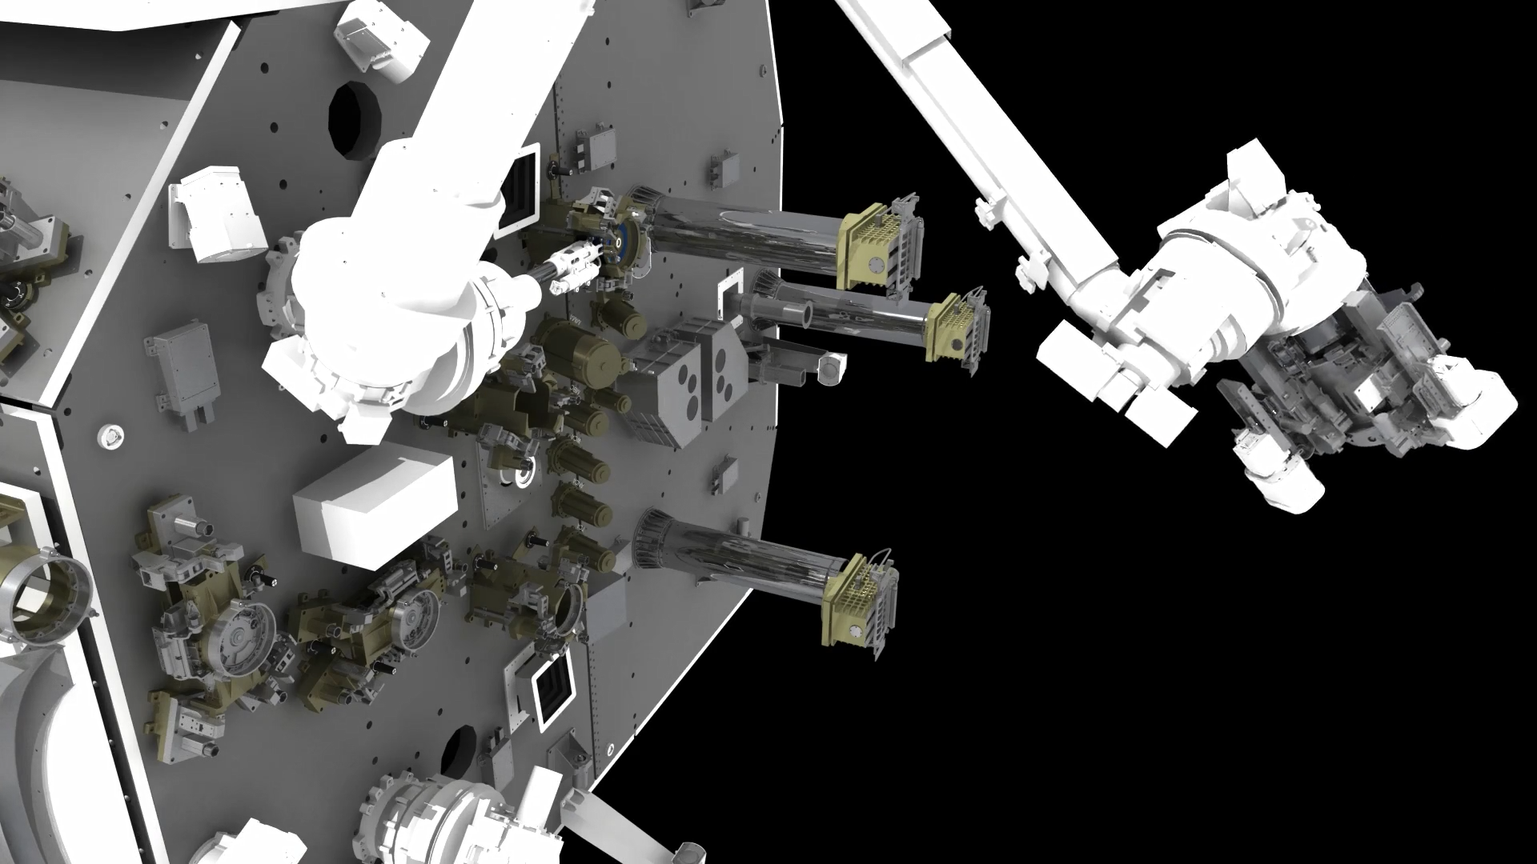
OSAM-1: Demonstrate In-Space Satellite Servicing, Antenna Assembly, and Beam Manufacturing
  Launch: Feb 2026; 7-month mission; animation shows Landsat-7 robotic servicing
4

Slide 5
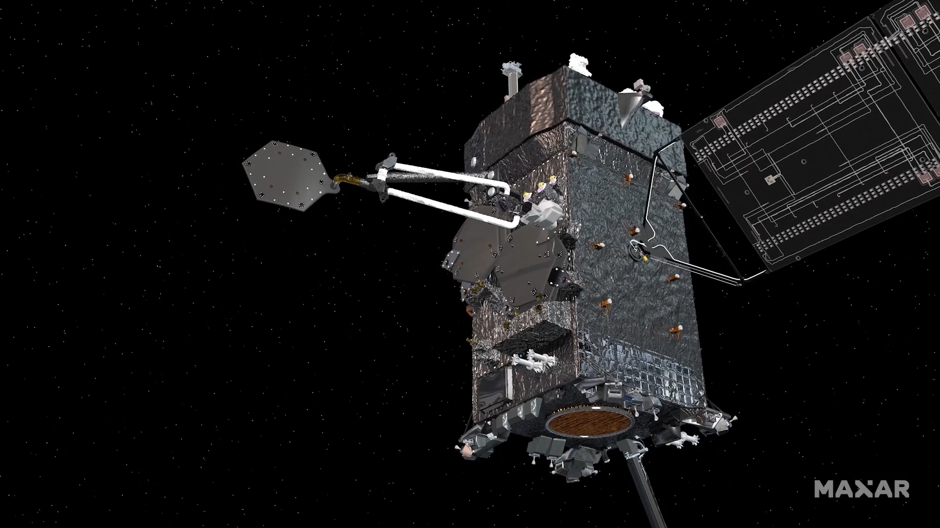
OSAM-1: Demonstrate In-Space Satellite Servicing, Antenna Assembly, and Beam Manufacturing
  Animation shows in-space antenna assembly and beam manufacturing
5

Slide 6
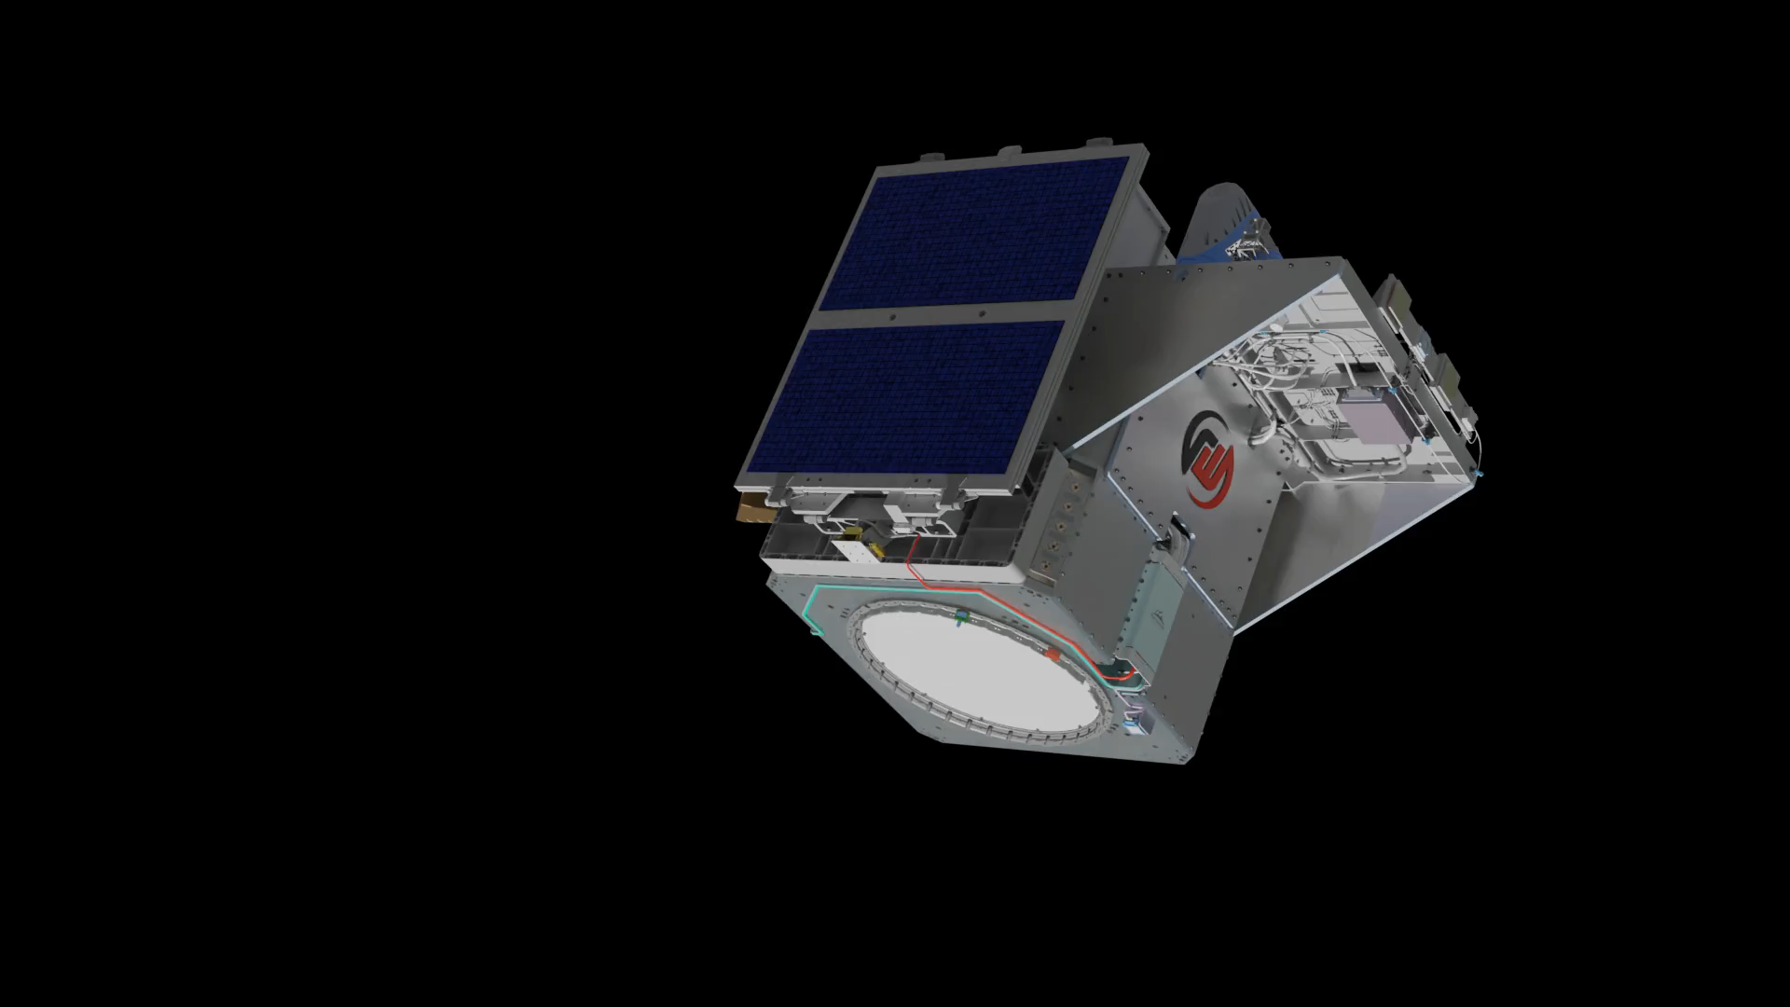
OSAM-2: Demonstrate In-Space Beam Manufacturing and Robotic Manipulation
  Launch August 2025; 4-month mission
6

Slide 7
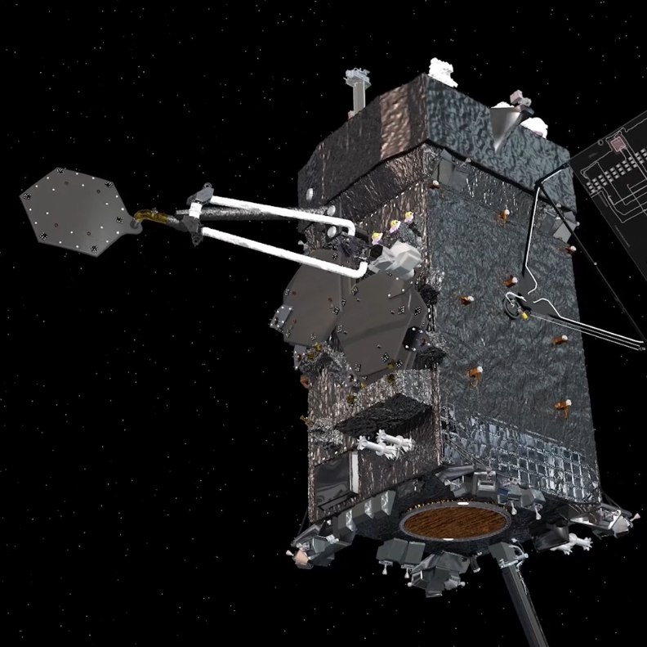
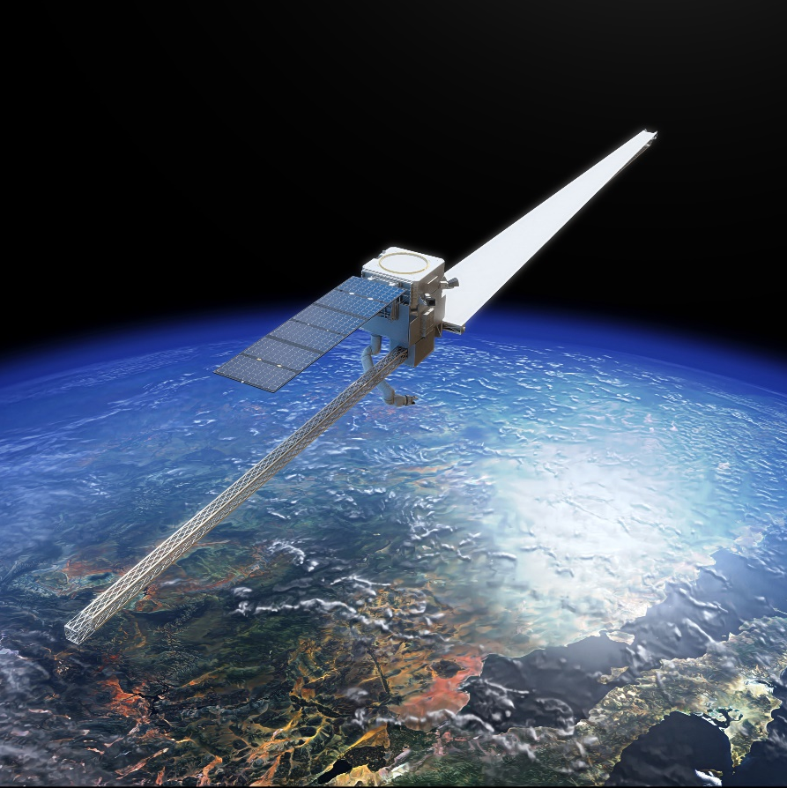
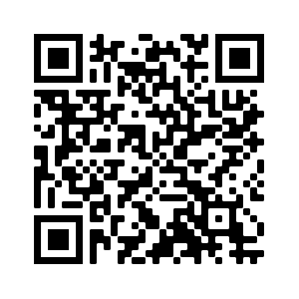
Questions?
For more information on NASA’s Space Tech, go to:
nasa.gov/TDM
Space Tech social media:
https://twitter.com/NASA_Technology
https://www.facebook.com/NASATechnology
https://www.youtube.com/nasaspacetech
For more information on Satellite Services:
https://twitter.com/NASASatServices
https://www.facebook.com/NASASatServices
7

