Slide 1
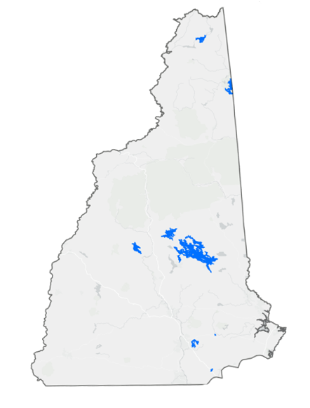

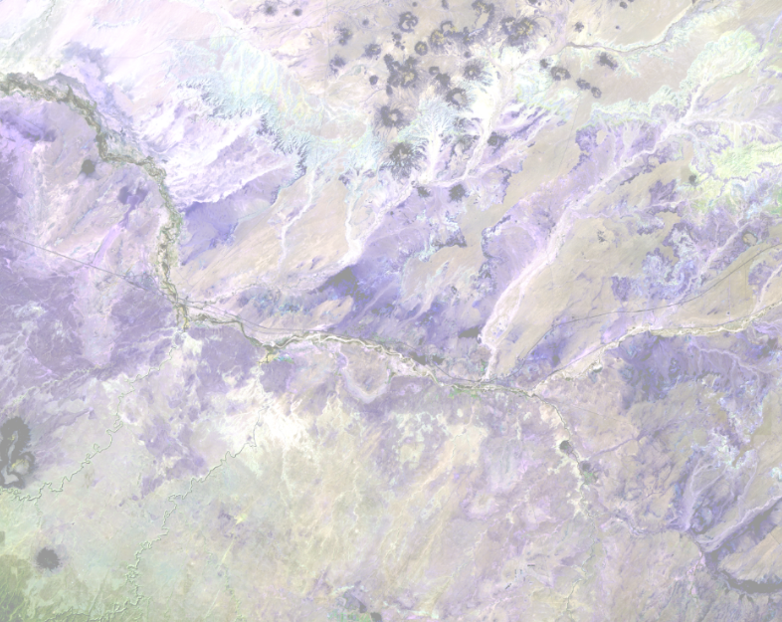
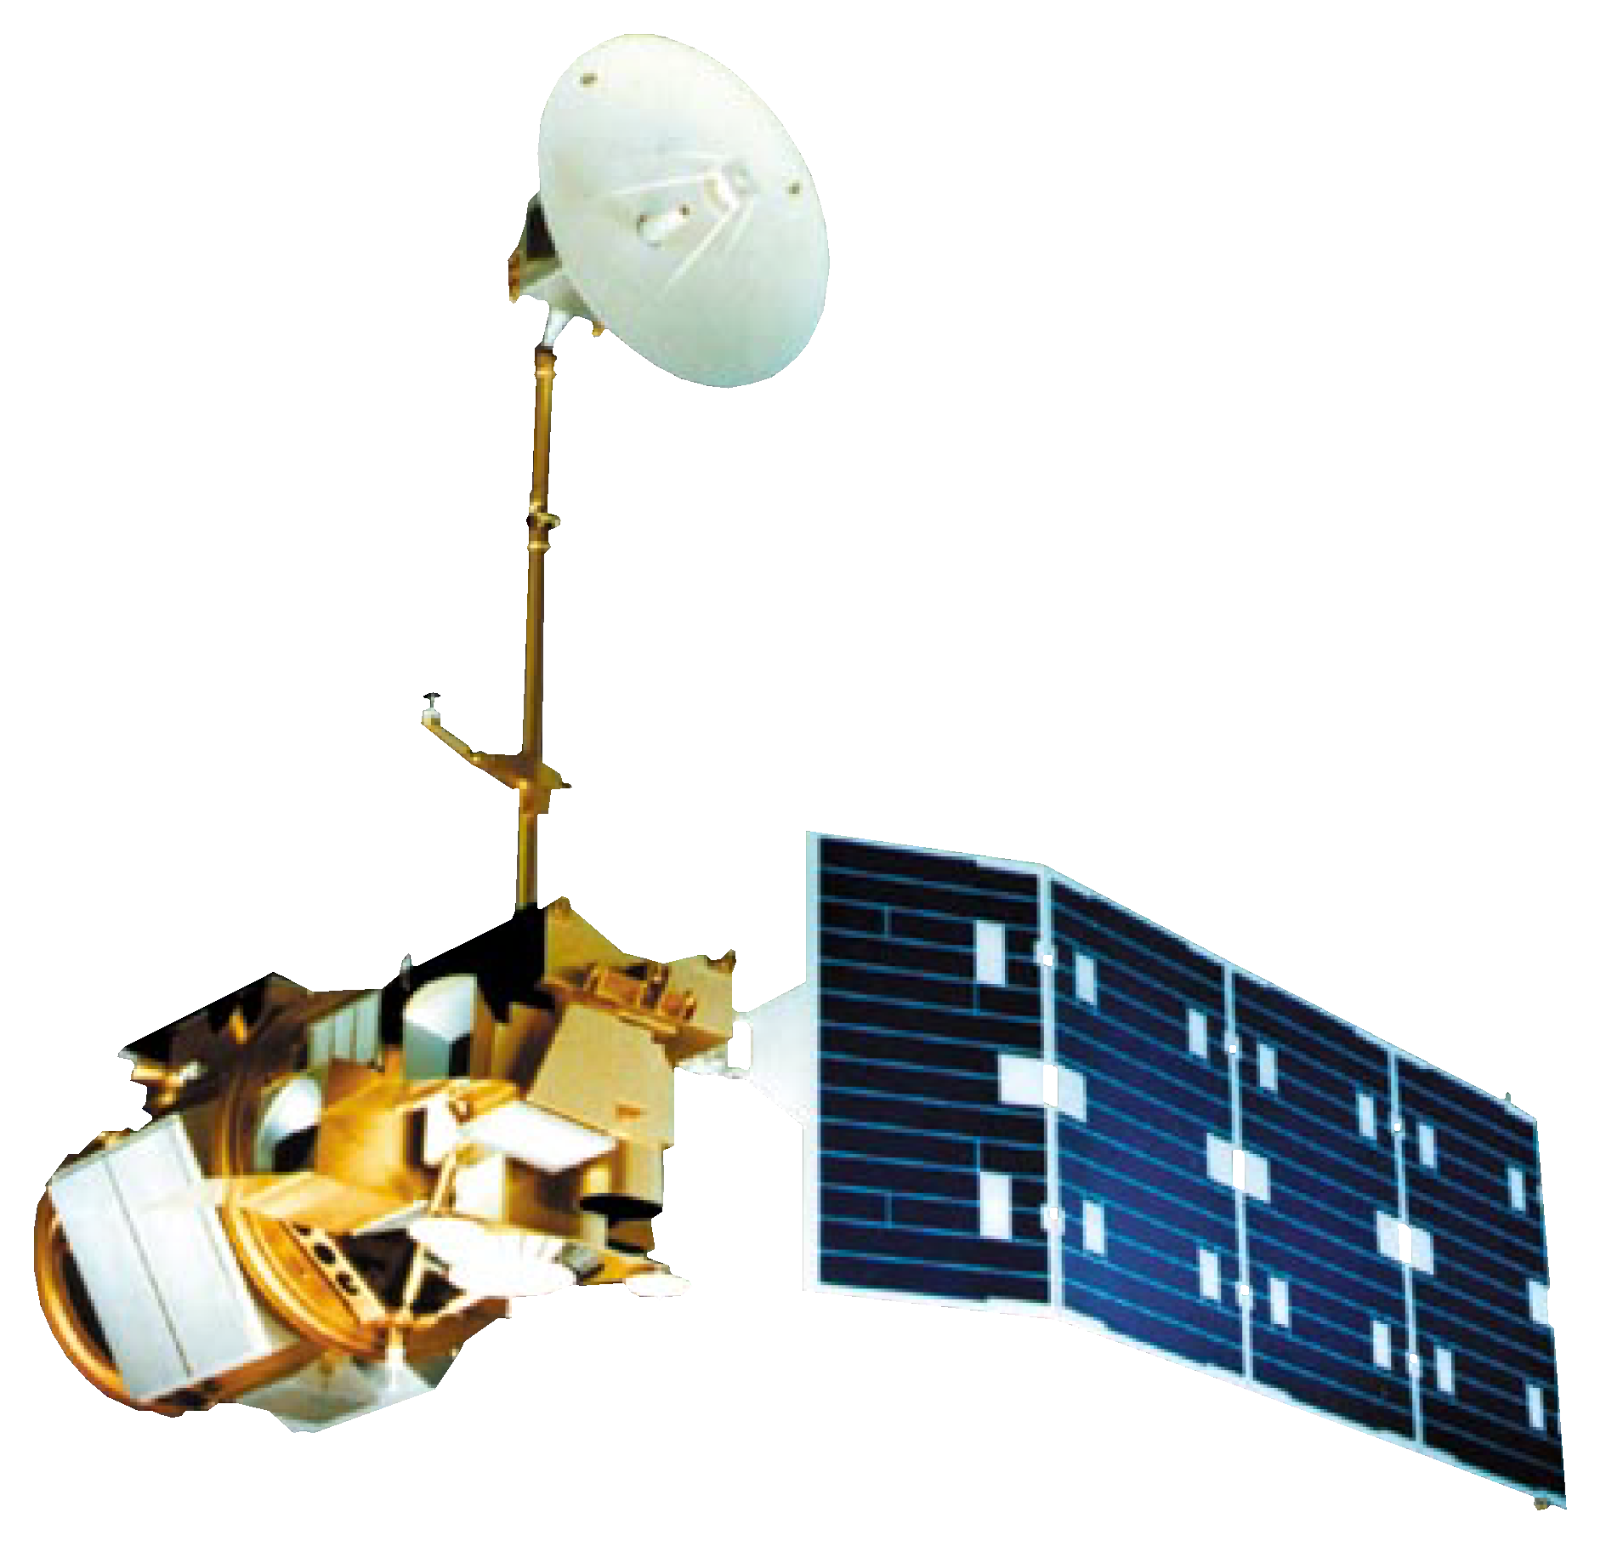
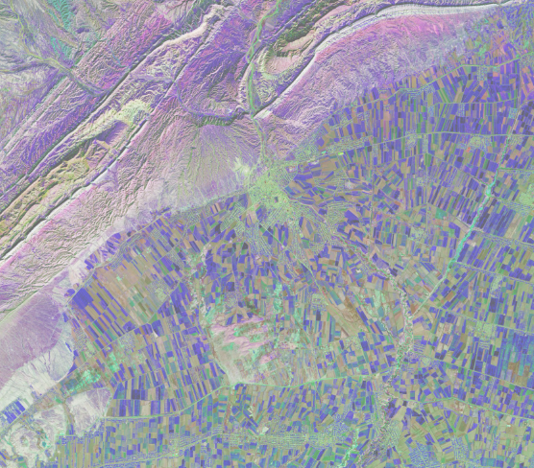
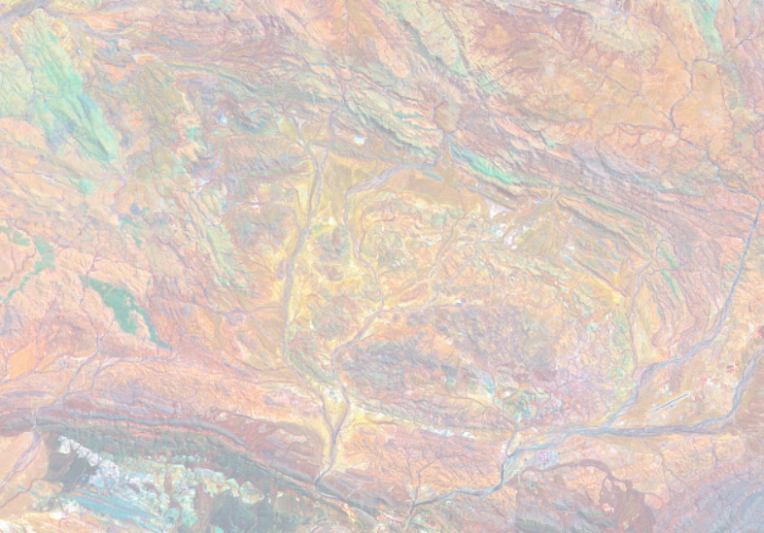
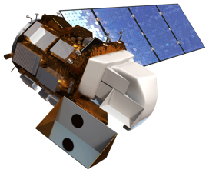
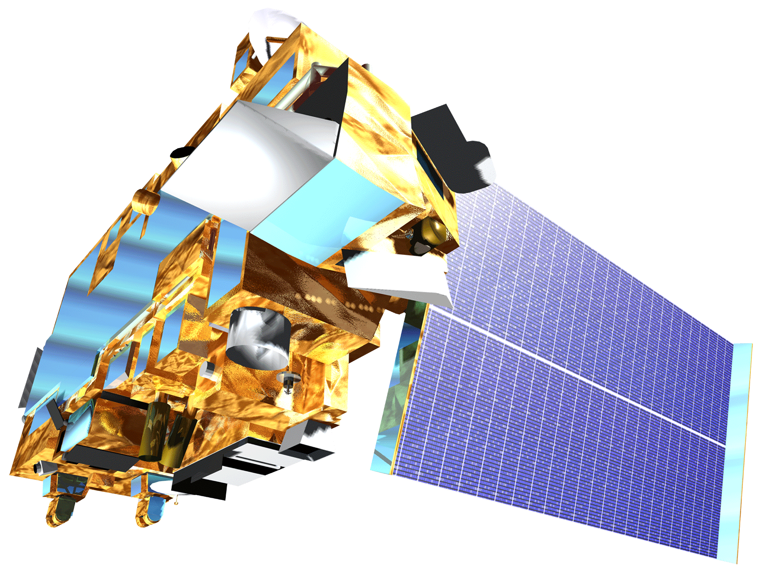


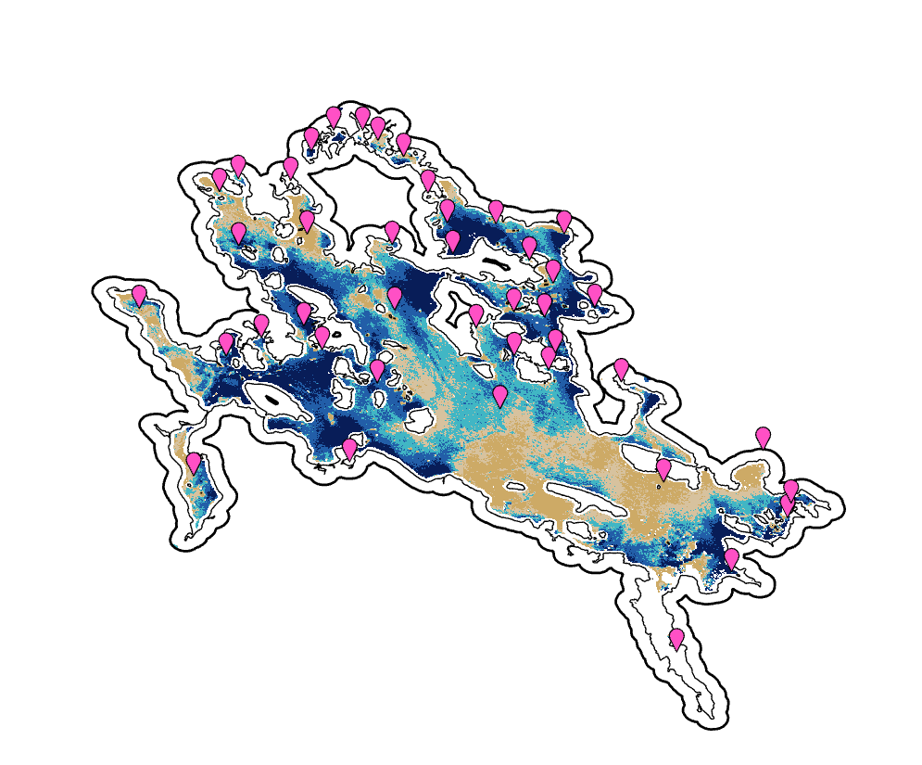
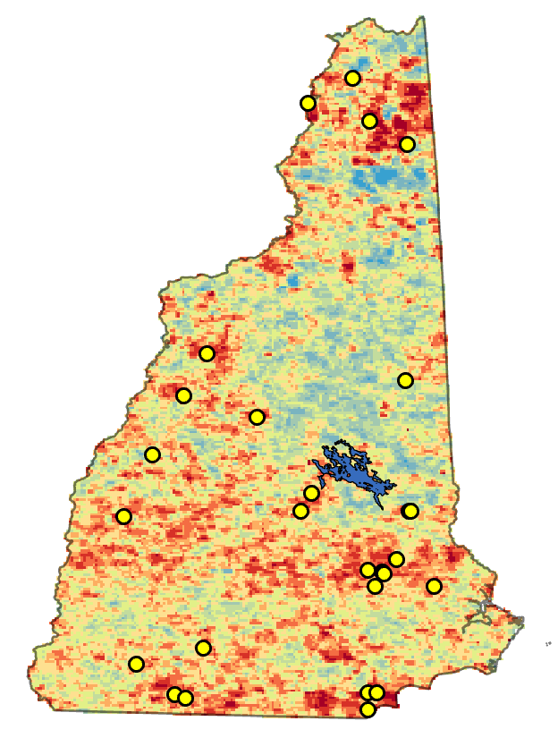
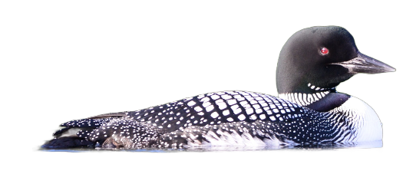
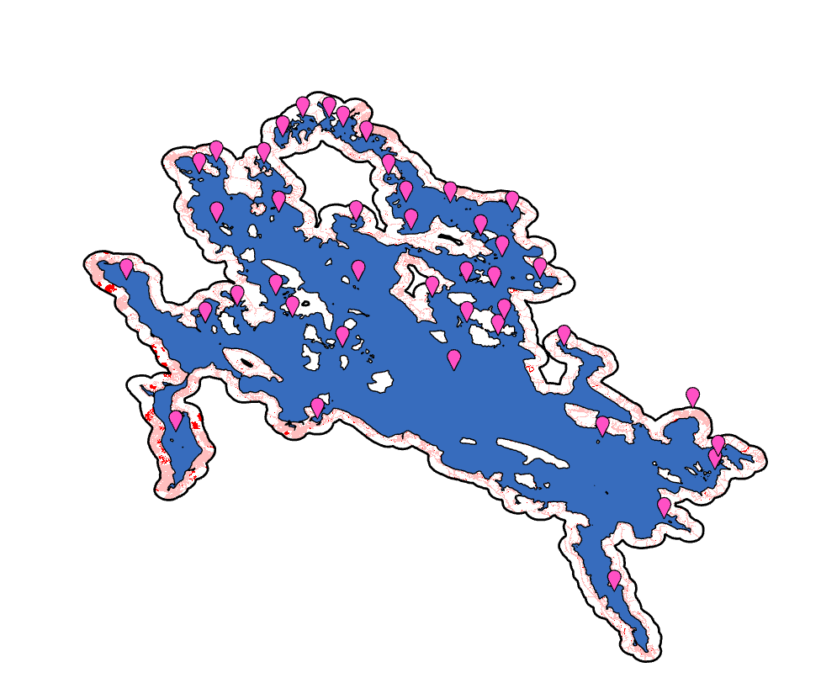




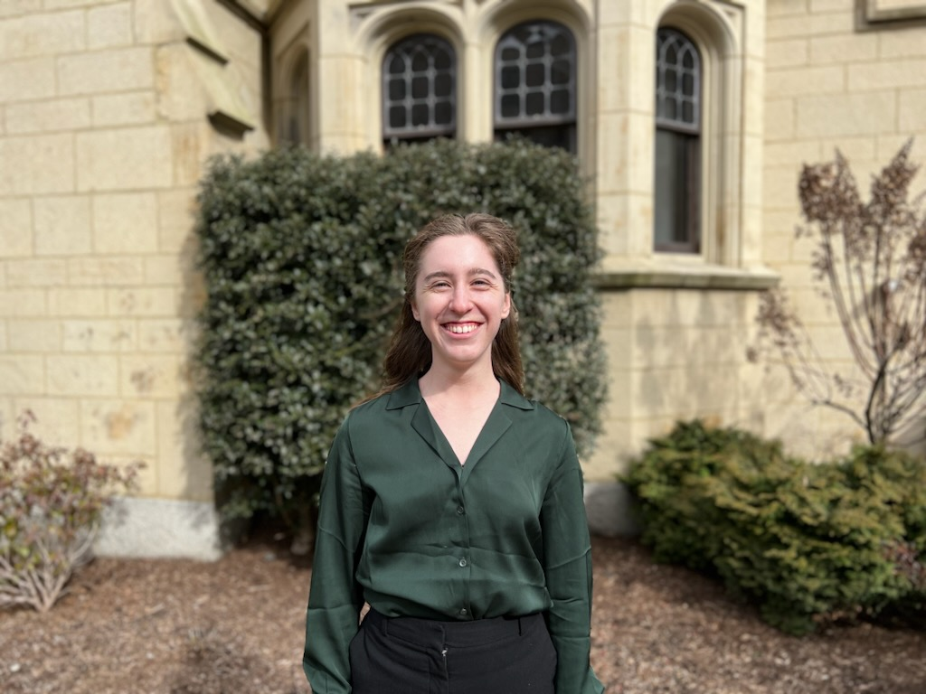
New Hampshire Ecological Conservation
Predicting Future Conflicts between Loon Habitats and Human Development in New Hampshire using NASA Earth Observations
Loons represent ecological and anthropogenic impacts on suitable lakefront habitat in New Hampshire
Understanding local land use and land cover (LULC), land surface temperature (LST), and water quality parameters are key in supporting loon abundance
Worked with the Loon Preservation Committee (LPC) to explore remote sensing as a monitoring technique
Study Area
New Hampshire &
8 Case Study Lakes (shown in blue)
Assess land use change
Explore water clarity
Landsat 5 TM
Landsat 8 OLI
Terra MODIS
Analyze temperature
Turbidity (FNU)
Turbidity (FNU)
Lakes with the greatest percentage of shoreline development were estimated to have the least turbid waters
Lake turbidity increased with an increase in latitude
0.23 – 1.43
1.44 – 1.77
1.78 – 2.03
LST
3% of NH is facing extreme temperatures greater than 2.7 °F
4% of loon nests are in areas of extreme temperatures
Despite this, loons have continuously been nesting in these areas
2.04 – 2.36
2.37 – 17.27
Loon Pair Nesting Sites
Credit: LPC
Land Use/Land Cover
Variations in development patterns; overall small increases in shoreline development between 2001–2019
Lakes with surrounding protected lands have low overall development
2001 Urban Development
5 °F
2001–2019 New Urban Development
Loon Pair Nesting Sites
-2 °F
Nests in Extreme Temperatures (≥ 2.7 °F)
Acknowledgements
Tyler Pantle - NASA DEVELOP Fellow
Dr. Cedric Fichot - Science Advisor, Boston University
Joseph Spruce - Science Advisor, Science Systems & Applications, Inc.
Harry Vogel - LPC Director, Senior Biologist
John Cooley - LPC Senior Biologist
Caroline Hughes - LPC Volunteer and Outreach Biologist
Anne Kuhn-Hines - LPC Board Member & Environmental Protection Agency Research Ecologist
Jane Zugarek
Project Lead
Madison Arndt
Jessica Gray
Amelia Untiedt
Massachusetts – Boston

