Slide 1
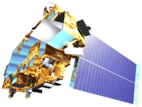
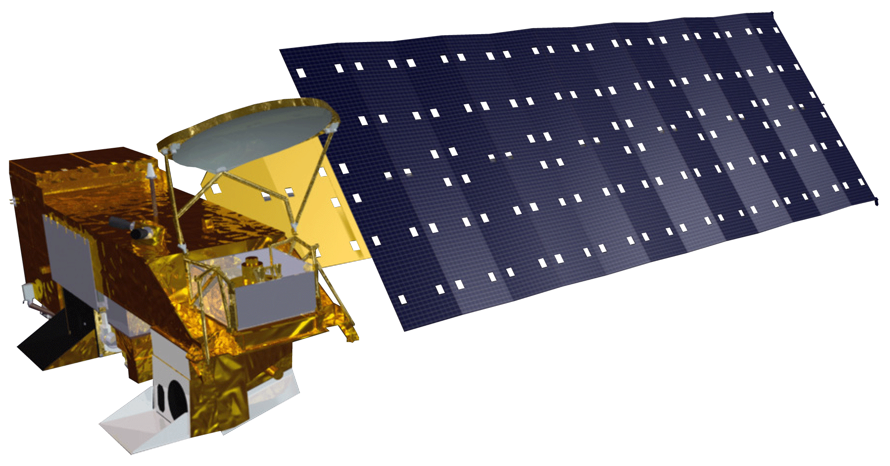
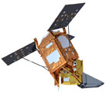
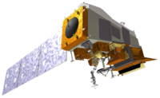
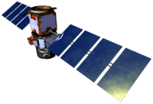
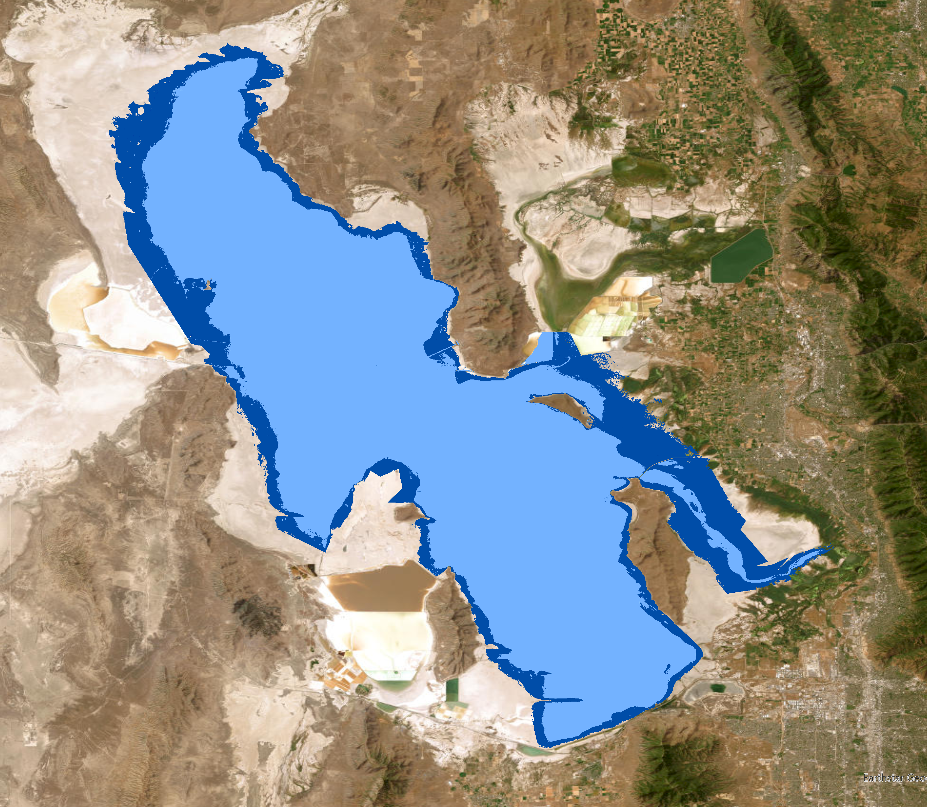
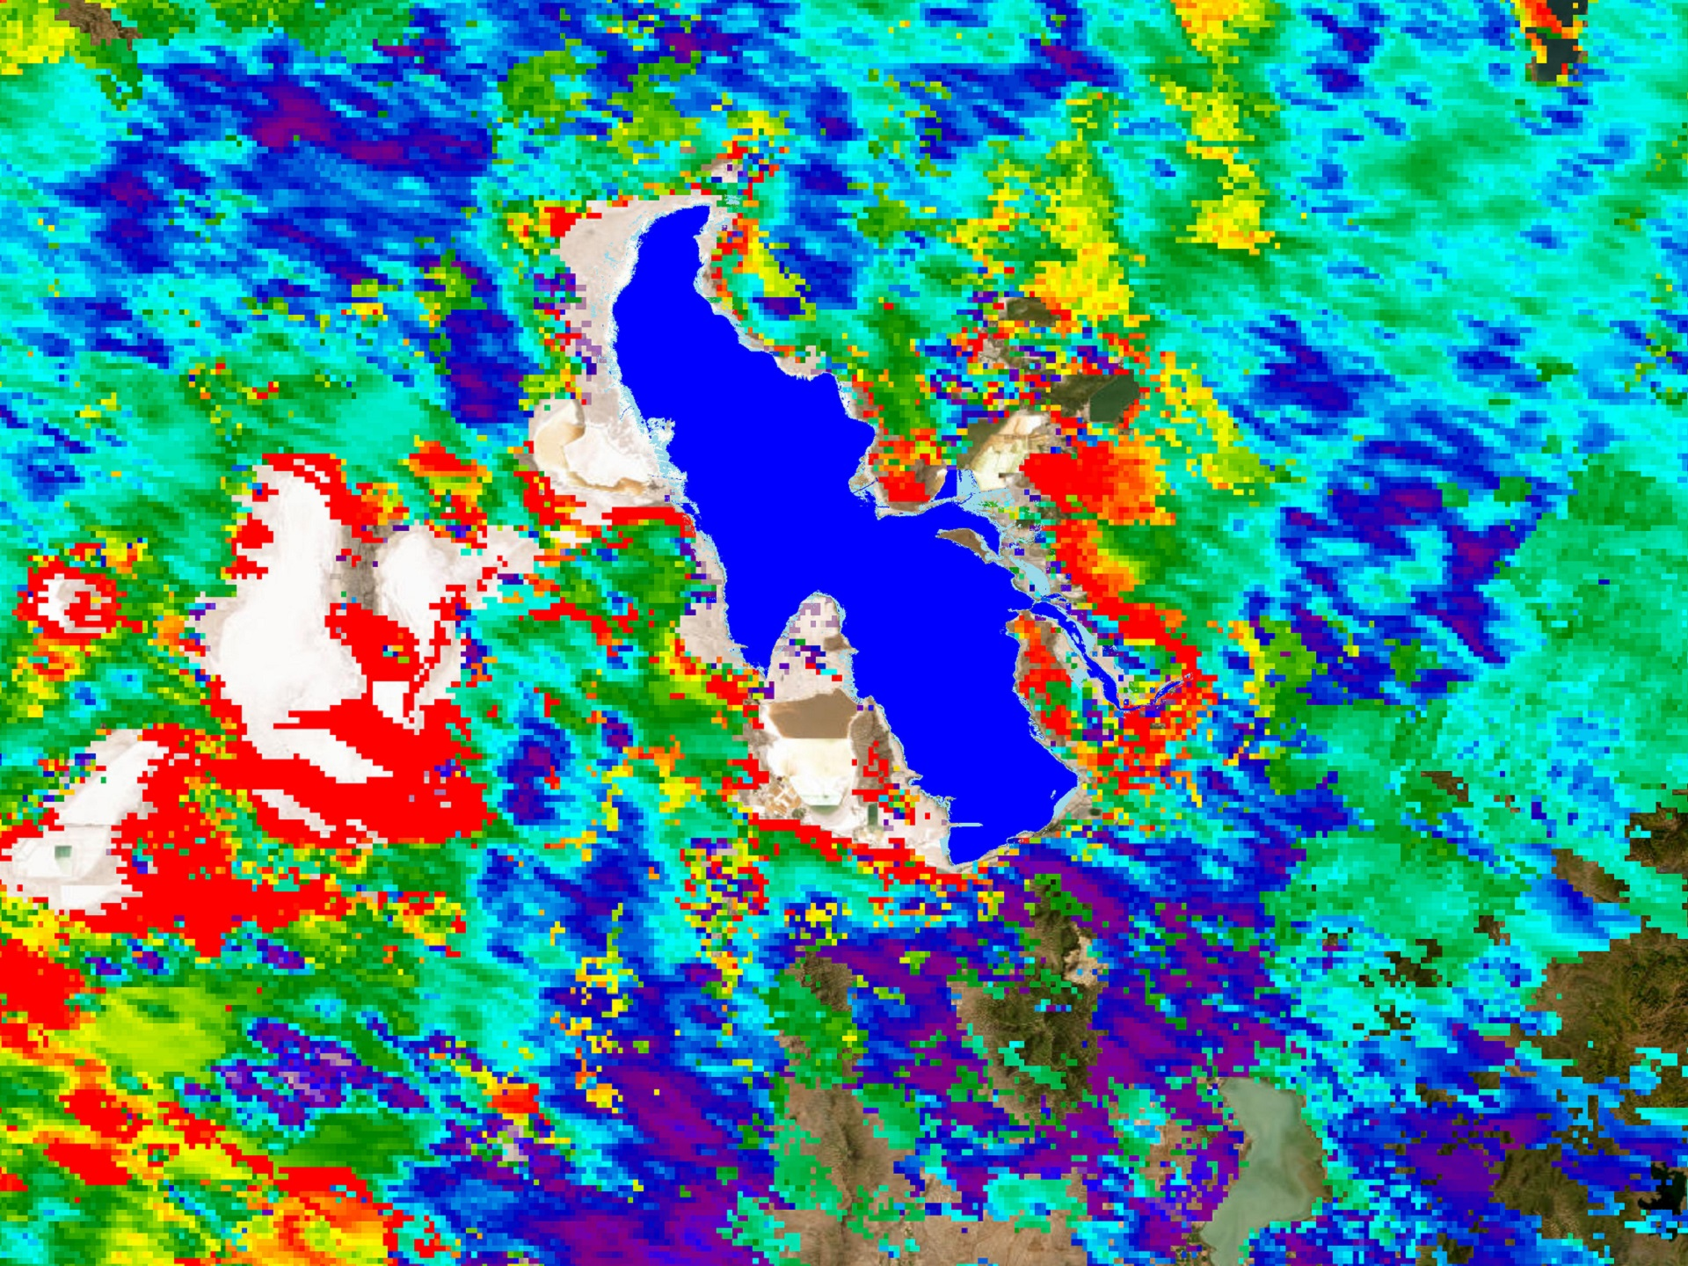
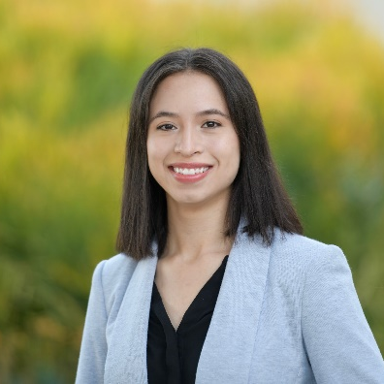
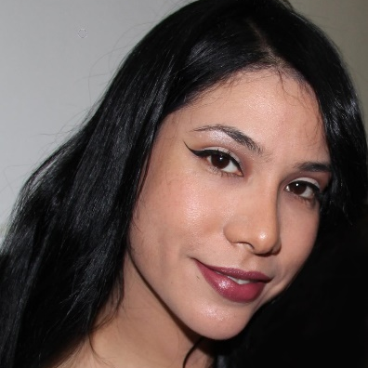
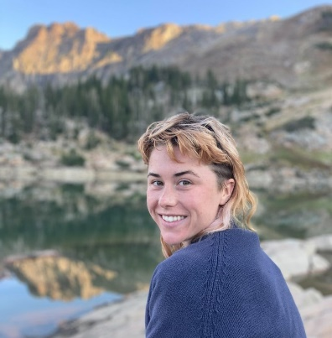
Great Salt Lake Health & Air Quality
Monitoring Lakebed Exposure and its Impact on Air Quality and Environmental Hazards in the Great Salt Lake Watershed
Community Needs
State government, academic, non-profit, local organization partnerships
Advocacy efforts for GSL stewardship
Targeted air monitoring efforts
Lakebed management practices
ENVIRONMENTAL JUSTICE
The Great Salt Lake (GSL) is a terminal saline lake located in northern Utah, USA. Water inflow has declined rapidly over the last forty years due to human withdrawals and climate change. Lake levels have been lowered which has exposed over 50% of the lakebed to erosion. There is a public health risk tied to the subsequent increased frequency and intensity of regional dust storms caused by airborne lakebed dust under specific meteorological conditions.
Redlining
Redlining legacy results in inequitable pollution exposure
Industry Pollution
Multiple point-source pollutants impact those near GSL
GSL Dust
GSL dust exacerbates environmental health disparities
ENVIRONMENTAL
VARIABLES
Aerosol Optical Depth (AOD)
Nitrogen Dioxide (NO2)
Formaldehyde (HCHO)
Climate Change
Public Health
Air Quality
Race
Income
Age < 5
Age > 64
Preexisting Medical Conditions
NASA DEVELOP is using Earth observations to better understand dust, air quality, lakebed exposure, alongside community vulnerability, at the Great Salt Lake.
VARIABLES CONSIDERED
SOCIAL
VARIABLES
Image Credits: NASA, ESA
Terra MODIS
Aqua MODIS
Landsat
5, 7, 8
Sentinel-5P
Suomi NPP VIIRS
CALIPSO CALIOP
N
2011
2021
SATELLITE IMAGERY, GROUND SENSOR ENVIRONMENTAL DATA, DEMOGRAPHIC DATA
Seasonal Trends
Case Studies
Pollution & Social Vulnerability
Dust and Air Quality Indicators
Dust Event Days (DEDs) Analysis
Dust and Air Quality Vulnerability
Declining lake levels are associated with elevated AOD from dust seasons
Local communities are disproportionately impacted by air pollution
0 4 7 15 Kilometers
Team Members
High (2011 in light blue) & Low (2021 in dark blue) Lake Surface Area during the study period.
Piper Christian
(Project Lead)
Andrea Delgado
Yoana Vargas
Fiona Summers
Acknowledgements
Julianne Liu NASA VEJ Node Fellow
Dr. Travis Toth NASA Langley Research Center
Dr. Kenton Ross NASA Langley Research Center
Lauren Childs-Gleason NASA Langley Research Center
Dr. Bonnie Baxter Westminster College, Great Salt Lake Institute
Dr. Maura Hahnenberger Salt Lake Community College, Dust^2
Project Partners
Utah Department of Natural Resources, Division of Forestry, Fires, and State Lands
Utah Department of Environmental Quality, Division of Air Quality
Westminster College, Great Salt Lake Institute
Dust^2
Great Salt Lake Coalition
Utah Physicians for Healthy Environment
Westside Coalition
Virtual Environmental Justice

