Slide 1

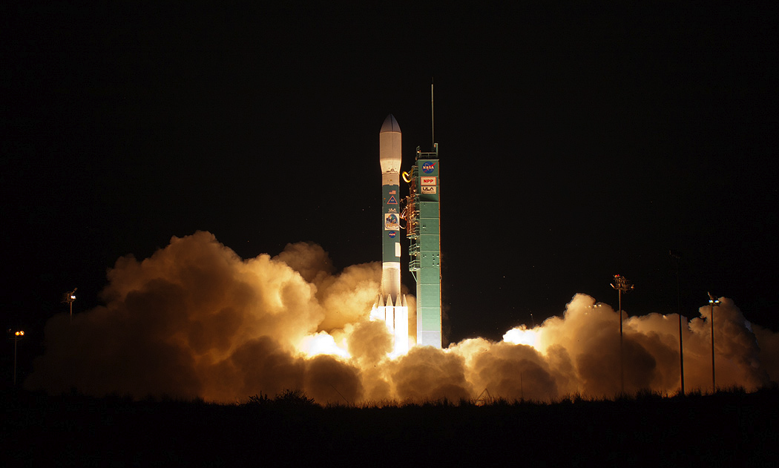
Changes in Earth's Energy Imbalance Since 2000
Norman G. Loeb
¹NASA Langley Research Center, Hampton, VA
Acknowledgements: Michael Mayer, Tyler J. Thorsen
Earth Energy Imbalance Assessment Workshop, May 15-18, 2023, Frascati, Italy

Slide 2
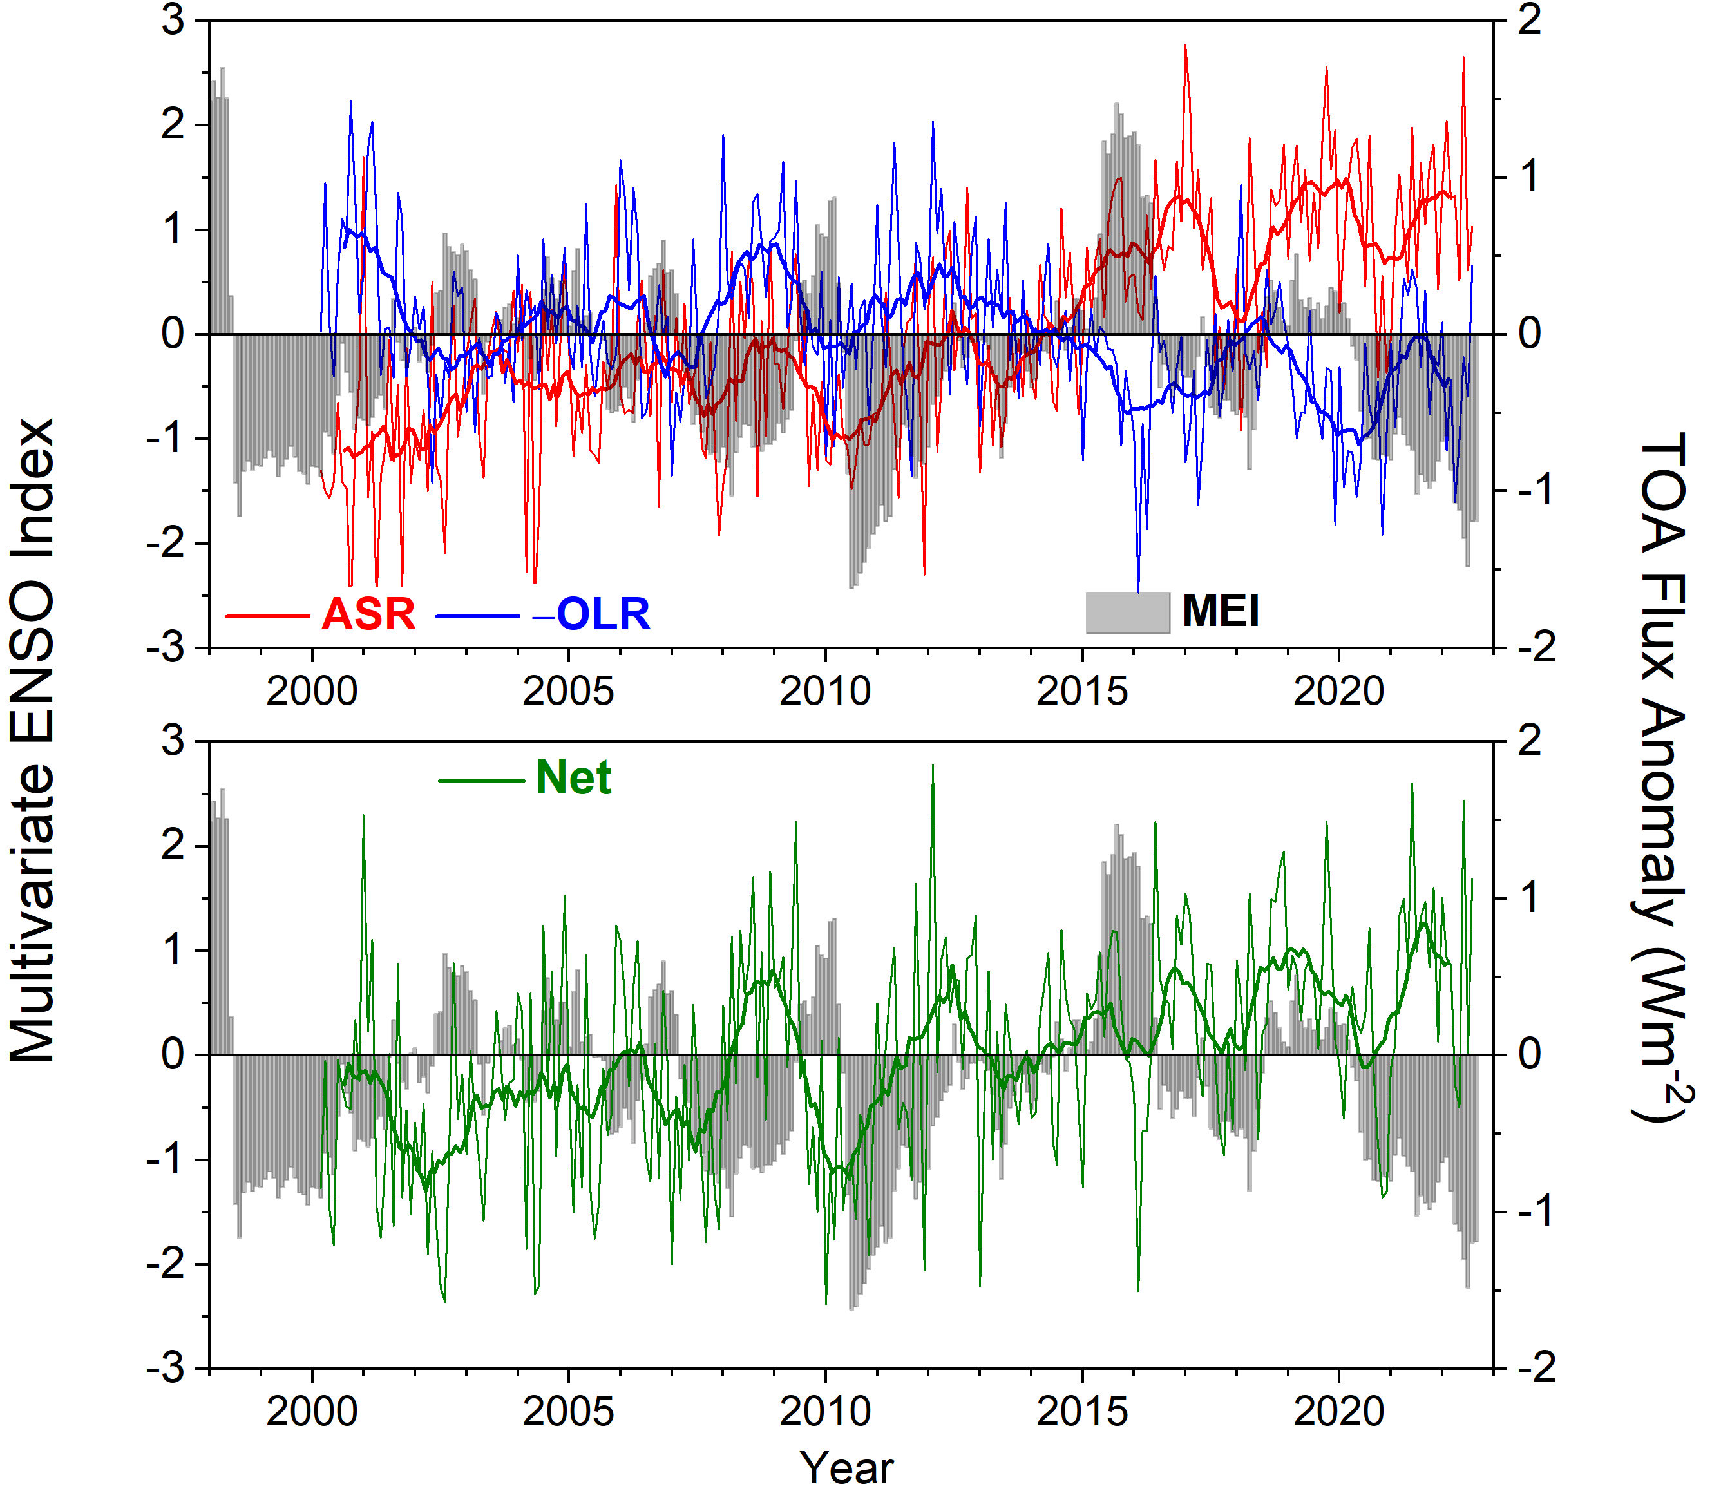
Global Mean All-Sky TOA Flux Anomalies & Multivariate ENSO Index (CERES EBAF Ed4.2; 03/2000–08/2022)
Figure 1
Notes:
Trends: ASR: 0.71+/-0.2 Wm-2 per decade; -OLR: -0.27+/-0.20 Wm-2 per decade; NET: 0.44+/-0.18 Wm-2 per decade.
Text: Discuss trend results and refer to robustness of results based upon comparisons with in-situ ocean data and Terra vs Aqua comparisons etc.

Slide 3
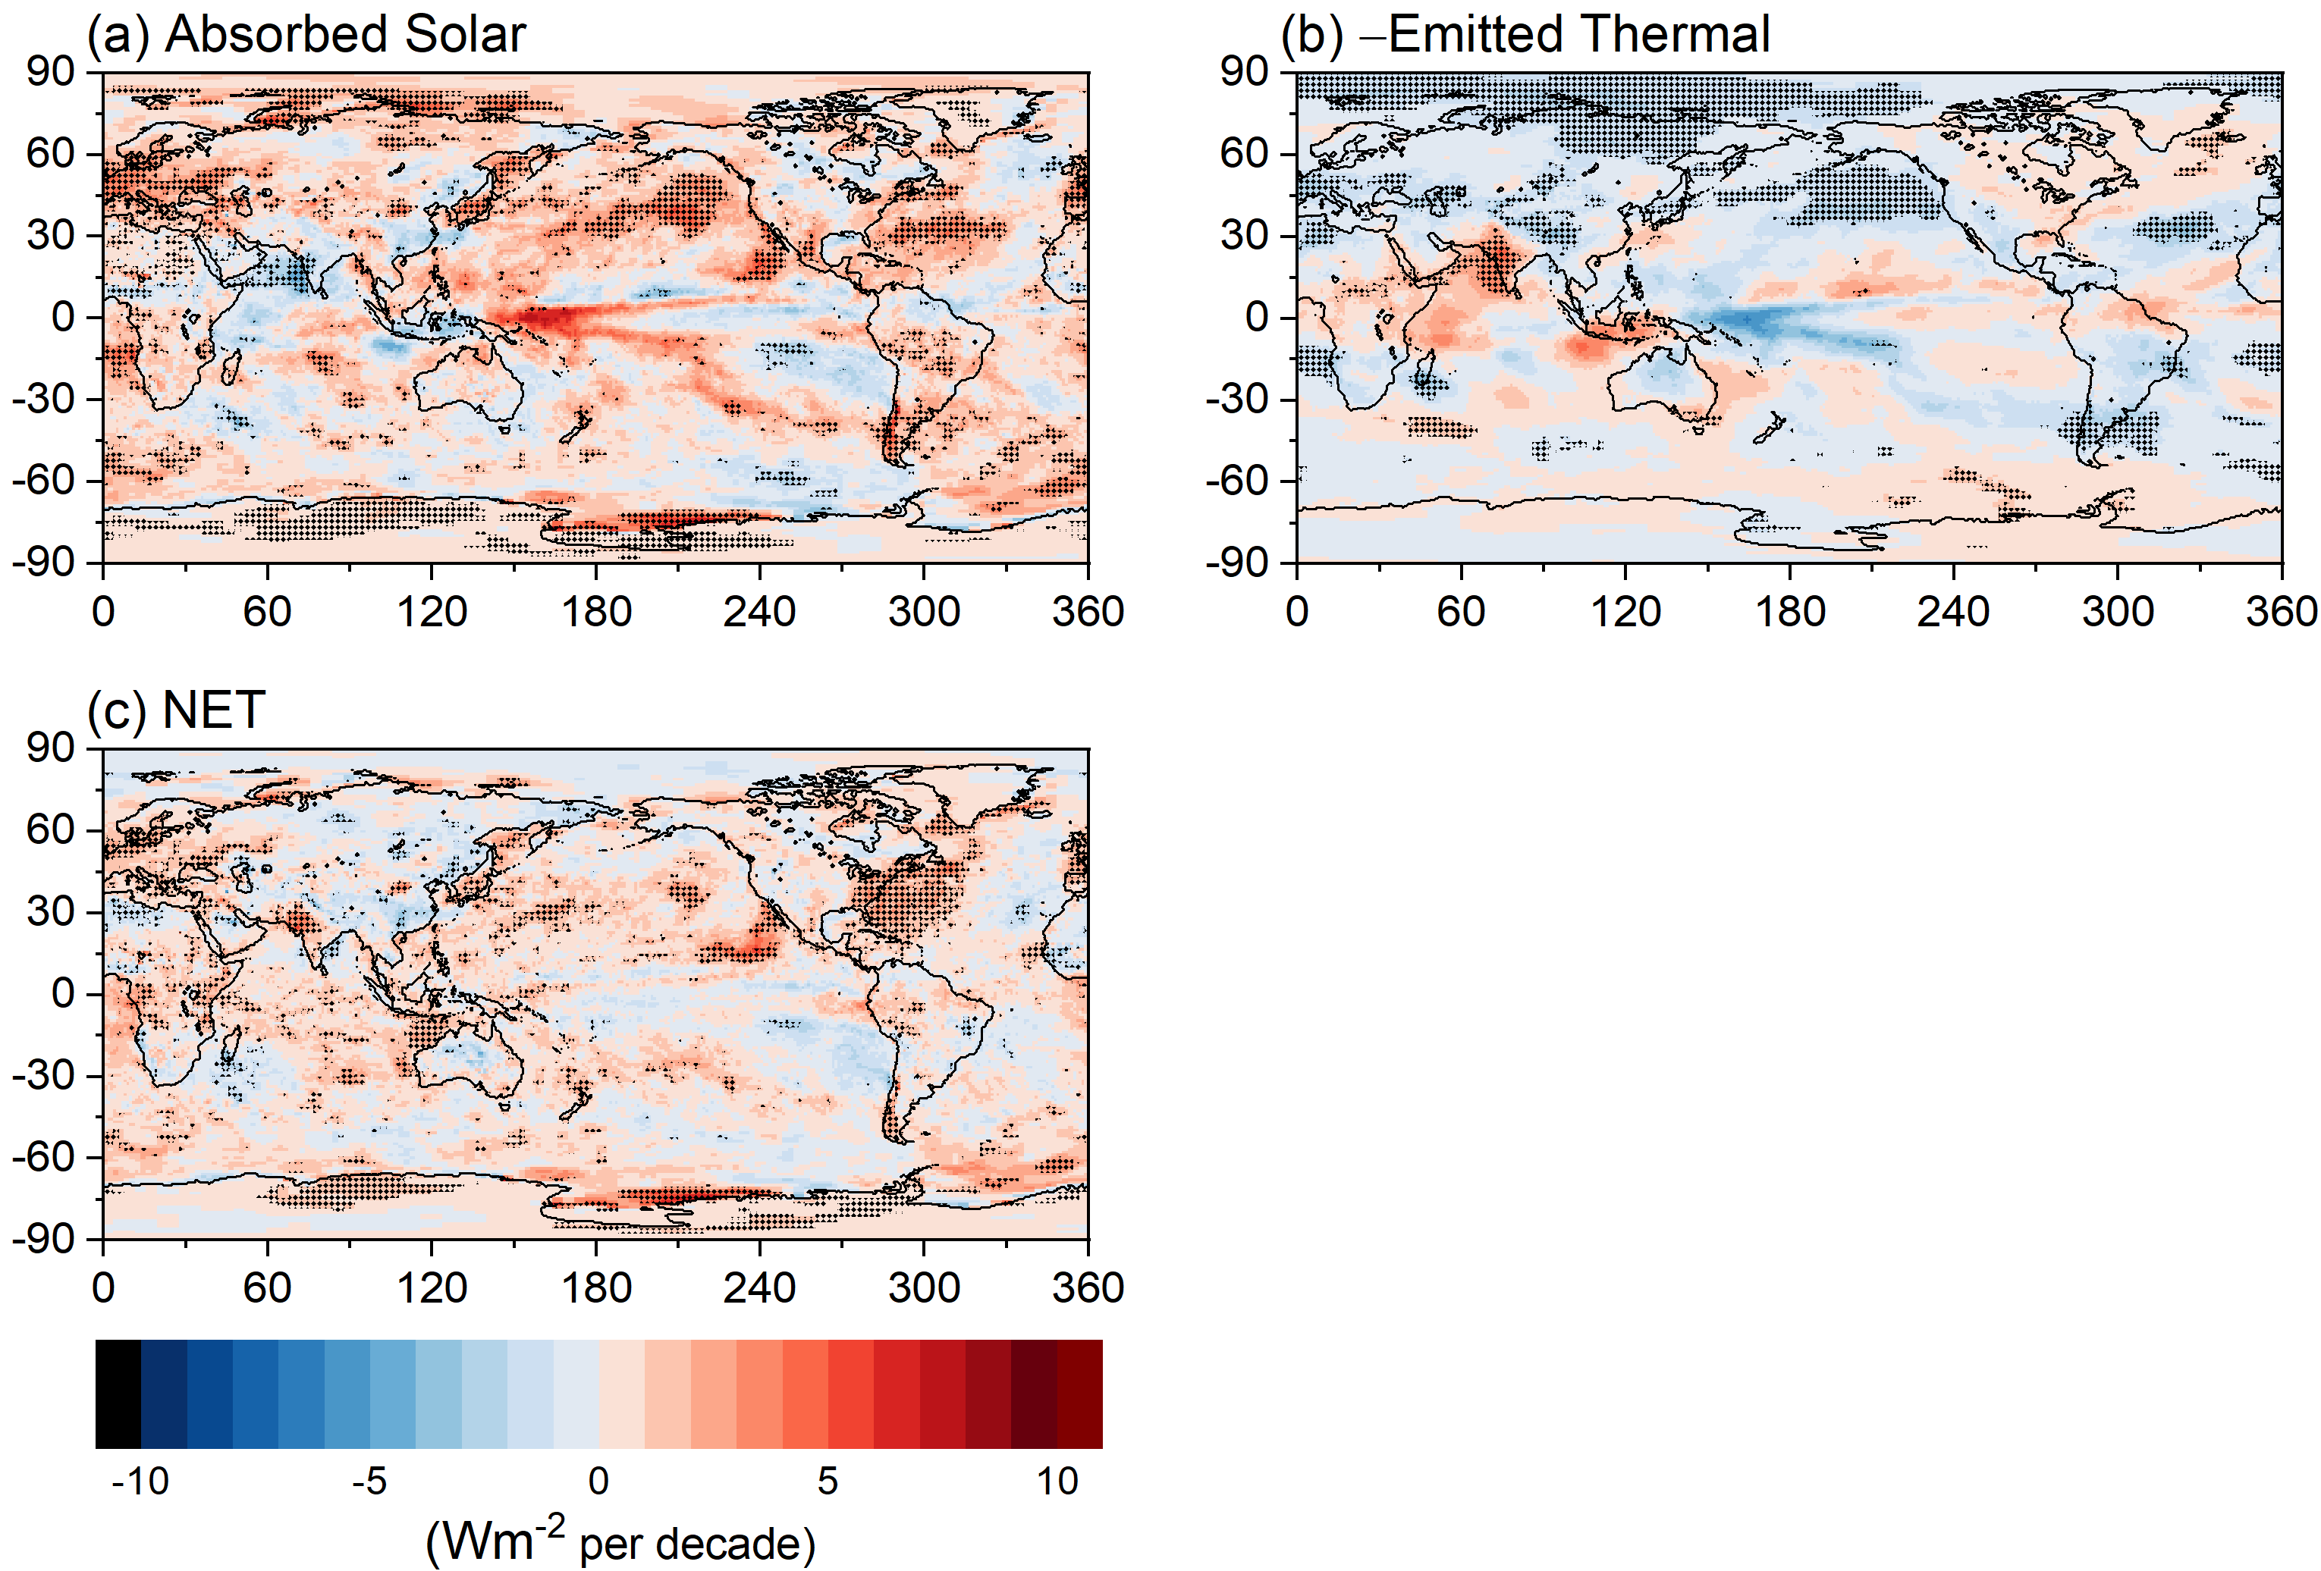
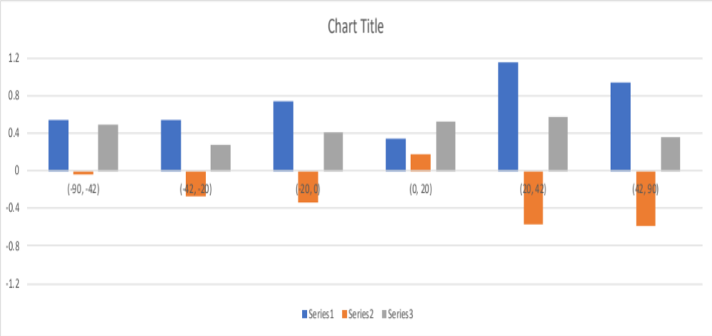
TOA Radiation Changes (03/2000−08/2022)

Slide 4
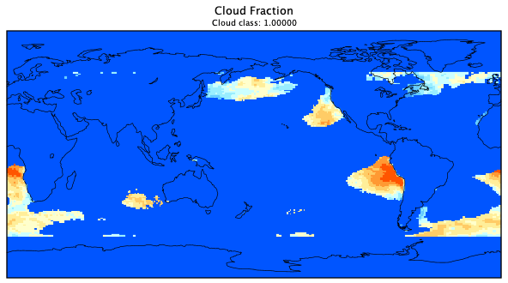
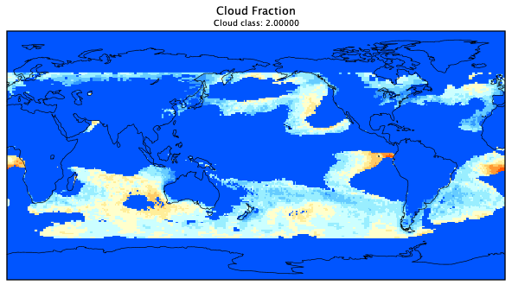
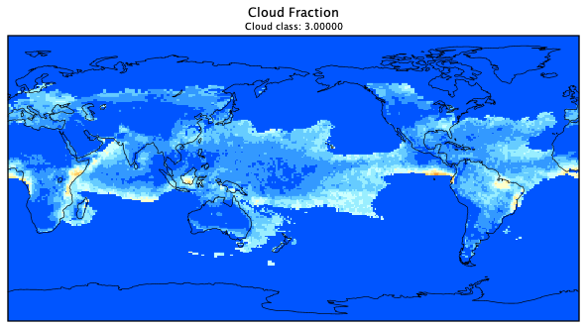
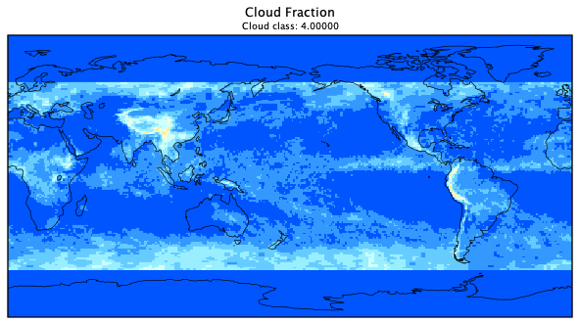
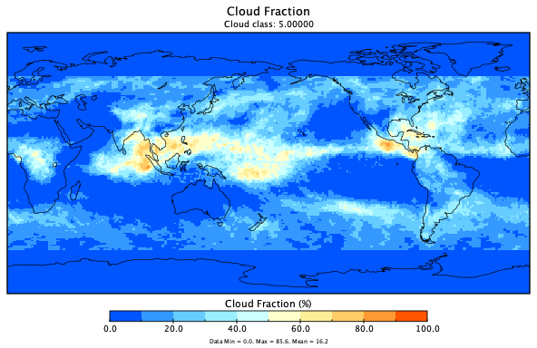
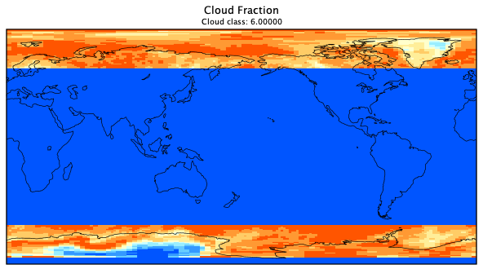
Cloud Fraction by Cloud Class (September 2002)
Stratocumulus (Sc)
Sc-to-Cu Transition (SCT)
Shallow Cumulus (Cu)
Global: 6%
Global: 13%
Global: 9%
Middle
High
Polar
Global: 11%
Global: 11%
Global: 16%

Slide 5
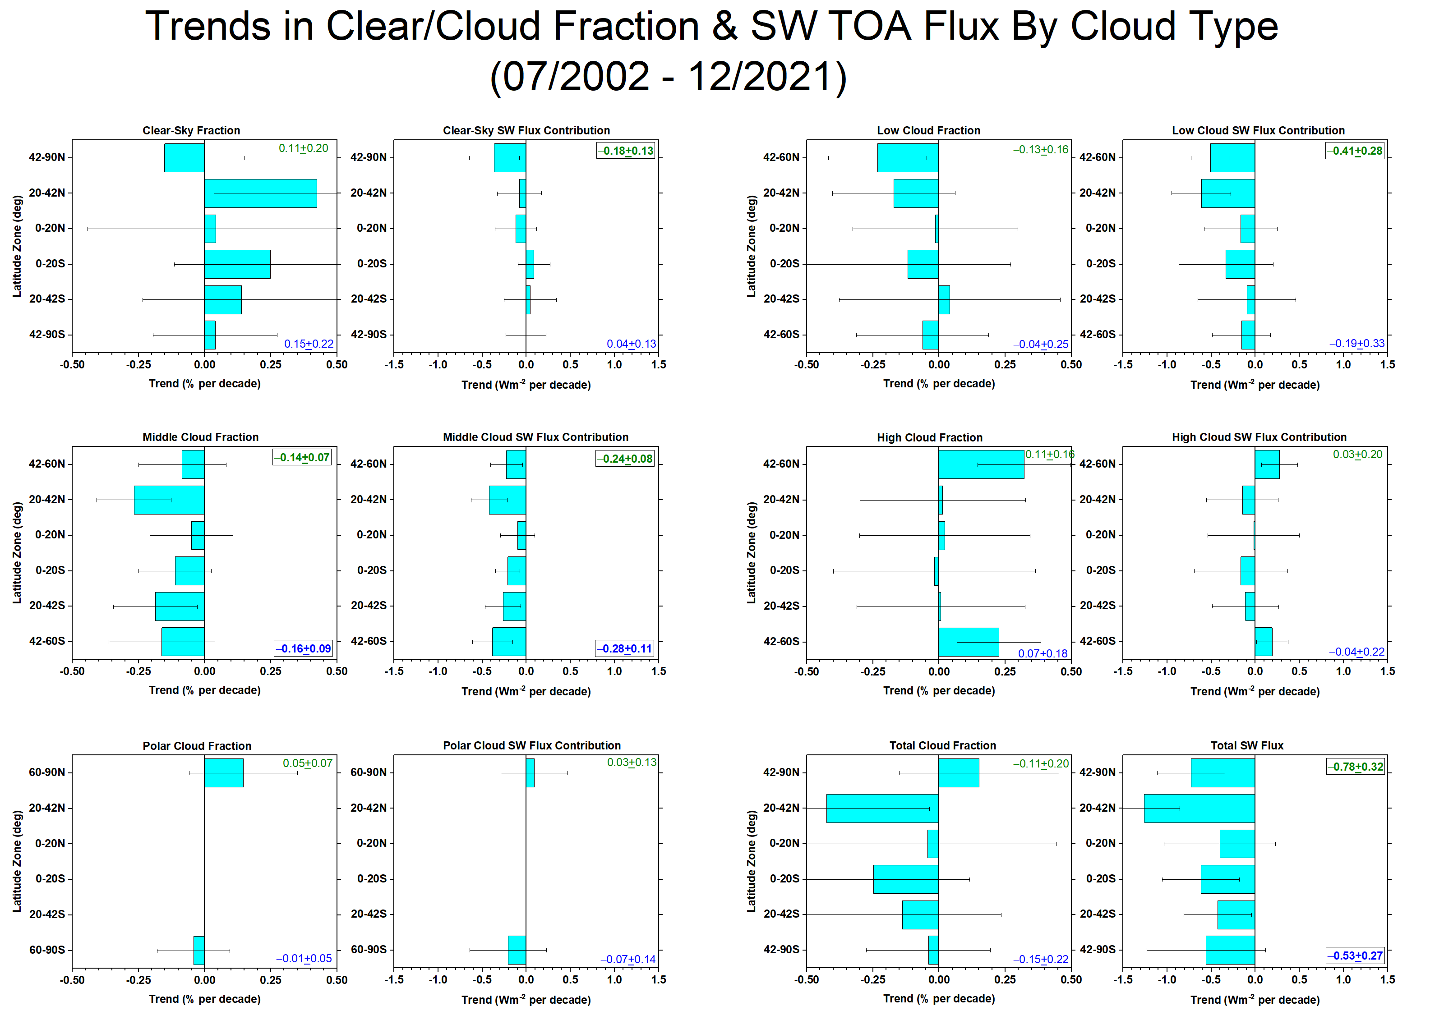
Trends in Clear/Cloud Fraction By Cloud Type (07/2002 – 12/2021)
Large increase in clear-sky fraction and decreases in low and middle cloud fraction in NH.
Increase in high cloud fraction in NH and SH mid latitudes.
Decrease in middle cloud fraction throughout SH.

Slide 6
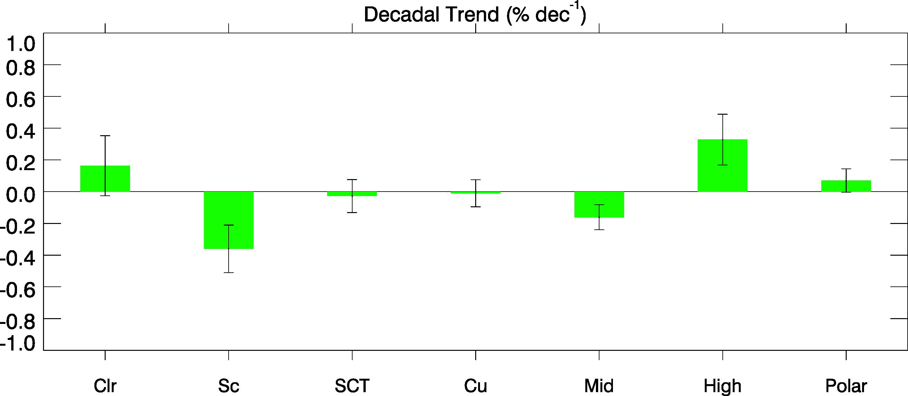
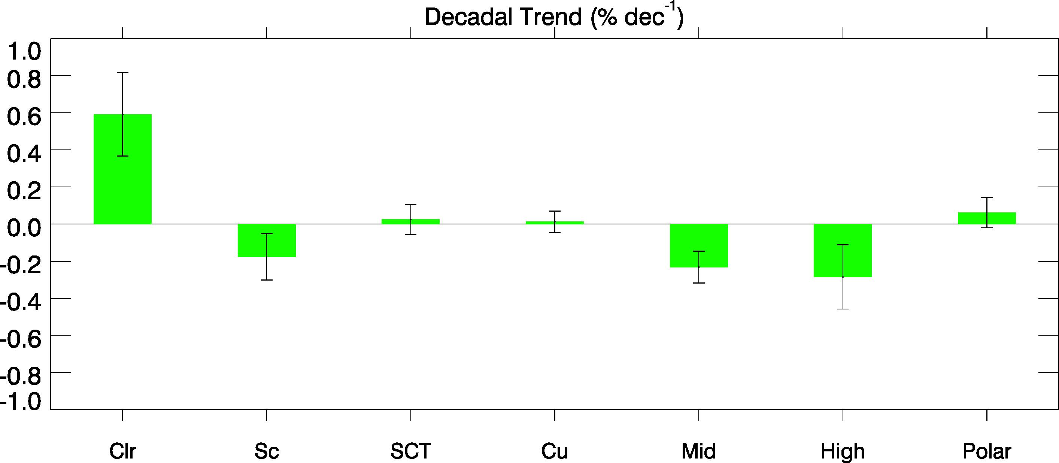
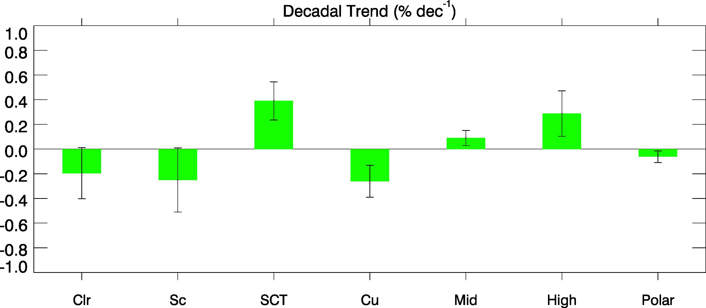
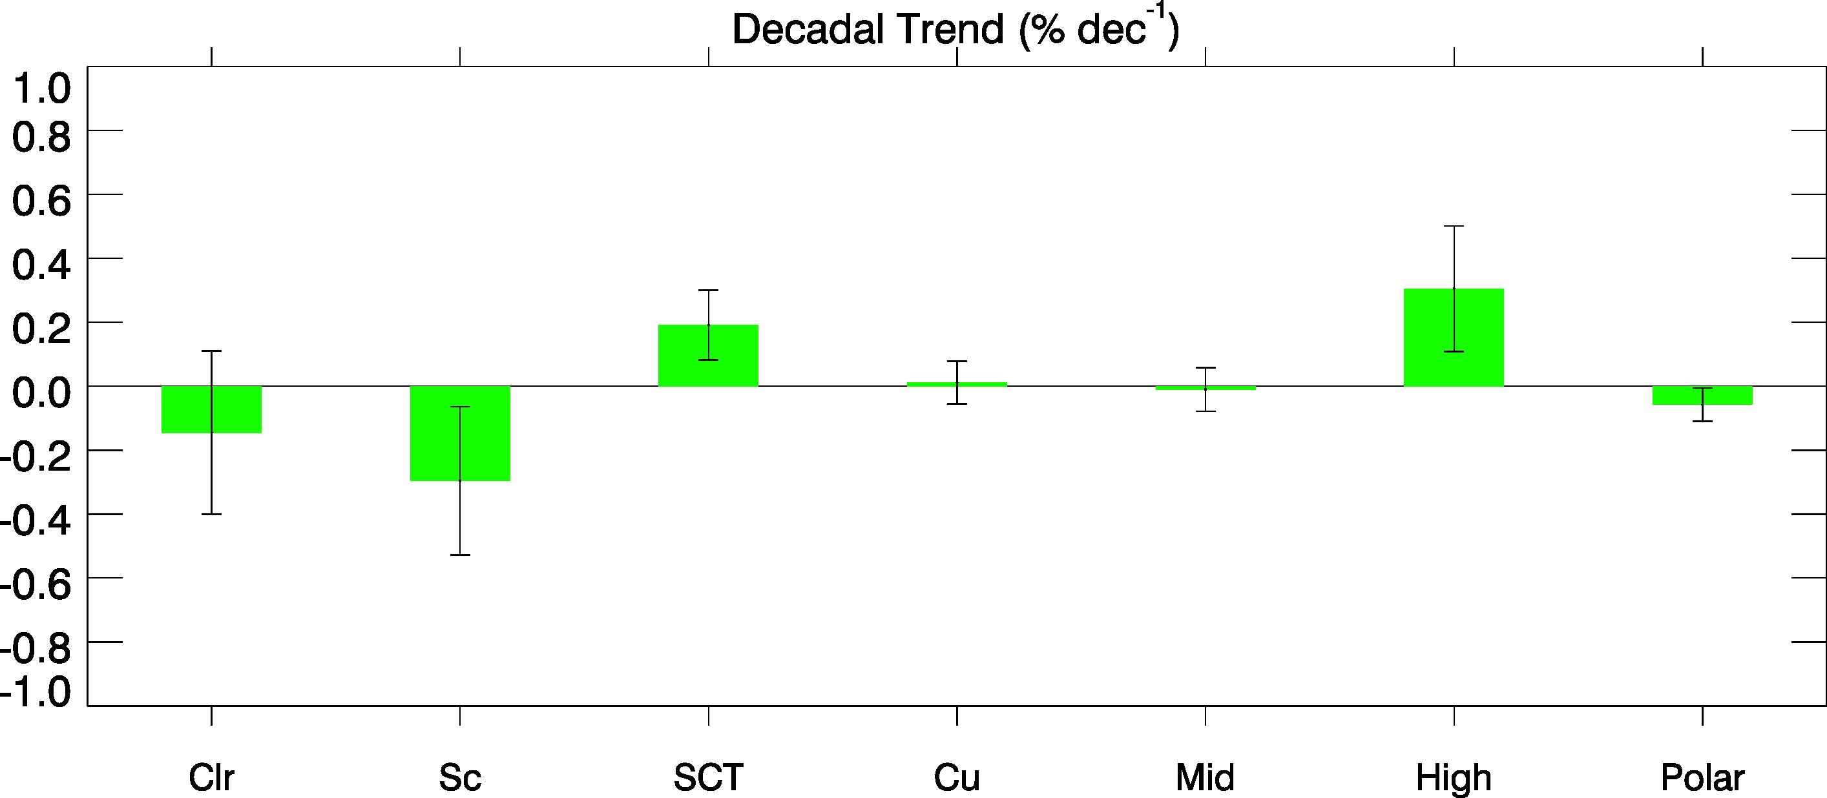
Clear and Cloud Fraction Trends: MODIS and CALIPSO (2007-2017)
MODIS
CALIPSO
NH
NH
SH
SH
Similar low and middle cloud trends in both hemispheres
Consistent high cloud trends in SH but opposite in NH

Slide 7
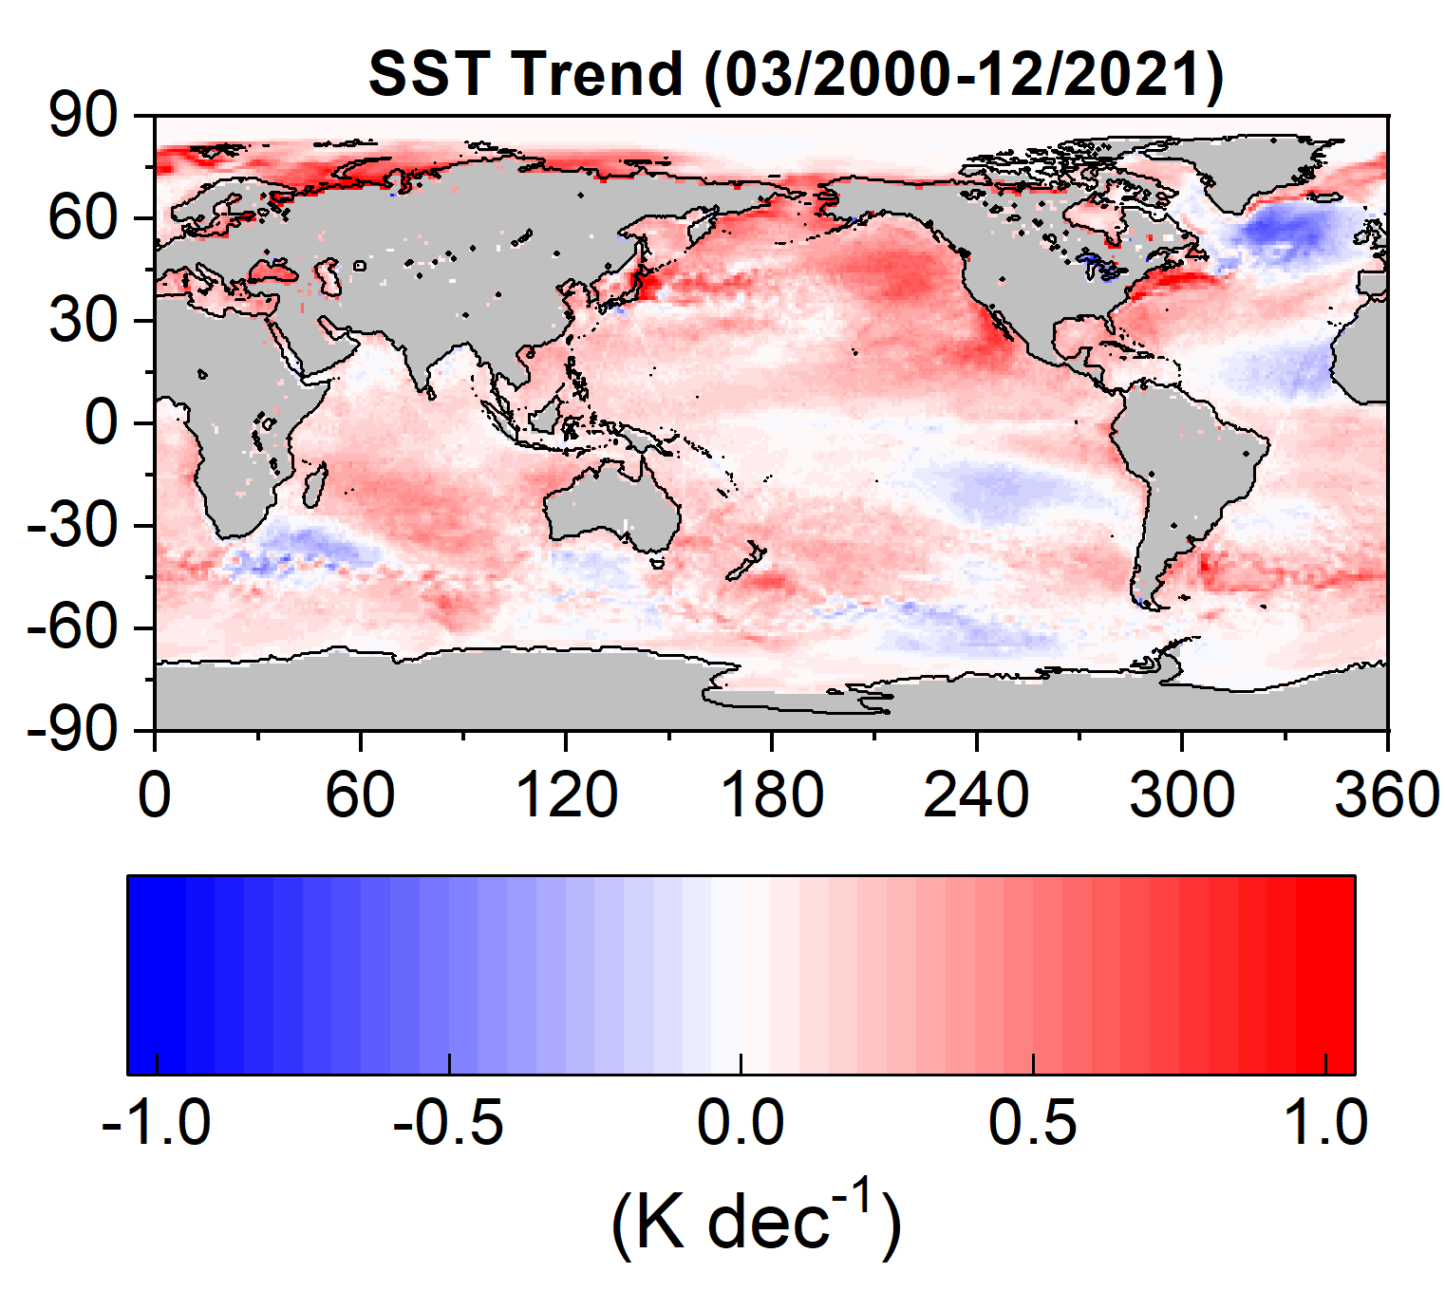
Notes:
Regional pattern of trends in ASR, cloud contribution and SST. Largest ASR

Slide 8
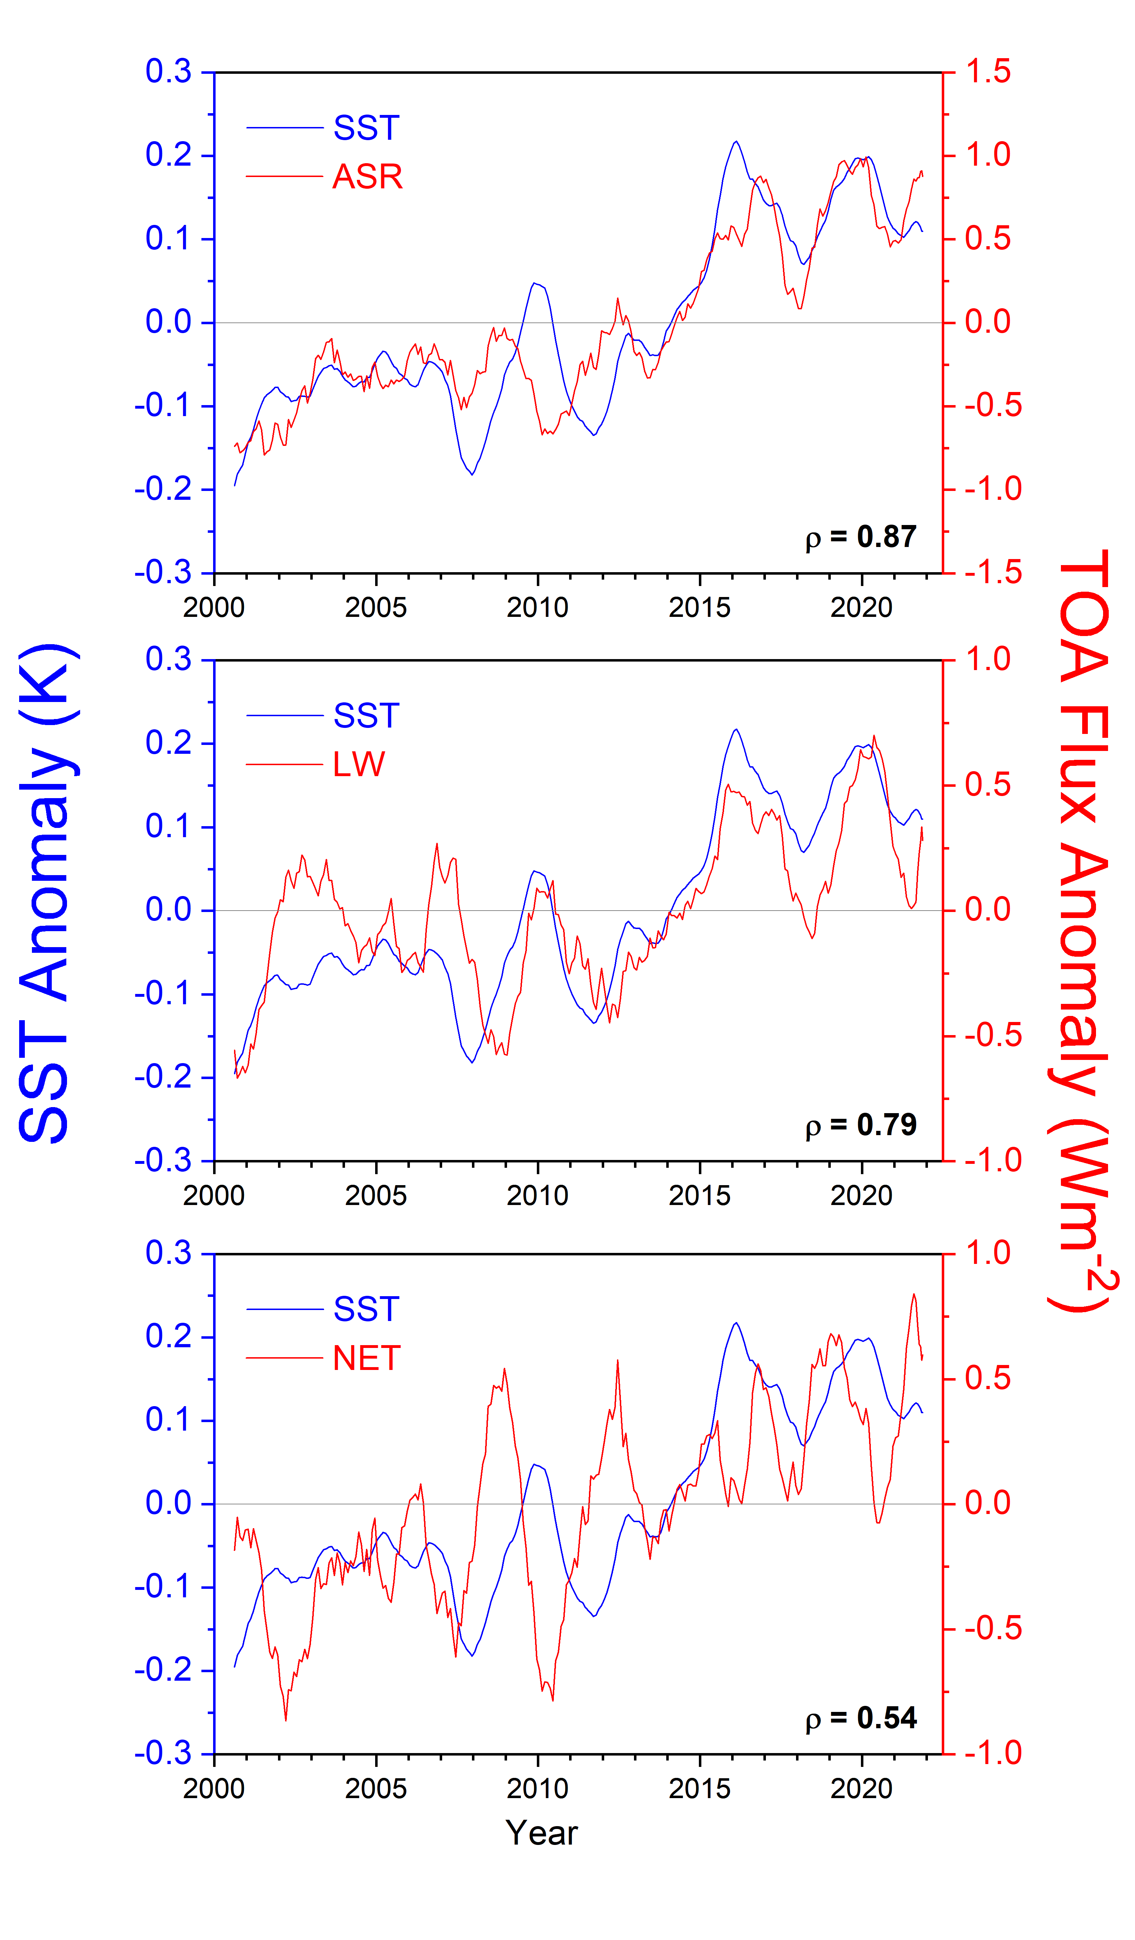
Global SST and TOA Flux Anomalies (03/2000-08/2022; 12-Month Running Averages)

Slide 9
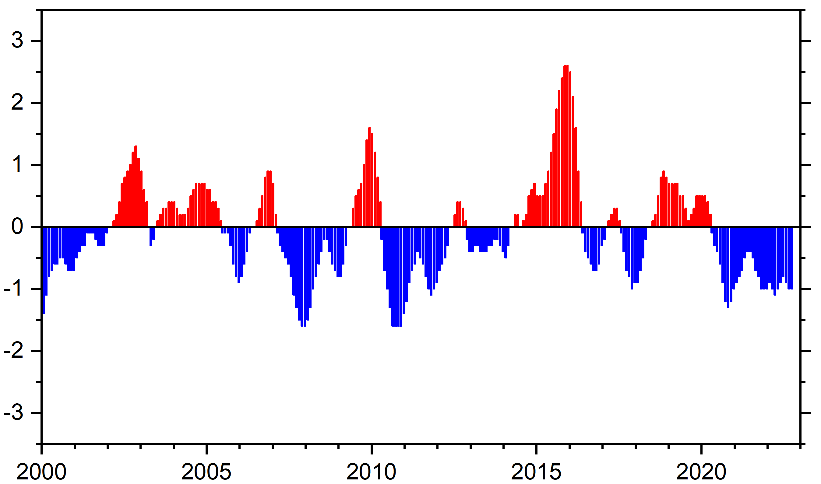
Niño 3.4 Index (ONI), PDO Index (01/2000 – 11/2022)
2015-2016
2009-2010
2002-2003
2006-2007
2018-2019
1998-2001
2020-2022
2007-2008
2010-2012
<PDO> = −0.87
(Jan 00 – Feb 14)
<PDO> = 0.7
(Mar 14 – Jun 17)
<PDO> = −1.04
(Jul 17 – Nov 22)

Slide 10
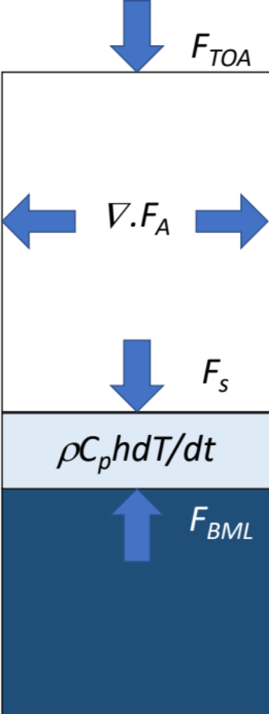


Ocean Mixed Layer Heat Budget (01/2006−12/2021)
(Monthly in 1x1 deg latitude-longitude oceanic regions)
F_{TOA}: Net TOA Flux } CERES EBAF Ed4.1
F_{S}: Surface Energy Flux
}
: divergence of lateral atmospheric energy transports
Mayer et al. (2017)
AET: vertically integrated atmospheric energy tendency
ρC_{p}hdT/dt = Ocean mixed layer heat content tendency
h = Ocean mixed layer depth (GODAS)
T = Sea-surface temperature (ERA5)
F_{BML} : F_{S} – ρC_{p}hdT/dt

Slide 11
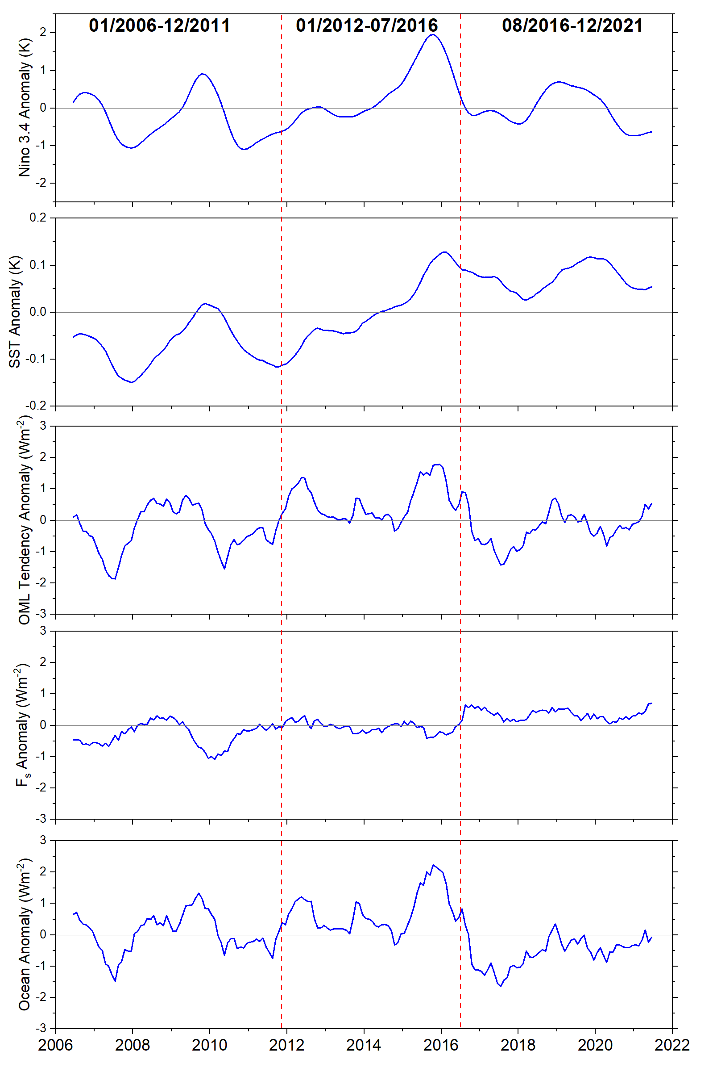
Global Ocean Mixed Layer (OML) Energy Budget (01/2006-12/2021)
Anomalies
Niño 3.4
(K)
Nino 3.4 (K)
-0.39
0.37
−0.20
SST
(K)
OML Heat Content Tendency (ρC_{p}hdT/dt; (Wm⁻²)
Surface Heat Flux (F_{s})
(Wm⁻²)
Ocean Heat Flux (F_{MBL})
(Wm⁻²)

Slide 12
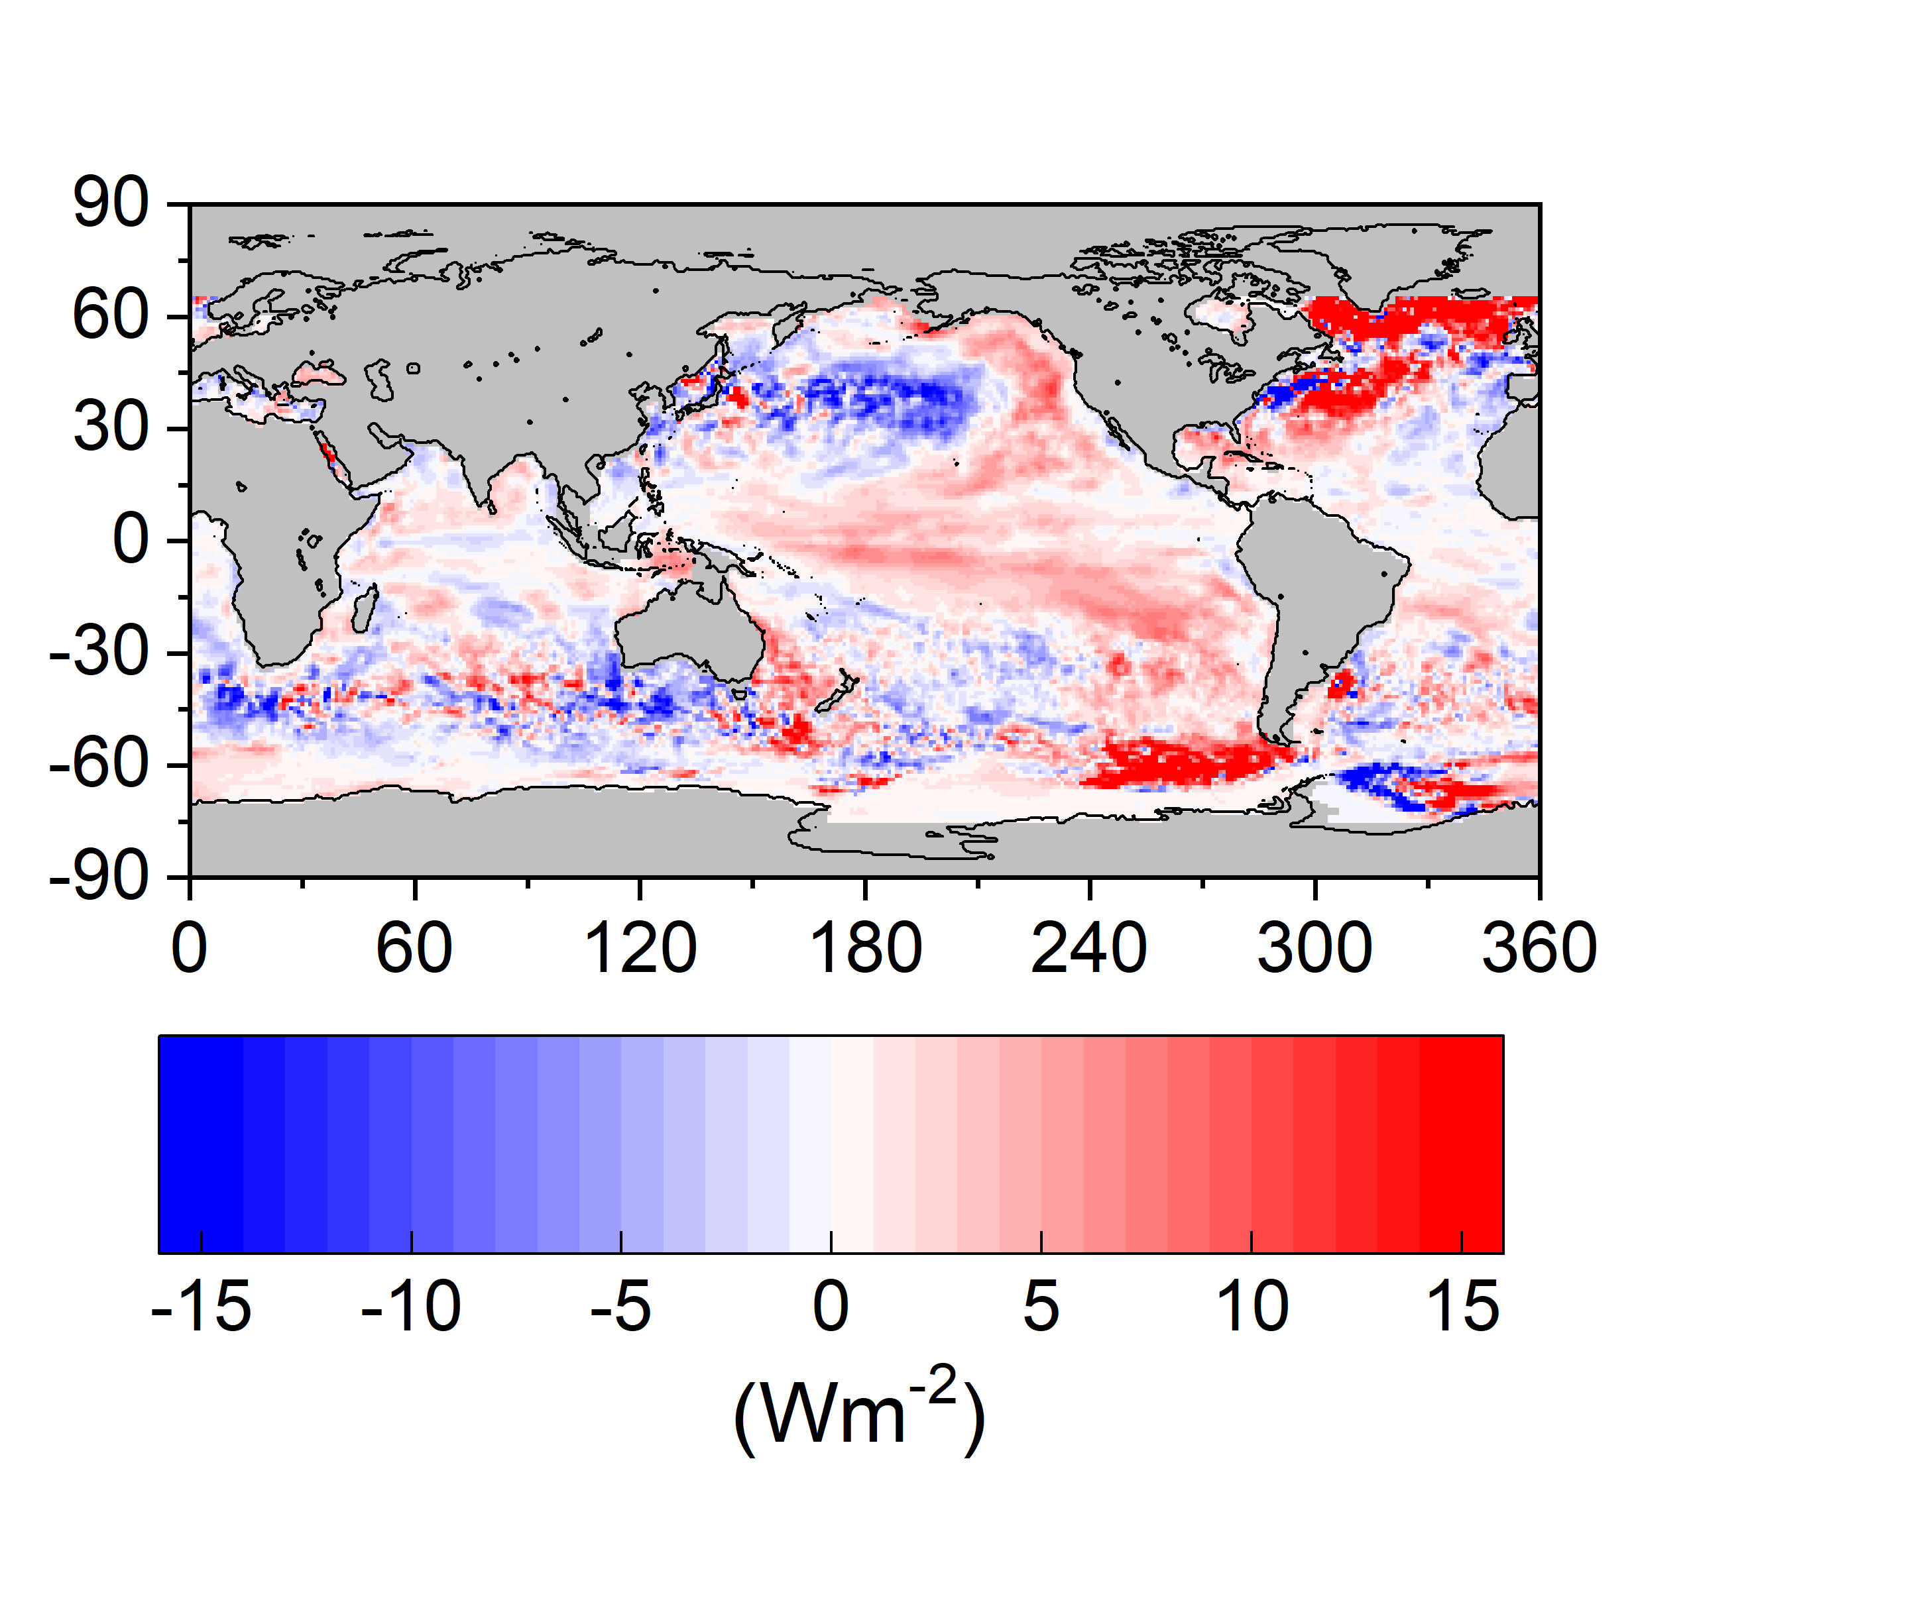
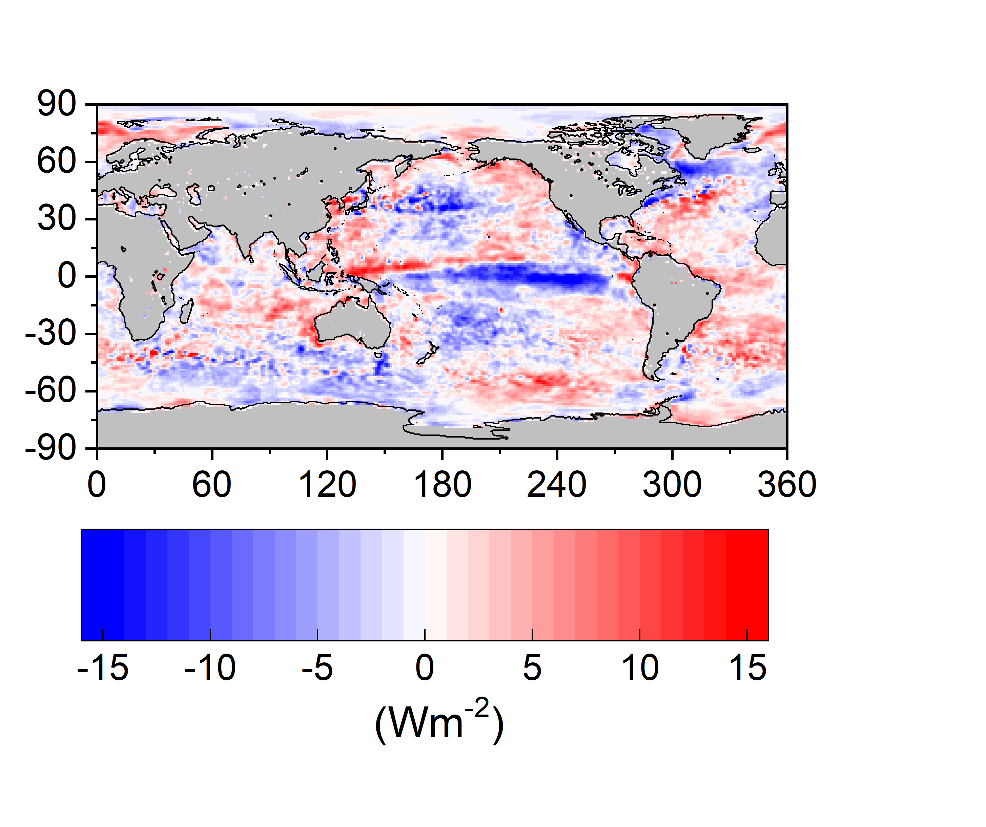

Regional Ocean Mixed Layer (OML) Energy Budget
(01/2012−07/2016)
OML Tendency Anomaly
Fs Anomaly
Ocean Mixing/Advection Anomaly
OML heating over much of Pacific Ocean and N. Atlantic.

Slide 13
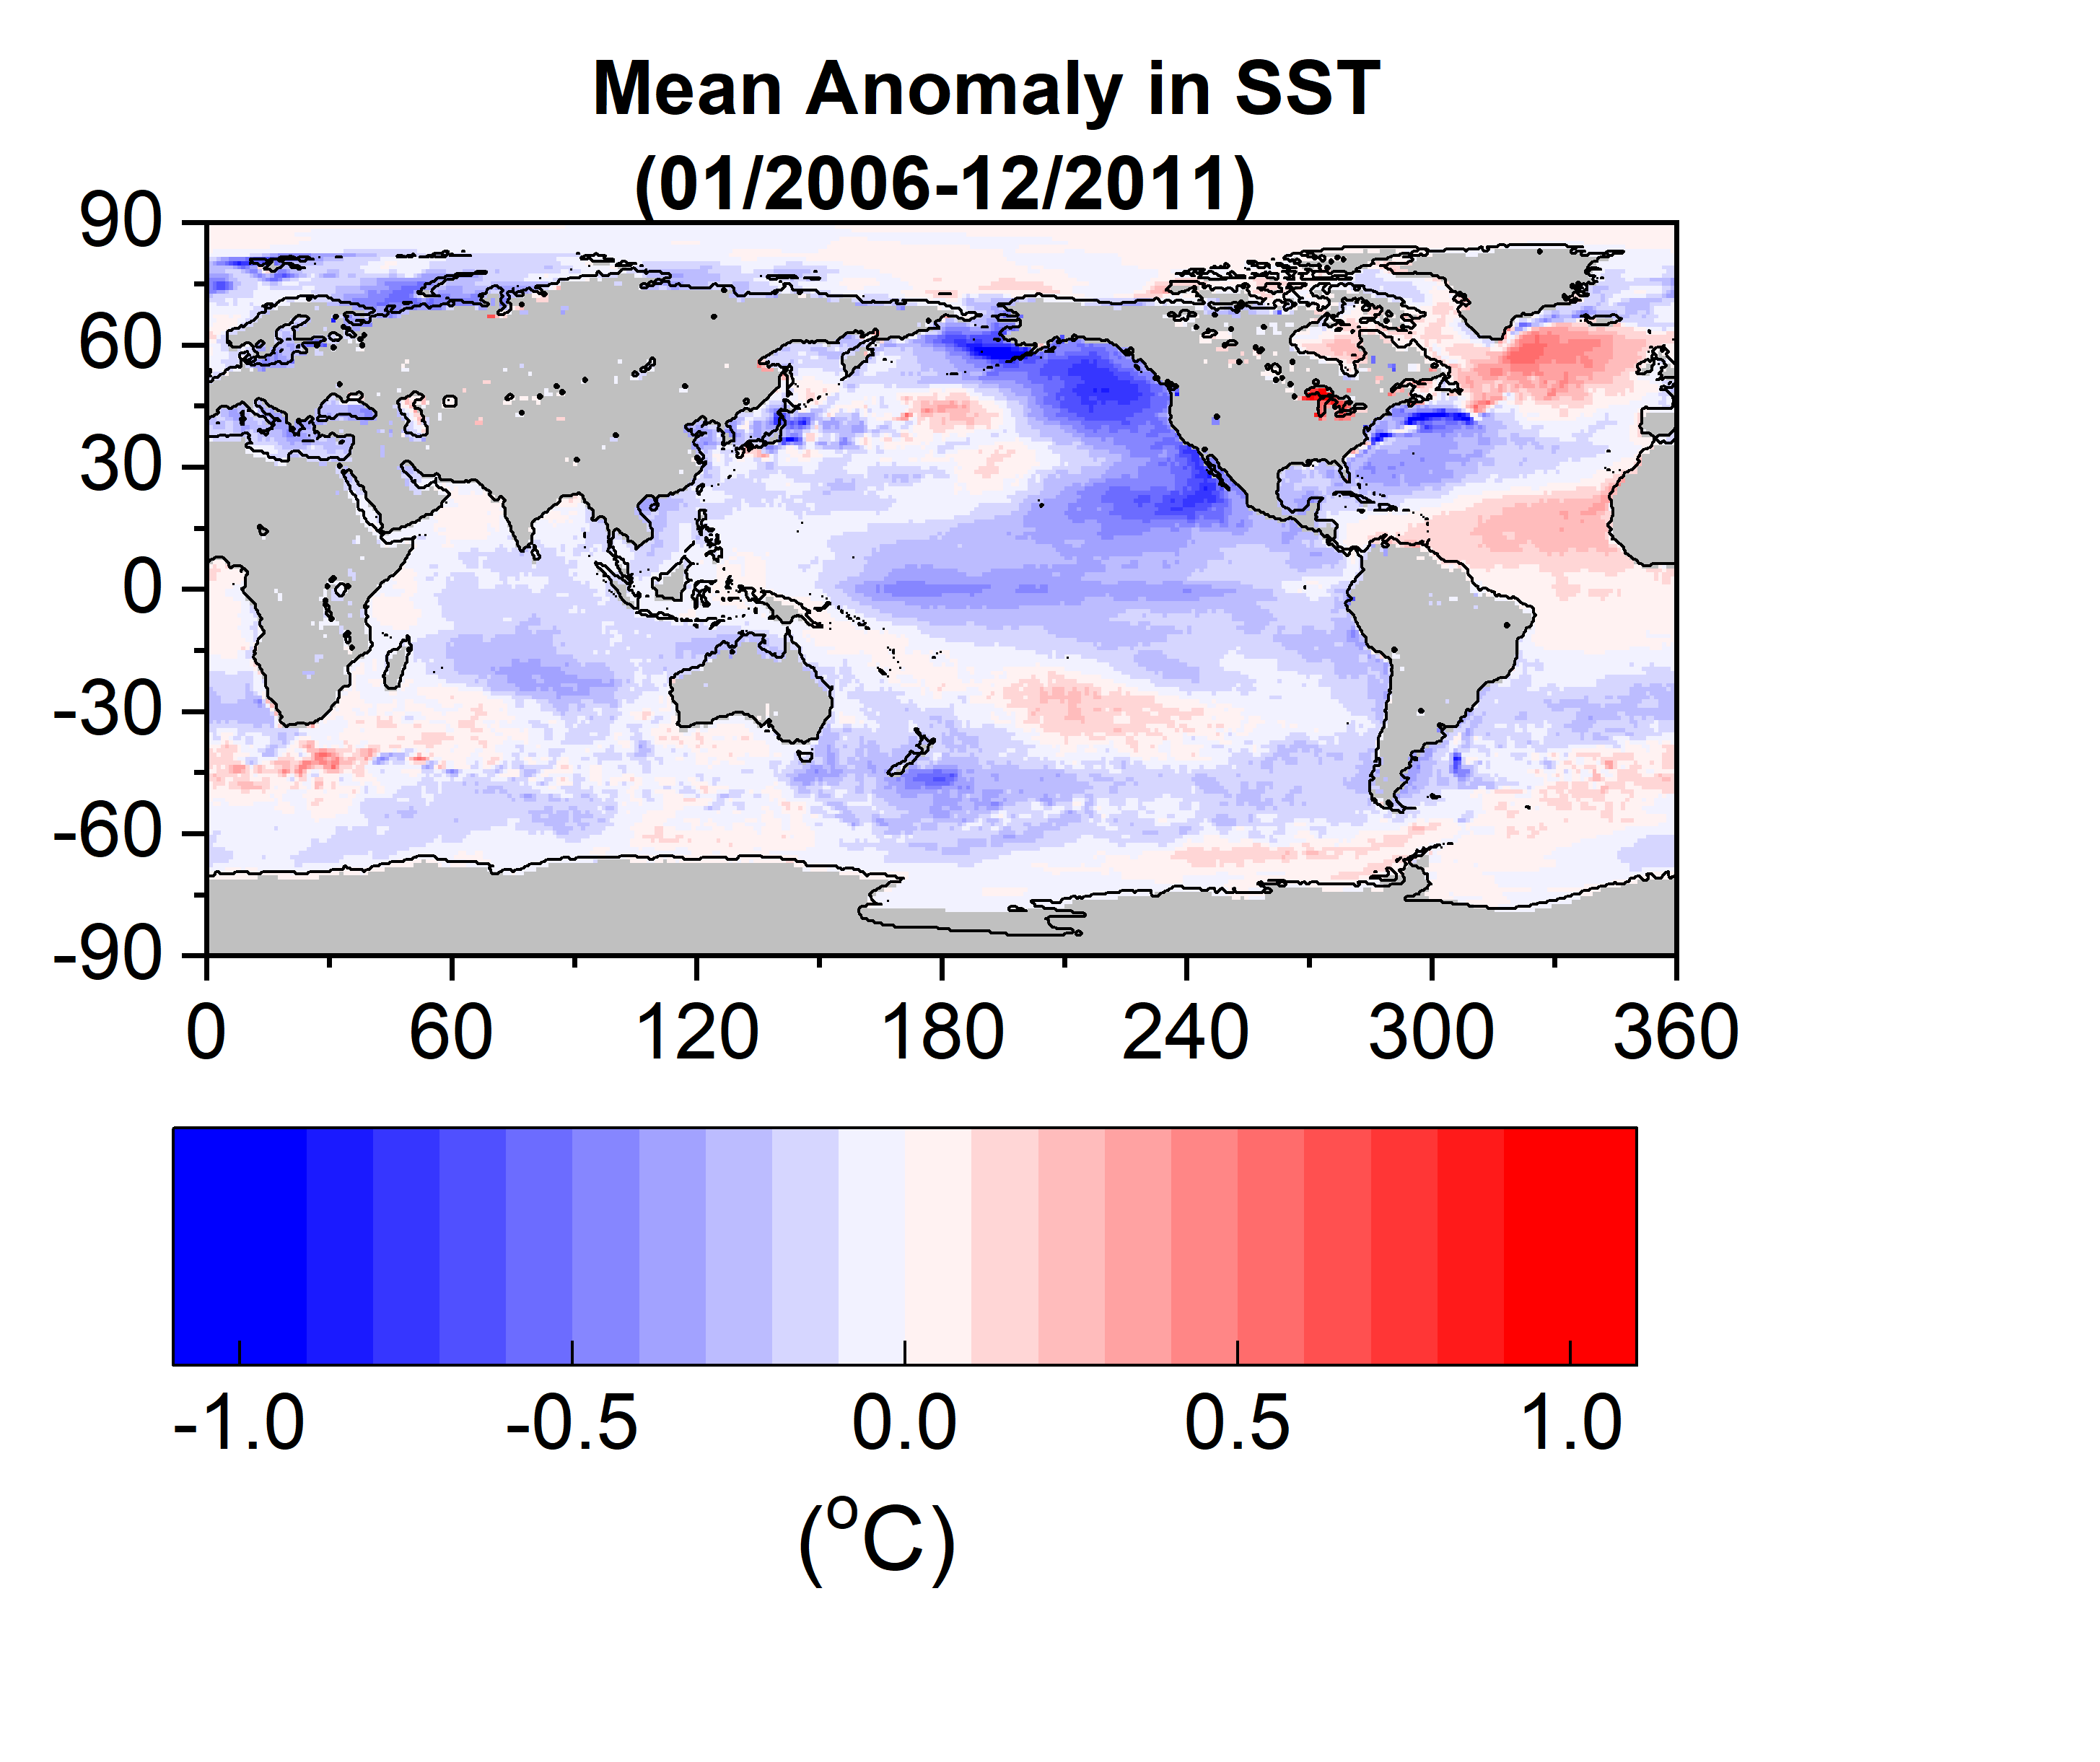
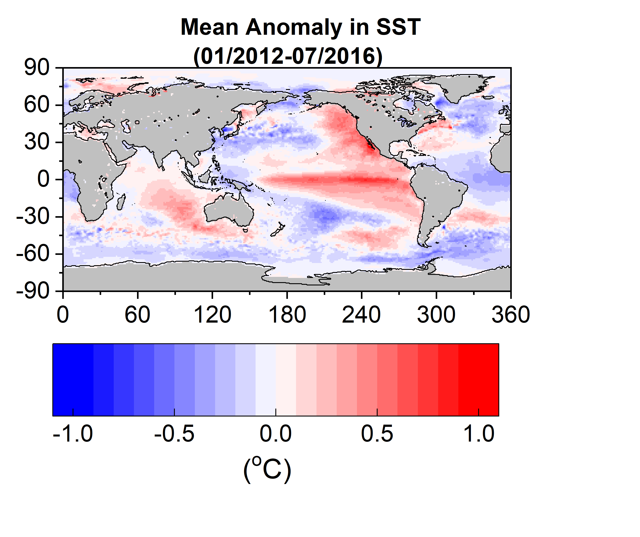
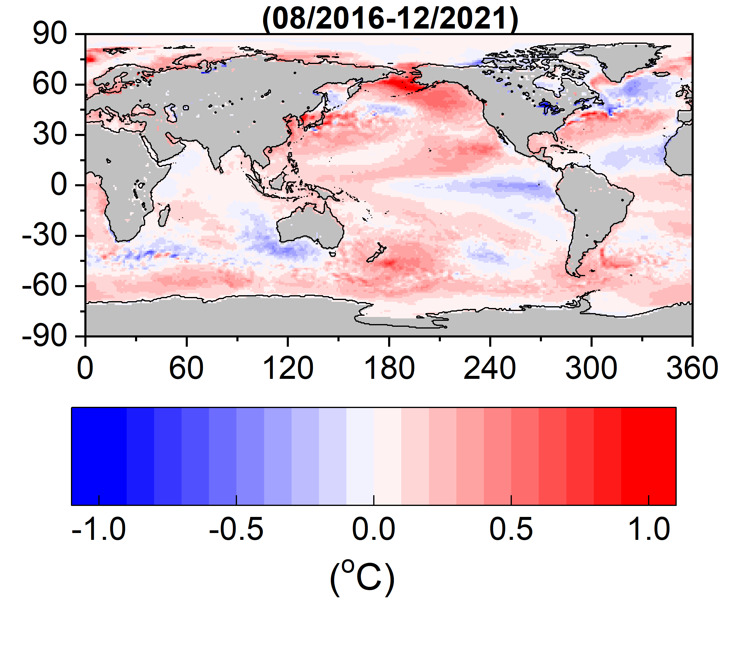
Mean Anomaly in SST
Mean Niño 3.4 Index
-0.39
0.37
−0.20

Slide 14
Conclusions
  CERES shows a trend in Earth's Energy Imbalance (EEI) of 0.44±0.18 Wm⁻² dec⁻¹ for 03/2000-08/2022.
  The EEI trend is primarily associated with an increase in absorbed solar radiation (ASR) due to cloud changes and, to a lesser extent, sea-ice changes.
  ASR and SST global variations and regional trend patterns track one another during the CERES period.
    ASR and SST both show rapid increases leading up to the 2015-2016 El Niño and then level off.
  Ocean mixed layer heat budget analysis reveals strong OML heating over much of Pacific Ocean and N. Atlantic between 2012 and mid-2016.
    Main contribution from ocean heating as surface flux (F_{s}) anomalies are weak.
    Internal variability (ENSO) likely plays a dominant role in explaining the large ASR and EEI trends observed by CERES.

