Slide 1
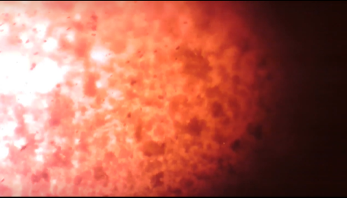
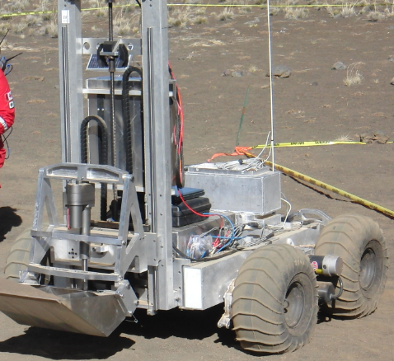
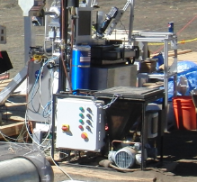
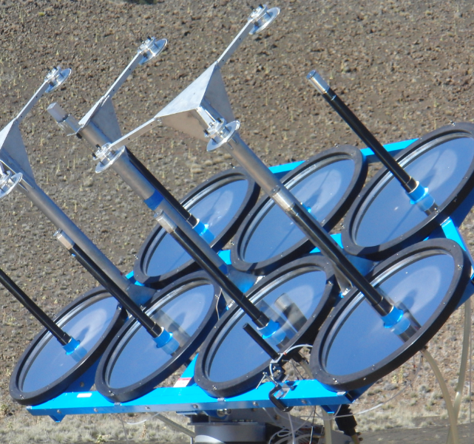
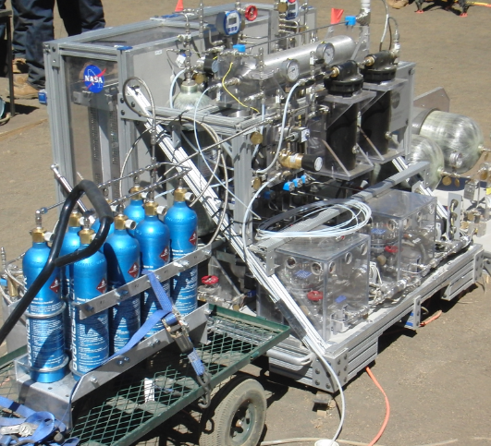
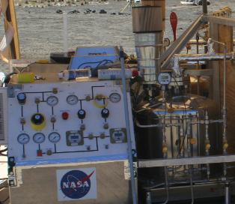
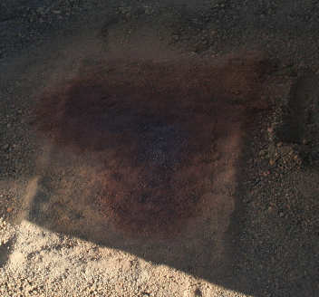
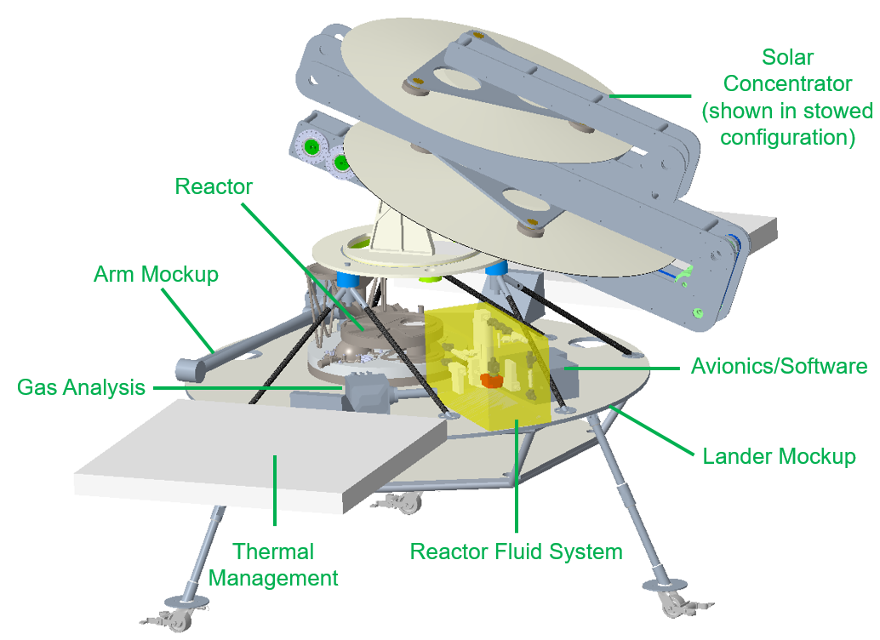
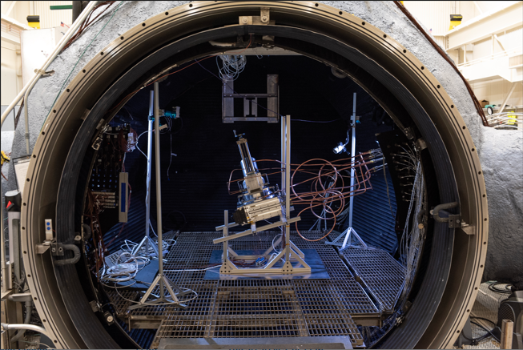
Carbothermal Reduction Demonstration (CaRD)
Project Management Aaron Paz / 281-244-0163 / aaron.paz-1@nasa.gov
Principal investigators Brant White, Tony Colozza, Nilab Azim, Desmond O’Connor
TX 7.1.3 Resource Processing for Production of Mission Consumables TRL: start 4 / current 5
overview
The CaRD project aims to increase the Technology Readiness Level (TRL) of a combined solar concentrator and carbothermal reduction system. Both of which were used to remove oxygen from lunar regolith simulant during an In-Situ Resource Utilization (ISRU) field demonstration in 2010.
Brassboard vacuum test
A 2 kW laser was used to heat lunar regolith simulant within a carbothermal reactor developed by Sierra Space. The reactor was tested inside of a 15ft thermal vacuum chamber at JSC.
Brassboard vacuum test results
Reaction products were analyzed using a gas analysis system provided by Kennedy Space Center. The gas analysis results were used to derive performance data.
prototype
The CaRD prototype is under development and is meant to demonstrate the functions necessary to understand the yield and byproducts that result from extracting oxygen from real lunar regolith when using the solar flux conditions at the south pole of the Moon.
INNOVATION
When scaled up, this technology can produce several times its own weight in oxygen per year of operation. Oxygen is extracted from regolith in the form of carbon monoxide. The downstream components that are necessary to convert CO into oxygen gas have commonality with Mars ISRU and ECLSS
*grams of oxygen extracted per KWh delivered to reactor
Test Number | g/KWh*
2010 Field Demo (for comparison) | 1.45
CaRD Ambient 2 | 13.42
CaRD Vacuum 1 | 11.53
CaRD Vacuum 2 | 15.79
CaRD Vacuum 3 | 10.77
Regolith
Heat
Summary of CaRD Brassboard Tests Compared to 2010
Molten Regolith Simulant During Reaction
Excavator
Canadian Space Agency
Water
Carbothermal Reactor
Orbitec
Solar Concentrator Physical Sciences Inc.
Oxygen
Thruster
Exhaust
Water Electrolysis Johnson Space Center
Liquefaction & Propulsion
Johnson Space Center
Sintered Regolith made with Solar Concentrator
“Dust to Thrust” Demonstration 2010
Carbothermal Reactor Developed by Sierra Space Inside 15ft Dirty Thermal Vacuum Chamber at JSC

