Slide 1
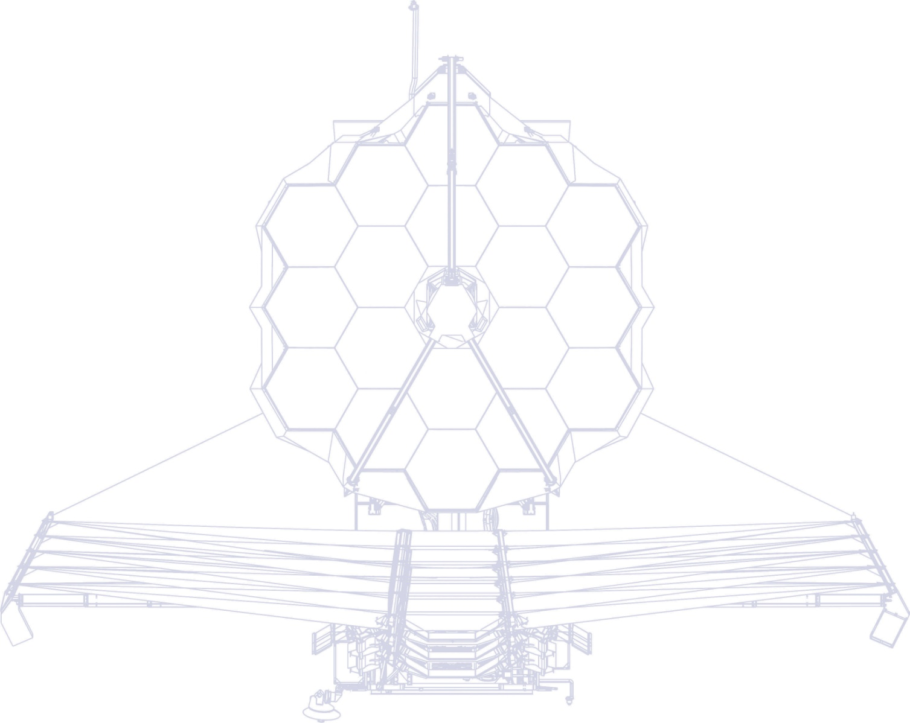
James Webb Space Telescope
Micro-Meteoroid Design and Performance
March 23, 2023
Mike Menzel

Slide 2
Appreciation
Appreciation to the JWST Micro-Meteoroid Working Group for the results presented in this presentation, in particular:
  Lee Feinberg (Lead, GSFC)
  Bill Cooke and Althea Moorehead (MEO MSFC)
  Joe Pitman (Heliospace)
  Lester Cohen, Mike Eisenhower (SAO)
  Chuck Bowers (GSFC)
  Margaret Jordan (STScI)
  Chuck Perrygo

Slide 3
Summary
The James Webb Space Telescope (JWST) has been operating in space for over a year. Given its capability to measure nanometer (nm) wavefront errors (WFE) on its Primary Mirror (PM), JWST offers a unique opportunity to record Micro-Meteoroid (MM) impacts.
As of this date 37 such events have been recorded on the PM, and all but one resulted in WFE well within pre-launch expectations.
Even after these the overall performance of the observatory is roughly 2.5 times better than its requirements.
This presentation will cover the following topics:
  Mission Description
  The Predicted MM Environment
  JWST On-Orbit MM Events and Analyses to Date
  MM Mitigations and Future Efforts
  Conclusion

Slide 4
Mission Description

Slide 5
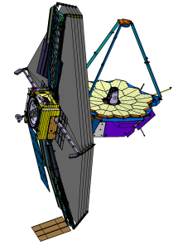
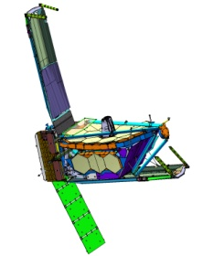
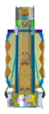
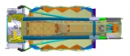
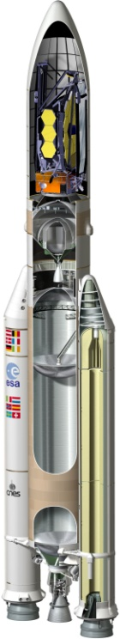
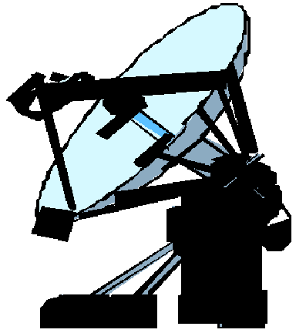
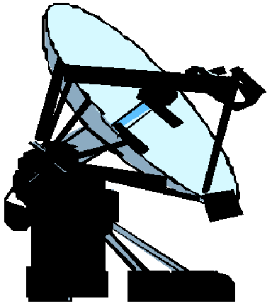

JWST System Architecture
Communications Coverage Provided
For all Critical Events
SOC Available 24 Hours, 7 Days per Week
Until Telescope Phased
5 Year Science Mission
-Consumable for 10 years
-180 day orbit around L2
Observatory Deployments
Solar Array
High Gain/ Medium Antennas
Sunshield
Optical Telescope Element
Ariane 5 Upper
Stage Injects JWST
Into Direct Transfer
Trajectory
Observatory – Upper Stage
Separation
L2 Point
L2 Orbit
L2 Transfer
Trajectory
Ariane 5
Launch
System
S-Band Tlm Link ( 8 Kbps)
S-Band Cmd Link (0.25 Kbps)
S-Band Ranging
Ka-Band Science Link ( Selectable 7, 14, 28 Mbps)
S-Band Tlm Link (Selectable 0.2 - 40 Kbps)
S-Band Cmd (Selectable 2 and 16 Kbps)
S-Band Ranging
Nominal 4 Hour Contact Every 12 Hours
S-Band Tlm Link (1,4 Kbps)
S-Band Ranging
Communications
Services for Launch
(TDRS, ESA/Malindi)
Deep Space Network
Space Telescope Science Institute
Science & Operations Center
NASCOM
Ariane PPF S5
GSFC Flight Dynamics Facility

Slide 6
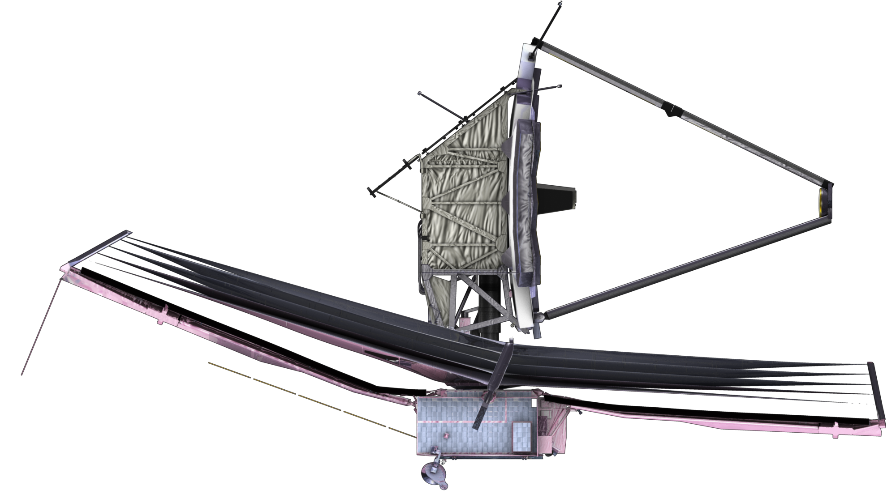
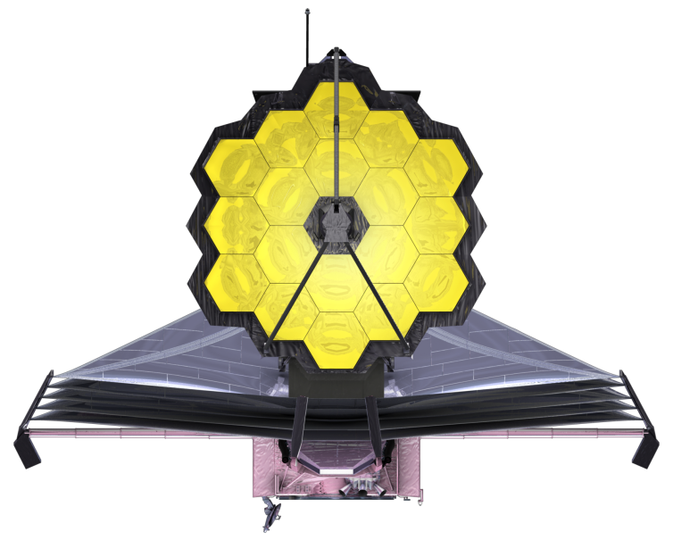
Observatory Design, Capabilities and Susceptibilities
Integrated Science Instrument
Module (ISIM) Inside OTE
Thermal Enclosure
6.100 m
6.600 m
Optical Telescope
Element (OTE)
Sunshield
Spacecraft Bus
21.197 m
14.625 m
Design Parameter
Optical Telescope Element (OTE) diffraction limited at 2 micron wavelength.
  25 m² , 6.35 m average diameter aperture. (Actual aperture 25.8 m²)
  Instantaneous Field of View (FOV) ~ 9’ X 18’.
  Deployable Primary Mirror (PM) and Secondary Mirror (SM).
  18 Segment PM with 7 Degree of Freedom (DOF) adjustability on each.
Integrated Science Instrument Module (ISIM) containing 4 cryogenic science instruments (SIs) to observe in the near and mid infrared.
  The FGS provides fine guidance error signals to maintain pointing
  The NIRCam functions as the on-board wavefront sensor for initial OTE alignment and phasing and periodic maintenance.
Deployable sunshield for passive cooling of OTE and ISIM.
Mass: < 6310 kg. (Actual Mass at launch 6161 kg)
Power Generation: 2138 Watts Solar Array, and a 105.6 AHr Lithium Ion battery
Data Capabilities: 471 Gbits on-board storage, 229 Gbits / 12 hours science data.
Science Data Downlink: 28 Mbps.
Life: Designed for 10.5 years of operation.
Micro-Meteoroid Features
Susceptibilities:
  Exposed Primary and Secondary Mirrors, due to lack of protective barrel. A protective barrel was not possible in order to allow passive cooling of the OTE to cryogenic temperatures.
  Five 2 or 1 mil thick coated Kapton sunshield layers to provide insulation from solar radiation to passively cool OTE and ISIM.
  External electrical cables between the Science Instruments and their Focal Plane Electronics (FPE)
Capabilities / Design Mitigations;
  NIRCam provides nm class WFE sensing of the OTE optical train. Sensing operations are conducted every 2 days. Sensing data cannot provide direct information on the time or direction of the impact.
  PM segments have 7 Degree of Freedom corrections that can be employed to correct certain MM induced WFE’s.
  WFE budget allocated 31 nm for MM degradation
  The Sunshield thermal design included allocated margin for predicted MM generated heat leaks from impact holes.
  External cables wrapped with protective Nextel fabric similar to that used on Space Station.

Slide 7
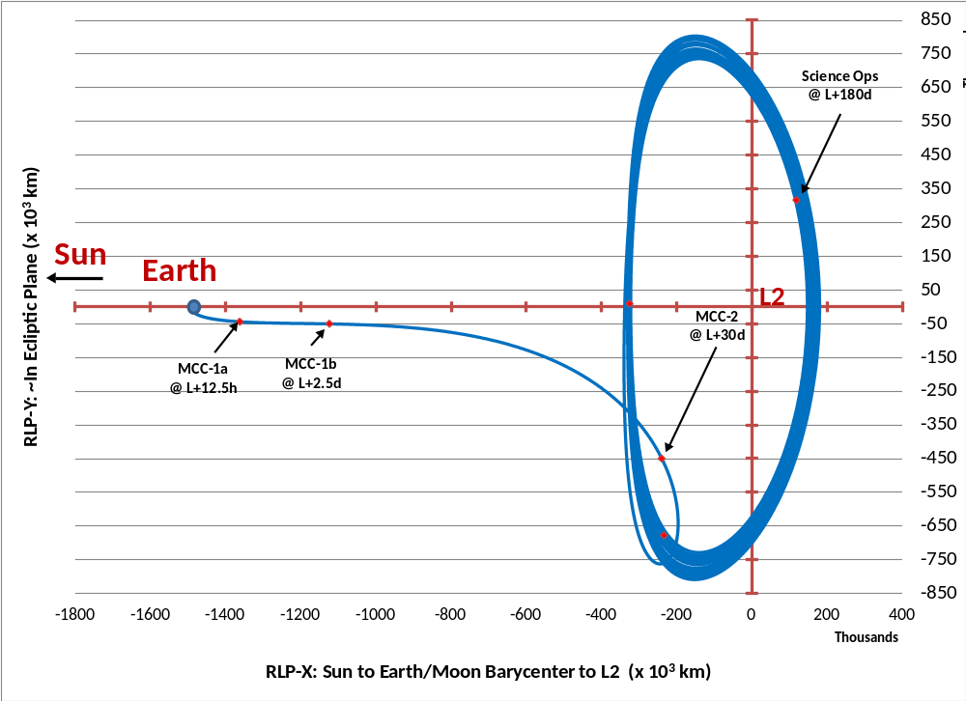
Mission Trajectory (1 of 2)
3-31-23: (X_{RLP}, Y_{RLP}, Z_{RLP}) =
(-324930 km, 8856 km, 349717 km)
Bow Shock
Magnetosheath
Magnetopause
3-1-23: (X_{RLP}, Y_{RLP}, Z_{RLP}) =
(-233938 km, -677884 km, 51728 km)

Slide 8
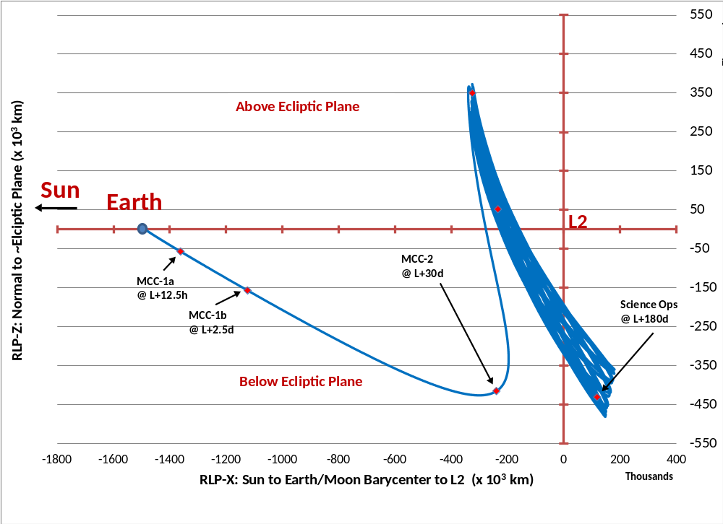
Mission Trajectory (2 of 2)
3-31-23: (X_{RLP}, Y_{RLP}, Z_{RLP}) =
(-324930 km, 8856 km, 349717 km)
Bow Shock
Magnetosheath
3-1-23: (X_{RLP}, Y_{RLP}, Z_{RLP}) =
(-233938 km, -677884 km, 51728 km)
Magnetopause

Slide 9
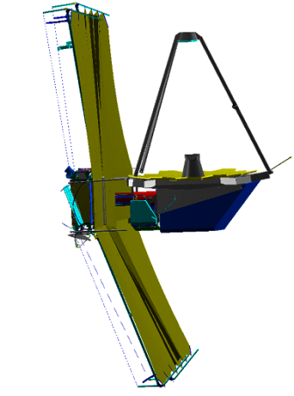
Observatory Celestial Coverage and Range of Pointing
The required celestial coverage for the observatory is 35% of the celestial sphere at any given time.
The sunshield is currently sized to give at least 39%.
Field of Regard is an annulus with rotational symmetry about the L2-Sun axis, 50° wide
The observatory will have full sky coverage over a sidereal year
There are continuous viewing zones 5° about the North and South Ecliptic Poles
The observatory will have a roll capability about the telescope boresight of +5°
North
Ecliptic
Pole
Continuous
Coverage
Zone North
5°
45°
Toward
the Sun
360°
Over a Year the Stars
Will Move Full Circle
as JWST Orbits the Sun
JWST Will See the Full Sky
Continuous
Coverage
Zone South
Notes:
The celestial coverage drives that sunshield size. Could compromise was an instantaneous coverage of a bout 35%

Slide 10
Predicted Micro-Meteoroid Environment

Slide 11
Micro-Meteoroid Environment (1 of 6)
The Micro-Meteoroid environment consists of two major types:
  Sporadics: An overall pervasive background of meteoroids, relatively time constant but not isotropic.
  Showers: Predictable meteoroid trails produced by comets. Shower activity peaks as the Earth and or spacecraft passes thru the trail on a yearly basis.
  The primary risks to spacecraft comes from the Sporadics.
The Sporadic Meteoroids have three orbital populations, that produce a non-isotropic distribution of particle fluxes, velocity and energy distributions.
  Helion and Anti-Helion from short period comets
  Apex, (North and South) from long period comets
  Toroidal (North and South) from Halley type comets

Slide 12
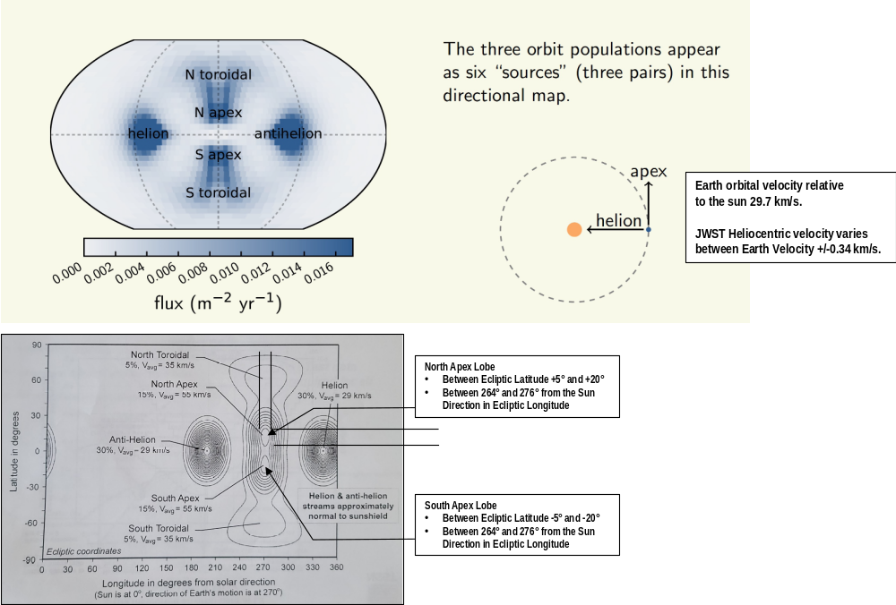
Micro-Meteoroid Environment (2 of 6)
Sporadic Meteor Population Flux and Velocities
The average velocity of the Sporadic meteoroids in a Heliocentric coordinate system is ~ 30 km/s.
JWST has approximately the same orbital velocity as the earth in the earth in this coordinate system 30 km/s.
MM velocities relative to JWST can be has high as 60 to 70 km/s in the Apex or “Ram” direction

Slide 13
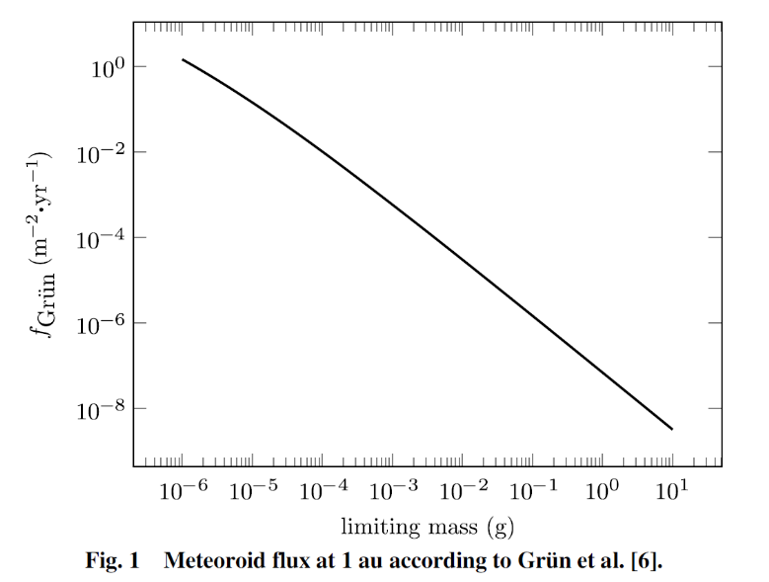
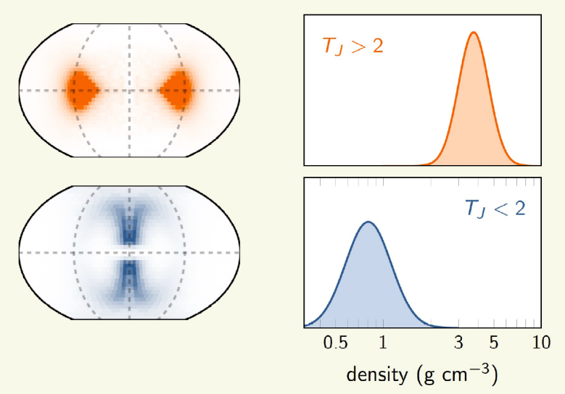
Micro-Meteoroid Environment (3 of 6)
The distribution of Sporadic MM masses is given by the Grun Model as shown on the upper right.
  Graph shows number of flux of particles (#/m²/y) with masses equal to or greater than mass on x axis.
  Majority of MM’s have masses 10⁻⁶ g of greater.
  With an average velocity of ~30 km/s this corresponds to MM energies of ~0.5J.
  With an area of 25 m² this would indicate the JWST PM should see ~25 hits per year (roughly 2 per month with energies .5 J or above)
The illustration on the bottom right shows the estimates of the MM densities for Helion – Anti-Helion and Apex populations.
  T_{j} is the Tisserand Parameter
  At these densities the particle diameters for a 10⁻⁶g MM is 0.1 to 0.2 mm.

Slide 14
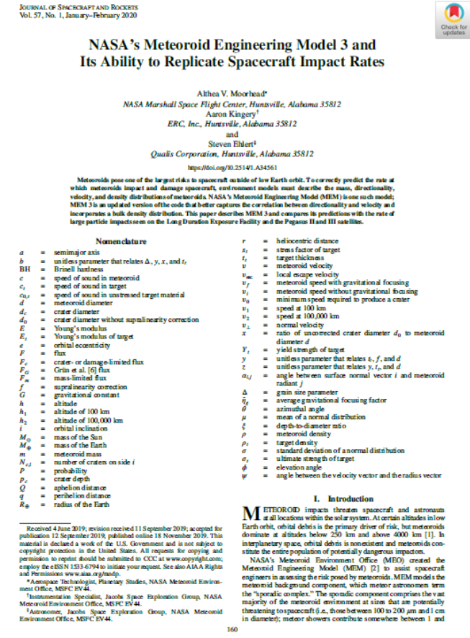
Micro-Meteoroid Environment (4 of 6)
JWST worked with the Meteoroid Environment Office (MEO) at MSFC to compute the expect L2 MM flux levels.
Employed the Meteoroid Engineering Model (MEM) Rev 1c for the final pre-launch verification calculations.
At the present time MEO has updated MEM to Rev 3.
  Differences are described in article shown on the right.
  Differences between MEM 1C and MEM 3 are relatively minor with respect to JWST predicts

Slide 15
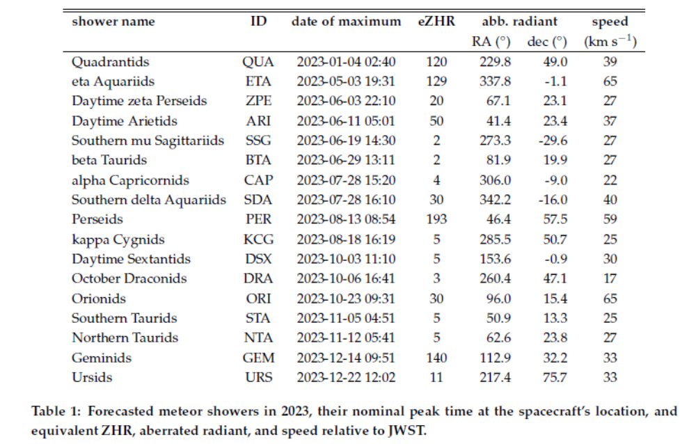
Micro-Meteoroid Environment (5 of 6)
Key Meteor Shower Forecasts For JWST for 2023 from the MEO

Slide 16
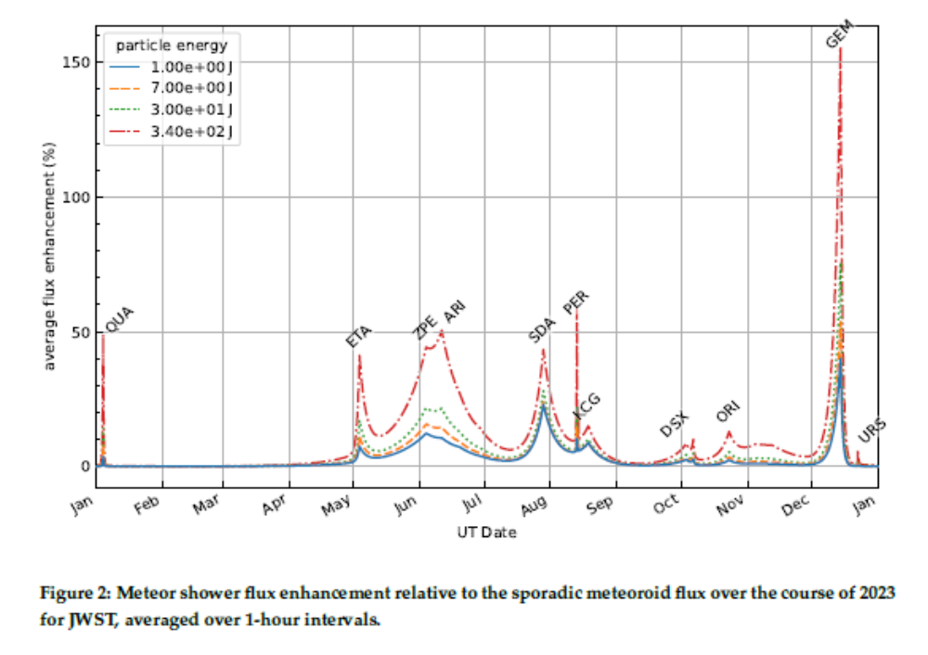
Micro-Meteoroid Environment (6 of 6)
Flux Enhancement Factors for Forecasted Shower over the Sporadic levels show that showers are a minor threat relative to the sporadic levels

Slide 17
JWST On-Orbit Micro-Meteoroid Events and Analyses To-Date

Slide 18
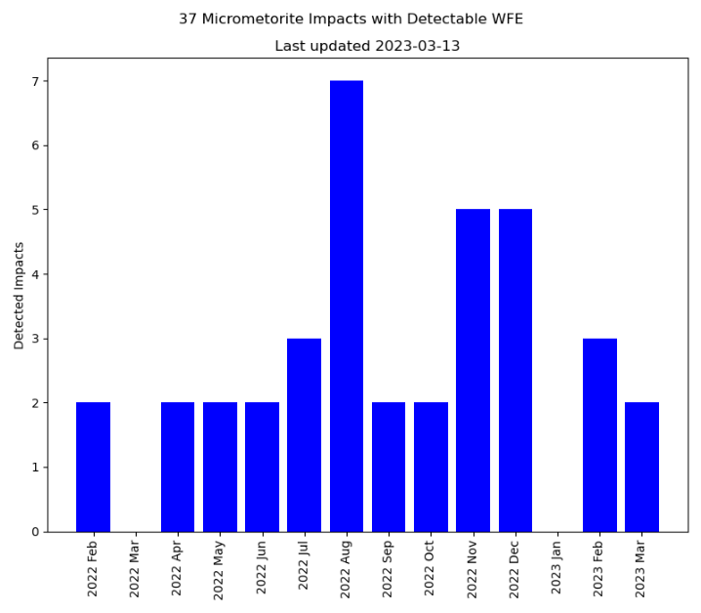
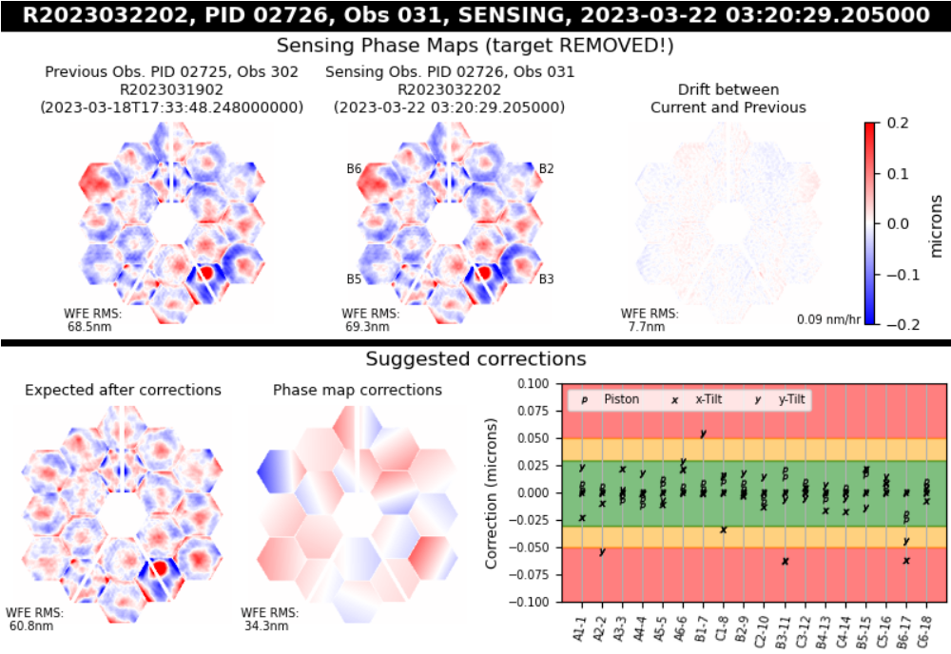
Primary Mirror Micro-Meteoroid Events to Date
As of 3-23-23 there have been 37 micro-meteoroid events that resulted in a measurable WFE on the Primary Mirror.
  The average rate of events is 2.6 events per month.
  The histogram on the upper right shows the events counts.
With exception of an event that occurred in May 2022, all events have produced minor WFE,
  Total WFE contribution at the system level has been ~1 nm for these MM events.
  Many of the resulting WFE have actually been correctable.
  Pre-launch allocation for MM induced WFE was 31 nm for a 5.5 year life.
At the present time the overall WFE of the NIRCam channel is 61 nm (2.5 x better than required).
  This includes the contributions from the anomalous May event described on the following chart
  See WFE map on the lower right.

Slide 19
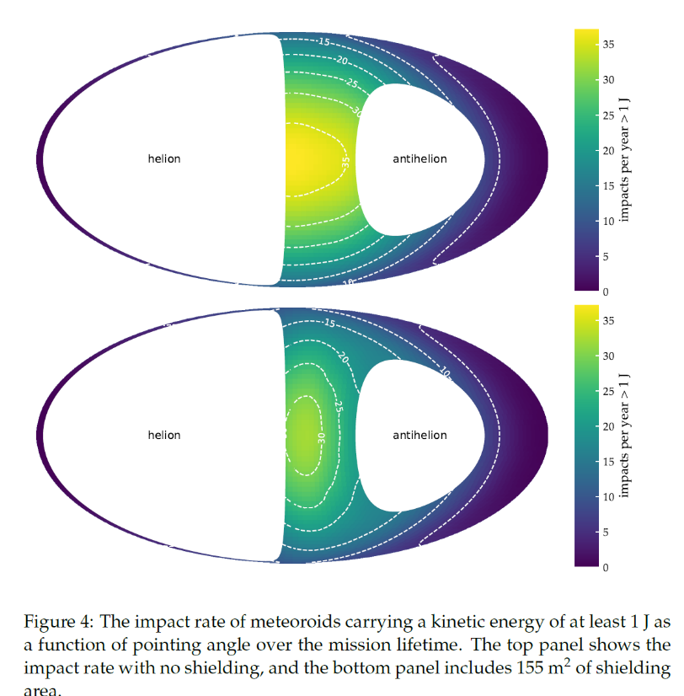
Analyses of Normal Activity
The MSFC MEO performed analyses to compute the impact rates on the PM as a function of observatory pointing for MM energies of 1 J or greater.
  The analysis was performed for with and without shielding of the PM by the sunshield.
  The analysis results on the right show the dominant flux levels are in the direction “RAM” direction.
The MEO conducted analysis to estimate the most likely Low Energy MM Threshold to correlate with the observed impact rate.
  The analysis estimated that the measurable impacts correlate with MM lower threshold energies between 0.88J and 1.03J
Figure taken from Memo OSMA/MEO/JWST-001, 24 August 2022

Slide 20
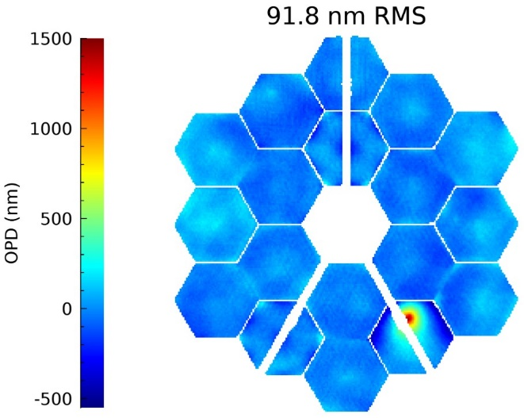
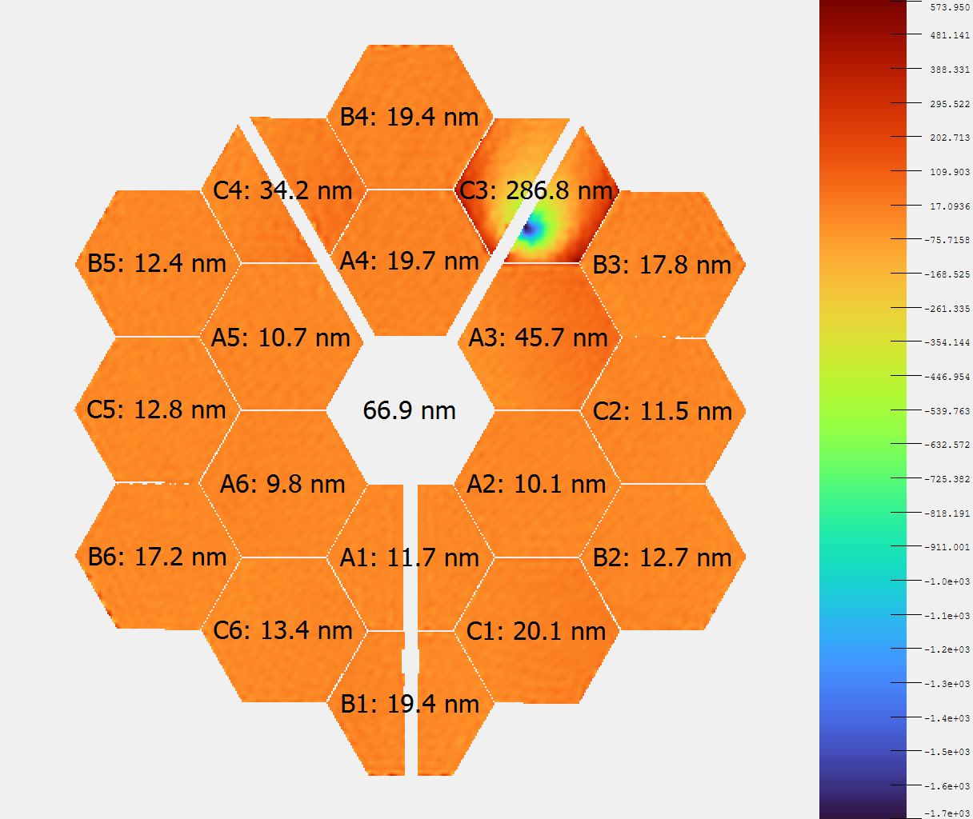
Anomalous MM Event of May 2022
An impact was recorded on Segment C3 in the period between 5-22-22 and 5-24-22 that was significant.
  WFE maps are shown on the right.
  This latest hit was in close proximity to a previous hit on C3.
Change in Static WFE of the NIRCam-OTE was ~ 20 nm before correction.
A good portion of the residual WFE from this event was correctable, but because of location on the C3 segment, a fair portion of the WFE was uncorrectable.
  After the full corrections, the system level WFE was reduced to ~ 9 nm.
The unexpected magnitude of this event triggered an investigation and the formation of a Micro-Meteoroid Working Group (MMWG).
Computations According to Telfer
Computations According to Jurling (OPD is flipped vertically)

Slide 21
Investigation of the C3 Event
The MMWG performed modeling of various hypothetical impacts on the C3 segment structure model to find likely scenarios that could explain not only the rms WFE but also observed surface error profile, which was rather large in extent.
  Leveraged hydrocode capabilities to model and simulate impacts.
  Compliment hydrocode results with finite element analyses.
The studies concluded that a likely scenario consisted of:
  A high energy meteoroid with energy between 7 and 26 J.
  An impact which penetrated the front of C3 segment and impacted the “Whiffle Tree” mount on the backside of the segment.
  The resulting stress in the Whiffle Tree mount produced the larger distortion field.
Given the estimate of the energy of the MM, and the smaller total area of the Whiffle Trees, this scenario was deemed relatively unlikely. However limiting celestial pointing where higher energy MM are more likely was considered and ultimately adopted as a mitigation.

Slide 22
Micro-Meteoroid Mitigations and Future Efforts

Slide 23
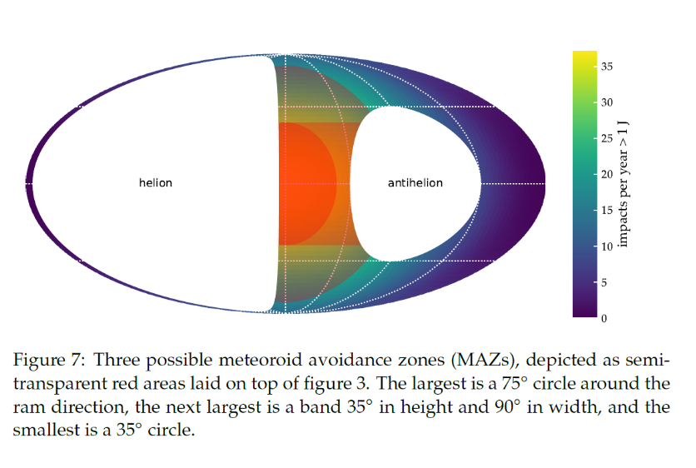
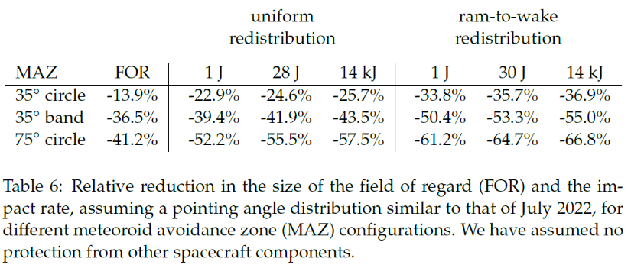
Meteoroid Avoidance Zone (MAZ)
Given the risk of damage from higher energy MM’s, the MMWG investigated the benefits of limiting observing time in the RAM direction.
  This limitation would not limit total observations, but would impose challenges on the scheduling and flexibility for rescheduling
The MEO investigated three such MAZ geometries as illustrated in the upper right:
  A 35° half angle about the RAM direction
  A 75° half angle about the RAM direction
  A 35° “band about the RAM direction
The MEO analyzed the reduction in MM fluxes for various threshold energies that would result from these, as shown on the lower right.
The MMWG recommended that Project adopt a 75° half angle MAZ for the Cycle 2 science, with the goal restricting science in this region to under 15%.
  The Project accepted this recommendation
  High value science of opportunity and or transient phenomenon would be allowed in this region
During or after Cycle 2, the MMWG will reconsider the benefits of this MAZ and any potentially modifications.

Slide 24
Hypervelocity Testing at White Sands
Because of the larger-than-expected micrometeoroid strike in May of 2022 on the primary mirror of the JWST, the project has commissioned the White Sands Test Facility Remote Hypervelocity Test Laboratory (RHTL) to perform hypervelocity impact testing on beryllium mirror materials.
  The purpose is to characterize the damage to the test articles by launching polymethyl methacrylate (PMMA) and Aluminum Oxide projectiles at 8 km/s.
The testing being conducted will expose the following sunshield and mirror materials to hypervelocity tests”
  Kapton at room temperature
  ULE Glass at room temperature
  Beryllium at 100K

Slide 25
Conclusion
Despite the one anomalous micro-meteoroid impact, the JWST optical system continues to perform about 2.5 x better than required.
The overall average flux rates seen on the PM are in family with pre-launch predicts and allocations.
Given the importance of JWST to astrophysics, the Project is implementing a MAZ to reduce the probability of higher energy impacts, and is conducting tests to help develop better models for WFE vs MM properties, including cryogenic tests.
The JWST Team is transferring lessons learned to the planning of future telescope missions, including the incorporation of more traditional telescope barrels which will reduce PM exposure to MM by a factor of 100.

