Slide 1
Use of assimilation increments for bias correction (and predictability studies)
Andrea Molod
Yehui Chang, Randy Koster and Siegfried Schubert
NASA Global Modeling and Assimilation Office
WCRP Symposium on Frontiers in Subseasonal to Decadal Prediction Reading, UK and online, March 28, 2023

Slide 2
Outline
IAU, “Replay” and Tendency Bias Correction (TBC)
TBC Applications:
    Climate Mean Bias and forecast skill
    Evaluation of sources of Model Error
    Use in Assimilation
Future plans/thoughts

Slide 3
GMAO Seasonal Prediction group uses coupled Earth-System models and analyses, in conjunction with satellite and in situ observations, to study and predict phenomena that evolve on seasonal to decadal timescales. A central motivation for GMAO is the innovative use of NASA satellite data to improve forecast skill
Atmosphere/Ocean Coupled Model Development
Ocean Analysis Development
Development of Initialization/Perturbation Strategy for ensembles of Sub/Seasonal Forecasts
Coupled Assimilation Strategy Development
Production of Coupled Data Assimilation (Re)Analysis
Production/Dissemination of Sub/Seasonal Forecasts
Validation/Assessment of Forecast Fidelity
Validation/Assessment of Assimilated Ocean State
Predictability Studies
GEOS-S2S-2 was released in November 2017 (Molod et al., 2020)
GEOS-S2S-3 System “frozen” December 2021, weakly coupled reanalysis (“MERRA-2 Ocean”) and forecasts under way and due for public release late 2023

Slide 4
IAU, “Replay” and TBC at GMAO: Flow Diagram
3z
6z
9z
12z
15z
forecast
Read
-------
Long-term averaged increments
Perform analysis:
increment = analysis - forecast
--------------
--------------------
Add increments to model for 6hr
forecast
Read
-------
-------------------
--------------------
Perform analysis:
increment = analysis - forecast
Long-term averaged increments
IAU of Bloom et al., 1996, depicted here
“Replay” described in Orbe et al., 2017
Updated IAU described in Takacs et al., 2018
Add increments to model for 6hr

Slide 5
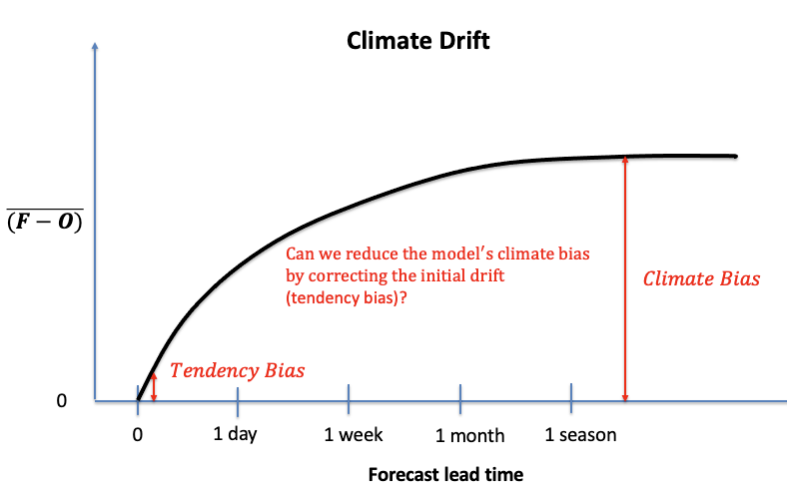
Underlying Motivation/Questions
Can we reduce the model’s climate bias by correcting the initial drift or tendency bias?
Does reduced climate bias manifest itself in increased forecast skill at subseasonal to seasonal lead times?
Some terms/concepts:
“Drift” refers to time mean differences between the model forecasts and observations (or reanalysis) that are functions of lead time.
The “tendency bias” and the model’s climatological bias represent the two end points of the bias evolution or drift, with the former measuring how the model initially starts to drift away from the observed climate and the latter measuring where it ends up.

Slide 6
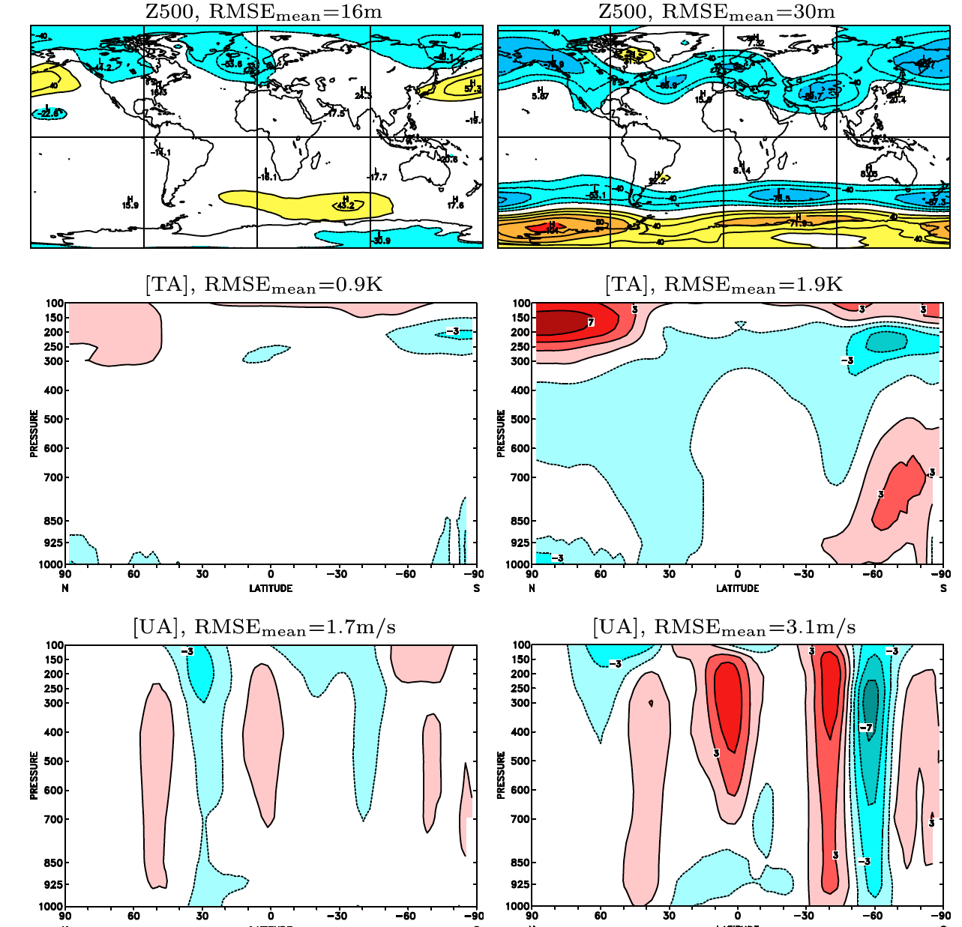
Climate Mean Bias/Forecast Skill: Atmospheric Correction in Atmospheric Model
Experiment
Long “AMIP” simulation (~30 years using an atmospheric model forced with observed sea surface temperatures) with nudging to EC Interim → compute daily mean “nudging increments” from 6-hour increments, and filter to keep the lowest 3 annual harmonics.
Results:
Time mean climate root mean squared error is reduced. Also improved interannual variability and seasonality.
Used AMIP as proxy for seasonal forecast (randomized initial conditions), see modest ENSO skill improvement
Corrected Control
Kharin and Scinocca, 2012

Slide 7
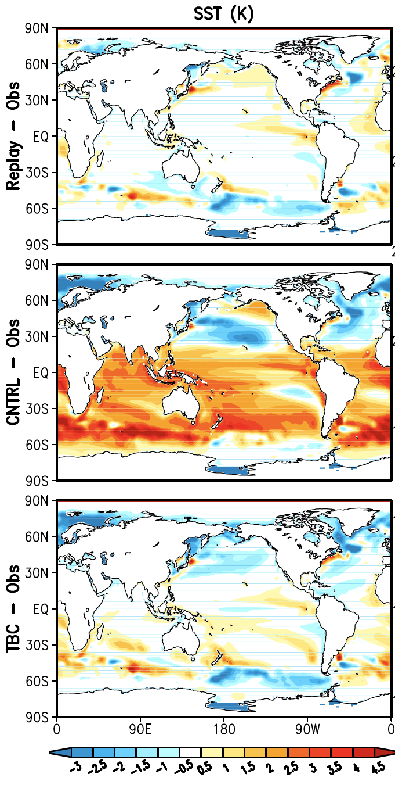
Climate Mean Bias/Forecast Skill: Atmospheric Correction in Coupled Model
Experiment
Long coupled simulation in which atmosphere is “replay”ed to MERRA-2. TBC terms are interannual averages of replay increments at each 6-hour interval. Since the experiment is only correcting atmospheric quantities, the ocean in only indirectly constrained by the TBC.
Results
Various improvements to the climate bias of the mean state, stationary waves and related transients, and more realistic ENSO variability and associated teleconnections
TBC-related skill improvements were rather modest at best at both subseasonal and seasonal time scales. The modest improvements were at subseasonal scales, for eddy heights over the Pacific–North American region and T2m over North America.
Chang et al., 2019

Slide 8
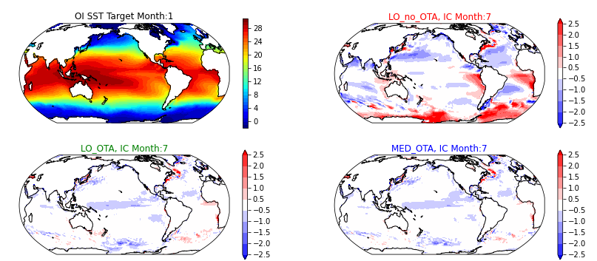
Climate Mean Bias/Forecast Skill: Ocean Correction in Coupled Model
Experiment
Long coupled simulation in which atmosphere is run free and ocean assimilation conducted using SPEAR-ODA with ARGO data only. Ocean Tendency Adjustment (OTA) terms are the climatological annual cycle of the analysis increments. Seasonal prediction and climate projection simulations were conducted
Results
Mean SST drift and mean bias at 6 months lead time in seasonal forecasts was reduced. In addition, the Nino3.4 drift was reduced.
For climate projection the climate bias was reduced. Added machine learning to OTA to make increments depend on the ocean state and surface fluxes – so far found that the Neural Network does good job of simulating the true ocean temperature
Lu, 6th WGNE workshop on systematic errors in weather and climate models 2022

Slide 9
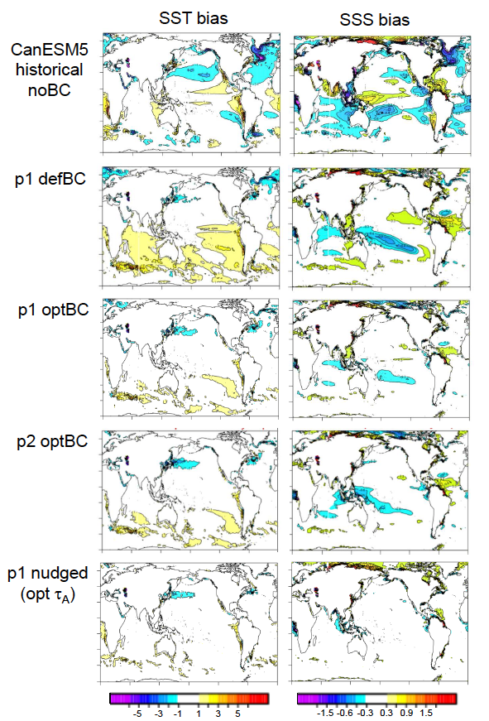
Climate Mean Bias/Forecast Skill: Atmosphere/Ocean Correction in Coupled Model
Experiment
Long (30 year) coupled simulation in which atmosphere and ocean were nudged to assimilations. Tendency adjustment (TA) increments in both fluids are the mean seasonal cycle of increments from nudging experiment
Performed 30 year free running simulation and seasonal hindcasts with and without TA
Results
Free running SST and SSS biases were reduced, and SST seasonality (and ENSO seasonality) were improved
Seasonal prediction of ENSO: skill not improved – also SMALL (significant?) improvement in z500mb height, temp and precip when averaged at all lead times (1-9 months) and initial condition months
Merryfield, 6th WGNE workshop on systematic errors in weather and climate models 2022

Slide 10
Climate Mean Bias/Forecast Skill – Summary
Saw examples from coupled and uncoupled models, using increments from assimilation, nudging and “replay”
ALL examples demonstrated general improvement in climate bias
ALL examples showed little to no improvement in forecast skill at subseasonal to seasonal leads

Slide 11
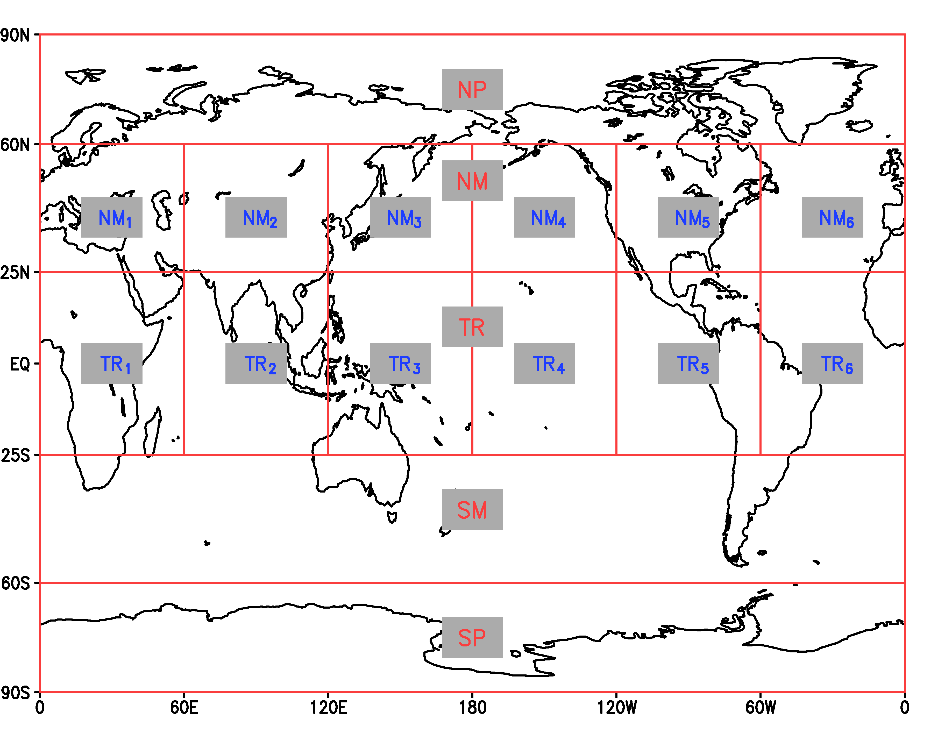
Evaluation of sources of Model Error
Regional TBC and Replay: A Tool for Addressing Model Error
The Regions Over Which Corrections were Applied
TBC corrections were applied together and separately in the regions shown here.
Experiments were performed with the GEOS AGCM forced with observed SST and run for the period 1980-2017. A TBC experiment was also conducted in which the increments were applied globally. In addition, a CNTRL run was made without any correction terms.
Schubert et al., 2019

Slide 12
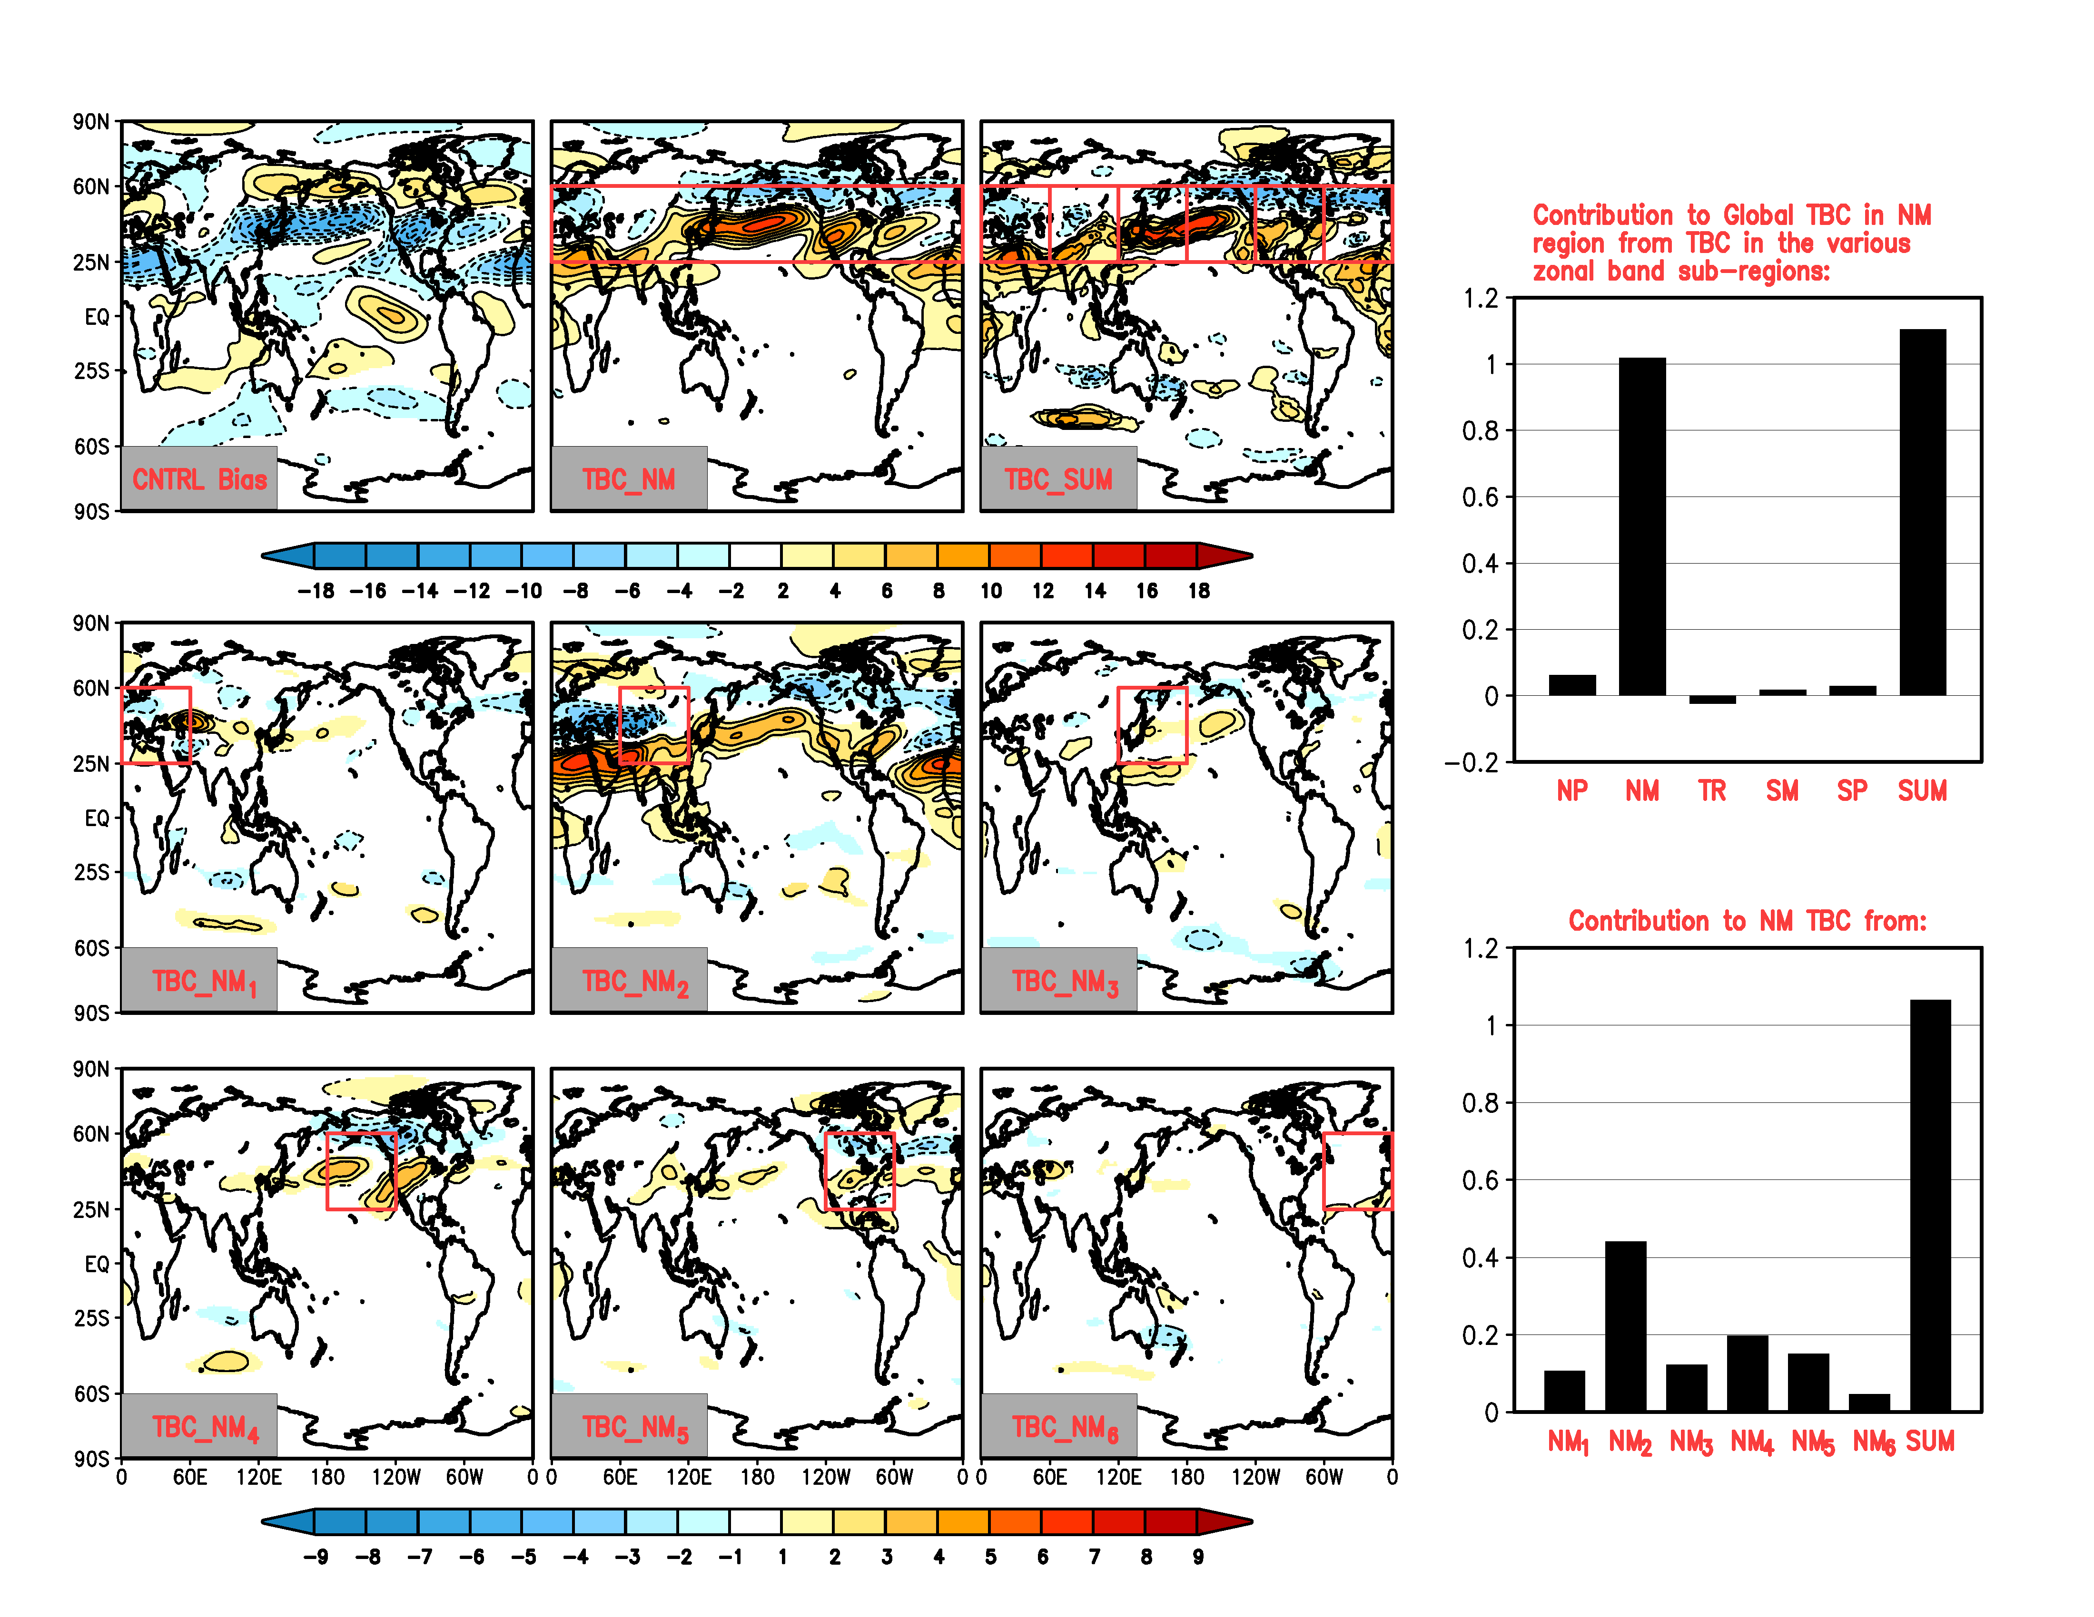
Evaluation of sources of Model Error (cont’d)
JJA 250mb U-wind: TBC
Upper left panel is (CNTRL-MERRA-2). The other panels are the experiments (TBC-CNTRL) for the regions shown by the red boxes. The upper right map is the sum of the results of the 6 NM regions. The bar graphs are the normalized spatial inner products from the various experiments.
Key results: much (87%) of the AGCM long term bias in the NM region can be corrected by the TBC in that region, and much of that (>40%) is achieved by the correction over the Tibet region (NM₂). Results are for the most part linear (cf. upper middle and upper right panels) .
Schubert et al., 2019

Slide 13
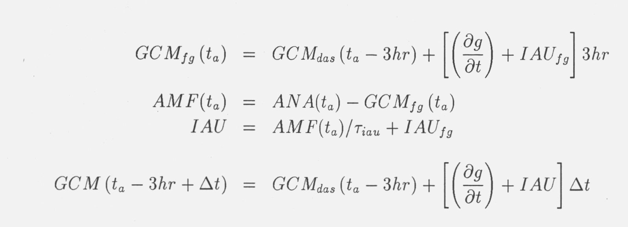
Use of Analysis Increments in Assimilation – Atmosphere
Motivation:
Provide the atmospheric analysis with a background that is unbiased, and “ask” the analysis to correct the random error only. This is more consistent with the underlying assumptions of the “BLUE” methods.
Technique:
“IAU with memory” computes a time averaged analysis increment over a time scale determined a priori. We see that the ensemble time-mean AMF will be zero (indicating statistically unbiased analysis adjustments) only if the model’s climatology is equal to that of the after-analysis. In general, for GCMs containing model bias, this will not be the case.
In the Analysis-minus-forecast (AMF) obtained from the “IAU with memory” technique used in GEOS, the contribution from the model bias has been eliminated. This substantially reduces the Mean Analysis Error
Takacs, NASA Tech Memo, 1996

Slide 14
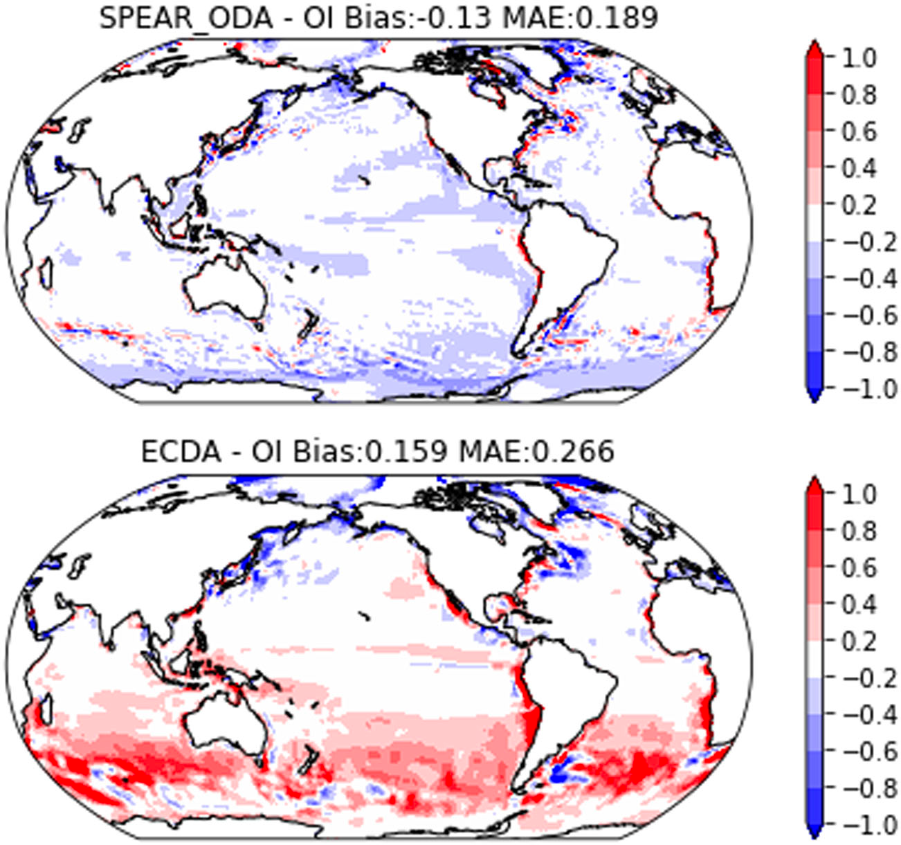
Use of Analysis Increments in Assimilation – Ocean in Coupled
Ocean Tendency Adjustment (OTA) terms are the climatological annual cycle of the analysis increments.
In SPEAR-ODA Ocean Assimilation with coupled model, the mean analysis error (ie., bias) in SST was reduced, and assimilated sea ice was in better agreement with NSIDC estimates.
The mean analysis error in ocean temperatures showed less improvement, however.
This use of OTA in the assimilation was viewed as an approximation to the methods proposed in, eg., Dee, 2005 for the atmosphere and Balmaseda, 2007 for the ocean, both of which use assimilation to estimate the bias rather than the averaged increments.
Lu et al., 2020

Slide 15
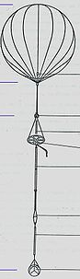
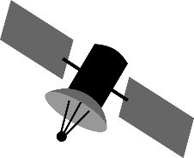

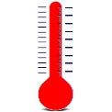


Use of Analysis Increments in Assimilation – Ocean with Replayed Atmosphere
GEOS-S2S-3 Weakly Coupled Data Assimilation
(Pre-Computed)
Atmospheric Analysis (MERRA-2)
Preliminary experiments were conducted in the GEOS weakly coupled data assimilation system.
Ocean TBC terms were computed as month-long running mean of ocean IAU increments in each 5-day window.
Day 5
0Z
6Z
12Z
18Z
0Z
Observed Precipitation
Predictor: Coupled Integration
O - F
O - F
O - F
O - F
O - F
O - F
Ocean Analysis
Corrector: Coupled Integration with Analysis Increments
Forecast
Forecast
“MERRA-2 Ocean” reanalysis is running from 1982-present
“GEOS_IT Ocean” is spinning up and will run in Near-Real Time

Slide 16
Summary
TBC (or similar technique) has been used in atmosphere, ocean and coupled models and assimilation systems
Shown to be a useful tool for assessing local vs remote error in models
Climate mean bias or mean analysis error was generally reduced
Forecast skill gains were marginal at best

Slide 17
Future Directions - Thoughts about Forecast Skill
Why is there little or no impact on forecast skill after demonstrating that TBC can significantly reduce climate bias?
The connection between forecast skill and the quality of a model’s climate (including variability) is not straightforward, though it seems plausible that a model with a better long-term climate should have better forecast skill. However…. Some possible obstacles are:
The “true” errors cannot be represented by a simple constant forcing term and are, in fact, state dependent (e.g., Leith 1978; Danforth et al. 2007)
Correcting climate drift (which is a function of forecast lead time) can presumably only lead to improved forecast skill if a substantial amount of the bias (and its correction) occurs before all predictability is lost. The two time scales (associated with drift development and predictability) serve to define a window of forecast leads during which TBC can be expected to have an impact on skill.

Slide 18
Future Directions – GMAO
Use atmospheric replay increments and ocean IAU increments, both modified by ML to model state dependance, to estimate TBC terms.
Use in weakly coupled assimilation with goal of improving Mean Analysis Error
Use in forecasts initialized from coupled assimilation to evaluate impact on skill
Question for thought/exploration:
Can TBC increments, together with climate bias, be used to estimate the lead-time evolution of model drift (currently estimated from extensive retrospective forecasts)?

Slide 19
Thank you for your attention!

