Slide 1
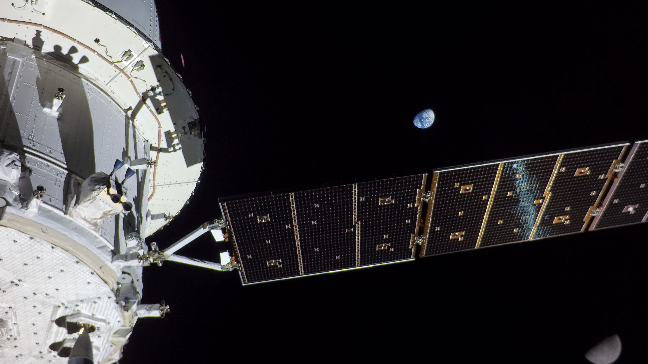


Analysis of the
Artemis I Orion Spacecraft
Power System Performance
Space Power Workshop
Torrance, CA
April 25, 2023
Spencer Furin
NASA Glenn Research Center
spencer.c.furin@nasa.gov
Hector Hernandez
NASA Johnson Space Center
hector.hernandez@nasa.gov
Anuj Patel
Lockheed Martin Space
anuj.patel@lmco.com

Slide 2
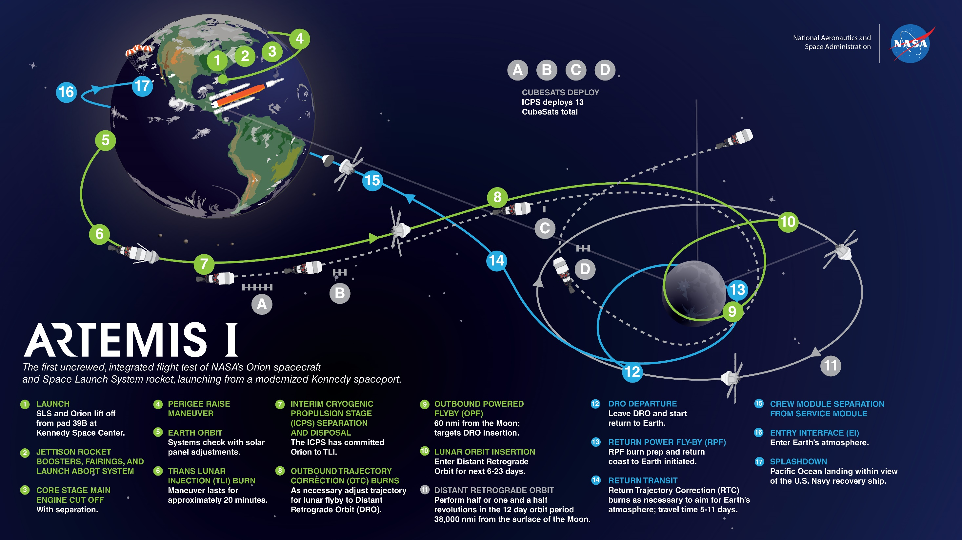
Notes:
Launched at 1:47am EST on Nov 16
Splashdown at 9:40am PST on Dec 11
Total duration of 25.5 days

Slide 3
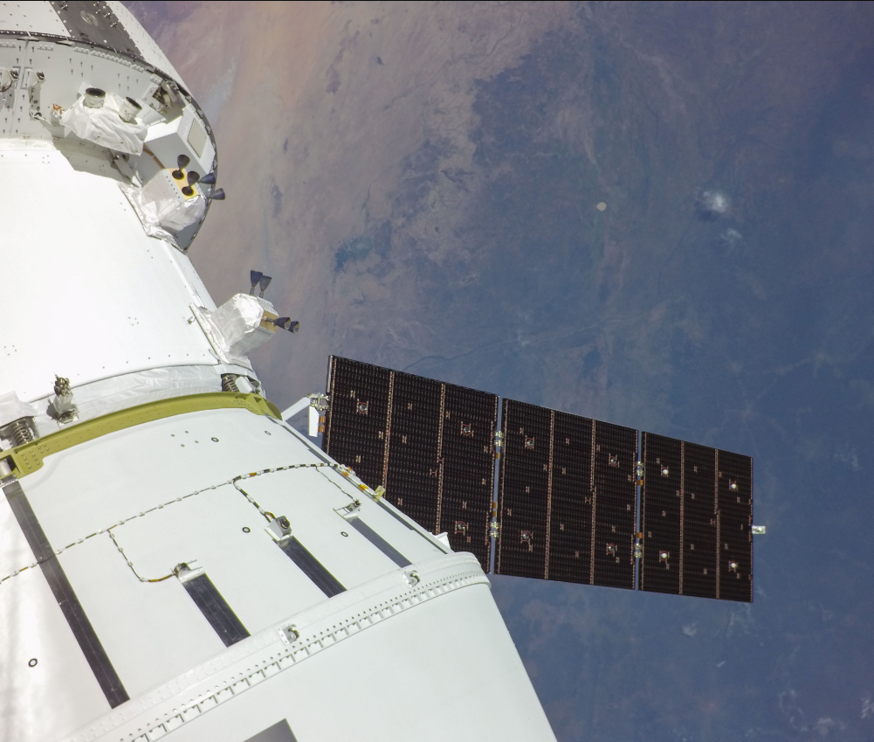

Flight Day 1 Post-Solar Array Deployment

Slide 4
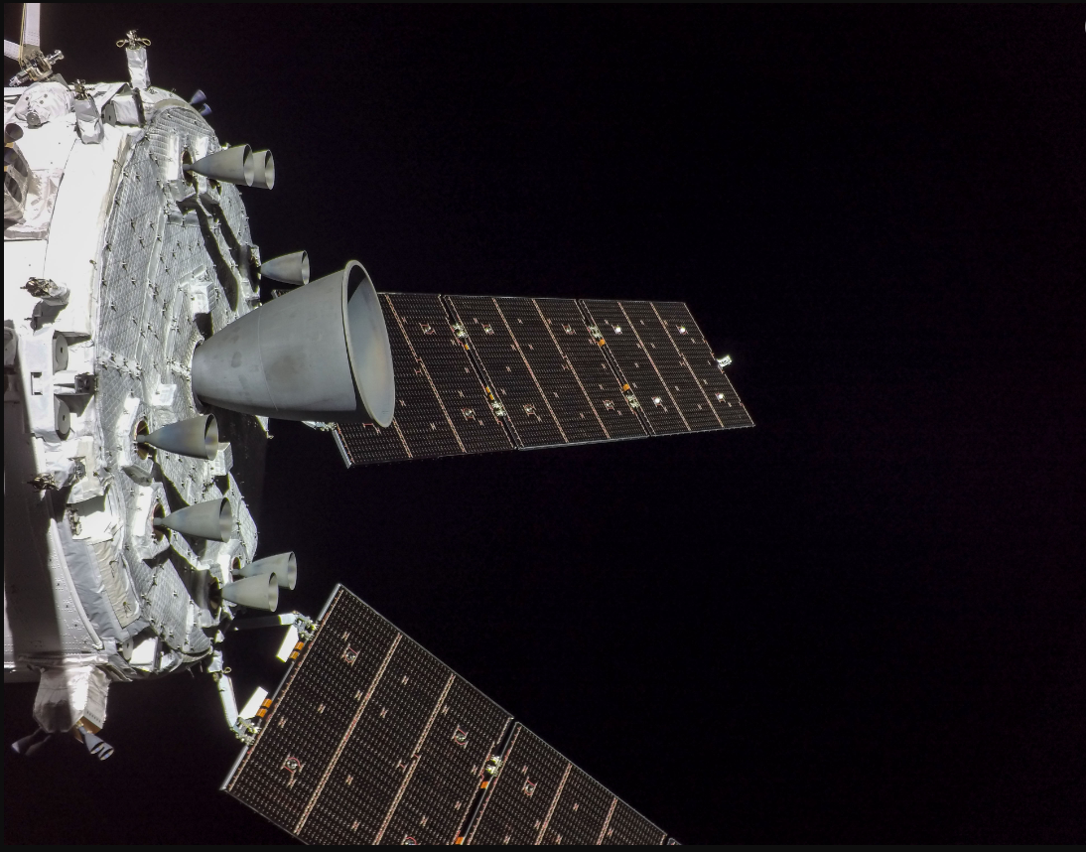
Flight Day 1 Service Module Inspection

Slide 5
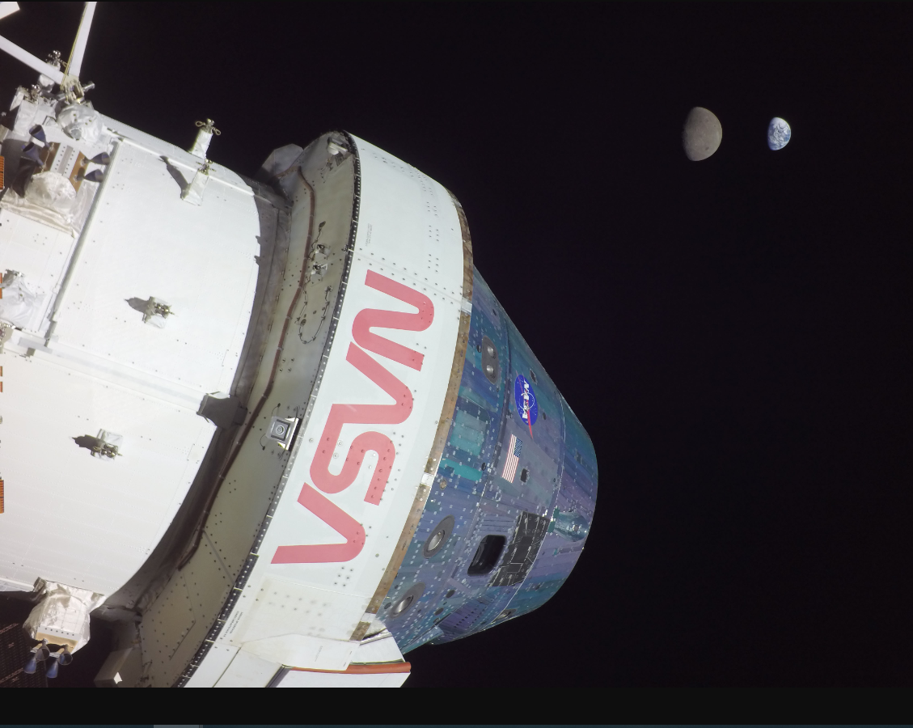
Flight Day 13 Orion Selfie

Slide 6
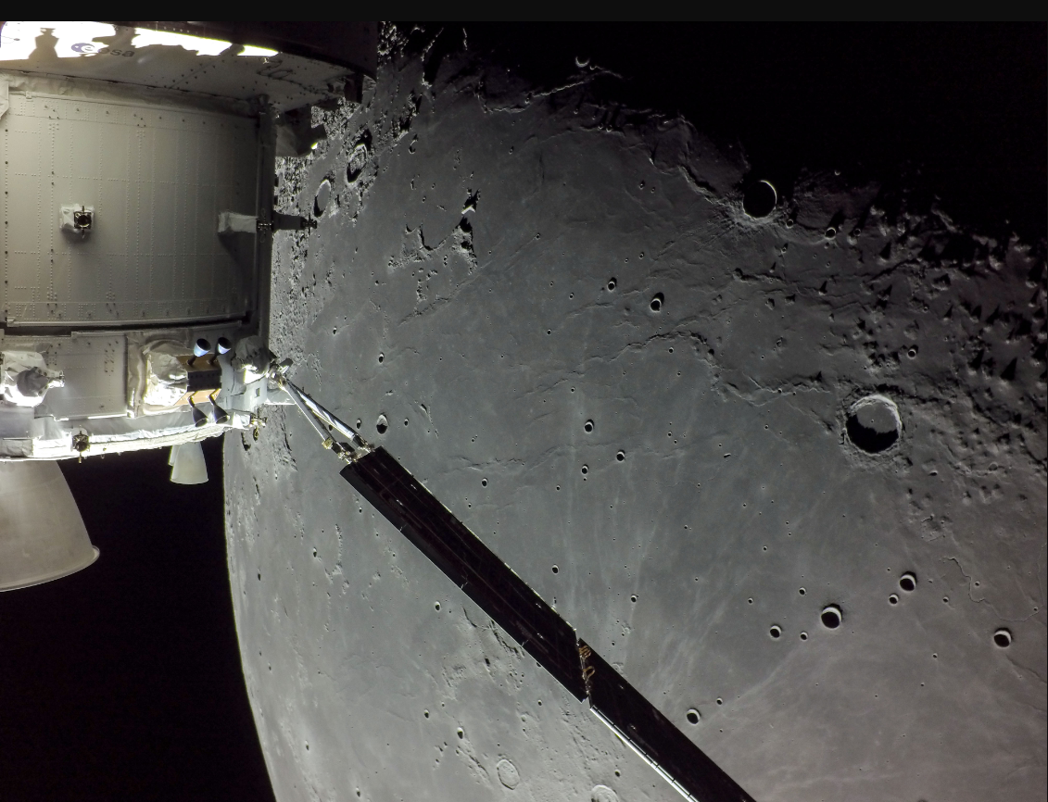
Flight Day 20 Pre-
Lunar Flyby

Slide 7
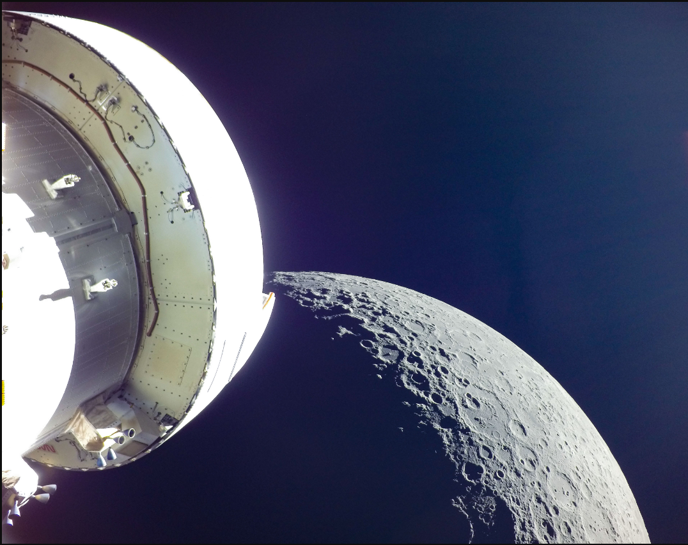
Flight Day 20 Post-
Lunar Flyby

Slide 8
Analysis Tools
High fidelity
  Spacecraft Power Capability (SPoC), Lockheed Martin
  System Power Analysis for Capability Evaluation (SPACE), NASA GRC
  Used for verification of requirements and validation of mission plans
  Detailed inputs and assumptions, modelling a particular case (slow to setup)
  Choosing a conservative and bounding case can be challenging
Screening
  Power screening tool, Lockheed Martin
  Simpler, conservative assumptions (fast to setup and run)
  Quickly assess thousands of possible trajectories

Slide 9

Challenges – Analyze the Mission Space
Rapidly analyze years’ worth of launch opportunities (17,000+ trajectories)
Sun, Earth and Moon phasing throughout the year causes eclipses to move relative to major mission events
  Could not use generic mission timeline analysis across the mission space
  Mission duration variability (28-42 days) caused additional complexity
Ensure Orion survives with potential power faults, such as:
  1 Battery Failure
  1 Solar Array Wing Failure
Provide mission ops situational awareness for potentially power stressing situations
  Deconflict events such as correction burns or out of attitude maneuvers (that reduce power generation)

Slide 10
Reducing Fidelity, Increasing Speed
Perform Power Screening
Find Stressing Mission Phases
Anchor Results with High Fidelity Analysis
Update Ground Rules & Assumptions
Create a new analysis tool that would leverage existing trajectory data, assume conservative CONOPS, and simple charging and discharging models to speed up the analysis
  Charging and Discharging assumptions are based in high fidelity SIMULINK Integrated battery model (SPOC)
High Fidelity analysis takes ~20 hours to run an End-to-End power analysis
New Power Screening Tool can scan over 17,000 trajectories in less than 2hrs
Ensure the Power Screening tool is more conservative such that the results are bounding
Continuous integration led to quick analysis turnaround

Slide 11
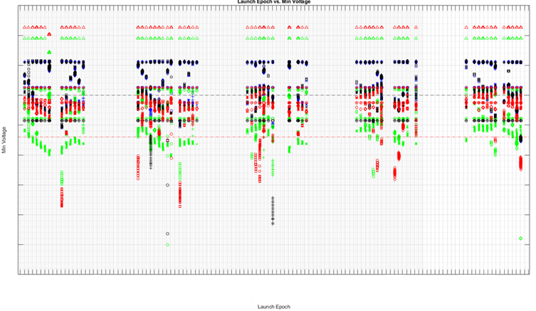
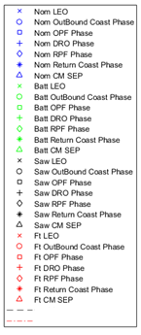
Go/No-Go Recommendations
Launch window cutouts based on minimum voltage for a given epoch
Provide situational awareness to mission ops to schedule power downs prior to stressing situations

Slide 12
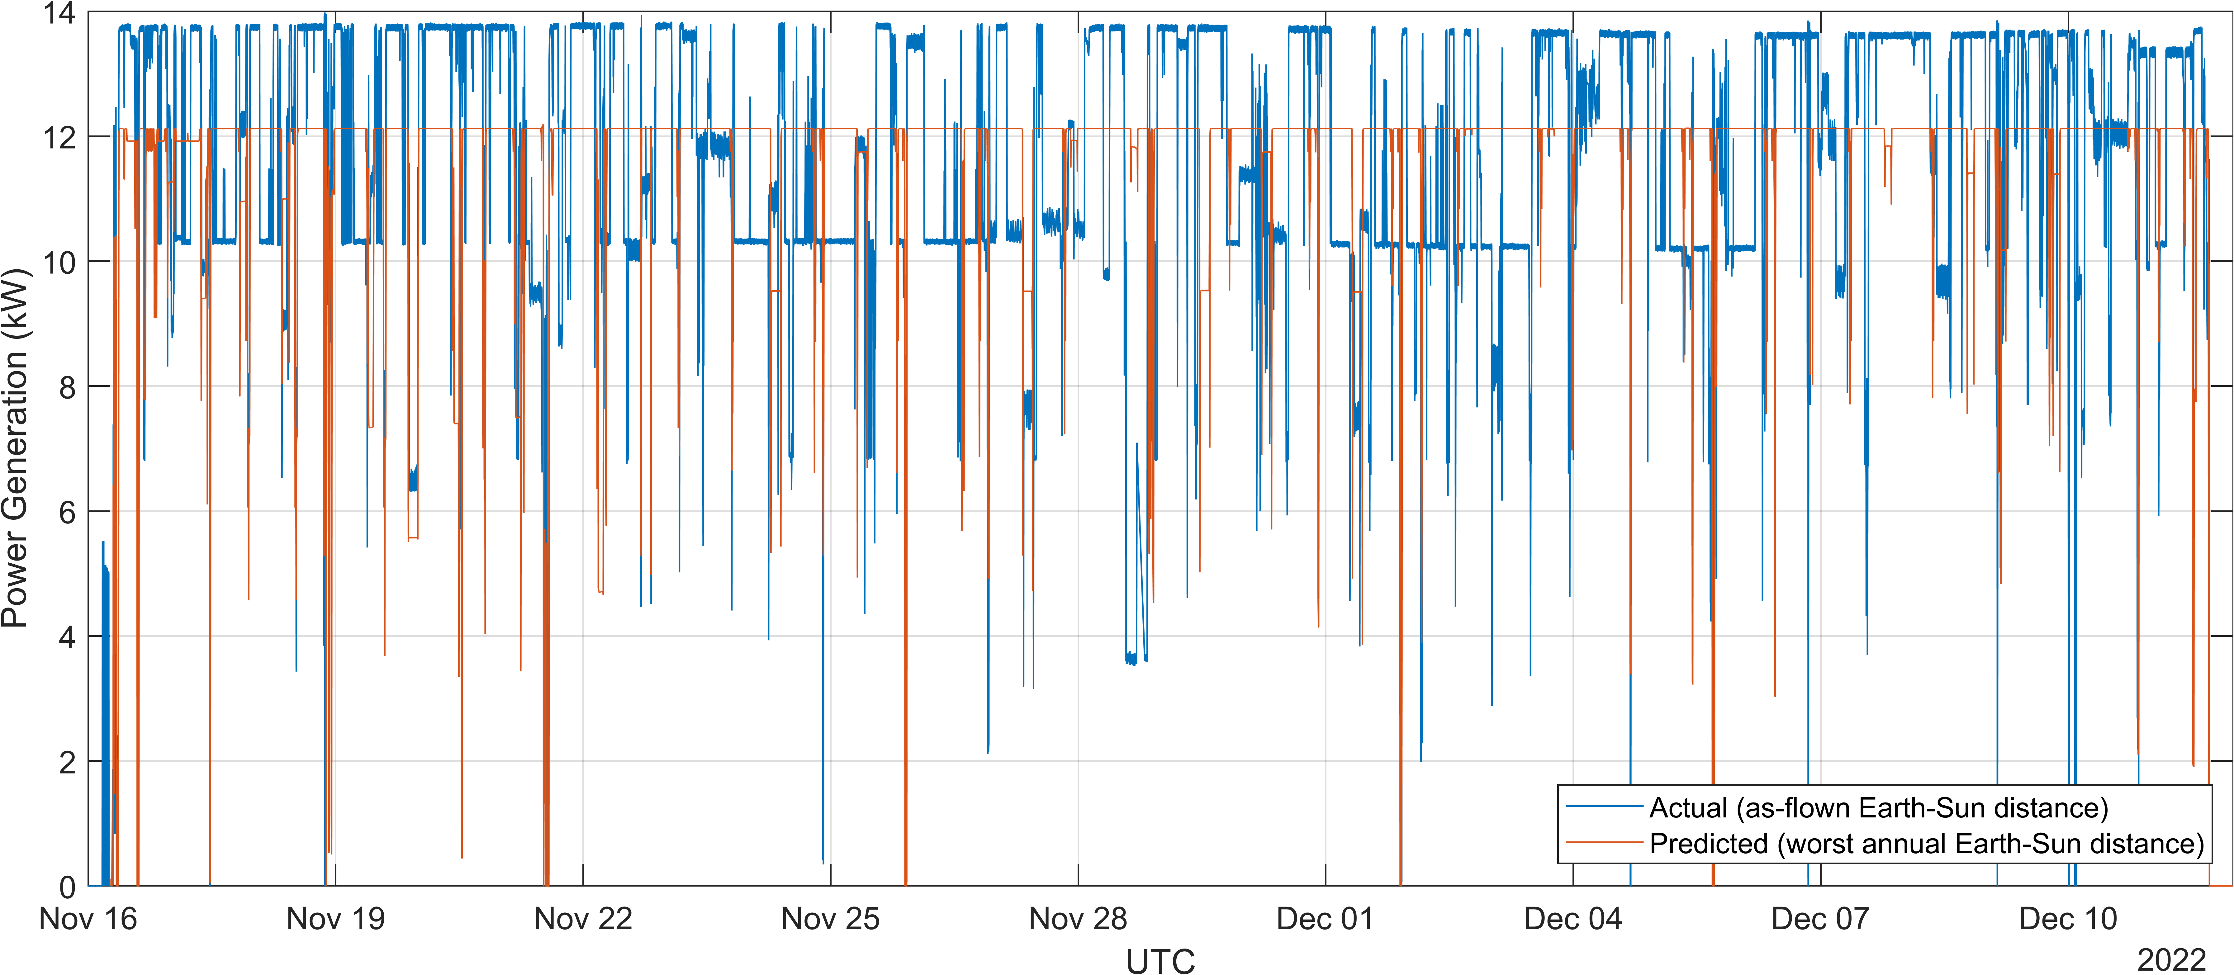
Power Generation
Significant additional power generation primarily due to higher solar flux in Nov/Dec
Model predictions were within ~3% after correcting for as-flown flux
Notes:
Will verbally point out areas with 25% drop are due to SAW off-pointing for imagery
Mention other hit factors, not just flux

Slide 13
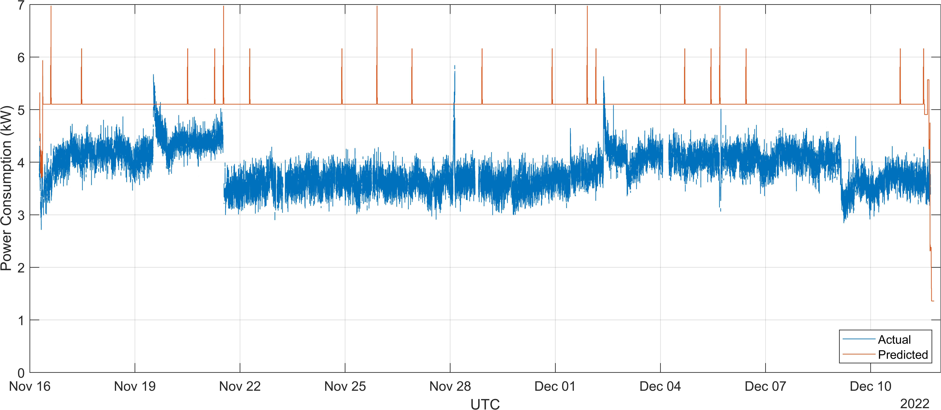
Load Demand
Lower than expected loads driven by heater usage
Notes:
Will verbally note that significant changes in loads were due to heater setpoint changes
Lower heaters may be due to warmer environment – same reason as higher power gen

Slide 14
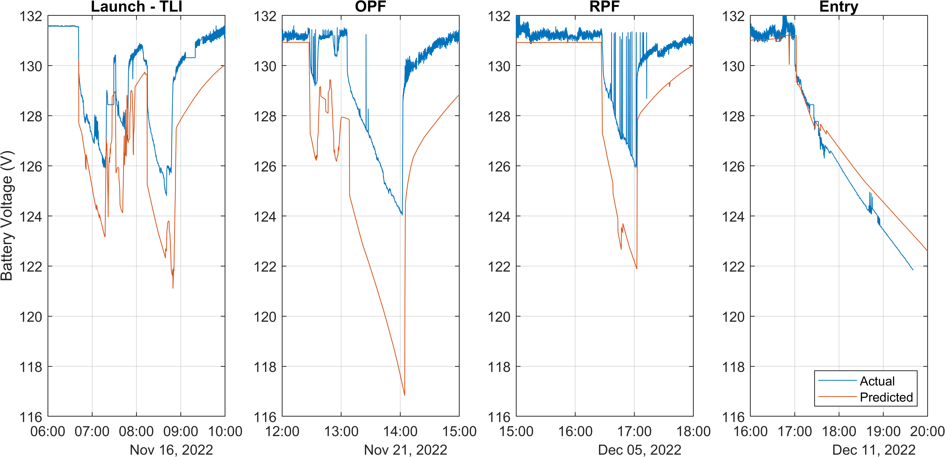
Battery Voltage
Battery performance benefited from low overall load demand
Notes:
Mention some data issues due to LOS around RPF
OPF predictions off more because of drop in heater power due to setpoint change
A little below predictions on entry, but still well above limits – mostly a load balancing issue, two batteries were below predicts/two above

Slide 15
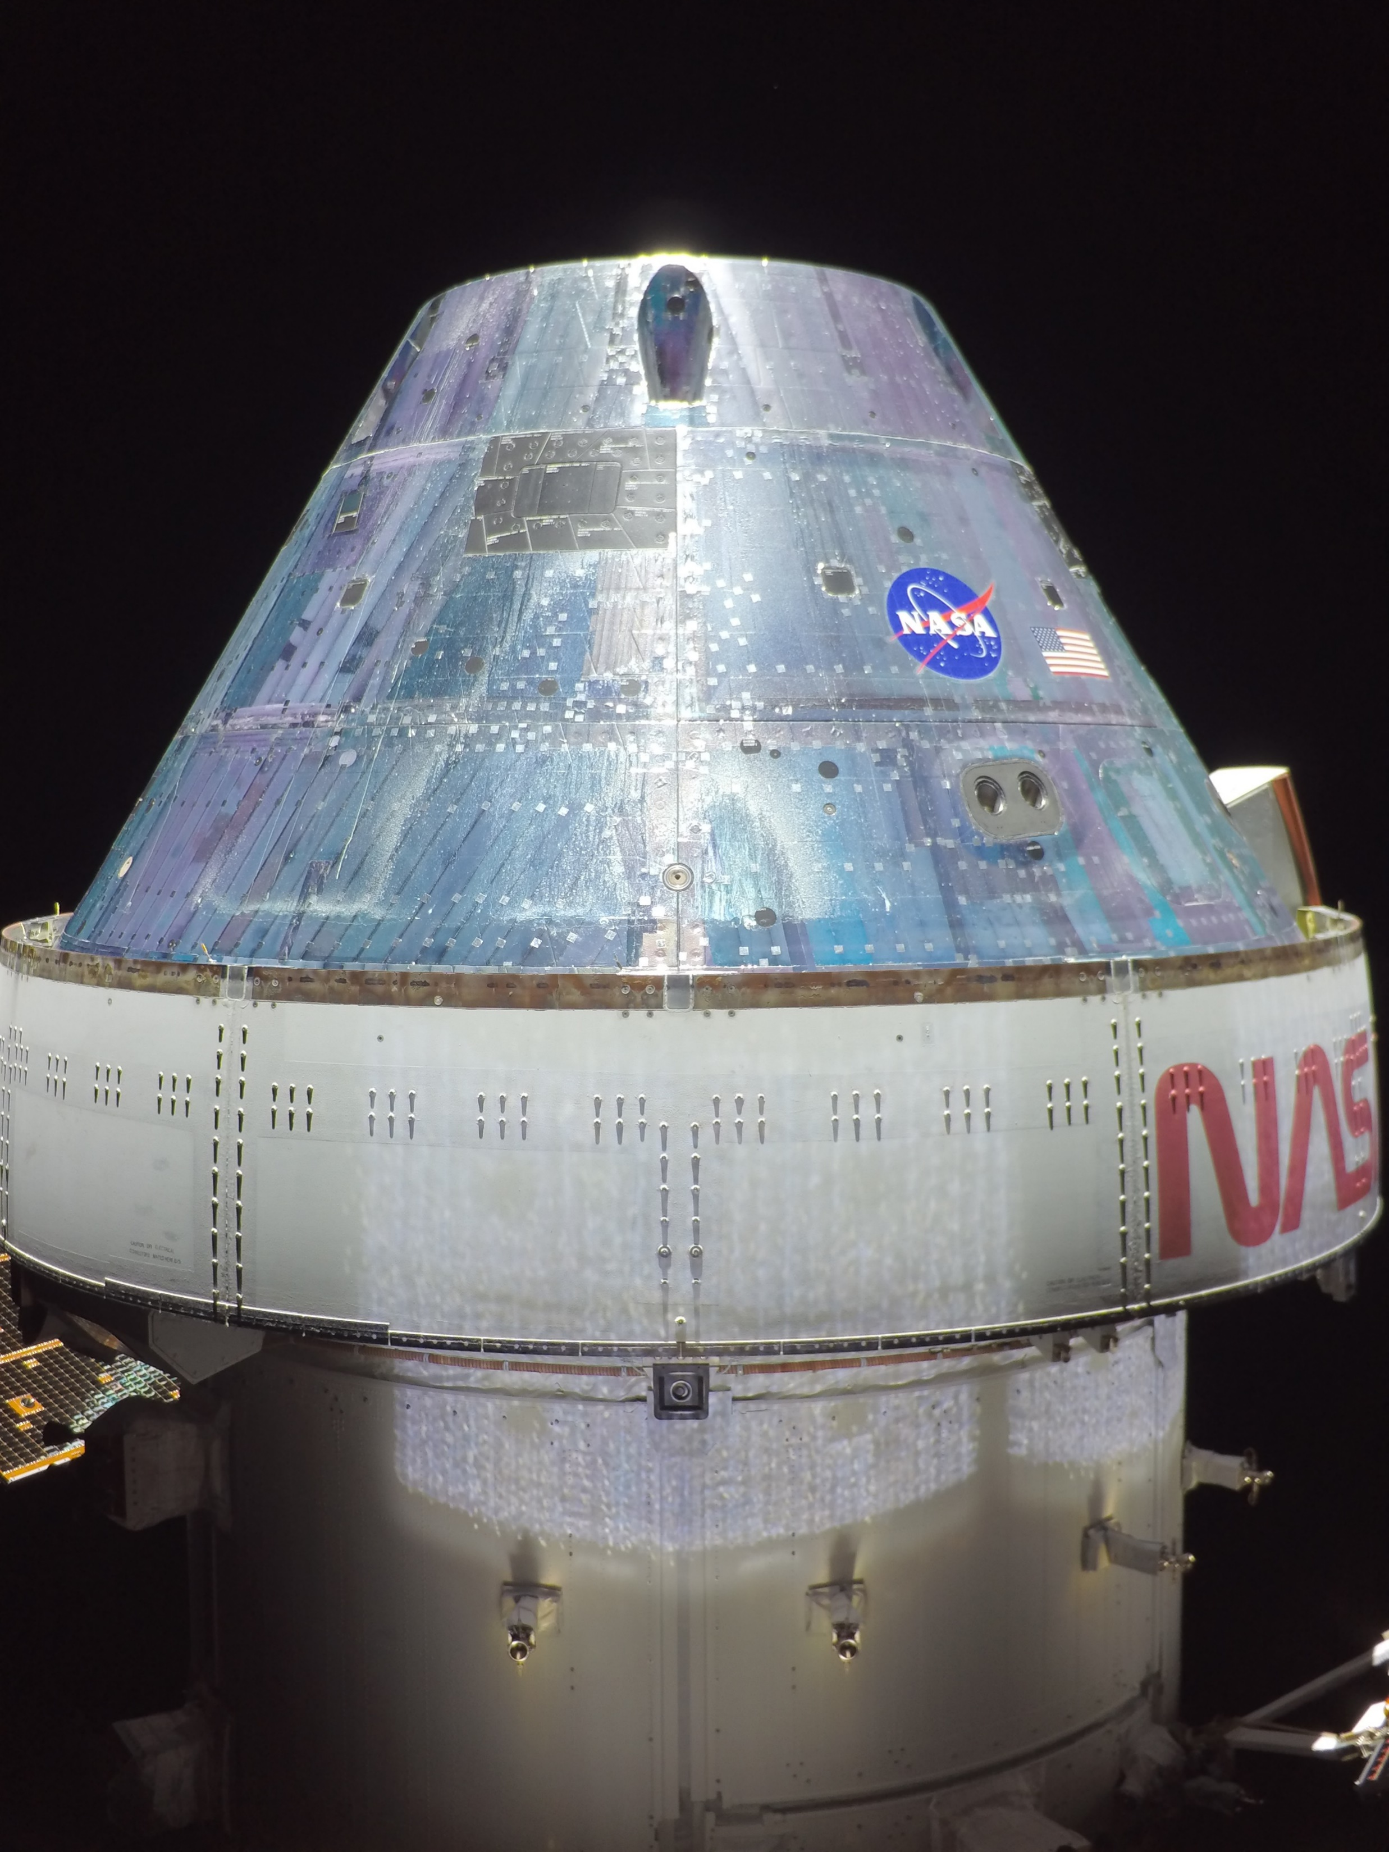
Anomalies and Interesting Observations
PCDU LCL Uncommanded Opening Anomaly
  Uncommanded opening of latching current limiter (LCL) on Power Conditioning and Distribution Unit (PCDU) end of umbilical
  Occurred 22 times on 4 different LCLs (one at a time, always Umbilical 1)
  One similar event involving multiple 120V load LCLs
  One similar event involving 28V DC-DC converter
  internal to the PCDU
  Never observed in ground testing at the component,
  subsystem, or vehicle level
  Root cause undetermined, investigation still ongoing
Glint from crew module backshell
  Planned to measure during external survey
  Observed localized current increases from increased flux

Slide 16
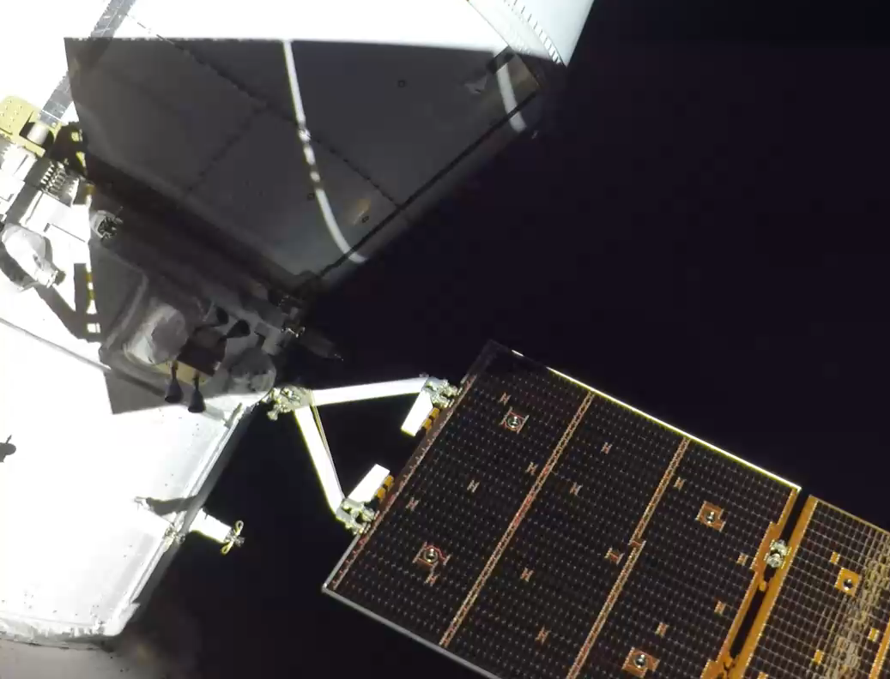
Anomalies and Interesting Observations
Solar array photoluminescence
  Partially shadowed string of solar cells
  III-V cell photoluminescence occurs in visible spectrum
  Happened to occur while filming upper stage separation

Slide 17
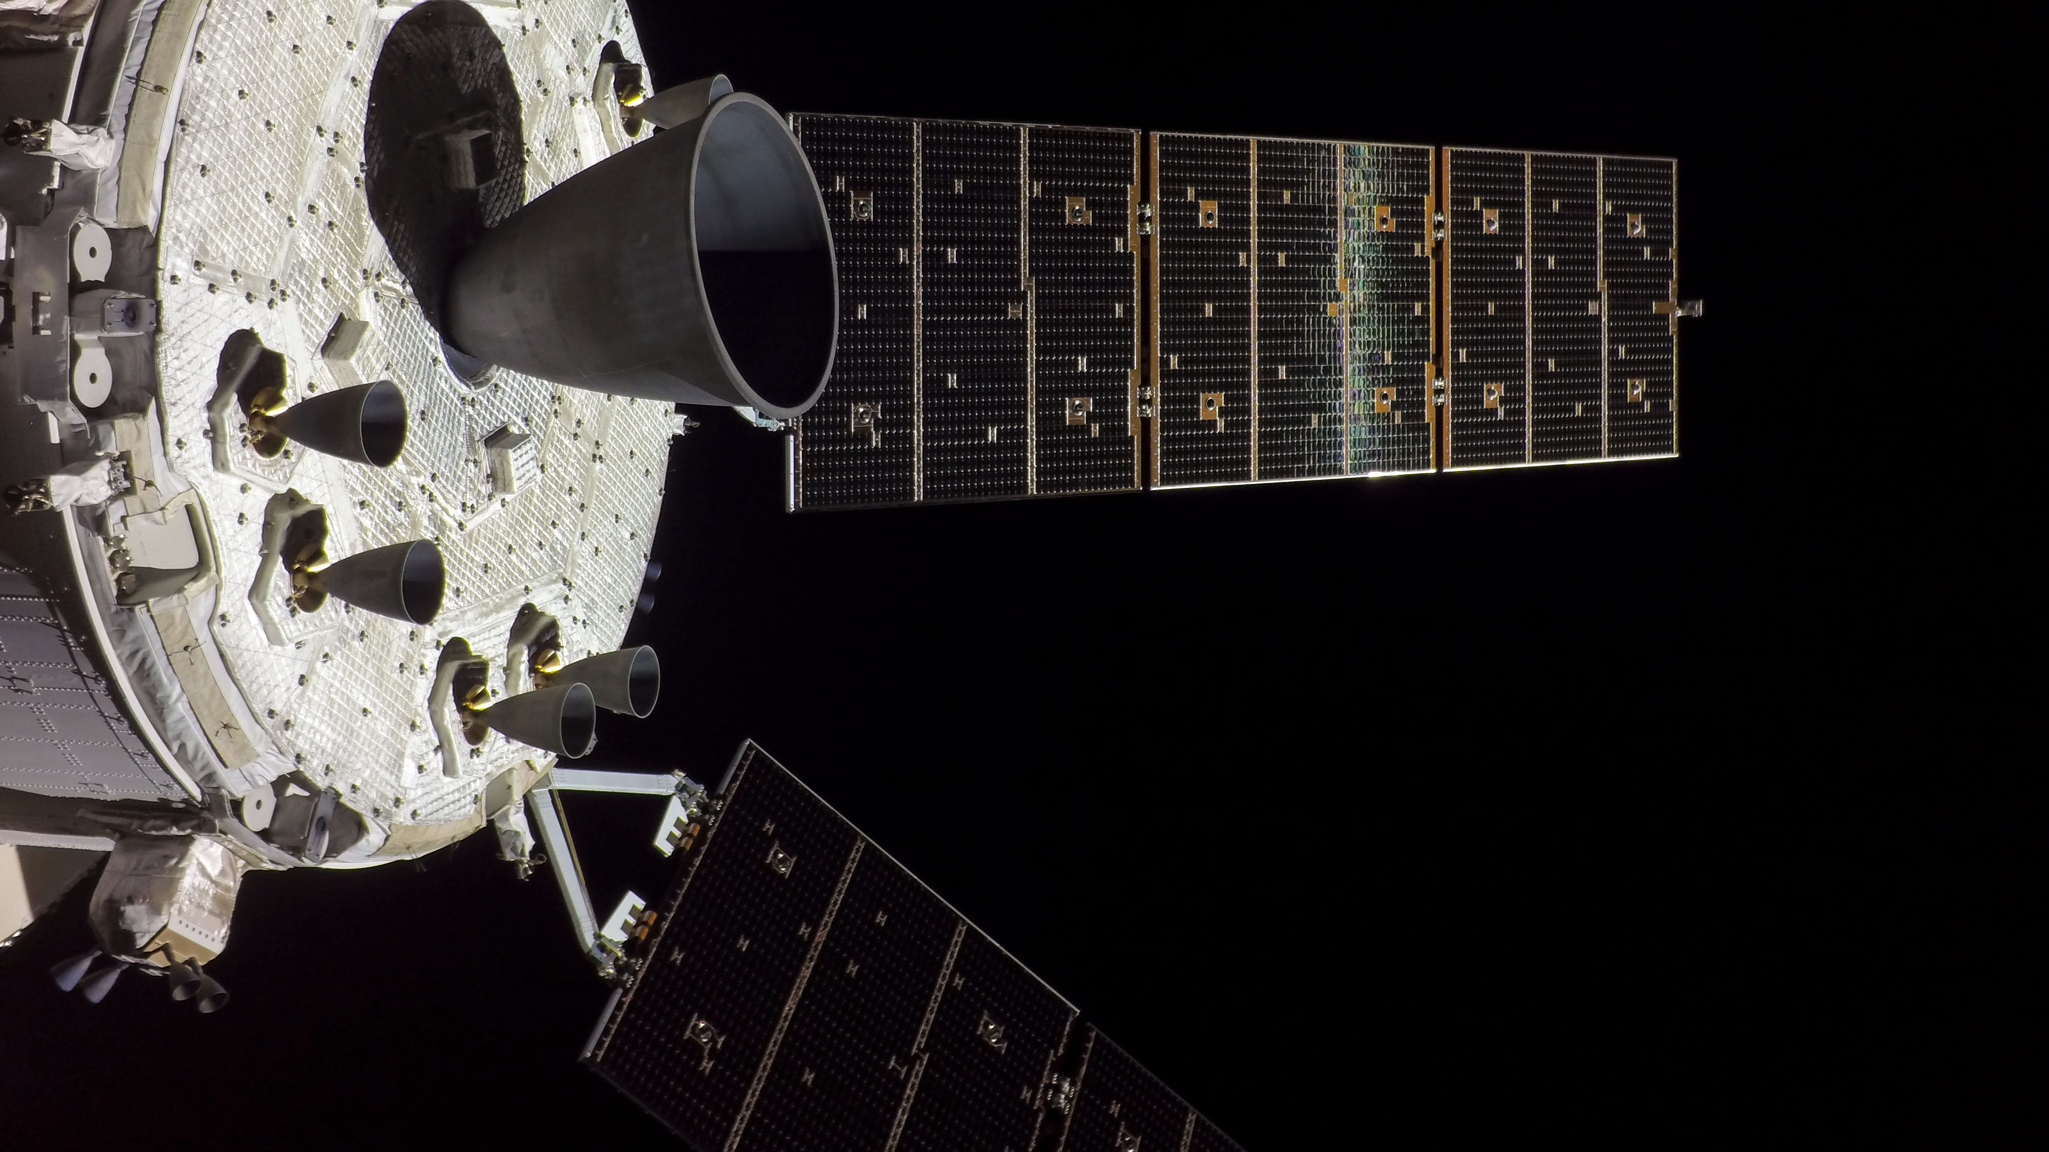
Questions?
Spencer Furin
Hector Hernandez
Anuj Patel

Slide 18
Acronym Definitions
CM – Crew Module
CONOPS – Concept of Operations
DC – Direct Current
DRO – Distant Retrograde Orbit
EI – Entry Interface
GRC – Glenn Research Center
ICPS – Interim Cryogenic Propulsion Stage
LCL – Latching Current Limiter
LEO – Low Earth Orbit
NASA – National Aeronautics and Space Administration
OPF – Outbound Powered Flyby
OTC – Outbound Trajectory Correction
PCDU – Power Conditioning and Distribution Unit
RPF – Return Powered Flyby
RTC – Return Trajectory Correction
SLS – Space Launch System
SPACE – System Power Analysis for Capability Evaluation
SPoC – Spacecraft Power Capability
TLI – Trans-Lunar Injection

