Slide 1
SAGE III/ISS v5.3 Level 2 Data Product Changes and Improvements
Carter Hulsey⁽¹⁾, David Flittner⁽²⁾, Robert Damadeo⁽²⁾, Michael Pitts⁽²⁾, Marsha Larosee ⁽¹⁾, Robert Manion⁽¹⁾
(1) Science Systems and Applications, Inc., Hampton, Virginia, USA (2) NASA Langley Research Center, Hampton, Virginia, USA

Slide 2
Background
The Stratospheric Aerosol and Gas Experiment on the International Space Station (SAGE III/ISS) is an occultation instrument that acquires measurements of aerosols and gases within the Earth’s stratosphere and upper troposphere
Level 2 Solar Data Products Includes: aerosol extinction (9 channels), nitrogen dioxide (NO2), ozone (O3), and water vapor (H2O)
  Currently provide three O3 profiles based on differing retrievals:
    MesO3 is based on measurements at short wavelengths within the Hartley-Huggins band
    MLR O3 is based on measurements made at visible wavelengths within the Chappius band
    AO3 is found using a more SAGE II like approach
Level 2 Lunar Data Products Includes: ozone (O3), nitrogen dioxide (NO2), and nitrogen trioxide (NO3)

Slide 3
Version 5.3 Significant Changes
Implementation of disturbance monitoring package (DMP) to solar algorithm corrections to improve pointing accuracy
Change in meteorological input from the 42 level Modern-Era Retrospective analysis for Research and Applications, Version 2 (MERRA-2) model data to the 72 level MERRA-2 model data for both solar and lunar algorithms
Changes to the automated quality assurance (QA) algorithm
Other changes include minor bug fixes as well as restoration of some data quality flags that were removed in v5.21
Notes:
inst3_3d_asm_Np (42 pressure levels) -> inst3_3d_asm_Nv (72 model layers)
Met change produced no significant product differences one way or the other through the reliable part of the L2 profiles

Slide 4
Disturbance Monitoring Package (DMP)
The SAGE III/ISS instrument being on the ISS causes certain problems when trying to acquire accurate and precise measurements
These problems can include ISS performing maneuvers, mechanical disturbances, and vehicle visits
The DMP is comprised of a miniature inertial measurement unit built by Honeywell Aerospace that measures rotation in inertial space using ring laser gyroscopes oriented about three orthogonal axes
The DMP is used in version 5.3 solar algorithm to improve pointing knowledge and correct pointing errors caused by disturbances on the ISS

Slide 5
Disturbance Monitoring Package (DMP)

Slide 6
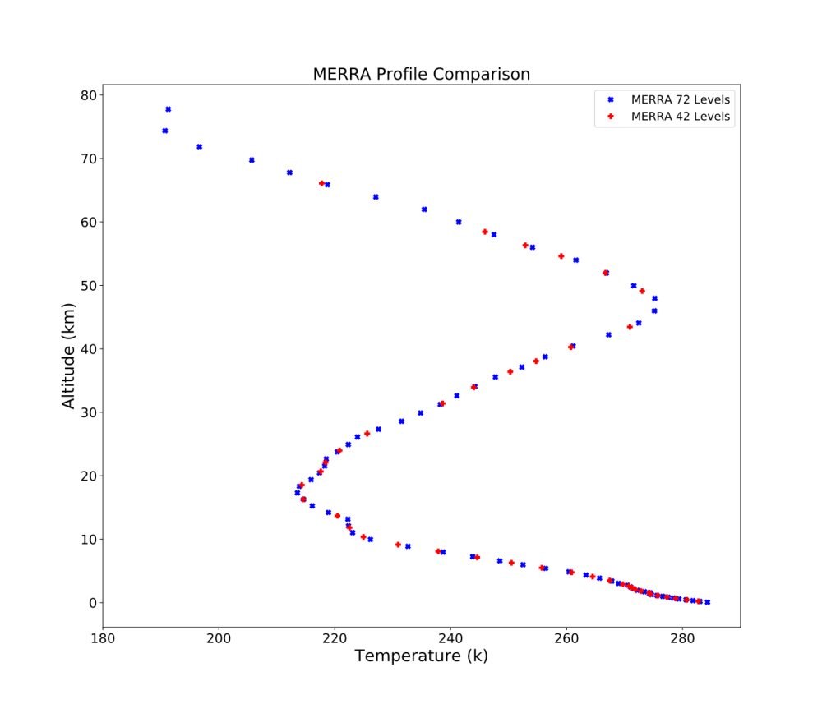
Meteorological Input (MERRA) Change
Increases the number of Meteorological Input levels from 42 to 72
Along with the higher resolution the 72 level MERRA also adds data points up to around 78 km compared 65 km for the 42 layer
The 72 level MERRA-2 data, unlike the 42 level MERRA-2 data, doesn't have data at constant pressure levels so the pressure is now interpolated
The Meteorological input change produced no significant product differences through the reliable part of the Level 2 profile

Slide 7
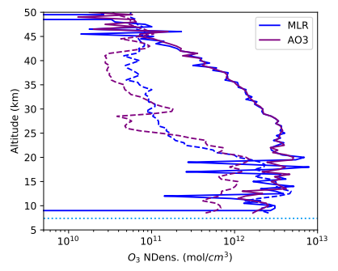
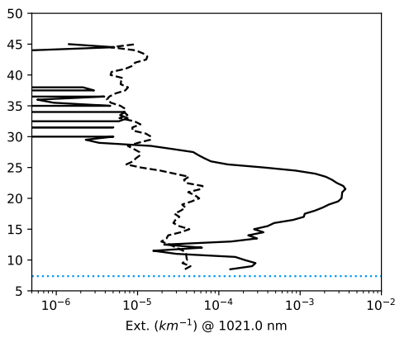
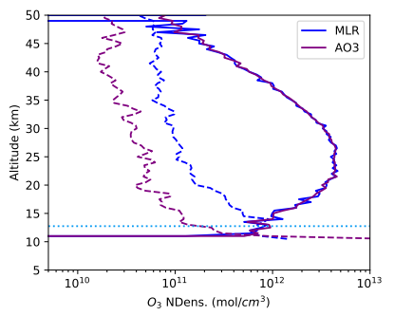
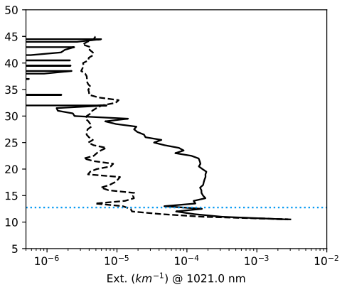
Automated QA Improvements
QA before v5.2 was done manually but since v5.2 QA has been automated
  Triggers include fill-dominated profiles, known instrument errors, suspected blockage, eclipse, etc.
  Less than 1% of solar occultation events are withheld (380 out of 46469)
Events withheld when “AO3” and “MLR” differ around the ozone maximum
  Through 30-August 2022, 68 solar occultation events withheld because of this criterion.
  Only 2 of those prior to Feb 2022
  These withheld events were caused by the eruption of Tonga–Hunga Haʻapai
These events were reviewed, deemed to be releasable, and this auto QA threshold was disabled.
Withheld Event 2022080141SR
Typical Event 2022080107SS
Notes:
66 events is a big chunk of QA, and it’s affecting a period when the data is interesting
Keep 3E-3 aerosol at 21km in mind for the next slide

Slide 8
SAGE III/ISS Version 5.3 Level 2 Data Product Results
Changes made from version 5.2 to version 5.3 only had minimal changes for the the solar products
The notable change to the products between the two versions was a decrease in product uncertainty
  Results from decreases in the noise dominated top of profiles because of a lower noise floor
  Uncertainty differences can be attributed to the implementation of the DMP correction reducing the noise in transmission
The changes between versions also show no significant changes within the Lunar level 2 data products

Slide 9
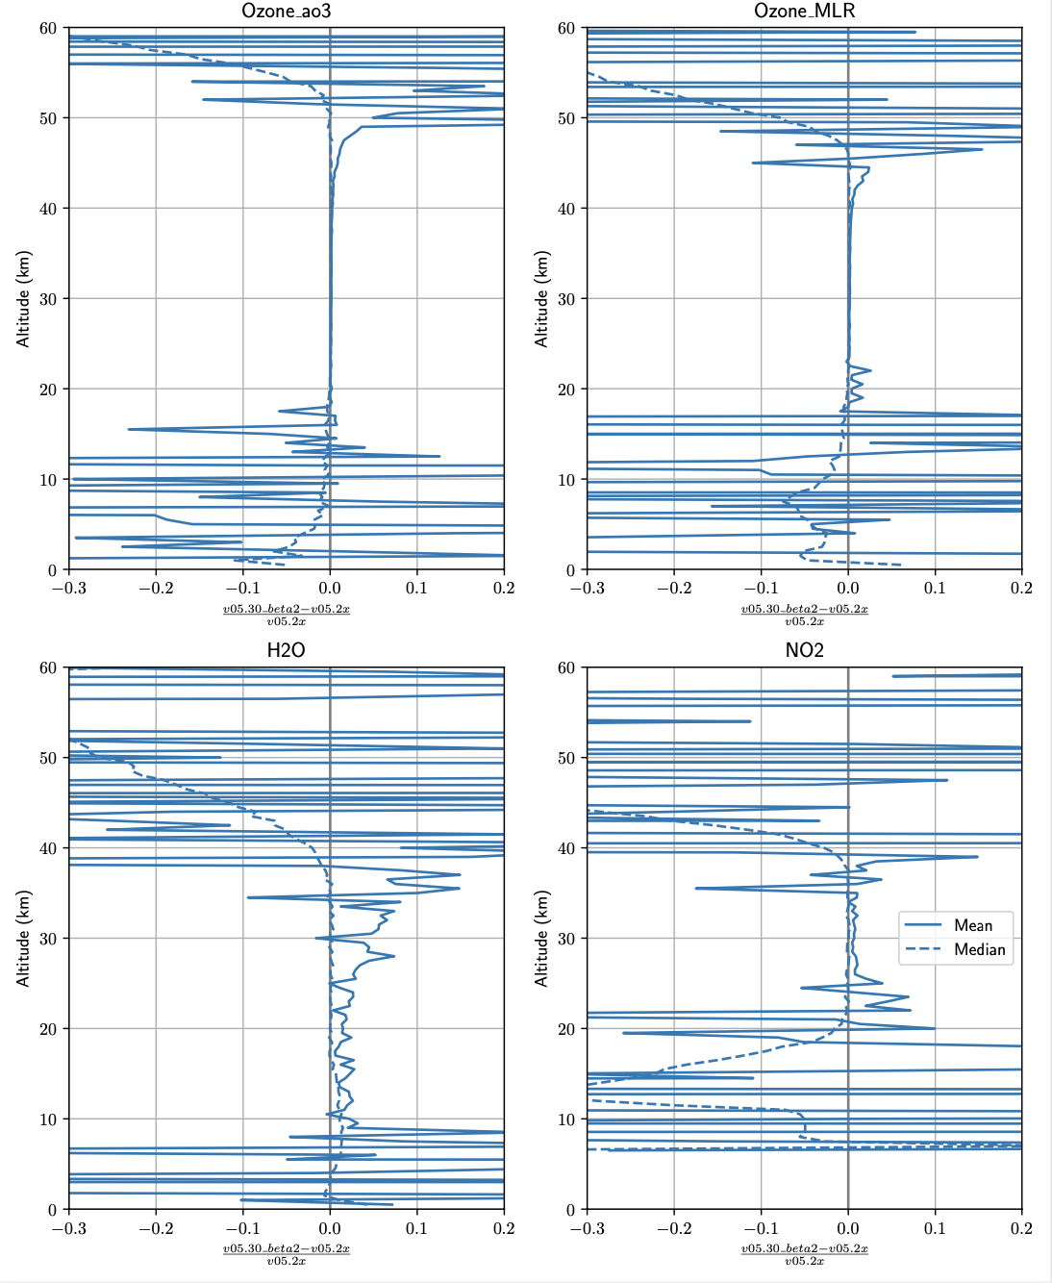
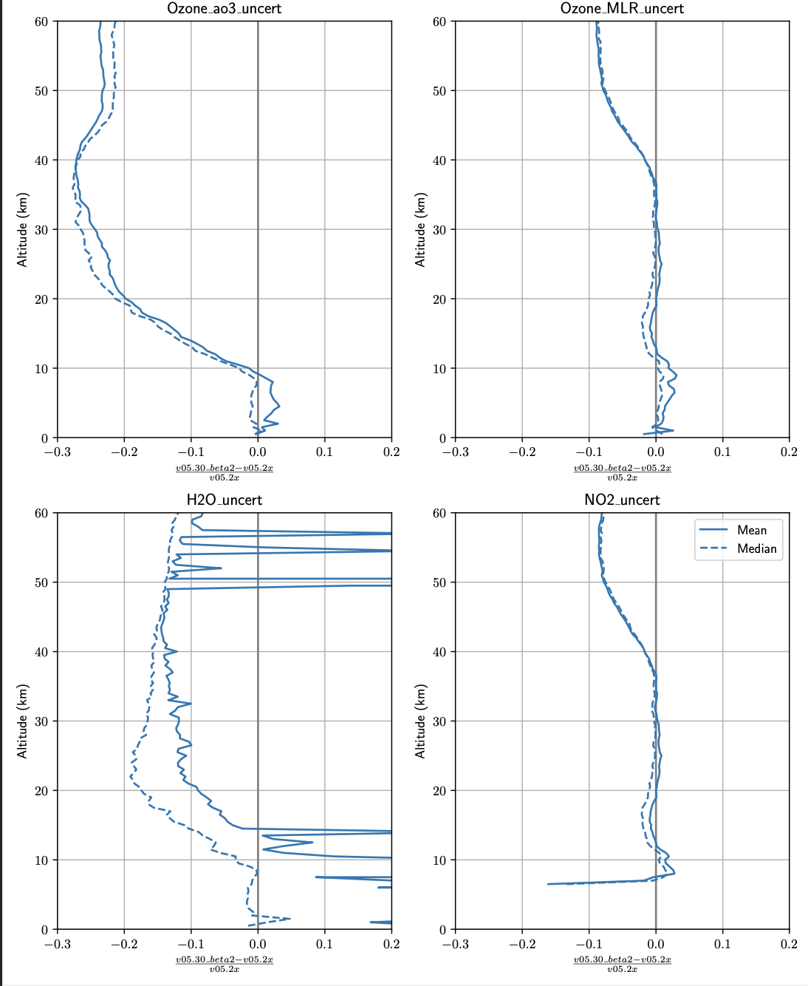

SAGE III/ISS Version 5.3 Level 2 Data Product Results

Slide 10
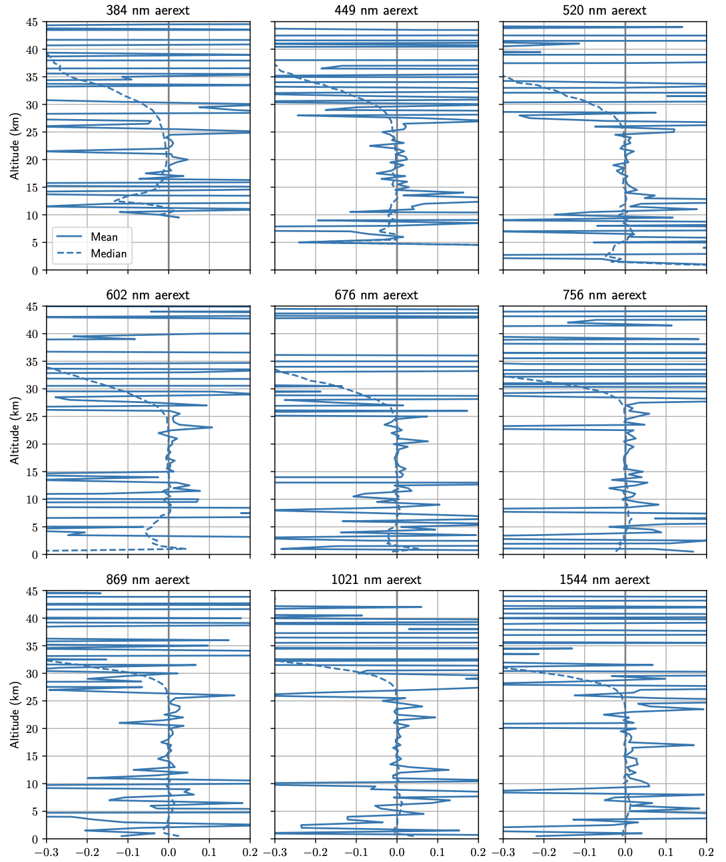
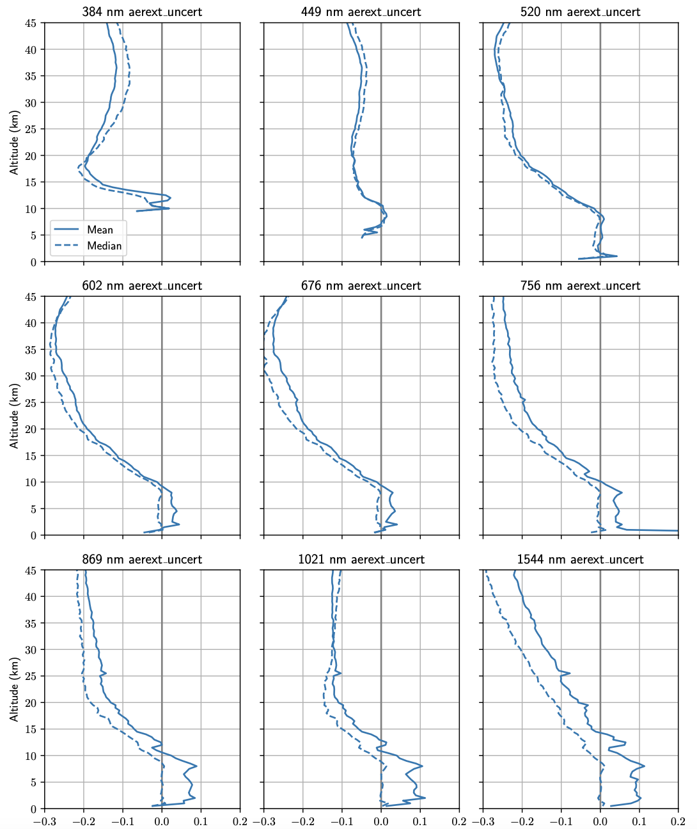
SAGE III/ISS Version 5.3 Level 2 Data Product Results

Slide 11
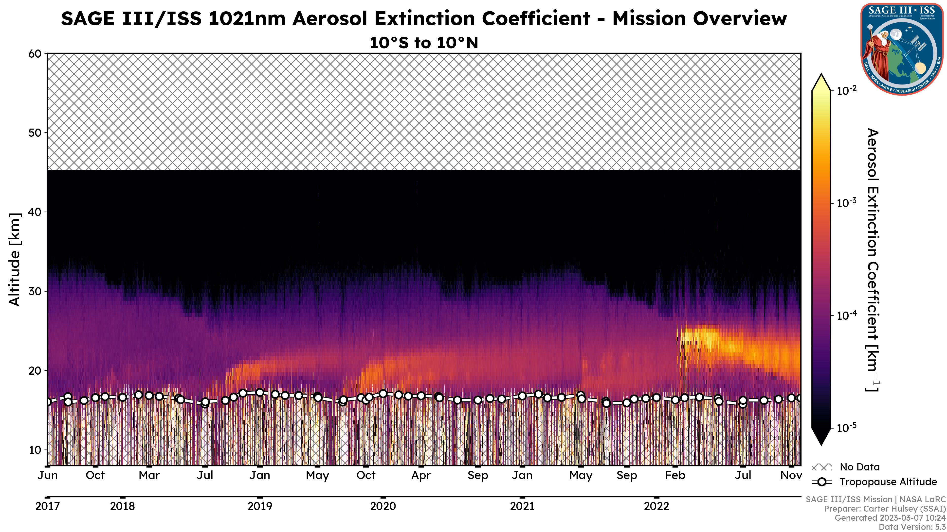
N. Hemisphere
Wildfires
Australia Wildfires
Hunga Tonga
Ambae
Raikoke
La Soufrière

Slide 12
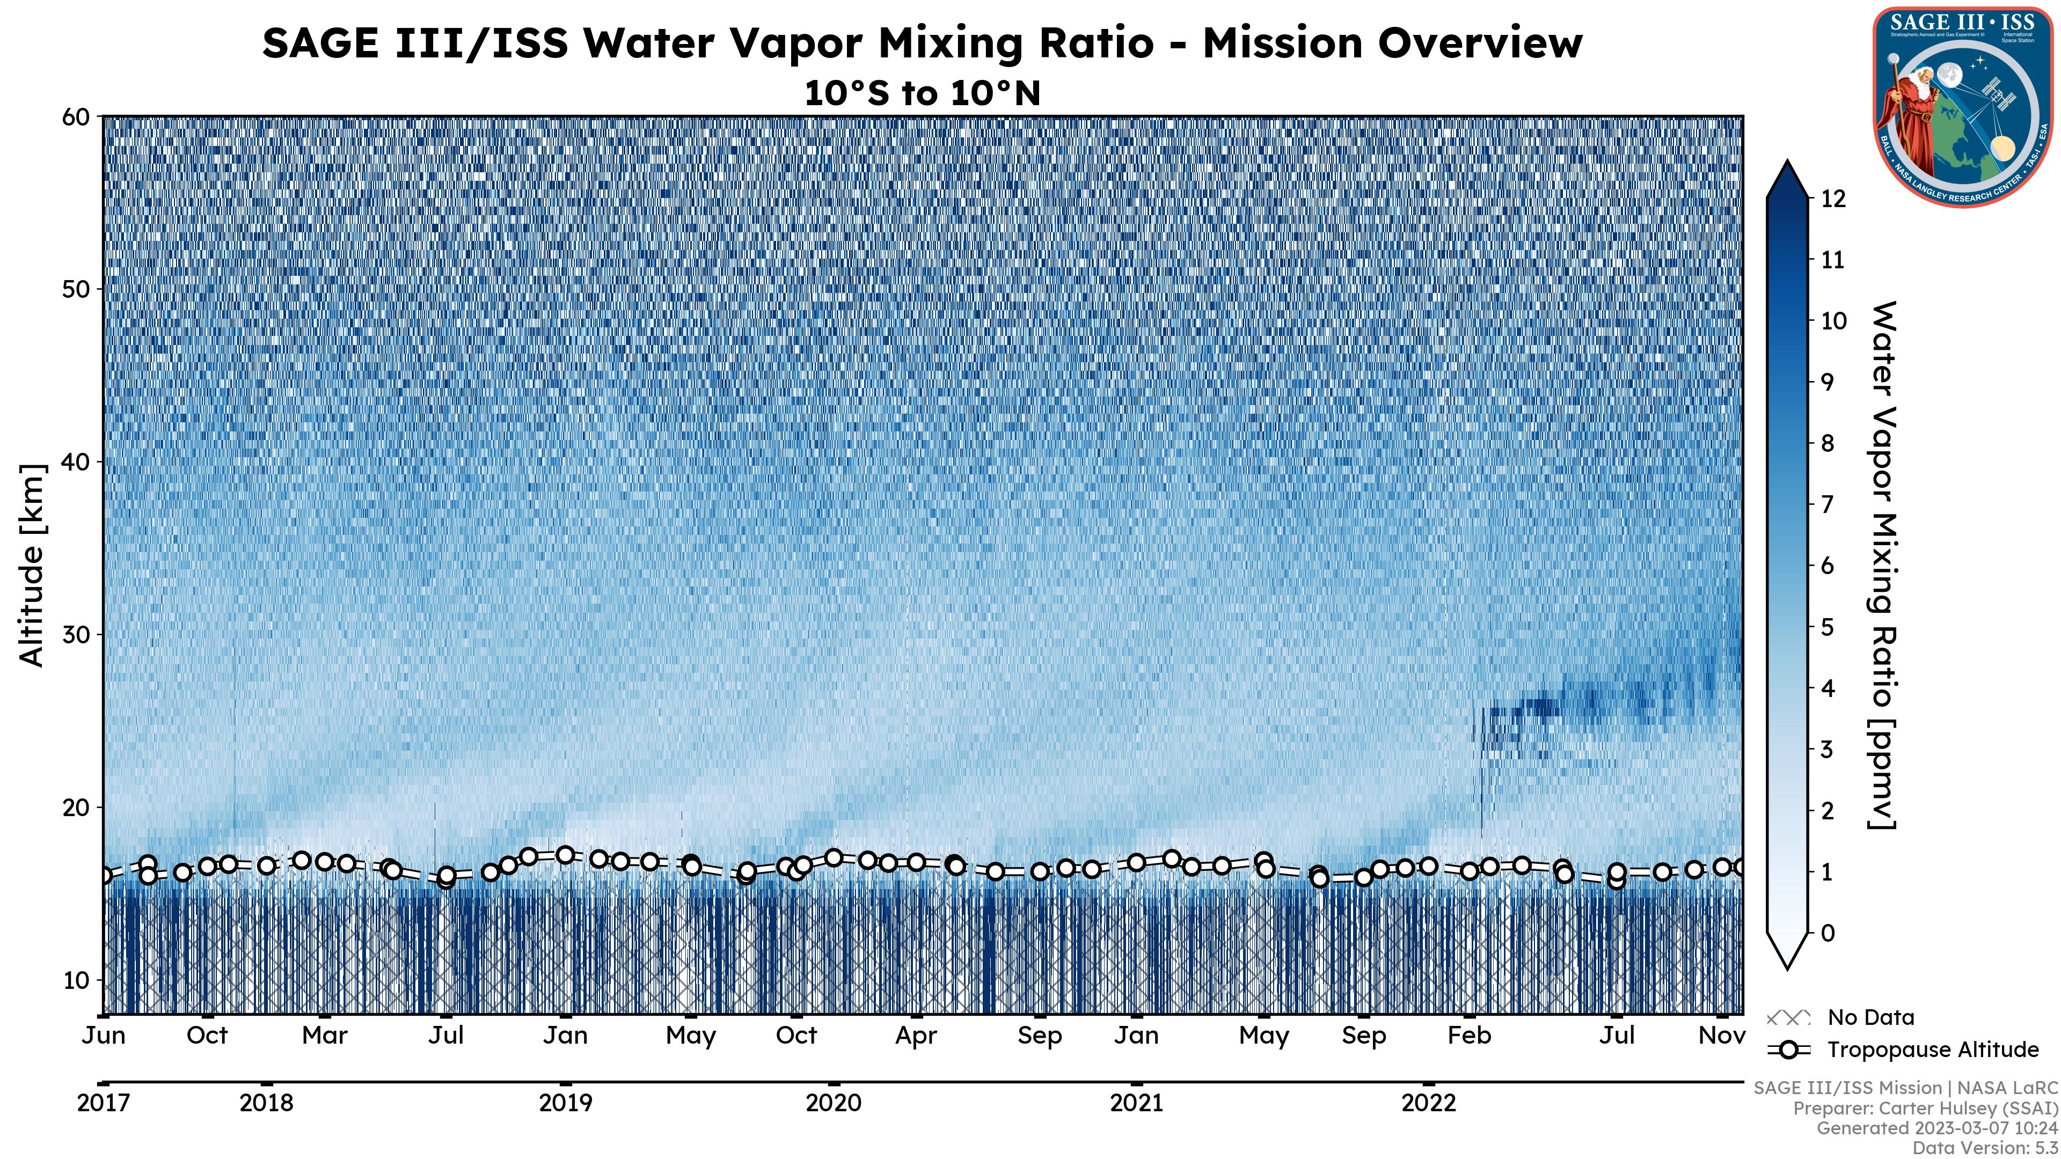
N. Hemisphere
Wildfires
Australia Wildfires
Hunga Tonga
Ambae
Raikoke
La Soufrière

Slide 13
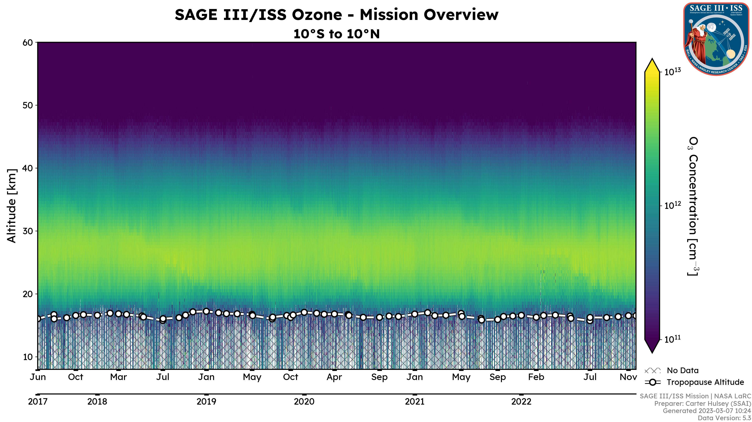
N. Hemisphere
Wildfires
Australia Wildfires
Hunga Tonga
Ambae
Raikoke
La Soufrière

Slide 14
Conclusions and Future Work
Version 5.3 of the SAGE III/ISS level 2 data product saw some significant changes to the algorithm.
Overall, these changes had only minimal changes to the level 2 data products from version 5.2.
Future work beyond version 5.3 will focus on level 1 part of the algorithm.
This will include additional improvements to on-target position & altitude registration, refraction, and stray light correction.

Slide 15
Questions
Carter Hulsey, Science Computing Facility
carter.b.hulsey@nasa.gov
Robbie Manion, Science Computing Facility Lead
robert.manion@nasa.gov
Rob Damadeo, Lead Algorithm Scientist
robert.damadeo@nasa.gov
David Flittner, Project Scientist
david.e.flittner@nasa.gov

