Slide 1
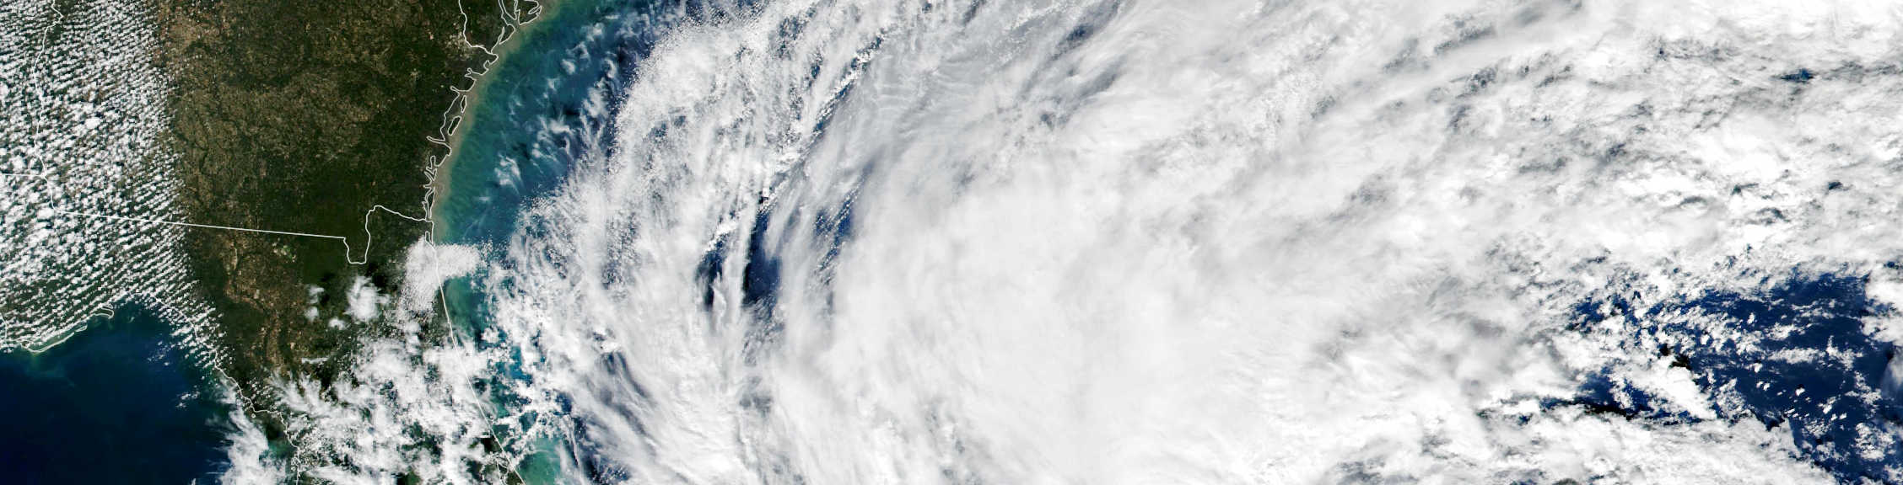


End-User Engagement to Understand NRT and Low Latency EO Data Needs
March 26, 2023
Rachel Soobitsky
Rachel.b.Soobitsky@nasa.gov
maps.disasters.nasa.gov

Slide 2

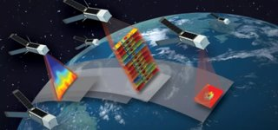
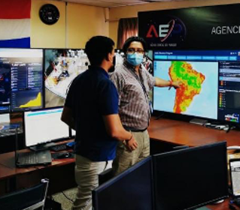



NASA’S EARTH APPLIED SCIENCES DISASTERS PROGRAM
“Advancing Science to Build Disaster Resilience”
We advance the field of disaster science and build tools to help communities make smarter decisions for disaster planning. ​
We work directly with local governments and response teams to support disaster response efforts with Earth observing data and expertise. ​
We foster partnerships around the world to build capacity and strengthen global disaster management efforts.
Core Elements
Disaster Applications
Disaster Response Coordination System
Disaster
Open Access Portal

Slide 3
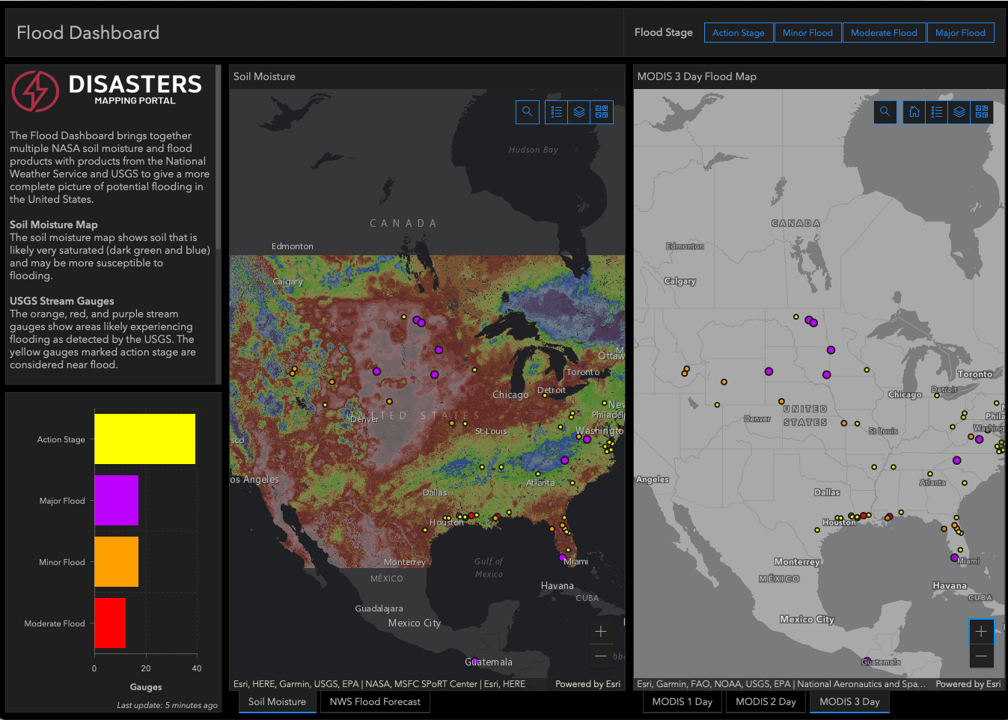

Disasters OPEN-ACCESS MAPPING Portal
maps.disasters.nasa.gov
Free and open data
REST and WMS endpoints for easy ingestion into response team workflows
Combines NASA Earth data with population & infrastructure for an integrated view of risk & vulnerability
Two types of products
  Event-based
  Near Real-Time
ArcGIS Enterprise 10.9.1 hosted at the NASA Center for Climate Simulations (NCCS) at GSFC
Flood dashboard visualizes multiple datasets for situational awareness across the U.S.

Slide 4
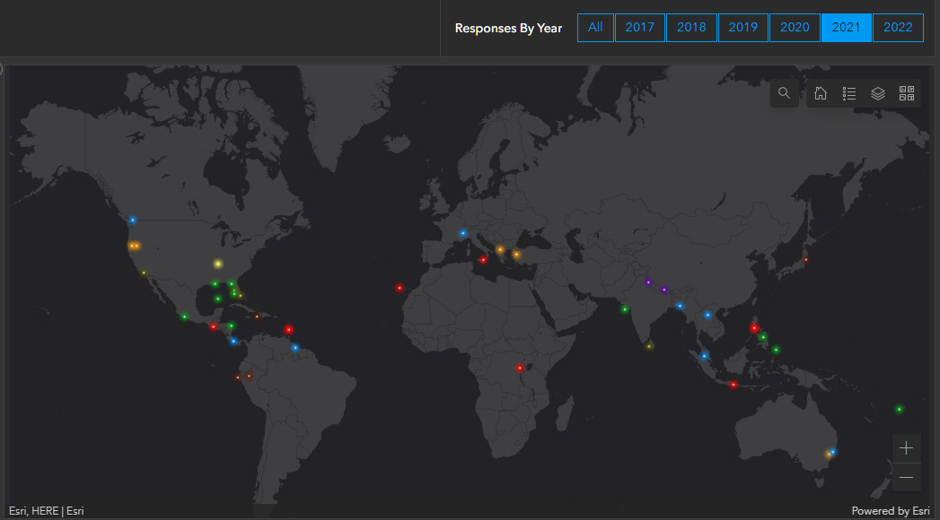
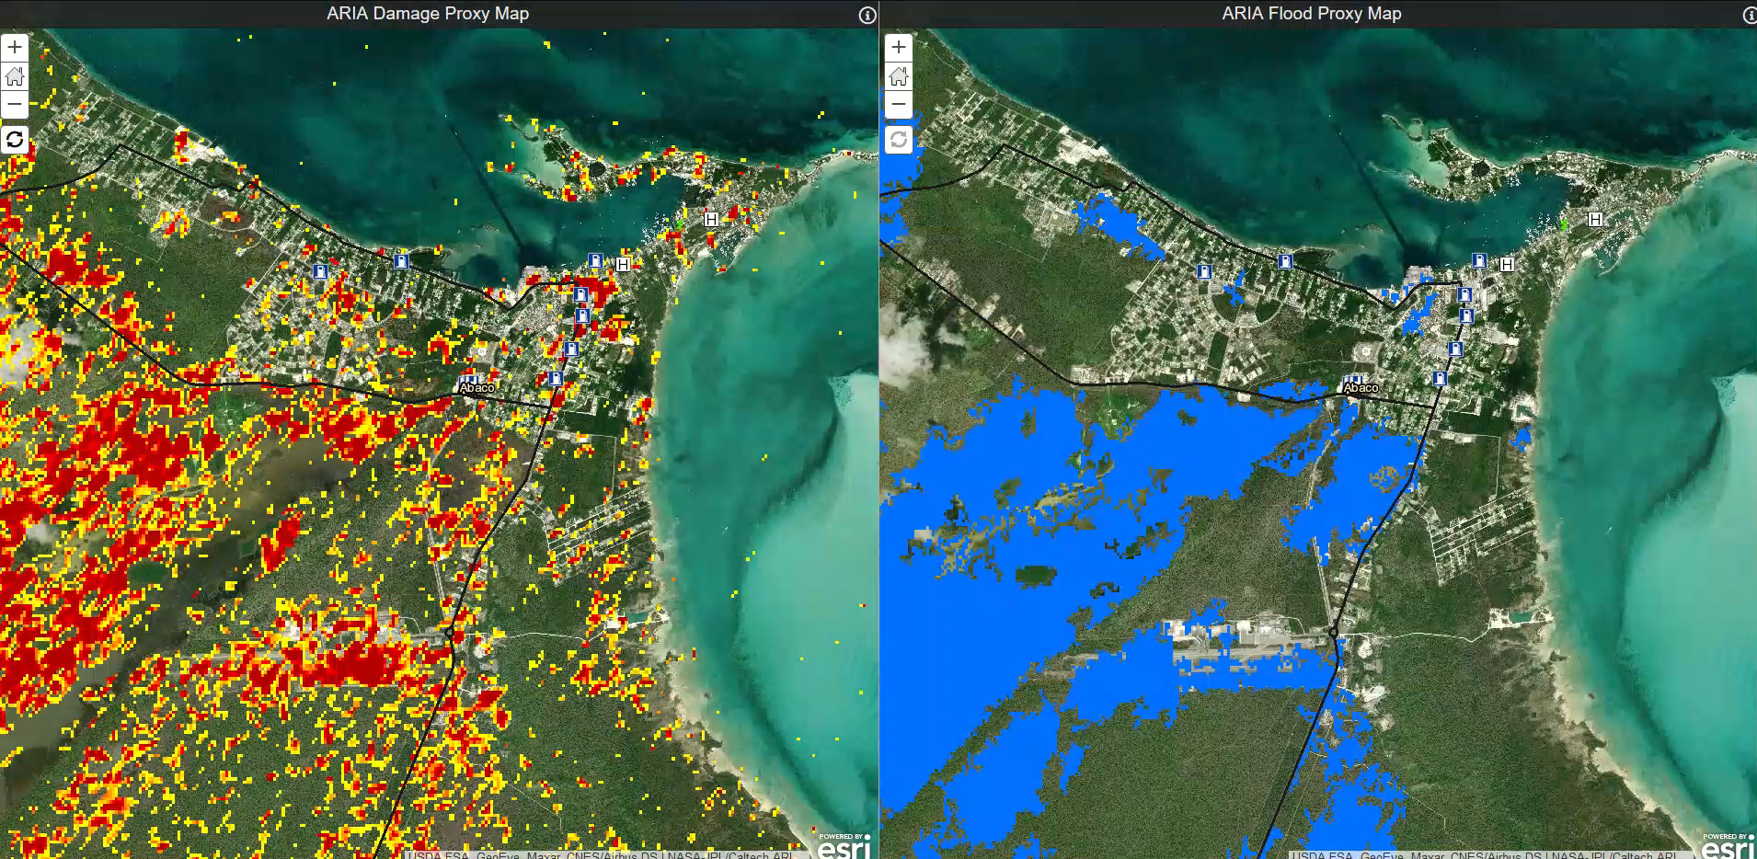
END-USER ENGAGEMENT
Different end-users:
  NGOs
  Government (local/national)
  Private Sector
  International organizations
  Academia
Determine needs
Provide support if available
  Depends on NRT data and satellite passes; program capacity

Slide 5
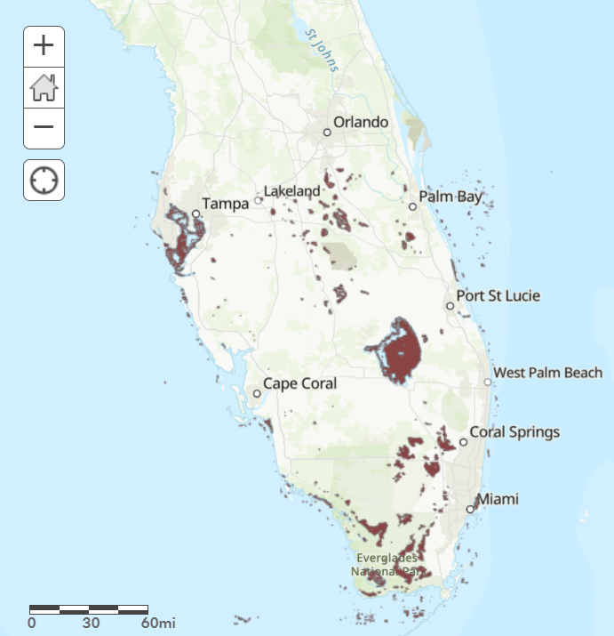
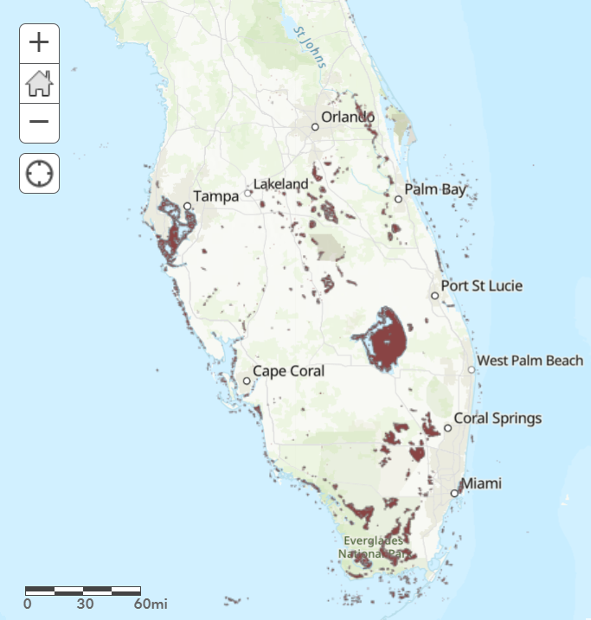
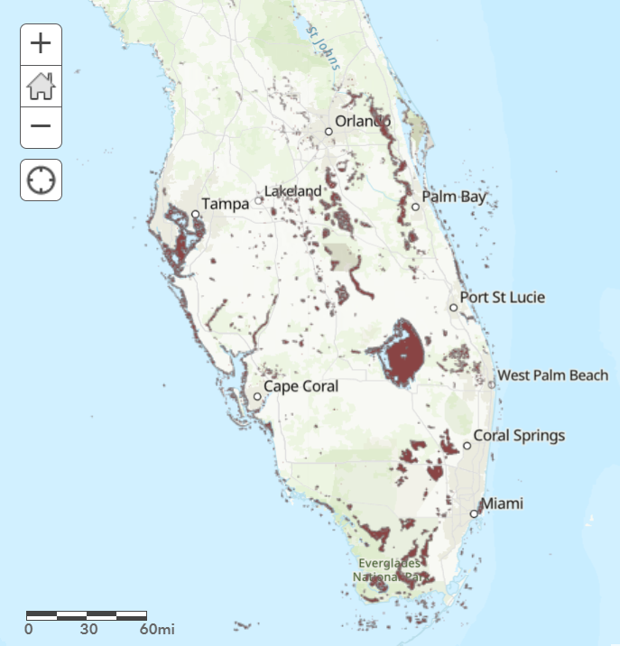
NEAR REAL-TIME AND LOW LATENCY EARTH OBSERVATION DATA NEEDS IN DISASTER RESPONSE
Response organizations need data as soon as possible to help guide efforts in the aftermath of a disaster. While Near Real-Time datasets are often coarser resolution, the quick and high-frequency access to information is vital to making decisions in the early stages of a response. NRT data can help with:
  Identifying which roads may be blocked
  Identifying which neighborhoods may have lost power
  Identifying which areas may have been impacted the most (can be particularly useful with large-scale disasters)
  High-frequency of NRT products helps organizations know where access may now be available to areas previously not
250 m MODIS flood data from 9/30/22, 10/2/22, 10/3/22 (left to right)

Slide 6

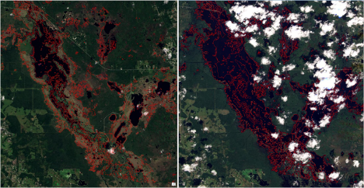
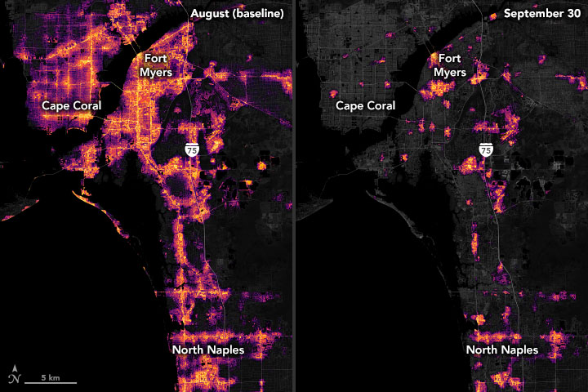
HURRICANE IAN
Team Rubicon is a non-profit that pairs the experience of military veterans with first responders, medical professionals, and technology solutions to provide relief to those affected by disasters. After Hurricane Ian made landfall in late September 2022, the NASA Disasters Program provided maps and imagery through the Disasters Mapping Portal to Team Rubicon for situational awareness to help them determine locations to send their response teams to. With the assistance of NASA’s products, Team Rubicon was able to provide relief efforts across Florida.
PlanetScope map of potentially flooded areas (red) before and after Hurricane Ian, developed in partnership with the Dartmouth Flood Observatory at University of Colorado
Black Marble imagery showing nighttime lights before (left) and after (right) the storm.

Slide 7

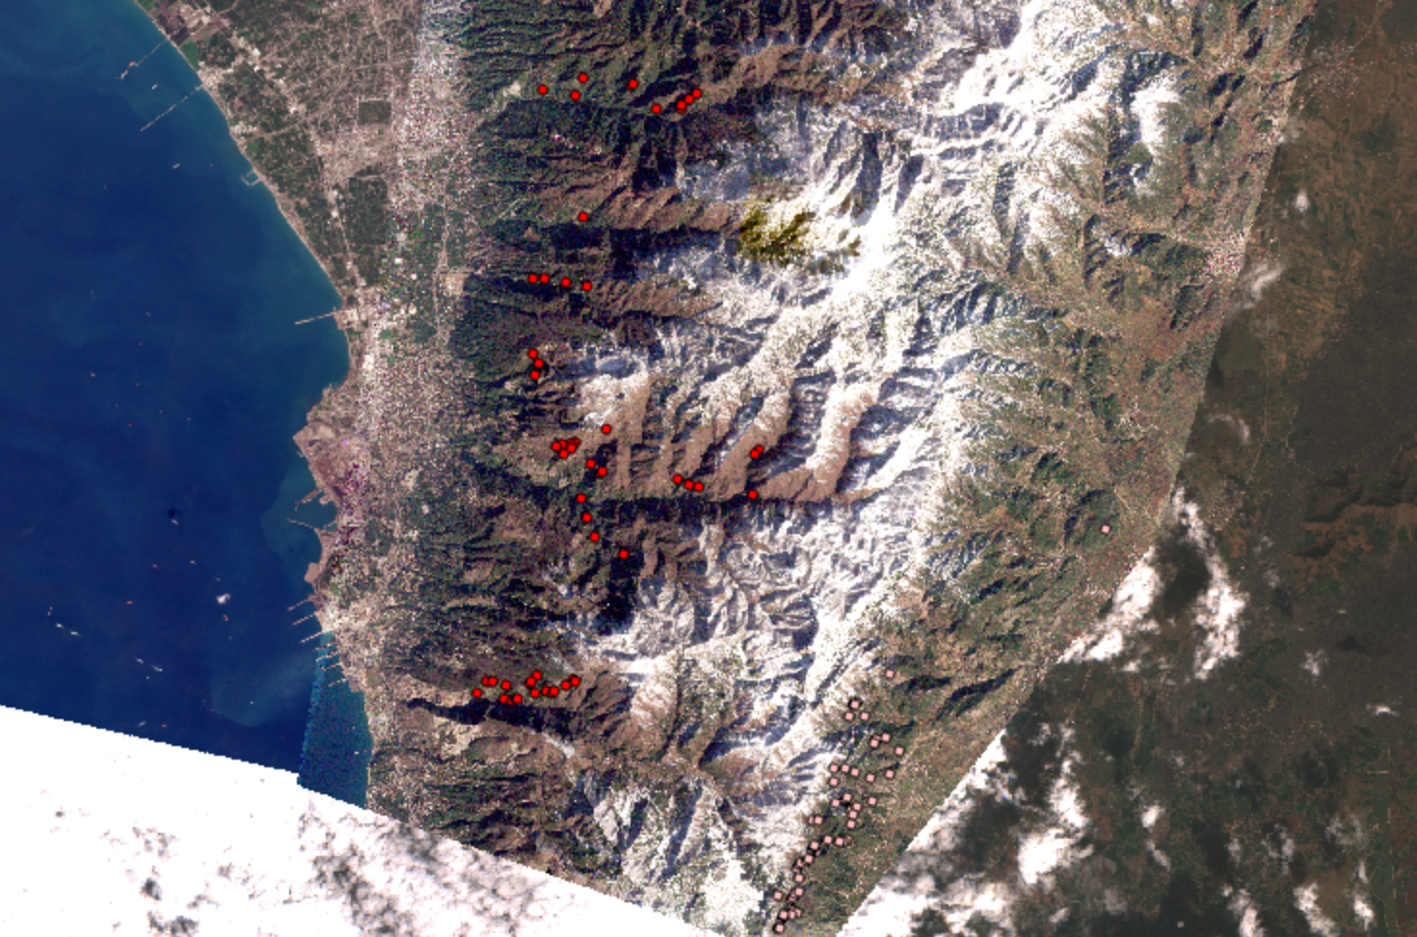
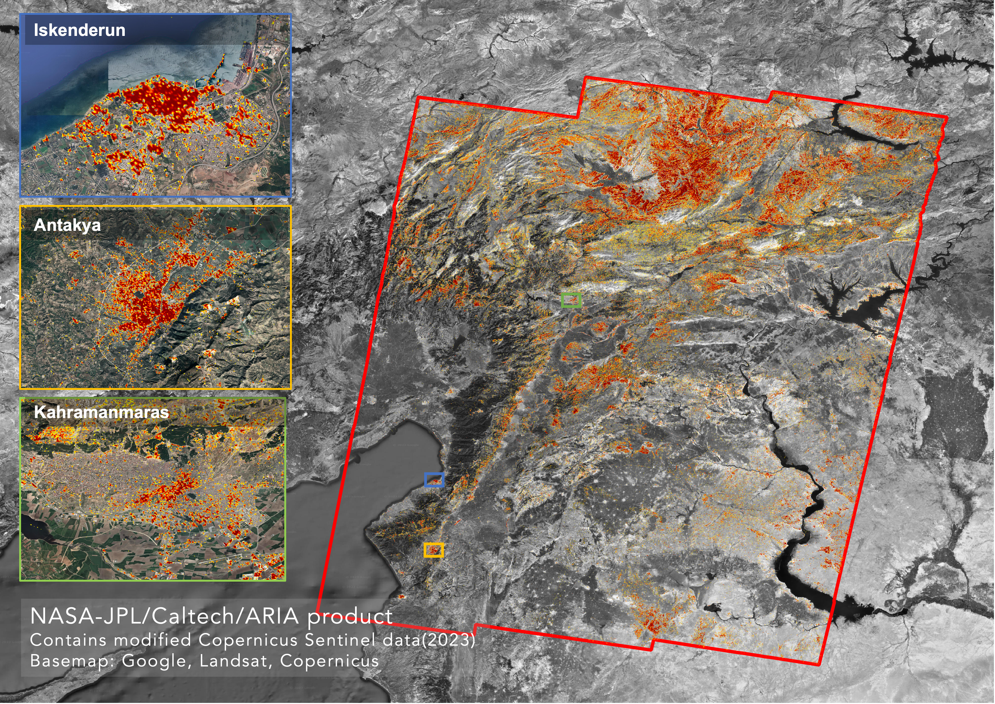
TÜRKIYE EARTHQUAKES
World Central Kitchen is a non-profit that provides meals and water to communities in crisis during a time when they may not have access to a working kitchen. After the February 6, 2023 earthquakes in Türkiye, the NASA Disasters Program provided maps and imagery through the Disasters Mapping Portal to World Central Kitchen for situational awareness to help them determine where to set up Relief Kitchens during their response. With the assistance of NASA’s products, World Central Kitchen identified communities affected by the earthquakes to help target their relief efforts.
The Advanced Rapid Imaging and Analysis (ARIA) team at NASA's Jet Propulsion Laboratory and California Institute of Technology in Southern California created this Damage Proxy Map (DPM) depicting areas that are likely damaged by the large earthquakes (Feb. 06, 2023) in Türkiye (Turkey) and Syria. The map was derived from synthetic aperture radar (SAR) images on Feb. 10, 2023 by the Copernicus Sentinel-1 satellites operated by the European Space Agency (ESA). The pre-event images were taken from Sep. 19, 2022 to Jan. 29, 2022).
Manually digitized landslides after the Türkiye earthquakes using PlanetScope imagery. Red and pink dots mark the locations of landslides mapped on February 10 and 17, 2023, respectively.

Slide 8
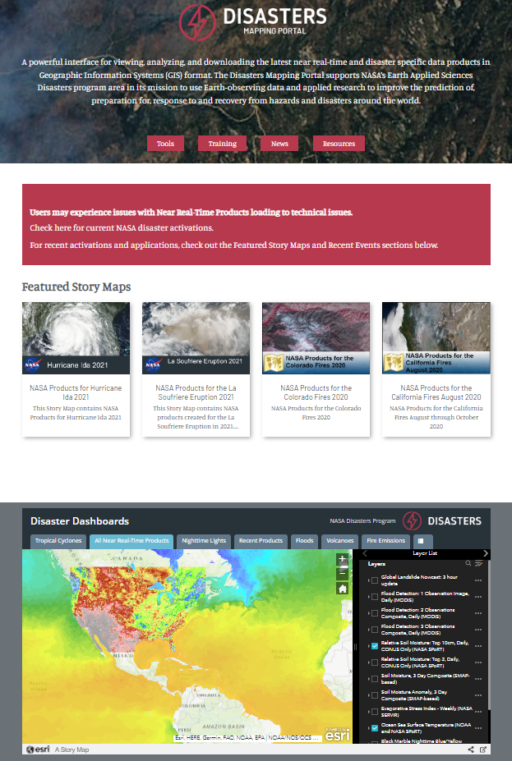
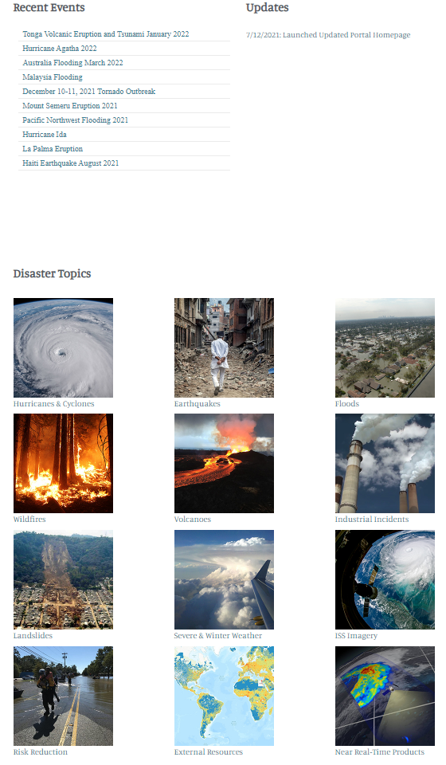
DISASTERS MAPPING PORTAL HOME
maps.disasters.nasa.gov
Featured Story Maps
  Story Maps for recent or prominent events
Home Page Story Map
  Near Real-Time Dashboard
    Most recent image displayed
  Recent Products
  Tropical Cyclone Dashboard
  Response Locations Dashboard
Recent Responses
  Direct link to event’s product gallery
Disaster Category Tiles
  Event specific products by disaster type
  Risk Reduction
  External resources
  Near Real-Time (NRT) Products

Slide 9
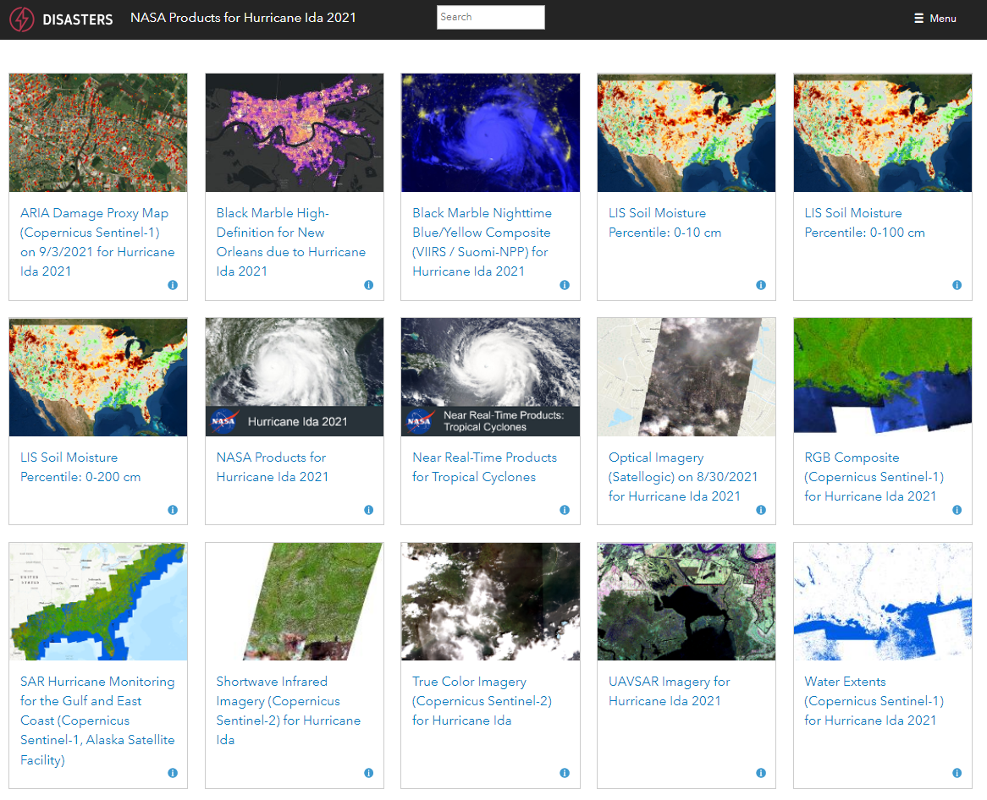
Hurricane Ida, August 2021
PRODUCT GALLERY
Event-specific products
Relevant Near Real-Time Products
Relevant Dashboards
Story Map (if created)

Slide 10
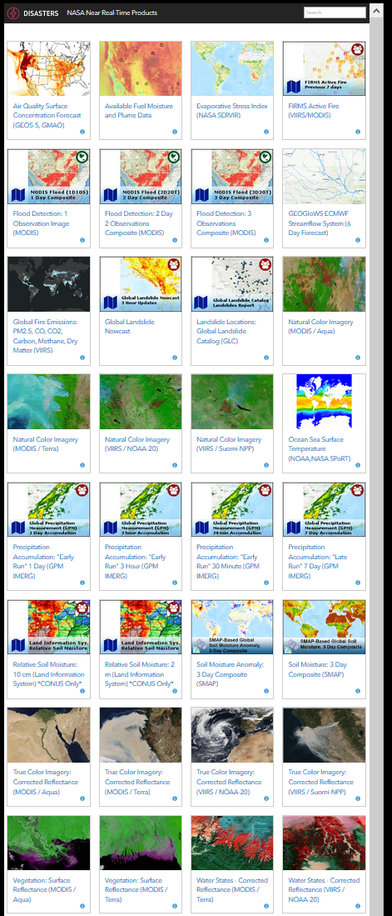
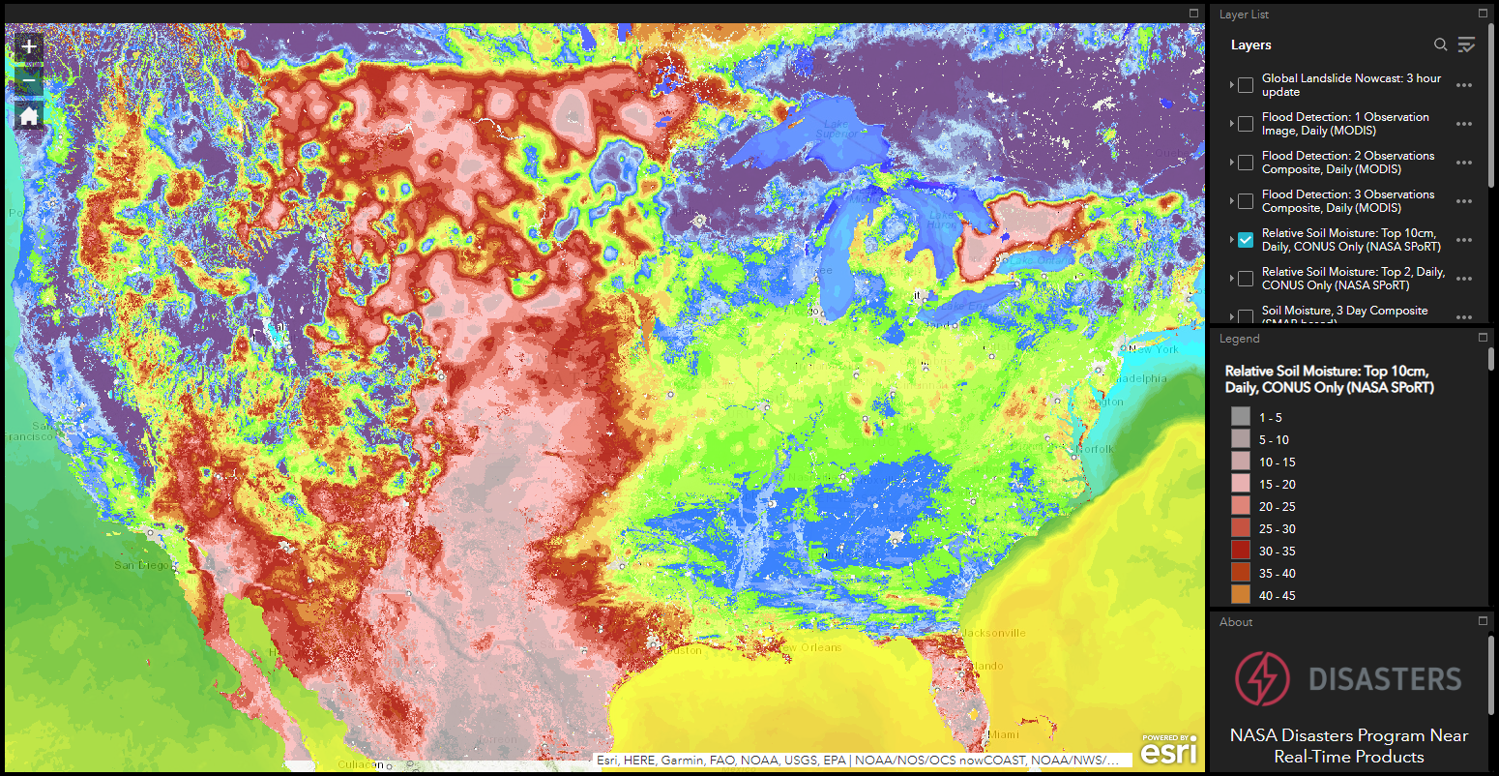
NEAR REAL-TIME DATA AND DASHBOARD
Global unless noted otherwise
Coarser resolution
Automatically updated every few hours to daily or weekly
  Black Marble Nighttime Blue/Yellow Composite
  Global Landslide Nowcast
  Flood Detection – 1, 2, 3 day observations (MODIS)
  Precipitation Accumulation – 30 min, 3 hour, 1 day (GPM IMERG)
  Evaporative Stress Index – weekly
  True Color Imagery – Daily (MODIS at 250m, VIIRS at 375m)
  Natural Color Imagery – Daily (MODIS at 250m, VIIRS at 375m)

Slide 11
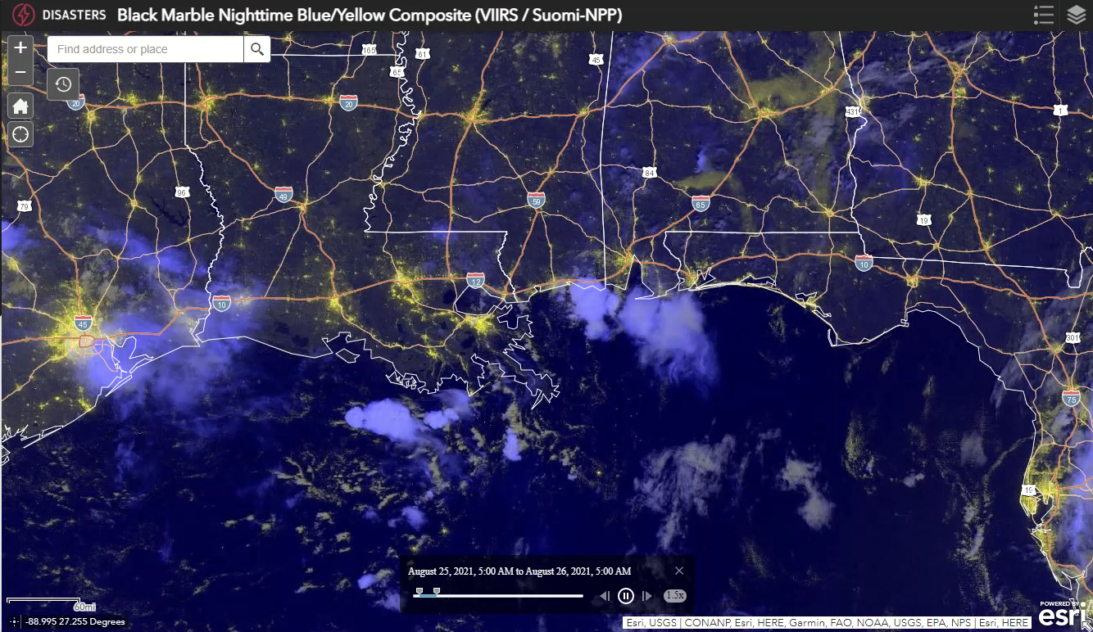
HURRICANE IDA 2021
Black Marble Nighttime Blue/Yellow Composite
VIIRS/Suomi-NPP
Resolution: 750 meters
Near Real-Time Product, Updates Daily
Data available within 3 hours of satellite overpass

Slide 12
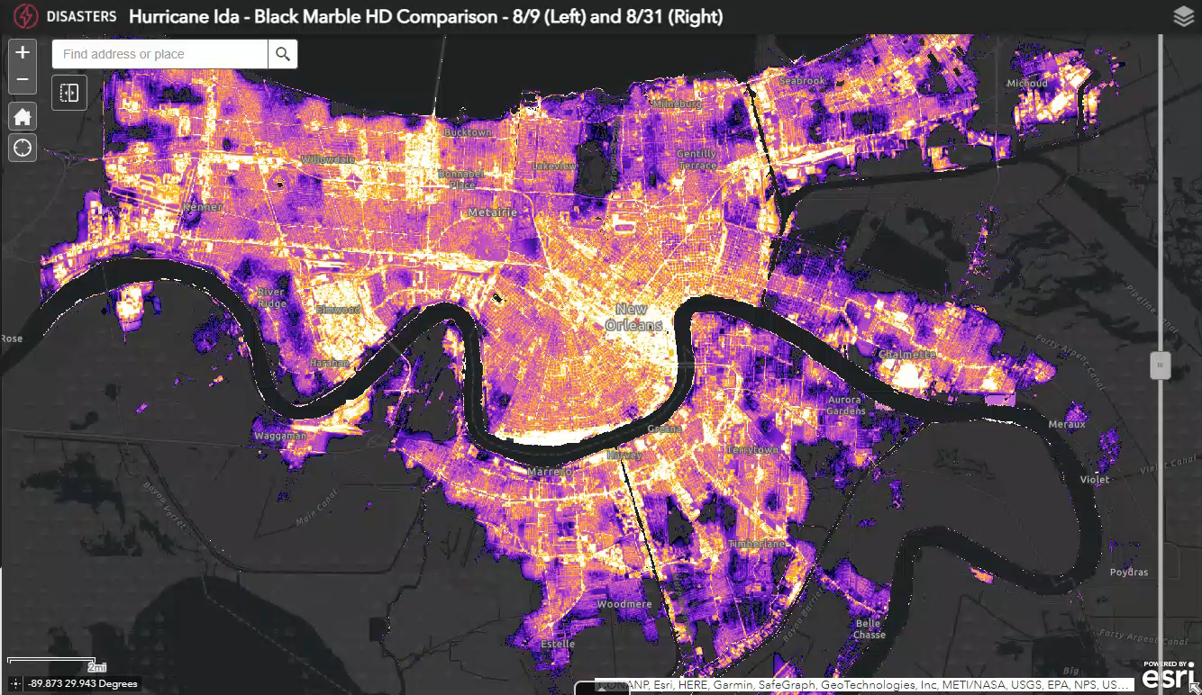
HURRICANE IDA 2021
Black Marble High Definition
Resolution: 30 meters
Created for event
Usually takes 3-5 days to get produced

Slide 13
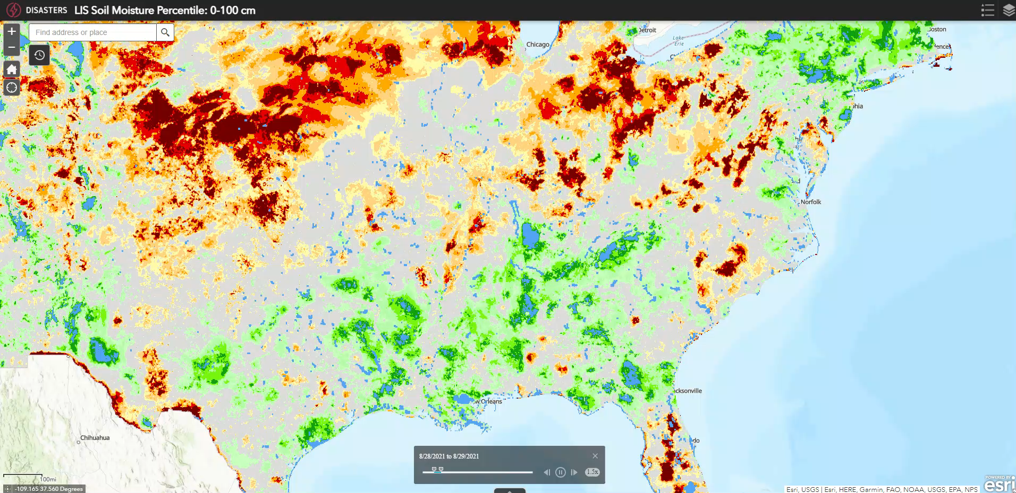
HURRICANE IDA 2021
Land Information System (LIS) Soil Moisture Percentile:
0-100cm
Resolution: 3 km
Near Real-Time Product, Updates Daily

Slide 14
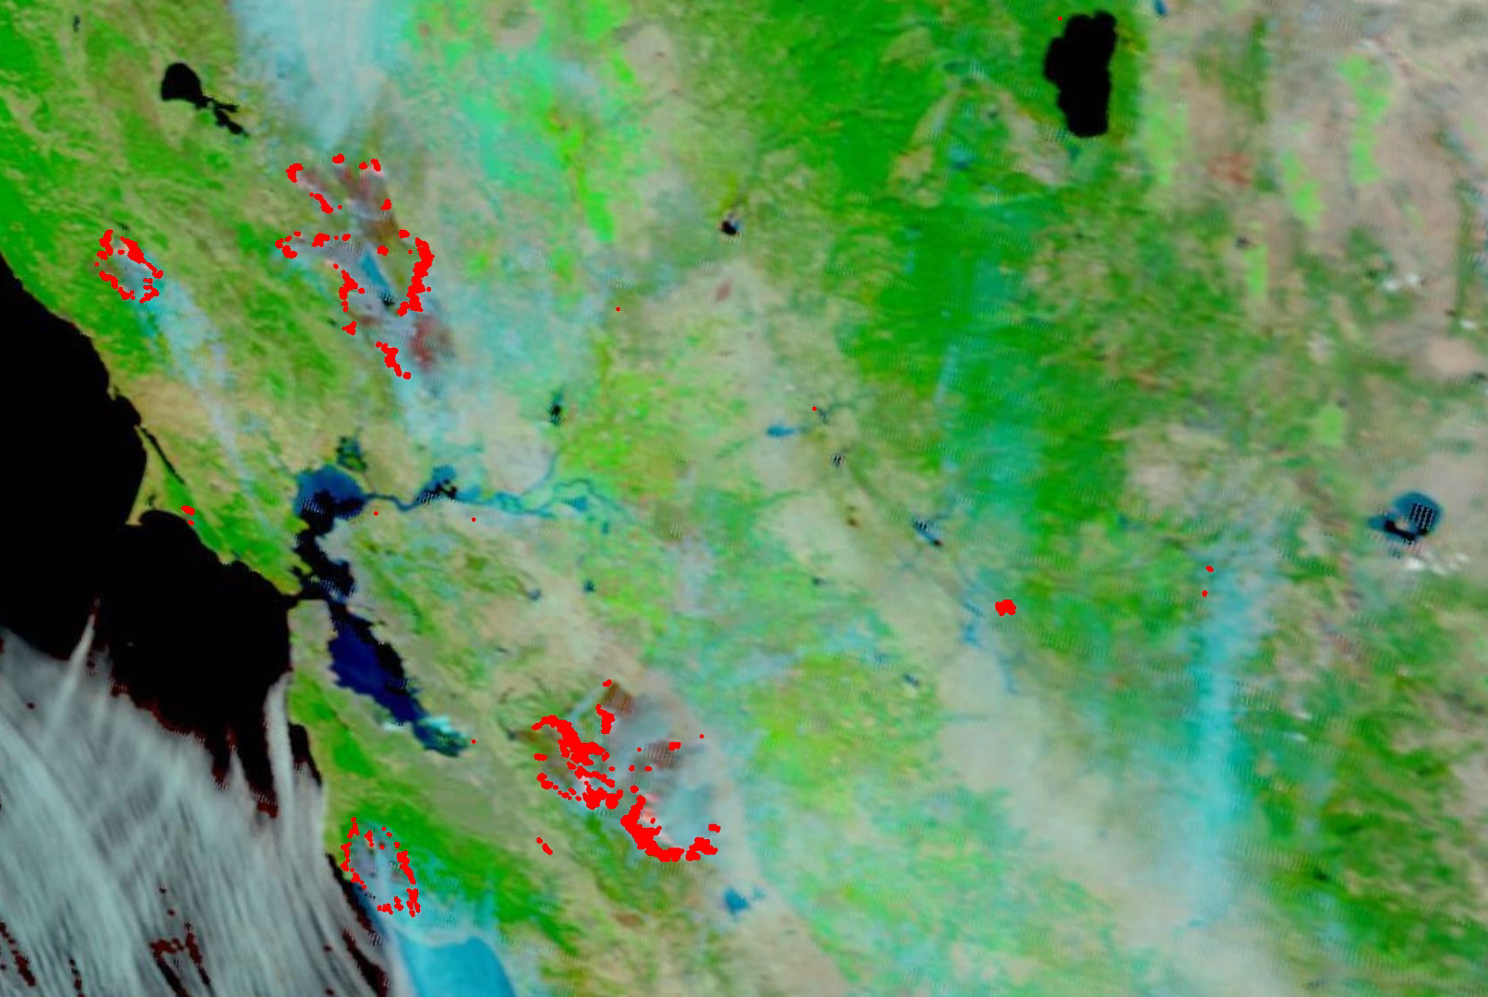
CALIFORNIA WILDFIRES 2020
Using Near Real-Time data to monitor and track the evolution of wildfires
  MODIS and VIIRS Natural Color Imagery
  FIRMS Active Fires Points
Updates multiple times per day
Moderate resolution at 500-750 meters
Can see active hot spots, burn scars and smoke transport
FIRMS Active Fire Points and MODIS Terra Natural Color Imagery from 8/15/20 to 9/1/20

Slide 15
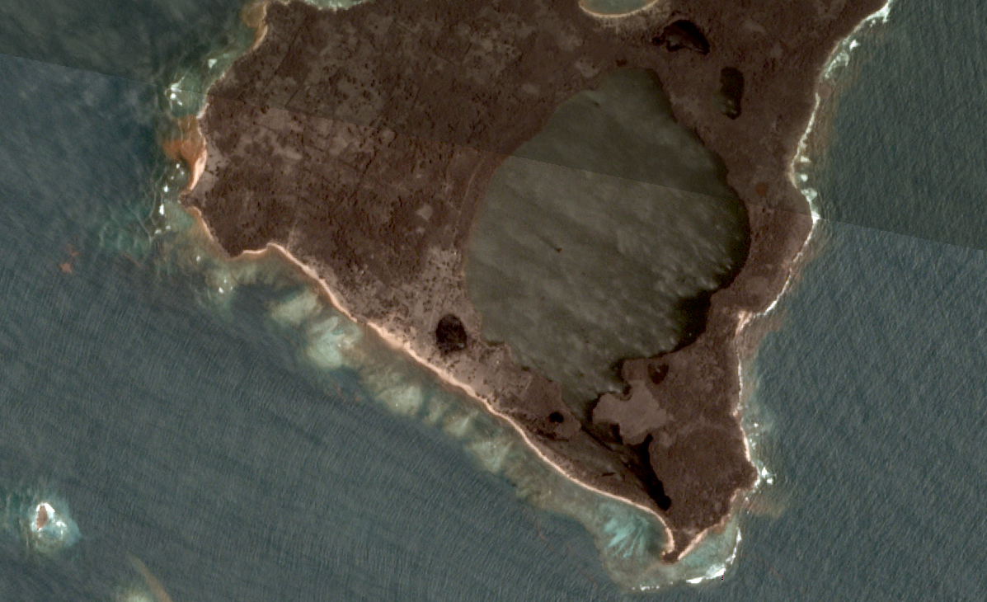
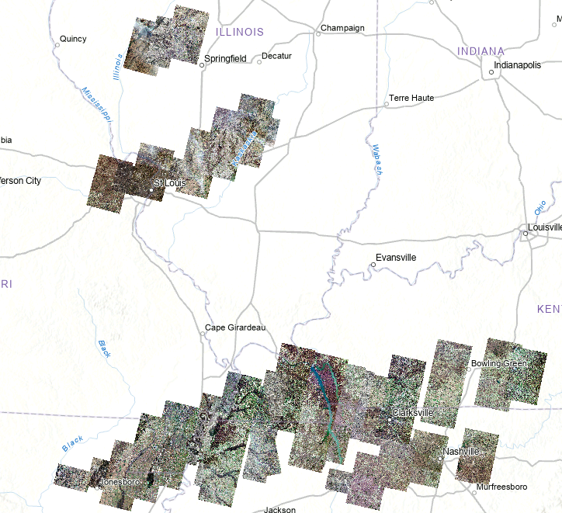
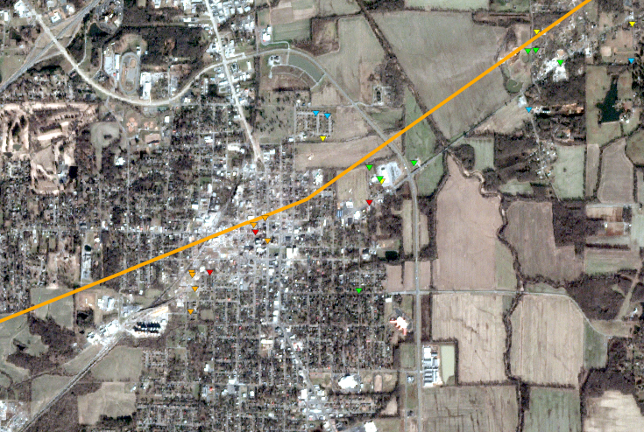

USING PLANET DATA
Top: Ashfall and destroyed vegetation on an island in Tonga after the Hunga Tonga-Hunga Ha’apai Volcano Eruption
Left: Planet data processed for the December 10-11, 2021 United States Tornado Outbreak
Left Inset: Mayfield, KY Planet image with NWS Path and Damage Points

Slide 16
Questions?
NASA Disasters Mapping Portal:
maps.disasters.nasa.gov
HQ-Disasters-GIS@mail.nasa.gov
Rachel.b.soobitsky@nasa.gov
Black Marble imagery showing nighttime lights before (left) and after (right) Hurricane Ian.

