Slide 1



Analysis of the Tropospheric Doppler Radar Wind Profiler Measurement Accuracy
Meghan E. Carrico (meghan.carrico@nasa.gov)
Natural Environments Branch, NASA Marshall Space Flight Center (Huntsville, AL)
Ryan K. Decker
Natural Environments Branch, NASA Marshall Space Flight Center (Huntsville, AL)
Natural Environments Day-of-Launch Working Group
April 25, 2023

Slide 2

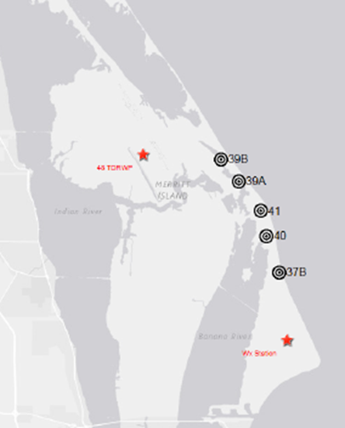
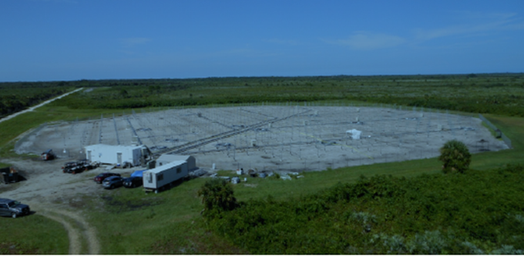
Overview
The Tropospheric Doppler Radar Wind Profiler (TDRWP) is a wind measurement instrument at NASA’s Kennedy Space Center, co-located on the United States Space Force’s (USSF) Eastern Range (ER) at the Cape Canaveral Space Force Station (CCAFS), that generates atmospheric wind profiles which are utilized in the design, certification and operations of various launch vehicles
  NASA’s Space Launch System (SLS)
  Commercial launch vehicles
    NASA Crew-4 in April 2022 was first NASA crewed mission to use TDRWP
Composed of twenty antenna sectors and transmitter unit pairs which operate at 48 MHz
TDRWP data is required for day-of-launch structural margin and performance assessments
TDRWP location
TDRWP site at KSC

Slide 3
Overview
TDRWP has two operational modes:
  SLS
  Enhanced Vertical Resolution (EVR)
These modes have different starting and ending altitudes as well as effective vertical resolution
 | EVR mode | SLS mode
Starting altitude | 1869 m | 1795 m
Ending altitude | 19505 m | 19430 m
EVR | 330 m | 450 m
The time gap between TDRWP profiles is 5 minutes with gate/altitude spacing of 150 m
To characterize the accuracy, TDRWP data is compared to Automated Meteorological Profiling System (AMPS) 1-second balloon data
TDRWP measurement uncertainty is used by commercial launch vehicles as an additional standoff term in day of launch vehicle assessments
The ultimate goal is for TDRWP data to have an accuracy equivalent to existing rawindsonde system (1.5 m/s root mean square or less) for each x and y wind component (u and v respectively)

Slide 4
Overview con’t
Studies have been conducted to quantify the accuracy of the differing TDRWP modes:
  Analyses of Kennedy Space Center Tropospheric Doppler Radar Wind Profiler Data for Space Launch System Certification, NASA memorandum (EV40 18-003), 6 August 2018
  Operational Acceptance Test Plan for the KSC Tropospheric Doppler Radar Wind Profiler After 2020 Effective Vertical Resolution Upgrade, NASA memorandum (EV44 20-004) , 11 May 2020
  KSC TDRWP Measurement Error at discrete altitudes, NASA memorandum (EV44 22-004) 3 March 2022
This presentation discusses an additional study to evaluate the TDRWP EVR mode over a longer time period / sample size (March 2020 to March 2022)
  Provides insights into seasonal variations
  Complements and provides comparison to EV44 22-004 TDRWP EVR mode analysis (timeframe of January 2020 to April 2020)

Slide 5
Datasets
Data sets used for the analysis include:
  Quality Controlled TDRWP data in EVR mode
  Balloon 1-second AMPS
  North American Regional Reanalysis (NARR) spatial Root Mean Squared (RMS) differences
  Small scale correction term
In the initial balloon dataset, approximately 2 balloon profiles are available for each day, with some days having a greater number depending on the launch schedule
  1-second intervals
  Considered to be ground truth
  Covers same time range as TDRWP data
NARR RMS data was calculated and provided by Nathan Curtis
  Helps to account for spatial differences between TDRWP and balloon as balloon drifts with altitude
Small scale correction term dataset is included due to the differences in resolution of the balloon and NARR data
  These values are used in the previous two analyses as well

Slide 6
Procedure
General procedure included
  Removing TDRWP data in SLS mode
  Parsing TDRWP and balloon data into individual years and variables such as windspeed, wind direction, altitude, balloon latitude and longitude, and creating time variables
  Calculating u and v from windspeed and direction for TDRWP and balloon data
  Average balloon data to TDRWP altitude intervals
  Comparing altitude and timestamp datasets between both TDRWP and balloon
    Completed to create a composite TDRWP profile within 5 minutes after each balloon datapoint
  Finding NARR RMS error for each balloon data point from NARR RMS dataset
  Calculating RMS/total error for TDRWP data for each season

Slide 7
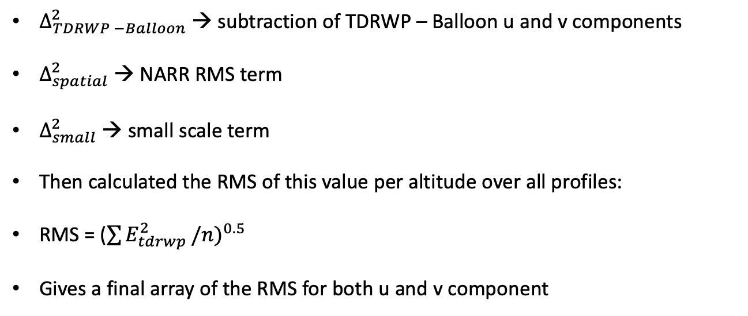
RMS/Error Calculation
Used the following formula to calculate the TDRWP error per altitude per profile for both u and v component:
$$E_{tdrwp}={(Δ_{TDRWP−Balloon}^{2}−Δ_{spatial}^{2}−Δ_{small}^{2})}^{0.5}$$
$Δ_{TDRWP −Balloon}^{2}$ → subtraction of TDRWP – Balloon u and v components
$Δ_{spatial}^{2}$ → NARR RMS term
$Δ_{small}^{2}$ → small scale term
Then calculated the RMS of this value per altitude over all profiles:
RMS = (${\sum{E_{tdrwp}^{2}}/n)}^{0.5}$
Gives a final array of the RMS for both u and v component

Slide 8
Final TDRWP and Balloon Data Distribution
Data start: March 4th, 2020
Data end: March 20th, 2022
Winter months: Dec, Jan, February, March
Summer months: June, July, August, September
Transition months: April, May, Oct, November
Year | Number of Days | Number of Profiles
2020 | 196 | 268
2021 | 114 | 178
2022 | 38 | 54
Season | Number of Days | Number of Profiles
Winter | 142 | 238
Summer | 91 | 93
Transition | 115 | 169

Slide 9
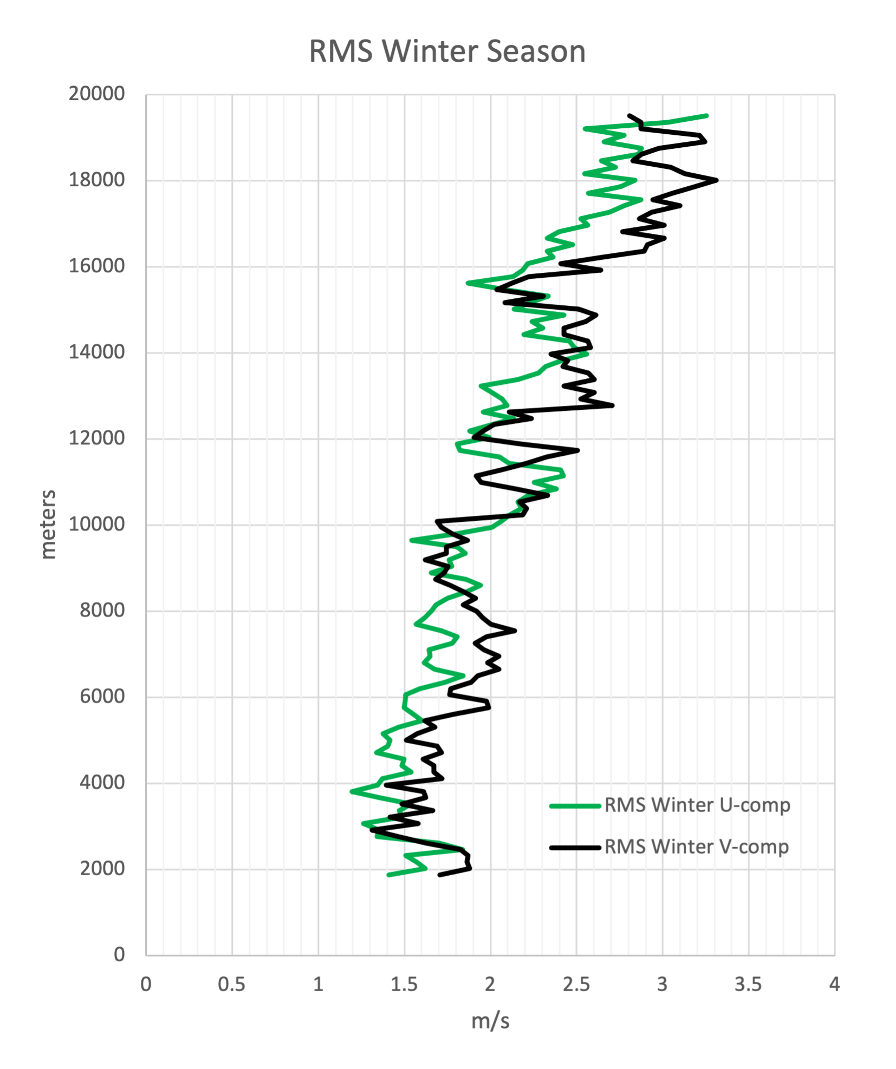
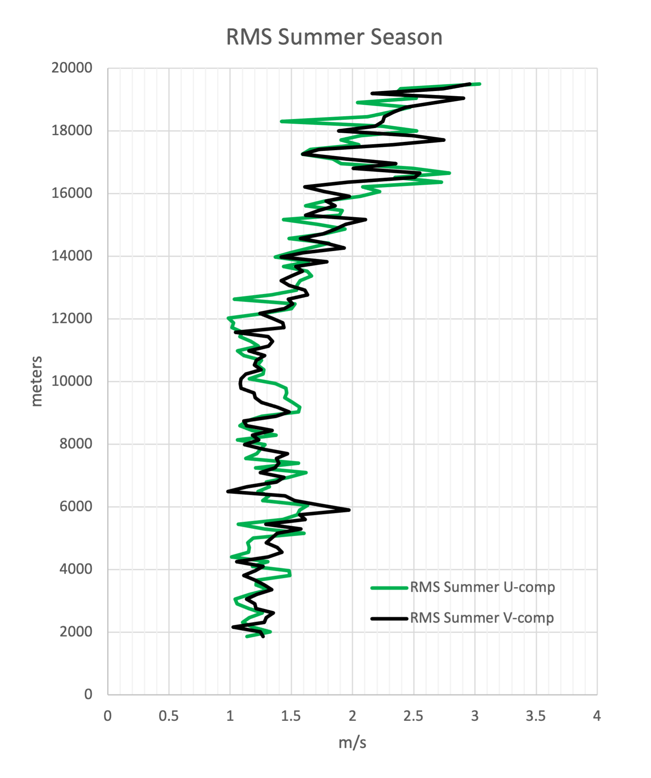
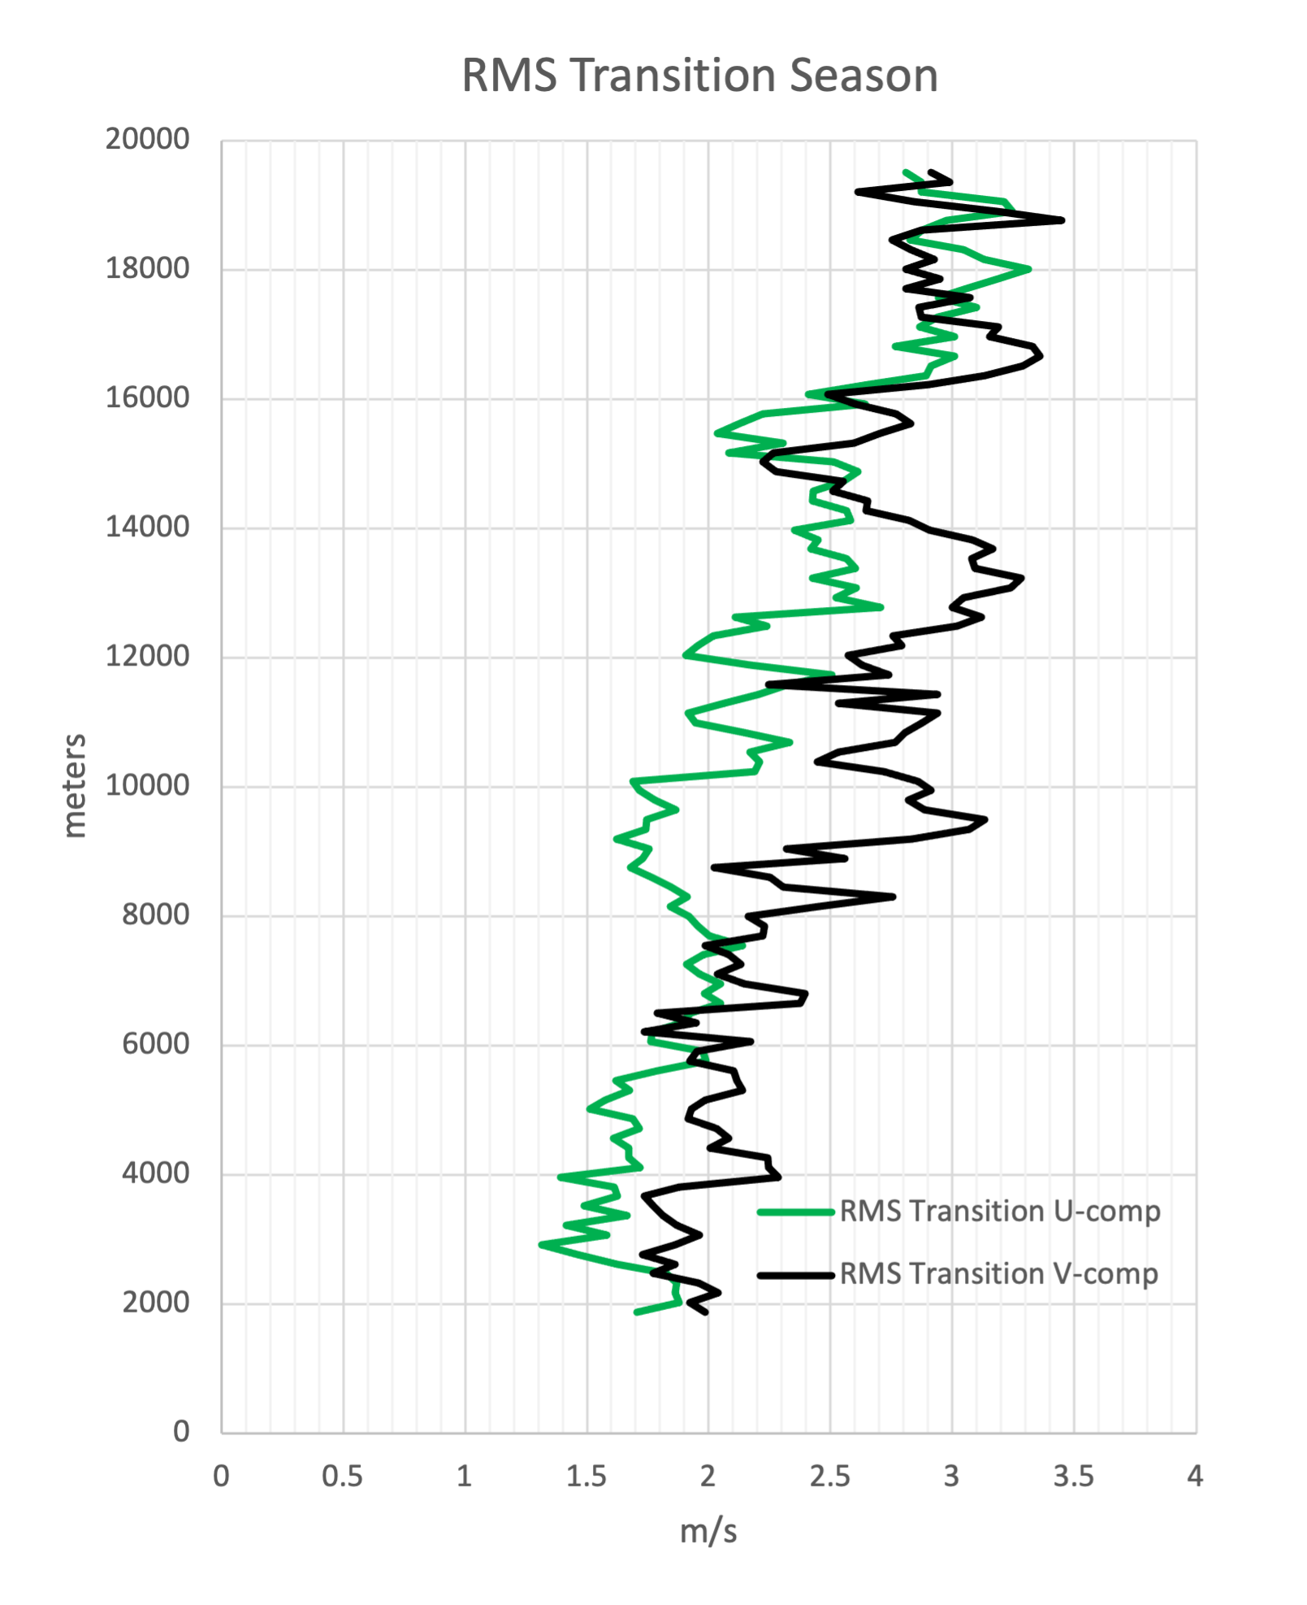
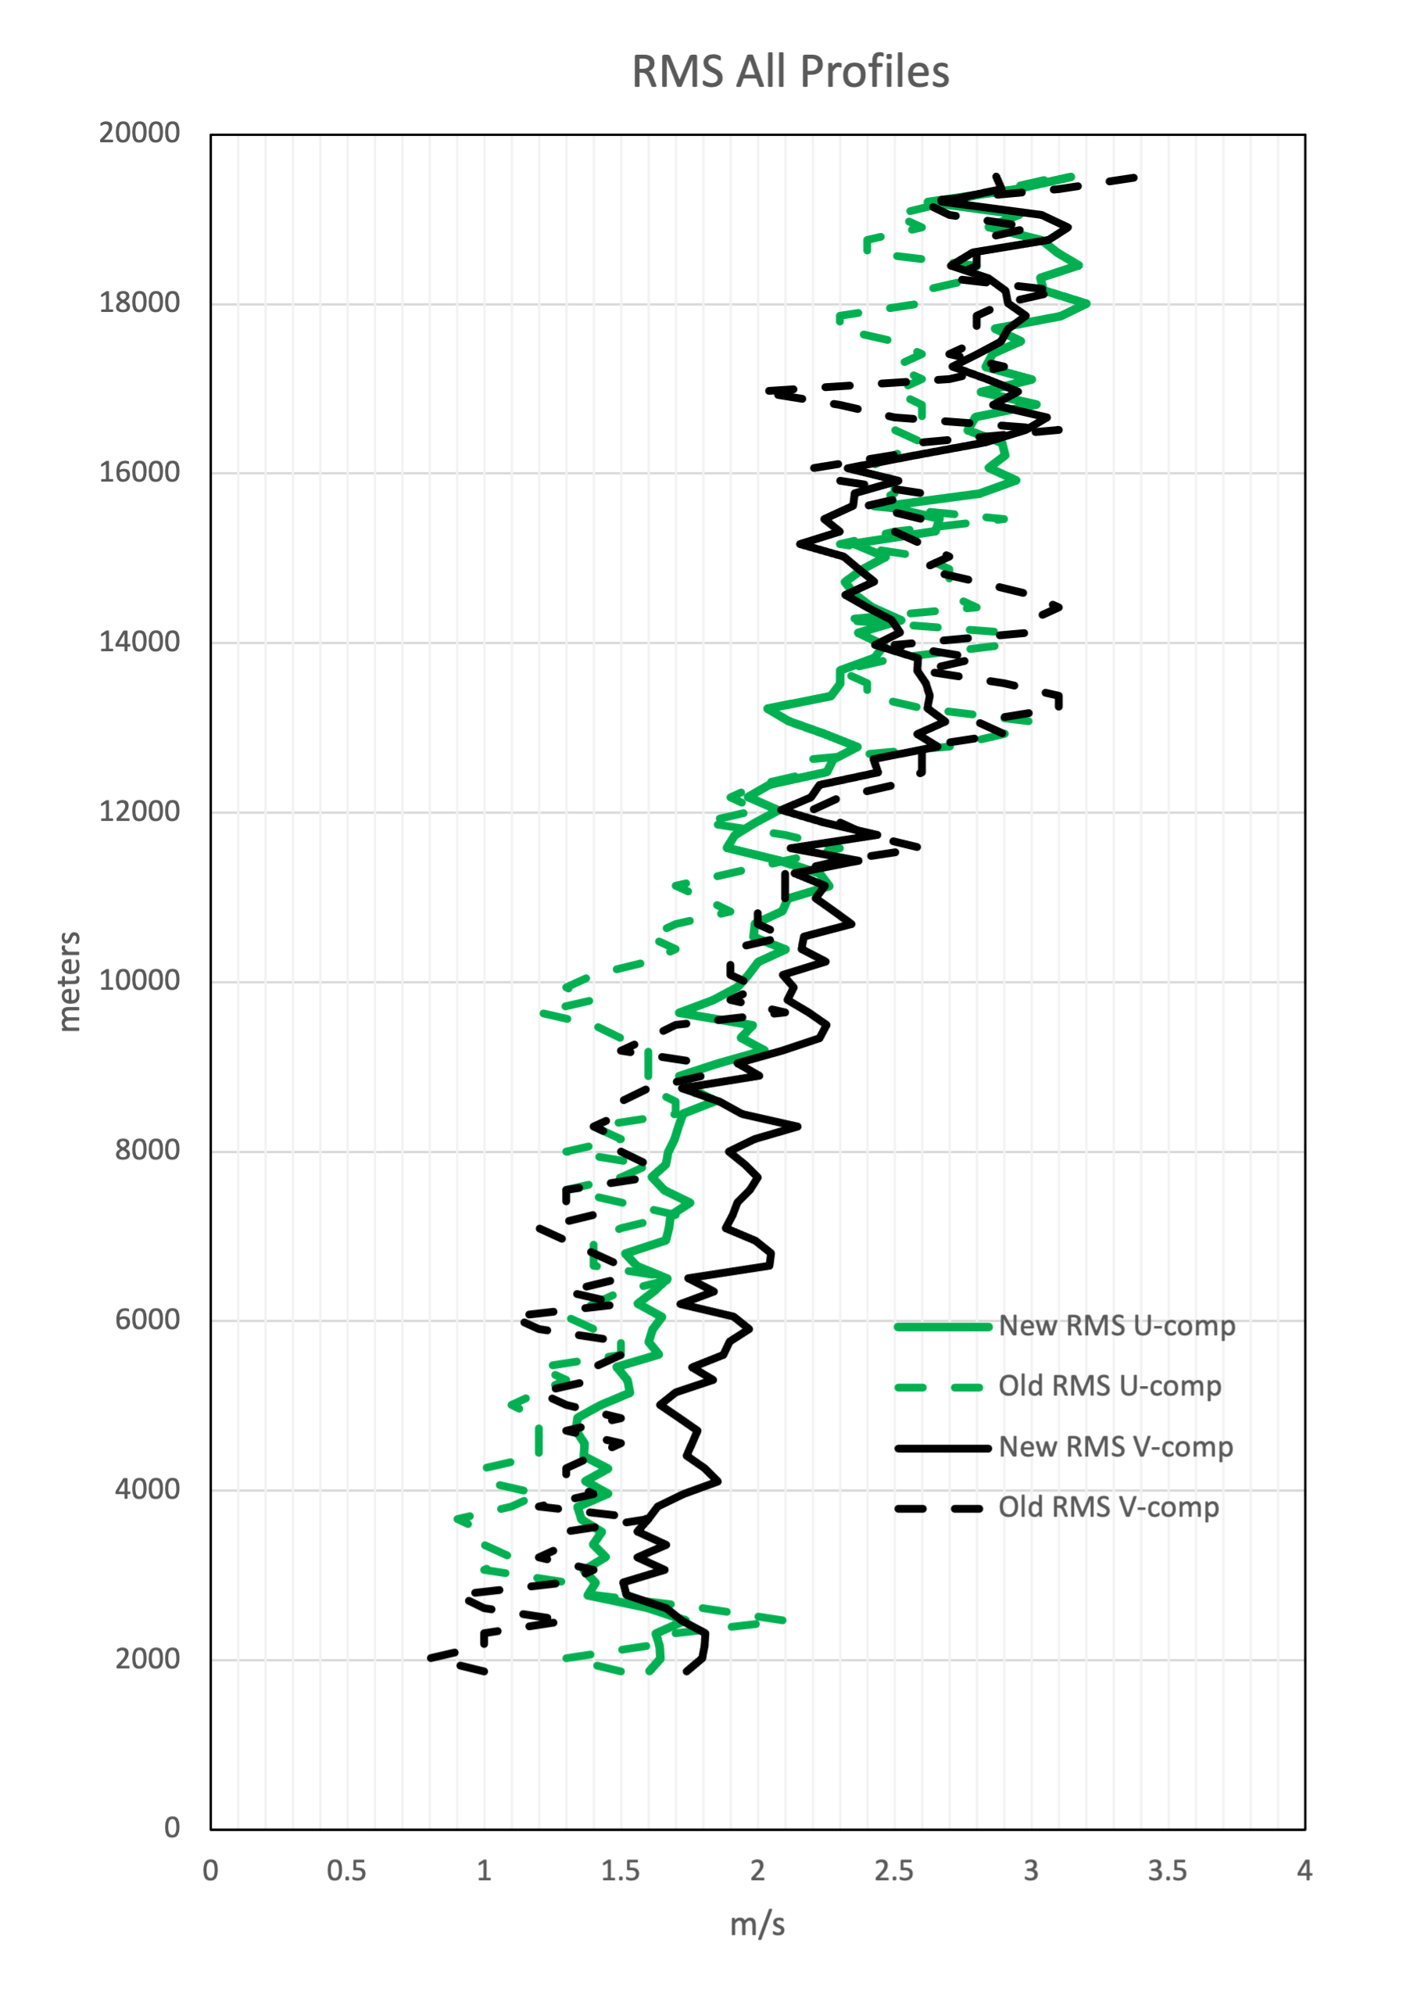
RMS Results

Slide 10
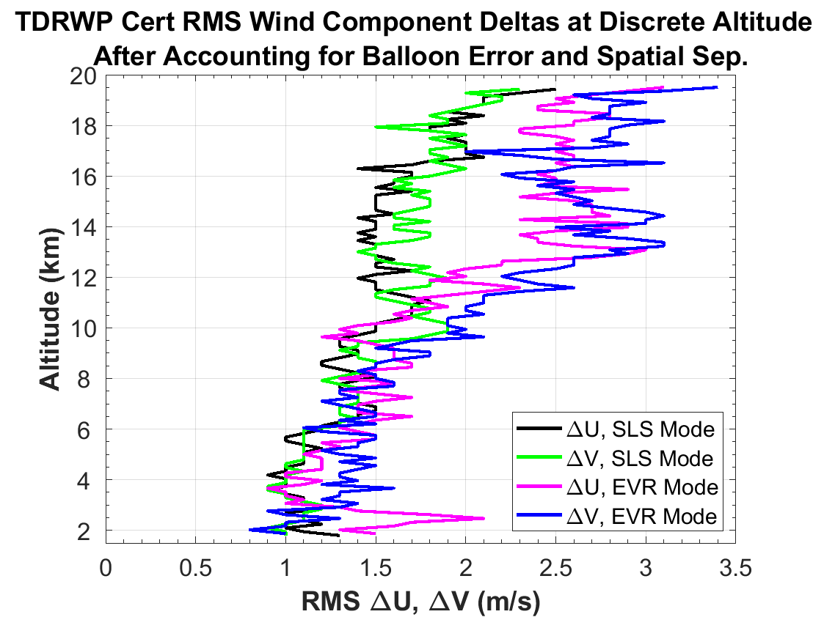
Discussion
The RMS for summer has the lowest RMS values of all the seasons
  Consistent with results from EV44 22-004
  Fully crosses the RMS threshold of 1.5 m/s by 12,000 m
Winter and the transition seasons have similar results
  Exceed the RMS threshold through nearly the entire altitude range
Overall, for this larger timeframe, the RMS values are higher than EV44 22-004 over a shorter timeframe
Increases in the RMS above 12,000m seen in all seasons can be attributed to decreased output power when the TDRWP is operating in the EVR mode
Use of TDRWP in EVR mode will need increased wind measurement uncertainty applied in analyses
RMS result from EV44 22-004

Slide 11
Questions?

