Slide 1
PREFIRE data update
Hazem Mahmoud, Ph.D.
ASDC Scientist
4/16/2023
Notes:
STILL

Slide 2
ASDC Overview
PREFIRE Data Products Archiving and Distribution
Data Distribution Tools and Services
PREFIRE E2E testing update
Way Forward

Slide 3
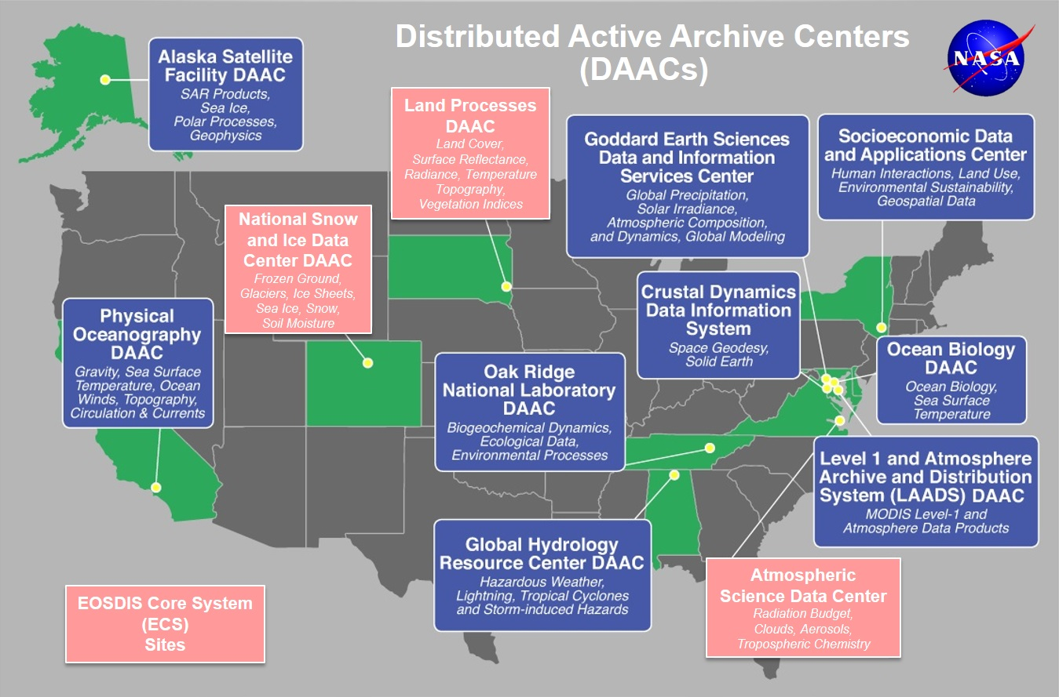
Earth Observation System Data and Information System EOSDIS
EOSDIS data centers process, archive, and distribute thousands of data products to the global user community. The primary services provided by EOSDIS are data archive & management, distribution, information management, product generation, and user support. It is comprised of multiple components including:
Distributed Active Archive Centers (DAACs)
Science Data Processing Segment (SDPS)
Science Investigator-led Processing Systems (SIPS)
Common Metadata Repository (CMR)
Earthdata Search (EDS)
Global Imagery Browse Services (GIBS)
more

Slide 4

ASDC Vision
"To be a leading provider of atmospheric science data products and services to the science community through agility, innovation, and technical excellence“

Slide 5
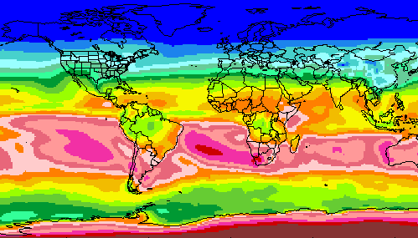
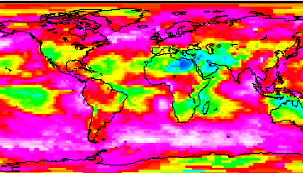
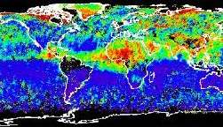
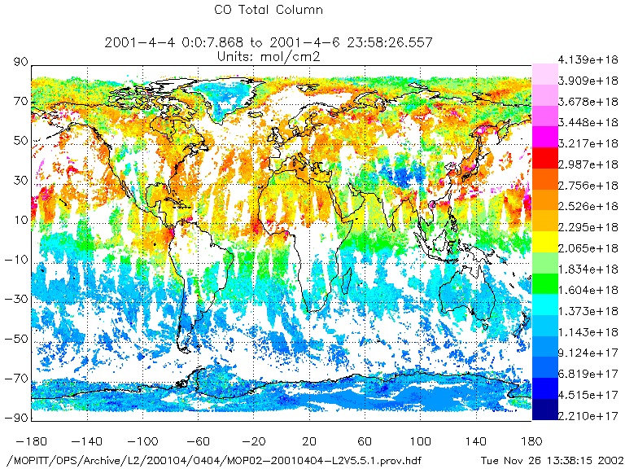
RADIATION BUDGET
CLOUDS
ASDC at a glance
44+ Science projects
  ⚬ MISR ⚬ MOPITT ⚬ MAIA ⚬ TEMPO ⚬ CERES
  ⚬ CALIPSO → RSIG (EPA)
  ⚬ Airborne field campaigns
  (KORUS AQ, DISCOVER AQ, FIREX AQ)
1100+ unique science products
Data usage
  ⚬ 2,061 Terabytes ⚬ 160,000 users
  ⚬ 158 countries
Data archive
  ⚬ 5.8 Petabytes ⚬ 141 million files (4,400 TB) on high-speed disks
Data in cloud (ongoing)
  ⚬ Data and services in the cloud
  ⚬ Scalable infrastructure
AEROSOLS
TROPOSPHERIC COMPOSITION
Primary Functions of ASDC
Ingest receive data from data provider
Archive preservation & provenance
Distribute tools and services
Process create higher level products
Outreach & Support research community

Slide 6
Services at the ASDC
PRE-LAUNCH
Preparation for Ingest
  Accurate metadata for discovery
  Well formatted data for maximum interoperability
  Digital Object Identifiers for each product
Support Data Flow Testing Prior to Launch
  Interface confidence tests
  End-to-end ground system testing with instrument or synthetic data
Discuss Service Options
  Customer/Product affinities and technical capacity
  Data Delivery Cadence
ACTIVE OPERATIONS
Standard curation of archived data
  Provenance and integrity
  Up to date documentation
  Disaster Recovery
User Services staff to assist customers
  Maintain FAQs, examples of scripts
  Perform reach back to science team when necessary
  Disseminate announcements to user community
  Use customer feedback from annual third-party ACSI survey, contacts, and ASDC User Working Group to determine changes in services
Subsetting and ArcGIS capabilities
  Temporal, spatial and variable slices

Slide 7
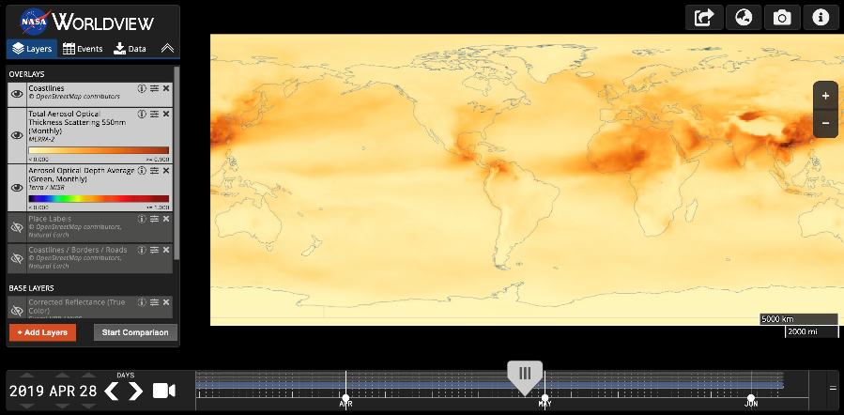



ASDC Data Distribution: Tools and Services
NASA Earthdata Search
  CMR Search ⚬ Metadata
NASA WorldView
  GIBS API ⚬ visualization
Harmony and OPeNDAP
  ⚬ transform ⚬ subsetting
  ⚬ reformatting ⚬ distribution
HTTPS data access
  ⚬ datapool
  ⚬ permanent URL/direct access
  ⚬ enables scripts/workflow
Example scripts
  ⚬ Python/Jupyter Notebook
  ⚬ R scripts
  ⚬ contributed tutorials/scripts
User Support and Other Resources
Earthdata Login https://urs.earthdata.nasa.gov
Earthdata Forum https://forum.earthdata.nasa.gov/
ASDC User Support support-asdc@earthdata.nasa.gov

Slide 8
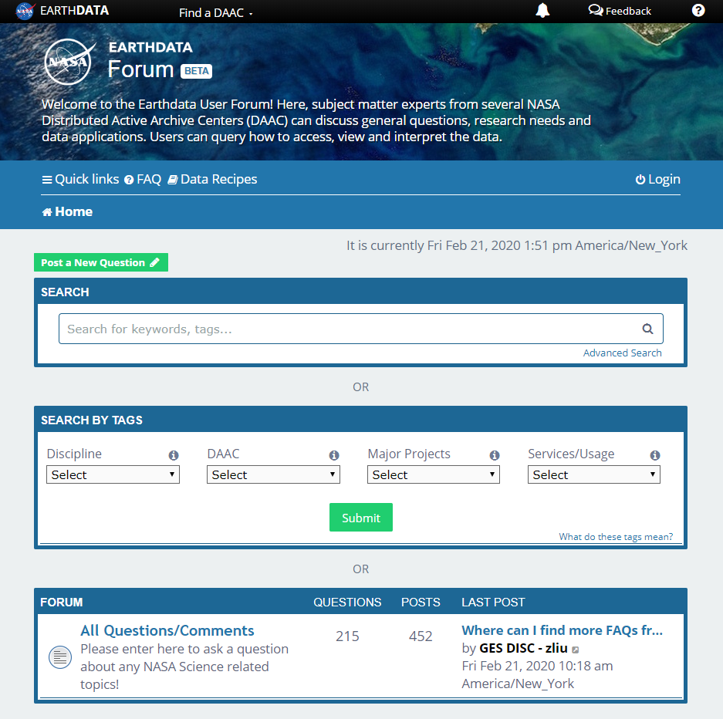
Earthdata Forum
Science Data Users can seamlessly search for information even if they do not know which DAAC the data belongs to.
Scientists & Data Providers can effectively assist their user community in more accurately using their products.
DAACs & Subject Matter Experts (SMEs) can quickly link users to existing resources.
DAAC User Services can swiftly provide inquirers with an authoritative source related to DAAC data products & services.
https://forum.earthdata.nasa.gov/
Notes:
The Earthdata Forum is our new online resource for staff members and subject matter experts from several NASA Distributed Active Archive Centers (DAACs) assist inquirers with questions about their NASA Earth science data. General questions, research needs, and data applications can all be subjects here. Members of the NASA scientific user community are encouraged also provide insights and collaborative assistance.​

Slide 9
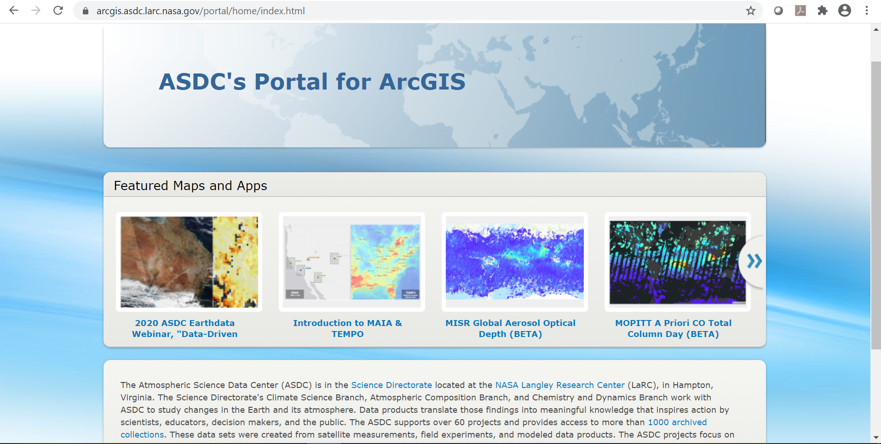

ASDC Portal for ArcGIS
Select ASDC datasets available publicly as image services and WMS
Incorporate data directly into web applications and desktop software
Develop storymaps, jupyter notebooks and outreach content
https://arcgis.asdc.larc.nasa.gov

Slide 10
ASDC in the Cloud
ESDIS is heavily investing in commercial cloud
  Primary motivations
    To allow the science community to do unprecedented science with unconstrained processing and storage capacity across all EOSDIS data in a highly available environment (AWS)
    The size of future datasets makes on-premise archiving undesirable
      SWOT and NISAR are most often cited
  Building an AWS-native ingest and archive system called Cumulus that is intended to be used by all DAACs
  ESDIS pays for the storage. Users pay for their own compute resources.
  Data download will still be available free of charge
  TEMPO, CLARREO-PF and PREFIRE are ingested on the cloud
  User experience will not be interrupted or degraded
  Activities are being planned in a way to avoid introducing technical and schedule risks and dependencies.
  ASDC will work closely with ESDIS to identify risks, technical challenges and uncertainties, and proposing concepts and architectures for mitigating any issues that arise

Slide 11
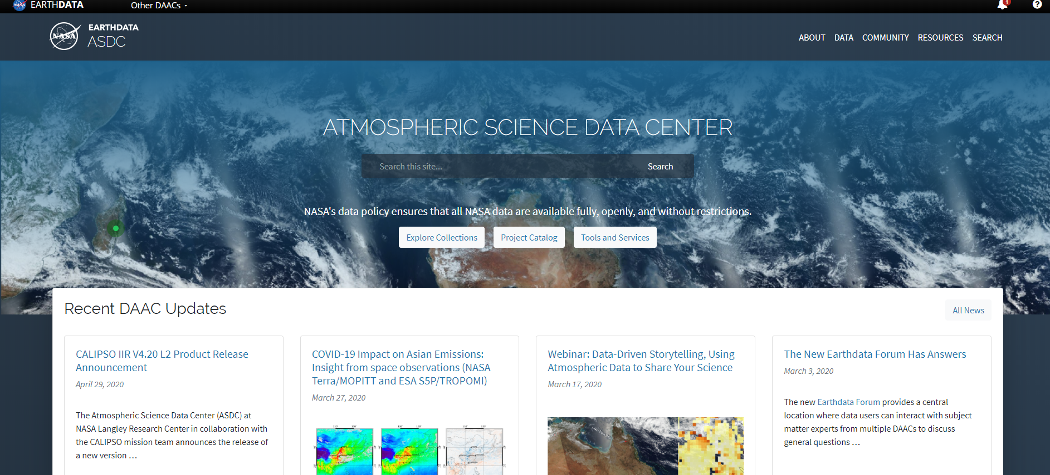
https://asdc.larc.nasa.gov/
Notes:
Brand new website with features like filters by discipline and tools, keyword search bar, new look matching Earthdata layout
Top buttons: Explore Collections, Project Catalog, Tools and Services
News stories, outreach section coming soon
Outreach activities: Webinars, tutorials, data recipes, Jupyter Notebooks, Story Maps, more ArcGIS friendly datasets
Will be able to easily access MAIA and TEMPO data and other tools & services from this main website

Slide 12
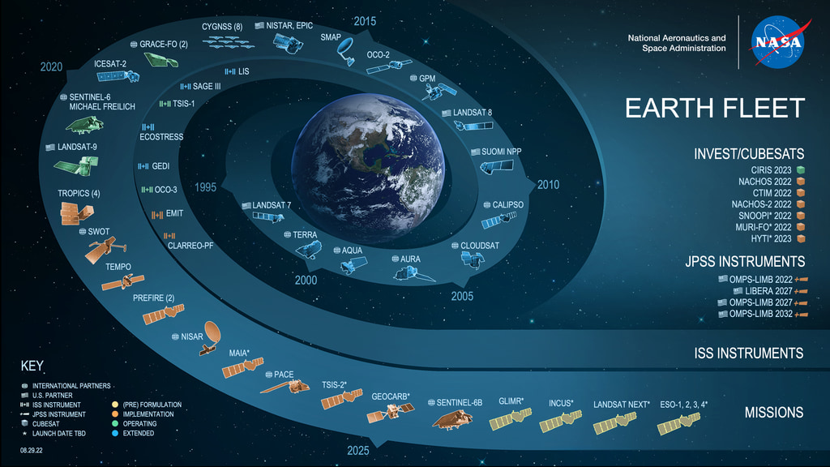

Slide 13
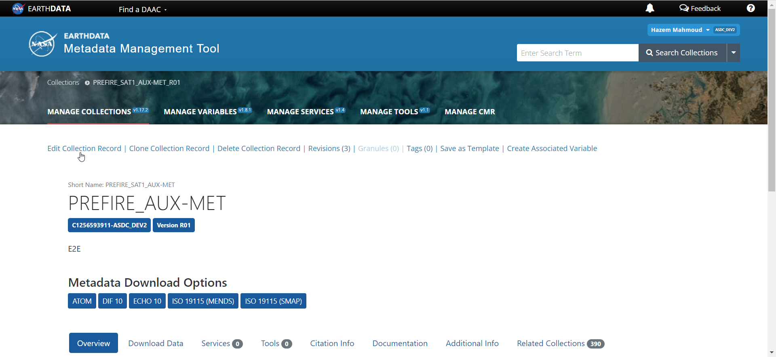

Slide 14
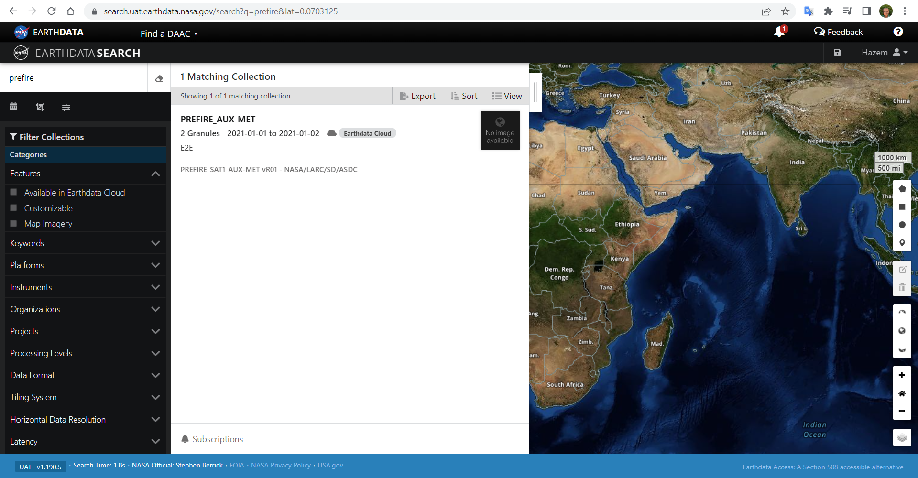

Slide 15
ASDC Overview
PREFIRE Data Products and Distribution
Data Distribution Tools and Services
Discussion

Slide 16
Atmospheric Science Data Center
NASA Langley Research Center
Hampton, Virginia (USA)
https://asdc.larc.nasa.gov/
support-asdc@earthdata.nasa.gov
Hazem.Mahmoud@nasa.gov

Slide 17
Status of PREFIRE interface documentation (in-progress)
Status of testing (test completed, test underway, test to go)

Slide 18
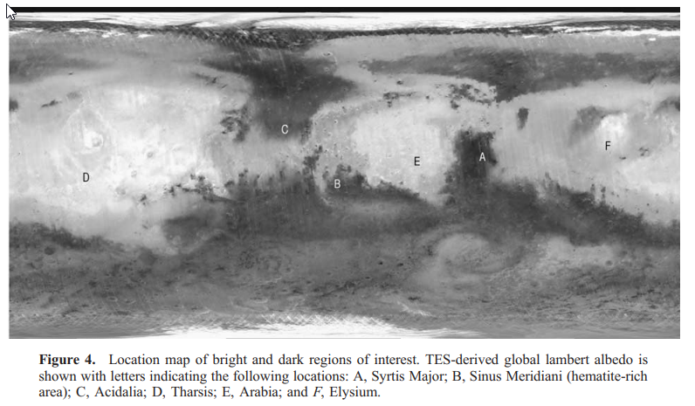

Slide 19
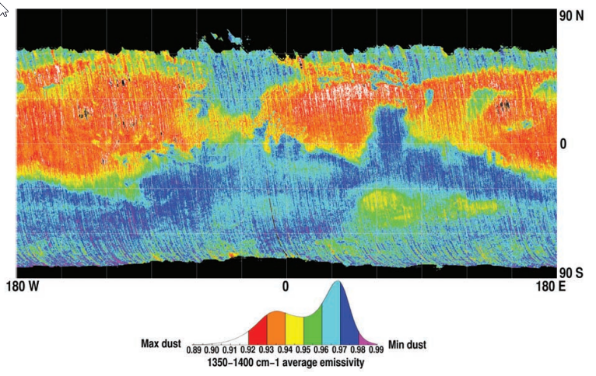

Slide 20
ASDC in the Cloud
ASDC engaged in a “Phase I” onboarding activity with ESDIS support
TEMPO, CLARREO-PF and PREFIRE are ingested on the cloud
Guiding Principles
  User experience will not be interrupted or degraded
  Activities are being planned in a way to avoid introducing technical and schedule risks and dependencies
  ASDC will work closely with ESDIS to identify risks, technical challenges and uncertainties, and proposing concepts and architectures for mitigating any issues that arise

Slide 21
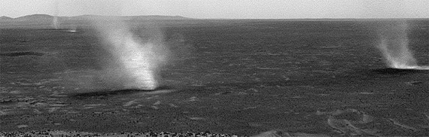
Image of dust devil vortices, laden with dust, passing the Spirit lander on sol 568. Image credit: NASA/JPL.

Slide 22


Slide 23
DSCOVR Data Products:
Number of Users per Product for 2020-2021
Average order size:
2020: 1143 granules, 232GB
2021: 1044 granules, 146GB
RECENT UPDATES:
DSCOVR_EPIC_L3_PAR
DSCOVR_EPIC_L2_GLINT
are now orderable

Slide 24
DSCOVR Distribution Volume by GB per Year
DSCOVR Distribution Volume by Granules per Year

