Slide 1

Development of a Weather Capability for the
Urban Air Mobility Airspace Research Roadmap
Tim Bonin¹, James Jones¹, Gabriele Enea¹,
Ian Levitt², and Nipa Phojanamongkolkij²
¹MIT Lincoln Laboratory
²NASA Langley Research Center
20 April 2023
Notes:
1
1

Slide 2











The evolution of UAM operations in the National Airspace System (NAS) is a highly complex problem with a growing research portfolio
Airspace Mgmt
Airspace Design
Regulations & Policies
Communications
Navigation
Secured Airspace
Separation Services
Surveillance
Vertiport Operations
Weather
Aviation System of Systems
partially decomposed into
capabilities that cover
the UAM airspace system
Discrete Progression of Capabilities
NASA is developing a way to effectively organize, integrate, and communicate research and development in the area, leveraging MBSE methodology and machine learning natural language processing (NLP)
The UAM Airspace Research Roadmap lays the foundation with system definitions, constraints, and a requirements framework to capture the progression of capabilities over time
UAM = Urban Air Mobility
MBSE = Model-Based Systems Engineering

Slide 3
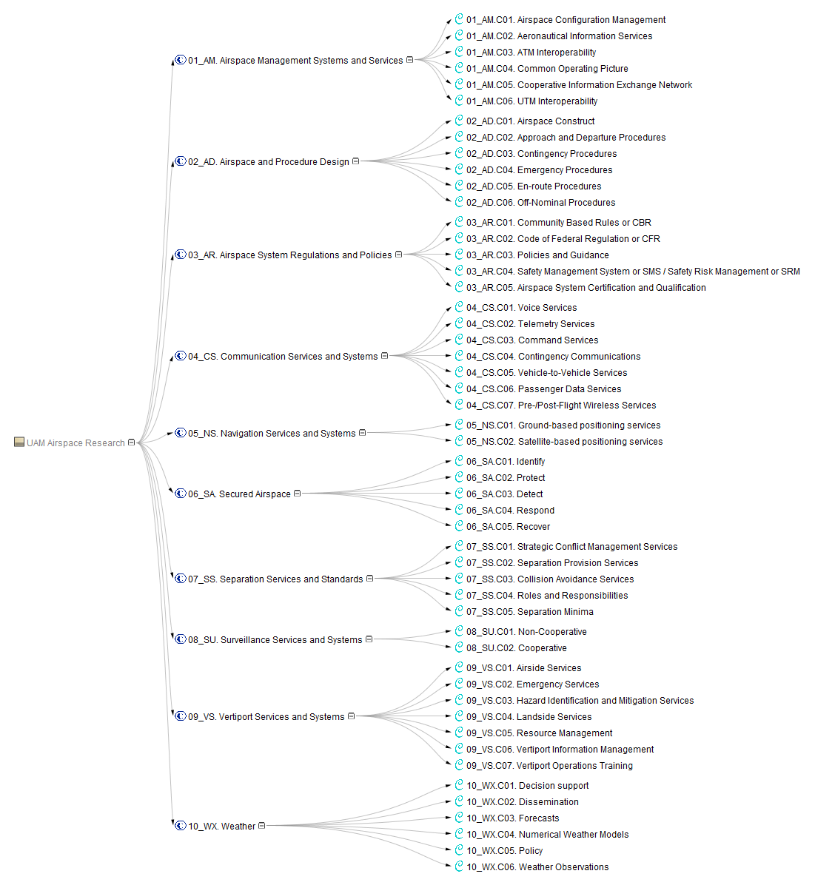
Application to NASA Air Traffic Management eXploration (ATM-X) research and development
Continuous process of requirements discovery and test & evaluation
Research requirements

Slide 4
Application to NASA Air Traffic Management eXploration (ATM-X) research and development
Continuous process of requirements discovery and test & evaluation
Research results
Notes:
Expect this to lead to both improved research results, but also an improved model reflecting more about what we know

Slide 5
Need for Development of Weather Capability for UAM
Resiliency of transportation systems to weather is often neglected or incorrectly assumed
  Leads to difficulties later in the R&D lifecycle
  Increases costs and timelines of R&D
  High-profile accidents of early operational technology erodes public confidence and widespread adoption
  Aviation is especially impacted by weather
For mitigation, NASA is addressing weather early on
  Integrating a weather capability into existing UAM research and system design
  Assessing weather assumptions and requirements
Adding a weather capability will ensure research is aligned with UAM system needs
  Enable safe and efficient travel with increasing tempo of UAM operations over time
R&D = Research and Development

Slide 6
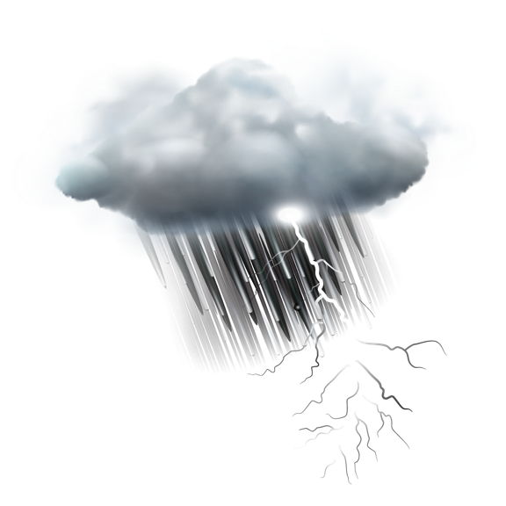

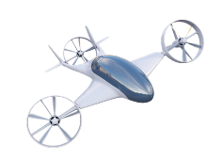



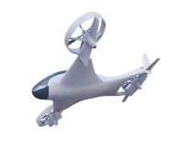

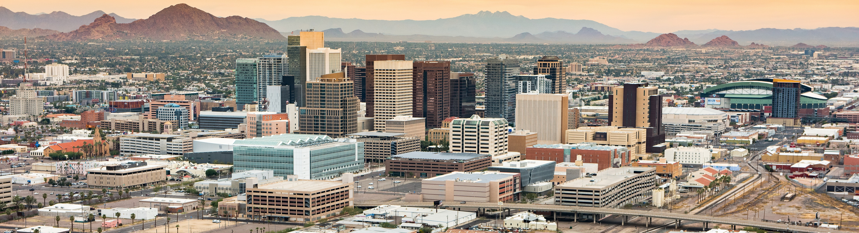







Primary Weather Conditions Impactful to UAM
Icing
Convection & Storms
Temperature
Precipitation
Reduced Visibility & Low Ceiling
Wind Shifts
Urban Canyons
Turbulence
Updrafts and Downdrafts
Wind Gusts
Wind Shear
Plethora of weather conditions are highly impactful to UAM operations

Slide 7

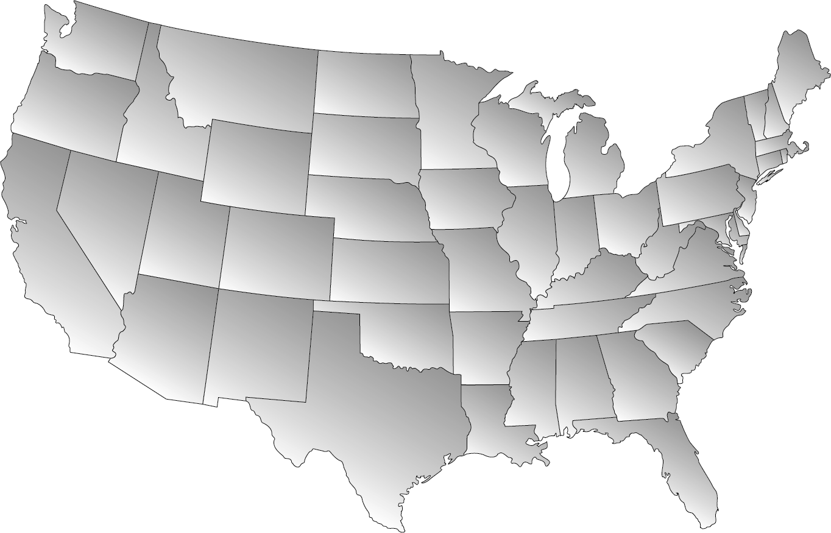
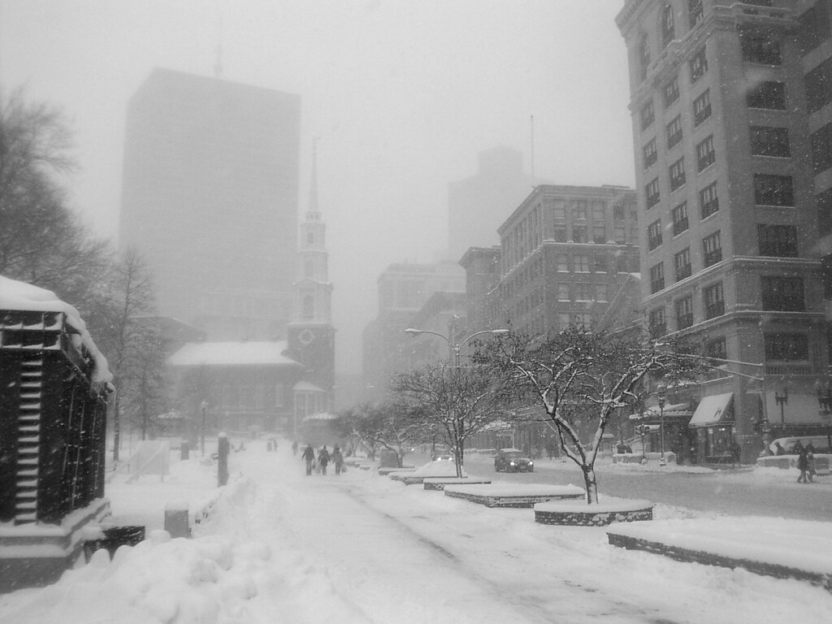


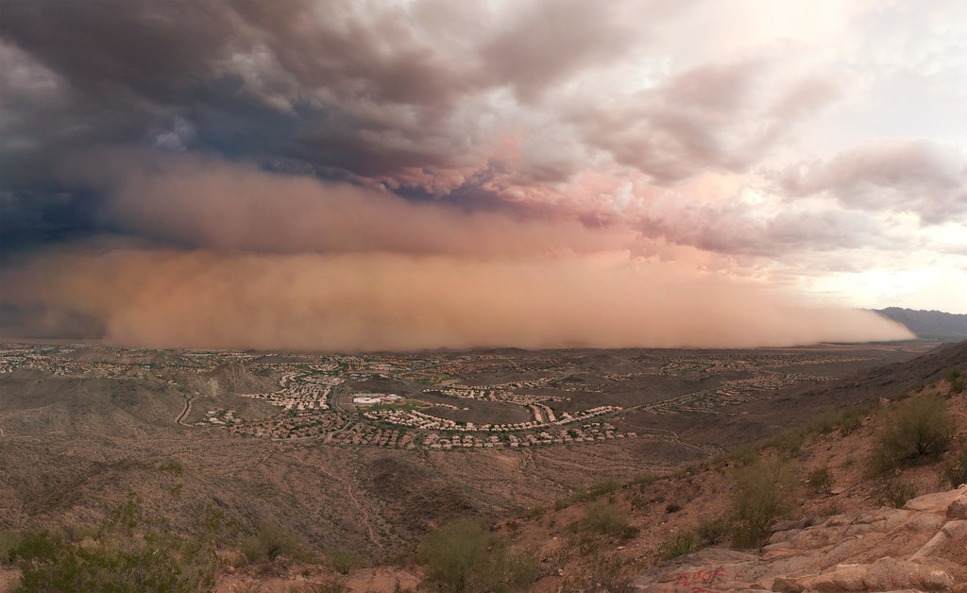
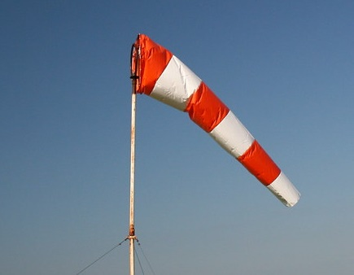
UAM Weather Challenges Vary by Location
1
6
Convection and Storms
Winter Weather and Icing
2
3
4
5
Heterogeneous Low Clouds
Dust Storms
Strong Wind Shear
Sea and Lake Breezes
Local climates need to be considered to assess relevant weather information needs
Image Credit to Creative Commons 1) dagpeak, 2) davidyuweb, 3) squeaks2569 4) Matt Mercer, 5) Richard Parmiter, 6) rcolonna.

Slide 8
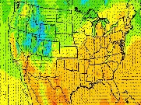
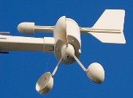

Gaps in Current Weather Information for UAM
Rank | Type | Prioritized ranking based on operational need*
1 |  | Numerical model performance is uncertain in off-airport areas and aloft
2 |  | Operationally available NWP products are too coarse to resolve impactful urban-scale phenomena
3 |  | Off-airport surface weather observations are sparse, particularly of wind, visibility, and ceiling
4 |  | Lack of measurements in the boundary-layer, particularly of wind, necessary to verify weather models and support UAM
5 |  | Forecasts lack accurate uncertainty metrics to support decisions
6 |  | Tactical convective weather products lack short-term storm forecasts, uncertainty, and are susceptible to latencies
7 |  | No method of alerting UAM operators of rapidly changing hazardous conditions (e.g., microbursts, gust fronts, convective growth)
8 |  | Given zero-tolerance for icing conditions, icing forecasts lack an uncertainty element
9 |  | Turbulence and icing models not designed for UAM
10 |  | Weather impact models for decision support do not exist for UAM
Gaps in weather information prompt creation of roadmap meet needs for safe and efficient UAM operations
Image Credits: NOAA
*Ranking modified from ‘Preliminary Weather Information Gap Analysis for UAS Operations’ report by Campbell et al (2017), considering differences between UAS and UAM operations

Slide 9
Outline
Introduction
Weather Roadmap Creation
Weather Requirements Tracing
Future Use of Roadmap

Slide 10
UAM Weather Roadmap Development Process
Various documentation were reviewed by aeronautical and meteorological SMEs
  UAM ConOps
  Literature related to UAM weather
  Other capabilities of the UAM Airspace Research Roadmap
Components of the weather capability were identified
  Specific functions, services, and other features that comprise the weather capability
  Aligned with how weather information is used to support aviation and standards in development
Requirements were discovered through evaluation of weather considerations and impacts on UAM system capabilities
  Requirements defined for UML-2, UML-3, and UML-4
  Refined based on community feedback
SME = Subject-Matter Expert
ConOps = Concept of Operations
UML = UAM Maturity Level

Slide 11
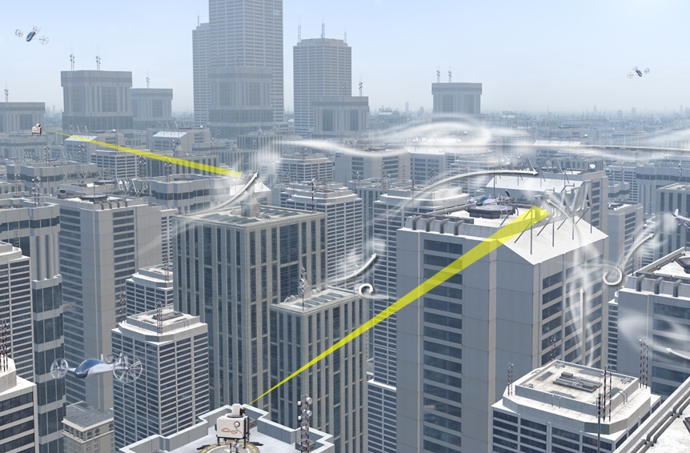
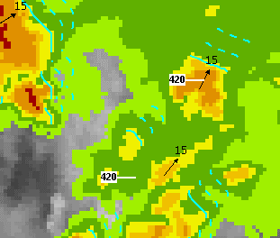
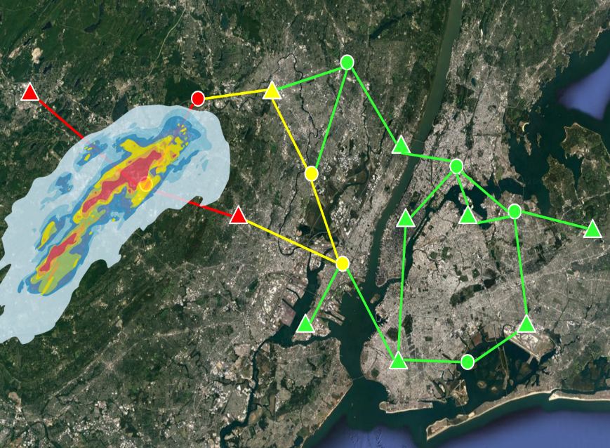
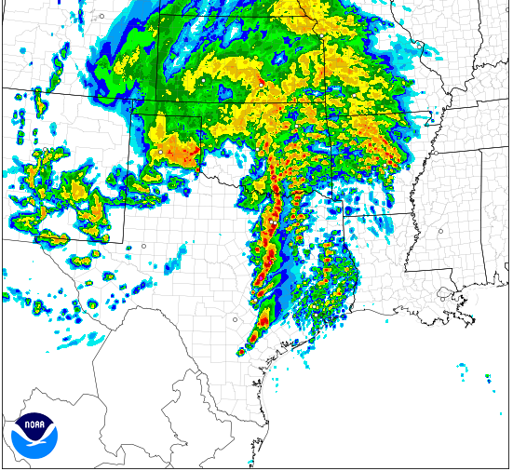
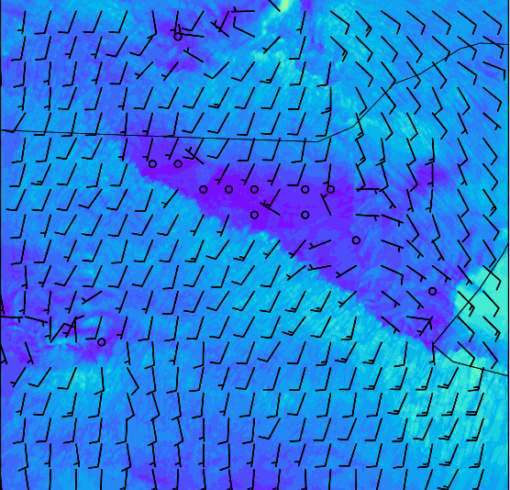
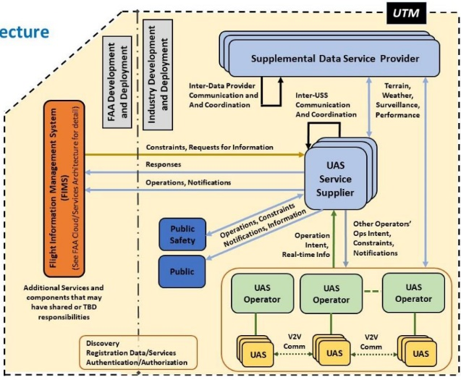
Seven Components of the UAM Weather Capability
Weather Measurements
Analyzed Weather
Decision Support
Weather Data Performance Standards
Dissemination Weather Policy
Weather Models
Weather Forecasts
Image Credit to NOAA (weather forecast example) and FAA (dissemination – notional UTM architecture from UTM ConOps v2.0).

Slide 12
Weather Requirements Creation Process
UML-2 – Initial commercial air taxi operations using newly certified eVTOL aircraft designs under existing airspace and regulations
  Requirements developed from current regulations
    Code of Federal Regulations Part 91 and 135
    FAA Order 8900.1, Volume 3, Chapter 26: Aviation Weather Regulatory Requirements
    Use ‘will’ statements, as certainty is established
  Additional requirements added for early available supplemental weather information to support UAM
    Derived from other UML-2 requirements in the Airspace Roadmap
    These are ‘should’ requirements, as products are not expected to be fully mature during UML-2
UML-3 (Transition and Growth) and UML-4 (New Predetermined Separator)
  Requirements identified from considering the impact of weather and the informational need to support UAM operations at each UML
    Derived from other requirements in the UAM Airspace Roadmap
    SME methodical review of existing requirements for other UAM capabilities and assessing weather considerations
  Similar common requirements are grouped together to mitigate redundancy
eVTOL = Electric Vertical Take-Off and Landing

Slide 13
Example of Weather Requirement Development at UML-3
Example of Weather Requirements Associated with Other Requirements of the UAM Airspace System:
Airspace Management Systems and Services Component at UML-3
Component | Requirement | Weather Considerations | General Weather Informational Need
Airspace Configuration Management | ATC will establish capacity constraints on shared airspace resources in accordance with the CBRs. (98 UML-3.AM)
Strong winds will impact capacity given separation requirements and reduced airspeed. Ceiling and visibility likely impact capacity dependent on CBRs.
Wind information, either sensed or modeled, with associated uncertainty. Ceiling and visibility information with associated uncertainty. Weather translational tools and procedures that map winds, ceiling, and visibility information into an estimate of airspace capacity should be established.
Derived weather requirements:
  Measurement: The SDSP shall collect and weather measurements meeting sensor and data performance standards for weather parameters including wind speed and direction, ceiling, and visibility. Uncertainty information should be included with each weather measurement in compliance with CBRs.
  Analyzed Weather: The SDSP shall produce analyzed weather meeting performance standards for estimating weather parameters such as wind speed and direction, ceiling, and visibility.
  Models: The SDSP shall use numerical weather prediction models and computational fluid dynamics meeting performance standards for estimating weather parameters such as wind speed and direction, turbulence, precipitation, ceiling, and visibility.
  Forecasts: The SDSP shall issue forecasts meeting performance standards for weather parameters such as estimate of wind speed and direction, ceiling, and visibility over all shared airspace resources.
  Decision Support: The SDSP and PSU shall include weather information and provide associated uncertainty information to assess capacity and availability of shared airspace resources. The uncertainty on that weather information and weather impacts should be validated.
ATC = Air Traffic Control
CBR = Community Based Rules
Notes:
In soundtrack, state that this process was following in review of every existing system requirement in the previous version of the UAM Airspace Research Roadmap.

Slide 14
Generalizing Specific Requirements
Specific
The SDSP or PSU shall incorporate weather information relevant to identify hazards in airspace around vertiports.
The SDSP or PSU shall incorporate weather information (e.g., winds) in comprehensive safety-assurance services to ensure appropriate spacing.
The SDSP or PSU shall incorporate weather information to help with establishing and conforming to the strategic schedule.
Generalized
The SDSP or PSU shall incorporate weather information to capacity, availability, and safety of shared airspace resources.
Example grouping and generalization of weather requirements
Overall 339 specific weather requirements were discovered
  Each derived from information necessary to enable other UAM capabilities at evolving UML
  Each has wording for specific information needed to support a service
  Resulted in numerous overlapping requirements
To reduce redundancy, specific requirements were consolidated and generalized
  Avoids over-specification for the research roadmap
SDSP = Supplemental Data Service Provider
PSU = Provider of Services for UAM

Slide 15
Feedback & Refinement
Targeted feedback solicited from various stakeholders including:
  NASA
  FAA
  Industry
  ASTM International Standards Group (WK73142)
General community feedback solicited through online portal
  Interim v1.2 draft of the UAM Roadmap with initial weather capability posted for public comment
  Deep dive forum hosted by NASA on UAM weather capability in July 2022¹
Descriptions of components and requirements were modified based on community input
  Align with state-of-the-art technology and consensus anticipated timelines
  Increase consistency with other standards in development
1 Available here:
https://www.youtube.com/watch?v=nR0Pa4RpgFU
ASTM = Supplemental Data Service Provider

Slide 16
Example of Final Requirements for Analyzed Weather
UMLs → Components ↓ | UML-2: Initial | UML-3: Transition and Growth | UML-4: New Predetermined Separator
Analyzed Weather | The UAM operator should use early analyzed weather products to support situational awareness and flight planning. | The SDSP shall publish analyzed weather meeting performance standards for estimating weather parameters including, but not limited to, wind speed and direction at the surface and aloft, turbulence, icing, wind shear, updraft and downdraft intensity, precipitation, ceiling, visibility, pressure, temperature, and/or dew point to all subscribers. The SDSP should publish associated validated uncertainty metrics for analyses of weather parameters using validation methods approved by the FAA to support risk-based decision making. | The SDSP shall publish analyzed weather meeting performance standards for estimating weather parameters including, but not limited to, wind speed and direction at the surface and aloft, turbulence, icing, wind shear, updraft and downdraft intensity, precipitation, ceiling, visibility, pressure, temperature, and/or dew point to all subscribers. The SDSP shall publish associated validated uncertainty metrics for analyses of weather parameters using validation methods approved by the FAA to support risk-based decision making.
More stringent requirements are given at higher UML
UMLs 3 and 4 incorporate new system actors
  Weather SDSPs, also called Meteorological Service Providers (MSPs) or Weather Information Providers (WIPs)
  PSUs
Notes:
In soundtrack, state that similar table of requirements is given for 6 other components as well. Audience is referred to full v2.0 roadmap to be published soon.

Slide 17
Outline
Introduction
Weather Roadmap Creation
Weather Requirements Tracing
Future Use of Roadmap

Slide 18
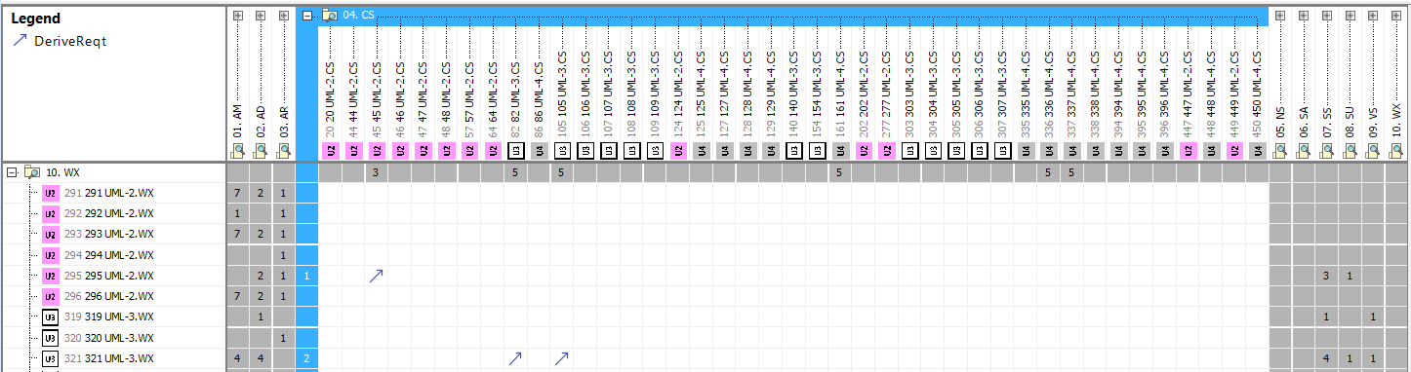
Establishing Traceability of the Weather Requirements
A set of 27 tables were generated defining weather requirements
  A table for each of the nine other UAM system capabilities at UML-2, 3, and 4
Tables were delivered to NASA and incorporated into their Systems Modeling Language (SysML) model
  Provides ability to identify backwards and forwards tracing of requirements
  Enables identification of:
    Requirements that need to be revised as research matures
    How requirements are leveraged throughout the system
Sample tracings from SysML between weather and other capability requirements

Slide 19
Trace Distribution to Other UAM Airspace Capabilities
Weather requirements are traced to most other UAM airspace capabilities
  Large number of weather impacts anticipated on top three capabilities:
    Airspace management systems
      Wide variety of weather conditions
    Separation services and standards
      Requires high-density weather information of winds and C/V specifically, especially at high UMLs
    Airspace and procedure design
      Airspace constructs should be established where increased predictability is necessary
  No tracings to secured airspace or navigation services and systems
    Some impacts from space weather on navigation, but more research is necessary before requirement can be established
    Dissemination of weather information should follow secured airspace procedures

Slide 20
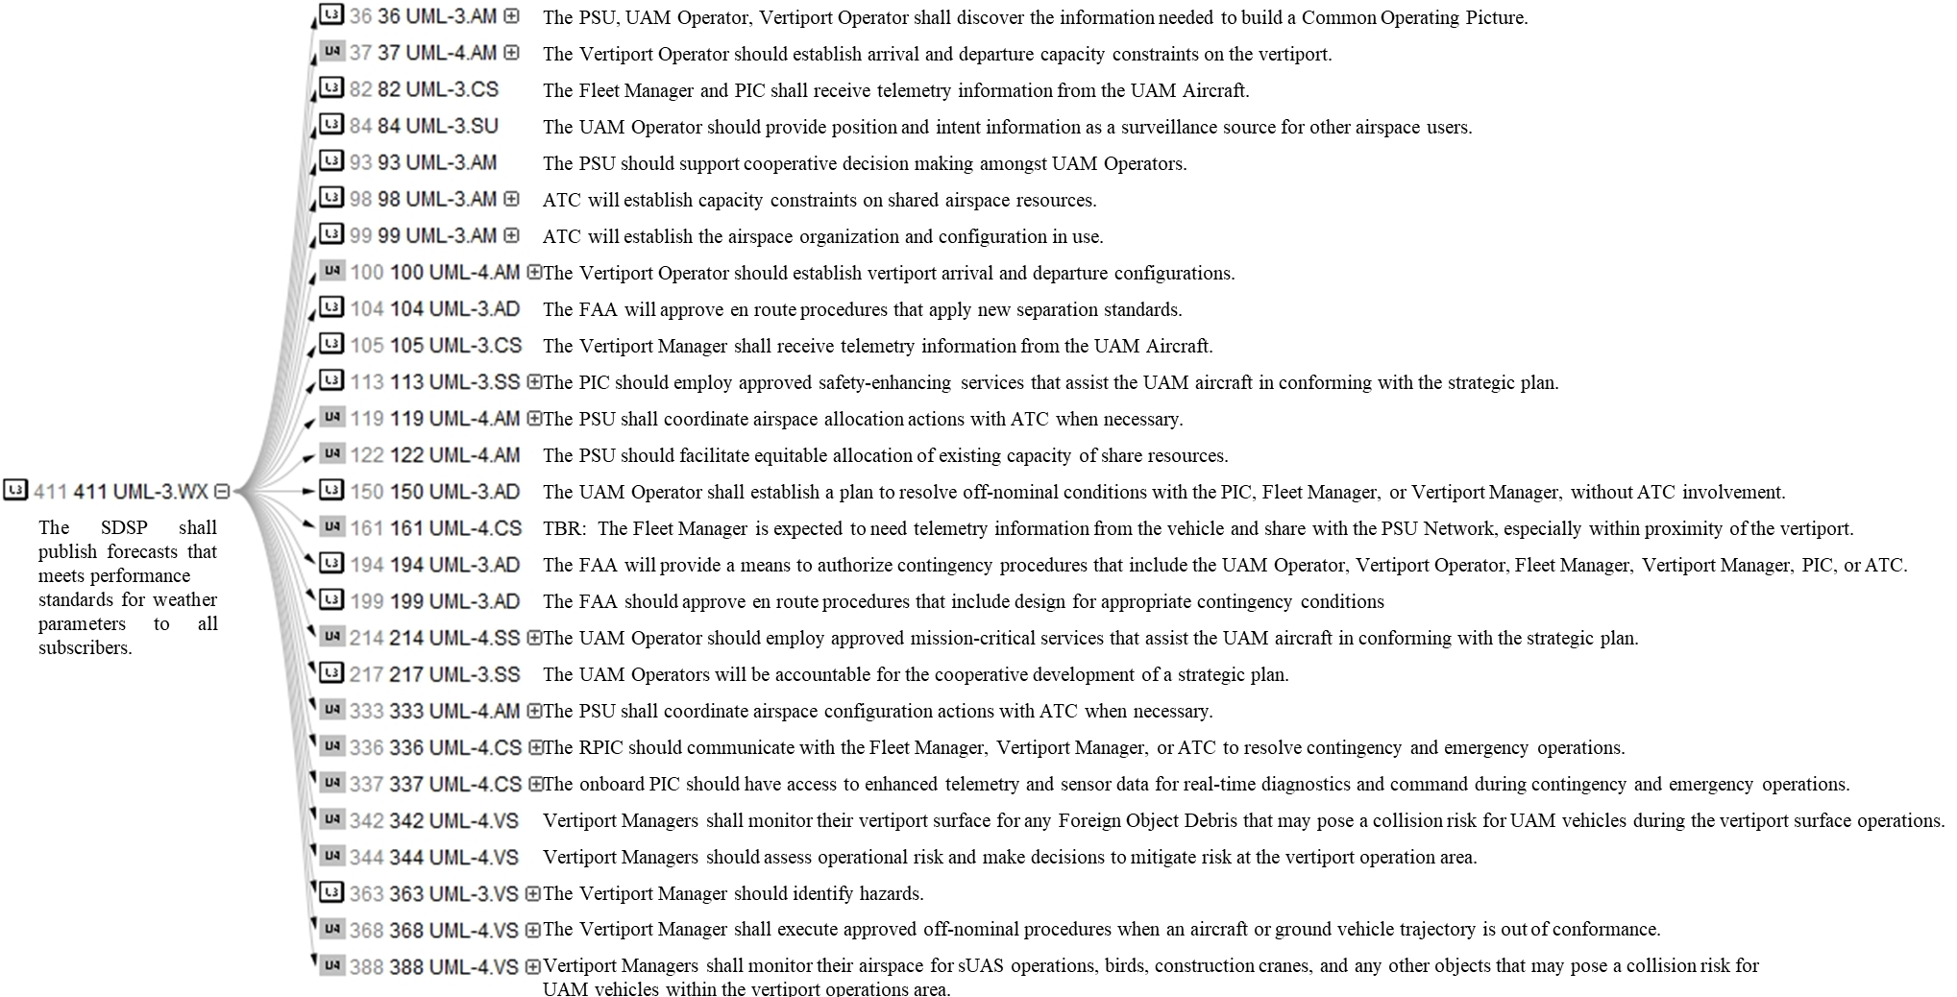
Example Tracing of the Weather Requirement Derived from Most Other System Requirements
Weather capability requirements will provide information used broadly across UAM ecosystem

Slide 21
Outline
Introduction
Weather Roadmap Creation
Weather Requirements Tracing
Future Use of Roadmap

Slide 22
Anticipated Usage of the Roadmap
Roadmap will be used as a guide
Identify technology for research and development to help provide necessary weather information to enable safe and efficient UAM operations at each UML
  Key is advancing weather measurements
    Improve spatial coverage and density
    Needed to improve and validate other derived products (e.g., analyses, models, forecasts)
  Concurrently will research improvements in other components of the weather element
Roadmap will be updated as capabilities and limitations of new weather sensing and forecasting technology are understood
  Requirements are based on current available working knowledge and are expected to evolve with additional research and development

Slide 23
Summary
Weather is a primary hazard in the UAM airspace
  Current weather information infrastructure is inadequate to support UAM
  Necessitates creation of roadmap to ensure UAM operations are safe and efficient
The initial weather capability has been developed within the UAM Airspace Research Roadmap to identify potential required weather information and policies
  Based on existing regulations with new requirements developed from other elements of airspace system and current understanding of the ConOps
Will be used to identify research priorities to ensure adequate weather information is provided to advance UAM operational tempo
  As the roadmap is a living document, will continue to evolve with increased understanding of ConOps and new technological capabilities and limitations

