Slide 1
Multiple CA Solutions:
Technical Issues and Potential Remedies
Lauri K. Newman
NASA Conjunction Assessment Program Officer
April 2023

Slide 2
Multiple Data/Product Sources
And “The Paradox of Choice”
Situations having more options/choices are often supposed to produce better effects/outcomes (e.g. consumer situations)
However, studies show that the opposite result is frequently observed
  For example, in employer retirement plans, the more investment options available to employees, the LOWER the overall plan participation*
  Multiple disparate choices/inputs create paralysis, an imputed need for additional analysis, and often a bad conscience about the decisions made
This phenomenon also at work in satellite conjunction assessment
  In the experience of NASA CARA, multiple CA solutions create more ambiguity and gamesmanship than enlightenment
Need to combine data and/or products from different sources into a single composite solution that can be clearly interpreted operationally
*Sethi-Iyengar, Sheena, Gur Huberman, and Gur Jiang, 'How Much Choice is Too Much? Contributions to 401(k) Retirement Plans’,
in Olivia S. Mitchell, and Stephen P. Utkus (eds), Pension Design and Structure: New Lessons from Behavioral Finance (Oxford, 2004)

Slide 3
CARA Operational Experience:
Two Solutions for Primary Object State
In conjunction assessment, primary object is the object you are protecting
  Secondary object is the one in conjunction with your primary
CARA receives two solutions for the primary object state (position/velocity)
  One from the predicted ephemeris supplied by the O/O
  A second from the USSF’s space catalog
Not always obvious (or consistent) which of these solutions is superior
  O/O usually receives regular telemetry data and has an accurate physical model of the satellite, so would presume has better computation of satellite’s position
  However, USSF has very good atmospheric density model, so generally does better job of predicting satellite future positions
When one solution counsels mitigation and the other does not, which to use for decision becomes problematic

Slide 4
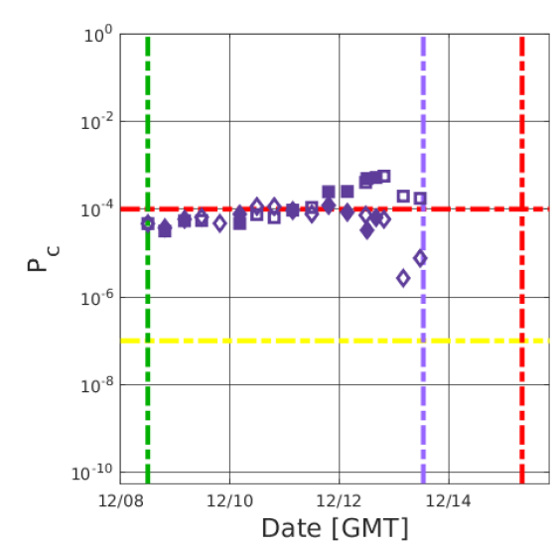
Two-solution Example:
Probability of Collision (Pc) vs Time
No data fusion: both results presented comparatively but separately
In absence of additional data to adjudicate situation, how to respond?
  Can always act based on the more worrisome of the two results
    This does not scale—with, say, 10 solutions, will often be only 1 that counsels mitigation
  Can choose based on one’s preference, since both solutions perhaps equally valid
    Invites “cherry-picking” of results to avoid mitigation actions
  The one out of family solution could be the correct one
USSF Solution for Primary—squares
(above red threshold; should maneuver)
Owner/Operator Solution for Primary—diamonds
(below red threshold; maneuver not needed)
Maneuver Commit Point (purple line)

Slide 5
Multiple Solutions Becoming the Norm
US-provided CA service (presently USSF; transitioning to DOC OSC)
  CDMs generated with US SSN data and potentially commercial data also
EUSST-provided CA service
  CDMs, drawing from EU sensor data and potentially commercial data also
Other emerging national services
Available commercial services
  e.g LeoLabs, Slingshot, ExoAnalytics
All of the above will generate different CA solutions for the same conjunction
  Difficulties will be similar to the O/O-ASW two-solution problem but be far more serious: multiple solutions for both primary and secondary
  Unless multiple solution problem addressed, presence of additional data and services will not operationally enhance orbital safety but rather confuse it
Potential ways forward summarized in subsequent slides

Slide 6
Possible Mitigation #1:
Sharing of Measurement Data
Engineering opinion clear that best way to “fuse” data into single solution is to combine sensor measurement data into single state estimate
Present experiment between DOC and EUSST exercising this data exchange
  Many attendant issues in exchanging even measurement data, but experiment has worked through most of these
Does not require exchange of all measurement data regularly
  Only episodically, for conjunctions still serious near the mitigation action point
  Exchanging data only for debris or other inert objects would also be helpful
Data Source 1
Orbit
Determination
Engine
Data Source 2
Improved
Trajectory

Slide 7
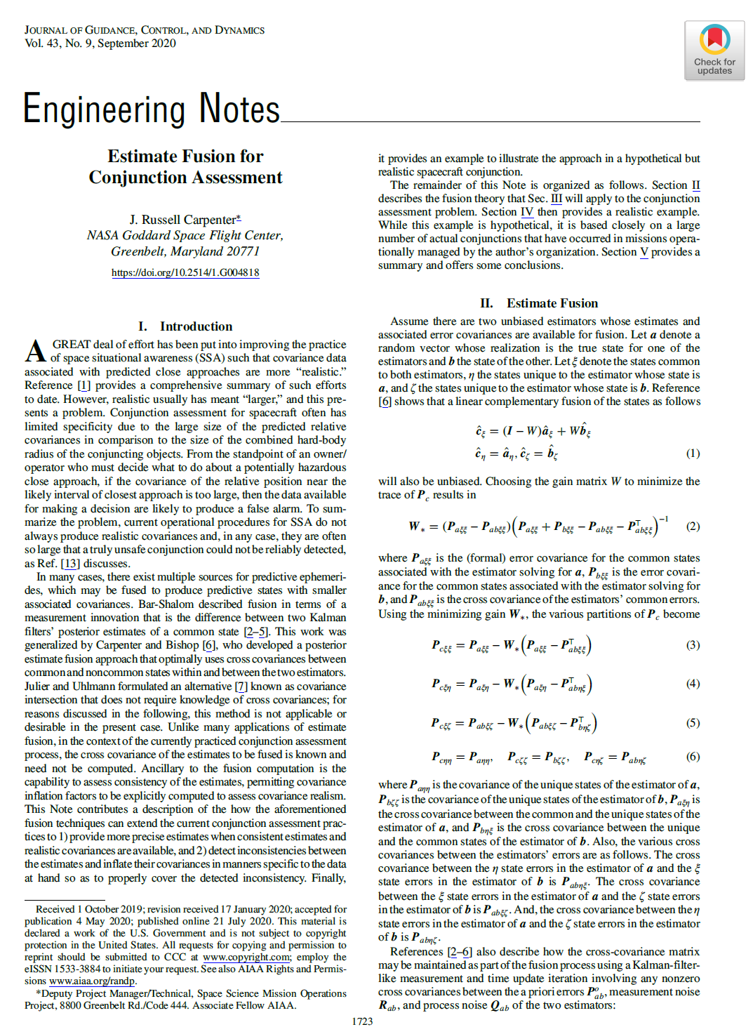
Possible Mitigation:
Direct Fusion of Products
Proposed methods exist for fusion of CDMs and other similar products
  NASA-developed approach shown at right
Theory verified by specialists and is legitimate
However, additional issues exist, some of which are considerable
  Need to have very precise statements of estimation uncertainty—something often not done well in astrodynamics discipline
  Need to verify rectitude of fusion results in large experiment
    Can verify against results from “combination of measurements” technique described on previous slide

Slide 8
Possible Mitigation:
Rubric for Selecting Single Solution
In the presence of multiple solutions and the absence of any data fusion, can assemble a rubric for choosing single solution from among them
Such a rubric would need to consider at least the following:
  Type, amount, and quality of measurement data feeding each state estimate
  Solution fidelity (modeling sophistication, especially for atmospheric density)
  History of prediction error and covariance realism for each solution
At present, no standardized or accepted method for evaluating the above
  Not easy to develop; substantial project for subject matter experts
  Requires access to the information that defines these attributes

Slide 9
Summary:
CA Operational Situation and Need
Multiple solutions, via multiple services, can easily become a source of CA confusion rather than enlightenment
Several approaches possible to create fused and unambiguous solutions
Policy and technical exploration needed to identify best operational resolution
  Acceptable to all parties from a policy perspective
  Necessary technical investment to bring solutions to operational maturity

