Slide 1
From Natural Language Requirements to the Verification of Programmable Logic Controllers: Integrating FRET into PLCverif
NASA AMES Robust Software Engineering & KBR
Anastasia Mavridou
Andreas Katis
Thomas Pressburger
Khanh V. Trinh
CERN BE-ICS group
Zsófia Ádám (BUTE)
Borja Fernández Adiego
Ignacio David Lopez Miguel (TU Wien)
Jean-Charles Tournier
Marcin Bes
Enrique Blanco Viñuela

Slide 2
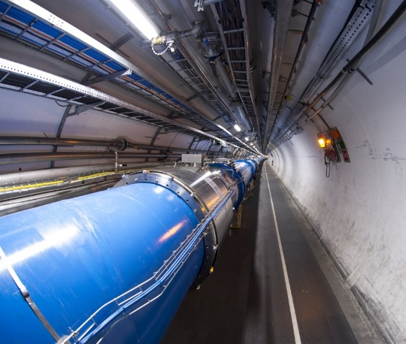
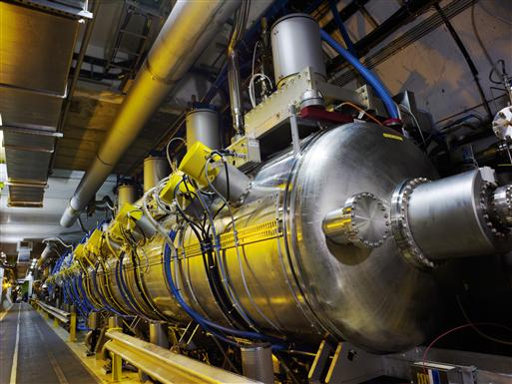
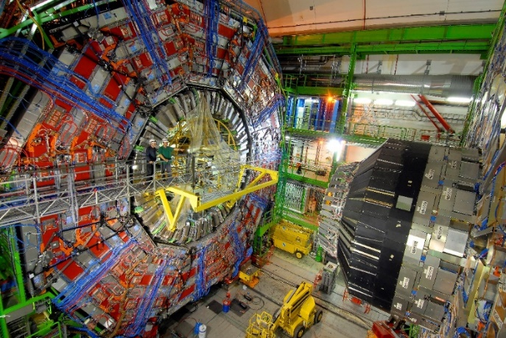
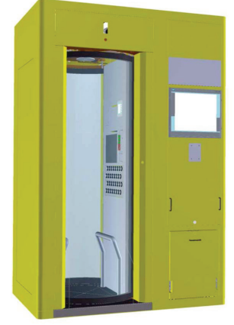
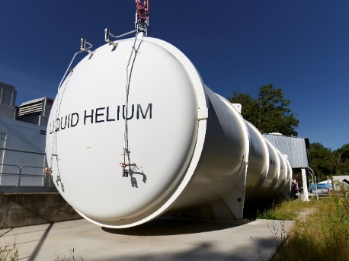
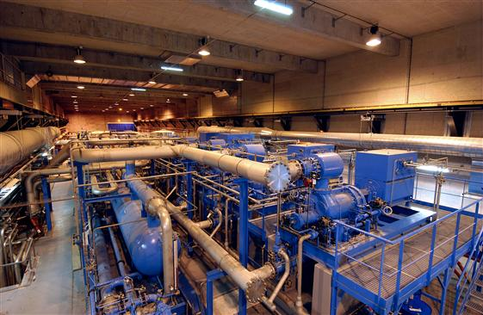
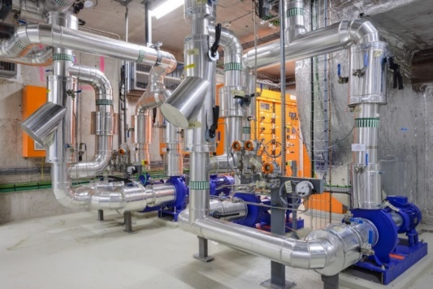
Context – CERN (European Organization for Nuclear Research)
CERN has the biggest particle accelerator complex in the world and many critical and complex industrial installations
LHC
(Large Hadron Collider)
Access and protection systems
Cryogenics plants
Cooling and ventilation systems
Superconducting magnet test benches
Images from cds.cern.ch

Slide 3
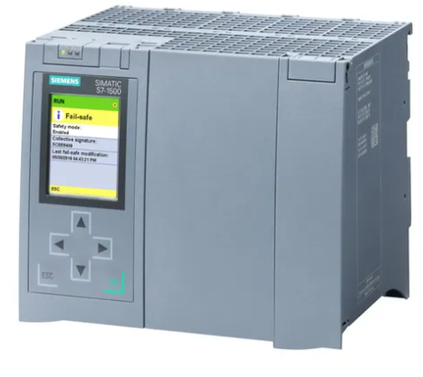
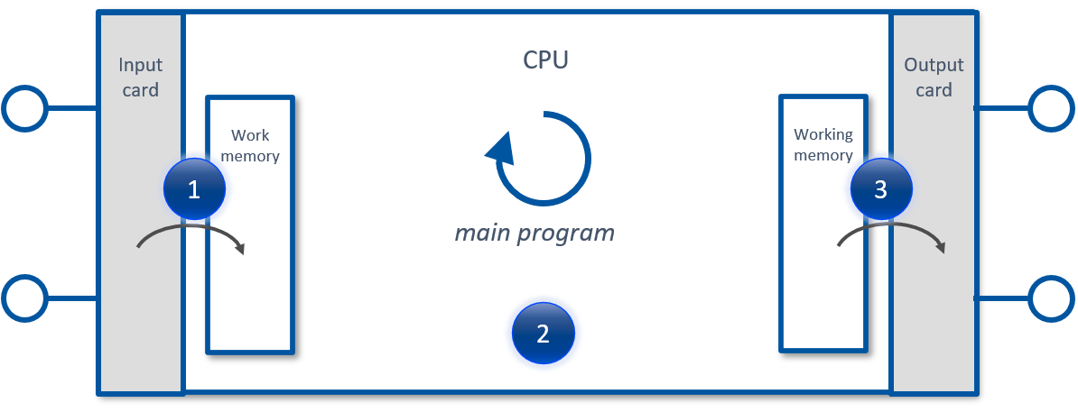
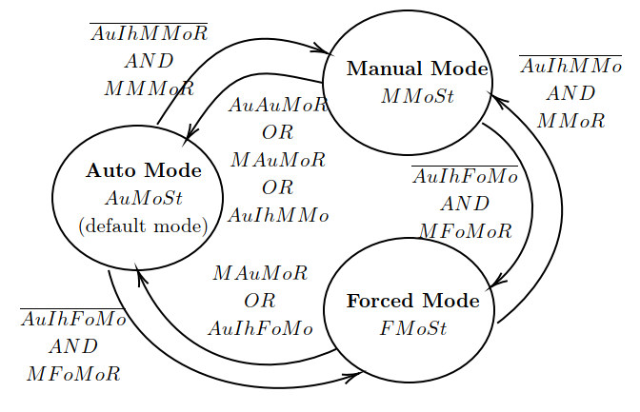
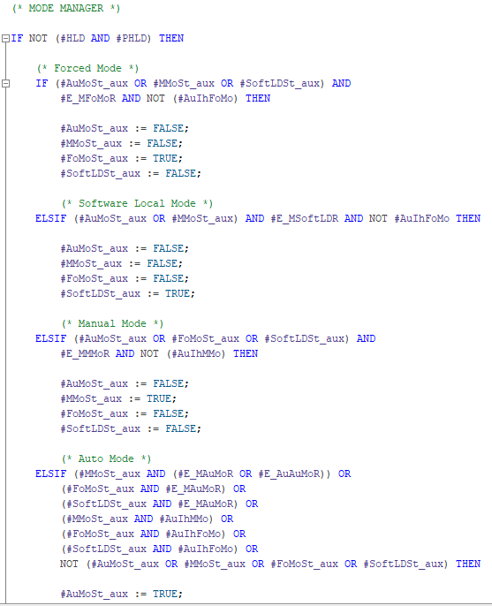
Context – PLCs at CERN
At CERN, more than 1000 PLCs (Programmable Logic Controllers) are installed to control and/or protect the installations
Example case study 2
Ambiguous or incomplete specification
PLCverif
Enables formal verification to PLC programs
Need to guarantee “complex” properties
if (MMoSt and AuAuMoR) at any time before the end of the PLC cycle,
then AuMoSt should be true at the end of the same PLC cycle

Slide 4
Roadmap
PLCverif limitations
PLCverif
FRET
FRET new developments
FRET-PLCverif integration
Conclusions

Slide 5
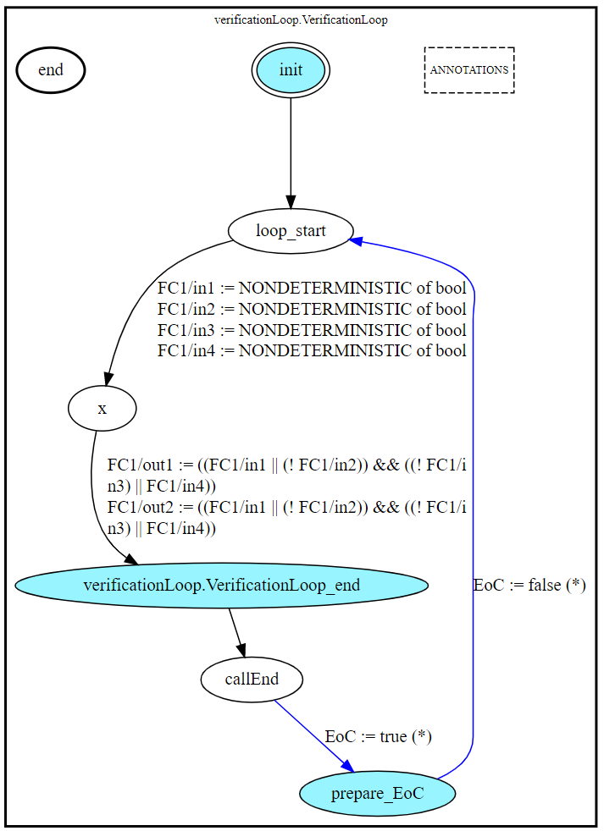
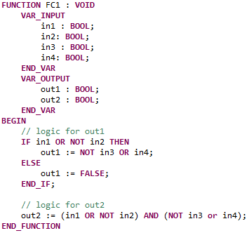
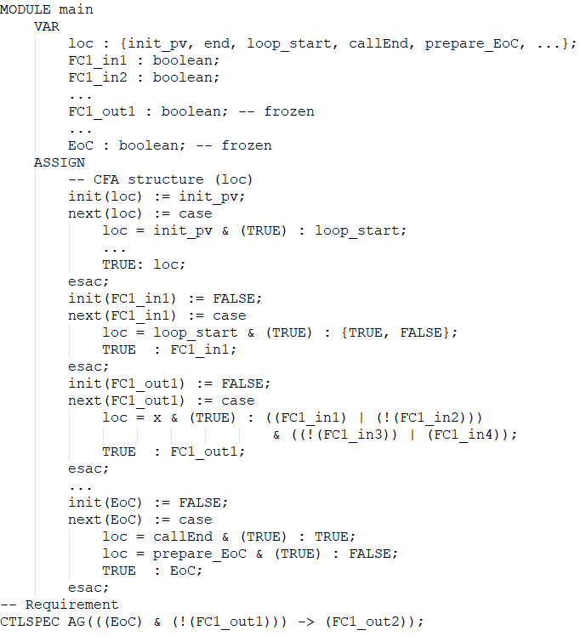
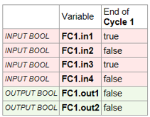
PLCverif
PLCverif hides the complexity of using formal methods
Different PLC languages, property specification methods and model checking tools can be added (open architecture)
Intermediate Model (IM)
Control-Flow Automaton (CFA)
Property OK
Model checking algorithms
(external tools)
✓
PLC program
5
1
4
✗
Property failed
Trace leading to the violation
2
3
Property to verify
(verification case)
If Out1 is FALSE
then Out2 is TRUE
Model reduction and abstraction techniques
Other methods
PLCverif references: https://gitlab.com/plcverif-oss and www.cern.ch/plcverif

Slide 6
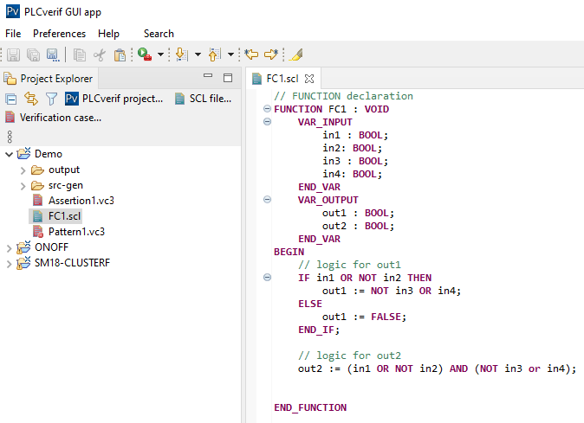
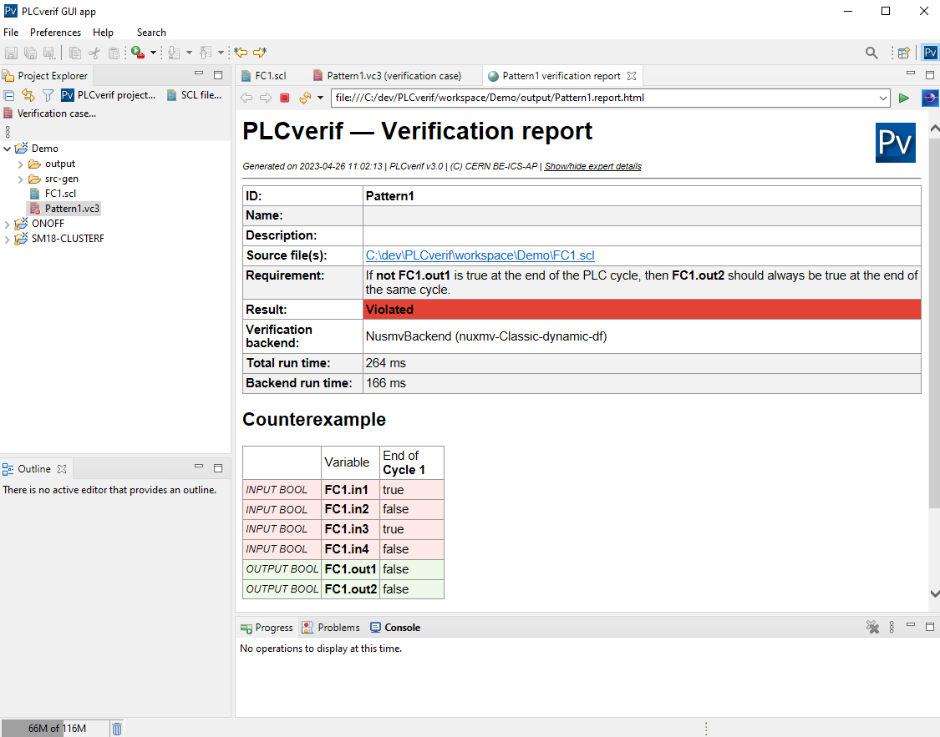
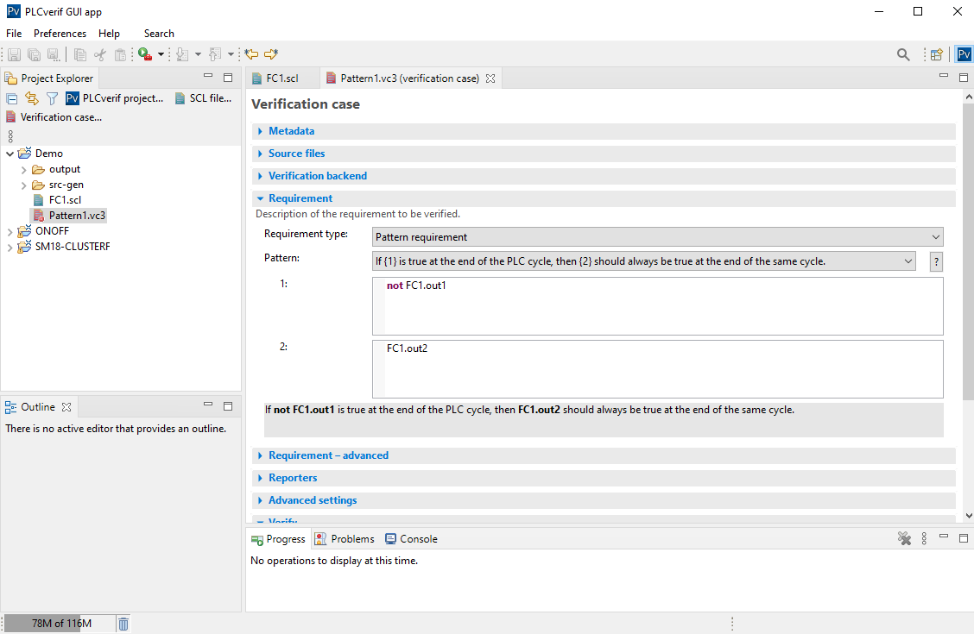
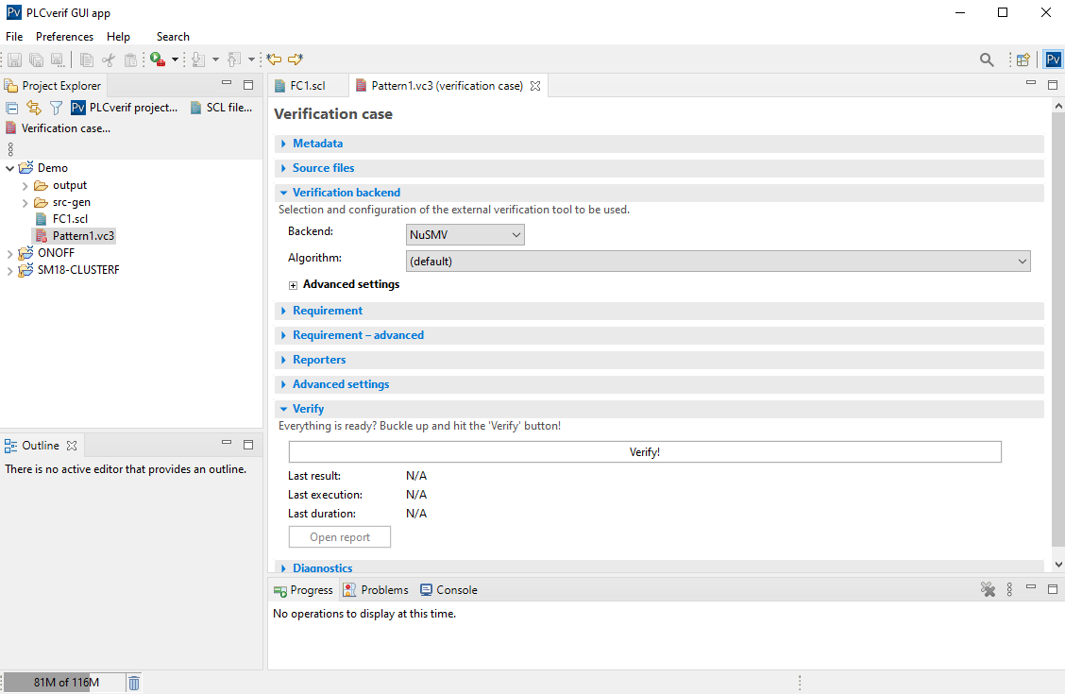
PLCverif
Currently 8 patterns based on
the experience of CERN PLC program developers

Slide 7
PLCverif current limitations
Example case study 1
2 main property specification limitations
Validation of (complex) requirements
(Very) limited expressive power
basic assertions
8 patterns
If ((not MTBF_WCC_PCLSW20_FSL) or (not MTBF1_WCC_LSW20_FSL and MTBF1_LSW20_POS) or (not MTBF2_WCC_LSW20_FSL and MTBF2_LSW20_POS) or (MTBF2_LSW20_POS and not MTBF2_WCC_LSW20_TSH) or (not MTBF_WCC_PCLSW20_TSH) or (not MTBF1_WCC_LSW20_TSH and MTBF1_LSW20_POS)) is true at the end of the PLC cycle,
then SIF01_DB.SIF01_PC20K should be always true at the end of the same cycle
Example case study 2
if (MMoSt and AuAuMoR) at any time before the end of the PLC cycle,
then AuMoSt should be true at the end of the same PLC cycle
Need for a new specification method → FRET

Slide 8
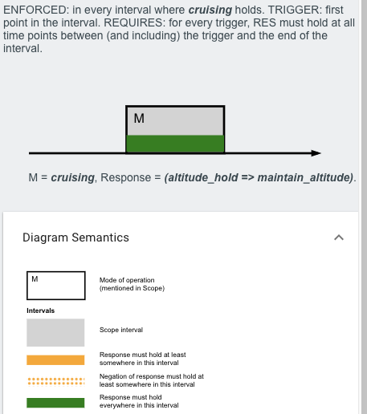
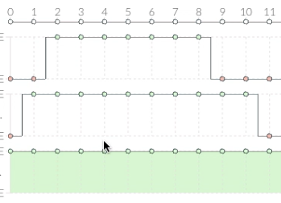
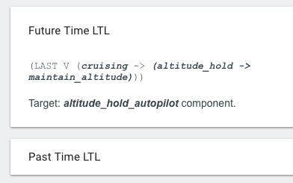
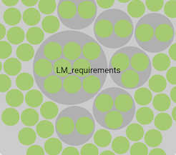
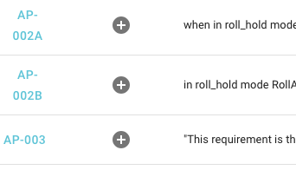
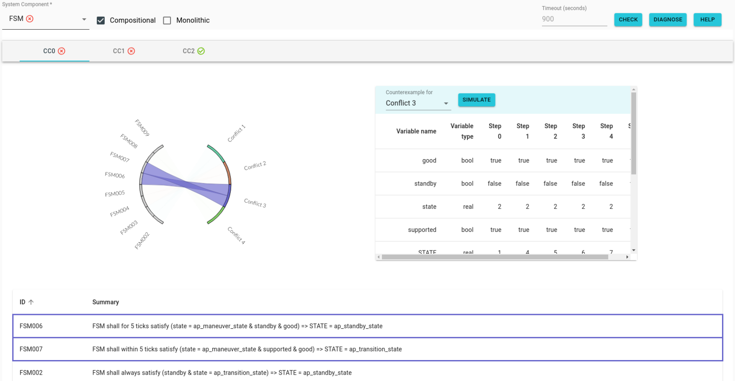
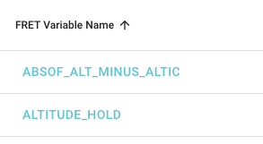
explains
captures + assists
FRETish
stores + displays
formalizes
connects + exports
analyzes + diagnoses

Slide 9
Capturing PLCVerif Requirements with FRET
Structured natural language (FRETish)
Scope condition component* shall* timing response*
Amenable to formal analysis and simulation
When (MMoSt & AuAuMoR) the CPC_FB_OnOff shall eventually satisfy AuMoSt & PLC_END
( G (((!( MMoSt and AuAuMoR )) and ( X ( MMoSt and AuAuMoR ))) -> ( X ( F ( AuMoSt and PLC_END ))))) and (( MMoSt and AuAuMoR ) ->
( F ( AuMoSt and PLC_END )))
New features
New “External Mode” facilitates connection with third-party tools e.g. PLCVerif
New phrase: “at the next/previous occurrence of p, q”
New requirement templates to support PLC Scan cycles (read sensor values, execute PLC program, write actuator values)

Slide 10
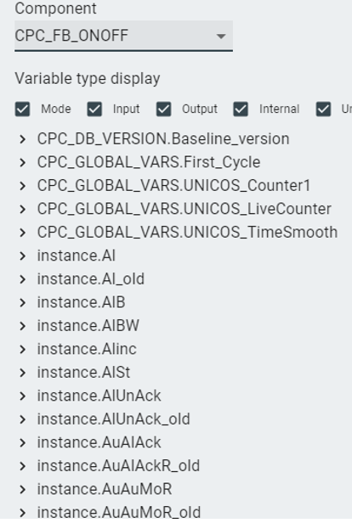
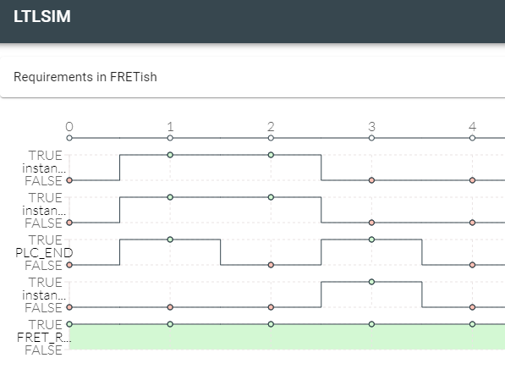
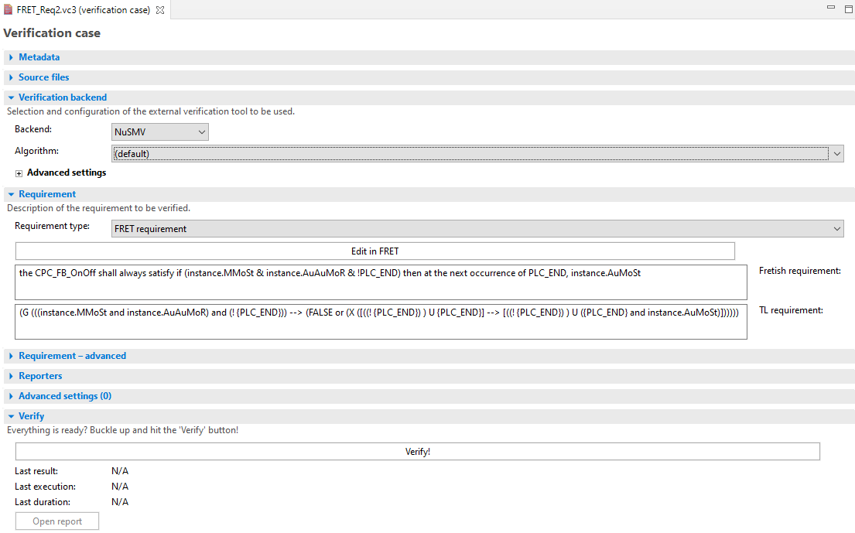
Case study 2
PLC program running in 100s of applications
(UNICOS framework)
Case study and integration
if (MMoSt and AuAuMoR) at any time before the end of the PLC cycle,
then AuMoSt should be true at the end of the same PLC cycle
Launch
FRET
1
PLC program
Variable glossary
1
2
LTL formula

Slide 11
Conclusions
Creations of requirements in FRET fits well into the PLCverif verification workflow
Thanks to FRET, PLCverif provides
validation capabilities for the verification requirements
bigger expressiveness for complex requirements
It has been applied to 2 real case studies at CERN
To the best of our knowledge, this is the first attempt to specify formal requirements using a structured natural language for PLC program verification
Future work: support of verification of time properties in PLCverif and the support for different type widths in the FRET simulator (e.g. 16/32 bit integers)

Slide 12
if (MMoSt and AuAuMoR) at any time before the end of the PLC cycle,
then AuMoSt should be true at the end of the same PLC cycle
Case study and integration
Launch
FRET
1
Variable glossary
1
2
LTL formula

Slide 13
FRET-PLCverif integration
Launch
FRET
1
Variable glossary
1
2
LTL formula

Slide 14
Case study
Several 100s of PLC-based control systems at CERN are developed with UNICOS
A failure in the UNICOS library would be propagated in all the UNICOS control systems
OnOff object designed to control digital actuators
FRET property specification
Part of the (simplified) OnOff specification
if (MMoSt and AuAuMoR) at any time before the end of the PLC cycle,
then AuMoSt should be true at the end of the same PLC cycle

Slide 15
Case study
FRET
Property validation
thanks to FRET simulator
PLCverif
LTL formula from FRET

Slide 16
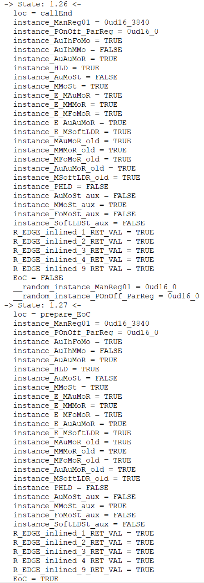
Case study

