Slide 1
Temperature Measurement by
Vincent Cuda, Jr. Ph.D., P.E.
AMA/NASA LaRC

Slide 2
Outline
Temperature Measurement
  History
  Measurement Standards
Thermocouples
  What are They?
  Diagnostics
  Lessons Learned
Example: Solid Rocket Motor Materials Test
  Nozzle Liner
  VAMAC®
  P-50 cork

Slide 3
Test your Temperature Scale Knowledge
How many scales are used to describe the weather?
  2 – Celsius and Fahrenheit.
How many scales are used by the scientific community?
  3 – Kelvin, Rankine, and electron Volt.
How many scales are unique to food preparation?
  4 – Reaumur, Gas Mark, Stufe, and Thermostat.
How many scales are no longer in use?
  64 – as of last count!

Slide 4
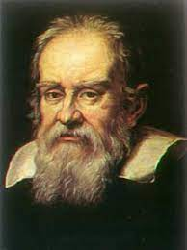
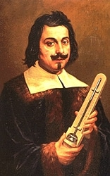
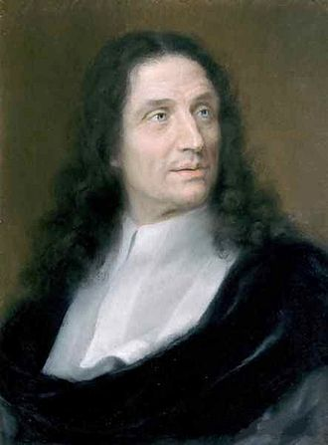
Early Pioneers
(The power of collaboration, mentoring and leaving a legacy)
Hero of Alexandria (10 – 70 AD) was a first century mechanical engineer credited with at least 78 inventions. One of them was the predecessor to the thermoscope (thermometer without a scale)
… and 1600 years later during the Renaissance …
Galileo Galilei (1564 – 1642) is credited with numerous inventions including the thermoscope (circa 1592). He also studied strength of materials (square-cube law). Francesco Sagredo (1571-1620) a close friend of Galileo – was the first person to put a scale on a thermoscope (1612).
Galileo’s student Torricelli (1608 – 1647) and Torricelli’s student Viviani (1622 – 1703) contributed to the invention of the Galileo thermometer. The design was published in 1666 – a 74-year gap between first concept to documented design. Torricelli and Galileo did not live to see this design in print. Viviani was Galileo’s last student and he spent most of his later life documenting Galileo’s work.
Ernst Mach would also have been proud of Viviani. In 1656, he estimated the speed of sound (Mach 1) to within 5% accuracy. Not bad for 17th century experimental methods and the fact that the sound barrier would not be broken by human flight for almost 300 years (Chuck Yeager – October 1947).
Galileo Galilei
Evangelista Torricelli
Vincenzo Viviani

Slide 5
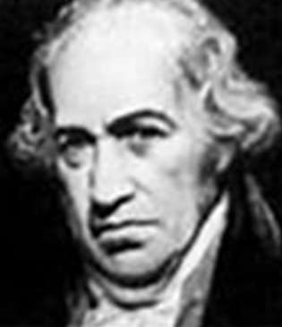
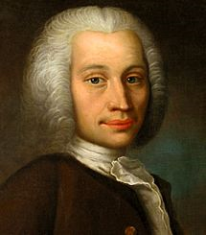
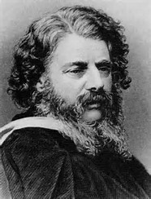
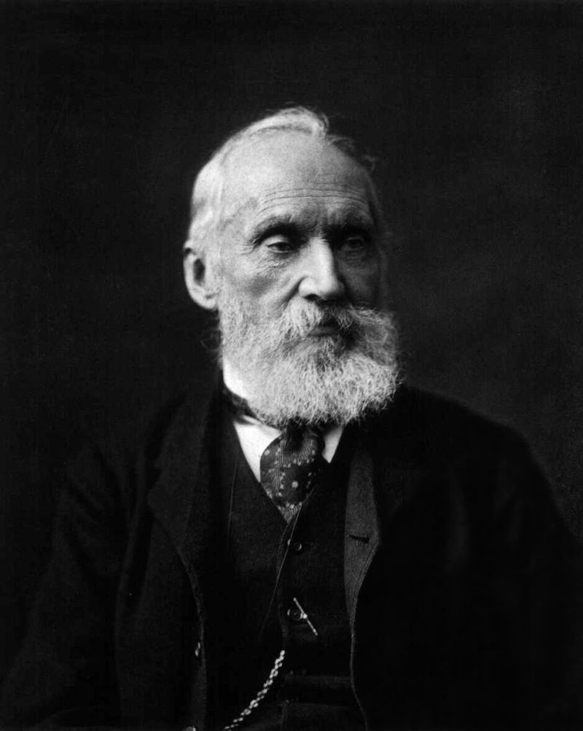
More Recent Pioneers
Daniel Gabriel Fahrenheit
(1686 – 1736)
  ice = 32 ˚F
  boiling = 212 ˚F
  US Standard
  scale invented in 1724
William John Macquorn Rankine
(1820 – 1872)
  ice = 491.67 ˚R
  boiling = 671.67 ˚R
  absolute temperature
  mainly used in the US
  scale invented in 1859
Anders Celsius
(1701 – 1744)
  ice = 0 ˚C
  boiling = 100 ˚C
  SI Standard
  scale invented in 1742
William Thomson, 1st Baron Kelvin (1824 – 1907)
  ice = 273.15 K
  boiling = 373.15 K
  absolute temperature
  SI Standard
  scale invented in 1848
Note: Fahrenheit remains the official scale for the following countries: the Bahamas, Belize, the Cayman Islands, Palau and the United States and associated territories (Puerto Rico, Guam and the U.S. Virgin Islands).

Slide 6
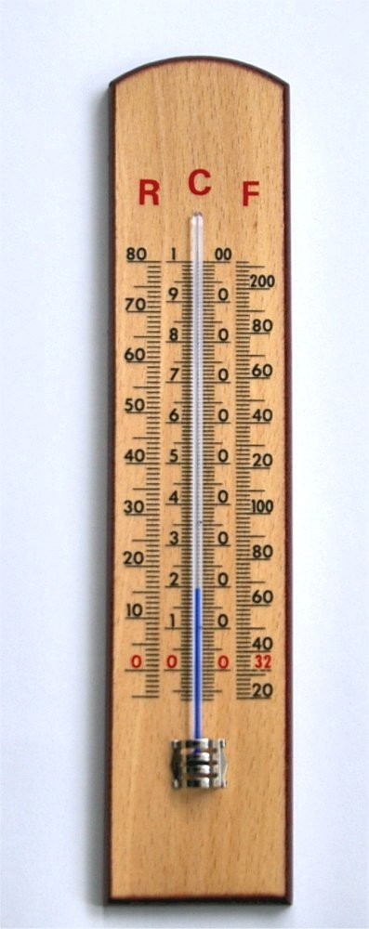
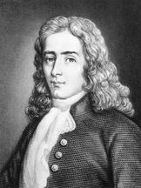
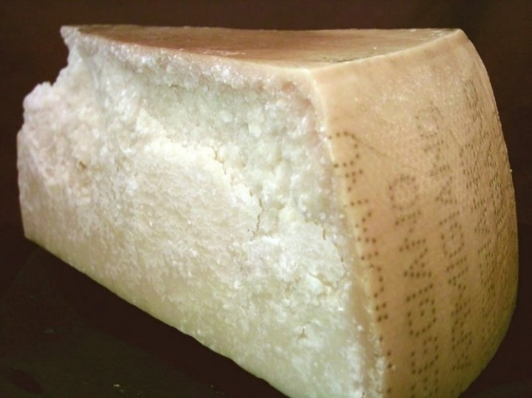
Réaumur – Honorable Mention
Rene Antoine Ferchault de Réaumur (1683 – 1757)
Freezing water is 0 degrees and boiling water is 80 degrees
Still finds use among European cheesemakers. It is used in a dairy to control the vat temperature during the making of Parmigiano-Reggiano; for some reason those factories still employ the Reaumur scale.
Réaumur often shows up in nineteenth-century Russian and French literature (see Chapter IX in Tolstoy’s War and Peace):
  Christmas came and except for the ceremonial Mass, the solemn and wearisome Christmas congratulations from neighbors and servants, and the new dresses everyone put on, there were no special festivities, though the calm frost of minus twenty degrees Réaumur, the dazzling sunshine by day, and the starlight of the winter nights seemed to call for some special celebration of the season.

Slide 7
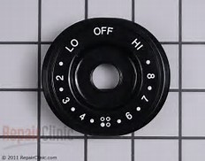
Oven Scales
Germany United Kingdom France
Gas Mark | °F | °C
¼ | 225 °F | 105 °C
½ | 250 °F | 120 °C
1 | 275 °F | 135 °C
2 | 300 °F | 150 °C
3 | 325 °F | 165 °C
4 | 350 °F | 175 °C
5 | 375 °F | 190 °C
6 | 400 °F | 205 °C
7 | 425 °F | 220 °C
8 | 450 °F | 230 °C
9 | 475 °F | 245 °C
Stufe | °C | °F
Stufe 1 | 150 °C | 300 °F
Stufe 2 | 160 °C | 320 °F
Stufe 3 | 180 °C | 355 °F
Stufe 4 | 200 °C | 390 °F
Stufe 5 | 220 °C | 430 °F
Stufe 6 | 240 °C | 465 °F
Stufe 7 | 260 °C | 500 °F
Stufe 8 | 280 °C | 535 °F
Thermostat | °C | °F
Th1 | 30 °C | 85 °F
Th2 | 60 °C | 140 °F
Th3 | 90 °C | 195 °F
Th4 | 120 °C | 250 °F
Th5 | 150 °C | 300 °F
Th6 | 180 °C | 355 °F
Th7 | 210 °C | 410 °F
Th8 | 240 °C | 465 °F
Th9 | 270 °C | 520 °F

Slide 8
Comprehensive List of Temperature Scales
1 Amonton 25 Edinburgh 49 Mariotte
2 Barnsdorf 26 electron Volts 50 Miles
3 Beaumuir 27 Fahrenheit 51 Murray
4 Benart 28 Fahrenheit [Pre-1707] 52 Newton
5 Bergen 29 Florentine [Large] 53 Oertel
6 Brisson 30 Florentine [Small] 54 Paris
7 Celsius 31 Florentine [Magnum] 55 Plancks
8 Cimento 32 Fowler 56 Poleni
9 Cruquius 33 Frick 57 Reaumur
10 Dalence 34 Gas Mark 58 Romer
11 Dalton 35 Goubert 59 Rankine
12 Daniell 36 Hales 60 Richter
13 De la Hire 37 Hanow [Newer] 61 Rinaldini
14 De la Ville 38 Hanow [Older] 62 Rosenthal
15 Delisle [Newer] 39 Hauksbee 63 Royal Soc. of London
16 Delisle [Older] 40 Jacobs-Holborn 64 Sagredo
17 De Luc 41 Kelvin 65 Saint-Patrice
18 De Lyon 42 Kirch [Christine] 66 Stufe
19 de Revillas 43 Kirch [Gottfried] 67 Sulzer
20 Derham [I] 44 La Court 68 Thermostat
21 Derham [II] 45 Lambert 69 Wedgwood [Original]
22 de Suede 46 Lange 70 Wedgwood [Modernized]
23 de Villeneuve 47 Leiden
24 Du Crest 48 Ludolf
Recent Additions
(since 2017)
71 Hoffmann CG
72 Kirch [Christfried]
73 Kirch [Maria]
Scales highlight in red are in current use.
http://www.curiousnotions.com/temperature-conversion/ date accessed: 20170815

Slide 9
ASTM International
ASTM International works together with NIST to provide best practice documents and NIST provides critical measurement solutions for commerce.
ASTM International has about 30,000 volunteers in 135 countries that support 150 committees and are custodians of about 17,300 standards.
ASTM Committee E20 on Temperature Measurement has a current membership of approximately 120 with jurisdiction over 43 standards. Members meet regularly to review and update standards within this committee.
ASTM standards are available at no cost to NASA credentialed individuals (https://standards.nasa.gov) and instructions for access are provided at the end of this presentation.
Temperature Measurement Governing Body (E20)
Subcommittees and Standards
E20.02 Radiation Thermometry
E20.03 Resistance Thermometers
E20.05 Liquid-in-Glass Thermometers and Hydrometers
E20.07 Fundamentals in Thermometry
E20.09 Digital Contact Thermometers
E20.11 Thermocouples - Calibration
E20.12 Thermocouples - Specifications
E20.13 Thermocouples - Materials and Accessories Specifications
E20.14 Thermocouples - Testing
E20.90 Executive
E20.91 Editorial and Terminology
E20.94 Publication
E20.96 Temperature Measurement Techniques Open Forum Workshop/Formal Colloquium
ASTM International was formerly known as the American Society for Testing and Materials.
National Institute for Standards and Technology (NIST) was formerly known as the National Bureau of Standards.

Slide 10

Subcommittee E21.08 on Thermal Protection
E285-08(2020) Standard Test Method for Oxyacetylene Ablation Testing of Thermal Insulation Materials
E341-08(2020) Standard Practice for Measuring Plasma Arc Gas Enthalpy by Energy Balance
E377-08(2020) Standard Practice for Internal Temperature Measurements in Low-Conductivity Materials
E422-22 Standard Test Method for Measuring Net Heat Flux Using a Water-Cooled Calorimeter
E457-08(2020) Standard Test Method for Measuring Heat-Transfer Rate Using a Thermal Capacitance (Slug) Calorimeter
E458-08(2020) Standard Test Method for Heat of Ablation
E459-22 Standard Test Method for Measuring Heat Transfer Rate Using a Thin-Skin Calorimeter
E471-96(2016) Standard Test Method for Obtaining Char Density Profile of Ablative Materials by Machining and Weighing
E511-07(2020) Standard Test Method for Measuring Heat Flux Using a Copper-Constantan Circular Foil, Heat-Flux Transducer
E598-08(2020) Standard Test Method for Measuring Extreme Heat-Transfer Rates from High-Energy Environments Using a Transient, Null-Point Calorimeter
E637-05(2016) Standard Test Method for Calculation of Stagnation Enthalpy from Heat Transfer Theory and Experimental Measurements of Stagnation-Point Heat Transfer and Pressure
E2683-17 Standard Test Method for Measuring Heat Flux Using Flush-Mounted Insert Temperature-Gradient Gages
E2684-17 Standard Test Method for Measuring Heat Flux Using Surface-Mounted One-Dimensional Flat Gages
E3057-19 Standard Test Method for Measuring Heat Flux Using Directional Flame Thermometers with Advanced Data Analysis Techniques

Slide 11
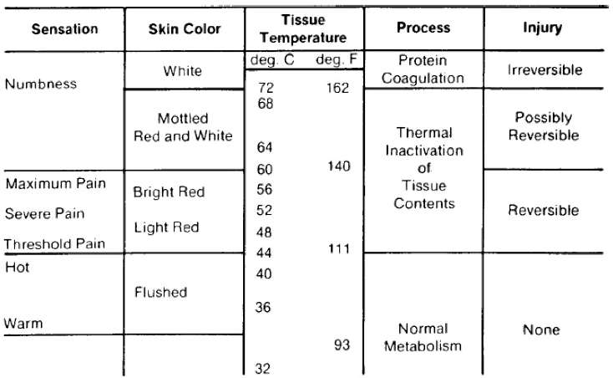
ASTM C1055-20
(Standard Guide for Heated System Surface Conditions that Produce Contact Burn Injuries)
ASTM C1055-20 recommends that pipe surface temperatures remain at or below 140 °F. The reason for this is that the average person can touch a 140 °F surface for up to five seconds without sustaining irreversible burn damage.
Exposure Limits
Short term (5 seconds) – 140 ˚F
Long term (up to 6 hours) – 111 ˚F

Slide 12
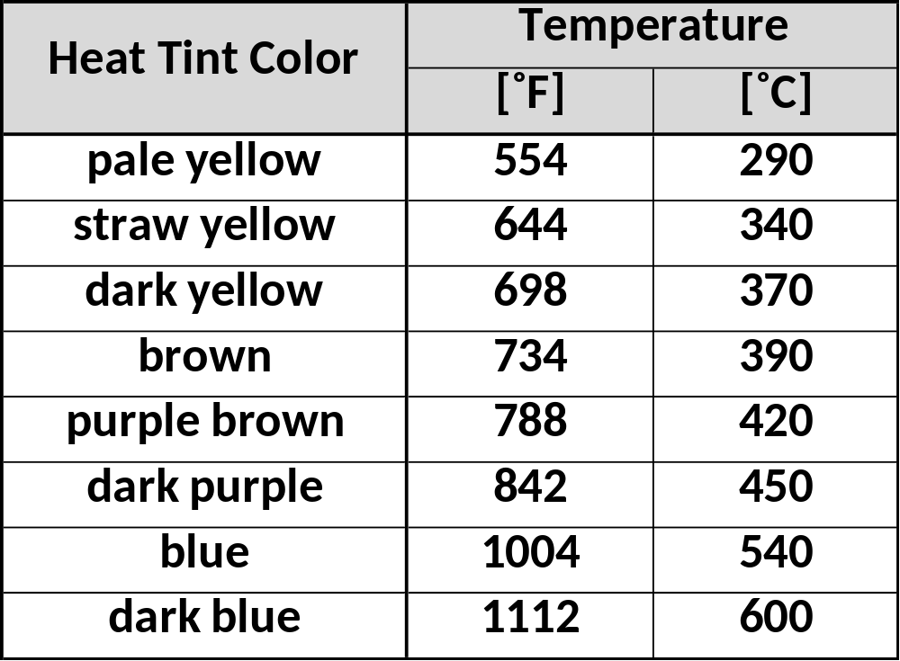
Rule of Thumb for Heat Tint (temper) Color on Stainless Steel Surfaces Heated in Air
Not all standards are formal. Some are derived by practical experience.
The rule of thumb concept was first cited in a 1685 text which quoted James Durham of Scotland:
  “… foolish builders, who build by guess, and by rule of thumb … and not by Square and Rule"
Although not an exact measurement, the color tint table has been observed to be a good indicator of the maximum temperature reached by steel surfaces in high temperature wind tunnel tests.
https://bssa.org.uk/bssa_articles/heat-tint-temper-colours-on-stainless-steel-surface-heated-in-air/

Slide 13
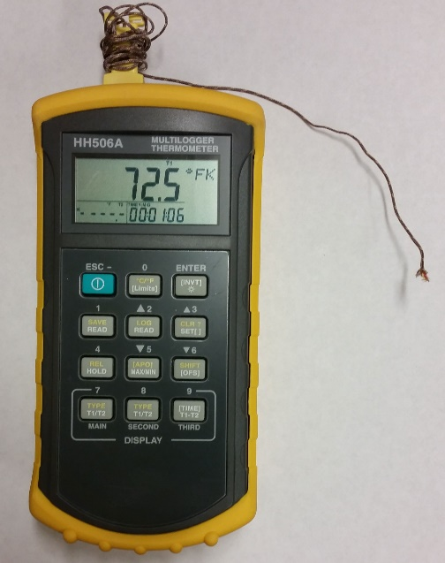
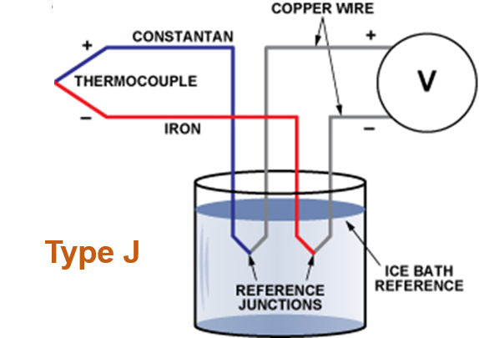
What is a Thermocouple?
Junction
Electronics
Instrumentationtools.com accessed 20170816
A temperature-measuring device consisting of two wires of different metals joined at each end.
One junction is placed where the temperature is to be measured.
The other end is kept at a constant lower temperature (i.e., an ice bath or a reference temperature).
A measuring instrument is connected to the circuit which converts voltage to a temperature.

Slide 14
Governing Law of Thermocouples
(The Law of Homogeneous Materials)
A thermoelectric current cannot be sustained in a circuit composed of a single homogeneous material by the application of heat alone, and regardless of how the material may vary in cross-section.
This law tells us four important things about thermocouples:
  No current flows in a thermocouple circuit made of a single metal material by the application of heat alone.
  Two different metals are required to form a thermocouple.
  The size or gage of the wire does not affect the voltage produced.
  The voltage signal produced is independent of the temperature variations along its path.
Excerpts from “How to Prevent Temperature Measurement Errors When Installing Thermocouple Sensors and Transmitters.” White Paper by Acromag.

Slide 15
Types of Thermocouples
THERMOCOUPLES
Type | Composition | Temp range, °C
B | Pt-30% Rh versus Pt-6% Rh | 0 to 1820
E | Ni-Cr alloy versus a Cu-Ni alloy | -270 to 1000
J | Fe versus a Cu-Ni alloy | -210 to 1200
K | Ni-Cr alloy versus Ni-Al alloy | -270 to 1372
N | Ni-Cr-Si alloy versus Ni-Si-Mg alloy | -270 to 1300
R | Pt-13% Rh versus Pt | -50 to 1768
S | Pt-10% Rh versus Pt | -50 to 1768
T | Cu versus a Cu-Ni alloy | -270 to 400
The most common (and inexpensive) thermocouple is the Type K. Range is -270 ˚C to 1372 ˚C (-454 ˚F to 2501 ˚F).
Platinum (Type B) can be used up to 1820 ˚C (3308 ˚F).
See NIST Monograph 175 for reference tables. This report is 640 pages long.
Tungsten thermocouples (not part of the Monograph 175) can be used up to 2320 ˚C (4208 ˚F).

Slide 16
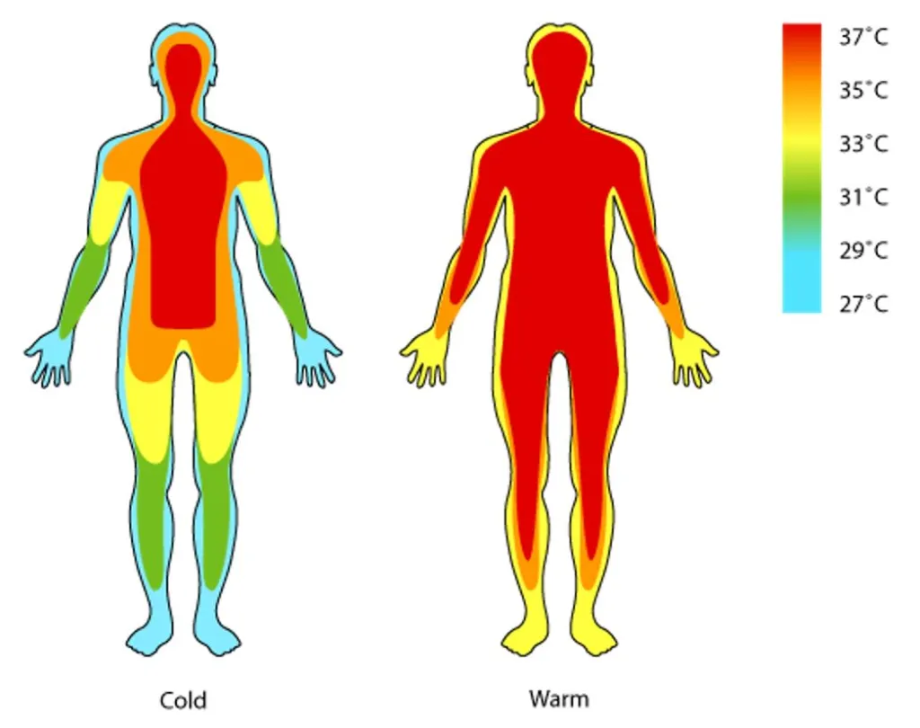
Multiple Measurements Are Needed for Complex Systems
Even with something as common as taking our body temperature, a single measurement does not tell the whole story.
Scramjet propulsion tests are highly focused on mapping engine flow path pressures. This can lead to dedicating only limited resources (time, money, and hardware volume) for other types of measurements like temperature, total heat flux, radiance, strain, acoustics, acceleration, etc.
Complex mechanical systems that incorporate many components and heating sources require an array of measurements to accurately map the temperature and heating environment.

Slide 17
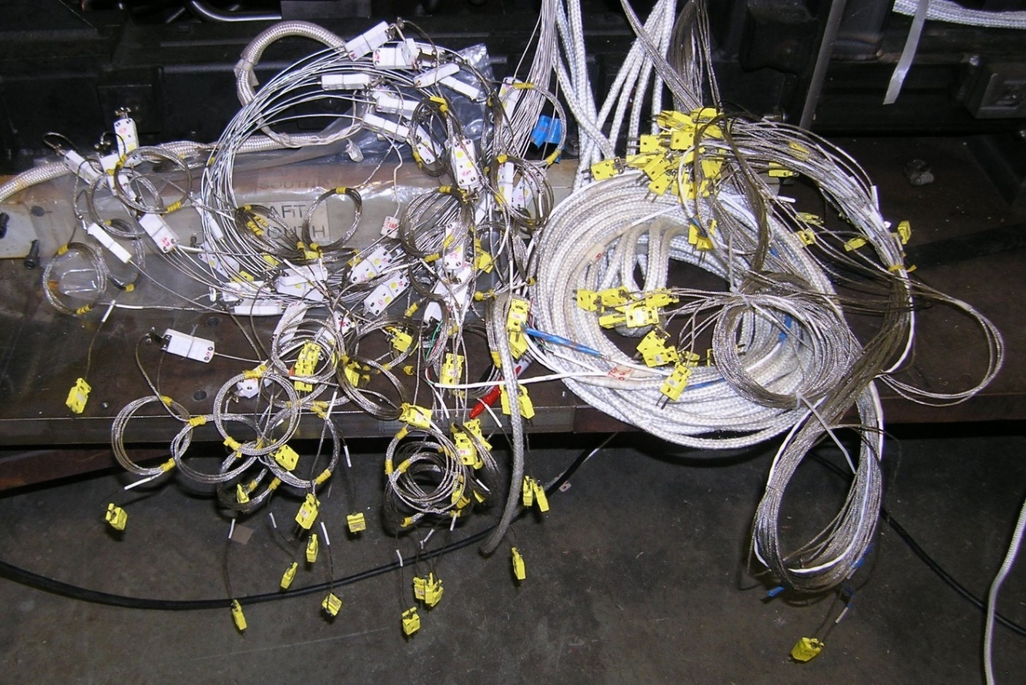
Two Key Questions
How many measurements are enough?
  You can’t have enough measurements.
  But you might not have access to important compartments or be able to drill “thru holes” for skin measurements.
  And you might run out of room to fit all the cables.
Can I trust my thermocouple reading?
  Was it installed properly?
  Has it been damaged in any way?
Hundreds of static pressure taps and K-type thermocouples were required to map engine performance over a range of flight conditions.

Slide 18
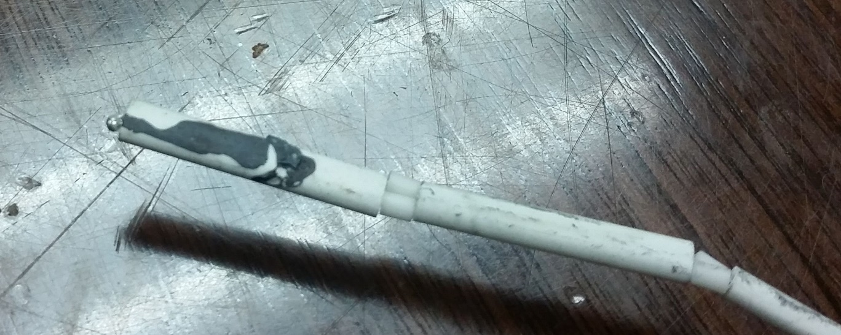
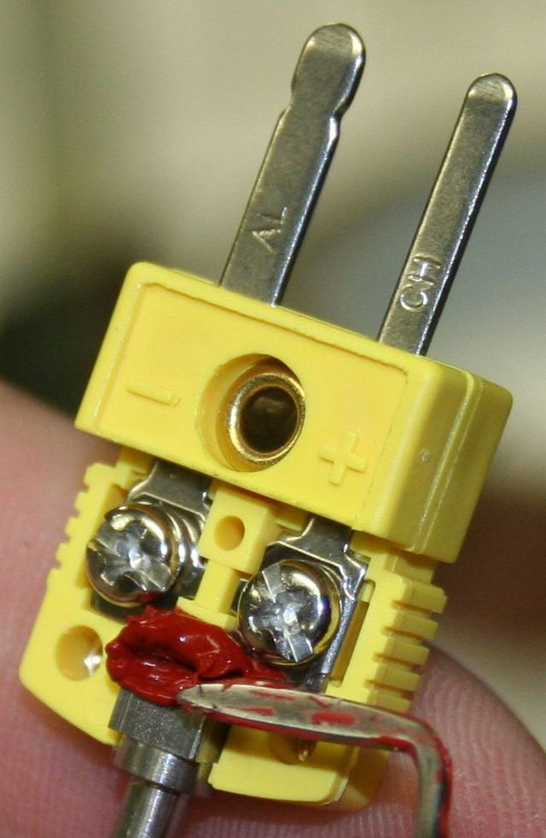
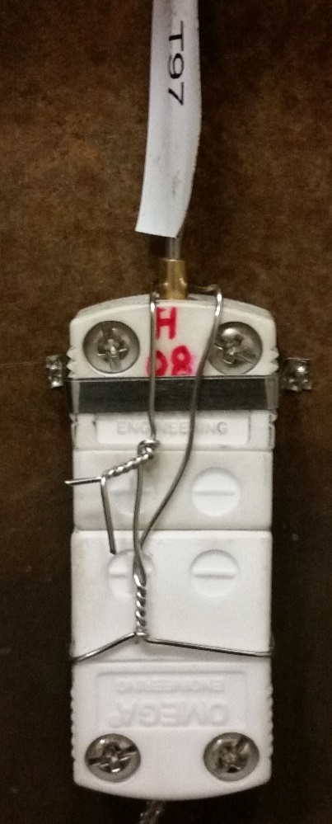
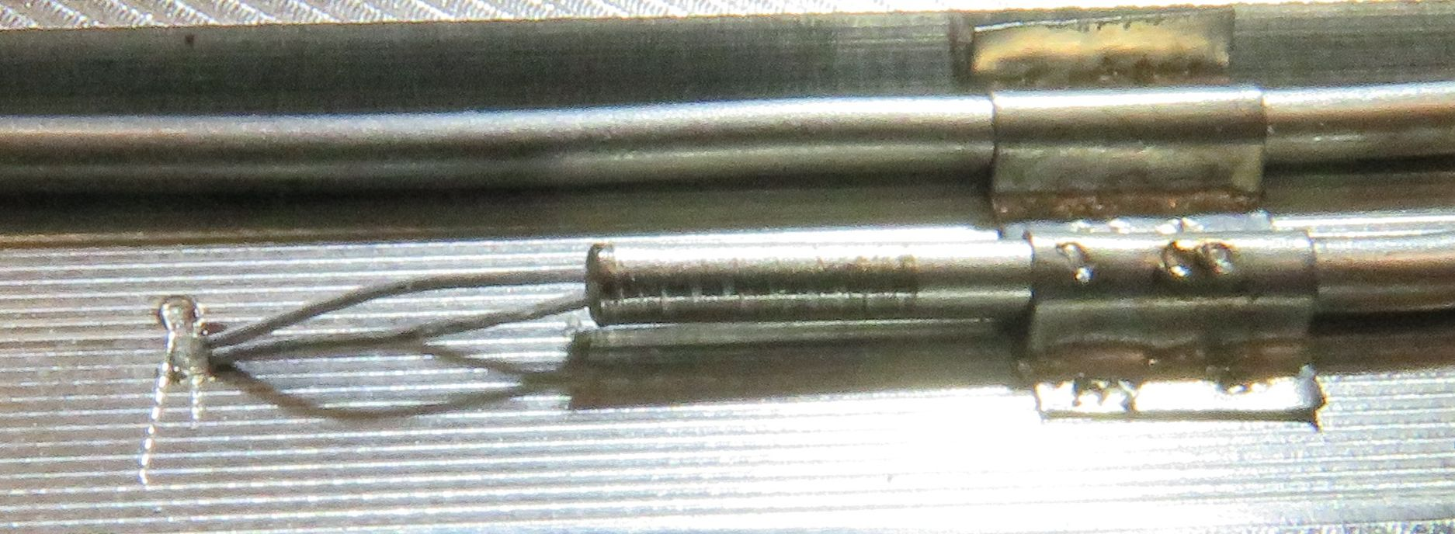
Thermocouple Connections
Leads need to be connected to the appropriate terminal
Platinum Thermocouple protected with ceramic shroud
Wire-wrapped miniplugs ensures connection integrity
RTV prevents leads from contacting opposing connector
Leads need to be isolated and not allowed to come into contact with a conducting material

Slide 19
Thermocouple Checkout
It is necessary to check the installation of every thermocouple to ensure that it has been properly installed.
A heat gun can be used to provide a thermal load to the thermocouple junction. Reading the output of the thermocouple with a digital thermometer will indicate if the electrical connection is present.
A fast response will indicate a proper junction.
A slow response may indicate multiple junctions. Applying the heat source along the entire cable run can detect unwanted junctions prior to the desired sensing element.
No reading may indicate either a broken junction, a loose connection, or the thermal load was applied to the wrong sensor.

Slide 20
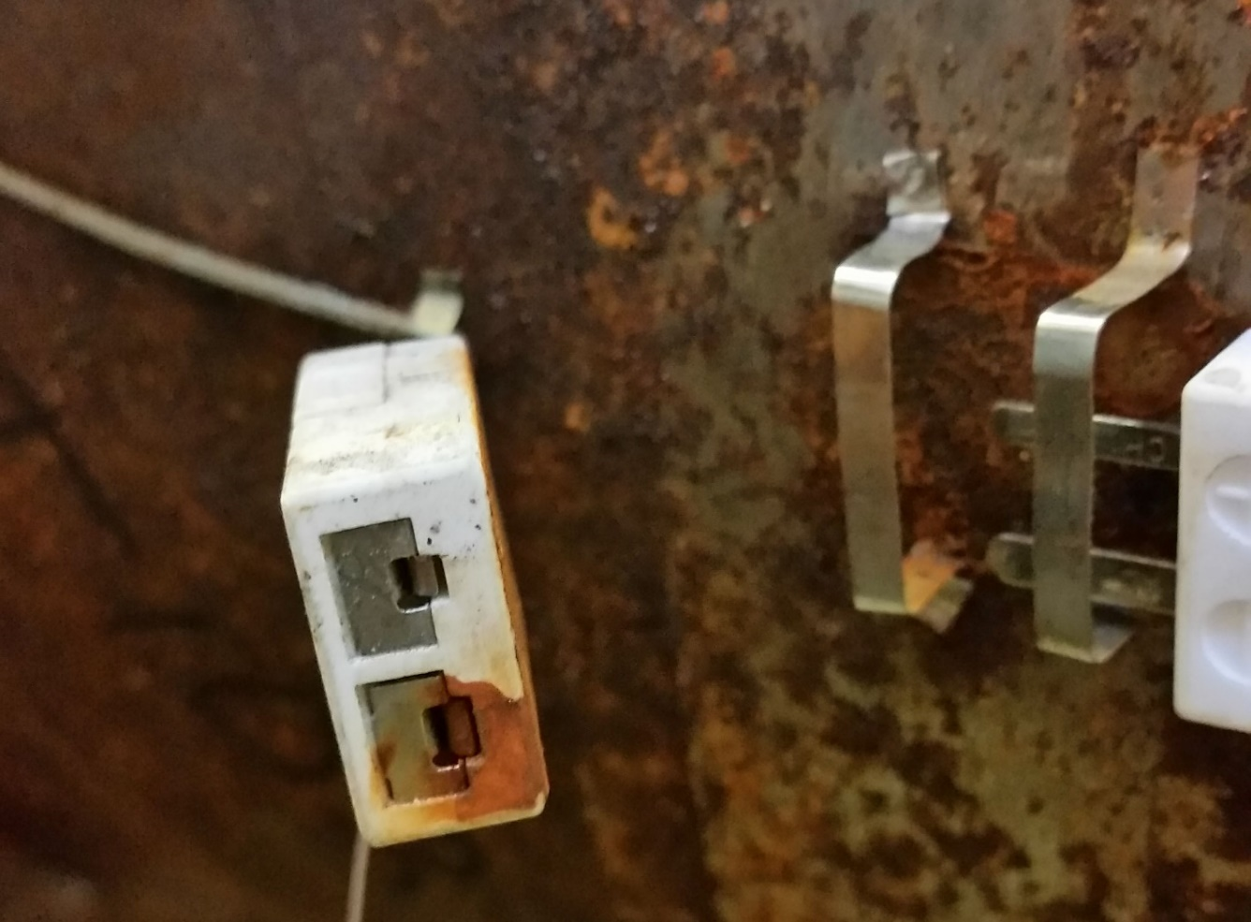
Unwanted Junction (1)
The goal in establishing a thermocouple junction is to have the two conducting wires isolated from each other until they connect at the location of interest (the junction).
Unwanted junctions occur when electrical contact is made prior to the desired junction.
On occasion, even rust can seep into a connector and create a junction.
How did this happen? The apparatus was in storage for an extended period of time and the thermocouple miniplugs were covered with a shroud which prevented visual inspection.

Slide 21
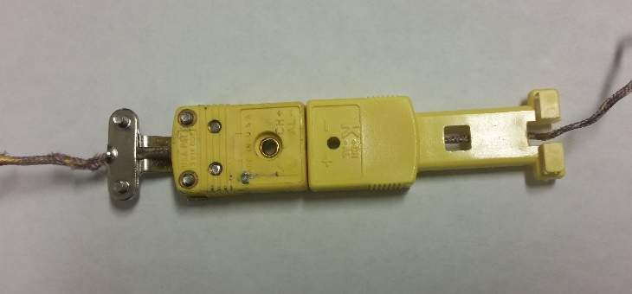
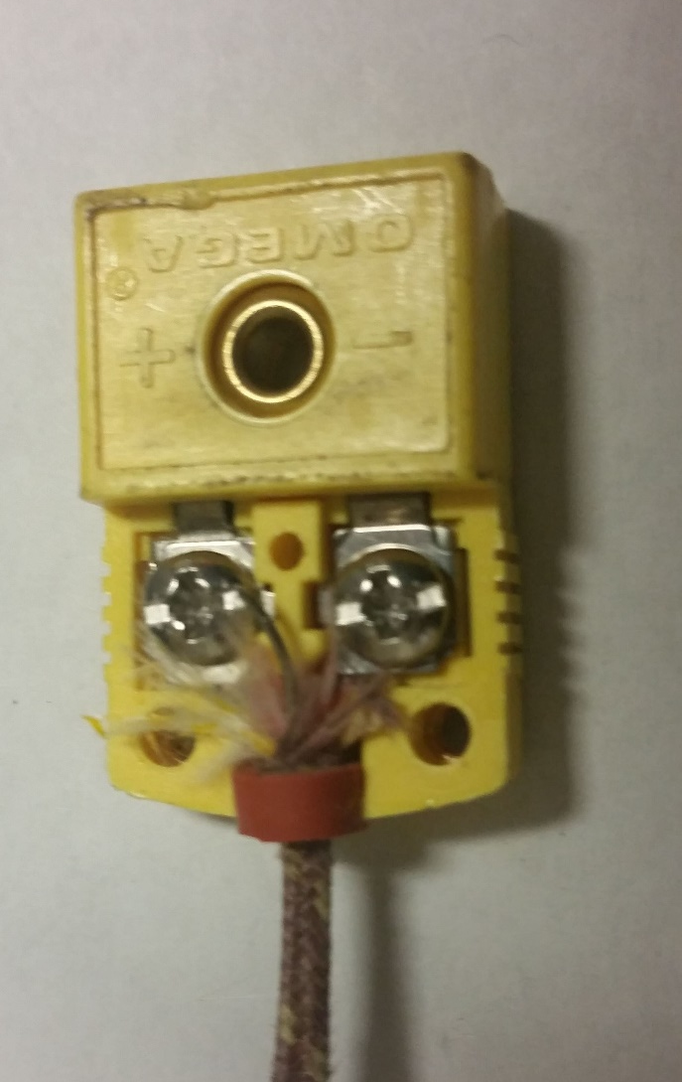
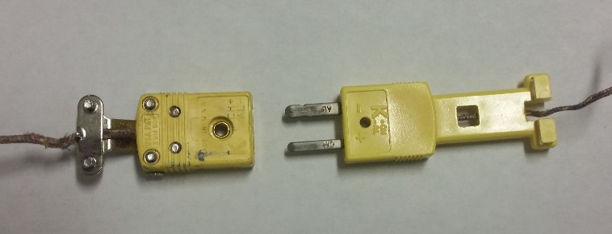
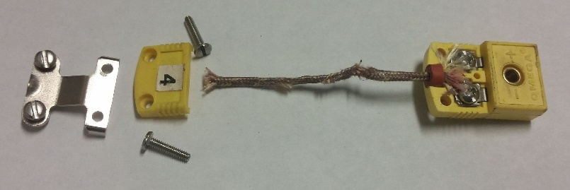
Unwanted Junction (2)
Miniplug connections are designed to have the correct lead attached to the correct terminal.
Switching leads will result in an erroneous reading.
Sometimes a wire will make electrical contact with the opposing lead and create a junction at the miniplug. This type of error is more likely with braided wire when one of the braids bridges the gap between terminals.
How can this happen? Some types of two-conductor wire are insulated with fiberglass which can hide the fact that both wires are in contact with the same terminal.

Slide 22
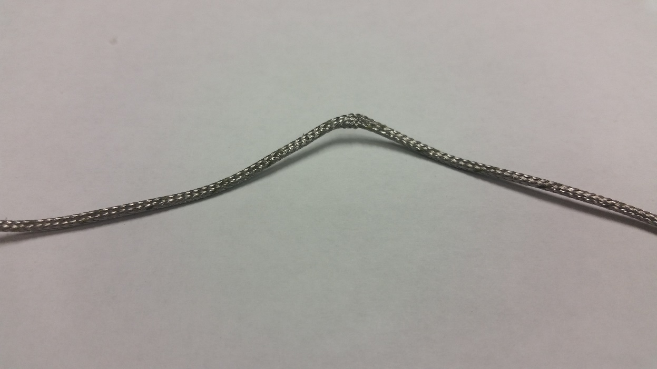
Unwanted Junction (3)
Stainless steel tubing and braided wire are often used to protect thermocouple leads against temperature extremes and abrasion.
If the tubing or braided wire is accidently bent or crushed to where the insulation is unable to electrically isolate the leads, a new junction will be created.
Braided wire was crimped and resulted in a junction. Testing with a heat gun can confirm this.
How can this happen? When pulling cable bundles through a model, wires can “catch” on other sensors, connectors, etc.

Slide 23

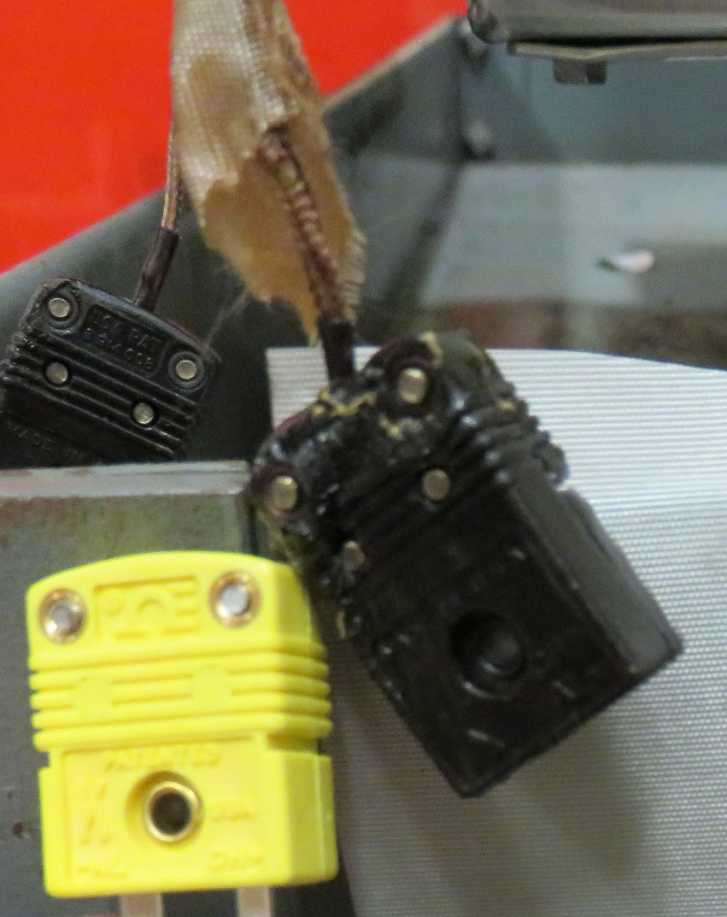
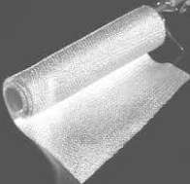
Exceeded the Temperature Rating
Equipment used for temperature measurement within a model should be rated higher than the maximum expected temperature for a test.
Items rated for 500 ˚F do not do well when exposed to 1000 ˚F.
Thermal blankets can help to reduce the thermal load to internal equipment.
Don’t neglect the effects of thermal buildup which can occur long after a test has been completed. (The hottest temperature on the Space Shuttle aluminum skin occurred after landing!)
Post-Test
Pretest
How can this happen? If the test series is going well, the test engineer may decide to try for a longer run time or a higher enthalpy condition than originally planned.

Slide 24
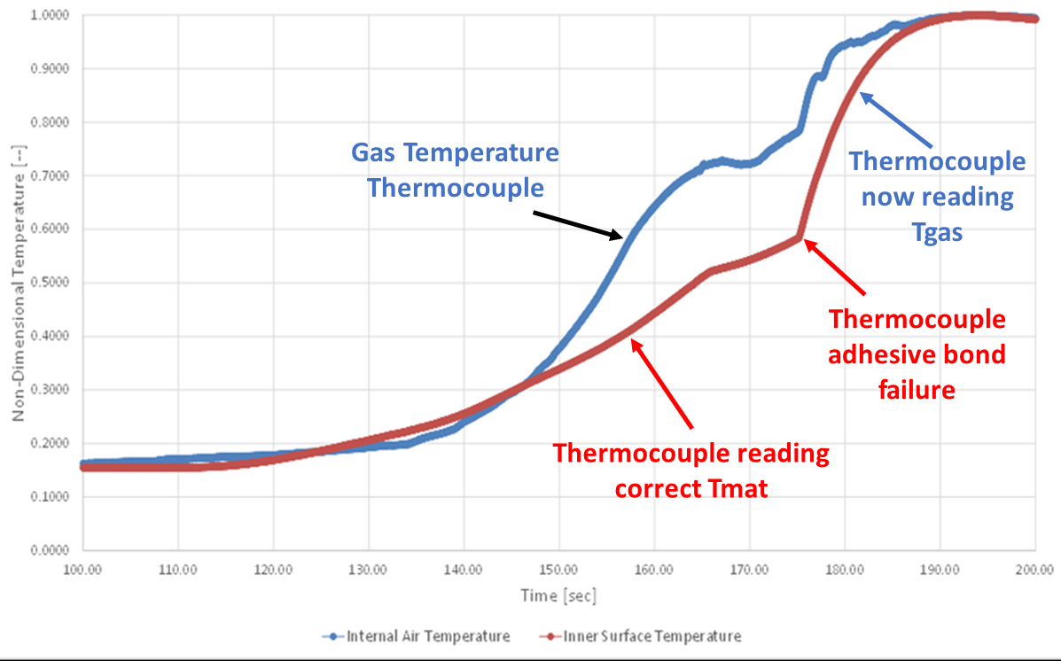
Bond Layer Failure
In a recent test, two thermocouples were included in the nose section of a model.
One thermocouple was designated as an environmental measurement (test gas temperature - blue line) and one was “epoxied = bonded” to the model to provide a skin temperature (red line).
At 175 seconds, the epoxy exceeded its maximum use temperature and failed. The thermocouple popped off the skin and essentially became the second test gas temperature measurement.

Slide 25
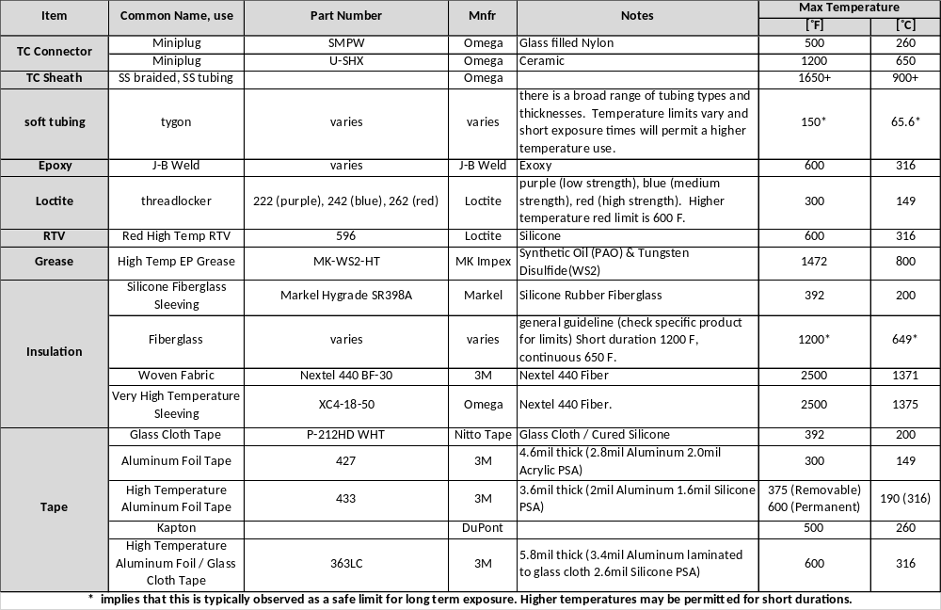
Maximum Use Temperatures

Slide 26
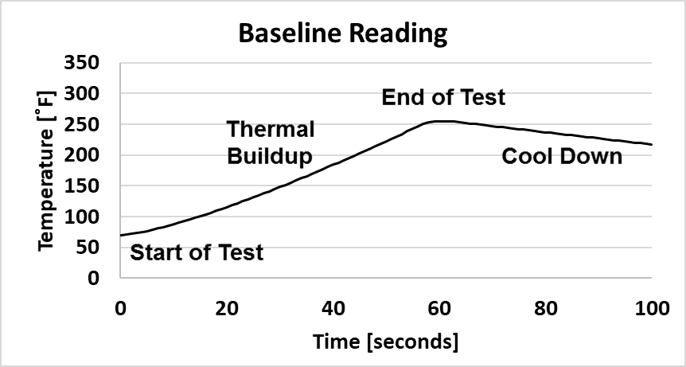
Thermocouple Response Diagnostics
This plot shows the expected thermocouple response on a test model during a wind tunnel run.
The next two slides will show different responses with probable causes for the errors.

Slide 27
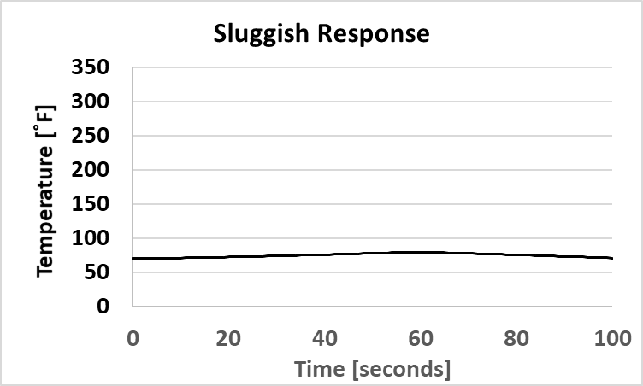
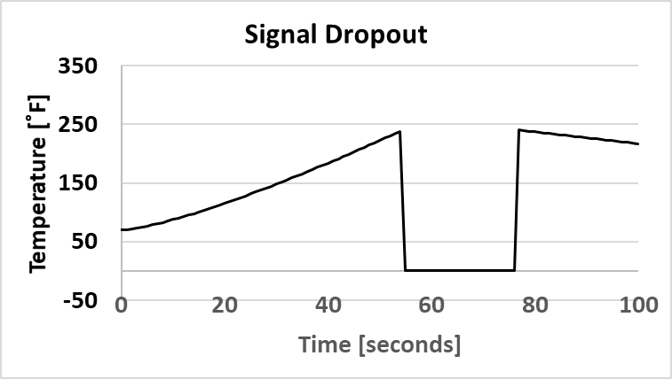
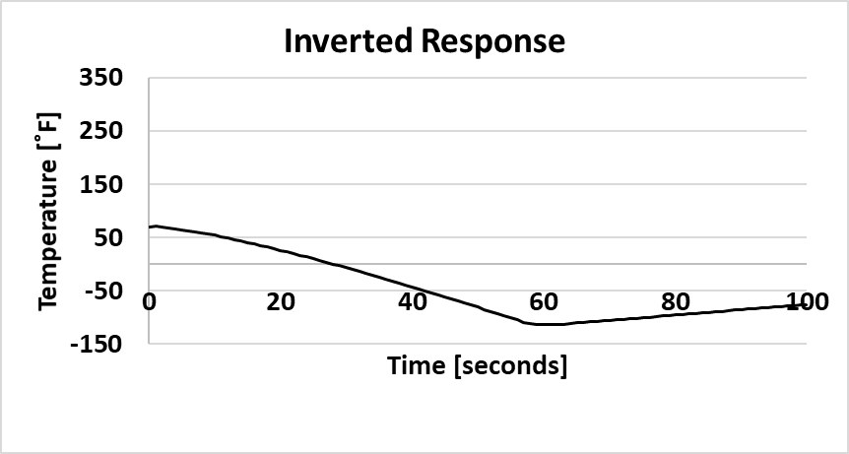
Potential Causes
Sluggish Response
  A sluggish response may mean that the measurement is an average of two or more junctions along the circuit. Check along entire circuit with a heat gun. At any point (other than the intended junction), if a response is observed, a secondary junction may be present.
Signal Dropout
  Thermocouple bead (junction) may have separated from its attachment point due to thermal expansion. Note that the signal was lost and then reestablished at about the same temperature.
Inverted Response
  The thermocouple leads may have been reversed. Check polarity on all attachment points and at every connector.

Slide 28
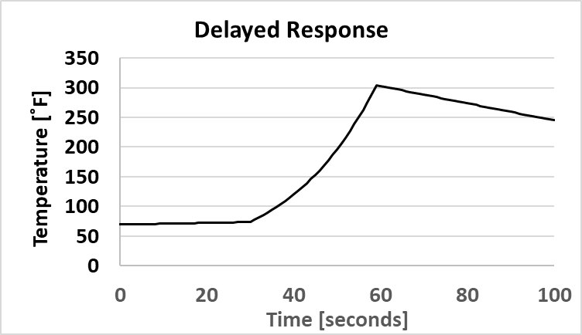
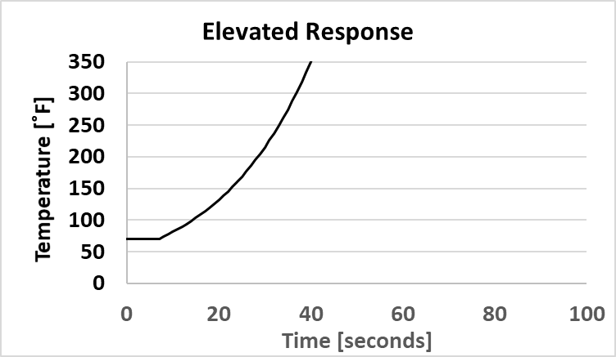
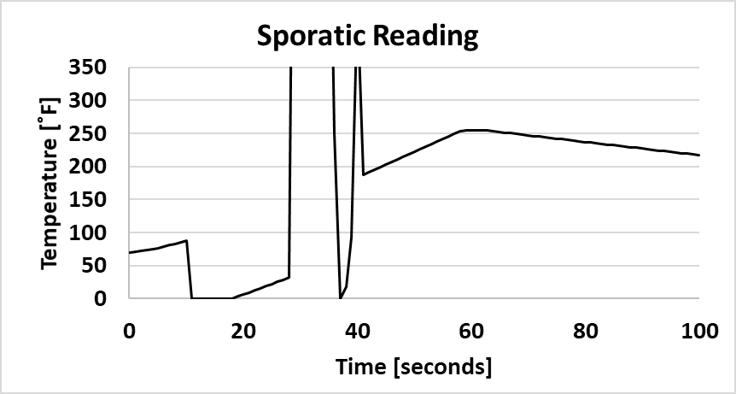
Potential Causes
Delayed Response
  This type of response was observed when a Type B thermocouple was connected with Type K leads. The Platinum (Type B) wire should have had copper extension wire instead of Chromel or alumina. High temperature thermocouples are slow to respond at ambient temperatures.
Elevated Response
  This kind of response was observed when the thermocouple popped off the surface of a panel in a highly energetic flow. The response was no longer indicating the wall temperature, but the flow temperature.
Sporadic Response
  Who knows? Loose connection, electronic noise, ungrounded connection, bad thermocouple junction. Might be time to call in a professional.

Slide 29
Top 5 Lessons Learned
(or better titled: Learn from my mistakes)
Outline analytical efforts needed to ensure that both methods and instrumentation will provide the required information needed for the thermal analyst. Often thermal instruments are purchased without understanding their limitations or use in analytical methods.
Identify the key people (by name) who will be using the data. They should be in the room when instrumentation decisions are being made.
Make sure that all components (wiring, connectors, tapes, adhesives, blankets, etc.) are rated to at least the highest expected temperature of any proposed test. If a high temperature rated sensor requires the use of an epoxy (or tape), it may become detached at a much lower temperature (epoxies are typically rated for ~550 ˚F).
Instrument access can be an issue once the test article has been built. Disassembly of a test article to repair one sensor can easily contribute to the loss of other sensors
Configuration control is important. As-designed, as-built, as-modeled, as-tested, as-flown (cold), and as-flown (thermally deformed) are typically all different versions of the same design.
NASA has a Lessons Learned Website: https://www.nasa.gov/offices/oce/functions/lessons
Over 2100 individual entries as of July 13, 2022

Slide 30
Solid Rocket Motor Materials Test

Slide 31
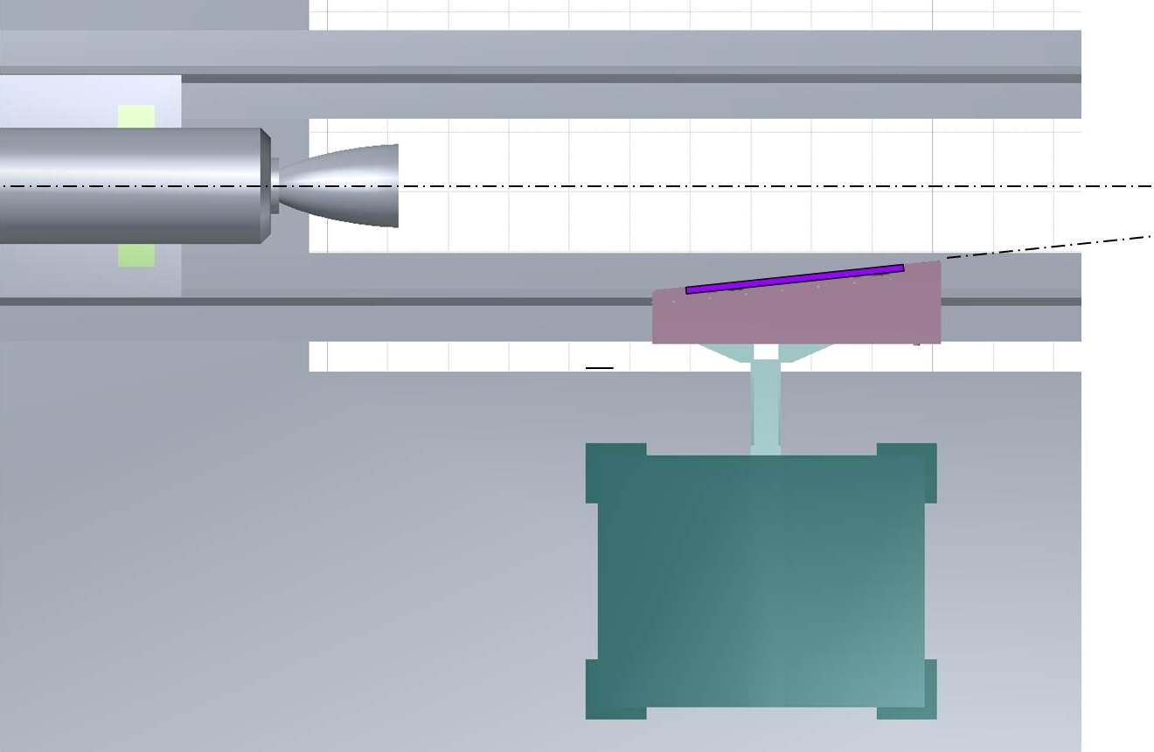
Plume Impingement Test Panel (PITP) Planform View for the Solid Rocket Test Motor V Nozzle 2 (SRTMV-N2) Test
SRTMV-N2
PITP
The test panel was positioned so that plume impingement would occur about halfway along the test panel.
SUPPORT
STAND

Slide 32
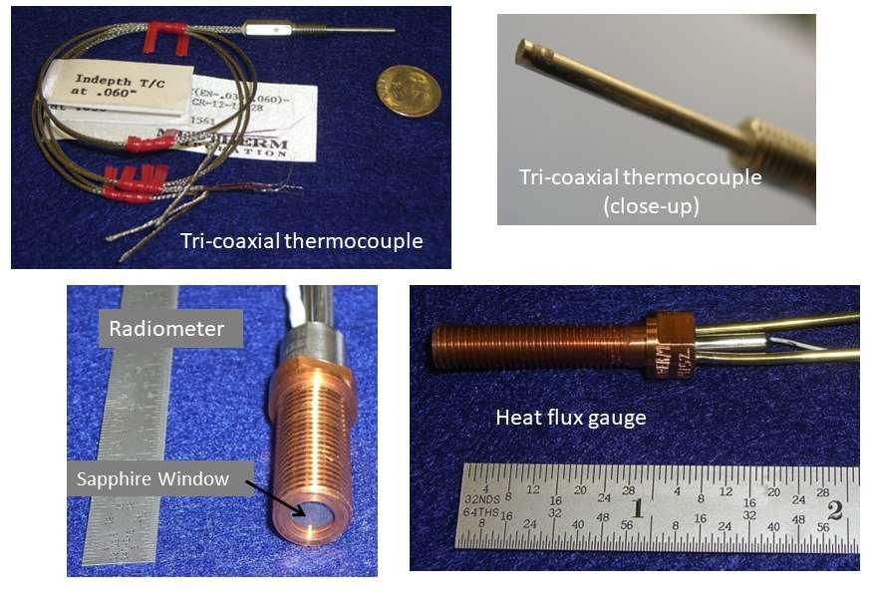
Thermal Instruments

Slide 33
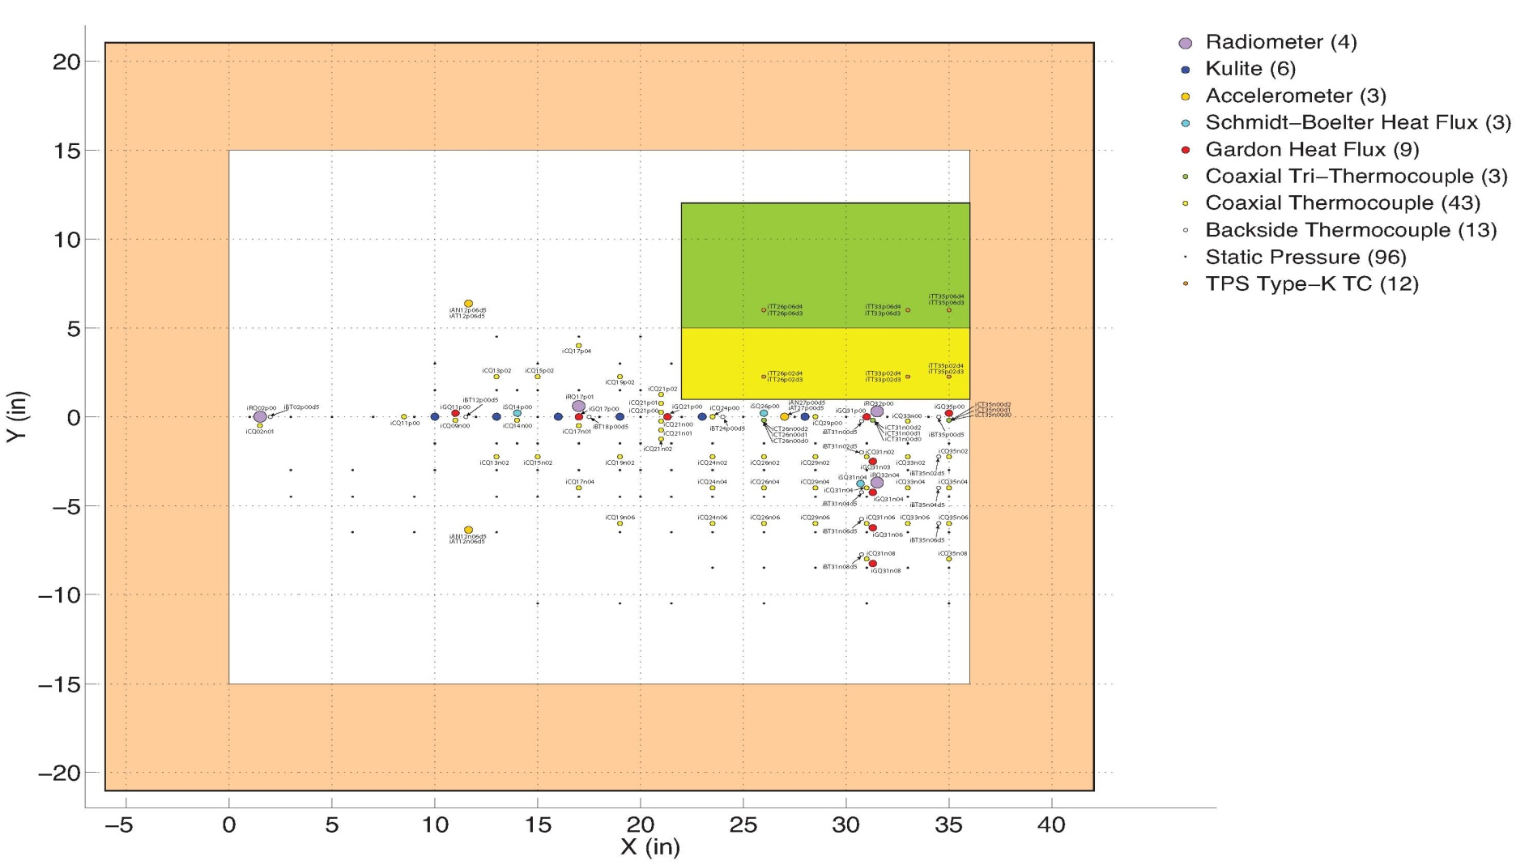
Instrument Layout
15-5 Stainless Steel
Measurements were concentrated on the panel centerline
FLOW
Instrument arrays were positioned to locate the plume centerline
Test Panel Dimensions 36” x 30” x 1”
A total of 192 sensors represented ten different types of measurements for the PITP test. The instrument suite included 87 thermal measurements which provided a unique opportunity to estimate heat flux at coincident locations using a variety of instrument types and analytical methods.

Slide 34
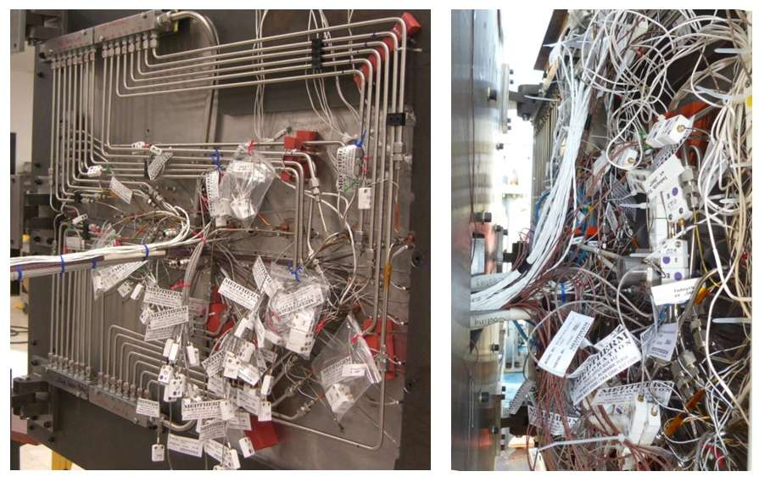
Instrument Installation
Manifolds for water cooling of 12 Heat flux gages and 4 radiometers
Bundle of 96 SS tubes to measure panel surface static pressure
Pretest bundles of 43 coaxial thermocouple connectors
Panel interior as shipped from LaRC model shop to rocket test stand in MSFC.
Panel interior after all connections were made.

Slide 35
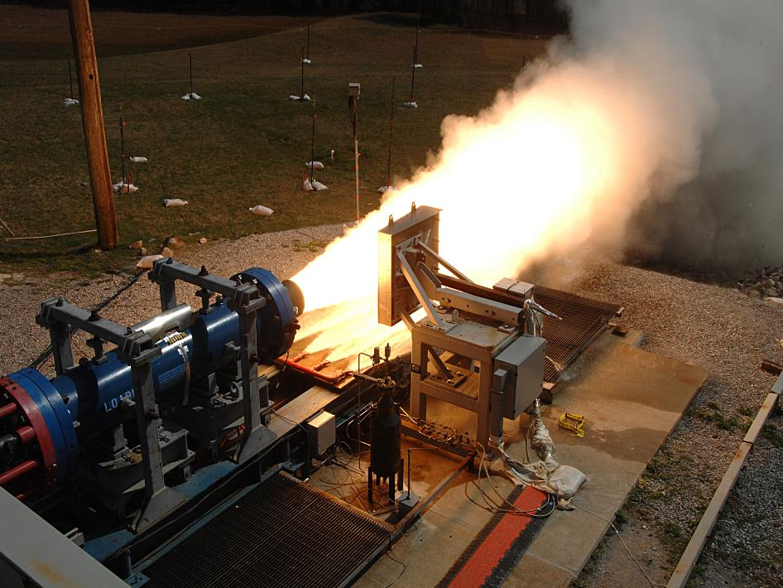
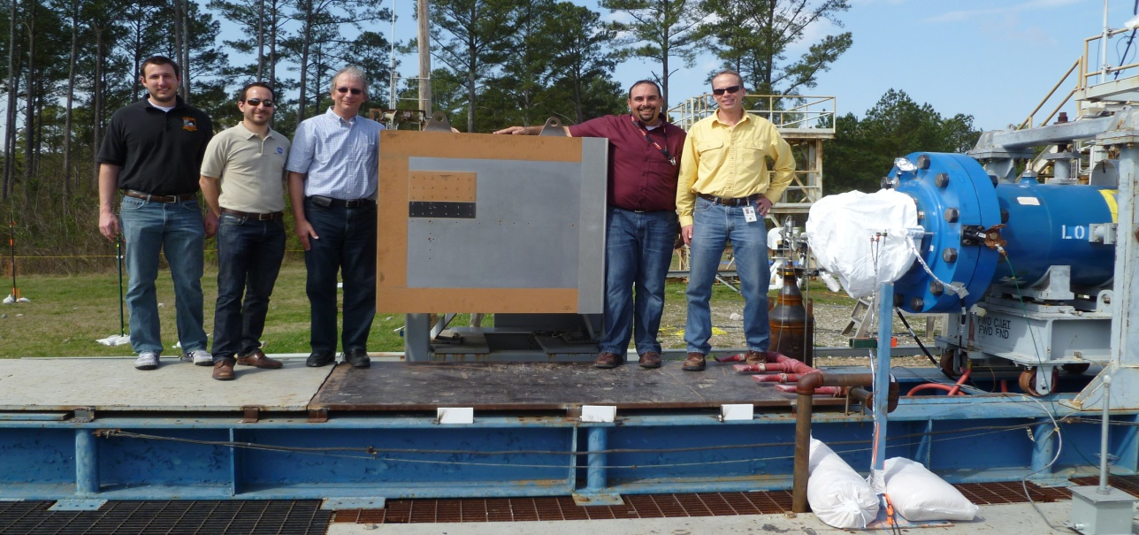
Motor Test - March 14, 2012
Test Objectives
Rocket Nozzle Liner Materials Test (MSFC)
Orion Abort Motor Plume Environment Test (NESC LaRC)
Acoustic Environment Test (MSFC)
Materials Test: P-50 cork, VAMAC® (NESC LaRC, JSC)
20,000 lbs of thrust
Challenging Measurement Environment – Nozzle exit temperature is approximately
½ the sun’s surface temperature
LaRC, MSFC, JSC Test Team

Slide 36
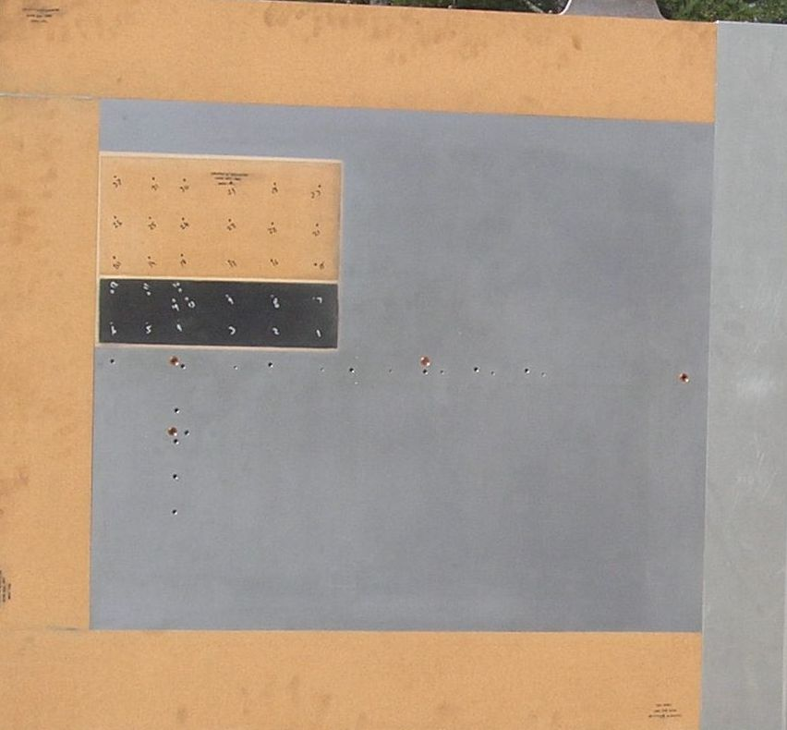
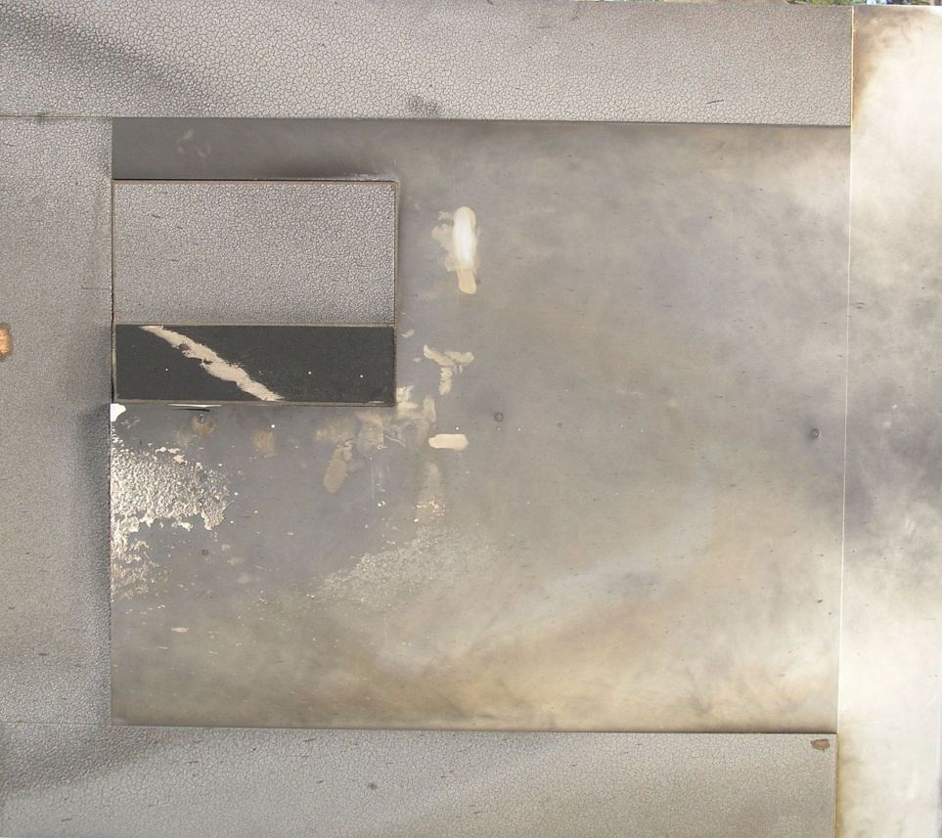
Test Panel – Before and After
P-50 cork
char
VAMAC®
bond layer
30”
Plume Flow
aluminum deposition
from rocket motor propellant
1” thick 15-5 SS plate
36”
Post-test examination of the panel revealed significant recession of both the P-50 cork and VAMAC® thermal protection materials. Cork char was removed to estimate the remaining material thickness. The VAMAC® sample consisted of three equal thickness layers with intermediate bonding adhesive. The bond layer between two layers is visible due to ablation. Propellant aluminum deposition occurred below the plate centerline near the back end of the panel.

Slide 37
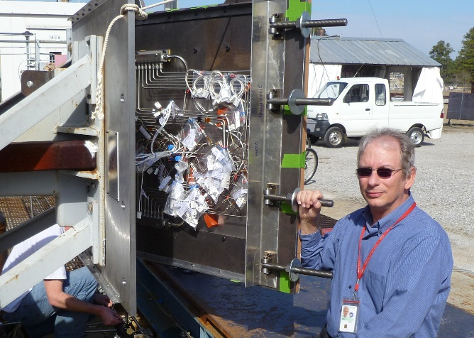
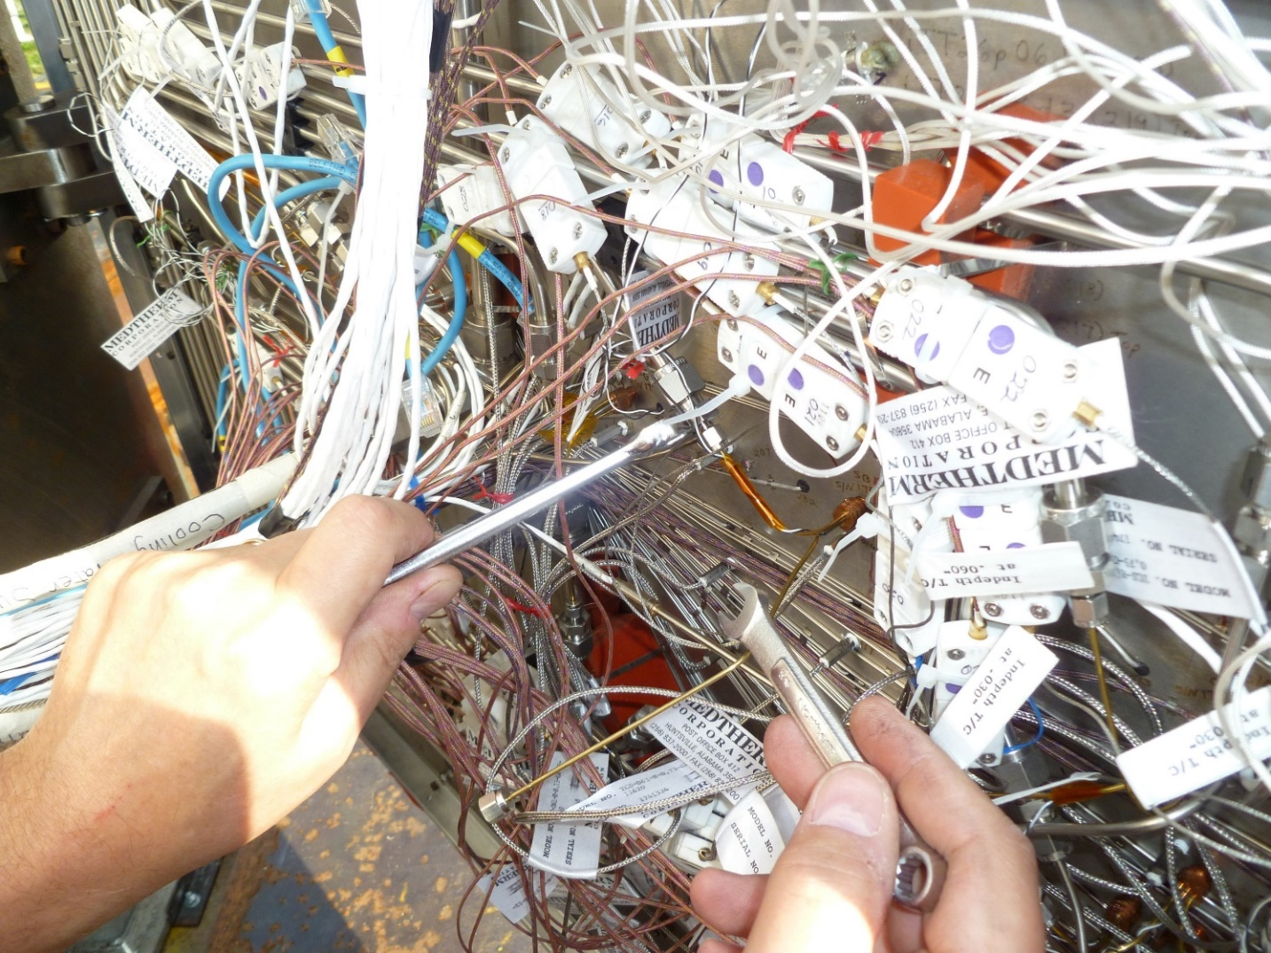
Post-test Instrument Retrieval
(expensive instruments should be repurposed)
Thermal Instrument Suite
(exposed panel surface only)
43 coaxial thermocouples
12 heat flux gages
4 radiometers
3 tri-coaxial thermocouples
Instrument cost: $51,000
All instruments survived, were retrieved, and recalibrated for further use! Several instruments were installed in a wind tunnel flow path to measure engine combustor temperatures (test completed in March 2023)
Results presented to ASTM Subcommittee E21.08 – Thermal Protection Meeting, November 29, 2012, NIST, Gaithersburg MD and to the Thermal and Fluids Analysis Workshop August 4-8, 2014, Cleveland, Ohio as “Thermal Analysis for the SRTMV-N2 Plume Impingement Test Panel” (Public Release).

Slide 38
For Further Information
Thermocouple Selection Guide Thermocouple Technical Reference Section Thermocouples - A Reference Guide Infrared Selection Guide Handheld Selection Guide Transmitter Selection Guide Recorder Selection Guide RTD Selection Guide Calibrator Selection Guide Panel Meter Selection Guide Controller Selection Guide Test and Measurement Selection Guide
http://www.omega.com/techref/Z-section.html

Slide 39
Additional Slides

Slide 40
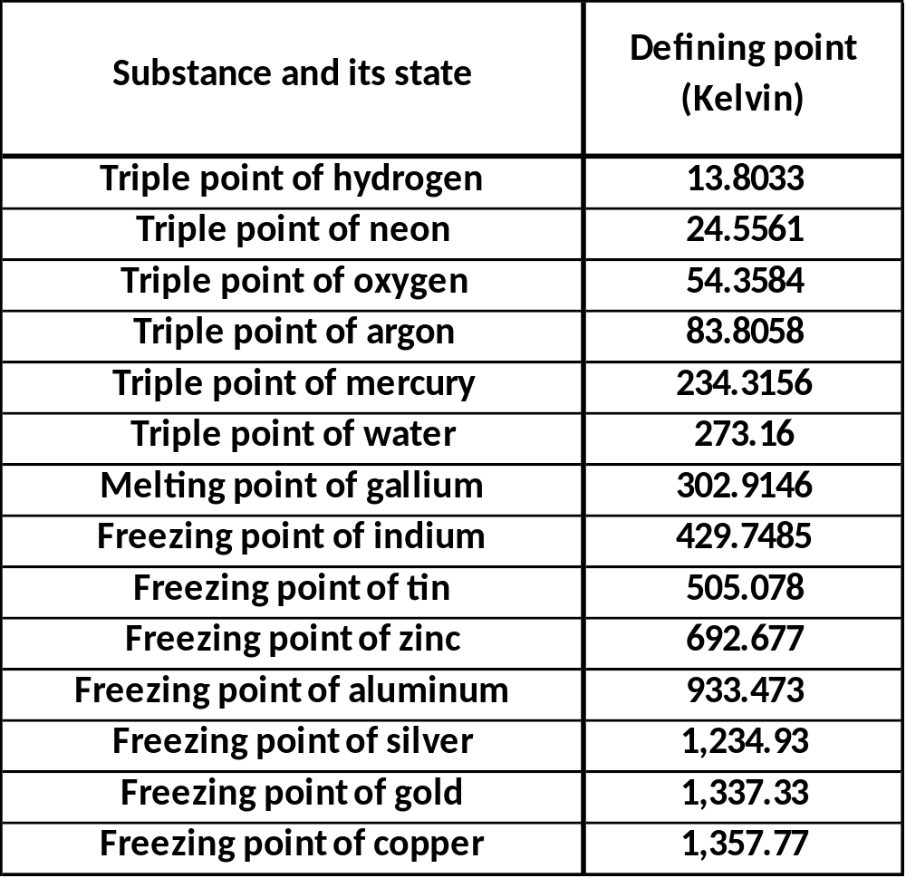
International Temperature Scale of 1990 (ITS-90)
ITS-90 published by the Consultative Committee for Thermometry of the International Committee for Weights and Measures is an equipment calibration standard for making measurements on the Kelvin and Celsius temperature scales.
ITS–90 is an approximation of the thermodynamic temperature scale that facilitates the comparability and compatibility of temperature measurements internationally.
It specifies fourteen calibration points.
https://srdata.nist.gov/its90/main/ date accessed: 20170815

Slide 41
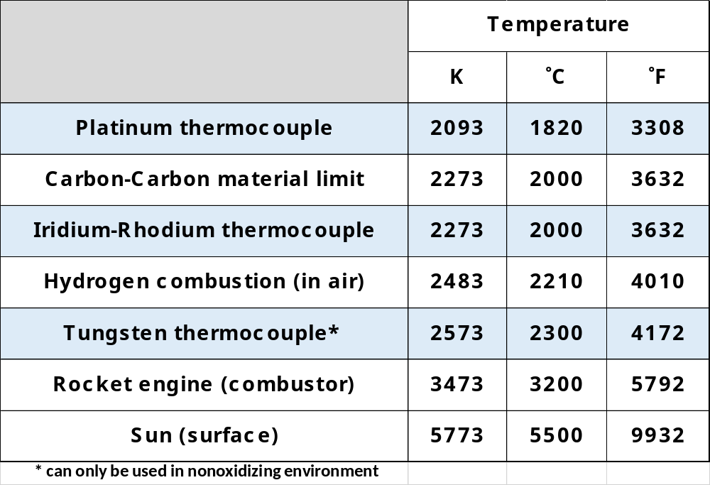

Slide 42
Degrees of Frost
A degree of frost is a nonstandard unit of measure for air temperature meaning degrees below melting point (also known as "freezing point") of water (0 degrees Celsius or 32 degrees Fahrenheit). "Degree" in this case can refer to degree Celsius or degree Fahrenheit.
When based on Celsius, 0 degrees of frost is the same as 0 °C, and any other value is simply the negative of the Celsius temperature. When based on Fahrenheit, 0 degrees of frost is equal to 32 °F. Conversion formulas:
T [degrees of frost] = 32 °F − T [°F]
T [°F] = 32 °F − T [degrees of frost]
The term "degrees of frost" was widely used in accounts of the Heroic Age of Antarctic Exploration in the early 20th century. The term appears frequently in Ernest Shackleton's books South and Heart of the Antarctic, Apsley Cherry-Garrard's account of his Antarctic adventures in The Worst Journey in the World (wherein he recorded 109.5 degrees [Fahrenheit] of frost, –77.5 °F or –60.8 °C), as well as Admiral Richard E. Byrd's book Alone.

Slide 43

Thermocouple Output
The temperature difference between the unknown temperature and the reference temperature causes the development of an electromotive force (Seebeck effect) that is approximately proportional to the difference between the temperatures of the two junctions.
Temperature can be read from standard tables, or the measuring instrument can be calibrated to read temperature directly.
https://reotemp.com/wp-content/uploads/2015/12/type-k-thermocouple-reference-table.pdf date accessed: 20170815

Slide 44


Semi-Infinite Analytical Method
TIME DEPENDENT HEAT FLUX PROFILE
Time |-- Temperature --| |----- Heat Flux -----|
[sec] [˚F] [˚R] [Btu/ft2-s] [Watts/m2]
0.000 540.000 999.670 -----------------------
0.100 547.700 1007.370 0.1078E+01 0.1224E+05
0.200 551.500 1011.170 0.9781E+00 0.1111E+05
0.300 554.400 1014.070 0.9686E+00 0.1100E+05
0.400 556.800 1016.470 0.9617E+00 0.1092E+05
0.500 558.900 1018.570 0.9589E+00 0.1089E+05
0.600 560.900 1020.570 0.9726E+00 0.1105E+05
0.700 562.600 1022.270 0.9580E+00 0.1088E+05
0.800 564.300 1023.970 0.9713E+00 0.1103E+05
0.900 565.900 1025.570 0.9758E+00 0.1108E+05
1.000 567.300 1026.970 0.9630E+00 0.1094E+05
1.100 568.700 1028.370 0.9692E+00 0.1101E+05
1.200 570.100 1029.770 0.9794E+00 0.1112E+05
1.300 571.400 1031.070 0.9777E+00 0.1110E+05
1.400 572.600 1032.270 0.9715E+00 0.1103E+05
1.500 573.800 1033.470 0.9757E+00 0.1108E+05
1.600 575.000 1034.670 0.9824E+00 0.1116E+05
1.700 576.100 1035.770 0.9767E+00 0.1109E+05
1.800 577.200 1036.870 0.9800E+00 0.1113E+05
1.900 578.200 1037.870 0.9715E+00 0.1103E+05
2.000 579.300 1038.970 0.9862E+00 0.1120E+05
2.100 580.300 1039.970 0.9810E+00 0.1114E+05
2.200 581.200 1040.870 0.9698E+00 0.1101E+05
2.300 582.200 1041.870 0.9824E+00 0.1116E+05
2.400 583.100 1042.770 0.9749E+00 0.1107E+05
2.500 584.100 1043.770 0.9897E+00 0.1124E+05
2.600 585.000 1044.670 0.9838E+00 0.1117E+05
2.700 585.800 1045.470 0.9717E+00 0.1103E+05
2.800 586.700 1046.370 0.9830E+00 0.1116E+05
2.900 587.600 1047.270 0.9882E+00 0.1122E+05
3.000 588.400 1048.070 0.9793E+00 0.1112E+05
3.100 589.200 1048.870 0.9788E+00 0.1112E+05
3.200 590.000 1049.670 0.9797E+00 0.1113E+05
3.300 590.800 1050.470 0.9815E+00 0.1115E+05
3.400 591.600 1051.270 0.9839E+00 0.1117E+05
3.500 592.400 1052.070 0.9867E+00 0.1121E+05
3.600 593.200 1052.870 0.9899E+00 0.1124E+05
3.700 593.900 1053.570 0.9793E+00 0.1112E+05
3.800 594.700 1054.370 0.9912E+00 0.1126E+05
3.900 595.400 1055.070 0.9824E+00 0.1116E+05
4.000 596.100 1055.770 0.9814E+00 0.1115E+05
4.100 596.800 1056.470 0.9816E+00 0.1115E+05
4.200 597.500 1057.170 0.9824E+00 0.1116E+05
4.300 598.200 1057.870 0.9838E+00 0.1117E+05
4.400 598.900 1058.570 0.9855E+00 0.1119E+05
4.500 599.600 1059.270 0.9875E+00 0.1121E+05
4.600 600.300 1059.970 0.9897E+00 0.1124E+05
4.700 600.900 1060.570 0.9781E+00 0.1111E+05
4.800 601.600 1061.270 0.9889E+00 0.1123E+05
4.900 602.300 1061.970 0.9930E+00 0.1128E+05
5.000 602.900 1062.570 0.9825E+00 0.1116E+05
Approach
  This is an established method for inferring heat-transfer rates from flows using surface coaxial thermocouple measurements. (see Cook, W. J and Felderman, E. J., “Reduction of Data from Thin Film Heat Transfer Gages: A concise Numerical Technique,” AIAA Journal, Vol. 4, No. 3, 1966, pp. 561-562.)
  the thermal product of the thermocouple, β, is adjusted as it increases with increasing temperature
  The thermocouple and test plate should be thermally matched (similar β=β(T))
  Accuracy increases with the number of terms used. 20 terms yields about a 0.1% variance from an exact solution (Cook, et.al.)
Requirement for the use of this analytical method
  the medium must be treated as a semi-infinite solid
  this assumption was valid for the chosen time-slice for the PITP test

Slide 45

The Minard Chart
One of the most interesting charts few have ever seen.
This chart shows the attrition of Napoleon’s Army during the Russian winter campaign.
Ignoring the 6000 soldiers held in reserve, Napoleon entered the campaign with 416,000 soldiers and regrouped with only 4,000 combatants. An attrition of 99%.
The plot highlights the declining temperature during the retreat which contributed to these losses. Temperature is recorded in degrees Reaumur.

Slide 46


Early Thermometers
Incorporated graduated glass tubes.
Consisted of a working fluid.
  alcohol
  mercury
  water
Thermal expansion or contraction of fluid was directly related to the change in temperature.

Slide 47


Non-Linear Scales
In all but one case, the temperature scales are entirely linear.
John Dalton’s system is logarithmic. This is useful when you’re plotting temperatures that vary exponentially, such as among different star types.
Absolute zero is negative infinity in the Dalton scale, freezing is 0.0 Dalton, water boils at 100, and lead melts at around 253.
The Dalton scale is not currently used.
http://www.curiousnotions.com/temperature-conversion/ date accessed: 20170815

Slide 48

Thermocouples and Thermometers
Thermocouples
Digital Thermometer
Infrared Thermometer

Slide 49

Selective Use of a Temperature Scale
Vermont Weather Report Tries to Heat Things Up
By Liz Fields - Mar 7, 2014
If spring hasn’t sprung, why not tailor it slightly?
That’s what one Vermont television station has done two years in a row, posting winter temperatures in Kelvin, a unit of measurement which starts at zero.
“To be more positive, we give up on the Fahrenheit scale and instead go with the Kelvin scale,” WCAX-TV weatherman, Gary posted on Facebook. “There are no negative numbers on the Kelvin scale … Doesn’t that just make you feel better seeing numbers like this?”

