Slide 1
Reactor Parametric Assessments for Alternative Propellant Nuclear Thermal Propulsion Engines
Powering the Next Era of Space Exploration
Corey Smith
Daria Nikitaeva, Jacob Stonehill, Matthew Duchek
Analytical Mechanics Associates, Inc.

Slide 2
Acknowledgements
This work was supported by NASA’s Space Technology Mission Directorate (STMD) through the Space Nuclear Propulsion (SNP) Project
Contract No. 80LARC17C0003
Task No. 10.020.000

Slide 3
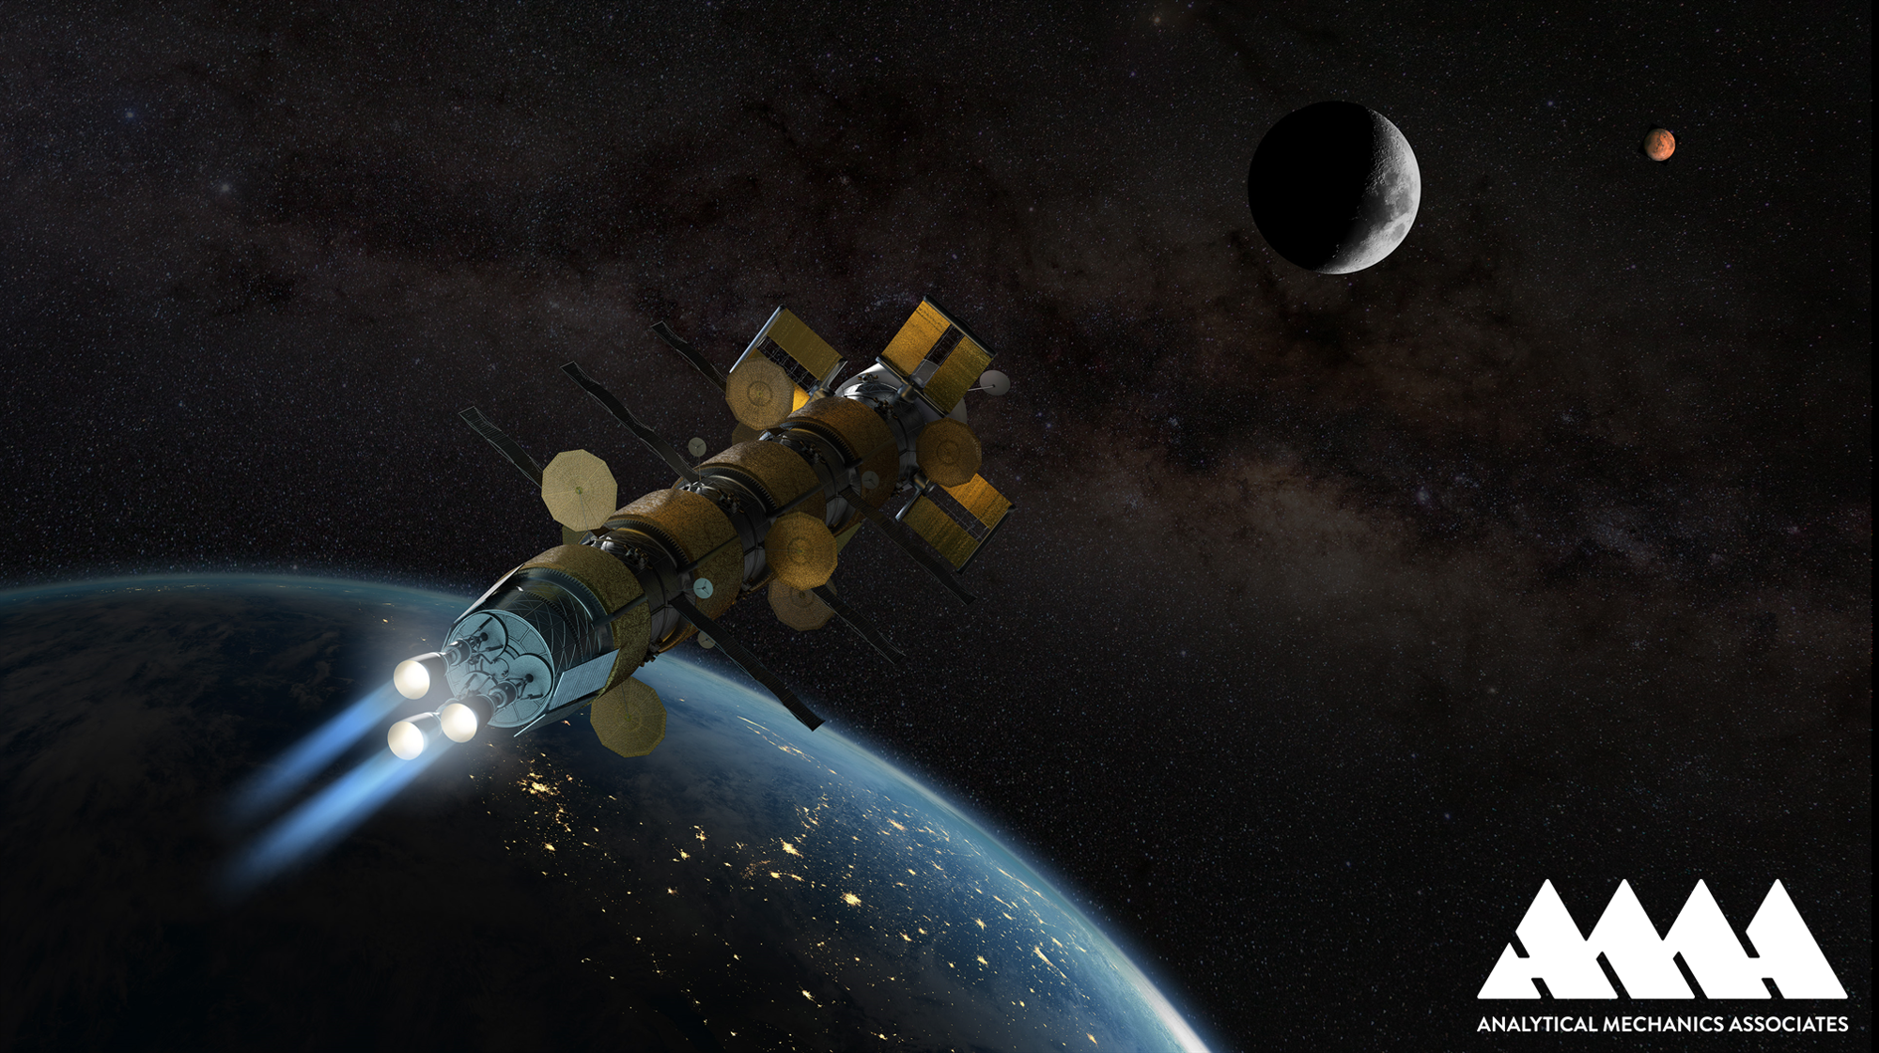
Agenda
Motivations and Objectives
  Alternative Propellant Options
Engine / Reactor Modeling Methodology
  H-NTP vs. A-NTP Engine Cycles
  Reactor Modeling Algorithm
Sensitivity Results
  Criticality and Control Drum Worth Investigation
  Geometry Extensibility Results
Conclusions and Forward Work

Slide 4
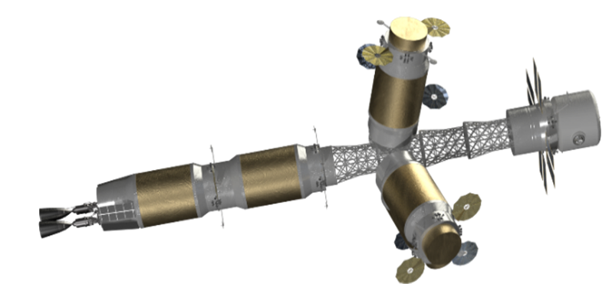
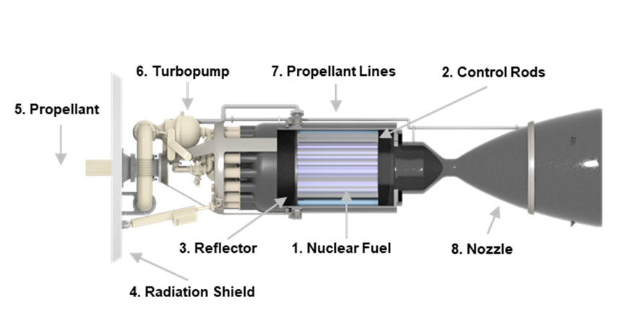
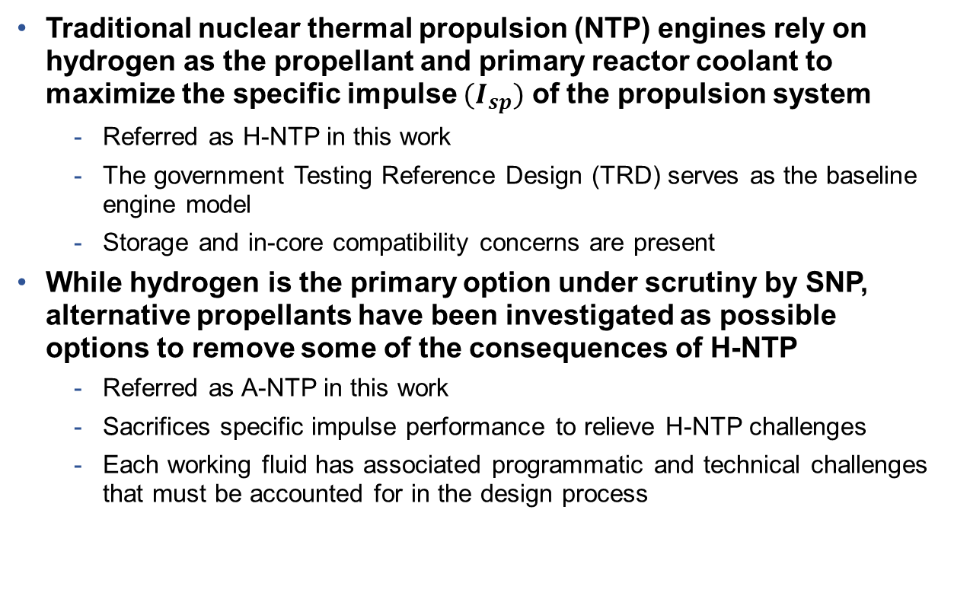
Motivations and Objectives
NTP is a viable nuclear-powered technology to enable cislunar and Martian mission architectures.
Traditional nuclear thermal propulsion (NTP) engines rely on hydrogen as the propellant and primary reactor coolant to maximize the specific impulse ${(I}_{sp})$ of the propulsion system
  Referred as H-NTP in this work
  The government Testing Reference Design (TRD) serves as the baseline engine model
  Storage and in-core compatibility concerns are present
While hydrogen is the primary option under scrutiny by SNP, alternative propellants have been investigated as possible options to remove some of the consequences of H-NTP
  Referred as A-NTP in this work
  Sacrifices specific impulse performance to relieve H-NTP challenges
  Each working fluid has associated programmatic and technical challenges that must be accounted for in the design process
Each propellant option has benefits and consequences related to the engine key performance parameters, specifically with respect to neutronics, mass scaling, and specific impulse / thrust.

Slide 5
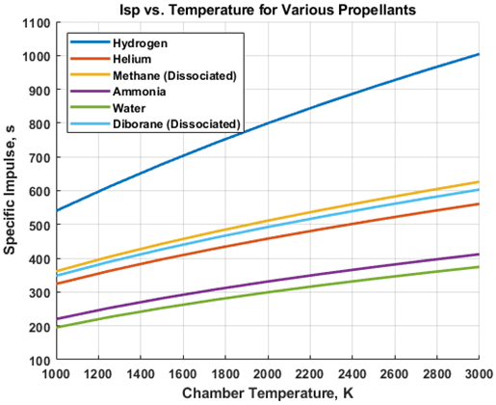
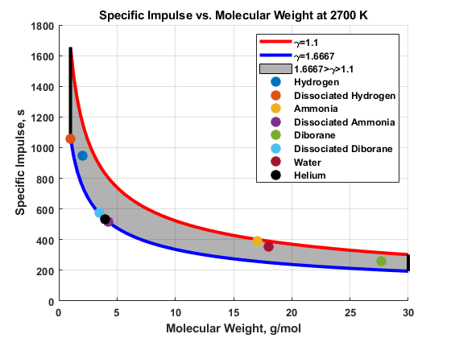
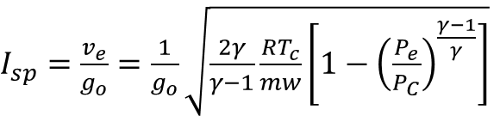
Alternative Propellant Options: Hydrogen, Ammonia, Enriched Diborane, Helium, Methane, Water
Increasing engine chamber temperature and decreasing effective molecular weight (including dissociation) increases specific impulse.

Slide 6
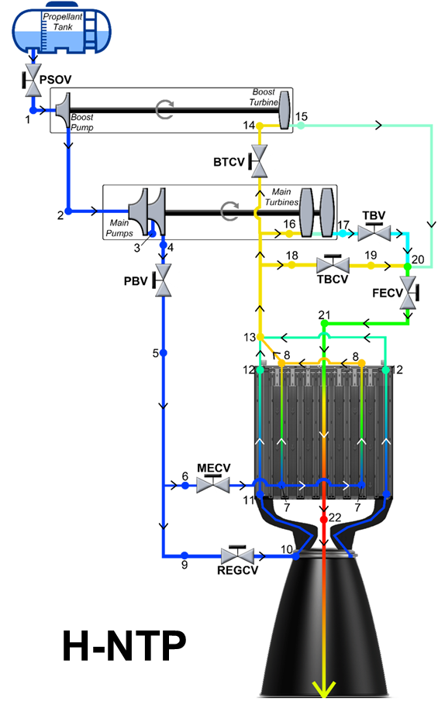
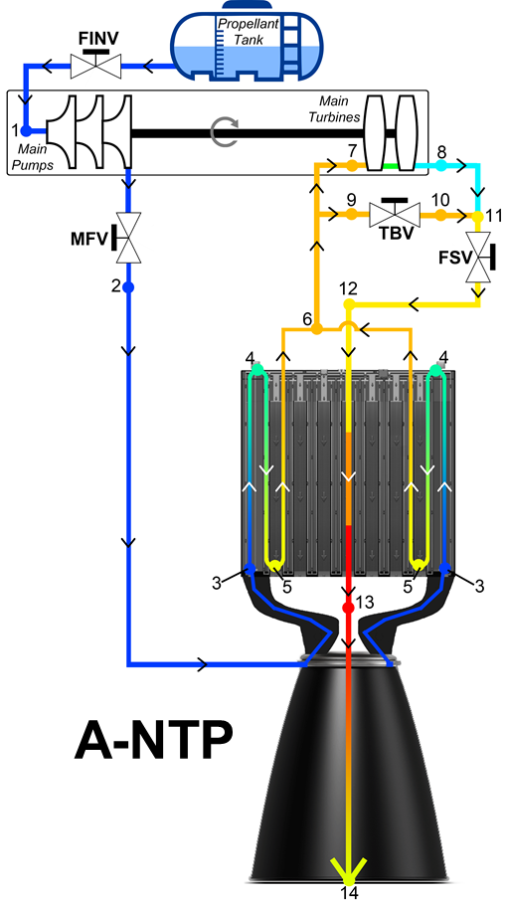
H-NTP vs. A-NTP
Fluid Preheating:
  Enthalpy gain from the moderator, reflector, and regenerative nozzle flows are not sufficient to reach a supercritical state
Parallel vs. Serial:
  Routing control drums and moderator element in parallel or serially
  Primarily used for flow scheduling and obtain location of initial reactor flow discharge

Slide 7
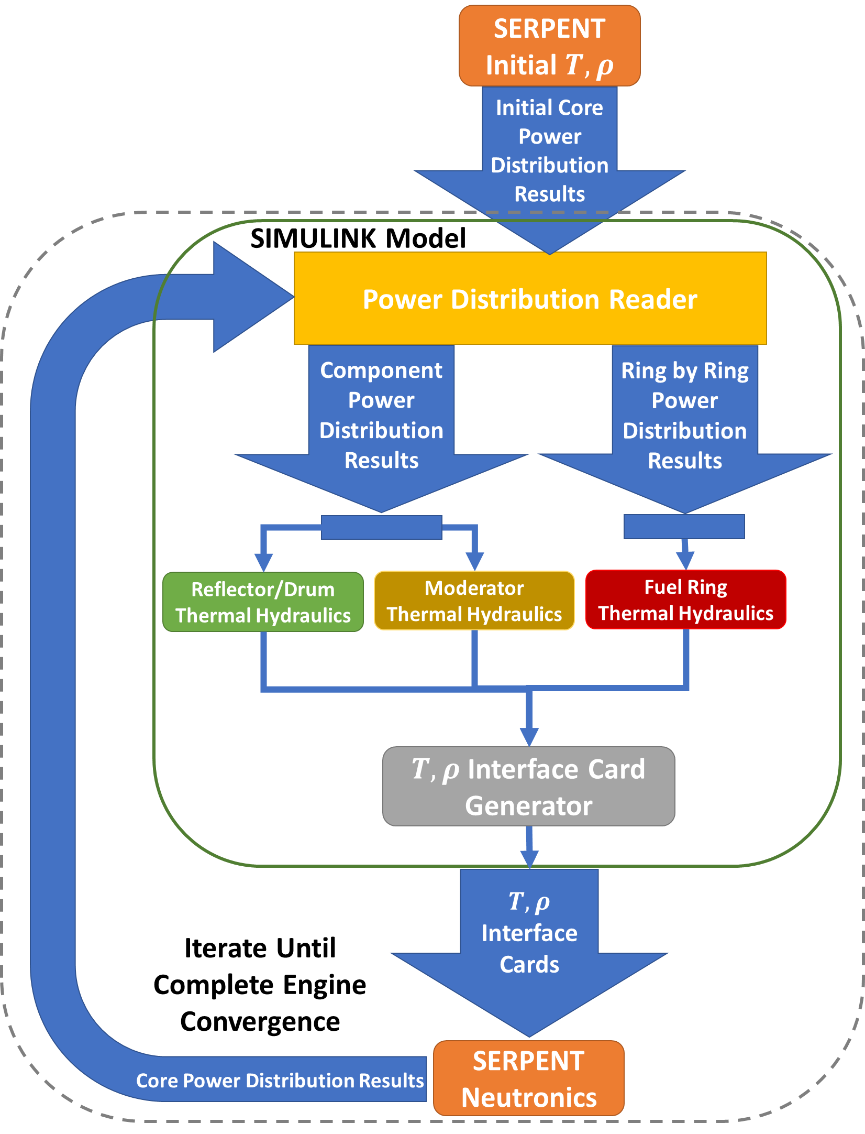
X-NTP Reactor Modeling Methodology
Assessing bulk reactor test cases requires an in-depth multiphysics modeling approach.
This algorithm investigates various reactor parametric studies that can be performed to reach desired thermal hydraulic and neutronic performance
  Thermal Hydraulics: AMA reactor / engine Simulink model
  Neutronics: Serpent (Monte Carlo reactor physics modeling tool)
Control Variables:
  Reactor Unit Cell
  Control Drum Quantity and Geometry
  Reflector Thickness
  Subcomponents
Parametric Variables:
  Working Fluid
  Fuel Assembly Pitch / Moderator Block Radius
  Control Drum Rotation
  Reactor Length

Slide 8
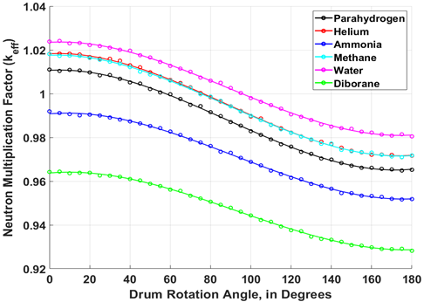
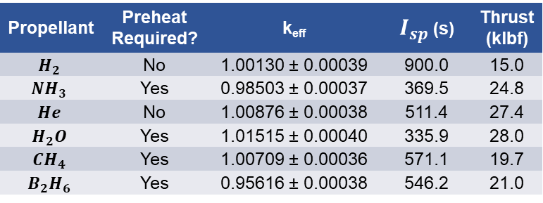
Criticality and Control Drum Worth Investigation
Neutron multiplication factor (k_{eff}) is assessed for the baseline reactor using each alternative propellant.
Initial parametric assessment focuses on the effects of X-NTP and control drum rotation on k_{eff}
  5-degree increments between fully out (0°) and fully in (180°) are analyzed
  Parahydrogen (black curve) serves as the main comparison point for the other propellants
Ammonia and diborane are shown to be subcritical for the baseline reactor and all drum rotation angles
  To enable a critical system, core designers may vary core length, reflector thickness, fissile material volume, fuel assembly pitch, and / or propellant enrichment
  Remaining sensitivities in this work focus on these options
Concerns over shutdown margin may be present, especially for off-nominal reactor transients
  One or more drum failure (stuck in position)
Propellant | Preheat Required? | k_{eff} | $I_{sp}$ (s) | Thrust (klbf)
$$H_{2}$$ | No | 1.00130 ± 0.00039 | 900.0 | 15.0
$$NH_{3}$$ | Yes | 0.98503 ± 0.00037 | 369.5 | 24.8
$$He$$ | No | 1.00876 ± 0.00038 | 511.4 | 27.4
$$H_{2}O$$ | Yes | 1.01515 ± 0.00040 | 335.9 | 28.0
$${CH}_{4}$$ | Yes | 1.00709 ± 0.00036 | 571.1 | 19.7
$$B_{2}H_{6}$$ | Yes | 0.95616 ± 0.00038 | 546.2 | 21.0

Slide 9
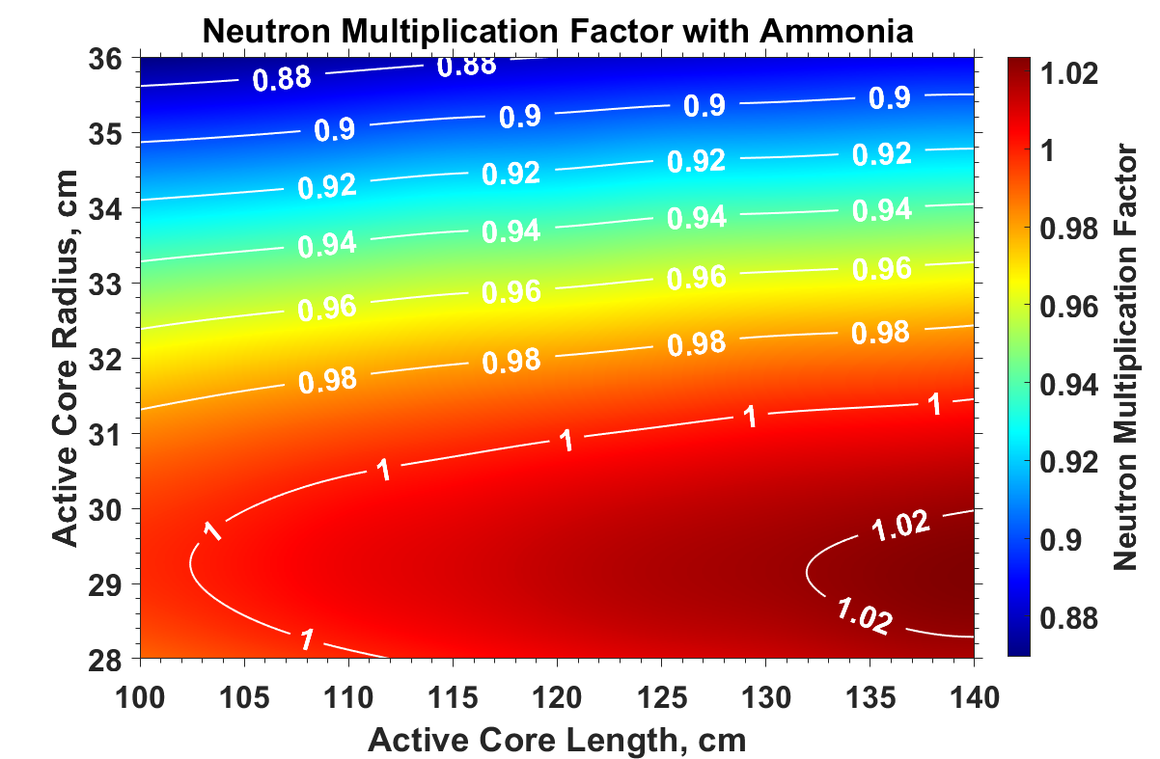
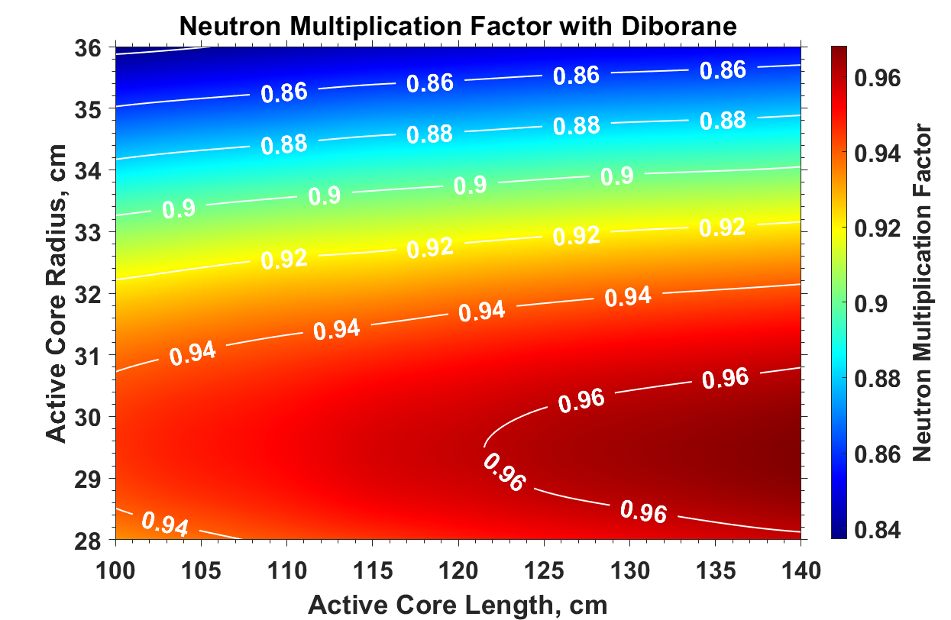
Geometry Extensibility Results
Parametric variation of the reactor sizing with ammonia and enriched diborane propellants.
Preliminary geometry sensitivity for the ammonia and 99.9% enriched diborane test cases using the TRD configuration
  Update active core length / radius to affect the moderator-to-fuel ratio
  All subcomponents around the core are scaled appropriately
  Each test case has the fuel volume loading pattern and a 60-degree control drum rotation angle present in the baseline reactor configuration
Key observations:
  The criticality vs. moderator-to-fuel ratio reaches a relative extremum around 29.5 cm, as seen by the sharp bend in the contours
  Increasing radius above the extrema will cause a sharp decrease in criticality due to significant over-moderation
  Increasing core length will see increases to criticality due to the increased fissile volume
  System mass follows the geometry changes, so optimizing the criticality is ideal

Slide 10
Conclusions and Forward Work
Impacts on neutron multiplication factor, excess reactivity and shutdown margin, and system and HALEU mass are analyzed for each alternative propellant option
  Ammonia is currently the most viable alternative propellant even without understanding of dissociation
  Enriched diborane has been de-emphasized due to storage and performance concerns
  Water and methane pose engine compatibility concerns; helium is difficult to store
Ammonia and 99.9% enriched diborane propellants do not enable a critical system with the baseline reactor configuration; small design changes can improve reactivity
  Decrease moderator to fuel ratio, increase average fuel volume loading
  For diborane, increasing the enrichment quantity above 99.95% can enable k_{eff} > 1
Future work scope includes fully integrated reactor / engine analyses to determine the impact of X-NTP engines on various mission architectures
  Cislunar and conjunction- / opposition-class Martian trajectories
  Performance scalability (mass, thrust, specific impulse, safety coefficients, etc.)

Slide 11
Additional Acknowledgements and References
This research made use of Idaho National Laboratory computing resources which are supported by the Office of Nuclear Energy of the U.S. Department of Energy and the Nuclear Science User Facilities under Contract No. DE-AC07-05ID14517.
REFERENCES
[1] S. D. Heister, W. E. Anderson and T. L. Pourpoint, Rocket Propulsion, Cambridge: Cambridge University Press, 2019.
[2] I. H. Bell, J. Wronski, S. Quoilin and V. Pourpoint, "Pure and Pseudo-Pure Fluid Thermophysical Property Evaluation and the Open-Source Property Library CoolProp," Industrial and Engineering Chemistry Research, vol. 53, no. 6, pp. 2498-2508, 2014.
[3] E. C. Selcow, R. E. Davis, K. R. Perkins, H. Ludwig and R. J. Cerbone, "Assessment of the Use of H2, CH4, NH3, and CO2 as NTR Propellants," in American Institute of Physics, Albuquerque, 1992.
[4] D. Nikitaeva, C. D. Smith and M. Duchek, "Effects of Heat Transfer Coefficient Variation on Nuclear Thermal Propulsion Engine Performance," in Nuclear and Emerging Technologies for Space, Idaho Falls, 2023.
[5] D. Nikitaev and D. L. Thomas, "Alternative Propellant Nuclear Thermal Propulsion Engine Architectures," Journal of Spacecraft and Rockets, 2022.
[6] D. Nikitaev and D. L. Thomas, "Impacts of In-Situ Alternative Propellant on Nuclear Thermal Propulsion Mars Vehicle Architectures," Journal of Spacecraft and Rockets, vol. 59, no. 6, pp. 2038-2052, 2022.
[7] Los Alamos National Laboratory, "Lib80x—Library based on ENDF/B-VIII.0," 2022.
[8] D. Nikitaev, C. Smith and K. Palomares, "Nuclear Thermal Propulsion Turbomachinery Modeling," in Nuclear and Emerging Technologies for Space Conference, Cleveland, 2022.
[9] J. Gustafson, M. Krecicki, R. Swanson, B. Zilka and J. K. .. Witter, "Space Nuclear Propulsion Fuel and Moderator Development Plan Conceptual Testing Reference Design," in Nuclear and Emerging Technologies for Space, Virtual Event, 2021.
[10] J. Leppanen, M. Pusa, T. Viitanen, V. Valtavirta and T. Kaltiaisenaho, "The Serpent Monte Carlo code: Status, development and applications in 2013," Annals of Nuclear Energy, vol. 82, pp. 142-150, 2015.

Slide 12
Questions?
Corey Smith
corey.d.smith@ama-inc.com
corey.d.smith@nasa.gov

Slide 13
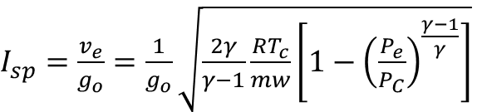
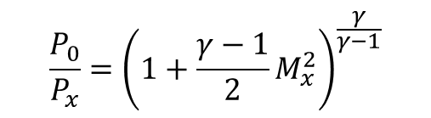
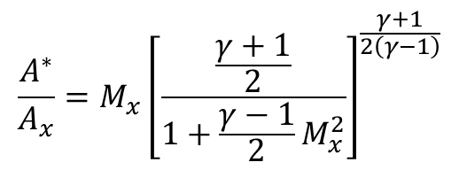
Isp Calculation Details
$I_{sp}=\frac{v_{e}}{g_{o}}=\frac{1}{g_{o}}\sqrt{\frac{2γ}{γ−1}\frac{RT_{c}}{mw}\left[1−{\left(\frac{P_{e}}{P_{C}}\right)}^{\frac{γ−1}{γ}}\right]}$
Chamber Pressure: 4.5 MPa
Chamber Temperature: 2700 K
Area Ratio: 381:1
Ratio of specific heats bounds
  Upper: 1.6667 (monoatomic)
  Lower: 1.1 (polyatomic)
$$\frac{P_{0}}{P_{x}}={\left(1+\frac{γ−1}{2}M_{x}^{2}\right)}^{\frac{γ}{γ−1}}$$
$$\frac{A^{∗}}{A_{x}}=M_{x}{\left[\frac{\frac{γ+1}{2}}{1+\frac{γ−1}{2}M_{x}^{2}}\right]}^{\frac{γ+1}{2\left(γ−1\right)}}$$

