Slide 1
An assessment of the SAGE III/ISS temperature and pressure research products
Michael Pitts, Larry Thomason, David Flittner, and Robert Manion
NASA Langley Research Center, Hampton, Virginia

Slide 2
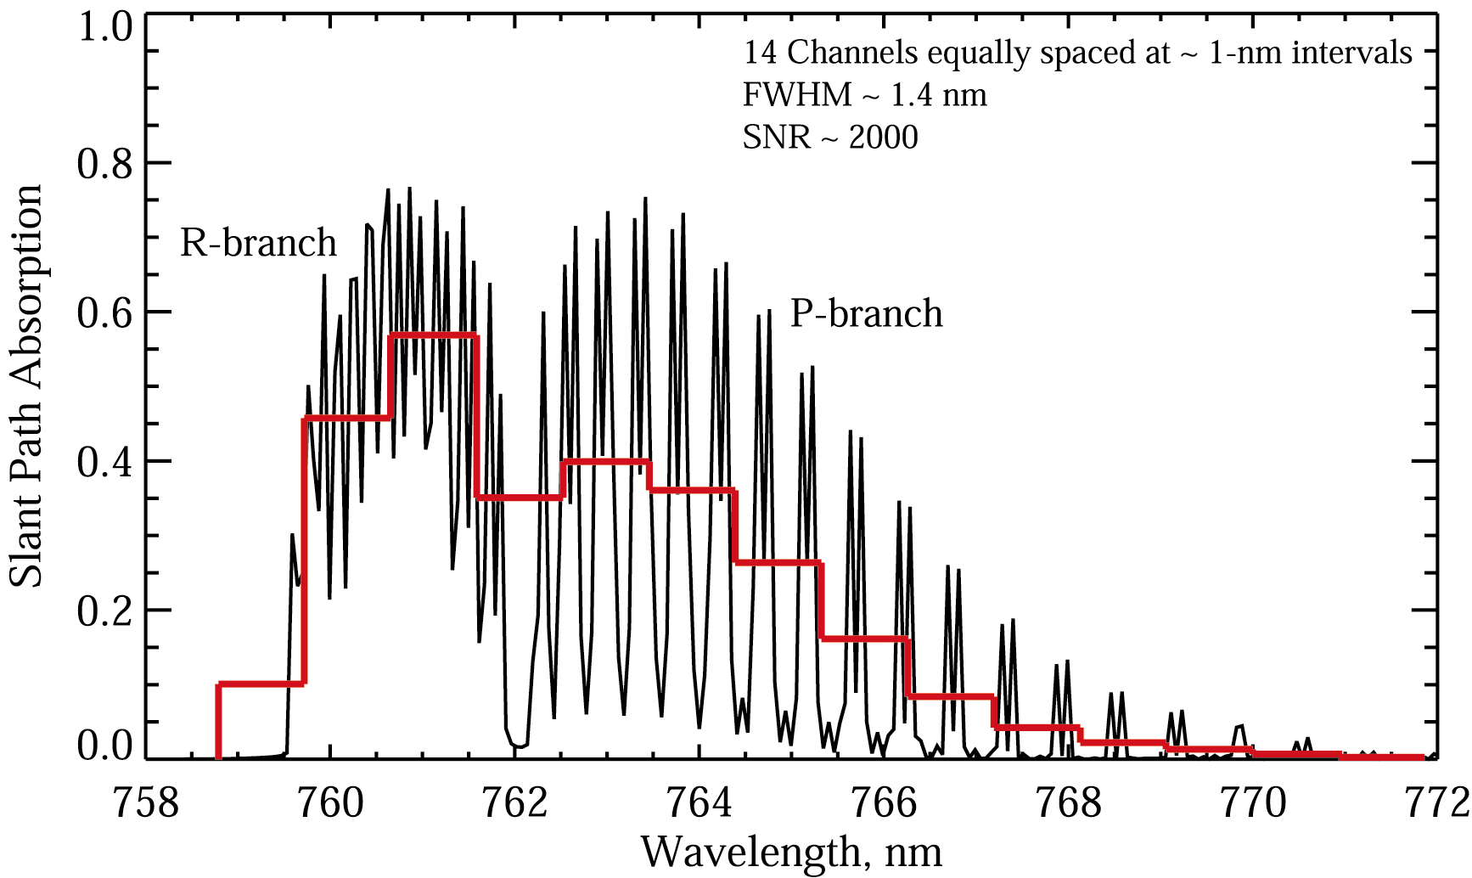
Strategy for Temperature/Pressure Retrievals
Iterative approach required due to non-linear nature of problem
Uses non-linear least squares fitting routine (Levenberg-Marquardt)
Simultaneously fits measured A-band spectra from all 14 channels and 90 tangent altitudes
Includes O₂ absorption, Rayleigh scattering, aerosol extinction, and O₃ absorption components
Solves for successive adjustments to trial T,p profiles by minimizing residuals between measured and modeled absorption
Includes non-rigid hydrostatic constraint
14 Channels at ~ 1-nm intervals
FWHM ~ 1.4 nm
SNR ~ 1500
A-band contains ~290 individual absorption lines with the distinctive R-branch and P-branch structure. Broad features are still visible at SAGE III resolution (red line)

Slide 3
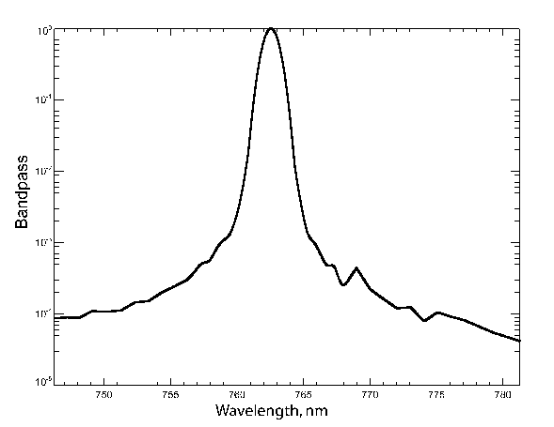
Forward Model Elements
Forward model simulates SAGE III/ISS LOS transmission measurements in 14 O₂ A-band channels using LBL radiative transfer calculations
Inputs:
Initial guess T/p profiles
Pathlength matrix
O₂ Spectroscopic parameters (HITRAN 2016)
Initial guess aerosol (linear fit: slope + intercept)
Initial guess ozone (cross sections + ozone number density)
Channel wavelength map
Channel point spread function (PSF)
Outputs
LOS transmission (O₂ + Rayleigh + aerosol + O₃)
14 Channels at ~ 1-nm intervals
FWHM ~ 1.4 nm
SNR ~ 1500
PSF
A-band contains ~290 individual absorption lines with the distinctive R-branch and P-branch structure. Broad features are still visible at SAGE III resolution (red line)

Slide 4
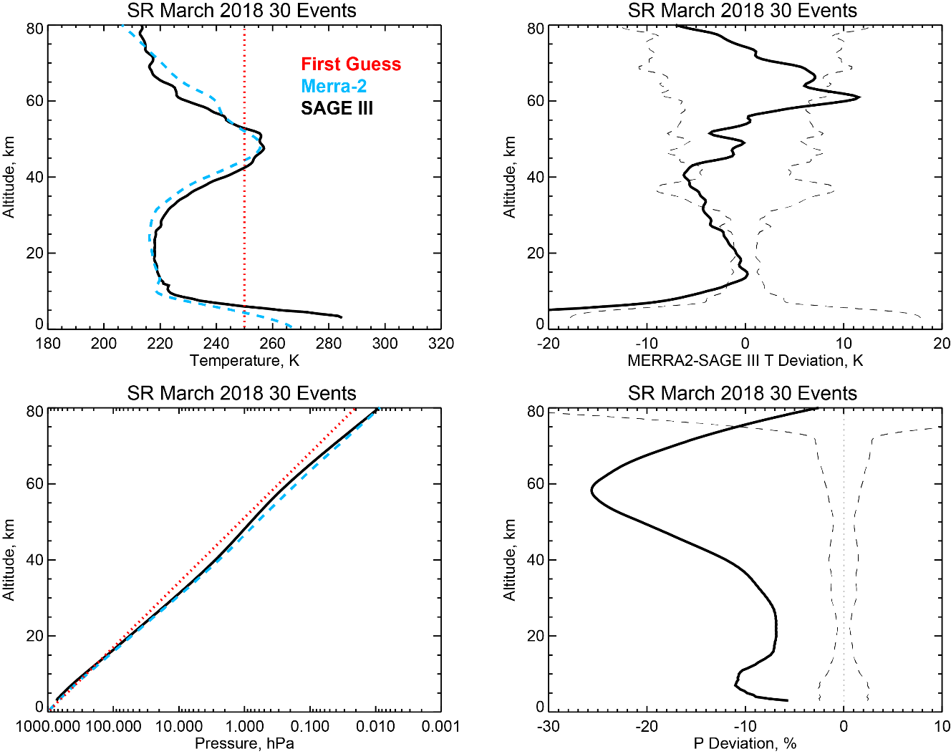
Baseline Retrievals (Sunrise Events)
Mean SAGE III/ISS retrieved temperature and pressure profiles from 30 sunrise events during March 2018 with baseline wavelength map and PSF factor

Slide 5
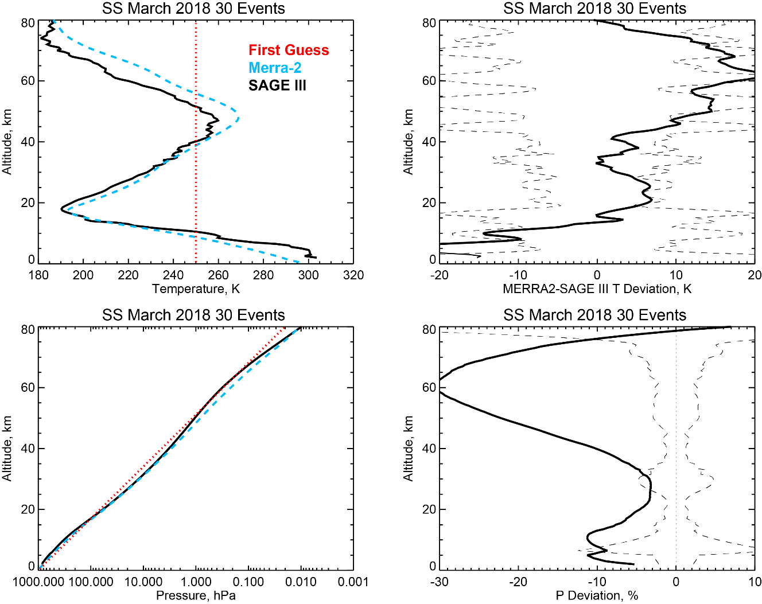
Baseline Retrievals (Sunset Events)
Mean SAGE III/ISS retrieved temperature and pressure profiles from 30 sunset events during March 2018 with baseline wavelength map and PSF factor

Slide 6
Measured vs. Modeled O₂ + Rayleigh Components
Baseline wavelength registration and instrument response functions
Modeled spectra too broad and misregistered in wavelength

Slide 7
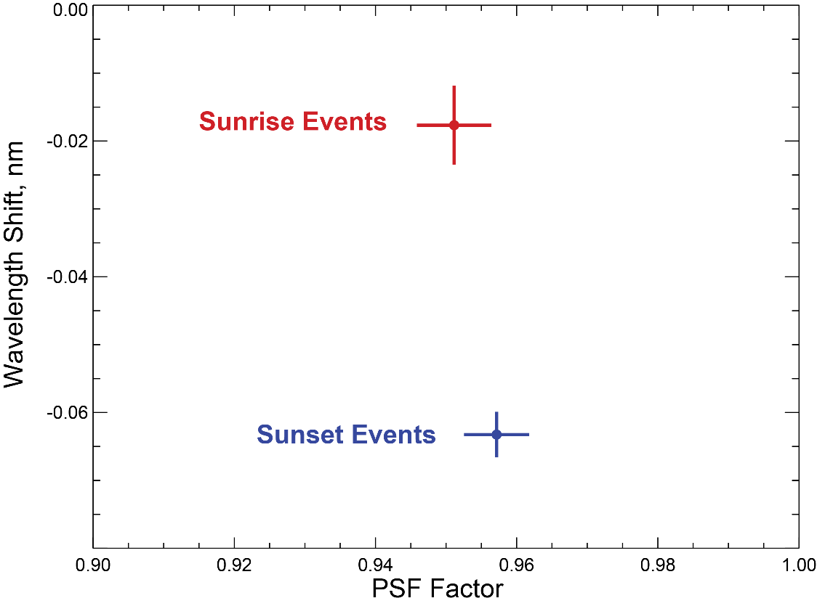
Wavelength and PSF Factor Adjustments
Assume Merra-2 T/p profiles are truth
Retrieved adjustments to baseline wavelength map and PSF widths (mean ± 1 σ) required to best fit measured spectra
Channel PSF

Slide 8
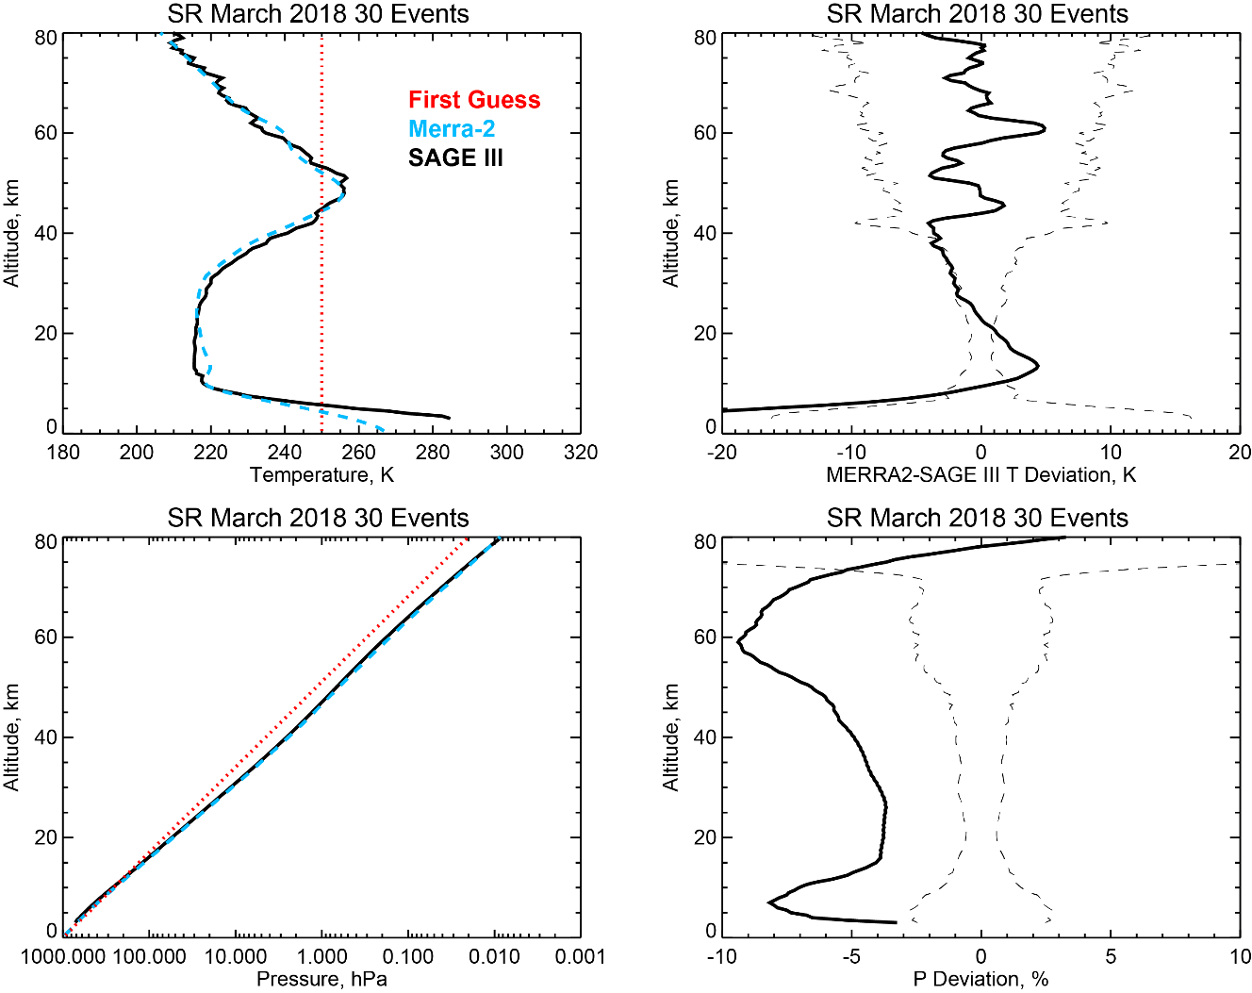
Retrievals Using Adjusted Wavelength & PSF
Mean SAGE III/ISS retrieved temperature and pressure profiles from 30 sunrise events during March 2018 with adjusted wavelength map (-0.018 nm) and PSF factor (0.95)

Slide 9
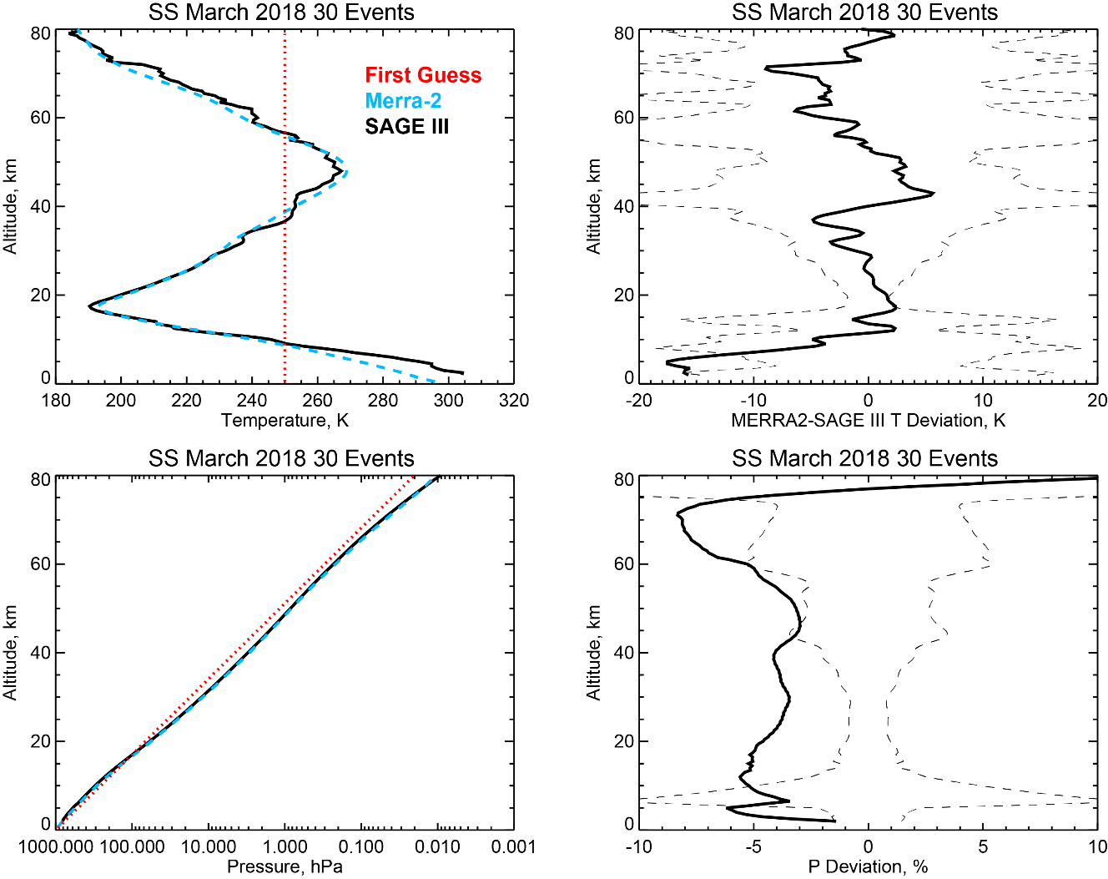
Retrievals Using Adjusted Wavelength & PSF
Mean SAGE III/ISS retrieved temperature and pressure profiles from 30 sunset events during March 2018 with adjusted wavelength map (-0.063 nm) and PSF factor (0.95)

Slide 10
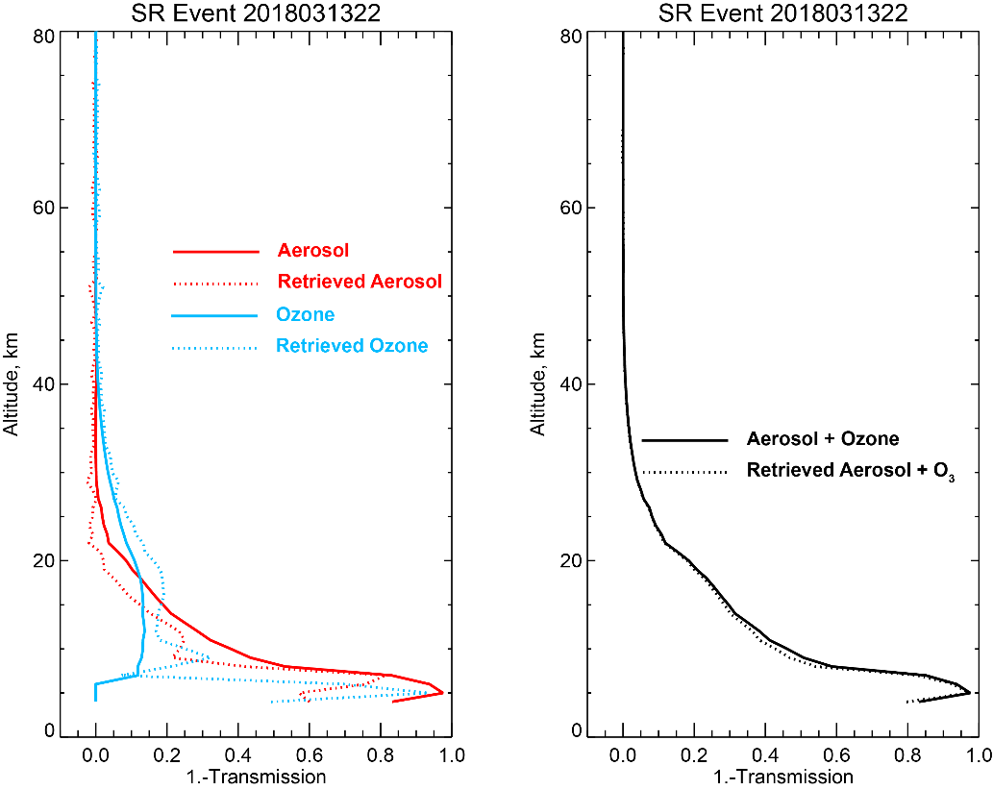
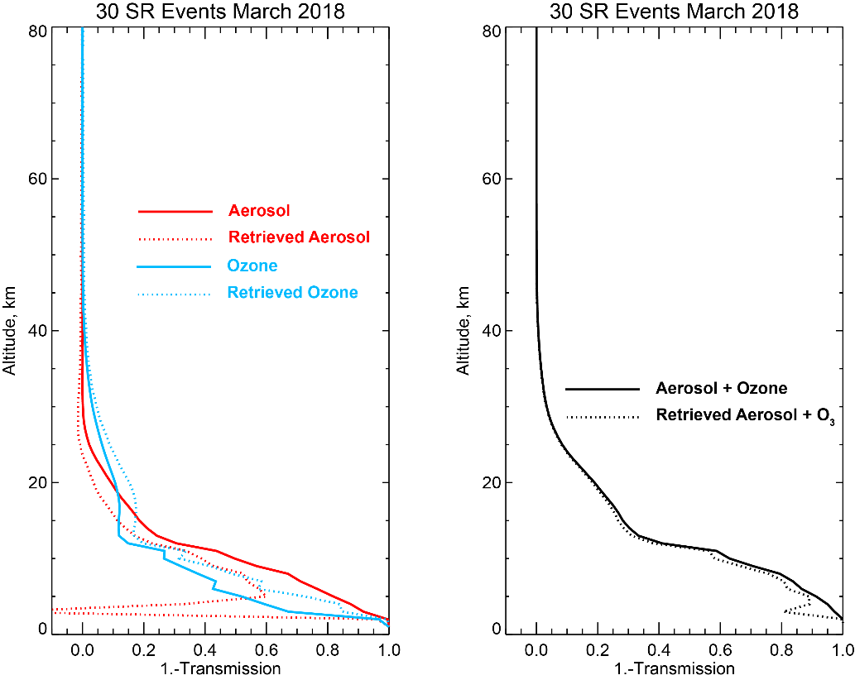
Aerosol and Ozone Fitting
Retrieved aerosol and ozone components compared with measurements (aerosol interpolated from aerosol channels and AO3 ozone product)

Slide 11
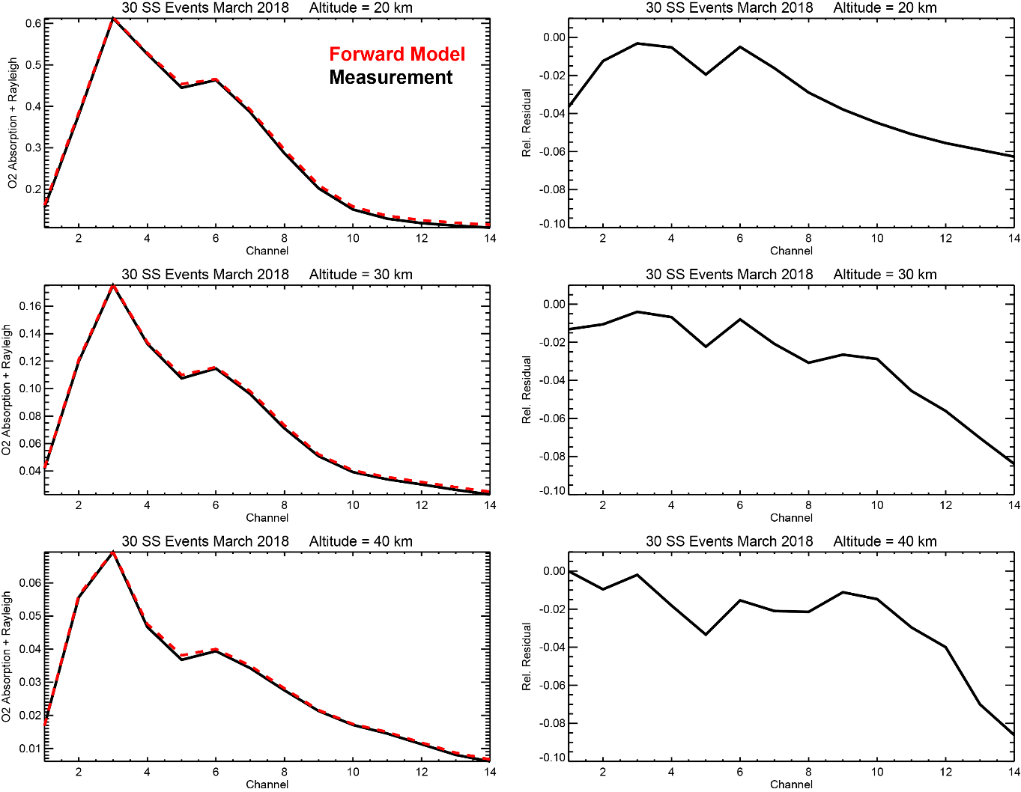
O₂ + Rayleigh Fitting
Mean measured vs. modeled O₂ absorption + Rayleigh scattering for 30 SS events
Forward model parameters:
Δλ = -0.063
PSF Factor = 0.95
Systematic shape of residuals may indicate that some component is not being properly fitted

Slide 12
SAGE III/ISS vs. Merra-2 zonal cross sections
MERRA-2
SAGE III/ISS
MERRA-2 (left) and SAGE III/ISS (right) meridional temperature distributions compiled from sunrise events over the period 1 January -15 February 2018. The SAGE III/ISS temperature distribution captures the general temperature structure seen in MERRA-2, but is colder at the tropopause and stratopause, and somewhat noisier at higher altitudes.

Slide 13
Summary and Future Work
Forward Model Assessment:
Small wavelength shifts are apparent in A-band spectra relative to baseline registration (approximately -0.018 nm for sunset and -0.063 nm for sunrise events)
Baseline PSFs too broad- fits are improved using narrower (0.95 x baseline) widths
Retrievals with adjusted forward model parameters look encouraging with near science quality temperature products, but some issues remain, especially in pressure product
Future Work:
Continue examining sensitivity to forward model parameters
Bandpass (width, wings, etc.)
Spectroscopy (line intensities, line shape)
Potential altitude offset
Aerosol + O₃ components
Exclude weaker channels
Explore alternative retrieval approaches to L-M (e.g., Newton-Raphson)
Perform more detailed comparisons with correlative measurements (e.g.,radiosondes, lidar, MLS, and global analyses) to quantify precision and accuracy of T/p products

