Slide 1
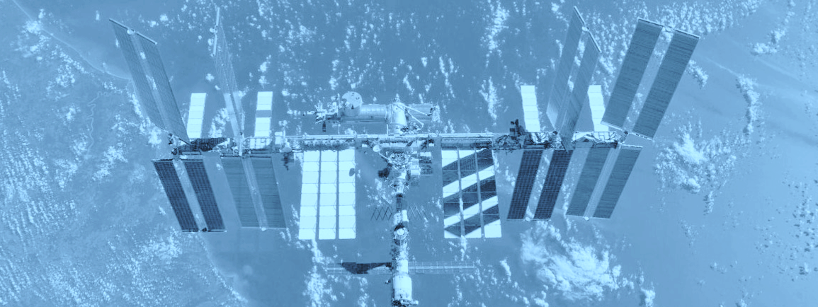



ISS Motion Control System
Operations & Upcoming Events
POIWG External Payloads Splinter
ADCO / E. Wieczorek
ADCO / S. Mitchell
Approved for Public Release: This document has been reviewed for Proprietary, CUI, and Export Control (ITAR/EAR) and has been determined to be non-sensitive. It has been released to the public via the NASA Scientific and Technical Information (STI) Process DAA20230005236.
Flight Operations Directorate
Johnson Space Center

Slide 2
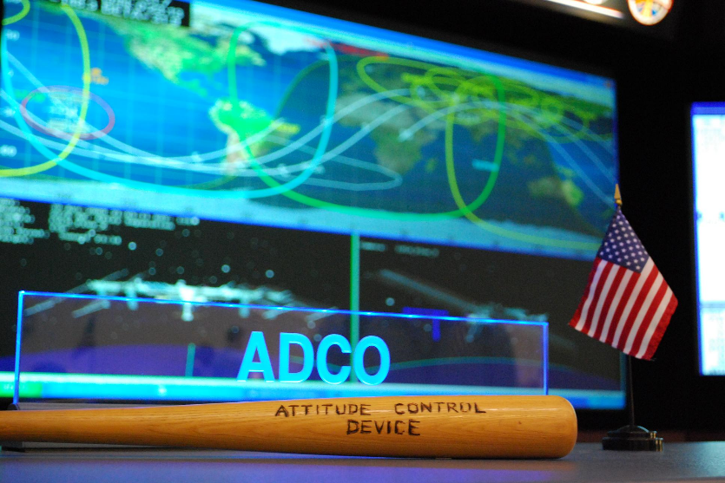
Outline
Motion Control System (MCS) overview
  CMG and Attitude Control basics
  Torque Equilibrium Attitude (TEA) definition
  MCS control types
  GPS FDIR
  Common operations
  Interpreting the ATL
Planning products
Planned Increment 69 events

Slide 3
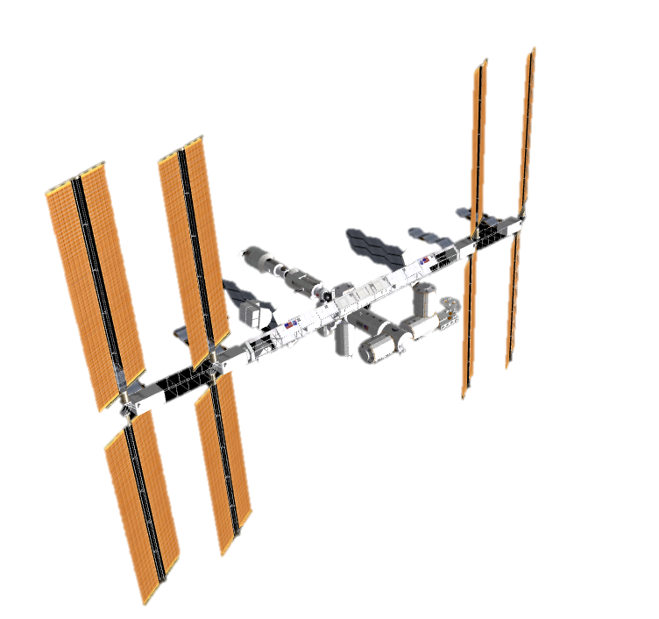
Attitude Control Basics
Attitude Determination and Control Officer
Attitude Control: The ability to maintain a spacecraft’s rotational orientation despite external disturbances.
Control
Disturbance

Slide 4
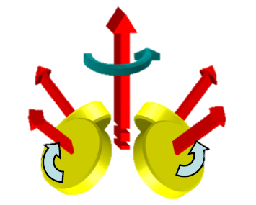

ISS Attitude Control Effectors
Control Moment Gyroscopes (CMGs)
Thruster
Control
Non Propulsive Attitude Control
Propulsive Attitude Control
Provide Microgravity Environment
Strongest Control Authority

Slide 5
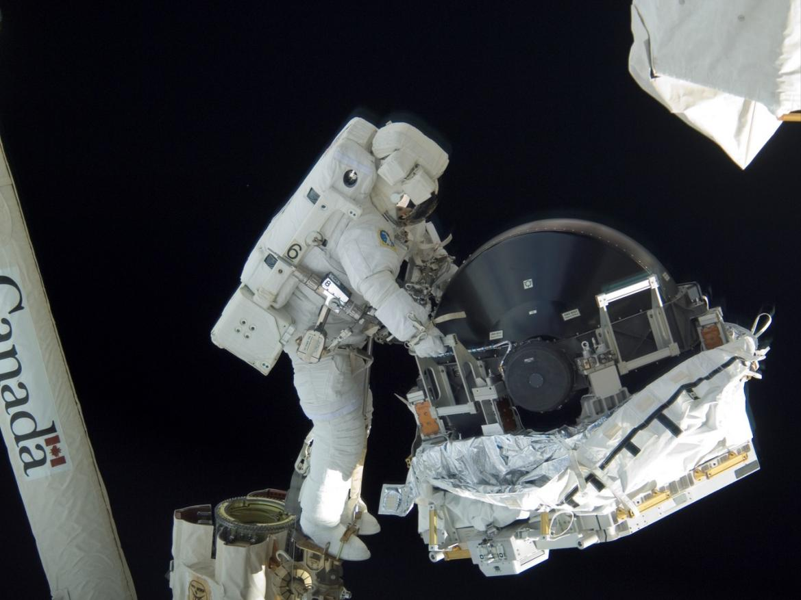
MCS Overview - CMG Basics

Slide 6
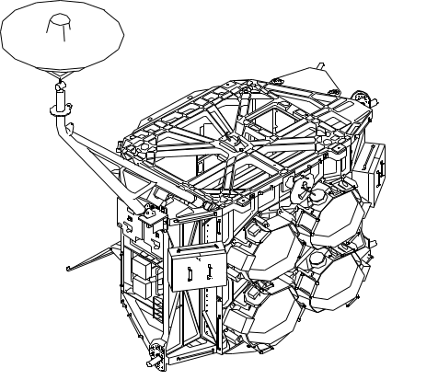
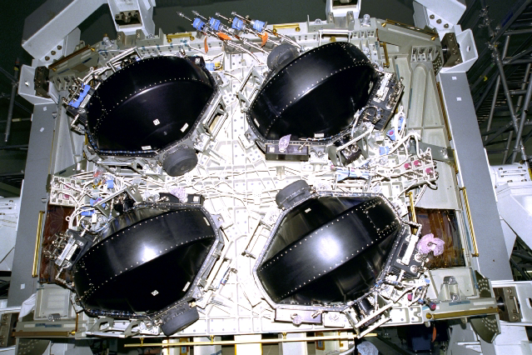
MCS Overview - CMG Basics
CMG : Control Moment Gyroscopes
2
3
Z1 Truss
1
4

Slide 7
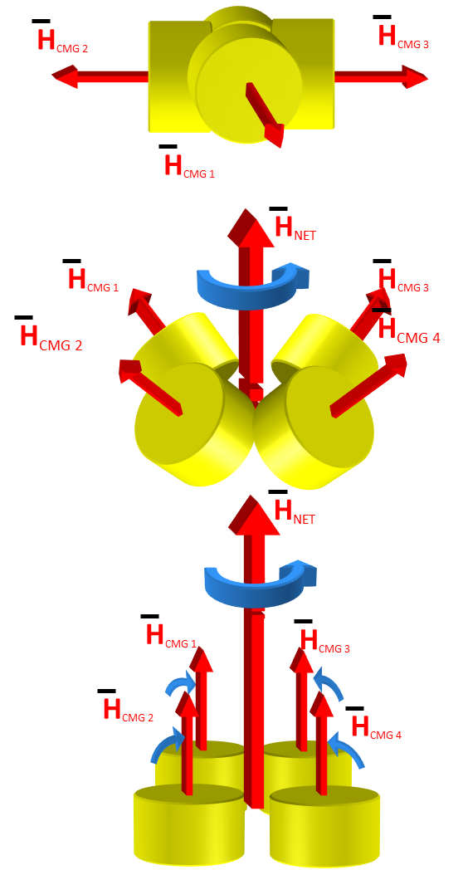
MCS Overview - CMG Basics
A spinning wheel has angular momentum.
Changing the net angular momentum vector of the CMGs creates a torque.

Slide 8
MCS Overview - CMG Desaturations
CMG Momentum
Momentum
On Line Momentum
65
%
85
55
95
45
75
0
100
CMG Desat In Prog
Yes
RS Desat Status
No
Active
Thruster Pulse Complete
Inactive
%
100
0
100

Slide 9

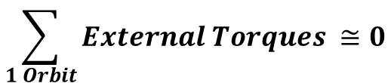
Torque Equilibrium Attitude
Drag
$$\sum_{1 Orbit}{External Torques ≅0}$$
Gravity

Slide 10
Torque Equilibrium Attitude
The ISS TEA is dependent on what ports have visiting vehicles docked to them
Current +XVV TEA: (-4, x, 0.9) Yaw, Pitch, Roll
x (Pitch angle) is between -12.0 and -2.0 deg depending on port configuration
Typically, ISS is pitched down further than it was prior to the addition of MLM
The analyzed thermal envelope that ISS is cleared to fly in (Flight Rule B2-57) is unchanged

Slide 11
MCS Control Types
Nominal (Quiescent)
Dynamic Events
Momentum Management (MM)
Attitude Hold (AH)
Keep attitude error as low as possible.
Maintain attitude while conserving momentum.
Expect attitude error to keep momentum stable.
Use CMGs
Use Thrusters
CMG AH
USTO
Hold attitude using CMGS
Hold attitude using thrusters
Dynamic Events and Contingency
RS Thrusters
More details on control modes in backup charts.
Hold attitude with highest control authority

Slide 12
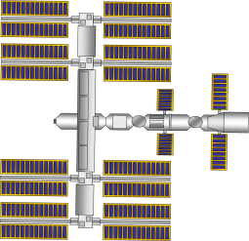
Momentum Management Control
Momentum Percentage
100%
0%
t
Att Error: <3⁰
*Note: Performance usually much better at <1 ⁰. Roll varies most, usually 0.5 ⁰ up and down per orbit

Slide 13
CMG Attitude Hold Control
With Desaturations Enabled
Momentum Percentage
100%
0%
t
Att Error: <1⁰

Slide 14
USTO Control / RS Thruster Control
Center of Mass

Slide 15
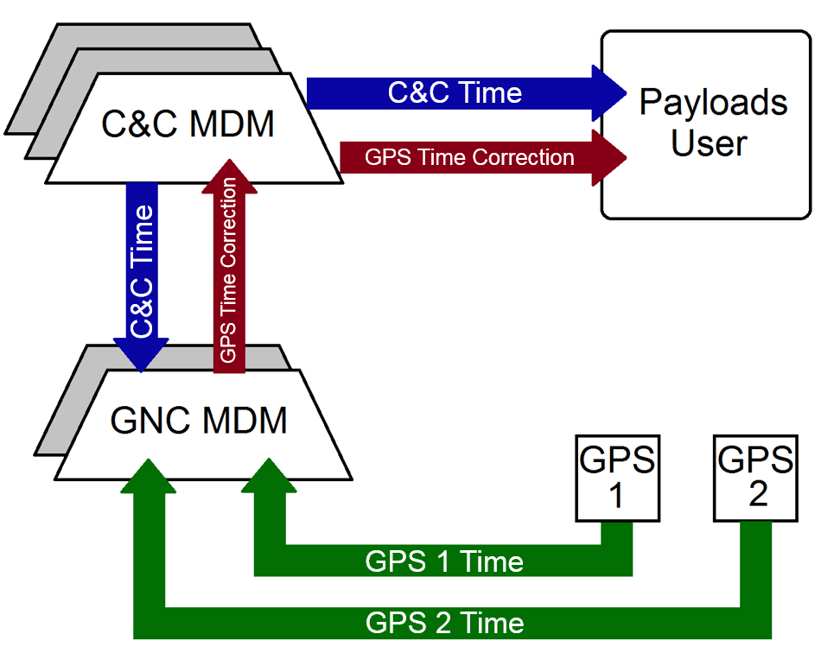
GPS Time Overview
Primary GPS for time is set by command
GPS Time Correction = GPS Time – C&C Time
Notes:
Main impact to payloads from GPS Lock-ups, lockups can also impact position and velocity data (all PVT can be affected)
GPS time correction = GPS time – C&C time

Slide 16
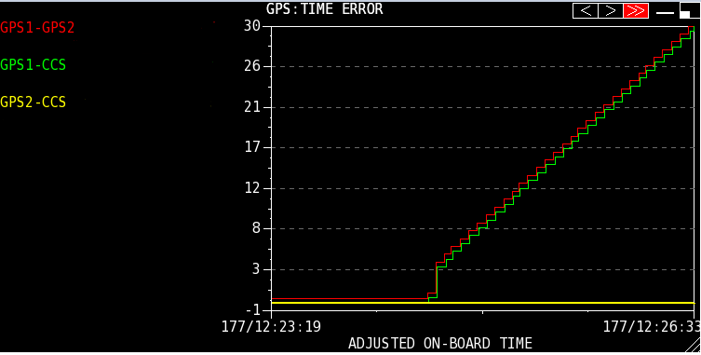
GPS Lock-up Time Impacts
Notes:
Mention that ADCO can see this plot

Slide 17
Timeliner Bundle Summary
Timeliner is software in the C&C MDMs that can monitor given parameters and take action as needed.
The Timeliner bundle will monitor for anomalies in GPS time data associated with GPS lockup events.
If the GPS time in use is inaccurate, the Timeliner bundle will command the GNC to use the other GPS for time information.
The bundle will maintain the C&C BAD GPS Time Correction to an accuracy of 2 seconds for payloads users.
Payloads exposure to time errors greater than 2 seconds will be limited to a 2 second window when the bundle is operating.

Slide 18
Notes on GPS Lock-ups
Term ‘lock-up’ used when GPS is not outputting state or attitude updates
  Not all lock-ups result in GPS time error increasing
In quiescent ops, GPS lock-ups are low-impact to ISS MCS operations
The state and attitude knowledge in the GNC MDM is propagated, valid, and provided to users
If the GPS locked up is first priority for time, ADCO will switch time priorities within 50 minutes of the lock-up
  Timeliner bundle would take action automatically if the GPS time is inaccurate

Slide 19
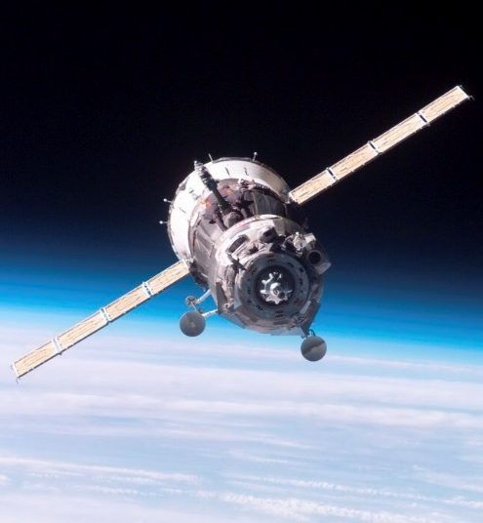
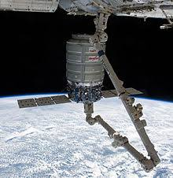
MCS Overview – Common Operations
Russian Visiting Vehicle Dockings/Undockings
  +XVV,-XVV, +ZVV, -ZVV attitudes all possible
  Can be performed in all mode types; expect thruster firings
Optimized Propellant Maneuvers
  Maneuver between +XVV and –XVV using USTO
USCV Dockings/Undockings (Dragon, CST-100, HTV-X)
Free-Flyer Capture/Release (Cygnus)
  Thruster firings and tight attitude hold periods
EVAs
Reboosts
  Can be performed in +XVV or -XVV
Thruster Disables (Can be requested by IPs/PDs)
Attitude maneuvers (Can be requested by IPs/PDs)
  Yaw Bias Maneuver of +/- 8 degrees for High Solar Beta periods lasting from a few days up to 2 weeks.
  Attitudes must be within defined attitude envelopes (Reference GEN OIP 7.5.4 ISS Attitude Change or Microgravity Request)

Slide 20
ISS Maneuvers
Optimized Propellant Maneuvers (OPMs)
  Between +XVV and –XVV using USTO or RS Thruster Control
  NOT a purely yaw maneuver

Slide 21
ISS Maneuvers
CMG attitude maneuvers
  Slower than thruster maneuvers
  Example: 8 degree CMG maneuver to YPR (-12.0, -1.3, +0.7) took ~1 hour and 7 minutes
ISS Translational Maneuver
  Reboost, Debris Avoidance Maneuver (DAM), or PDAM
  Russian thrusters fire to provide delta v and change ISS orbit
  Often done in or near TEA
  https://www.youtube.com/watch?v=cmHamp0IIyE

Slide 22
ISS Maneuvers
Notes on PDAMs for Payloads
  MCC-H will coordinate with POIC to ensure all payloads are safed appropriately. Typical handover time to RS Thruster control is 70 minutes prior to TIG.
  A small attitude maneuver on RS Thrusters will typically occur 21 minutes prior to TIG.
  Capability now exists to initiate a 180 degree yaw maneuver 65 minutes prior to TIG (a.k.a. 180deg PDAM). Unlike OPMs, this is a pure yaw maneuver on Russian Thrusters.

Slide 23
ISS Loss of Attitude Control Review
ISS lost attitude control twice in 2021
  One due to a stuck on MLM thruster shortly after MLM docking
  One due to an unintended long duration thruster firing during 64S Thruster Test
Result of LoACs (generally)
  ISS will be free drift for an indeterminate amount of time while ground and crew work together to safe ISS for recovery on RS thrusters
  ISS could leave the typical analyzed attitude envelope during this time, will return to nominal attitude once control is regained
  Expect rates to build on ISS until attitude control is regained
  Recovery back to Momentum Management in the nominal attitude could be on the order of hours
GJOP work
  Crew is prime to execute the LoAC response
  Procedure updates being made to LoAC procedure to ensure that crew does not initiate control on RS Thrusters prior to the vehicle being safed

Slide 24
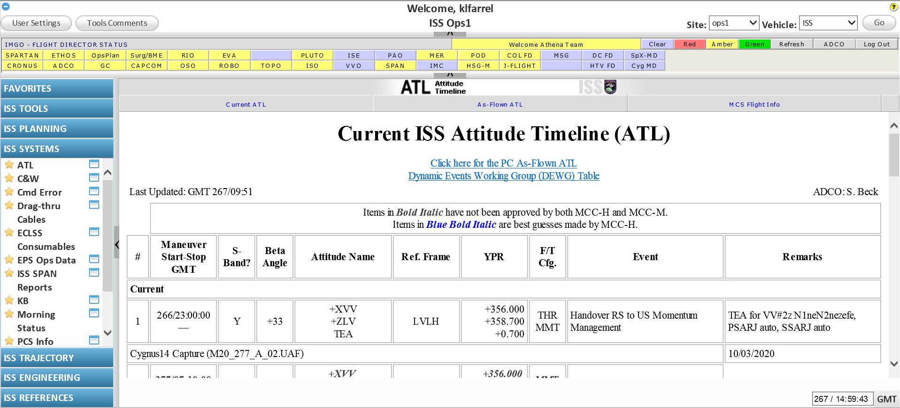
Interpreting the ATL
Attitude Timeline (ATL) accessible through ISS Gateway

Slide 25
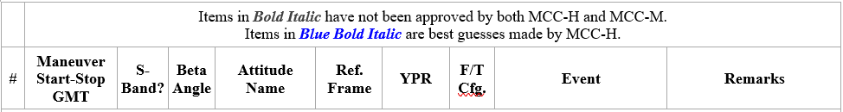
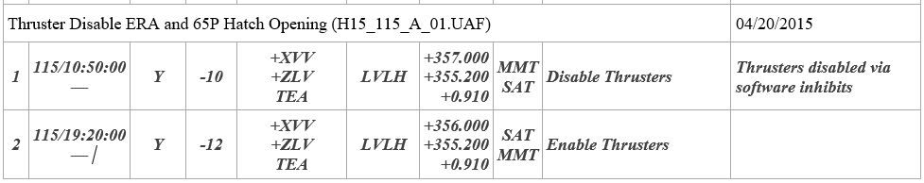
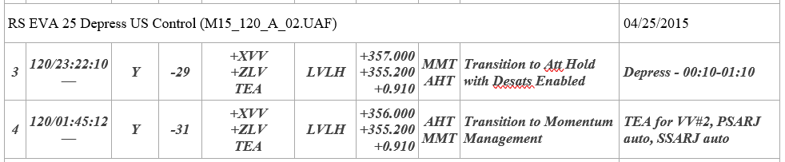
Interpreting the ATL
Attitude Timeline (ATL) shows upcoming events involving changes to the MCS.

Slide 26
Interpreting the ATL
Time of event (GMT)
For maneuvers, start and stop time shown.

Slide 27
Interpreting the ATL
Attitude name in Velocity Vector, Local Vertical nomenclature
TEA designation if applicable

Slide 28
Interpreting the ATL
Reference frame and commanded attitude in YPR

Slide 29
Interpreting the ATL
From/to config – see backup slides for full decoder
Some common ones:
MMT – Momentum Management with desats enabled
SAT – Momentum Management with desats inhibited
THR – Russian thruster control
UST – USTO control

Slide 30
Interpreting the ATL
Event – what is happening

Slide 31
Interpreting the ATL
Remarks – additional information

Slide 32
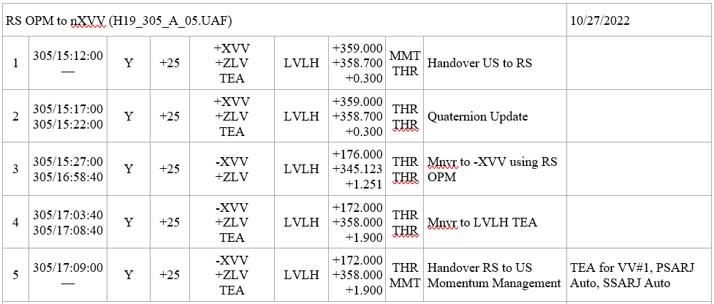
Maneuvers in the ATL
RS OPM from +XVV to -XVV
OPMs can look misleading in attitude name and the commanded attitude.
Remarks remind users that this is not a pure Eigen axis rotation.

Slide 33
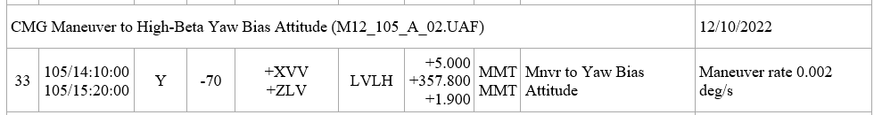
Maneuvers in the ATL
CMG Maneuvers
Momentum Management used for maneuver
Maneuver rate provided in Remarks column

Slide 34
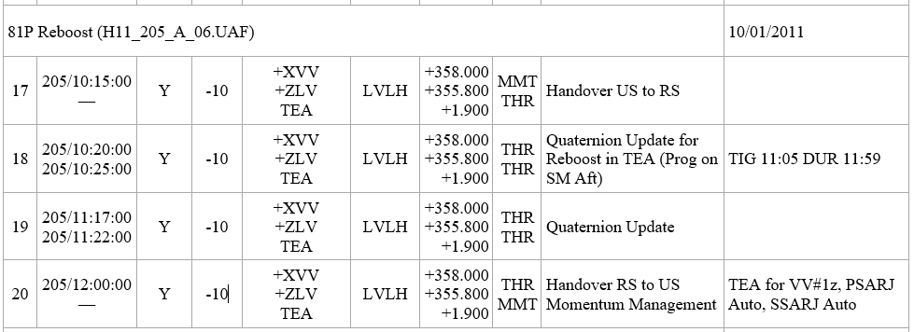
Maneuvers in the ATL
Reboost
ISS attitude not changing – reboost in the TEA.
Time of Ignition (TIG) and duration included in Remarks column

Slide 35
Planning Products
Long-range planning
Flight Program Integration Panel (FPIP)*
Only dock/undock dates are generally known long-term
Medium-range planning
Dynamics Events Working Group (DEWG)*
DEWG table published ~6 months ahead
Adds events such as prop purges, thruster tests, EVAs, and maneuvers
*See backup slide for more info

Slide 36
Planning Products
Short-range planning
Attitude Timeline (ATL)
Per agreement with Moscow, ATL published at E-30 days
Adds more events such as reboosts, thruster disables, or anything that comes up late
Payload inputs (Gen OIP 7.5.4)
OIP 7.5.4 ISS Attitude Change or Microgravity Request
Allows payloads to request thruster disable or attitude maneuver

Slide 37
Increment 69 Dynamic Events
 | RS VV Dockings/ Undockings | US Docking/ Undockings | US & RS EVAs | Free-Flyer Capture/ Release
Expected Events | 68S Undocking 69S Port Relocate 84P Docking 83P Undocking 85P Docking 70S Docking 69S Undocking | SpX-27 Undocking Boe-CFT Ax-2 Crew-6 Port Relocate Crew-6 Undocking Crew-7 Docking | US IROSA 1A & 1B RS EVA 56 RS EVA 57 RS EVA 58 RS EVA 59 RS EVA 60 | NG-19
Control Type | Can be performed in all mode types; expect thruster firings | Can be performed in all mode types; expect thruster firings | CMG Momentum Management; Thrusters Disabled* | USTO & CMG Attitude Hold
Expected Attitudes | +XVV,-XVV, +ZVV, -ZVV attitudes all possible | Expect +XVV | +XVV | +XVV

Slide 38
Trade Fair
Trade Fair Booth
ADCO, POINTING, and TOPO available for questions

Slide 39
ADCO Contact Information
Contact info for ADCO Payloads Integration Team
  jsc-dl-fod-cm5-sme-team-payloads-coordination@mail.nasa.gov
Contact info for ADCO console (24/7/365)
  JSC-ADCO@nasa.gov
  (281) 244-5292
  Loops: FCR SYS 1, ADCO 1
  ADCO and OC also converse on OC1 and OC2 loops

Slide 40
Q&A

Slide 41
Presentation Resources
  Access to these links may be restricted.
  MCS flight info page
  Crew Training Notebook – pages 4 & 5, 8-10 ,12 & 13
The data incorporated in this presentation is from the DEWG website. Please refer to the following website for the latest 6 month attitude plan:
  Viperweb.jsc.nasa.gov/team_viper/web/DEWGTable.shtml
The current VIPER Baseplate can be found at:
  viperweb.jsc.nasa.gov/team_viper/web/baseplate.shtml
  “Reading the BASEPLATE Tutorial” and “Test Your BASEPLATE knowledge” can be found at:
    viperweb.jsc.nasa.gov/team_viper/web/tutorials.shtml
The current ISS Flight Plan Graphic can be found at:
  https://iss-www.jsc.nasa.gov/nwo/mio/riit/fpwg/web/
The data in this presentation is in the planning stages and is therefore subject to change, please confirm using the published ISS operational products

Slide 42
Control Type Details
ISS attitude control is performed by Control Moment Gyroscopes (CMGs), Russian Segment (RS) thruster firings, or a combination
CMG Momentum Management (MM)
  CMGs are used to balance and manage external torques on ISS
  ISS controls to the Torque Equilibrium Attitude (TEA)
  Some attitude error is allowed to keep momentum vector stable
  RS thrusters available to provide desaturation firings (desats) to the CMGs
CMG Attitude Hold (AH)
  Tight attitude tolerances
  Time-limited without thruster assist
  Desats may or may not be available, depending on operation
USTO (US Thrusters Only)
  US segment software controls attitude using RS thrusters
  CMGs do not provide attitude control torques
RS Thruster Control
  RS in complete attitude control of ISS
  CMGs do not provide attitude control torques

Slide 43
Navigation and Control
Performance Envelopes
How accurately does ISS navigate?
Depends on source of navigation data (US GPS, Russian GPS, or propagation)
ISS attitude data provided to BAD* is typically accurate to within ±0.3 deg
How accurate does ISS control?
Depends on control mode (see previous slides) – quiescent ops is CMG MM
CMG MM certified to ±3 deg but performance is usually ±1 deg or less
Nominal Attitude Performance
Total attitude accuracy is summation of instantaneous control error and nav error
Expect accuracy up to ±1 deg (several miles of ground pointing error)
What attitudes do we fly?
Flight Rule B2-57 defines thermally analyzed attitude envelopes for LVLH ±XVV, ±YVV and ±ZVV attitudes
Quiescent microgravity operations are in the LVLH ±XVV +ZLV envelope
Can the envelopes or attitudes change?
Envelope: updated thermal analysis or ISS Module additions (both rare)
Attitude: slight tweak to attitude as vehicles come and go (frequent)
DISCLAIMER: Navigation Data my be impacted by GPS failures. Subscribers to NAV Data should be aware of and prepared for periodic dropouts in NAV Data.

Slide 44
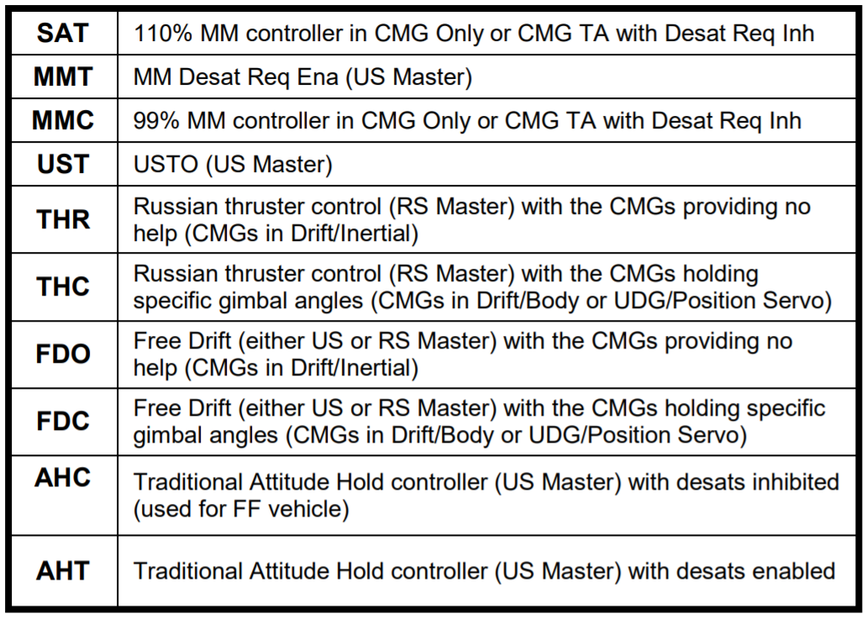
ATL From/To Config Decoder

Slide 45
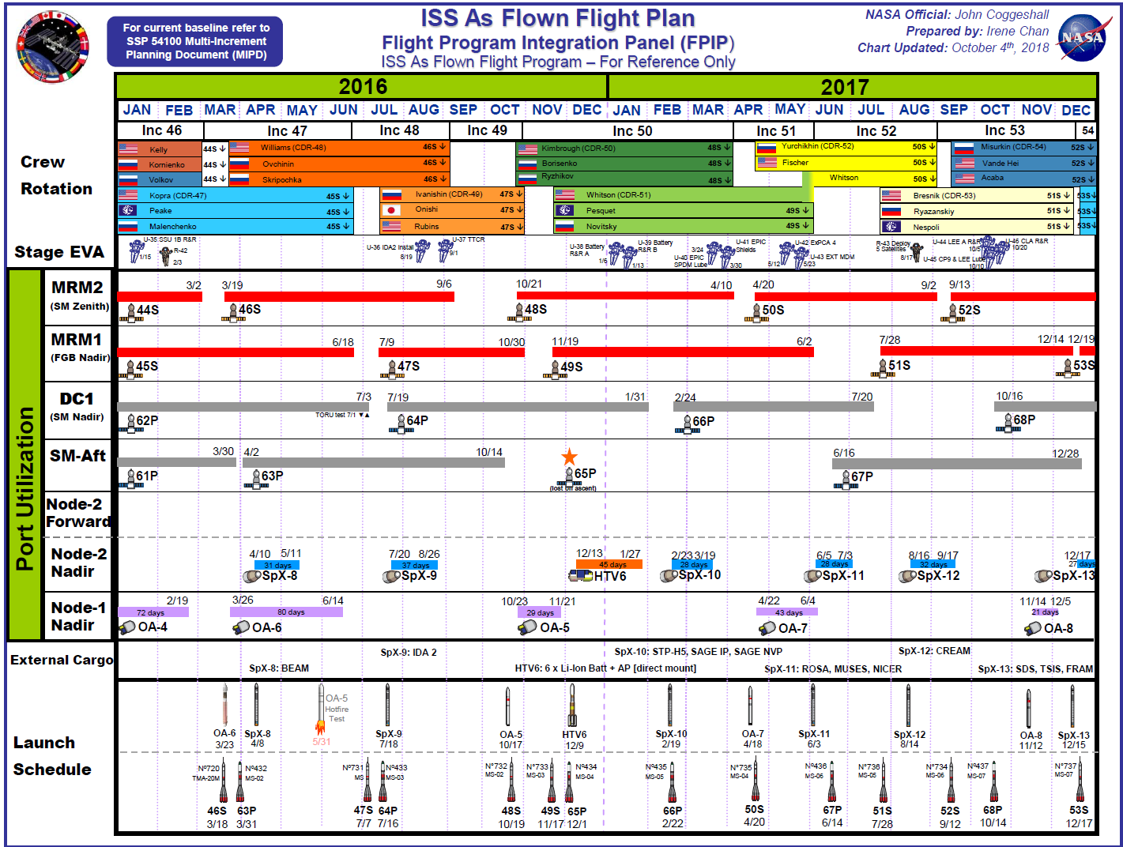
Planning Product Process References
FPIP = Flight Program Integration Panel sets the flight plan (ie, when are vehicles coming and going) and creates the useful graphic to show it
DEWG = Dynamic Events Working Group Bi-lateral working group to determine details for upcoming events: docking attitude, thruster configuration, solar array angles, etc. (see https://home.iss.nasa.gov/om/team-viper/index-4/dewgtable/)

Slide 46
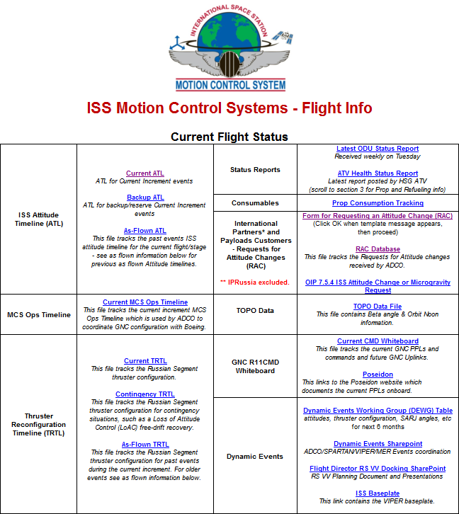
MCS Flight Info
  Access to MCS Flight Info and associated links may be restricted.
Links include:
Current ATL
Backup ATL
  Same format as ATL, but for contingency events
As-Flown ATL
MCS Ops Timeline
Thruster Reconfiguration Timeline (TRTL)
Contingency TRTL
As-Flown TRTL
Prop Consumption Spreadsheet
RAC form and database
TOPO Data File

Slide 47
OIP 7.5.4 – Request for Attitude Change
“It may be necessary for Payload Developers (PD) or IPs to request changes to the ISS Attitude Timeline (ATL). There are three types of changes that can be requested:
Specific ISS LVLH commanded attitude
Microgravity operations (thruster inhibit)
CCDB parameter update
Justification for a request will come through the Program Office and will be documented in the IDRD or CSRD depending on the timing of the request. The process for implementing these changes is documented below. Requests approved through the Attitude Change Request or Thruster inhibit procedures require an Attitude Change Request (ACR) be sent to MCC-M using Generic OIP 7.5.6, Attitude Plan Coordination and Notification During ISS Operations. This data exchange is required to occur per OIP by 30 days prior to execution.”

Slide 48
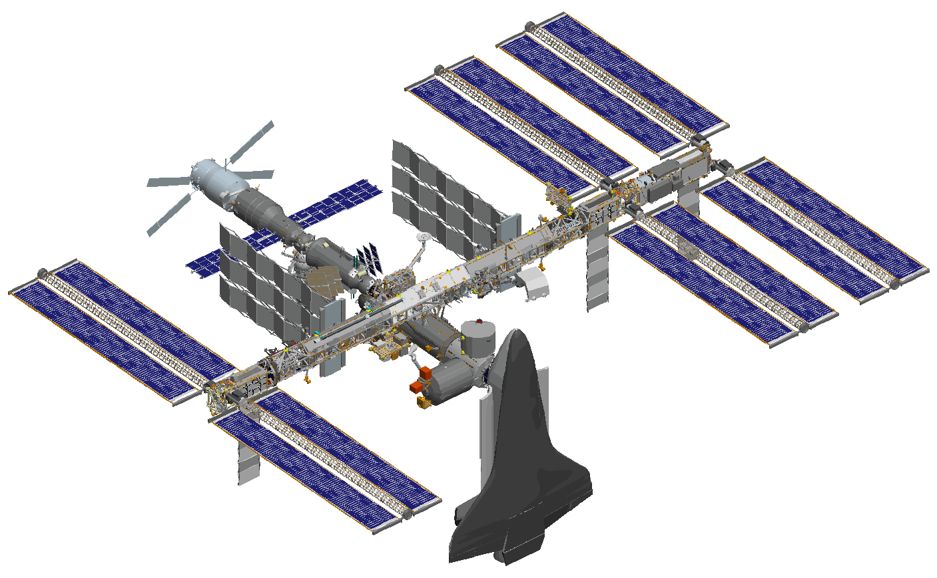
Reference Frames: ISS Body
X-axis: Forward, runs parallel with ISS stack
Y-axis: Starboard, runs parallel with truss
Y
X
ISS
ISS
Z-axis: Deck, completes RHR
Z
ISS

Slide 49

Reference Frames: LVLH
Orbit
X
Z
Pitch at 4° per minute
Y

Slide 50

Reference Frames: Inertial
There are a couple of inertial reference frames used in ISS program
They are Earth-centered and not very useful for describing attitudes
They are used for describing position and velocity around the Earth
Z
Y
X

Slide 51

Reference Frames: Depression Angle
ISS depression angle is about 18 degrees
Thus there are periods when the station is in sunlight all orbit
Velocity Vector
Depression Angle

Slide 52
New Rapid Depress FDIR
New software automatically configures the ISS Solar Arrays and Motion Control System in the event of a Rapid Depress
SARJs parked at an accelerated rate
Automatic Attitude Control Handover to Russian segment enabled when SARJs locked or ISS inertial rate exceeds 1 deg/sec
  Handover to Russian thruster control will occur if the ISS LoACs due to rates > 0.1 deg/sec or attitude error > 10 degrees

