Slide 1
Update on Recent Human Response Modeling (and an NPD database)
Ran Cabell
Structural Acoustics Branch
NASA Langley Research Center

Slide 2
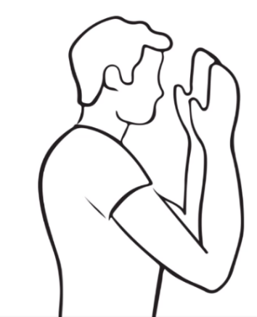
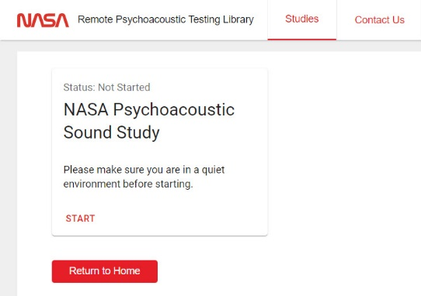
Remote Psychoacoustic Feasibility Test
Browser-based test platform (NASA-developed)
Subjects recruited from UNWG participant companies
October 15 – 30, 2022
48 subjects completed test
Self-Calibration: adjust headphone volume to match recorded and live hand rubbing sound
Annoyance Response Prompt

Slide 3
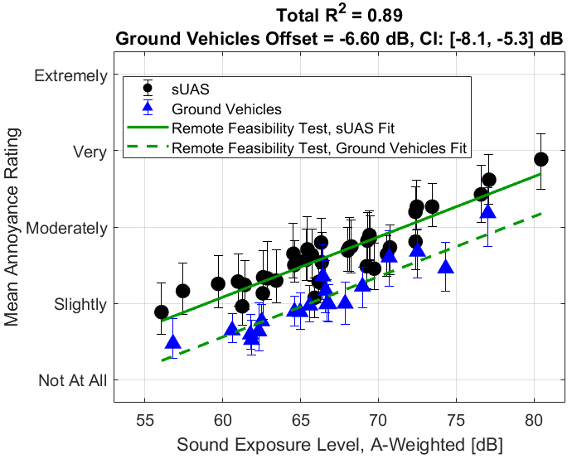
Feasibility Test Results
Successfully replicated annoyance offset between sUAS and ground vehicles from in-person test
Contextual cue affected annoyance response to sUAS but not ground vehicles
  “Imagine hearing this sound several times each day while outdoors and near your home, how annoying would this sound be to you?”
  versus
  “How annoying was this sound to you?

Slide 4
Test of UAM Sound Quality
Explored spectral & temporal aspects of UAM noise to improve annoyance prediction (beyond SELA)
In-person test (NASA Exterior Effects Room), June 29-July 8, 2022
Subjects compared sounds against “reference” at different loudness levels to assess annoyance equivalence between loudness and other qualities (sharpness, roughness, tonality, impulsiveness)
Results being analyzed
Change in annoyance due to secondary SQ metrics can be comparable to a change in loudness of 3.3 sones, equal to just over 6dB.

Slide 5
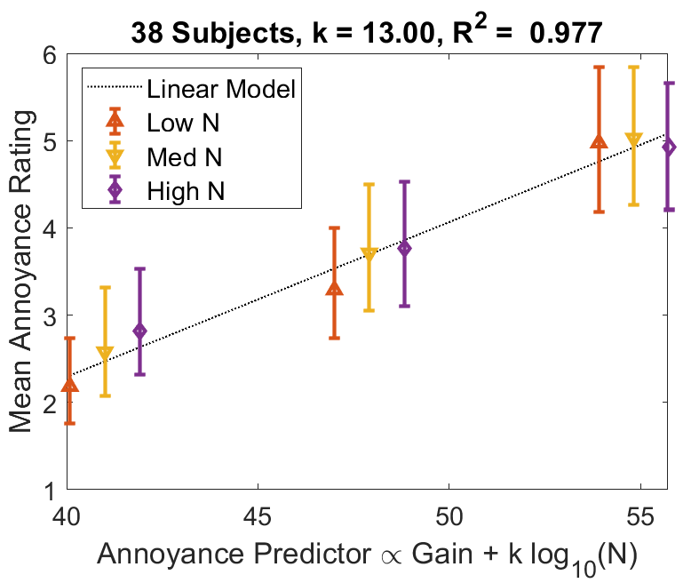

Noise and Number Test
Annoyance to UAM noise: is Leq sufficient or is it dependent on the number of events in a more complex way?
In-person test (EER); Jan 25-31, 2023
Subjects rated scenarios containing multiple UAM flyovers; much greater event density than typical airport
k=13 better predictor than k=10 (Leq) when flyovers distinct
Response likely returns to k=10 when flyovers no longer distinct

Slide 6
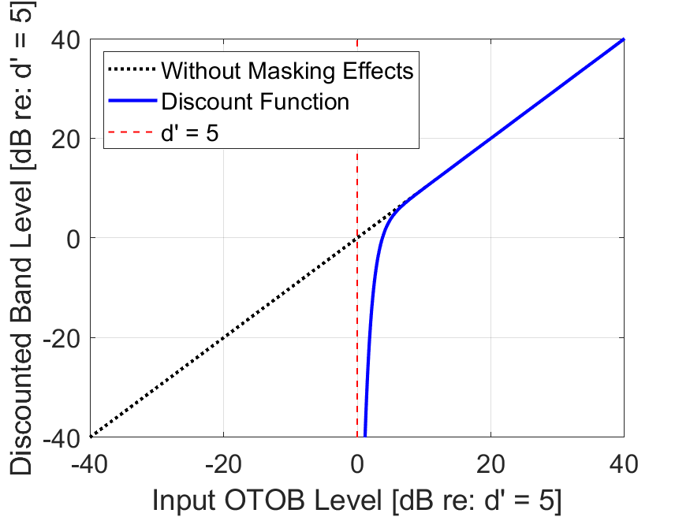
Upcoming Audibility Test
Annoyance model developed that includes audibility
Uses discounted OTOB audibility as annoyance predictor (blue curve)
Model will be calibrated using data from future EER tests.
When applied to route planning, the method will allow the ambient to be quantitatively taken into consideration

Slide 7
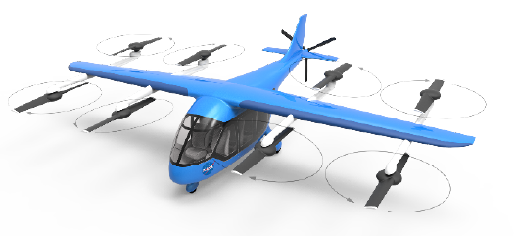
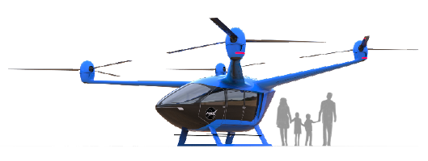
NPD Dataset Available for AEDT Assessments
Prediction-based approach used to generate NPDs for AEDT
Described in AIAA 2022-2839 (Rizzi, Letica, Boyd, Lopes)
RLVT concept vehicles (L+C and Quad)
Periodic thickness and loading and broadband self noise hemispheres for various flight velocities and climb angle
“Prediction-Based Approaches for Generation of Noise-Power-Distance Data with Application to Urban Air Mobility Vehicles” Rizzi et. al. AIAA Paper No. AIAA 2022-2839 https://doi.org/10.2514/6.2022-2839

Slide 8
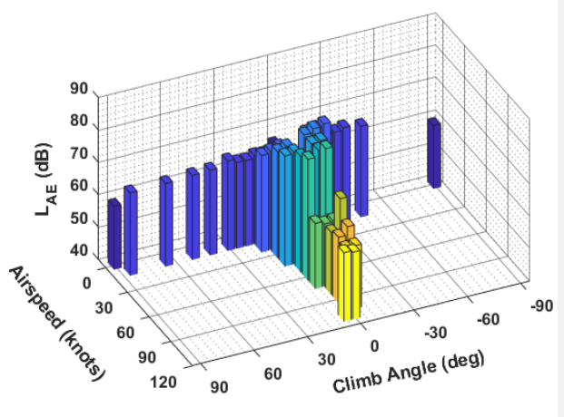
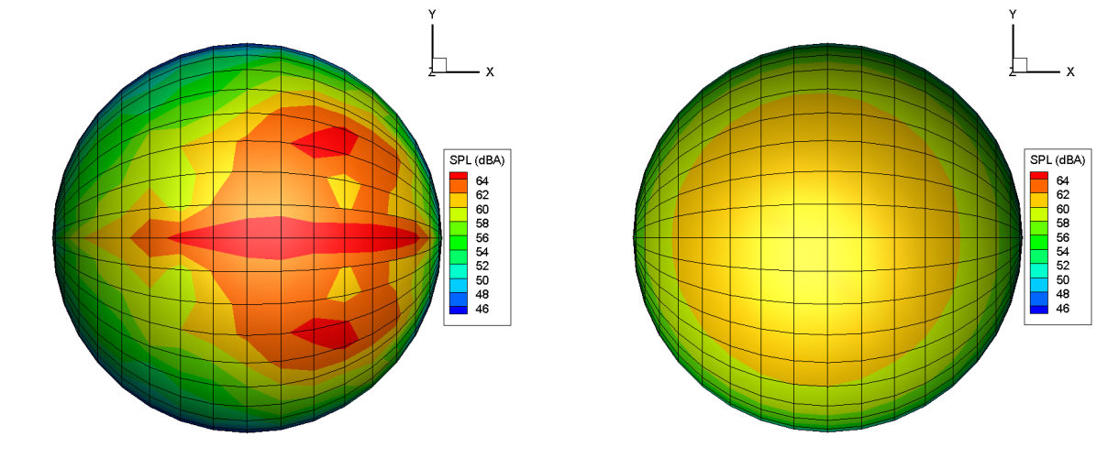
Source Noise Hemisphere Generation
Lift + Cruise vehicle operational states: airspeed/climb angle combinations
Periodic
CAMRAD II for aerodynamics
ANOPP2 Aeroacoustic Rotor Noise tool (AARON) for acoustics
  AF1AIFM and ASNIFM for source noise hemispheres
  ASRPIFM for far field propagation
  AMAT to generate NPDs
Broadband Self Noise

Slide 9
References & Points of Contact
Feasibility test:
Krishnamurthy et al., “Remotely Administered Psychoacoustic Test for sUAS Noise to Gauge Feasibility of Remote UAM Noise Study,” SAE Noise and Vibration Conference, May 15-18, 2023.
POC: Siddhartha Krishnamurthy, siddhartha.krishnamurthy@nasa.gov
UAM Sound Quality test:
Boucher et al., “A Psychoacoustic Test for Urban Air Mobility Vehicle Sound Quality,” SAE Noise and Vibration Conference, May 15-18, 2023.
POC: Matt Boucher, matthew.a.boucher@nasa.gov
UAM Noise and Number test, Audibility Test:
POCs: Matthew Boucher (matthew.a.boucher@nasa.gov) and Andrew Christian (andrew.christian@nasa.gov)
NPD Database
Rizzi et al., “Prediction-Based Approaches for Generation of Noise-Power-Distance Data with Application to Urban Air Mobility Vehicles” AIAA 2022-2839 https://doi.org/10.2514/6.2022-2839
POC Stephen Rizzi, s.a.rizzi@nasa.gov

Slide 10


