Slide 1
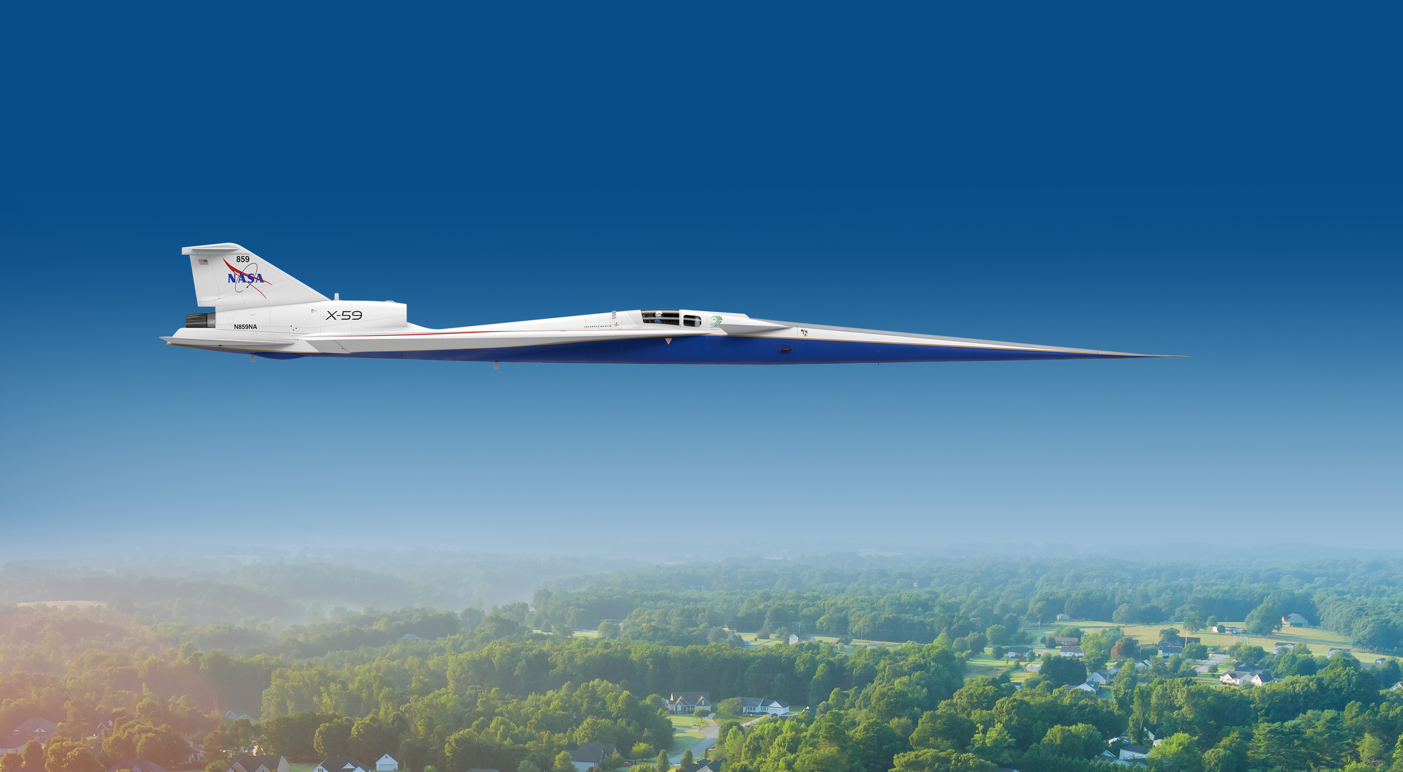


Experimental and Computational Study for the X-59 Wind Tunnel Model at Glenn Research Center 8- by 6-Foot Supersonic Wind Tunnel
Melissa Carter | NASA CST Project Prediction Validation Tools (ProViT) Tech Lead
NASA Langley Research Center | June 15, 2023
This material is a work of the U.S. Government and is not subject to copyright protection in the United States.
www.nasa.gov

Slide 2
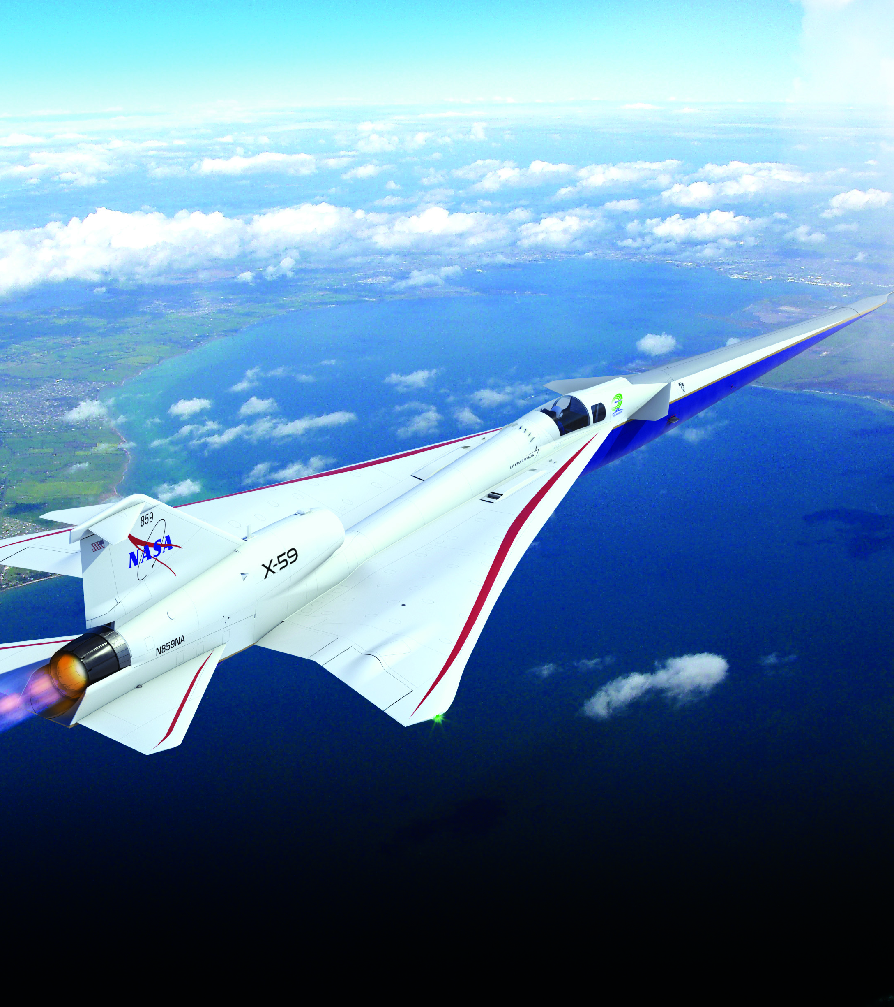

Presentation Topics
Motivation
NASA CFD Codes Descriptions
Cases Computed
Results
Concluding Remarks
www.nasa.gov
Illustration Credit: Lockheed Martin

Slide 3
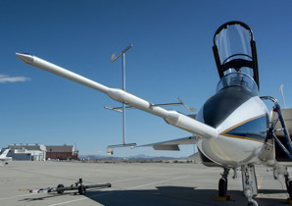
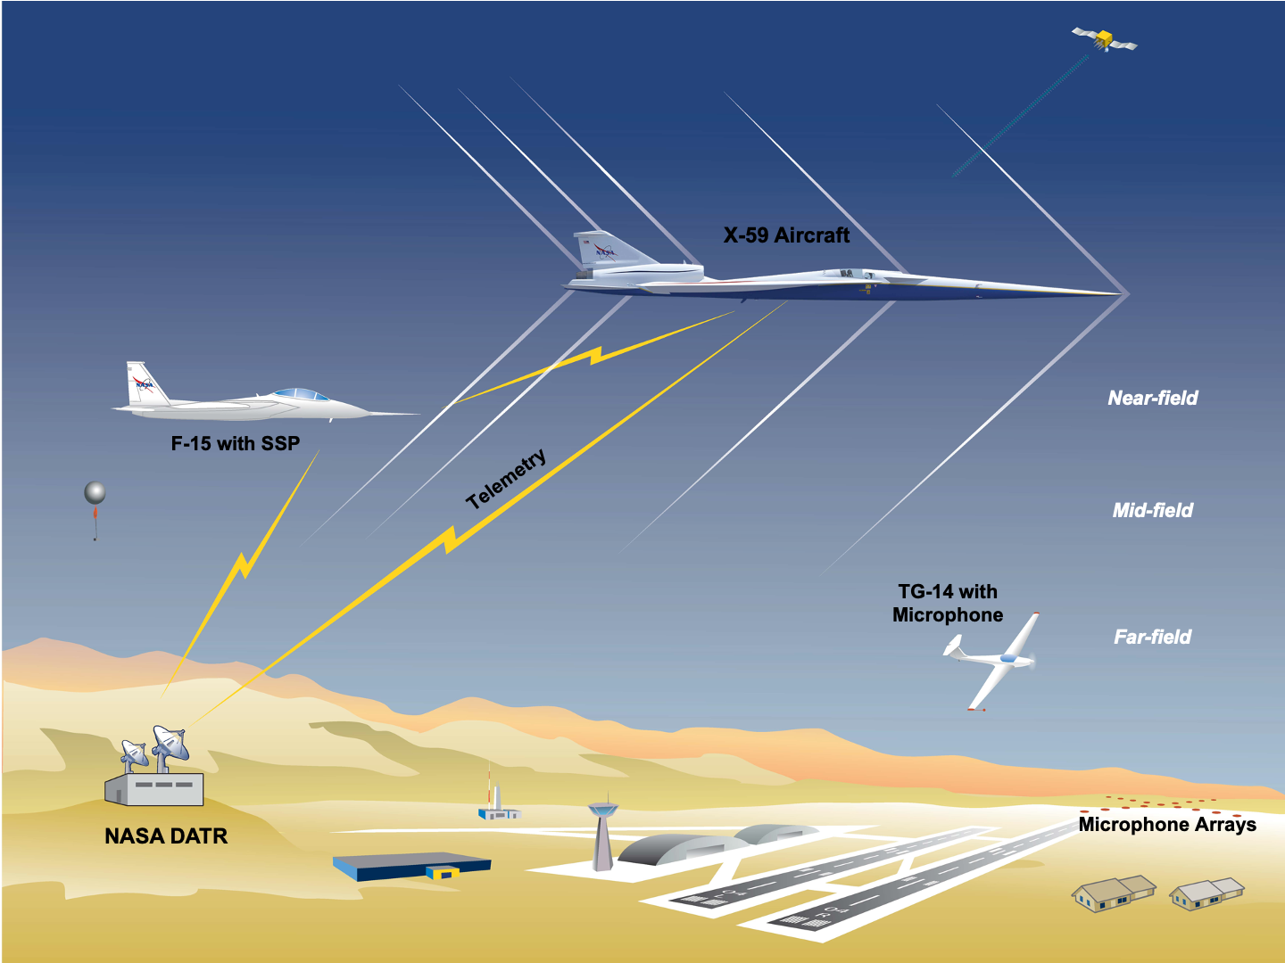
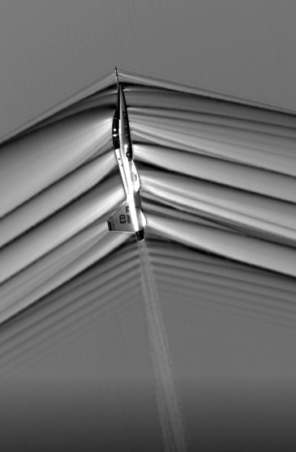
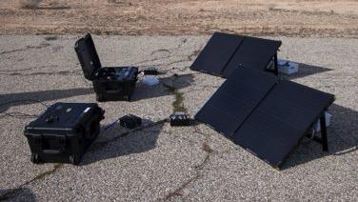
Acoustic Validation Test Planning and Execution
Plan and execute a test series to validate ground acoustic signature loudness that is acceptable for community response testing and to gather airborne and ground data that will be used to anchor sonic boom propagation and acoustics models in a real atmosphere. Coordinate multiple ground and flight assets to efficiently gather multiple data types.
F-15 With Shock Sensing Probe
Advanced Air-Air Schlieren Imaging
Ground Recording Systems
Notes:
All images from 20220009074

Slide 4
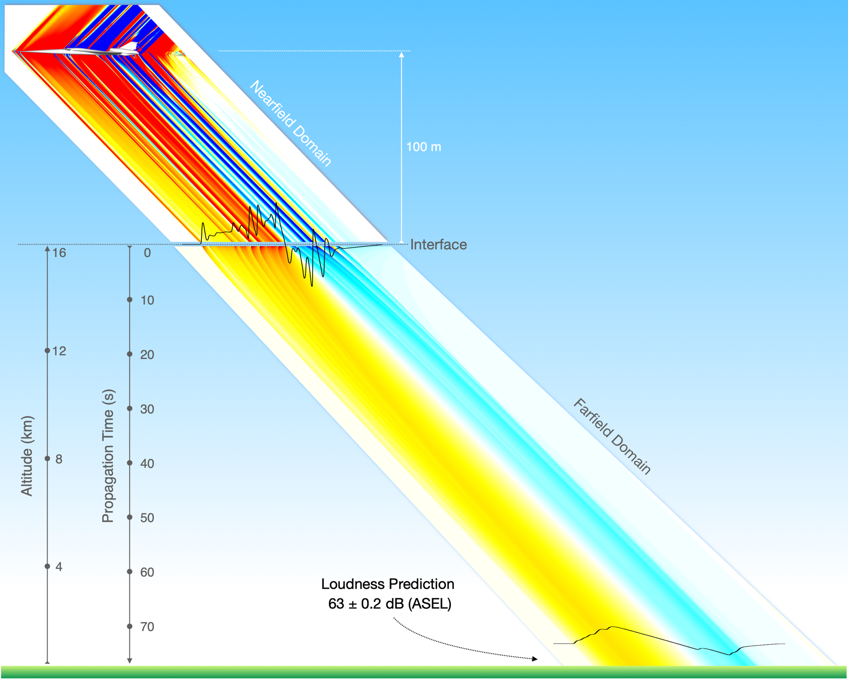

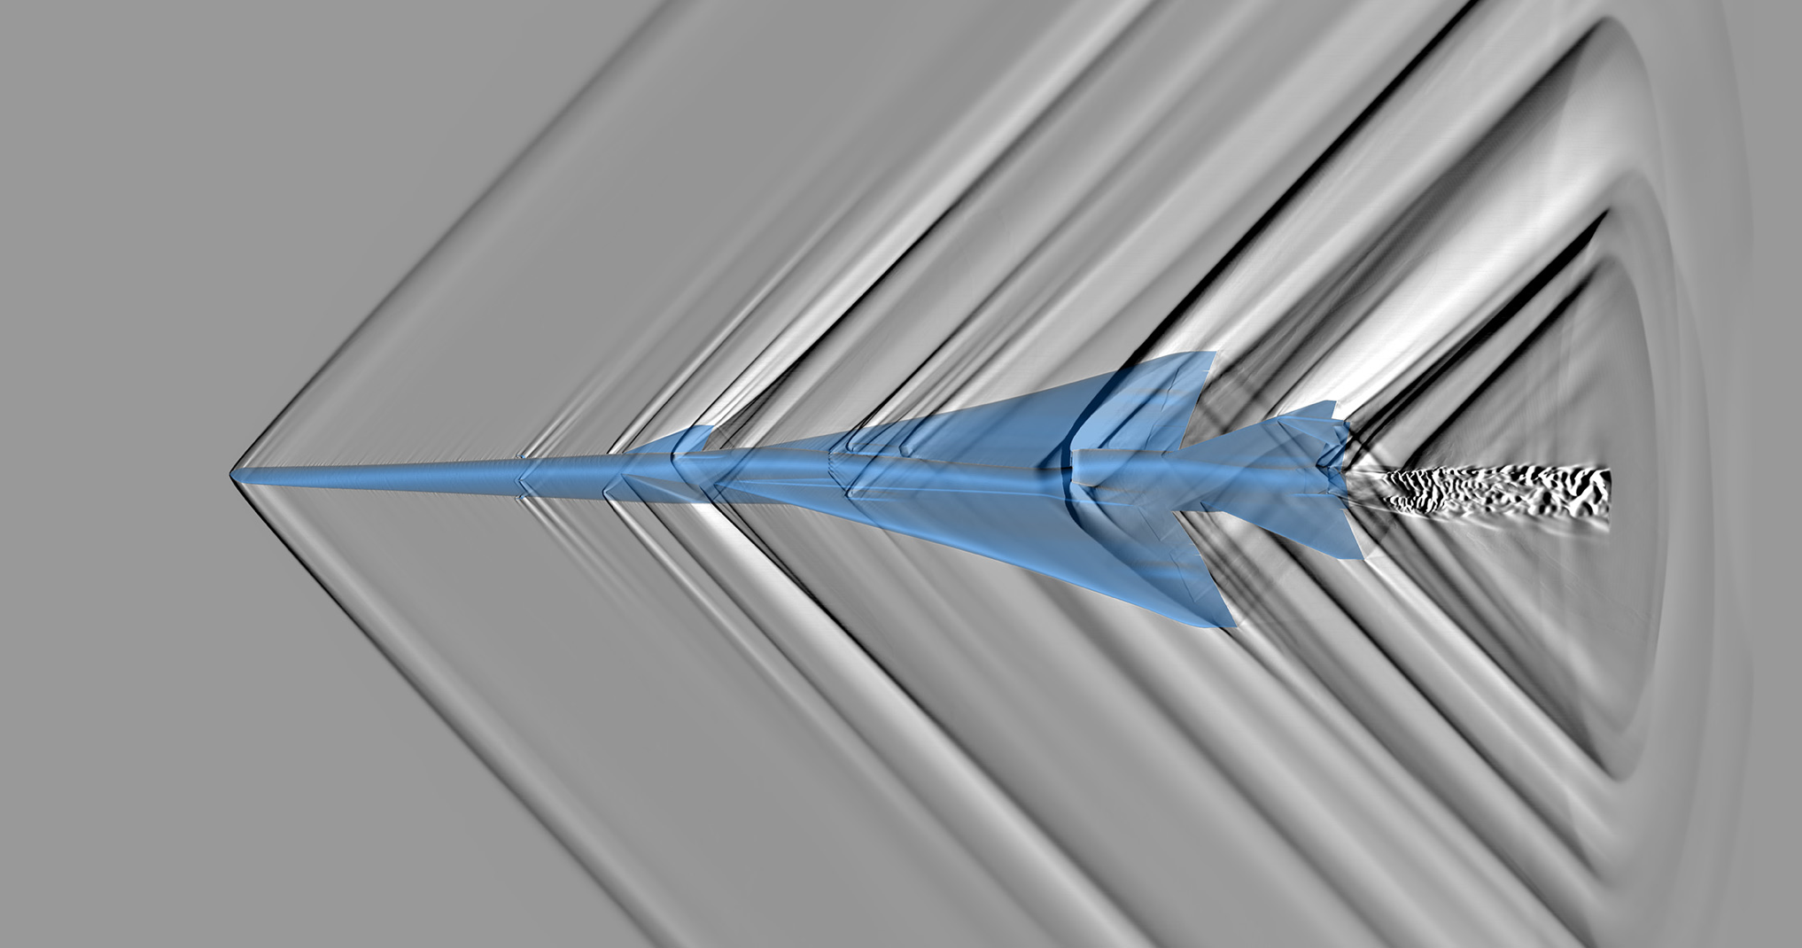

Prediction Tools and Validation
In preparation for community response testing, NASA is creating a suite of prediction tools to support timely and accurate validation of the acoustic performance of the X-59 aircraft, rapid preflight exposure planning for Community Testing, and provide a foundation for future configuration design and certification analysis of supersonic aircraft.
Sonic Thump on the Ground
(75 PLdB Target)
High Fidelity Computational Results (CFD)
Notes:
Top part of Left image: Supercomputers Aid Quesst Researchers in Predicting X-59’s Sound | NASA and approved by Export. Right image 20220009074

Slide 5
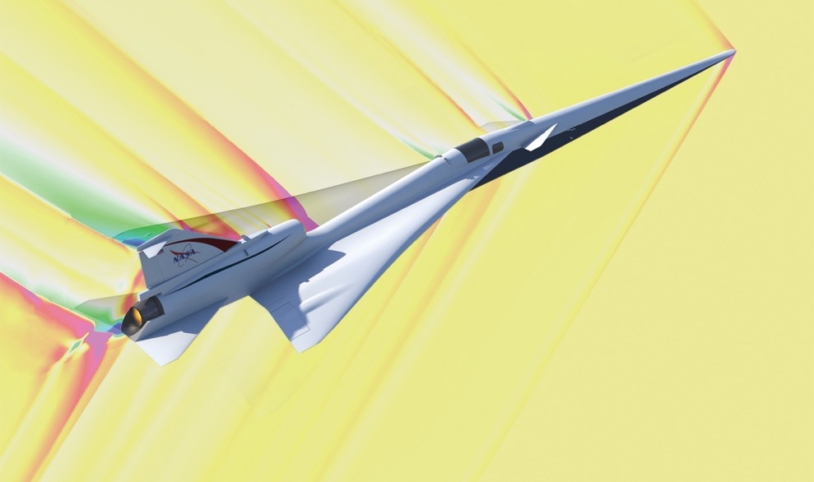
NASA CFD Codes
FUN3D
LAVA
USM3D-ME
Cart3D (not discussed)
www.nasa.gov
Notes:
Image from citation 20220009074

Slide 6
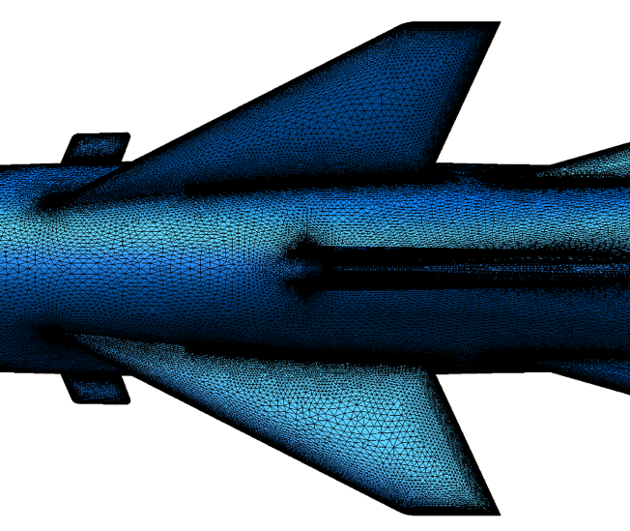
NASA FUN3D CFD Description
Node based
Euler and Navier-Stokes equations
Upwind spatial discretization
Local time stepping
Combination of tetrahedral, pyramidal, prismatic, and hexahedral grids
Limiters (van Leer)
Turbulence Model Spalart-Allmaras (SA)
For this study:
  FUN3D feature-based mesh adaptation, utilizing three adaption cycles
  The mesh is modified to conform to the metric with the boundary layer region frozen.
https://fun3d.larc.nasa.gov
www.nasa.gov

Slide 7
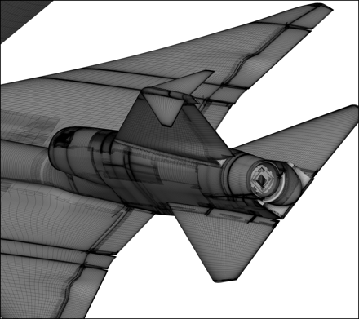
NASA LAVA CFD Description
LAVA Curvilinear
  Node based finite difference solver
  Reynolds-averaged Navier-Stokes equations
  Modified Roe scheme
  Koren limiter
  Structured overset grids
  Turbulence model Spalart-Allmaras (SA)
LAVA Unstructured
  Cell-centered, finite volume
  Reynolds-averaged Navier-Stokes equations
  MUSCL scheme with fluxes using AUSMPW+
  Minmod limiter
  Arbitrary polyhedral cells
  Turbulence model Spalart-Allmaras (SA)
www.nasa.gov

Slide 8
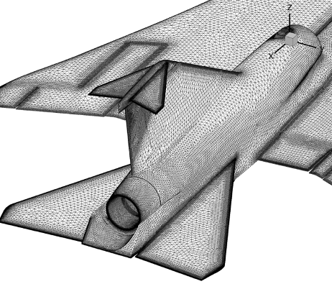
NASA USM3D-ME CFD Description
Cell-centered, finite volume
Euler and Navier-Stokes equations
Upwind spatial discretization
Flux functions: FDS, AUSM, HLLC, LDFSS, FVS
LTS and 2nd-order time stepping
Two different methods for nonlinear iterations (PA and HANIM)
Combination of tetrahedral, pyramidal, prismatic, and hexahedral grids
Barth-Jespersen limiter
Turbulence Models SA, standard and negative
www.nasa.gov

Slide 9
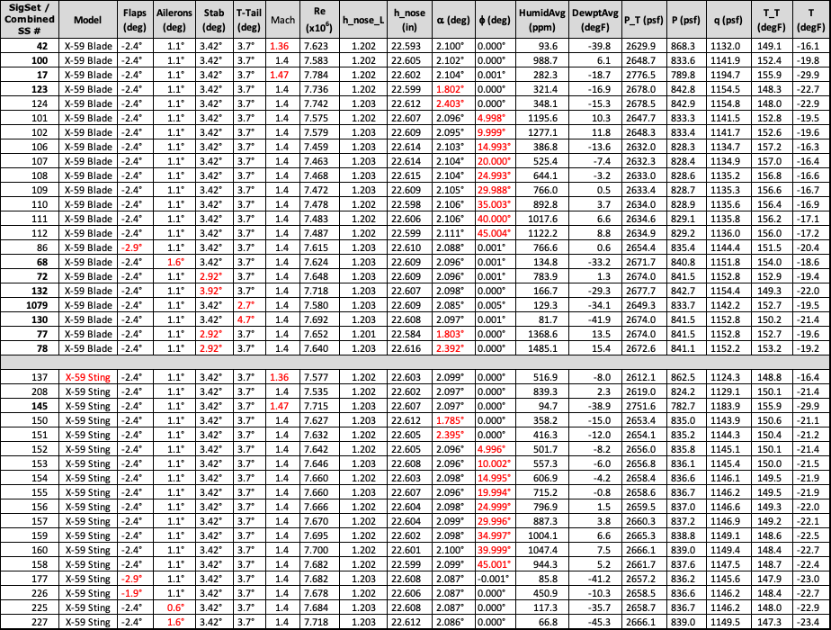
Cases Computed
www.nasa.gov

Slide 10
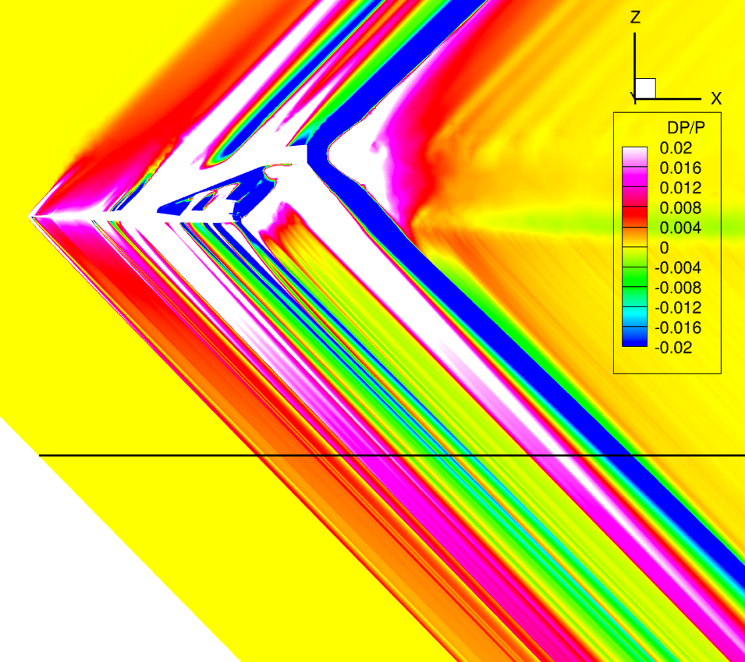
Data Extraction
Computational DP/P Contours of the Baseline X-59 Blade Configuration (y=0 plane), Mach 1.4, α 2.1 deg, H/L=1.2.
www.nasa.gov

Slide 11
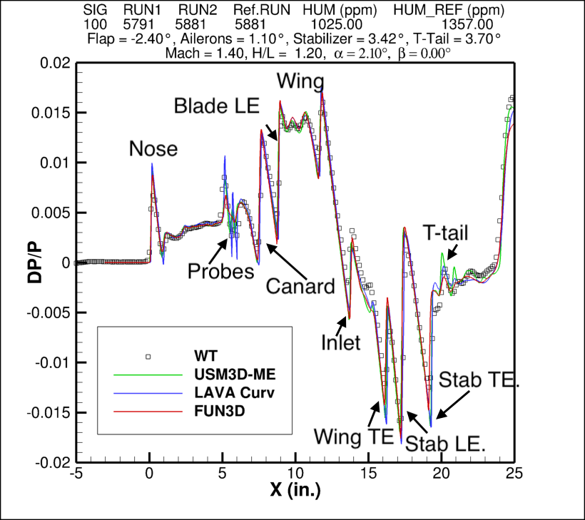
Shock Labels
www.nasa.gov

Slide 12
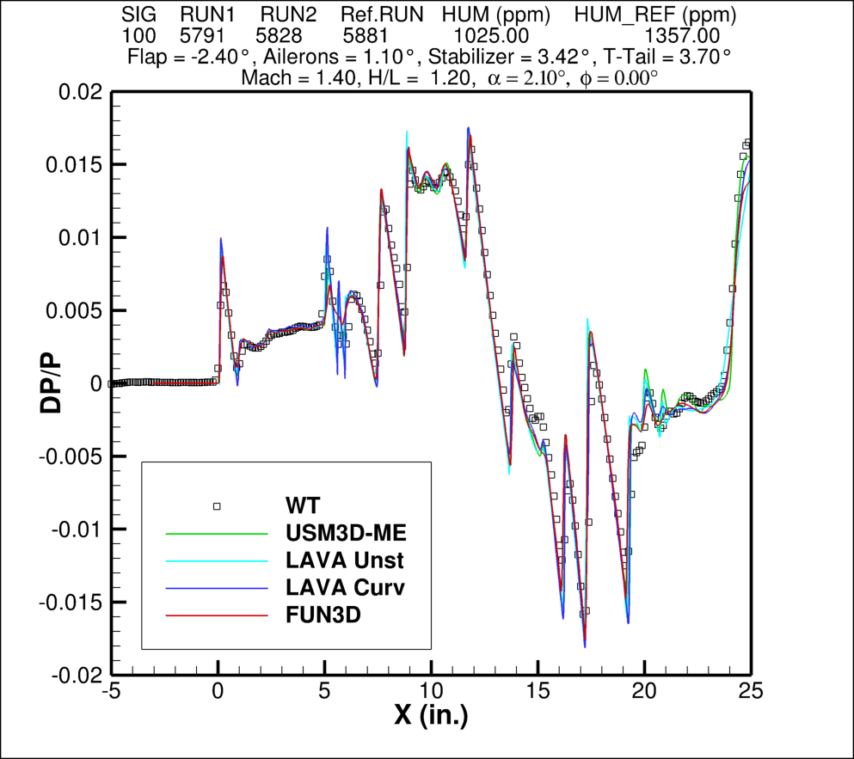
Baseline Blade Configuration
www.nasa.gov

Slide 13
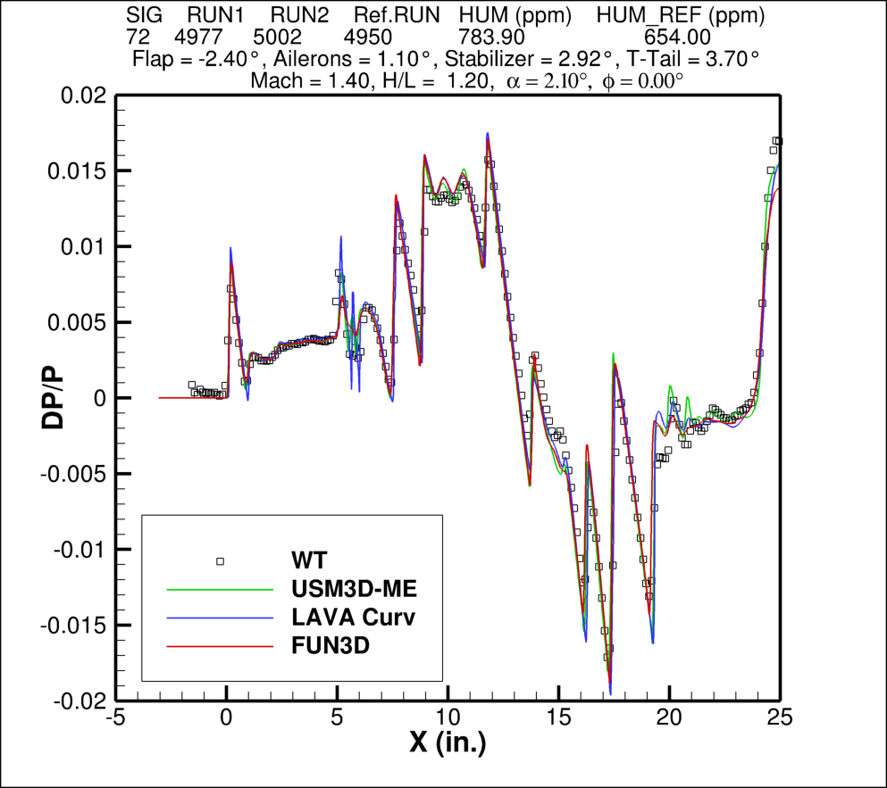
Baseline Blade Configuration
Reduced Stabilizer Deflection
www.nasa.gov

Slide 14
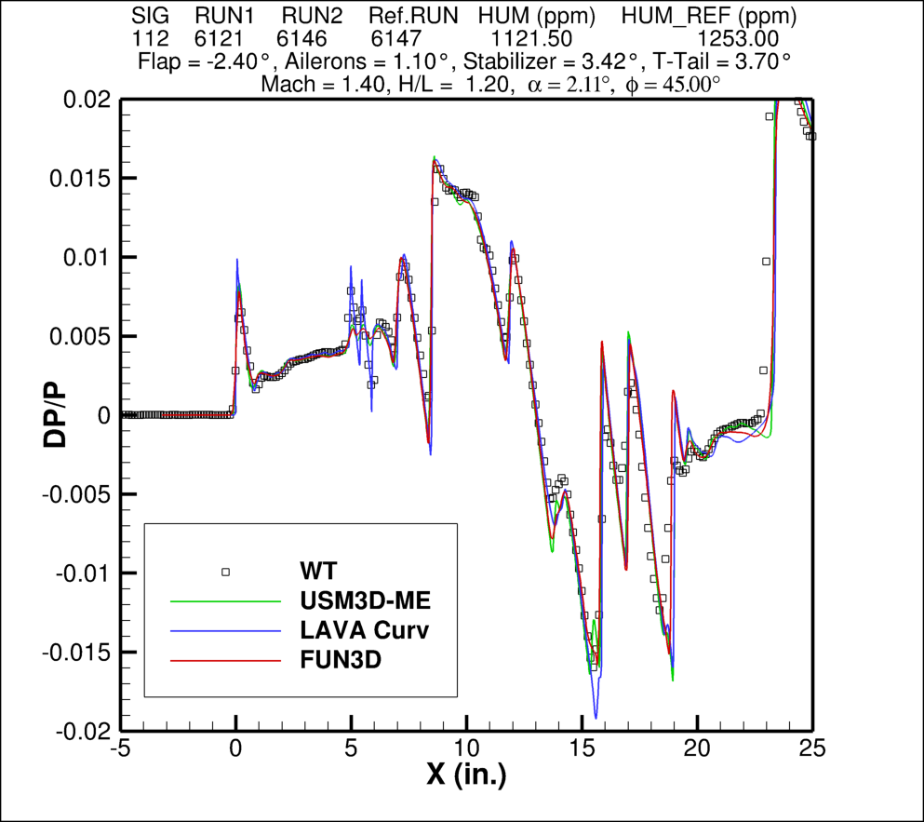
Baseline Blade Configuration φ=45º
www.nasa.gov

Slide 15
Baseline Blade Configuration
www.nasa.gov

Slide 16
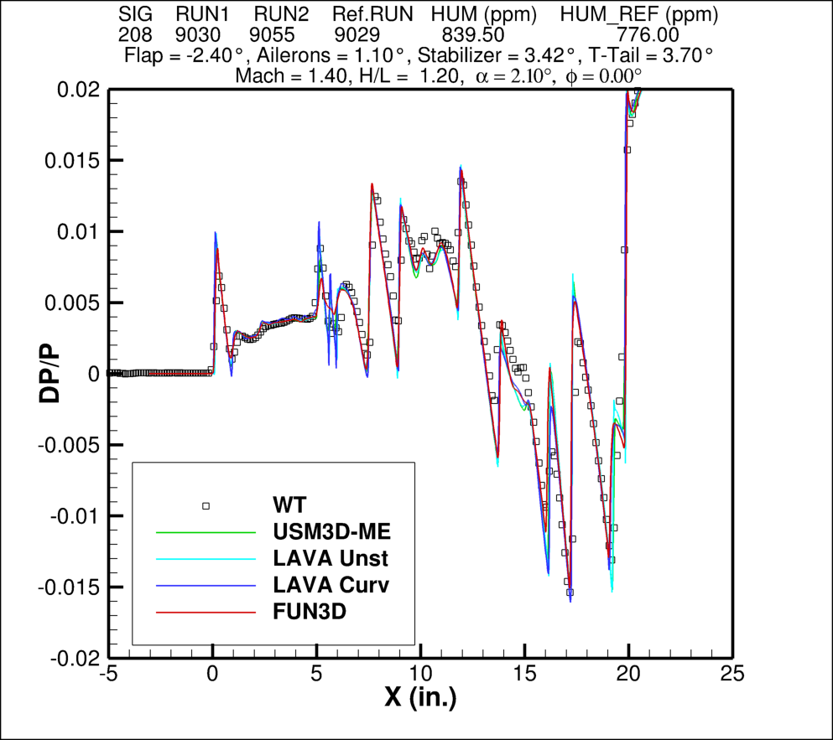
Baseline Sting Configuration
www.nasa.gov

Slide 17
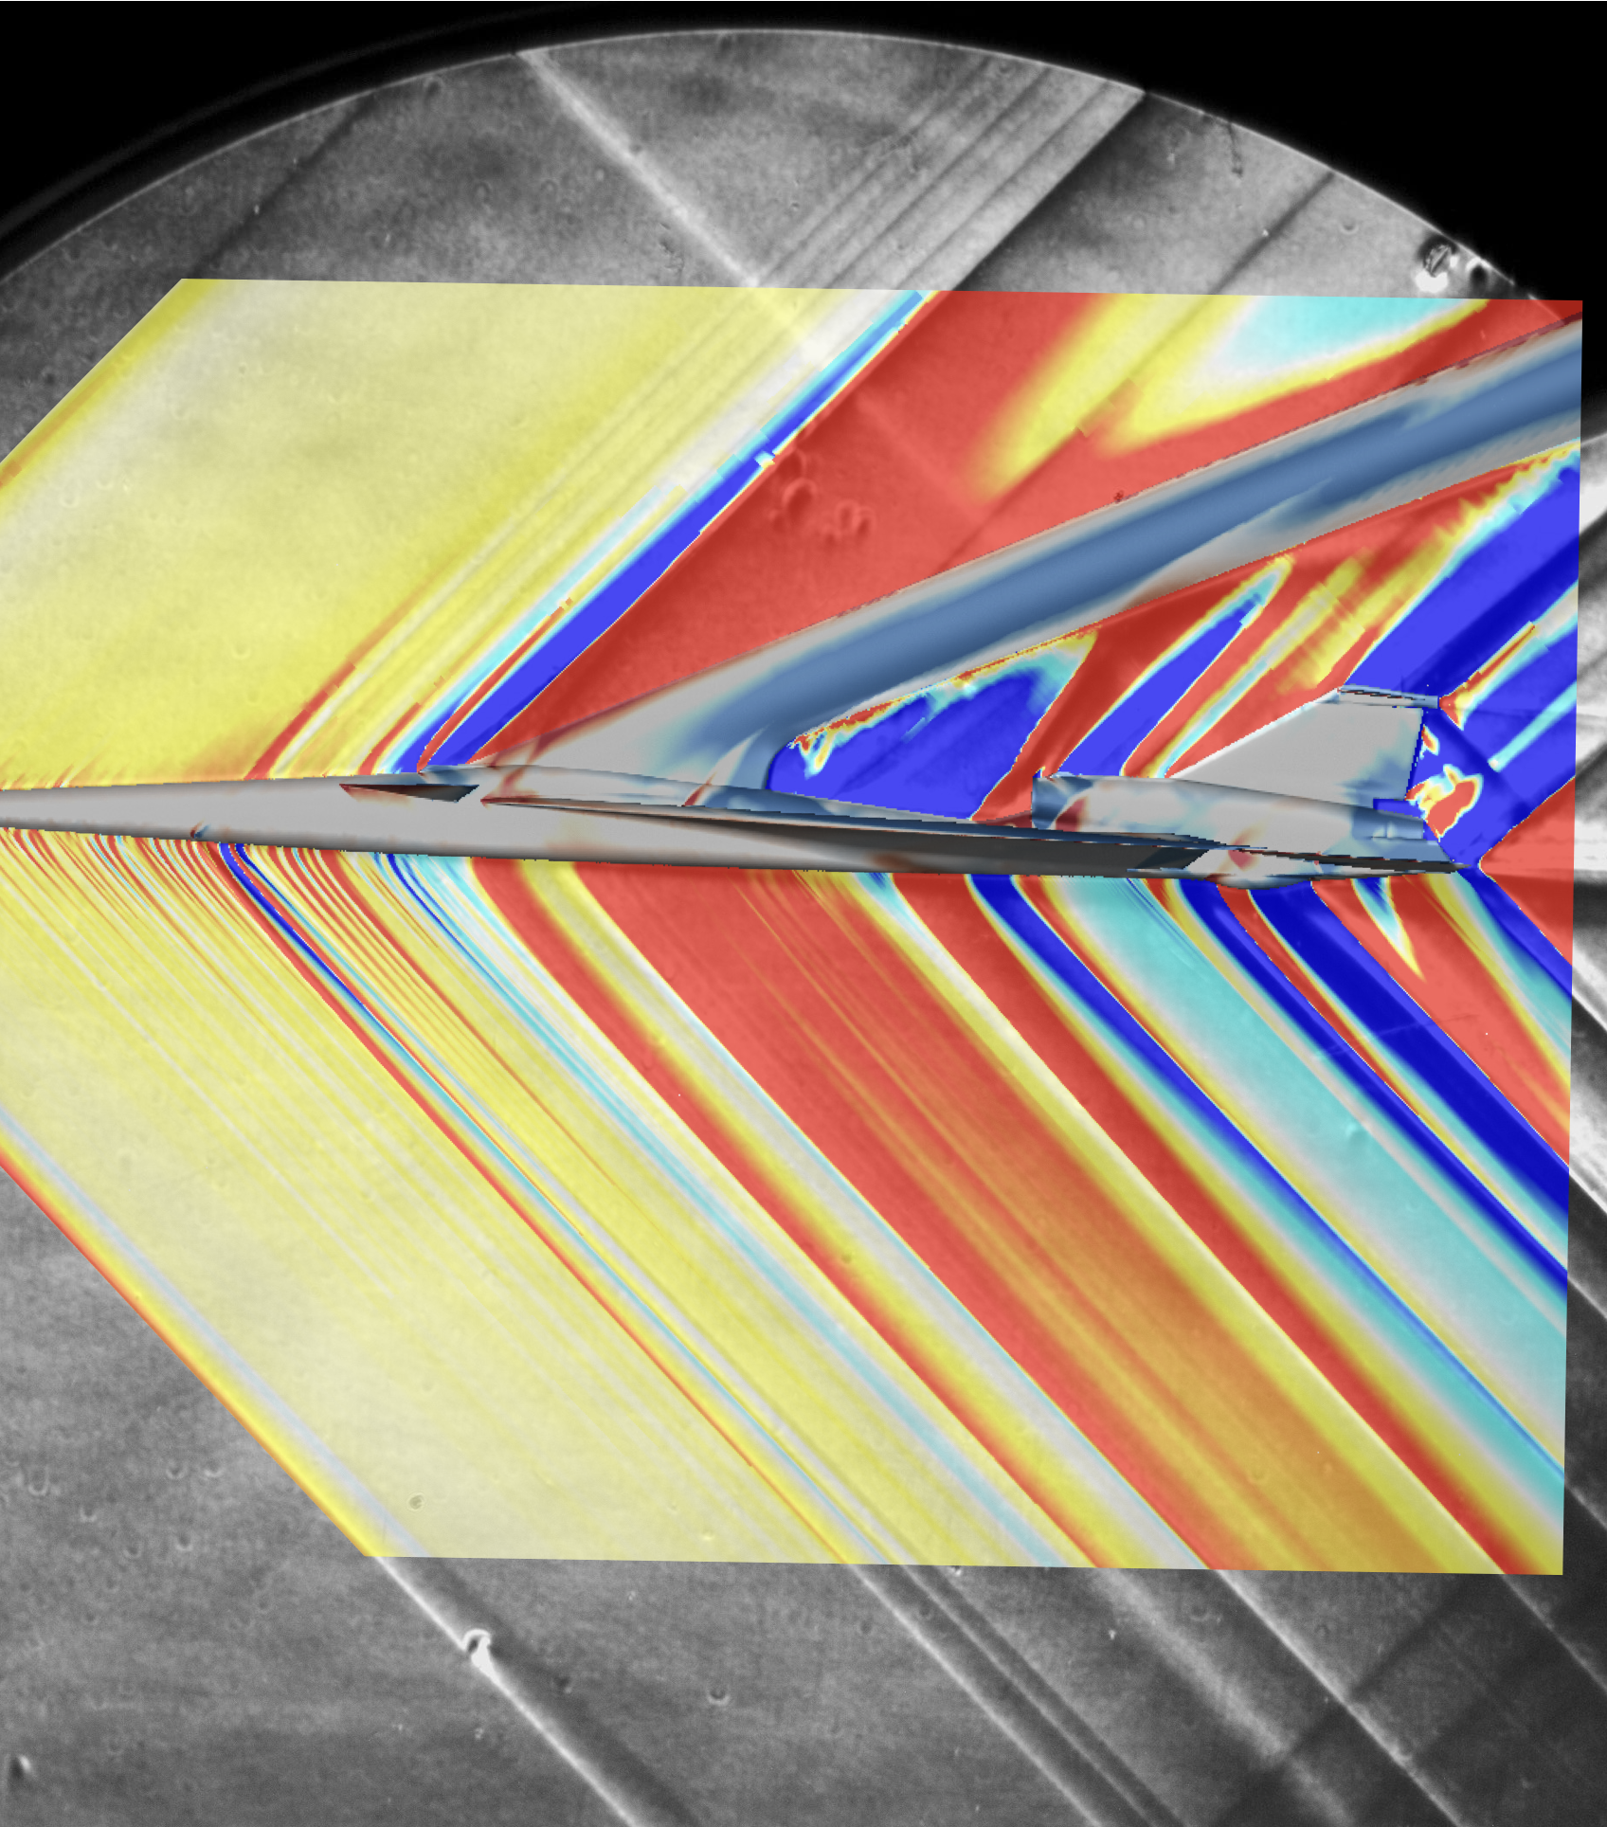
Schlieren/CFD Comparison
Schlieren images were obtained during the GRC 8- by 6-foot wind tunnel test
CFD solutions that were run at the matching conditions were sliced to compare to the schlieren
Excellent agreement was seen between all the codes and the experimental images
www.nasa.gov

Slide 18

Concluding Remarks
CFD studies were conducted on:
  two different mounting systems
  various control devices deflections
  slight changes in angle of attack and Mach number
All three codes match the experimental data well
First NASA produced near-field pressure set for a mature low-boom aircraft and shows the accuracy of the codes, giving confidence that the team is ready for Phase 2 flight prediction
www.nasa.gov
Full report can be found at NASA NTRS website TM-20220011496

Slide 19
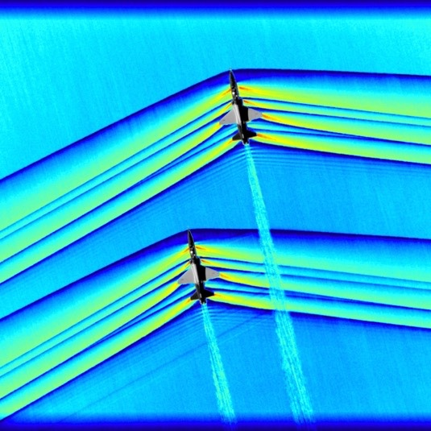
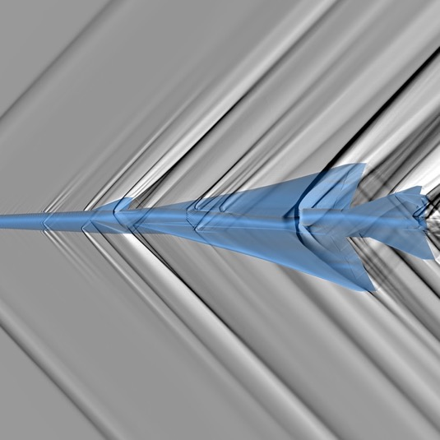
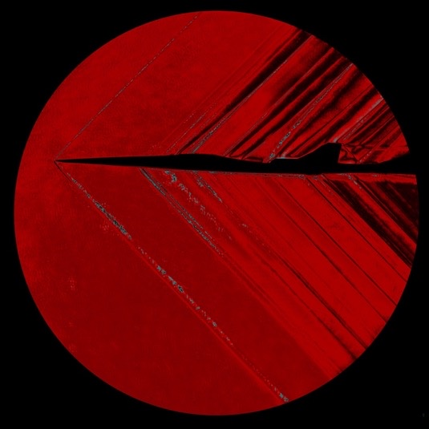
Co-Authors
Durston, Donald
Jensen, James
Neuhoff, Scott
Wagner, Jacob
Elmiligui, Alaa
Shea, Patrick
Winski, Courtney
Park, Michael
Wolter, John
Notes:
All images been used in NASA Public Outreach

Slide 20

nasa.gov/quesst
www.nasa.gov

