Slide 1
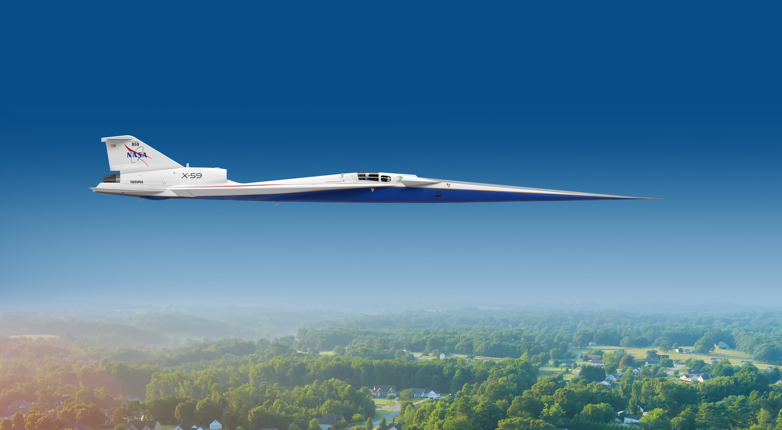

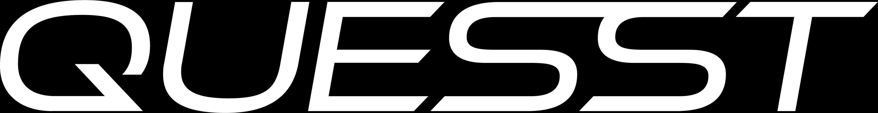
X-59 Air Data Probe Calibration Wind Tunnel Test
Courtney Winski , Michael Bozeman, Alaa Elmiligui , Jeffrey Flamm, Lee Mears | NASA Langley Research Center
Kurtis Long | NASA Armstrong Flight Research Center
David Friedlander | NASA Glenn Research Center
NASA | AIAA SciTech | June 16, 2023
This material is a work of the U.S. Government and is not subject to copyright protection in the United States.
www.nasa.gov
courtney.s.winski@nasa.gov

Slide 2
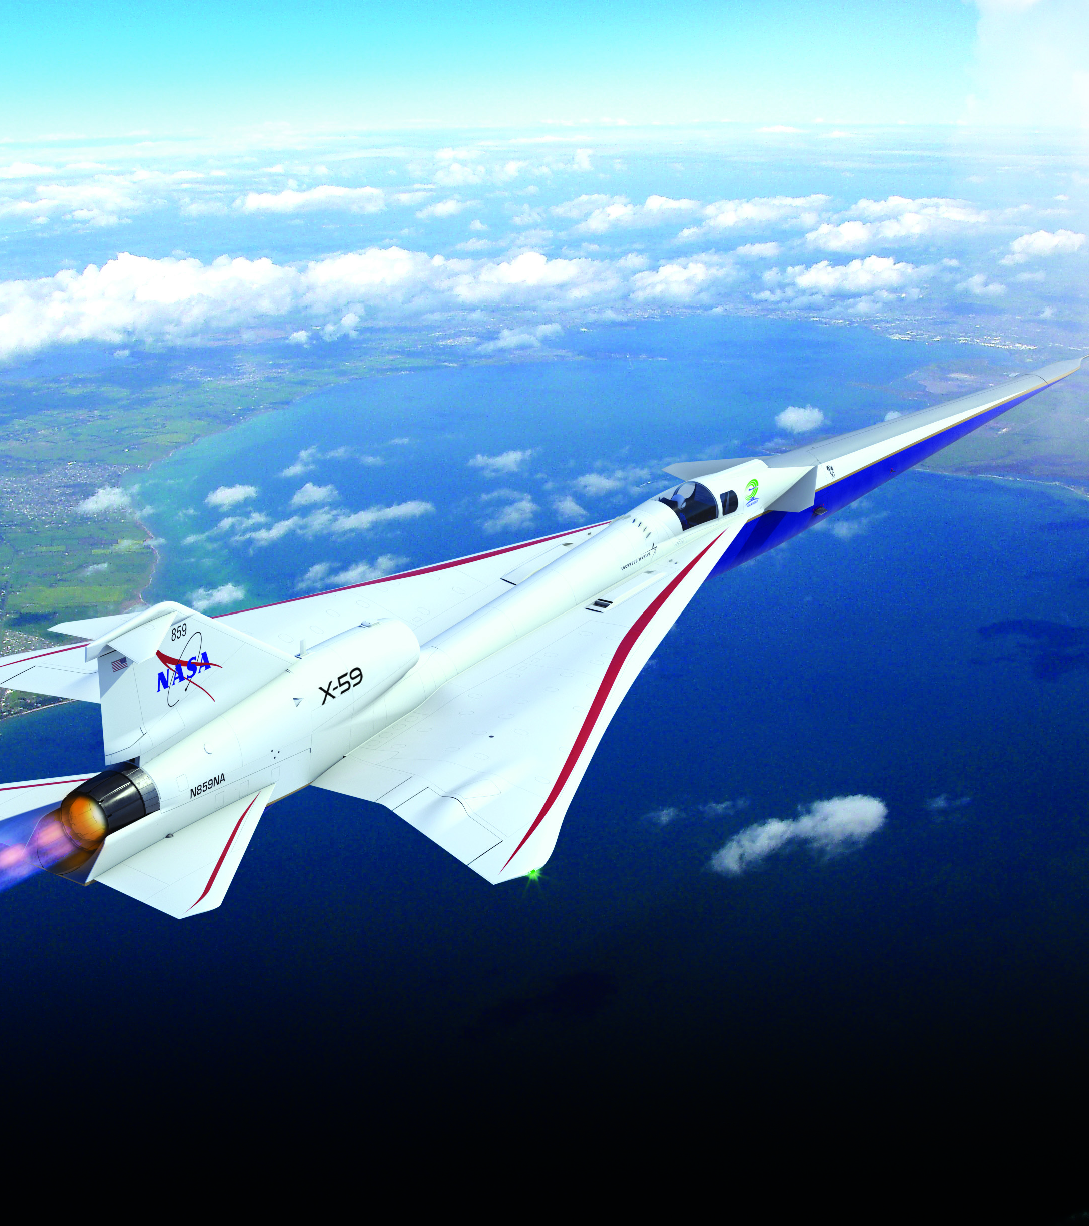

Presentation Overview
Introduction
Experimental Setup
Instrumentation and Measurements
Calibrations and Checkouts
Test Results
Concluding Remarks
2
Illustration Credit: Lockheed Martin

Slide 3
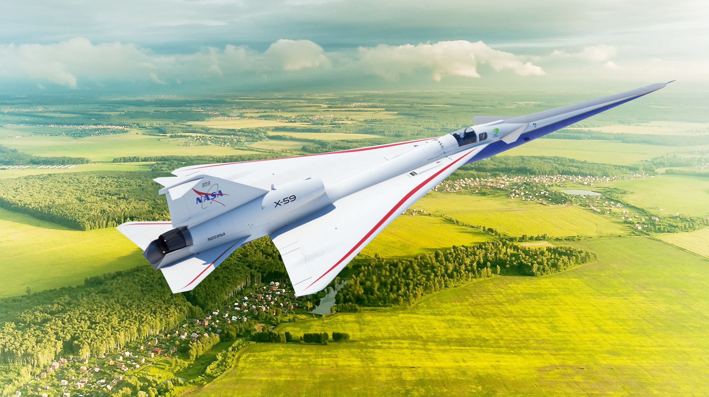
Introduction
NASA and Lockheed are working to design and build a supersonic X-plane, the X-59, that produces a gentle thump rather than a loud sonic boom
Jeffrey Flamm et al. – Overview of the X-59 QueSST Phase I Mission and Air Data Nose Probe Calibration @ 9:30am
The nose probe is the primary instrument for the flight test of the X-59 for determining angle of attack, sideslip angle, airspeed, and pressure altitude of the aircraft in flight. It is critical for flight safety and for the sonic boom mission.
Two wind tunnel tests were conducted in the NASA Glenn 8- by 6-Foot Supersonic Wind Tunnel (8x6) to calibrate the nose probe for the X-59
Illustration Credit: Lockheed Martin
www.nasa.gov
3

Slide 4
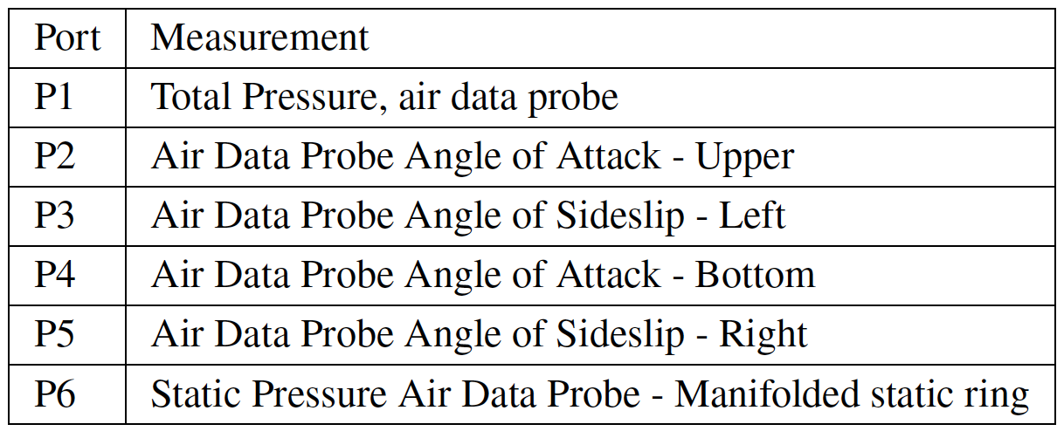
X-59 Multi Function Nose Probe
Rosemount Collins 857CK sharp-lipped multifunction air data probe
Roughly 15 inches long
Installed 2 deg nose down on the aircraft for drainage
9 pressure ports
  Angle of attack (AOA)
  Sideslip angle (AOS)
  Pressure altitude
  Airspeed
Total pressure on the tip of the nose
4 flush static pressure ports on a shaped compensation bump
  Manifolded together for static pressure
4 flush ports further aft
  Independently measures AOA and AOS
LBFD Air Data Nose Probe
4

Slide 5
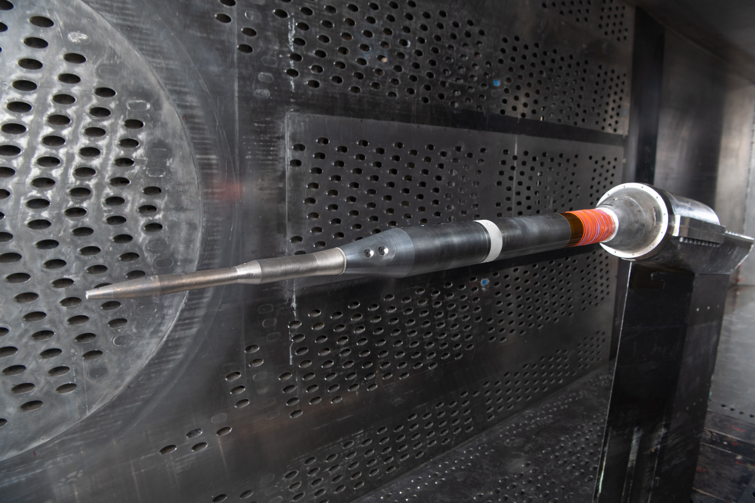
Wind Tunnel Tests
Two wind tunnel tests to calibrate the probe
March and June 2021
  2 probes
Targeted wind tunnel calibration between tests for P_{s}
  Unexpected trends seen during the first test entry
January 2022
  Primary probe only
  Focused on supersonic Mach numbers
19 Mach numbers between Mach 0.25 and 1.7
  Landing Mach 0.2
  Subsonic cruise Mach 0.9
  Supersonic cruise Mach 1.4
Continuous roll sweeps at a set Mach number and pitch angle
  0 deg to 360 deg roll
  0 deg to -14 deg pitch
Photo Credit: NASA
5

Slide 6
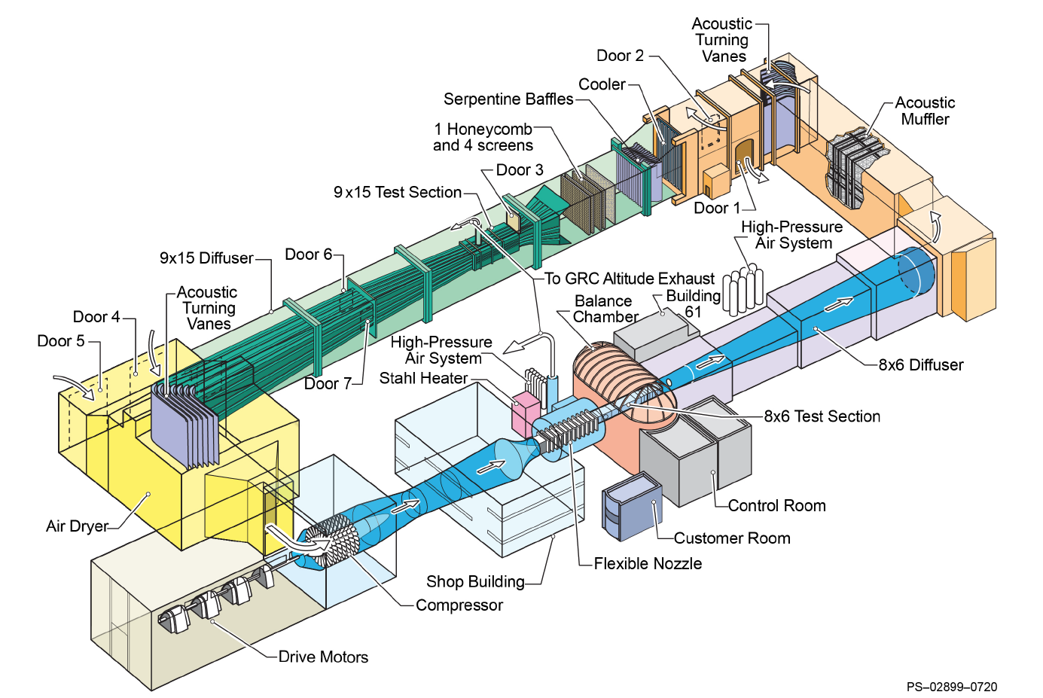
NASA Glenn Research Center 8- by 6-Foot Supersonic Wind Tunnel
Atmospheric
Continuous flow
Discrete Mach numbers
Tested from Mach 0.25 to Mach 1.7
Transonic test section
  Porous walls
  14 feet 5 inches long
Supersonic test section
  Schlieren
Subsonic data at position 6 in the transonic test section
  1st test campaign
Supersonic data at position 11 in the transonic test section
  2nd test campaign
6

Slide 7
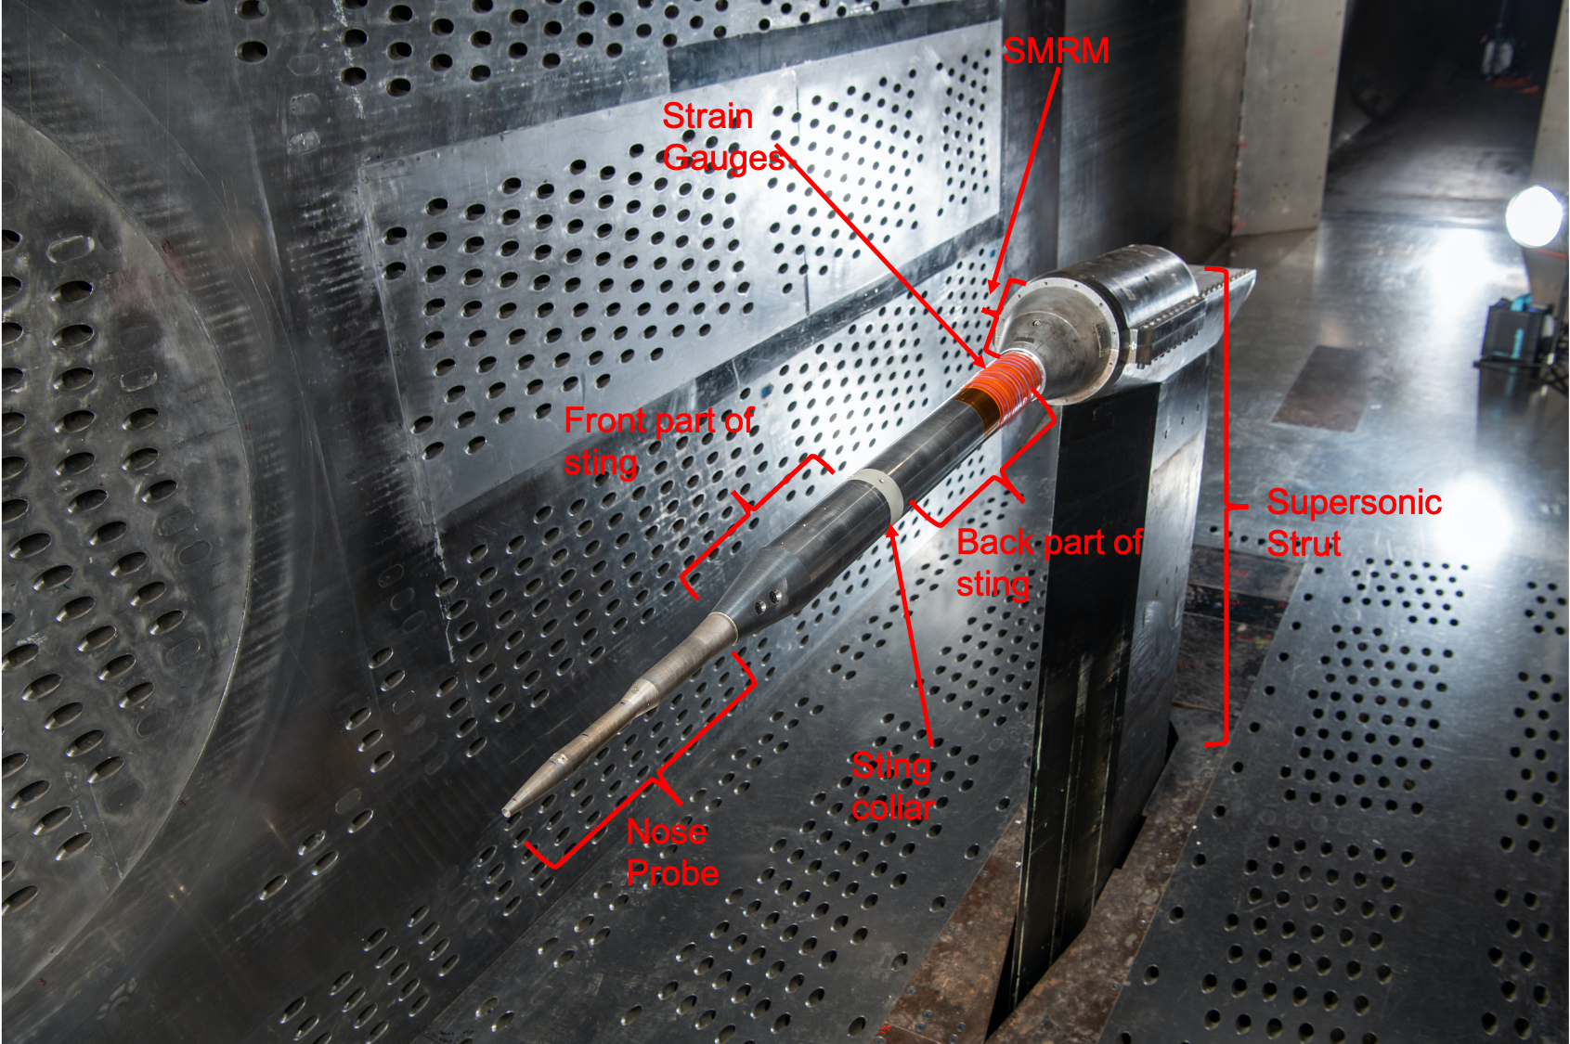
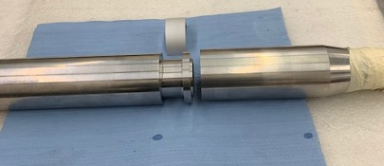
Model Support System
Ames Small Model Roll Mechanism (SMRM)
  0 deg to 360 deg
Sting
  Pressure tubing and connectors coming out the back of the probe were wider than the probe itself
  Cut sting into 2 pieces lengthwise
  Front piece bored out to fit tubing and connectors
  Flange machined to fit the 2 sting pieces together with a collar
  Probe inserted through the back of the front half of sting
Cap assembly/pressure connectors
  Fabricated to attach the pressure tubing in the probe to the tunnel pressure measurement system
8x6 Supersonic strut
Photo Credit: NASA
7
Photo Credit: Modern Machine &Tool

Slide 8
Run Procedure
Set Mach
  Set theta and roll the probe
  Set Phi and pitch the probe
All theta angles were negative in the tunnel because of the test hardware
Screening matrix with point-pause data
Continuous roll at set pitch and Mach for most testing
  0 deg to 360 deg then 360 deg to 0 deg
  5 minutes (1st test entry) or 10 minutes (2nd test entry)
  12.5 Hz
Both probes run through the same data collection matrix
  1st entry only
Supersonic runs required dry air
8

Slide 9
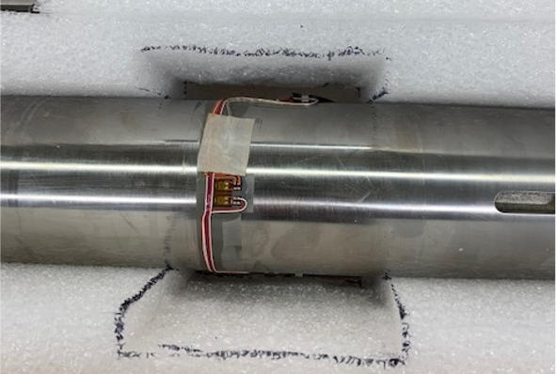
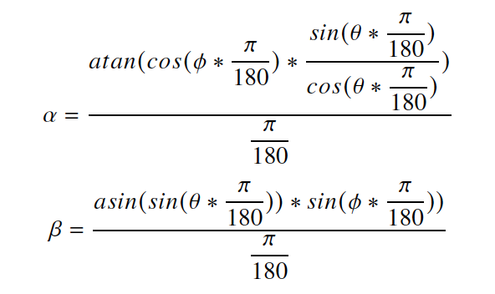
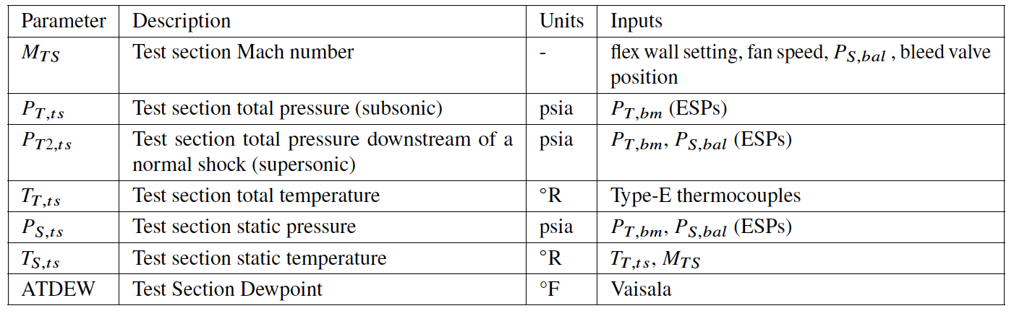
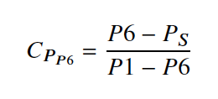
Instrumentation and Measurements
Strain gauge measurements
  1st entry only
Pressure measurements
  6 probe pressures
    ESP
Tunnel parameters
Computations
  Test was in theta and phi (Cartesian)
  Calibration used alpha and beta (polar)
Coefficient of pressure 6
(manifolded)
Photo Credit: NASA
9

Slide 10
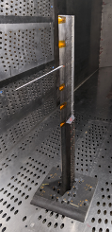
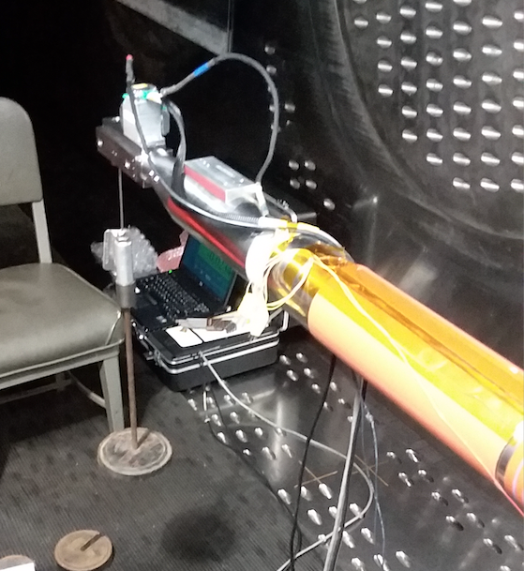
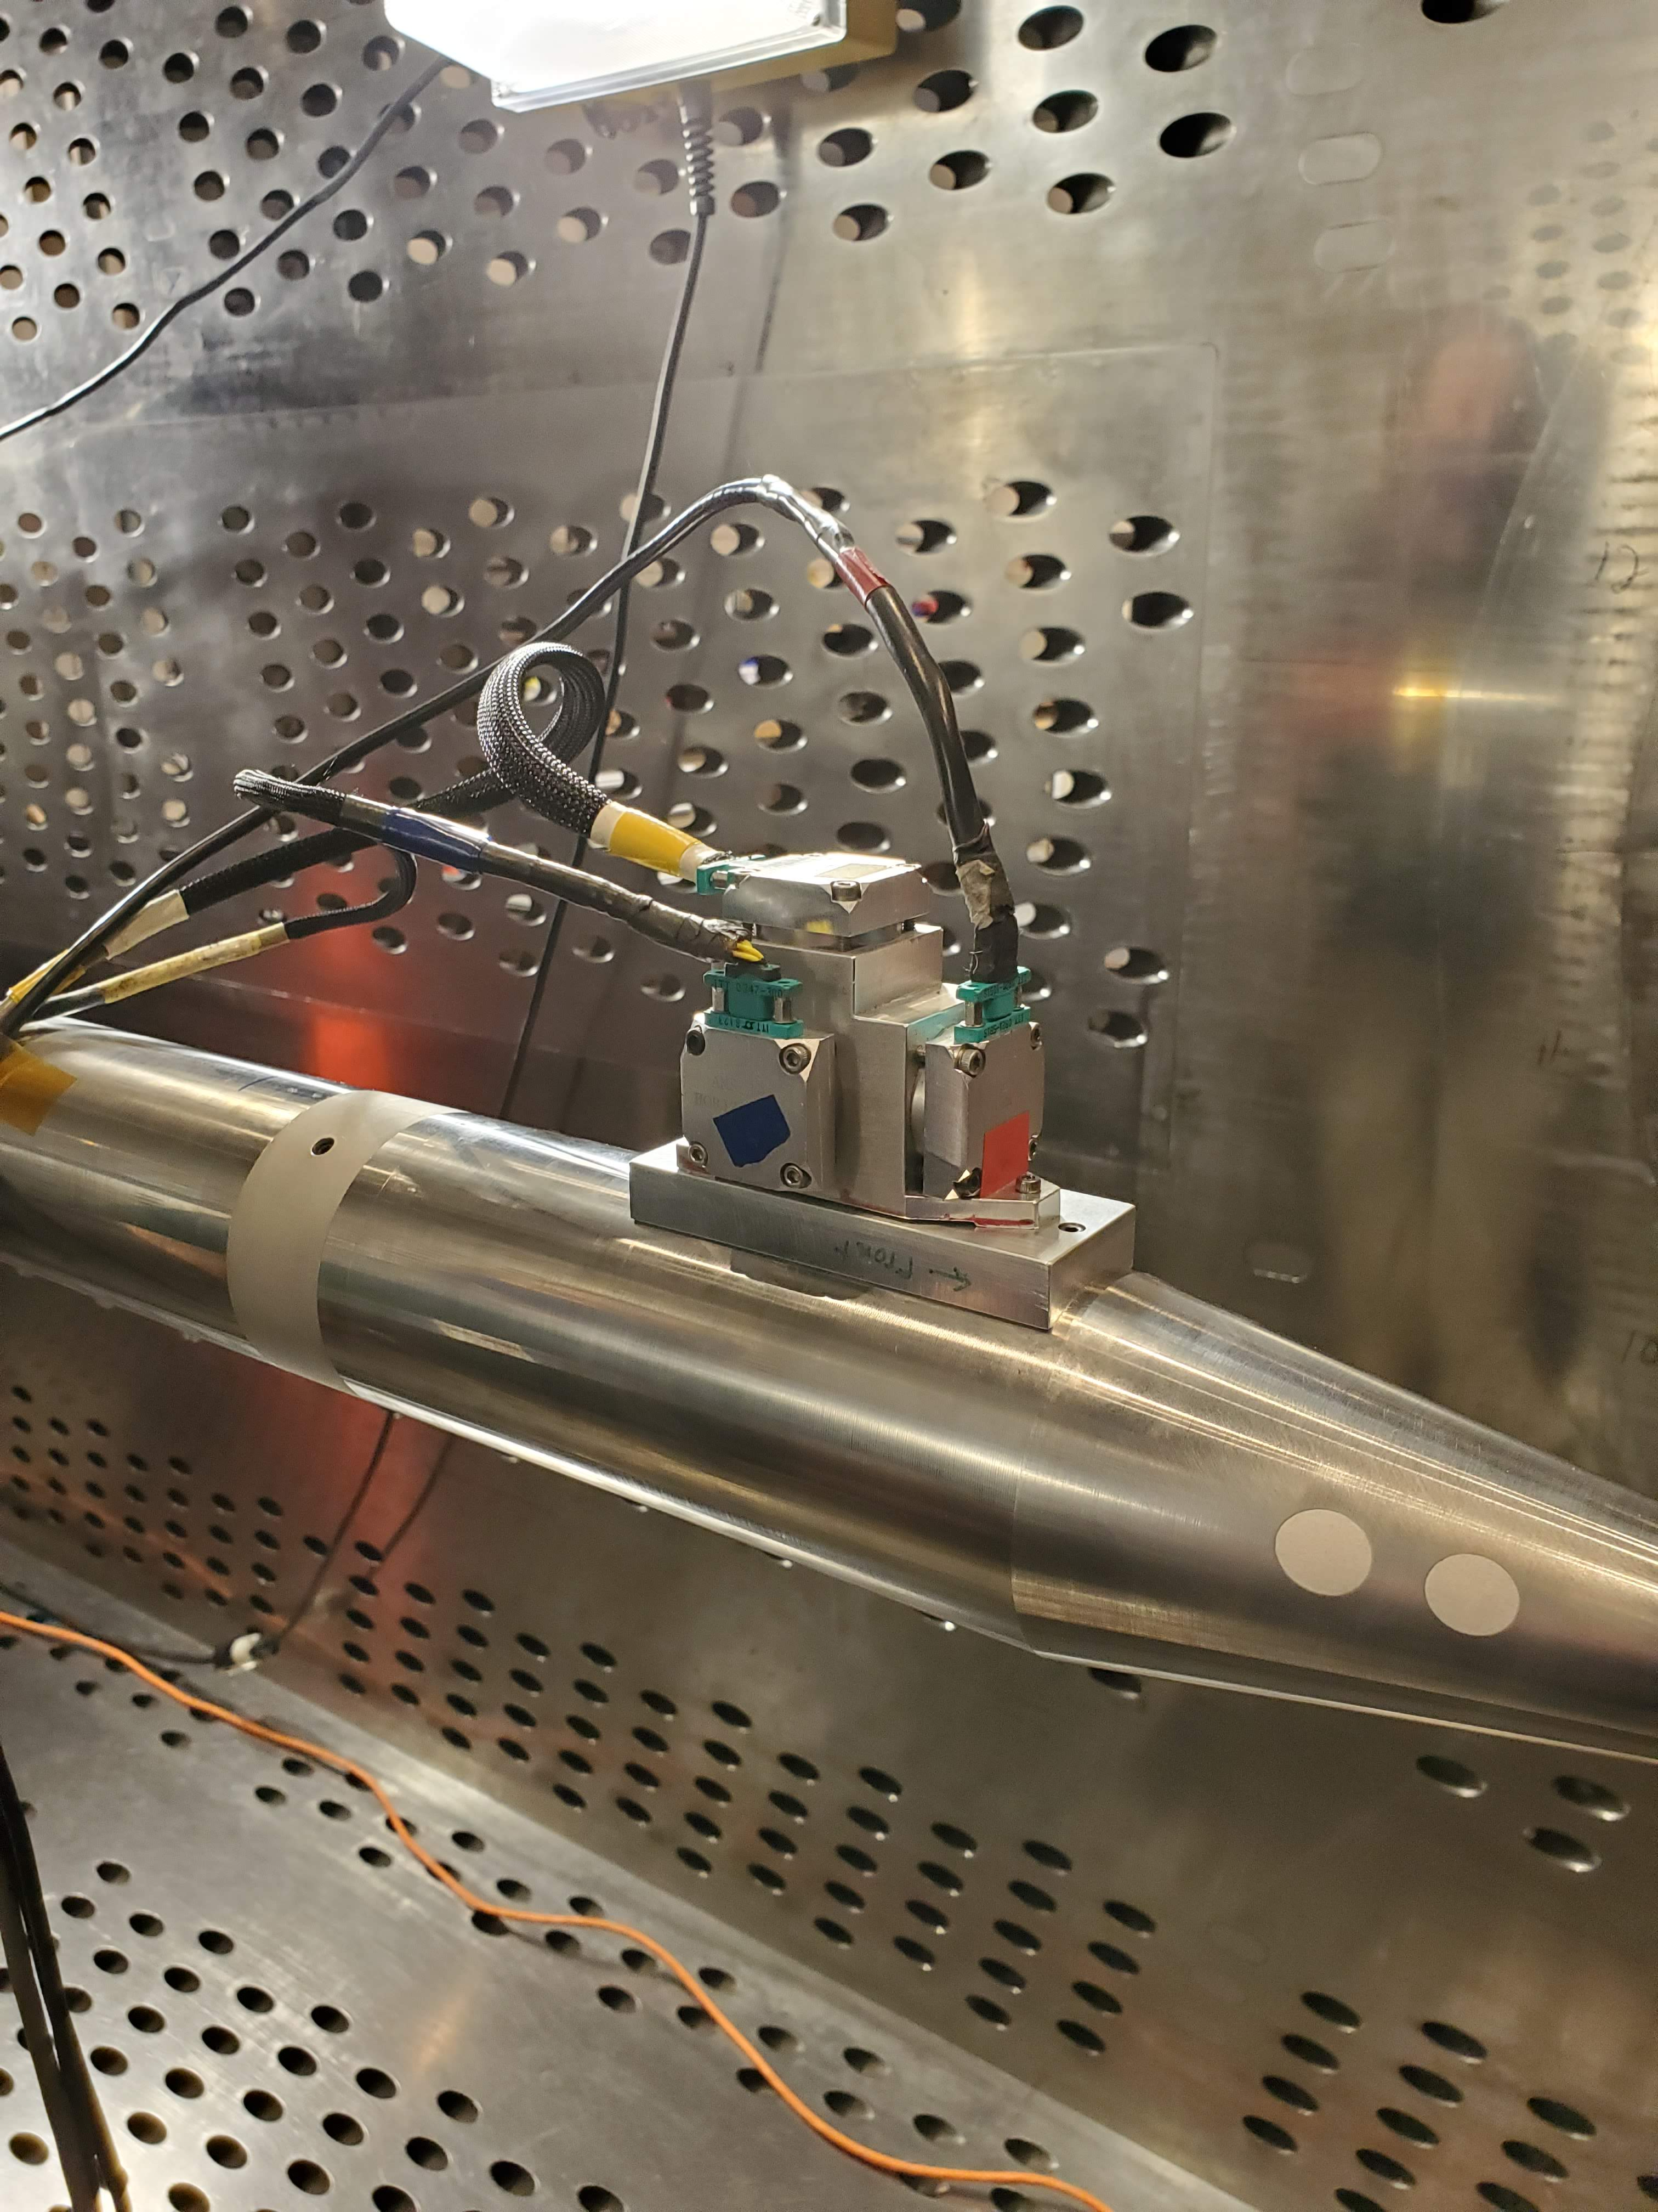
Calibrations and Checkouts
Winter 2021 8x6 check calibration
  Initial entry of the probe was outside of the tunnel x location used to calculate P_{STS}
  Targeted P_{STS} calibration with a centerline probe to create a P_{STS} lookup table based on tunnel x location
Faro Arm to measure misalignment angles
Dial gauge to check the coning angle
Leak check of the probe pressures
Sting deflections
Photo Credit: NASA
Photo Credit: NASA
Photo Credit: NASA
10

Slide 11
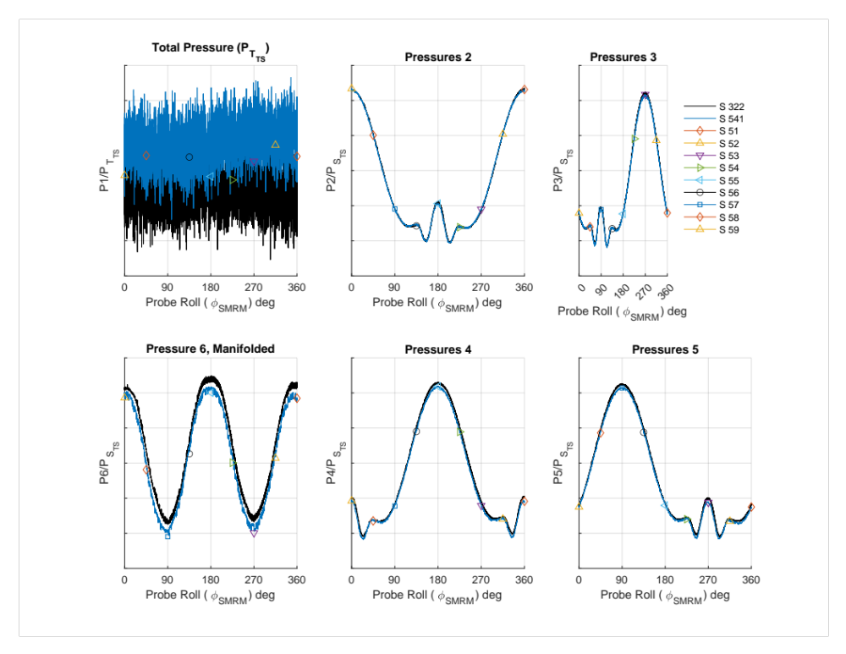
Test Results – Data Repeatability – Point-Pause and Between Probes
Repeat roll sweeps
Mach 1.25
Theta_{Probe} -8 deg
1st test entry
11

Slide 12
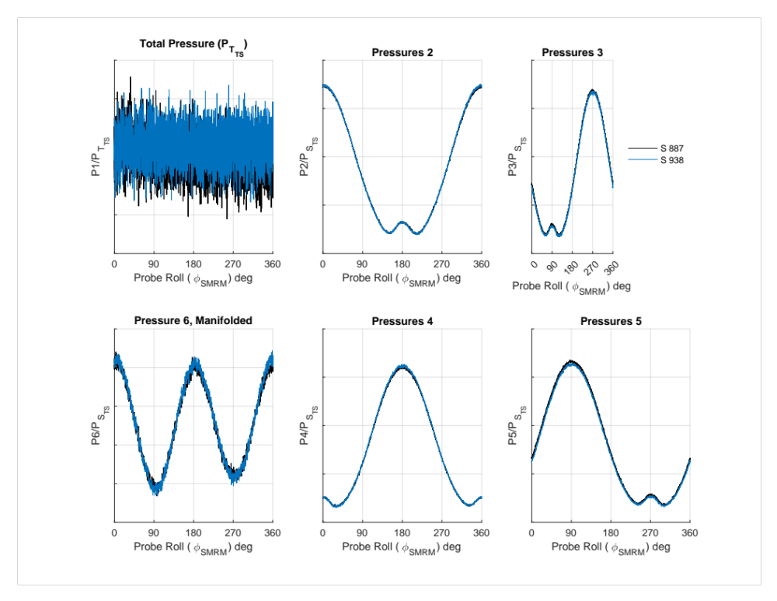
Test Results – Data Repeatability – Calibration Data
Repeat roll sweeps
Mach 1.46
Theta_{Probe} -4 deg
2nd test entry
12

Slide 13
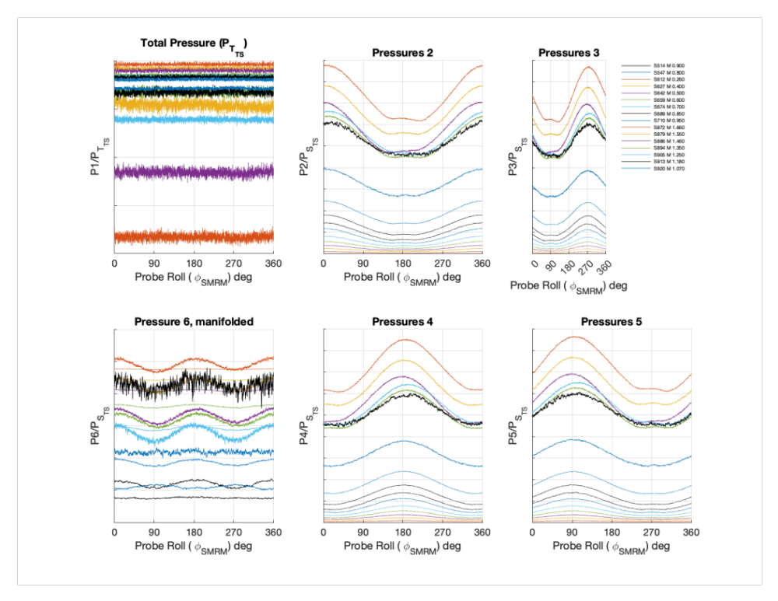
Test Results – Data Trends – Mach Number Effects in Pitch
Roll sweeps
Mach varied
0.26 to 1.66
Theta_{Probe} -3 deg
13

Slide 14
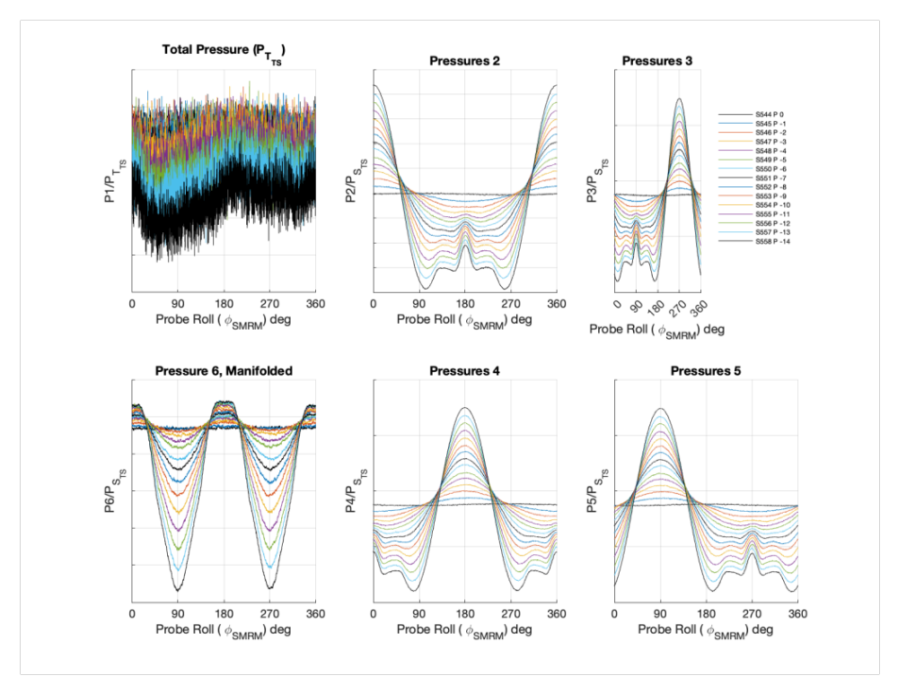
Test Results – Data Trends – Probe Angle Effects in Mach
Roll sweeps
Mach 0.8
Theta_{Probe} varied 0 deg to -14 deg
14

Slide 15
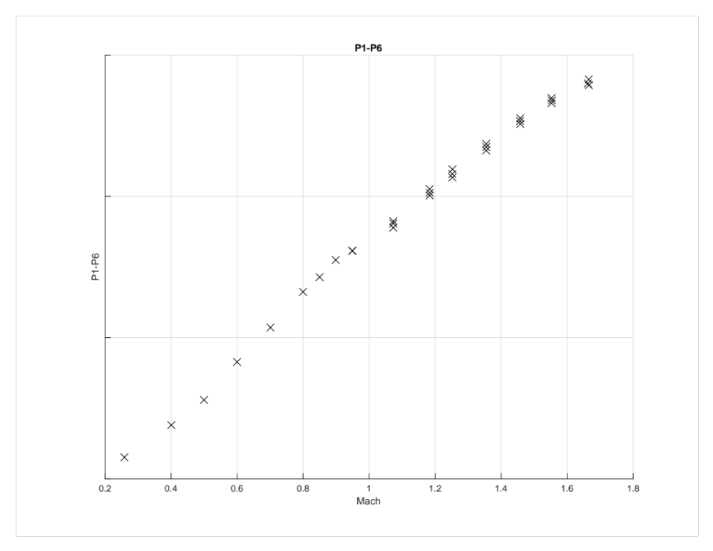
Test Results – Mach Sweep
0 deg roll data extracted from roll sweeps and averaged
15

Slide 16
Conclusions
X-59 nose probe
  Airspeed
  Pressure altitude
  Angle of attack
  Sideslip angle
  Critical for flight safety
  Critical for the sonic boom mission
Calibrated in the NASA Glenn Research Center 8- by 6-Foot Supersonic Wind Tunnel
Two test campaigns and a targeted tunnel calibration
Most calibration data collected setting Mach and theta, and then collecting continuous data while rolling 360 deg
Best practices for the tunnel were followed
Long term repeats, probe-to-probe repeats, point-pause vs. continuous repeats were all within expected tolerance
Trends for Mach and roll at set probe pitch angles showed expected trends
Data used to calibrate the probe
16

Slide 17

nasa.gov/quesst
17
www.nasa.gov
courtney.s.winski@nasa.gov

