Slide 1
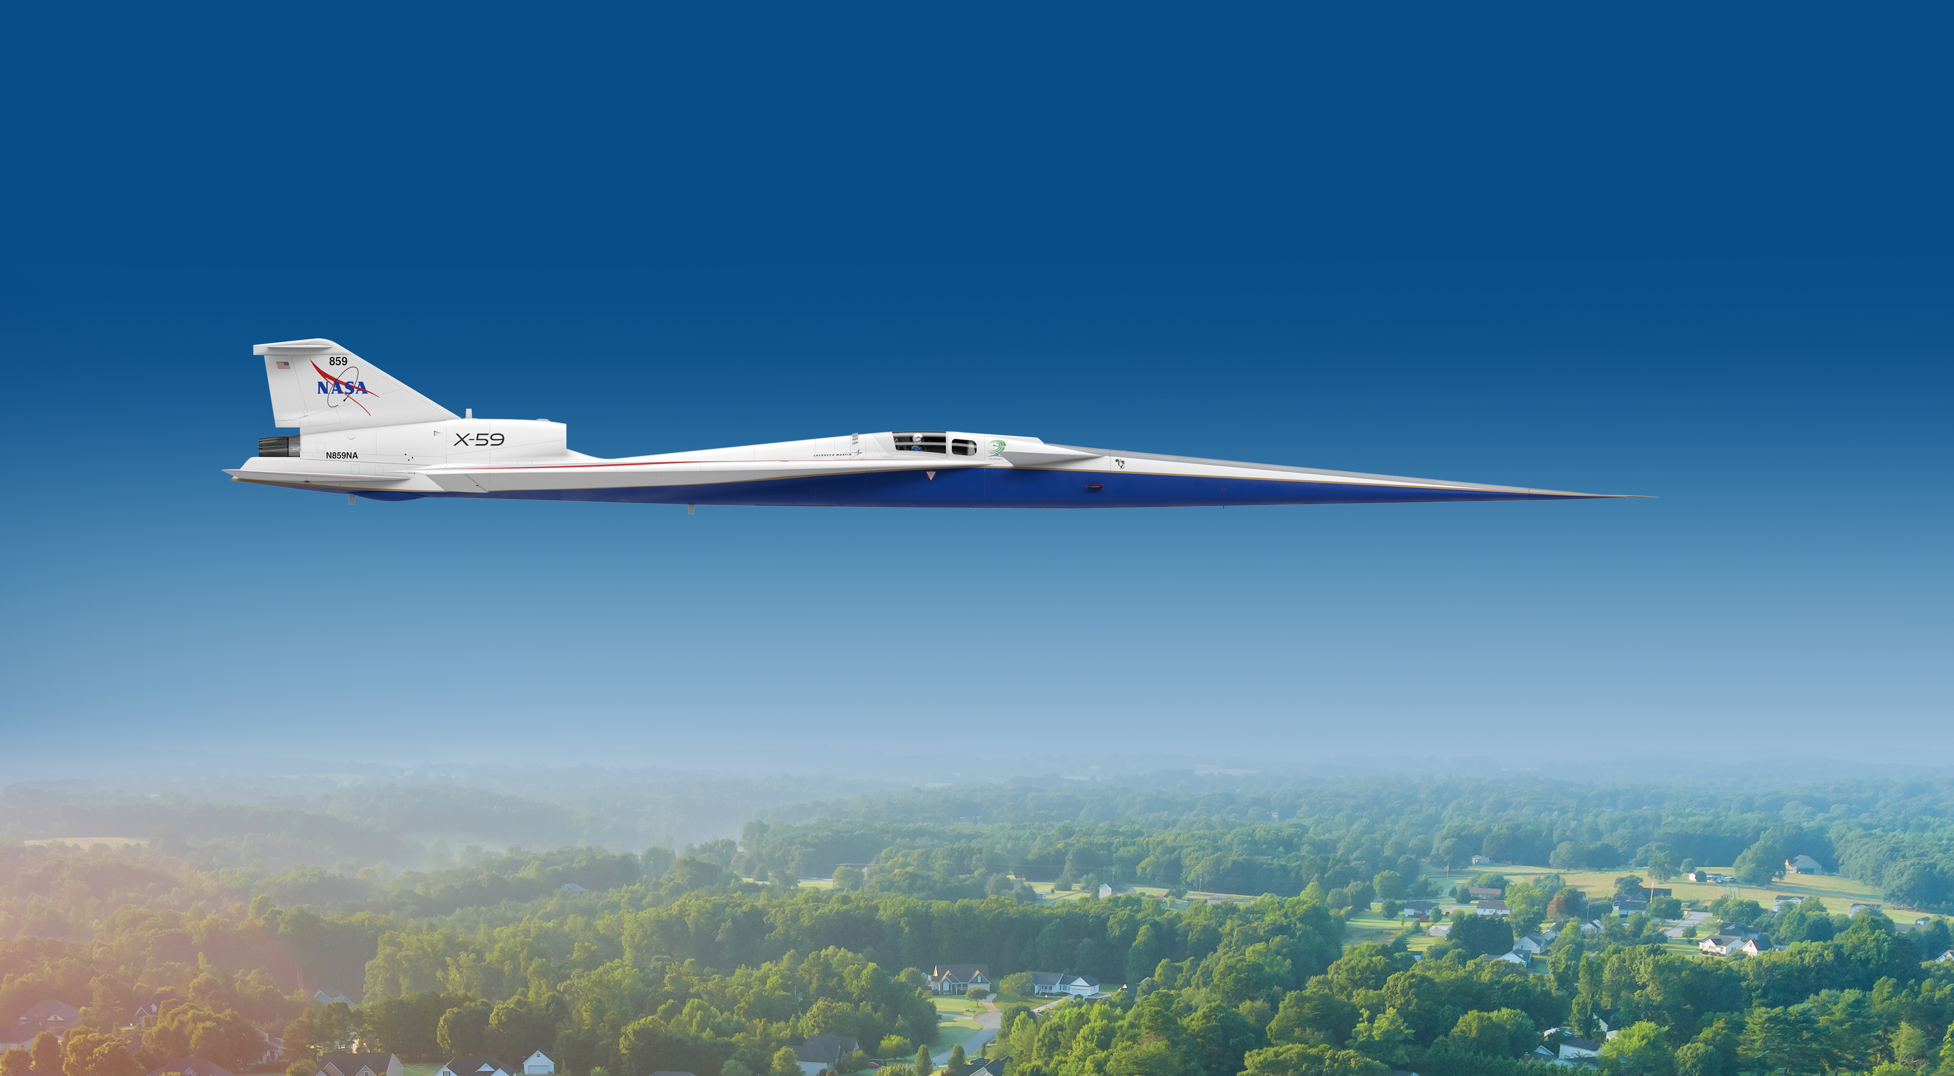


Overview of the X-59 Quesst Phase I Mission and Air Data Nose Probe Preflight Calibration
Jeffrey Flamm, Courtney Winski, Alaa Elmiligui, Michael Bozeman, Lee Mears | NASA Langley Research Center
Kurtis Long | NASA Armstrong Flight Research Center
David Friedlander | NASA Glenn Research Center
NASA | June 2023
www.nasa.gov

Slide 2
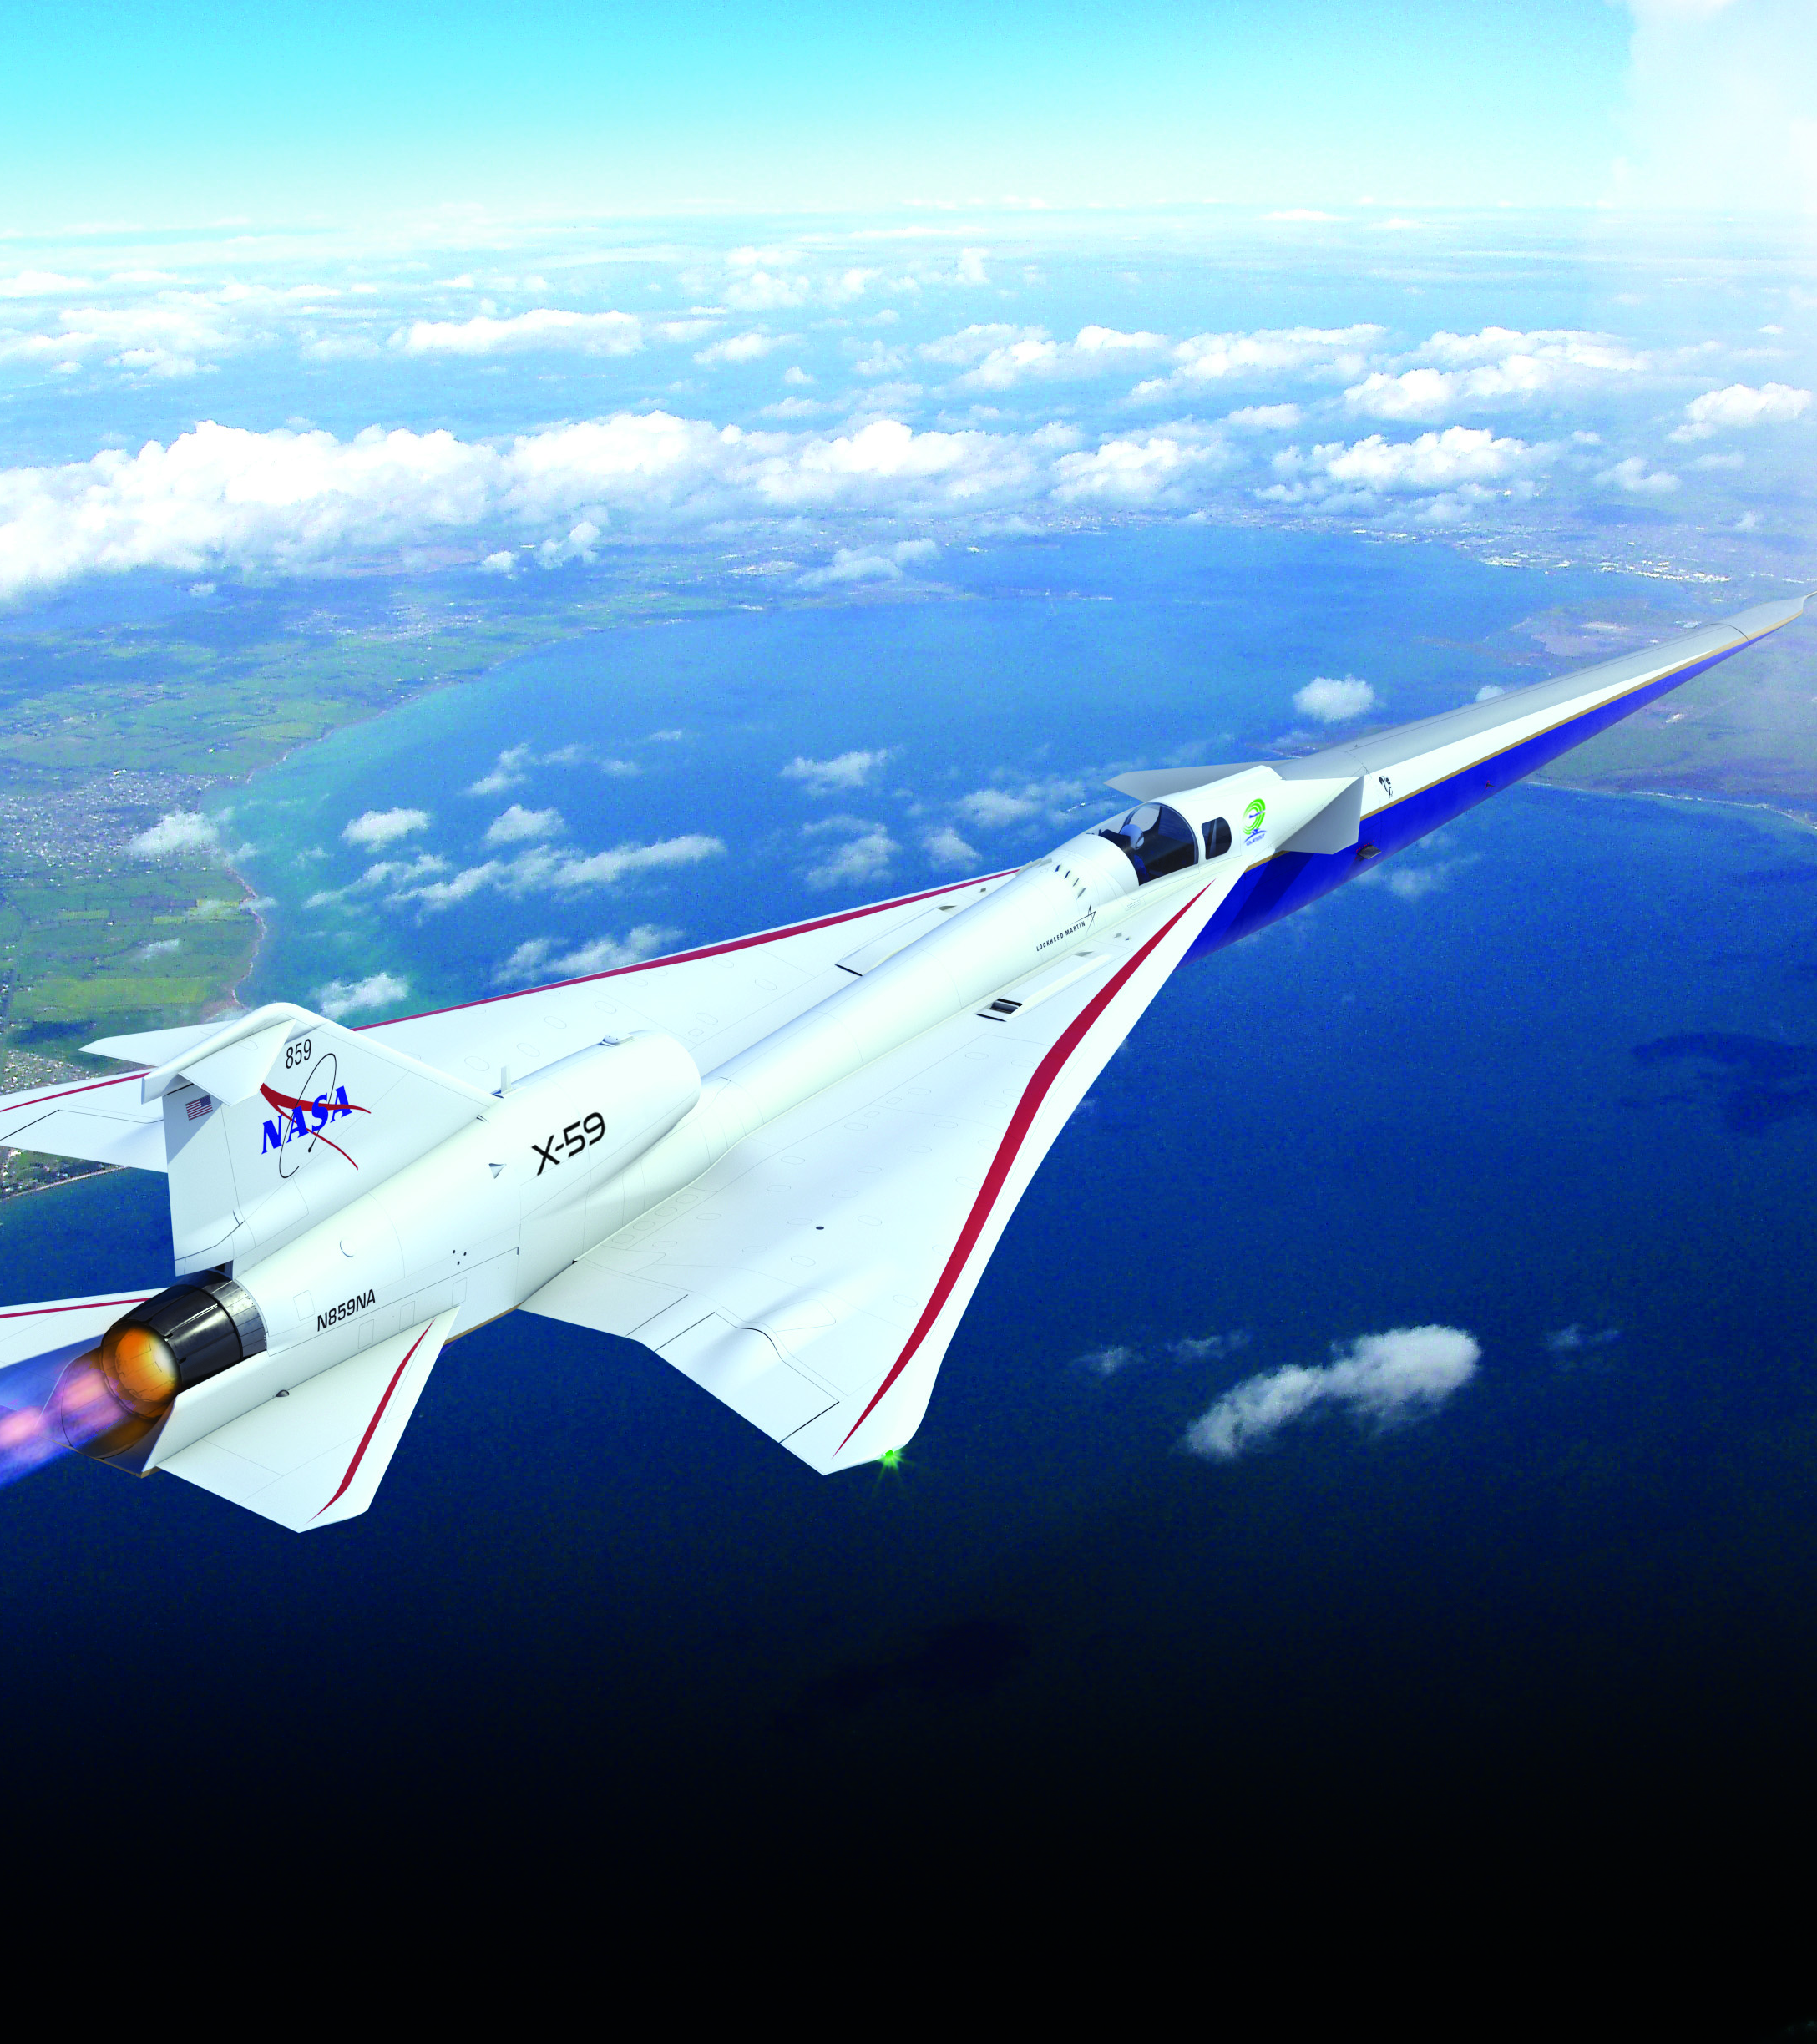


Presentation Topics
Vision for Commercial Supersonic Flight
Sonic Thump
Quesst Mission Overview
X-59 Aircraft Overview
Validation Efforts
Air Data Instrumentation
Accuracy Requirements
Nose Probe Source Error Calibration Overview
Acknowledgments
  David Richwine, Melissa Carter (NASA LaRC); Ray Castner (NASA GRC); Michael Aftosmis, Wade Spurlock (NASA ARC); Lockheed Martin
www.nasa.gov |
Illustration Credit: Lockheed Martin
Notes:
https://www.nasa.gov/mission_pages/lowboom/overview

Slide 3
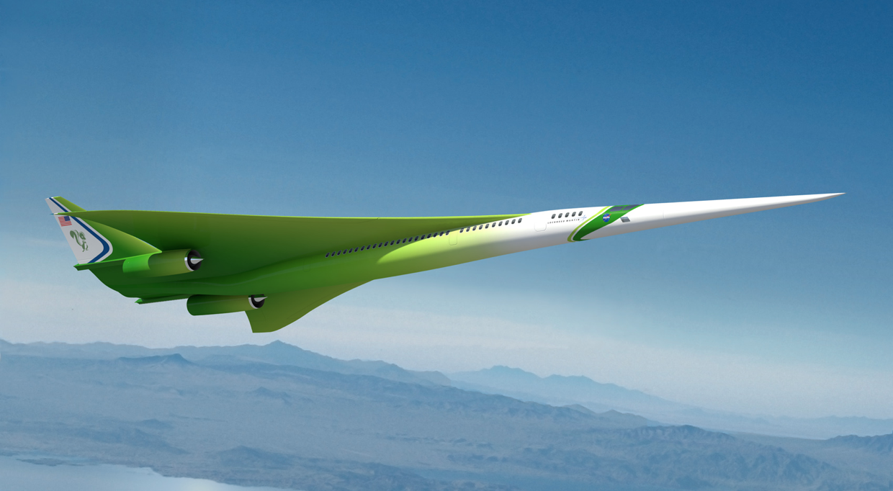
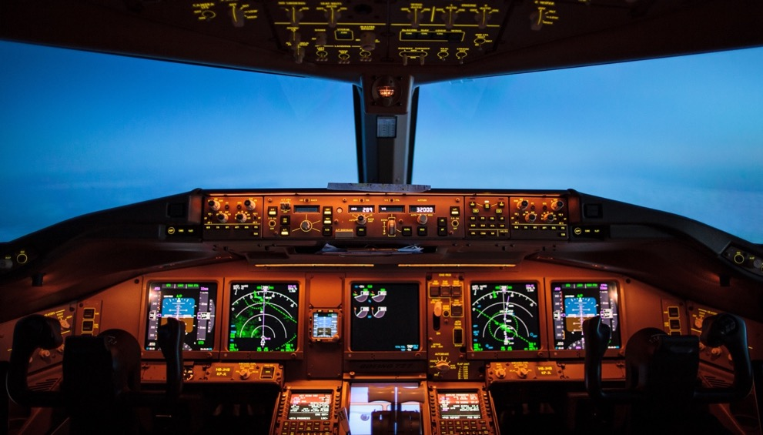
Vision for Commercial Supersonic Flight
Exciting new market potential seen for supersonic civil aircraft
Evidenced by the appearance of several commercial programs even with existing restrictions on overland flight and other challenges
A future where fast air travel is available for a broad spectrum of the traveling public
Future supersonic aircraft should have an environmental impact that is compatible with a sustainable global aviation transportation system
Overland flight restrictions based on unacceptable sonic boom noise are viewed as the main barrier
www.nasa.gov |
3
Illustration Credit: Lockheed Martin
Notes:
NTRS 20210012713

Slide 4
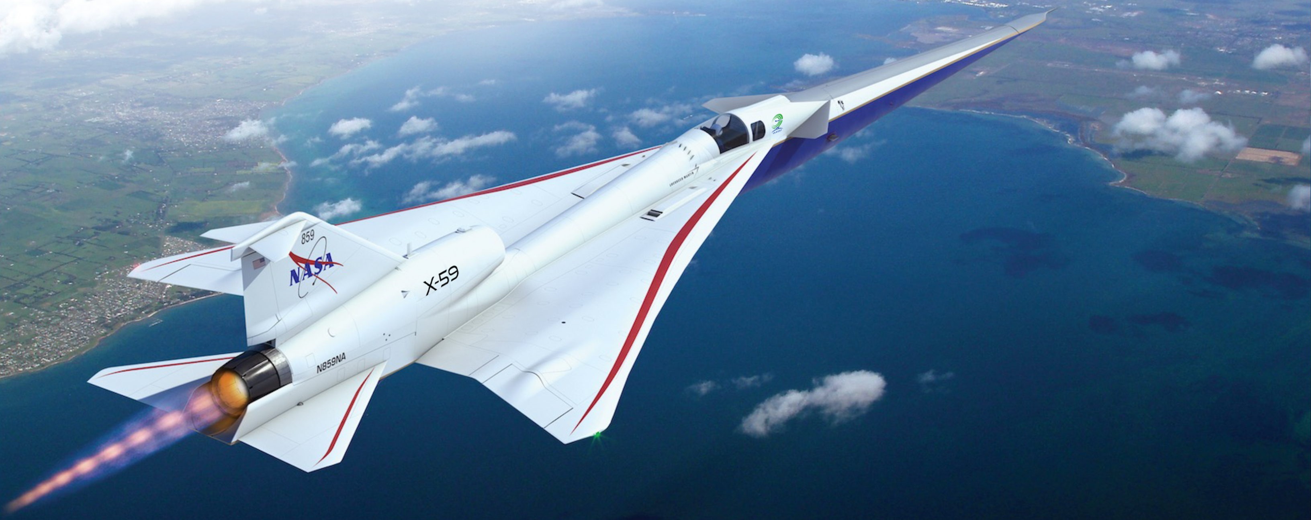
The NASA Quesst Mission
The mission aims to provide U.S. and international regulators with statistically valid data required to approve new rules that could allow commercial supersonic flight over land
www.nasa.gov |
4
Illustration Credit: Lockheed Martin
Notes:
https://www.nasa.gov/mission_pages/lowboom/overview

Slide 5
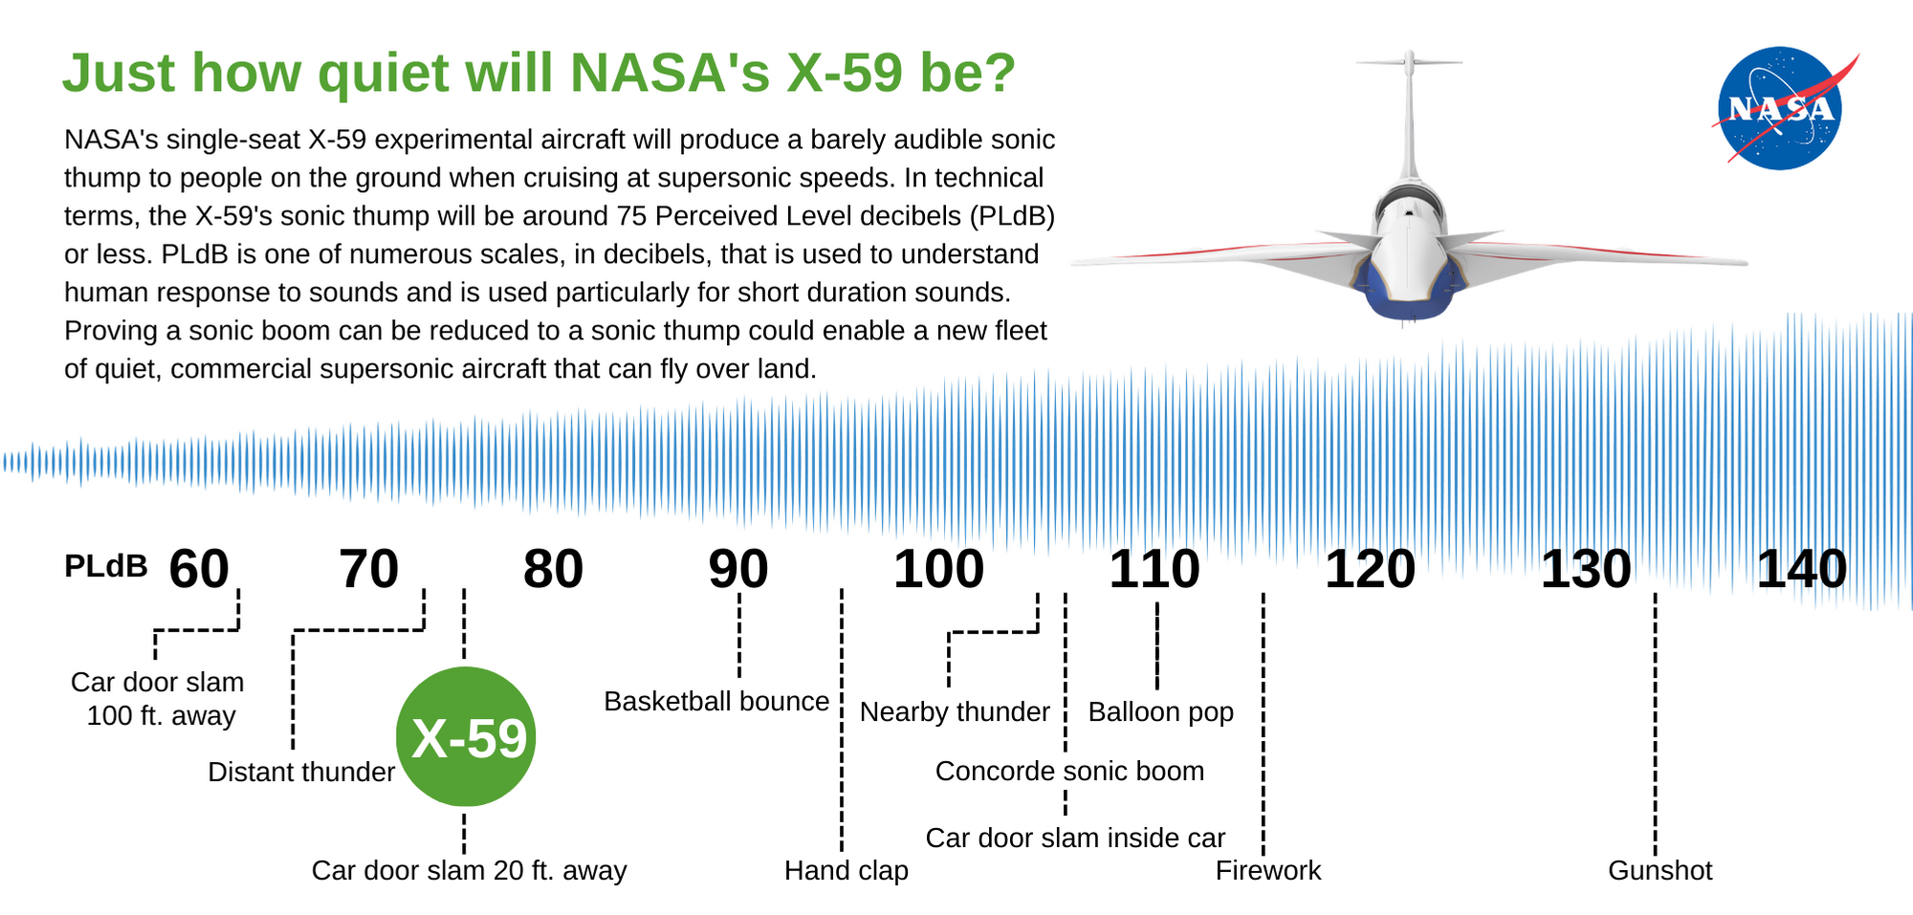
Sonic Thump
Just how quiet will the NASA X-59 be?
The NASA single-seat X-59 experimental aircraft will produce a barely audible sonic thump to people on the ground when cruising at supersonic speeds. In technical terms, the X-59 sonic thump will be around 75 Perceived Level decibels (PLdB) or less. PLdB is one of numerous scales, in decibels, that is used to understand human response to sounds and is used particularly for short duration sounds. Proving a sonic boom can be reduced to a sonic thump could enable a new fleet of quiet, commercial supersonic aircraft that can fly overland.
www.nasa.gov |
5
Illustration Credit: Will Doebler, Jonathan Rathsam, Sasha Ellis
Notes:
NASA's single-seat X-59 experimental aircraft will produce a barely audible sonic thump to people on the ground when cruising at supersonic speeds. In technical terms, the X-59's sonic thump will be around 75 Perceived Level decibels (PLdB) or less. PLdB is one of numerous scales, in decibels, that is used to understand human response to sounds and is used particularly for short duration sounds. Proving a sonic boom can be reduced to a sonic thump could enable a new fleet of quiet, commercial supersonic aircraft that can fly over land.
Additional detail if more technical audience: AESL metric uses a reference window of 1 sec. LAF_{max} metric (A-weighted, Fast, Sound Level) uses a reference window of 125 msec that tends to be more representative of rapid events like a sonic boom. For this comparison, PLdB will be compared to LAF_{max} metric which is the most representative comparison.
Aircraft ASEL (dB) LAFmax (dB) PL (dB)
Concorde 94 101 109
F-18 87 94 102
Demonstrator 60 66 75

Slide 6
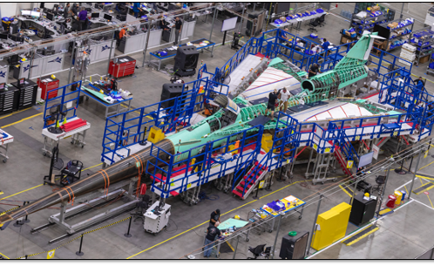
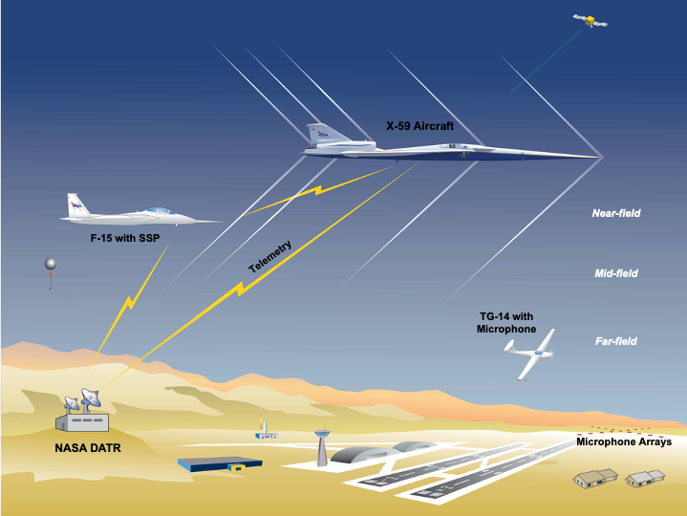
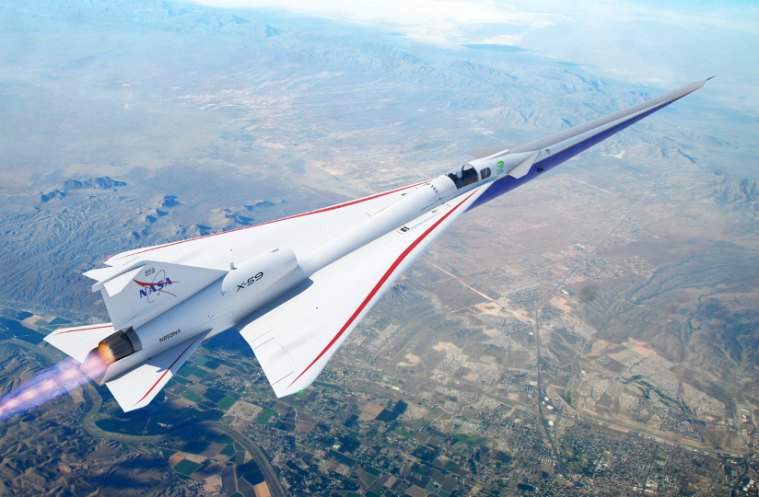
Quesst Mission Overview
Phase 1 – Aircraft Development
Aircraft design, fabrication, and ground test
Checkout and envelope expansion
Systematic Approach Leading
to Community Testing
First Flight 2023
Credit: Lockheed Martin
Phase 2 – Acoustic Validation
Detailed ground and flight measurements
Phase 3 – Community Response
Community response overflights, ground measurements, and surveys
over representative communities across the U.S.
2024
2025
www.nasa.gov |
6
Notes:
NTRS record 20220017632

Slide 7
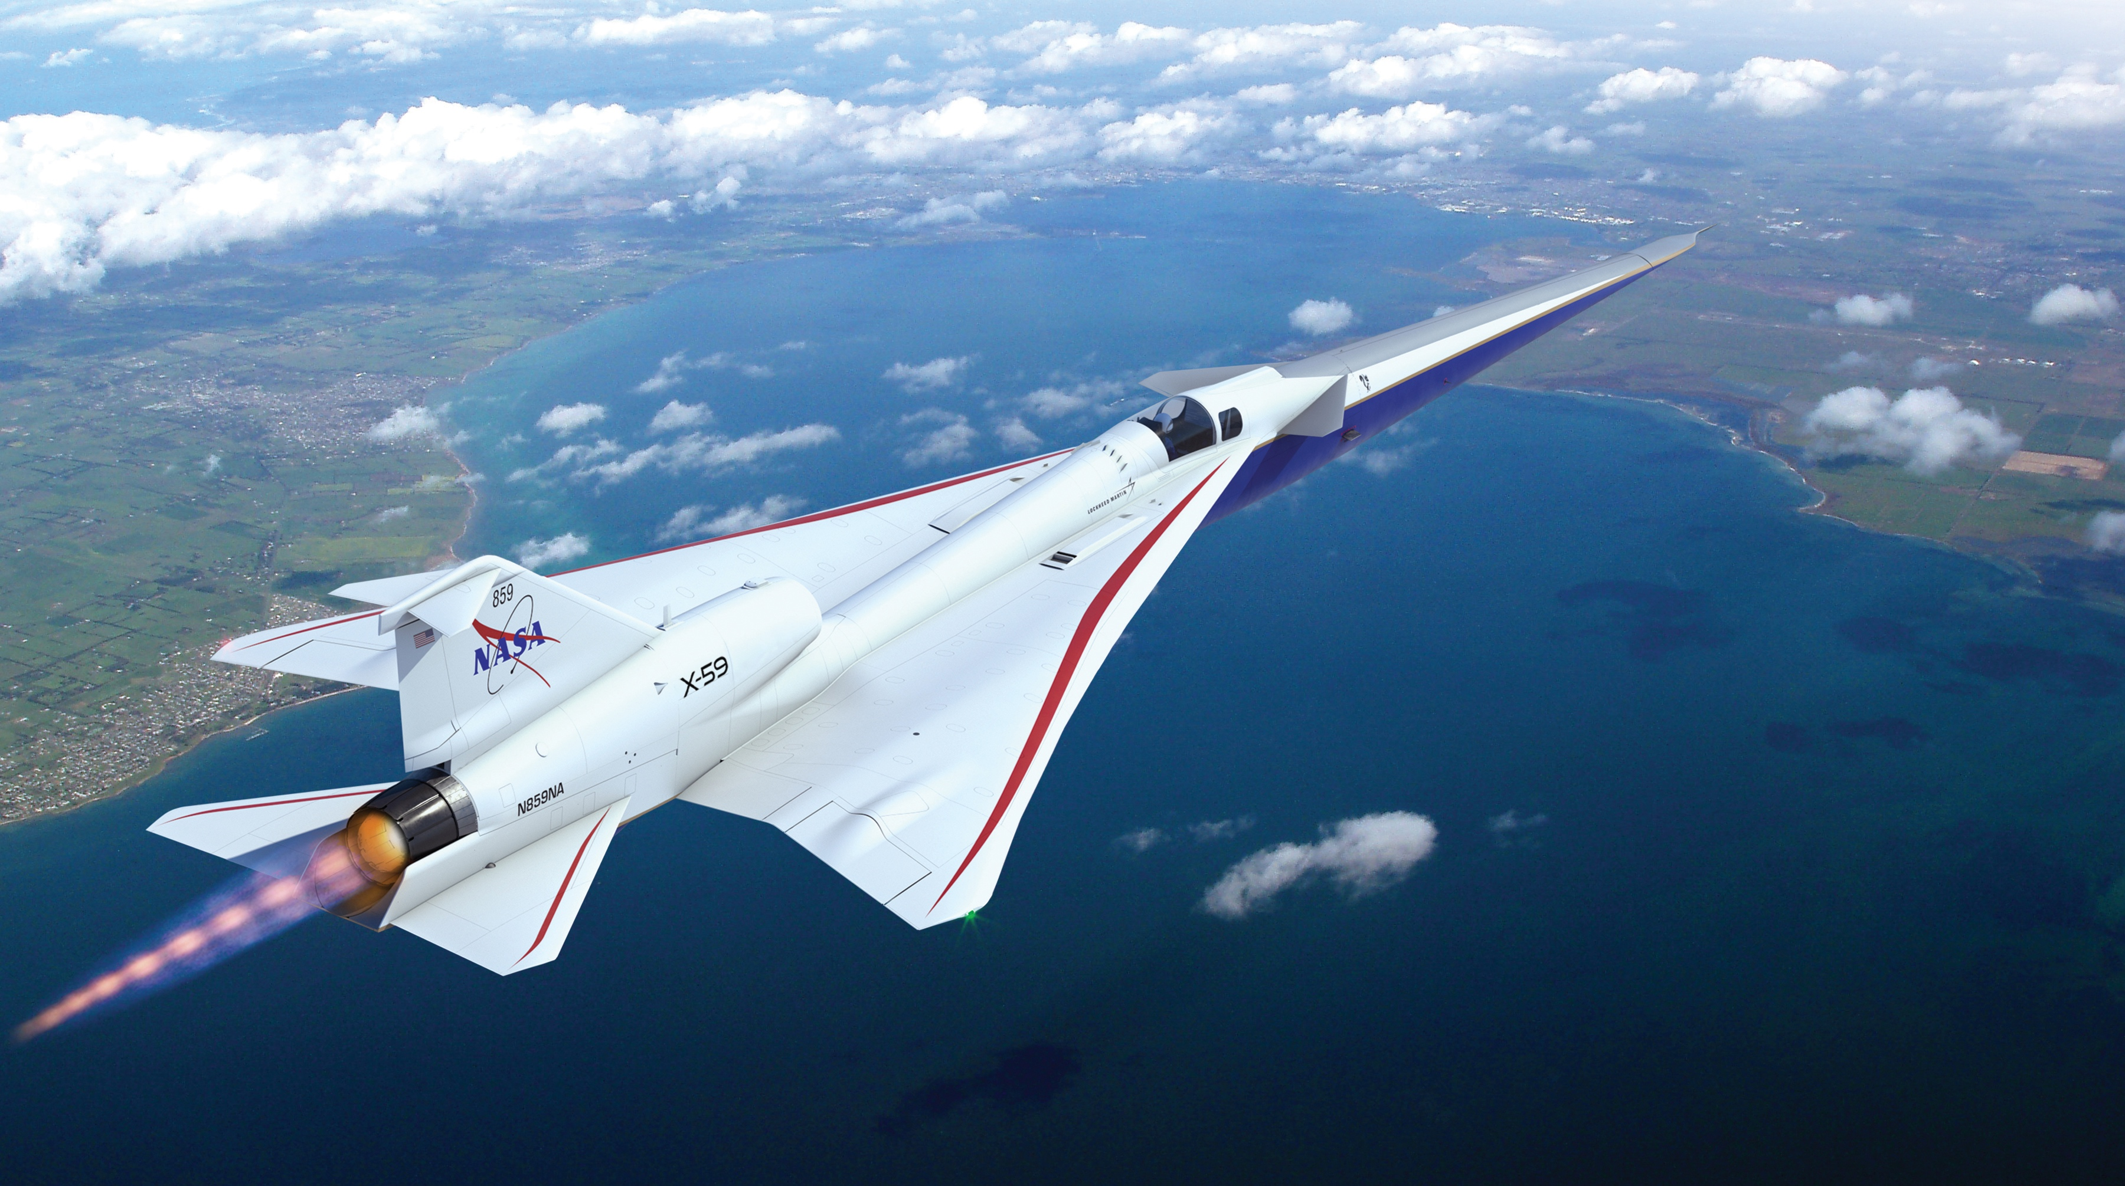
Overview of X-59 Aircraft Features
X-plane approach that meets key requirements in a cost-effective design
Long nose to shape forward shock
External and forward visions systems for forward visibility
T-38 aft canopy and ejection seat to minimize qualification cost and schedule
Fixed canard for nose-up trim at low-boom design point
T-tail to minimize aft shock
Large, unitized skins reduce parts count and manufacturing cost
F-16 landing gear and other systems from high performance aircraft to minimize qualification cost and schedule
Wing shielding to minimize impact of inlet spillage on sonic boom
Conventional tail arrangement to simplify stability and control considerations
Single GE-F414 engine with standard nozzle to minimize cost and schedule
www.nasa.gov |
7
Illustration Credit: Lockheed Martin
Notes:
NTRS record 20220017632
https://www.nasa.gov/mission_pages/lowboom/overview

Slide 8
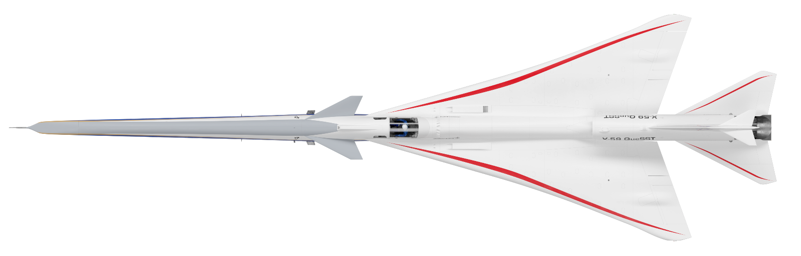
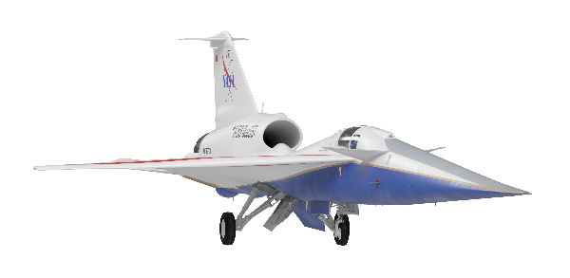
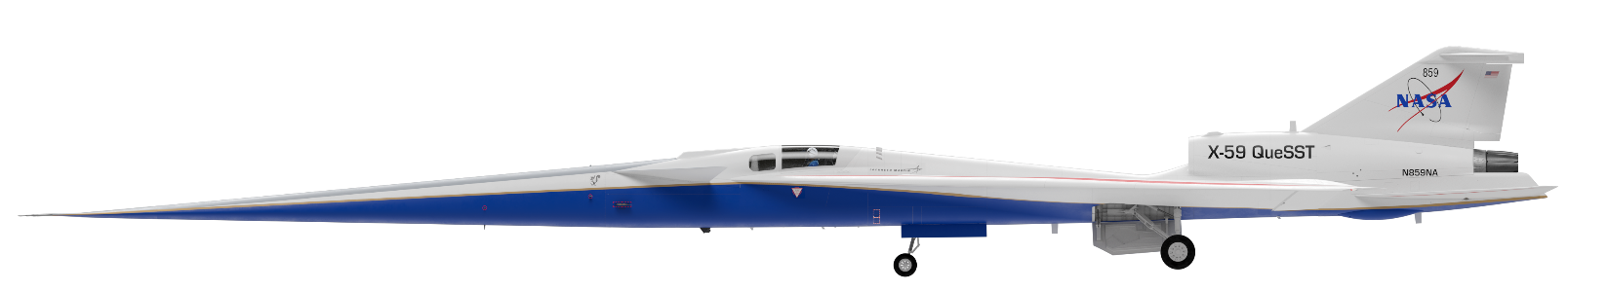
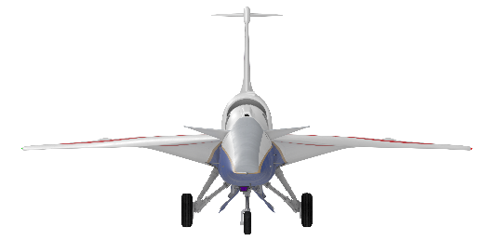

X-59 Aircraft 3-View
Configuration C612A
Max Ramp Weight | 25,000 lbs
Max Takeoff Weight | 24,300 lbs
Max Fuel Capacity | 8,700 lbs
Payload | 600 lbs
Design Mach | 1.4
Engine | 1 x F414-GE-100
Landing Gear | F-16 Blk25 NLG F-16 Blk25 MLG
Control Surfaces
Aileron | 12.9 sq ft/+35/-25 deg
Flap | 12.4 sq ft/+30/-3 deg
Stabilator | 39.9 sq ft/+20/-15 deg
Rudder | 8.5 sq ft/+25/-25 deg
T-tail | 5.7 sq ft/+10/-0 deg
63.0˚
74.0˚
63.0˚
55.7˚ Turnover
Fwd CG
68.6˚
29’ 7”
Wing span
99’ 7”
Overall length
59.0˚
23.0˚ Fwd CG
12.2˚ Aft CG
Static ground line (0.6˚ nose-up)
17’ 7”
Wheelbase
14’
Overall
height
7’ 10”
Wheel track
9.2˚
Fuselage strike
www.nasa.gov |
8
Illustration Credit: Lockheed Martin
Notes:
NTRS record 20220017632

Slide 9
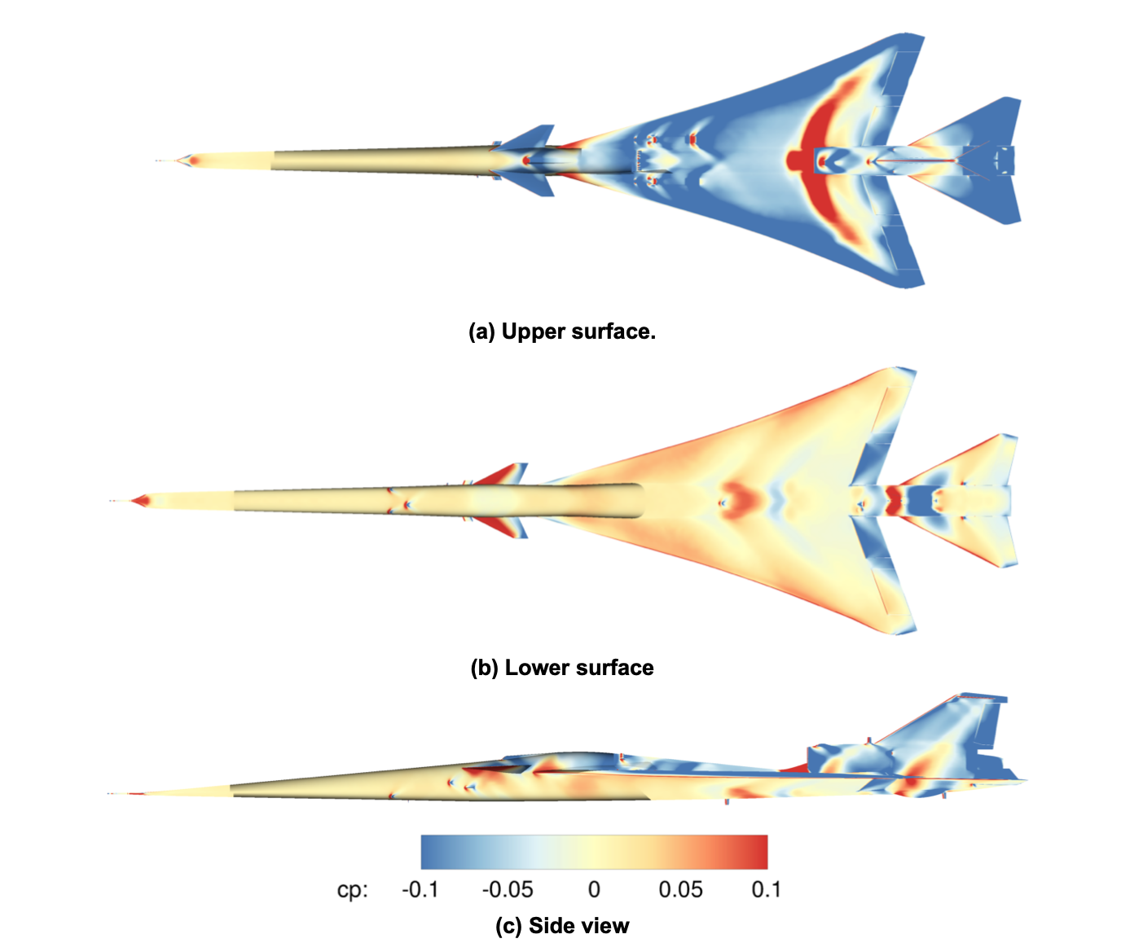
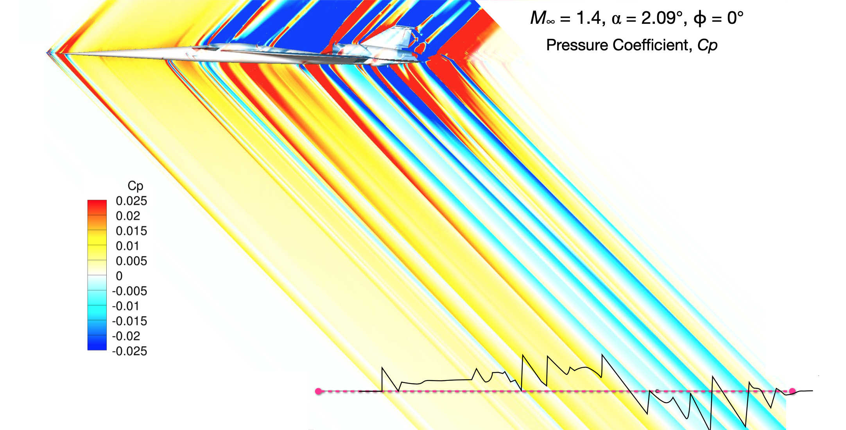
X-59 Aircraft Assessments
Sonic Boom
Aerodynamic Performance
Credit: M. Aftosmis, W. Spurlock
Credit: A. Elmiligui
www.nasa.gov |
9
Credit: Lockheed Martin Corporation
Notes:
20205002862

Slide 10
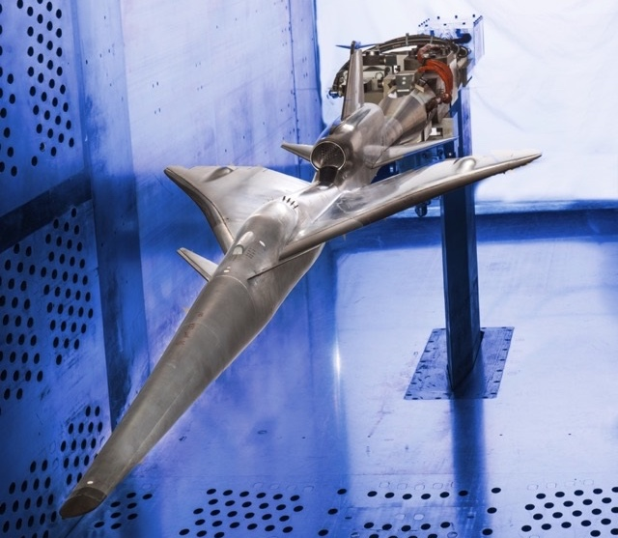
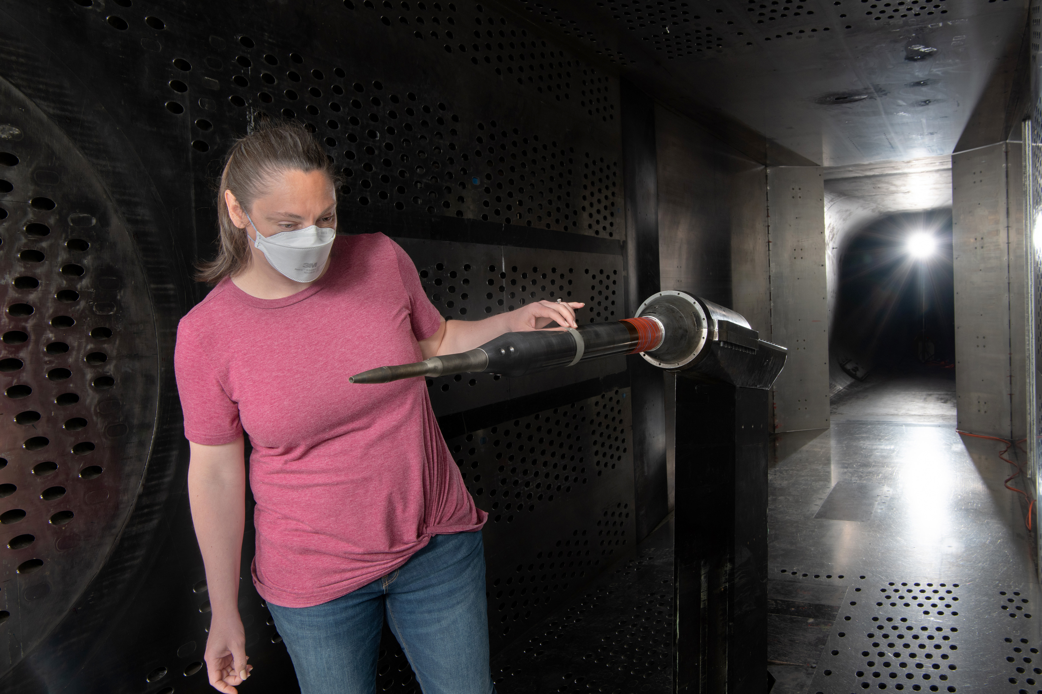
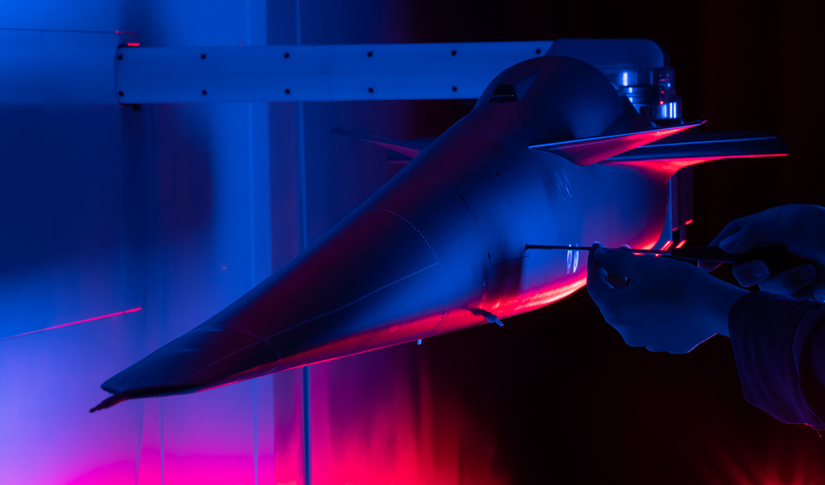
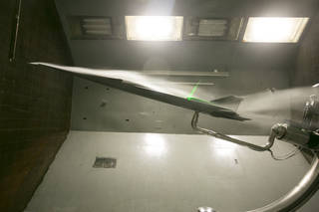
Wind Tunnel Validations
Low-and high-speed aerodynamic and Propulsion Airframe Interaction (PAI) wind-tunnel tests validate predictions and ensure readiness of the design
Photo Credit: NASA
Photo Credit: NASA
Photo Credit: NASA
www.nasa.gov |
10
Photo Credit: Lockheed Martin
Photo Credit: NASA
Photo Credit: NASA
Notes:
NTRS record 20220017632
https://www.nasa.gov/image-feature/preparing-for-the-next-generation-of-flight

Slide 11
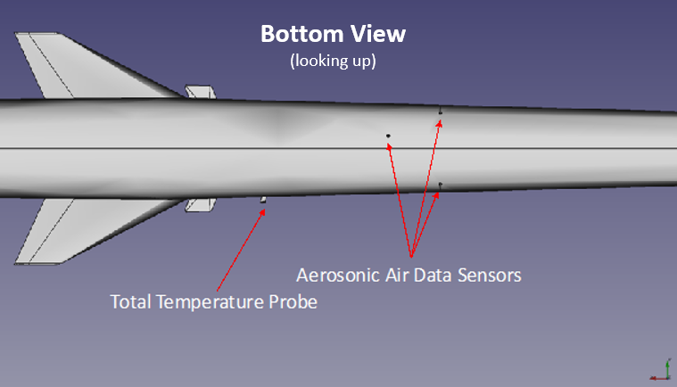
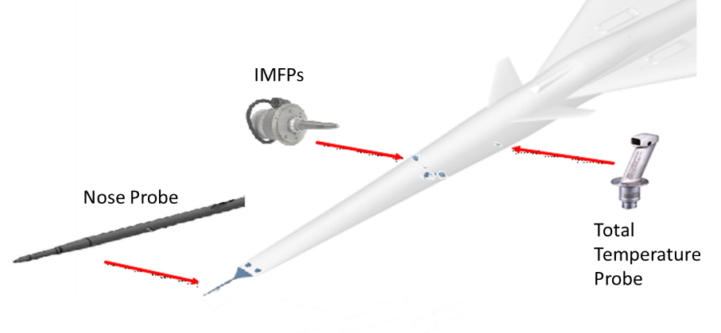
Air Data Instrumentation
Mission performance parameters (KEAS, Angle of Attack (AOA), Angle of Sideslip (AOS), Mach, Pressure Altitude)
Rosemount 857CK Sharp-Lipped Multifunction Probe (Nose Probe)
  Nose Probe mounted on 20-inch extension on nose
  Total length ~30 inch in front of aircraft nose
  Canted 2° down relative to the aircraft waterline
  Nose probe derived air data parameters (P_{T}, P_{S}, AOA and AOS)
Three Aerosonic Integrated Multifunction Probes (IMFP)
  Located forward of cockpit
  Additional sources of P_{T}, P_{S}, AOA and AOS
  Check health of nose probe
  ~26 ft aft of nose
Single Rosemount model 0102CA2W1 probe is used to measure Total Air Temperature (TAT)
Credit: Lockheed Martin
Credit: Lockheed Martin
www.nasa.gov |
11
Source: Lockheed Martin Air Data Flight Test Plan 2004-1266-06, Rev. NC

Slide 12
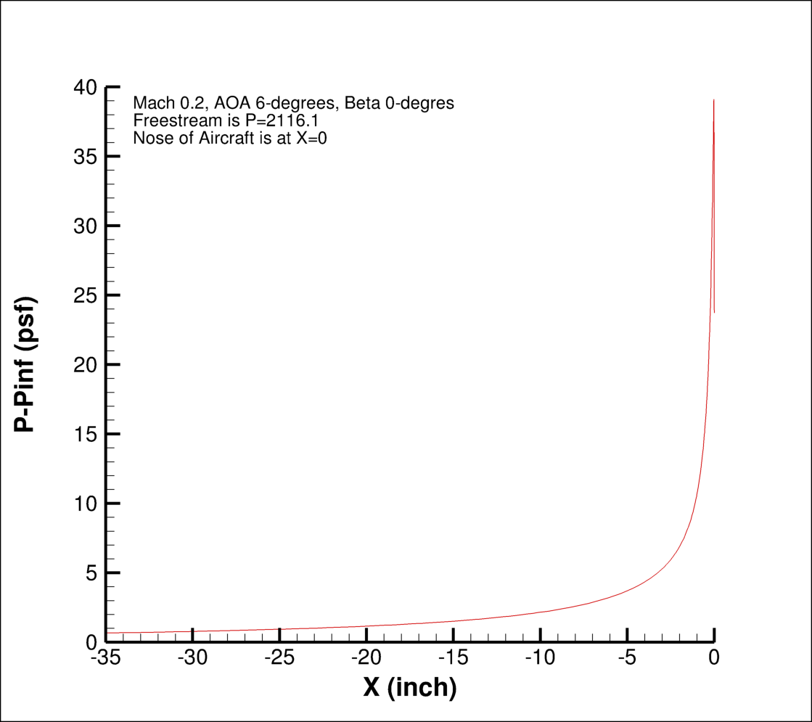
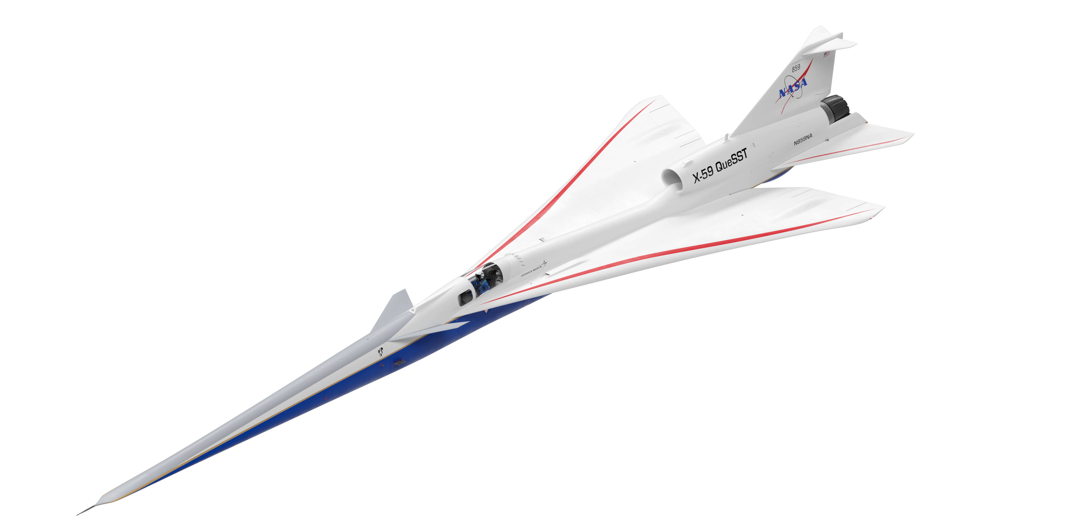
Nose Probe
Source Error Corrections
  Two wind tunnel tests of the nose probe in NASA GRC 8x6 foot Supersonic Wind Tunnel
Position Error Corrections
  Long slender nose
  Probe mounted ~30” in front of nose
  CFD – No corrections needed for P_{T}
  Minimal corrections for AOA, AOS, Mach at subsonic conditions
P_{T}
LBFD Air Data Nose Probe
Credit M. Carter
www.nasa.gov |
12

Slide 13
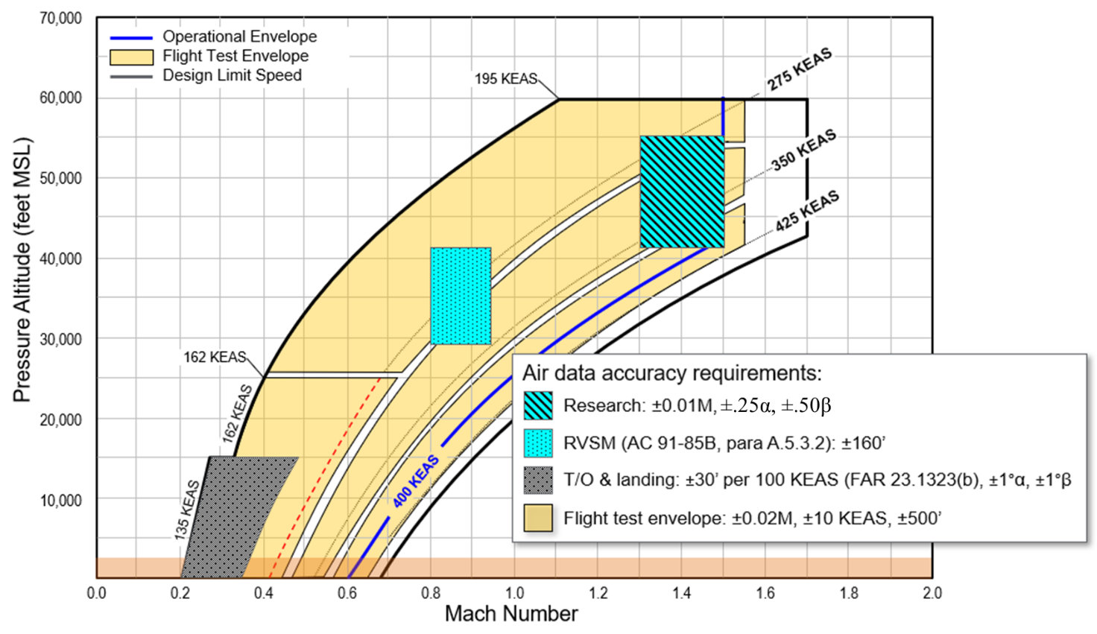
Air Data Accuracy Requirements
Research: ±0.1M, ±0.25°⍺, ±0.50°β
RVSM (AC 91-85B, para. A.5.3.2): ±160’
T/O & landing: ±30’ per 100 KEAS (FAR 23.1323(b), ±1°⍺, ±1°β
Flight test envelope: ±0.02M, ±10 KEAS, ±500’
Source: Lockheed Martin Air Data Flight Test Plan 2004-1266-06, Rev. NC
www.nasa.gov |
13

Slide 14
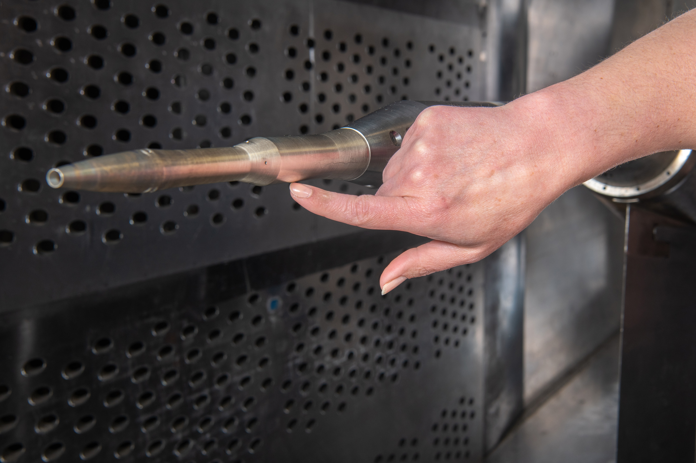
Test Overview
Wind tunnel test to calibrate the X-59 air data nose probe prior to flight
  2 entries in the NASA Glenn 8x6-Foot Supersonic Wind Tunnel, May/June 2021 and January 2022
  2 Collins 857CK multifunction air data probes (primary flight instrument and spare)
  19 Mach numbers investigated between Mach 0.25 and Mach 1.7
  Continuous roll angle sweeps at set Mach numbers and pitch angles
  Researchers from Langley, Armstrong, and Glenn attended the test, as well as employees from Lockheed Martin Skunkworks and Collins Aerospace
Nose probe, primary instrument for determining air speed, pressure altitude, AOA, and AOS of the X-59 aircraft in flight
  Critical for flight safety
  Critical data for the sonic boom research mission
The calibration will be used in the flight controls system
  Wind tunnel test to develop source error corrections for preflight calibration
  Lockheed Martin Skunkworks will do the full preflight calibration
  Neural Net check of the calibration by NASA (Ames)
  Wind tunnel data will be supplemented by CFD data (Langley)
  During Phase I flight testing, the air data nose probe and air data system as a whole will be further calibrated to account for additional installed effects of the airframe
“X-59 Air Data Probe Calibration Wind Tunnel Test” – C. Winski et al. @ 9:50
Photo Credit: NASA
X-59 Air Data Nose Probe installed in the GRC 8x6 Supersonic Wind Tunnel
www.nasa.gov |
14

Slide 15
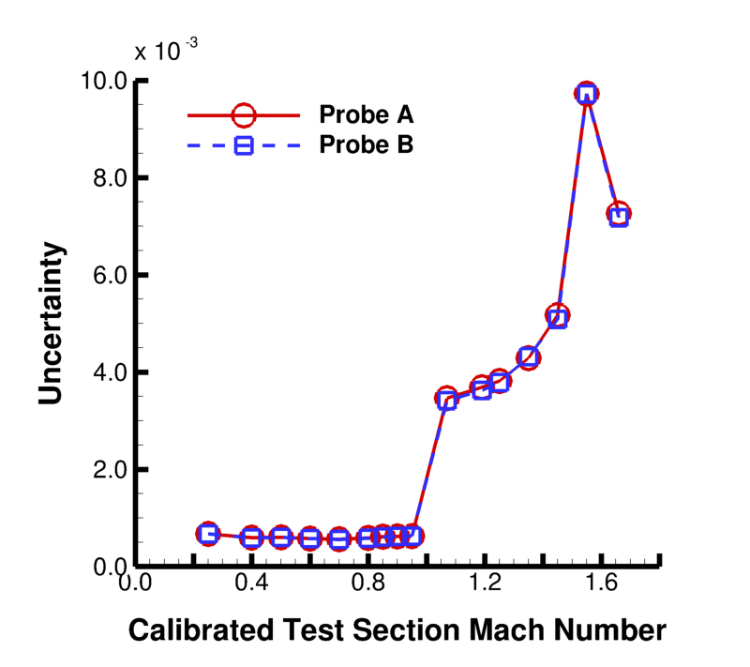
Data Uncertainty
Measurement accuracy and uncertainty analyses performed regarding:
  Calibrated Test Section
    Mach number
    Static pressure
    Total pressure
    Total temperature
  Air Data Probe Pressures
    Static and total
  Air Data Probe Orientation
    Yaw angle
    Pitch angle
The analyses showed that the two air data probes tested are statistically identical
“Measurement Accuracy and Uncertainty Analysis of the X-59 Air Data Probe Calibration Test Entry One” - D Friedlander et al. @ 10:10
Uncertainty in normalized air data total pressure
www.nasa.gov |
15

Slide 16
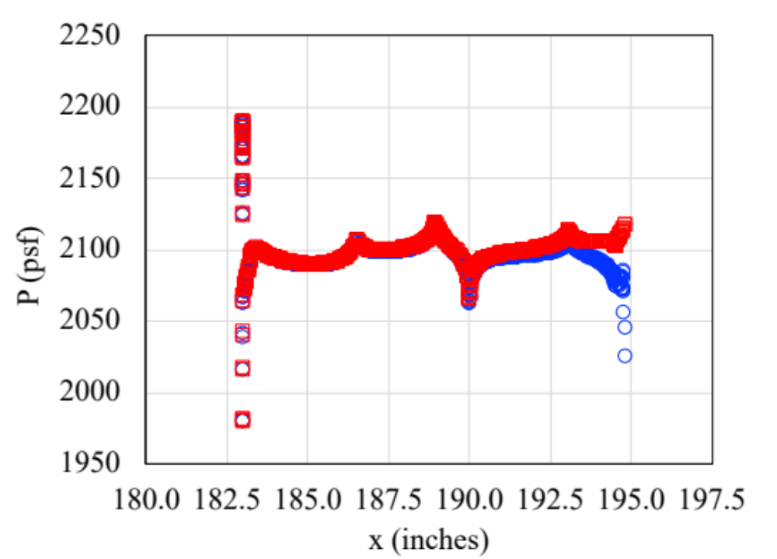
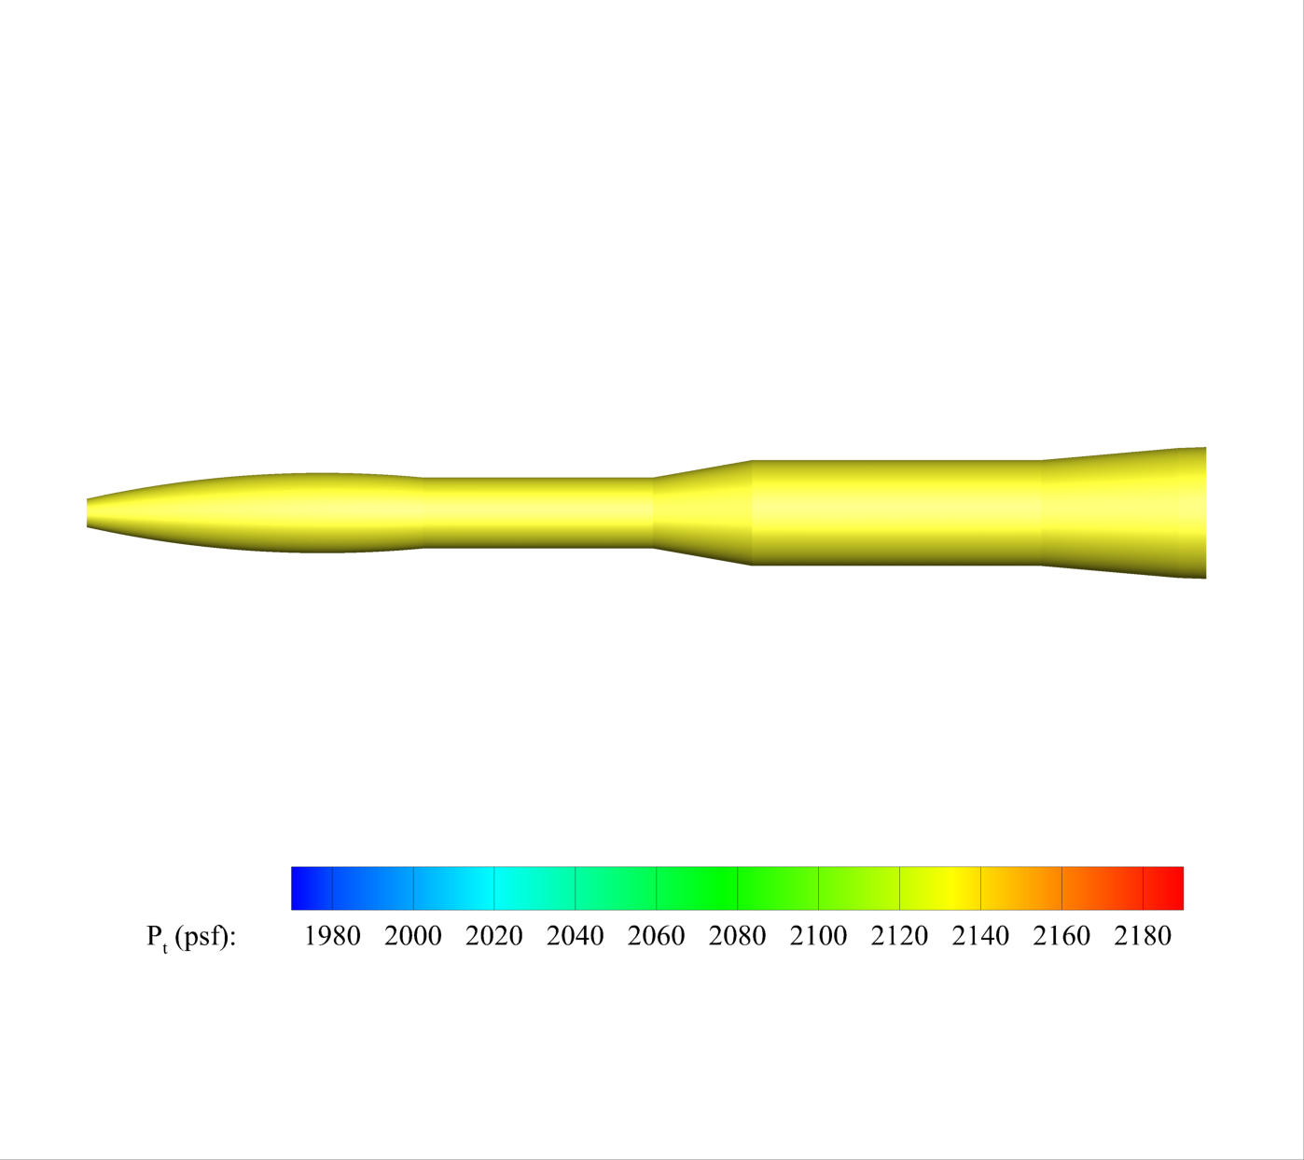
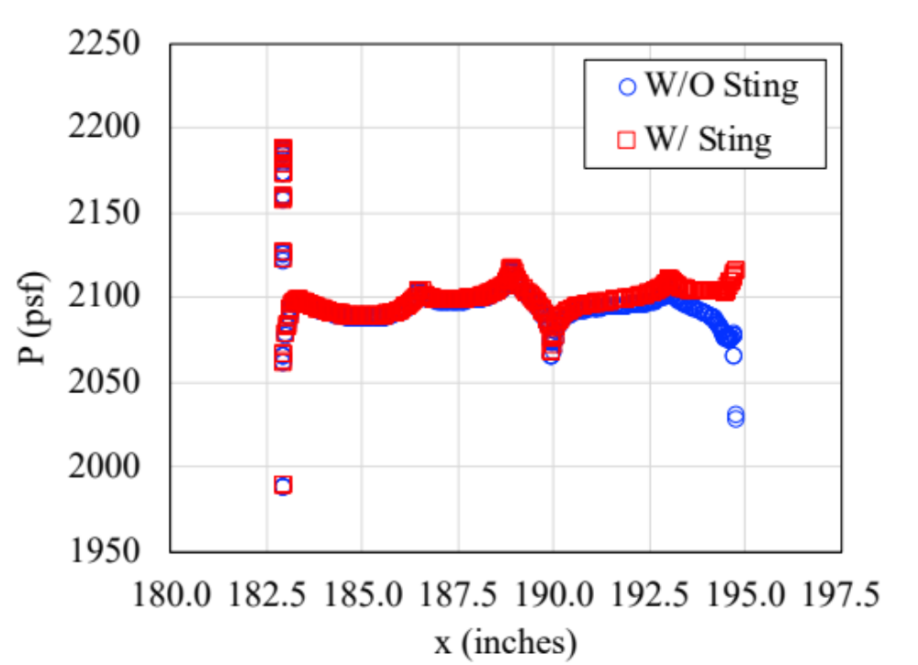
CFD Overview
Mach 0.25, Re/in = 138,417, 𝛂, 𝛃 = 0°
Pre- and Post-Test CFD with FUN3D Flow Solver
  Grid Refinement Study
  Assessment of Sting Effects
  Altitude Study
  Pressure Port Modeling Studies
“FUN3D Analyses in Support of the X-59 Pitot Probe Wind Tunnel Test” – M. Bozeman et al. @ 10:30
Sting Effects on Predicted Static Pressure
www.nasa.gov |
16

Slide 17
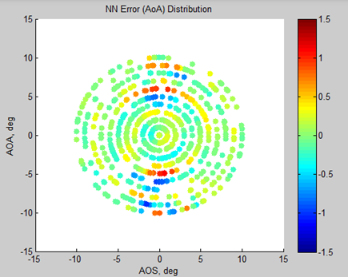
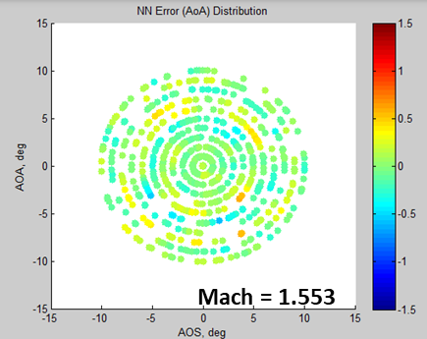
Neural Net (NN) Development
NASA NN development is a parallel independent effort to the Lockheed Martin (LM) NN effort
Desire relating 6 probe port pressures to 5 flight parameters
  Mission performance parameters (KEAS, AOA, AOS, etc…
15 Mach numbers x 19 probe angles x 7500 probe azimuths x 11 parameters ~ 20M data points to model
Large number of data points, large number of inputs and outputs >> use a Neural Net!
  (Neural net ~ multidimensional curve fit)
Quantify modelling errors/accuracies
LM baseline and potential higher accuracy input vs output models
Robust models that are more tolerant to sensor/port degradations
“The development of neural net algorithms used to calibrate the X-59 air data system nose probe, using wind tunnel data” – K Long et al. @ 10:50
Larger modelling errors when fewer input parameters are used
AoA Error (deg), 3 input parameters
Angle of Attack, deg
Mach = 1.553
Angle of Sideslip, deg
AoA Error (deg), 6 input parameters
Angle of Attack, deg
Angle of Sideslip, deg
Effects of Modelling Assumptions
on X-59 Air Data Probe NN AoA Calibration Error (zero sensor error)
www.nasa.gov |
17

Slide 18
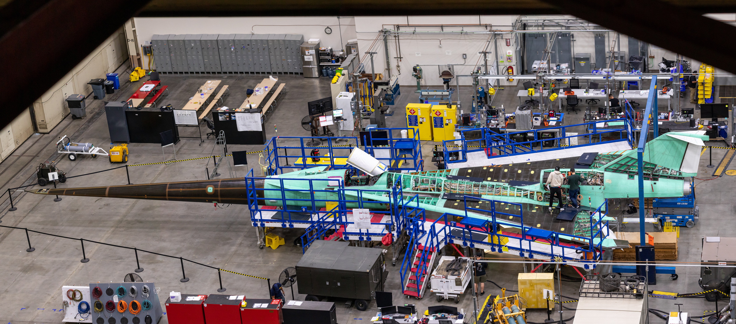
Current Aircraft Status
Photo Credit: Lockheed Martin
www.nasa.gov |
18

Slide 19

nasa.gov/quesst
www.nasa.gov |
19

