Slide 1



Effects of Defects Analysis and Sizing Framework for Efficient Design of Composite Structures
August Noevere
Collier Aerospace

Slide 2
Outline
Background and Introduction
Integration into Commercial Stress Analysis Tool
Approach
Example with Wrinkling Data
Conclusions

Slide 3
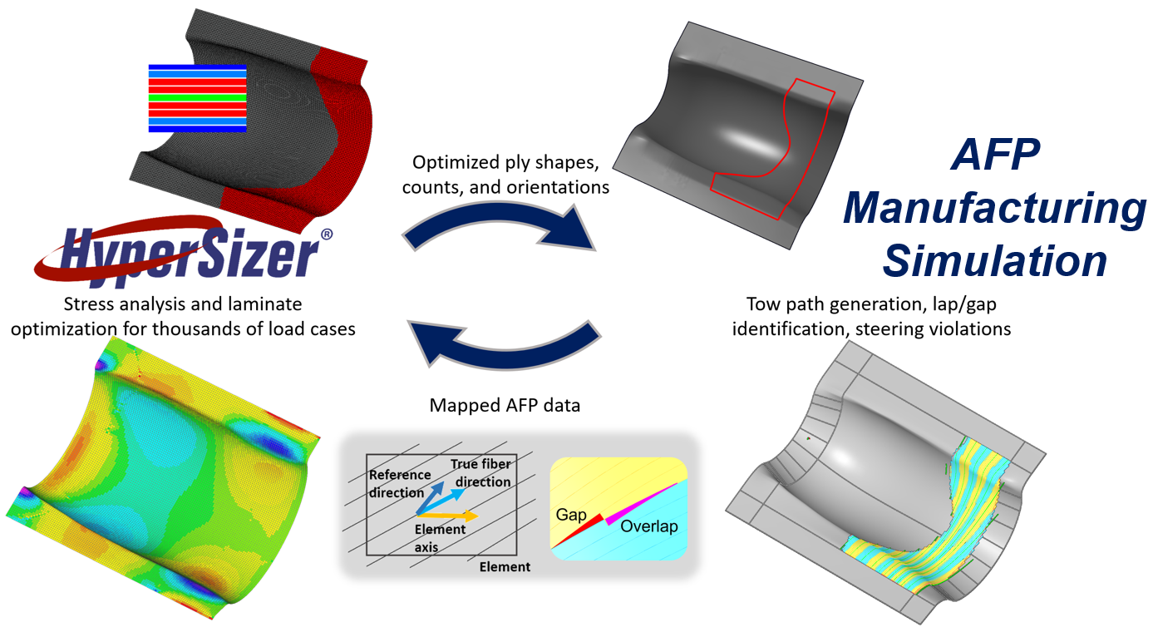




Background: HiCAM Design for Manufacturing (DFM) Project
CAPP

Slide 4
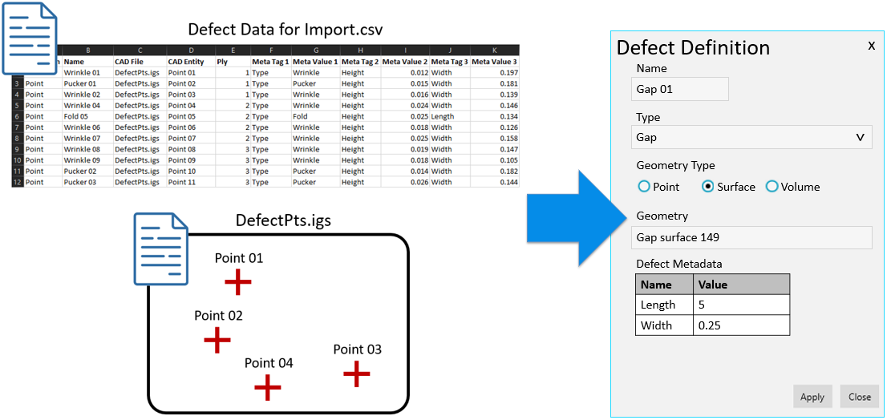
Introduction and Background
Previous work done in the Advanced Composite Consortium (ACC) Design for Manufacturing (DFM) project:
  Map as-manufactured fiber directions from VCP to analysis model
  Map lap and gap data from VCP to analysis model
  Map simulated wrinkles from COMPRO to VCP
The goal of the current work is to expand this defect mapping into a generalized tool that can import and analyze defects from any source
  Manufacturing process simulations
  Kinematic simulations
  Real defect data – recorded in-situ or via NDE

Slide 5
Outline
Background and Introduction
Integration into Commercial Stress Analysis Tool
Approach
Example with Wrinkling Data
Conclusions

Slide 6
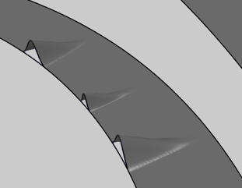
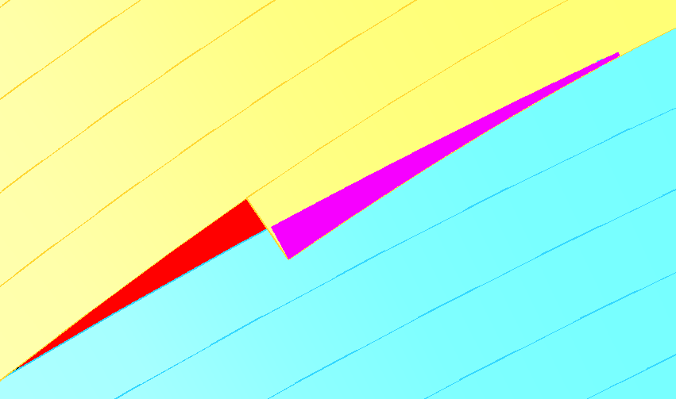
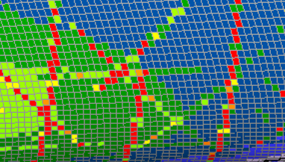

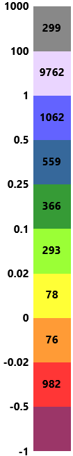

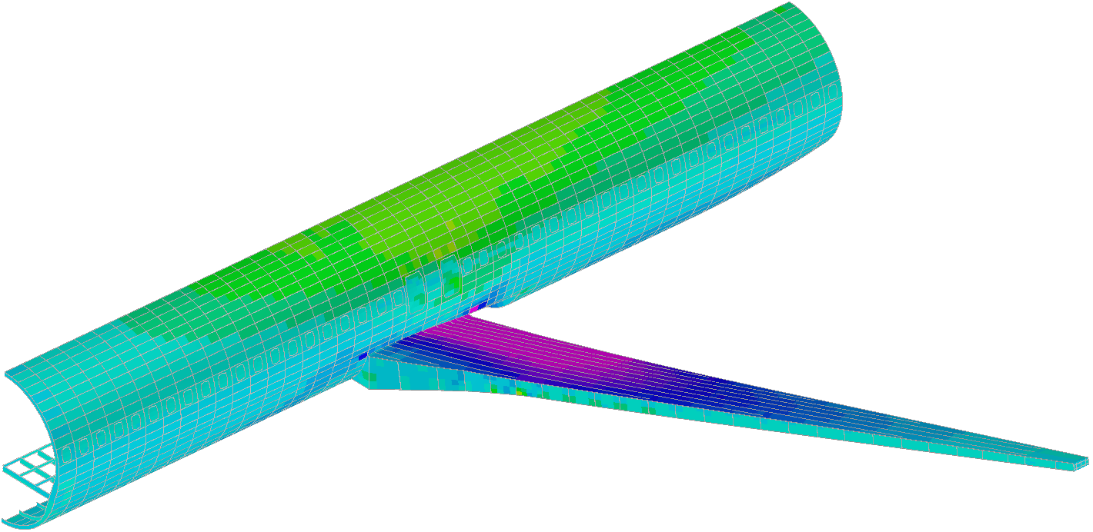
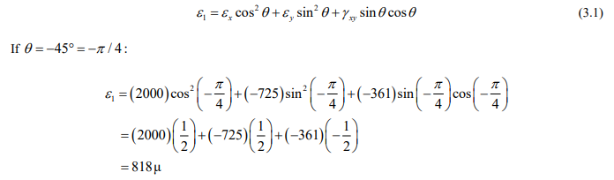
Integration into HyperX
Defect data
  Imported from any source and mapped to the FEM
Custom analysis plugins
  (In work)
  Define custom analysis approaches using defect data
  View analysis results in HyperX
Structural design and loads
  Loads from FEA are stored in HyperX and used to optimize the composite design
Effect of Defects Framework
Defect Data Mapped to FEM
Analysis and Margin Writing
Custom Analysis Plugins
Structural Design and Loads
Wrinkle Analysis
Gap Analysis
Fiber Dev. Analysis

Slide 7
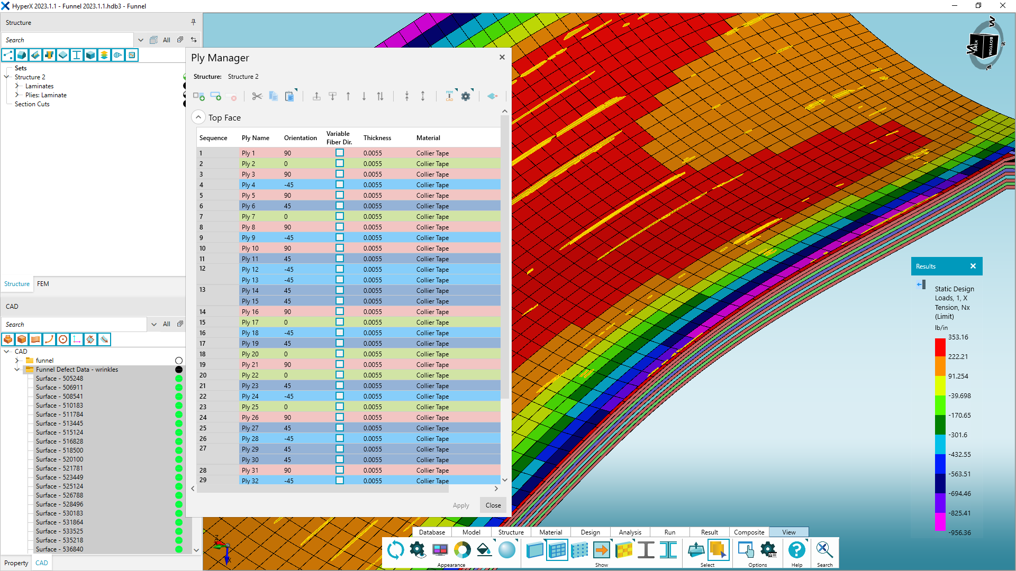
Defects in HyperX

Slide 8
Outline
Background and Introduction
Integration into Commercial Stress Analysis Tool
Approach
Example with Wrinkling Data
Conclusions

Slide 9
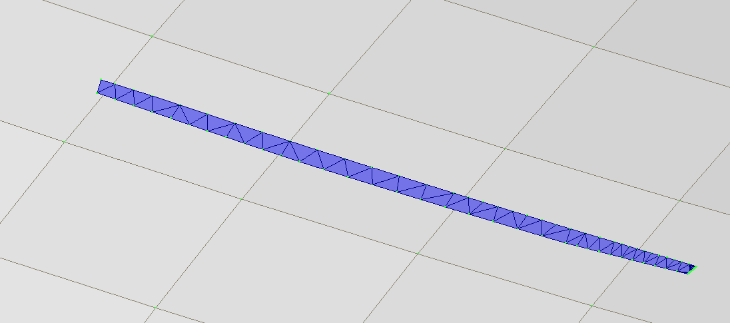
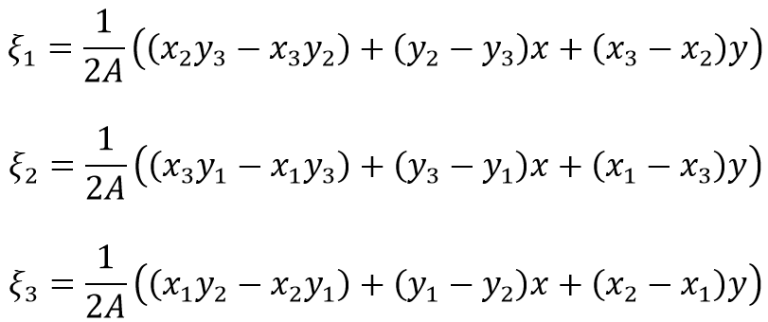
Mapping Approach
A standard approach for mapping was implemented:
  Defect surface is tessellated
  Centroid of each triangle in the tessellation is projected to the FEM mesh
  Once a FEM element is found that has a successful projection, the defect data (length, width, etc) is associated with that element
Mesh mapping with area coordinates
Tessellation Centroid
D_{proj}
Node 3
FEM Mesh
A₂
A₁
Node 1
A₃
Node 2
Defect Mesh

Slide 10
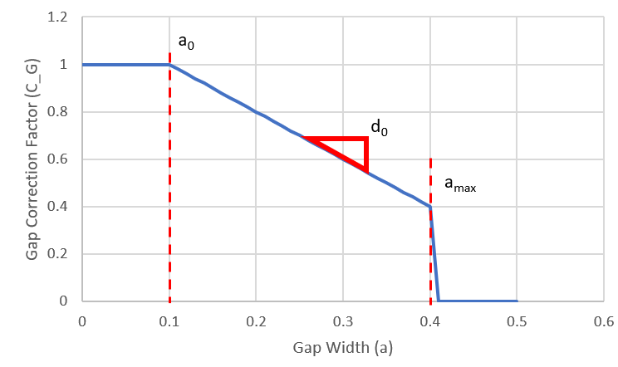
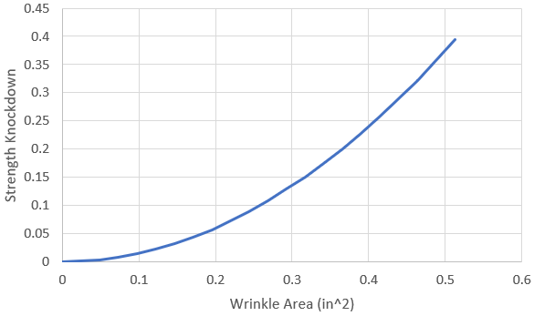
Analysis Approach
Example knockdown for gaps as a function of gap width
Long-term goal is for the defect analysis approach to be fully customizable – still in work
Short-term: a knockdown based approach is used
  A knockdown curve is created to define the severity as a function of a defect trait (such as area or length)
  This curve is referenced during analysis and used to modify the composite strength allowable (ply based or laminate based)
Example knockdown for wrinkles as a function of wrinkle area

Slide 11
Outline
Background and Introduction
Integration into Commercial Stress Analysis Tool
Approach
Example with Wrinkling Data
Conclusions

Slide 12
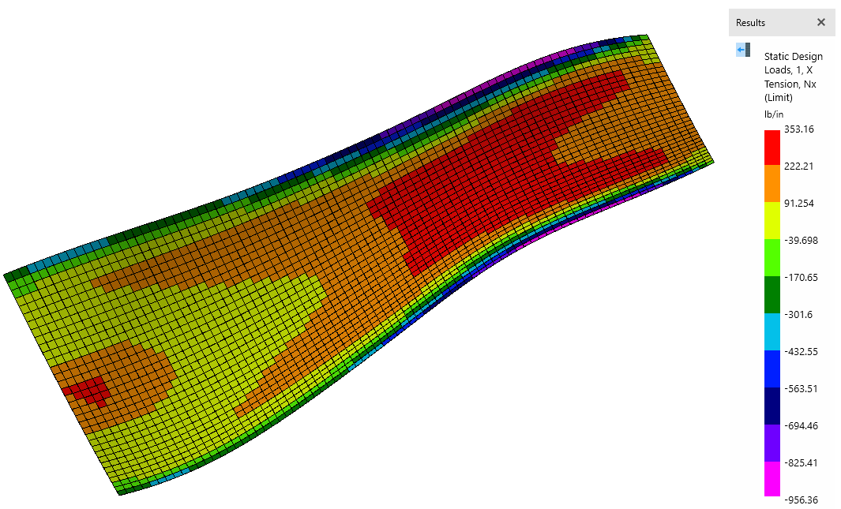
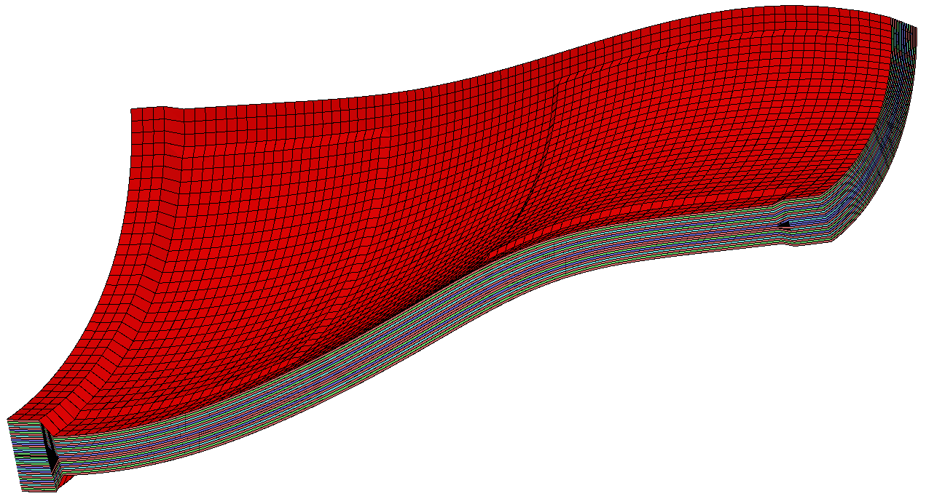
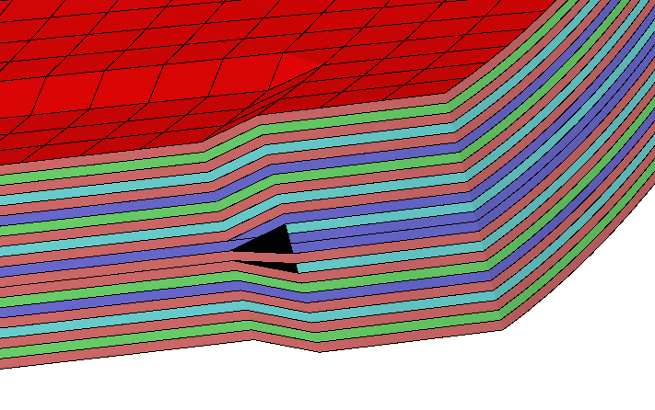
Setup for Demonstration
The demonstration model has a “funnel” shape with double curvature
A FEM was built and FEA performed with three load cases to generate representative loads
  Tension on long axis
  Tension on short axis
  Pressure
Laminate optimization was performed in HyperX to generate plies

Slide 13
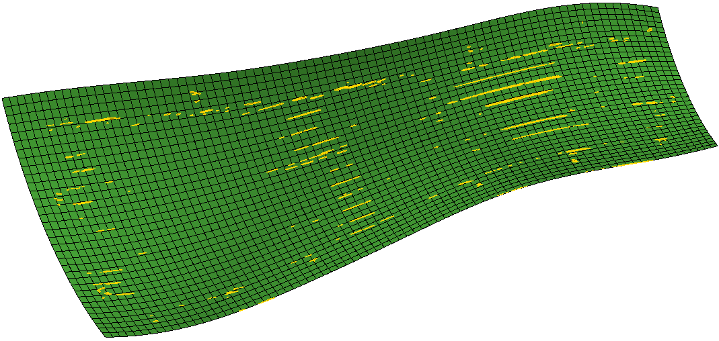
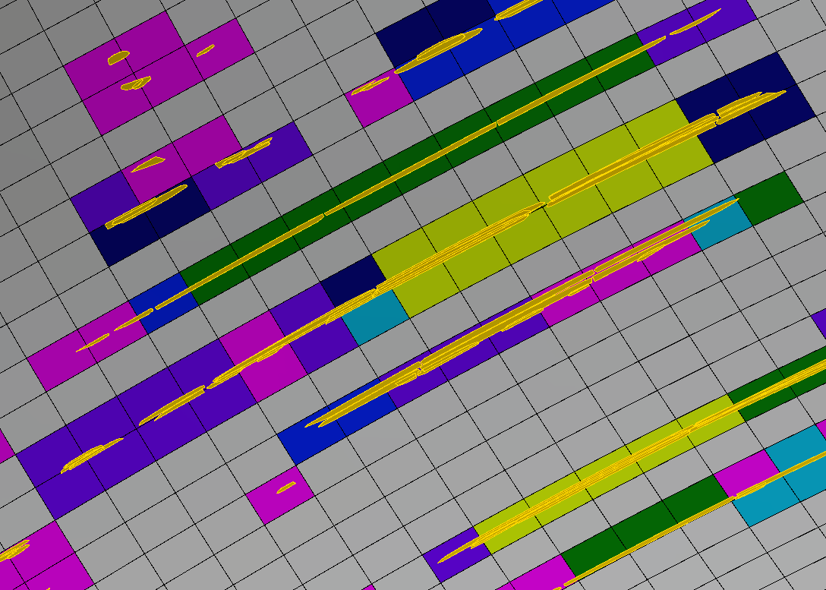
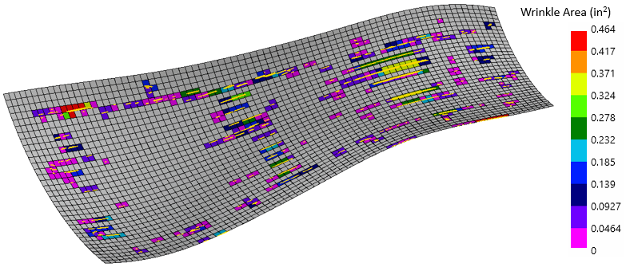
Mapping of Wrinkling Data
Wrinkles were recorded in-situ at USC’s McNair center with the ACSIS system
Wrinkles were provided in a .stp file as surface patches
Mapping

Slide 14
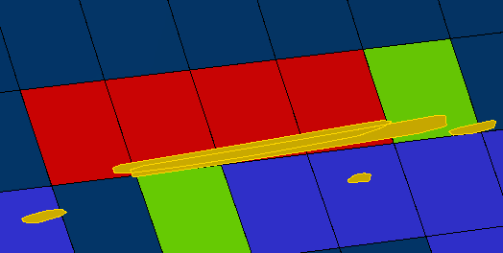
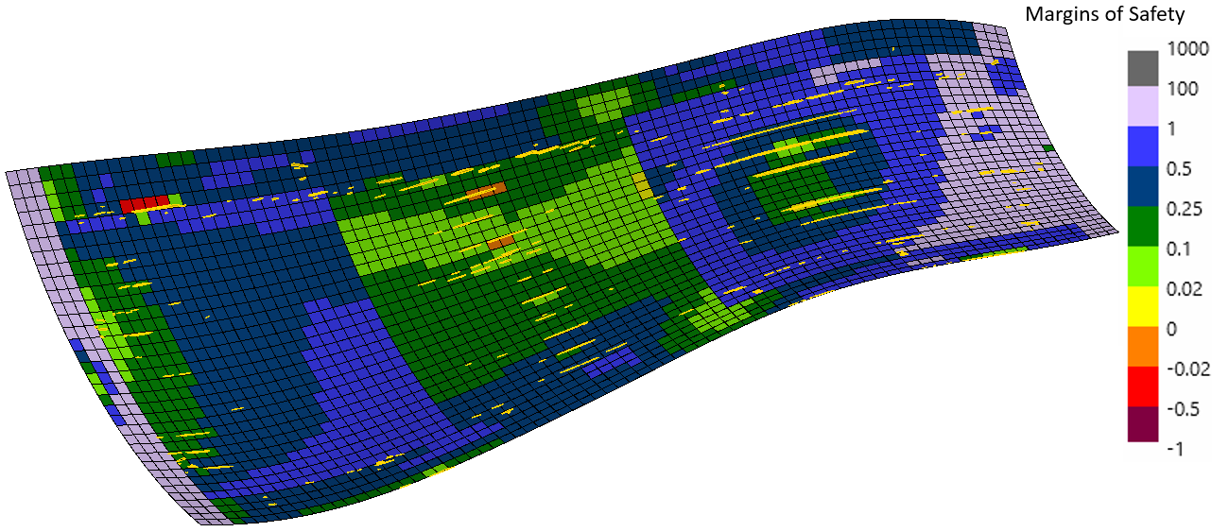
Analysis with Wrinkles
Strength knockdowns per element were applied according to the area of the wrinkle covering the element
Ply-based analysis revealed that the wrinkles could cause structural failure (negative margins)
Effected Elements
Wrinkles

Slide 15
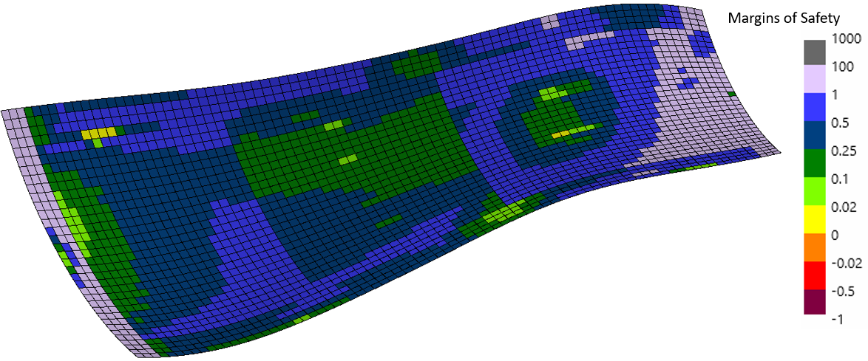
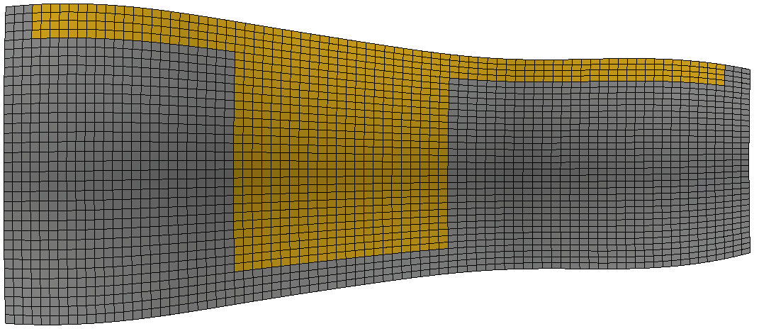
Resizing the Laminate
The laminate was resized to resolve negative margins generated by the wrinkles
Resizing was achieved by using the negative margins to establish “required” margins during resizing with pristine properties
  Example: element with -10% margin would be required to have a +10% margin during resizing
After resizing structure
After resizing structure
Added ply

Slide 16
Outline
Background and Introduction
Integration into Commercial Stress Analysis Tool
Approach
Example with Wrinkling Data
Conclusions

Slide 17
Conclusions
An effects of defects framework has been planned and initiated in HyperX
  Mapping of defects
  Analysis with a simple knockdown based approach
The process was demonstrated on a model with real wrinkle data captured from in-situ scans
Future work: improve HyperX analysis plugins to allow fully customizable analysis of defects

Slide 18
Thank you! Questions?
Acknowledgements
The material contained in this paper is based upon work supported by NASA under award No. 80NSSC22M0157.
Any opinions, findings, and conclusions or recommendations expressed in this material are those of the author(s) and do not necessarily reflect the views of the National Aeronautics and Space Administration.
Thanks to the McNAIR Center at University of South Carolina for providing the CAD model and wrinkle scan data.

