Slide 1
Modeling of particle transport and impact in transient, multiphase oxidizer-rich environments using computational fluid dynamics and Lagrangian particle tracking
M.V. Fischels⁰, M.J. Brunhart¹, A.J. Rips², H.Q. Yang³, J.S. West⁰, and B.R. Williams⁰
⁰ER42, Fluid Dynamics Branch
¹ Jacobs Technology, Incorporated | JSEG
² Tuskegee University | JSEG
³CFD Research Corporation
NASA Marshall Space Flight Center, AL

Slide 2
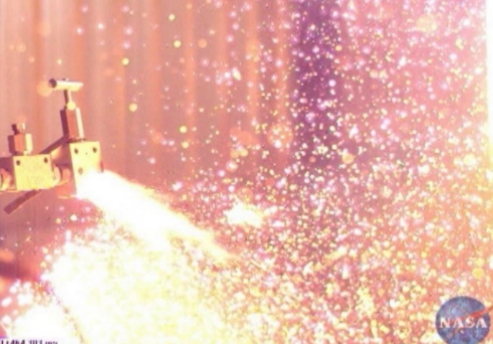
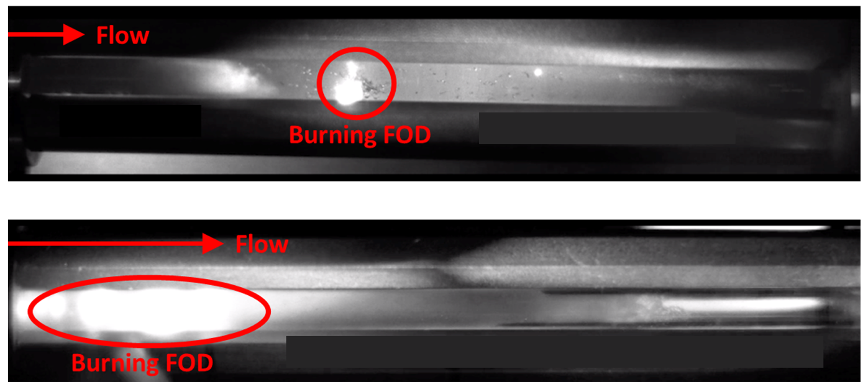
Background
Oxidizer-rich environments in propulsion systems present a risk for ignition and combustion, which can lead to catastrophic failure
  Both cryogenic oxygen and storable oxidizer systems
  Risk is dependent on oxidizer, wall material, and ignition source
Ignition sources include adiabatic compression, frictional heating, and particle impact
  Present work focuses on particle impact from foreign object debris (FOD)
NASA programs conduct oxidizer compatibility assessments to determine if conditions for ignition exist and are likely
Particle impact testing used to assess ignition criteria (WSTF)
Aftermath of particle impacts causing burning of the parent metal and resulting in catastrophic failure
Fluid dynamics branch (ER42) at NASA Marshall Space Flight Center developed capability to model oxidizer environments and predict particle impacts using CFD
  Reduce need for repeated, expensive system level testing
  Analysis provided for multiple compatibility assessments
  Analysis for WSTF test support (test rig characterization)
Particles burning in liquid oxidizer
Images courtesy of Steve Peralta/NASA WSTF

Slide 3
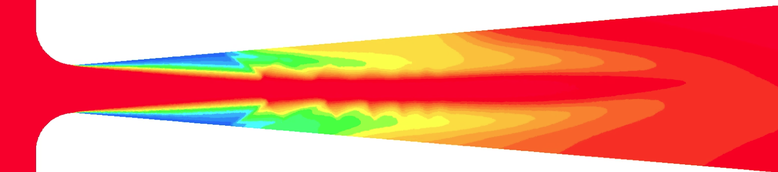
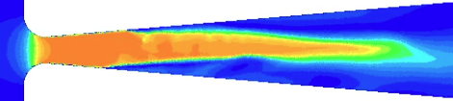
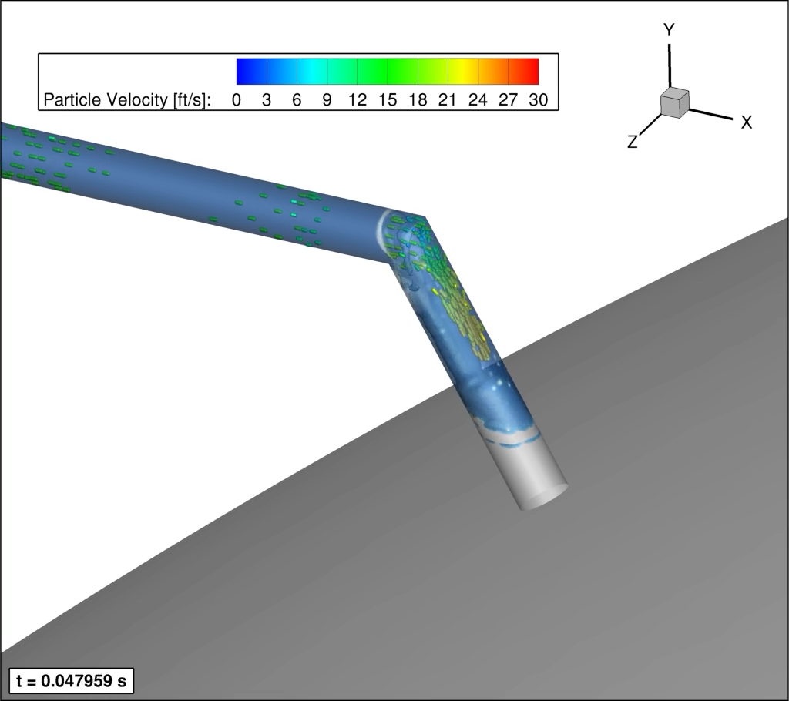
Analysis Models
CFD modeling performed with solvers based on Loci framework
Loci/CHEM solver is a density-based solver
  Real fluids equations of state for liquid oxidizers using tabulated data
  Merkle cavitation model for phase change
Loci/STREAM-VoF solver is a pressure-based solver
  Volume of Fluid model tracks liquid-vapor interfaces and captures vapor bubbles and liquid droplets
  Both solvers highly parallel, unstructured, finite-volume solvers with multiple turbulence models including RANS & hybrid RANS-LES
  FOD particles modeled using debris transport analysis (DTA)
    One-way coupled Lagrangian particle tracking using CFD flow field
    Multiple particle models including spheres, cylinders, and cubes
    Predicts particle impacts and reports impact velocity, energy, angle as well as local fluid environment (pressure, temperature, phase)
  CFD and DTA of several oxidizer components in following charts
Loci/CHEM Simulation of Cavitating Device
Cavitation region, vapor
Density
Velocity
Loci/STREAM-VoF Simulation of Liquid with DTA
Particle tracking, colored by velocity
Liquid (blue) onrush around tube bend

Slide 4
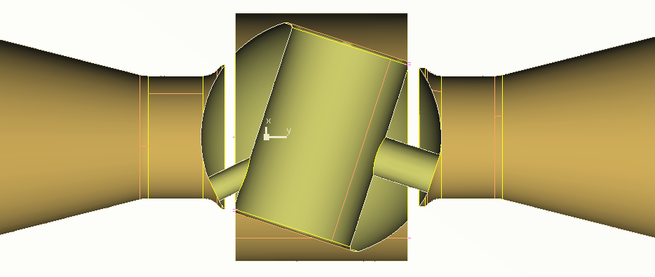
Valve Analysis Model
Multiple types of valves exist in oxidizer systems and can produce high particle velocities
Time-accurate 3D CFD and DTA analysis completed for ball valve below using Loci/CHEM
Priming operation occurs with valve in partially open priming position (see below)
Two fluid conditions of interest:
  Pure gas oxidizer with ideal gas fluid model
  Liquid oxidizer with cavitation and flashing in downstream line
Inlet is at tank pressure and outlet at near vacuum
Ball Valve In Priming Position
Ball
Near Vacuum
Valve Housing
Tank Pressure
Outlet
Inlet
Priming Orifice
Upstream Orifice

Slide 5
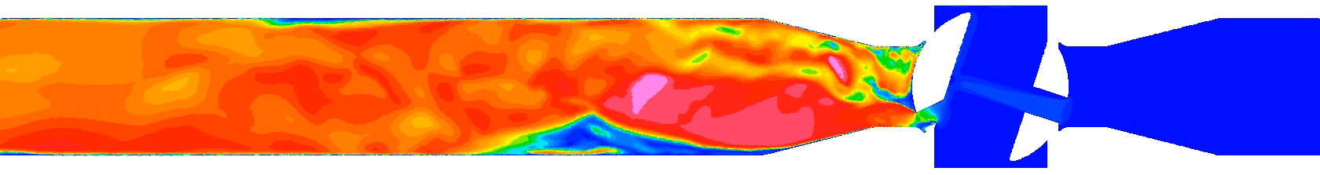
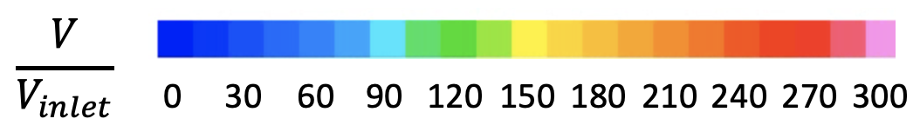
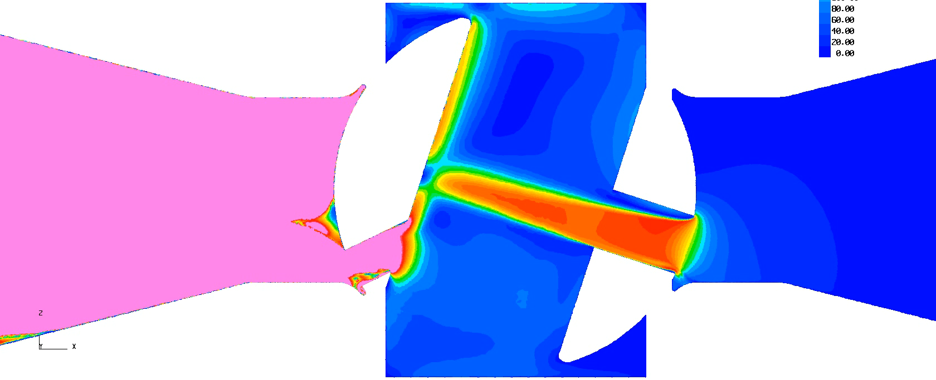
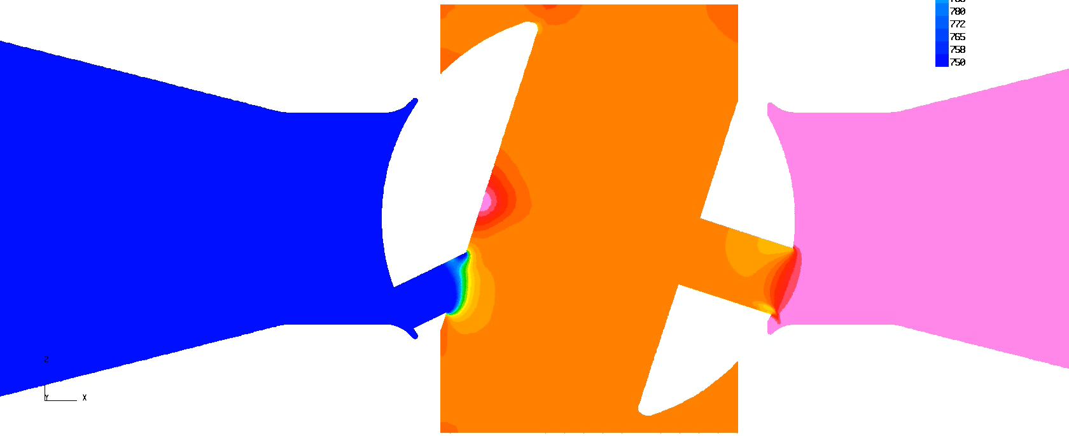
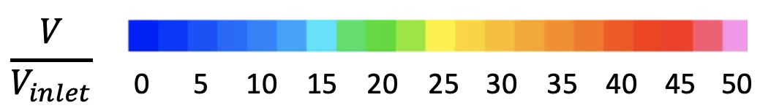
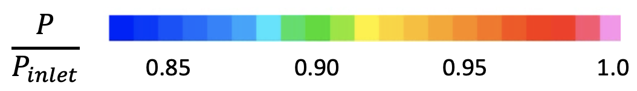
Valve: Gas Simulation Flow Field
Animations are from cuts through center plane
Flow
High velocity unsteady flow downstream
Smaller orifice chokes flow
Larger orifice increases velocity 45x over inlet velocity
1: Valve interior impact region at higher pressure
Two regions where high velocity FOD impacts are possible
Flow
2: Downstream impact region at lower pressure

Slide 6
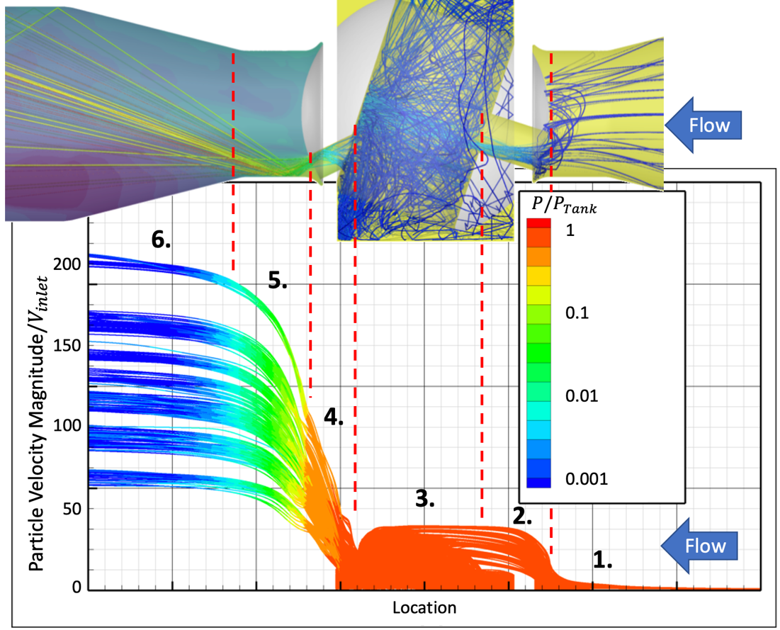
Valve: Gas Simulation DTA
Time-averaged CFD used for DTA
5-100 micron diameter spherical particles seeded at inlet
Particle trajectories shown at right
Particle Impacts:
Lower velocity normal impacts in valve interior near tank pressure (point 3)
Higher velocity shallow impacts at valve exit in lower pressure region (points 4-6)
Higher ignition risk at higher fluid pressure
  Trade-off between particle velocity and fluid pressure
  Requires impact testing over a range of fluid pressures to assess ignition risk

Slide 7
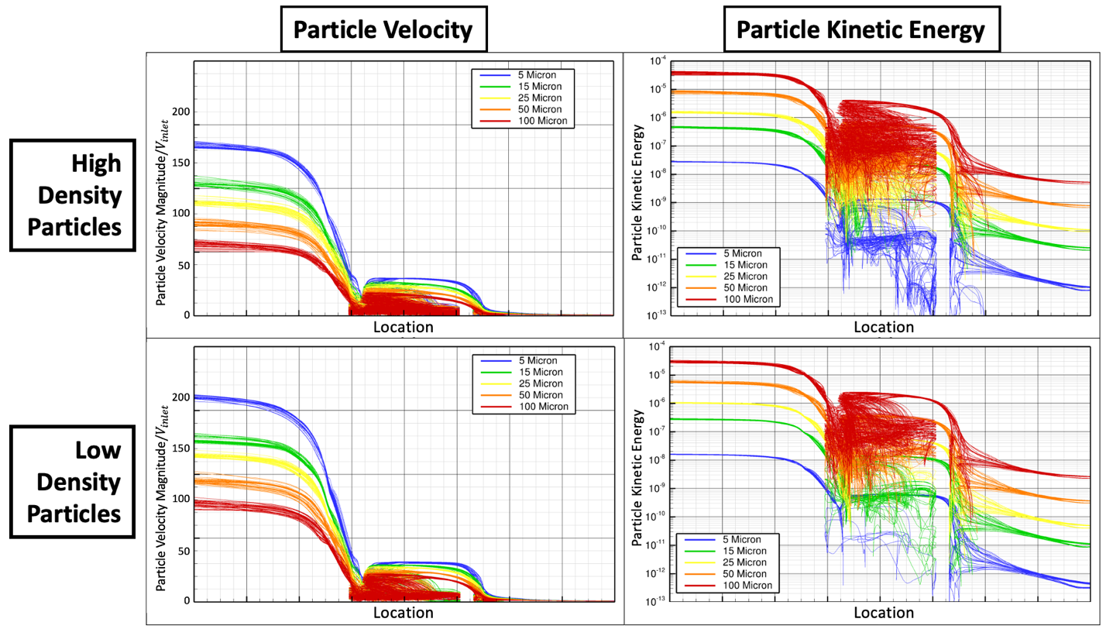
Valve: Gas Simulation DTA – Particle Sensitivity
Particle size and density has significant effect on velocity
Despite lower velocities, larger and more dense particles have significantly higher kinetic energy
  Kinetic energy directly relates to ignition
  Filters are key to reducing impact kinetic energy
Smaller particles, higher velocity
Larger particles, higher kinetic energy
Lower particle density, higher velocity
Lower particle density, lower kinetic energy

Slide 8
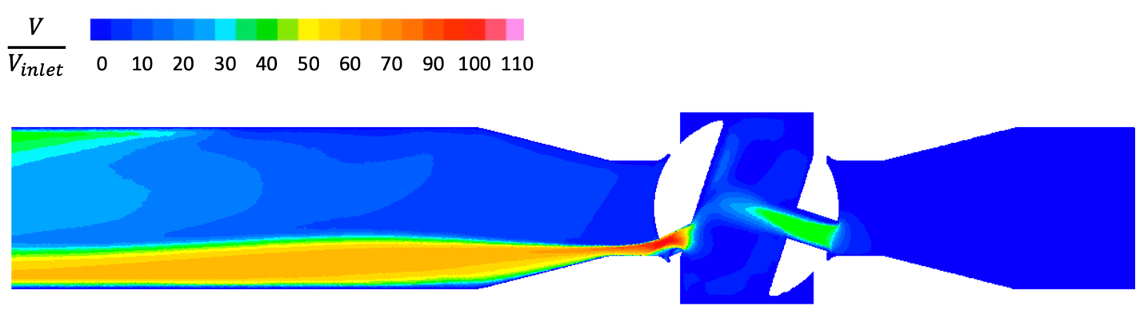
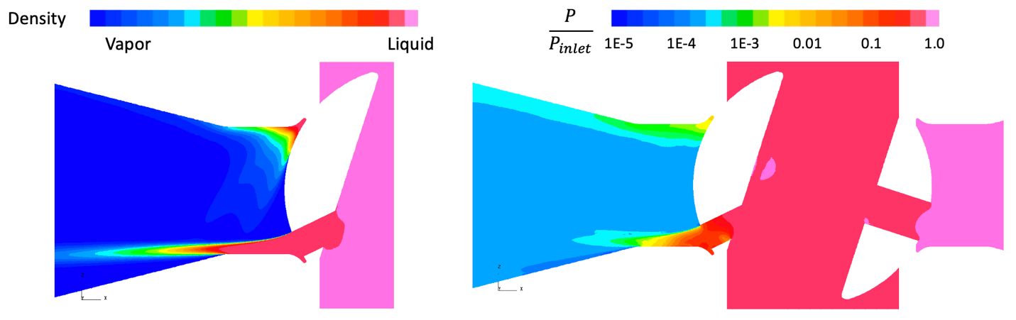
Valve: Liquid Simulation Flow Field
Note: liquid inlet velocity is three times lower than gas simulation
40x inlet velocity
100x inlet velocity
Liquid flashes to vapor exiting smaller orifice
Significant increase in velocity through orifices, similar to gas simulation
Liquid flashes to vapor

Slide 9
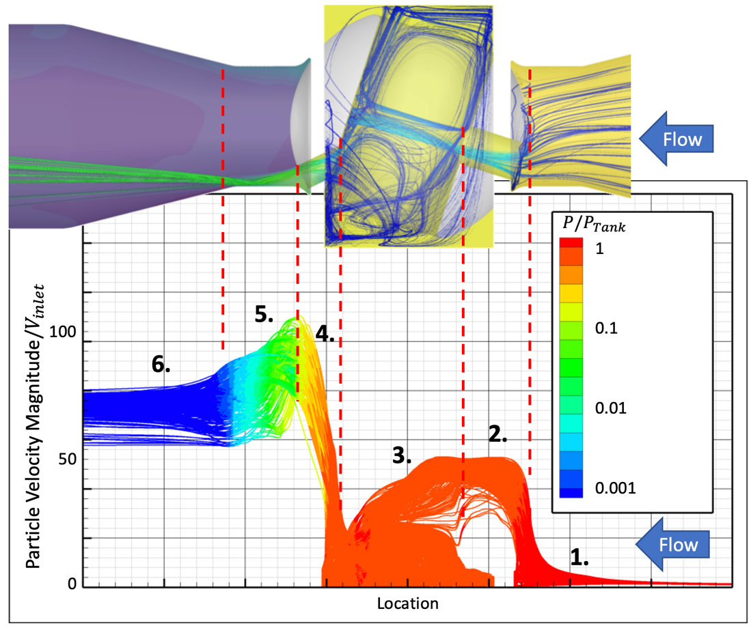
Valve: Liquid Simulation DTA
Same DTA setup as gas simulation
Significant differences in FOD transport between liquid and gas:
Liquid accelerates FOD to fluid velocity quicker than gas
FOD coasts better through low velocity gas than low velocity liquid
Liquid Simulation DTA Results
Previous Gas Simulation DTA Results

Slide 10
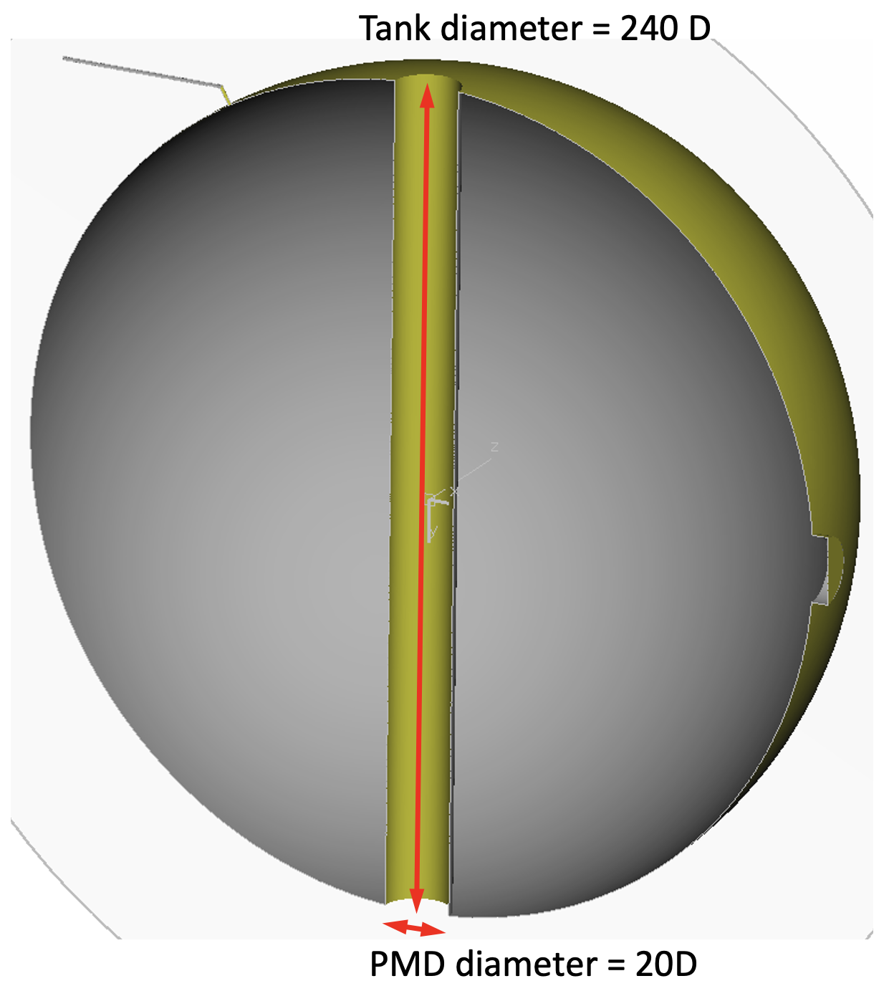
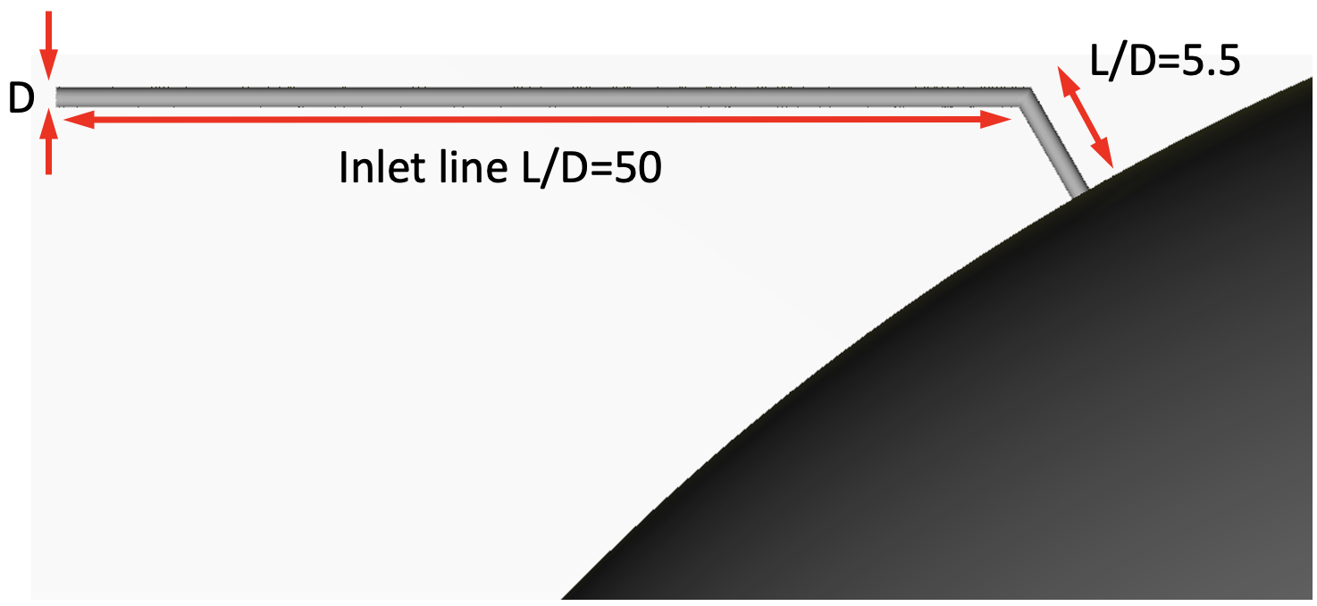
Tank Refueling Analysis Model
Feed lines transfer oxidizer between tank and engine
Feed lines susceptible to particle impact ignition
  In particular around bends where fluid acceleration occurs
Analysis of feed line leading into an oxidizer tank (right)
  Refueling of tank on orbit, transient onrush of liquid oxidizer
  Concern for particle impacts on inlet line bend and PMD
Loci/STREAM-VoF solver used to capture liquid interface

Slide 11
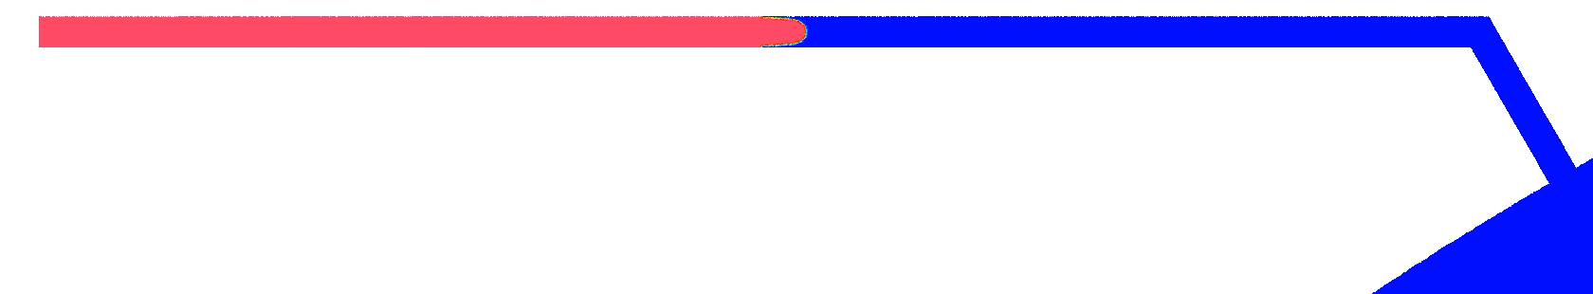
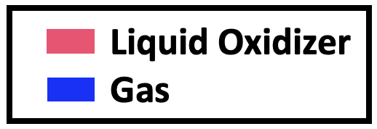
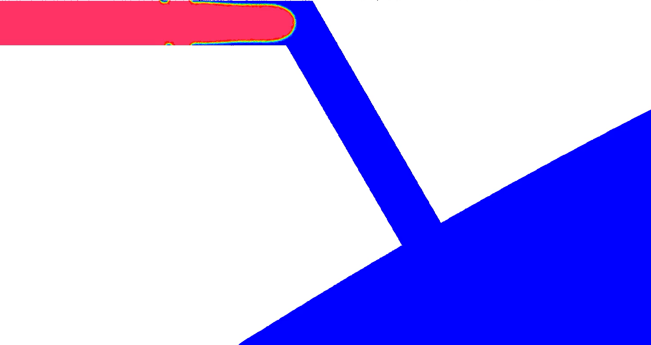
Tank Refueling Simulation Results
Contours on slice through center of tank/inlet line
Parabolic profile develops at the liquid front
Dynamics within feed line:
Liquid front develops parabolic profile
Liquid streams across the corner, impacting opposite tube wall
Liquid wraps around tubing after corner
Vapor recirculation region forms downstream of intrados
Liquid front splashes into extrados of corner
Liquid separates at intrados, leading to a vapor recirculation region
Liquid wraps around tubing after corner to develop annulus of liquid

Slide 12
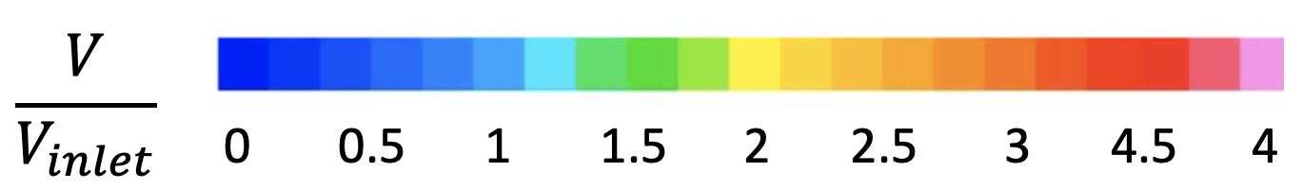
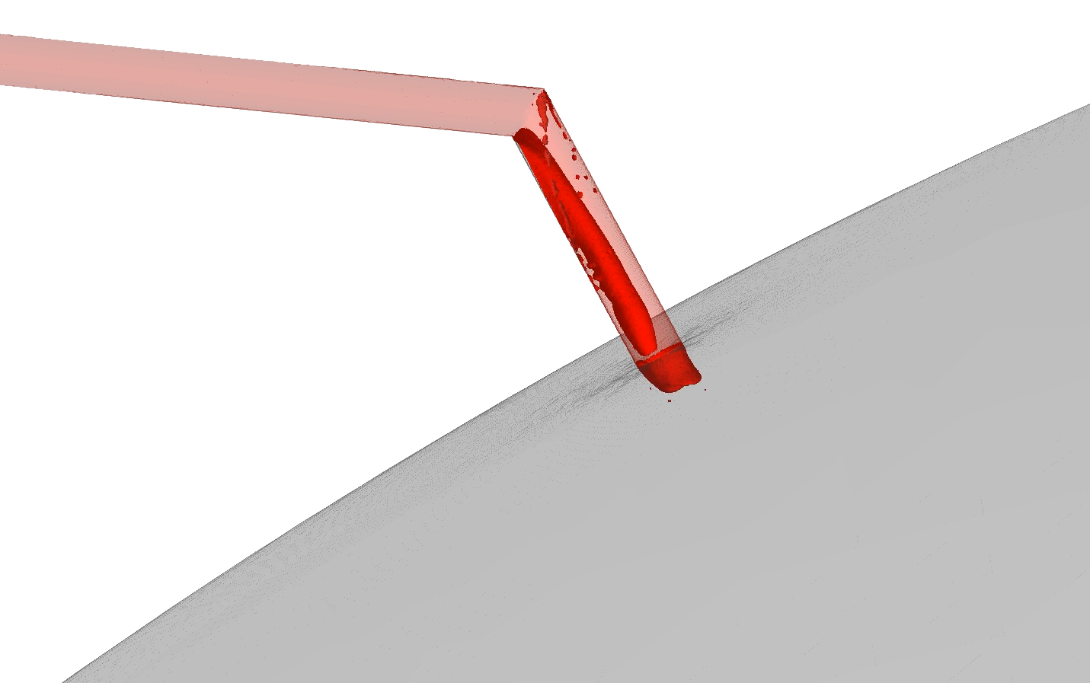
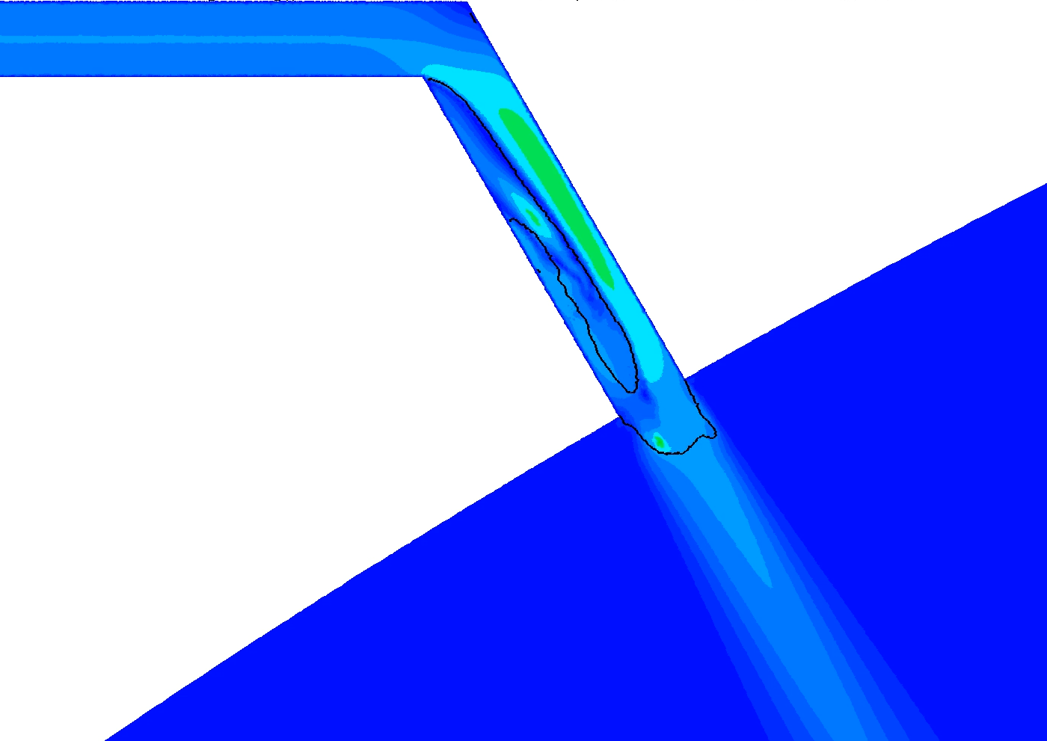
Tank Refueling Simulation Results
Liquid splashes and wraps around corner, vapor recirculation region volume decreases with time
Fluid velocity increase to 1.5x inlet velocity downstream of corner
Some small, transient regions with velocity >3x inlet velocity
Higher liquid velocity due to recirculation region and acceleration around corner
Iso-surface of liquid-vapor interfaces in red
Surfaces wetted by liquid are colored light red

Slide 13
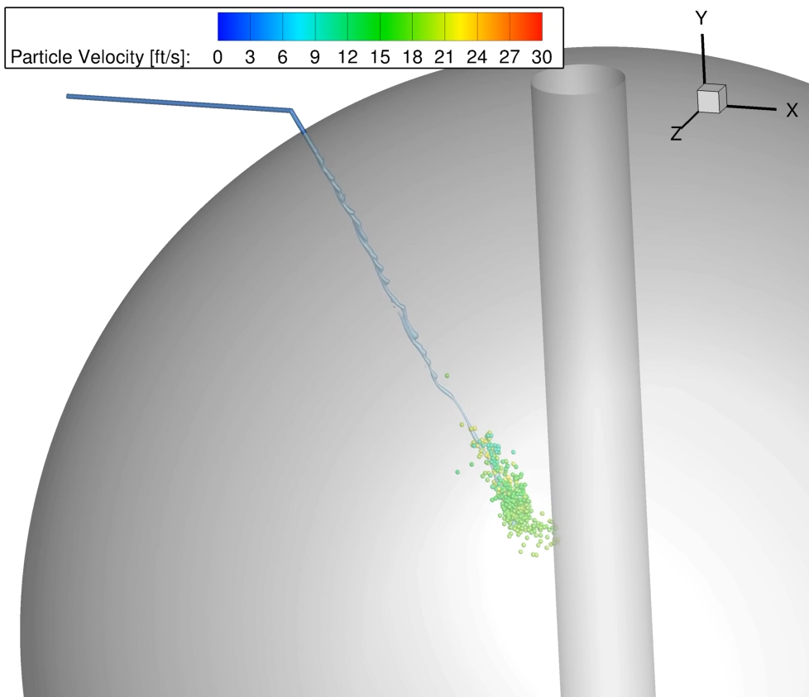
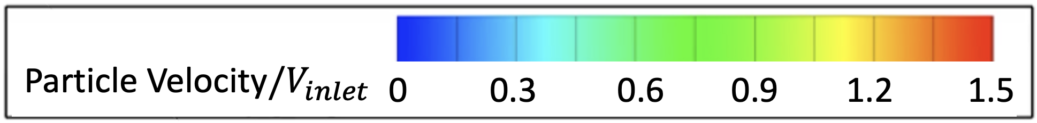
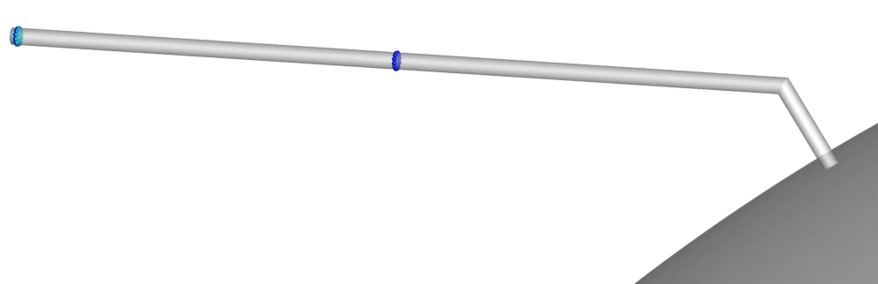
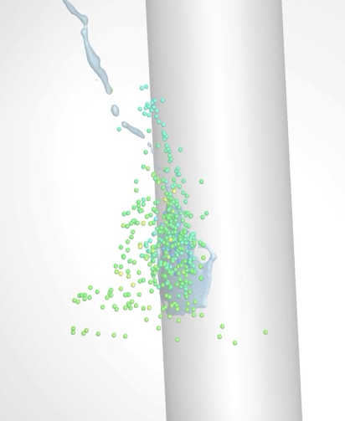
Tank Refueling DTA
Transient CFD used for DTA with 100-400 micron diameter spherical particles
Liquid quickly accelerates particles to liquid velocity
Particles stream across and impact extrados of the bend, then accelerate downstream of bend
Particles coast across tank interior with liquid, decelerating slightly before reaching PMD
FOD seed locations
Initial impacts
FOD impacts and liquid oxidizer splashing on PMD
Acceleration, scraping wall

Slide 14
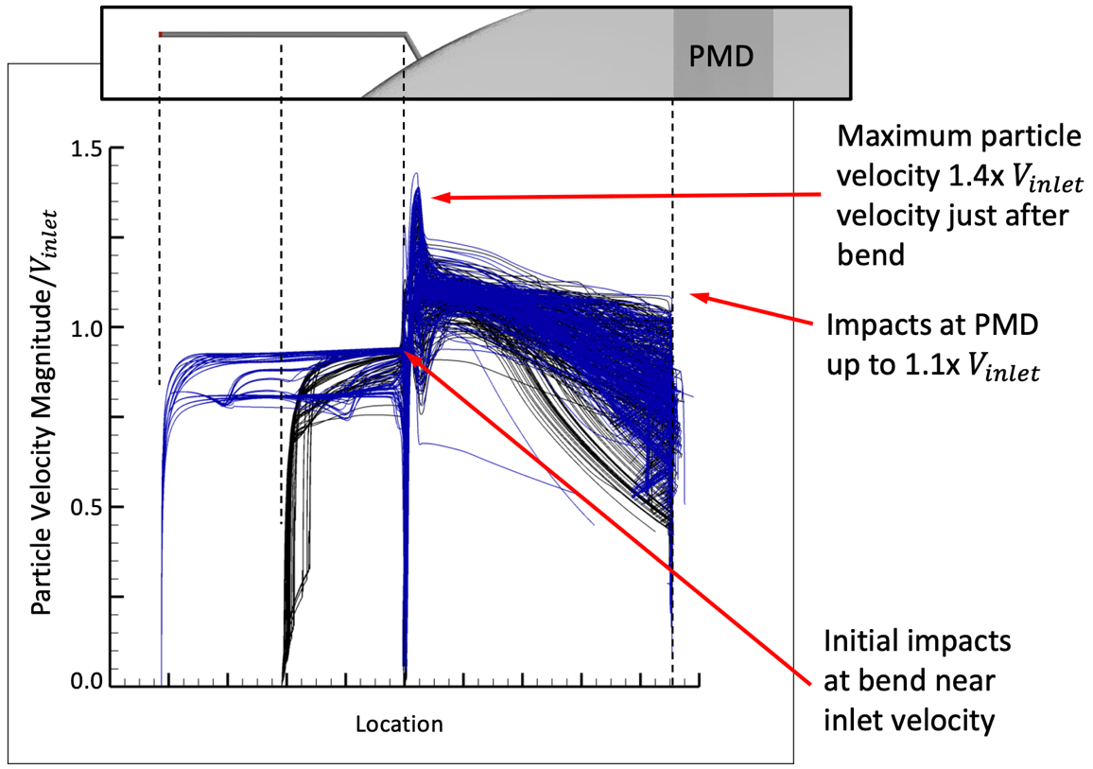
Tank Refueling DTA
Three Regions of Interest:
Particles accelerate up to liquid velocity in inlet line before impacting at bend
Particles accelerate above inlet velocity after bend, impacting the line at shallow angles
Particles enter tank above inlet velocity and slowly decelerate before impacting PMD
2.
3.
1.
Seed location 1
Seed location 2

Slide 15
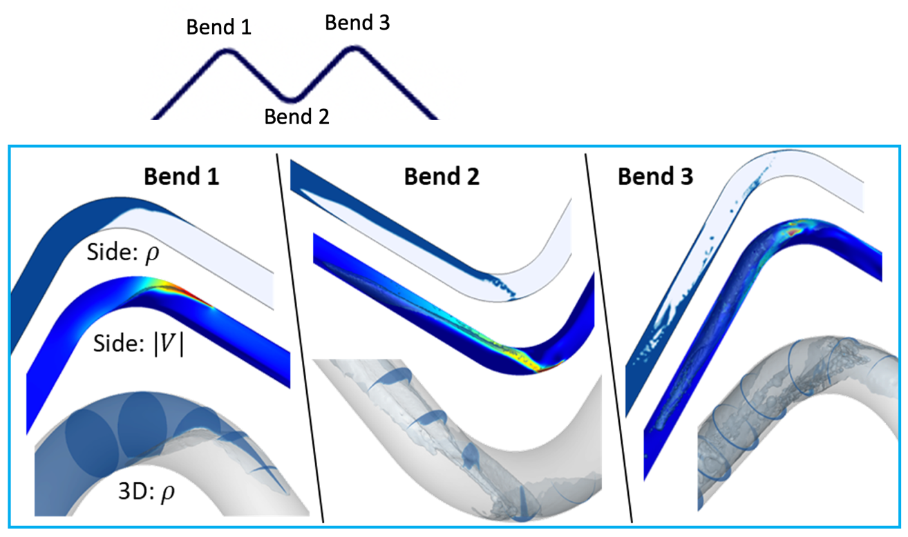
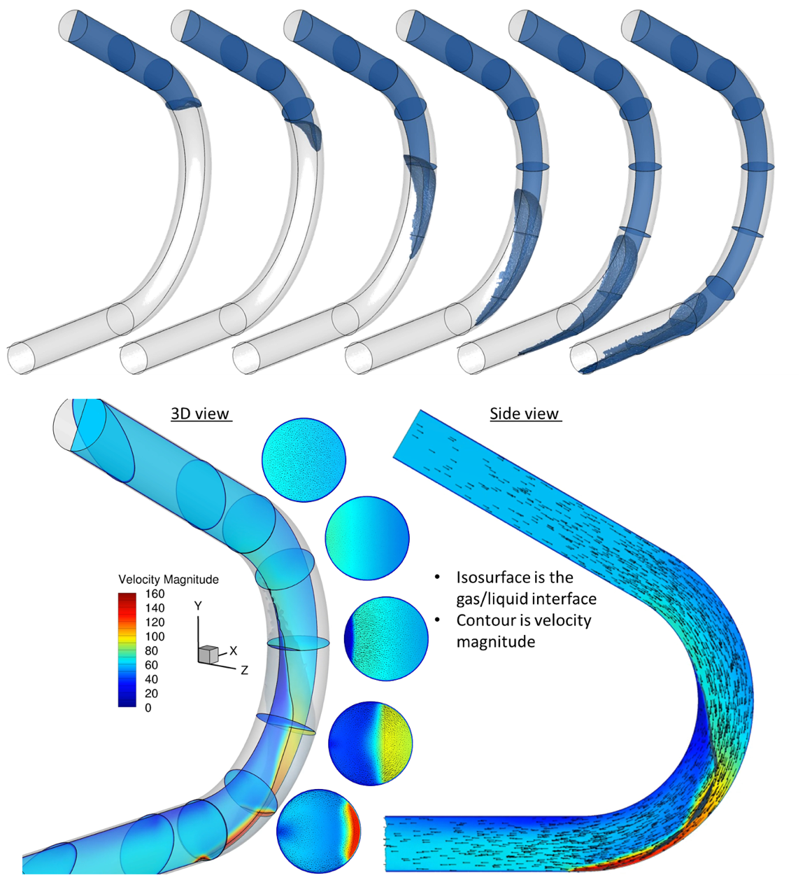
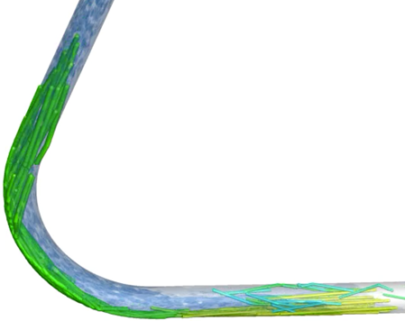
Tube Bend Analyses
Overview of liquid front behavior in feed line bends
1. Single bend:
“Tongue” at extrados
Up to 2.5x velocity
Depends on bend angle and radius
2. Multiple bends:
Front streams across bends 2 and 3
Annular front develops
Depends on separation and relative orientation
3. Particles in bends:
Particles impact extrados of bends
Multiple impacts or scrapes
Exit the bend with higher velocity

Slide 16
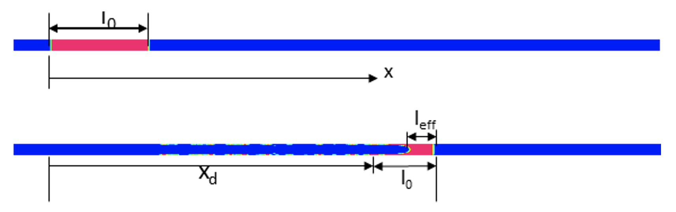
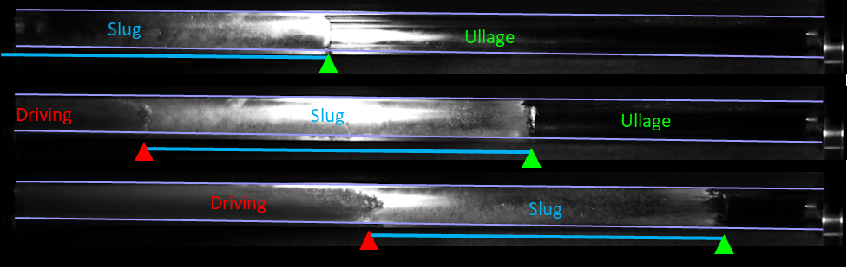
Liquid Slug Breakup
Liquid slugs can develop in feed lines
Can be accelerated by pressurant gas
Slugs deposit liquid on walls and decrease in length as they travel
High velocities occur as slugs get small
Breakup produces a violent high velocity “shot gunning” of liquid drops
High velocity liquid accelerates FOD
  Risk for impacts on bend or other components such as valves
Behavior predicted by CFD and validated by flow visualization testing
t=0
t>0

Slide 17
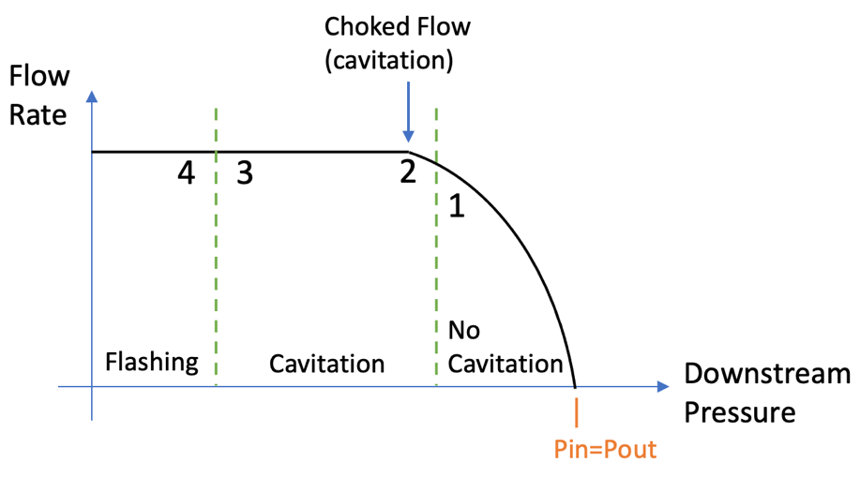
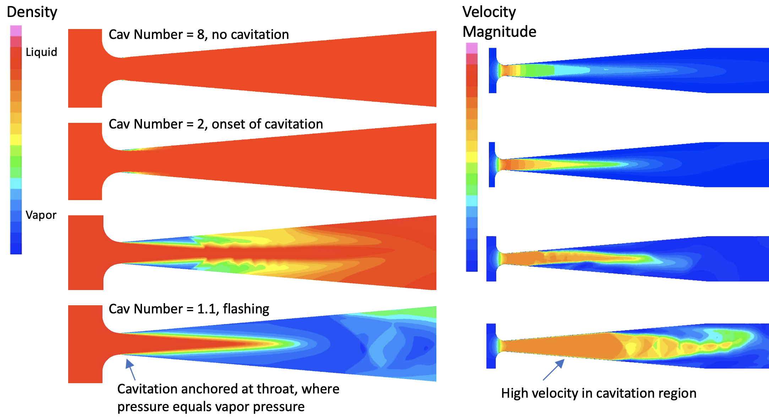
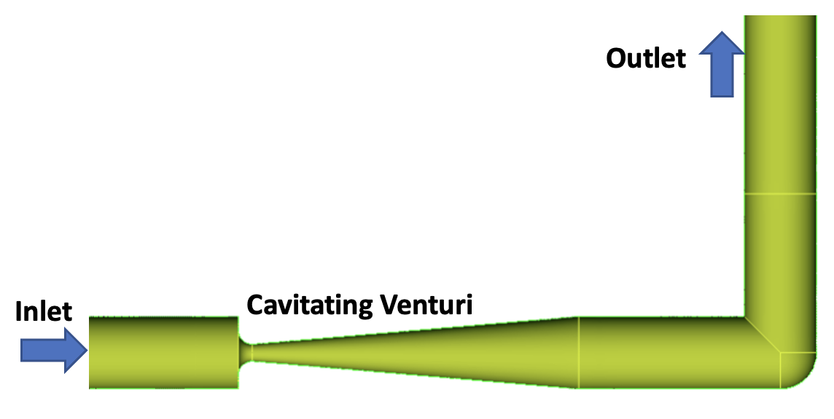

Cavitating Venturi Analysis Model
Cavitating devices produce high velocities
  Liquid accelerated to point where static pressure < vapor pressure
Cavitating venturis limit flow rate in liquid systems
  At choked flow rate cavitation occurs at throat (see lower-right)
Analysis of cavitating venturi with a downstream elbow (below)
  Part of oxidizer compatibility assessment
  Concerns for particle impact on elbow which is relatively close to throat
  Priming condition of most concern (cavitation number ~1.0)
Time-accurate 3D CFD and DTA analysis using Loci/CHEM
  Includes Merkle cavitation model
$$Cav number=\frac{P_{in}−P_{vapor}}{P_{in}−P_{out}}$$
General Behavior of Cavitating Venturis
Low Pressure (near vapor pressure)
Tank Pressure
Liquid Inflow

Slide 18
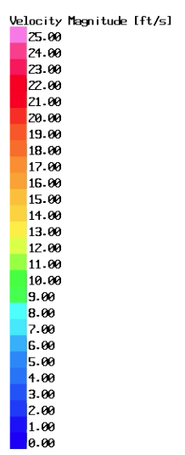
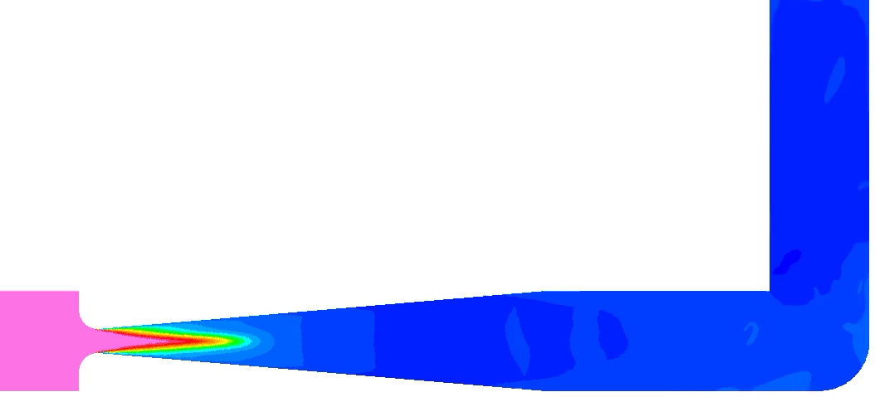
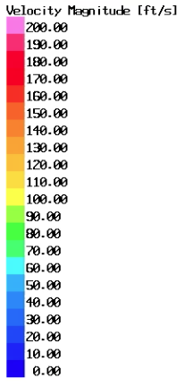
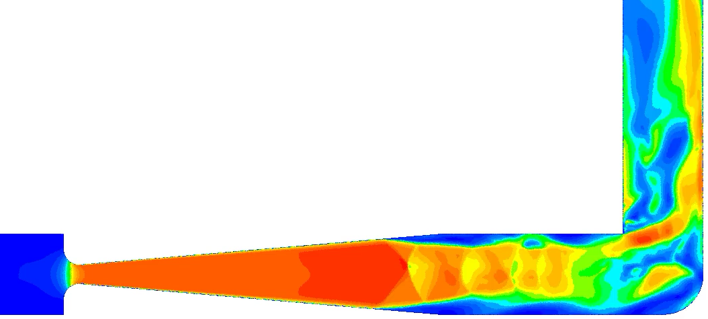
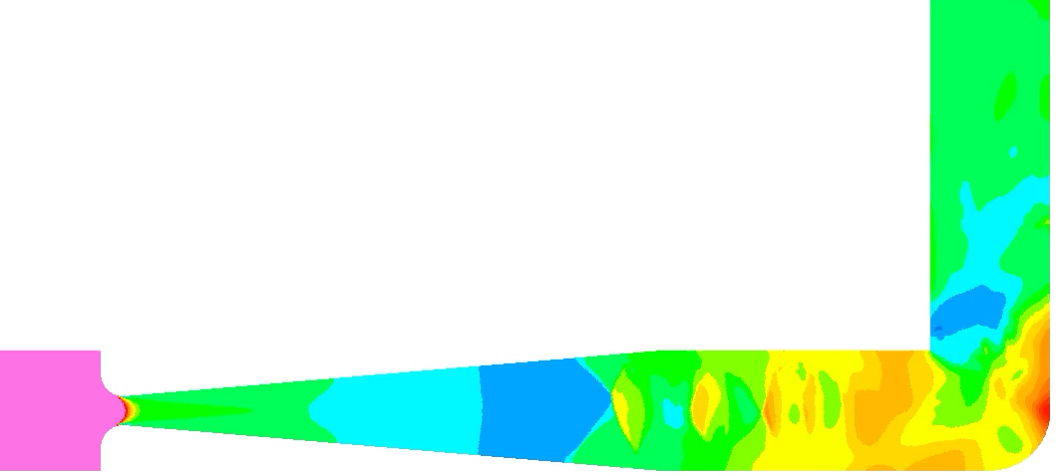



Cavitating Venturi Simulation Results
Liquid flashes to vapor at throat, and slowly condenses back to liquid downstream
Velocity at throat ~15x inlet velocity, accelerates supersonically due to low multiphase sound speed
Unsteady flow and separation at exit of venturi
XXX
Liquid Oxidizer Volume Fraction
0
0.25
0.5
0.75
1
Around 10% liquid volume fraction at elbow
Liquid flashing to vapor
$$\frac{V}{V_{inlet}}$$
0
5
10
15
20
$$\frac{P}{P_{tank}}$$
Fluid shocks down and separates from walls
0
0.05
0.10
0.15
0.20
Fluid velocity increases via supersonic expansion
$$P_{vapor}$$
Higher pressure region on elbow at stagnation

Slide 19
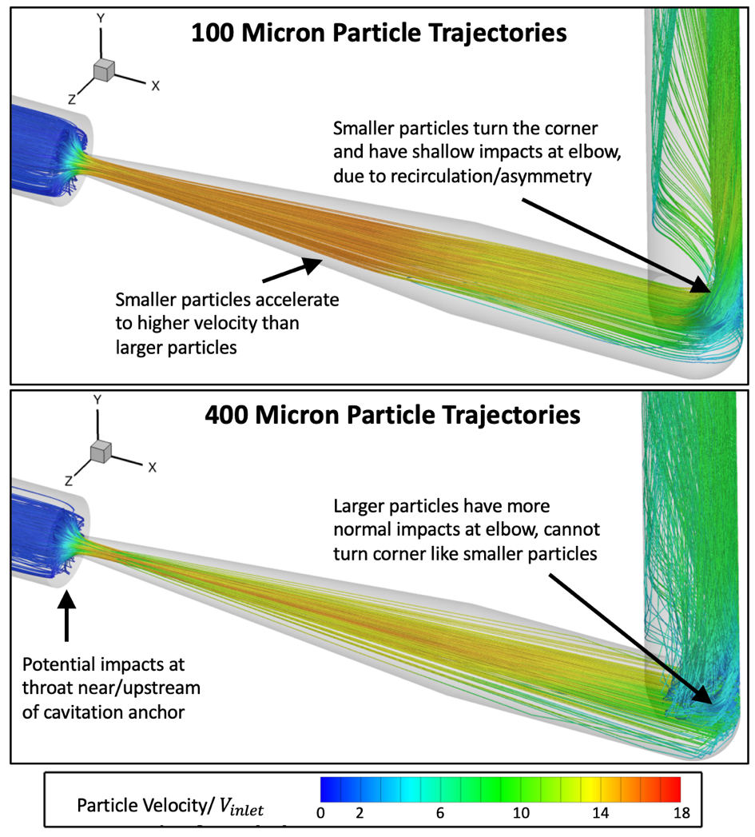
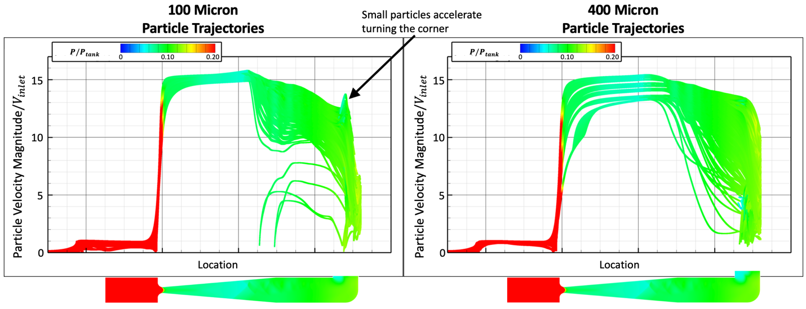
Cavitating Venturi DTA
100-400 micron diameter particles seeded at inlet
Particles accelerate rapidly through throat
Particles maintain high velocity until elbow
Larger particles impact at higher velocity as they coast better through lower velocity fluid
Impacts as high as 10x inlet velocity

Slide 20
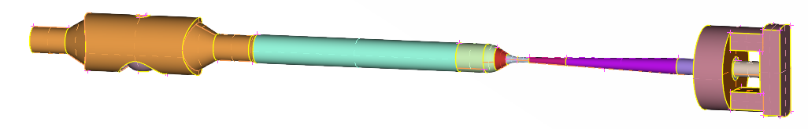
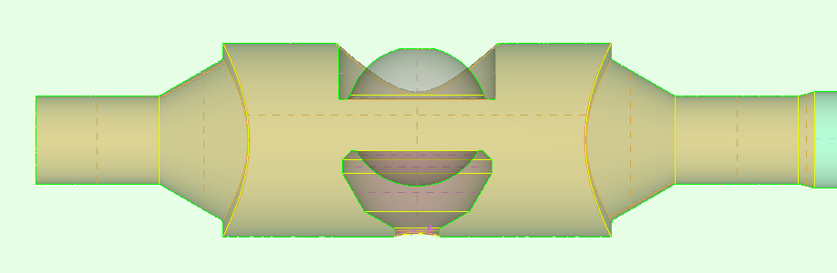
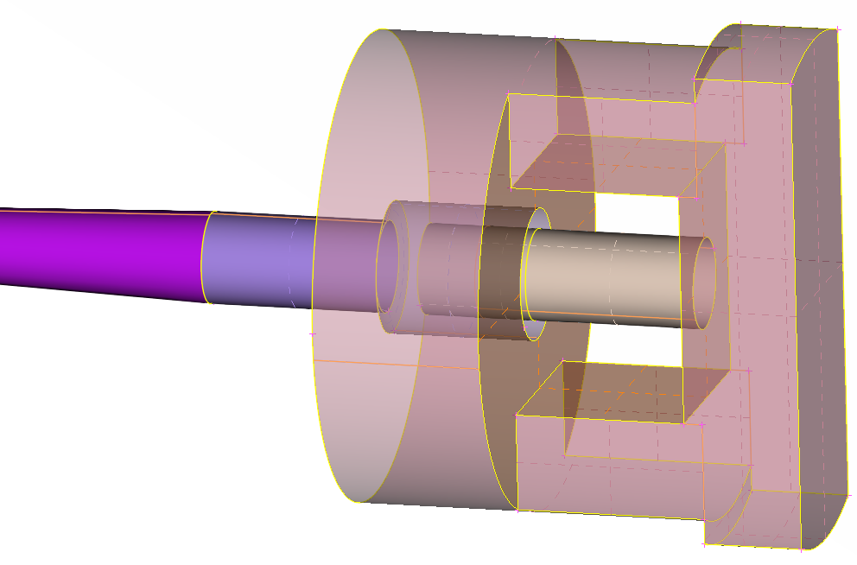
Characterization of WSTF Particle Impact Test Rig
CFD simulation and DTA of WSTF supersonic test rig to assess particle impacts
  Not always possible to measure impact velocity and local impact environment during testing
Geometry model shown below
  Gas flow driven by pressurized tank and open to atmosphere on downstream side
Ideal gas fluid model with Loci/CHEM solver
Converging-Diverging Nozzle
Inlet
Open to atmosphere
Particle injector cup
Target

Slide 21
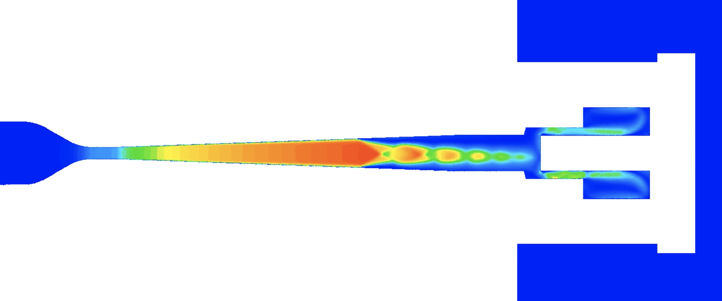
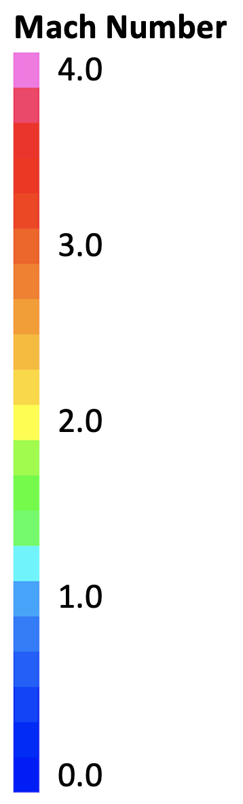



WSTF Particle Impact Test Rig CFD Results
CFD simulation results with flat and angled targets
  Both result in supersonic flow in nozzle that separates before the target due to overexpansion (right)
  Fluid pressure on target is non-uniform, with higher pressure at center due to flow stagnation (below)
Asymmetry and unsteadiness can result in unexpected impacts or impact environments
Flat Target
Angled Target
Fluid pressure on targets

Slide 22



WSTF Particle Impact Test Rig CFD Results
50-150 micron diameter particles seeded in injector cup
Particles accelerate to high velocity through nozzle
  Don’t reach peak fluid velocity of ~2800 ft/s before target
  Smaller particles accelerate to higher velocity before impact than larger particles
Particle trajectories
50 micron
Particle seed locations
100 micron
150 micron
Particles do not instantaneously track fluid velocity, require some time/distance to accelerate
  Without enough runway, particles will not reach desired velocity

Slide 23


Summary and Conclusions
Capability developed to simulate multiphase oxidizer environments for oxidizer compatibility assessments
  Cavitating flows simulated with phase change model
  Volume of fluids model to resolve liquid-vapor interfaces
FOD particle trajectories and impacts predicted using coupled CFD and DTA
Predicted particle impacts compared to ignition thresholds from particle impact test data to determine risk
  Ignition dependent on impact velocity, energy, and angle as well as local fluid pressure and phase → all predicted by CFD/DTA
Analysis has been provided for multiple programs and resulted in direct improvements to design and operation
Test support in characterizing particle impact rig to assess particle acceleration and velocity/environment of impacts
  Particles take some time to accelerate, cannot assume particle velocity equals fluid velocity

