Slide 1

Dose Impacts From Fission Products and Flux Fields for NTP Ground Testing
Powering the Next Era of Space Exploration
Reed Herner¹
Alexander Foutch², Kelsa Palomares¹, Adam Boylston¹, Lindsey Holmes¹
¹Analytical Mechanics Associates
²Missouri University of Science and Technology

Slide 2
Acknowledgements
This work was supported by NASA’s Space Technology Mission Directorate (STMD) through the Space Nuclear Propulsion (SNP) Project
Contract No. 80LARC17C0003
Task No. 10.020.000
This research made use of Idaho National Laboratory computing resources which are supported by the Office of Nuclear Energy of the U.S. Department of Energy and the Nuclear Science User Facilities
Contract No. DE-AC07-05ID14517.
Dose Impacts from FP and Flux for NTP Ground Testing

Slide 3
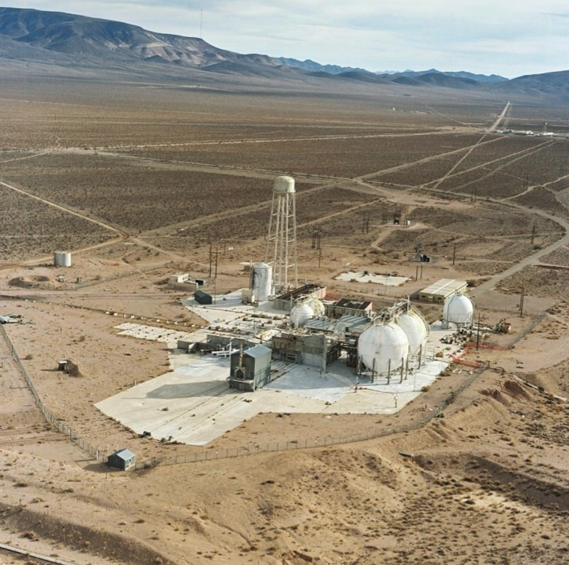
Agenda
Motivation and Background
Methodology
Axial Fractional Release
Flux-to-Dose Conversion
Shielding Analysis
Conclusions and Recommendations
Future Work
Nuclear Rocket Development Station Test Cell “C”¹
Dose Impacts from FP and Flux for NTP Ground Testing
1 - https://ntrs.nasa.gov/api/citations/20140008805/downloads/20140008805.pdf
Notes:
https://ntrs.nasa.gov/api/citations/20140008805/downloads/20140008805.pdf

Slide 4
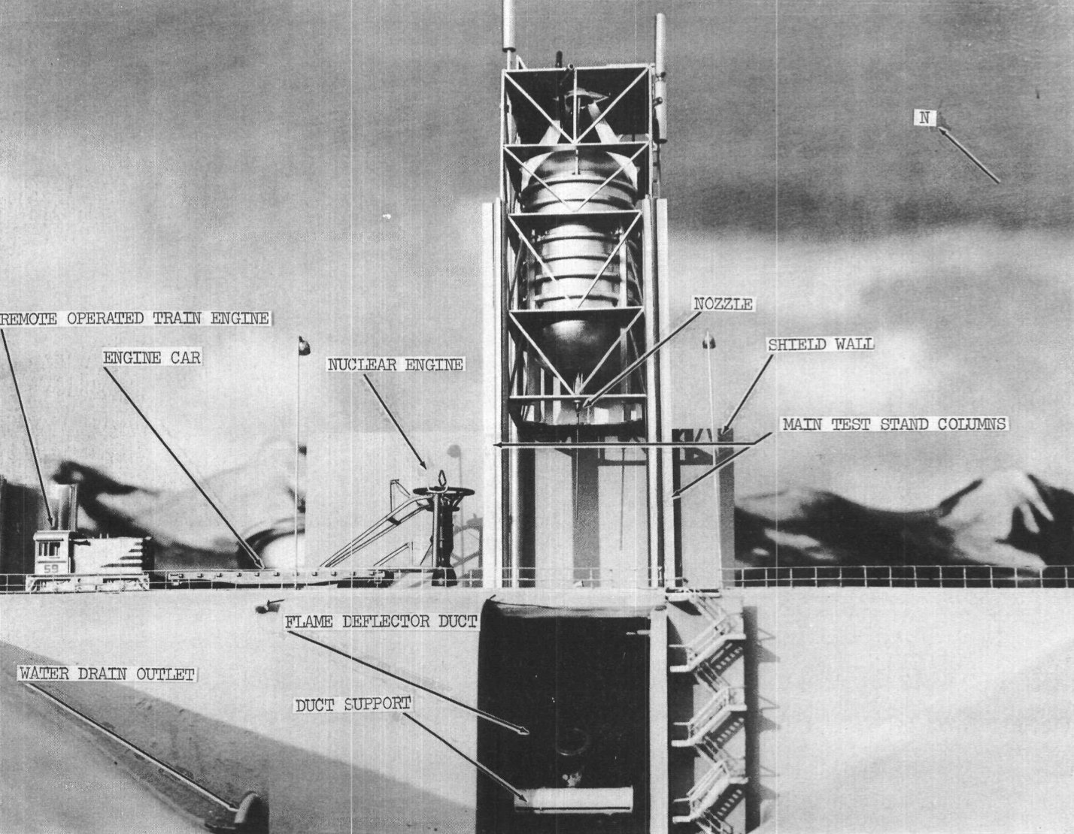
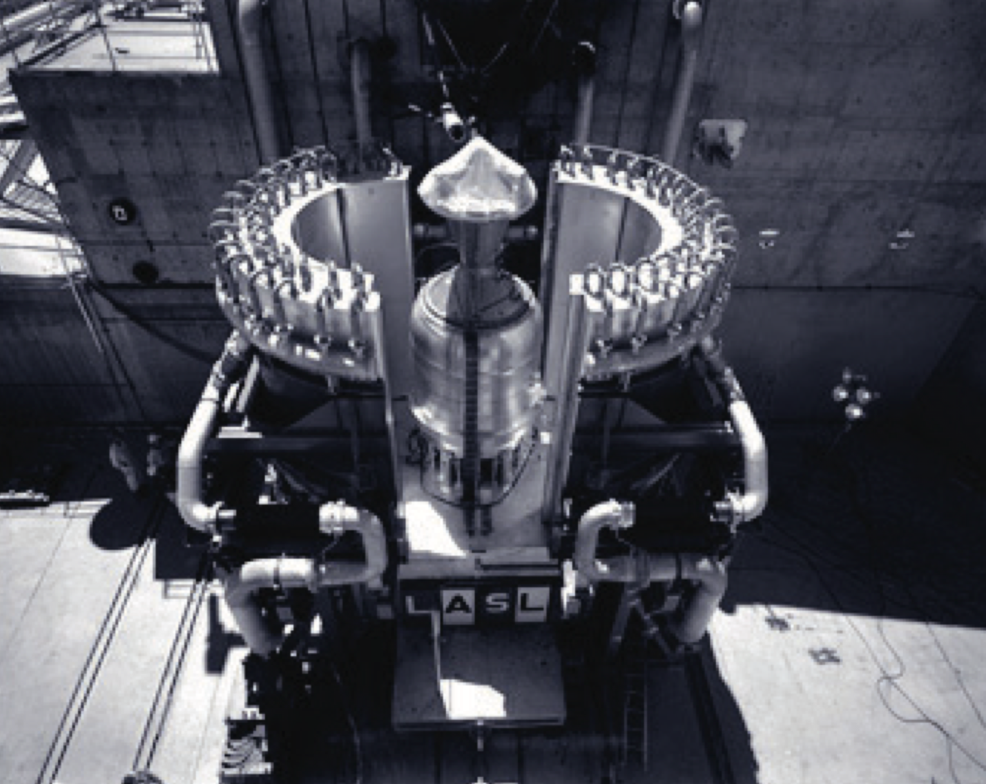
Motivation and Objectives
Planning for the safe ground testing of NTP engines requires an accurate estimation of fission product inventories, incident flux, and dose resulting from reactor operation.
Model of Engine Test Stand (ETS-1) from NERVA Program, 1962¹
Phoebus-2A being prepared for testing at Lost Alamos Scientific Laboratory (LASL)²
The goal of this work is to quantify the behavior of fission products and reactor spatial flux for impacts to ground testing development needs.
Dose Impacts from FP and Flux for NTP Ground Testing
1 - https://www.osti.gov/servlets/purl/4151294 2 - https://cdn.lanl.gov/files/arq-2021-01_22d7e.pdf
Notes:
https://www.osti.gov/servlets/purl/4151294
https://cdn.lanl.gov/files/arq-2021-01_22d7e.pdf

Slide 5
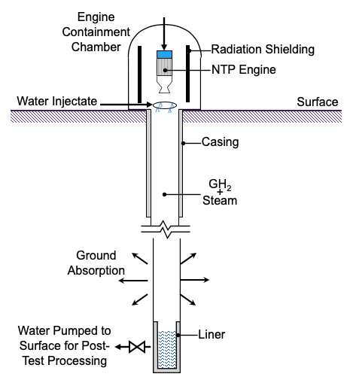
Background and Assumptions
Fission products, neutron, and gamma flux are sources of radiation that need to be mitigated for any in-proximity operation of nuclear reactors, which a ground test NTP engine would require.
Fission Products
  Produced from nuclear reactor operation, fission products undergo radioactive decay and release high energy particles that will deposit energy into materials.
  Correlations for fission product diffusion behavior were compiled during the NERVA program and serve as the base assumption for diffusion rate in this work.
  Dose is the amount of energy deposited in a material and dose equivalent is a modified calculation of dose that considers radiation type and biological effects.
Flux-to-Dose Conversions
  For neutron and gamma radiation fields, dose can be calculated using tabulated data from the International Commission on Radiological Protection (ICRP) publications.
  Using Flux-to-Dose conversion factors, the amount of dose to an individual can be quantified spatially in and around the reactor during operation.
  The reactor geometry and fuel loading assumptions for this work were used from the Test Reference Design (TRD). Reactor physics models in MCNP and Serpent were constructed.
Shielding
  To meet facility safety requirements and ensure radiological impacts are As Low As Reasonably Achievable (ALARA), proper shielding configurations need to be in place.
  Shielding materials need to attenuate and capture incident radiation, which requires choosing the right material types and thicknesses for the reactor design.
Subsurface Active Filtration of Exhaust (SAFE) Concept Diagram
Dose Impacts from FP and Flux for NTP Ground Testing

Slide 6
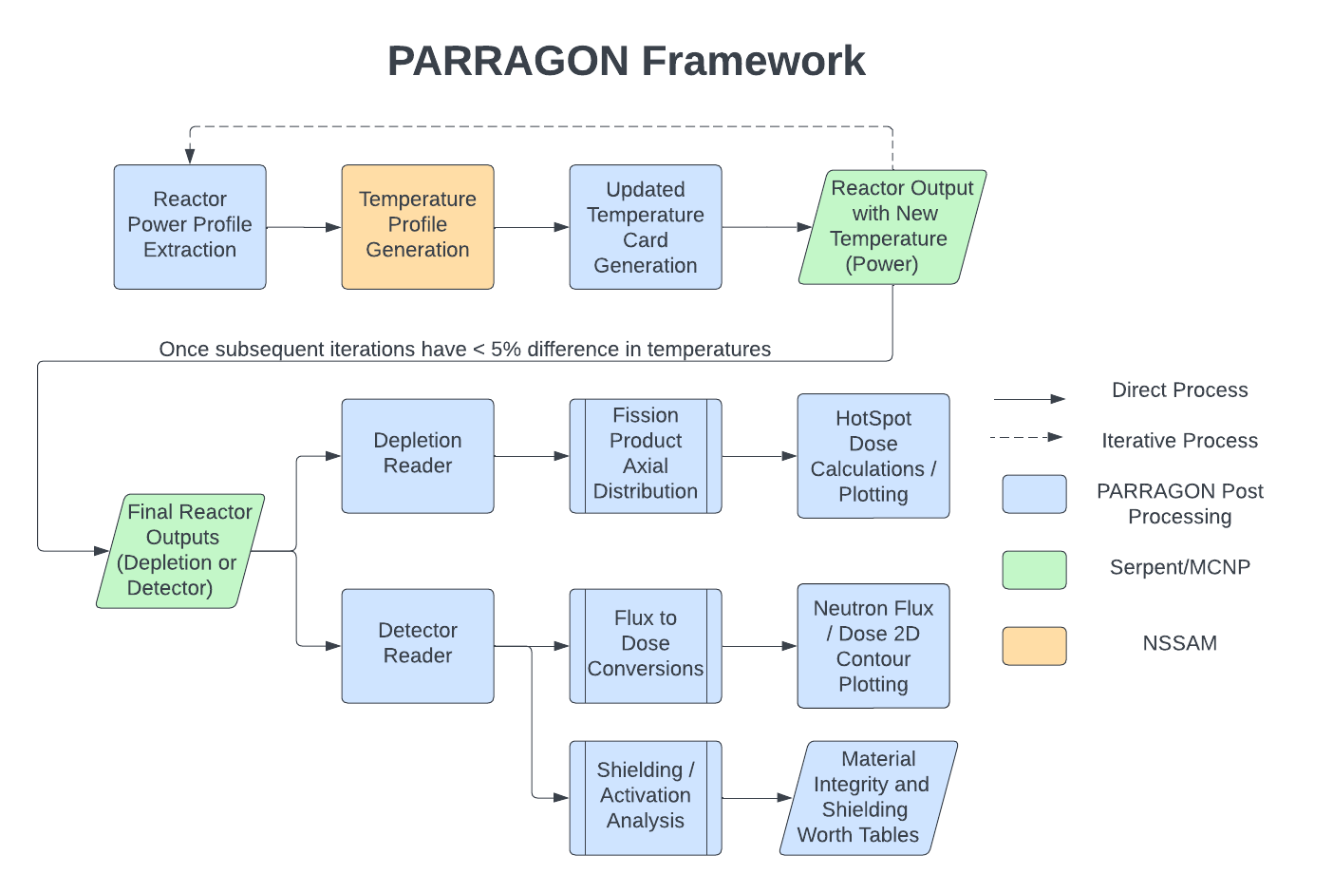
Methodology – PARRAGON Framework
The PArametric Reactor Radiation Activity Generator and Output Normalization (PARRAGON) tool assess the activity, flux and dose from radiation sources with streamlined post-processing capabilities.
Dose Impacts from FP and Flux for NTP Ground Testing

Slide 7
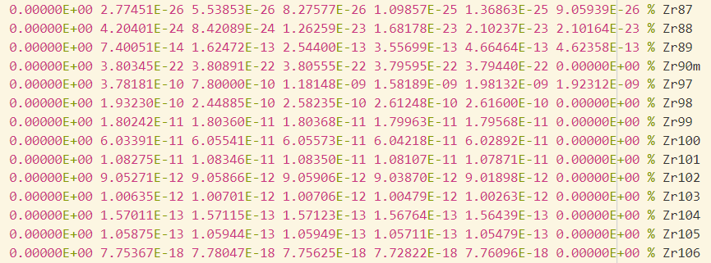
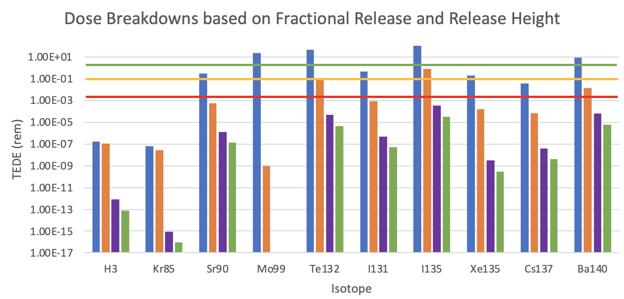
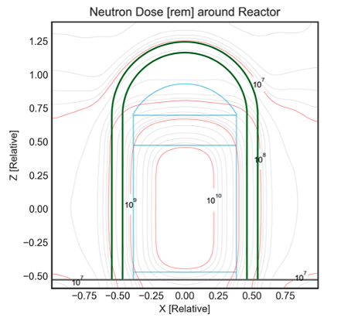
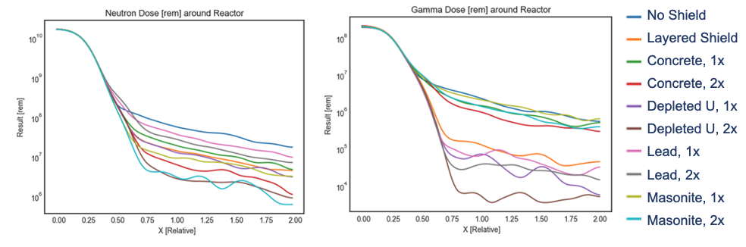
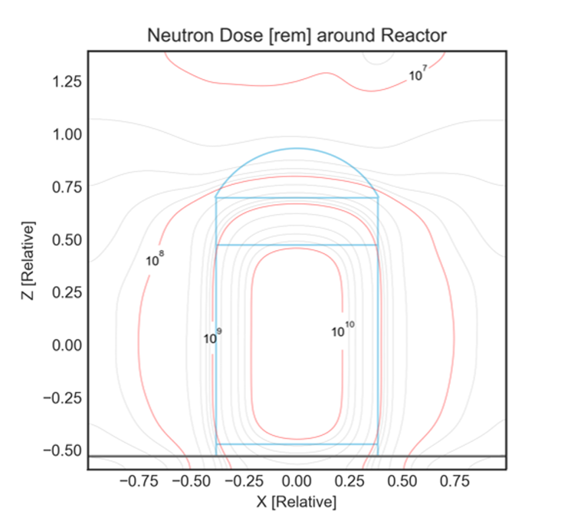
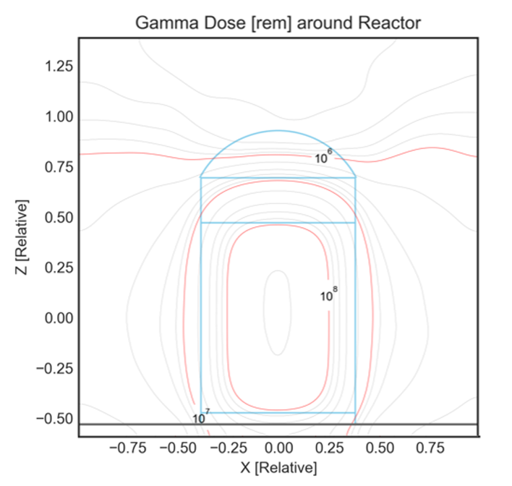
Methodology – PARRAGON Framework
Each process used in this analysis has its own series of tools and post-processing scripts, but all work in conjunction with the temperature dependent input generation of the reactor physics model.
Temperature Solver
FP Analysis
Flux-to-Dose Analysis
Shielding Analysis
Dose Impacts from FP and Flux for NTP Ground Testing

Slide 8
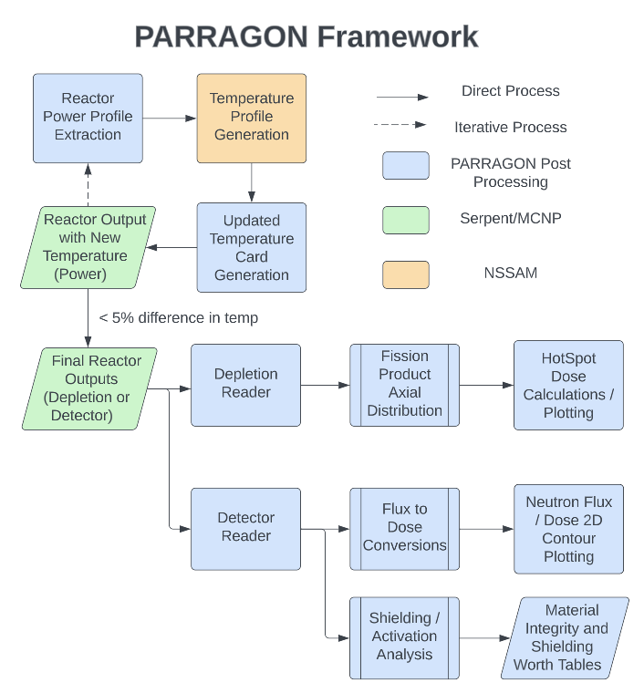
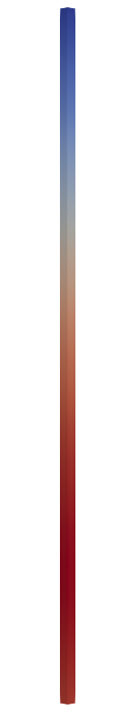













Methodology – Fission Product Axial Release
Starting from reactor physics depletion files of activity, and using NERVA derived fractional release equations, an axial temperature dependence on FP release was developed using nodal power and temperature.
Fractional Release Equations from NERVA
Fuel Element Axial Nodes
$$1 − f_{0}e^{−Dt}=F_{R}$$
$$n_{}$$
$$P_{n}$$
$$T_{n}$$
$D = D_{0}e^{−E/(RT)}$
$${n+1}_{}$$
$$P_{n+1}$$
$$T_{n+1}$$
$${n+2}_{}$$
$$P_{n+2}$$
$$T_{n+2}$$
.
.
.
.
.
.
$$\sum_{i=1}^{I}{\sum_{n=1}^{N}{A_{i}}}\frac{P_{n}}{P_{total}}F_{R}^{i}\left(T_{n}\right)$$
.
.
.
Axial Temperature Dependent Fractional Release for all isotope (I) Activities
$$N_{}$$
$$P_{N}$$
$$T_{N}$$
This methodology creates a power, temperature, time, and spatial dependent fractional release equation compared to the only time and temperature dependent NERVA correlations.
Dose Impacts from FP and Flux for NTP Ground Testing
Notes:
The nodal temperature was gathered from automatically generated interface output files in the Serpent reactor physics code, and the nodal power found using those temperatures to define a power profile.

Slide 9
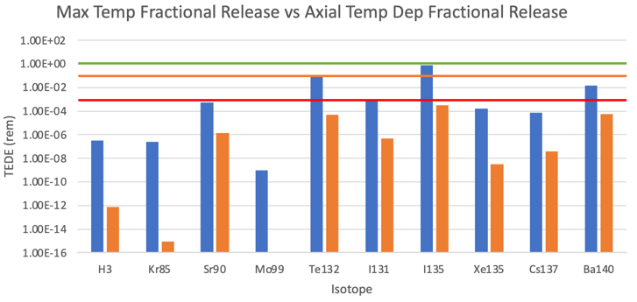
Results – Max Temp vs Axial Temp Fractional Release
The goal of developing an axial temperature dependence for fractional release was to simulate more realistic diffusion conditions than a single estimated maximum temperature scenario, as assumed in past work.
Occupational Dose Limit
(5 rem per year) General Employees from NRC
Occupational Dose Limit
(0.1 rem per year) General Public in Controlled Area from NRC
NESHAP Exposure Limit
(0.002 rem per year) Highest Exposed Individual from EPA
Max Temperature Fractional Release
Axial Temp Dependent Fractional Release
The axial temperature dependent fractional release decreases overall dose contribution. All individual isotopes fall under 2 mrem NESHAP Exposure Limit with axial temp release.
Dose Impacts from FP and Flux for NTP Ground Testing

Slide 10
Results – Release Height Effect on Total Dose
One of the inputs in the HotSpot source term code is “release height” or how high above ground level the release occurs. The higher the release height the lower potential dose impact occurs from radioactivity.
Occupational Dose Limit
(5 rem per year) General Employees from NRC
Occupational Dose Limit
(0.1 rem per year) General Public in Controlled Area from NRC
NESHAP Exposure Limit
(0.002 rem per year) Highest Exposed Individual from EPA
Maximum Possible Dose
(No FR at 0 m release height)
Dose at Max Temperature FR
(release height 0 m)
Axial Temp Dependent FR Dose
(release height 0 m)
Axial Temp Dependent FR Dose
(release height 5 m)
Max temperature based fractional release (orange) decreases total possible dose impact (blue), but axial temperature release at 0 m and 5 m release heights (purple then green) reduce dose even further.
Dose Impacts from FP and Flux for NTP Ground Testing

Slide 11
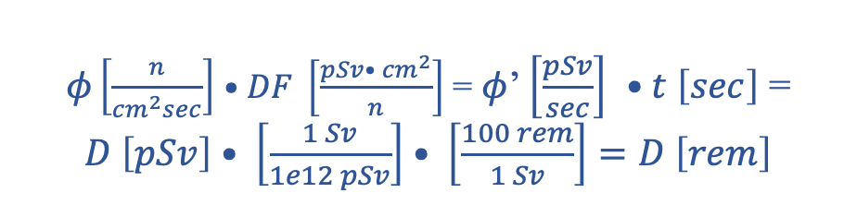
Methodology – Flux-to-Dose Conversion
Reactor physics calculations of spatial neutron and gamma flux are converted to dose using conversion factors. This allows for spatial mapping of the dose expected during reactor operations.
Flux to Dose Conversion Equation
$φ\left[\frac{n}{{cm}^{2}sec}\right]$ $•DF \left[\frac{pSv• {cm}^{2}}{n}\right]$ = $φ$’ $\left[\frac{pSv}{sec}\right]$ $•t \left[sec\right]$ = $D \left[pSv\right]• \left[\frac{1 Sv}{1e12 pSv}\right]• \left[\frac{100 rem}{1 Sv}\right]=D \left[rem\right]$
Time of operation (t) = 300 seconds
Dose factors were gathered from the International Commission on Radiological Protection (ICRP) Publication 116. Assumption of isotropic directions were chosen for results in this work.
Dose Impacts from FP and Flux for NTP Ground Testing

Slide 12
Results – Flux-to-Dose Visualization
Neutron and gamma fluxes were converted to dose so total effective dose equivalent (TEDE) could be quantified around the reactor geometry.
These contour maps do not have any exterior facility or shielding components modeled to serve as a flux and dose “baseline” case.
Dose Impacts from FP and Flux for NTP Ground Testing
Notes:
The contour lines were smoothed with a Gaussian filter for clarity of the results.

Slide 13
Methodology – Shielding Analysis
Different options for shielding were assessed to quantify impact on overall magnitude and determine “ideal” shielding combinations.
Neutron Shielding Materials | Gamma Shielding Materials
Concrete, Generic | Lead
Masonite | Depleted Uranium
Boral (10B) | Bismuth
Boral (5B) | Tungsten
Boral (35B4C 65Al)
Polyethylene (Borated)
Polyethylene (Non-Borated)
Polystyrene
Polyurethane Foam
Water
The shielding configuration consisted of a cylindrical wall of homogeneous material surrounding the reactor. Isolated shielding materials as well as layers of different homogenous shielding material were also examined.
Dose Impacts from FP and Flux for NTP Ground Testing
Notes:
The shielding configuration consisted of a cylindrical wall of homogeneous material surrounding the reactor. The size of this cylindrical wall was increased incrementally and the shield’s size impact on overall neutron dose outside the reactor is quantified. Layers of different homogenous shielding material were also examined.

Slide 14
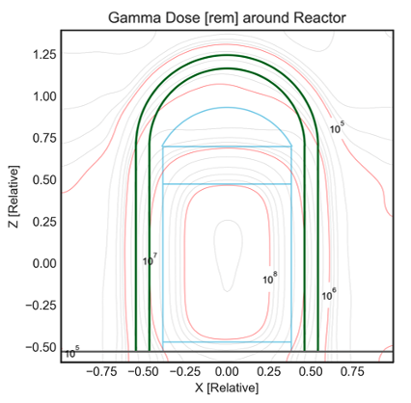
Results – Shielding Analysis
Varying shielding materials and thickness were assessed to determine largest reduction in total dose. Layering of neutron and gamma shields was found to be the optimal configuration, 5 concrete layers next to depleted uranium is shown below.
Dose Impacts from FP and Flux for NTP Ground Testing

Slide 15
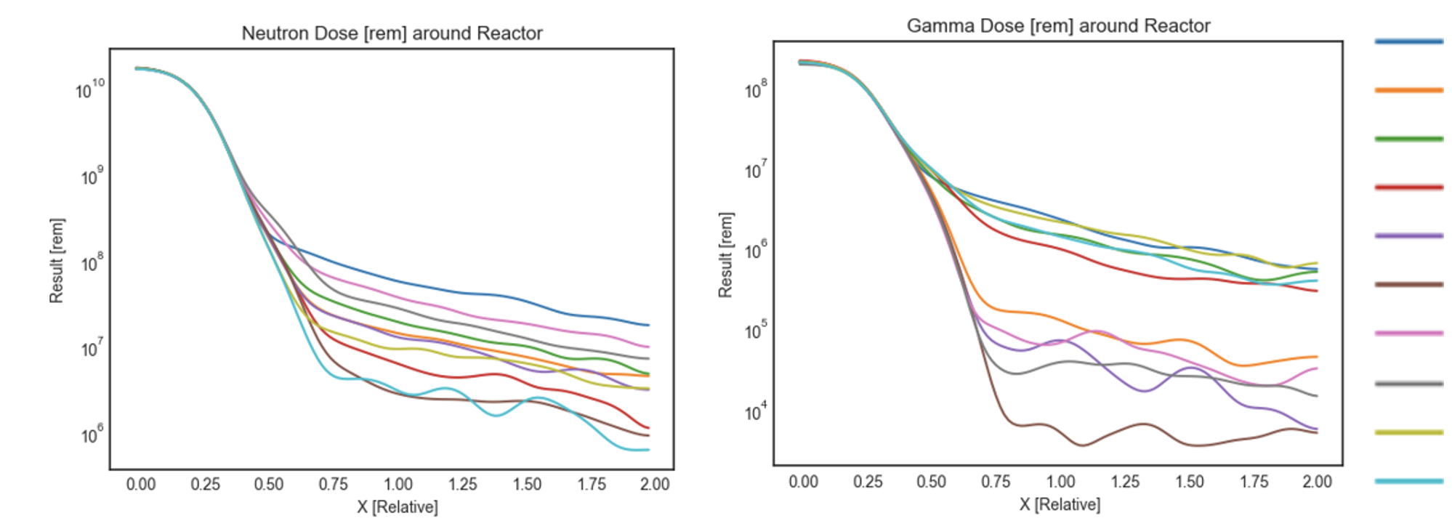
Results – Shielding Analysis
Masonite, concrete, and depleted uranium were found to be the most effective neutron shields; lead and depleted uranium were the most effective gamma shields.
No Shield
Layered Shield
Concrete, 1x
Concrete, 2x
Depleted U, 1x
Depleted U, 2x
Lead, 1x
Lead, 2x
Masonite, 1x
Masonite, 2x
Dose Impacts from FP and Flux for NTP Ground Testing

Slide 16
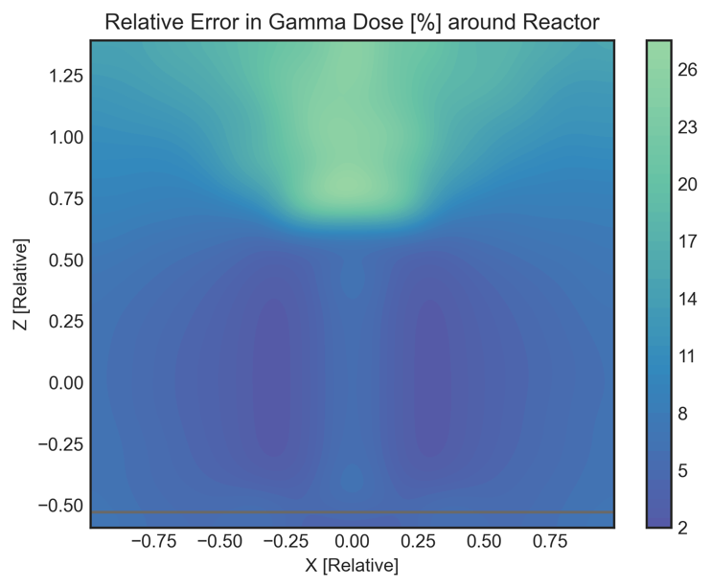
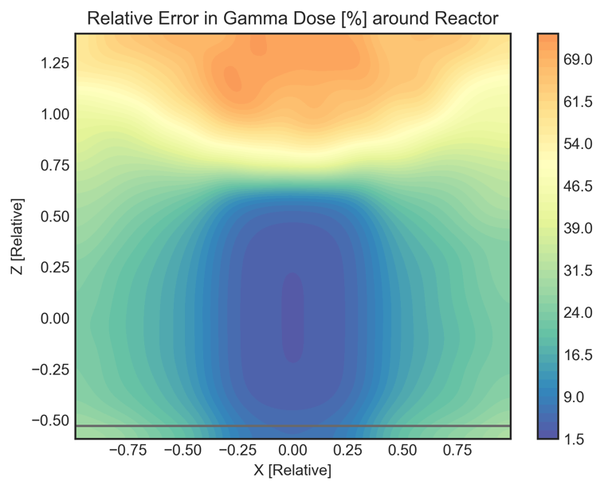
Results – Shielding Analysis with Variance Reduction
Due to large uncertainties from initial shielding analysis, variance reduction methods were necessary. Weight windows were developed in MCNP and are being investigated for Serpent.
With weight windows
No weight windows
Dose Impacts from FP and Flux for NTP Ground Testing
Notes:
Continued development of variance reduction techniques in all reactor physics codes is underway.

Slide 17
Conclusions and Recommendations for Future Work
Fission Product Analysis
Initial results indicate that the worst-case scenario of full release of all fission products would exceed radiation exposure limits without any mitigation from shielding or exhaust filtration.
Temperature dependent fractional release estimates show over an order of magnitude reduction in TEDE
Initial fractional release estimates are based on NERVA diffusion data. To improve accuracy, new correlations for current fuels under development by SNP are needed.
Shielding Design
To optimize shielding design, additional analysis is needed to assess flux dependence on power level and operating duration.
Improved variance reduction techniques are also recommended to further reduce uncertainties.
Dose Impacts from FP and Flux for NTP Ground Testing
Nuclear and Emerging Technologies for Space (NETS) Conference 2023

Slide 18
Conclusions and Recommendations for Future Work
Facilities Design and Operational Considerations
With proper filtration systems in place, fission products with high energy radioactivity can be managed without release into the environment.
Following a cool-down period, activity from fission products will significantly decrease and allow for handling of components following operation.
Future work should evaluate contributions from site-specific meteorological impacts on TEDE and the benefits of a filtration system on further reducing dose.
Future work will also evaluate time dependent fission product release rates and detector selection for radiation monitoring during an NTP engine test
Dose Impacts from FP and Flux for NTP Ground Testing
Nuclear and Emerging Technologies for Space (NETS) Conference 2023

Slide 19
Thank you for your time.
Questions?
Reed Herner reed.a.herner@ama-inc.com
A special thanks to the Nuclear Team at Analytical Mechanics Associates, Jim Werner (AMA), Jarvis Caffery (NASA MSFC), Shane Stimpson (BWXT), Herschel Smith (BWXT), Luke Cornejo (BWXT), the INL HPC, the CORE Lab at Georgia Tech, and the organizers of NETS 2023.
Dose Impacts from FP and Flux for NTP Ground Testing
Nuclear and Emerging Technologies for Space (NETS) Conference 2023

Slide 20
References
A. JOHNSON, D. KOTLYAR, S. TERLIZZI, G. RIDLEY, “serpentTools: A Python Package for Expediting Analysis with Serpent,” Nuc. Sci. Eng, (in press) (2020).
C. WERNER ET AL., "MCNP Users Manual – Code Version 6.2," 2017.
DOE-STD-1027-2018, DEPARTMENT OF ENERGY STANDARD - HAZARD CATEGORIZATION OF DOE NUCLEAR FACILITIES, Jan. 2019
G. BAUMGARTEL, "Final Environmental Impact Statement for Particle Bed Reactor Propulsion Technology Development and Validation," Space Nuclear Thermal Propulsion Program, Department of the Air Force, 1993.
5. J. D. CLEARY, G. T. RYMER, “Interim Report on Fission Product Diffusion Code (FIPDIF)”. AEC Research and Development Report, WANL-TME-958, Jan. 9 1982.
J. GUSTAFSON, J. MONITO, J. WITTER, “A SYSTEM DESIGN PROCESS FOR NASA NTP REACTOR TESTING REFERENCE DESIGN CONCEPTS,” BWX Technologies, NETS 2022.
J. LEPPÄNEN, M. PUSA, T. VIITANEN, V. VALTAVIRTA, and T. KALTIASENAHO. The Serpent Monte Carlo code: Status, development and applications in 2013. Ann. Nucl. Energy, 82.
N. PETOUSSI-HENSS, W. BOLCH, K. ECKERMAN, A. ENDO, N. HERTEL, J. HUNT, M. PELLICCIONI, H. SCHLATTL, M. ZANKL, "Conversion Coefficients for Radiological Protection Quantities for External Radiation Exposures," ICRP Publication 116, 2010.
N. RAO, D. A. HAGEMEYER, U. MCCORMICK, "DOE 2016 Occupational Radiation Exposure," Office of Environment, Health, Safety, and Security, 2017.
R. HERNER ET AL. “NUCLEAR THERMAL PROPULSION (NTP) FISSION PRODUCT AND SOURCE TERM BEHAVIOR,” Analytical Mechanics Associates, NETS 2022.
S. G. HOMANN, F. ALUZZI, “HotSpot Health Physics Codes Version 3.0,” National Atmospheric Release Advisory Center, Lawrence Livermore National Laboratory, Livermore CA. (2014).
Dose Impacts from FP and Flux for NTP Ground Testing
Nuclear and Emerging Technologies for Space (NETS) Conference 2023

