Slide 1
Regulatory Approach for Nuclear Thermal Propulsion
Powering the Next Era of Space Exploration
Alexander Pingel¹, James Werner¹, Alexander Foutch^{1, 2}
¹Analytical Mechanics Associates, Inc.
²Missouri University of Science and Technology

Slide 2
Acknowledgements
This work was supported by NASA’s Space Technology Mission Directorate (STMD) through the Space Nuclear Propulsion (SNP) Project
Contract No. 80LARC17C0003
Task No. 10.020.000
Regulatory Approach for NTP

Slide 3
Agenda
Introduction and Assumptions
Regulatory Roadmap
Challenges
Conclusions
Regulatory Approach for NTP

Slide 4
Introduction and Assumptions
NTP Regulatory Approach
Nuclear Thermal Propulsion (NTP) testing required to mature technology and demonstrate system performance
This work summarizes scoping for NTP system ground testing
  Identifying deliverables for authorization
  Identifying focus areas for testing to support those deliverables
  Identifying challenges to be addressed early in project planning
Assumptions:
  A ground test is the preferred option for NTP testing
  Testing will occur at a Department of Energy (DOE) regulated site
Regulatory Approach for NTP
Notes:
In 2022, AMA performed regulatory planning and analysis for the SNP project.
Identified
Note that while ground testing preferred, swim lane included for flight testing.

Slide 5
Regulatory Roadmap
NTP Regulatory Approach
Diagram intended to show, at a high level, the deliverables and dependencies through the regulatory authorization and testing
  Notes the interdependence between development areas
    Fuel development and testing
    Reactor design
    Regulatory submittals
  Describes dependencies and likely development path
Full diagram included in Appendix to paper
Regulatory Approach for NTP

Slide 6
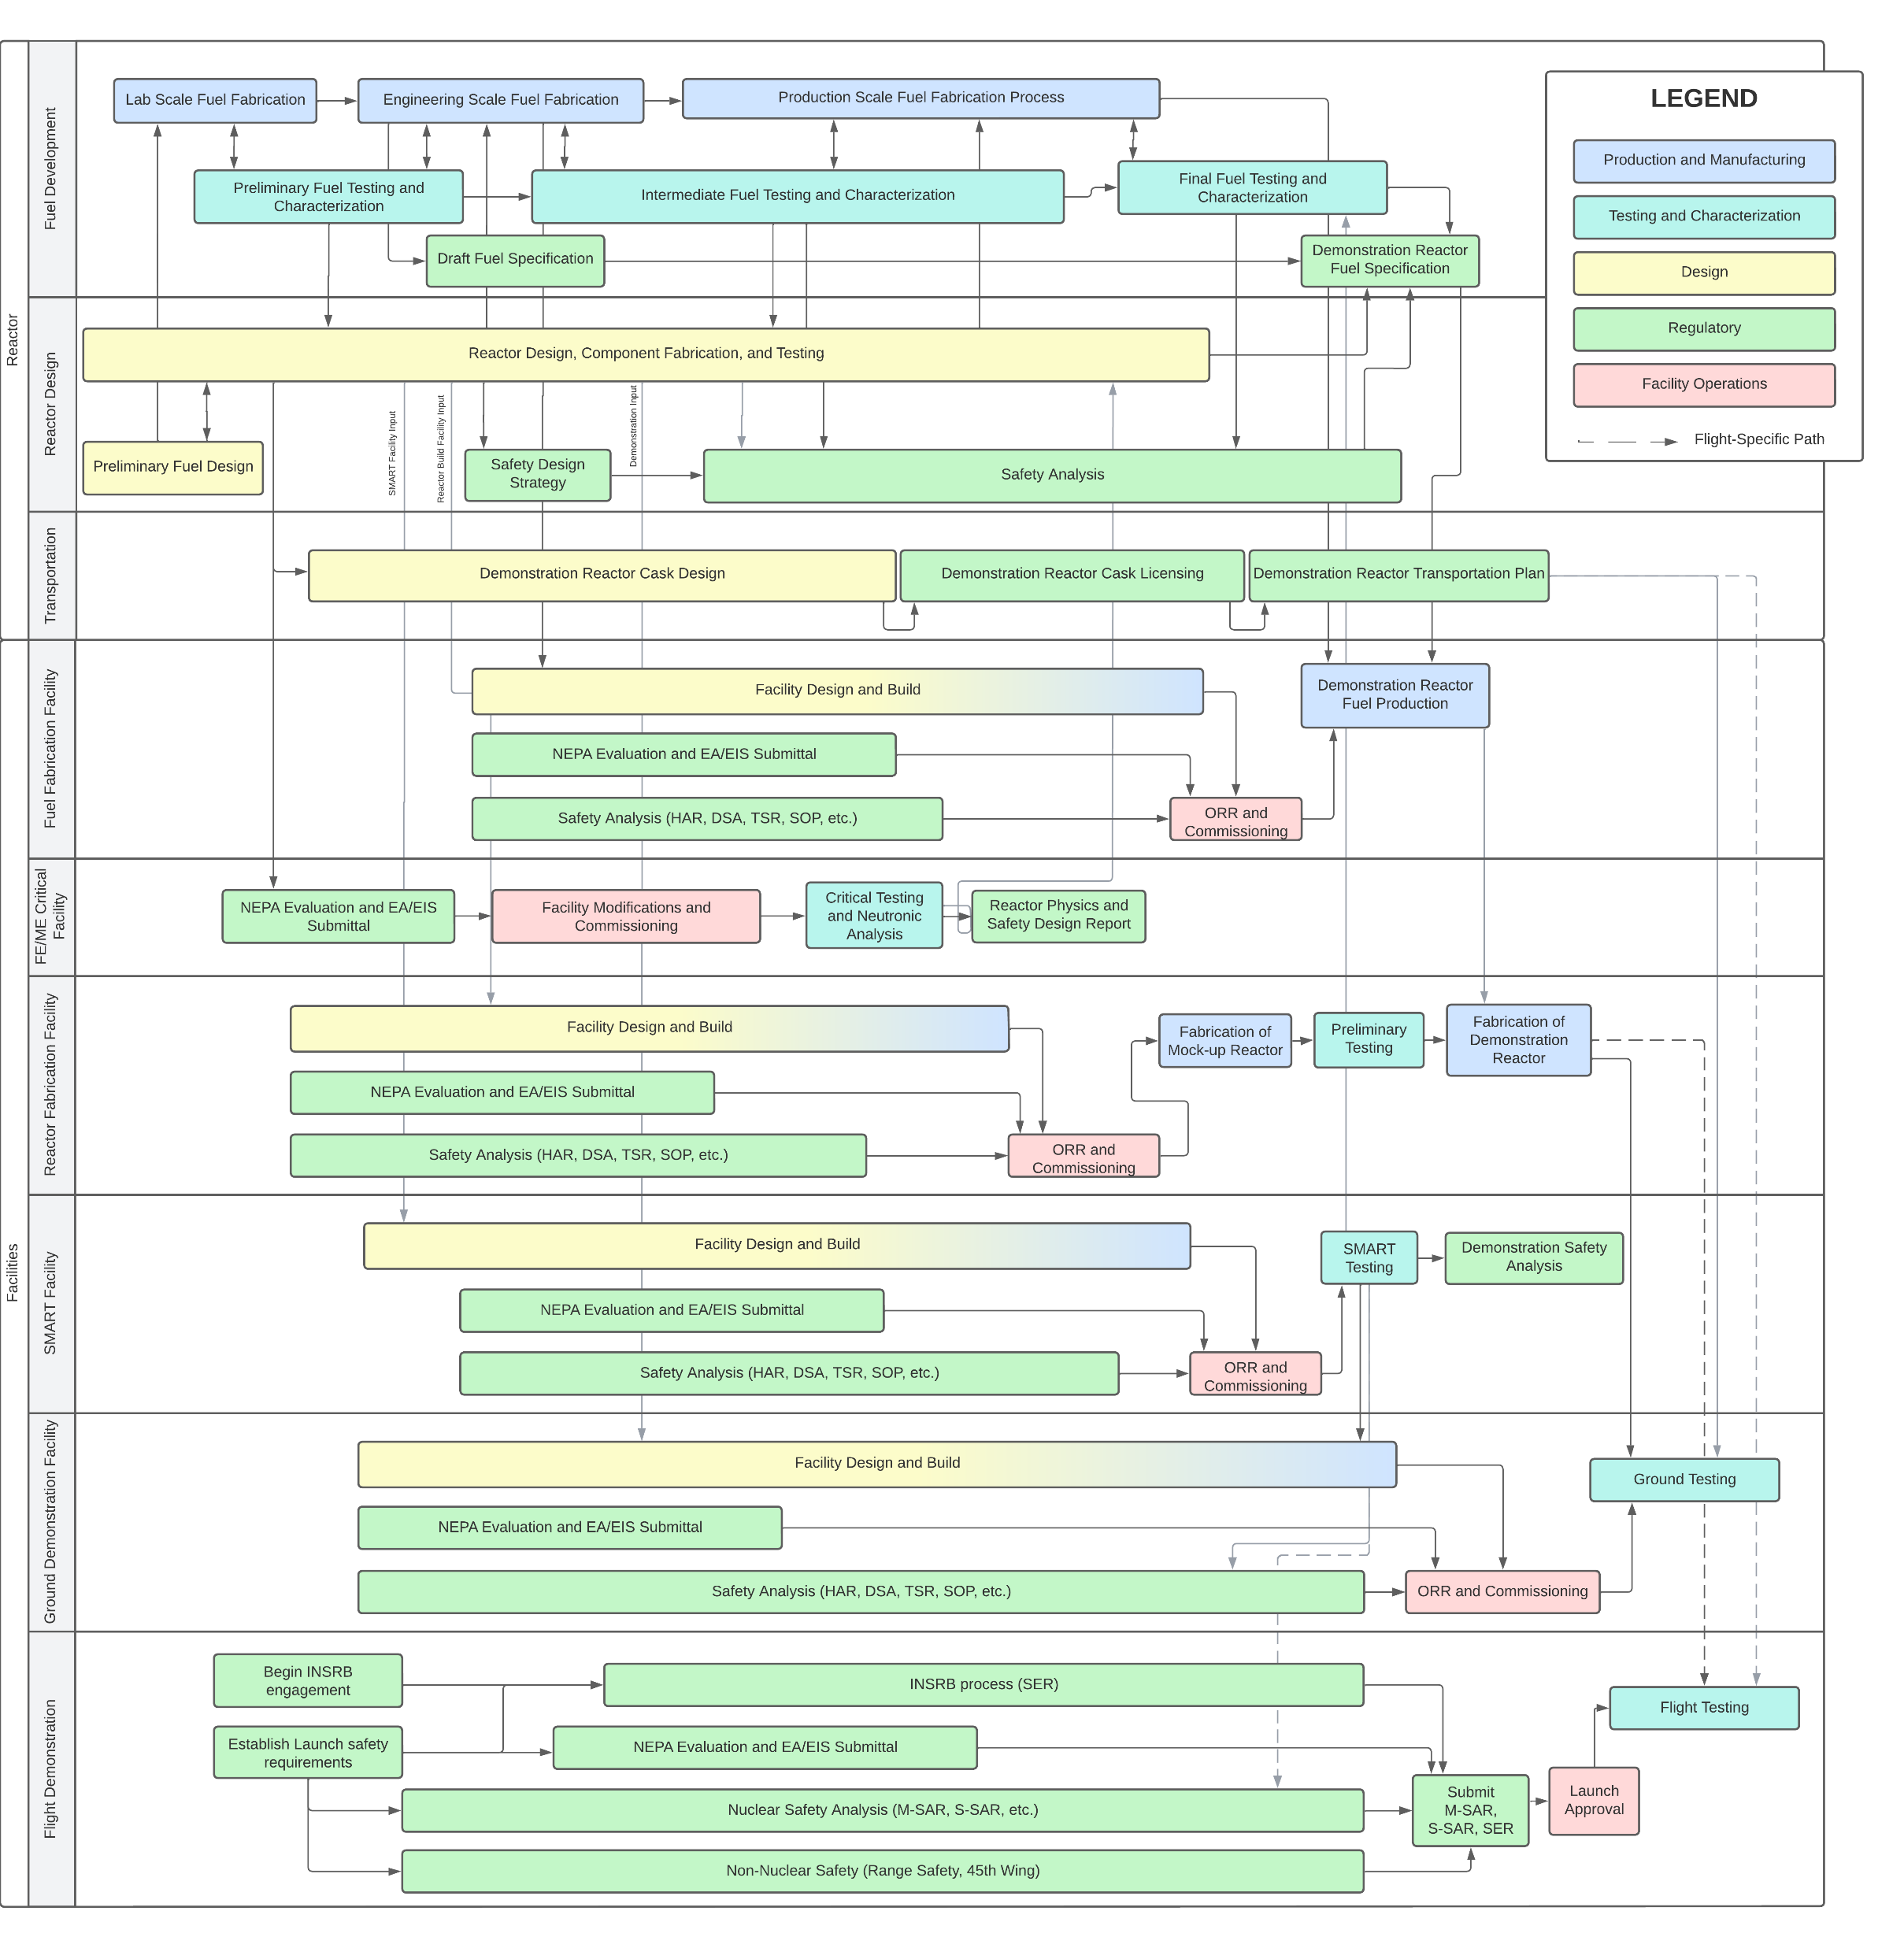
Regulatory Roadmap
Overview Diagram
Regulatory Approach for NTP
Notes:
Full roadmap – too small to really see, but the presentation will move through the “swim lanes” top to bottom

Slide 7
Reactor Design Components
Fuels
  Development and characterization of fuels
  Confirm performance under expected conditions
Reactor
  Confirm design constraints will be satisfied
  Confirm mission parameters will be met
Transportation
  Ensure safe transportation of reactor to test site
Regulatory Approach for NTP

Slide 8
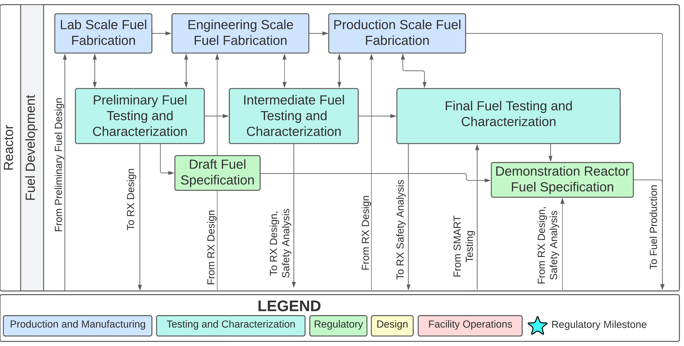
Iterative Fuel Design Essential for Authorization
Novel fuel usage through extensive characterization
Fuel Design requires iteration and interfaces throughout the system design process
Regulatory Approach for NTP

Slide 9
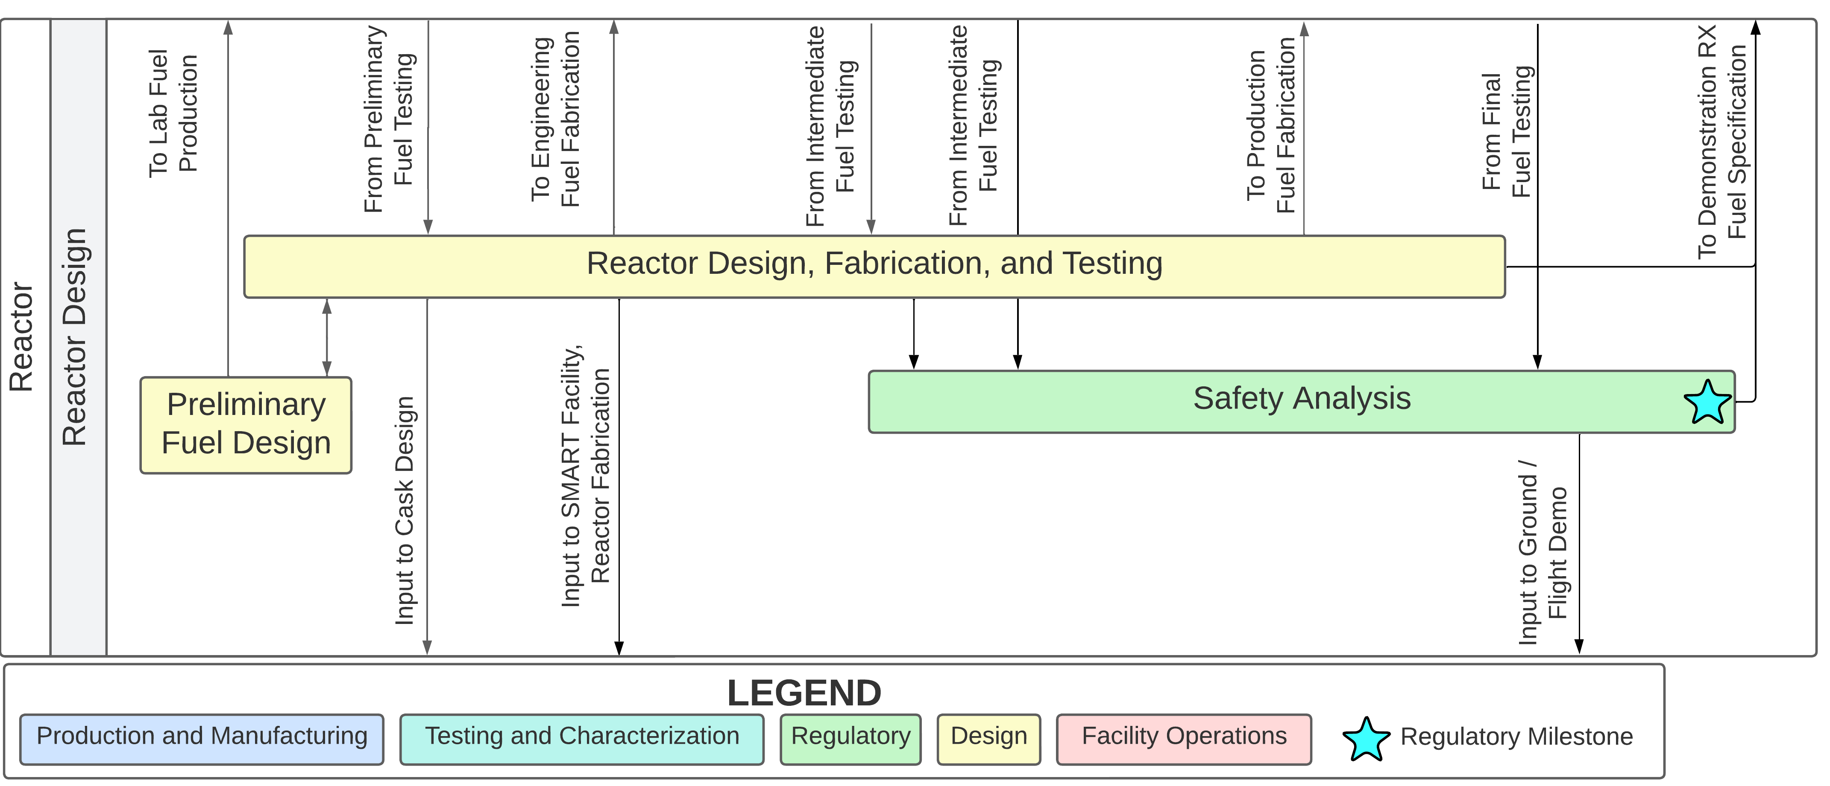
Reactor Design Options Narrow with Testing
Reactor design is shaped by fuel requirements as well as mission parameters
Regulatory Approach for NTP

Slide 10
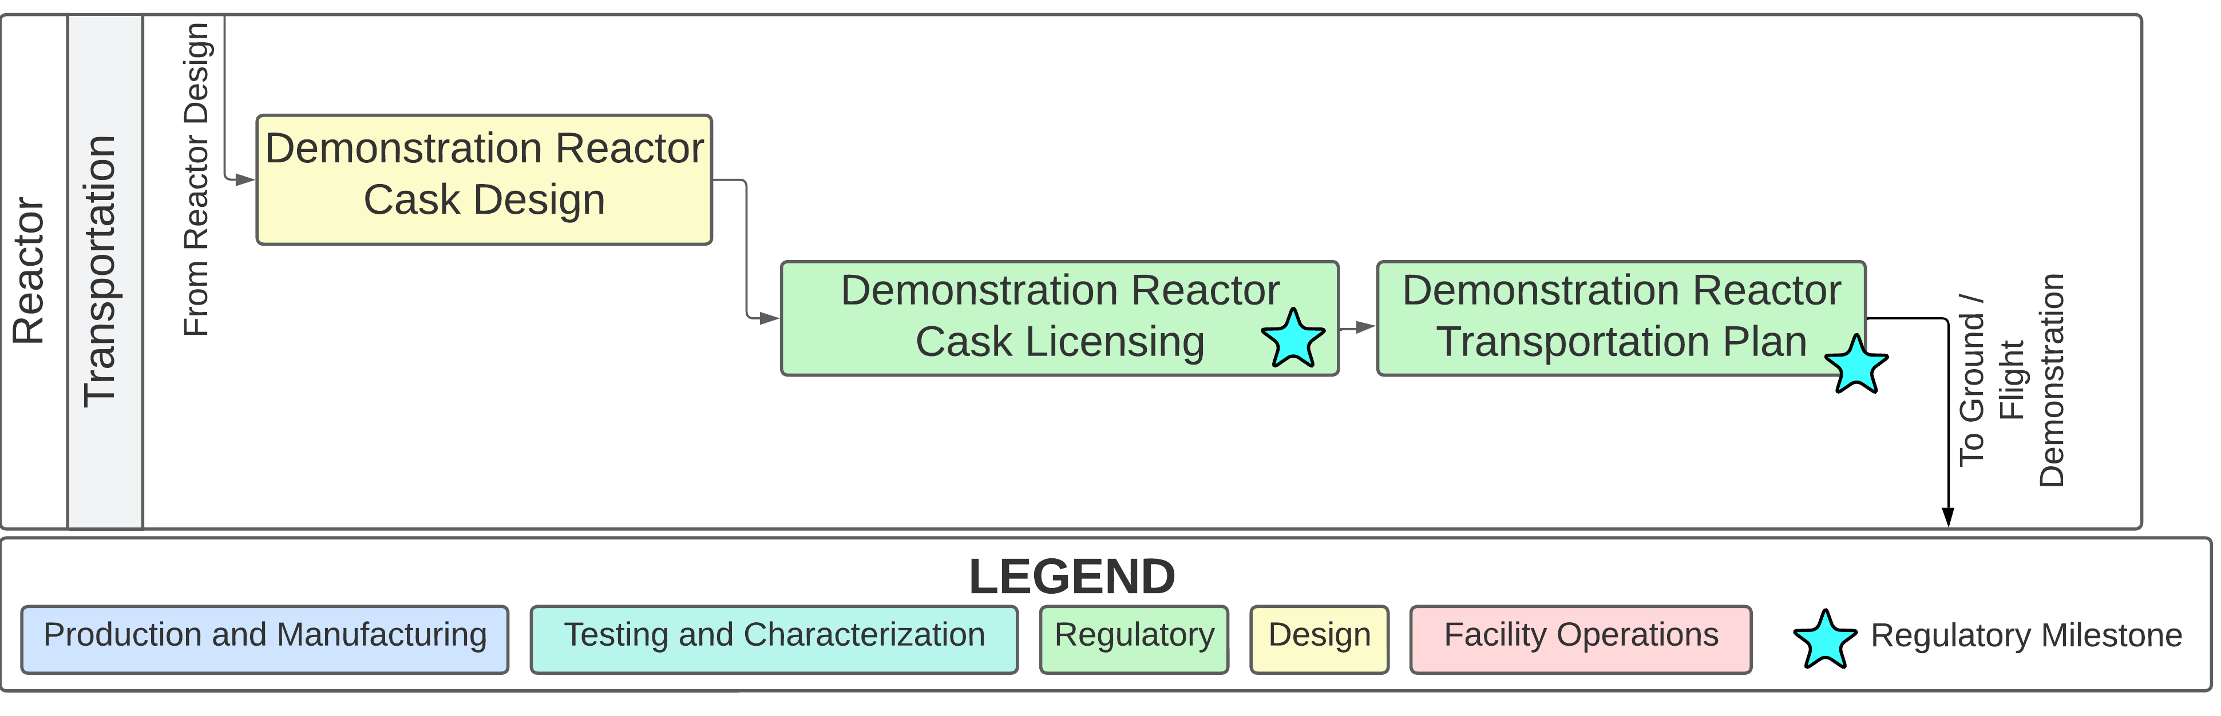
Cask Design Required for Transporting Entire Reactor
Development to begin after initial form factor is estimated, due to lengthy design cycle
Lessons can be learned from SMR transport of complete reactors
Regulatory Approach for NTP

Slide 11
Facilities Development
Facilities required for technology maturation
Existing
  Fuel fabrication
  Critical testing
  Reactor fabrication
New
  SMART
  Integration
  Ground testing
Regulatory Approach for NTP

Slide 12
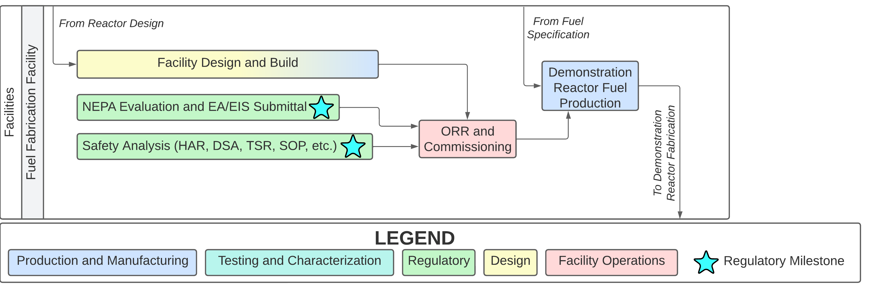
Final Fuel Quantities Require Large Production Line
Modification of existing licensed facility
Regulatory Approach for NTP

Slide 13
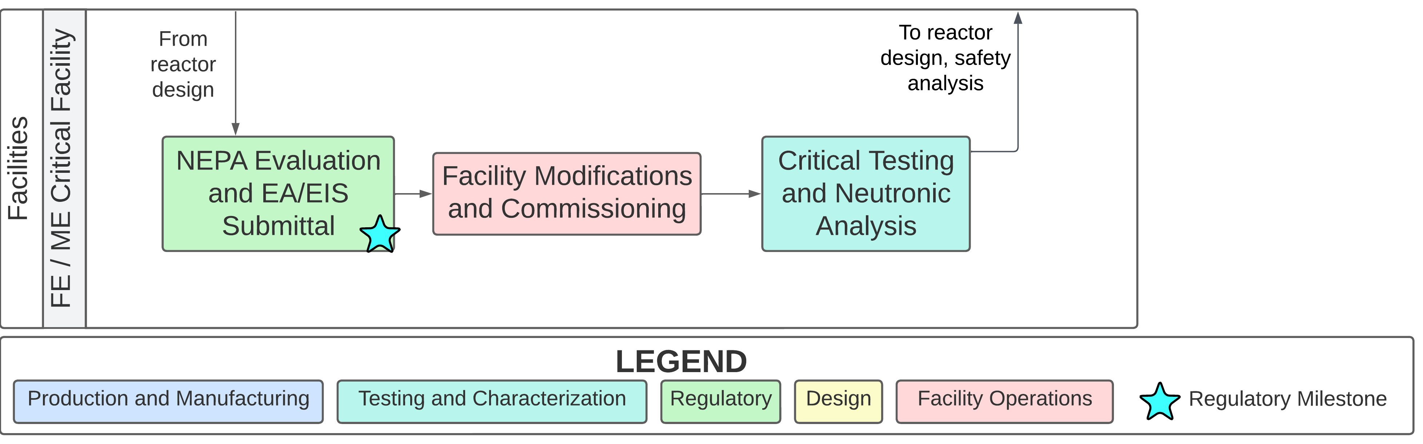
Critical Tests Confirm Neutronic Design
Critical testing for neutronic design planned early to provide feedback to reactor design
Regulatory Approach for NTP

Slide 14
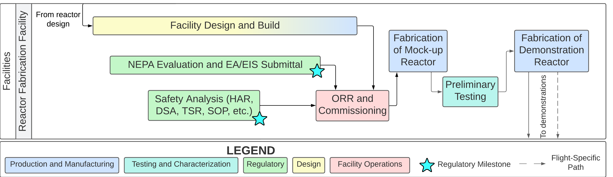
Reactor Fabrication for Specialized Components
Modification from existing fabrication facility or new facility
Integration and assembly possible at test site or separate location
Regulatory Approach for NTP

Slide 15
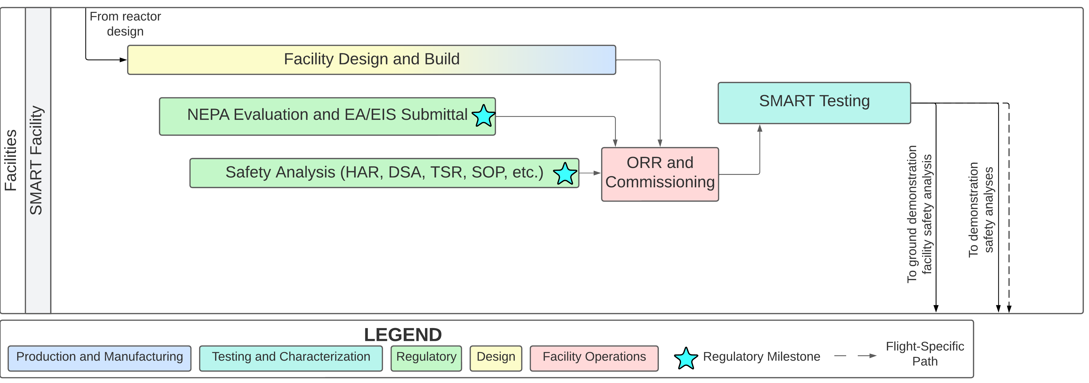
SMART Facility Valuable, but Significant Effort
Advanced fuel testing facility can provide excellent data but adds risk and complexity
Advanced development options offer technical assurance at increase to cost and schedule
Regulatory Approach for NTP

Slide 16
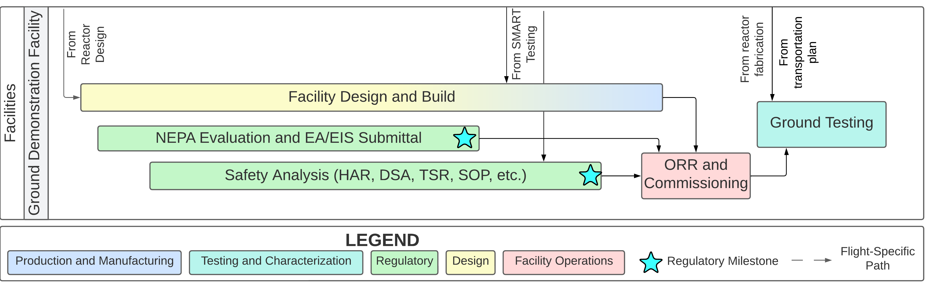
Design and Approach Dependent on Site, Testing
Affordable designs with less containment possible, if testing results can support fuel performance
Ground demonstration facility a consideration early to set ground test requirements
Regulatory Approach for NTP

Slide 17
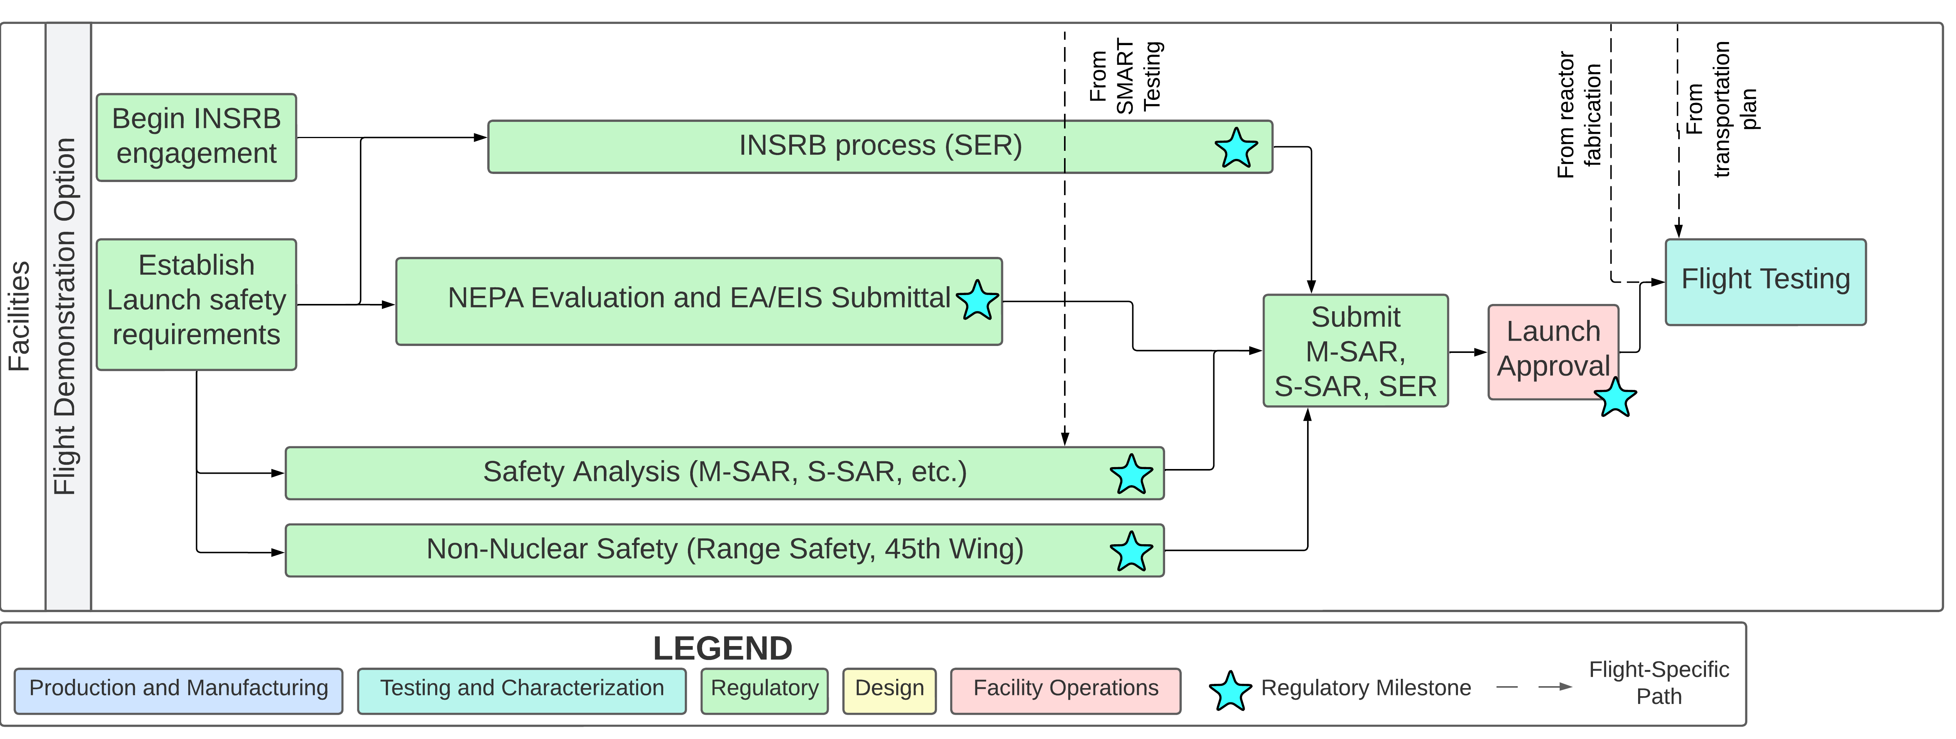
Flight Demonstration Option Considered
Relieves ground environment restrictions in exchange for launch requirements
Flight demonstration has advantages/disadvantages in regulatory space
Regulatory Approach for NTP

Slide 18
Challenges
Requiring advance planning and specific consideration
Model extrapolation
  Large uncertainties for prospective system analysis
Test authorization with open system
  Fission product release analysis requires fuel characterization
  High speed and temperature exhaust requires extensive containment
    Alternatively high system confidence if exhaust is not captured
Test results from ground test applying to space application
  Environment changes
  Auxiliary systems
    Supporting terrestrial regulations and requirements
Regulatory Approach for NTP

Slide 19
Conclusions
NTP Ground Testing poses challenges, as with any novel system
Foresight, planning, and cooperation can:
  Analyze proposed system
  Assure safe operation
  Obtain testing authorization
Demonstrating capabilities is the first step
  Flight testing
  Technology maturation
  Faster and more efficient space travel
Regulatory Approach for NTP

Slide 20
Questions and Contact
Questions?
Happy to discuss further:
  At the AMA or NASA booths
  Email @ alexander.j.pingel@ama-inc.com
Thank you!
Regulatory Approach for NTP

