Slide 1
2023 DZ2 Hypothetical Impact Exercise Risk Assessment: Epoch 1
Jessie Dotson, Gregoire Chomette, Ashley Coates
Lorien Wheeler, Donovan Mathias
NASA Ames Research Center
Asteroid Threat Assessment Project

Slide 2
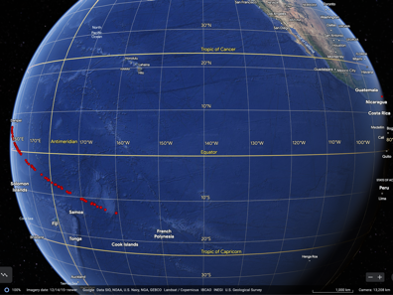
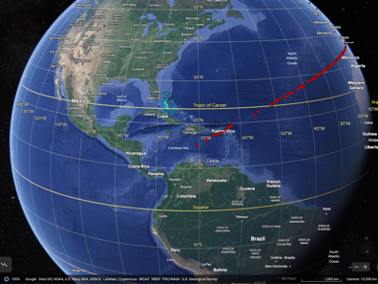
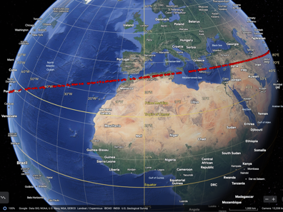
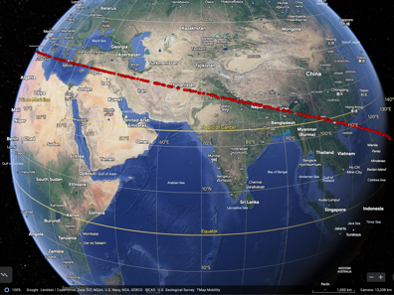
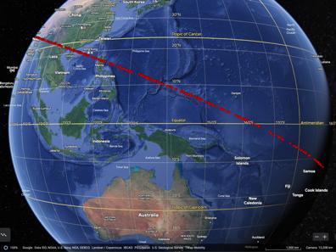
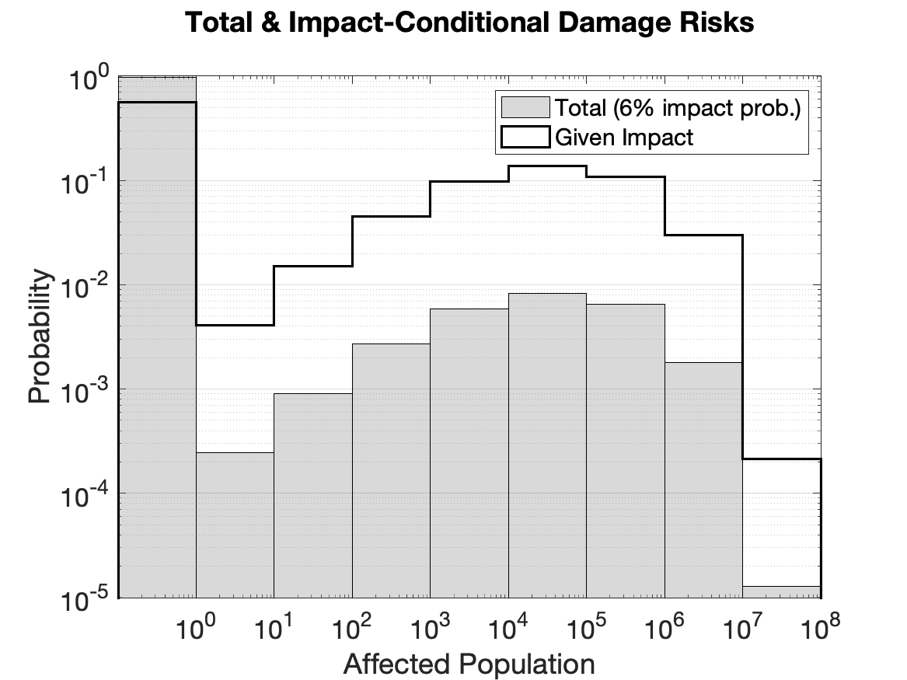
Impact Risk Summary
Asteroid Characterization Summary
Assessment Date: 20 March 2023
Earth impact probability: 6%
Only characterization available is absolute magnitude
Diameter: range 19-446m, most likely 34-185m, median 64m
Energy: range 32-3557Mt, most likely1-138Mt, median 6Mt
Hazard Summary
Affected population: 0 – 18M; most likely outcome is no damage
Asteroid is likely to miss Earth, but there is a 44% chance of population damage if impact occurs
Impact could cause blast damage, with serious damage most likely extending 0-100km, and possibly out to 300km
Only the worst case scenarios cause thermal radiation damage
Global effects are not observed
Impact locations and Affected Population
Affected Population Risks
97%
Probabilities of how many people could be affected by the potential damage
Range: 0-18M ppl
Likely no damage
56%
9.8%
14%
11%
0.6%
0.8%
0.7%
0.02%
0.001%

Slide 3
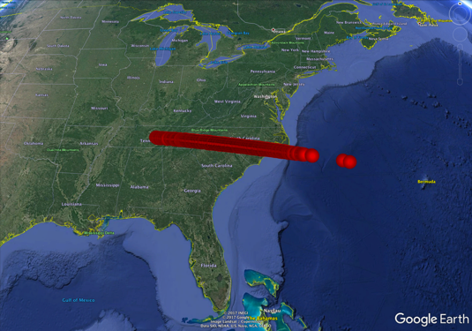
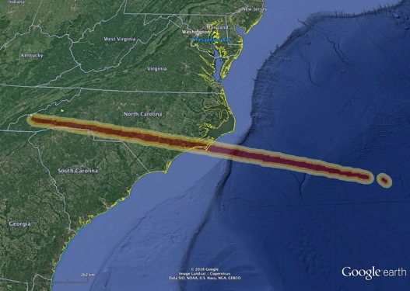
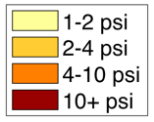
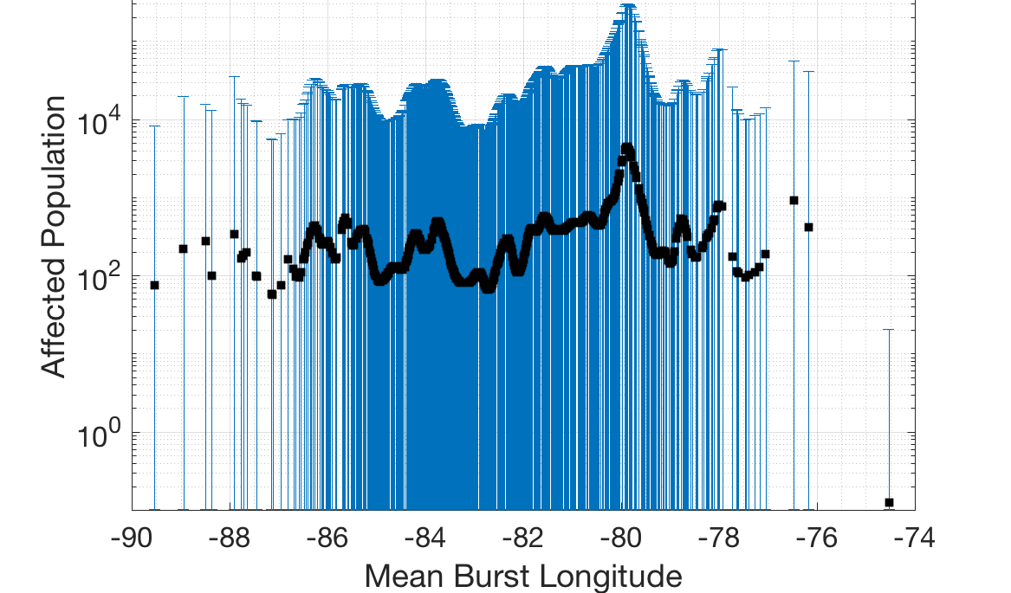
Probabilistic Asteroid Impact Risk
Hypothetical Entry points
Damage Map
Updated by Davide as
Astrometry improves
New Damage Maps
PAIR
Physical Property Distributions
Damage Range
Updated by Jessie based on
characterization observations
New Damage Metrics
HYPOTHETICAL EXERCISE

Slide 4
Asteroid Property Inference Network
Available measurement (epoch 1)
PAIR input node
Inference network node
H
diameter
albedo
taxonomy
base density
density
porosity
strength
HYPOTHETICAL EXERCISE

Slide 5
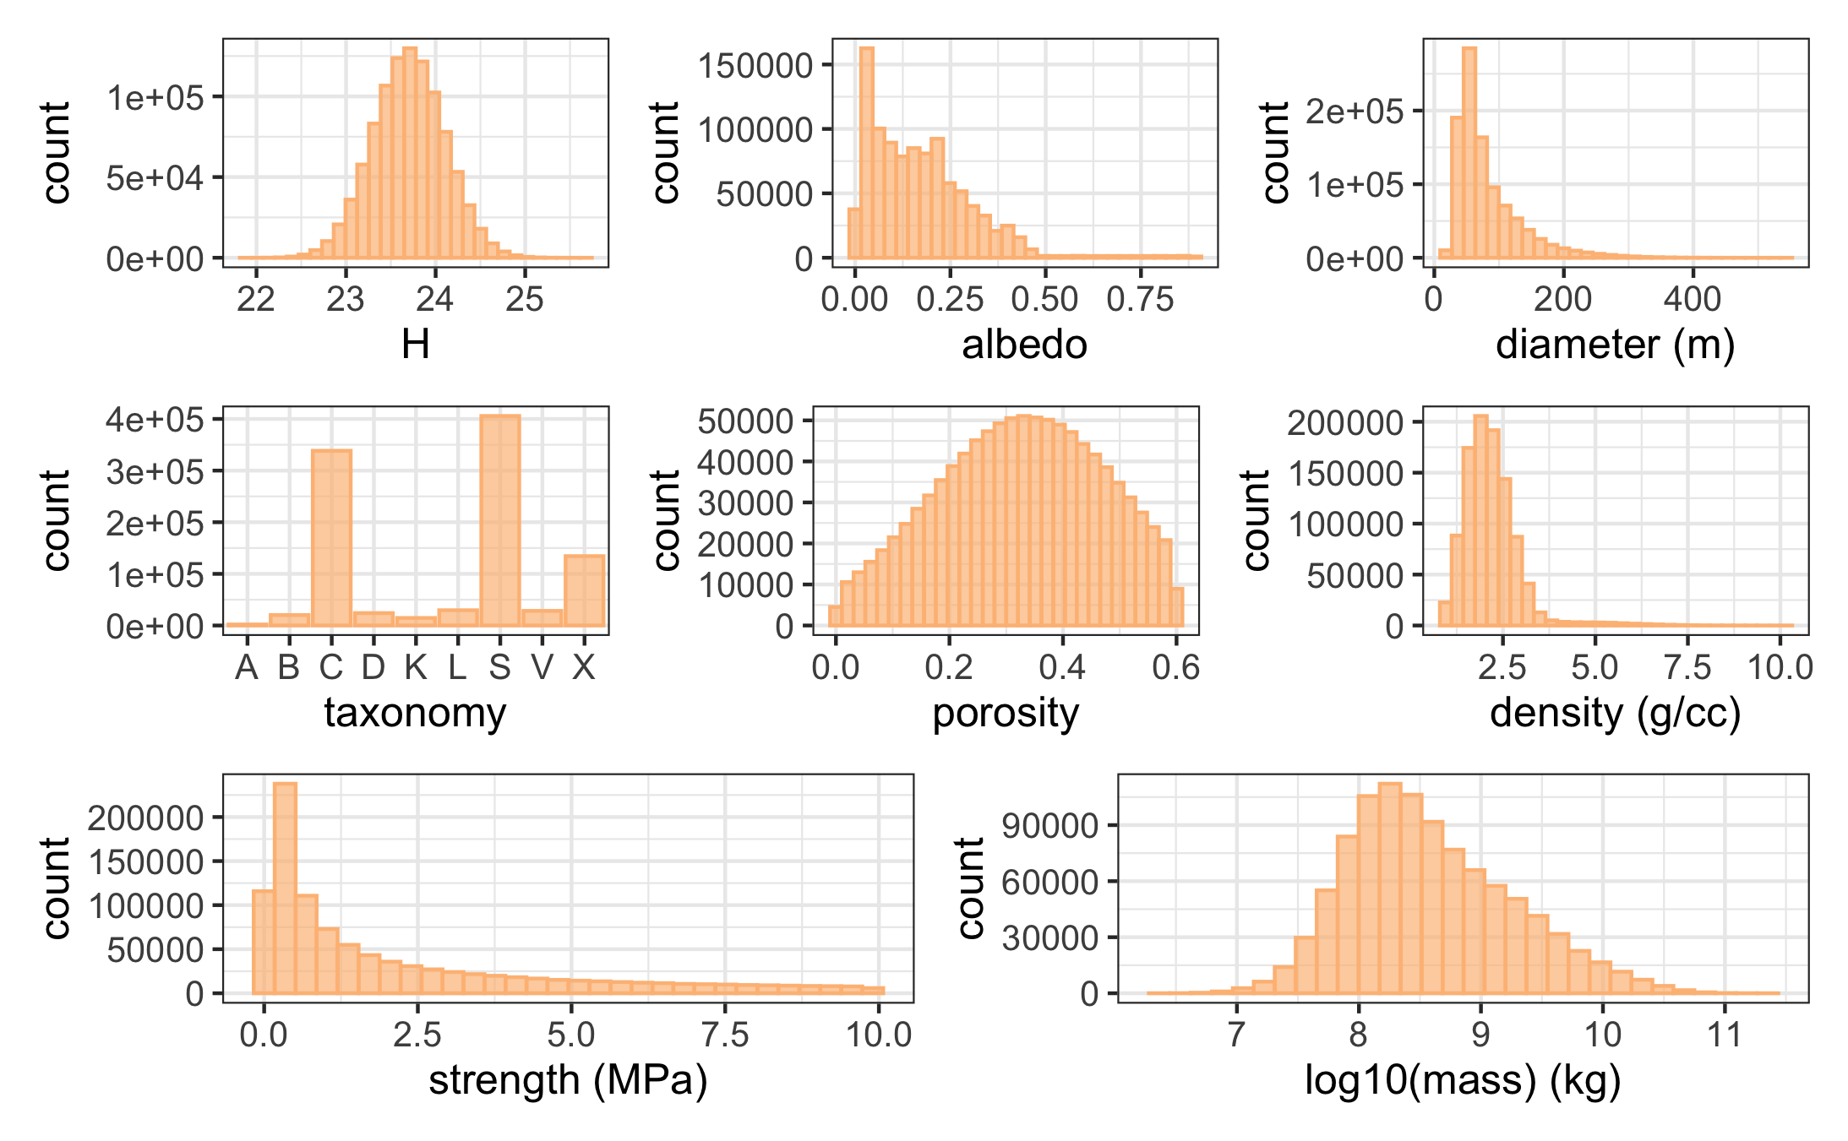
Asteroid Properties
(Epoch 1: Initial Discovery)
Determined by observations:
  H
From population statistics:
  albedo
  porosity
Inferred:
  density
  taxonomy
  strength
Calculated:
  diameter
  mass

Slide 6
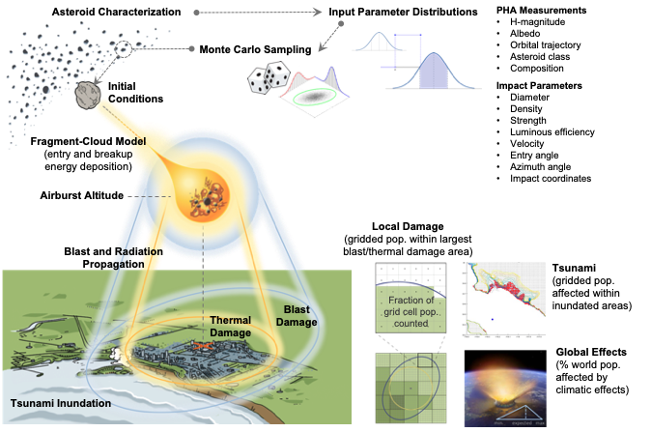
Probabilistic Asteroid Impact Risk
(PAIR) Model
Notes:
There are skimming shallow entries down to fractions of a degree that should maybe be thrown out.

Slide 7
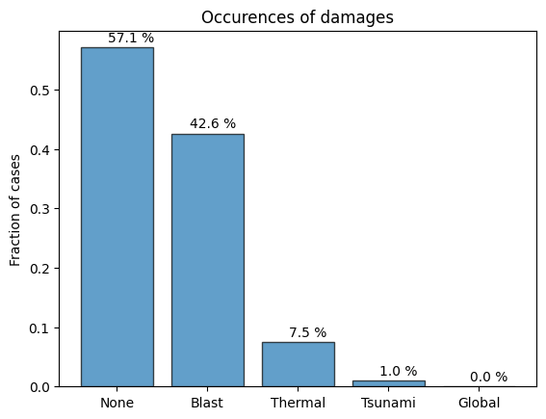
Hazard Sources
Relative hazard probabilities among 6% of Earth-impacting cases
No damage occurs in about 56% of Earth-impacting cases
Local blast and/or thermal damage occurs in about 43% of Earth-impacting cases
  Blast occurs in all 43% of local damage cases
  Thermal occurs in only 8% of cases
Tsunami damage occurs in about 0.9% of Earth-impacting cases
No global effects are observed
Notes:
Not sure I’m pulling the correct numbers from the hazard stats on this slide

Slide 8
Affected Population Risks
Low chance of Earth-impact, with some chance of very large populations being affected if impact occurs:
  2.6% probability of damage when including the Earth-impact probability of 6%
  44% chance of damage if Earth-impact occurs, likely affecting thousands to tens-of-thousands of people
Probabilities of large population damage:
  Chance of affecting over 100K people: 0.8% total, 14% given impact
  Chance of affecting over 1M people: 0.2% total, 3% given impact
  Chance of affecting over 10M people: 0.001% total, 0.02% given impact
97%
56%
9.8%
14%
11%
0.6%
0.8%
0.7%
Probabilities of affecting the number of people within each range
0.02%
0.001%
Minimum Affected Population | Probability if Earth-Impact Occurs | Total Probability (with Earth-Impact)
Any | 44% | 2.6%
>1K | 37% | 2.2%
>10K | 28% | 1.7%
>100K | 14% | 0.8%
>1M | 3% | 0.2%
>10M | 0.02% | 0.001%
Probabilities of affecting at least the given number of people or more

Slide 9
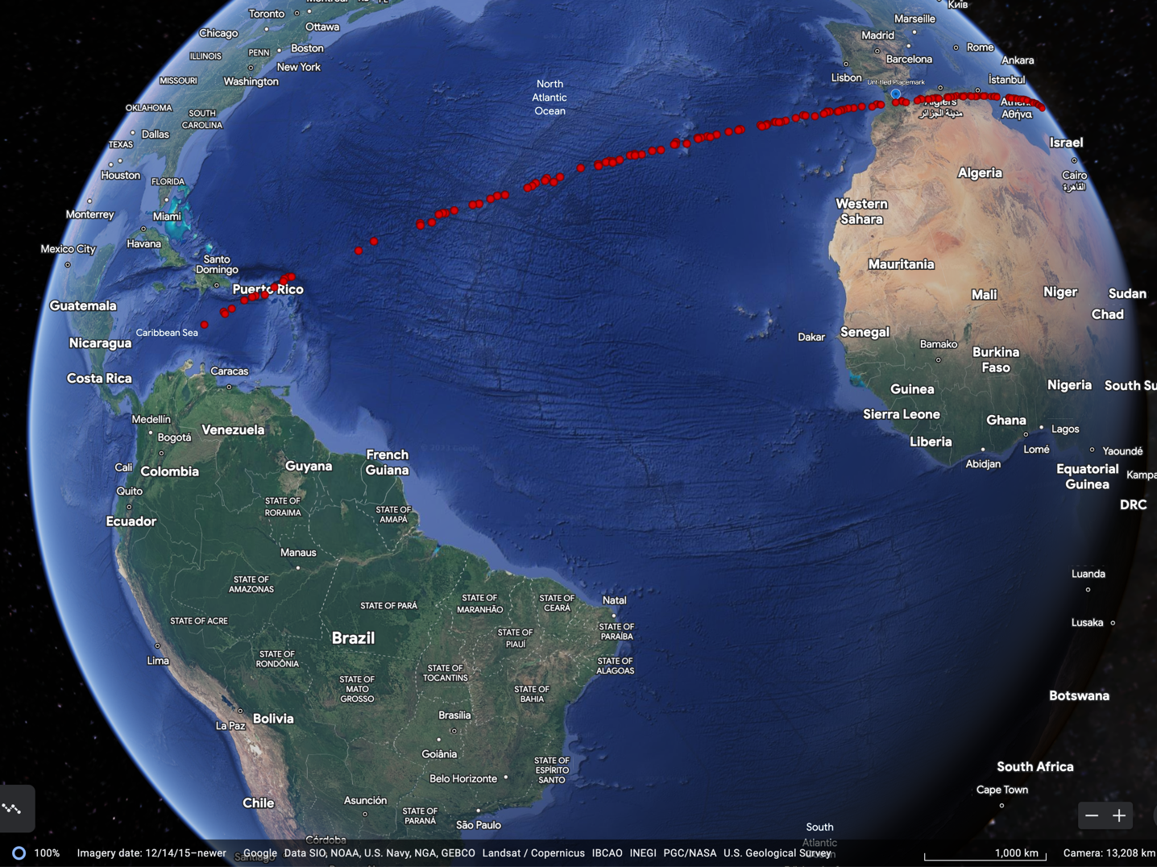
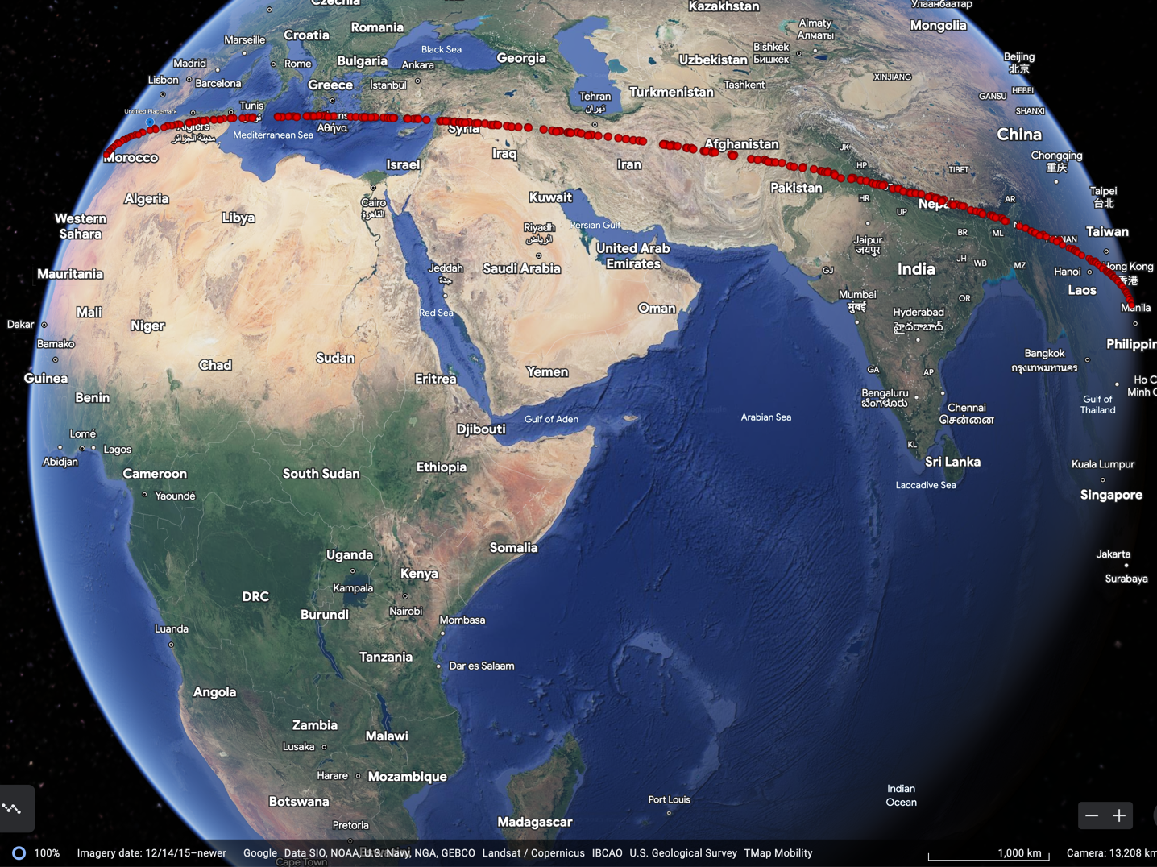
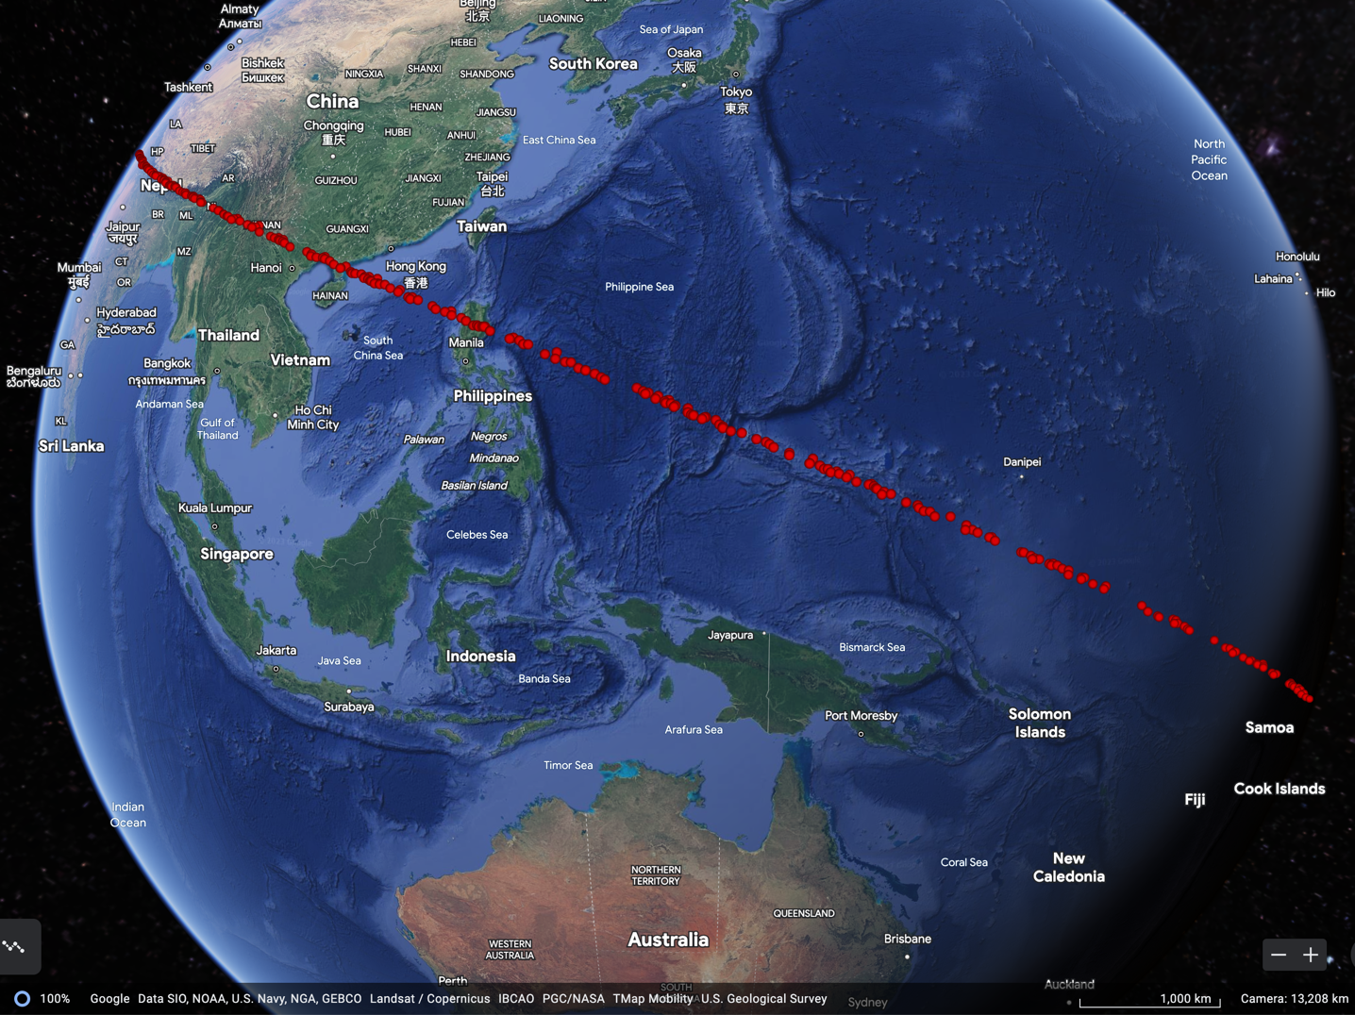
Swath Location

Slide 10
Affected Population Ranges Along Swath
Min/Mean/Max Affected Population

Slide 11
backup

Slide 12
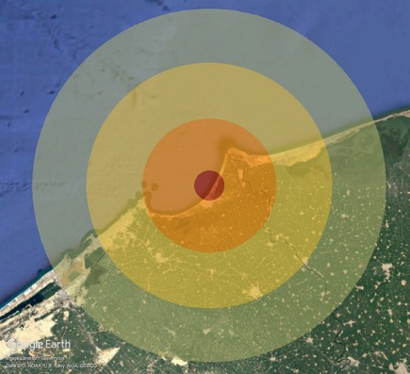
Local Damage Level Definitions
PAIR models local ground damage due to both blast overpressure and thermal radiation hazards.
Ground damage is assessed at four severity levels, with each level affecting different fractions of the population within that region
For each damage level, the larger of the blast or thermal radius is used to determine the area and population for that level.
Damage Level | Population fraction | Blast Threshold (psi) | Thermal Exposure Threshold
Serious | 10% | 1 psi – window breakage and some structural damage | 2nd degree burns
Severe | 30% | 2 psi – doors and windows blown out, widespread structural damage | 3rd degree burns
Critical | 60% | 4 psi – most residential structures collapse | cotton/denim clothing ignites
Unsurvivable | 100% | 10 psi – complete devastation | sand explodes, roll roofing ignites

