Slide 1
RF Sensing for NASA
NDE Applications
WME-5
¹William (Cy) Wilson
¹NASA Langley Research Center

Slide 2
Outline
Motivation
CFRP Strain Sensing
Crack Sensing using Antenna/SAW
Passive Wireless Sensors
Flutter Sensing
Carbon Fiber Tow Angle Sensing
Defect Detection using Spoof Surface Plasmons
Microwave Detection of Voids in Lunar Regolith Simulant
3D Microwave Imager for Damage Detection
Terahertz Imaging of Thermal Protection Systems
Conclusions

Slide 3

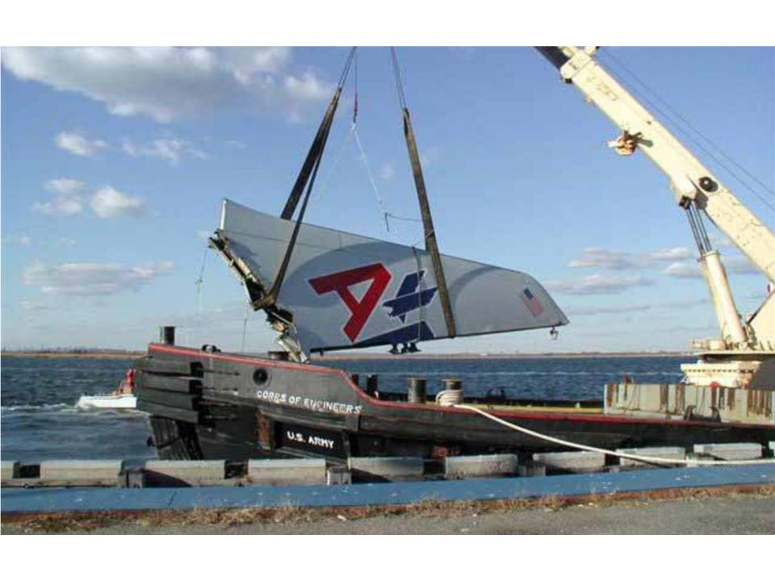
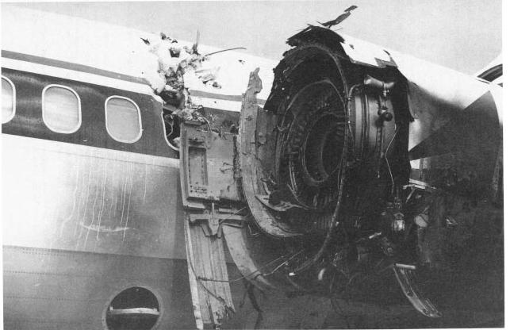

Motivation
Need for Improved Aviation Safety
Can we detect changes in the structure before this happens?
Forward fuselage, Aloha Airlines (1 person killed)
Vertical Tail, American Airlines Flt 587 (265 killed)
Engine, Delta Flight 1288 (2 people killed)
U.S. Forest Service C-130, near Walker, CA (3 killed)
Notes:
We would like to use Structural Health Monitoring to determine if there is a problem before someone gets onboard an aircraft.
Data from the FAA and the NTSB have shown that subsystem and component failures together contribute to 24% to onboard fatalities and are the underlying factors in many of the 26% of loss of control accidents.
Alleviating future accidents such as these is the motivation for NASA’s Aviation Safety Program.
We are

Slide 4
Test Setup
Microwave Frequency Domain Reflectometry (FDR) is being investigated as a method of enabling rapid remote measurement of strain occurring at the first carbon fiber layer of a composite fiber reinforced polymer (CFRP).
A Carbon fiber–reinforced polymer (CFRP) composite panel measuring 406 mm by 406 mm by 2.78 mm was fabricated at NASA Langley Research Center.
The composite laminate IM7/8552 is quasi-isotropic and is made up of IM7 fibers and 8552 prepreg material with a 26 ply thick layup of [(0/+45/−45/90)3 0]S.
The composite panel is interrogated using an Agilent N5230C vector network analyzer connected to an A. H. Systems SAS-571, 700 MHz ~ 18 GHz horn antenna located 120mm from the panel, using 5.5~6 GHz
William C. Wilson, Jason P. Moore, Peter D. Juarez, “Remote Strain Sensing of CFRP using Microwave Frequency Domain Reflectometry”, IEEE Natl. Aerospace & Elec. Conf., Dayton, Ohio, July 26-29, 2016, pp. 401-406.
Notes:
Here is our experimental setup, the composite panel is interrogated using a vector network analyzer connected to linearly polarized horn antenna located 120mm from the panel.
A thermocouple is attached to the panel to measure the temperature, and a hygrometer is located above the panel to measure the humidity.
All of the instrumentation is connected to a laptop via USB. The data is collected and stored using LabVIEW software.

Slide 5
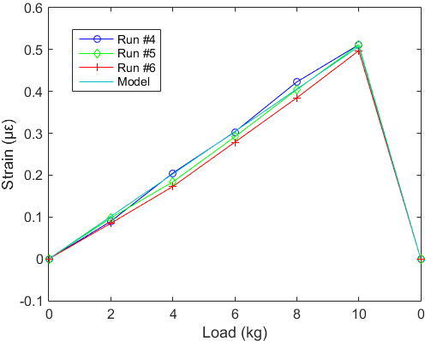
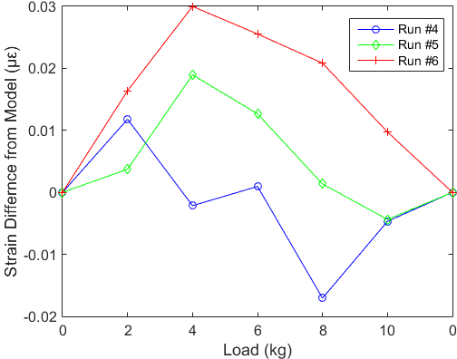
Compensated Strain
(a) (b)
(a) Strain and model strain data for three load runs.
(b) Difference data for the three load runs.
Notes:
To prove that the compensation equation works, we performed another three runs, and used the coefficient values from the first three runs to produce this data.
Data matches the model fairly well, however, again, we would like to reduce the error values.
Note that the maximum strain for this work is only 0.507 µε; larger loading of the panel, via a load-frame for example, would most likely reduce the percentage error.

Slide 6
Multifunctional Crack Sensing
Experimental setup: micrometer actuator, moveable stage, linear polarized horn antenna, and network analyzer.
SAW device and slotted microstrip antenna as mounted on the dog-bone aluminum plates.

Slide 7
Multifunctional Crack Sensing
Antenna Response
SAW Response
SAW Response
The combined EM response of the antenna/SAW device from 966 ~ 996 MHz.
The spectral shifts from the antenna and SAW data for the 10 datasets when the plate is separated from 0 to 225 um in 25 µm increments, while the temperature is increasing.

Slide 8
Multifunctional Crack Sensing
The fitted response of the SAW device, as determined by the spectral centroid method and the crack separation, for the case when the temperature is increasing and when the temperature is decreasing.
The fitted antenna response, as determined by the spectral centroid method and the crack separation, for the case when the temperature is increasing and when the temperature is decreasing.

Slide 9
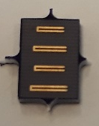
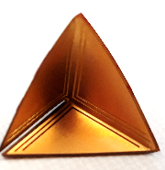
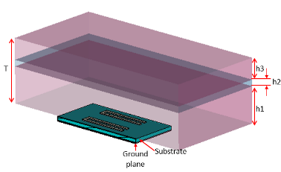
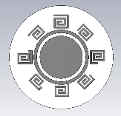
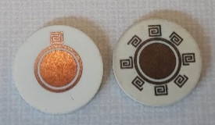
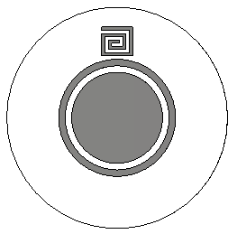
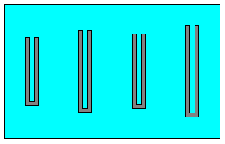
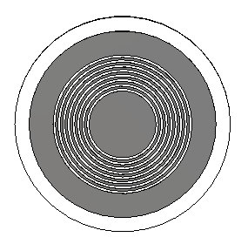
Passive Wireless Sensors
NASA Space NASA Space Technology Graduate Research Opportunities (NSTGRO)
Grant 80NSSC17K0279
TITLE | Passively-Coded Embedded Wideband Microwave Sensors for Material Characterization and Structural Health Monitoring (SHM)
SPACE TECHNOLOGY FELLOW |  | Katelyn Brinker
FACULTY ADVISOR / PRINCIPAL INVESTIGATOR |  | Reza Zoughi
UNIVERSITY |  | Iowa State University
DEGREE PROGRAM |  | Ph.D. Electrical Engineering
NASA RESEARCH COLLABORATOR |  | William C. Wilson, NASA Langley Research Center (LaRC)
MAJOR ACCOMPLISHMENTS
1 master’s thesis, 4 journal articles, 13 conference papers/presentations, and 50+ citations.
Chipless RFID embedded materials characterization proof-of-concept.
Creation of a chipless RFID coding method for sensing applications and enhanced resolution and dynamic range.
Development of a chipless tag design methodology.
Design of high bit density chipless tags that can be used in materials characterization and rotation sensing.
Investigation and trade study of inkjet-printing parameters for tag fabrication.
Development of a hybrid spatial and frequency domain chipless tag approach utilizing microwave SAR imaging for simultaneous identification and sensing.
Development of a new reading method based on circular polarization.
Creation of a corner reflector-based misalignment tolerant tag design methodology.
Demonstration of chipless RFID tags for delamination sensing in multi-layer structures.
Creation of a physics-based model for mapping pressure to resonance frequency of chipless tags for pressure sensing by way of additively manufactured substrates.
Misalignment-tolerant corner reflector based tag
Delamination Sensing Model
High bit density, rotation sensitive chipless tag

Slide 10
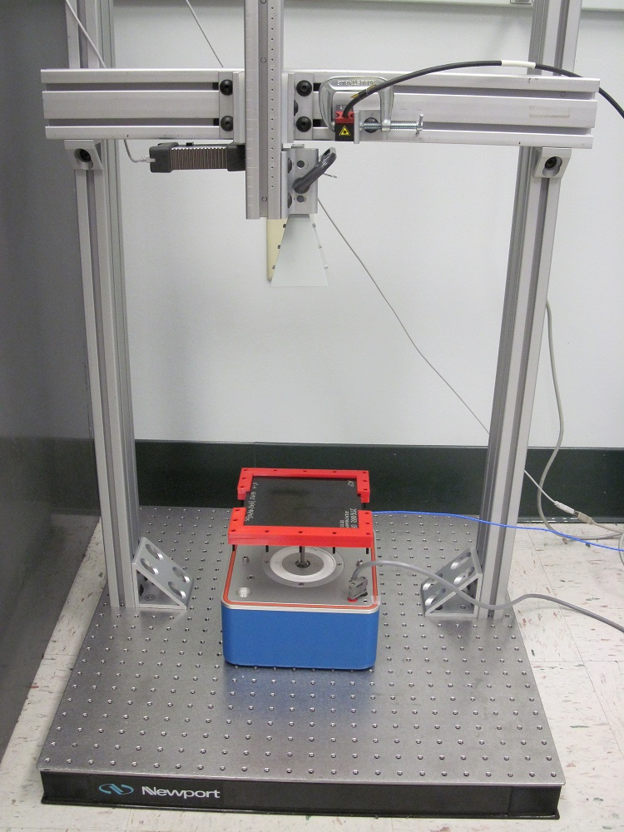
Flutter Sensing Test Setup
Laser
Displacement
The Far Field measurement distance from the antenna to the panel = 600 mm.
At 1Hz vibration, the panel moves ~3.95 mm, with a max velocity of 12.39 mm/s.
Sensor
Horn
Reflectometer
Antenna
CFRP Panel
Shaker
The test setup consist of the reflectometer, the horn antenna, the composite test panel,
the shaker, and laser displacement sensor.
William C. Wilson, Jason P. Moore, Peter D. Juarez, “Surface Acoustic Wave Vibration Sensors for Measuring Aircraft Flutter”, IEEE Intl Conf. on Prognostics and Health Management, Ottawa, ON, Canada, June 20-22, 2016, pp. 1-7.
Notes:
To investigate flutter like vibrations we have created a testbed to evaluate the use of a small, low cost reflectometer as a monostatic radar.
The test setup showing the network analyzer, the horn antenna, the composite test panel, the shaker, and laser displacement sensor.
For this work, a Carbon fiber–reinforced polymer (CFRP) composite panel measuring 152 mm by 152 mm by 2.78 mm was fabricated at NASA Langley Research Center.
The composite IM7/8552 (IM7 fibers and 8552 prepreg resin) with a 16 ply thick layup of [0/+45/−45/90]_{2s}.

Slide 11
Swept Frequency IFFT Data
Spectrogram of the random data set, nine frequencies
(10, 75, 125, 100, 5, 2, 50, 25, 1 Hz) with 90MHz Bandwidth.
Notes:
After making sequential runs of data we decided to double check the data by making runs with the frequencies in random order.

Slide 12
Swept Frequency IFFT Data
Fundamental
1st Harmonic
2nd Harmonic
Spectrogram of the harmonic data set, six fundamental frequencies
(20, 28, 32, 42, 50, 64 Hz), and harmonics with 90MHz Bandwidth.
Notes:
In addition to single vibration measurements, the reflectometer system can measure multiple frequencies simultaneously. To demonstrate this capability, a low quality waveform generator that generates harmonics along with the fundamental frequency was employed.
The generator was set to six fundamental frequencies: 20, 28, 32, 42, 50, and 64 Hz.

Slide 13
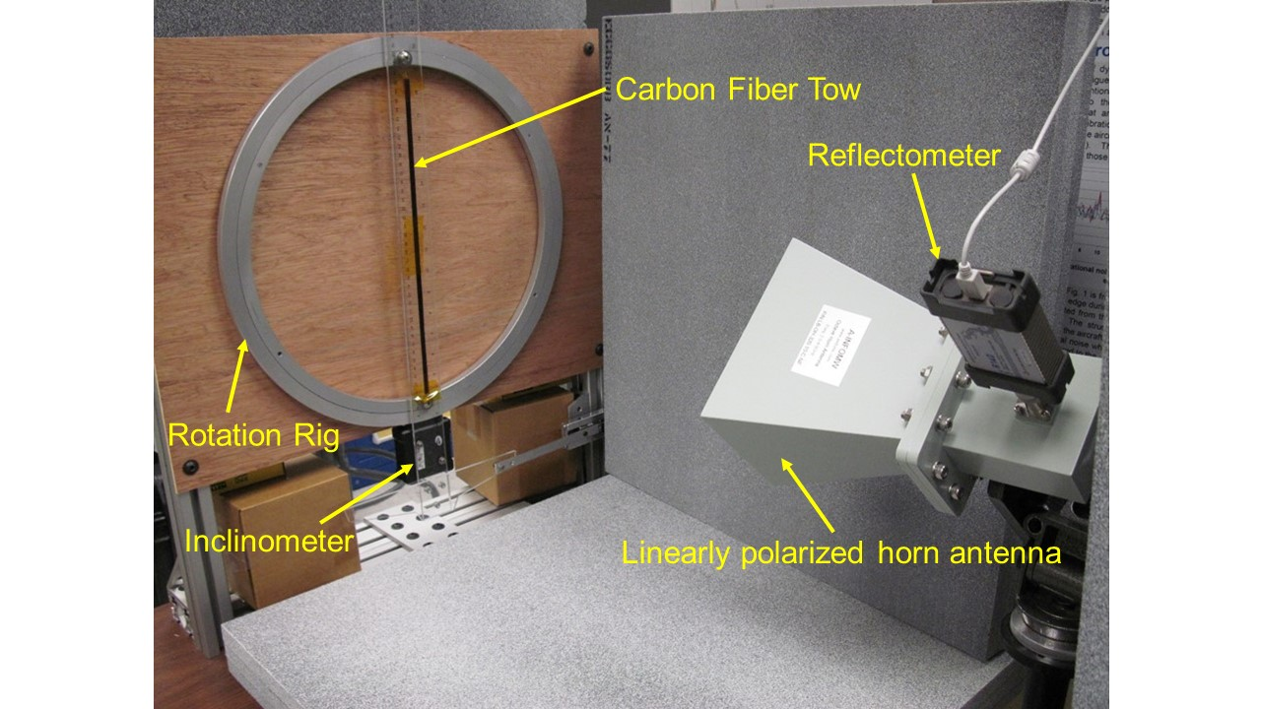
Carbon Fiber Tow Angle Sensing
Experimental Setup
Planar R140 Reflectometer
A-Info 2-4 GHz, linearly polarized, octave horn antenna
Rotation ring
Carbon Fiber tow attached with Kapton tape.
Gating 400 ~ 600 mm.
William C. Wilson, Jason Moore, Peter D. Juarez, “Carbon Fiber TOW Angle Determination using Microwave Reflectometry”, IEEE Sensors Conf., Orlando, FL, Oct. 30- Nov. 2, 2016, pp. 1-3
William C. Wilson, Jason Moore, Peter D. Juarez, “Far Field Measurements of Small Angle Carbon Fiber Misalignments”, IEEE Wireless and Microwave Tech. Conf. (WAMICON), Cocoa Beach, FL, April 24-25, 2017. Pp 1-4.
William C. Wilson, Jason Moore, and Hunter McCraw “Measurement of Sub Degree Angular Carbon Fiber Tow Misalignment”, IEEE ARFTG 90th Microwave Meas. Sym., Boulder, CO, Nov. 28 – Dec. 1, 2017.
Notes:
The experimental setup consists of a microwave reflectometer positioned to record the EM signature of a 6.4 mm wide, 250 mm long IM7 carbon fiber tape. The EM signature of the carbon fiber tape was interrogated using a vector network analyzer connected to a 2-4 GHz, linearly polarized, octave horn antenna with an aperture of 124 mm by 164 mm.
Here is the test rig we used. The carbon fiber tow is attached to a plastic protractor, which is attached to a rotation rig (a lazy Susan by another name).
The tow is interrogated by a linearly polarized horn antenna. The antenna is connected to a network analyzer and a laptop running LabVIEW was used to collect data.
Before beginning the experiments the antenna as aligned to the marks on the board below the test rig. It was then raised up to 0.8m above the tow. The test rig was then placed under the antenna and aligned to the marks on the board.

Slide 14
Results of 1.0 ° and 0.1° increments
The change in impedance as the angle of the carbon fiber tape is rotated from 40° to 50° in 1° increments.
The error bars indicate one standard deviation
Change in impedance as a function of tow angle relative to 45° in increments of 0.1°.
The error bars indicate one standard deviation.

Slide 15
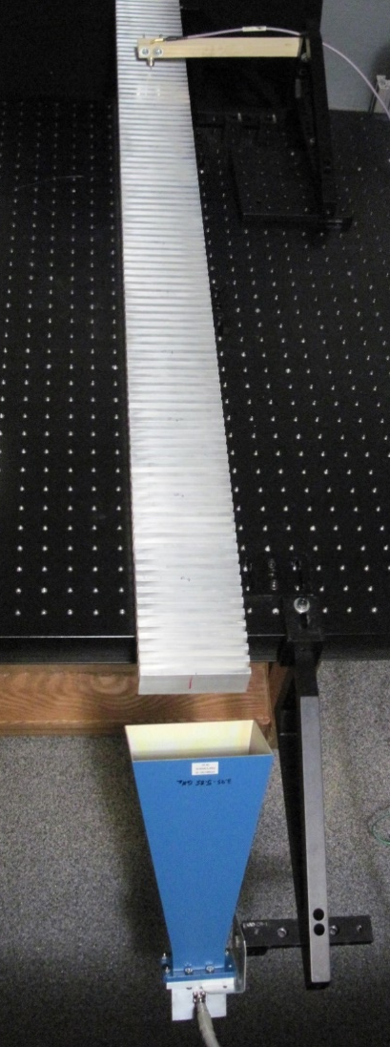
Defect Detection using
Spoof Surface Plasmons
Wire Coaxial Antenna
(Receiver)
1m
Defect location
Aluminum (T6061)
31mm
Horn Antenna
(Transmitter)
45°
Test setup for spoof plasmon polaritons showing the horn antenna, wire coaxial antenna, and grooved test specimen.
A Fieldfox Vector Network Analyzer (VNA) was used to generate and receive signals, in the 2.9 to 3.3 GHz range.
William C. Wilson, Katelyn R. Brinker, “Spoof Plasmon Sensing for NDE Applications”, IEEE Sensors Conference, Dallas, TX, Oct. 30`Nov. 2, 2022.
Notes:
To demonstrate the detection of defects using spoof plasmons, we used the test setup shown here.
The test setup is comprised of a horn antenna for transmitting, and a wire coaxial antenna for receiving, and an aluminum grooved test sample.
A Fieldfox VNA was used to generate and receive signals, in the 2.9 to 3.3 GHz range.

Slide 16
Spoof Surface Plasmons Test Specimen
Simulated Defects: solid aluminum wires that are 2, 5, 10, 15, and 25 mm long and are 1.6, 2.3 and 3.1 mm in diameter.
Simulated Defect (wire)
6.35mm
6.35mm
38.1mm
19.05mm
1212.8m
101.6mm
Test specimen, aluminum (T6061), with a wire as a simulate defect.
Notes:
Defects were simulated using small pieces of solid aluminum wires, that are 2, 5, 10, 15, and 25 mm long and 1.6, 2.3 and 3.1mm in diameter. So 15 defects in all.
These wires are placed in the grooves of the test specimen to simulate metal inclusions from the fabrication process.

Slide 17
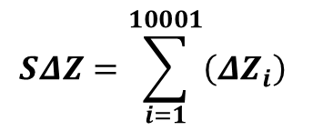

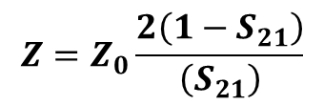
Spoof Surface Plasmon Results
EM Response
S₂₁ (dBm)
The S₂₁ response of the test specimen without any simulated defects.
The change (delta) impedance for 9 distances with an aluminum wire as a simulated defect (1.6 diameter, 2 mm).
$$SΔZ=\sum_{i=1}^{10001}{\left({ΔZ}_{i}\right)}$$
$$Z=Z_{0}\frac{2\left(1−S_{21}\right)}{\left(S_{21}\right)}$$
$$ΔZ=Z_{i}−{Znd}_{i}$$
Notes:
Here is the raw S21 response, however it does not change very much. We have found that there was a larger change in the delta in impedance. We tried several methods for reducing the dimensionality, spectral centroid, principal component analysis, correlation, however none of this methods produced results that are better than a simple summation of the delta impedance.

Slide 18
Defect Detection using Spoof Surface Plasmons
The sum of the change (delta) impedance at multiple locations with wires segments simulating defects.
The black line represents the threshold for defect detection (50).
The simulated defects are Al wires 1.6, 2.3 and 3.1 mm in diameter, and are 2, 5, 10, 15, and 25 mm in length.
Notes:
Here is the plot of the sum of the delta impedance for all of the data sets, where each simulated defect (15 in all) were placed in each of the 9 locations from 10 to 90 cm.
As you can see, for each run there is an increase in the values when a defect is present for all locations.
Naturally, the smaller the defect the smaller the response. Note that the smallest response, which is barely above the case where there are no defects.
We found that a threshold value of 50Ω is above the no defect cases and below the values for the 2mm long 1.6mm diameter cases.
Using the threshold value of 50Ω, we have demonstrated the ability of using spoof plasmons to detect simulated inclusion defects.

Slide 19
Volume Estimation
1.6 mm Dia.
2.3 mm Dia.
3.1 mm Dia.
The fitted average sum of delta values for all 15 defect cases, and the fitting equation. The error bars represent one standard deviation.
Notes:
In addition to detecting the presence of defects, the spoof plasmon technique can also estimate the volume of the defect.
The plot on the left is the average values for the data from the previous slide. That have been fitted using a cubic fit to the volume of the simulated defect for all 15 defects.
The plot on the right is the averaged fitted values on a 3D volume surface where the three diameters of the defects are represented by three different colored spheres.

Slide 20
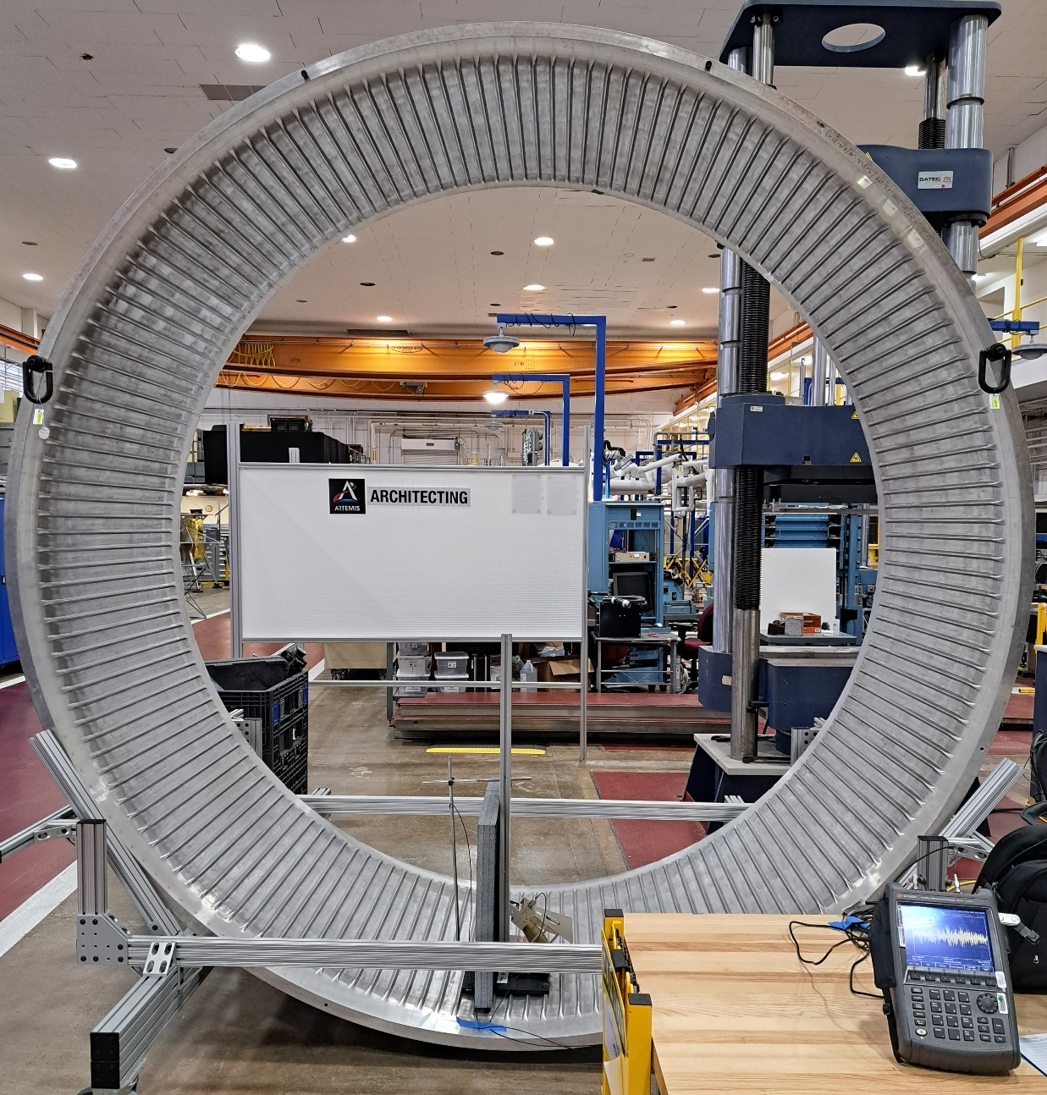
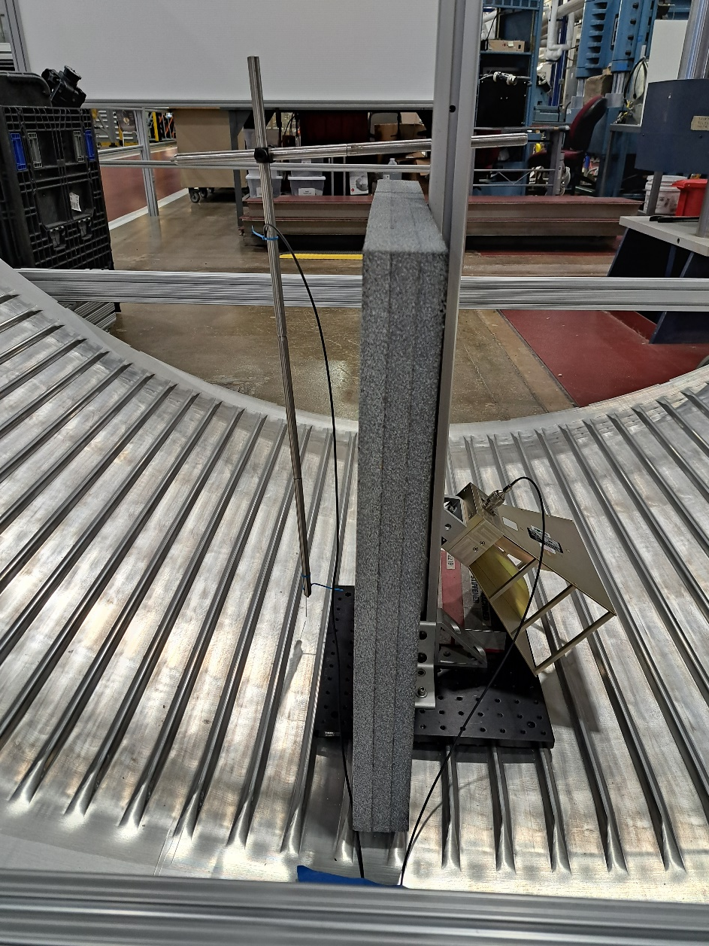

Spoof Plasmons on Integrally Stiffened Cylinder (ISC)
Plasmons
Transmitting
Horn
Antenna
10’ (3.05m)
Defect
Location
Receiving
Coaxial
Antenna
Network
Analyzer

Slide 21
12 ribs from the receiving antenna

Slide 22
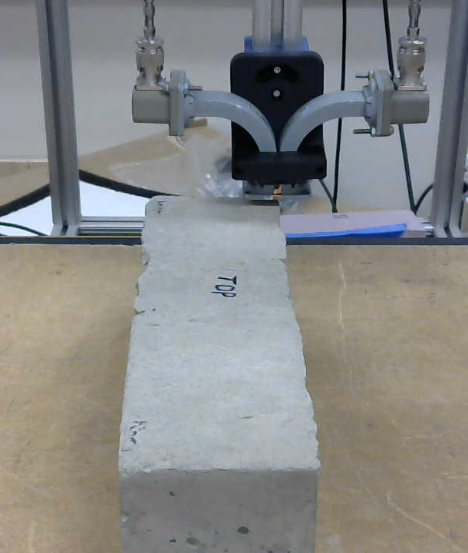
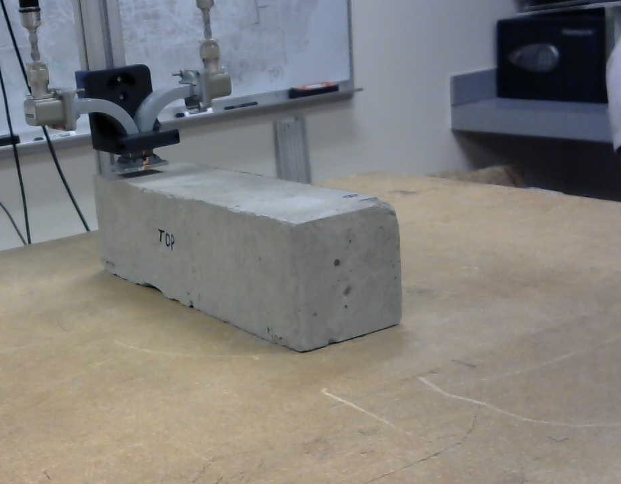
Bistatic Microwave Detection of Voids in
Cementitious Lunar Regolith Simulant
Bistatic Waveguides
Bistatic Waveguides
Side B
Bottom
Side A
Side B
Side A
Photographs of the Lunar Test sample and the Bistatic Waveguide System during scanning performed by ISU’s CNDE Laboratory. ISU has an Space Act Agreement (SAA) with NASA.
RWC CSA concrete per Mix 29 Log Sheet.
The left picture is a top scan, the right picture is a side B scan. Scanned with X-band (8.2 – 12.4 GHz)

Slide 23
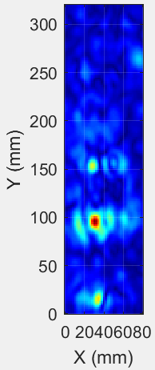
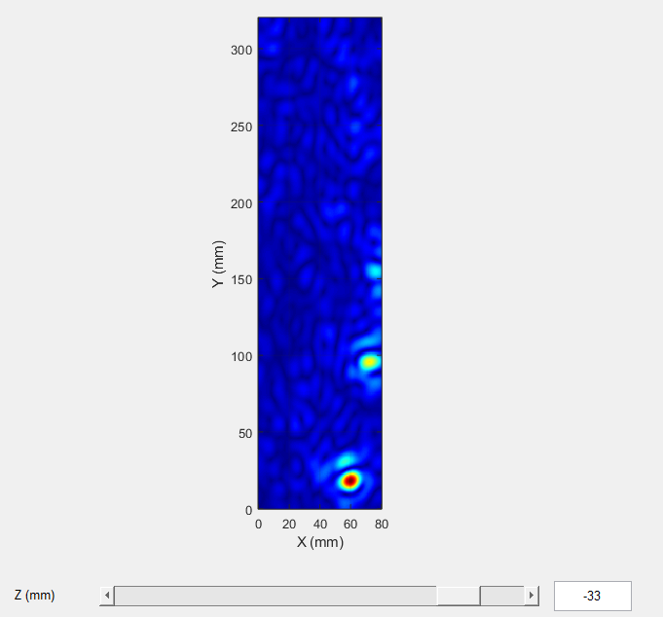
Bistatic Microwave Detection of Voids in
Cementitious Lunar Regolith Simulant
Side B
Side A
Bottom A
Top
Scan from the top surface, shows three of the defects, roughly along the center line.
Defects are 46mm, 38mm and 20mm, from bottom to top in both images.
Scan from the side B, shows three of the defects, which have floated towards the top surface.

Slide 24
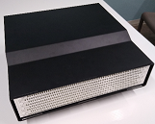


3D Microwave Imager for Damage Detection
In a Phase II SBIR effort, TRI and ISU produced a Millimeter wave SAR imaging system.
Provides high-resolution three-dimensional (3D) images.
The system has 8 linear arrays, each containing 32 transmitting and 32 receiving antennas (512 total) and performs multi-static measurements.
Operation frequency range of 26.5–40 GHz. Cross-range resolution (lateral directions) of ~2.5 mm and an along-range resolution of ~9.4 mm (depth direction).
Resolution figures are calculated for vacuum (or air) and the resolution increases inside dielectrics.
Sample image-set shown of a foam calibration block with embedded rubber targets.
Using the SAR algorithm, 2D image slices were generated from the 3D data.
TRI and ISU’s multi-static imaging array developed in the Phase II SBIR effort consisting of 8 linear arrays, each with 64 antennas (width is ~ 16”).
(a) Foam calibration block with embedded rubber targets and 2D slices of the Ka-band (26.5-40 GHz) 3D SAR image at two depths; (b) surface of tile and (c) 25 mm deep.

Slide 25
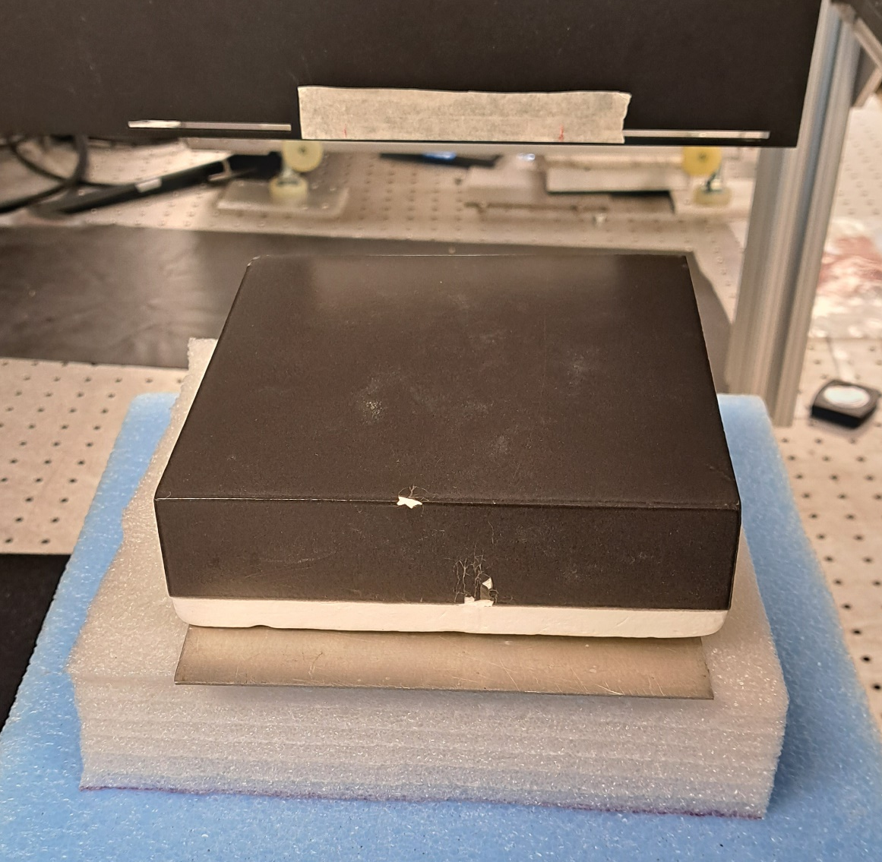
RTV Detection under Shuttle Tile
Image of 25.4mm square of felt with 0.16mm thick RTV on top of aluminum plate underneath shuttle tile.

Slide 26
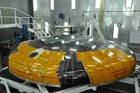
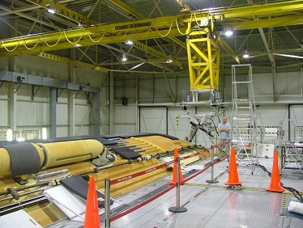
Terahertz Imaging of
Thermal Protection Systems
Orion Heat Shield - AVCOAT
Avcoat – Ablative heat shield
Shuttle External Tank Spray on Foam Insulation (SOFI)
Very low thermal conductivity
Very low electrical conductivity
Highly attenuates Ultrasound
Requires single-sided inspection

Slide 27
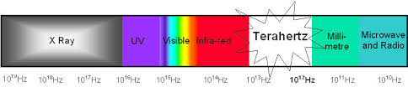
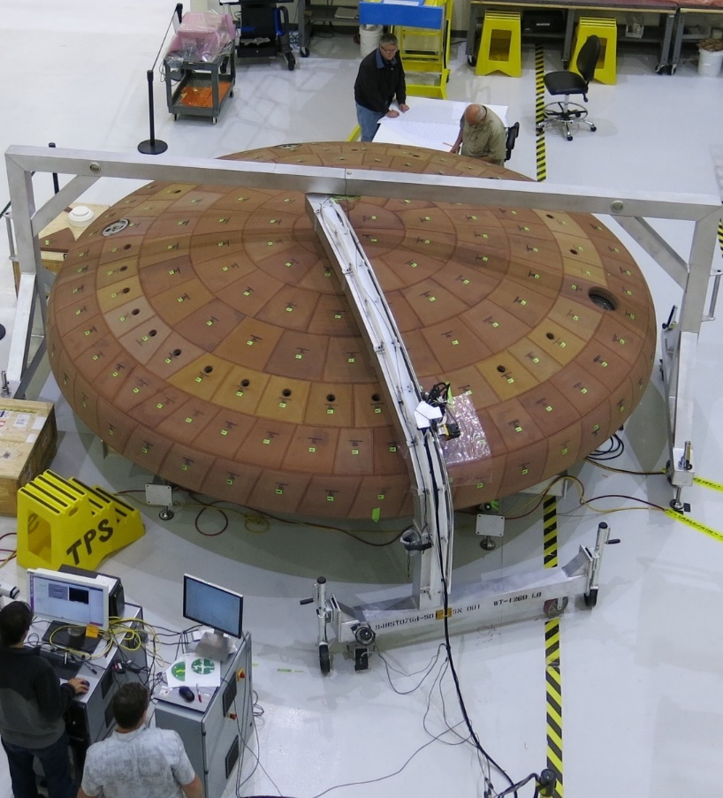
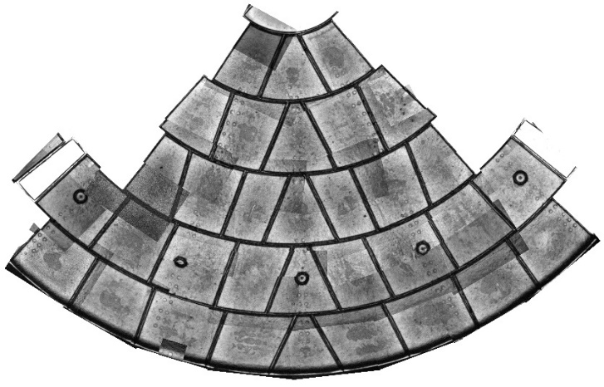
Terahertz Imaging
Mosaic Terahertz Scanned Image
Installation/processing Defect Porosity at the bond-line
Terahertz Inspection Orion EM-1 Heatshield

Slide 28
Conclusions
In addition to other NDE methods, NASA Nondestructive Evaluation Sciences Branch (NESB) and its partners, are using a variety RF and Electromagnetics techniques to investigate defects and damage in structures.
From 900 MHz to Terahertz are being utilized.
Emerging electromagnetic sensing techniques have been shown to detect: strain, cracks, flutter, tow angle, manufacturing defects in metal, voids in Lunar regolith simulant, and damage in dielectrics (such as thermal protection systems).
As NASA develops new projects within the Moon to Mars program, novel sensor applications with autonomous NDE capabilities will become more important.

Slide 29
NASA Funding/Partnership Opportunities
NASA Research Opportunities (NRAs)
Grants & Contracts
  http://nspires.nasaprs.com/
Small Business Innovation Research (SBIR)
  http://sbir.gsfc.nasa.gov/
  Z4.05 Nondestructive Evaluation (NDE) Sensors, Modeling, and Analysis
Space Act Agreements (SAA)
  Partnerships with and without exchange of funds
NASA Space Technology Graduate Research Opportunities (NSTGRO)
  https://www.nasa.gov/directorates/spacetech/strg/nstgro
Notes:
- NASA does not have the resources to develop all of the technologies it needs; therefore, we are looking for partners!

Slide 30
Auxiliary Slides

Slide 31


Spoof Plasmon Background
Spoof plasmon polaritons are EM surface waves that exhibit a non-radiative mode where the energy of the mode is concentrated at the interface, and it decays exponentially from the interface between a dielectric and a metal.
The spoof plasmon polaritons act as a series chain of microwave cavity resonators. “Any array of cavities with subwavelength geometry that individually support a resonance, such as a waveguide mode, can be used as a metamaterial structure that will support a surface wave.” [1]
Microwave resonators can be described using basic electrical properties such as the electrical impedance.
Anything that is placed within the grooves of the plasmon grating will affect the impedance due either to the change of the cavity shape and/or a change of the dielectric coefficient.
Our hypothesis is that any material added to the ideal grating will cause changes in the impedance, and that these changes can be used to indicate defects in manufacturing if the changes are caused by the addition of unintentional metal during manufacturing.
Plasma
Region
$$ω_{sp}=\frac{ω_{plasma}}{\sqrt{2}}$$
Light line
Infrared Region
Frequency (Hz)
}
Surface
Plasmon
Polaritons
Visible Region
$$υ_{Limiting}$$
}
Surface Spoof Plasmon Polaritons
Microwave Region
Wavevector k_{x}(m⁻¹)
Y
X
Z
E
A
d
L
H
Plasmonic Metamaterial
[1] E. M. G. Brock, "The Lateral Confinement of Microwave Surface Waves," PhD, Dept. of Physics and Astronomy, Univ. of Exeter, pp. 1-190, 2013.
Notes:
NASA is investigating spoof plasmons for structural health monitoring.
Spoof plasmon are electromagnetic surface waves that are non-radiative.
Plasmonic metamatrial act as a series chain of microwave cavity resonators.
The electrical impedance can be used as a means of evaluating microwave resonators.
Anything that is placed within the grooves of the plasmon grating will affect the impedance due either to the change of the cavity shape and/or a change of the dielectric coefficient.
Our hypothesis is that any material added to the ideal grating will cause changes in the impedance, and that these changes can be used to indicate defects in manufacturing if the changes are caused by the addition of unintentional metal during manufacturing.

Slide 32
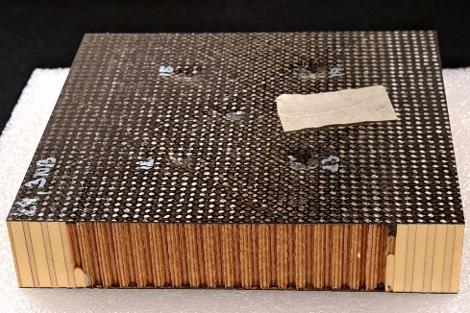
Woven Composite Honeycomb Sample

Slide 33
Woven Composite Honeycomb Sample

Slide 34
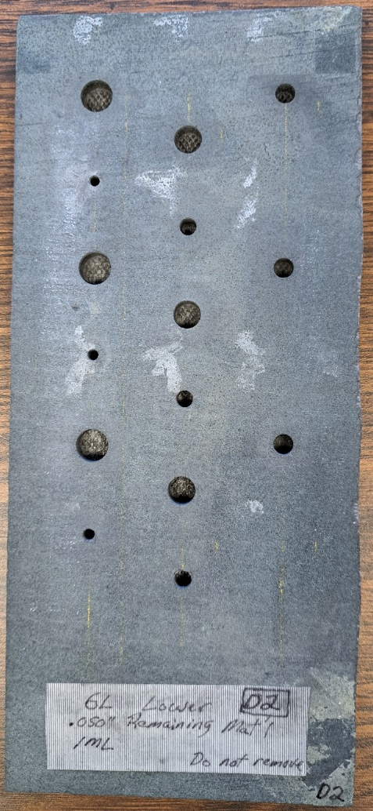
Reinforced Carbon Carbon Sample
9.33mm
5.63mm
8.00mm
2.74mm
4.80mm
5.36mm deep

