Slide 1
Motion sickness induced by g-transitions during spaceflight: Research operations perspective
Scott Wood, PhD
Neuroscience Laboratory
NASA Johnson Space Center, Houston TX
Space-related Motion Sickness: from Launch to Landing
April 18, 2023 | SpaceX | Hawthorne, CA

Slide 2
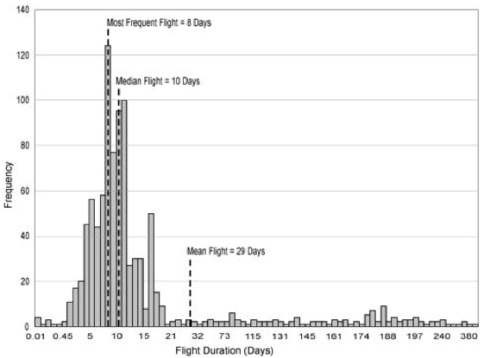
General observations
Motion sickness represents one of the greatest clinical challenges impacting crew activities during g-transitions
Given the high frequency of short duration missions (median 10 days), the major focus has been on early in-flight “Space Motion Sickness” (SMS)
The incidence and severity of re-entry motion sickness symptoms during return to Earth increases with flight duration
Given the operational nature of the environment, it has been difficult to characterize due to clinical interventions (medications) and variations in missions
Reschke et al., SP–2007–560

Slide 3
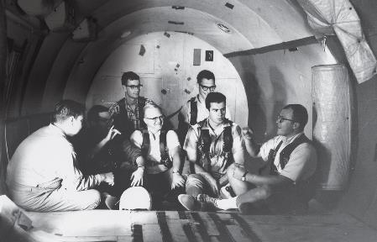
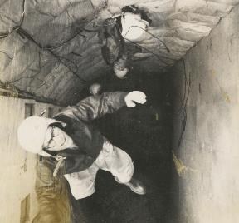
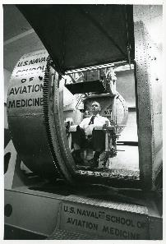
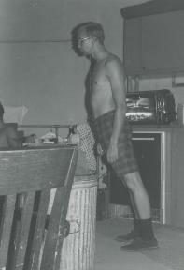
Gallaudet 11: The deaf right stuff
Prior to human space flight, Graybiel and colleagues began to test bilateral vestibular loss subjects from Gallaudet University on various motion stressors
Key findings from this research were that “labyrinthine defective” (LD) subjects showed no signs of motion sickness (e.g., Kellogg et al., Aerosp Med, 1965) and negligible change in performance associated with the slow rotating room (Clark & Graybiel, Aerosp Med, 1961).
Human
Disorientation
Device (HDD)
Slow
Rotating
Room (SRR)
Parabolic
Flights

Slide 4
Inflight SMS symptoms
SMS symptoms differ from acute terrestrial motion sickness likely due lack of normal air-current vection and gravitational force on stomach contents, e.g., sweating is less common, and flushing is more common than pallor.
SMS typically is more often associated with stomach awareness, vomiting, headache (due perhaps to headward fluid shifts), impaired concentration (Davis et al. 1988).
Vomiting is usually sudden, infrequent, and is often not marked by prodromal nausea. Bowel sounds, obtained by auscultation, are decreased or absent in crewmembers experiencing SMS (Thornton et al. 1987).
Despite these differences, nearly universal symptoms are malaise, anorexia or loss of appetite, lack of initiative, and (for some) increased irritability.
Fluctuating waves of drowsiness or "sopite syndrome" can mask other symptoms

Slide 5
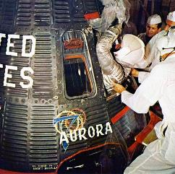
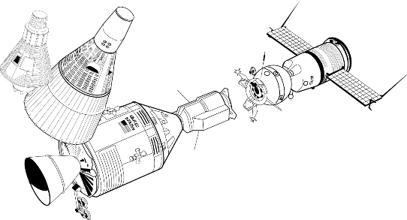
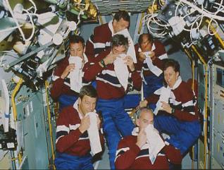
Inflight SMS incidence
Incidence has varied with spacecraft volume:
  No SMS reported in Mercury or Gemini programs
  33% incidence in Apollo (Homick 1975), 54% in Soyuz (Bryanov et al. 1986)
  73% in Shuttle (Jennings 1998)
  Decreased incidence and severity in repeat flyers (Davis et al, 1988)
Mercury
1 crew, 1 m³
Gemini
2 crew, 1.6 m³
Soyuz
3 crew, 4+6.5 m³
Apollo
3 crew, 6+4.5 m³
Shuttle
6 crew, 71.5 m³
Notes:
Microgravity by itself does not induce space sickness – you need to move!

Slide 6
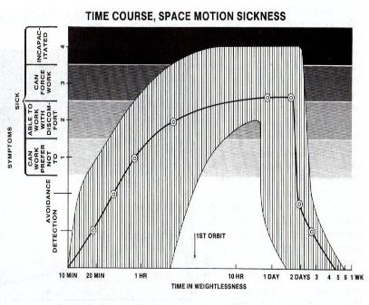
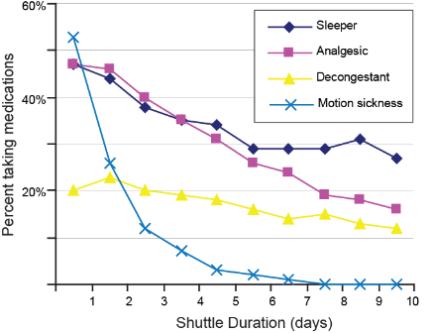
Inflight SMS severity & time course
Symptom severity is variable, with over half categorized as moderate to severe (Jennings 1998)
  Symptoms generally last 2-3 days inflight, although may persist more than 1 week (Reschke et al 2018)
  Critical performance-related procedures such as extra-vehicular activity (EVA) are restricted during the first three days of missions
Thornton et al., 1987
Putcha et al, 1999

Slide 7
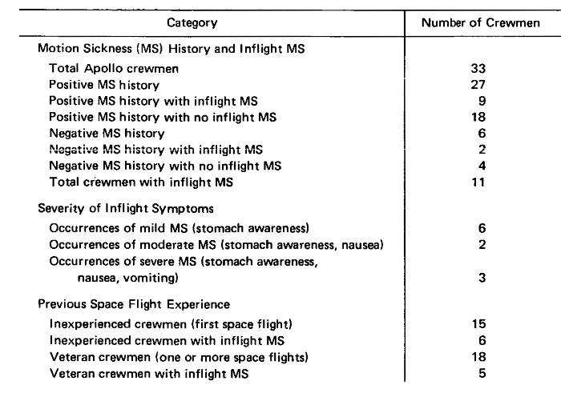
Apollo motion sickness
Inflight
11 or 33 reported inflight motion sickness during Apollo
Lunar activity
None reported motion sickness or vestibular problems during lunar surface activity throughout Apollo, although several had symptoms during Earth reentry
From Homick JL, Miller EF. Apollo flight crew vestibular assessment. In: Johnston RS, Dietlein LF, Berry CA, eds. Biomedical Results of Apollo. Washington, D.C.: NASA 1975:323-40.

Slide 8
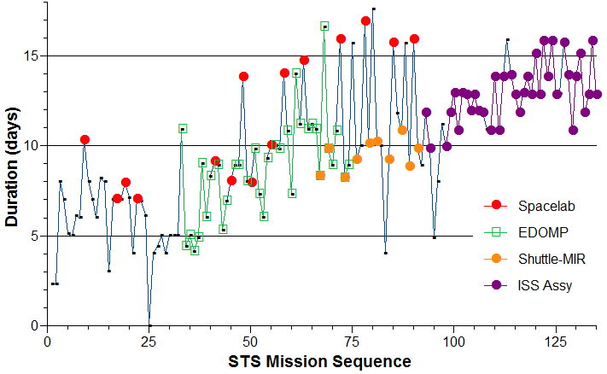
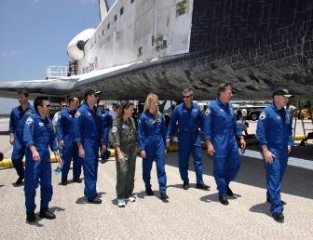
STS reentry motion sickness
Incidence of re-entry nausea was ~15% after Shuttle with majority of crewmembers experiencing clumsiness in movements, difficulty walking and persisting sensation after-effects (Bacal et al. 2003)
Since post-flight impairment was greater with longer flights only CDRs with prior landing experience were considered for flights of extended duration
Apollo transit durations prior to lunar descent
Notes:
While there were no reports of symptoms or vestibular impairment during Apollo lunar landings, its interesting to note that post-flight symptoms were also negligible following Shuttle missions of similar duration as the microgravity transit time to the lunar surface

Slide 9
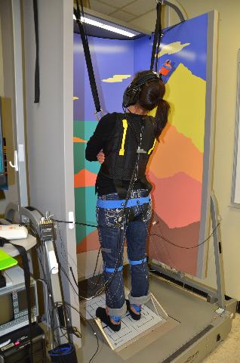
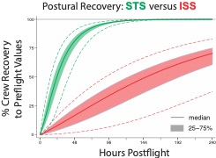

Postflight Dynamic Posturography
SOT-5M
Eyes Closed,
Unstable support,
Head moving

Slide 10
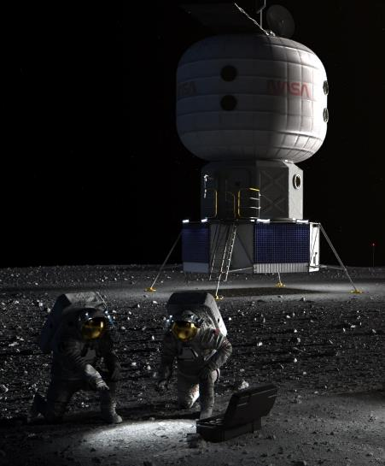
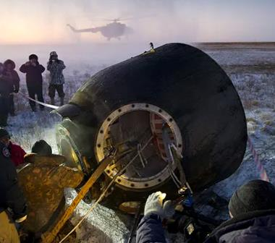
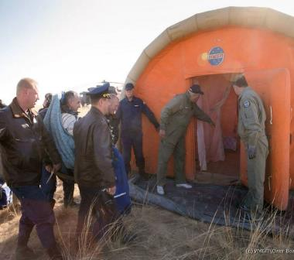
Field Tests
Characterize functional abilities following long-duration spaceflight as soon as possible after g-transition
Develop a recovery timeline of functional performance

Slide 11
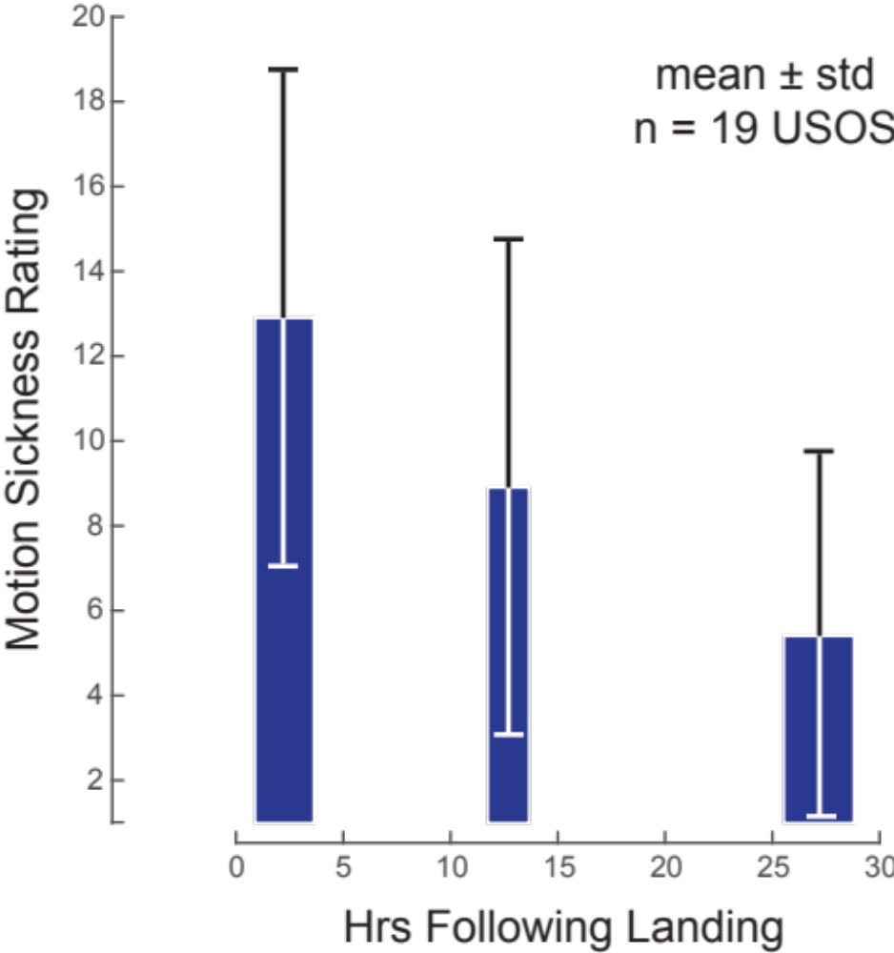
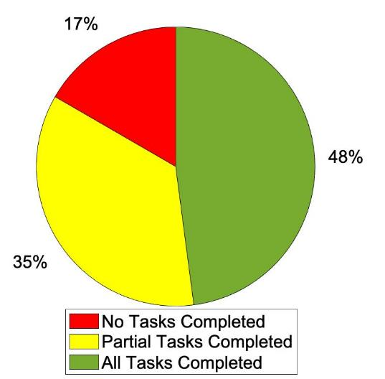
ISS Reentry Motion Sickness
R+0a
R+0a
N=48
R+0b

Slide 12
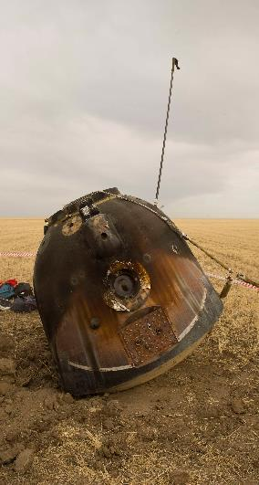
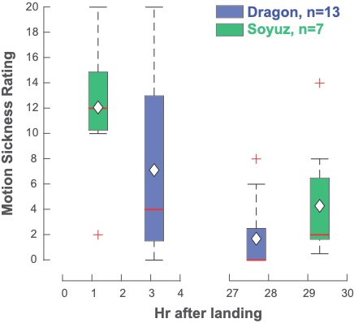
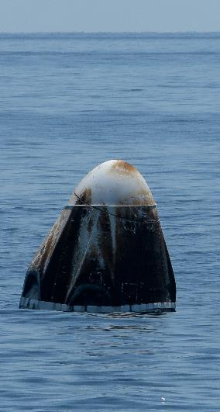
Spaceflight Standard Measures

Slide 13
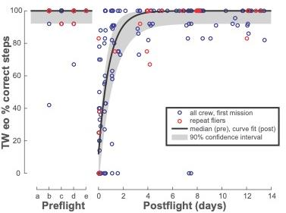
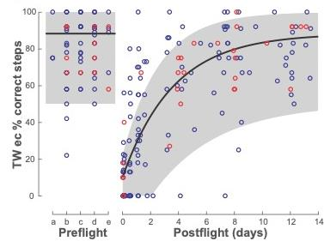
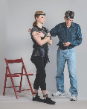
Tandem walk
Eyes Open
Eyes Closed

Slide 14
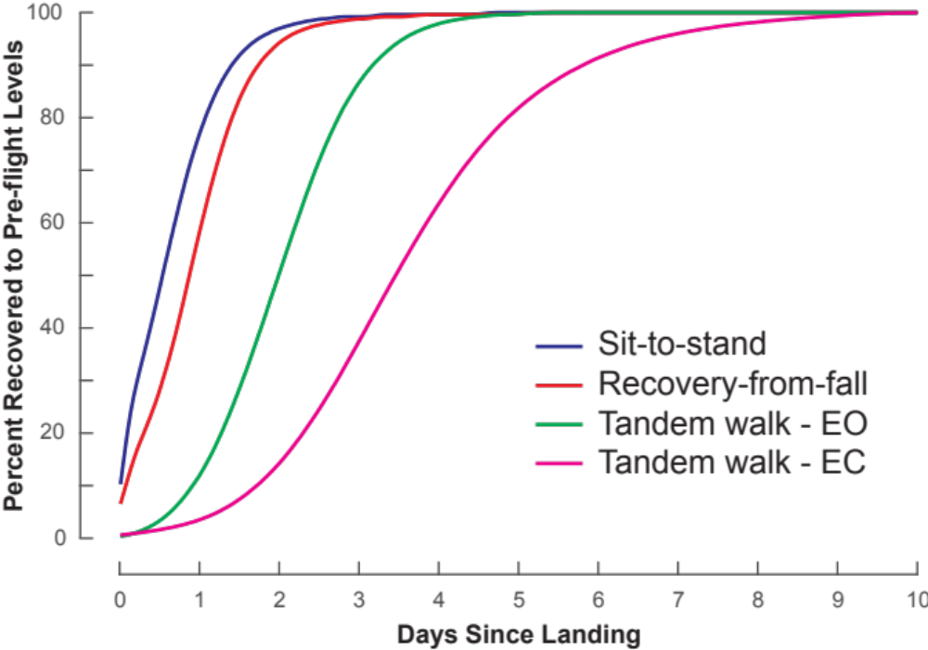
Recovery to preflight levels
Sit-to-stand and recovery from fall tasks followed similar recovery trajectories
In contrast, tandem walking presented a more challenging dynamic gait task requiring a longer timeframe for recovery
Comparison of eyes open and closed conditions underscore the importance of visual cues

Slide 15
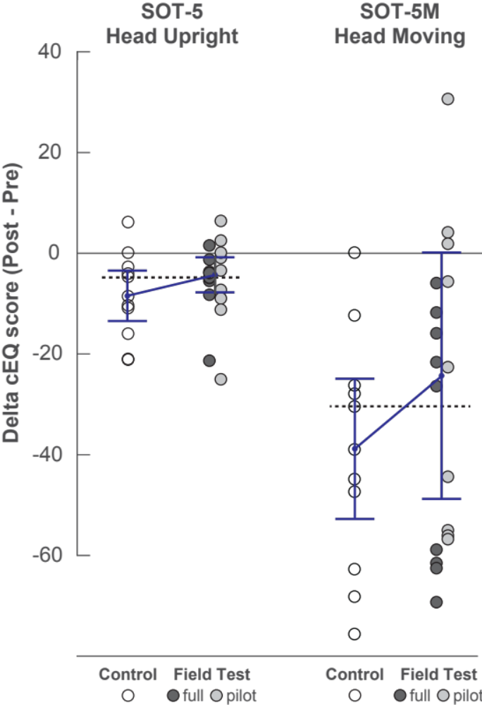

Effects of multiple test sessions
}
SOT-5: Eyes closed, unstable surface
Potentially benefitted from multiple testing
}
Activity may have exceeded motion tolerance
Rosenberg et al., Front Physiol, 2022

Slide 16
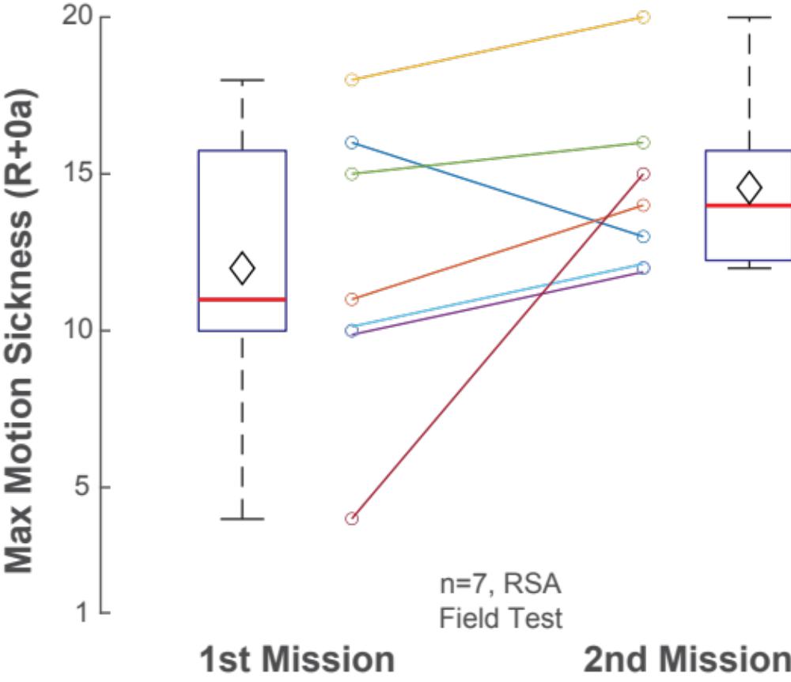

Reentry MS with repeat fliers

Slide 17
Inflight versus reentry motion sickness
Both have a similar onset with symptoms appearing within minutes of g-transition with head movement sensitivity persisting for several days (more pronounced following longer duration spaceflight)
In-flight provocative head movements and/or visual reorientation illusions (e.g., seeing inverted crewmember or unexpected cabin orientation) can trigger sudden vomiting
In-flight susceptibility does not necessarily predict re-entry susceptibility. Heat stress, dehydration, orthostasis (fainting on standing), sleep deprivation and exhaustion are commonly observed post-flight and may increase susceptibility.
In contrast to in-flight motion sickness, the incidence or severity of re-entry sickness does not appear consistently lower with repeat flights.
Post-flight there have been reports of “relapse” phenomenon, e.g., when turning a corner in a car, eliciting ‘mild’ to ‘severe’ symptoms

Slide 18
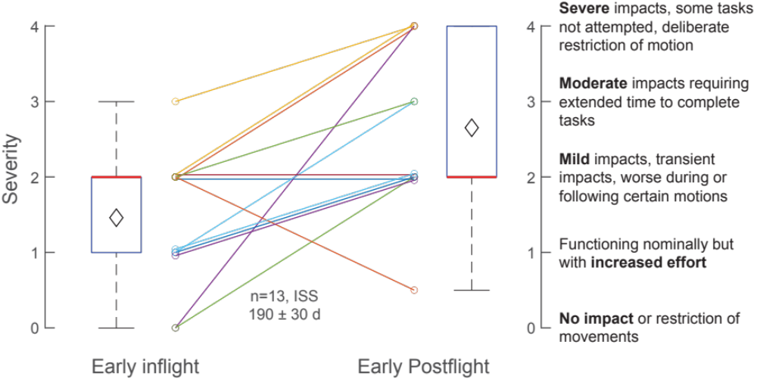
Inflight versus reentry: Functional impacts

Slide 19
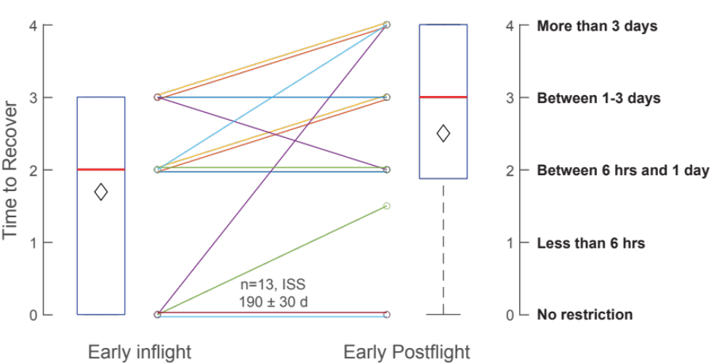
Inflight versus reentry: Movement recovery

Slide 20
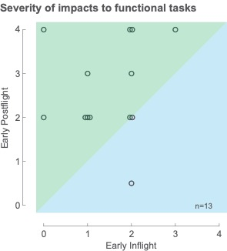
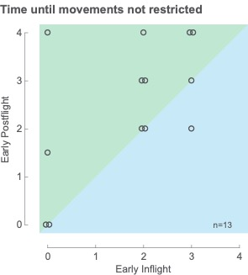
Inflight versus reentry: ISS long duration

Slide 21
Reentry MS medications
Subject | Before landing | Before R+0A | To refueling | To JSC
1 | Meclizine | Ondansetron, Promethazine (PMZ) | Meclizine | Promethazine
2 | Not available | Not available | Not available | Not available
3 | None reported | Promethazine | None reported | None reported
4 | Ondansetron | None reported | Promethazine | None reported
5 | None reported | Ondansetron, PMZ, Meclizine | Promethazine | None reported
6 | Scopolamine | None reported | Scopolamine | Scopolamine
7 | Meclizine | Ondansetron | None reported | Meclizine
8 | Meclizine | Meclizine, Ondansetron | None reported | None reported
9 | Meclizine | Meclizine | None reported | None reported
10 | Meclizine | Meclizine | None reported | None reported
11 | None reported | None reported | None reported | None reported
Lee et al, 2020, Front Physiol

Slide 22
Interventions
Intramuscular promethazine has been the most effective in-flight with a 90% initial response rate and reduction in residual symptoms the next flight day. When possible, treatment is offered in the pre-sleep period to mask potential treatment-related drowsiness. (Jennings 1998)
Meclizine is the more common post-flight treatment, often administered prophylactically prior to landing (Lee 2020)
Preflight training techniques, including desensitization to provocative stimuli in the Russian program (Clément 2001) or preflight adaptation (Harm et al. 1994), have not been validated to reduce motion sickness with spaceflight.
In-flight symptoms can be alleviated by restricting early activities, maintaining familiar orientation with respect to the visual environment, and maintaining contact cues
Immediately following landing, the earlier introduction of head movements and other motor activity, as long as they are self-paced and within one’s threshold for motion tolerance, has been used to facilitate adaptation (Wood 2011)

Slide 23
Predicting susceptibility
Part of the difficulty in predicting motion sickness is the lack of a terrestrial vestibular analog. Another challenge is the operational nature of the environment wherein pharmaceutical countermeasures or other interventions confound any systematic investigation.
Inversion immersion (II) in Weightless Environment Training Facility (WETF) pool was proposed during Shuttle due to anecdotal evidence that EVA training may be beneficial, incidence of MS during II was 78% (Norfleet et al. 1995)
Other promising terrestrial predictors include:
  Reversing prisms (Oman et al. 1986)
  Torsional disconjugacy (Markham and Diamond 1993)
  Sickness induced by centrifugation (SIC, Nooij et al. 2007)
  The only reliable predictor of susceptibility to date is motion sickness experienced during a previous spaceflight
23

Slide 24


Slide 25
References
Bacal K, Billica R, Bishop S (2003) Neurovestibular symptoms following space flight. J Vestib Res 13:93-102
Bryanov I, Gorgiladze GI, Kornilova LN (1986) Vestibular function. In: Gazenko OG (ed) Results of Medical Research Performed on the Salyut 6-Soyuz Orbital Scientific Research Complex. Meditsina, Moscow, pp 169-185, 248-256
Clark B, Graybiel A (1961) Human performance during adaptation to stress in the Pensacola slow rotation room. Aerosp Med 32:93-106
Clément G, Deguine O, Parant M, Costes-Salon MC, Vasseur-Clausen P, Pavy-LeTraon A (2001) Effects of cosmonaut vestibular training on vestibular function prior to spaceflight. Eur J Appl Physiol 85:539-545
Davis JR, Vanderploeg JM, Santy PA, Jennings RT, Stewart DF (1988) Space motion sickness during 24 flights of the space shuttle. Aviat Space Environ Med 59:1185-1189
Harm DL, Parker DE (1994) Preflight adaptation training for spatial orientation and space motion sickness. J Clin Pharmacol 34:618-627
Homick JL, Miller EF (1975) Apollo flight crew vestibular assessment. In: Johnston RS, Dietlein LF, Berry CA (eds) Biomedical Results of Apollo. NASA, Washington, D.C., pp 323-340
Jennings RT (1998) Managing space motion sickness. J Vestib Res 8:67-70
Kellogg RS, Kennedy RS, Graybiel A (1965) Motion sickness symptomatology of labyrinthine defective and normal subjects during zero gravity maneuvers. Aerosp Med 36:315
Lee SMC, Ribeiro LC, Laurie SS, et al. (2020) Efficacy of Gradient Compression Garments in the Hours After Long-Duration Spaceflight. Front Physiol 11:784 doi: 10.3389/fphys.2020.00784
Markham CH, Diamond SG (1993) A predictive test for space motion sickness. J Vestib Res 3:289-295
Nooij SA, Bos JE, Groen EL, Bles W, Ockels WJ (2007) Space sickness on earth. Microgravity Sci Technol 19:113-117 doi: 10.1007/BF02919464
Norfleet WT, Coats AC, Powell MR (1995) Inverted immersion as a novel gravitoinertial environment. Aviation Space & Environmental Medicine 66:825-828
Oman CM, Lichtenberg BK, Money KE, McCoy RK (1986) M.I.T./Canadian vestibular experiments on the Spacelab-1 mission: 4. Space motion sickness: symptoms, stimuli, and predictability. Exp Brain Res 64:316-334
Putcha L (1999) Pharmacotherapeutics in space. J Gravit Physiol 6:P165-168
Reschke MF, Good EF, Clément GR (2017) Neurovestibular symptoms in astronauts immediately after space shuttle and international space station missions. OTO Open 1 doi: 10.1177/2473974x17738767
Reschke MF, Krnavel JM, Somers JT, Ford G (2007) A brief history of space flight with a comprehensive compendium of vestibular and sensorimotor research conducted across the various flight programs. NASA SP–2007–560, Houston, TX
Reschke MF, Wood SJ, Clément GR (2018) A case study of severe space motion sickness. Aerosp Med Hum Perform 89:749-753 doi: 10.3357/AMHP.5071.2018
Thornton WE, Moore TP, Pool SL, Vanderploeg J (1987) Clinical characterization and etiology of space motion sickness. Aviat Space Environ Med 58:A1-8
Wood SJ, Loehr JA, Guilliams ME (2011) Sensorimotor reconditioning during and after spaceflight. NeuroRehabilitation 29:185-195 doi: 10.3233/NRE-2011-0694

