Slide 1
Lean Model-Based Systems Engineering on the NASA High-Density Vertiplex Subproject
Demetrios Katsaduros and Andrew Ging, NASA Ames Research Center

Slide 2
Agenda
Speaker Introductions
Purpose
Subproject Background
Benefits of MBSE to subproject
Challenges
How was MBSE implemented?
  Behavior
  Requirement
  Structure
Lessons Learned

Slide 3
Introductions
Demetrios Katsaduros
  Systems Engineer
  5.5 years at NASA
  Purdue University
    Electrical Engineering
Andrew Ging
  SE Group Co-Lead
  17 years at NASA
  Cal Poly Pomona
    Aerospace Engineering

Slide 4
Purpose
Demonstrate impact of MBSE on full lifecycle design, build and fly aeronautics subproject.
  SysML (Systems Modeling Language) paired with MagicDraw modeling tool provided digital elements for SE team to model a physical architecture.
Outline MBSE challenges, solution and lessons learned.

Slide 5
What is HDV (High Density Vertiplex)?
A subproject inside of NASA’s Advanced Air Mobility (AAM) portfolio focusing on the development and testing of concepts, requirements, software architectures, and technologies needed for the terminal environment around vertiports.

Slide 6
HDV Video

Slide 7
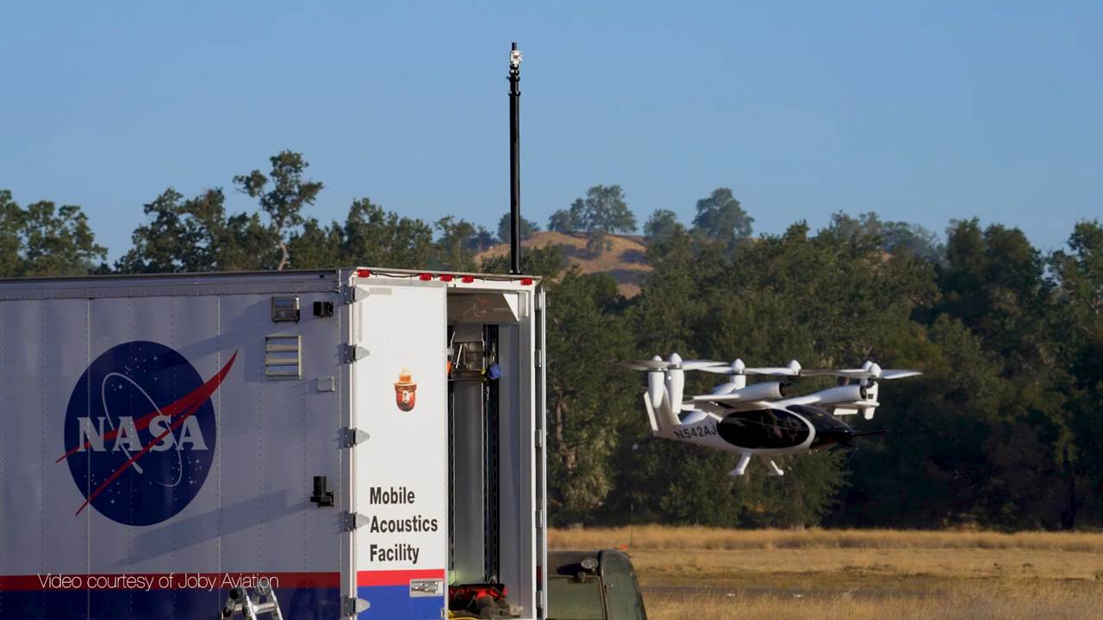

Slide 8
Benefits of SysML and MBSE to HDV
SysML provides a model-centric means of carrying out the NASA SE common technical processes by providing tools for complete system modeling including;
Requirements capture
System Design Capture
Interface management
MBSE serves HDV by:
Documenting the subproject’s logical architecture for external distribution.
Capturing the subproject’s physical architecture in a single-source-of-truth for internal use.

Slide 9
Challenges
1
2
3
4
5
MBSE Adoption prior to subproject formulation
Small & lean SE team learn MagicDraw from scratch
HDV is the 1st team w/in AAM to proceed with Magicdraw
Multi-Center and multiple time zone collaboration
Implementation and Integration

Slide 10
How was MBSE implemented?

Slide 11
Behavior Diagram

Slide 12
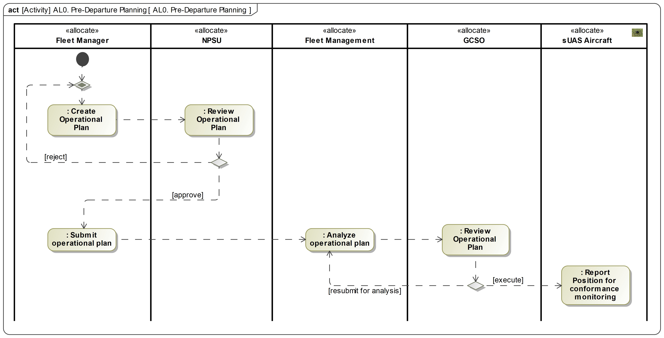
Activity Diagram
HDV uses activity diagrams to represent behavior by placing actions in order with their inputs/outputs.

Slide 13
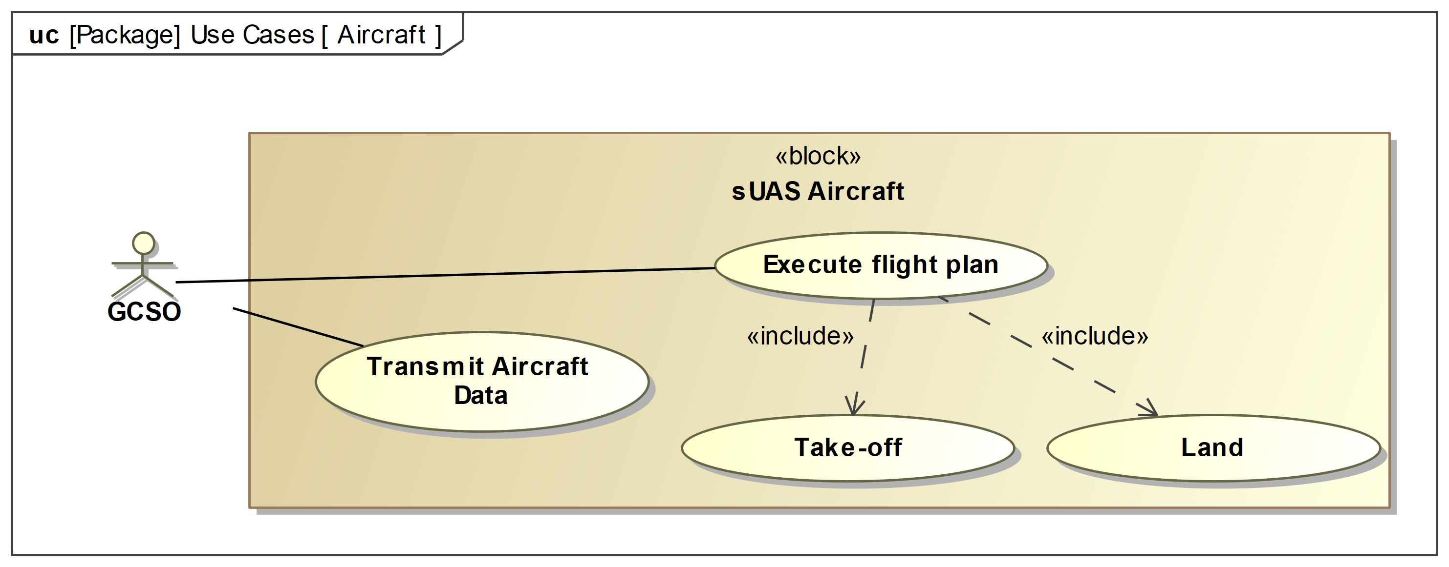
Use Case Diagram
HDV uses use case diagrams to represent how external entities (i.e, actors) interact with a system.

Slide 14
Requirement Diagram

Slide 15
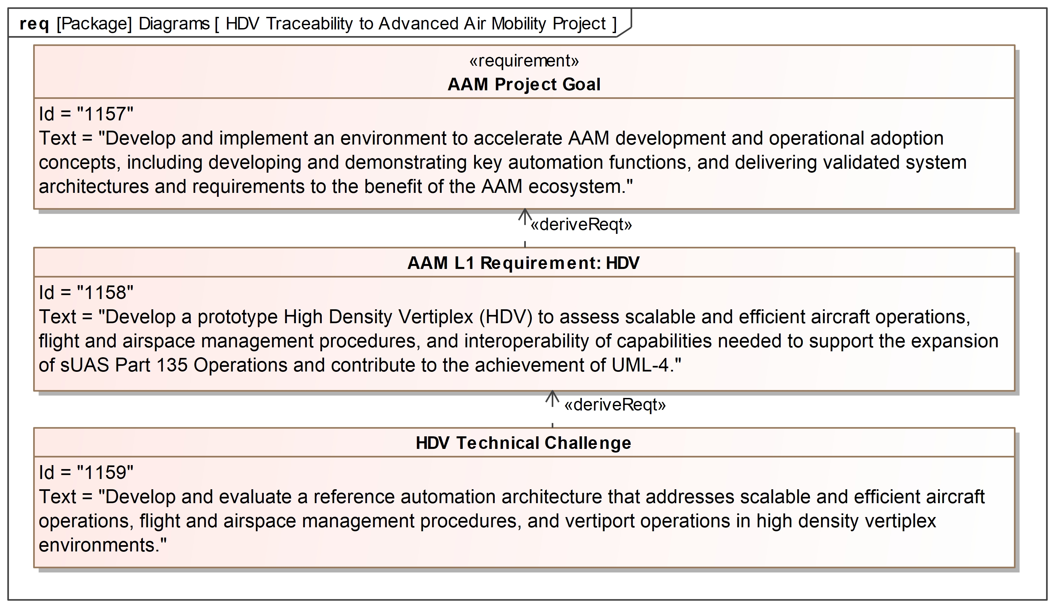
Requirement Diagram
HDV uses requirements diagrams to show text-based requirements, their relationships with other requirements or elements and showcases traceability.

Slide 16
Structure Diagram

Slide 17
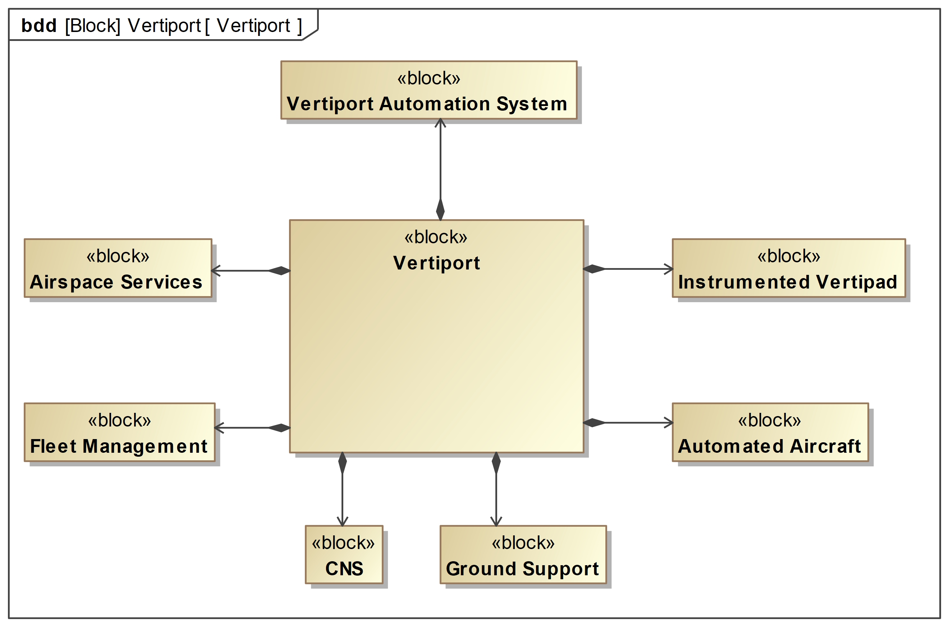
Block Definition Diagram
HDV uses block definition diagrams to represent system architecture via blocks, its composition and classification.

Slide 18
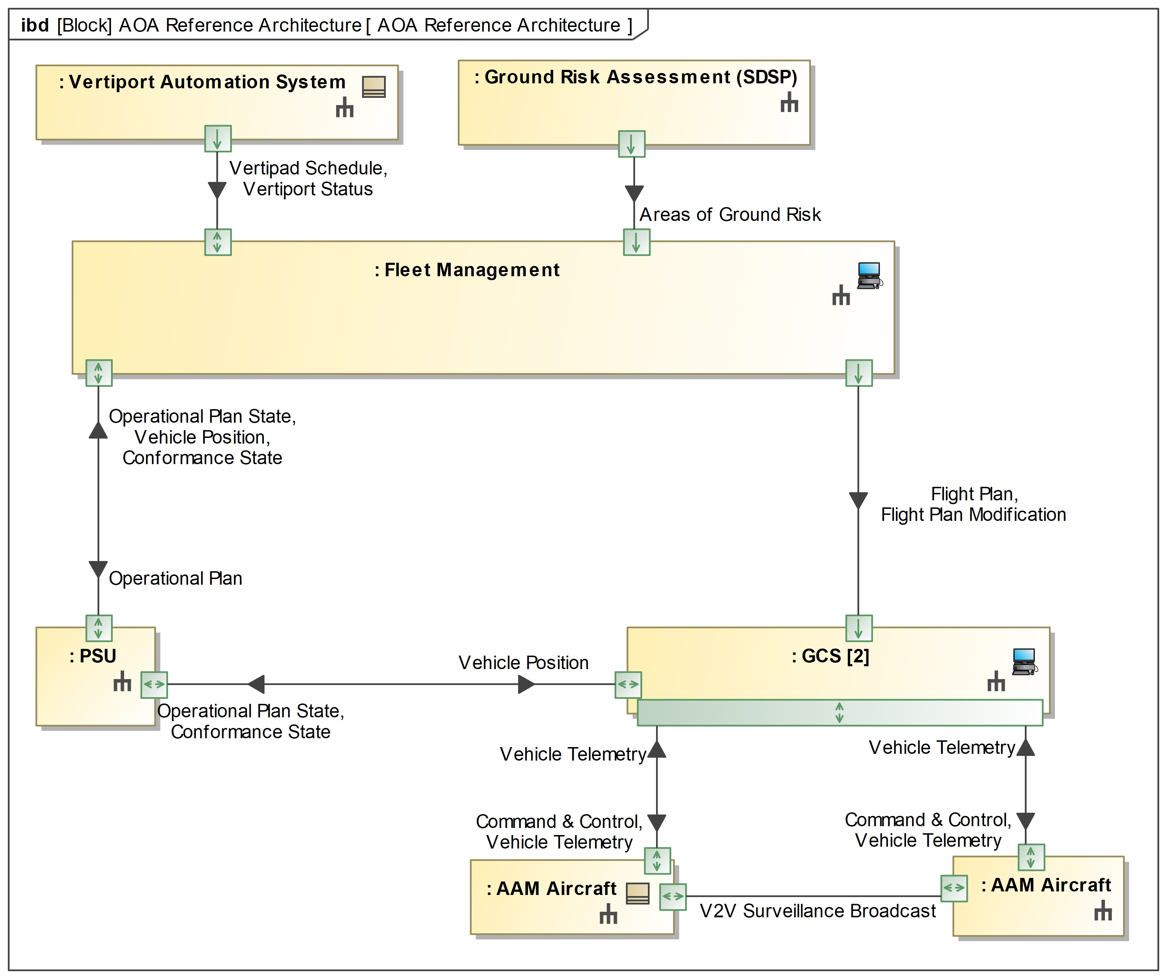
Internal Block Diagram
HDV uses internal block diagrams to show the interfaces and connections between the parts of a block.

Slide 19
Lessons Learned

Slide 20
Impact of MBSE on HDV
Traditional Method
MBSE Method
White paper documentation
Static PowerPoints for system modeling
Dynamic models
Traceability
User Interacting Diagrams
Report generation

Slide 21
Moving forward?
System Modeling
Verification and Validation
Simulation

Slide 22
Thank you for listening!
Thoughts?

